Slide 1
Restructuring the Economy
Transforming manufacturing to create a green, sustainable model
Jon Rynn
Presented at the Economic Democracy Conference
October 11, 2012
Madison Wisconsin
ManufacturingGreenProsperity.com

Slide 2
Systemic problems…
A manufacturing base, which is the foundation of a wealthy economy and a middle class, is disappearing
Income inequality is leading to a plutocracy of billionaires who control the political system
Global warming
The end of cheap fossil fuels (e.g., peak oil)
Ecosystem destruction (Desert Earth)

Slide 3
…Require systemic solutions
We need an interlocking set of large-scale solutions to our civilization-threatening problems
We need to set up a clear vision of what a sustainable, just society would look like.
We need to go on the offensive
We need a concrete platform for elections
Solutions should be government-based
Cost should be in trillions, over 10 to 20 years

Slide 4
What are the goals?
Eliminate unemployment and poverty or, guarantee everyone a good job
Indefinitely sustainable economic growth for the entire population
Environmentally sustainable – over eons
  Carbon-free
  Pollution and garbage free
  Without using up natural capital
Economic and political democracy

Slide 5
How does the economy work?
The economy is a system – an ecosystem
An economy has many functional parts
Each part is critical
Each part needs to be physically close
If we look at the economy as a system of production, manufacturing is at the center, as plants are at the center of an ecosystem
Retail and finance distribute that which production system creates

Slide 6
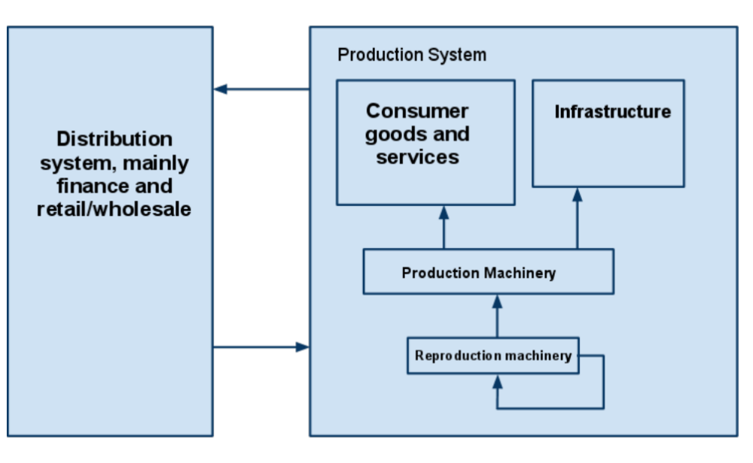
Economy as a production and distribution system

Slide 7
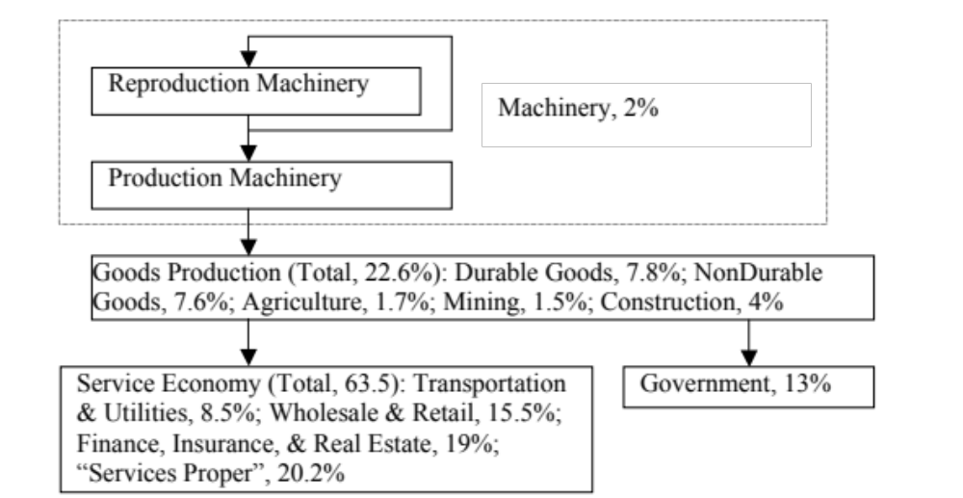
The production system

Slide 8
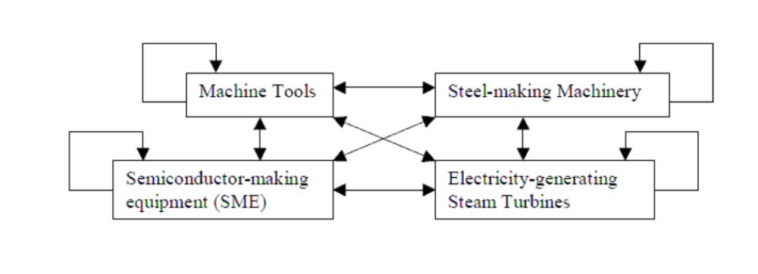
Reproduction machinery is the source of economic growth

Slide 9
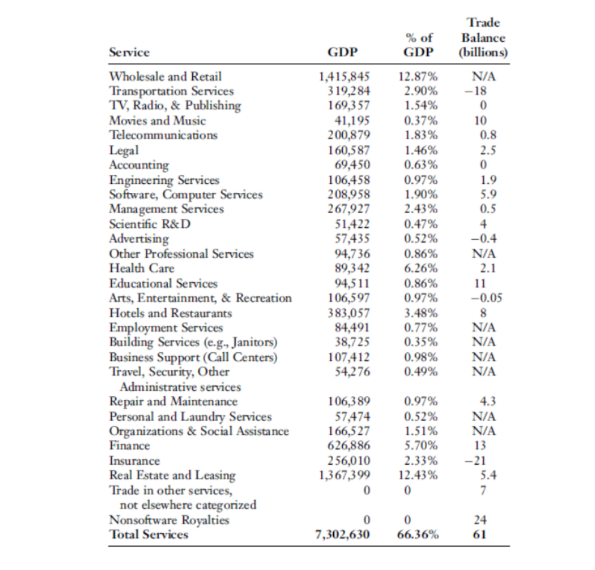
Services are what you do with manufactured goods

Slide 10
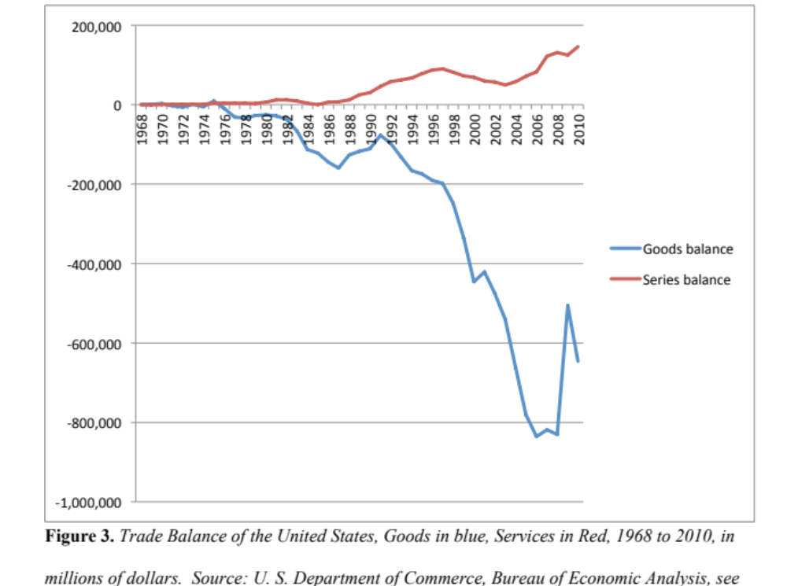
A wealthy country can’t trade services for goods

Slide 11
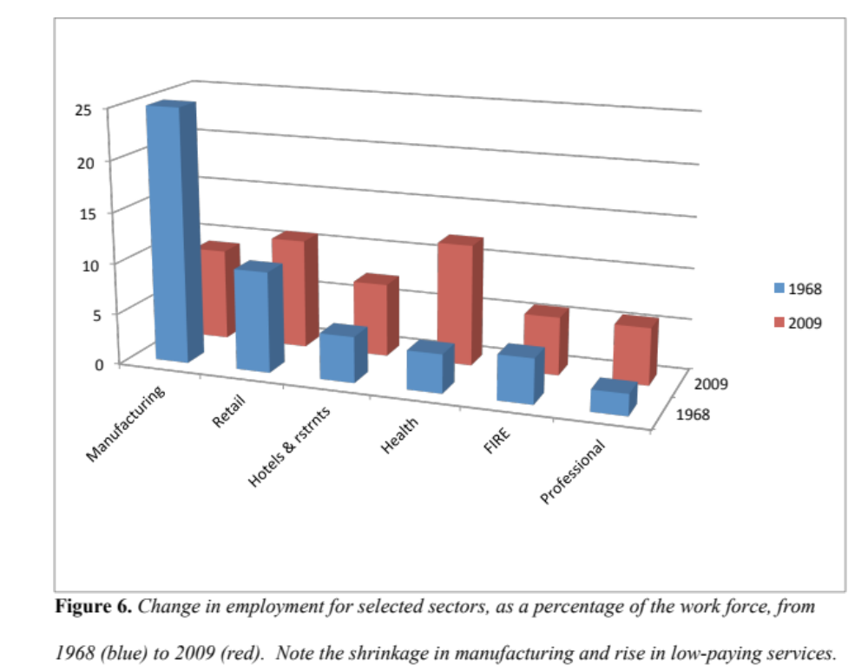
Manufacturing anchors the middle class

Slide 12
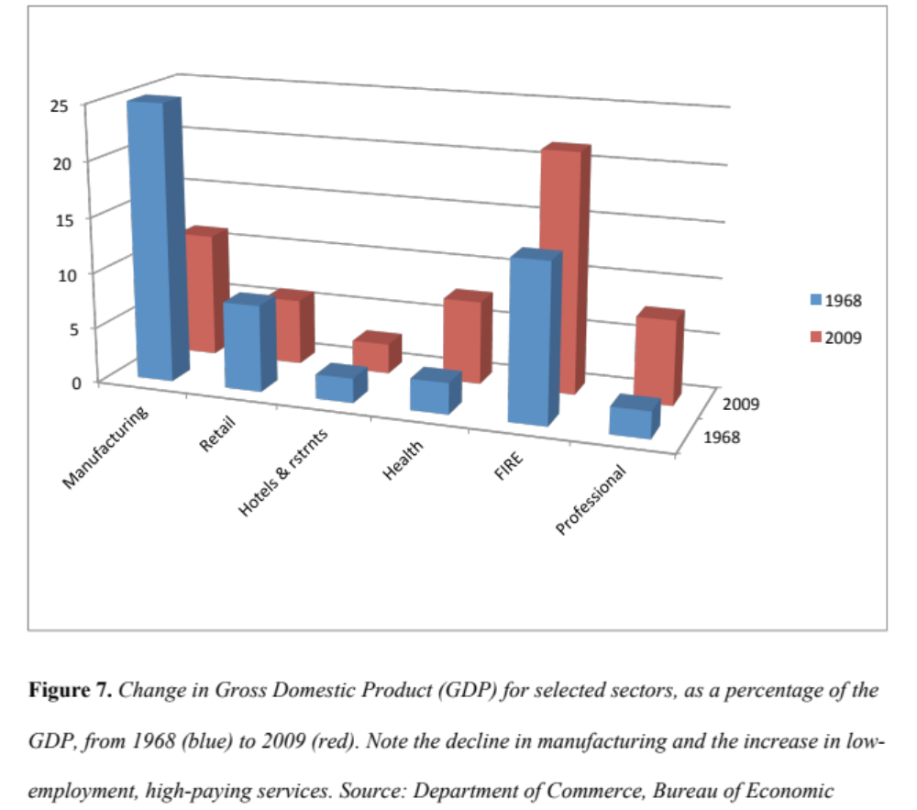
Manufacturing should anchor the GDP, not Finance

Slide 13
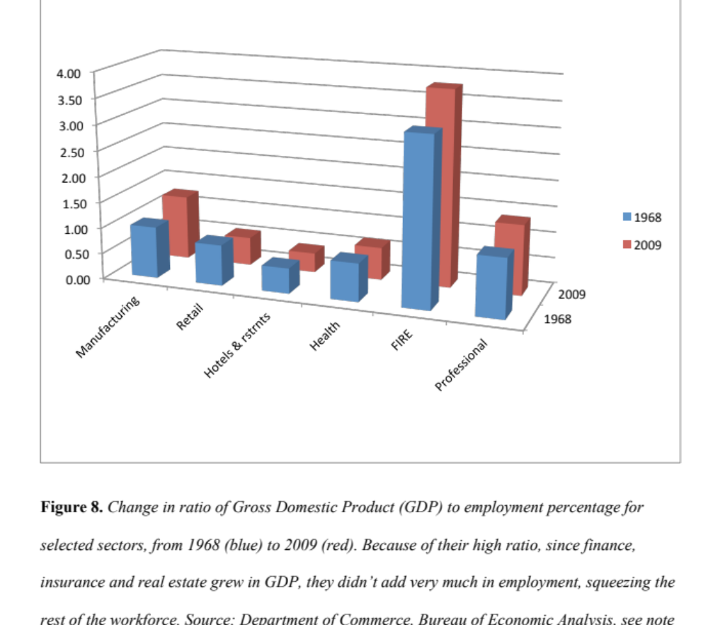
Manufacturing middle class, finance upper class

Slide 14
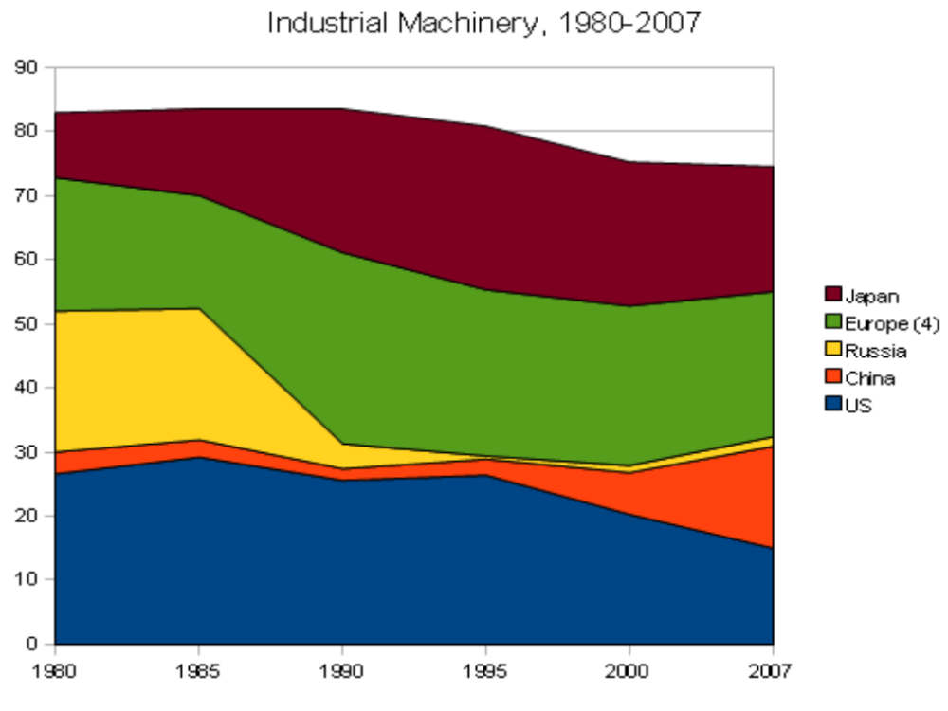
The wealthiest economies have the biggest production machinery sectors

Slide 15
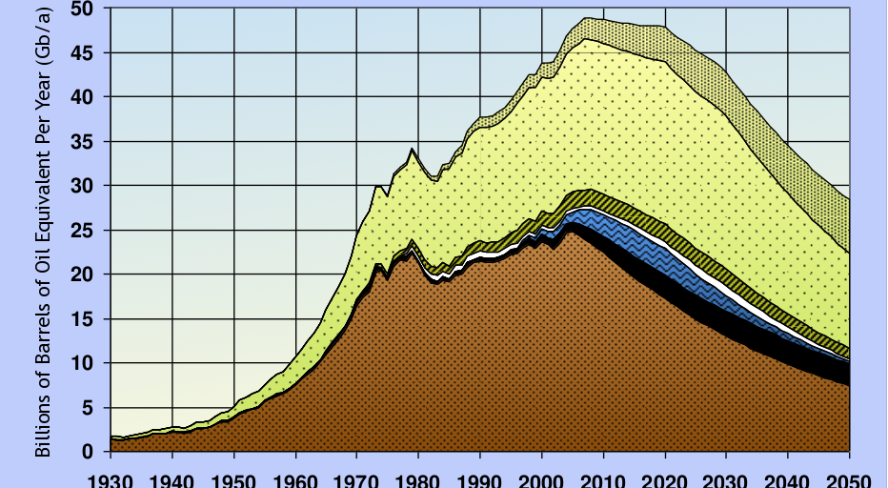
Peak Oil hurting economy

Slide 16
Other eco-problems hurting the economy
Global warming causing droughts, etc.
Agriculture destroying soil, polluting water
Natural gas fracking threatening water
Oil polluting oceans, threatens fresh water
Coal major pollution problem
Shortages in other materials like phosphorus

Slide 17
How to restore the economy?
As manufacturing goes, so goes the economy
Middle class is dependent on manufacturing
Government revenues dependent also
Manufacturing needs stable demand
Needs more than trade protection
Need to stop using fossil fuels
Need sustainable agriculture
Need to keep ecosystems intact

Slide 18
Need to solve ecological and economic problems together
Market can’t solve long-term, systemic problems
Only government can design and finance
Government can guarantee 20 year program
Government can require domestic content
Even WTO says “general infrastructure” is OK to subsidize and require domestic content
By rebuilding the infrastructure, can rebuild manufacturing; by rebuilding manufacturing, can rebuild economy

Slide 19
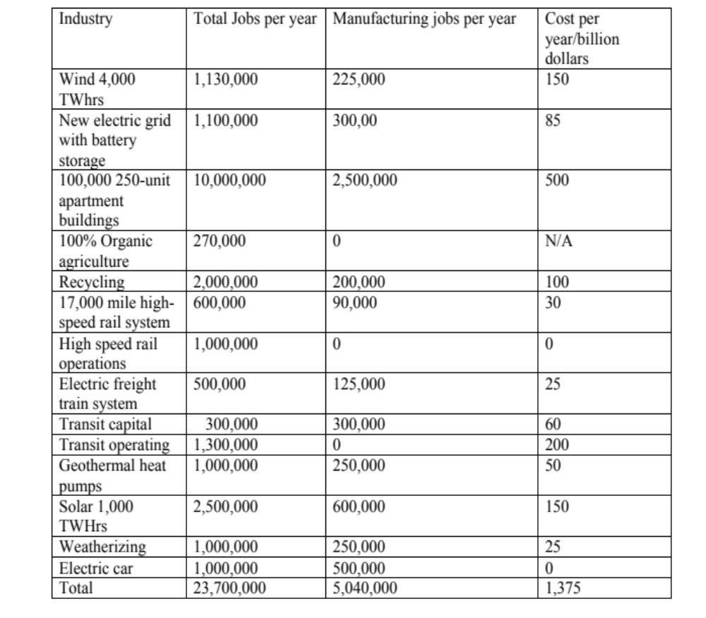
Green Transformation: Rebuild the infrastructure and manufacturing over 20 years

Slide 20
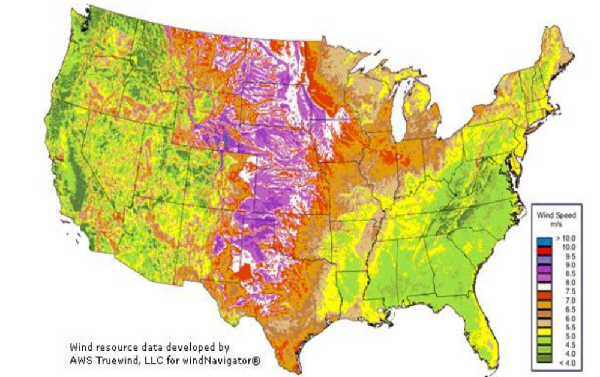
Interstate Wind System, plus an Interstate Smart Grid, plus…

Slide 21
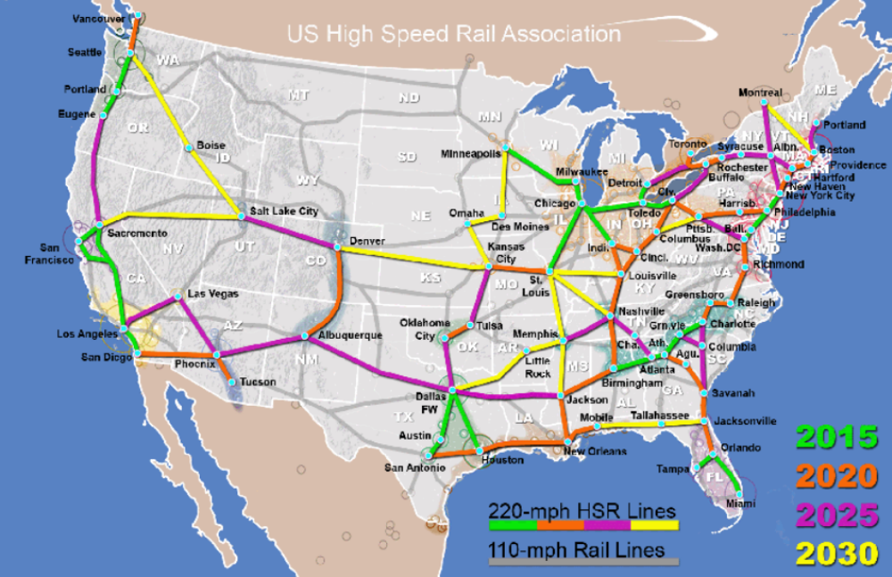
…an Interstate High-Speed Rail system, equals Interstate Sustainability System

Slide 22
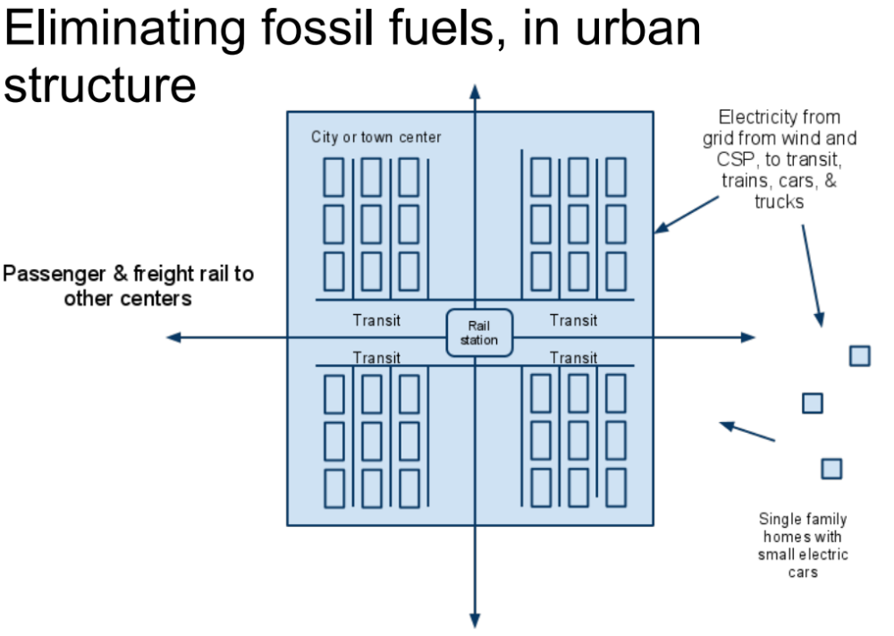

Slide 23
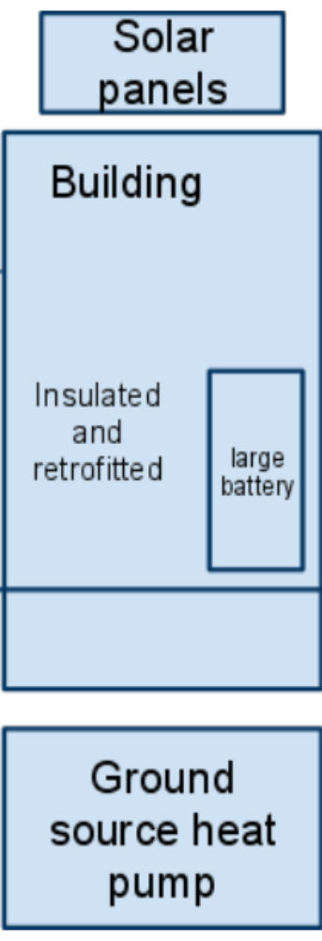
Sustainable buildings: Solar panels on top, heat pump below, insulated with battery

Slide 24
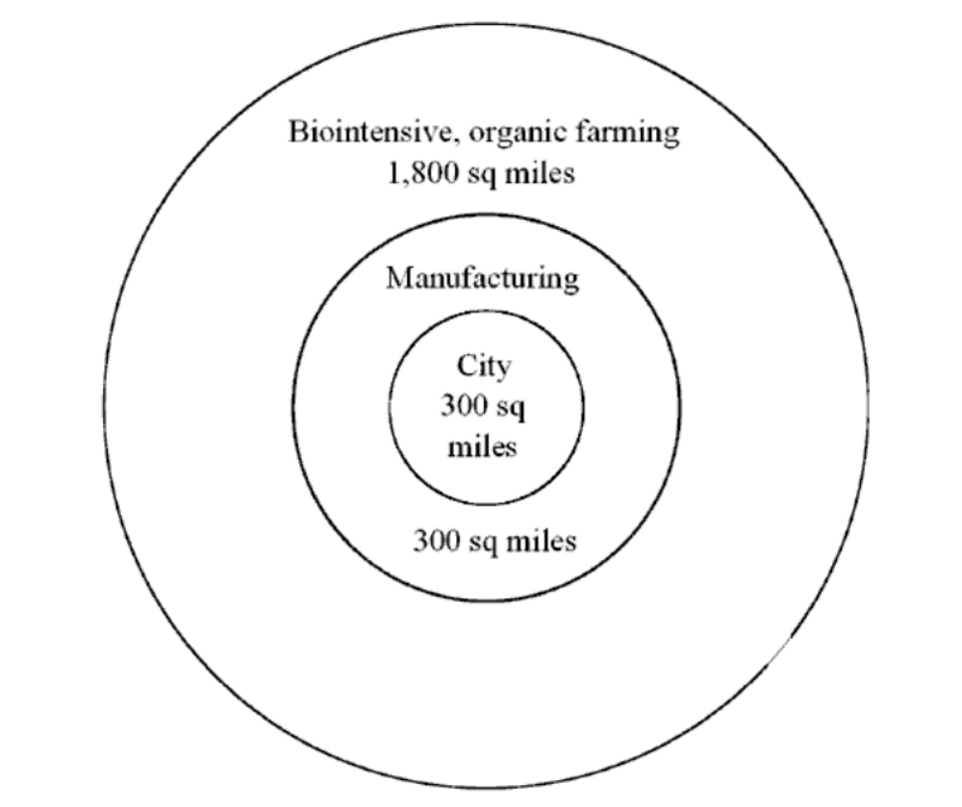
For urban area the size of NYC, with 20% of population in intensive organic farming

Slide 25
How can government help?
Recycling would be government function
Efficiency bank for building improvements
Manufacturing service for no-pollution and conversion to reusable and recyclable production
Government financing for relocation to city region
Government financing for intensive organic farming, including subsidized produce
National employment system, guaranteeing job

Slide 26
This preserves physical and eco-capital
Approximately 30 major urban regions would only use about 2% of the land area of U.S.
Most of the rest of the 98% could revert to natural ecosystems, e.g. prairies and forests
Urban regions would be linked by Interstate Systems
No fossil fuel use, little or no mining
Manufacturing rebuilt

Slide 27
We need to rebuild human capital
Universal health care system
  Medicare for all, expanded Medicare
  National system of clinics
  Buy out health insurance companies
Federal Education System
  Provide half of payroll to get class size to 15
  Provide payroll for science, tech, art teachers
  Universal childcare from birth through preschool
  Free public college
  Technical school/college/apprenticeship system

Slide 28
How democratize economy?
Must be part of an economy that can generate wealth, that has manufacturing sector
Must be part of an economy that is ecologically sustainable
Encourage employee ownership
Democratize the financial system

Slide 29
National Employee Ownership System
Based on Mondragon Cooperative System
  Firms 100% owned by employees
  Can’t sell shares
  Bank at center of system, helps startups
Each Congressional District (CD) has its own Mondragon-like system
  Congressperson as head of board
  Regional and National versions
Seed money from Federal government
Use with Green Transformation program

Slide 30
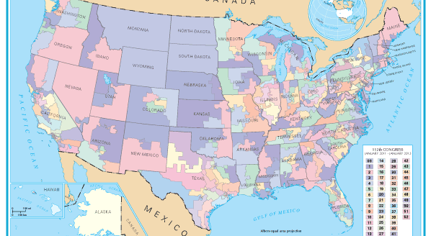
Congressional Districts

