Slide 1
Singing Transportation Electric:
What would an all-electric transportation system look like?
by Jon Rynn
jonrynn@gmail.com

Slide 2
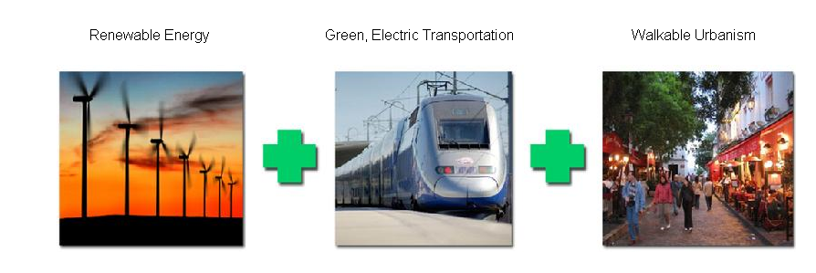
Green transformation

Slide 3
To simplify, there are 3 energy systems:
1) Oil, almost 75% used for transport
2) Natural gas that is used for heat
3) Electricity
The electricity system can be made sustainable (wind, solar, geothermal, water), the other two can’t.
The transportation system is over 99% based on oil; it must become 99% based on electricity to be sustainable.

Slide 4
In 2008 Al Gore declared:
“Today I challenge our nation to commit to producing 100 percent of our electricity from renewable energy and truly clean carbon-free sources within 10 years.”
Two years earlier he said:
“The maximum that seems politically feasible still falls far short of the minimum that would be effective in solving the crisis”
Let’s assume that we put a renewable energy system in place, and that electricity generation will be carbon-free. Then to make transportation carbon-free, it will have to shift from oil to electricity.

Slide 5
An all-electric transportation system
Intercity passenger travel -- High speed rail
Intercity freight -------------- High speed and regular rail
Suburbs/Towns to City ------ Fast regular rail
InterSuburbs/Towns -------- Light rail/electric BRT
Intracity passenger travel--- Light rail, trolley, subways
Intracity freight -------------- Small electric trucks
IntraSuburb/Town freight-- Small electric trucks
IntraSuburb/Town passenger travel: Small, low-range (~50 miles), slow (<30 mph) all-electric cars
Cross-ocean passenger: some air travel
Cross-ocean freight: ships? (ask Anthony Perl)

Slide 6
City region
suburb
suburb
suburb
City
suburb
suburb
suburb
Regular trains to and from suburbs/towns and city
Light rail/electric BRT between suburbs/towns

Slide 7
Suburb/Town
Residential area
Town Center
10 miles, max
Regular train link to city
Light rail suburban links
Main commercial district
Parking structures for electric cars

Slide 8
How much electricity do we need for intracity passenger transportation?
New York City, with 8 million people, uses 1.8 billion kilowatt/hours per year for subway propulsion
Assume that electrified buses/light rail would double that, to 3.6. Since NYC transit use is over 50%, double that again to include the entire population, to 7.2. Round to 10 billion kw/hrs, to make the calculations easier
If the rest of the country was as dense as NYC, we would need about 40 times the electrical use of our fully electrified NYC, or 400 Billion Kw/hr
That’s 10% of the current annual output of the country, a bit over 4,000 billion Kwhr
This amount, even a few multiples of it, could easily be handled by a national Interstate Wind System that took advantage of the fact that wind is always blowing somewhere in the continental United States

Slide 9
Intercity rail system
City
Region
City
Region
City
Region
High speed rail links downtown of cities

Slide 10
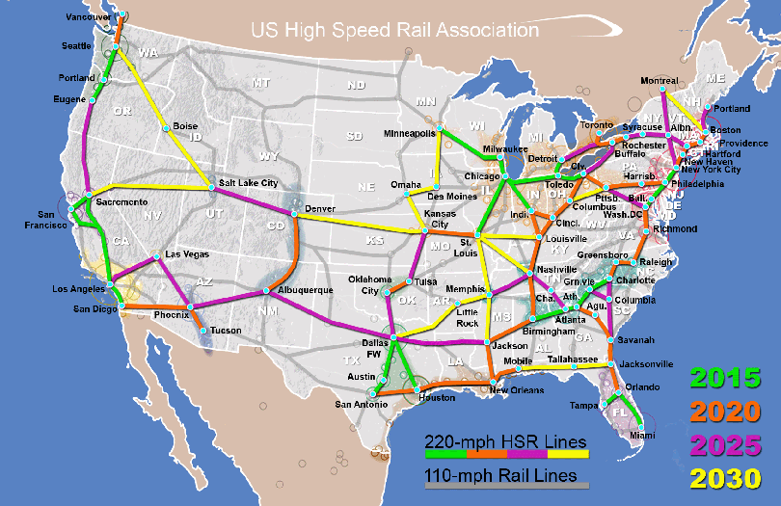
US High Speed Rail Assoc plan
17,000 miles, for $600 billion, in 20 years

Slide 11
The Millenium Insitute plan for freight and transit
Transferring freight from diesel trucks to electric rail increases BTU efficiency by 20 times
$500 billion over 20 years for freight and regular rail upgrades and electrification, for 110 mph travel
Includes 2-2.5 million per mile to electrify 60,000 miles of track, for $120-$150 billion (France has committed to electrifying all rail by 2025)
$60 billion per year for light rail/BRT, for an unspecified number of years for towns over 100,000 ($30 million per mile for 2,000 miles per year)

Slide 12
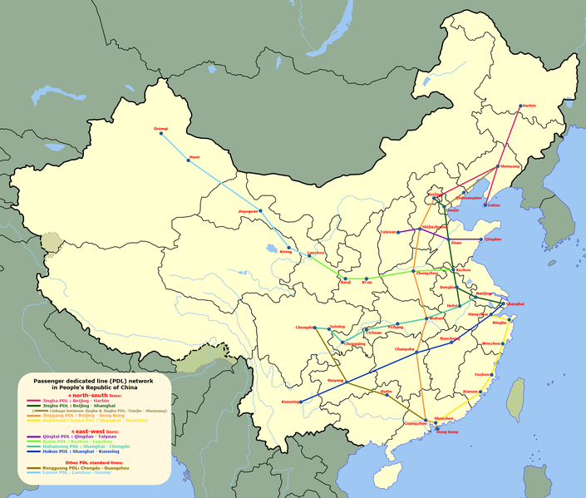
China’s high speed rail plan
15,000 miles, $300 billion, in about 5 years

Slide 13
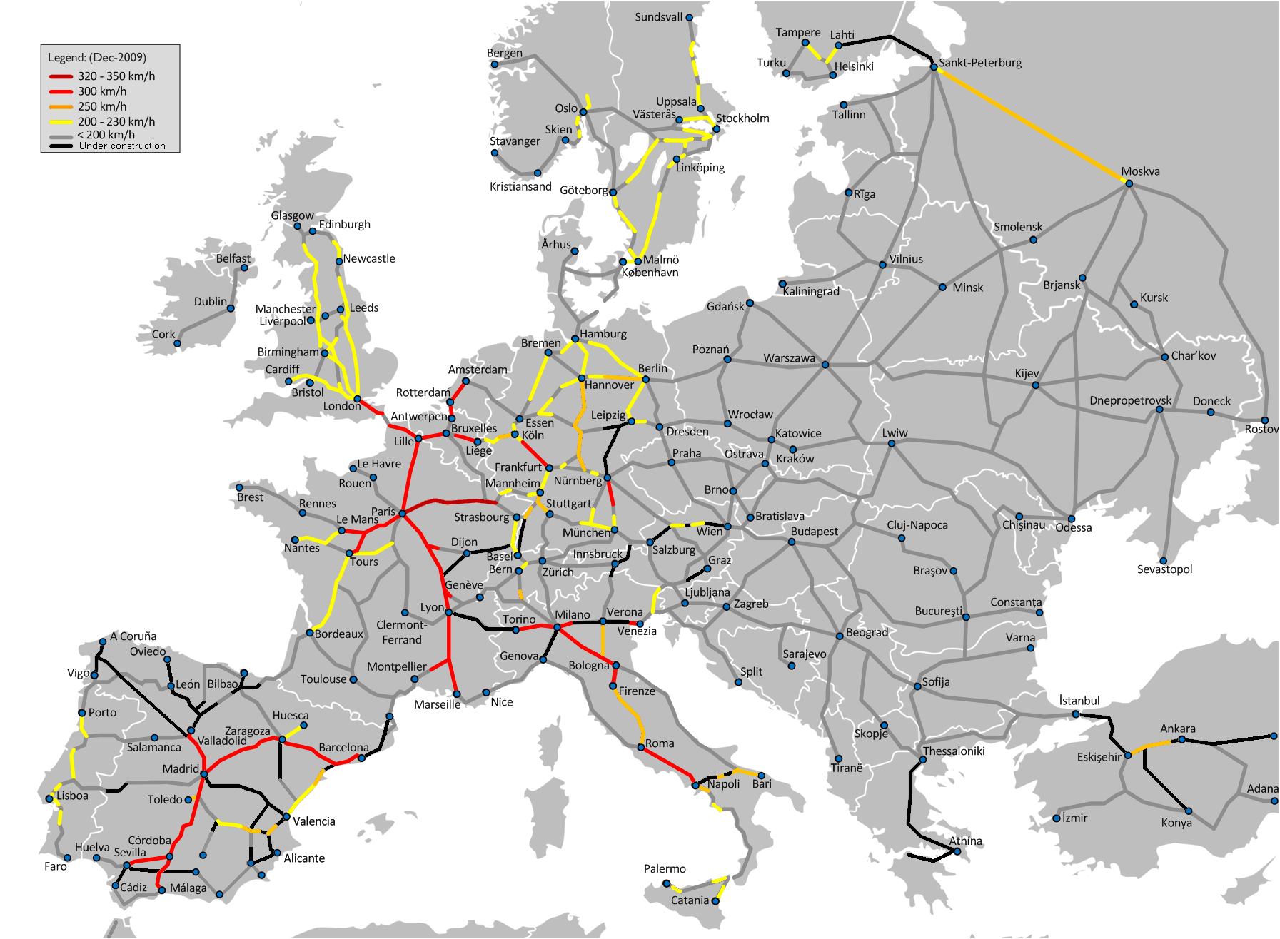
Europe’s high speed rail plan

Slide 14
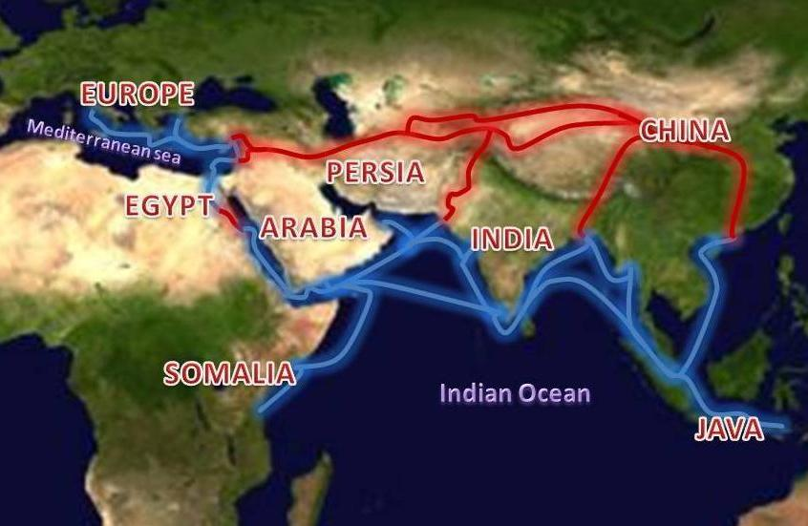
“China’s long-term vision calls for high-speed rail routes linking Shanghai to Singapore and New Delhi by way of Myanmar, and someday connecting Beijing and Shanghai to Moscow to the northwest and through Tehran to Prague and Berlin” N.Y. Times, 4/8/10
The Silk Road, medieval and 21st century?

Slide 15
Is a new transportation revolution possible?
In 1900:
4000 automobiles were sold and 8,000 registered
60,000 electric rail passenger cars were in operation
38,000 steam (and electric) locomotives existed
In other words, not much oil was used…
…and very little electricity; 6,000 million kwhrs generated, now almost 700 times that amount
Yeah, we can make another revolution!

Slide 16
Rebuild manufacturing at the same time as we transform transportation and energy
Trains and wind turbines use the basic components of the machinery industries
By planning for multi-trillion dollar, multi-decade programs, we can stabilize demand and encourage companies and people to engage in train/transit, wind and other sustainable technologies
The government will have to design and finance this transformation

Slide 17
Takeaway: Paint a picture
People respond to images and attractive visions of the future, more than to numbers
We need to “free our minds” and imagine what a world will look like that will actually solve the problems of climate change, peak oil, ecosystem destruction, and manufacturing decline

