Slide 1
CMPS 4123 Database Managements Systems
Installing MySQL
Lopamudra Roychoudhuri
Midwestern State University

Slide 2

MySQL
An open-source relational database management system (RDBMS) under the terms of the GNU General Public License
(GNU GPL –series of free software licenses to run, study, share and modify software)
Its name is a combination of "My", the name of co-founder Michael Widenius's daughter My, and "SQL”
MySQL was owned and sponsored by the Swedish company MySQL AB, which was bought by Sun Microsystems (now Oracle Corporation)
In 2010, when Oracle acquired Sun, Widenius forked the open-source MySQL project to create MariaDB.
- Wikipedia

Slide 3
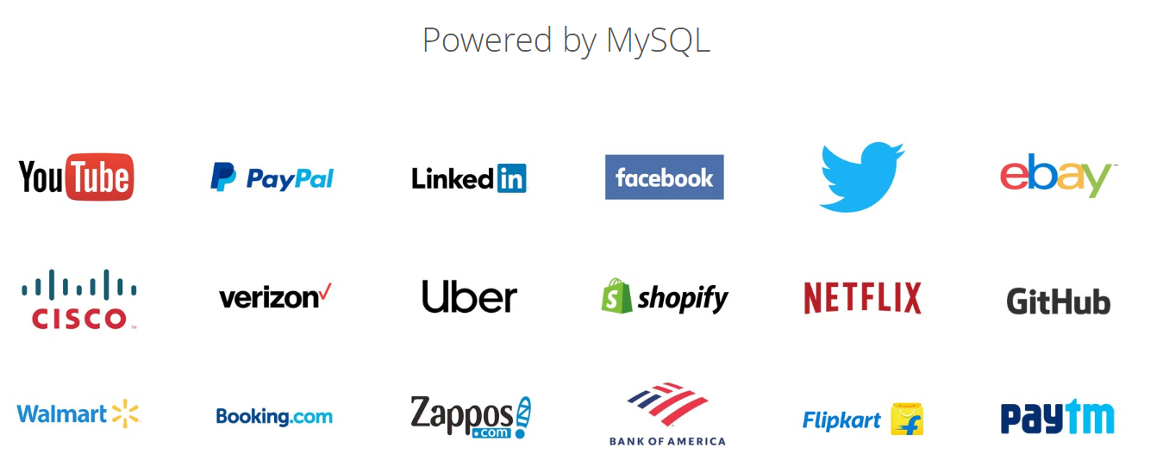
MySQL background cont.
MySQL is a component of the LAMP web application software stack
an acronym for Linux, Apache, MySQL, Perl/PHP/Python.
MySQL is used by many database-driven web applications
including Drupal, Joomla, phpBB, and WordPress.
MySQL is also used by many popular websites
including Facebook, Twitter, GitHub and YouTube

Slide 4



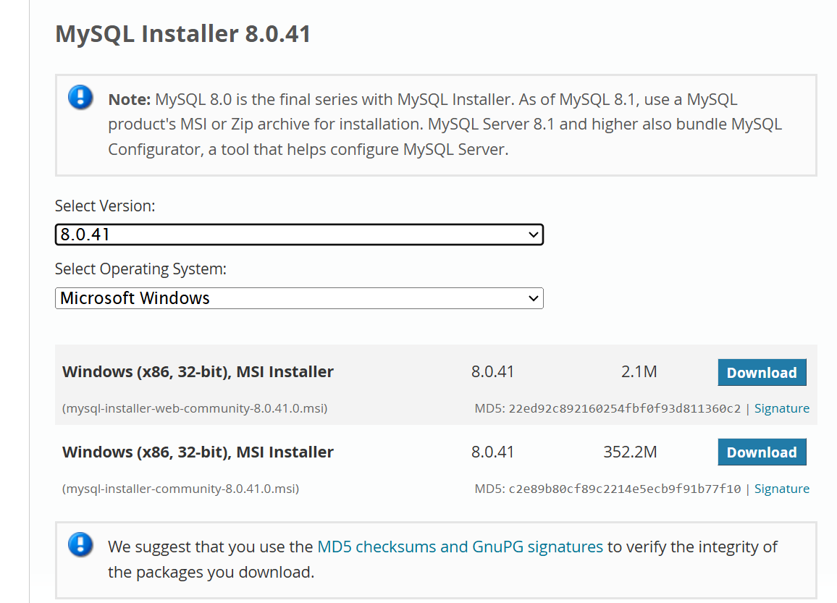
MySQL Download
From MySQL home page, click ‘Downloads’, scroll down to bottom to MySQL Community (GPL) Downloads
Then get to ‘MySQL Installer for Windows’
Download the second one

Slide 5
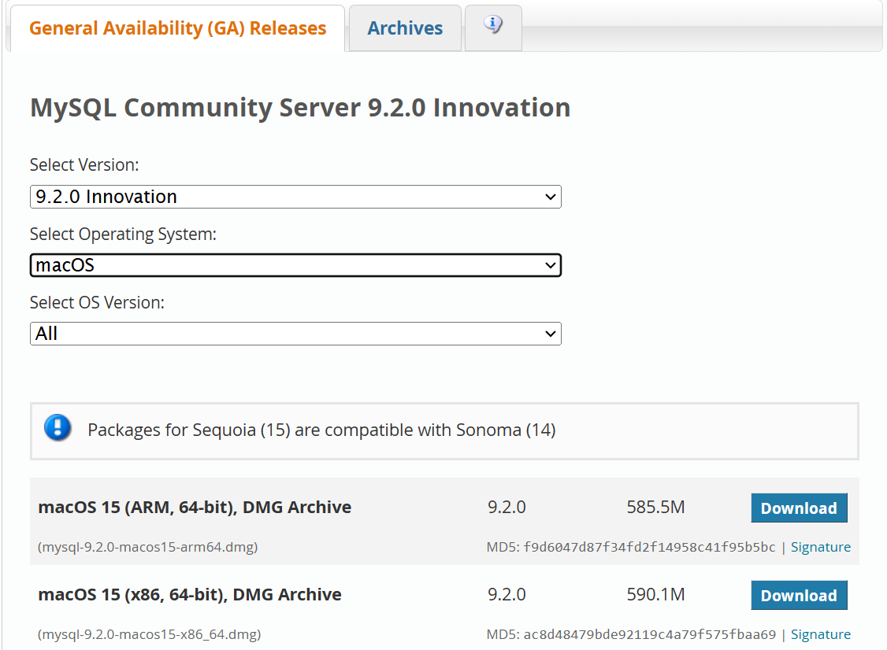
MySQL for Mac
Go to https://dev.mysql.com/downloads/mysql/
Choose macOS
Multiple options

Slide 6
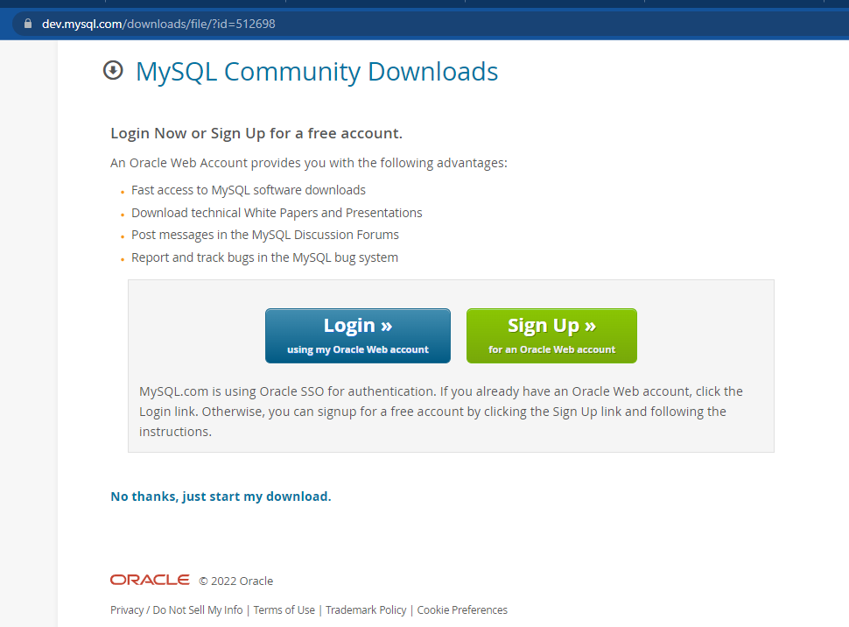
It will ask if you want to create an Oracle account
I created an account, but I think it will still work even if you don’t create one

Slide 7
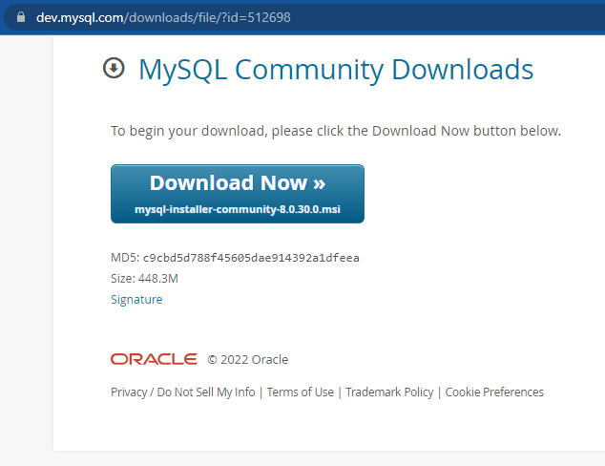
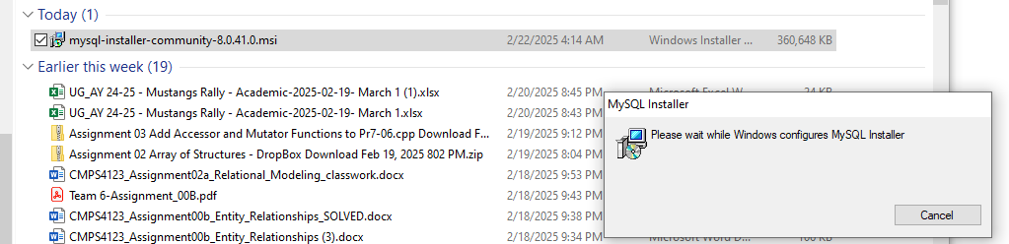
To start installing..
Download the file and double-click it

Slide 8
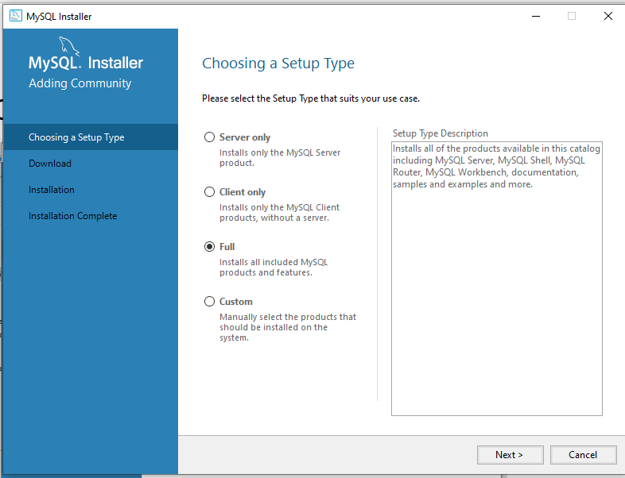
It comes back with a menu, choose Full

Slide 9
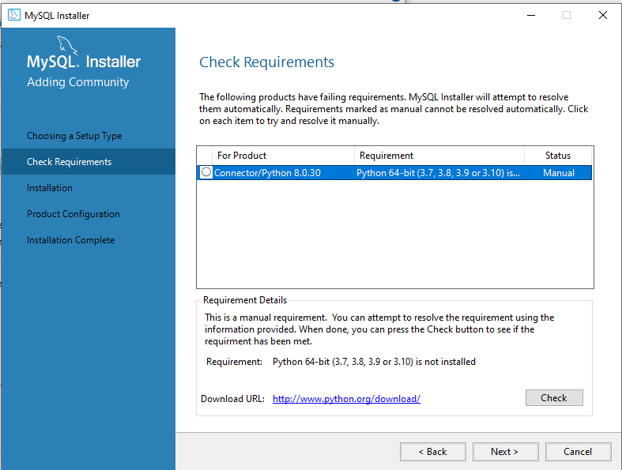
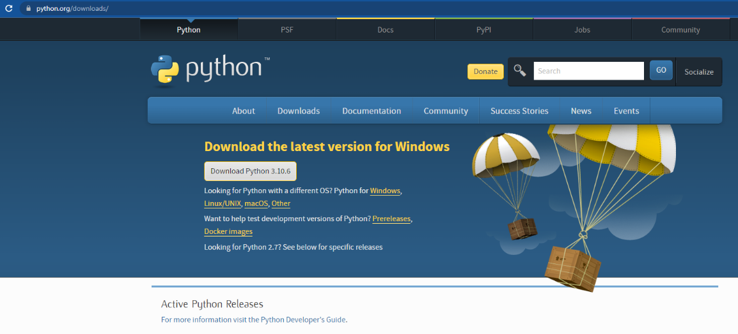
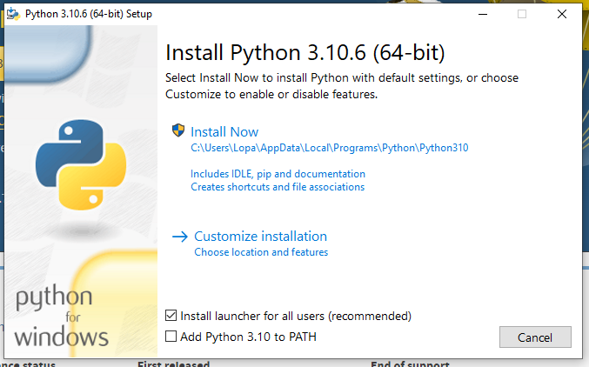
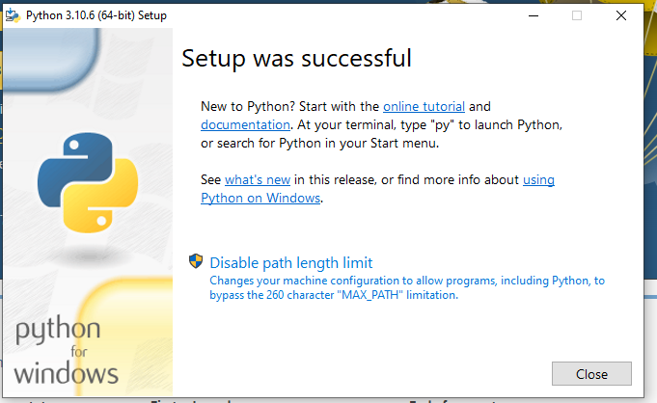
At the ‘Check Requirement’ it may ask for Python
Number of MySQL tools need Python
You will have to download Python from python.org/downloads – fairly simple

Slide 10
It may also flag ‘MySQL for Visual Studio’
We will not need this
Skip it if you get that under ‘Check Requirement’

Slide 11
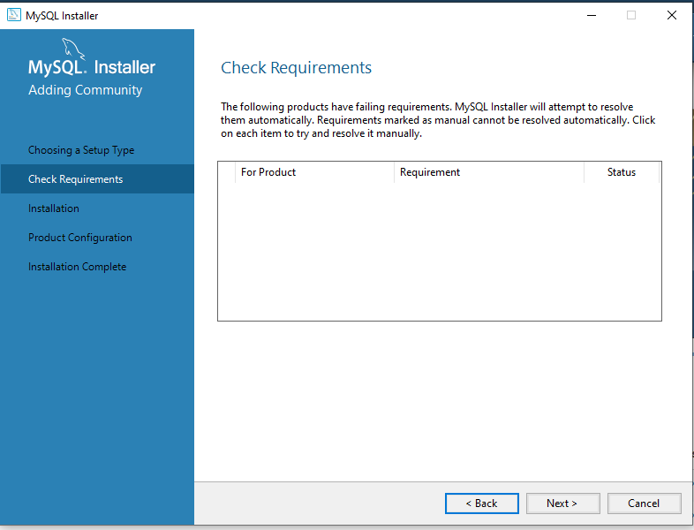
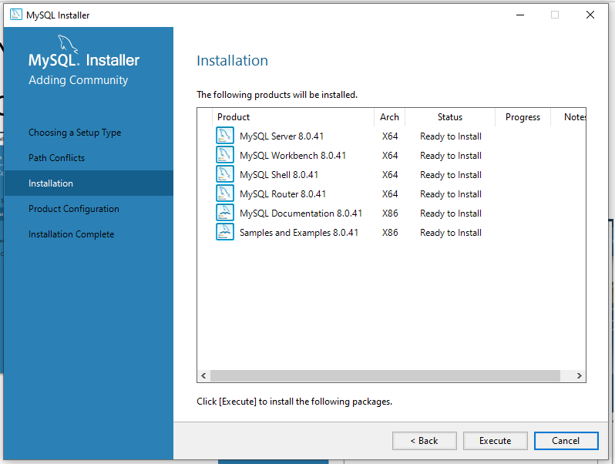
Now ‘Check Requirements’ is clean! Ready to install products..
Install everything!

Slide 12
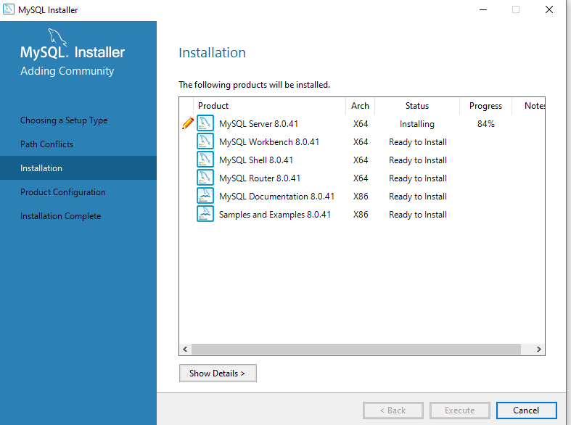
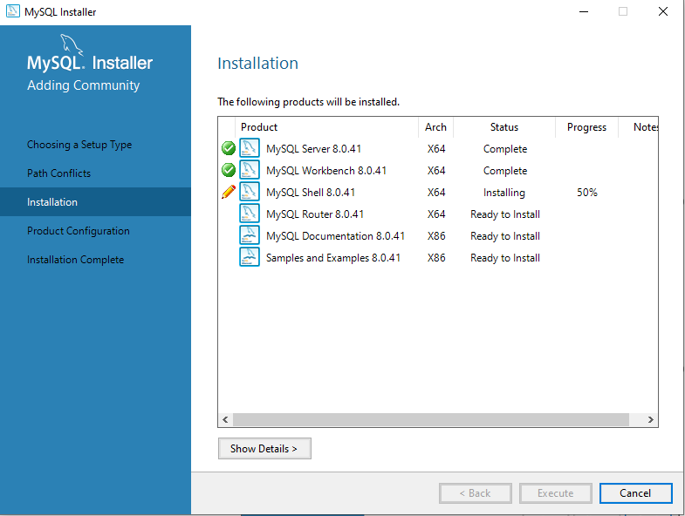
It will take some time to install all the components..

Slide 13
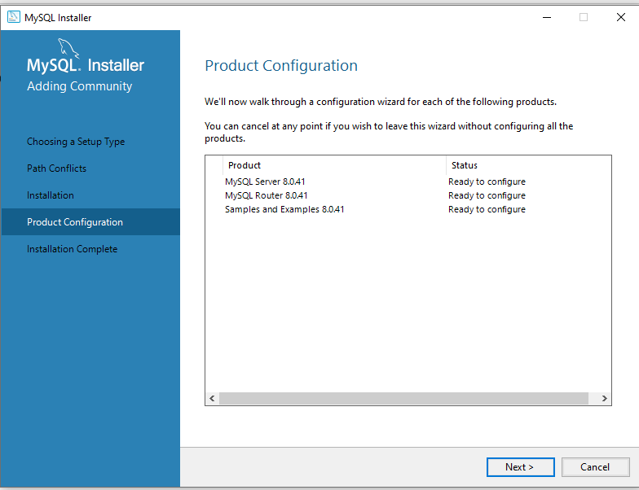
Now we are ready to configure..

Slide 14
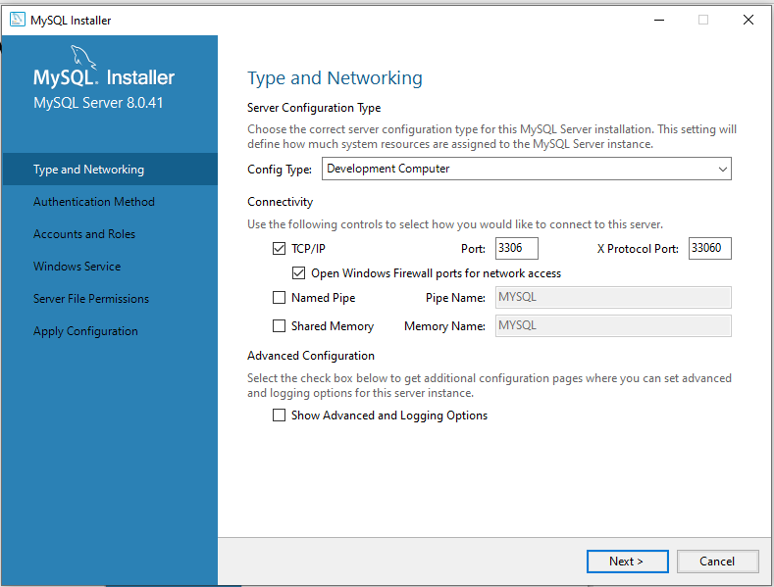
MySQL Server Configuration
MySQL Server is a TCP/IP server that listens to port 3306 (see slide 24)
TCP – Transmission Control Protocol, IP –Internet Protocol
Essential protocols that are used to communicate over the Internet
Don’t change anything here

Slide 15
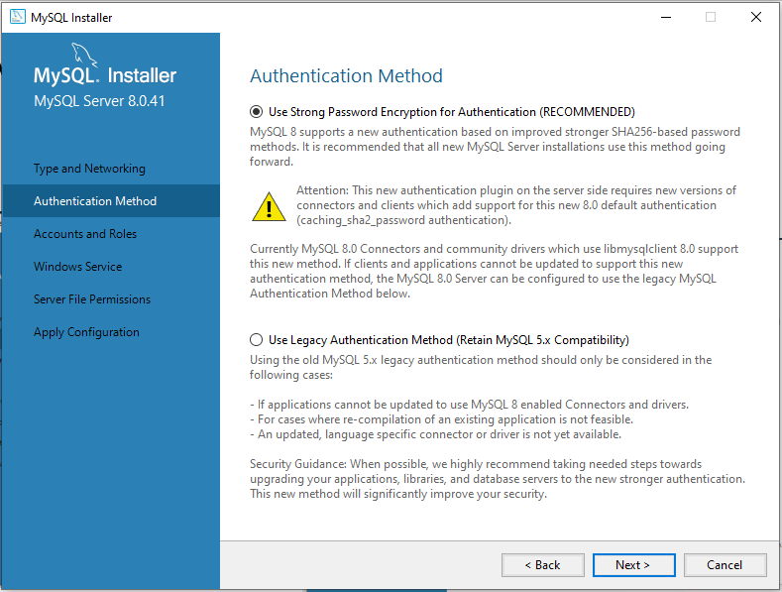
MySQL Server Configuration cont.
Proceed thru the next configuration without changing anything

Slide 16
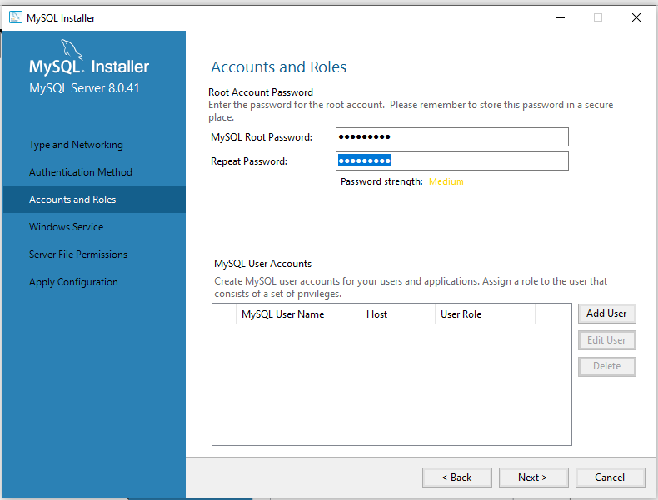
MySQL Server Configuration cont.
‘root’ is the all-powerful user of the database who has all administrative rights
Now the important part – setting up the ‘root’ password
Keep this password handy – you will need it all the time
If you want, you can set up another user as well

Slide 17
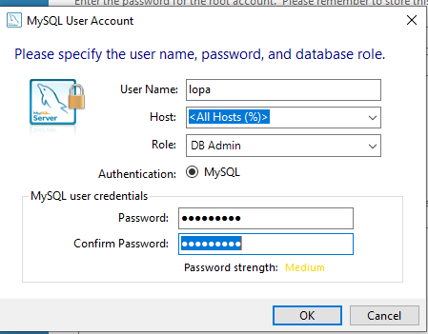
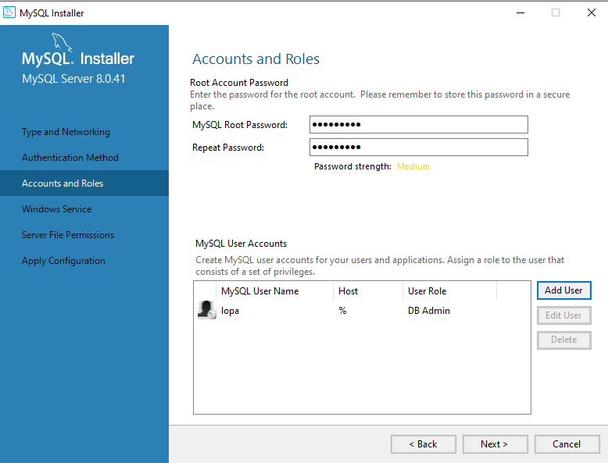
MySQL Server Configuration cont.
Setting up another user with DB Admin role

Slide 18
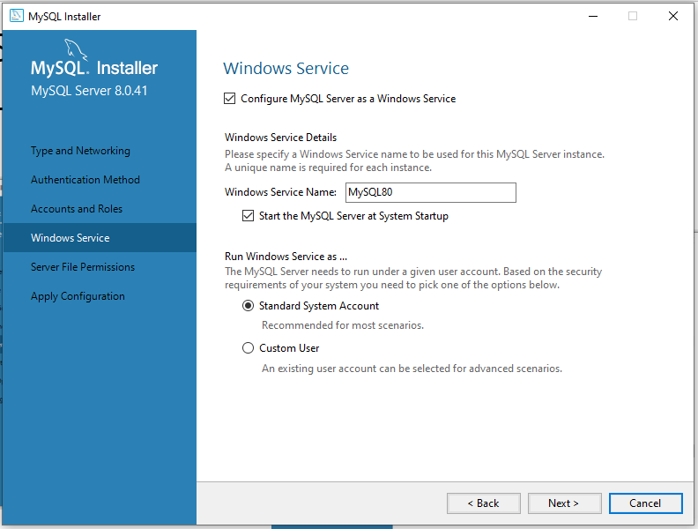
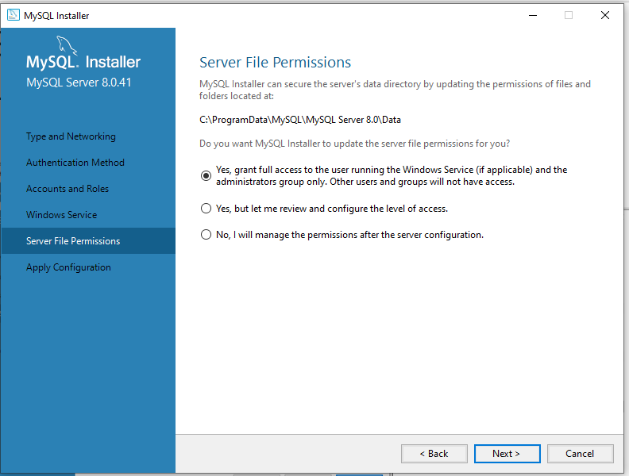
Setting up a Windows Service and Logging Options
Don’t change anything for these..

Slide 19
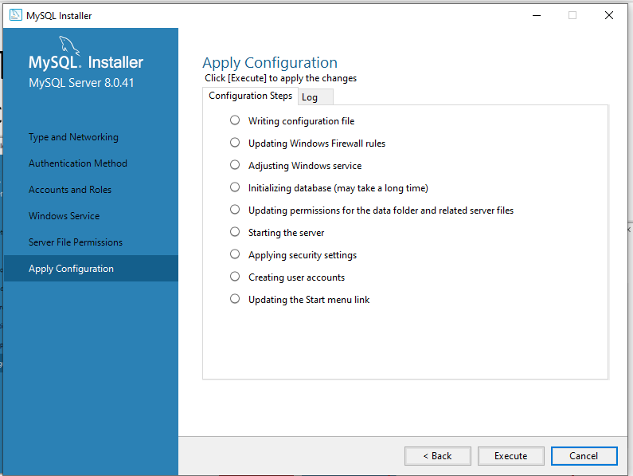
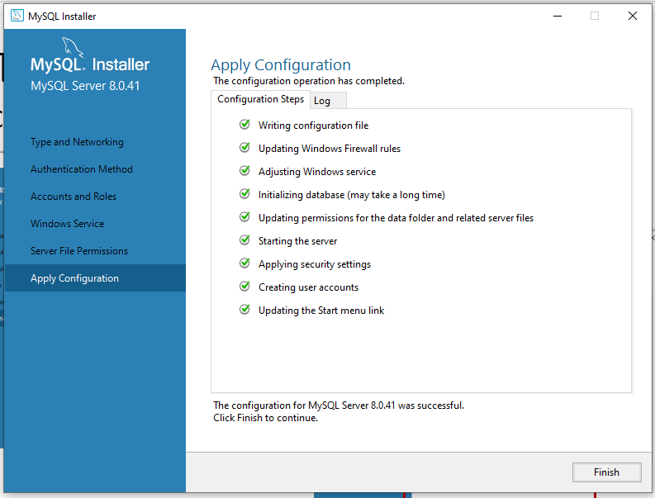
Time to Apply Configuration
Click ‘Execute’

Slide 20
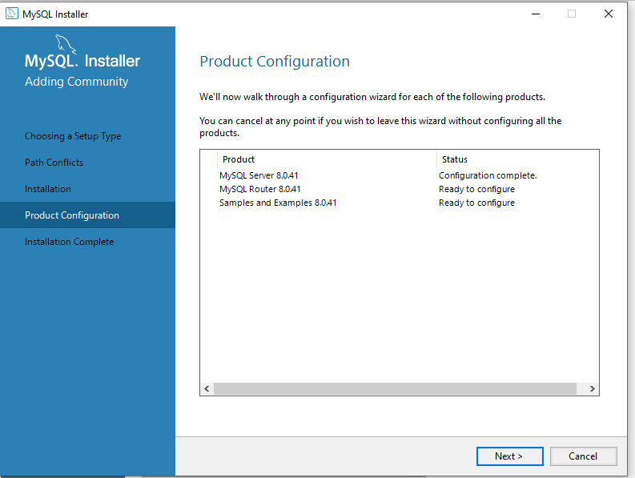
MySQL Server Configuration
Is now complete!!

Slide 21
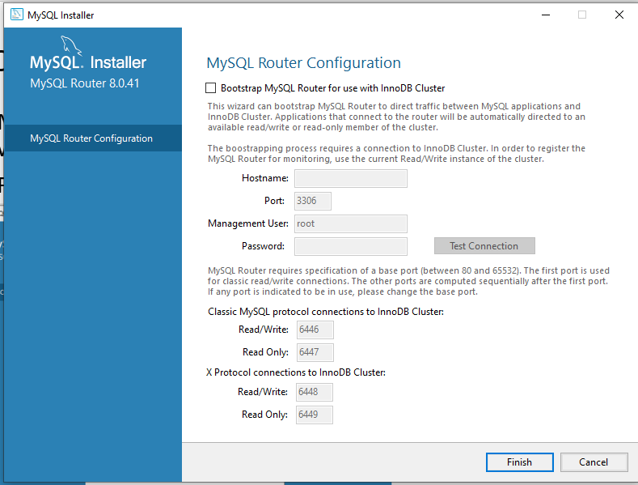
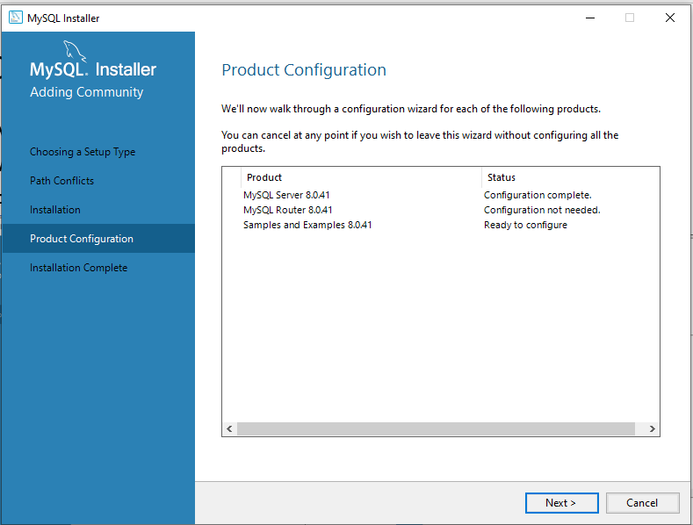
No need to configure MySQL Router
MySQL Router is a middleware used to connect applications with backend MySQL servers
For now, let’s not worry about it

Slide 22
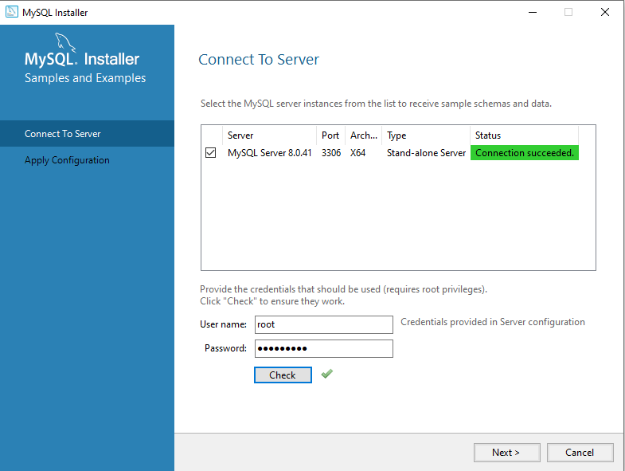
To install Samples and Examples, we need to connect to server
Put the root password and click ‘Check’

Slide 23
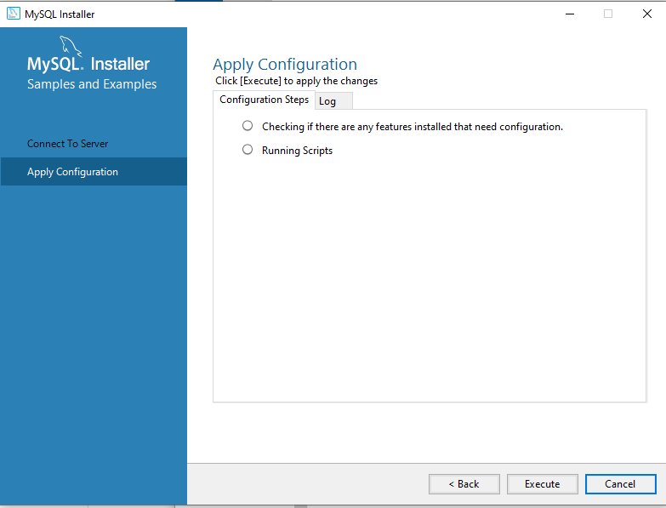
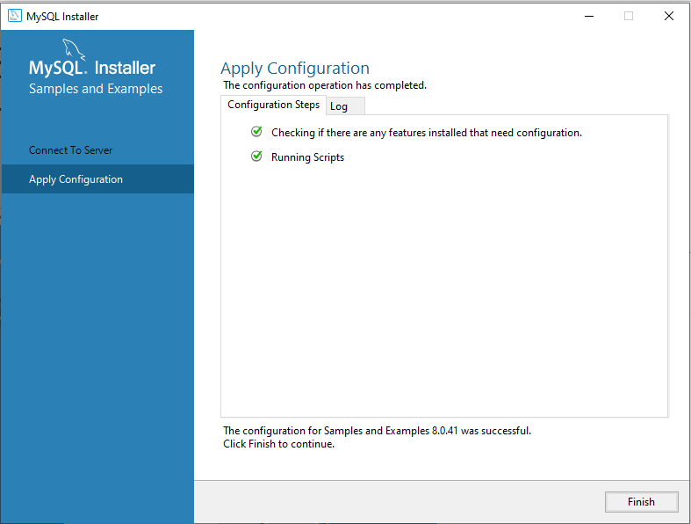
Samples and Examples - another round of ‘Apply Configuration’
Hit ‘Execute’ like before

Slide 24
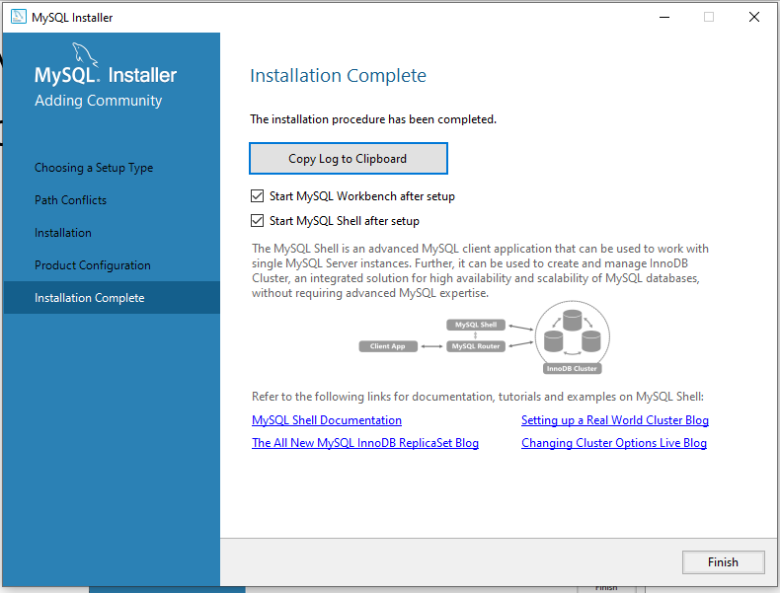
MySQL Installation is now complete!!

Slide 25
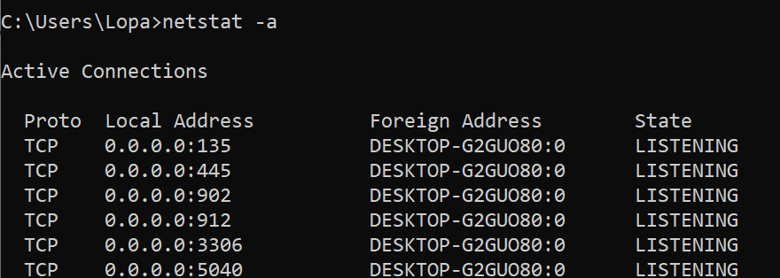
Time to test the product!
First check that the server is running and listening to port 3306
Network ports are ‘doors’ for processes to send and receive information, managed by the operating system
Open a cmd window, run the command netstat -a
You will see that a network process is listening to port 3306

Slide 26
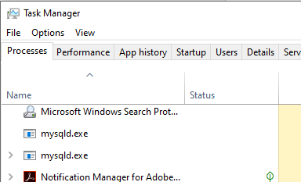
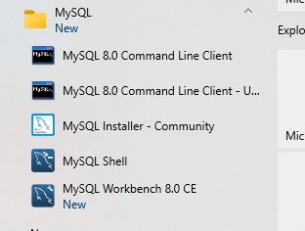
Time to test the product! Cont.
You can also check Task Manager for the server process
You will see mysqld.exe running
Servers are referred to as ‘daemons’ – it’s a Unix thing!
Check all the apps that were installed with the server under Start
MySQL Command Line Client
MySQL Shell
MySQL Workbench
These are MySQL client apps

Slide 27
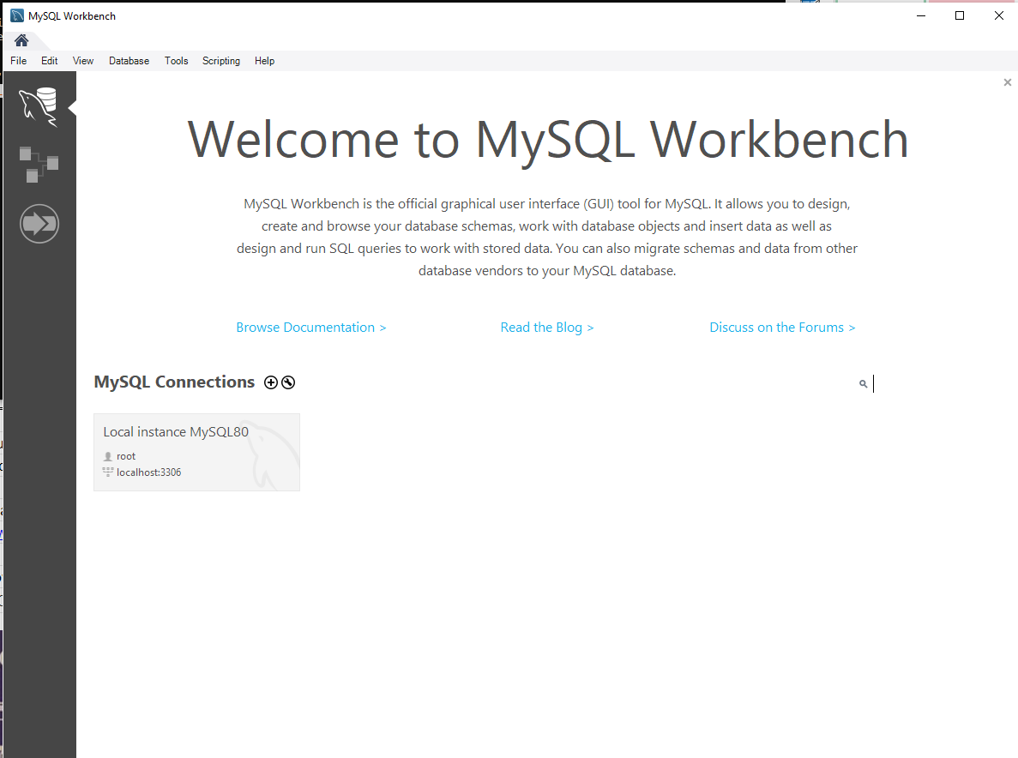
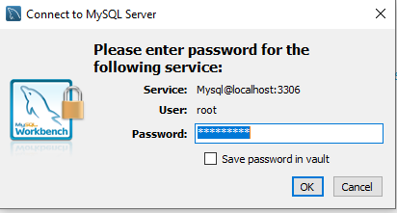
Time to test the product! Cont.
MySQL Workbench
A graphical application development tool with many features
One can design tables, populate tables, execute queries, and much more
You may need root password to connect to the server, or it may log you automatically as root

Slide 28

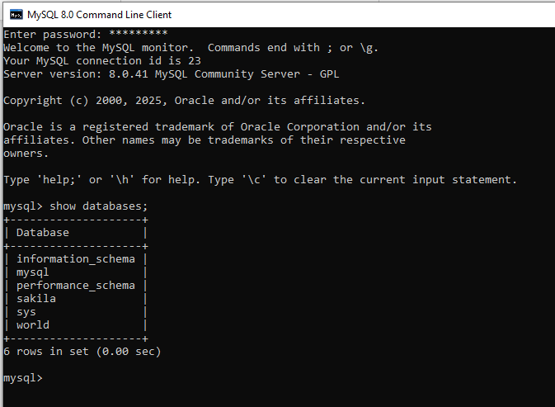
Time to test the product! Cont.
MySQL Client
A terminal application to connect to the database, execute commands and run queries, very useful!
Enter root password

Slide 29
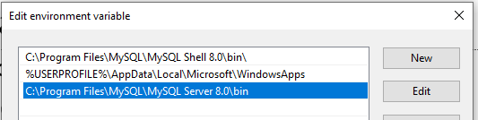
Or you can directly connect to the database server
By executing the command mysql in cmd
Add the path to MySQL server bin to your path environment variable
Likely path: C:\Program Files\MySQL\MySQL Server 8.0\bin
To change your path environment
Search-> env (Edit System Environment Variables) -> Click on ‘Environment Variables’
Edit the user variable Path, click ‘New’ to add the new location

Slide 30
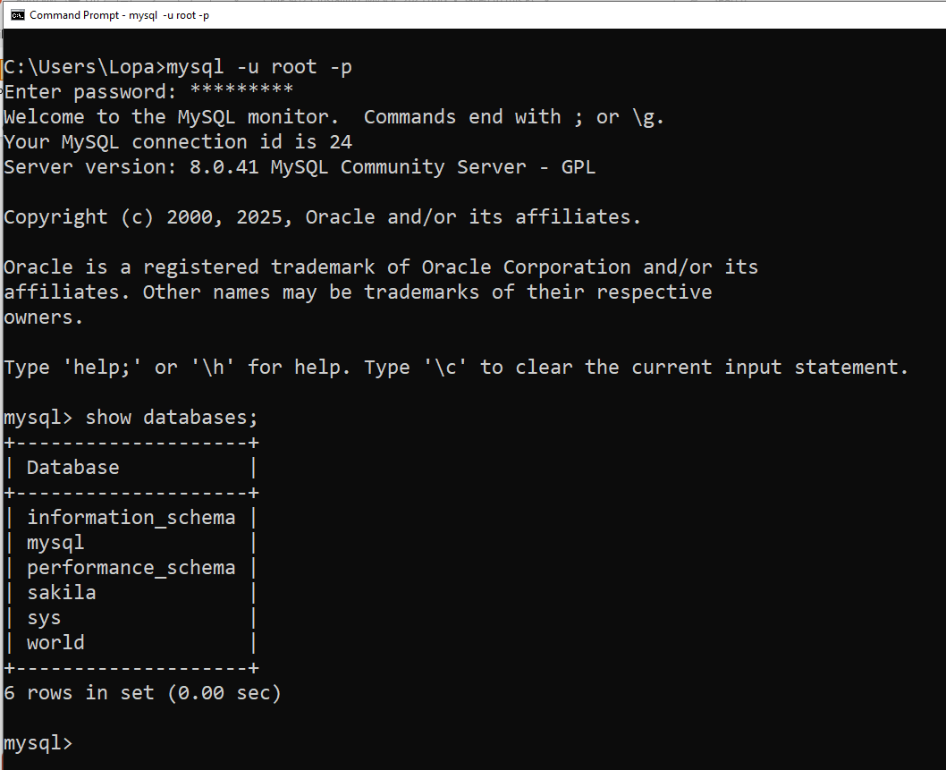
You can directly connect to the database server cont.
Now you can run the command mysql at a command prompt, as follows: mysql -u root -p
You will also be able to run scripts easily in this cmd mode

Slide 31
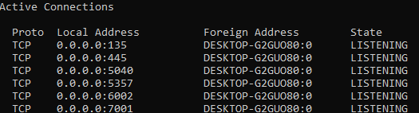
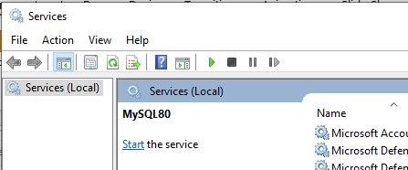
If you need to stop MySQL server on Windows
Log on to your system as Administrator.
Stop the MySQL server if it is running. For a server that is running as a Windows service, go to the Services manager: From the Start menu, search Control Panel -> System and Security -> Administrative Tools -> Services. Find the MySQL service in the list and stop it
You will not see the server running in netstat –a (port 3306 missing):
To restart, go back to Services and Start

Slide 32
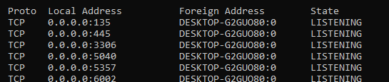
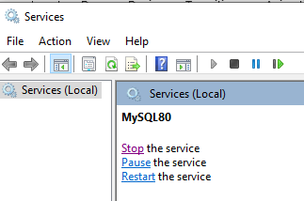
Restart mysql server on Windows
To restart, go back to Services and Start
Now the server is back again, listening to the port
As well as showing itself under services

Slide 33
If you forgot your root password
And need to reset it, this page discusses it
https://dev.mysql.com/doc/mysql-windows-excerpt/5.7/en/resetting-permissions-windows.html
Carefully follow this (I haven’t tried this myself)

