Slide 1
AVL Trees
(Georgy Adelson-Velsky and Evgenii Landis' tree, named after the inventors)
Terry Griffin & Tina Johnson
Midwestern State University

Slide 2

The AVL tree overview and explanation of its operations were all taken from http://en.wikipedia.org/wiki/AVL_tree
Wikipedia’s copyright information can be viewed here: http://en.wikipedia.org/wiki/Wikipedia:Copyrights

Slide 3

AVL Tree Overview
A self-balancing binary search tree (the first such data structure to be invented).
The heights of the left and right subtrees differ by no more than 1 level.
Lookup, insertion, and deletion all take O(log n) time in both the average and worst cases.
Additions and deletions may require the tree to be rebalanced by one or more tree rotations.

Slide 4
AVL Tree Overview
The height of a tree is the number of edges on the longest downward path between the root and a leaf. Note: This definition varies slightly depending on who you're talking to!
The balance factor of a node is the height of its left subtree minus the height of its right subtree.
A node with balance factor 1, 0, or -1 is considered balanced.
A node with any other balance factor is considered unbalanced and requires rebalancing the tree.
The balance factor is either stored directly at each node or computed from the heights of the subtrees.

Slide 5
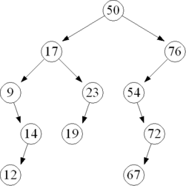
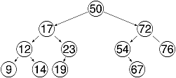
Non AVL Tree Height Balanced Tree
Note: This is an example only. NOT a conversion from the left tree to the right. Trees are balanced as they are created.
images: wikipedia.org

Slide 6
bf = 0
bf = 3
bf = 1
bf = 0
bf = 1
bf = 0
bf = 1
bf = -2
bf = -2
bf = 1
bf = -1
bf = 0
bf = 1
bf = 1
bf = 0
bf = 0
bf = 0
bf = 0
bf = 0
bf = 0
bf = 0
bf = 0
Non AVL Tree Height Balanced AVL Tree
images: wikipedia.org

Slide 7
Operations
The basic operations of an AVL tree generally involve carrying out the same algorithms as would be carried out on an unbalanced binary search tree.
The difference is they are preceded or followed by one or more of the so-called "AVL rotations."

Slide 8
Insertion
Insertion into an AVL tree may be carried out by inserting the given value into the tree as if it were an unbalanced binary search tree, and then retracing one's steps toward the root updating the balance factor of the nodes.
Retracing is stopped when a node's balance factor becomes 0, 1, or -1.
If the balance factor becomes 0 then the height of the subtree hasn't changed because of the insert. The insertion is finished.

Slide 9
Insertion
If the balance factor becomes 2 or -2 then the tree rooted at this node is unbalanced, and a tree rotation is needed.
The tree rotation will always leave the subtree evenly balanced. The rotation can be done in constant time.

Slide 10
Insertion
Similar to an unbalanced binary search tree, insertion takes O(height) time.
This is O(height) to find the insertion point plus O(height) to check for any needed rotations.

Slide 11
Lookup
Lookup in an AVL tree is performed exactly as in an unbalanced binary search tree.
But is guaranteed to takes O(log n) time, since an AVL tree is always kept balanced (this is not guaranteed in a BST).
No special provisions need to be taken, and the tree's structure is not modified by lookups.

Slide 12
Rotation
A tree rotation is an operation on a binary search tree that changes the structure without interfering with the order of the elements.
A tree rotation moves one node up in the tree and one node down.
Rotations are used to change the shape of the tree, and in particular to decrease its height by moving smaller subtrees down and larger subtrees up, resulting in improved performance of many tree operations.

Slide 13
Rotation
x
Left-Rotate(T, x)
y
α
γ
y
Right-Rotate(T, y)
x
β
γ
α
β

Slide 14
Right Rotation
SubRoot
Q
Temp
Z
M
A
N
  TreeNode *Temp;
  Temp = SubRoot->left;
  SubRoot->left = Temp->right;
  Temp->right = SubRoot;
  SubRoot = Temp;
  ComputeAvlValues(SubRoot);

Slide 15
Right Rotation
SubRoot
Q
Temp
M
Z
A
N
  TreeNode *Temp;
  Temp = SubRoot->left;
  SubRoot->left = Temp->right;
  Temp->right = SubRoot;
  SubRoot = Temp;
  ComputeAvlValues(SubRoot);

Slide 16
Right Rotation
SubRoot
Q
Temp
M
Z
N
A
  TreeNode *Temp;
  Temp = SubRoot->left;
  SubRoot->left = Temp->right; Temp->right = SubRoot;
  SubRoot = Temp;
  ComputeAvlValues(SubRoot);

Slide 17
Right Rotation
SubRoot
Temp
M
Q
A
Z
N
  TreeNode *Temp;
  Temp = SubRoot->left;
  SubRoot->left = Temp->right; Temp->right = SubRoot;
  SubRoot = Temp;
  ComputeAvlValues(SubRoot);

Slide 18
Right Rotation
SubRoot
M
-1
A
Q
0
0
  TreeNode *Temp;
  Temp = SubRoot->left;
  SubRoot->left = Temp->right; Temp->right = SubRoot;
  SubRoot = Temp;
  ComputeAvlValues(SubRoot);
Z
N
0
0

Slide 19
Left Rotation
SubRoot
M
Temp
A
Q
N
Z
  TreeNode *Temp;
  Temp = SubRoot->right;
  SubRoot->right = Temp->left;
  Temp->left = SubRoot;
  SubRoot = Temp;
  ComputeAvlValues(SubRoot);

Slide 20
Left Rotation
SubRoot
M
Temp
A
Q
N
Z
  TreeNode *Temp;
  Temp = SubRoot->right;
  SubRoot->right = Temp->left;
  Temp->left = SubRoot;
  SubRoot = Temp;
  ComputeAvlValues(SubRoot);

Slide 21
Left Rotation
SubRoot
M
Temp
A
Q
N
Z
  TreeNode *Temp;
  Temp = SubRoot->right;
  SubRoot->right = Temp->left;
  Temp->left = SubRoot;
  SubRoot = Temp;
  ComputeAvlValues(SubRoot);

Slide 22
Left Rotation
SubRoot
M
Temp
A
Q
  TreeNode *Temp;
  Temp = SubRoot->right;
  SubRoot->right = Temp->left;
  Temp->left = SubRoot;
  SubRoot = Temp;
  ComputeAvlValues(SubRoot);
Z
N

Slide 23
Left Rotation
SubRoot
Temp
Q
M
Z
A
N

Slide 24
Left Rotation
SubRoot
Q
M
Z
A
N

Slide 25
Left Rotation
SubRoot
Q
-1
M
Z
0
0
A
N
  TreeNode *Temp;
  Temp = SubRoot->right;
  SubRoot->right = Temp->left;
  Temp->left = SubRoot;
  SubRoot = Temp;
  ComputeAvlValues(SubRoot);
0
0

Slide 26
Double Rotations
What if we added a node that ended up as one of N’s Children??
SubRoot
Q
M
Z
A
N

Slide 27
Double Rotations
Is our tree balanced?? No so we do a right rotation, correct?
SubRoot
Q
M
Z
A
N
P

Slide 28
Double Rotations
Lets try….
SubRoot
Q
Temp
M
Z
A
N
P

Slide 29
Double Rotations
Lets try….
SubRoot
Q
Temp
M
Z
A
N
P

Slide 30
Double Rotations
Lets try….
SubRoot
Q
Temp
M
Z
A
N
P

Slide 31
Double Rotations
Lets try….
Q
SubRoot
Temp
M
Z
A
N
P

Slide 32
Double Rotations
Are we balanced??
SubRoot
M
A
Q
Z
N
P

Slide 33
Double Rotations
Before rotation: After rotation:
SubRoot
M
SubRoot
Q
A
Q
M
Z
Z
N
A
N
P

Slide 34
Double Rotations
The reason our right rotation did not work, is because the left subtree has a negative balance factor, and is thus right heavy.
SubRoot
Q
M
Z
A
N
P

Slide 35
Double Rotations
To fix the problem, we must do a “left rotation” on the “right” subtree to make it left heavy.
Then can do a “right rotation” on the rest of the tree and it will be balanced.
SubRoot
Q
M
Z
A
N
P

Slide 36
Double Rotations
Do a left rotation on the “right subtree”
SubRoot
Q
SubRoot
M
Z
A
N
P

Slide 37
Double Rotations
Do a left rotation on the “right subtree”
SubRoot
Q
SubRoot
M
Z
A
N
Temp
P

Slide 38
Double Rotations
Do a left rotation on the “right subtree”
SubRoot
Q
SubRoot
M
Z
A
N
Temp
P

Slide 39
Double Rotations
Do a left rotation on the “right subtree”
SubRoot
Q
SubRoot
M
Z
A
N
Temp
P

Slide 40
Double Rotations
Do a left rotation on the “right subtree”
SubRoot
Q
SubRoot
M
Z
A
N
Temp
P

Slide 41
Double Rotations
Now our “left” subtree is “left” heavy and we can do a “right” rotation on the tree itself
SubRoot
Q
N
Z
M
P
A

Slide 42
Double Rotations
Now our “left” subtree is “left” heavy and we can do a “right” rotation on the tree itself
SubRoot
Q
Temp
N
Z
M
P
A

Slide 43
Double Rotations
Now our “left” subtree is “left” heavy and we can do a “right” rotation on the tree itself
SubRoot
Q
Temp
N
Z
M
P
A

Slide 44
Double Rotations
Now our “left” subtree is “left” heavy and we can do a “right” rotation on the tree itself
SubRoot
Q
Temp
N
Z
M
P
A

Slide 45
Double Rotations
Now our “left” subtree is “left” heavy and we can do a “right” rotation on the tree itself
SubRoot
Q
Temp
N
Z
M
P
A

Slide 46
Double Rotations
SubRoot
Q
Temp
N
P
M
Z
A

Slide 47
Double Rotations
SubRoot
N
M
Q
A
P
Z

Slide 48
Double Rotations
void AvlTree::RotateLeft(TreeNode *&SubRoot){
  if(LeftHeavy(SubRoot->right)){
  RotateRight(SubRoot->right);
  }
  TreeNode *Temp;
  Temp = SubRoot->right;
  SubRoot->right = Temp->left;
  Temp->left = SubRoot;
  SubRoot = Temp;
  ComputeAvlValues(SubRoot);
}
void AvlTree::RotateRight(TreeNode *&SubRoot){
  if(RightHeavy(SubRoot->left)){
  RotateLeft(SubRoot->left);
  }
  TreeNode *Temp;
  Temp = SubRoot->left;
  SubRoot->left = Temp->right;
  Temp->right = SubRoot;
  SubRoot = Temp;
  ComputeAvlValues(SubRoot);
}

Slide 49
An Extended Example
Insert 3,2,1,4,5,6,7, 16,15,14

Slide 50
An Extended Example
Insert 3,2,1,4,5,6,7, 16,15,14
Insert Value
3

Slide 51
An Extended Example
Insert 3,2,1,4,5,6,7, 16,15,14
Calculate Balance Factor
3
0

Slide 52
An Extended Example
Insert 3,2,1,4,5,6,7, 16,15,14
Insert Value
3
0
2

Slide 53
An Extended Example
Insert 3,2,1,4,5,6,7, 16,15,14
Calculate Balance Factors
3
1
2
0

Slide 54
An Extended Example
Insert 3,2,1,4,5,6,7, 16,15,14
Insert Value
3
1
2
0
1

Slide 55
An Extended Example
Insert 3,2,1,4,5,6,7, 16,15,14
Calculate BF’s
3
2
2
1
1
0
  TreeNode *Temp;
  Temp = SubRoot->left;
  SubRoot->left = Temp->right;
  Temp->right = SubRoot;
  SubRoot = Temp;
  ComputeAvlValues(SubRoot);

Slide 56
An Extended Example
Insert 3,2,1,4,5,6,7, 16,15,14
Rotate and re-calculate
2
0
1
3
0
0

Slide 57
An Extended Example
Insert 3,2,1,4,5,6,7, 16,15,14
Insert Value
2
0
1
3
0
0
4

Slide 58
An Extended Example
Insert 3,2,1,4,5,6,7, 16,15,14
Calculate BF’s
2
-1
1
3
0
-1
4
0

Slide 59
An Extended Example
Insert 3,2,1,4,5,6,7, 16,15,14
Insert Value
2
-1
1
3
0
-1
4
0
5

Slide 60
An Extended Example
Insert 3,2,1,4,5,6,7, 16,15,14
Calculate BF’s
2
-2
1
3
0
-2
4
-1
5
0

Slide 61
An Extended Example
Insert 3,2,1,4,5,6,7, 16,15,14
Rotate and re-calculate
2
-1
1
4
0
0
3
5
0
0

Slide 62
An Extended Example
Insert 3,2,1,4,5,6,7, 16,15,14
Insert Value
2
-1
1
4
0
0
3
5
0
0
6

Slide 63
An Extended Example
Insert 3,2,1,4,5,6,7, 16,15,14
Calculate BF’s
2
-2
1
4
0
-1
3
5
0
-1
6
0

Slide 64
An Extended Example
Insert 3,2,1,4,5,6,7, 16,15,14
Rotate and re-calculate
4
0
2
5
0
-1
1
3
6
0
0
0

Slide 65
An Extended Example
Insert 3,2,1,4,5,6,7, 16,15,14
Insert a value
4
0
2
5
0
-1
1
3
6
0
0
0
7

Slide 66
An Extended Example
Insert 3,2,1,4,5,6,7, 16,15,14
Calculate BF’s
4
-1
2
5
0
-2
1
3
6
0
0
-1
7
0

Slide 67
An Extended Example
Insert 3,2,1,4,5,6,7, 16,15,14
Rotate and re-calculate
4
0
2
6
0
0
1
3
5
7
0
0
0
0

Slide 68
An Extended Example
Insert 3,2,1,4,5,6,7, 16,15,14
Insert a Value
4
0
2
6
0
0
1
3
5
7
0
0
0
0
16

Slide 69
An Extended Example
Insert 3,2,1,4,5,6,7, 16,15,14
Calculate BF’s
4
-1
2
6
0
-1
1
3
5
7
0
0
0
-1
16
0

Slide 70
An Extended Example
Insert 3,2,1,4,5,6,7, 16,15,14
Insert a value
4
-1
2
6
0
-1
1
3
5
7
0
0
0
-1
16
0
15

Slide 71
An Extended Example
Insert 3,2,1,4,5,6,7, 16,15,14
Calculate BF’s
4
-2
2
6
0
-2
1
3
5
7
0
0
0
-2
16
1
15
0

Slide 72
An Extended Example
Insert 3,2,1,4,5,6,7, 16,15,14
Rotate and Re-calculate
4
-2
2
6
0
-2
1
3
5
7
0
0
0
-2
16
1
15
0

Slide 73
An Extended Example
Insert 3,2,1,4,5,6,7, 16,15,14
Rotate and Re-calculate
4
-2
Right subtree
left heavy!!
2
6
0
-2
1
3
5
7
0
0
0
-2
16
  if(LeftHeavy(SubRoot->right)){
  RotateRight(SubRoot->right);
  }
1
15
0

Slide 74
An Extended Example
Insert 3,2,1,4,5,6,7, 16,15,14
Rotate
4
-2
Right rotate subsubtree
2
6
0
-2
1
3
5
7
0
0
0
-2
16
1
15
0

Slide 75
An Extended Example
Insert 3,2,1,4,5,6,7, 16,15,14
Rotate
4
-2
Right rotate subsubtree
2
6
0
-2
1
3
5
7
0
0
0
-2
15
1
16
0

Slide 76
An Extended Example
Insert 3,2,1,4,5,6,7, 16,15,14
Rotate
4
-2
Left rotate subtree
2
6
0
-2
1
3
5
7
0
0
0
-2
15
1
16
0

Slide 77
An Extended Example
Insert 3,2,1,4,5,6,7, 16,15,14
Rotate
4
-2
Left rotate subtree
2
6
0
-2
1
3
5
15
0
0
0
-2
7
16
0
1

Slide 78
An Extended Example
Insert 3,2,1,4,5,6,7, 16,15,14
Re-calculate BF’s
4
-1
2
6
0
-1
1
3
5
15
0
0
0
0
7
16
0
0

Slide 79
An Extended Example
Insert 3,2,1,4,5,6,7, 16,15,14
Insert Value
4
-1
2
6
0
-1
1
3
5
15
0
0
0
0
7
16
0
0
14

Slide 80
An Extended Example
Insert 3,2,1,4,5,6,7, 16,15,14
Calculate Bf’s
4
-2
2
6
0
-2
1
3
5
15
0
0
0
1
7
16
-1
0
14
0

Slide 81
An Extended Example
Insert 3,2,1,4,5,6,7, 16,15,14
Rotate and Re-calculate
4
-1
2
6
0
-2
1
3
5
15
0
0
0
1
7
16
-1
0
14
0

Slide 82
An Extended Example
Insert 3,2,1,4,5,6,7, 16,15,14
Rotate and Re-calculate
4
-1
SubRoot
2
6
0
-2
1
3
5
15
0
0
0
1
7
16
-1
0
Right subtree is left heavy,
rotate right
14
0

Slide 83
An Extended Example
Insert 3,2,1,4,5,6,7, 16,15,14
Rotate and Re-calculate
4
-1
SubRoot
2
6
0
-2
1
3
5
15
0
0
0
1
7
16
-1
0
Right subtree is left heavy,
Double rotation:
rotate right on 15
rotate left on 6
14
0

Slide 84
An Extended Example
Insert 3,2,1,4,5,6,7, 16,15,14
Rotate and Re-calculate
4
2
6
1
3
5
7
15
After rotate right on 15
14
16
0

Slide 85
An Extended Example
Insert 3,2,1,4,5,6,7, 16,15,14
Rotate and Re-calculate
4
2
7
1
3
6
15
5
14
16
0
After left rotate left on 6

Slide 86
An Extended Example
Insert 3,2,1,4,5,6,7, 16,15,14
Re-calculate balance factors
4
-1
2
7
0
0
1
3
6
15
0
0
1
0
5
14
16
0
0
0
0
After left rotate left on 6

Slide 87
Deletion
If the node is a leaf, remove it.
If the node is not a leaf, replace it with either the largest in its left subtree or the smallest in its right subtree, and remove that node.
Thus the node that is removed has at most one child.
After deletion retrace the path back up the tree to the root, adjusting the balance factors as needed.

Slide 88
Deletion
The retracing can stop if the balance factor becomes -1 or 1 indicating that the height of that subtree has remained unchanged.
If the balance factor becomes 0 then the height of the subtree has decreased by one and the retracing needs to continue.
If the balance factor becomes -2 or 2 then the subtree is unbalanced and needs to be rotated to fix it.
If the rotation leaves the subtree's balance factor at 0 then the retracing towards the root must continue since the height of this subtree has decreased by one.
This is in contrast to an insertion where a rotation resulting in a balance factor of 0 indicated that the subtree's height has remained unchanged.

Slide 89
Deletion
The time required is O(h) for lookup plus O(h) rotations on the way back to the root.
So the operation can be completed in O(log n) time.

Slide 90
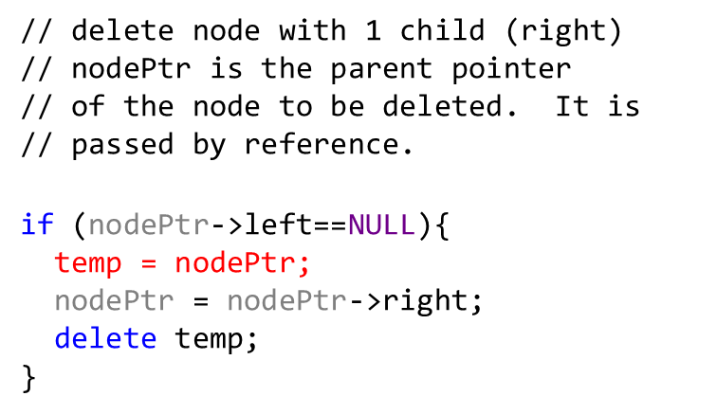


An Extended Example
Delete 15
4
-1
2
14
0
0
1
3
6
15
0
0
0
-1
5
7
16
0
0
0

Slide 91
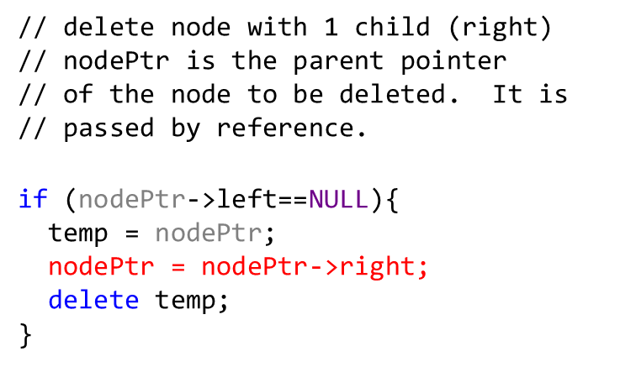

An Extended Example
Delete 15
4
-1
2
14
0
0
1
3
6
15
0
0
0
-1
5
7
16
0
0
0

Slide 92
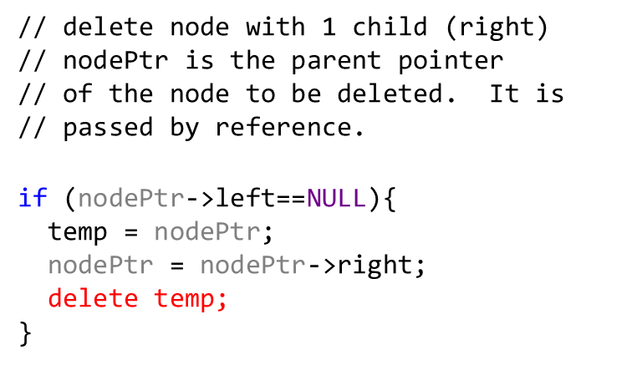
An Extended Example
Delete 15
4
-1
2
14
0
0
1
3
6
0
0
0
5
7
16
0
0
0

Slide 93

An Extended Example
4
-1
2
14
0
1
1
3
6
16
0
0
0
0
5
7
0
0

Slide 94
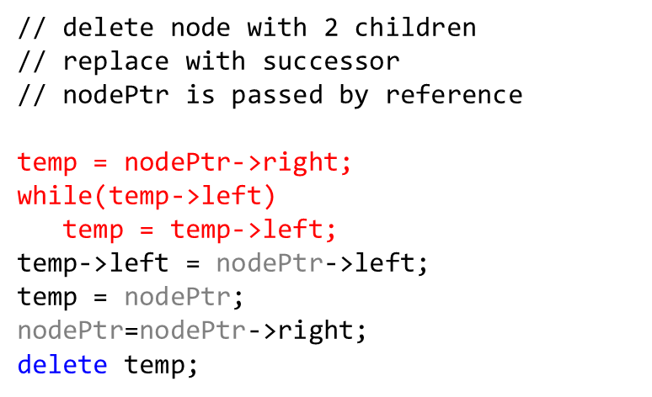


An Extended Example
Delete 14
4
-1
2
14
0
1
1
3
6
16
0
0
0
0
5
7
0
0

Slide 95
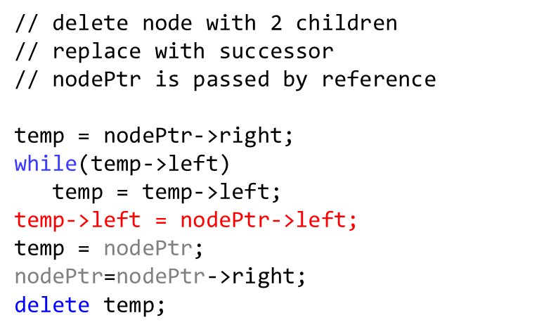
An Extended Example
Delete 14
4
-1
2
14
0
1
1
3
6
16
0
0
0
0
5
7
0
0

Slide 96
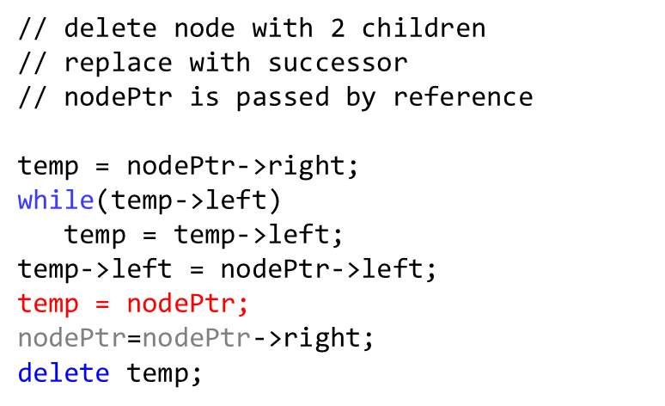

An Extended Example
Delete 14
4
-1
2
14
0
1
1
3
6
16
0
0
0
0
5
7
0
0

Slide 97
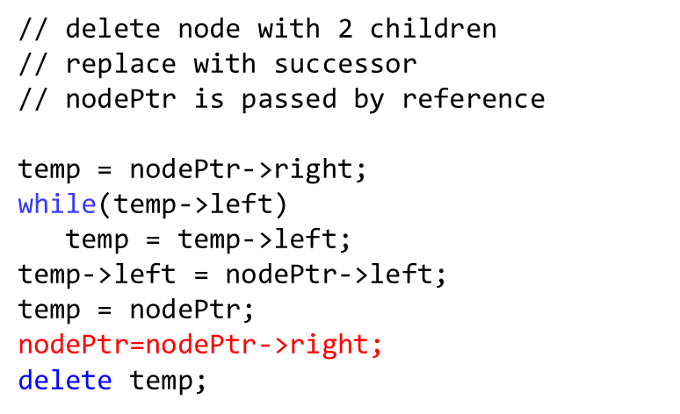
An Extended Example
Delete 14
4
-1
2
14
0
1
1
3
6
16
0
0
0
0
5
7
0
0

Slide 98
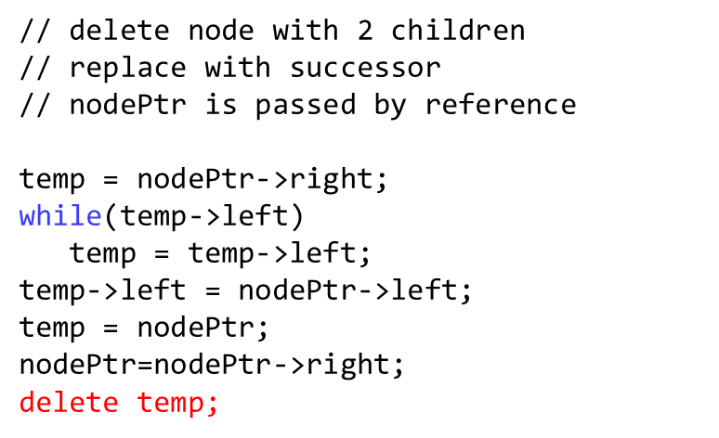
An Extended Example
Delete 14
4
-1
2
0
1
3
6
16
0
0
0
0
5
7
0
0

Slide 99
An Extended Example
4
-1
2
16
0
-2
1
3
6
0
0
0
5
7
0
0

Slide 100


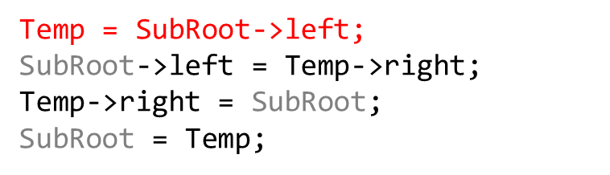

An Extended Example
4
-1
2
16
0
-2
1
3
6
0
0
0
5
7
0
0

Slide 101
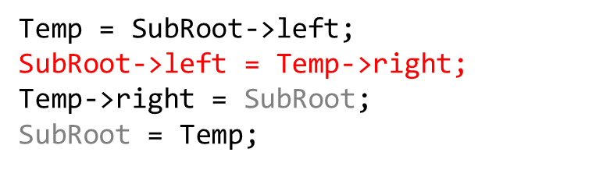
An Extended Example
4
-1
2
16
0
-2
1
3
6
0
0
0
5
7
0
0

Slide 102
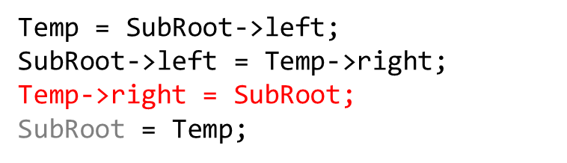
An Extended Example
4
-1
2
16
0
-2
1
3
6
0
0
0
5
7
0
0

Slide 103

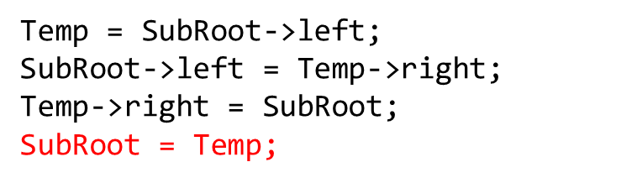
An Extended Example
4
-1
2
16
0
-2
1
3
6
0
0
0
5
7
0
0

Slide 104
An Extended Example
4
-1
2
6
0
-1
1
3
5
16
0
0
0
-1
7
0

Slide 105
AVL Implementation
All methods mimic a BST implementation
  (with one tiny modification: rotations).
The addition of rotation keeps the tree balanced (as stated previously)
Rotations also add some complexity to the implementation.

Slide 106
AVL Implementation
Methods that can be added to maintain the balance factor of each node
  Height – the height of a given tree.
  AvlValue – the Avl Value of a tree node.
  LeftHeavy – Is the left subtree heavier than the right?
  RightHeavy – Is the right subtree heavier than the left?
  RotateLeft – Performs a left rotation from a given node.
  RotateRight – Performs a right rotation from a given node.
  ComputeAvlValues – Computes avl values for entire tree.

Slide 107
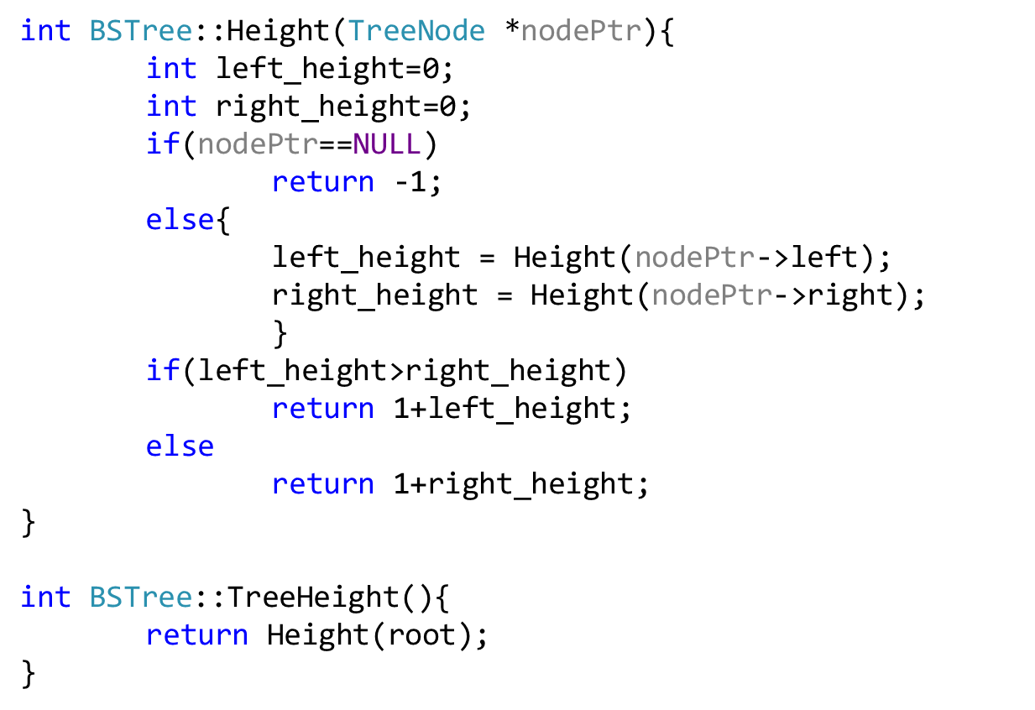
Height

Slide 108
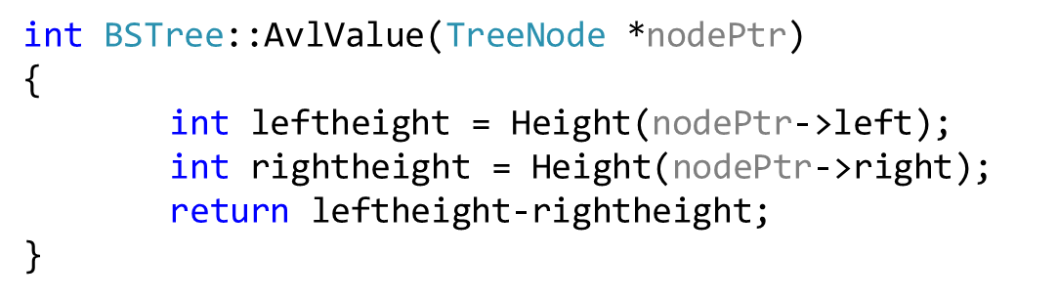
AvlValue

Slide 109
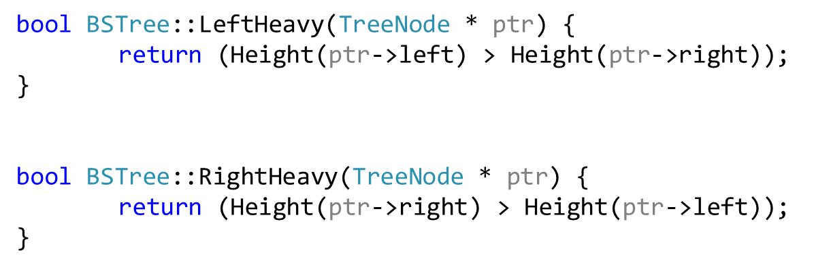
Left / Right Heavy

Slide 110
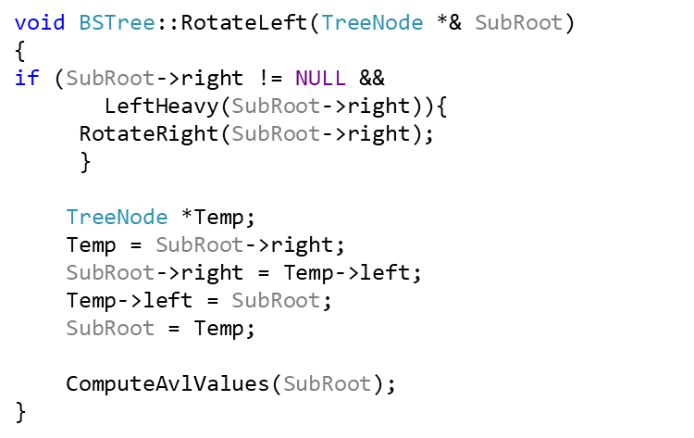
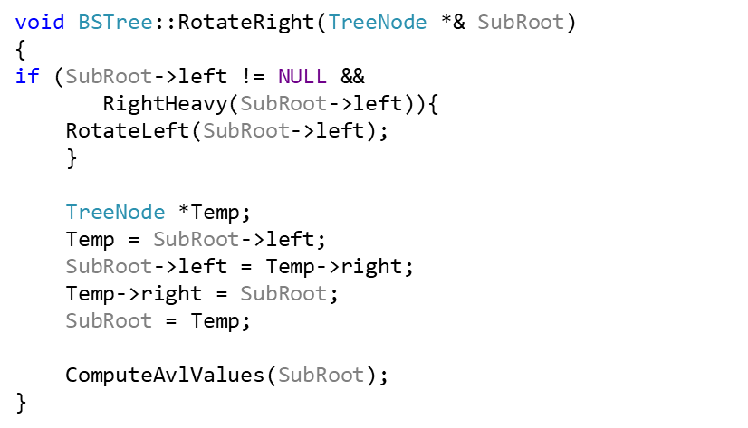
Rotate Left/Right

Slide 111
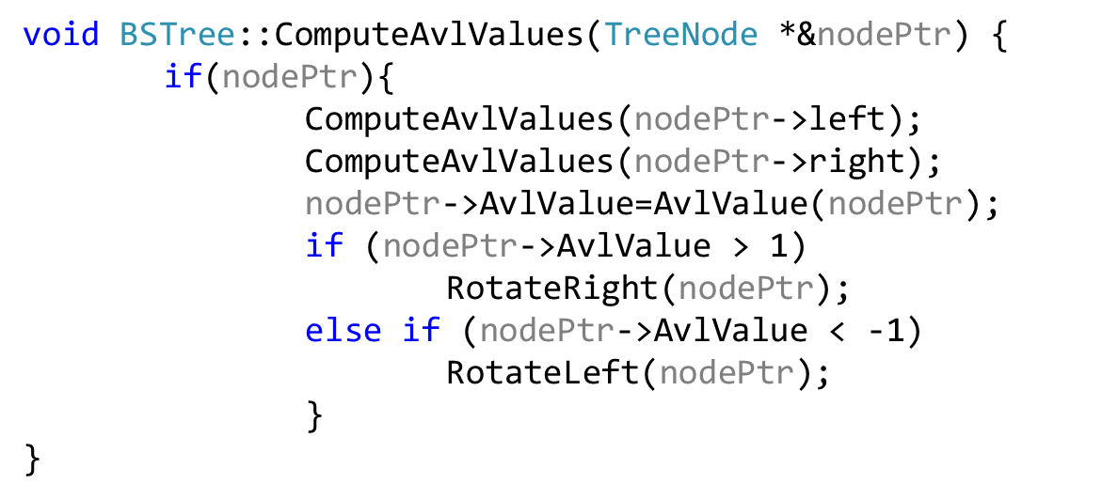
ComputeAvlValues

