Slide 1
Masta-mundo
Insert Awesome Team Name Here

Slide 2
Design

Slide 3
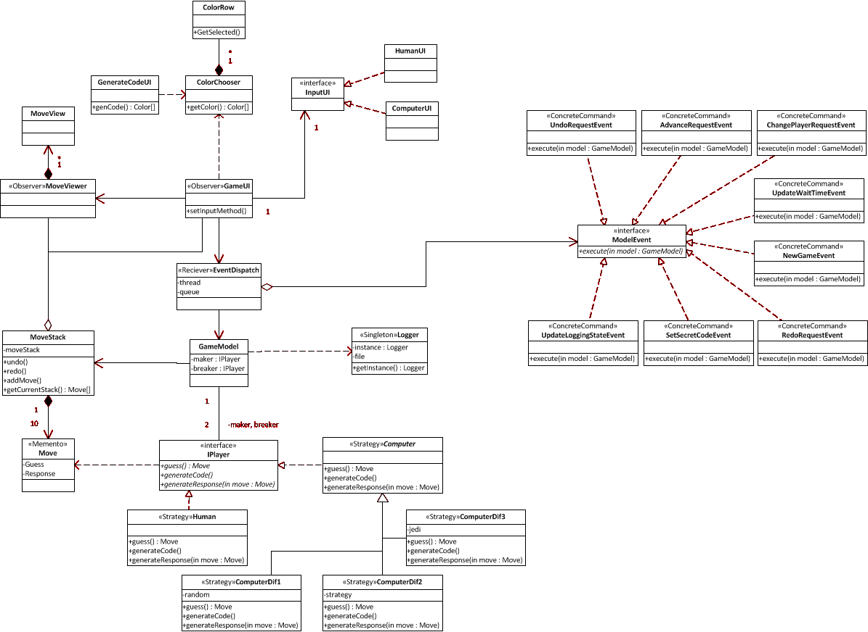
Design Overview

Slide 4
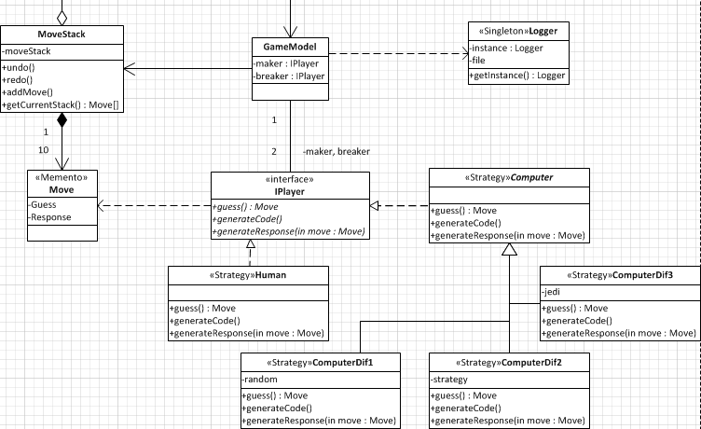
Model

Slide 5
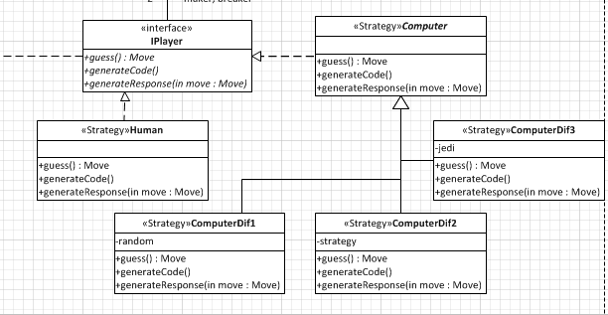
Strategy

Slide 6
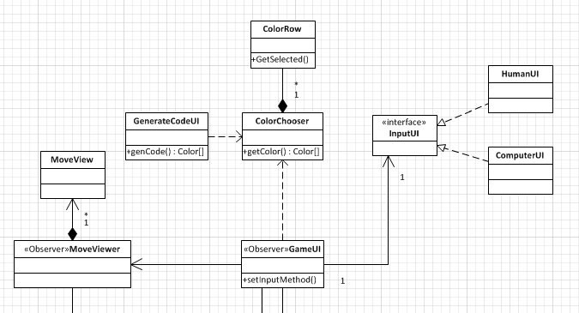
GUI

Slide 7
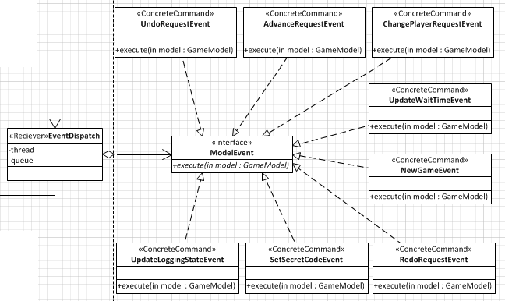
Events

Slide 8
Back to the Overview

Slide 9
Demo

Slide 10

Questions

Slide 11
