Slide 1
Lecture 3
Work and Leisure
Macroeconomics (Quantitative)
Econ 101B
Jón Steinsson
University of California, Berkeley

Slide 2
Work and Leisure
Choosing a job/career one of most important decisions we make
Politics: Jobs, jobs, jobs!!!
Unemployment extremely serious and frightening risk
But abstracting from unemployment, more work
not always better
For many their job is a means
to an end
Work takes time away from time you have to enjoy fruits of labor
Important choice: How much should we work?
We present a model to help us think about this question

Slide 3
Household Behavior
Our starting point: People act in a purposeful manner
How should we “model” purposeful choices by households (people)?
Rational choice model:
  Assume that people have preferences over, e.g., goods and leisure
  Represent preferences by a utility function
  Assume that people maximize utility
  Recognize that people are constrained by the resources they have
  at their disposal

Slide 4

Household Utility Function
Utility over consumption and hours worked:
$$U\left(C,H\right)$$
Very “broad brush” model of preferences
We ignore all the details associated with different
types of job and goods, etc.

Slide 5
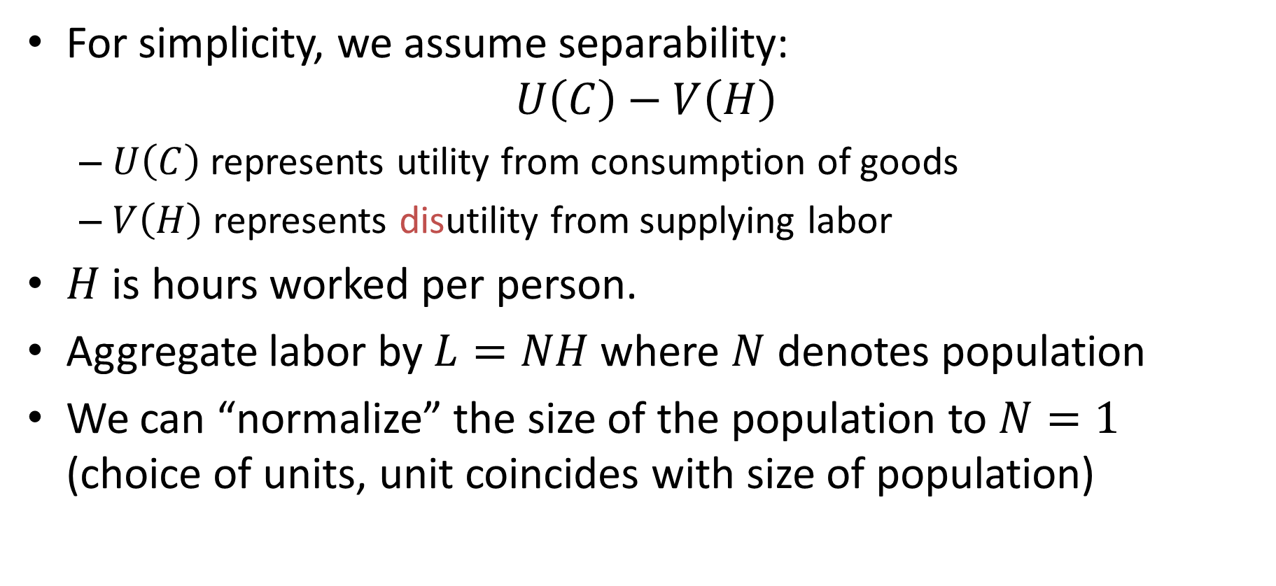
Household Utility Function
For simplicity, we assume separability:
$$U\left(C\right)−V\left(H\right)$$
  $U\left(C\right)$ represents utility from consumption of goods
  $V\left(H\right)$ represents disutility from supplying labor
$H$ is hours worked per person.
Aggregate labor by $L=NH$ where $N$ denotes population
We can “normalize” the size of the population to $N=1$
(choice of units, unit coincides with size of population)

Slide 6
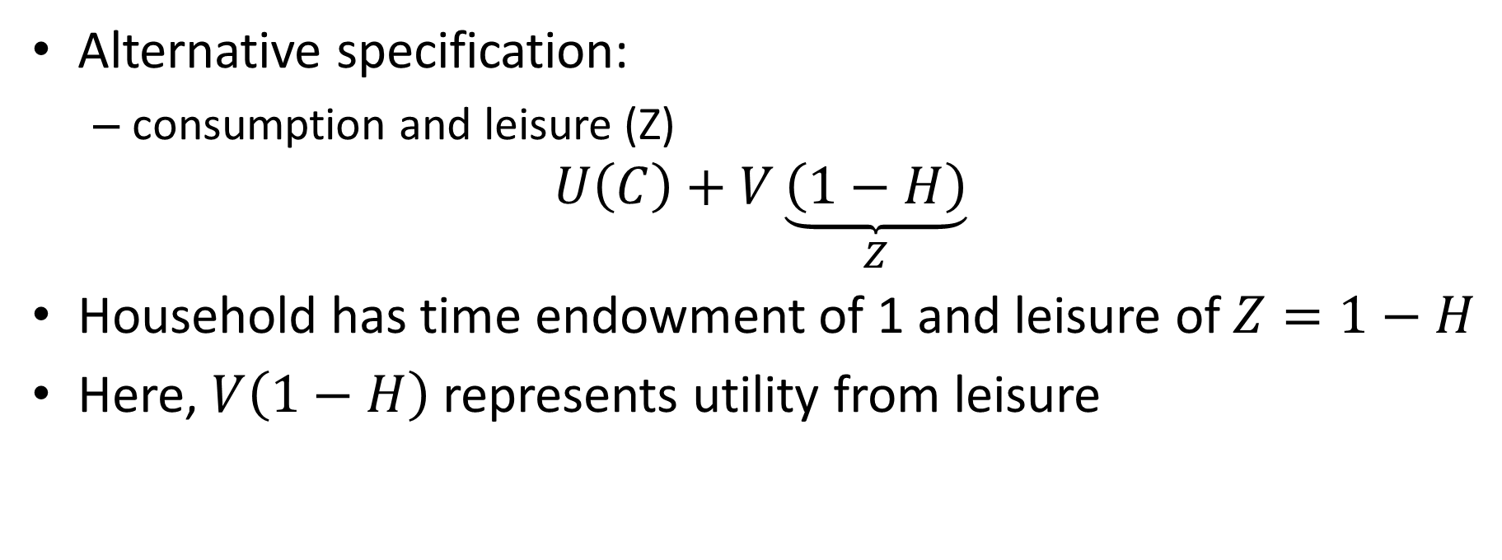
Household Utility Function
Alternative specification:
  consumption and leisure (Z)
$$U\left(C\right)+V\underset{Z}{\underbrace{\left(1−H\right)}}$$
Household has time endowment of 1 and leisure of $Z=1−H$
Here, $V\left(1−H\right)$ represents utility from leisure

Slide 7
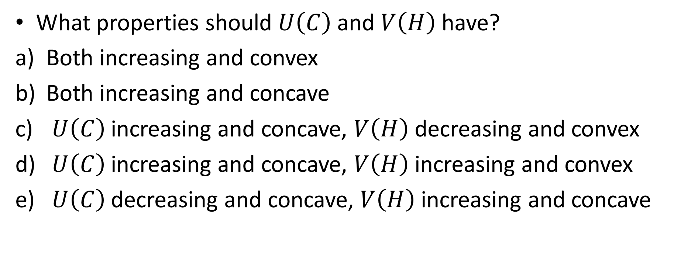
iClicker Poll
What properties should $U\left(C\right)$ and $V\left(H\right)$ have?
Both increasing and convex
Both increasing and concave
$U\left(C\right)$ increasing and concave, $V\left(H\right)$ decreasing and convex
$U\left(C\right)$ increasing and concave, $V\left(H\right)$ increasing and convex
$U\left(C\right)$ decreasing and concave, $V\left(H\right)$ increasing and concave

Slide 8
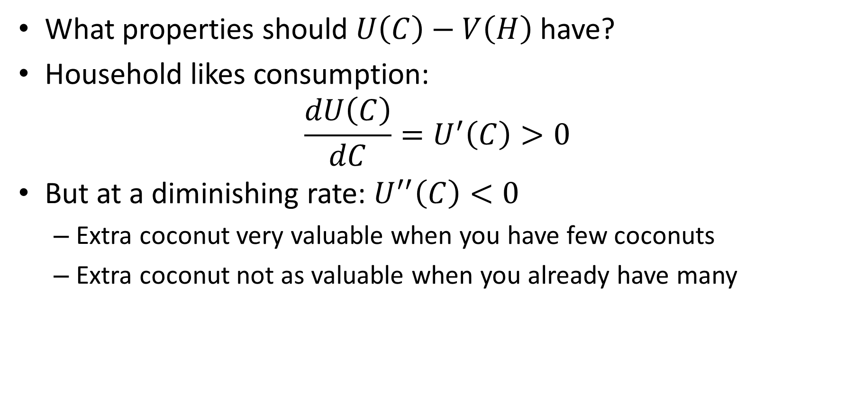
Household Utility Function
What properties should $U\left(C\right)−V\left(H\right)$ have?
Household likes consumption:
$$\frac{dU\left(C\right)}{dC}=U^{′}\left(C\right)>0$$
But at a diminishing rate: $U^{′′}\left(C\right)<0$
  Extra coconut very valuable when you have few coconuts
  Extra coconut not as valuable when you already have many

Slide 9
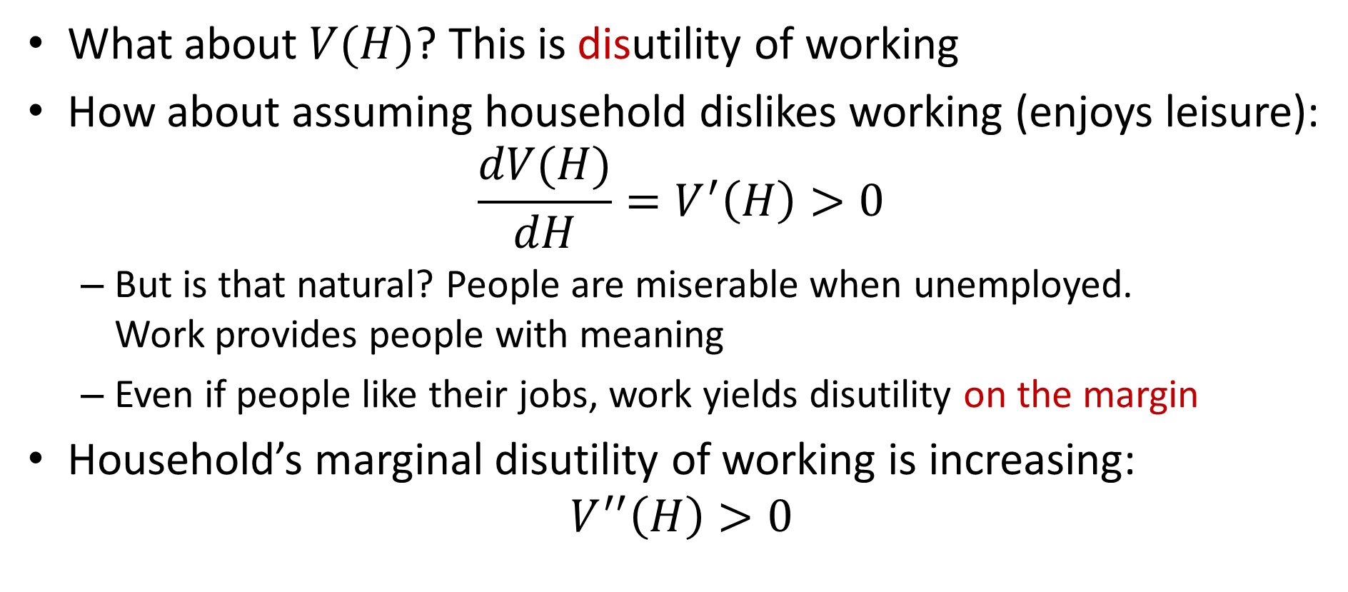
Household Utility Function
What about $V(H)$? This is disutility of working
How about assuming household dislikes working (enjoys leisure):
$$\frac{dV(H)}{dH}=V^{′}\left(H\right)>0$$
  But is that natural? People are miserable when unemployed.
  Work provides people with meaning
  Even if people like their jobs, work yields disutility on the margin
Household’s marginal disutility of working is increasing:
$$V^{′′}\left(H\right)>0$$

Slide 10
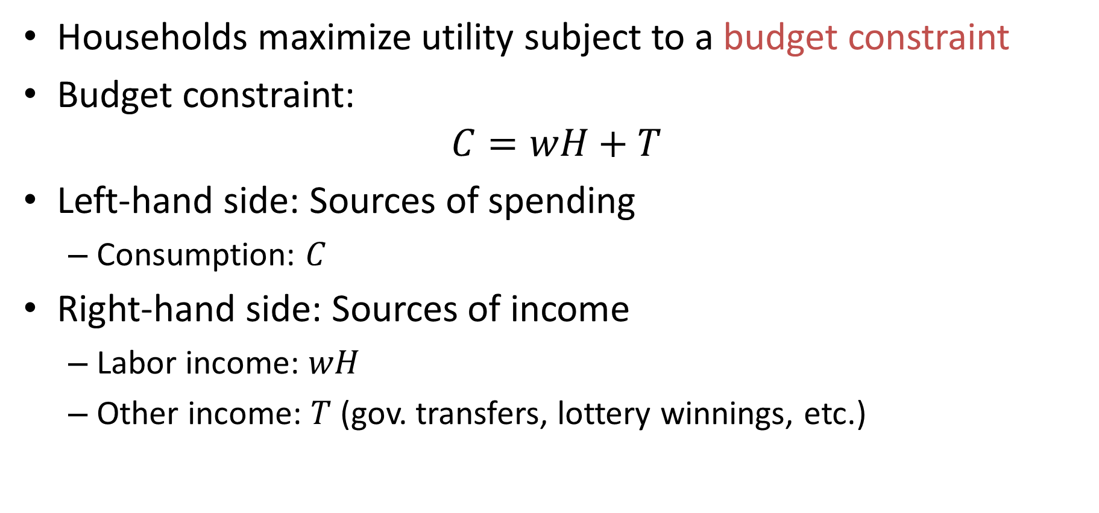
Household Budget Constraint
Households maximize utility subject to a budget constraint
Budget constraint:
$$C=wH+T$$
Left-hand side: Sources of spending
  Consumption: $C$
Right-hand side: Sources of income
  Labor income: $wH$
  Other income: $T$ (gov. transfers, lottery winnings, etc.)

Slide 11
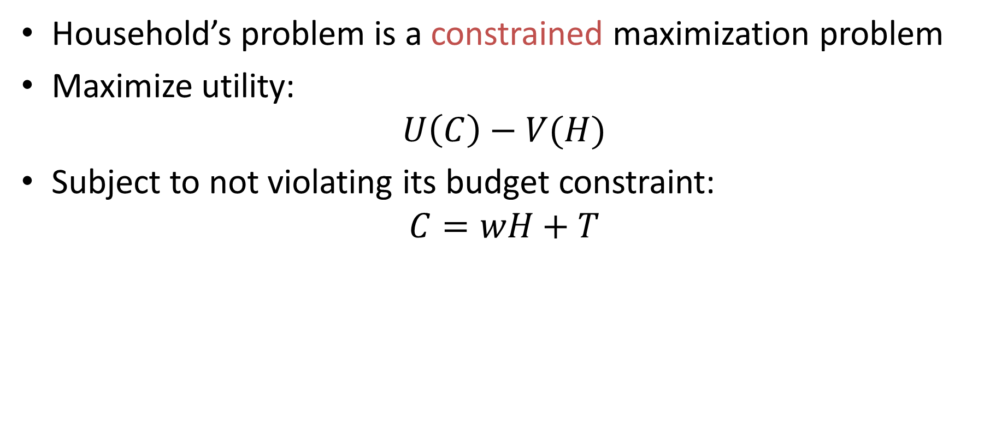
Household’s Problem
Household’s problem is a constrained maximization problem
Maximize utility:
$$U\left(C\right)−V(H)$$
Subject to not violating its budget constraint:
$$C=wH+T$$

Slide 12
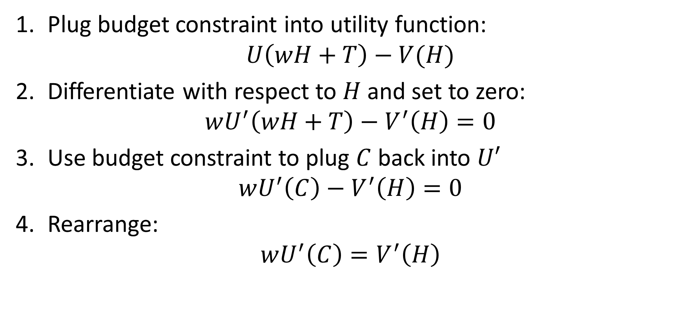
Household’s Problem: Plug and Chug
Plug budget constraint into utility function:
$$U\left(wH+T\right)−V(H)$$
Differentiate with respect to $H$ and set to zero:
$$wU^{′}\left(wH+T\right)−V^{′}\left(H\right)=0$$
Use budget constraint to plug $C$ back into $U′$
$$wU^{′}\left(C\right)−V^{′}\left(H\right)=0$$
Rearrange:
$$wU^{′}\left(C\right)=V^{′}\left(H\right)$$

Slide 13
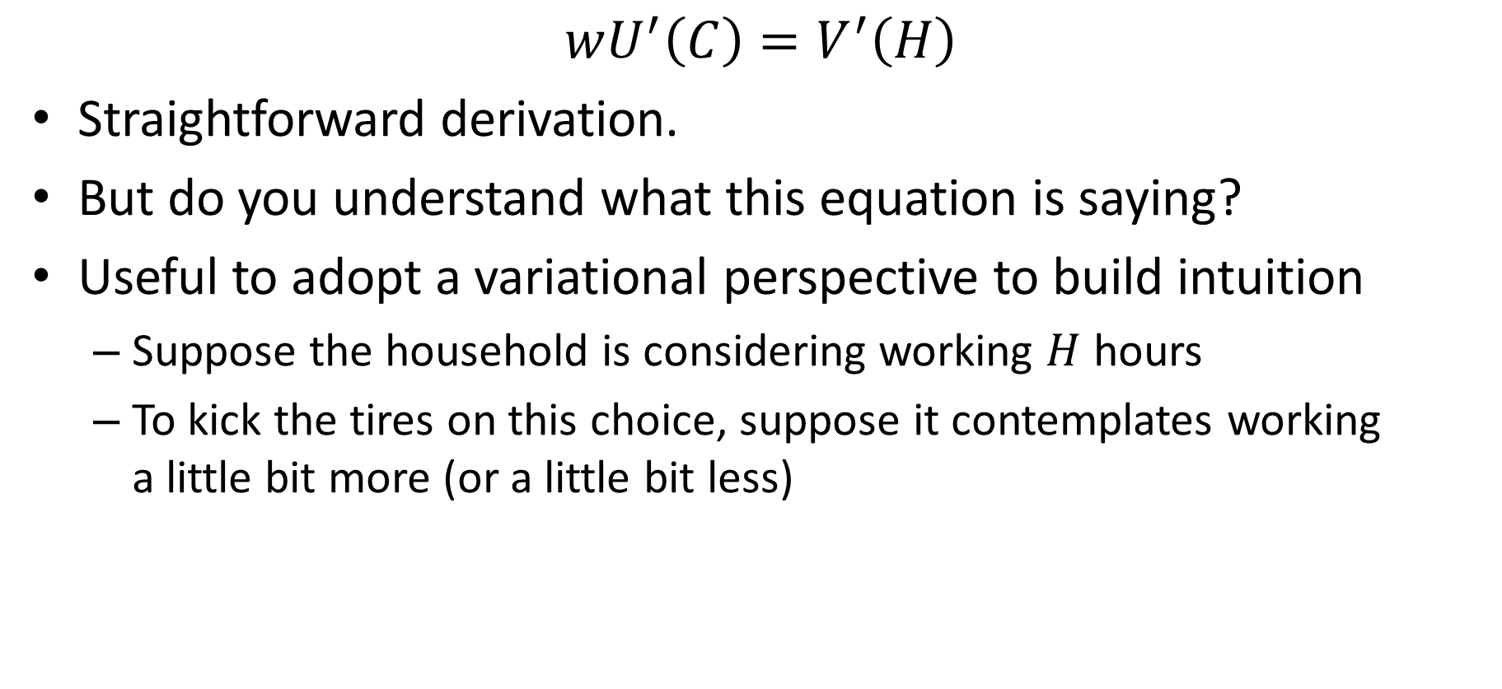
Labor-Leisure: Intuition
$$wU^{′}\left(C\right)=V^{′}\left(H\right)$$
Straightforward derivation.
But do you understand what this equation is saying?
Useful to adopt a variational perspective to build intuition
  Suppose the household is considering working $H$ hours
  To kick the tires on this choice, suppose it contemplates working
  a little bit more (or a little bit less)

Slide 14
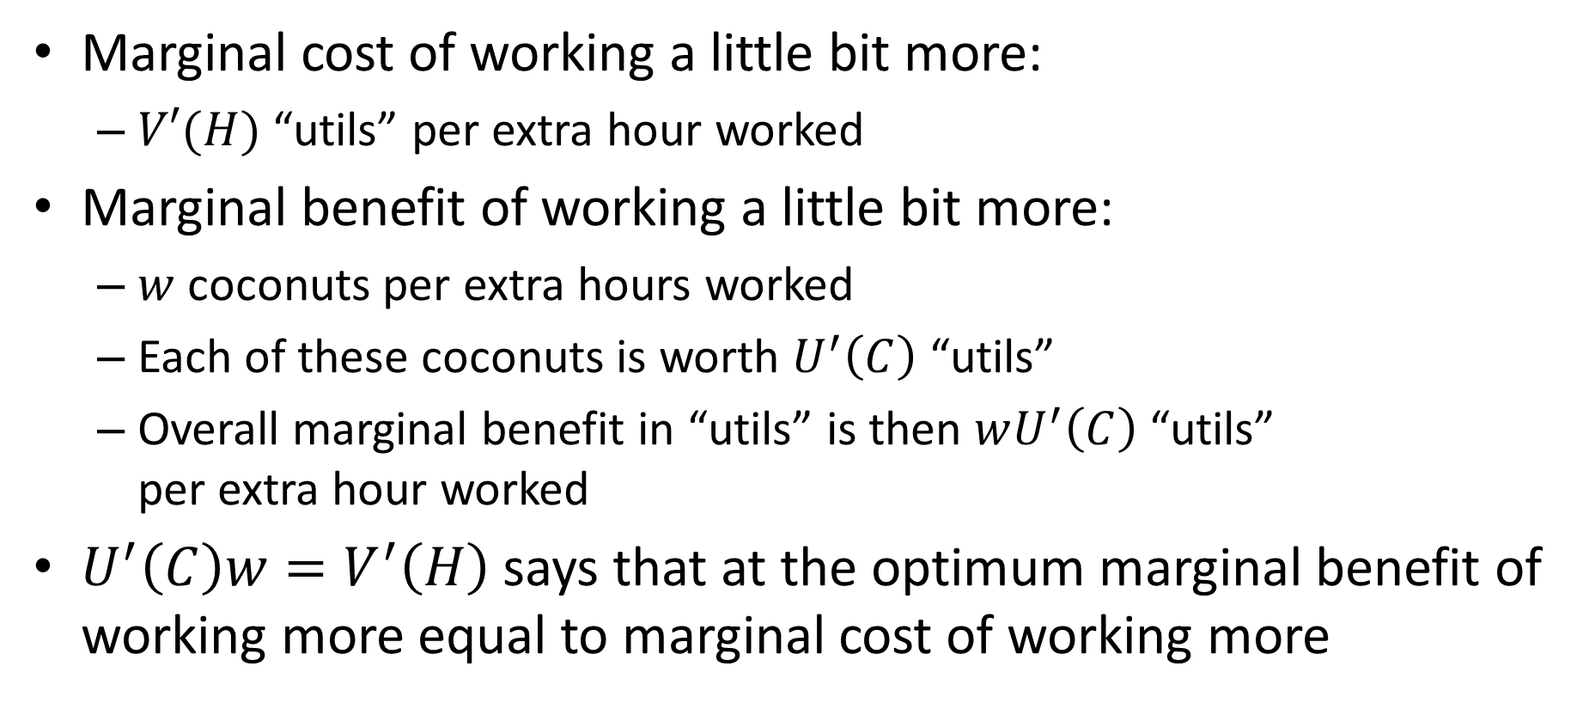
Labor-Leisure: Intuition
Marginal cost of working a little bit more:
  $V′(H)$ “utils” per extra hour worked
Marginal benefit of working a little bit more:
  $w$ coconuts per extra hours worked
  Each of these coconuts is worth $U^{′}\left(C\right)$ “utils”
  Overall marginal benefit in “utils” is then $wU^{′}\left(C\right)$ “utils”
  per extra hour worked
$U^{′}\left(C\right)w=V^{′}\left(H\right)$ says that at the optimum marginal benefit of working more equal to marginal cost of working more

Slide 15
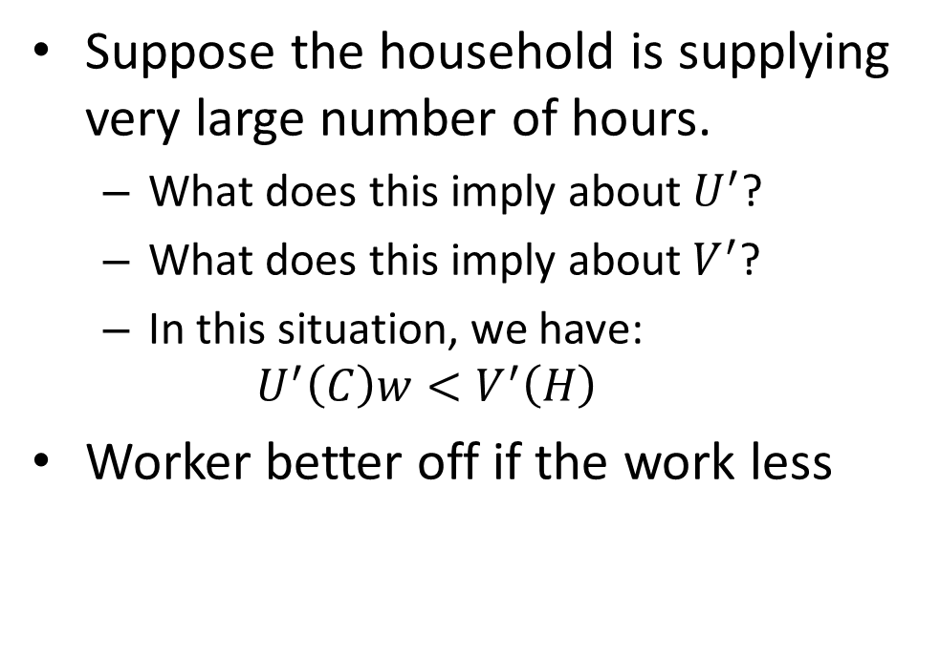
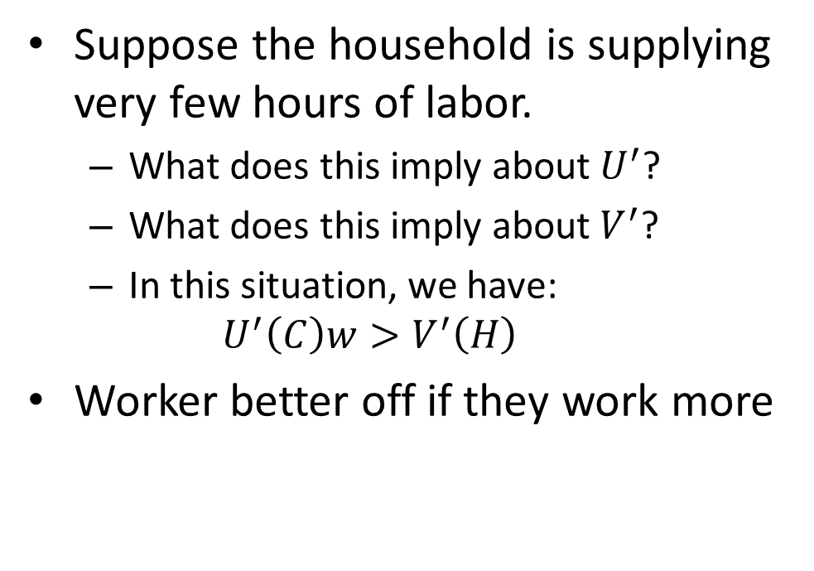
Labor-Leisure: Intuition
Suppose the household is supplying very few hours of labor.
  What does this imply about $U^{′}$?
  What does this imply about $V^{′}$?
  In this situation, we have:
  $$U^{′}\left(C\right)w>V^{′}\left(H\right)$$
Worker better off if they work more
Suppose the household is supplying very large number of hours.
  What does this imply about $U^{′}$?
  What does this imply about $V^{′}$?
  In this situation, we have:
  $$U^{′}\left(C\right)w<V^{′}\left(H\right)$$
Worker better off if the work less

Slide 16
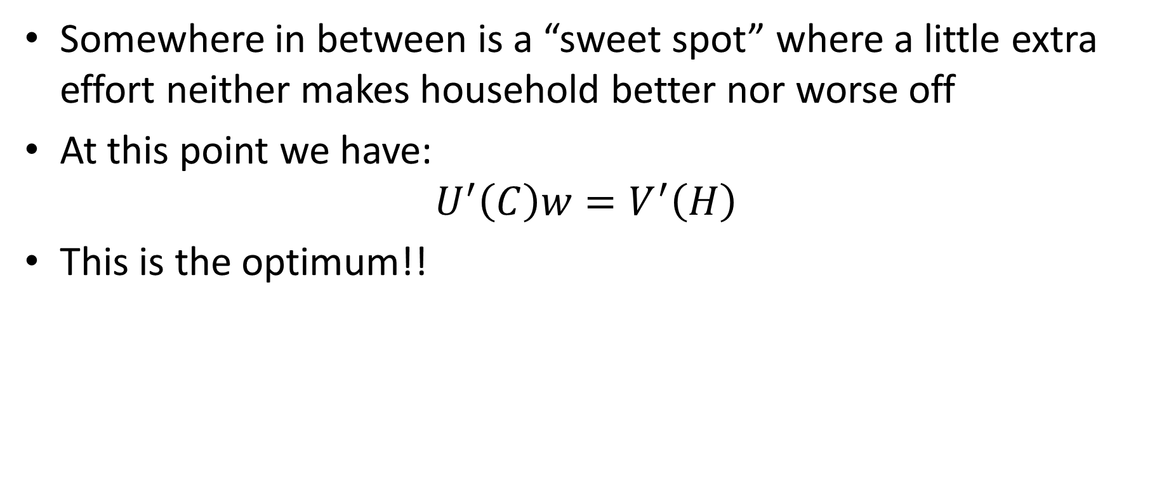
Labor-Leisure: Intuition
Somewhere in between is a “sweet spot” where a little extra effort neither makes household better nor worse off
At this point we have:
$$U^{′}\left(C\right)w=V^{′}\left(H\right)$$
This is the optimum!!

Slide 17
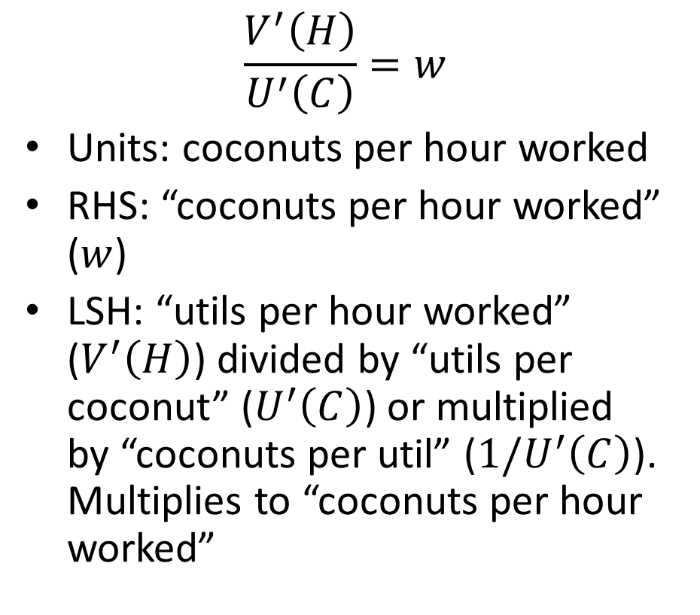
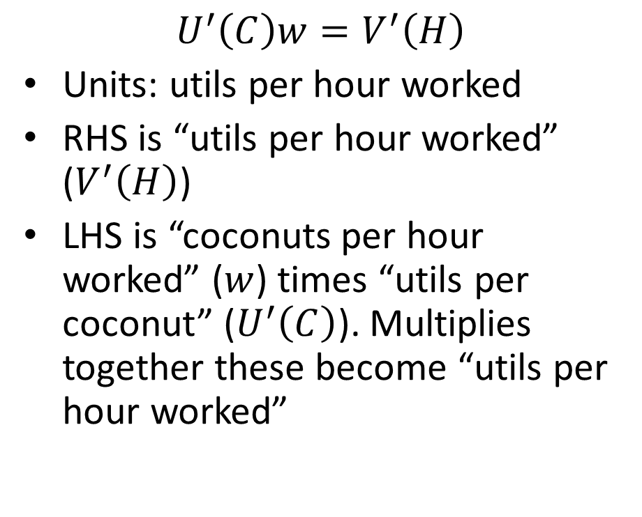
Units: Utils versus Coconuts
$$U^{′}\left(C\right)w=V^{′}\left(H\right)$$
Units: utils per hour worked
RHS is “utils per hour worked” ($V^{′}\left(H\right)$)
LHS is “coconuts per hour worked” ($w$) times “utils per coconut” ($U^{′}\left(C\right)$). Multiplies together these become “utils per hour worked”
$$\frac{V^{′}\left(H\right)}{U^{′}\left(C\right)}=w$$
Units: coconuts per hour worked
RHS: “coconuts per hour worked” ($w$)
LSH: “utils per hour worked” ($V^{′}\left(H\right)$) divided by “utils per coconut” ($U^{′}\left(C\right)$) or multiplied by “coconuts per util” ($1/U^{′}\left(C\right)$). Multiplies to “coconuts per hour worked”

Slide 18
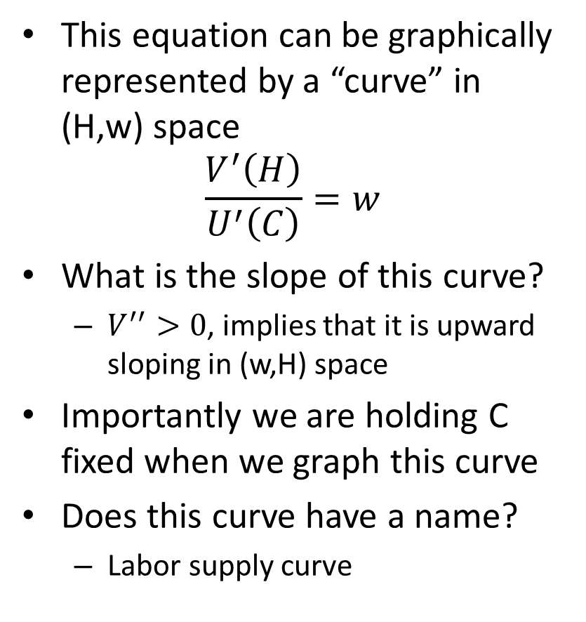
Household’s Problem
This equation can be graphically represented by a “curve” in (H,w) space
$$\frac{V^{′}\left(H\right)}{U^{′}\left(C\right)}=w$$
What is the slope of this curve?
  $V^{′′}>0$, implies that it is upward sloping in (w,H) space
Importantly we are holding C fixed when we graph this curve
Does this curve have a name?
  Labor supply curve
Real wage, w
L^{s}
Hours, H

Slide 19
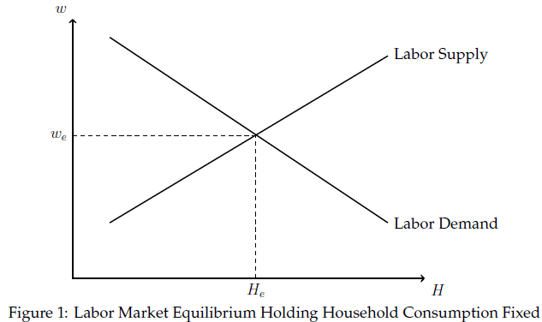
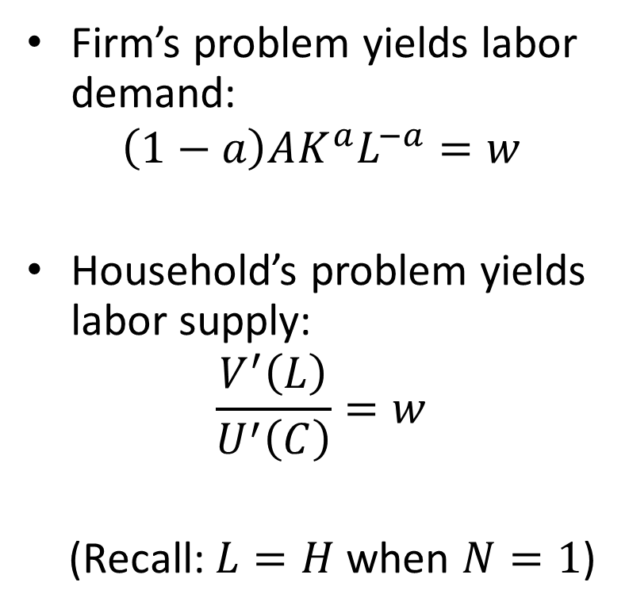
Labor Market Equilibrium
Firm’s problem yields labor demand:
$$\left(1−a\right)AK^{a}L^{−a}=w$$
Household’s problem yields labor supply:
$$\frac{V^{′}\left(L\right)}{U^{′}\left(C\right)}=w$$
(Recall: $L=H$ when $N=1$)

Slide 20
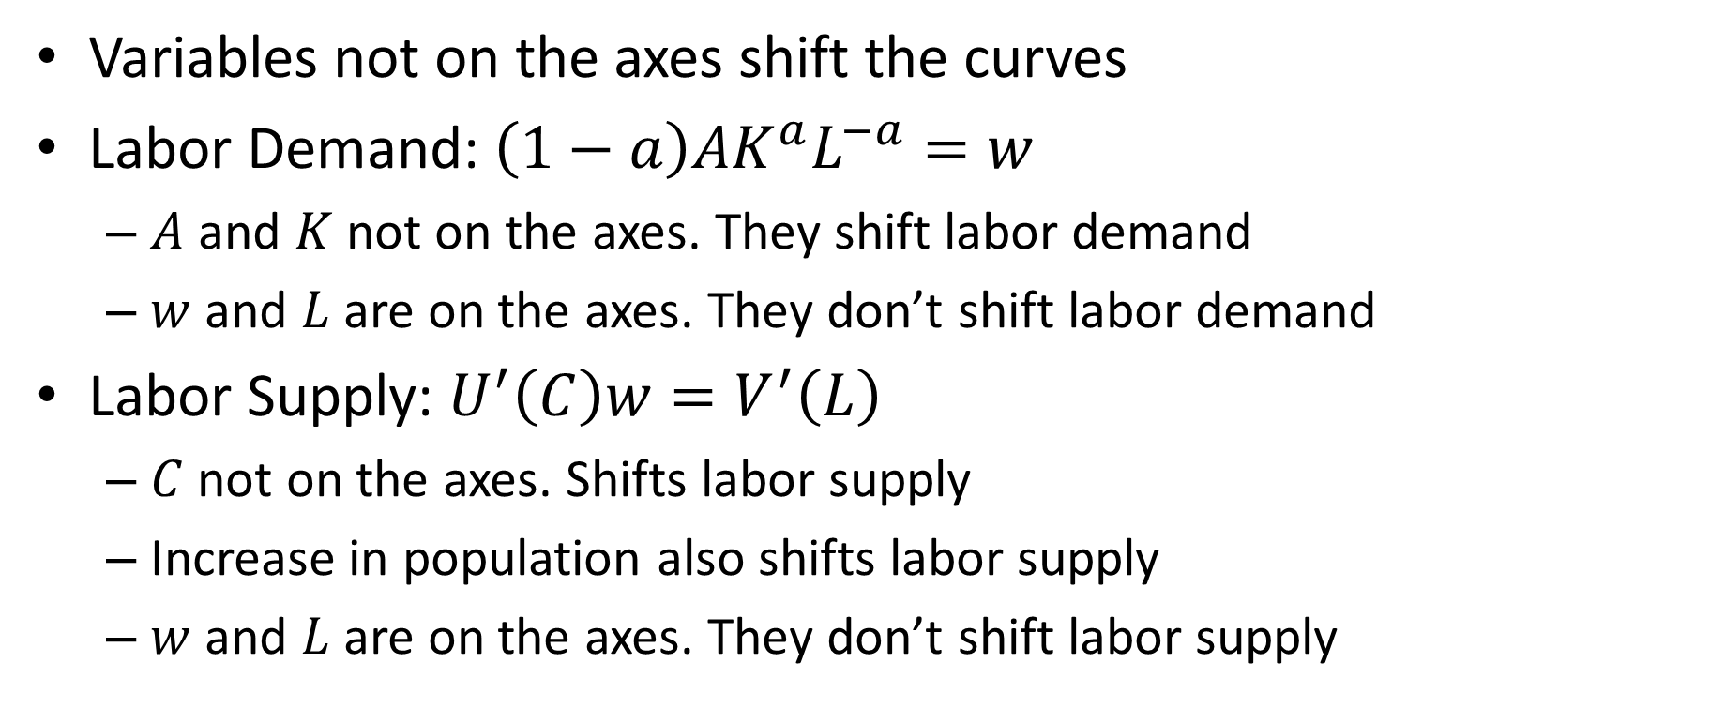
What Shifts Labor Demand and Labor Supply
Variables not on the axes shift the curves
Labor Demand: $\left(1−a\right)AK^{a}L^{−a}=w$
  $A$ and $K$ not on the axes. They shift labor demand
  $w$ and $L$ are on the axes. They don’t shift labor demand
Labor Supply: $U^{′}\left(C\right)w=V^{′}\left(L\right)$
  $C$ not on the axes. Shifts labor supply
  Increase in population also shifts labor supply
  $w$ and $L$ are on the axes. They don’t shift labor supply

Slide 21
Effect of Wage Increase on Labor Supply
Substitution effect:
  Working more lucrative
  Leisure more “expensive”
  Wage is opportunity cost of leisure
  Households substitute towards lucrative activities and away from expensive activities
  Work more
Income effect:
  Higher wage means worker is richer
  Richer workers chooses more consumption and more leisure
  Leisure is a “normal” good
  (you buy more of it the richer you are)
  More leisure means less work
  Work less

Slide 22
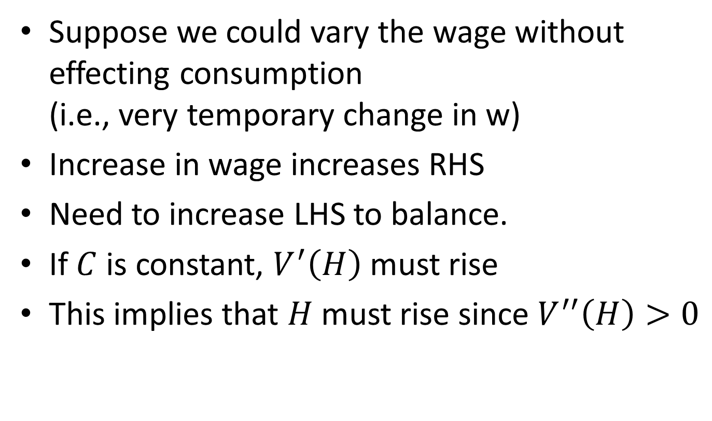
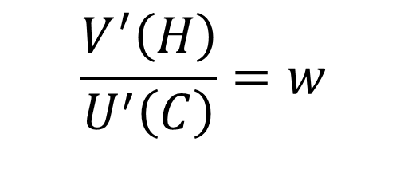
Substitution Effect
Suppose we could vary the wage without effecting consumption
(i.e., very temporary change in w)
Increase in wage increases RHS
Need to increase LHS to balance.
If $C$ is constant, $V^{′}\left(H\right)$ must rise
This implies that $H$ must rise since $V^{′′}\left(H\right)>0$
$$\frac{V^{′}\left(H\right)}{U^{′}\left(C\right)}=w$$

Slide 23

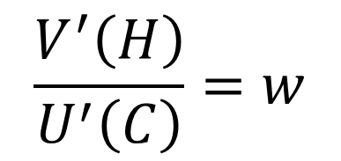
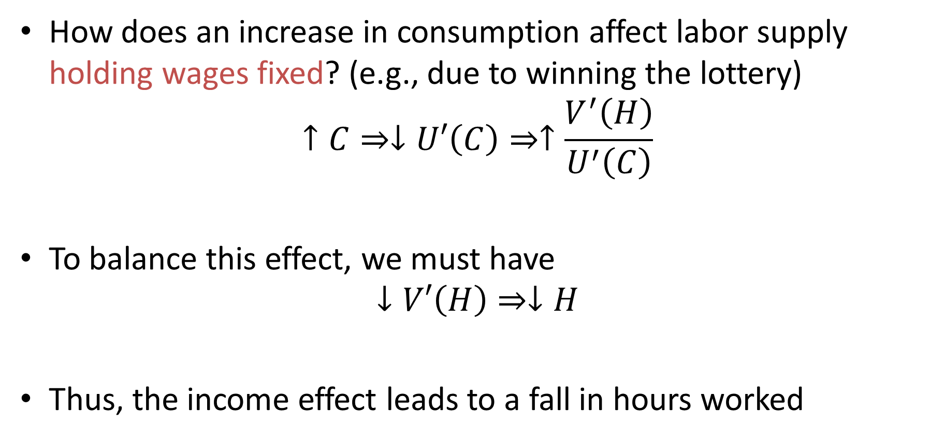

Income Effect
How does an increase in consumption affect labor supply holding wages fixed? (e.g., due to winning the lottery)
$$↑C⇒↓U′\left(C\right)⇒↑\frac{V^{′}\left(H\right)}{U^{′}\left(C\right)}$$
To balance this effect, we must have
$$↓V′\left(H\right)⇒↓H$$
Thus, the income effect leads to a fall in hours worked
$$U^{′′}\left(C\right)<0$$
$$\frac{V^{′}\left(H\right)}{U^{′}\left(C\right)}=w$$
$$V^{′′}\left(H\right)>0$$

Slide 24
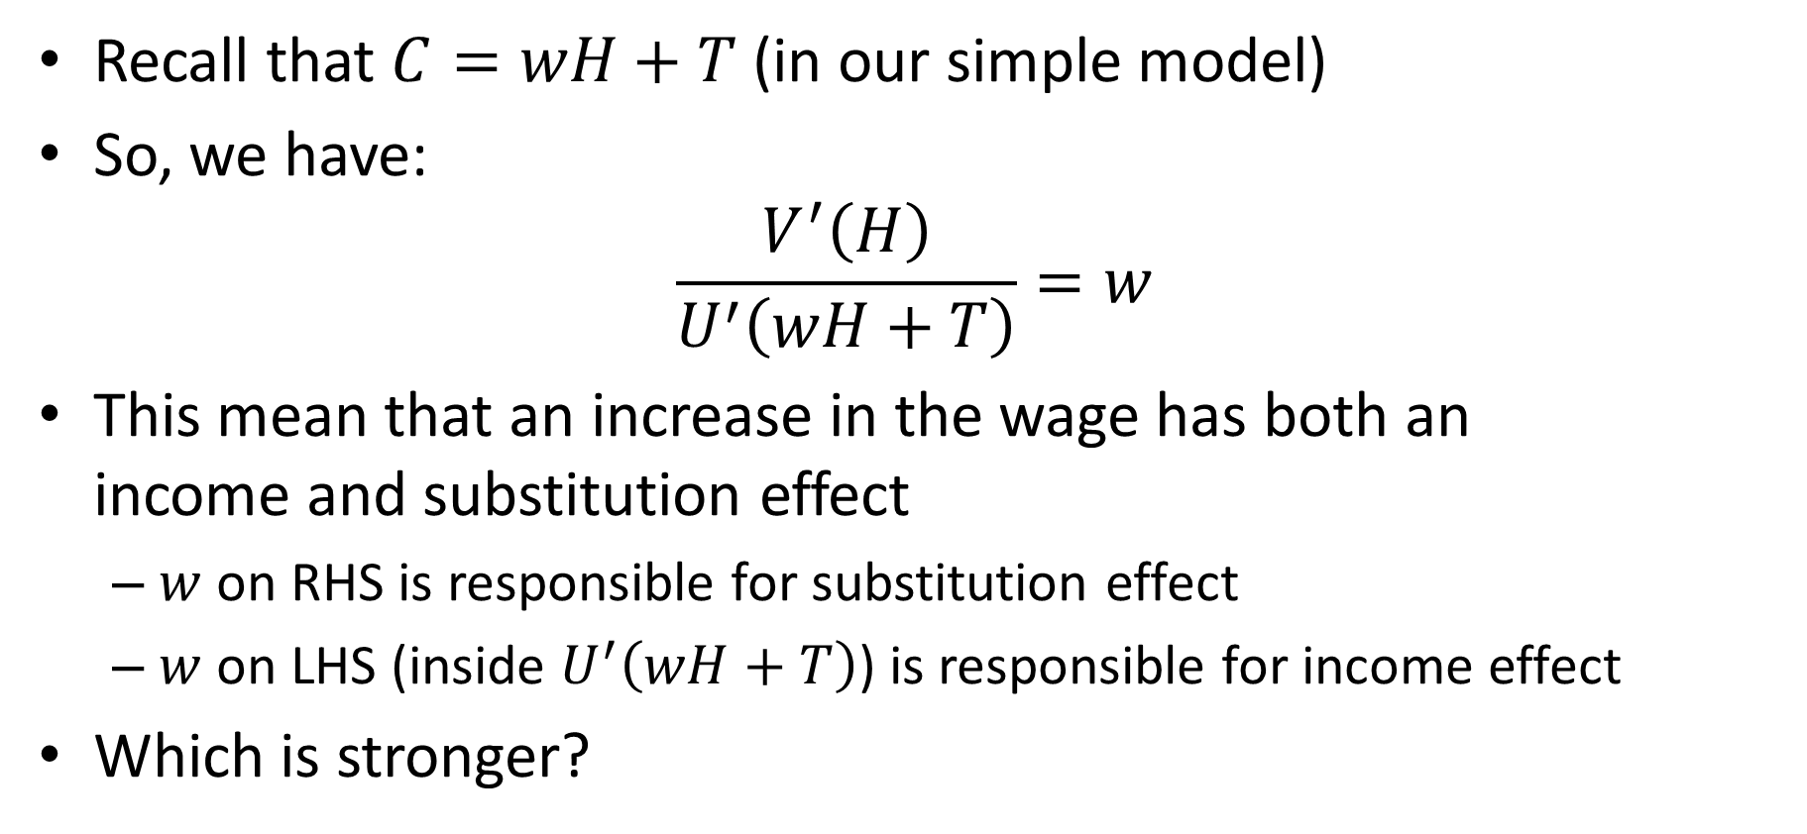
Increase in the Wage
Recall that $C=wH+T$ (in our simple model)
So, we have:
$$\frac{V^{′}\left(H\right)}{U^{′}\left(wH+T\right)}=w$$
This mean that an increase in the wage has both an
income and substitution effect
  $w$ on RHS is responsible for substitution effect
  $w$ on LHS (inside $U^{′}\left(wH+T\right)$) is responsible for income effect
Which is stronger?

Slide 25
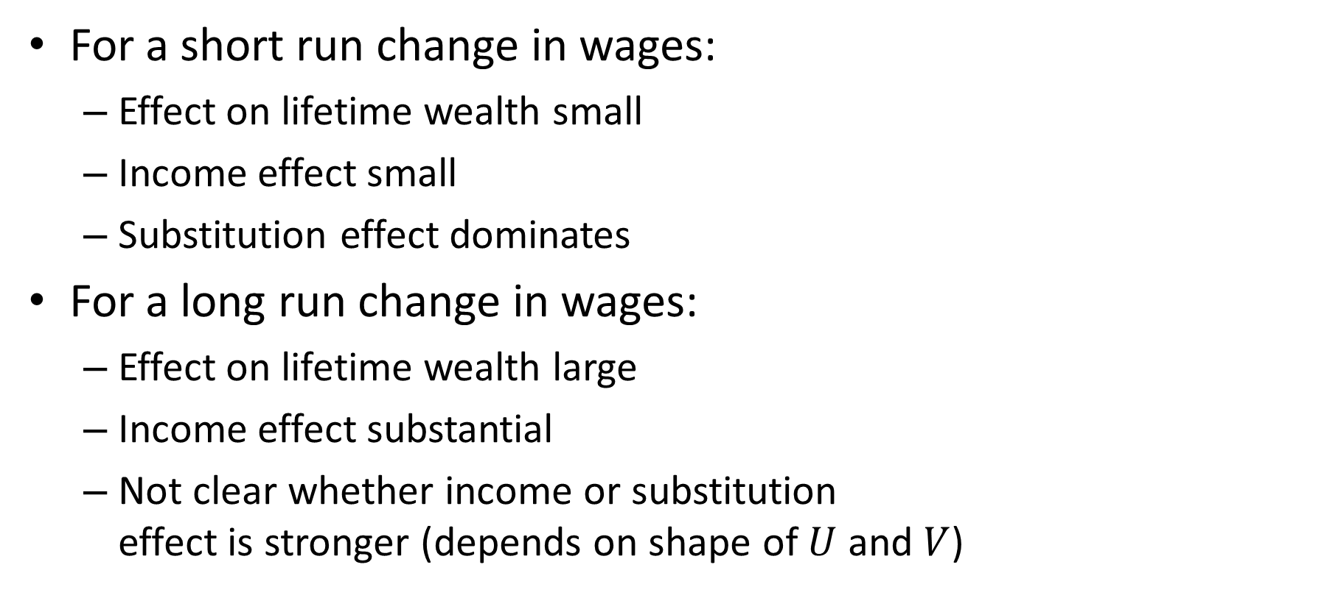
Short Run versus Long Run
For a short run change in wages:
  Effect on lifetime wealth small
  Income effect small
  Substitution effect dominates
For a long run change in wages:
  Effect on lifetime wealth large
  Income effect substantial
  Not clear whether income or substitution
  effect is stronger (depends on shape of $U$ and $V$)

Slide 26
Labor Supply in Practice?
Two first order facts:
  Real wages have risen by roughly 1.5% per year for over 100 years
  (real wages adjust for changes in prices)
  Hours worked per worker in the U.S. have declined gradually

Slide 27
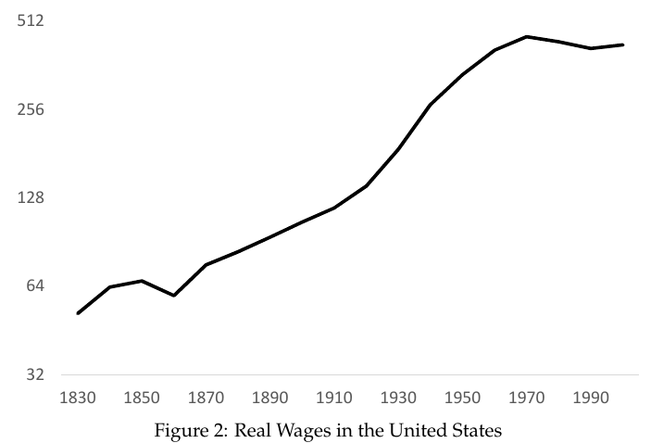
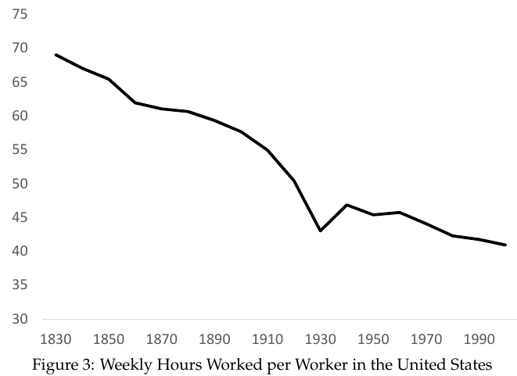
Real Wages and Hours Worked per Worker
Over 800% cumulative increase.
Roughly 50% cumulative decrease.

Slide 28
Labor Supply in Practice?
What do these figures imply about relative size of income and substitutions effects in the long run?
  Income effect slightly larger than substitution
Common to ignore income effects and assume wage increases will increase labor supply (e.g., tax cuts)
But income effects are large over the long run!!

Slide 29
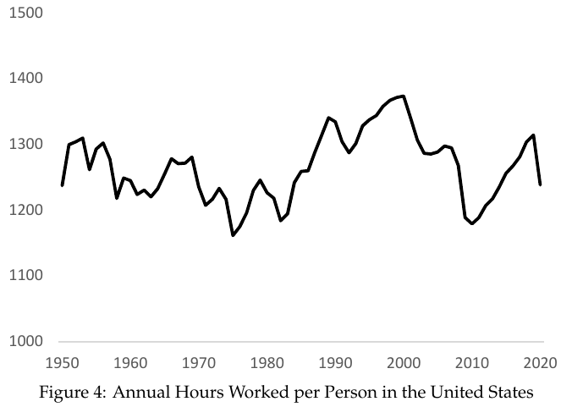
Hours Worked Per Person
Hours worked per worker have fallen
But hours worked per person have not
Why might this be?

Slide 30
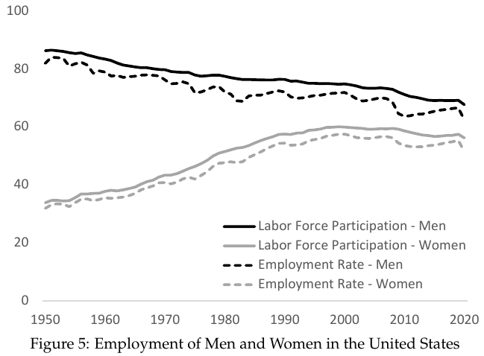
Gender Revolution
Labor force participation rate of men fallen steadily
Labor force participation rate of women rose rapidly in 2nd half of 20th century
Changing cultural normal, less discrimination led women to enter labor force
One-time shock that obscured underlying downward trend

Slide 31
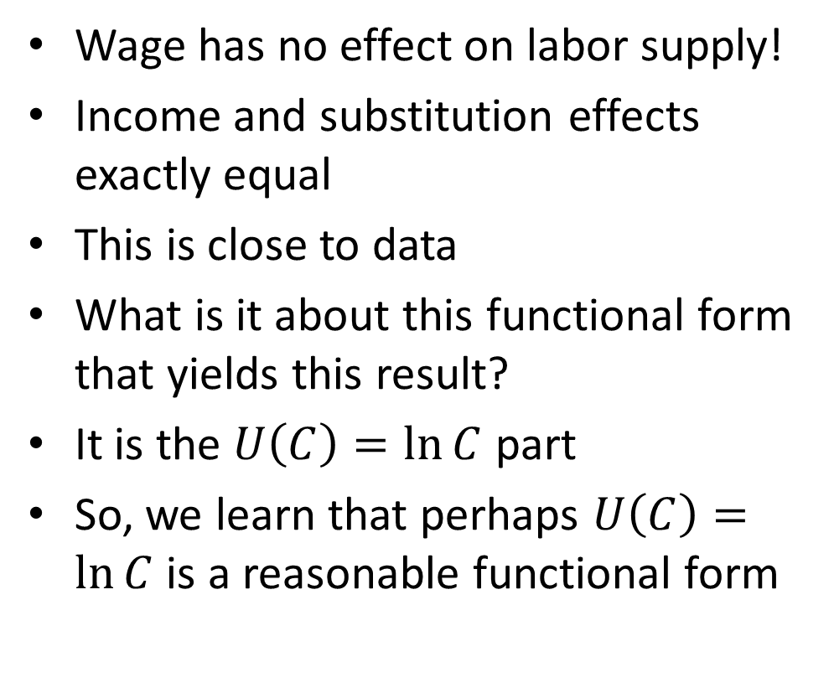
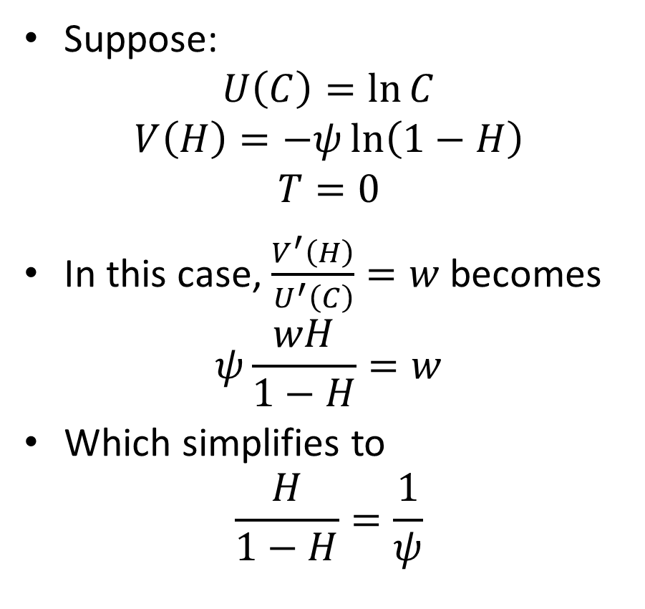
What Do We Learn about the Utility Function?
Suppose:
$$U\left(C\right)=\ln{C}$$
$$V\left(H\right)=−ψ\ln\left(1−H\right)$$
$$T=0$$
In this case, $\frac{V^{′}\left(H\right)}{U^{′}\left(C\right)}=w$ becomes
$$ψ\frac{wH}{1−H}=w$$
Which simplifies to
$$\frac{H}{1−H}=\frac{1}{ψ}$$
Wage has no effect on labor supply!
Income and substitution effects exactly equal
This is close to data
What is it about this functional form that yields this result?
It is the $U\left(C\right)=\ln{C}$ part
So, we learn that perhaps $U\left(C\right)=\ln{C}$ is a reasonable functional form

Slide 32
Keynes and Income Effect
What did Keynes think about the relative strength of the income effect and the substitution effect?
Economic Possibilities for Our Grandchildren written in 1930
“Suppose that a hundred years hence we are all of us, on the average, eight times better off in the economic sense than we are to-day.” (i.e., 2% annual growth)

Slide 33
Keynes and Income Effect
Income effect dominant in the long run:
  “Absolute needs … satisfied”
  “prefer to devote our further energies to
  non-economic purposes” (leisure)
  Main worry “general ‘nervous breakdown’”
  “need to do some work … to be contented”
  “Three-hour shifts or a fifteen hour week”
Clearly, Keynes overestimated the strength of the income effect

Slide 34
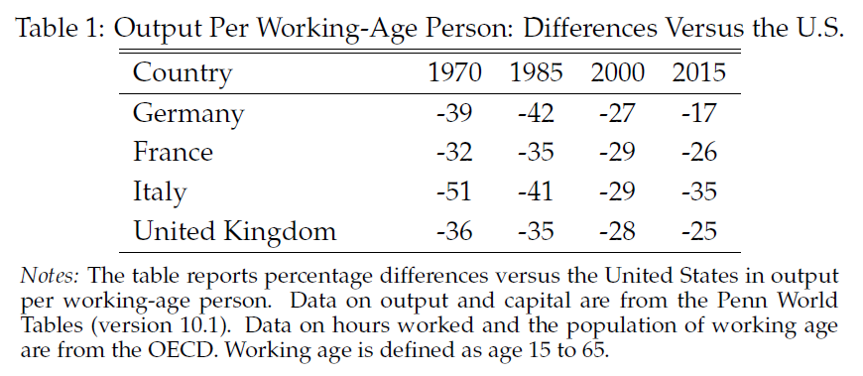
Is Europe in a Depression?
Output per working-age person in Europe 30% lower than in U.S.
Prescott: Europe is in a depression
Is this due to major malfunction of economy?
Is it similar to Great Depression of 1930s?

Slide 35
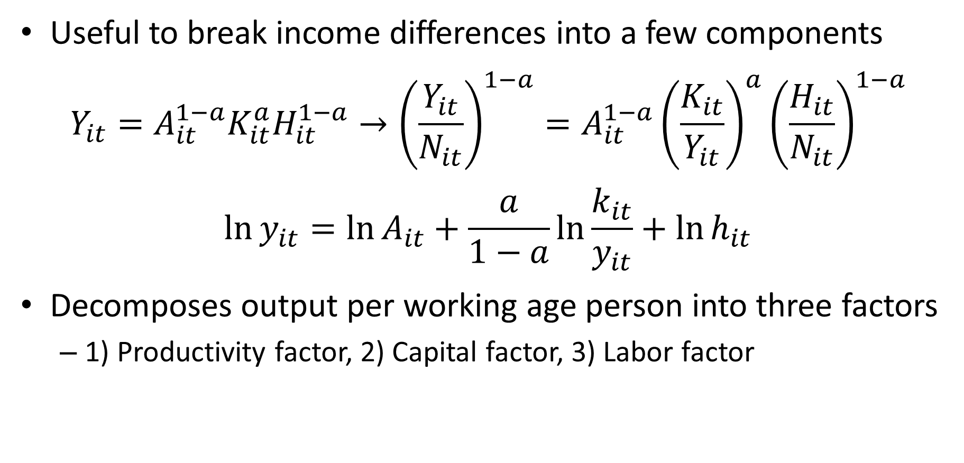
Accounting for Income Levels
Useful to break income differences into a few components
$$Y_{it}=A_{it}^{1−a}K_{it}^{a}H_{it}^{1−a}→{\left(\frac{Y_{it}}{N_{it}}\right)}^{1−a}=A_{it}^{1−a}{\left(\frac{K_{it}}{Y_{it}}\right)}^{a}{\left(\frac{H_{it}}{N_{it}}\right)}^{1−a}$$
$$\ln{y_{it}}=\ln{A_{it}+\frac{a}{1−a}\ln{\frac{k_{it}}{y_{it}}+\ln{h_{it}}}}$$
Decomposes output per working age person into three factors
  1) Productivity factor, 2) Capital factor, 3) Labor factor

Slide 36
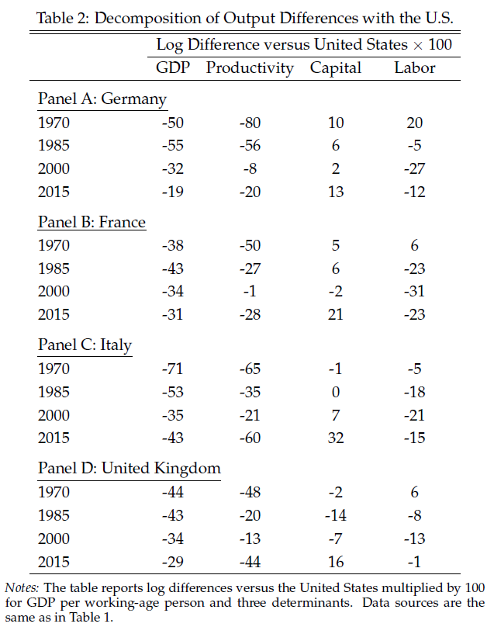
Accounting for Income Levels
1970:
  Most of difference productivity
  Hours similar to US
2000:
  Most of difference hours
  Productivity largely caught up in Germany and France
2015:
  Productivity has fallen off again
  Hours still much lower in France

Slide 37
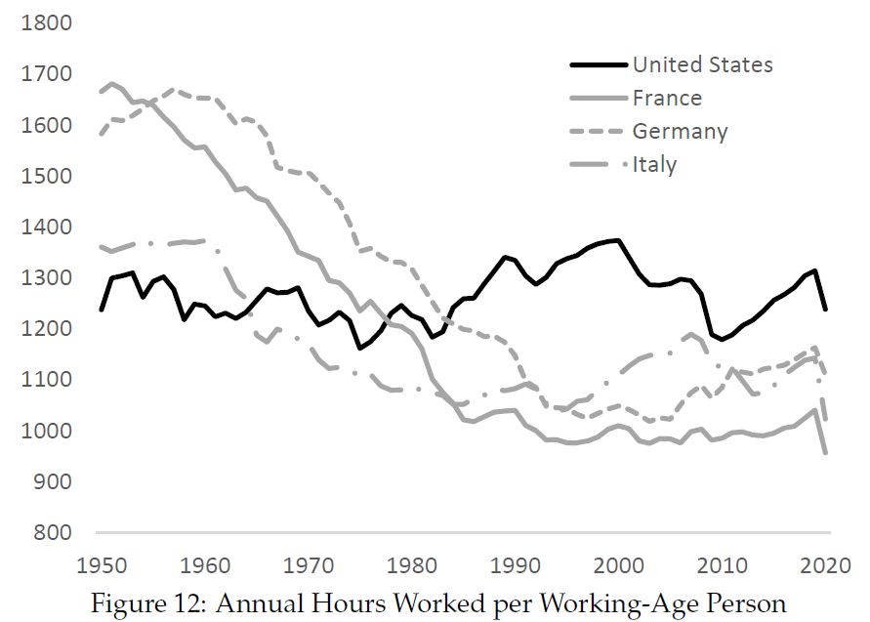
Hours in the Europe vs. U.S.
Europeans worked more than Americans in 1950s and 60s
Hours in Europe fell dramatically
Since 1980, Europeans have worked considerably less than Americans

Slide 38
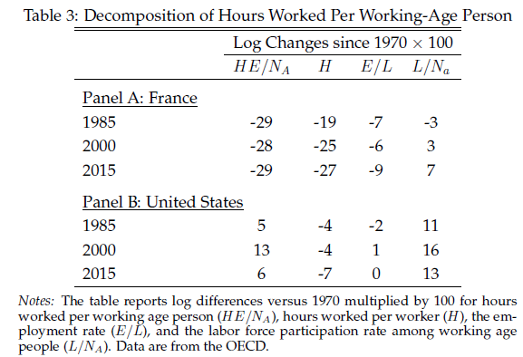
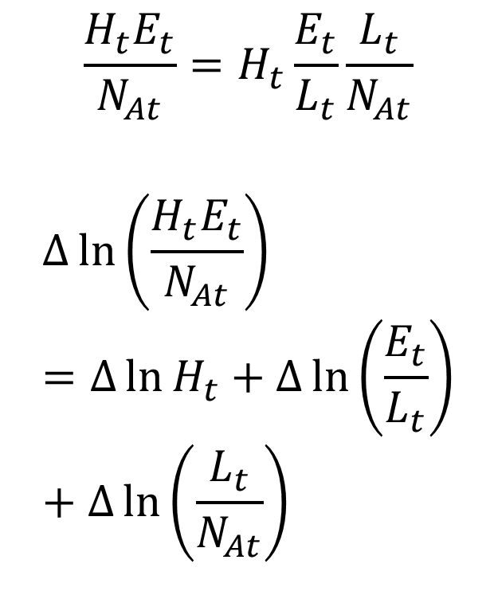
Hours in France vs. U.S.
$$\frac{H_{t}E_{t}}{N_{At}}=H_{t}\frac{E_{t}}{L_{t}}\frac{L_{t}}{N_{At}}$$
$$∆\ln\left(\frac{H_{t}E_{t}}{N_{At}}\right)=∆\ln{H_{t}}+∆\ln\left(\frac{E_{t}}{L_{t}}\right)+∆\ln\left(\frac{L_{t}}{N_{At}}\right)$$

Slide 39
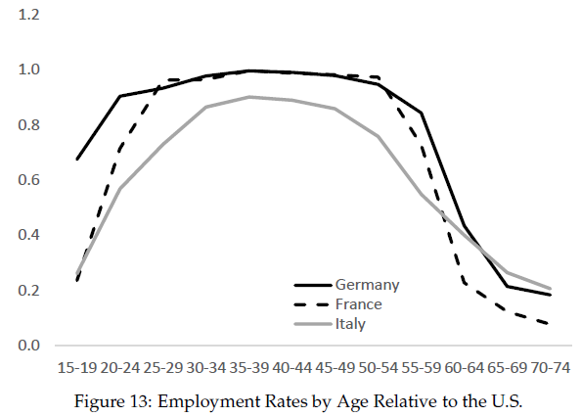
Hours in Europe vs. U.S.
Employment rates comparable for “prime age” workers
Employment rates lower in Europe for young and older workers

Slide 40
iClicker Poll
Why do the French work so much less?
(Pick answer you think is most important)
Different preferences and culture
More generous social safety net (UI, health insurance, etc.)
Higher minimum wage / labor market regulations
Unions
Higher taxes

Slide 41
Why Do Europeans Work So Little?
Differences in preferences and culture
(enlightened, women, coordination)
More generous social safety net (UI, health insurance, etc.)
(weak incentives)
Higher minimum wages
Unions
(work less – work all, coordination device)
Labor market regulation (hiring and firing costs)
Taxes

Slide 42
Taxes and Europe’s “Depression”
Labor supply is about 30% lower in France than in the US. Why?
Student A: Perhaps it is because taxes are so high in France?
Student B: That is ridiculous! There is no way taxes could matter that much.
How can students A and B make progress in figuring out
who is right?

Slide 43
Taxes and Europe’s “Depression”
Direct empirical evidence not conclusive since taxes correlated with other factors affecting labor supply
But can we use theory to help us think about what the size
of the effect of taxes on labor supply depends on?
If so, this will allow us to sharpen the debate
Then we can argue about the key determining factors and
seek out evidence about these factors

Slide 44
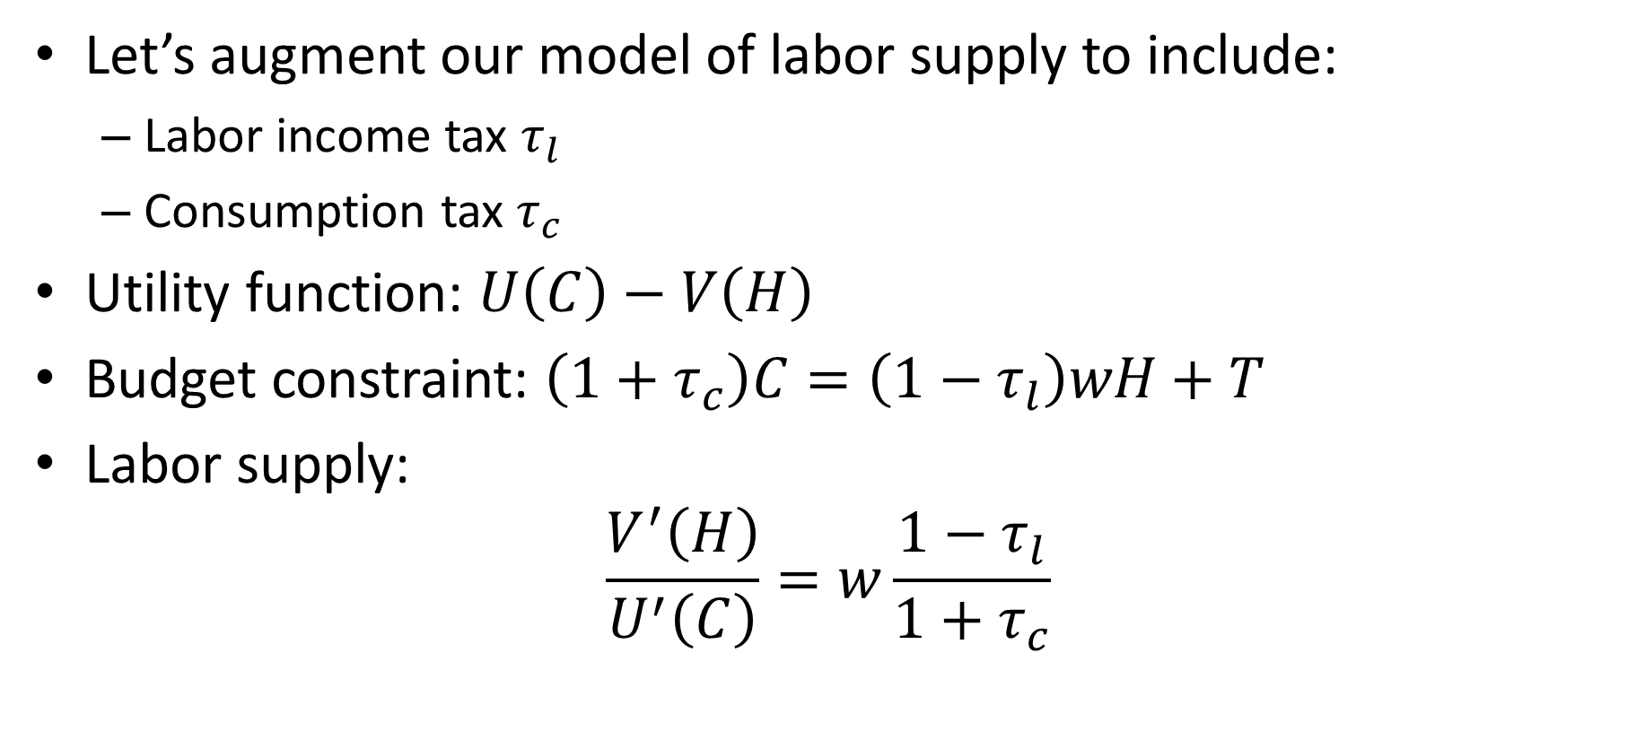
Taxes and Europe’s “Depression”
Let’s augment our model of labor supply to include:
  Labor income tax $τ_{l}$
  Consumption tax $τ_{c}$
Utility function: $U\left(C\right)−V\left(H\right)$
Budget constraint: $\left(1+τ_{c}\right)C=\left(1−τ_{l}\right)wH+T$
Labor supply:
$$\frac{V^{′}\left(H\right)}{U^{′}\left(C\right)}=w\frac{1−τ_{l}}{1+τ_{c}}$$

Slide 45
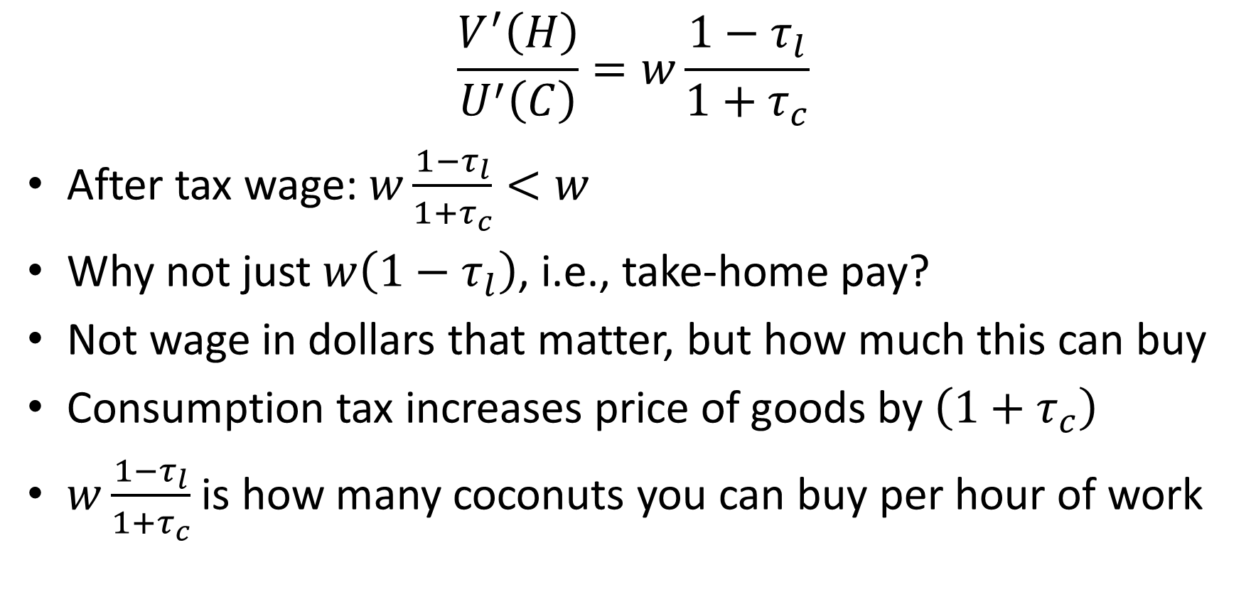
Labor Supply and Taxes
$$\frac{V^{′}\left(H\right)}{U^{′}\left(C\right)}=w\frac{1−τ_{l}}{1+τ_{c}}$$
After tax wage: $w\frac{1−τ_{l}}{1+τ_{c}}<w$
Why not just $w\left(1−τ_{l}\right)$, i.e., take-home pay?
Not wage in dollars that matter, but how much this can buy
Consumption tax increases price of goods by $\left(1+τ_{c}\right)$
$w\frac{1−τ_{l}}{1+τ_{c}}$ is how many coconuts you can buy per hour of work

Slide 46
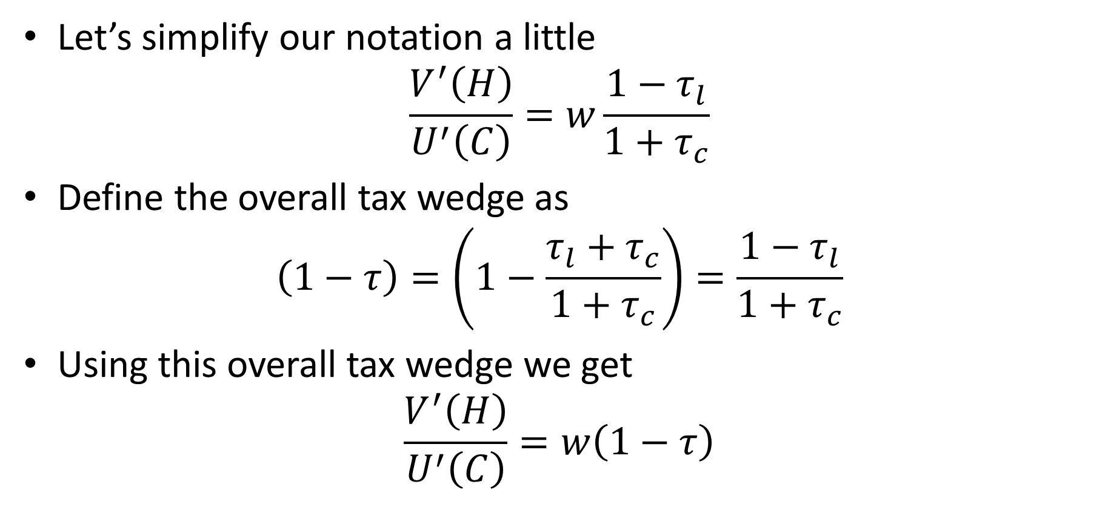
Tax Wedge
Let’s simplify our notation a little
$$\frac{V^{′}\left(H\right)}{U^{′}\left(C\right)}=w\frac{1−τ_{l}}{1+τ_{c}}$$
Define the overall tax wedge as
$$\left(1−τ\right)=\left(1−\frac{τ_{l}+τ_{c}}{1+τ_{c}}\right)=\frac{1−τ_{l}}{1+τ_{c}}$$
Using this overall tax wedge we get
$$\frac{V^{′}\left(H\right)}{U^{′}\left(C\right)}=w\left(1−τ\right)$$

Slide 47
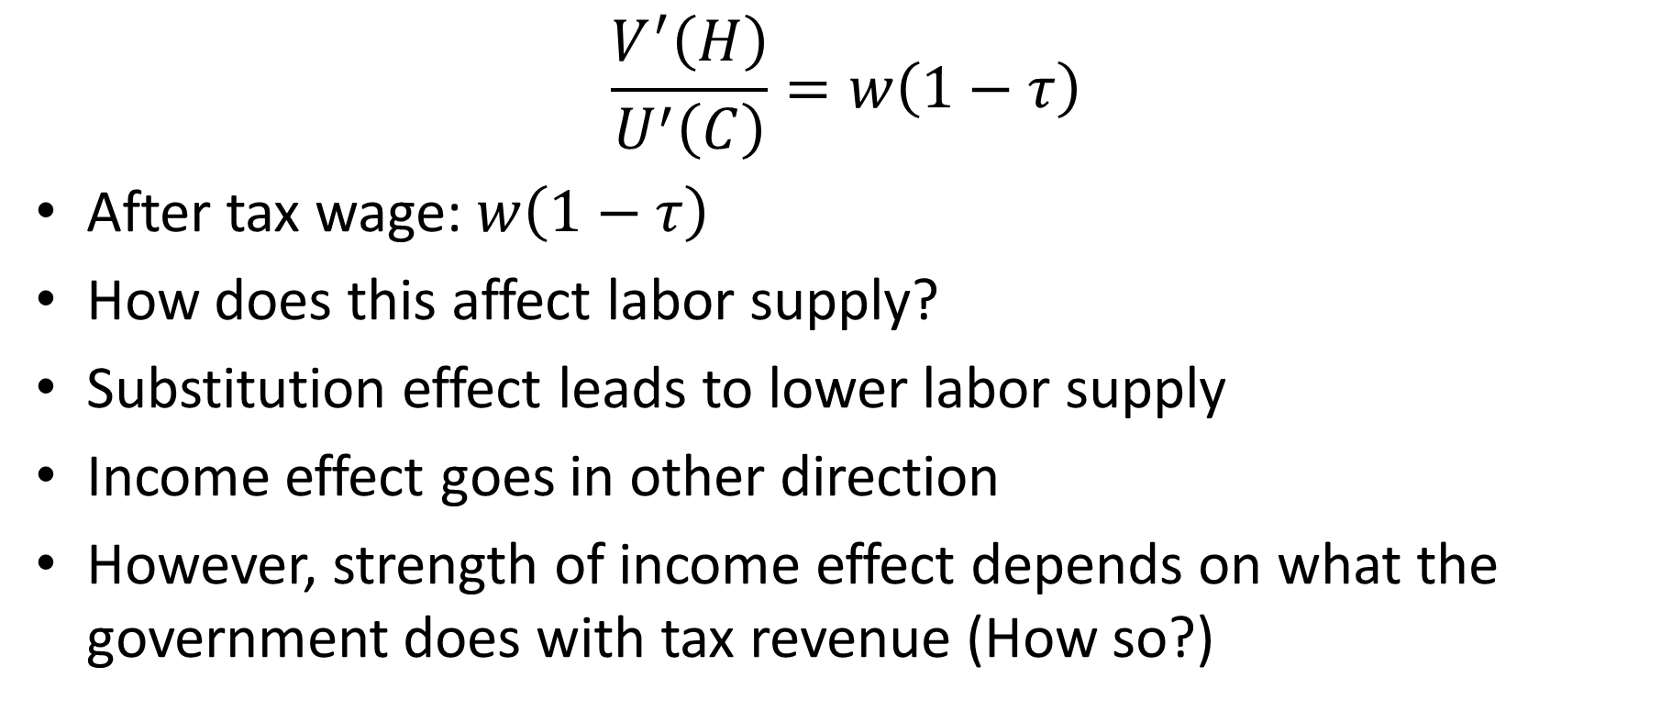
Taxes and Labor Supply
$$\frac{V^{′}\left(H\right)}{U^{′}\left(C\right)}=w\left(1−τ\right)$$
After tax wage: $w\left(1−τ\right)$
How does this affect labor supply?
Substitution effect leads to lower labor supply
Income effect goes in other direction
However, strength of income effect depends on what the government does with tax revenue (How so?)

Slide 48
Income Effect and Use of Tax Revenue
Suppose the government threw the tax revenue in the ocean (wasted it, bridges to nowhere, military spending to fight wars on foreign soil)
Would people feel poorer due to taxes?
  Yes they would
Taxes would have income effect
Income effect might be as large or larger than
substitution effect

Slide 49
Income Effect and Use of Tax Revenue
Suppose the government transferred money back to people though “lump-sum” transfers
Would people feel poorer due to taxes?
  No. (They pay taxes but get same amount back in transfer)
Suppose the government used tax revenue to buy goods people would have bought anyway (childcare, healthcare, etc.)
  Income effect depends on quality of the stuff the government buys
  Taxes would have smaller (possibly no) income effect

Slide 50
Income Effect and Use of Tax Revenue
Income effect from taxes is large if government wastes money (or spends on things people would not buy, such as military)
Income effect from taxes is small if government uses revenue for transfers or to provide goods and services people would have bought anyway.

Slide 51
Income Effect and Use of Tax Revenue
Real world probably somewhere between two polar cases discussed above
For simplicity, however, we follow Prescott (2002) and assume all tax revenue is transferred back to household lump-sum
This implies there is no income effect of taxes
This therefore maximizes the effect of taxes on hours

Slide 52
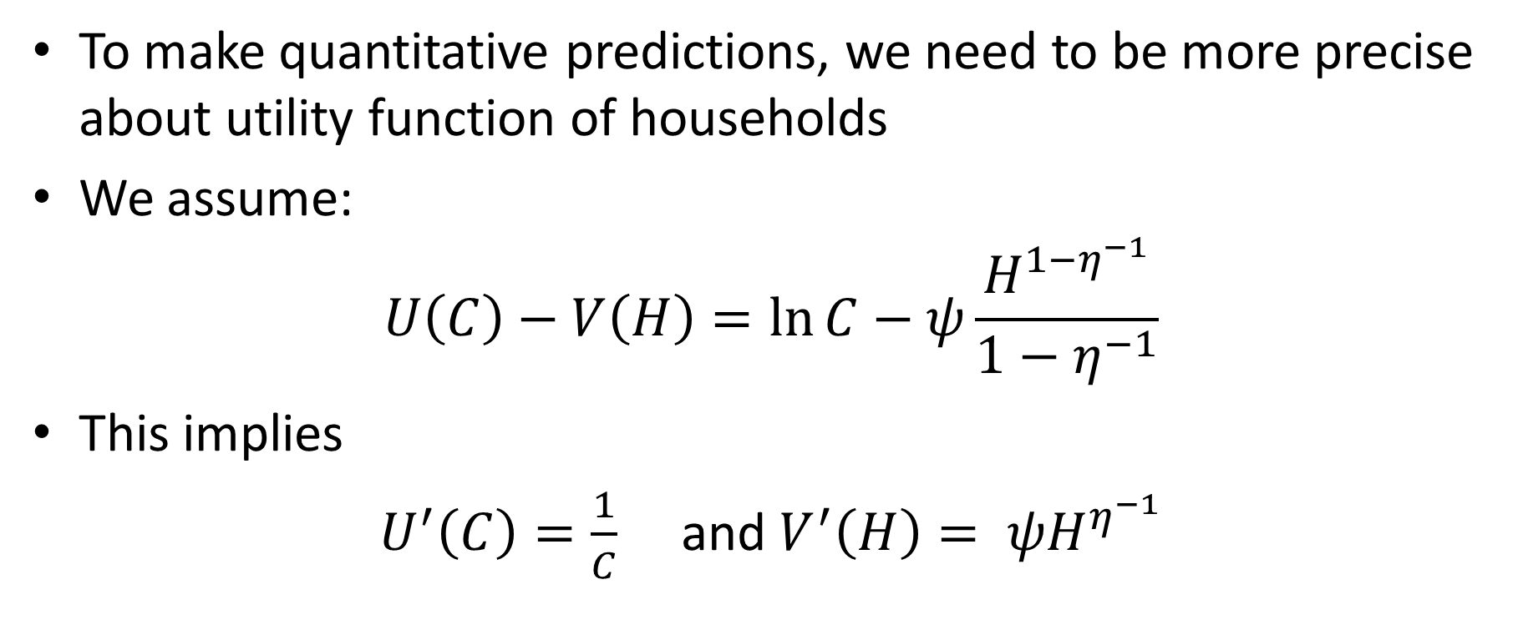
How Much Do Taxes Depress Labor Supply?
To make quantitative predictions, we need to be more precise about utility function of households
We assume:
$$U\left(C\right)−V\left(H\right)=\ln{C}−ψ\frac{H^{1−η^{−1}}}{1−η^{−1}}$$
This implies
$U^{′}\left(C\right)=\frac{1}{C}$ and $V^{′}\left(H\right)= ψH^{η^{−1}}$

Slide 53
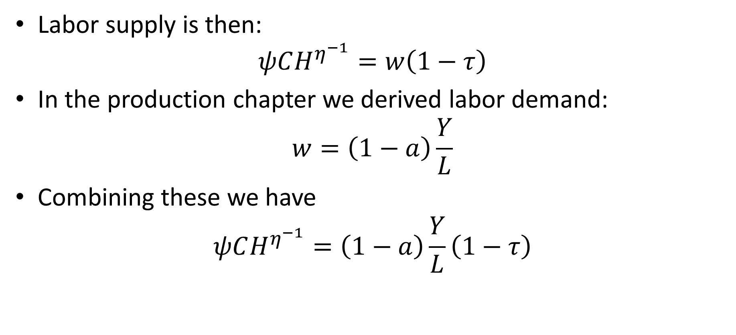
How Much Do Taxes Depress Labor Supply?
Labor supply is then:
$$ψCH^{η^{−1}}=w\left(1−τ\right)$$
In the production chapter we derived labor demand:
$$w=\left(1−a\right)\frac{Y}{L}$$
Combining these we have
$$ψCH^{η^{−1}}=\left(1−a\right)\frac{Y}{L}\left(1−τ\right)$$

Slide 54
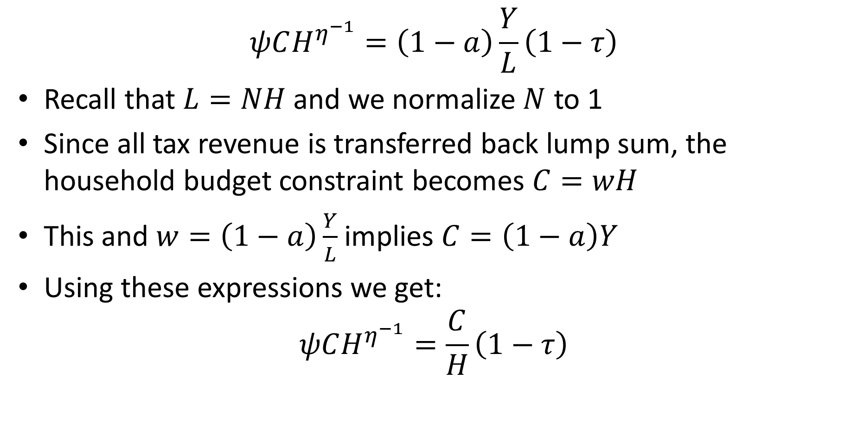
How Much Do Taxes Depress Labor Supply?
$$ψCH^{η^{−1}}=\left(1−a\right)\frac{Y}{L}\left(1−τ\right)$$
Recall that $L=NH$ and we normalize $N$ to 1
Since all tax revenue is transferred back lump sum, the household budget constraint becomes $C=wH$
This and $w=\left(1−a\right)\frac{Y}{L}$ implies $C=\left(1−a\right)Y$
Using these expressions we get:
$$ψCH^{η^{−1}}=\frac{C}{H}\left(1−τ\right)$$

Slide 55
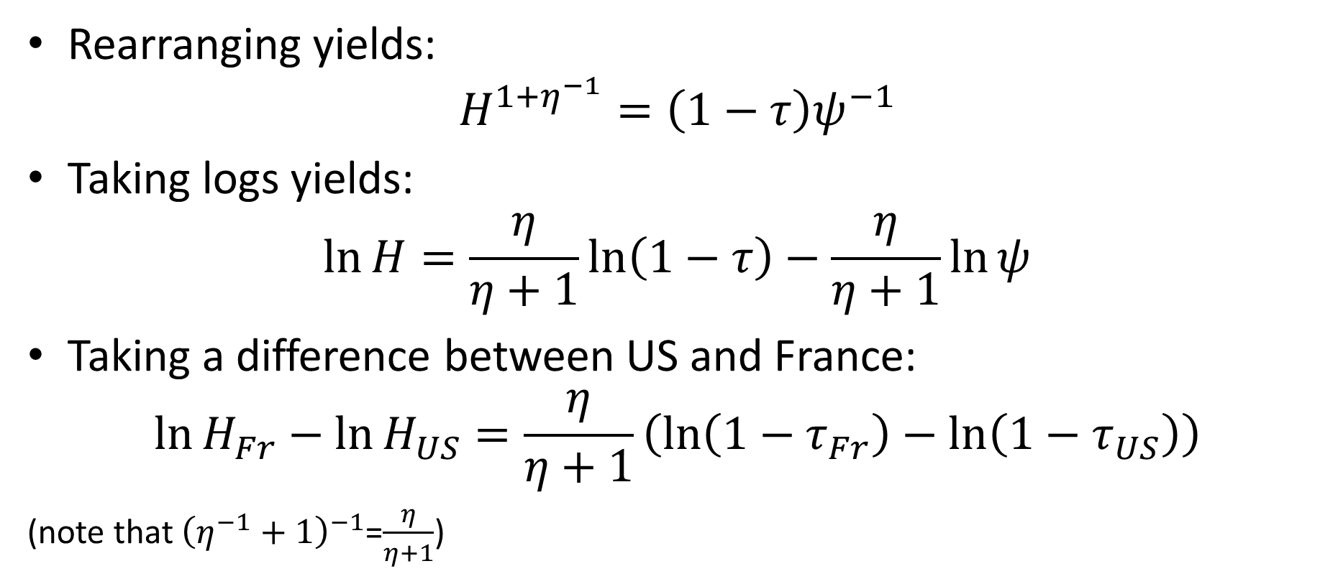
How Much Do Taxes Depress Labor Supply?
Rearranging yields:
$$H^{1+η^{−1}}=\left(1−τ\right)ψ^{−1}$$
Taking logs yields:
$$\ln{H}=\frac{η}{η+1}\ln\left(1−τ\right)−\frac{η}{η+1}\ln{ψ}$$
Taking a difference between US and France:
$$\ln{H_{Fr}}−\ln{H_{US}}=\frac{η}{η+1}\left(\ln\left(1−τ_{Fr}\right)−\ln\left(1−τ_{US}\right)\right)$$
(note that ${\left(η^{−1}+1\right)}^{−1}$=$\frac{η}{η+1}$)

Slide 56
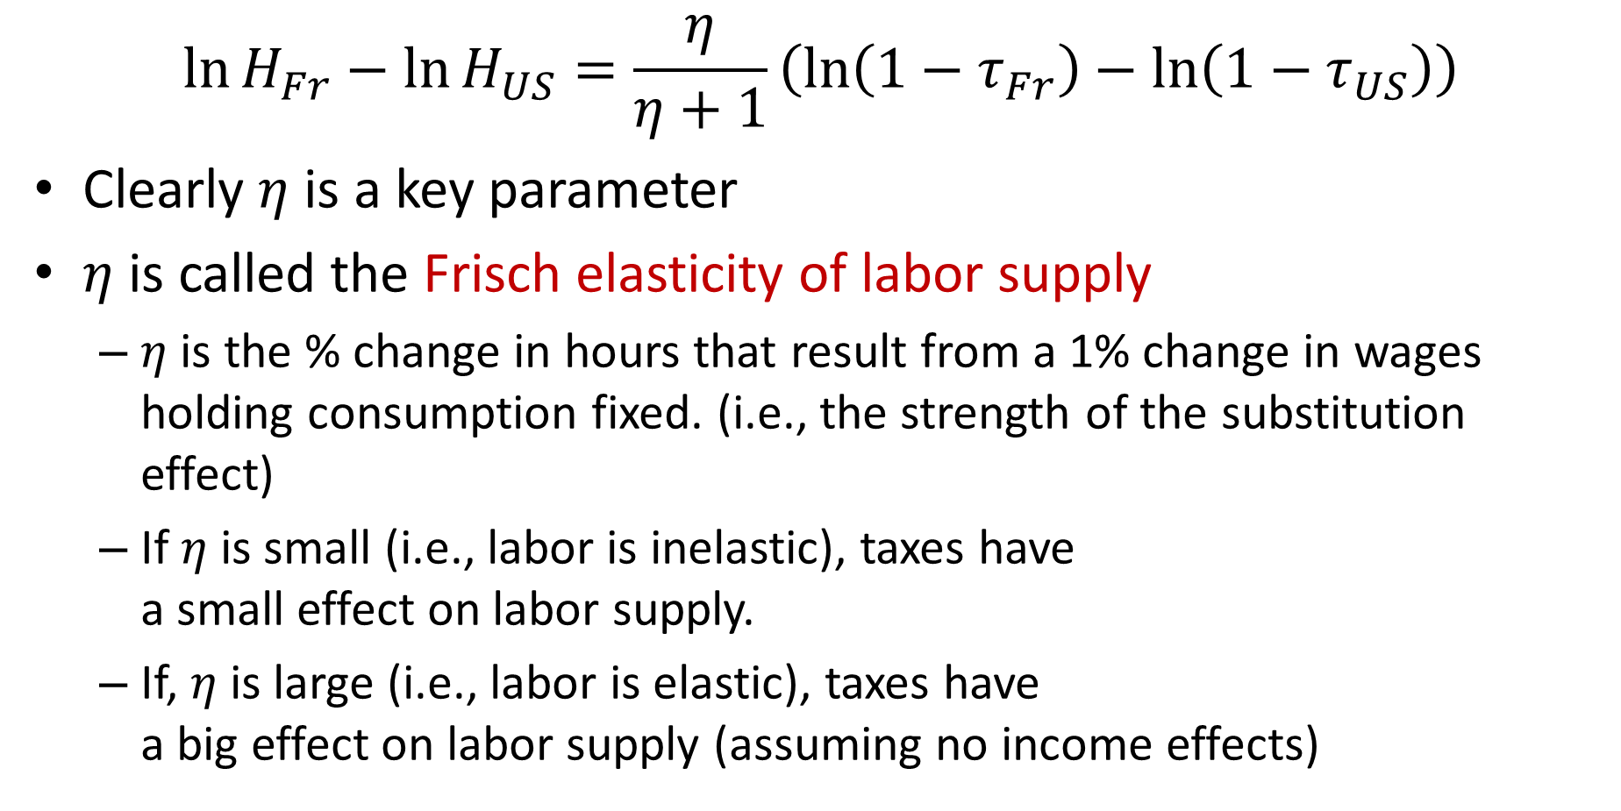
Key Determinant
$$\ln{H_{Fr}}−\ln{H_{US}}=\frac{η}{η+1}\left(\ln\left(1−τ_{Fr}\right)−\ln\left(1−τ_{US}\right)\right)$$
Clearly $η$ is a key parameter
$η$ is called the Frisch elasticity of labor supply
  $η$ is the % change in hours that result from a 1% change in wages holding consumption fixed. (i.e., the strength of the substitution effect)
  If $η$ is small (i.e., labor is inelastic), taxes have
  a small effect on labor supply.
  If, $η$ is large (i.e., labor is elastic), taxes have
  a big effect on labor supply (assuming no income effects)

Slide 57
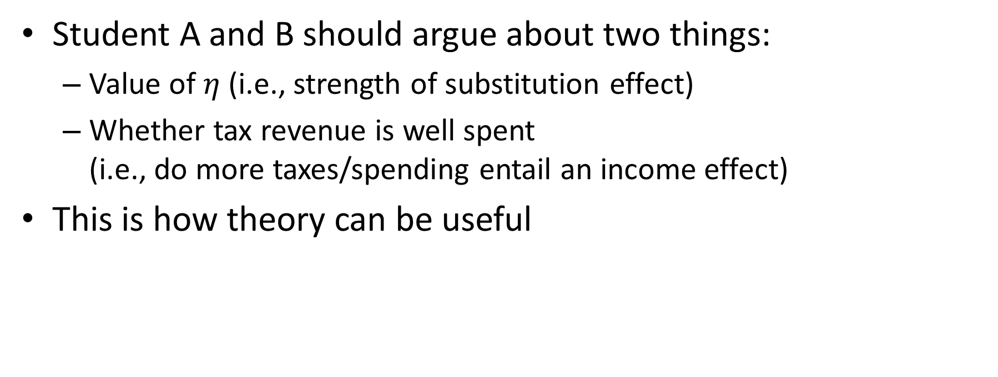
Value of Theory
Student A and B should argue about two things:
  Value of $η$ (i.e., strength of substitution effect)
  Whether tax revenue is well spent
  (i.e., do more taxes/spending entail an income effect)
This is how theory can be useful

Slide 58
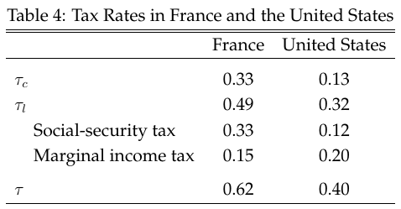
Taxes in France and U.S.
Prescott (2002) reported taxes in U.S. and France in late 1990s
Reproduced in Table 4
Taxes much higher in France
Difference in hours in 2000 was 31 log points
Can taxes explain this difference?

Slide 59
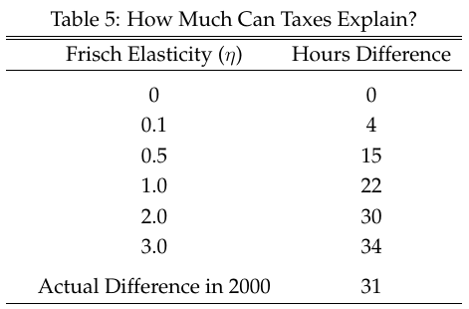

How Much Can Taxes Explain?
If Frisch elasticity is small (0.1-0.5), taxes can explain modest amount
If Frisch elasticity is large (say 3), taxes can explain entire amount
Prescott argued for $η=3$
This is all assuming no income effect

Slide 60
Estimating the Frisch Elasticity is Hard
Need temporary tax change
  Frisch elasticity holds consumption fixed
  Permanent tax changes have potentially large effects on consumption which adds a negative income effect (downward bias)
Hard to extrapolate from small changes due to frictions
  Costly adjustment and inattention may prevent response to
  small tax changes
  Results in downward biased estimates
  Also, some adjustment may occur gradually (new jobs / retirement)

Slide 61
Tax Holidays
Tax holidays provide very appealing “treatments” to
estimate Frisch elasticity
  Temporary / Large
  Possible to estimate both intensive and extensive margin effects
Two recent papers on tax holidays:
  Sigurdsson (2025) -- Iceland
  Martinez, Saez, and Siegenthaler (2021) – Switzerland

Slide 62

Tax Free Year in Iceland
In 1988, Iceland moved to pay-as-you-earn tax system (from a system where people paid taxes based on last year’s income)
Income in 1987 never taxed!!

Slide 63

How to Use Tax Free Year
We can compare 1987 with surrounding years
But perhaps there are other things that are different in 1987 from other years
What is the counterfactual?
  Trend up before, down after
  Hard to know
Icelandic economy volatile due to varying fish stocks and volatile policy

Slide 64

Difference-in-Difference
Compare workers in high tax bracket (more affected) with those in low tax bracket
(less affected)
Assumption: Would have followed “parallel trends”
(i.e., equally affect by other special factors)
Looking at difference between groups means effect of other factors cancels out
Source: Sigurdsson (2019)

Slide 65

Tax Free Year in Iceland
Workers in high tax bracket increased earning by 7% more than workers in low tax bracket
Sigurdsson converts this into estimate of Frisch elasticity
His conclusion:
  Intensive margin: 0.4
  Extensive margin: 0.1
  Overall Frisch elasticity of 0.5

Slide 66

Tax Free Year in Switzerland
Martinez, Saez, and Siegenthaler estimate Frisch elasticity close to zero – less than 0.05
Also Diff-in-Diff, but not across tax brackets, rather across Swiss cantons
Cantons transitioned to new tax system in different years. So, different tax-free year in different cantons
Effect on earning very small

Slide 67
Tax Holiday Estimates
Frisch elasticity estimates:
  Sigurdsson for Iceland: 0.50
  Martinez, Saez, Siegenthaler for Switzerland: <0.05
Both much lower than number Prescott used
Why is Iceland different from Switzerland?
  Perhaps because labor market is more flexible in Iceland
  than in Switzerland
  US labor market arguably even more flexible

Slide 68
The Economics of Marx
Karl Marx is arguably the most influential labor economist
of all time
Ideas resonate strongly with students today
Contrast strongly with ideas we have presented
Worth exploring the difference
We consider essay Wage-Labor, and Capital published in 1849
Marx and Engels (1848): Communist Manifesto

Slide 69
The Economics of Marx
Marx writes:
“the productive power of labor is raised, above all, by
the greater division of labor
“division of labor” is Marx’ preferred term for labor productivity

Slide 70
The Economics of Marx
“The greater division of labor enables one worker to do the work of five, ten or twenty”
“It therefore multiplies competition among workers fivefold, tenfold and twentyfold.”
“As the division of labor increases, labor is simplified. The special skill of the worker becomes worthless.”
Marx (1849): Wage-Labor and Capital

Slide 71

The Economics of Marx
Productivity growth (division of labor) leads wages to fall
What did our model imply about this?

Slide 72


Increase in Productivity
Increase in productivity shifts labor demand out
$$\left(1−a\right)AK^{a}L^{−a}=w$$
  Increases wage
Permanent increase in productivity shifts labor supply back (income effect)
$$wU^{′}\left(C\right)=V′(H)$$
  Increases wage even more

Slide 73

Empirically Marx Was Dead Wrong
Labor productivity has increased at a sustained rate for over 200 years
Real wages of workers have grown at approximately the same rate over this period

Slide 74

Was Marx Simply Confused?
Marx is clear that higher productivity lowers prices of goods
But doesn‘t this make workers better off
Neither nominal wage $W$ nor nominal price $P$ determine worker welfare. Rather it is real wage $W/P$
If $P$ goes down more than $W$, $W/P$ will rise and workers are better off
Not clear Marx understood this point when reading his essay

Slide 75
Can We Make Sense of Marx?
1. Does labor demand shifts out?
Our model: People get more productive => production increases
Marx: Higher productivity => less work
  “It therefore multiplies competition among workers
  fivefold, tenfold and twentyfold.”
This idea resonates strongly with people
  Technological change destroys jobs and makes workers worse off

Slide 76
Does Labor Demand Shift Out?
Which view – more output or less works – is correct?
Depends on demand in the product market.
I.e., can the firm sell extra output?
Suppose firm productivity double. Should it:
  Produce twice as much with same number of workers
  Fire half of workers
Suppose firm decides to produce more
  Who is going to buy the extra goods?
  Do people have enough income to buy the extra goods?

Slide 77
Circular Flow of Payments
If someone buys the extra goods, this provides extra
income to seller and employees of seller
Income goes up in tandem with expenditures:
  One person’s expenditure is another person’s income
  Circular flow of payments in a market economy
But there seems to be a chicken and egg problem:
  If the goods sell, people will have income to buy them
  But what comes first, the income or the expenditures

Slide 78
Market Clearing
Basic assumption in neoclassical economics: Markets clear
  This means everything that is produced will sell
  And this implies that someone will have enough income to buy it
  Timing issues about who gets paid first assumed away
  (everything assumed to happen simultaneously)
  The real question is at what price it will sell
This perspective effectively assumes away
the Marxist/Keynesian worry of insufficient demand

Slide 79
Do Markets Clear?
Changes in prices and wages are what clear markets
  Price of goods goes down, wage goes up, workers have more purchasing power
But what if prices are sticky?
  Can’t expand production. Don’t need as many workers.
  Sticky prices yield insufficient demand (after increase in productivity)
  Such models are called Keynesian (Keynes, 1936)
Perhaps Marx was a Keynesian long before Keynes
Sticky prices more plausible in the short run than long run

Slide 80
Can We Make Sense of Marx?
Marx makes a “Malthusian” argument:
Wages will be determined by:
“the cost of production of labor power” …
“the cost required for maintaining
the worker as a worker” …
“the cost of existence and reproduction”
Wages of unskilled labor driven down to subsistence
Wages fall due to “division of labor” because work requires less skill and so cost of “developing him into a worker” falls

Slide 81

Can We Make Sense of Marx?
In our model labor supply shifts back
In Marx’ view, labor supply shifts out due to increased population (Malthusian effect)
Economy moves from A to C rather than A to B
Wages stuck at subsistence
Had been true until shortly before Marx’ time

Slide 82

Wage, Labor, and
Capital 1849
Real Wages of Laborers in Building Industry in England from Clark (2005, 2010)

Slide 83
Can We Make Sense of Marx?
Immiserizing growth
Can productivity growth make wages go down?
In one-good economy: No!
  Worker can always keep using old technology
In multi-good economy: Yes!
  Price of good that workers produces may fall relative to price of other goods. This can reduce real wage of workers using old tech
  Think of hand-loom weavers when mechanized weaving came in

Slide 84

Was Marx Right After All?
Real wages and productivity move in lock-step 1948-80
Divergence after this
Real wages stagnant 1980-96
Real wages grow after 1996, but not as fast as productivity
Our labor market model needs modification to explain this
Active area of research

