Slide 1
How Did Growth Begin? The Industrial Revolution and Its Antecedents
Jón Steinsson
University of California, Berkeley

Slide 2
Why Did Industrial Revolution Happen?
Not a settled issue! (Very contentious, actually)
We discuss four strands of thought:
Changes to Institutions
The Enlightenment
The Agricultural Revolution
The role of high wages and cheap coal

Slide 3
Institutions

Slide 4
What Happened in the 1640s?

Slide 5
England in the 17th Century
Two revolutions: 1640s and 1688
Civil War in 1640’s:
Parliamentarians overthrow Charles I and set up Commonwealth
Great deal of institutional change
Growth despite much turmoil!!
“Glorious” Revolution of 1688:
Formalization of constitutional monarchy in England
Marxist historians stress revolution of 1640s, while Whig history stresses Glorious Revolution of 1688

Slide 6
Growth Began at a Time of Institutional Change

Slide 7
North and Weingast (1989)
The fundamental barrier to growth before Glorious Revolution was despotism of sovereign
The sovereign faced a commitment problem
Would like to promise to respect property rights of citizens. Why?
Because this provides citizens with good incentives to invest and produce more (yielding higher taxes)
Why is it hard to make such a promise credible?
Once citizens have amassed wealth, sovereign has irresistible temptation to renege and confiscate wealth (especially in time of war)

Slide 8
Commitment Problem
Ex-ante: Sovereign wants to promise to respect property rights
Ex-post: Sovereign wants to renege and expropriate
Subjects understand this. Don’t believe initial promise
Promise is not credible
Sovereign has a commitment problem
Parent says to child: “If you don’t eat your vegetables, you won’t get ice cream.”
Child may understand that this is not a credible threat
Government says to banks: “If you get into trouble, we will not bail you out.”
Banks may understand that this is not a credible threat

Slide 9
Commitment Problem
How can we solve commitment problems?
Reputation (when play is repeated)
Weight current profit against future loss
Need long horizon
Commitment devices:
Odysseus tied himself to the mast
Cortez burned the boats he arrived on in Mexico
Enforceable contracts
Constitutions
Balance of power
The Civil War and Glorious Revolution resulted in dramatic institutional change
Power of the Crown reduced
Power of Parliament enhanced
Stable power-sharing arrangement between Crown, Parliament, Courts.
Improved incentives of citizens to innovate and invest
Notes:
Odysseus wanted to hear songs of the Siren but knew that he would temporarily loose his ability to act rationally and would try to join the siren. So, he ties himself to the mast.

Slide 10
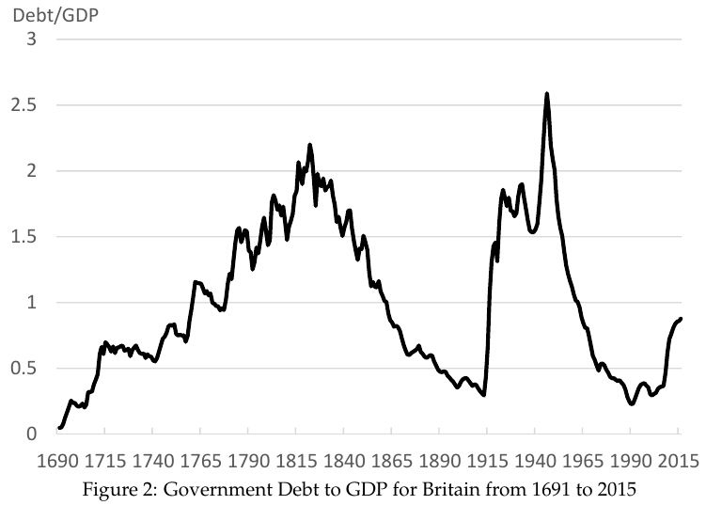
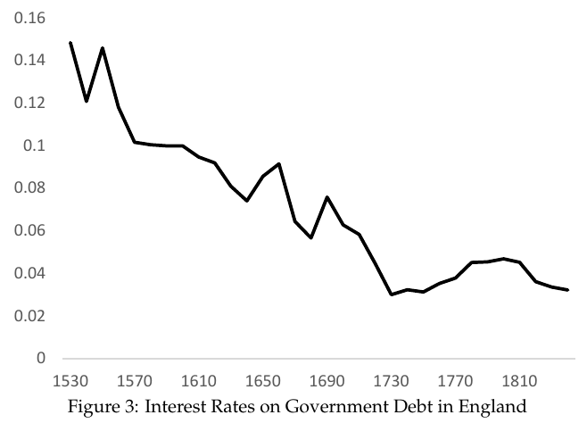
The Financial Revolution

Slide 11
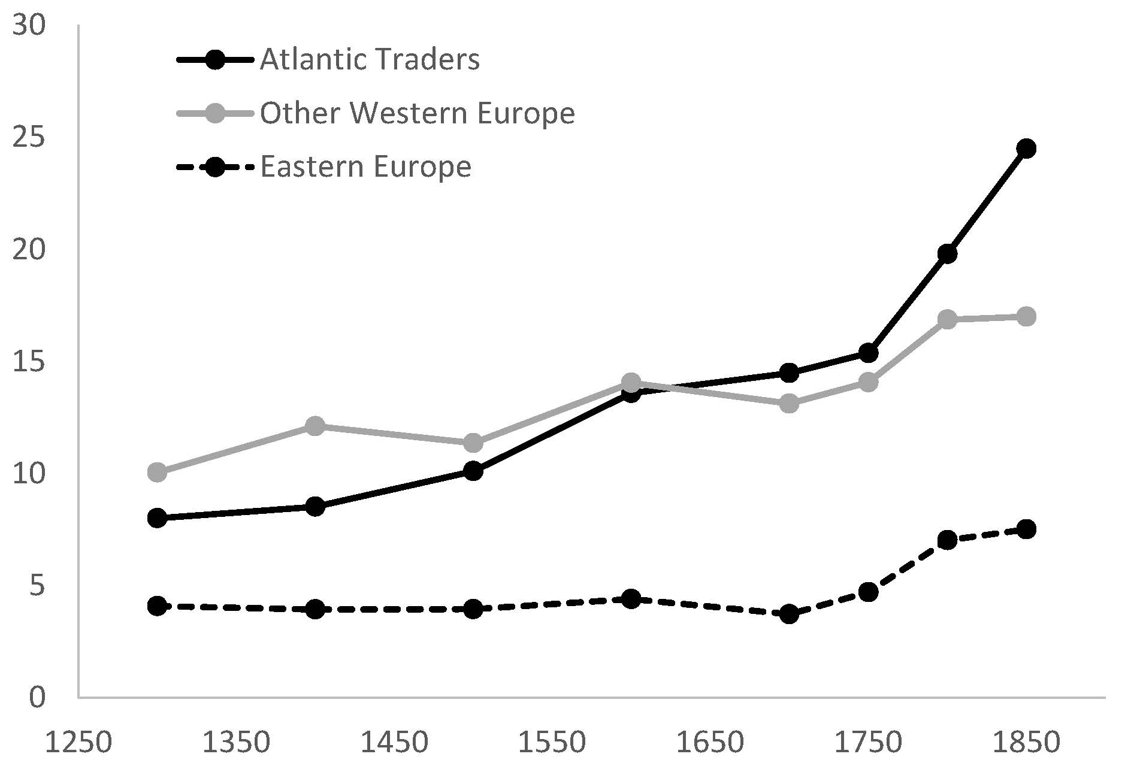
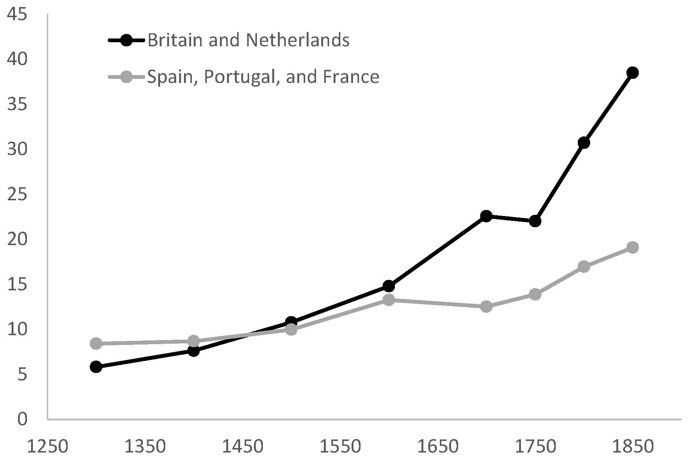
The Role of Atlantic Trade
Atlantic trade highly profitable after Great Discoveries
In Britain/Netherlands, created merchant class that demanded better institutions
In Spain/Portugal(/France) dominated by Crown
Mediterranean countries (Venice/Baltics) didn’t have access

Slide 12
iClicker Poll
North and Weingast (1989) argue that key problem preventing growth in England prior to Glorious Revolution was
Population growth that held down wages
Attacks by foreign powers (e.g., Spanish Armada)
Pervasive lack of individual freedom (serfdom)
Inability of sovereign commit to protect property rights

Slide 13
The Enlightenment

Slide 14
Technological Innovation
Huge increase in speed of technical innovation
Textiles: Spinning jenny, water frame, mule, etc.
Steam: Newcomen engine, separate condenser, rotary engine, high pressure engine, etc.
Coke smelting, railroads, etc.
“A wave of gadgets swept over England” (Ashton, 1948)
Why did technological innovation take off?

Slide 15
A Theory of the Enlightenment
Perhaps there was an unusual clustering of talented and freethinking individuals in Northwestern Europe in the 17th and 18th centuries
Seems unlikely!
Plenty of smart and freethinking individuals have likely lived in all places at all times
So, why have so few ideas survived from other times and places?
Perhaps because they were suppressed/lost
Freethinkers are often a threat to the ruling elite

Slide 16
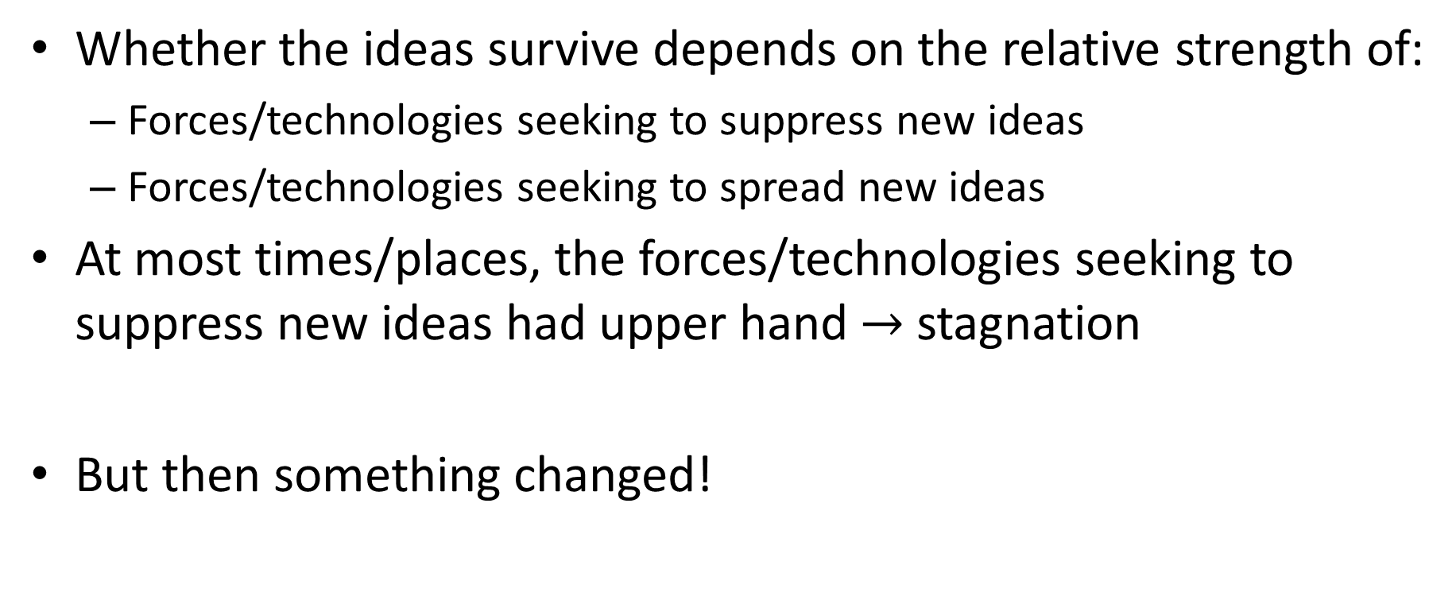
A Theory of the Enlightenment
Whether the ideas survive depends on the relative strength of:
Forces/technologies seeking to suppress new ideas
Forces/technologies seeking to spread new ideas
At most times/places, the forces/technologies seeking to suppress new ideas had upper hand $→$ stagnation
But then something changed!

Slide 17
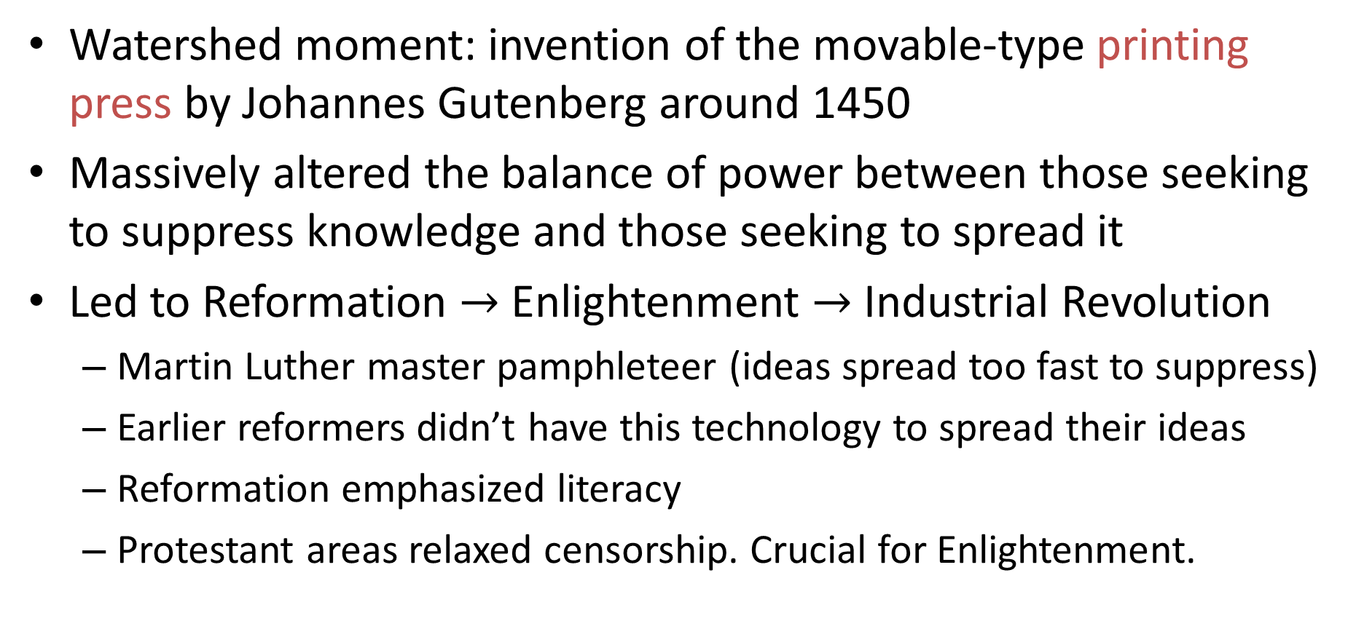
A Theory of the Enlightenment
Watershed moment: invention of the movable-type printing press by Johannes Gutenberg around 1450
Massively altered the balance of power between those seeking to suppress knowledge and those seeking to spread it
Led to Reformation $→$ Enlightenment $→$ Industrial Revolution
Martin Luther master pamphleteer (ideas spread too fast to suppress)
Earlier reformers didn’t have this technology to spread their ideas
Reformation emphasized literacy
Protestant areas relaxed censorship. Crucial for Enlightenment.

Slide 18
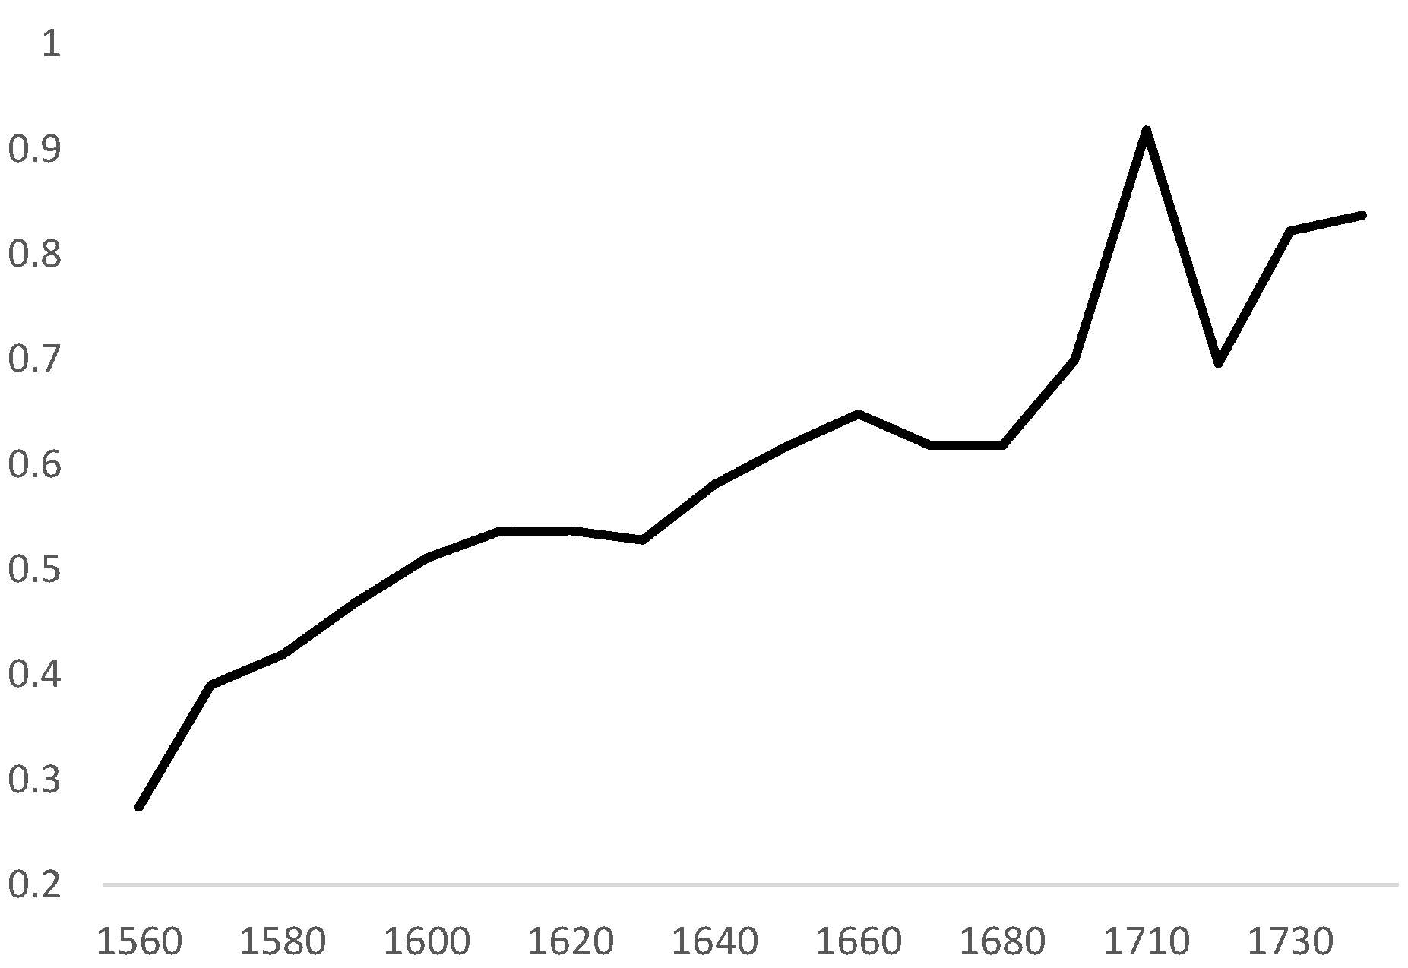
Rise in Literacy
Literacy rates seem to have been extremely low throughout most of history
Rose rapidly in England over 250 years before Industrial Revolution
Protestant churches encouraged literacy
Price of books fell by more than a factor of 20
Source: Estimate of literacy rate of husbandmen in London and Middlesex
Notes:
Numeracy based on age awareness (based on age heaping data) suggests widespread lack of basic numeracy in the ancient world. Clark (2007, page 177-179).

Slide 19
Evidence on Role of Enlightenment/Reformation?
Speculative theory
Can we provide any “hard evidence” for it?
Quite difficult
Becker and Woessmann (2009) provide interesting attempt
Did Protestantism cause growth in 19th century Prussia?
Max Weber: Protestant Ethic
But perhaps literacy is key channel

Slide 20
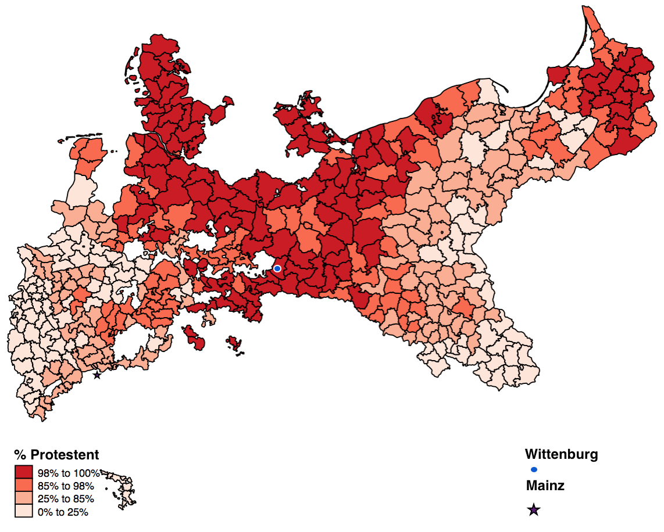
Protestant Prosperity
Protestantism correlated with prosperity around 1900
But a correlation doesn’t prove causation!
Perhaps Protestant areas differed in other way and this explains their prosperity
How can we test whether Protestantism caused prosperity?
We need “exogenous variation” in Protestantism
Becker-Woessmann propose “distance to Wittenberg”

Slide 21
Structure of the Argument
First Stage: Is distance to Wittenberg correlated with Protestantism?
Balance Tests: Were areas close to Wittenberg different in other ways?
Reduced Form: Is distance to Wittenberg correlated with prosperity?
Becker and Woessmann use data on Prussian counties in late 19th century

Slide 22
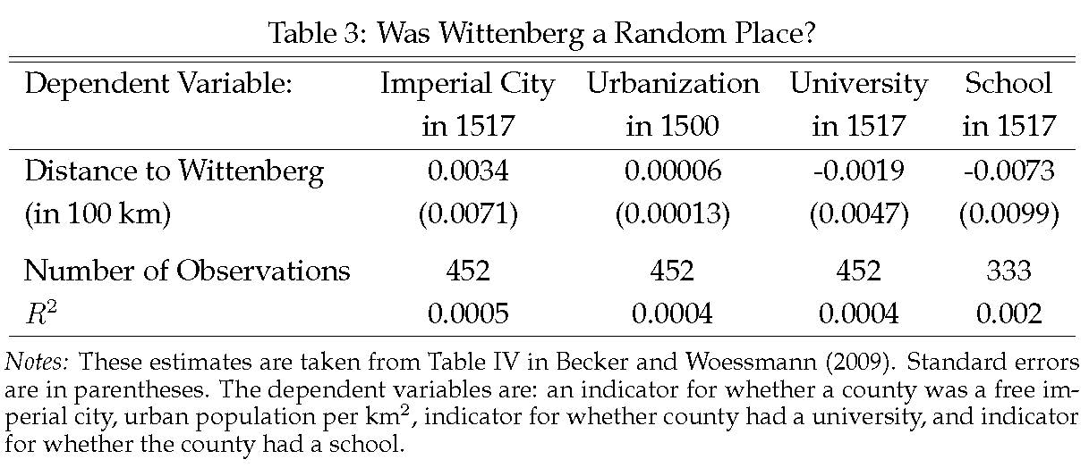
Is Distance to Wittenberg Different in Other Ways?
Becker and Woessmann assume: Nothing special about Wittenberg when it comes to prosperity other than it being center of Protestant revolution
Can they corroborate this assumption?
Distance to Wittenberg is not correlated with proxies for economic and educational development prior to Reformation
$$Y_{i}=α+β{\text{DIST}}_{i}+X_{i}^{′}γ+ε_{i}$$

Slide 23
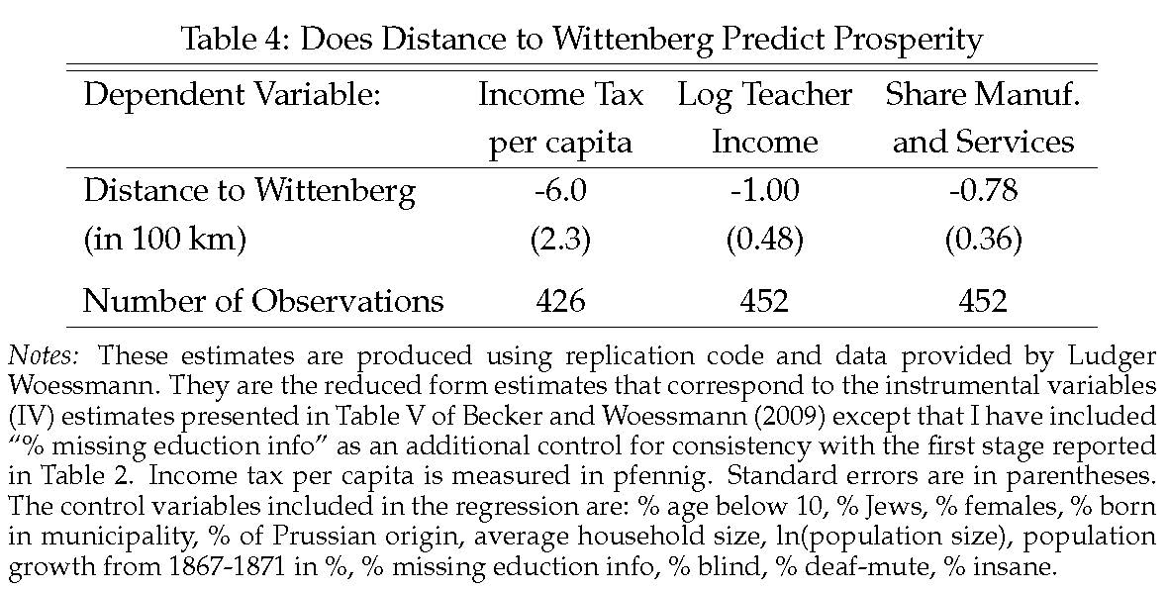
Distance to Wittenberg and Prosperity
Final step: Show that distance to Wittenberg is correlated with prosperity
If DIST is uncorrelated with all determinants of PROSP other than PROT, then any correlation between DIST and PROSP must be due to PROT.
$${\text{PROSP}}_{i}=α+β{\text{DIST}}_{i}+X_{i}^{′}γ+ε_{i}$$

Slide 24
iClicker Poll
Suppose Becker and Woessmann had found that distance to Wittenberg was correlated with literacy in 1450 across Prussian counties. This would have
Supported their argument Protestantism caused Prosperity
Undermined their argument that Protestantism caused Prosperity

Slide 25
The Agricultural Revolution

Slide 26
Agricultural Revolution
Population of England tripled from 1700 to 1850
Very little imports of food
Share of population working in agriculture fell
Massive increase in agricultural productivity
Did Agricultural Revolution cause Industrial Revolution?
Or did Industrial Revolution cause Agricultural Revolution?

Slide 27
Agricultural Revolution
Proximate causes:
1) Improvements in land, 2) Intensive crop rotations, 3) breeding of higher yield animals and crops
Crop rotations:
Traditional rotation: 1) Wheat or rye, 2) Barley or oats, 3) fallow
New rotation: 1) Wheat, 2) Turnips, 3) Barley, 4) Clover
Clover a legume (nitrogen fixing)
Turnips/Clover used as feed for animals
Much larger animal herds yielded lots of natural fertilizer
Why did this not happen much earlier?

Slide 28
The Enclosure Movement
Before 1500:
Villages with three open fields + commons
Each farmer owned several strips + rights to use commons
After 1850:
Ancient system swept away by thousands of “enclosure” acts and agreements
Replaced by modern system of private property rights
Very controversial!
One view:
Rationalization of property right
Crucial for innovation / Ag. Revolution
Another view:
Massive act of expropriation by large landowners of complex system of antient peasant rights
Enclosed farms were more efficient, but open farms also increased yields substantially

Slide 29
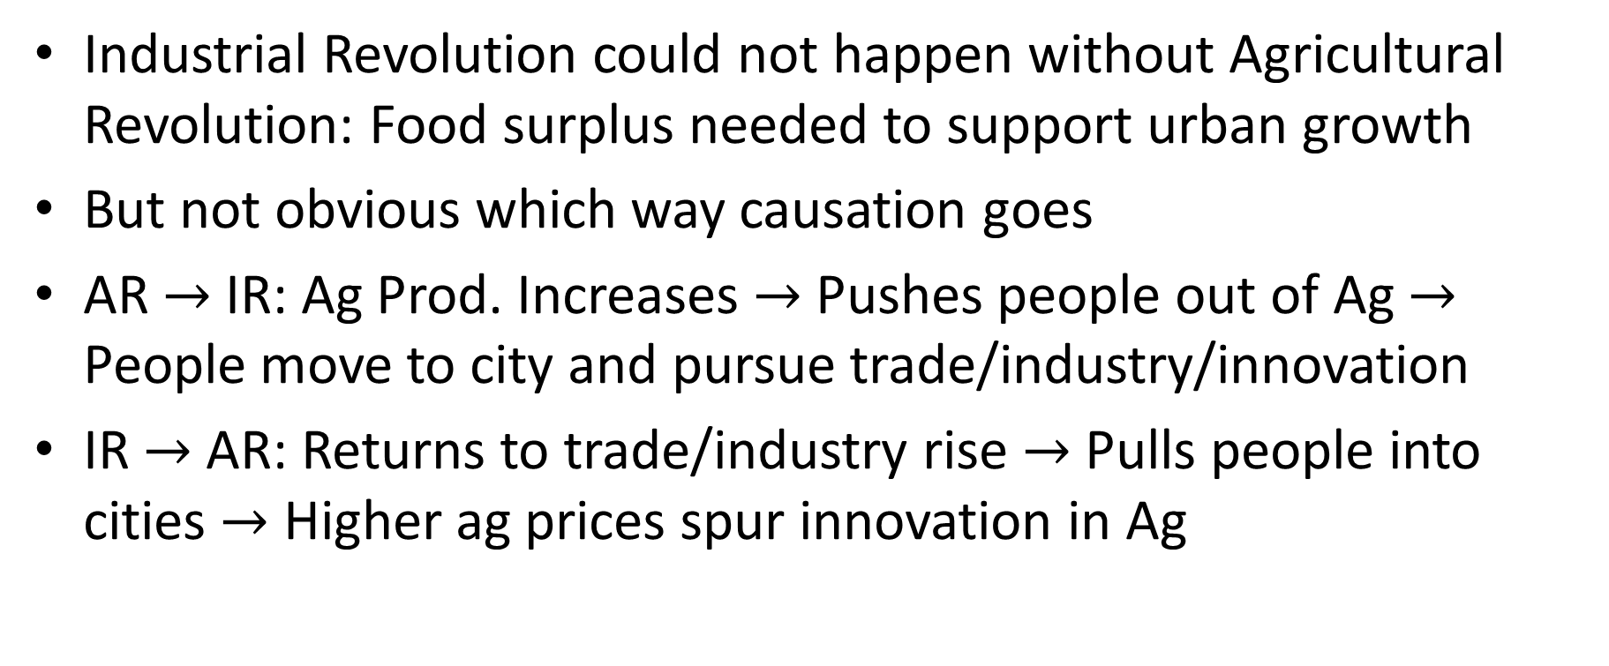
Rural Growth and Urban Growth: Did One Cause the Other?
Industrial Revolution could not happen without Agricultural Revolution: Food surplus needed to support urban growth
But not obvious which way causation goes
AR $→$ IR: Ag Prod. Increases $→$ Pushes people out of Ag $→$ People move to city and pursue trade/industry/innovation
IR $→$ AR: Returns to trade/industry rise $→$ Pulls people into cities $→$ Higher ag prices spur innovation in Ag

Slide 30
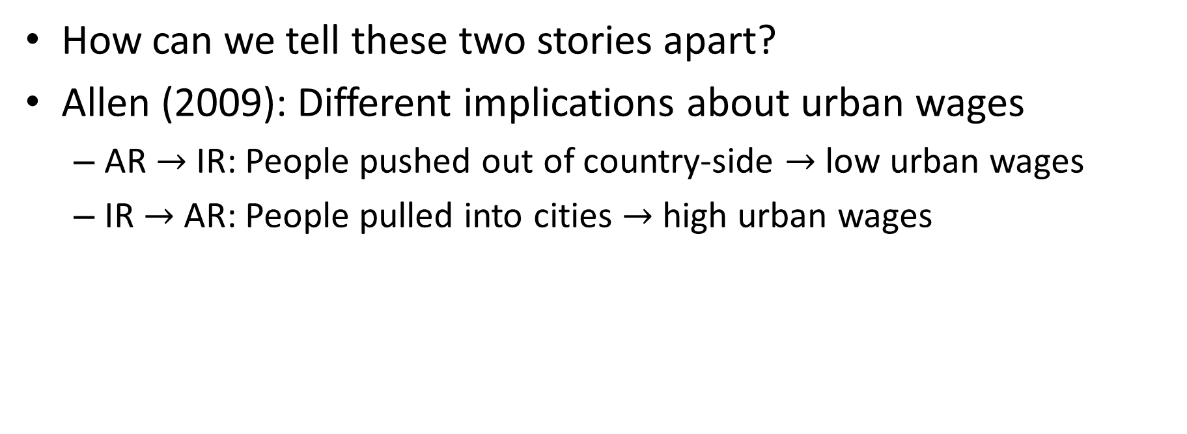

AR $→$ IR or IR $→$ AR
How can we tell these two stories apart?
Allen (2009): Different implications about urban wages
AR $→$ IR: People pushed out of country-side $→$ low urban wages
IR $→$ AR: People pulled into cities $→$ high urban wages

Slide 31
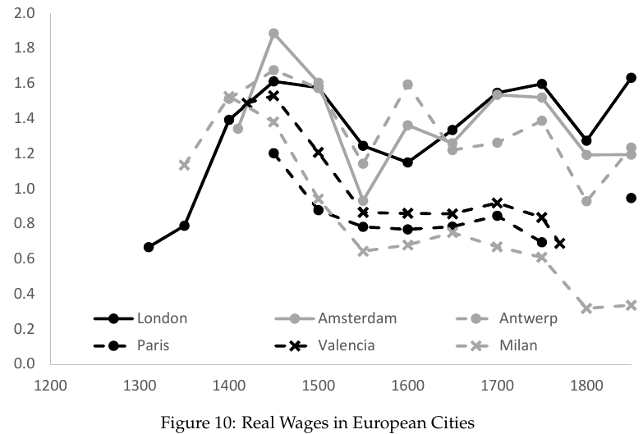
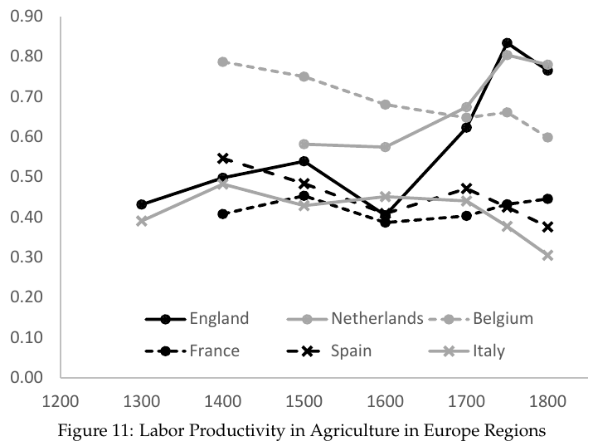
AR $→$ IR or IR $→$ AR
Agricultural Revolution happens in places with high urban wages

Slide 32
Decline of Feudalism and Rise of Capitalism
Medieval England was a feudal society
Crown, lords, freehold farmers, serfs
Gradual increase in freedom/property rights/rule of law
Royal courts gradually protected freeholds from lords (Common Law)
Black Death led to collapse of serfdom and early enclosures
Crown reacted to expropriation by gradual protection of tenant farmers
By 17th century: Rise of yeoman farmers with substantial proprietary interest in the soil (and thus incentive to innovate)
Contrast: More intense serfdom in E. Europe after Black Death

Slide 33
iClicker Poll
High wages in English cities at the time of the Agricultural Revolution suggests that
The Agricultural Revolution caused the Industrial Revolution
The Industrial Revolution caused the Agricultural Revolution

Slide 34
High Wages and Cheap Coal

Slide 35
Why Britain?
Industrial Revolution very concentrated in Britain
Newcomen steam engine, separate condenser, high pressure steam engine, flying shuttle, spinning jenny, water frame, mule, coke smelting furnace, etc.
In 1500: Britain relatively unimportant island off of NW Europe
By 1800: Industrial powerhouse / global empire
What was so special about Britain?

Slide 36
Allen (2009): High Wages and Cheap Coal
High wages and cheap coal gave British strong incentive to produce labor-saving innovations
“The Industrial Revolution, in short, was invented in Britain in the eighteenth century because it paid to invent it there, while it would not have been profitable to invent in other times and places.”

Slide 37
Directed Technical Change
High wages? How can that be an advantage? Shouldn’t that make British industry less competitive?
But it spurs labor-saving innovation
Industrial Revolution was about the invention of machines
Needed high wages to make it profitable to invent machines
Machines use a lot of energy.
Need cheap energy to invent machines

Slide 38
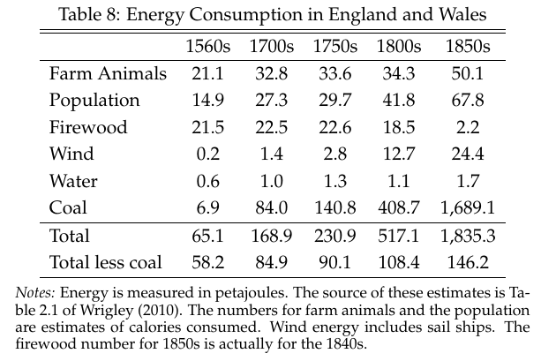
Ecological Bottleneck
Pre-industrial economy was very land intensive
Food land intensive
Energy land intensive
Feed for animals / Firewood
Energy necessary for growth
Land intensity of energy was a severe bottleneck
Steam Engine + fossil fuels cleared this bottleneck

Slide 39
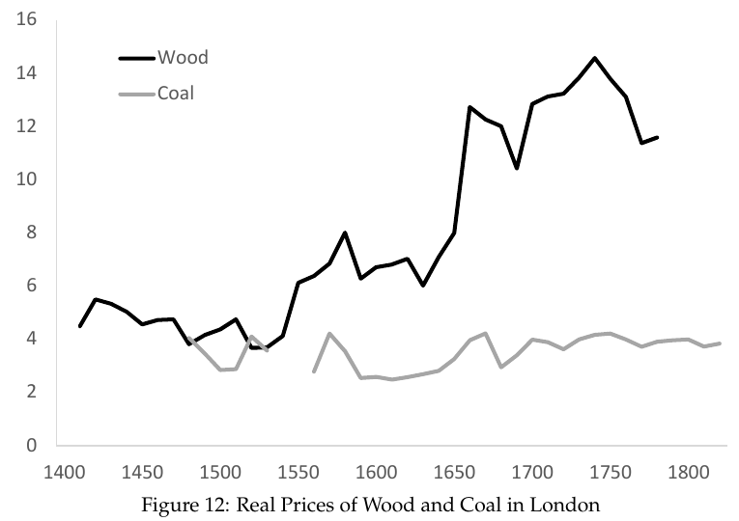
Why Was Steam Engine Invented in England?
Explosive growth of London led to “timber crisis”
Led to huge growth in coal industry to heat London houses
Large demand to drain coal mines
Strong incentive to invent engine that could help drain coal mines
First steam engine very inefficient. But coal was free at coal fields

Slide 40
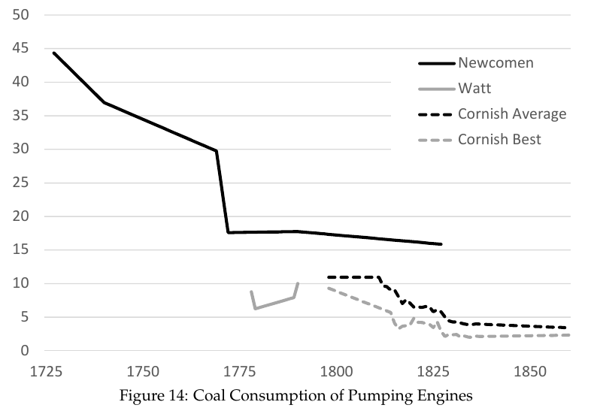
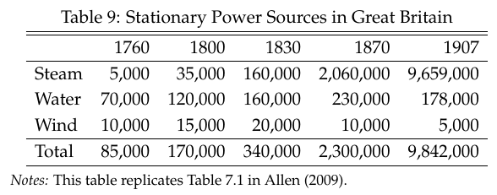
Gradual Improvement/Expansion of Steam Power

Slide 41
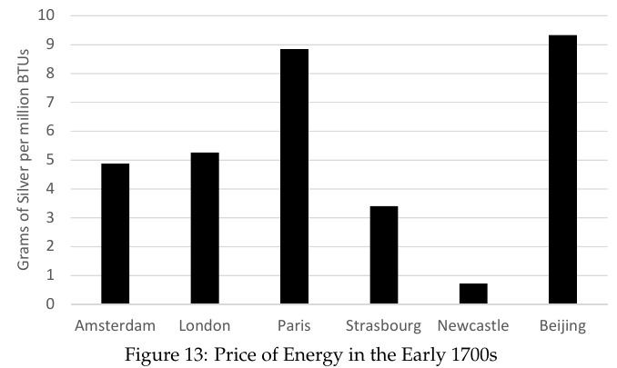
Aided by Low Cost of Energy in Northern England
Cost of energy was very low in Northern England due to coal industry
Huge difference versus other locations
No wonder industrialization occurred in Northern England (Manchester)

Slide 42
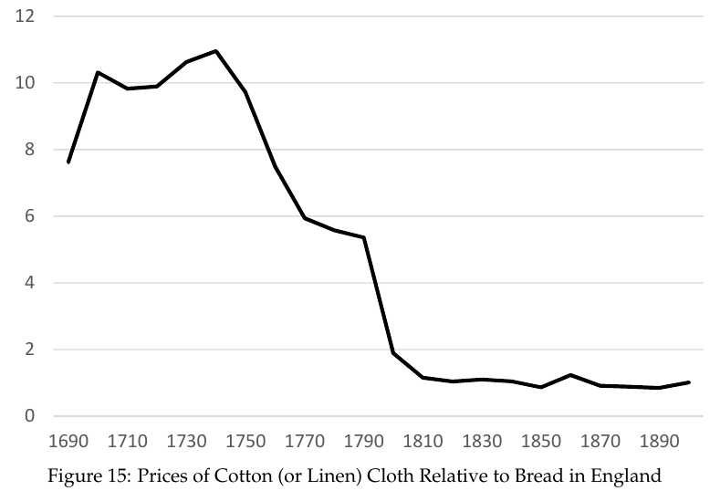
Cotton: The Marvel of the Industrial Revolution
British cotton industry grew by 2200% from 1770 to 1815
Productivity growth of 2.6% per year
25% of all productivity growth in British economy over this period
Resulted in massive fall in relative price of cotton cloth

Slide 43
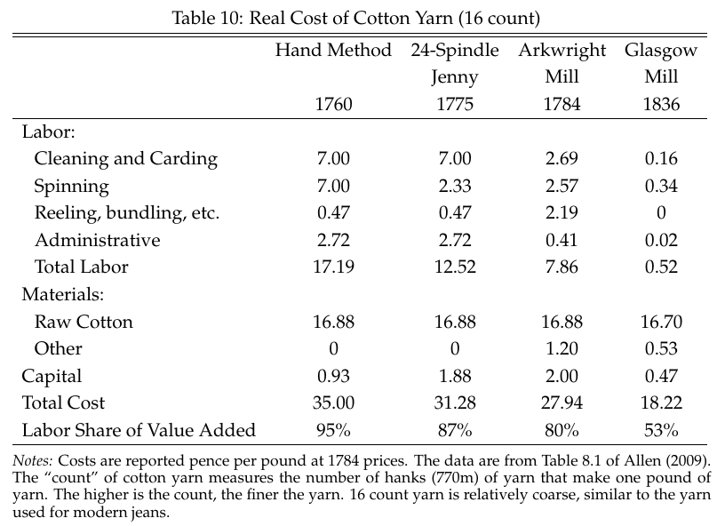
Miracle of Labor-Saving Technology
Cotton spinning was hugely labor intensive (labor share of value added: 95%)
High wages spurred labor-saving technical change
Labor share of value added fell to 53%
Incentive to mechanize much smaller in France/Italy

