Slide 1
Work and Leisure
Jón Steinsson
University of California, Berkeley

Slide 2
Work and Leisure
Choosing a job/career one of most important decisions we make
Politics: Jobs, jobs, jobs!!!
Unemployment extremely serious and frightening risk
But abstracting from unemployment, more work not always better
For many their job is a means to an end
Work takes time away from time you have to enjoy fruits of labor
Important choice: How much should we work?
We present a model to help us think about this question

Slide 3
Household Behavior
Our starting point: People act in a purposeful manner
How should we “model” purposeful choices by households (people)?
Rational choice model:
Assume that people have preferences over, e.g., goods and leisure
Represent preferences by a utility function
Assume that people maximize utility
Recognize that people are constrained by the resources they have at their disposal

Slide 4

Household Utility Function
Utility over consumption and hours worked:
$$U\left(C,H\right)$$
Very “broad brush” model of preferences
We ignore all the details associated with different types of job and goods, etc.

Slide 5
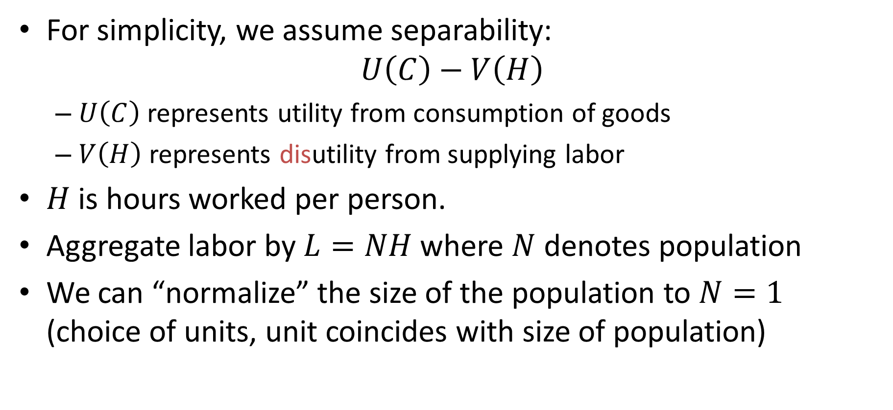
Household Utility Function
For simplicity, we assume separability:
$$U\left(C\right)−V\left(H\right)$$
$U\left(C\right)$ represents utility from consumption of goods
$V\left(H\right)$ represents disutility from supplying labor
$H$ is hours worked per person.
Aggregate labor by $L=NH$ where $N$ denotes population
We can “normalize” the size of the population to $N=1$ (choice of units, unit coincides with size of population)

Slide 6
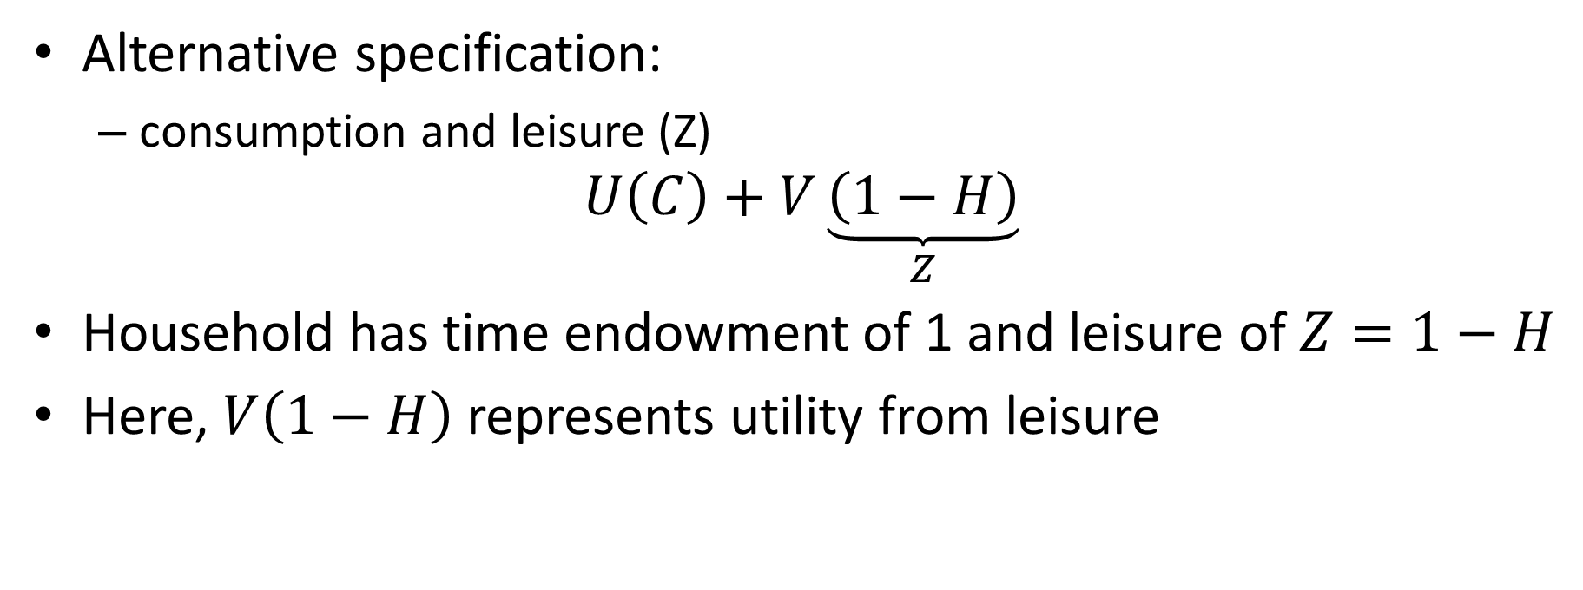
Household Utility Function
Alternative specification:
consumption and leisure (Z)
$$U\left(C\right)+V\underset{Z}{\underbrace{\left(1−H\right)}}$$
Household has time endowment of 1 and leisure of $Z=1−H$
Here, $V\left(1−H\right)$ represents utility from leisure

Slide 7
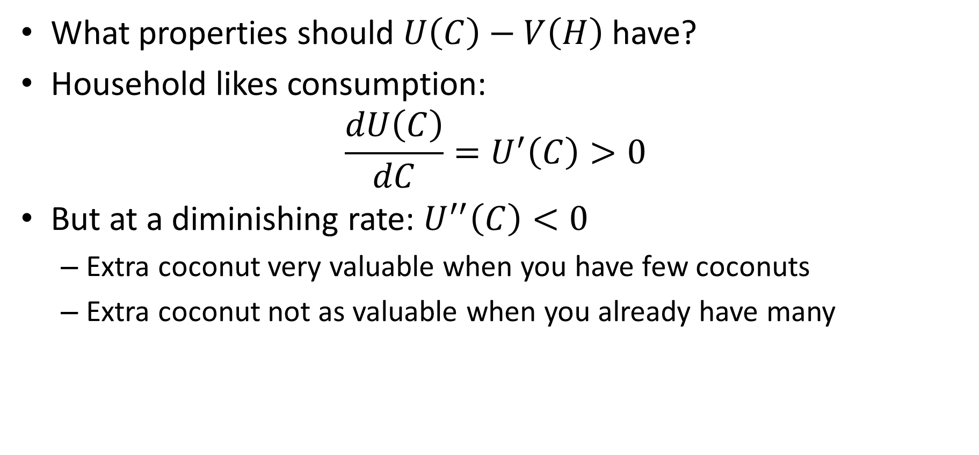
Household Utility Function
What properties should $U\left(C\right)−V\left(H\right)$ have?
Household likes consumption:
$$\frac{dU\left(C\right)}{dC}=U^{′}\left(C\right)>0$$
But at a diminishing rate: $U^{′′}\left(C\right)<0$
Extra coconut very valuable when you have few coconuts
Extra coconut not as valuable when you already have many

Slide 8
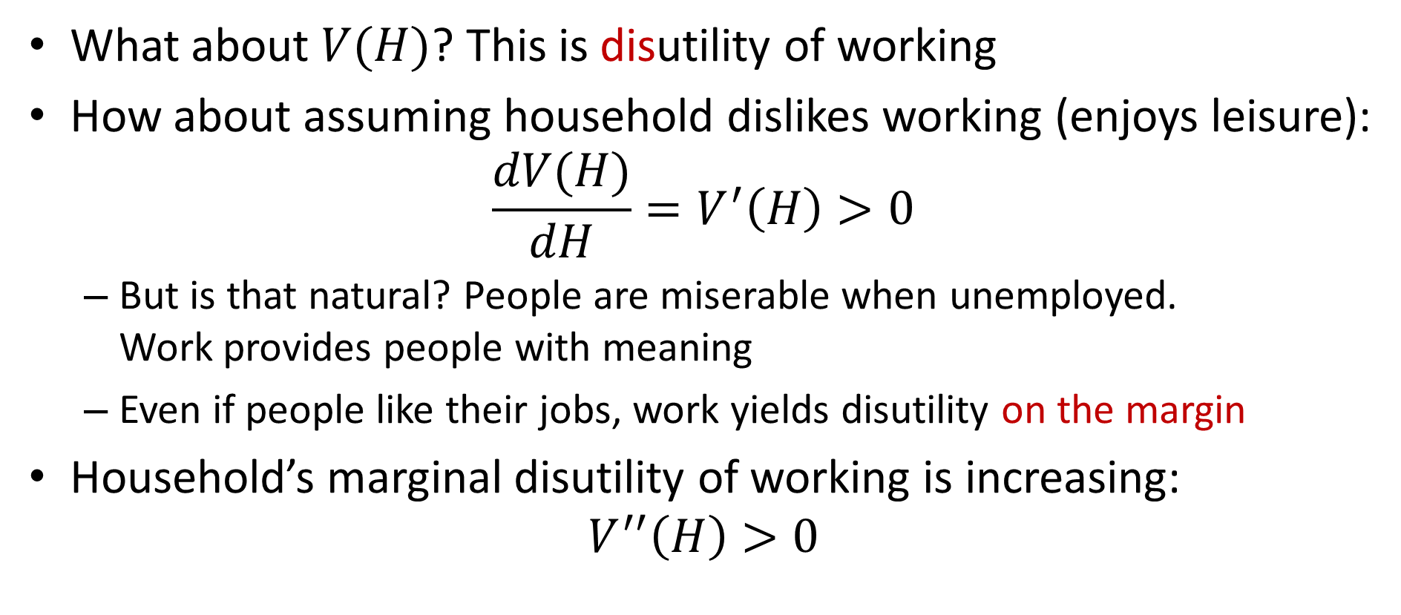
Household Utility Function
What about $V(H)$? This is disutility of working
How about assuming household dislikes working (enjoys leisure):
$$\frac{dV(H)}{dH}=V^{′}\left(H\right)>0$$
But is that natural? People are miserable when unemployed. Work provides people with meaning
Even if people like their jobs, work yields disutility on the margin
Household’s marginal disutility of working is increasing:
$$V^{′′}\left(H\right)>0$$

Slide 9
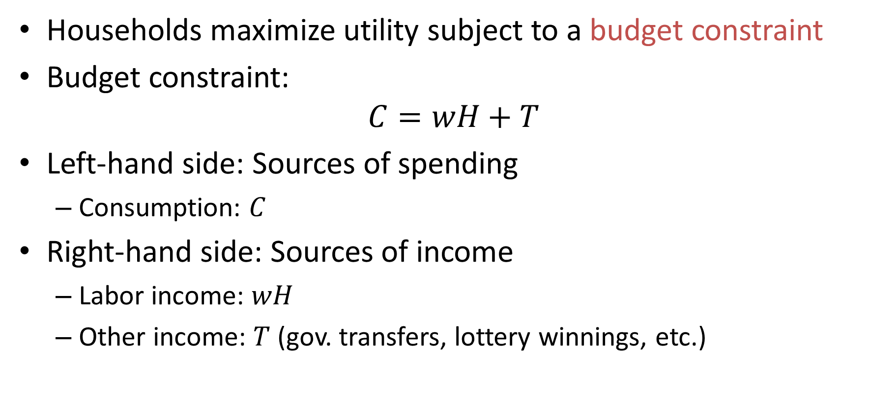
Household Budget Constraint
Households maximize utility subject to a budget constraint
Budget constraint:
$$C=wH+T$$
Left-hand side: Sources of spending
Consumption: $C$
Right-hand side: Sources of income
Labor income: $wH$
Other income: $T$ (gov. transfers, lottery winnings, etc.)

Slide 10
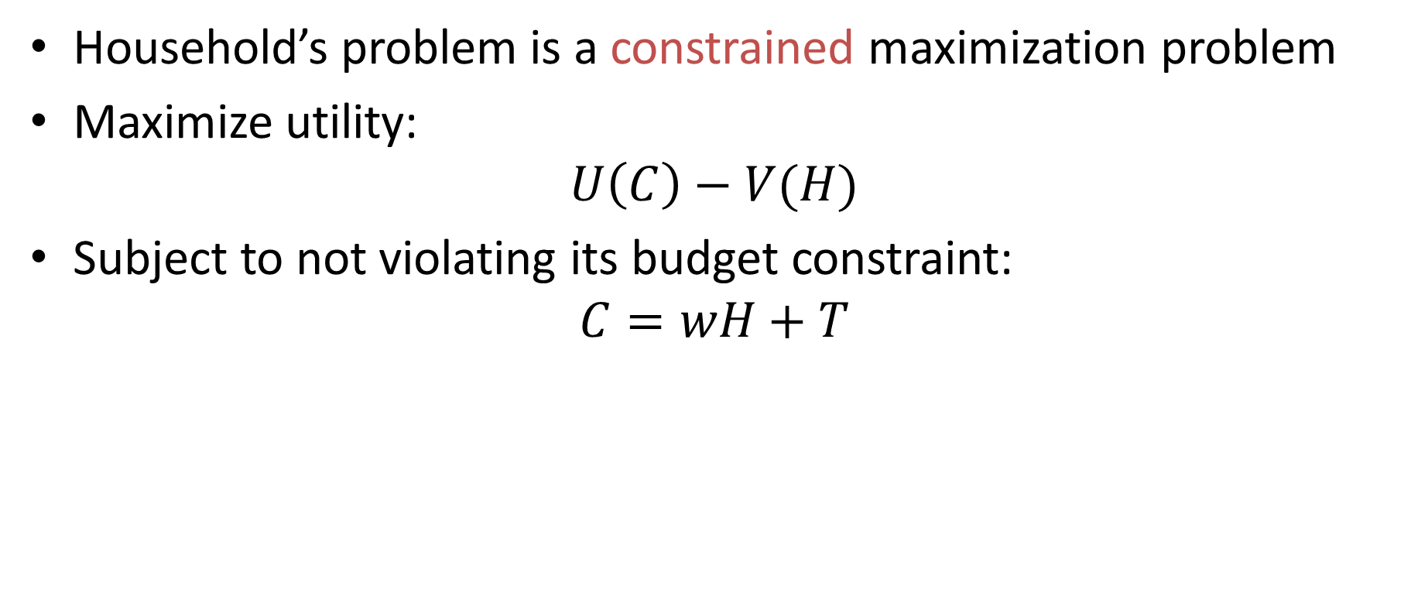
Household’s Problem
Household’s problem is a constrained maximization problem
Maximize utility:
$$U\left(C\right)−V(H)$$
Subject to not violating its budget constraint:
$$C=wH+T$$

Slide 11
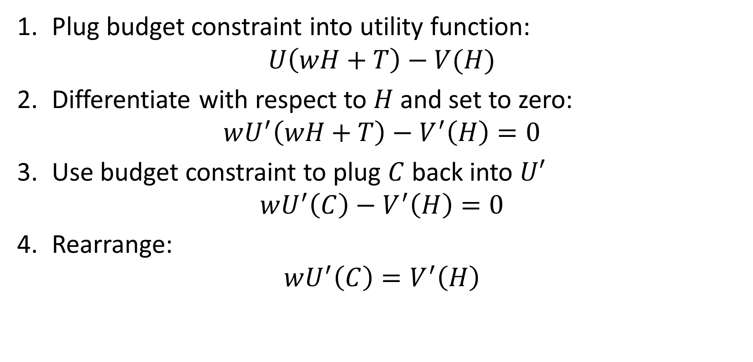
Household’s Problem: Plug and Chug
Plug budget constraint into utility function:
$$U\left(wH+T\right)−V(H)$$
Differentiate with respect to $H$ and set to zero:
$$wU^{′}\left(wH+T\right)−V^{′}\left(H\right)=0$$
Use budget constraint to plug $C$ back into $U′$
$$wU^{′}\left(C\right)−V^{′}\left(H\right)=0$$
Rearrange:
$$wU^{′}\left(C\right)=V^{′}\left(H\right)$$

Slide 12
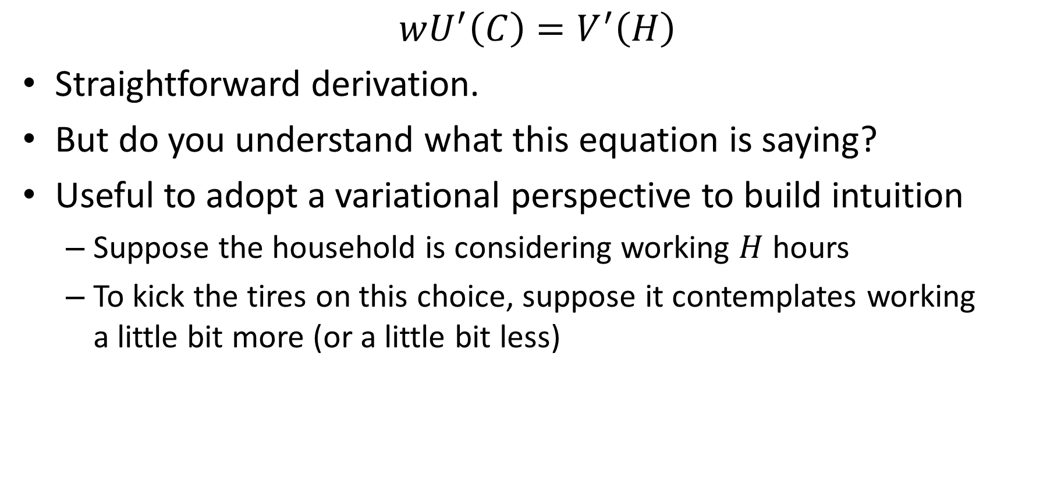
Labor-Leisure: Intuition
$$wU^{′}\left(C\right)=V^{′}\left(H\right)$$
Straightforward derivation.
But do you understand what this equation is saying?
Useful to adopt a variational perspective to build intuition
Suppose the household is considering working $H$ hours
To kick the tires on this choice, suppose it contemplates working a little bit more (or a little bit less)

Slide 13
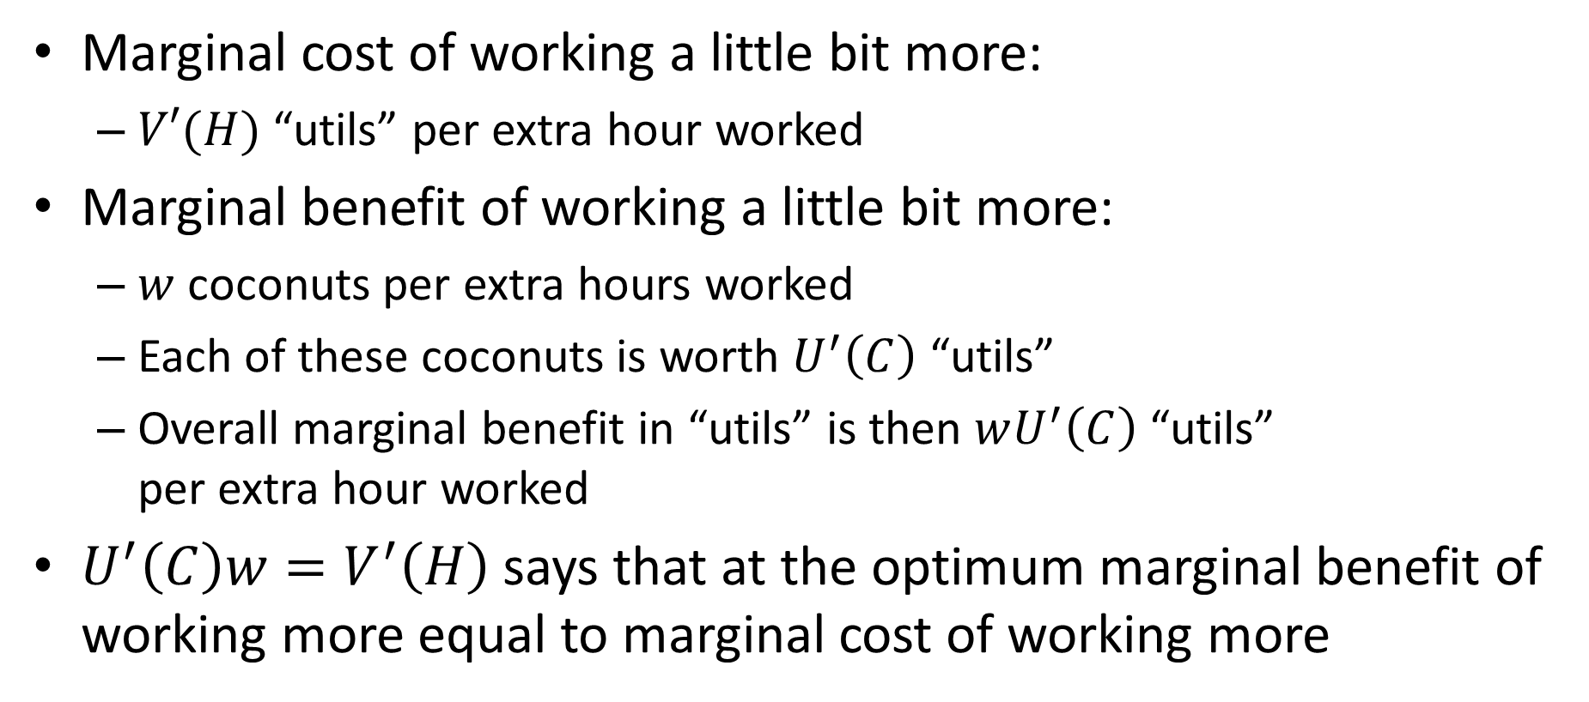
Labor-Leisure: Intuition
Marginal cost of working a little bit more:
$V′(H)$ “utils” per extra hour worked
Marginal benefit of working a little bit more:
$w$ coconuts per extra hours worked
Each of these coconuts is worth $U^{′}\left(C\right)$ “utils”
Overall marginal benefit in “utils” is then $wU^{′}\left(C\right)$ “utils” per extra hour worked
$U^{′}\left(C\right)w=V^{′}\left(H\right)$ says that at the optimum marginal benefit of working more equal to marginal cost of working more

Slide 14
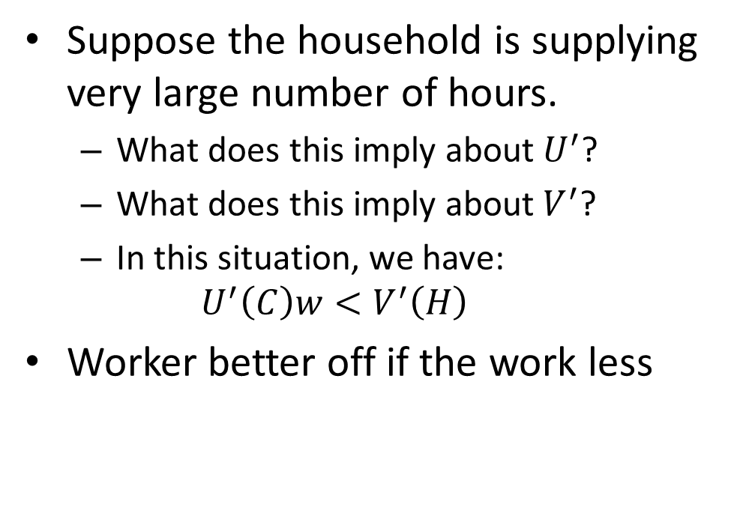
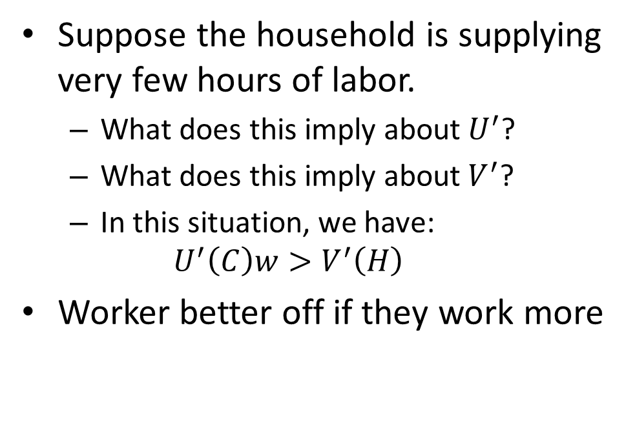
Labor-Leisure: Intuition
Suppose the household is supplying very few hours of labor.
What does this imply about $U^{′}$?
What does this imply about $V^{′}$?
In this situation, we have:
$$U^{′}\left(C\right)w>V^{′}\left(H\right)$$
Worker better off if they work more
Suppose the household is supplying very large number of hours.
What does this imply about $U^{′}$?
What does this imply about $V^{′}$?
In this situation, we have:
$$U^{′}\left(C\right)w<V^{′}\left(H\right)$$
Worker better off if the work less

Slide 15
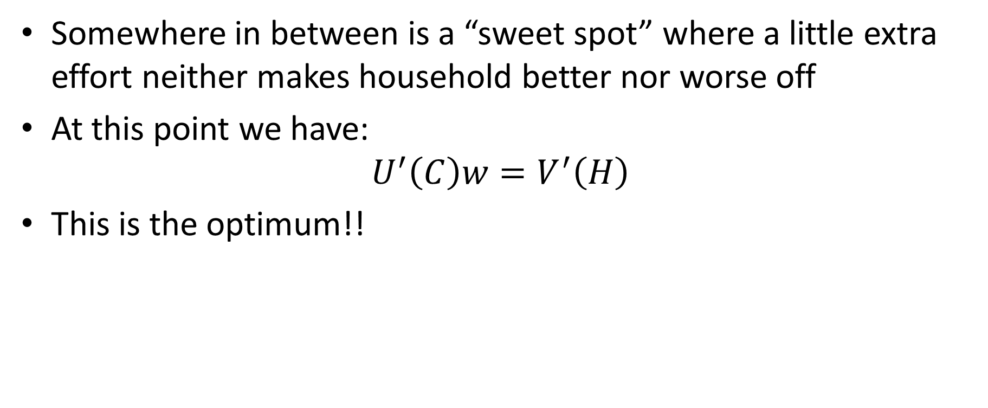
Labor-Leisure: Intuition
Somewhere in between is a “sweet spot” where a little extra effort neither makes household better nor worse off
At this point we have:
$$U^{′}\left(C\right)w=V^{′}\left(H\right)$$
This is the optimum!!

Slide 16
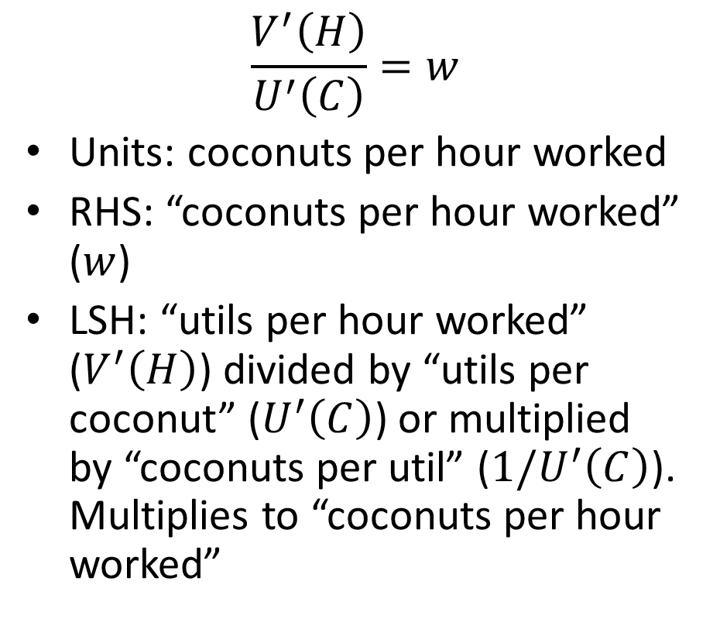
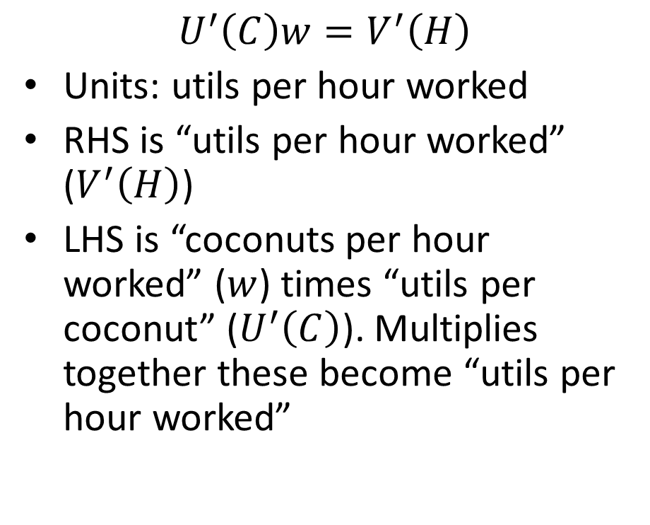
Units: Utils versus Coconuts
$$U^{′}\left(C\right)w=V^{′}\left(H\right)$$
Units: utils per hour worked
RHS is “utils per hour worked” ($V^{′}\left(H\right)$)
LHS is “coconuts per hour worked” ($w$) times “utils per coconut” ($U^{′}\left(C\right)$). Multiplies together these become “utils per hour worked”
$$\frac{V^{′}\left(H\right)}{U^{′}\left(C\right)}=w$$
Units: coconuts per hour worked
RHS: “coconuts per hour worked” ($w$)
LSH: “utils per hour worked” ($V^{′}\left(H\right)$) divided by “utils per coconut” ($U^{′}\left(C\right)$) or multiplied by “coconuts per util” ($1/U^{′}\left(C\right)$). Multiplies to “coconuts per hour worked”

Slide 17
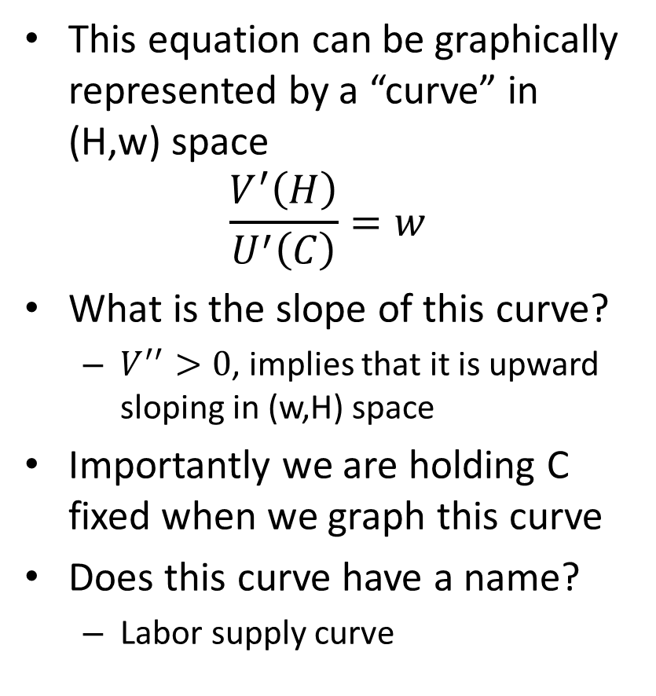
Household’s Problem
This equation can be graphically represented by a “curve” in (H,w) space
$$\frac{V^{′}\left(H\right)}{U^{′}\left(C\right)}=w$$
What is the slope of this curve?
$V^{′′}>0$, implies that it is upward sloping in (w,H) space
Importantly we are holding C fixed when we graph this curve
Does this curve have a name?
Labor supply curve
Real wage, w
L^{s}
Hours, H

Slide 18
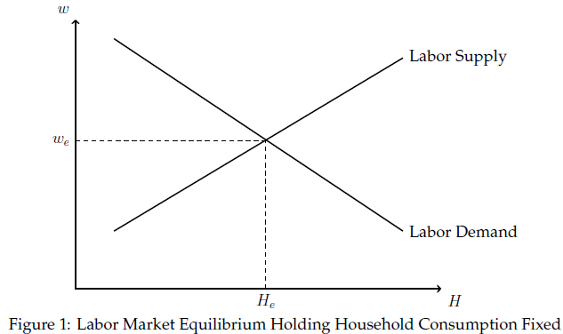
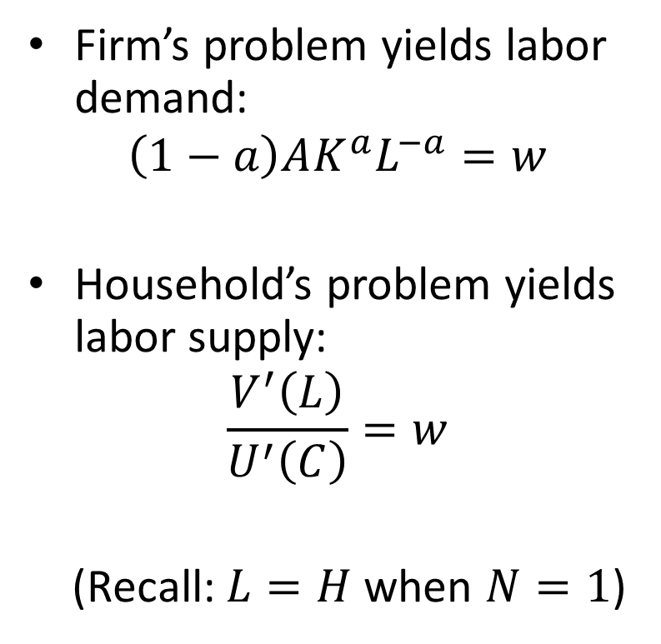
Labor Market Equilibrium
Firm’s problem yields labor demand:
$$\left(1−a\right)AK^{a}L^{−a}=w$$
Household’s problem yields labor supply:
$$\frac{V^{′}\left(L\right)}{U^{′}\left(C\right)}=w$$
(Recall: $L=H$ when $N=1$)

Slide 19
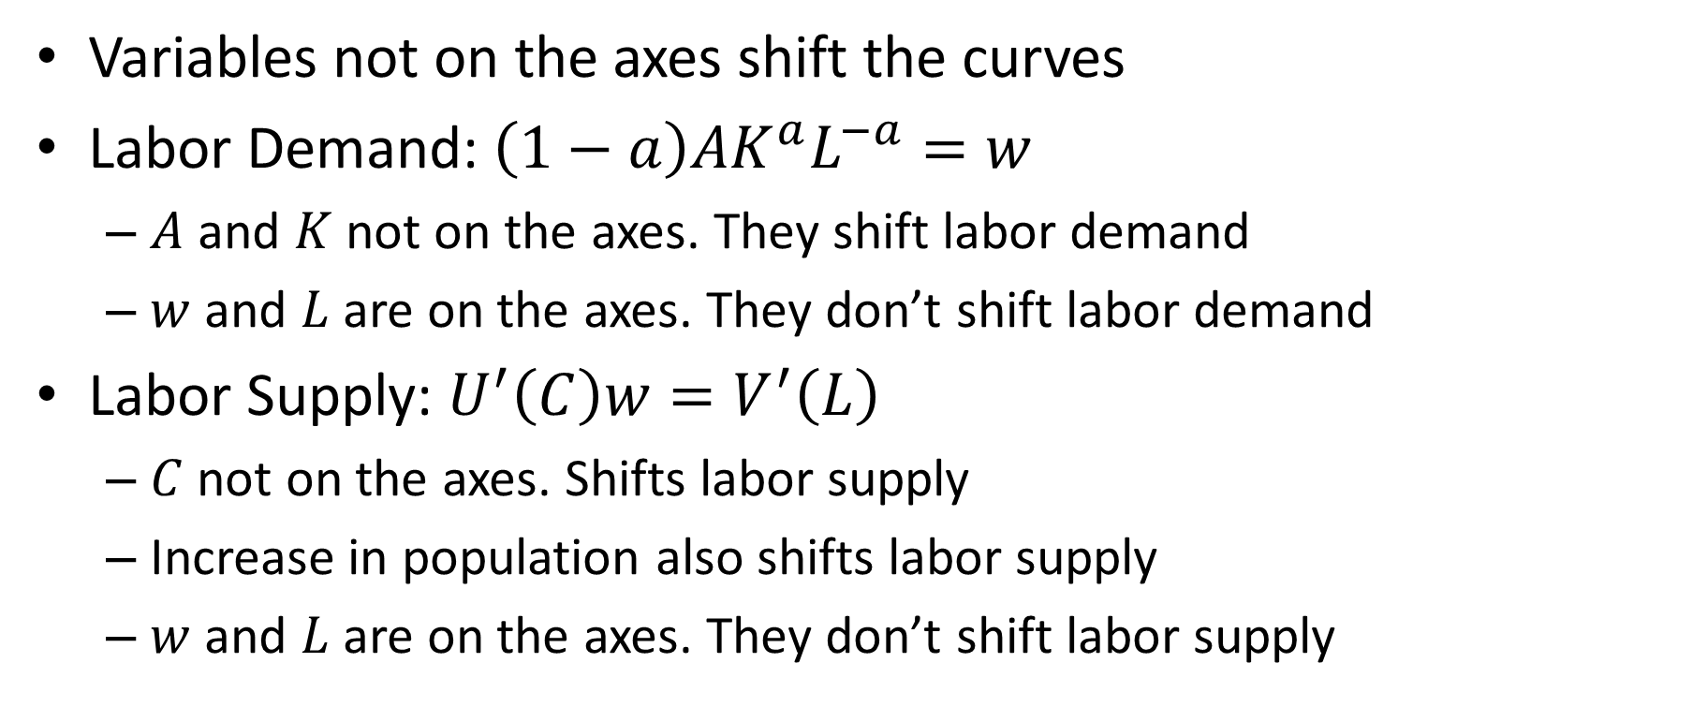
What Shifts Labor Demand and Labor Supply
Variables not on the axes shift the curves
Labor Demand: $\left(1−a\right)AK^{a}L^{−a}=w$
$A$ and $K$ not on the axes. They shift labor demand
$w$ and $L$ are on the axes. They don’t shift labor demand
Labor Supply: $U^{′}\left(C\right)w=V^{′}\left(L\right)$
$C$ not on the axes. Shifts labor supply
Increase in population also shifts labor supply
$w$ and $L$ are on the axes. They don’t shift labor supply

Slide 20
Temporary versus Permanent Wage Changes
Suppose your wage was temporarily high for one week.
How would this affect your labor supply?
Now, suppose your wage was permanently higher
How would this affect your labor supply?

Slide 21
Effect of Wage Increase on Labor Supply
Substitution effect:
Working more lucrative
Leisure more “expensive”
Wage is opportunity cost of leisure
Households substitute towards lucrative activities and away from expensive activities
Work more
Income effect:
Higher wage means worker is richer
Richer workers chooses more consumption and more leisure
Leisure is a “normal” good (you buy more of it the richer you are)
More leisure means less work
Work less

Slide 22
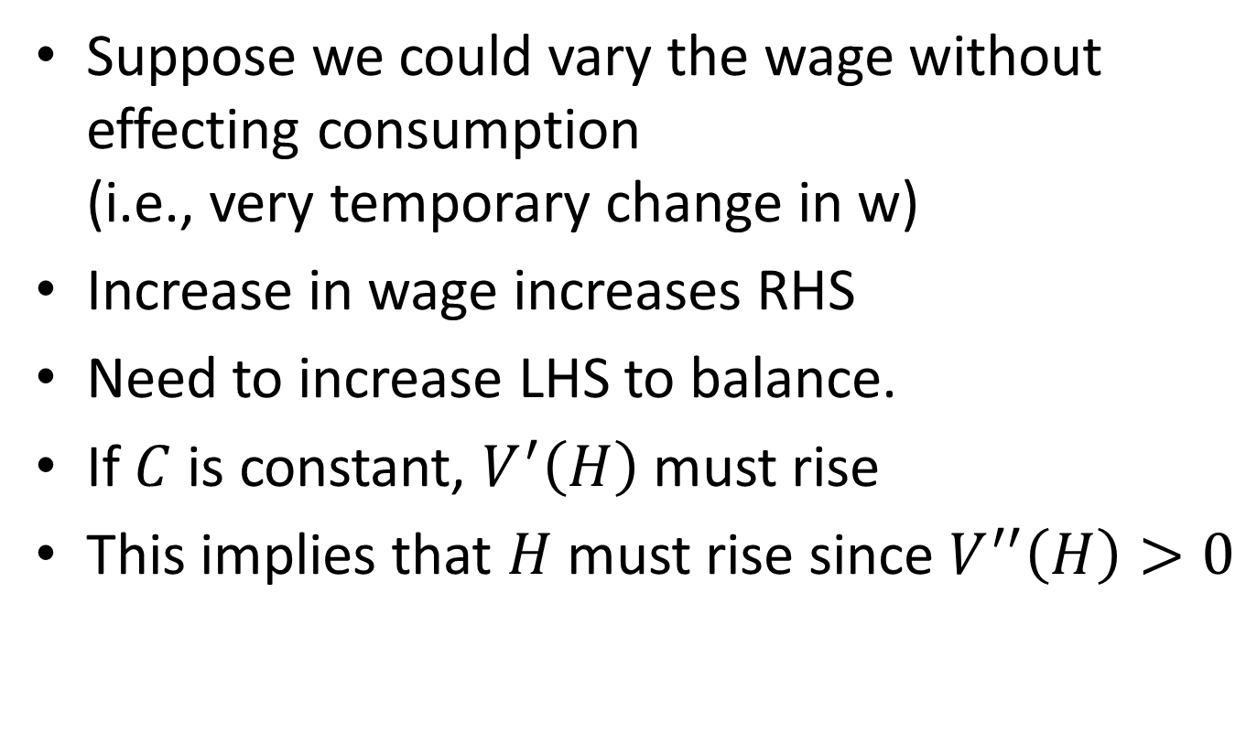
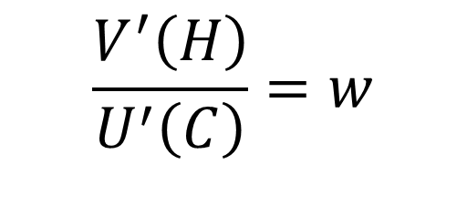
Substitution Effect
Suppose we could vary the wage without effecting consumption (i.e., very temporary change in w)
Increase in wage increases RHS
Need to increase LHS to balance.
If $C$ is constant, $V^{′}\left(H\right)$ must rise
This implies that $H$ must rise since $V^{′′}\left(H\right)>0$
$$\frac{V^{′}\left(H\right)}{U^{′}\left(C\right)}=w$$

Slide 23

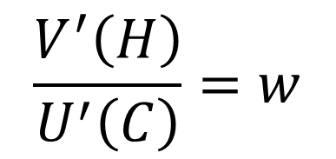
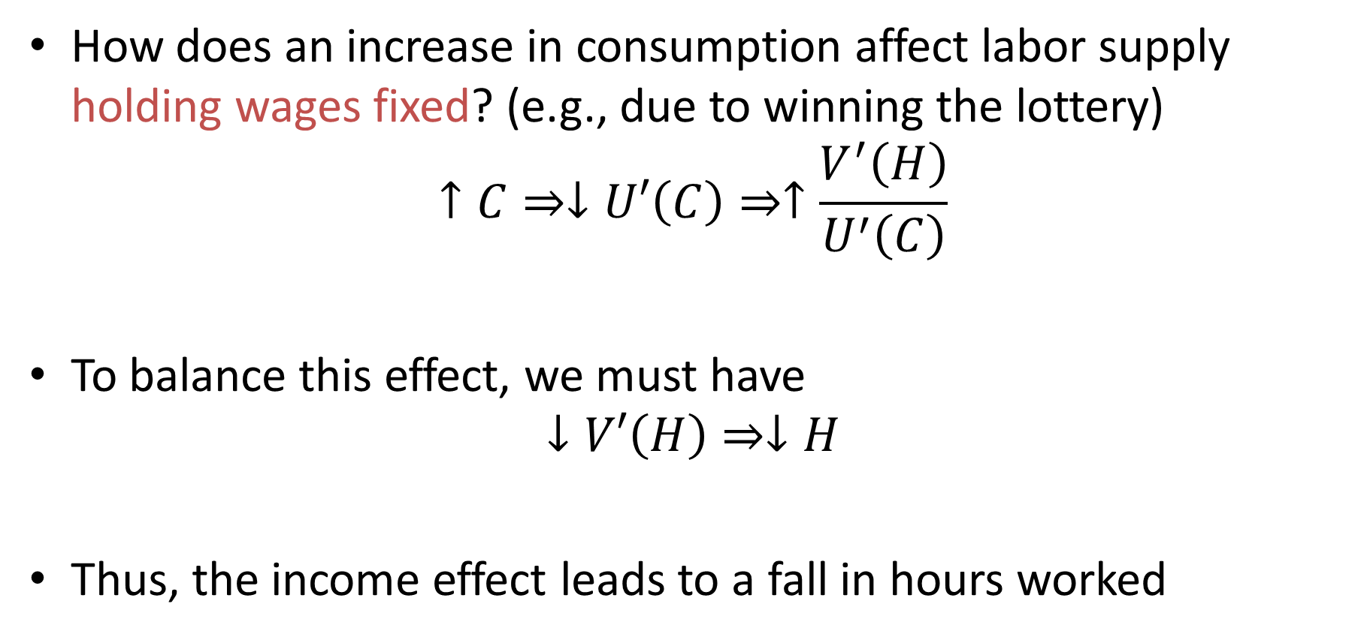

Income Effect
How does an increase in consumption affect labor supply holding wages fixed? (e.g., due to winning the lottery)
$$↑C⇒↓U′\left(C\right)⇒↑\frac{V^{′}\left(H\right)}{U^{′}\left(C\right)}$$
To balance this effect, we must have
$$↓V′\left(H\right)⇒↓H$$
Thus, the income effect leads to a fall in hours worked
$$U^{′′}\left(C\right)<0$$
$$\frac{V^{′}\left(H\right)}{U^{′}\left(C\right)}=w$$
$$V^{′′}\left(H\right)>0$$

Slide 24
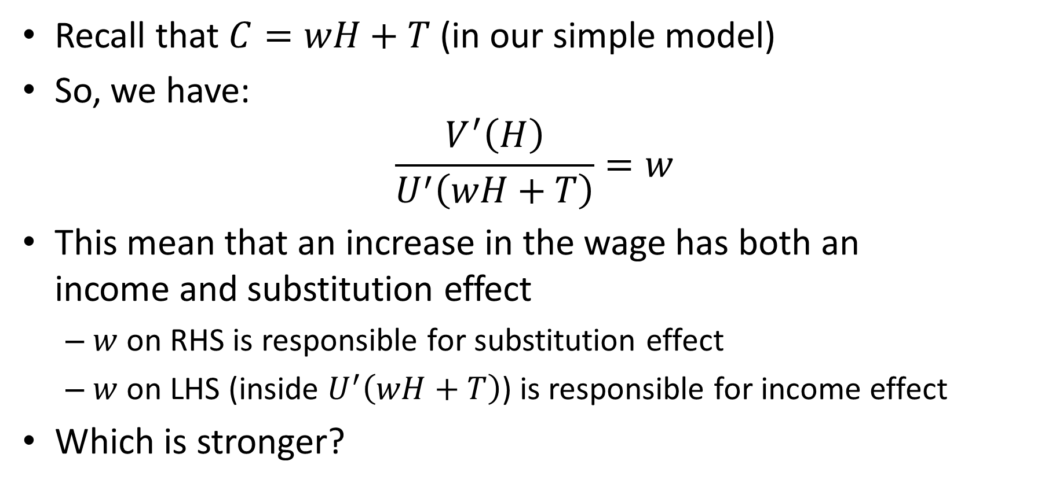
Increase in the Wage
Recall that $C=wH+T$ (in our simple model)
So, we have:
$$\frac{V^{′}\left(H\right)}{U^{′}\left(wH+T\right)}=w$$
This mean that an increase in the wage has both an income and substitution effect
$w$ on RHS is responsible for substitution effect
$w$ on LHS (inside $U^{′}\left(wH+T\right)$) is responsible for income effect
Which is stronger?

Slide 25
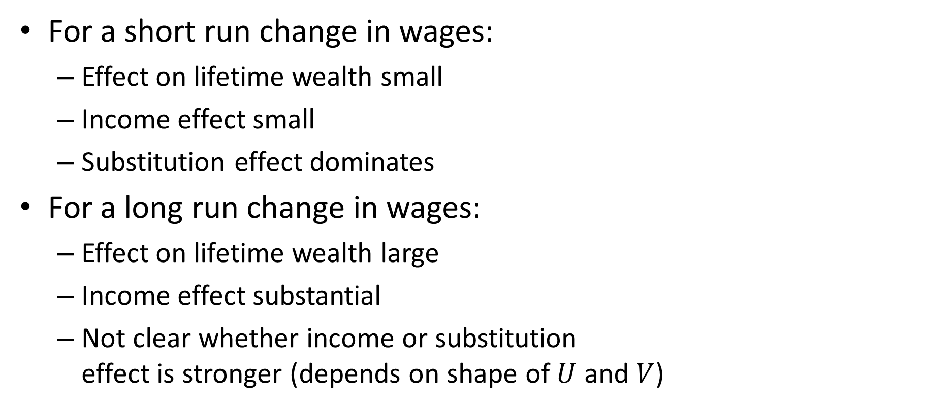
Short Run versus Long Run
For a short run change in wages:
Effect on lifetime wealth small
Income effect small
Substitution effect dominates
For a long run change in wages:
Effect on lifetime wealth large
Income effect substantial
Not clear whether income or substitution effect is stronger (depends on shape of $U$ and $V$)

Slide 26
Labor Supply in Practice?
Two first order facts:
Real wages have risen by roughly 1.5% per year for over 100 years (real wages adjust for changes in prices)
Hours worked per worker in the U.S. have declined gradually

Slide 27
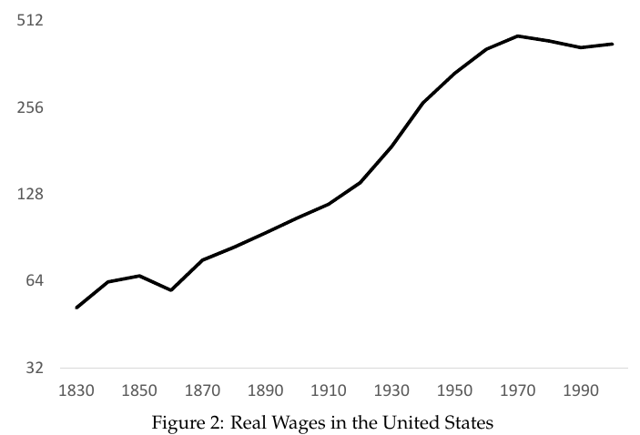
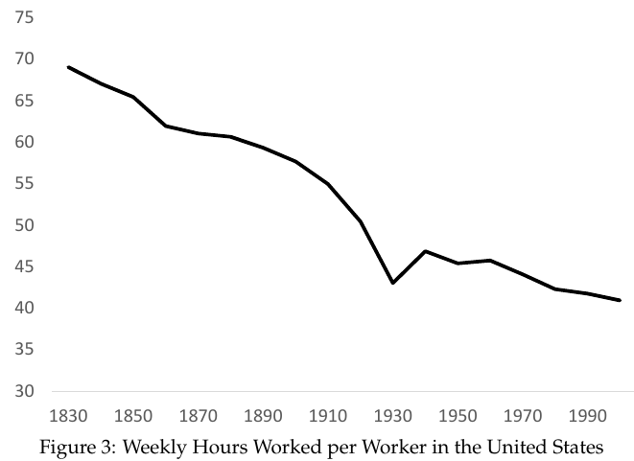
Real Wages and Hours Worked per Worker
Over 800% cumulative increase.
Roughly 50% cumulative decrease.

Slide 28
Labor Supply in Practice?
What do these figures imply about relative size of income and substitutions effects in the long run?
Income effect slightly larger than substitution
Common to ignore income effects and assume wage increases will increase labor supply (e.g., tax cuts)
But income effects are large over the long run!!

Slide 29
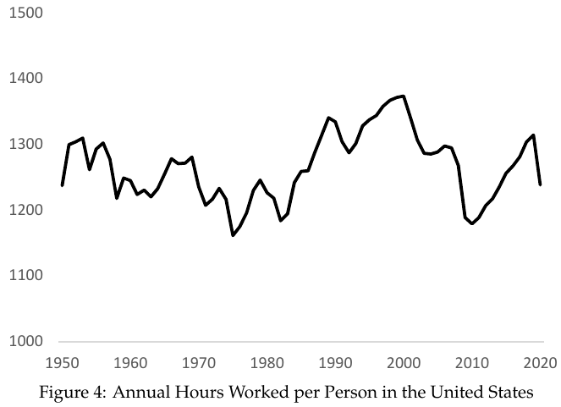
Hours Worked Per Person
Hours worked per worker have fallen
But hours worked per person have not
Why might this be?

Slide 30
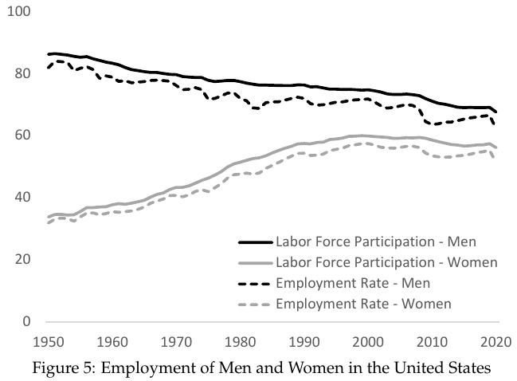
Gender Revolution
Labor force participation rate of men fallen steadily
Labor force participation rate of women rose rapidly in 2nd half of 20th century
Changing cultural normal, less discrimination led women to enter labor force
One-time shock that obscured underlying downward trend

Slide 31
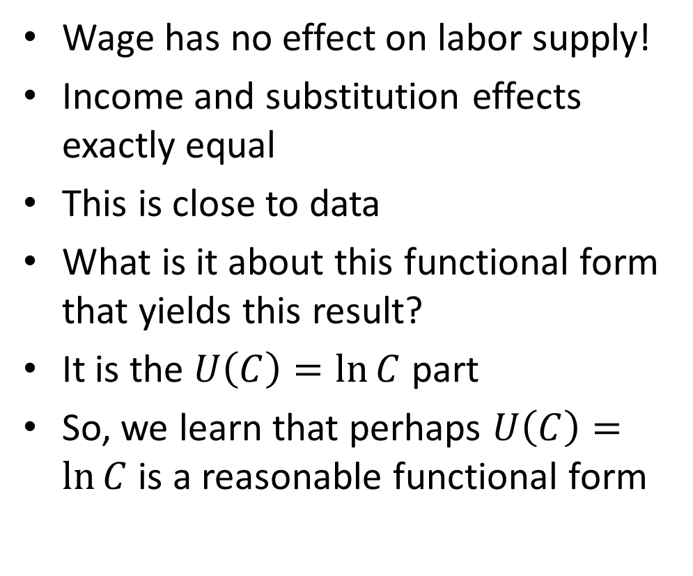
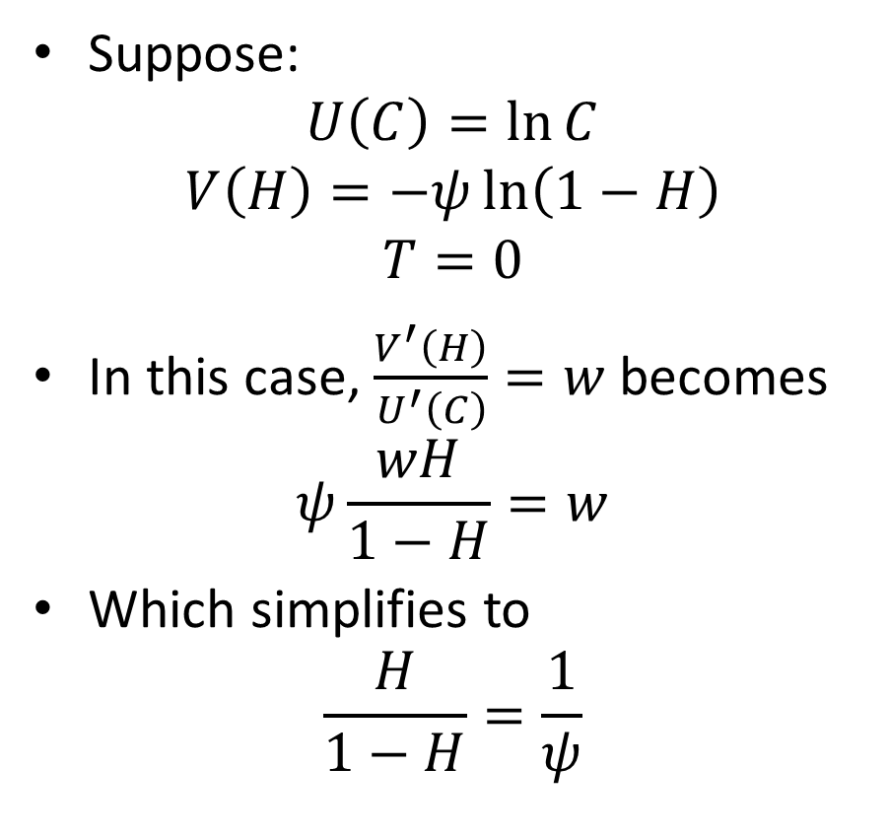
What Do We Learn about Utility Function?
Suppose:
$$U\left(C\right)=\ln{C}$$
$$V\left(H\right)=−ψ\ln\left(1−H\right)$$
$$T=0$$
In this case, $\frac{V^{′}\left(H\right)}{U^{′}\left(C\right)}=w$ becomes
$$ψ\frac{wH}{1−H}=w$$
Which simplifies to
$$\frac{H}{1−H}=\frac{1}{ψ}$$
Wage has no effect on labor supply!
Income and substitution effects exactly equal
This is close to data
What is it about this functional form that yields this result?
It is the $U\left(C\right)=\ln{C}$ part
So, we learn that perhaps $U\left(C\right)=\ln{C}$ is a reasonable functional form

Slide 32
Keynes and Income Effect
What did Keynes think about the relative strength of the income effect and the substitution effect?
Economic Possibilities for Our Grandchildren written in 1930
“Suppose that a hundred years hence we are all of us, on the average, eight times better off in the economic sense than we are to-day.” (i.e., 2% annual growth)

Slide 33
Keynes and Income Effect
Income effect dominant in the long run:
“Absolute needs … satisfied”
“prefer to devote our further energies to non-economic purposes” (leisure)
Main worry “general ‘nervous breakdown’”
“need to do some work … to be contented”
“Three-hour shifts or a fifteen hour week”
Clearly, Keynes overestimated the strength of the income effect

Slide 34
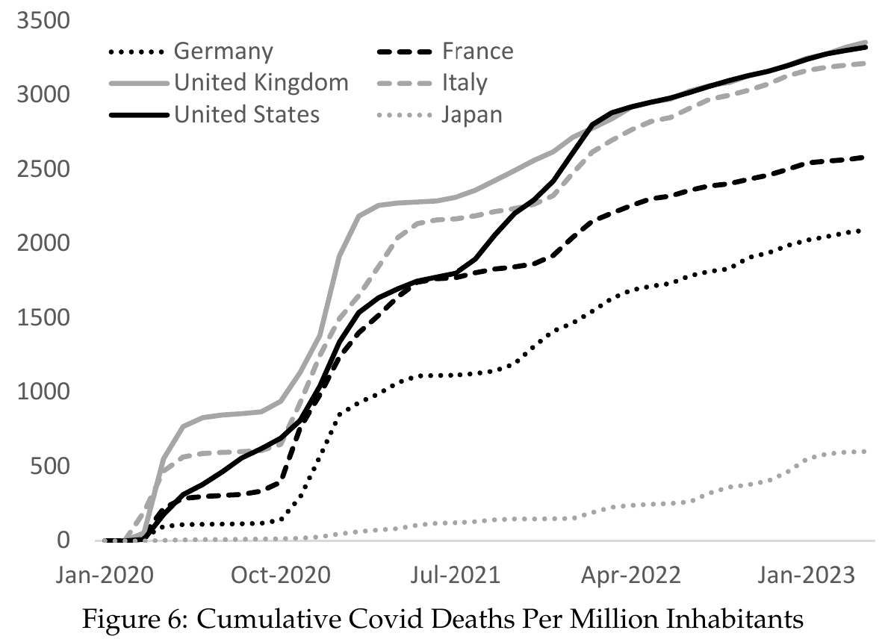
Covid Recession
Causes of most recession complex and hotly debated
Not so for 2020 recession
Caused by Covid-19 virus
Widespread lockdowns in 2020
Huge uncertainty about virality and morbidity
Killed millions over several years

Slide 35
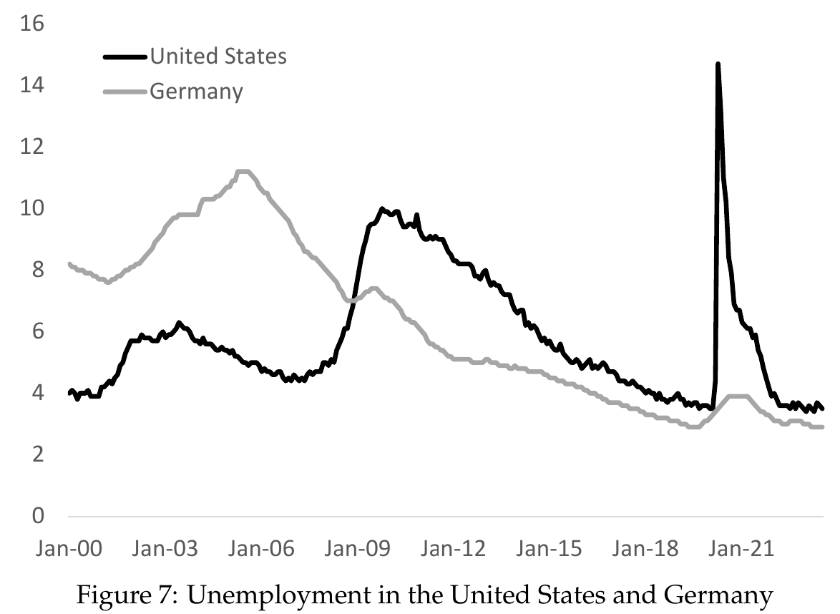
Covid Recession
Very sharp recession in spring of 2020
Rapid recovery
US: High unemployment
Germany: Kurzarbeit
More on policy response below

Slide 36
Modelling Covid Recession
Why did economic activity fall during Covid?
Virus causes people to want to limit contact so as to limit spread and risk of infection
Specifically:
People want to limit consumption that involves contact (shopping, restaurants, travel, concerts, sports events, etc.)
People don’t want to go to workplaces that involve contact

Slide 37
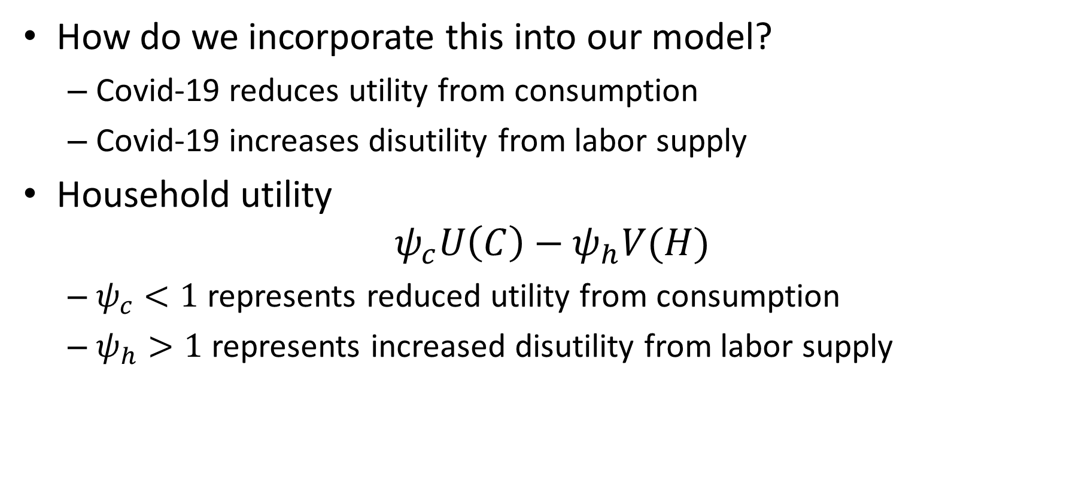
Modelling Covid Recession
How do we incorporate this into our model?
Covid-19 reduces utility from consumption
Covid-19 increases disutility from labor supply
Household utility
$$ψ_{c}U\left(C\right)−ψ_{h}V(H)$$
$ψ_{c}<1$ represents reduced utility from consumption
$ψ_{h}>1$ represents increased disutility from labor supply

Slide 38

Household‘s Problem with Covid
Maximize
$$ψ_{c}U\left(C\right)−ψ_{h}V(H)$$
Subject to
$$C=wH+T$$
Same steps as before yield:
$$\frac{ψ_{h}}{ψ_{c}}\frac{V′\left(H\right)}{U′\left(C\right)}=w$$

Slide 39
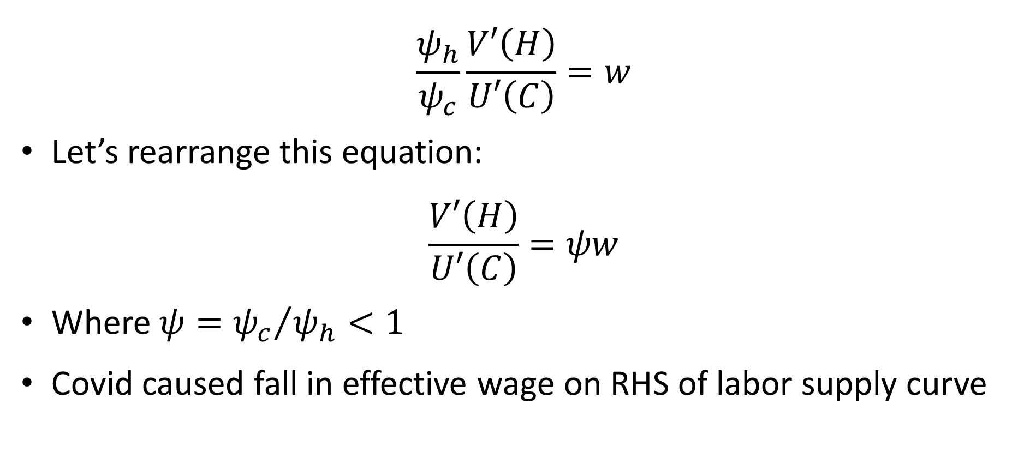
Household’s Problem with Covid
$$\frac{ψ_{h}}{ψ_{c}}\frac{V′\left(H\right)}{U′\left(C\right)}=w$$
Let’s rearrange this equation:
$$\frac{V′\left(H\right)}{U′\left(C\right)}=ψw$$
Where $ψ={ψ_{c}}/{ψ_{h}<1}$
Covid caused fall in effective wage on RHS of labor supply curve

Slide 40
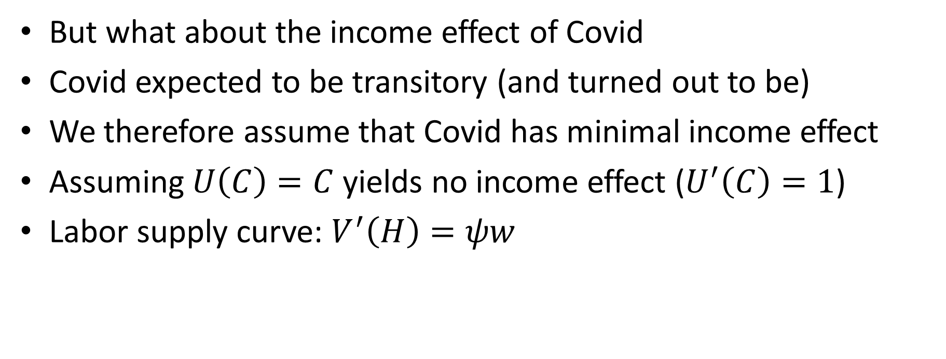
Covid and Income Effects
But what about the income effect of Covid
Covid expected to be transitory (and turned out to be)
We therefore assume that Covid has minimal income effect
Assuming $U\left(C\right)=C$ yields no income effect ($U^{′}\left(C\right)=1$)
Labor supply curve: $V^{′}\left(H\right)=ψw$

Slide 41
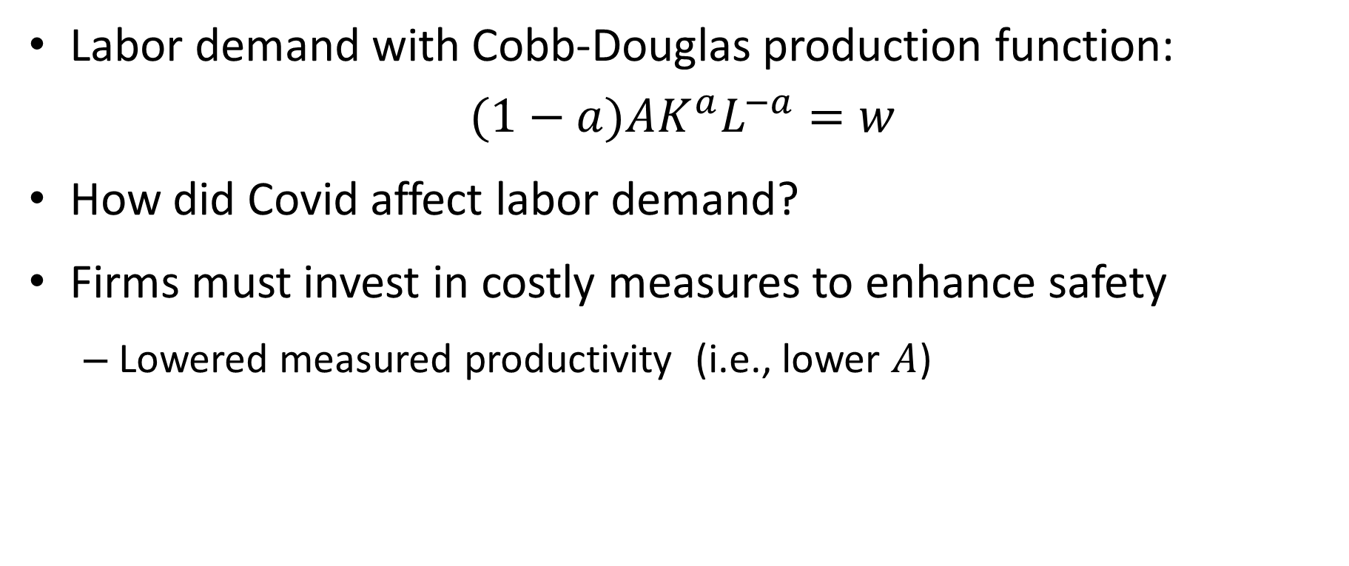
Covid and Labor Demand
Labor demand with Cobb-Douglas production function:
$$(1−a)AK^{a}L^{−a}=w$$
How did Covid affect labor demand?
Firms must invest in costly measures to enhance safety
Lowered measured productivity (i.e., lower $A$)

Slide 42
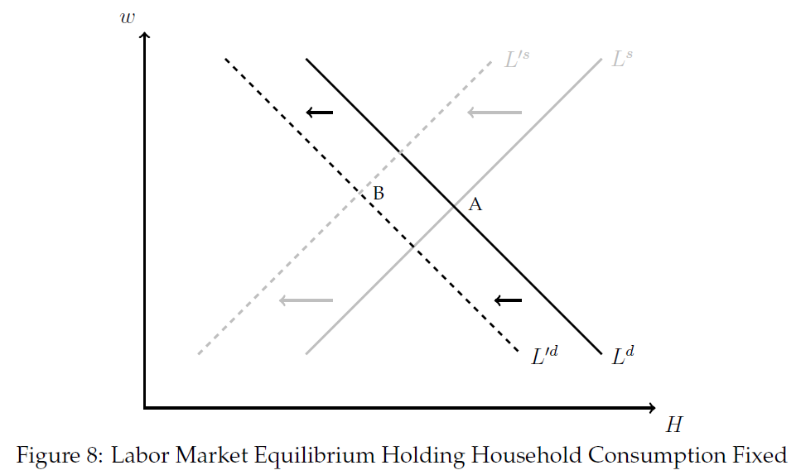
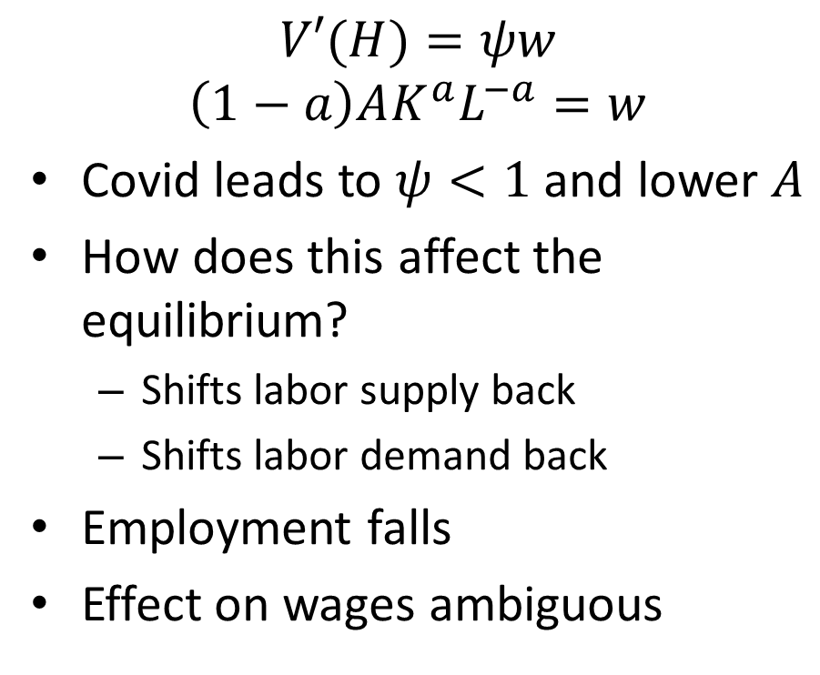
Effects of Covid-19 on Labor Market
$$V′(H)=ψw$$
$$\left(1−a\right)AK^{a}L^{−a}=w$$
Covid leads to $ψ<1$ and lower $A$
How does this affect the equilibrium?
Shifts labor supply back
Shifts labor demand back
Employment falls
Effect on wages ambiguous

Slide 43
Policy Response to Covid
Policy response not at all straightforward
‘Fog of war’ due to uncertainty about virality and morbidity
Strong policy response along many dimensions:
Public health interventions
Income support policies
Monetary policy

Slide 44
Public Health Interventions
Public health interventions:
Lockdowns, school closures, mask mandates, social distancing, public announcements
Vaccine development
Crucial distinction:
Suppression
Mitigation
Suppression not viable (outside China)
What is the point of mitigation?
Two rationales for mitigation:
“Flatten the curve” to avoid overwhelming health care system
Buy time to develop vaccines
Operation Warp Speed
Vaccines available by Dec 2020
Saved 800,000 lives in US alone

Slide 45
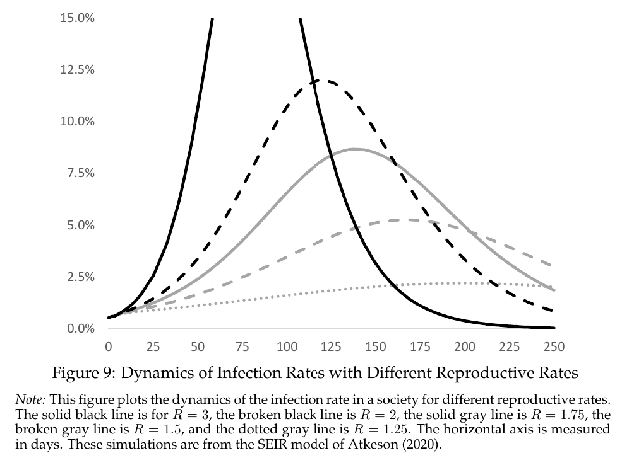
Flatten the Curve
Base reproductive rate: 2-3
Generation time: 1 week
Absent mitigation policies or behavioral responses, growth rate of 140% per week
Lower reproductive rate “flattens the curve”

Slide 46
Public Health Interventions
Lockdowns etc. have high costs
Severe encroachment on civil liberties
Very broad brush: prevents high benefit/low cost activities
Why can’t people choose freely what is best for them?
Most natural justification: externalities
People bear cost of own infections (except medical costs)
But they don’t bear cost of other people’s infections
People will therefore socialize more than is optimal

Slide 47
Covid Recession vs. Most Recessions
Most recessions:
Output inefficiently low
Major goal of policy to stimulate economy
Covid recession:
Efficient level of output low
People wanted to socially distance due to health threat
Recession by design
Goal of policy NOT to stimulate economy

Slide 48
Goal of Policy in Covid Recession
So, what was the goal of policy in Covid recession?
Some sectors hit hard by Covid (contact intensive sectors)
Other sectors less affected or even benefited
Goal of policy: Insurance
People did not have insurance against Covid shock
Government could transfer funds to those hard hit from those less affected (including future generations)

Slide 49
Fiscal Relief Policies
Fiscal relief payments:
Three rounds (Mar 2020: $1200 per adult/$500 per child, Dec 2020: $600 per adult and child, Mar 2021: $1400 per adult and child)
Total for family of four: $11,400
Payment Protection Program:
Forgivable loans to small businesses that maintained employment
Total of about $1.5 trillion (7% of GDP)
Easy to implement, but poorly targeted

Slide 50
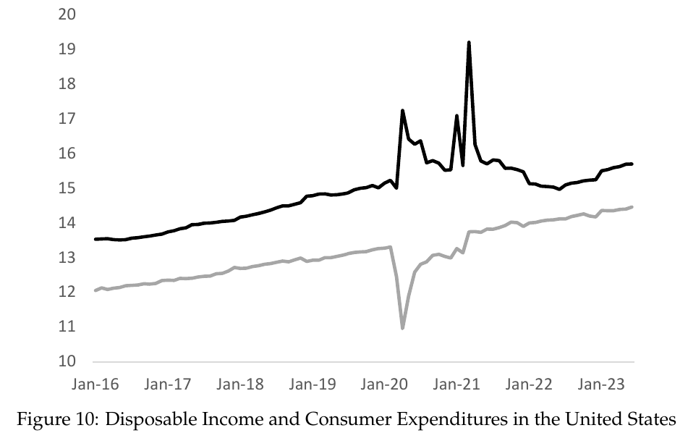
Buildup of Savings
Americans built up large amounts of savings during Covid
Spent less and received large transfers from government
Probably aided fast recovery
May have contributed to high inflation in 2021-2023

Slide 51
Forbearance Policy
Government mandated mortgage forbearance by banks
Borrowers could delay payment for up to 18 months
Government provided forbearance on student loans (and 0% interest rates)
Some states issued eviction moratoria for renters
People allowed to withdraw from 401(k) and IRA accounts without penalty

Slide 52
Extended Unemployment Insurance
Normal UI: 26 weeks at roughly 50% replacement rate
Extended Benefits Program: 39 weeks during recessions
Plus special extensions during each recession since 1973 (up to 99 weeks after Great Recession)
Covid UI Extensions:
Up to 79 weeks.
Expanded scope (self-employed, contract and gig workers)
$600 extra (massively raised replacement rate)

Slide 53
Controversy about UI Extensions
Benefits:
Provide quite targeted insurance to those that lose jobs
Provide fiscal stimulus
Costs:
Reduce incentives of unemployed to seek work
Potentially prolong recessions
How larger are costs?
Hard to figure out empirically
UI is extended because unemployment is high
Serious “reverse causality problem”
Acosta et al. (2023): 13 week extension raises unemployment by 0.3 p.p.

Slide 54
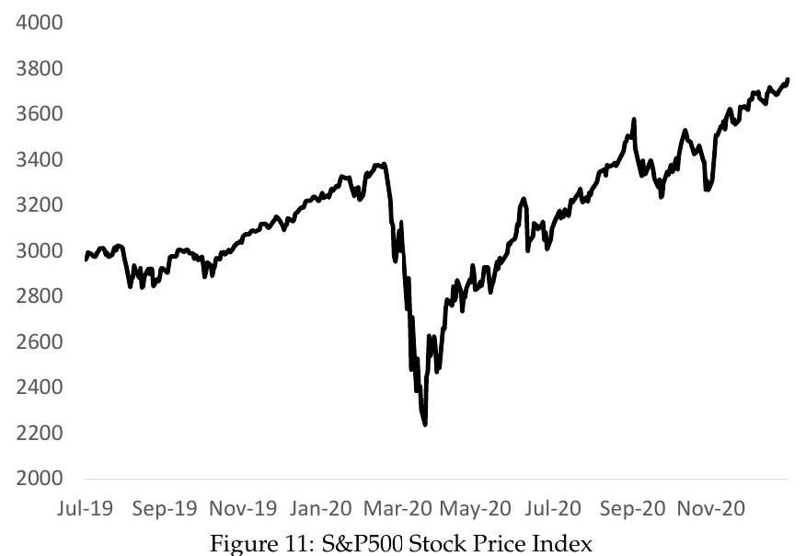
Monetary Policy
Lowered interest rates to zero
Acted as “lender of last resort”
Lent massively to various segments of private sector and government
Forestalled what looked to be a colossal financial crisis
Stock market turned around on March 23rd announcement by Fed

Slide 55
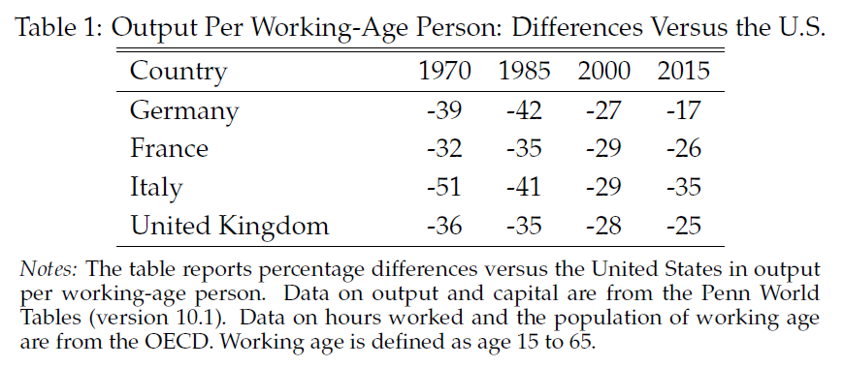
Is Europe in a Depression?
Output per working-age person in Europe 30% lower than in U.S.
Prescott: Europe is in a depression
Is this due to major malfunction of economy?
Is it similar to Great Depression of 1930s?

Slide 56
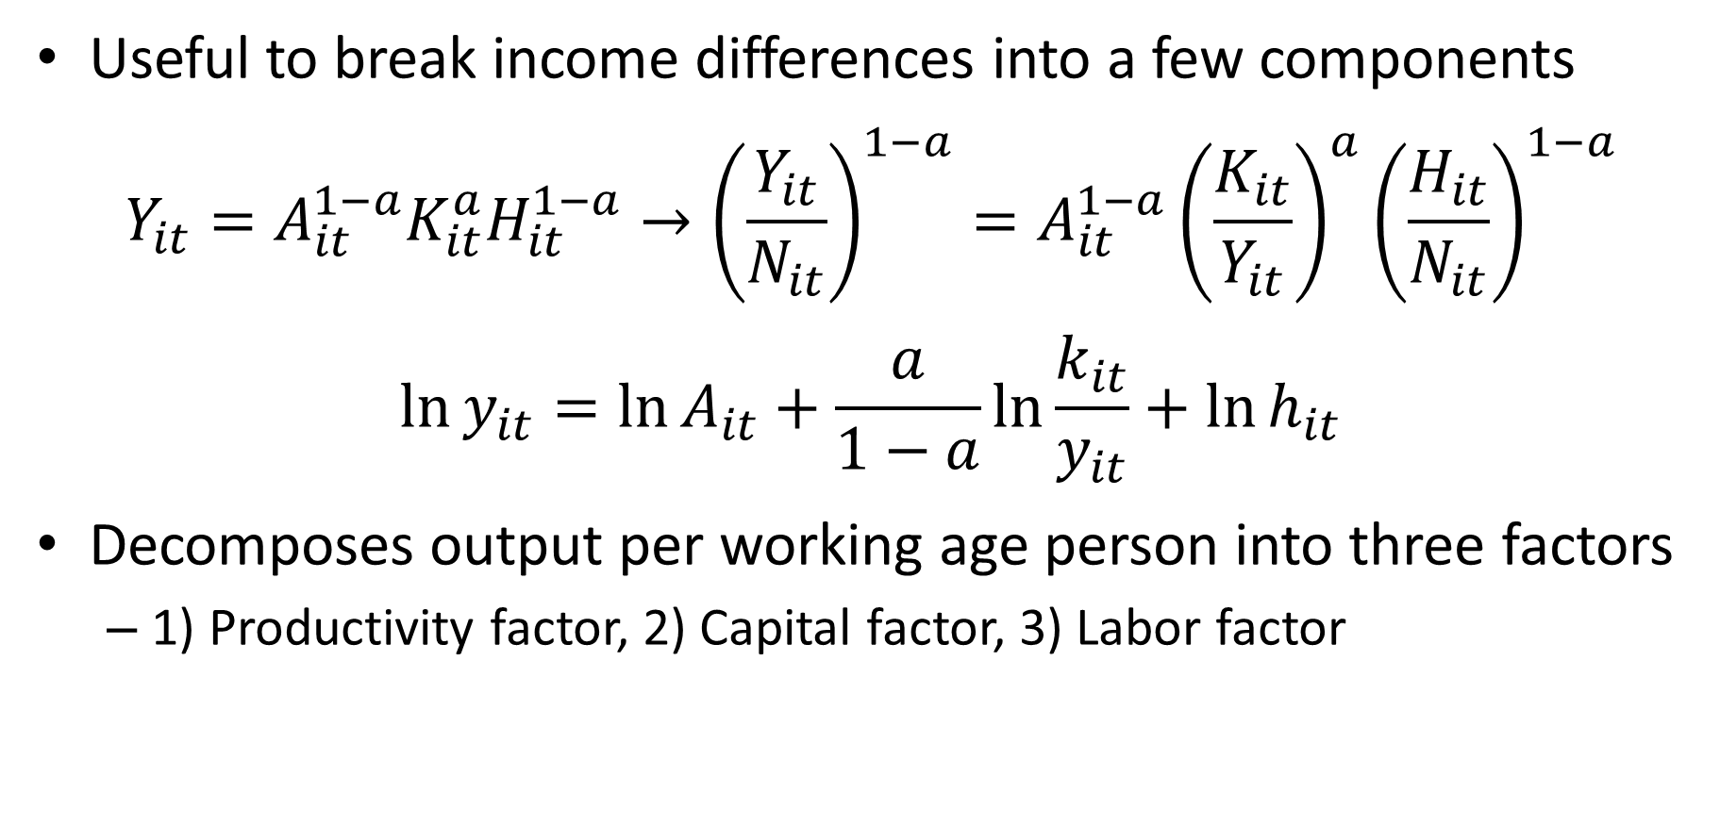
Accounting for Income Levels
Useful to break income differences into a few components
$$Y_{it}=A_{it}^{1−a}K_{it}^{a}H_{it}^{1−a}→{\left(\frac{Y_{it}}{N_{it}}\right)}^{1−a}=A_{it}^{1−a}{\left(\frac{K_{it}}{Y_{it}}\right)}^{a}{\left(\frac{H_{it}}{N_{it}}\right)}^{1−a}$$
$$\ln{y_{it}}=\ln{A_{it}+\frac{a}{1−a}\ln{\frac{k_{it}}{y_{it}}+\ln{h_{it}}}}$$
Decomposes output per working age person into three factors
1) Productivity factor, 2) Capital factor, 3) Labor factor

Slide 57
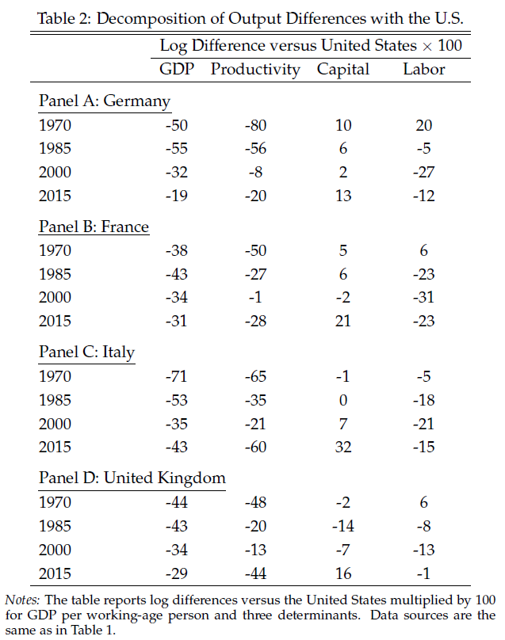
Accounting for Income Levels
1970:
Most of difference productivity
Hours similar to US
2000:
Most of difference hours
Productivity largely caught up in Germany and France
2015:
Productivity has fallen off again
Hours still much lower in France

Slide 58
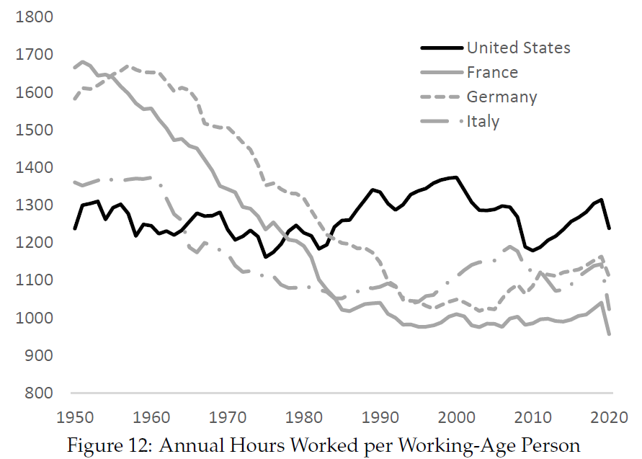
Hours in the Europe vs. U.S.
Europeans worked more than Americans in 1950s and 60s
Hours in Europe fell dramatically
Since 1980, Europeans have worked considerably less than Americans

Slide 59
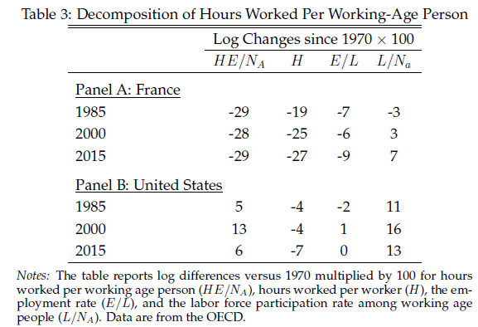
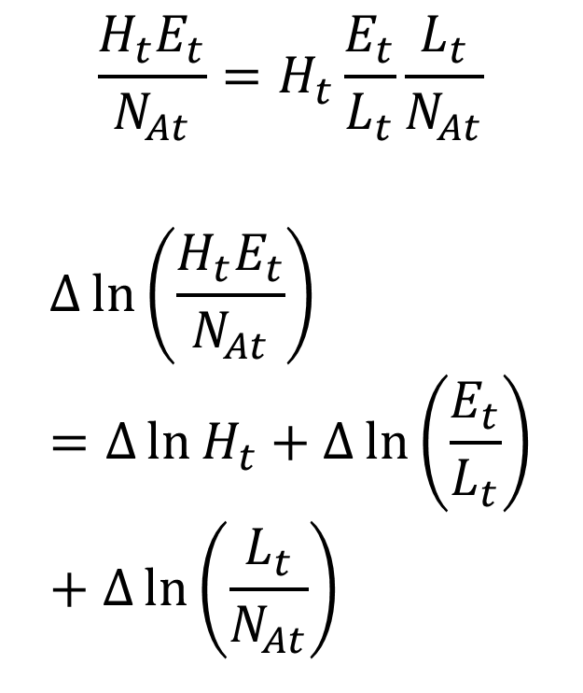
Hours in France vs. U.S.
$$\frac{H_{t}E_{t}}{N_{At}}=H_{t}\frac{E_{t}}{L_{t}}\frac{L_{t}}{N_{At}}$$
$$∆\ln\left(\frac{H_{t}E_{t}}{N_{At}}\right)=∆\ln{H_{t}}+∆\ln\left(\frac{E_{t}}{L_{t}}\right)+∆\ln\left(\frac{L_{t}}{N_{At}}\right)$$

Slide 60
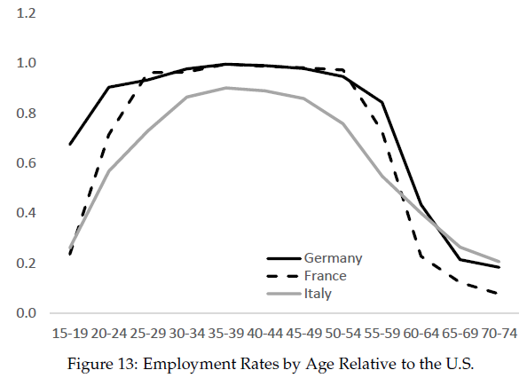
Hours in Europe vs. U.S.
Employment rates comparable for “prime age” workers
Employment rates lower in Europe for young and older workers

Slide 61
Why Do Europeans Work So Little?
Differences in preferences and culture (enlightened, women, coordination)
More generous social safety net (UI, health insurance, etc.) (weak incentives)
Higher minimum wages
Unions (work less – work all, coordination device)
Labor market regulation (hiring and firing costs)
Taxes

Slide 62
Taxes and Europe’s “Depression”
Labor supply is about 30% lower in France than in the US. Why?
Student A: Perhaps it is because taxes are so high in France?
Student B: That is ridiculous! There is no way taxes could matter that much.
How can students A and B make progress in figuring out who is right?

Slide 63
Taxes and Europe’s “Depression”
Direct empirical evidence not conclusive since taxes correlated with other factors affecting labor supply
But can we use theory to help us think about what the size of the effect of taxes on labor supply depends on?
If so, this will allow us to sharpen the debate
Then we can argue about the key determining factors and seek out evidence about these factors

Slide 64
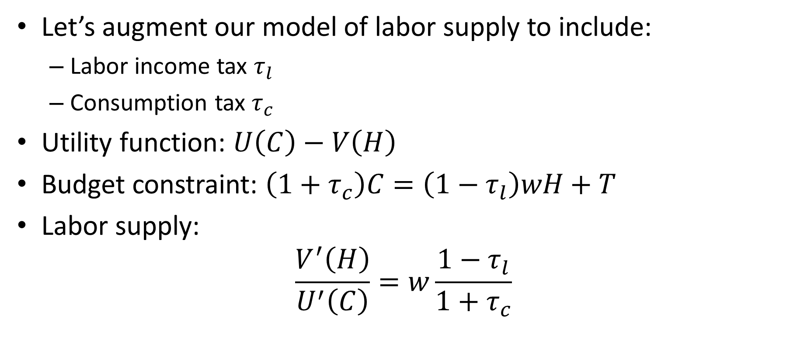
Taxes and Europe’s “Depression”
Let’s augment our model of labor supply to include:
Labor income tax $τ_{l}$
Consumption tax $τ_{c}$
Utility function: $U\left(C\right)−V\left(H\right)$
Budget constraint: $\left(1+τ_{c}\right)C=\left(1−τ_{l}\right)wH+T$
Labor supply:
$$\frac{V^{′}\left(H\right)}{U^{′}\left(C\right)}=w\frac{1−τ_{l}}{1+τ_{c}}$$

Slide 65

Labor Supply and Taxes
$$\frac{V^{′}\left(H\right)}{U^{′}\left(C\right)}=w\frac{1−τ_{l}}{1+τ_{c}}$$
After tax wage: $w\frac{1−τ_{l}}{1+τ_{c}}<w$
Why not just $w\left(1−τ_{l}\right)$, i.e., take-home pay?
Not wage in dollars that matter, but how much this can buy
Consumption tax increases price of goods by $\left(1+τ_{c}\right)$
$w\frac{1−τ_{l}}{1+τ_{c}}$ is how many coconuts you can buy per hour of work

Slide 66

Tax Wedge
Let’s simplify our notation a little
$$\frac{V^{′}\left(H\right)}{U^{′}\left(C\right)}=w\frac{1−τ_{l}}{1+τ_{c}}$$
Define the overall tax wedge as
$$\left(1−τ\right)=\left(1−\frac{τ_{l}+τ_{c}}{1+τ_{c}}\right)=\frac{1−τ_{l}}{1+τ_{c}}$$
Using this overall tax wedge we get
$$\frac{V^{′}\left(H\right)}{U^{′}\left(C\right)}=w\left(1−τ\right)$$

Slide 67

Taxes and Labor Supply
$$\frac{V^{′}\left(H\right)}{U^{′}\left(C\right)}=w\left(1−τ\right)$$
After tax wage: $w\left(1−τ\right)$
How does this affect labor supply?
Substitution effect leads to lower labor supply
Income effect goes in other direction
However, strength of income effect depends on what the government does with tax revenue (How so?)

Slide 68
Income Effect and Use of Tax Revenue
Suppose the government threw the tax revenue in the ocean (wasted it, bridges to nowhere, military spending to fight wars on foreign soil)
Would people feel poorer due to taxes?
Yes they would
Taxes would have income effect
Income effect might be as large or larger than substitution effect

Slide 69
Income Effect and Use of Tax Revenue
Suppose the government transferred money back to people though “lump-sum” transfers”
Would people feel poorer due to taxes?
No. (They pay taxes but get same amount back in transfer)
Suppose the government used tax revenue to buy goods people would have bought anyway (childcare, healthcare, etc.)
Income effect depends on quality of the stuff the government buys
Taxes would have smaller (possibly no) income effect

Slide 70
Income Effect and Use of Tax Revenue
Income effect from taxes is large if government wastes money (or spends on things people would not buy, such as military)
Income effect from taxes is small if government uses revenue for transfers or to provide goods and services people would have bought anyway.

Slide 71
Income Effect and Use of Tax Revenue
Real world probably somewhere between two polar cases discussed above
For simplicity, however, we follow Prescott (2002) and assume all tax revenue is transferred back to household lump-sum
This implies there is no income effect of taxes
This therefore maximizes the effect of taxes on hours

Slide 72

How Much Do Taxes Depress Labor Supply?
To make quantitative predictions, we need to be more precise about utility function of households
We assume:
$$U\left(C\right)−V\left(H\right)=\ln{C}−ψ\frac{H^{1−η^{−1}}}{1−η^{−1}}$$
This implies
$U^{′}\left(C\right)=\frac{1}{C}$ and $V^{′}\left(H\right)= ψH^{η^{−1}}$

Slide 73

How Much Do Taxes Depress Labor Supply?
Labor supply is then:
$$ψCH^{η^{−1}}=w\left(1−τ\right)$$
In the production chapter we derived labor demand:
$$w=\left(1−a\right)\frac{Y}{L}$$
Combining these we have
$$ψCH^{η^{−1}}=\left(1−a\right)\frac{Y}{L}\left(1−τ\right)$$

Slide 74

How Much Do Taxes Depress Labor Supply?
$$ψCH^{η^{−1}}=\left(1−a\right)\frac{Y}{L}\left(1−τ\right)$$
Recall that $L=NH$ and we normalize $N$ to 1
Since all tax revenue is transferred back lump sum, the household budget constraint becomes $C=wH$
This and $w=\left(1−a\right)\frac{Y}{L}$ implies $C=\left(1−a\right)Y$
Using these expressions we get:
$$ψCH^{η^{−1}}=\frac{C}{H}\left(1−τ\right)$$

Slide 75

How Much Do Taxes Depress Labor Supply?
Rearranging yields:
$$H^{1+η^{−1}}=\left(1−τ\right)ψ^{−1}$$
Taking logs yields:
$$\ln{H}=\frac{η}{η+1}\ln\left(1−τ\right)−\frac{η}{η+1}\ln{ψ}$$
Taking a difference between US and France:
$$\ln{H_{Fr}}−\ln{H_{US}}=\frac{η}{η+1}\left(\ln\left(1−τ_{Fr}\right)−\ln\left(1−τ_{US}\right)\right)$$
(note that ${\left(η^{−1}+1\right)}^{−1}$=$\frac{η}{η+1}$)

Slide 76

Key Determinant
$$\ln{H_{Fr}}−\ln{H_{US}}=\frac{η}{η+1}\left(\ln\left(1−τ_{Fr}\right)−\ln\left(1−τ_{US}\right)\right)$$
Clearly $η$ is a key parameter
$η$ is called the Frisch elasticity of labor supply
$η$ is the % change in hours that result from a 1% change in wages holding consumption fixed. (i.e., the strength of the substitution effect)
If $η$ is small (i.e., labor is inelastic), taxes have a small effect on labor supply.
If, $η$ is large (i.e., labor is elastic), taxes have a big effect on labor supply (assuming no income effects)

Slide 77

Value of Theory
Student A and B should argue about two things:
Value of $η$ (i.e., strength of substitution effect)
Whether tax revenue is well spent (i.e., do more taxes/spending entail an income effect)
This is how theory can be useful

Slide 78

Taxes in France and U.S.
Prescott (2002) reported taxes in U.S. and France in late 1990s
Reproduced in Table 4
Taxes much higher in France
Difference in hours in 2000 was 31 log points
Can taxes explain this difference?

Slide 79


How Much Can Taxes Explain?
If Frisch elasticity is small (0.1-0.5), taxes can explain modest amount
If Frisch elasticity is large (say 3), taxes can explain entire amount
Prescott argued for $η=3$
This is all assuming no income effect

Slide 80
Estimating the Frisch Elasticity is Hard
Need temporary tax change
Frisch elasticity holds consumption fixed
Permanent tax changes have potentially large effects on consumption which adds a negative income effect (downward bias)
Hard to extrapolate from small changes due to frictions
Costly adjustment and inattention may prevent response to small tax changes
Results in downward biased estimates
Also, some adjustment may occur gradually (new jobs / retirement)

Slide 81
Tax Holidays
Tax holidays provide very appealing “treatments” to estimate Frisch elasticity
Temporary / Large
Possible to estimate both intensive and extensive margin effects
Two recent papers on tax holidays:
Sigurdsson (2025) -- Iceland
Martinez, Saez, and Siegenthaler (2021) – Switzerland

Slide 82

Tax Free Year in Iceland
In 1988, Iceland moved to pay-as-you-earn tax system (from a system where people paid taxes based on last year’s income)
Income in 1987 never taxed!!

Slide 83

How to Use Tax Free Year
We can compare 1987 with surrounding years
But perhaps there are other things that are different in 1987 from other years
What is the counterfactual?
Trend up before, down after
Hard to know
Icelandic economy volatile due to varying fish stocks and volatile policy

Slide 84

Difference-in-Difference
Compare workers in high tax bracket (more affected) with those in low tax bracket (less affected)
Assumption: Would have followed “parallel trends” (i.e., equally affect by other special factors)
Looking at difference between groups means effect of other factors cancels out
Source: Sigurdsson (2019)

Slide 85

Tax Free Year in Iceland
Workers in high tax bracket increased earning by 7% more than workers in low tax bracket
Sigurdsson converts this into estimate of Frisch elasticity
His conclusion:
Intensive margin: 0.4
Extensive margin: 0.1
Overall Frisch elasticity of 0.5

Slide 86

Tax Free Year in Switzerland
Martinez, Saez, and Siegenthaler estimate Frisch elasticity close to zero – less than 0.05
Also Diff-in-Diff, but not across tax brackets, rather across Swiss cantons
Cantons transitioned to new tax system in different years. So, different tax-free year in different cantons
Effect on earning very small

Slide 87
Tax Holiday Estimates
Frisch elasticity estimates:
Sigurdsson for Iceland: 0.50
Martinez, Saez, Siegenthaler for Switzerland: <0.05
Both much lower than number Prescott used
Why is Iceland different from Switzerland?
Perhaps because labor market is more flexible in Iceland than in Switzerland
US labor market arguably even more flexible

Slide 88
The Economics of Marx
Karl Marx is arguably the most influential labor economist of all time
Ideas resonate strongly with students today
Contrast strongly with ideas we have presented
Worth exploring the difference
We consider essay Wage-Labor, and Capital published in 1849
Marx and Engels (1848): Communist Manifesto

Slide 89
The Economics of Marx
Marx writes:
“the productive power of labor is raised, above all, by the greater division of labor
“division of labor” is Marx’ preferred term for labor productivity

Slide 90
The Economics of Marx
“The greater division of labor enables one worker to do the work of five, ten or twenty”
“It therefore multiplies competition among workers fivefold, tenfold and twentyfold.”
“As the division of labor increases, labor is simplified. The special skill of the worker becomes worthless.”
Marx (1849): Wage-Labor and Capital

Slide 91

The Economics of Marx
Productivity growth (division of labor) leads wages to fall
What did our model imply about this?

Slide 92


Increase in Productivity
Increase in productivity shifts labor demand out
$$\left(1−a\right)AK^{a}L^{−a}=w$$
Increases wage
Permanent increase in productivity shifts labor supply back (income effect)
$$wU^{′}\left(C\right)=V′(H)$$
Increases wage even more

Slide 93

Empirically Marx Was Dead Wrong
Labor productivity has increased at a sustained rate for over 200 years
Real wages of workers have grown at approximately the same rate over this period

Slide 94

Was Marx Simply Confused?
Marx is clear that higher productivity lowers prices of goods
But doesn‘t this make workers better off
Neither nominal wage $W$ nor nominal price $P$ determine worker welfare. Rather it is real wage $W/P$
If $P$ goes down more than $W$, $W/P$ will rise and workers are better off
Not clear Marx understood this point when reading his essay

Slide 95
Can We Make Sense of Marx?
1. Does labor demand shifts out?
Our model: People get more productive => production increases
Marx: Higher productivity => less work
“It therefore multiplies competition among workers fivefold, tenfold and twentyfold.”
This idea resonates strongly with people
Technological change destroys jobs and makes workers worse off

Slide 96
Does Labor Demand Shift Out?
Which view – more output or less works – is correct?
Depends on demand in the product market. I.e., can the firm sell extra output?
Suppose firm productivity double. Should it:
Produce twice as much with same number of workers
Fire half of workers
Suppose firm decides to produce more
Who is going to buy the extra goods?
Do people have enough income to buy the extra goods?

Slide 97
Circular Flow of Payments
If someone buys the extra goods, this provides extra income to seller and employees of seller
Income goes up in tandem with expenditures:
One person’s expenditure is another person’s income
Circular flow of payments in a market economy
But there seems to be a chicken and egg problem:
If the goods sell, people will have income to buy them
But what comes first, the income or the expenditures

Slide 98
Market Clearing
Basic assumption in neoclassical economics: Markets clear
This means everything that is produced will sell
And this implies that someone will have enough income to buy it
Timing issues about who gets paid first assumed away (everything assumed to happen simultaneously)
The real question is at what price it will sell
This perspective effectively assumes away the Marxist/Keynesian worry of insufficient demand

Slide 99
Do Markets Clear?
Changes in prices and wages are what clear markets
Price of goods goes down, wage goes up, workers have more purchasing power
But what if prices are sticky?
Can’t expand production. Don’t need as many workers.
Sticky prices yield insufficient demand (after increase in productivity)
Such models are called Keynesian (Keynes, 1936)
Perhaps Marx was a Keynesian long before Keynes
Sticky prices more plausible in the short run than long run

Slide 100
Can We Make Sense of Marx?
Marx makes a “Malthusian” argument:
Wages will be determined by:
“the cost of production of labor power” …
“the cost required for maintaining the worker as a worker” …
“the cost of existence and reproduction”
Wages of unskilled labor driven down to subsistence
Wages fall due to “division of labor” because work requires less skill and so cost of “developing him into a worker” falls

Slide 101

Can We Make Sense of Marx?
In our model labor supply shifts back
In Marx’ view, labor supply shifts out due to increased population (Malthusian effect)
Economy moves from A to C rather than A to B
Wages stuck at subsistence
Had been true until shortly before Marx’ time
Notes:
Of course this doesn’t show that technical progress makes people worse off. Just that it doesn’t make people better off.

Slide 102

Wage, Labor, and Capital 1849
Real Wages of Laborers in Building Industry in England from Clark (2005, 2010)

Slide 103
Can We Make Sense of Marx?
Immiserizing growth
Can productivity growth make wages go down?
In one-good economy: No!
Worker can always keep using old technology
In multi-good economy: Yes!
Price of good that workers produces may fall relative to price of other goods. This can reduce real wage of workers using old tech
Think of hand-loom weavers when mechanized weaving came in

Slide 104

Was Marx Right After All?
Real wages and productivity move in lock-step 1948-80
Divergence after this
Real wages stagnant 1980-96
Real wages grow after 1996, but not as fast as productivity
Our labor market model needs modification to explain this
Active area of research

