Slide 1
Lecture 4 Efficiency of Markets and Market Failure Macroeconomics (Quantitative) Econ 101B
Jón Steinsson
University of California, Berkeley

Slide 2
Age of Capitalism
What is the appropriate role of markets in society?
Question central to economics
Highly charged and frequently debated
What are the intellectual justifications for free market capitalism?
Freedom: Free market capitalism is a system based on a great deal of individual freedom. Freedom is good in and of itself.
Material well-being: Free market capitalism generates more material well-being than other systems of organizing the economy

Slide 3
Designing Utopia
Our goal: Design a government – laws, regulation and institutions – that is as good as possible in terms of generating material well-being
Two challenges:
Information challenge: How do we figure out what to produce, who should produce it, and who should consume it?
Incentive challenge: Even if we know what needs to be done, how do we get people to do these things?

Slide 4
Different Ways to Organize Societies
Families / Villages / Tribes
Kin-based altruism, tit-for-tat, loyalty to group
Respect for authority and existing hierarchies
Larger societies:
Raw coercion, respect for authority and existing hierarchies
Society very rigid / No solution to information challenge
Is there another way?
Central planning? Something else?

Slide 5
Adam Smith’s Radical Idea
How about if we simply:
Grant the individuals of society freedom to choose themselves what they produce and consume
Allow then to engage in free exchange of goods and labor to realize these choices
Smith argued:
Such freedom might in many circumstances lead to better social outcomes than more directed, coercive, and centrally controlled economic management

Slide 6
Surprising Result
Free-market capitalism can attain high level of material well-being without relying at all on:
Altruism, group loyalty, respect for existing hierarchies
Planning and centralized control
Perhaps the most surprising and interesting idea in all of economics
Economics is mostly “organized common sense”.
But the idea of the laissez faire policy can do as well as an ominous/omnipotent/benevolent central planner is for from obvious

Slide 7
A Formal Model
To grasp these ideas better, it is useful to write down a formal model
We begin by describing only the physical environment
No assumptions about institutions such as markets, laws, property rights, etc.
Derive what is efficient
Then show that competitive markets deliver this outcome

Slide 8
Simplest Possible Setting
Two consumers:
Robinson Crusoe (R) and Friday (F)
Two inputs to production:
Labor (L) and land (N)
Two outputs:
Coconuts (C) and shelter (S)
Two technologies:
One produces coconuts, the other shelter

Slide 9
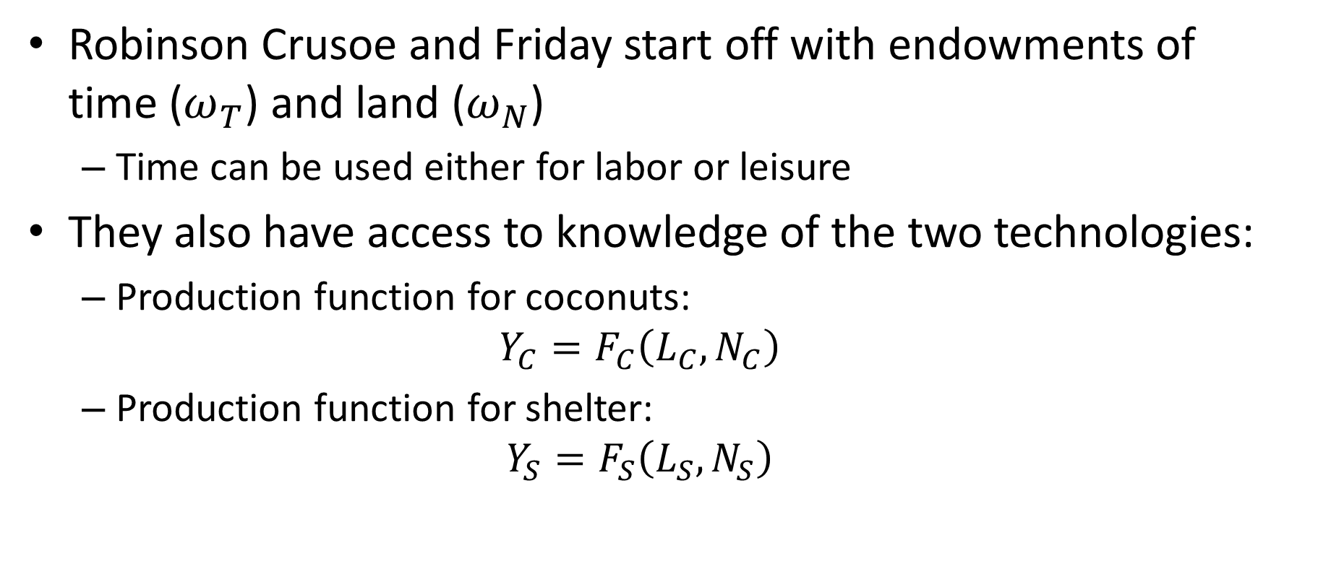
Endowments and Technology
Robinson Crusoe and Friday start off with endowments of time ($ω_{T}$) and land ($ω_{N}$)
Time can be used either for labor or leisure
They also have access to knowledge of the two technologies:
Production function for coconuts:
$$Y_{C}=F_{C}\left(L_{C},N_{C}\right)$$
Production function for shelter:
$$Y_{S}=F_{S}\left(L_{S},N_{S}\right)$$

Slide 10
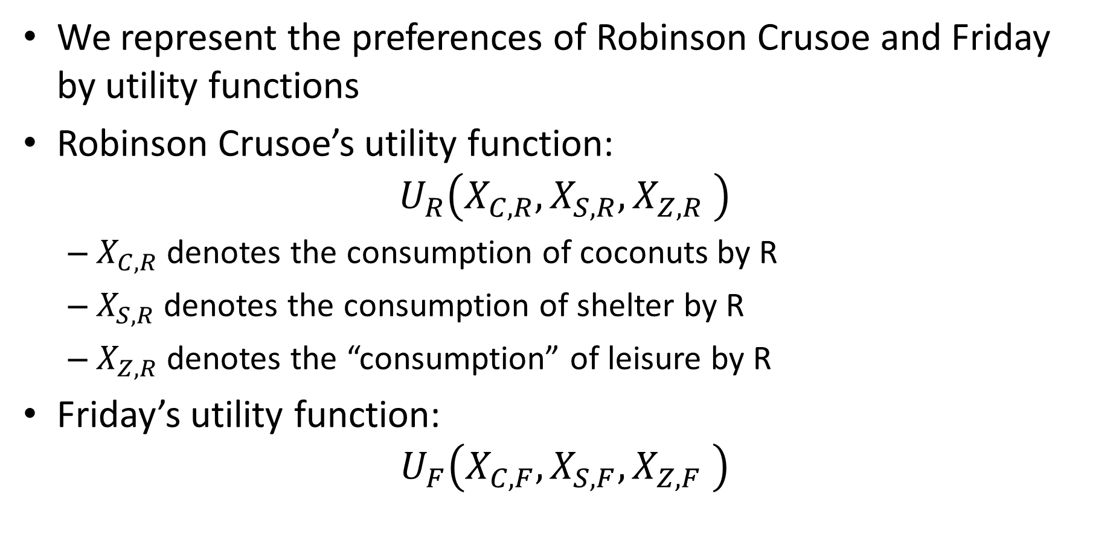
Preferences
We represent the preferences of Robinson Crusoe and Friday by utility functions
Robinson Crusoe’s utility function:
$$U_{R}\left(X_{C,R},X_{S,R},X_{Z,R} \right)$$
$X_{C,R}$ denotes the consumption of coconuts by R
$X_{S,R}$ denotes the consumption of shelter by R
$X_{Z,R}$ denotes the “consumption” of leisure by R
Friday’s utility function:
$$U_{F}\left(X_{C,F},X_{S,F},X_{Z,F} \right)$$

Slide 11
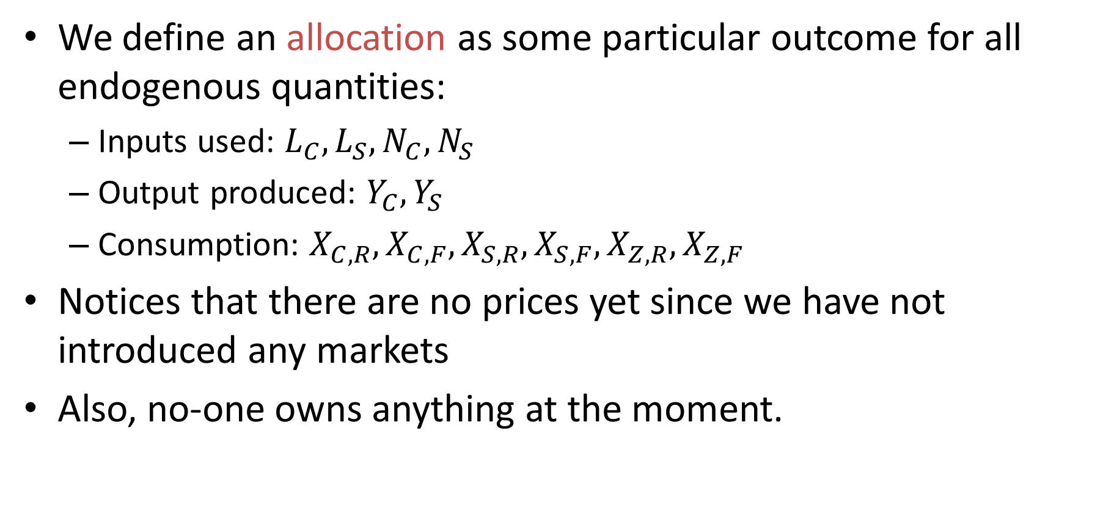
An Allocation
We define an allocation as some particular outcome for all endogenous quantities:
Inputs used: $L_{C},L_{S},N_{C},N_{S}$
Output produced: $Y_{C}, Y_{S}$
Consumption: $X_{C,R}, X_{C,F}, X_{S,R}, X_{S,F}, X_{Z,R}, X_{Z,F}$
Notices that there are no prices yet since we have not introduced any markets
Also, no-one owns anything at the moment.

Slide 12
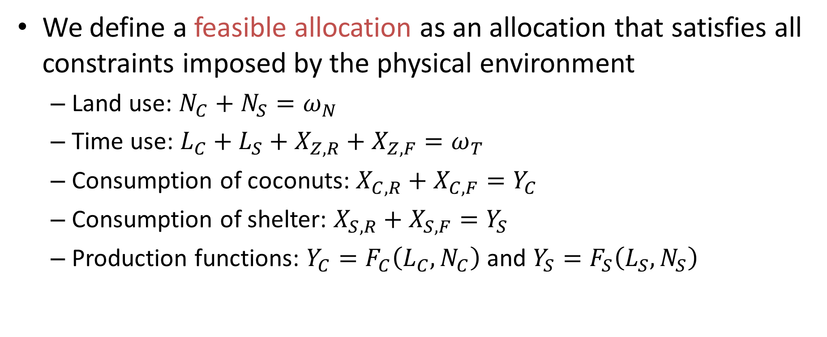
A Feasible Allocation
We define a feasible allocation as an allocation that satisfies all constraints imposed by the physical environment
Land use: $N_{C}+N_{S}=ω_{N}$
Time use: $L_{C}+L_{S}+X_{Z,R}+X_{Z,F}=ω_{T}$
Consumption of coconuts: $X_{C,R}+X_{C,F}=Y_{C}$
Consumption of shelter: $X_{S,R}+X_{S,F}=Y_{S}$
Production functions: $Y_{C}=F_{C}\left(L_{C},N_{C}\right)$ and $Y_{S}=F_{S}\left(L_{S},N_{S}\right)$

Slide 13
Efficient Allocation
Our goal is to describe the efficient feasible allocation (efficient allocation for short)
How do we define what is efficient?
Efficiency refers to lack of waste
Since our ultimate aim is utility of people, we define efficiency in terms of whether we are squandering opportunities to make someone better off without making anyone else worse off

Slide 14
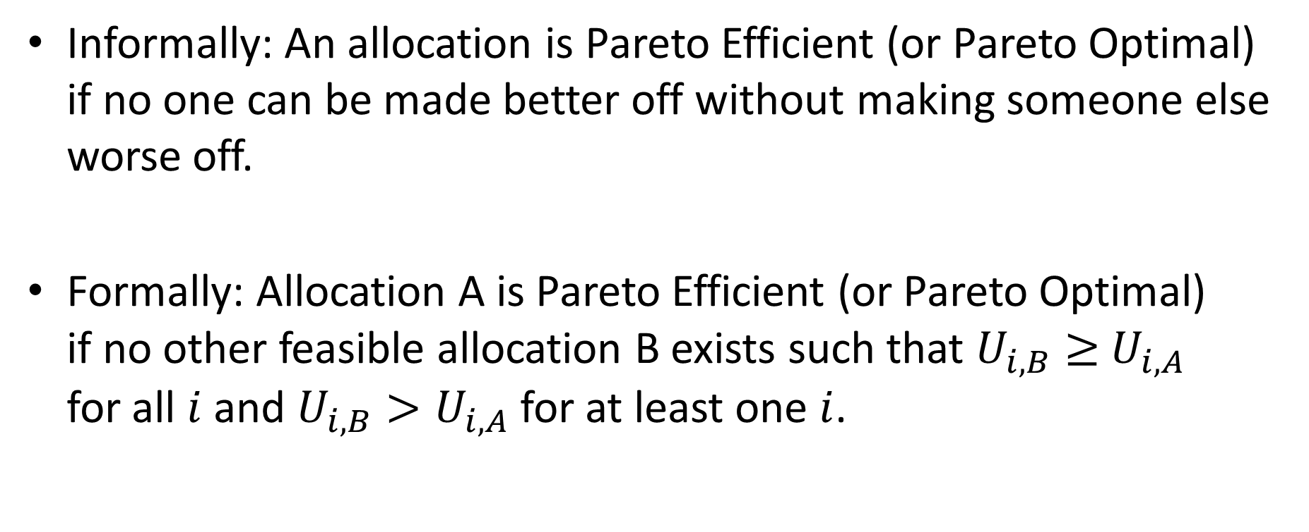
Pareto Efficiency
Informally: An allocation is Pareto Efficient (or Pareto Optimal) if no one can be made better off without making someone else worse off.
Formally: Allocation A is Pareto Efficient (or Pareto Optimal) if no other feasible allocation B exists such that $U_{i,B}≥$ $U_{i,A}$ for all $i$ and $U_{i,B}>U_{i,A}$ for at least one $i$.

Slide 15
Pareto Improvement
An allocation A is said to be a Pareto improvement over allocation B if someone is better of under allocation A but no one is worse off
In this case, allocation B is said to be Pareto inefficient.

Slide 16
Pareto Efficiency: Example
Government builds a bridge
People pay tolls. Tolls pay for bridge
Potential Pareto improvement
Why only potential?
Perhaps bridge diverts traffic and business away from some stores. Owners worse off.
Perhaps noise or shadow from bridge adversely affects neighbors of bridge
How can this be fixed? (in principle)

Slide 17
The “Weakness” of Pareto Efficiency
Pareto efficiency is a rather “weak” concept
Many Pareto efficient allocations:
Consider an allocation where one agent gets all the resources.
This is Pareto efficient since all other allocations make them worse off
Many allocations that cannot be Pareto ranked
Pareto efficiency does not concern itself at all with distributional issues

Slide 18
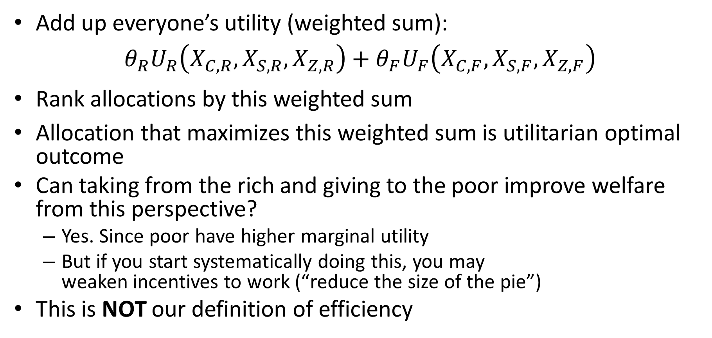
Utilitarian Optimal Outcome
Add up everyone’s utility (weighted sum):
$$θ_{R}U_{R}\left(X_{C,R},X_{S,R},X_{Z,R}\right)+θ_{F}U_{F}\left(X_{C,F},X_{S,F},X_{Z,F}\right)$$
Rank allocations by this weighted sum
Allocation that maximizes this weighted sum is utilitarian optimal outcome
Can taking from the rich and giving to the poor improve welfare from this perspective?
Yes. Since poor have higher marginal utility
But if you start systematically doing this, you may weaken incentives to work (“reduce the size of the pie”)
This is NOT our definition of efficiency

Slide 19
Conditions for Pareto Efficiency
Exchange Efficiency
There cannot be any scope for mutually advantageous trade in final goods
Production Efficiency
There cannot be any scope for Pareto improving reallocation of factors of production between their different uses.

Slide 20
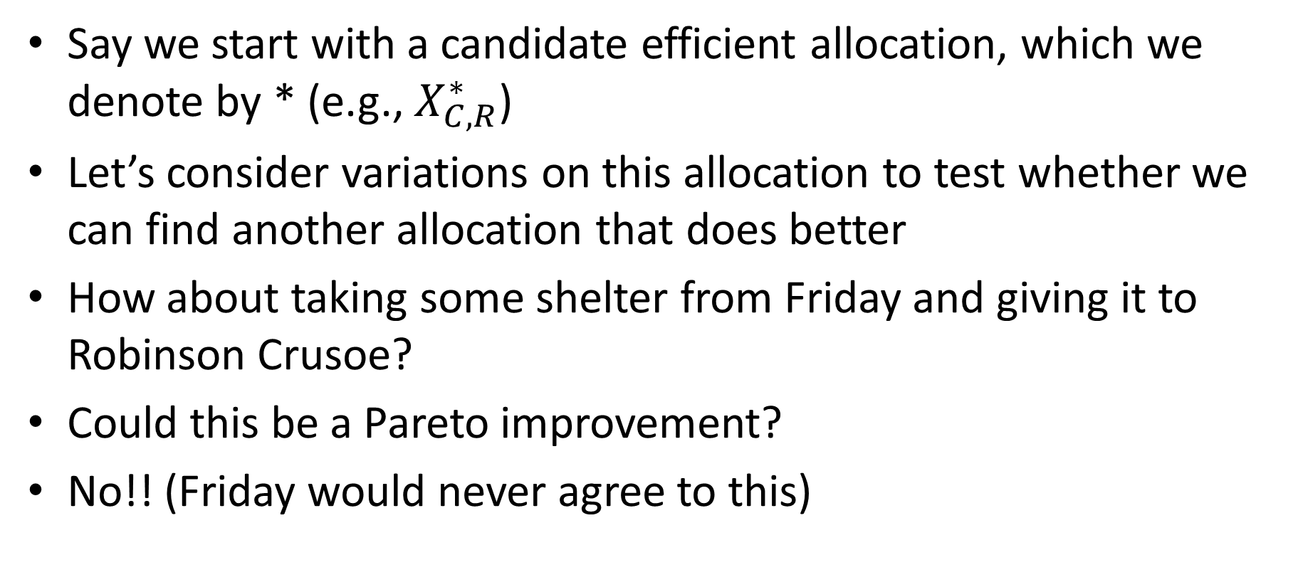
Exchange Efficiency
Say we start with a candidate efficient allocation, which we denote by * (e.g., $X_{C,R}^{∗}$)
Let’s consider variations on this allocation to test whether we can find another allocation that does better
How about taking some shelter from Friday and giving it to Robinson Crusoe?
Could this be a Pareto improvement?
No!! (Friday would never agree to this)

Slide 21
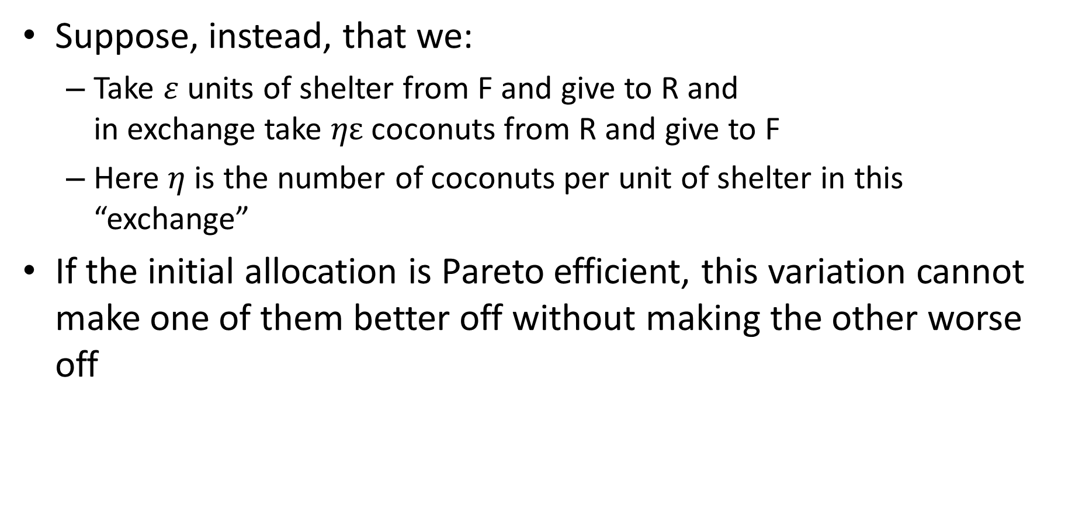
Exchange Efficiency
Suppose, instead, that we:
Take $ε$ units of shelter from F and give to R and in exchange take $ηε$ coconuts from R and give to F
Here $η$ is the number of coconuts per unit of shelter in this “exchange”
If the initial allocation is Pareto efficient, this variation cannot make one of them better off without making the other worse off

Slide 22
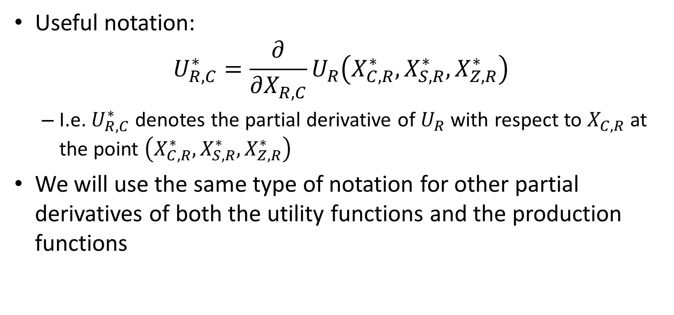
Exchange Efficiency
Useful notation:
$$U_{R,C}^{∗}=\frac{∂}{∂X_{R,C}}U_{R}\left(X_{C,R}^{∗},X_{S,R}^{∗},X_{Z,R}^{∗}\right)$$
I.e. $U_{R,C}^{∗}$ denotes the partial derivative of $U_{R}$ with respect to $X_{C,R}$ at the point $\left(X_{C,R}^{∗},X_{S,R}^{∗},X_{Z,R}^{∗}\right)$
We will use the same type of notation for other partial derivatives of both the utility functions and the production functions

Slide 23
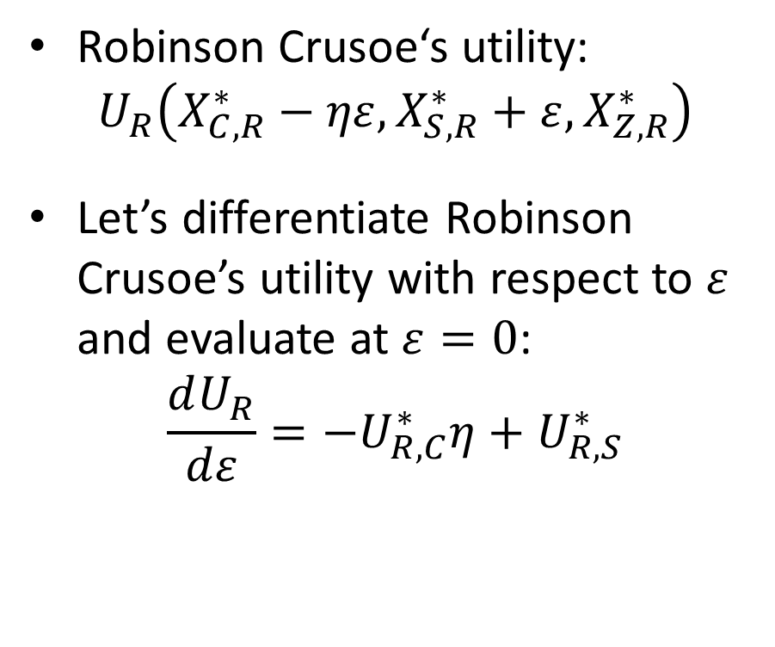
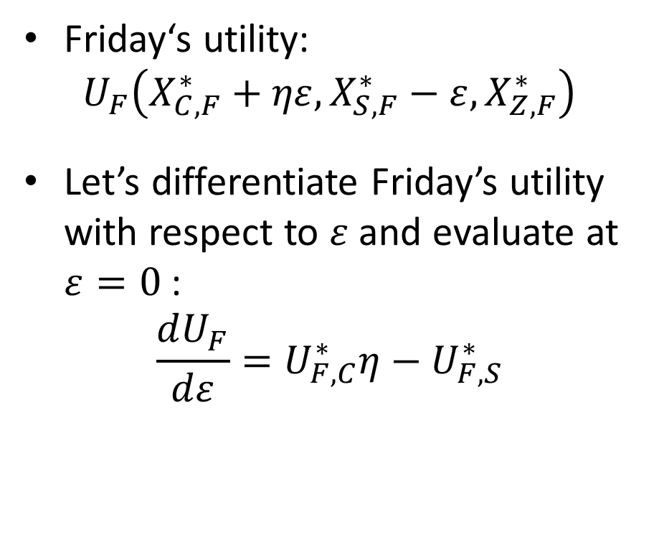
Exchange Efficiency
Robinson Crusoe‘s utility:
$$U_{R}\left(X_{C,R}^{∗}−ηε,X_{S,R}^{∗}+ε,X_{Z,R}^{∗}\right)$$
Let’s differentiate Robinson Crusoe’s utility with respect to $ε$ and evaluate at $ε=0$:
$$\frac{dU_{R}}{dε}=−U_{R,C}^{∗}η+U_{R,S}^{∗}$$
Friday‘s utility:
$$U_{F}\left(X_{C,F}^{∗}+ηε,X_{S,F}^{∗}−ε,X_{Z,F}^{∗}\right)$$
Let’s differentiate Friday’s utility with respect to $ε$ and evaluate at $ε=0$:
$$\frac{dU_{F}}{dε}=U_{F,C}^{∗}η−U_{F,S}^{∗}$$

Slide 24
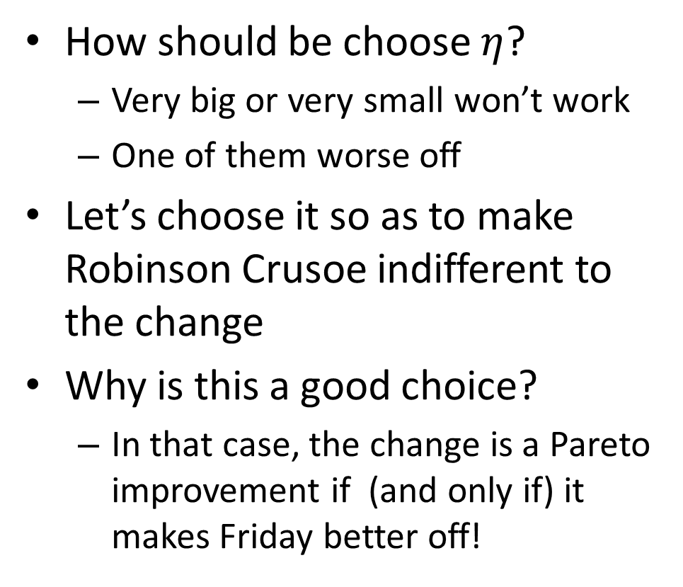

Exchange Efficiency
How should be choose $η$?
Very big or very small won’t work
One of them worse off
Let’s choose it so as to make Robinson Crusoe indifferent to the change
Why is this a good choice?
In that case, the change is a Pareto improvement if (and only if) it makes Friday better off!
$$\frac{dU_{R}}{dε}=−U_{R,C}^{∗}η+U_{R,S}^{∗}=0$$
$$η=\frac{U_{R,S}^{∗}}{U_{R,C}^{∗}}$$

Slide 25
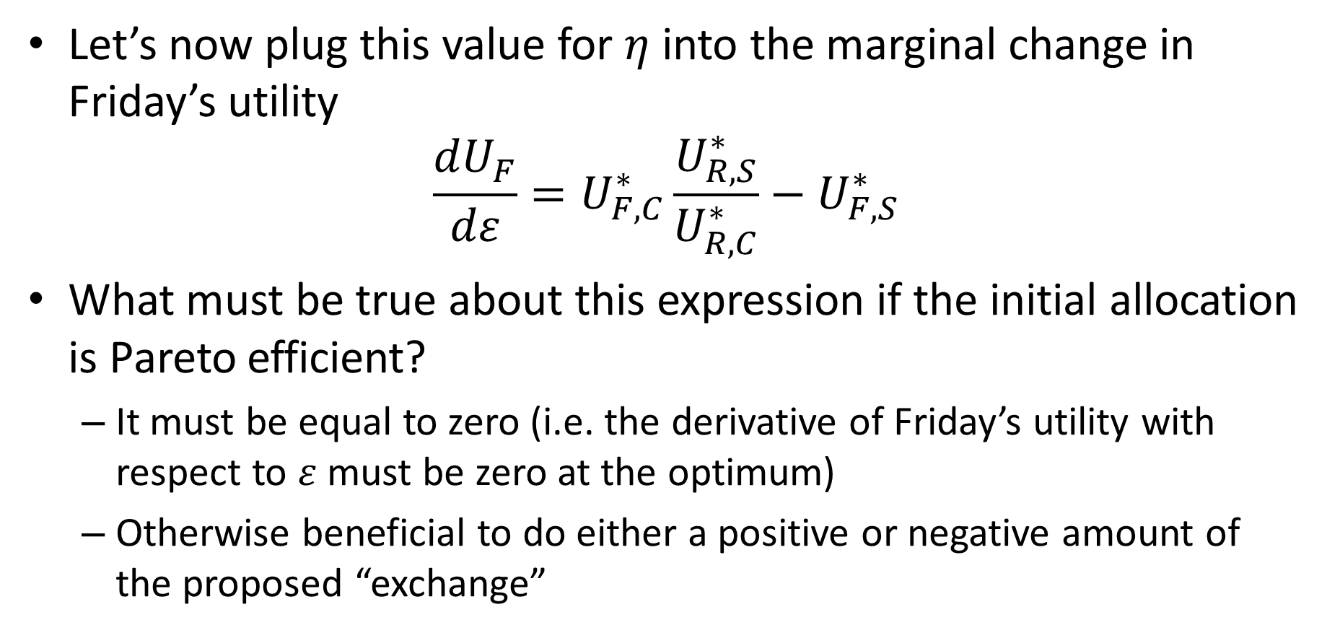
Exchange Efficiency
Let’s now plug this value for $η$ into the marginal change in Friday’s utility
$$\frac{dU_{F}}{dε}=U_{F,C}^{∗}\frac{U_{R,S}^{∗}}{U_{R,C}^{∗}}−U_{F,S}^{∗}$$
What must be true about this expression if the initial allocation is Pareto efficient?
It must be equal to zero (i.e. the derivative of Friday’s utility with respect to $ε$ must be zero at the optimum)
Otherwise beneficial to do either a positive or negative amount of the proposed “exchange”

Slide 26
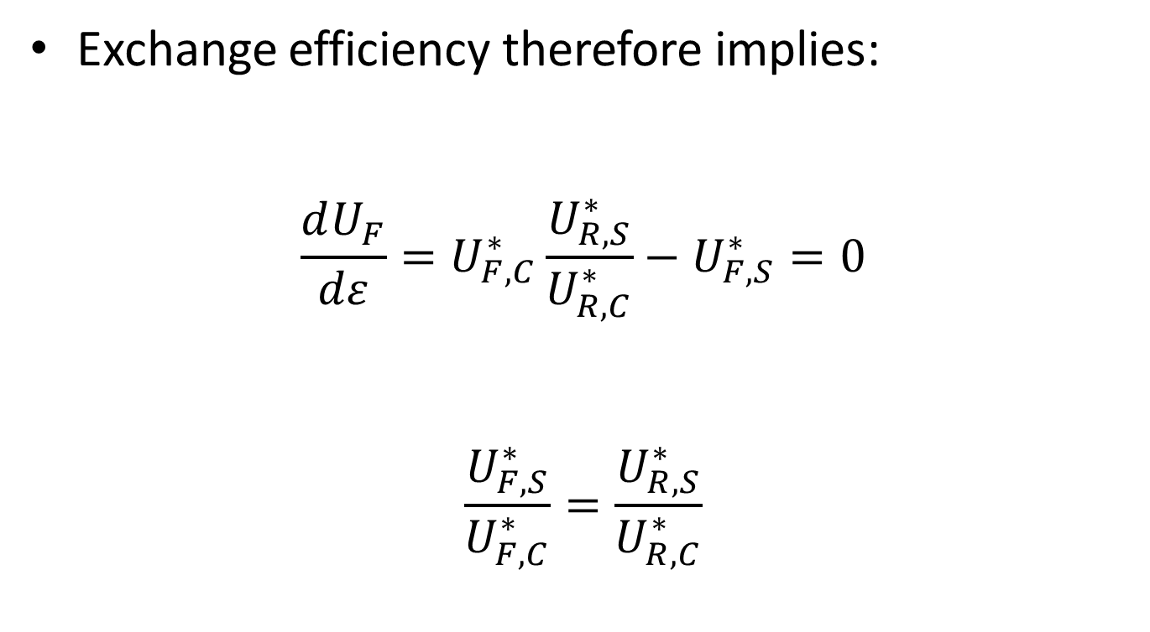
Exchange Efficiency
Exchange efficiency therefore implies:
$$\frac{dU_{F}}{dε}=U_{F,C}^{∗}\frac{U_{R,S}^{∗}}{U_{R,C}^{∗}}−U_{F,S}^{∗}=0$$
$$\frac{U_{F,S}^{∗}}{U_{F,C}^{∗}}=\frac{U_{R,S}^{∗}}{U_{R,C}^{∗}}$$

Slide 27
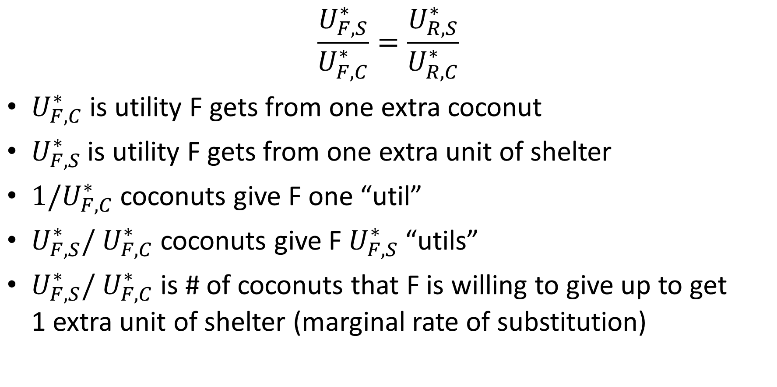
Exchange Efficiency
$$\frac{U_{F,S}^{∗}}{U_{F,C}^{∗}}=\frac{U_{R,S}^{∗}}{U_{R,C}^{∗}}$$
$U_{F,C}^{∗}$ is utility F gets from one extra coconut
$U_{F,S}^{∗}$ is utility F gets from one extra unit of shelter
$1/U_{F,C}^{∗}$ coconuts give F one “util”
$U_{F,S}^{∗}/$ $U_{F,C}^{∗}$ coconuts give F $U_{F,S}^{∗}$ “utils”
$U_{F,S}^{∗}/$ $U_{F,C}^{∗}$ is # of coconuts that F is willing to give up to get 1 extra unit of shelter (marginal rate of substitution)
Notes:
Exchange efficiency: This is number of coconuts that F and R would be willing to give up for one more unit of shelter. One coconut gives U_c utils. One shelter gives U_s. So, to add one util add 1/U_c coconuts. To add U_s utils takes U_s/U_c coconuts.
U_Fs/U_Fc = 4. This means that if someone offers F 5 coconuts for a unit of shelter he takes it. But if someone offers him a unit of shelter for 3 coconuts, he also takes it. U_Rs/U_Rc = 2 means that is someone offers R 3 coconuts for a unit of shelter he takes it. So, F offering R 3 coconuts for a unit of shelter is a trade that makes both better off.

Slide 28
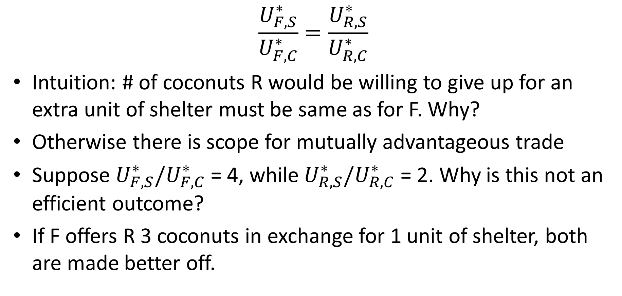
Exchange Efficiency
$$\frac{U_{F,S}^{∗}}{U_{F,C}^{∗}}=\frac{U_{R,S}^{∗}}{U_{R,C}^{∗}}$$
Intuition: # of coconuts R would be willing to give up for an extra unit of shelter must be same as for F. Why?
Otherwise there is scope for mutually advantageous trade
Suppose $U_{F,S}^{∗}/U_{F,C}^{∗}$ = 4, while $U_{R,S}^{∗}/U_{R,C}^{∗}$ = 2. Why is this not an efficient outcome?
If F offers R 3 coconuts in exchange for 1 unit of shelter, both are made better off.

Slide 29
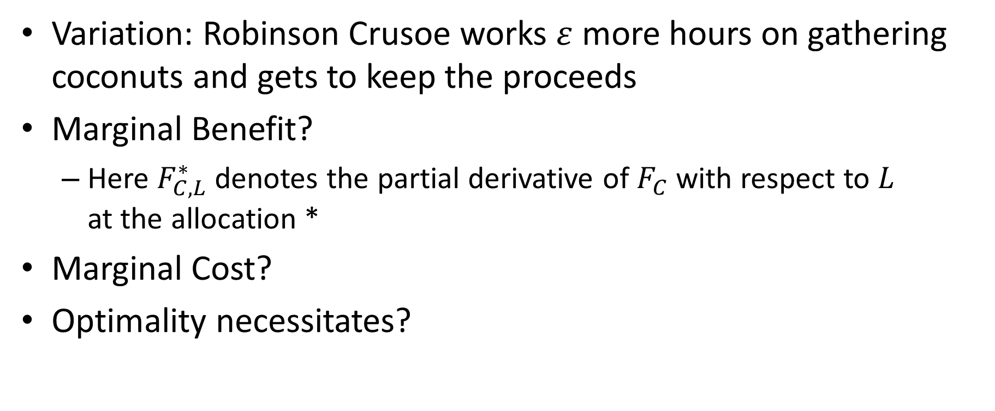
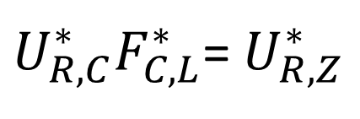



Production Efficiency
Variation: Robinson Crusoe works $ε$ more hours on gathering coconuts and gets to keep the proceeds
Marginal Benefit?
Here $F_{C,L}^{∗}$ denotes the partial derivative of $F_{C}$ with respect to $L$ at the allocation *
Marginal Cost?
Optimality necessitates?
$$U_{R,C}^{∗}F_{C,L}^{∗}$$
$$U_{R,Z}^{∗}$$
$$\frac{U_{R,Z}^{∗}}{U_{R,C}^{∗}}=F_{C,L}^{∗}$$
$U_{R,C}^{∗}F_{C,L}^{∗}$= $U_{R,Z}^{∗}$
or

Slide 30
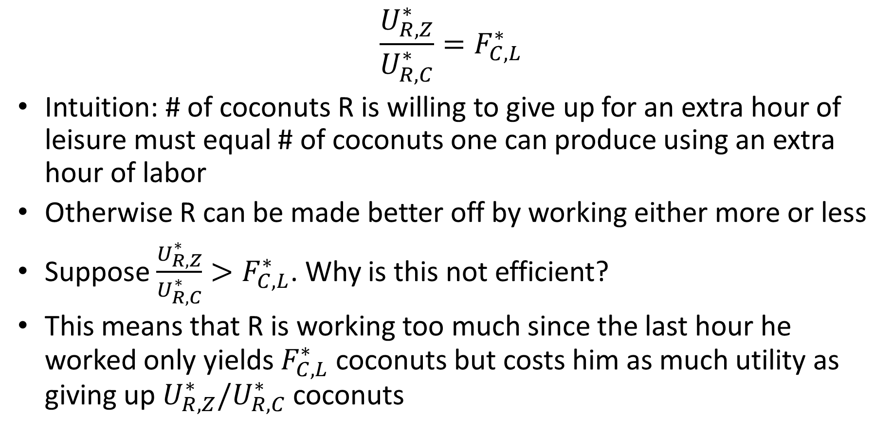
Production Efficiency Intuition
$$\frac{U_{R,Z}^{∗}}{U_{R,C}^{∗}}=F_{C,L}^{∗}$$
Intuition: # of coconuts R is willing to give up for an extra hour of leisure must equal # of coconuts one can produce using an extra hour of labor
Otherwise R can be made better off by working either more or less
Suppose $\frac{U_{R,Z}^{∗}}{U_{R,C}^{∗}}>F_{C,L}^{∗}$. Why is this not efficient?
This means that R is working too much since the last hour he worked only yields $F_{C,L}^{∗}$ coconuts but costs him as much utility as giving up $U_{R,Z}^{∗}/U_{R,C}^{∗}$ coconuts
Notes:
Production efficiency: One coconut gives U_c utils. So, for one util you need 1/U_c coconuts. For U_z utils you need U_z/U_c coconuts. U_z is the number of utils for one extra hour of leisure. Now how many coconuts to you get if you supply one extra hour of labor: F_L

Slide 31
Production Efficiency
Similar arguments yield similar conditions for
Robinson Crusoe working more/less on shelter
Friday working more/less on coconuts
Friday working more/less on shelter
These conditions are listed in draft chapter

Slide 32
Efficient Use of Land
What about land use? How much land is it efficient to use?
We assumed (for simplicity) that land has no alternative use. So, they might as well use all the land for coconut and shelter production.
Only question is how to divide up the land between coconut and shelter production
What condition must hold for the division of land between coconut and shelter production to be efficient?

Slide 33

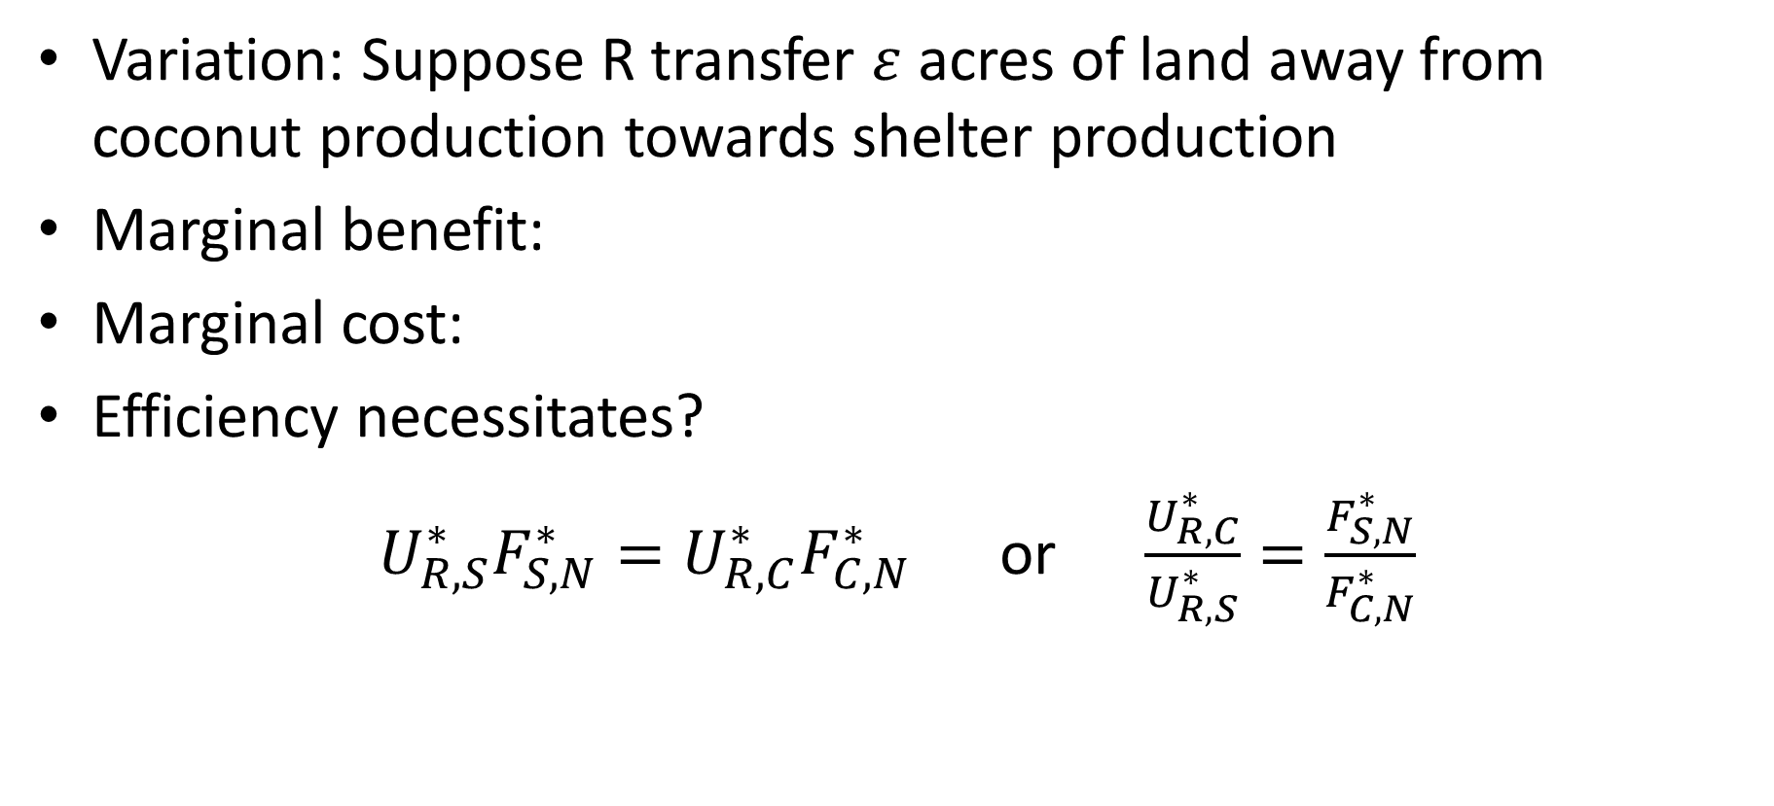

Efficient Use of Land
Variation: Suppose R transfer $ε$ acres of land away from coconut production towards shelter production
Marginal benefit:
Marginal cost:
Efficiency necessitates?
$U_{R,S}^{∗}F_{S,N}^{∗}={U_{R,C}^{∗}F}_{C,N}^{∗}$ or $\frac{U_{R,C}^{∗}}{U_{R,S}^{∗}}=\frac{F_{S,N}^{∗}}{F_{C,N}^{∗}}$
$$U_{R,S}^{∗}F_{S,N}^{∗}$$
$${U_{R,C}^{∗}F}_{C,N}^{∗}$$

Slide 34
Pareto Efficiency
Exchange efficiency
Production efficiency
Efficient land use (part of production efficiency)
These are all the conditions that need to hold for an allocation to be Pareto efficient

Slide 35

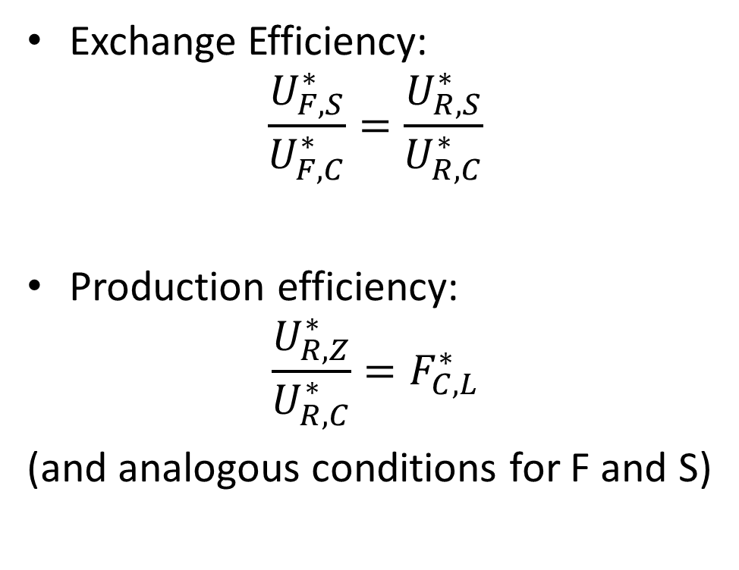
Conditions for Efficiency
Exchange Efficiency:
$$\frac{U_{F,S}^{∗}}{U_{F,C}^{∗}}=\frac{U_{R,S}^{∗}}{U_{R,C}^{∗}}$$
Production efficiency:
$$\frac{U_{R,Z}^{∗}}{U_{R,C}^{∗}}=F_{C,L}^{∗}$$
(and analogous conditions for F and S)
Efficient use of land:
$$\frac{U_{R,C}^{∗}}{U_{R,S}^{∗}}=\frac{F_{S,N}^{∗}}{F_{C,N}^{∗}}$$

Slide 36
Pareto Efficient Allocation
How can we bring about this outcome?
Central Planning
A benevolent, omniscient, omnipotent central authority could achieve this allocation by directive
I.e, they would calculate what the optimum was and tell everyone they have to do that or else they will be shot (less extreme measures might work)
Is there an alternative?

Slide 37
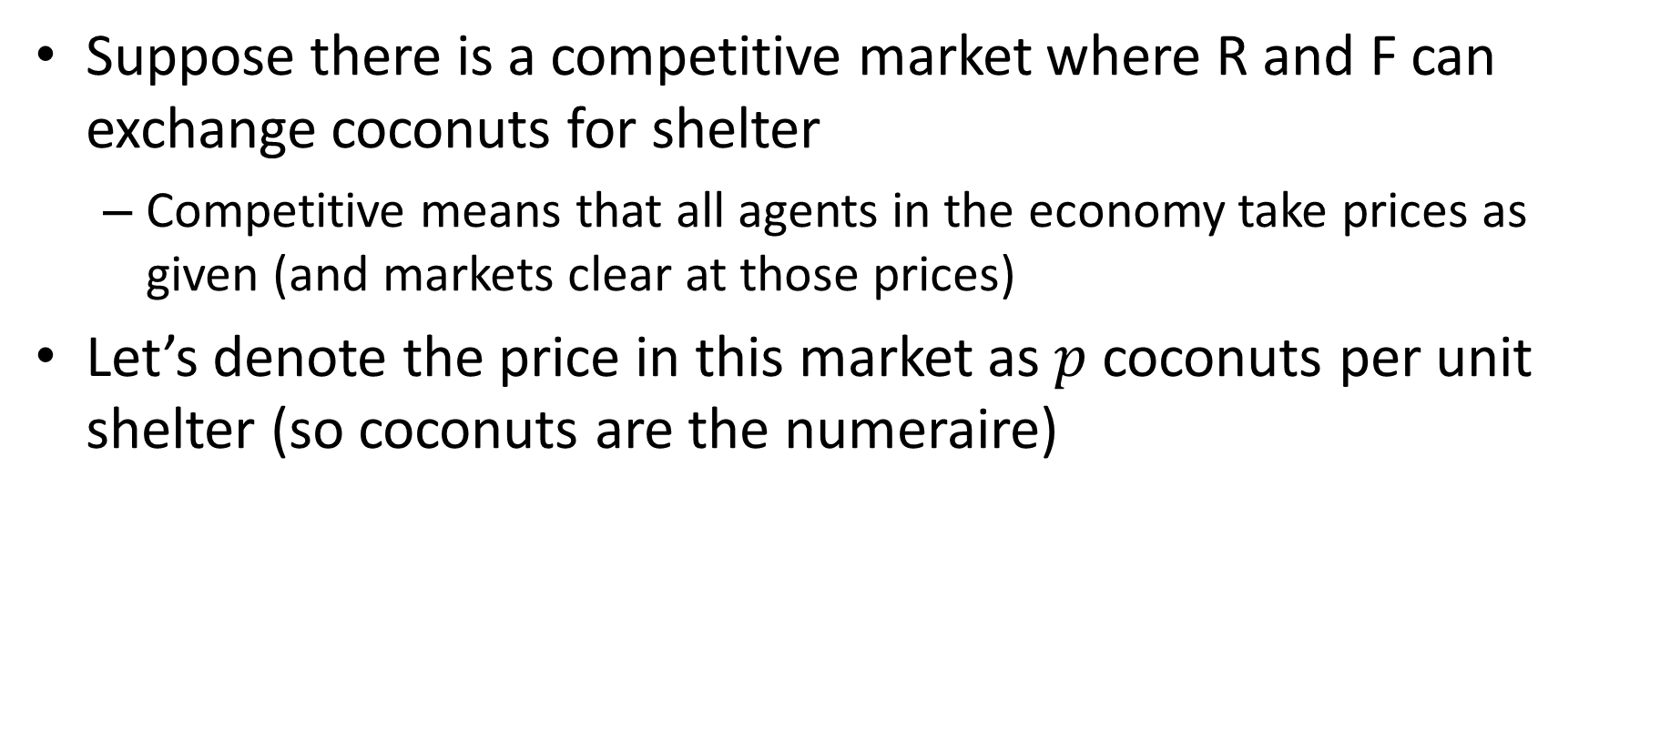
Markets
Suppose there is a competitive market where R and F can exchange coconuts for shelter
Competitive means that all agents in the economy take prices as given (and markets clear at those prices)
Let’s denote the price in this market as $p$ coconuts per unit shelter (so coconuts are the numeraire)

Slide 38
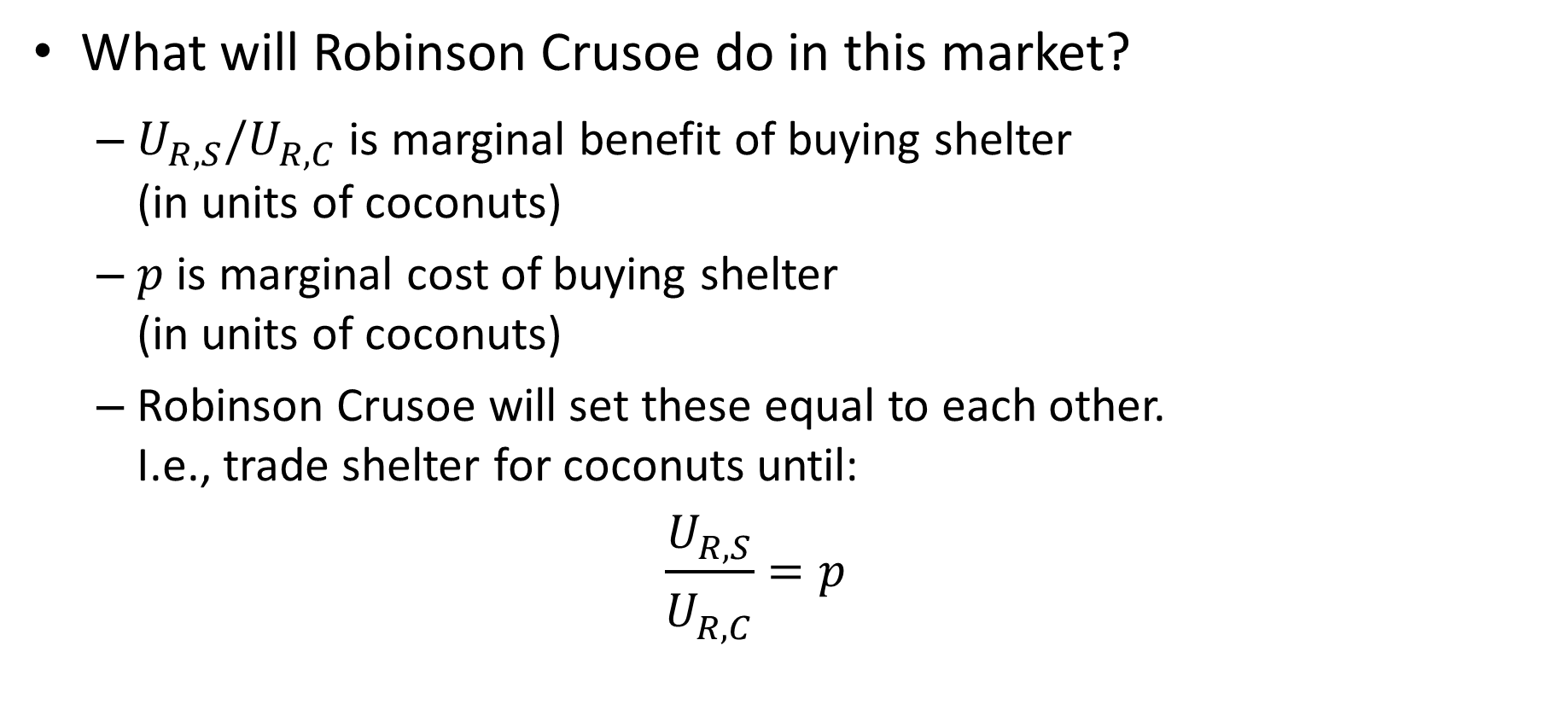
Product Market
What will Robinson Crusoe do in this market?
$U_{R,S}^{}/U_{R,C}^{}$ is marginal benefit of buying shelter (in units of coconuts)
$p$ is marginal cost of buying shelter (in units of coconuts)
Robinson Crusoe will set these equal to each other. I.e., trade shelter for coconuts until:
$$\frac{U_{R,S}^{}}{U_{R,C}^{}}=p$$

Slide 39
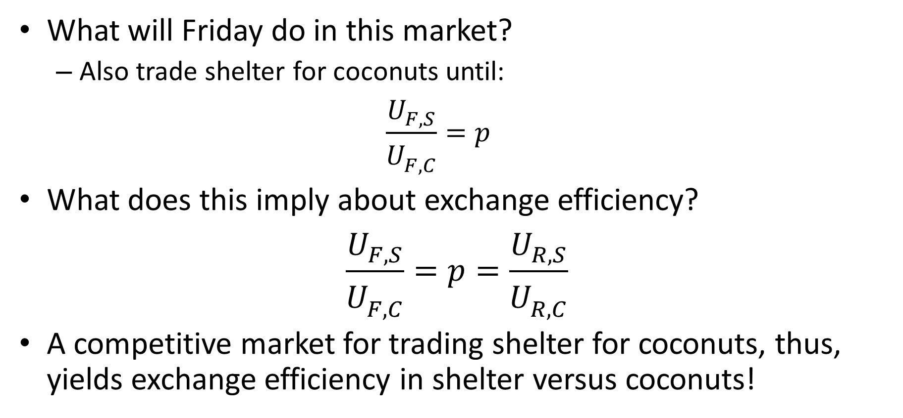
Product Market
What will Friday do in this market?
Also trade shelter for coconuts until:
$$\frac{U_{F,S}^{}}{U_{F,C}^{}}=p$$
What does this imply about exchange efficiency?
$$\frac{U_{F,S}^{}}{U_{F,C}^{}}=p=\frac{U_{R,S}^{}}{U_{R,C}^{}}$$
A competitive market for trading shelter for coconuts, thus, yields exchange efficiency in shelter versus coconuts!

Slide 40
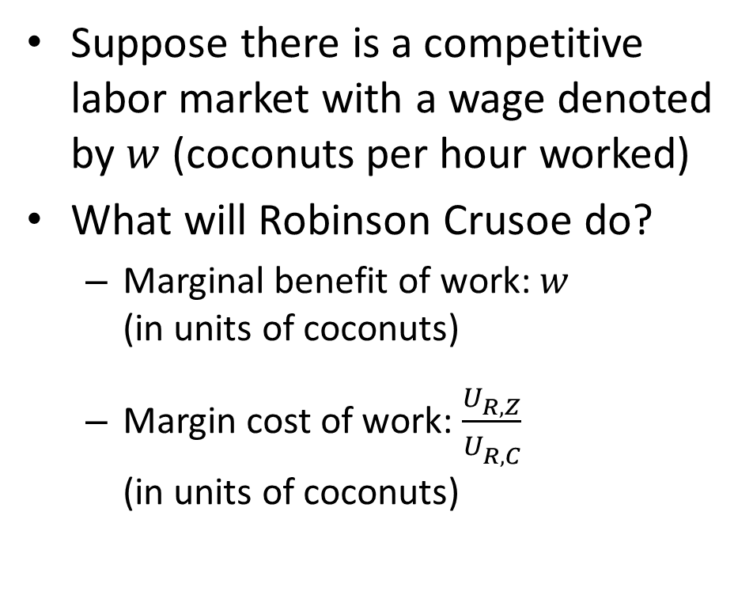
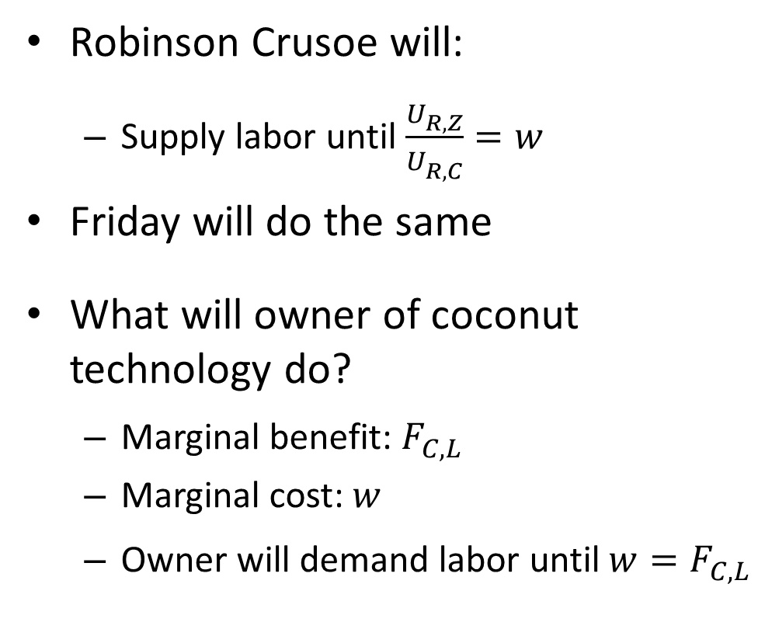
Labor Market
Suppose there is a competitive labor market with a wage denoted by $w$ (coconuts per hour worked)
What will Robinson Crusoe do?
Marginal benefit of work: $w$ (in units of coconuts)
Margin cost of work: $\frac{U_{R,Z}^{}}{U_{R,C}^{}}$ (in units of coconuts)
Robinson Crusoe will:
Supply labor until $\frac{U_{R,Z}^{}}{U_{R,C}^{}}=w$
Friday will do the same
What will owner of coconut technology do?
Marginal benefit: $F_{C,L}^{}$
Marginal cost: $w$
Owner will demand labor until $w=F_{C,L}^{}$

Slide 41
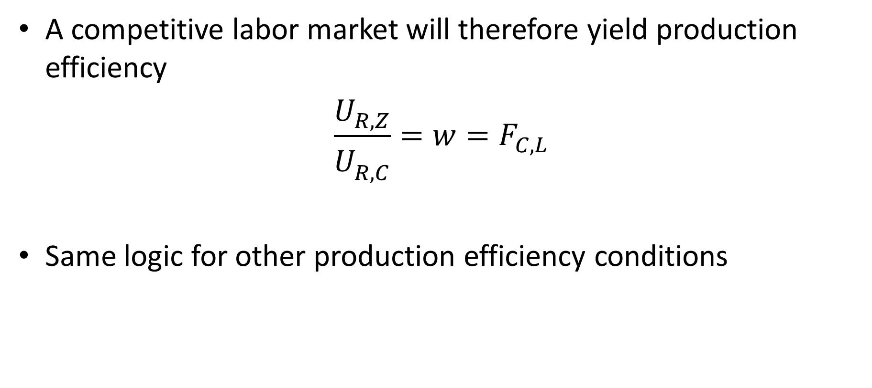
Labor Market
A competitive labor market will therefore yield production efficiency
$$\frac{U_{R,Z}^{}}{U_{R,C}^{}}=w=F_{C,L}^{}$$
Same logic for other production efficiency conditions

Slide 42
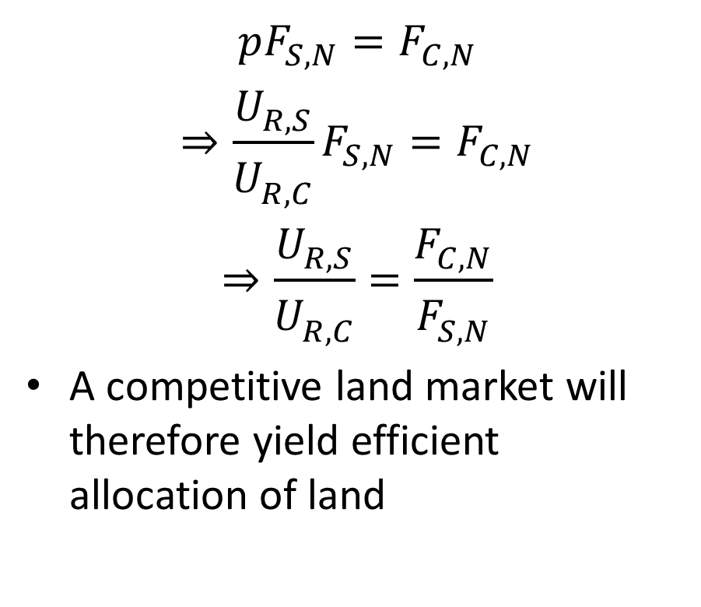
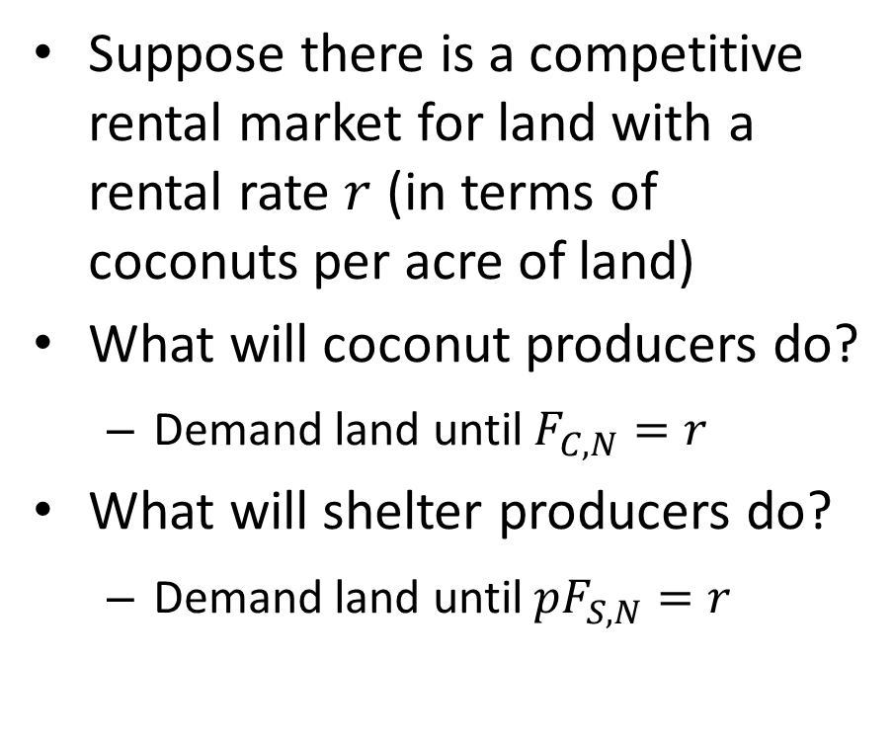
Land Market
Suppose there is a competitive rental market for land with a rental rate $r$ (in terms of coconuts per acre of land)
What will coconut producers do?
Demand land until $F_{C,N}^{}=r$
What will shelter producers do?
Demand land until ${pF}_{S,N}^{}=r$
$$pF_{S,N}^{}=F_{C,N}^{}$$
$$⇒\frac{U_{R,S}^{}}{U_{R,C}^{}}F_{S,N}^{}=F_{C,N}^{}$$
$$⇒\frac{U_{R,S}^{}}{U_{R,C}^{}}=\frac{F_{C,N}^{}}{F_{S,N}^{}}$$
A competitive land market will therefore yield efficient allocation of land

Slide 43
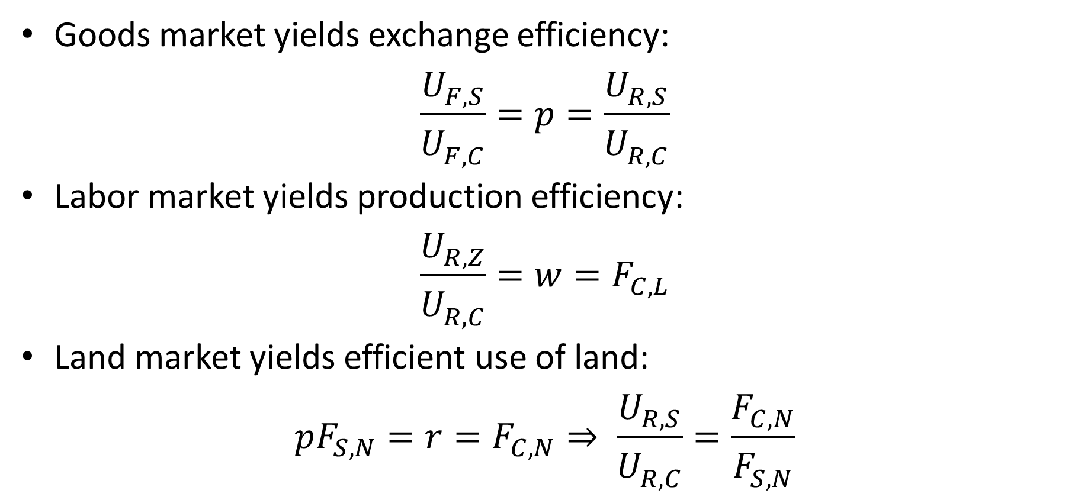
Competitive Markets Can Achieve Efficiency
Goods market yields exchange efficiency:
$$\frac{U_{F,S}^{}}{U_{F,C}^{}}=p=\frac{U_{R,S}^{}}{U_{R,C}^{}}$$
Labor market yields production efficiency:
$$\frac{U_{R,Z}^{}}{U_{R,C}^{}}=w=F_{C,L}^{}$$
Land market yields efficient use of land:
$$pF_{S,N}^{}=r=F_{C,N}^{}⇒ \frac{U_{R,S}^{}}{U_{R,C}^{}}=\frac{F_{C,N}^{}}{F_{S,N}^{}}$$

Slide 44
First Welfare Theorem
If:
Everyone is able to choose what is best for themselves among the set of options they have
Competitive markets for all goods and services (both inputs and output) exist
Property rights over all goods and services are well defined and costlessly enforceable
Equilibrium will be Pareto efficient
This result is called the First Welfare Theorem

Slide 45
First Welfare Theorem
We have derived FWT for a simple example
Can be generalize to economies with:
Any number of goods
Multiple periods (if all people exist at all times)
Uncertainty (as long as information is “symmetric”)

Slide 46
Remarkable Results
Milton and Rose Friedman: “Adam Smith’s flash of genius was his recognition that the prices that emerged from voluntary transactions between buyers and sellers … could coordinate the activity of millions of people, each seeking his [or her] own interest, in such a way as to make everyone better off. It was a startling idea then, and it remains one today.”

Slide 47
Ideal Free Market Capitalism
With competitive markets and well defined property rights: No one can rip off anyone else!!
Competition keeps everyone in check
Everyone is paid their marginal product
All goods are priced at marginal cost
E.g., labor market:
Competition between firms bids wage up to marginal product
Competition between workers bids wage down to marginal product

Slide 48
Implications for Role of Government?
If markets are “complete” and “perfect”, and property rights are well defined and costlessly enforceable, laissez faire government policy yields a Pareto efficient outcome
Even if we are concerned with redistribution, the only necessary government policy is an initial redistribution of wealth. (Second Welfare Theorem discussed in chapter)

Slide 49
“Only”
Low cost enforcement of property rights and contracts and maintenance of institutions needed for competitive markets NOT easy
“Let the market take care of things” is an illusion.
Need to work hard to create maintain competitive markets

Slide 50
Conditions for Efficiency
“Complete” and “perfect” markets for all goods (First Welfare Theorem)
In our simple setting, market for labor, land, coconuts and shelter
In real world, markets for every conceivable thing
Huge “institutional” requirement
Or:
No impediments to private contracts (Coase theorem)
Even with no “markets” if Crusoe and Friday could costlessly negotiate and enforce private contracts they should arrive at an efficient outcome
Also large institutional requirement (enforcement of contracts)
In both cases: Government must exist to enforce property rights and contracts. “Perfect courts” needed.

Slide 51
Flip Side of the Coin
If conditions of “First Welfare Theorem” or “Coase Theorem” are not satisfied, markets / voluntary exchange will not yield an efficient outcome
We will refer to deviations from the conditions needed for the First Welfare Theorem as market failures
Main sources of market failures:
Monopoly, public goods, transactions costs, asymmetric information, imperfect rationality, commitment problems, price and wage rigidity, missing market

Slide 52
Typical Argument about Economic Policy
Issue: Should government do X?
Free market advocate:
Markets can take care of X
Voluntary exchange can take care of X
Very powerful argument rhetorically
One way a skeptic of laissez faire can potentially win argument is by pointing out a market failure and explaining how government can resolve the market failure

