Slide 1
Lecture 5 Consumption and Saving Macroeconomics (Quantitative) Econ 101B
Jón Steinsson
University of California, Berkeley

Slide 2
Where Do We Stand?
We have studied:
Production (labor demand and capital demand)
Household Labor-Leisure (labor supply)
Efficiency of private property/free market setting
Next topic:
Household Consumption-Savings decision

Slide 3
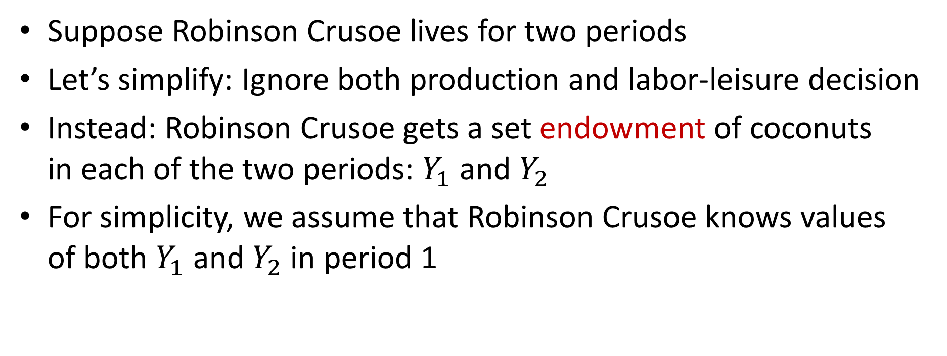
The Consumption-Savings Model
Suppose Robinson Crusoe lives for two periods
Let’s simplify: Ignore both production and labor-leisure decision
Instead: Robinson Crusoe gets a set endowment of coconuts in each of the two periods: $Y_{1}$ and $Y_{2}$
For simplicity, we assume that Robinson Crusoe knows values of both $Y_{1}$ and $Y_{2}$ in period 1

Slide 4
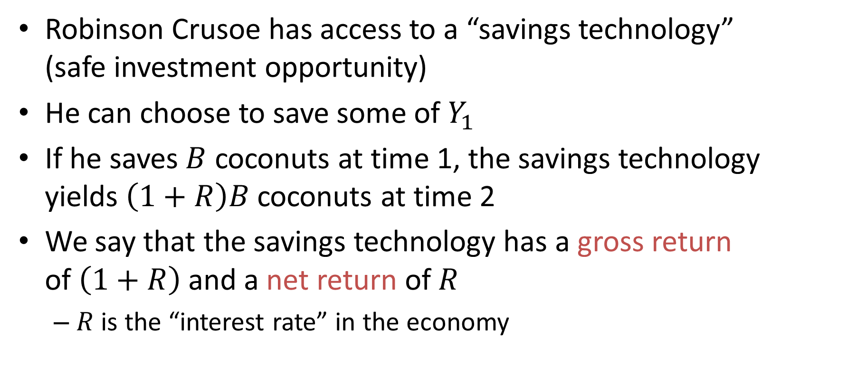
A Savings Technology
Robinson Crusoe has access to a “savings technology” (safe investment opportunity)
He can choose to save some of $Y_{1}$
If he saves $B$ coconuts at time 1, the savings technology yields $\left(1+R\right)B$ coconuts at time 2
We say that the savings technology has a gross return of $\left(1+R\right)$ and a net return of $R$
$R$ is the “interest rate” in the economy

Slide 5
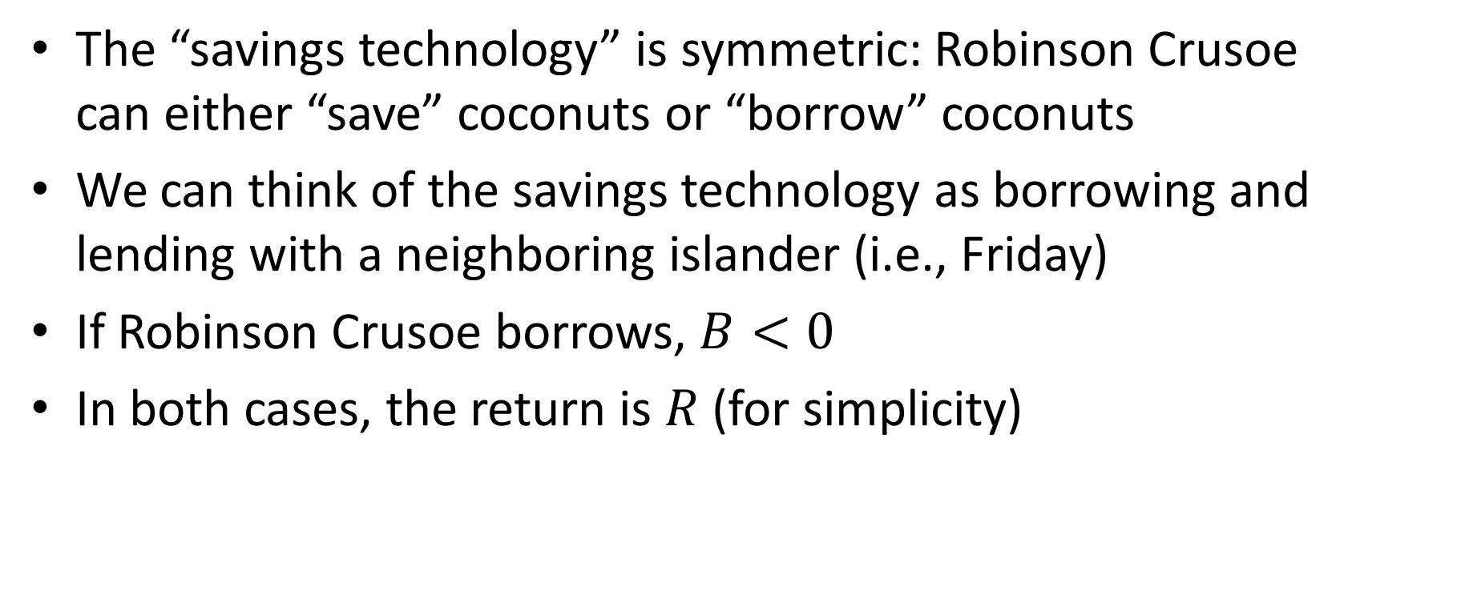
Saving and Borrowing
The “savings technology” is symmetric: Robinson Crusoe can either “save” coconuts or “borrow” coconuts
We can think of the savings technology as borrowing and lending with a neighboring islander (i.e., Friday)
If Robinson Crusoe borrows, $B<0$
In both cases, the return is $R$ (for simplicity)

Slide 6

The Consumption-Savings Model
Robinson Crusoe’s budget constraints are:
In period 1?
$$C_{1}+B=Y_{1}$$
In period 2?
$$C_{2}= Y_{2}+\left(1+R\right)B$$

Slide 7
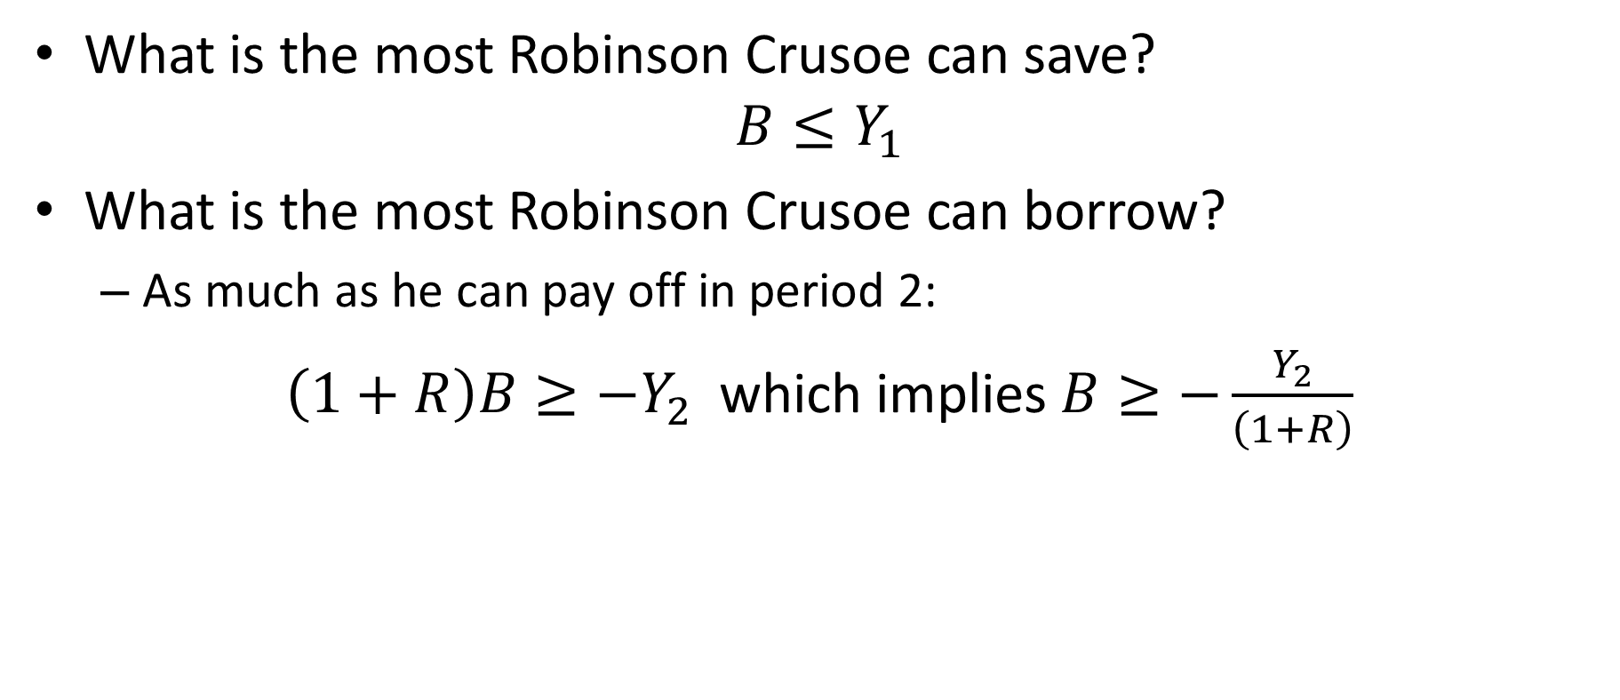
Limits on Saving and Borrowing
What is the most Robinson Crusoe can save?
$$B≤Y_{1}$$
What is the most Robinson Crusoe can borrow?
As much as he can pay off in period 2:
$\left(1+R\right)B≥{−Y}_{2}$ which implies $B≥−\frac{Y_{2}}{\left(1+R\right)}$

Slide 8
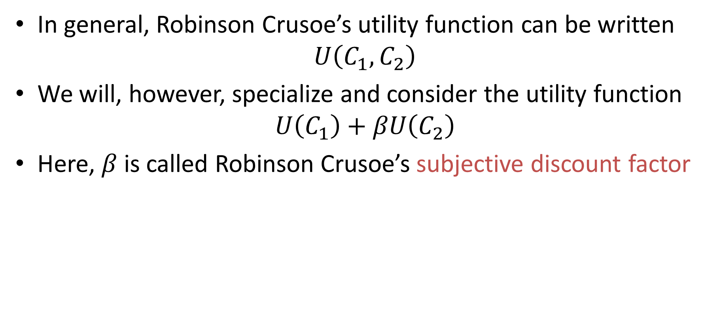
Utility Function
In general, Robinson Crusoe’s utility function can be written
$$U\left(C_{1},C_{2}\right)$$
We will, however, specialize and consider the utility function
$$U\left(C_{1}\right)+βU\left(C_{2}\right)$$
Here, $β$ is called Robinson Crusoe’s subjective discount factor

Slide 9

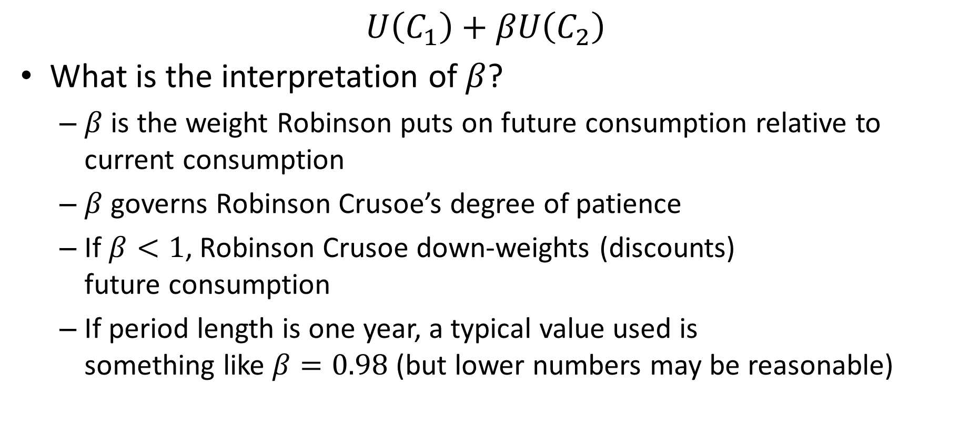
Interpretation of $β$
$$U\left(C_{1}\right)+βU\left(C_{2}\right)$$
What is the interpretation of $β$?
$β$ is the weight Robinson puts on future consumption relative to current consumption
$β$ governs Robinson Crusoe’s degree of patience
If $β<1$, Robinson Crusoe down-weights (discounts) future consumption
If period length is one year, a typical value used is something like $β=0.98$ (but lower numbers may be reasonable)

Slide 10
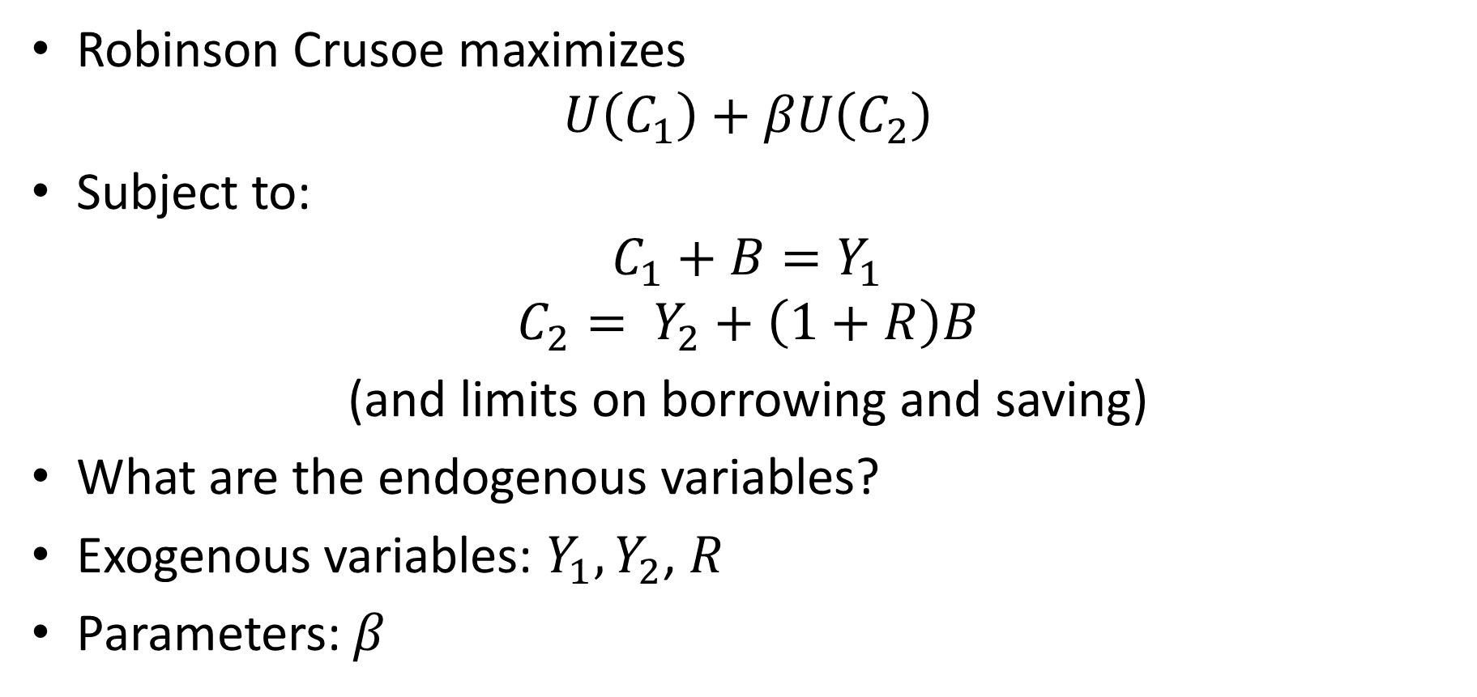

Consumption-Savings Model
Robinson Crusoe maximizes
$$U\left(C_{1}\right)+βU\left(C_{2}\right)$$
Subject to:
$$C_{1}+B=Y_{1}$$
$$C_{2}= Y_{2}+\left(1+R\right)B$$
(and limits on borrowing and saving)
What are the endogenous variables?
Exogenous variables: $Y_{1},Y_{2}$, $R$
Parameters: $β$
$$C_{1},C_{2},B$$

Slide 11
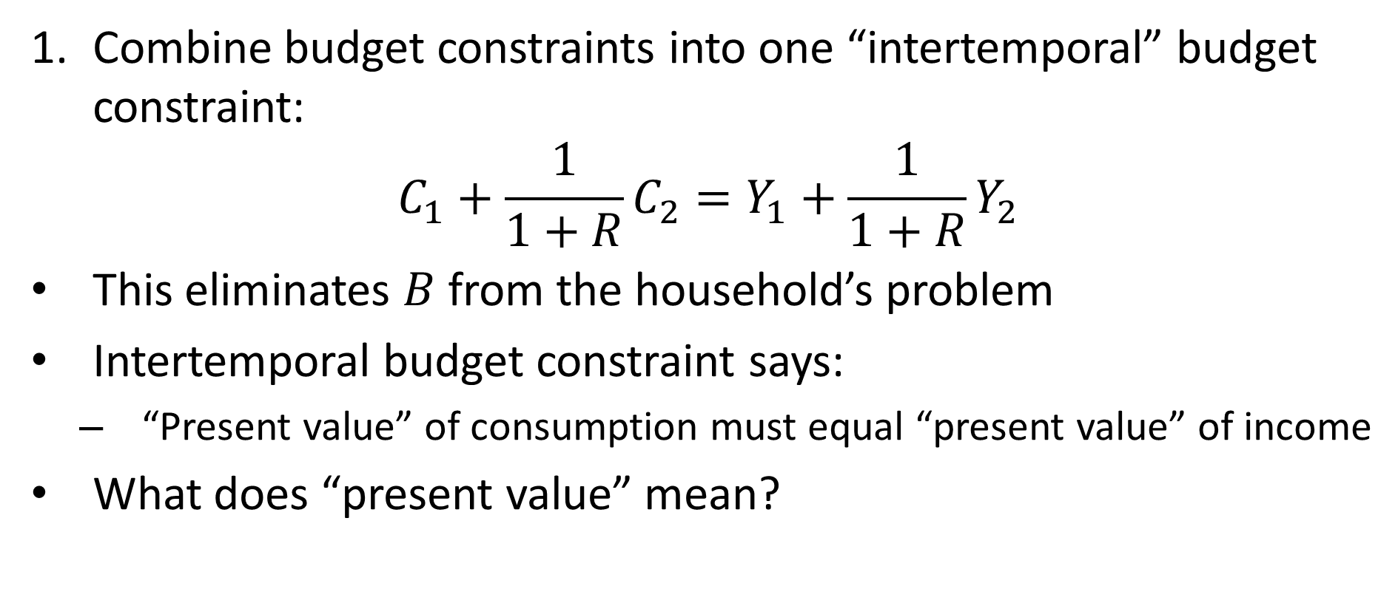
Solving Model: Plug and Chug
Combine budget constraints into one “intertemporal” budget constraint:
$$C_{1}+\frac{1}{1+R}C_{2}=Y_{1}+\frac{1}{1+R}Y_{2}$$
This eliminates $B$ from the household’s problem
Intertemporal budget constraint says:
“Present value” of consumption must equal “present value” of income
What does “present value” mean?

Slide 12
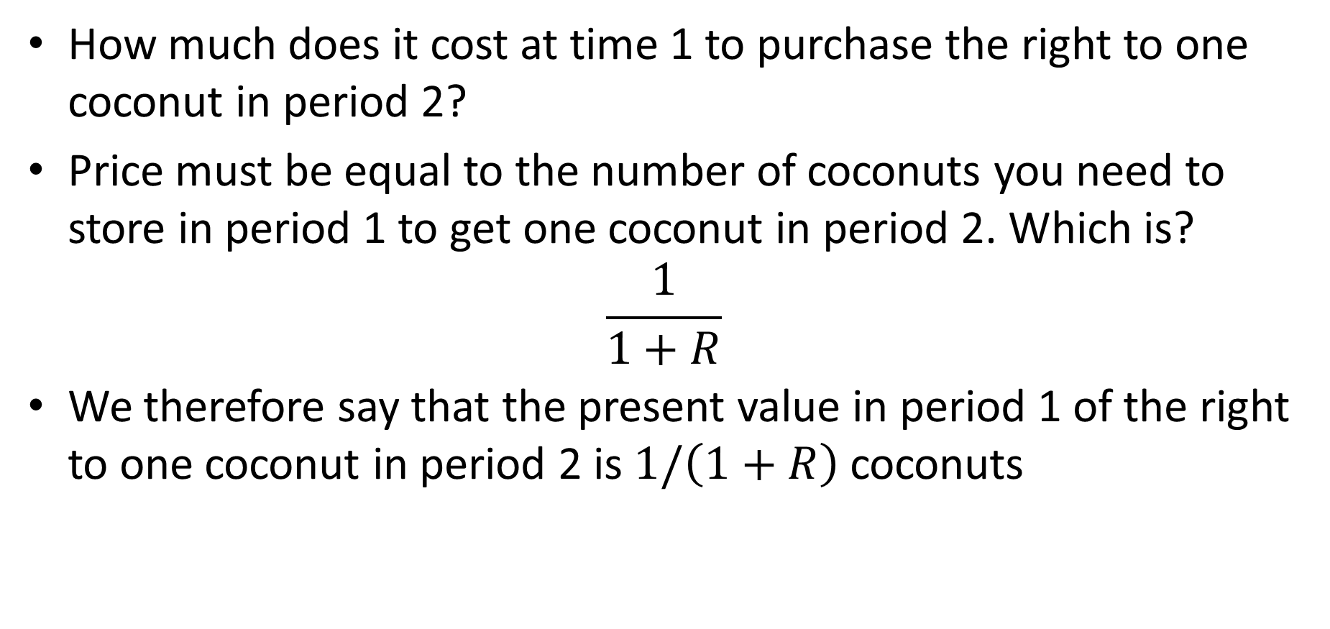
Present Value
How much does it cost at time 1 to purchase the right to one coconut in period 2?
Price must be equal to the number of coconuts you need to store in period 1 to get one coconut in period 2. Which is?
$$\frac{1}{1+R}$$
We therefore say that the present value in period 1 of the right to one coconut in period 2 is $1/\left(1+R\right)$ coconuts

Slide 13
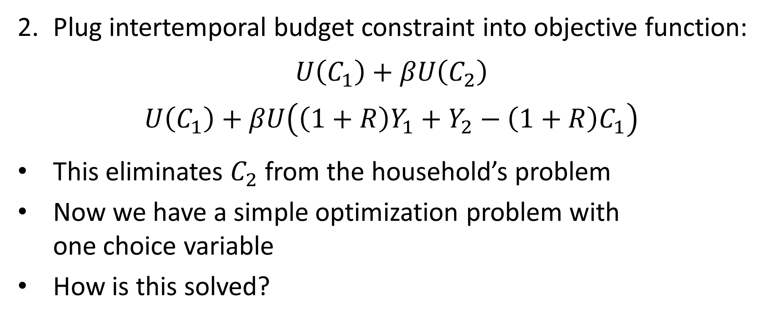
Solving Model
Plug intertemporal budget constraint into objective function:
$$U\left(C_{1}\right)+βU\left(C_{2}\right)$$
$$U\left(C_{1}\right)+βU\left({\left(1+R\right)Y}_{1}+Y_{2}−{\left(1+R\right)C}_{1}\right)$$
This eliminates $C_{2}$ from the household’s problem
Now we have a simple optimization problem with one choice variable
How is this solved?

Slide 14
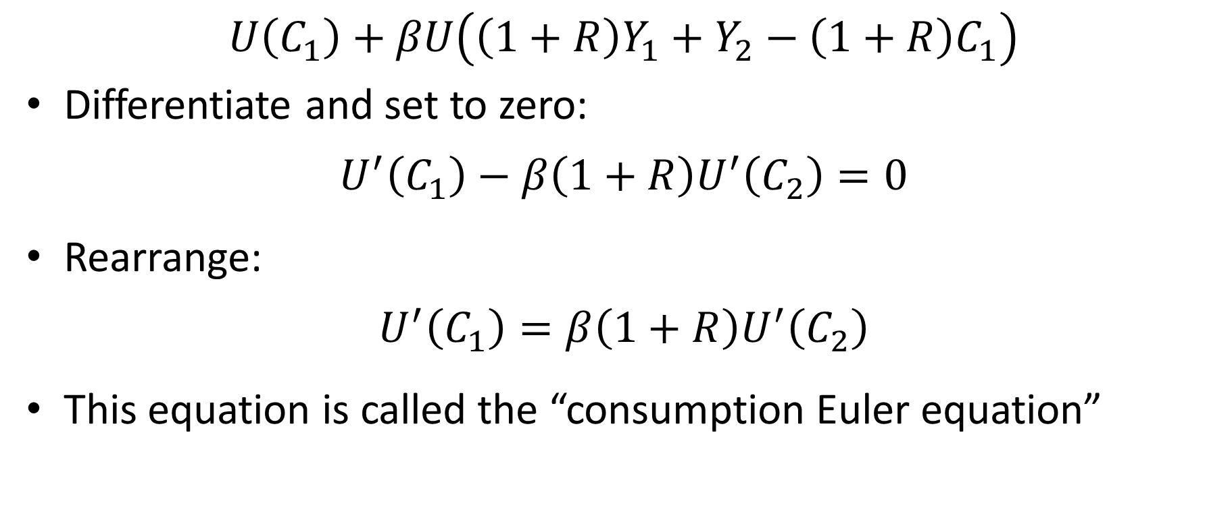
Solving Model
$$U\left(C_{1}\right)+βU\left({\left(1+R\right)Y}_{1}+Y_{2}−{\left(1+R\right)C}_{1}\right)$$
Differentiate and set to zero:
$$U^{′}\left(C_{1}\right)−β\left(1+R\right)U^{′}\left(C_{2}\right)=0$$
Rearrange:
$$U^{′}\left(C_{1}\right)=β\left(1+R\right)U^{′}\left(C_{2}\right)$$
This equation is called the “consumption Euler equation”

Slide 15
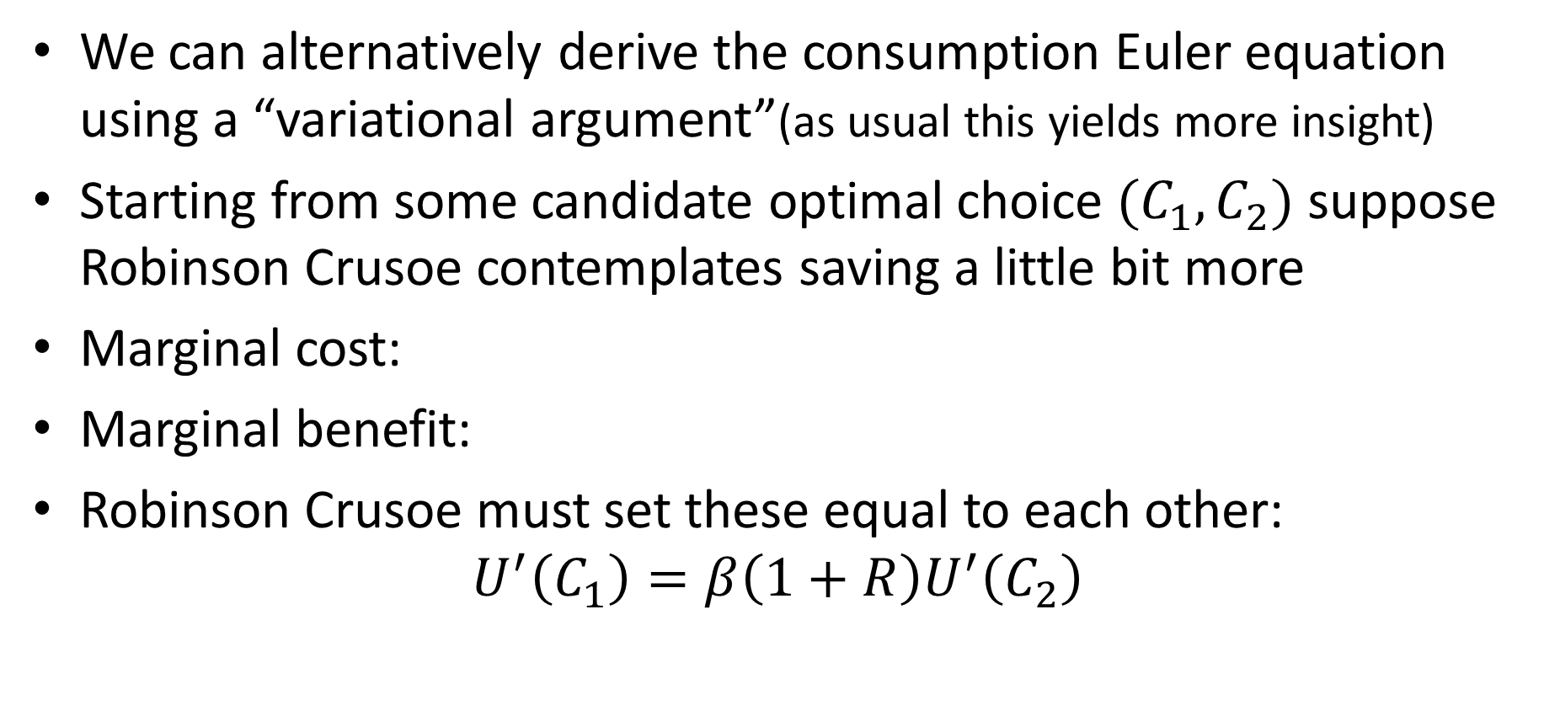


Euler Equation by Variational Argument
We can alternatively derive the consumption Euler equation using a “variational argument”(as usual this yields more insight)
Starting from some candidate optimal choice $(C_{1}, C_{2})$ suppose Robinson Crusoe contemplates saving a little bit more
Marginal cost:
Marginal benefit:
Robinson Crusoe must set these equal to each other:
$$U^{′}\left(C_{1}\right)=β\left(1+R\right)U^{′}\left(C_{2}\right)$$
$$U^{′}\left(C_{1}\right)$$
$$βU^{′}\left(C_{2}\right)\left(1+R\right)$$

Slide 16
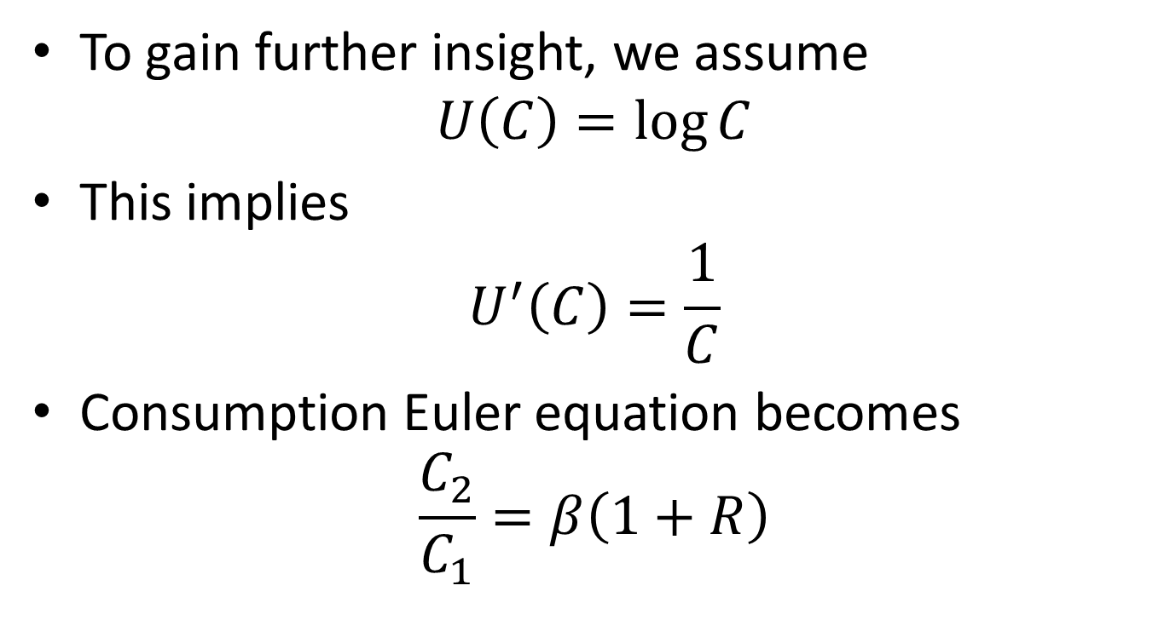
Log Utility
To gain further insight, we assume
$$U\left(C\right)=\log{C}$$
This implies
$$U^{′}\left(C\right)=\frac{1}{C}$$
Consumption Euler equation becomes
$$\frac{C_{2}}{C_{1}}=β\left(1+R\right)$$

Slide 17
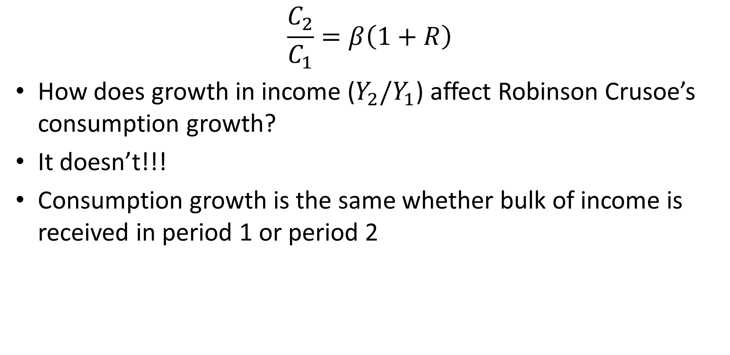
Consumption Growth
$$\frac{C_{2}}{C_{1}}=β\left(1+R\right)$$
How does growth in income ($Y_{2}/Y_{1}$) affect Robinson Crusoe’s consumption growth?
It doesn’t!!!
Consumption growth is the same whether bulk of income is received in period 1 or period 2

Slide 18
Consumption-Savings
Suppose most of income is in period 2
Robinson Crusoe could have consumption track income
Why is this not the “optimal” thing to do?
Because of diminishing marginal utility
Marginal utility will be much lower in period 2 than in period 1
Last coconut in period 2 yields much less utility than next coconut in period 1
So, Robinson Crusoe should transfer consumption to period 1 and increase utility

Slide 19
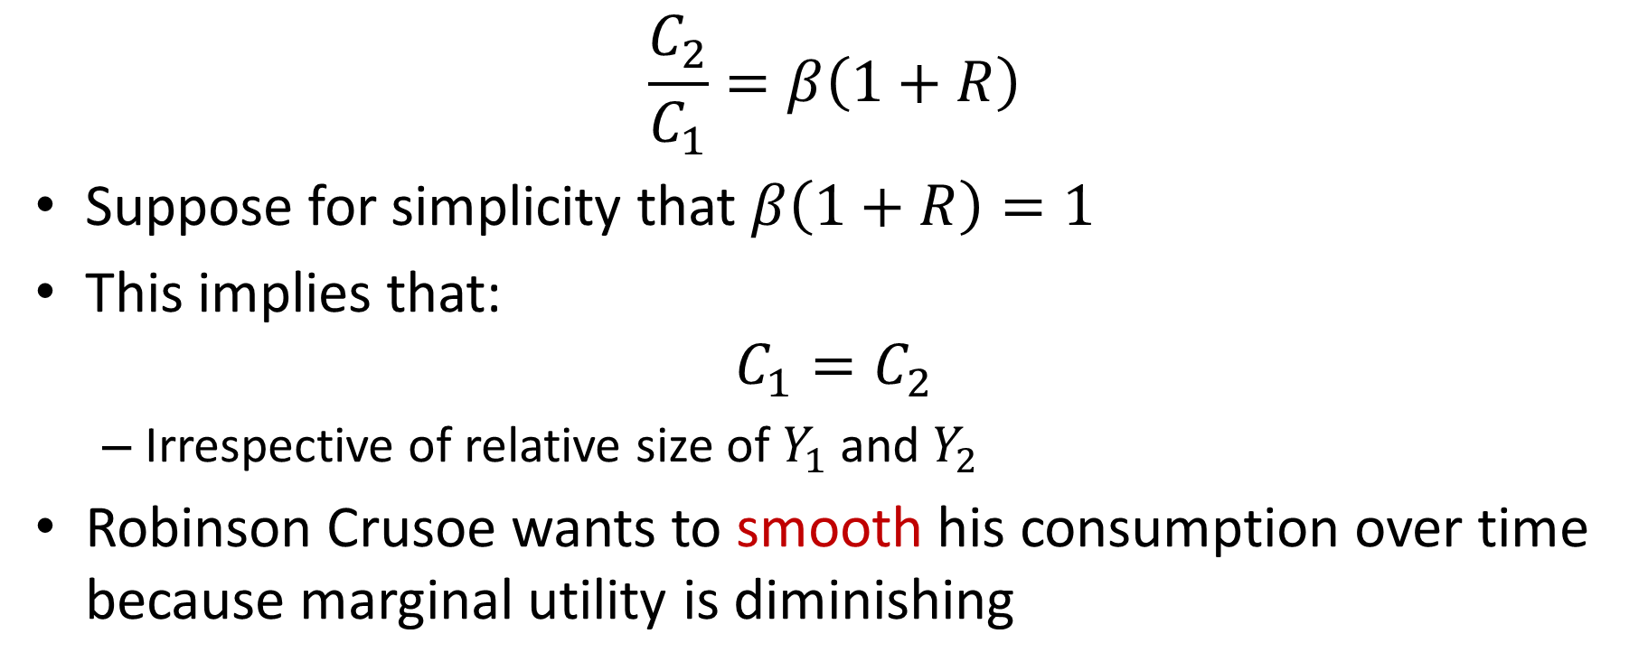
Consumption Smoothing
$$\frac{C_{2}}{C_{1}}=β\left(1+R\right)$$
Suppose for simplicity that $β\left(1+R\right)=1$
This implies that:
$$C_{1}=C_{2}$$
Irrespective of relative size of $Y_{1}$ and $Y_{2}$
Robinson Crusoe wants to smooth his consumption over time because marginal utility is diminishing

Slide 20
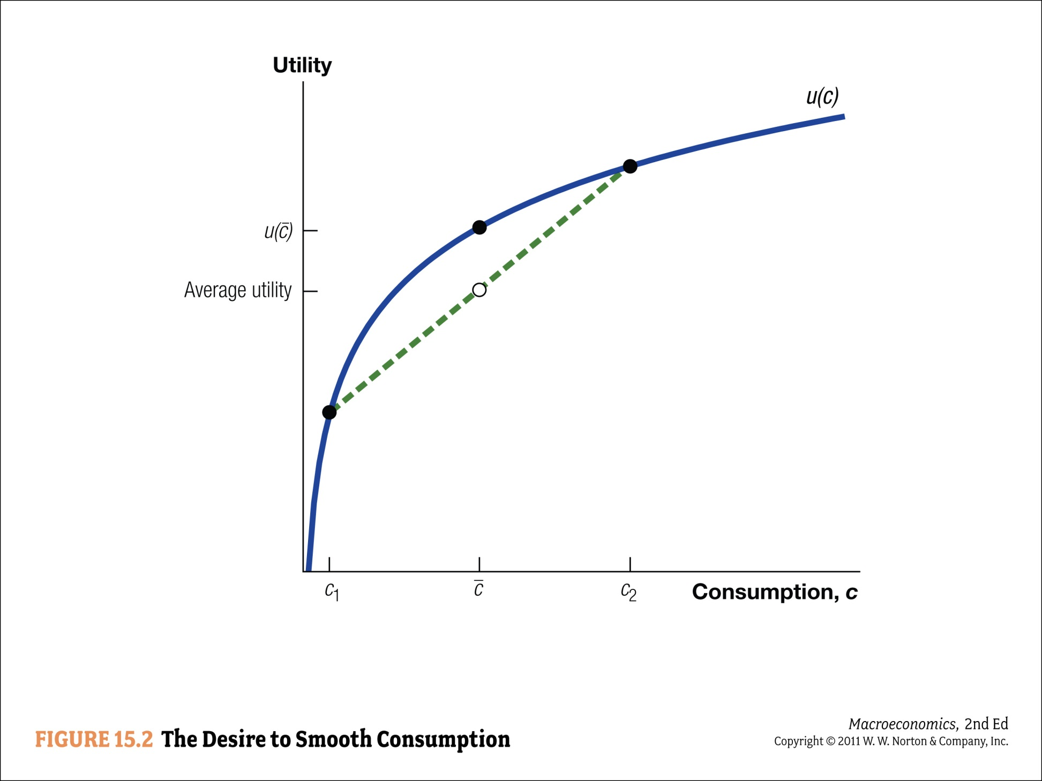

Slide 21
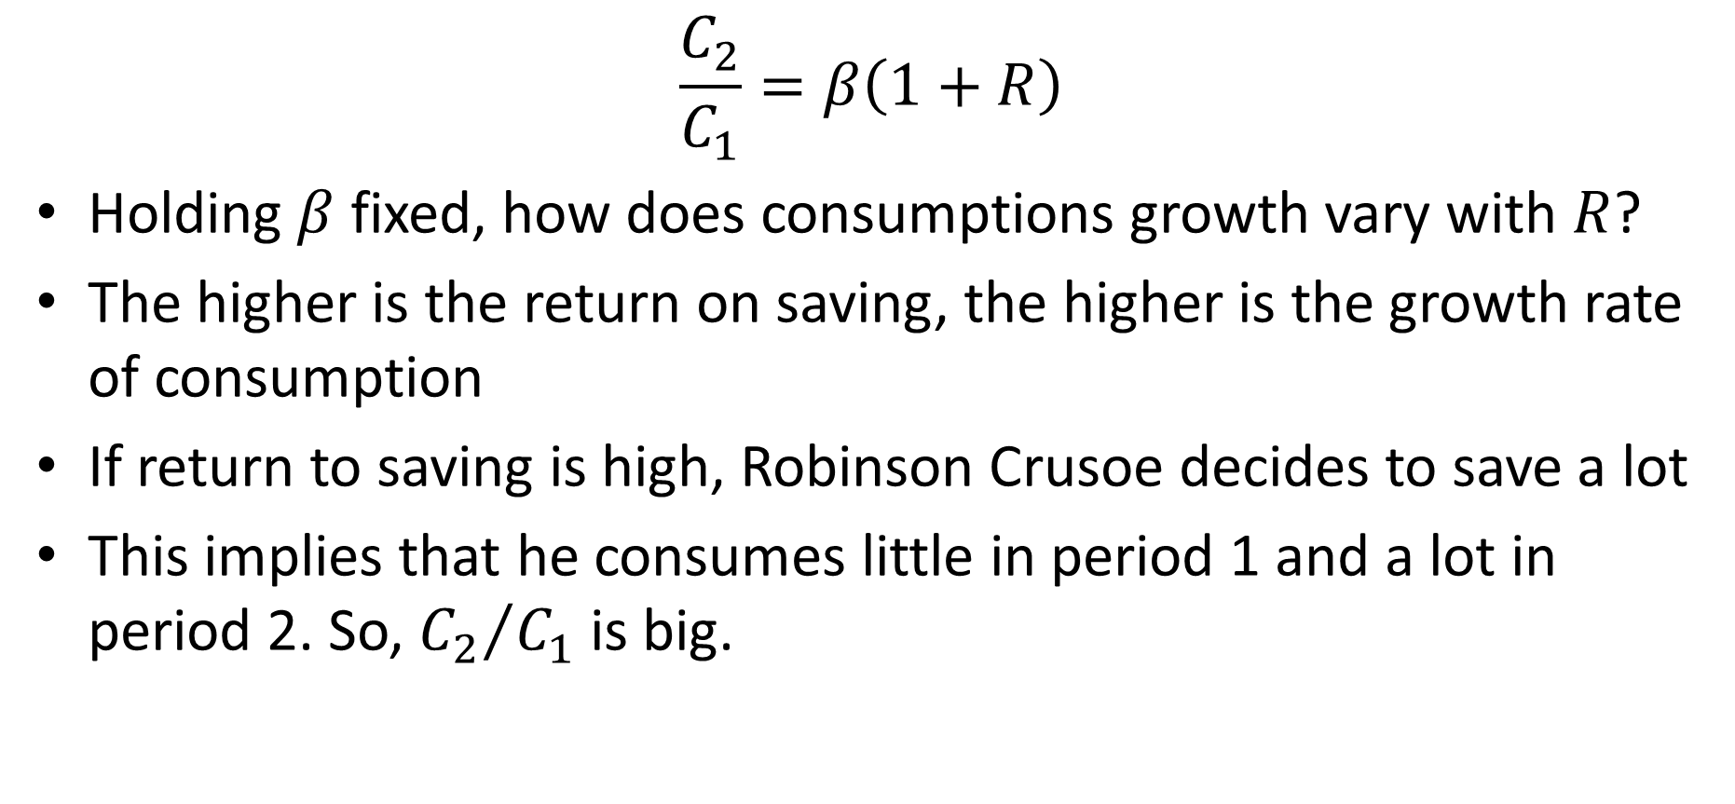
Consumption Growth
$$\frac{C_{2}}{C_{1}}=β\left(1+R\right)$$
Holding $β$ fixed, how does consumptions growth vary with $R$?
The higher is the return on saving, the higher is the growth rate of consumption
If return to saving is high, Robinson Crusoe decides to save a lot
This implies that he consumes little in period 1 and a lot in period 2. So, ${C_{2}}/{C_{1}}$ is big.

Slide 22
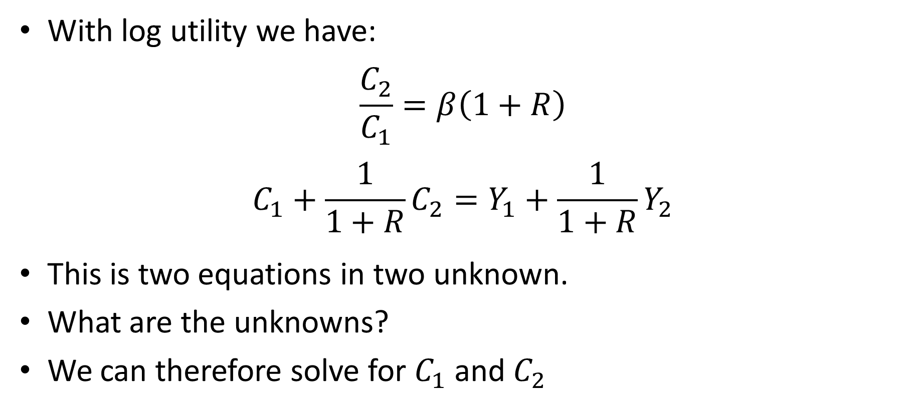
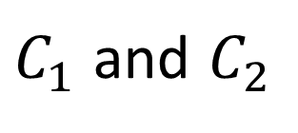
Solving for Level of Consumption
With log utility we have:
$$\frac{C_{2}}{C_{1}}=β\left(1+R\right)$$
$$C_{1}+\frac{1}{1+R}C_{2}=Y_{1}+\frac{1}{1+R}Y_{2}$$
This is two equations in two unknown.
What are the unknowns?
We can therefore solve for $C_{1}$ and $C_{2}$
$C_{1}$ and $C_{2}$

Slide 23
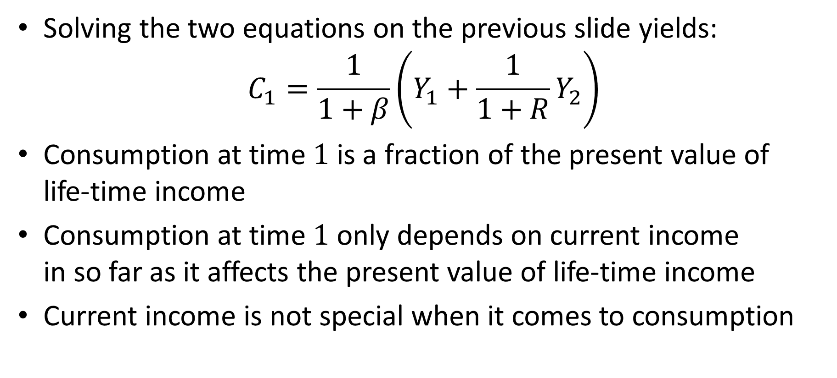
Level of Consumption
Solving the two equations on the previous slide yields:
$$C_{1}=\frac{1}{1+β}\left(Y_{1}+\frac{1}{1+R}Y_{2}\right)$$
Consumption at time $1$ is a fraction of the present value of life-time income
Consumption at time $1$ only depends on current income in so far as it affects the present value of life-time income
Current income is not special when it comes to consumption

Slide 24
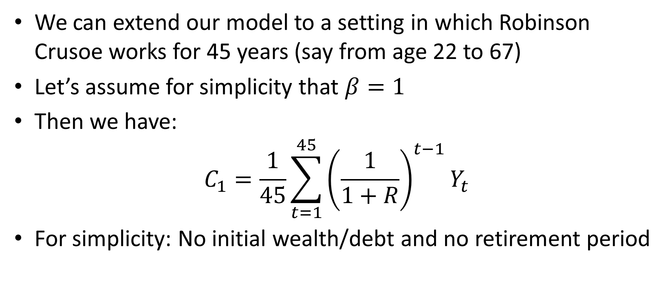
45 Year Working Life
We can extend our model to a setting in which Robinson Crusoe works for 45 years (say from age 22 to 67)
Let’s assume for simplicity that $β=1$
Then we have:
$$C_{1}=\frac{1}{45}\sum_{t=1}^{45}{{\left(\frac{1}{1+R}\right)}^{t−1}Y_{t}}$$
For simplicity: No initial wealth/debt and no retirement period

Slide 25
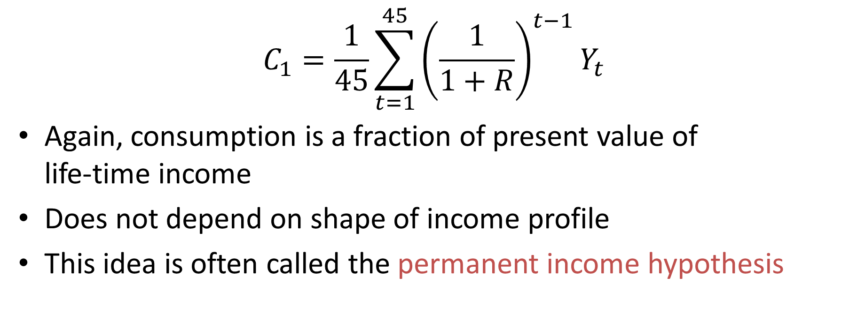
Consumption and Income
$$C_{1}=\frac{1}{45}\sum_{t=1}^{45}{{\left(\frac{1}{1+R}\right)}^{t−1}Y_{t}}$$
Again, consumption is a fraction of present value of life-time income
Does not depend on shape of income profile
This idea is often called the permanent income hypothesis

Slide 26
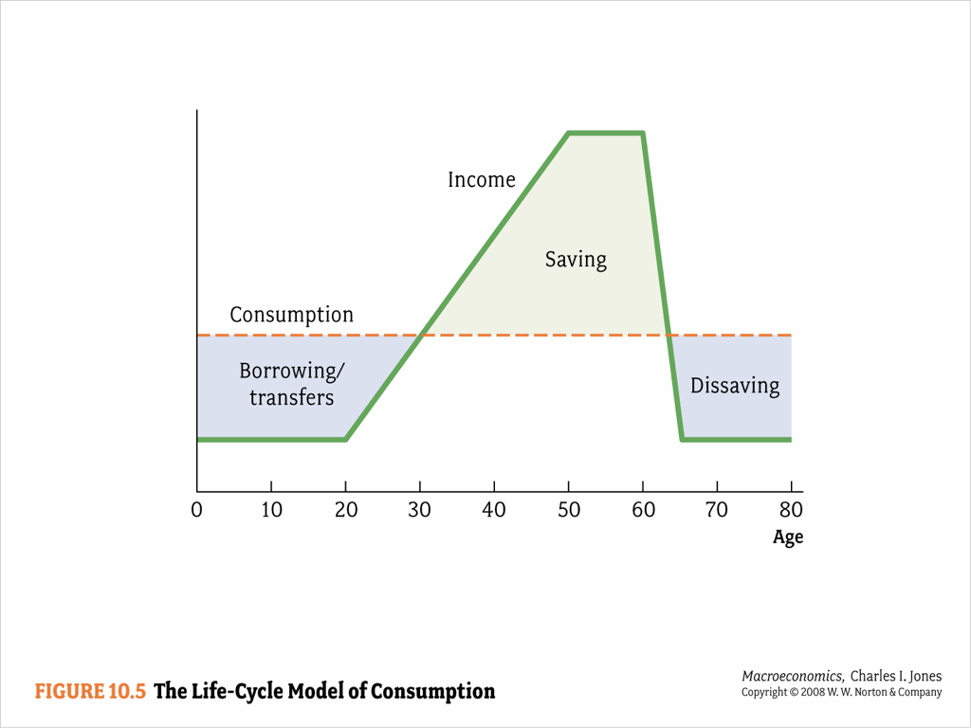
Permanent Income Hypothesis

Slide 27
Poll
Suppose you receive a surprise one-time $1,000 scholarship. How much of the funds would you spend within a year? (paying down debts is not spending)
0-20%
20-40%
40-60%
60-80%
80-100%

Slide 28
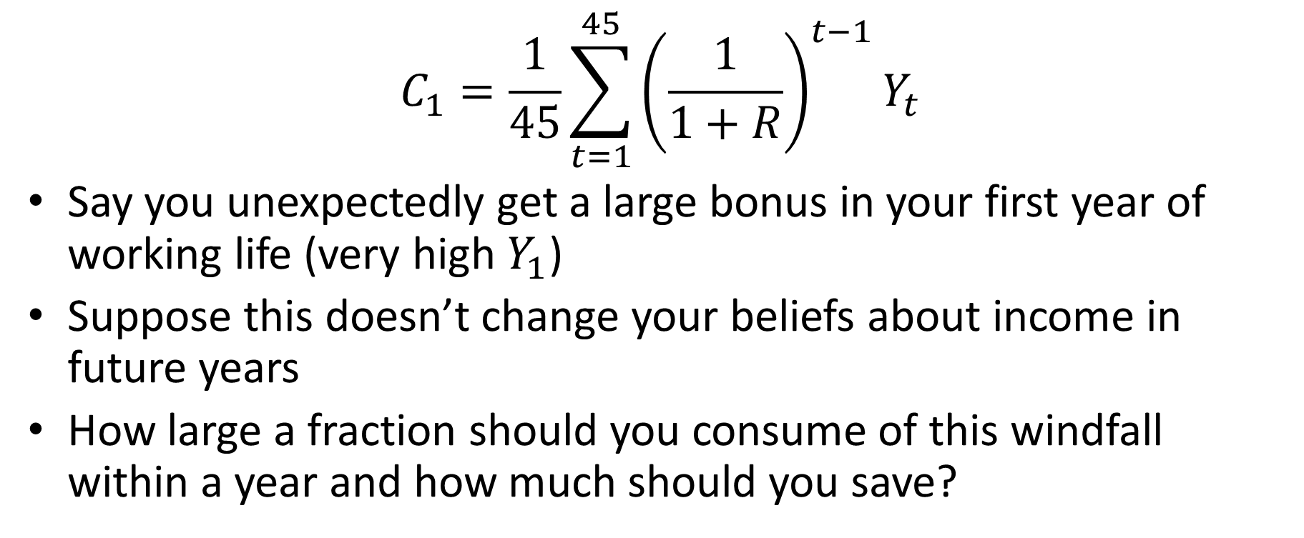
Consumption and Income
$$C_{1}=\frac{1}{45}\sum_{t=1}^{45}{{\left(\frac{1}{1+R}\right)}^{t−1}Y_{t}}$$
Say you unexpectedly get a large bonus in your first year of working life (very high $Y_{1}$)
Suppose this doesn’t change your beliefs about income in future years
How large a fraction should you consume of this windfall within a year and how much should you save?

Slide 29
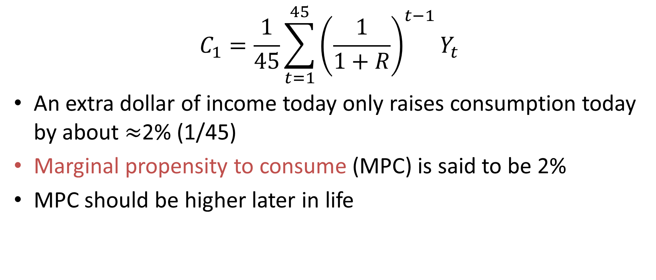
Marginal Propensity to Consume
$$C_{1}=\frac{1}{45}\sum_{t=1}^{45}{{\left(\frac{1}{1+R}\right)}^{t−1}Y_{t}}$$
An extra dollar of income today only raises consumption today by about $≈$2% (1/45)
Marginal propensity to consume (MPC) is said to be 2%
MPC should be higher later in life

Slide 30
Forward-Looking Behavior
Consumption-savings model embodies forward-looking behavior on the part of Robinson Crusoe
Nothing special about current period income
Current consumption depends on current and future income, NOT past consumption
Forward-looking behavior unique to economics (nothing like this in physics)

Slide 31
Forward-Looking Behavior
Suppose you are hiking down a mountain.
You don’t take the easiest first step, the easiest second step, …, and then fall off a cliff
You look ahead and plot a route that overall is best.
This is forward-looking behavior
Water does not look down the hillside and decide on the “best” way down
Water is not forward-looking

Slide 32
Forward-Looking Behavior
60 years ago, economists modeled people as behaving much like water (today’s consumption depending on yesterday’s consumption and current income)
The idea that people display forward-looking behavior is one of the most important ideas of 20th century macroeconomics
Pioneered by Milton Friedman and Robert Lucas among others

Slide 33
Rational Expectations
Today, most economists model people as forming “rational expectations” about the future and acting optimally given these expectations.
Rational expectations: People should form optimal forecasts given their information
They should not make systematic mistakes (mistakes they should have been able to avoid given their information)
Very strong form of forward-looking behavior

Slide 34
Rational Expectations
Do people have rational expectations?
Think of a wide-receiver in football. Where does he run?
In contrast, think of a squirrel (or an infant).
Needless to say, rational expectations is very controversial
Real world is probably somewhere in between:
People are forward-looking
But perhaps not fully rational
Much current research focuses on this

Slide 35
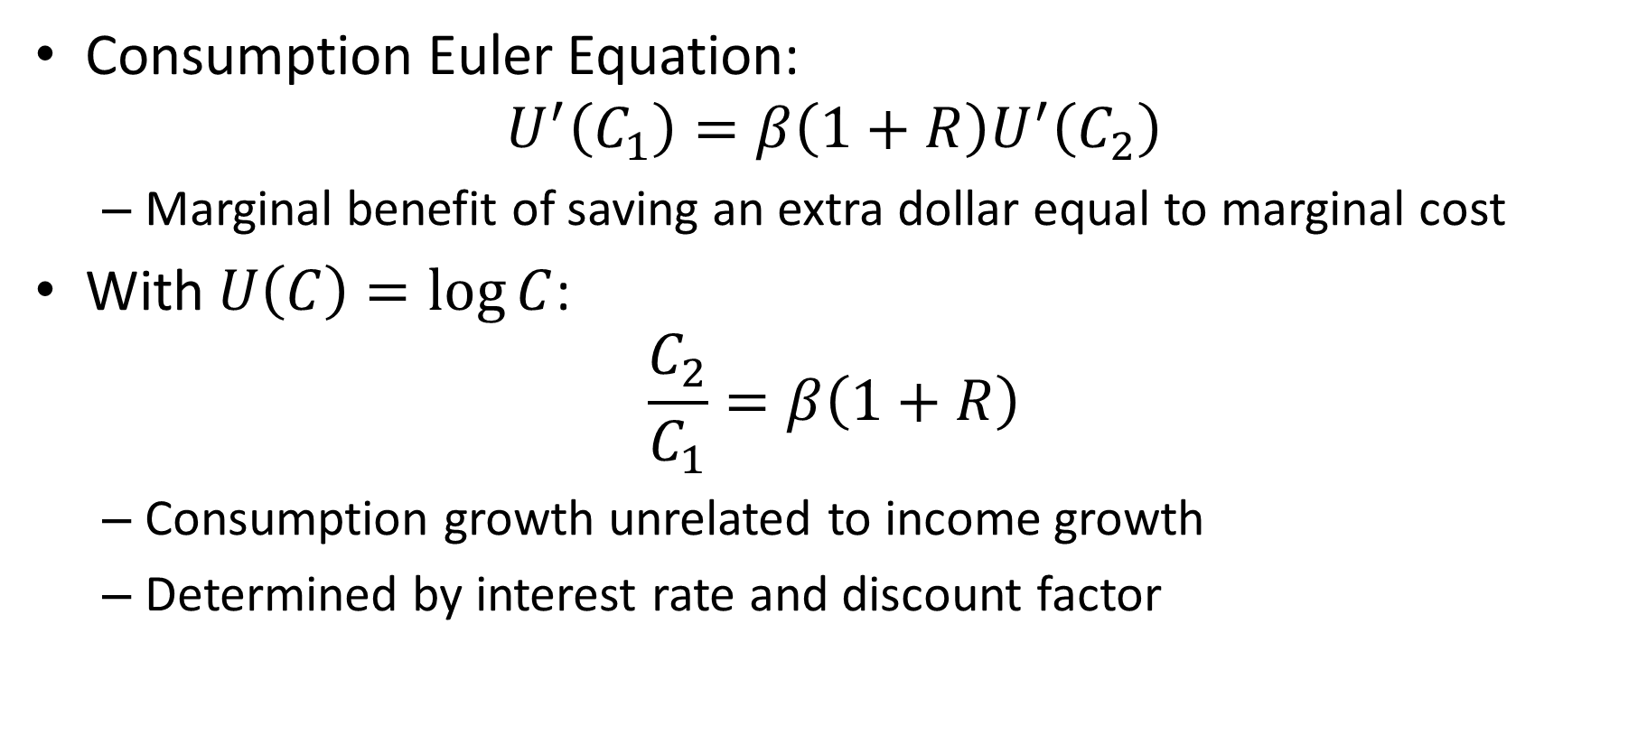
Consumption-Savings: Review
Consumption Euler Equation:
$$U^{′}\left(C_{1}\right)=β\left(1+R\right)U^{′}\left(C_{2}\right)$$
Marginal benefit of saving an extra dollar equal to marginal cost
With $U\left(C\right)=\log{C}$:
$$\frac{C_{2}}{C_{1}}=β\left(1+R\right)$$
Consumption growth unrelated to income growth
Determined by interest rate and discount factor

Slide 36
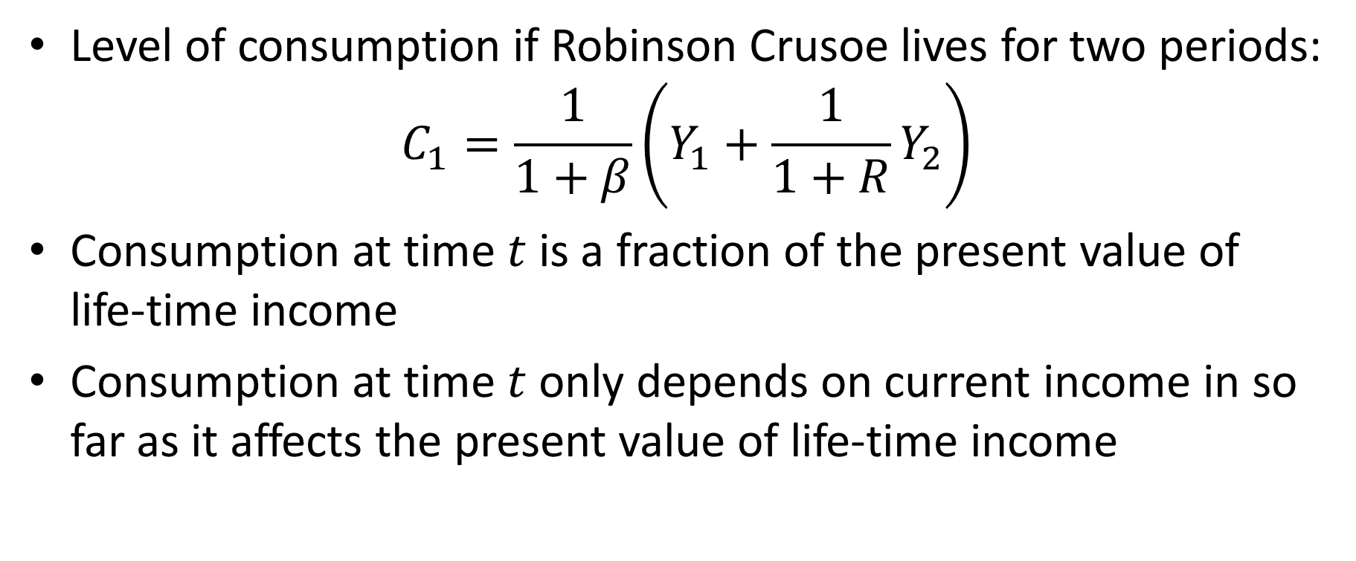
Consumption-Savings: Review
Level of consumption if Robinson Crusoe lives for two periods:
$$C_{1}=\frac{1}{1+β}\left(Y_{1}+\frac{1}{1+R}Y_{2}\right)$$
Consumption at time $t$ is a fraction of the present value of life-time income
Consumption at time $t$ only depends on current income in so far as it affects the present value of life-time income

Slide 37
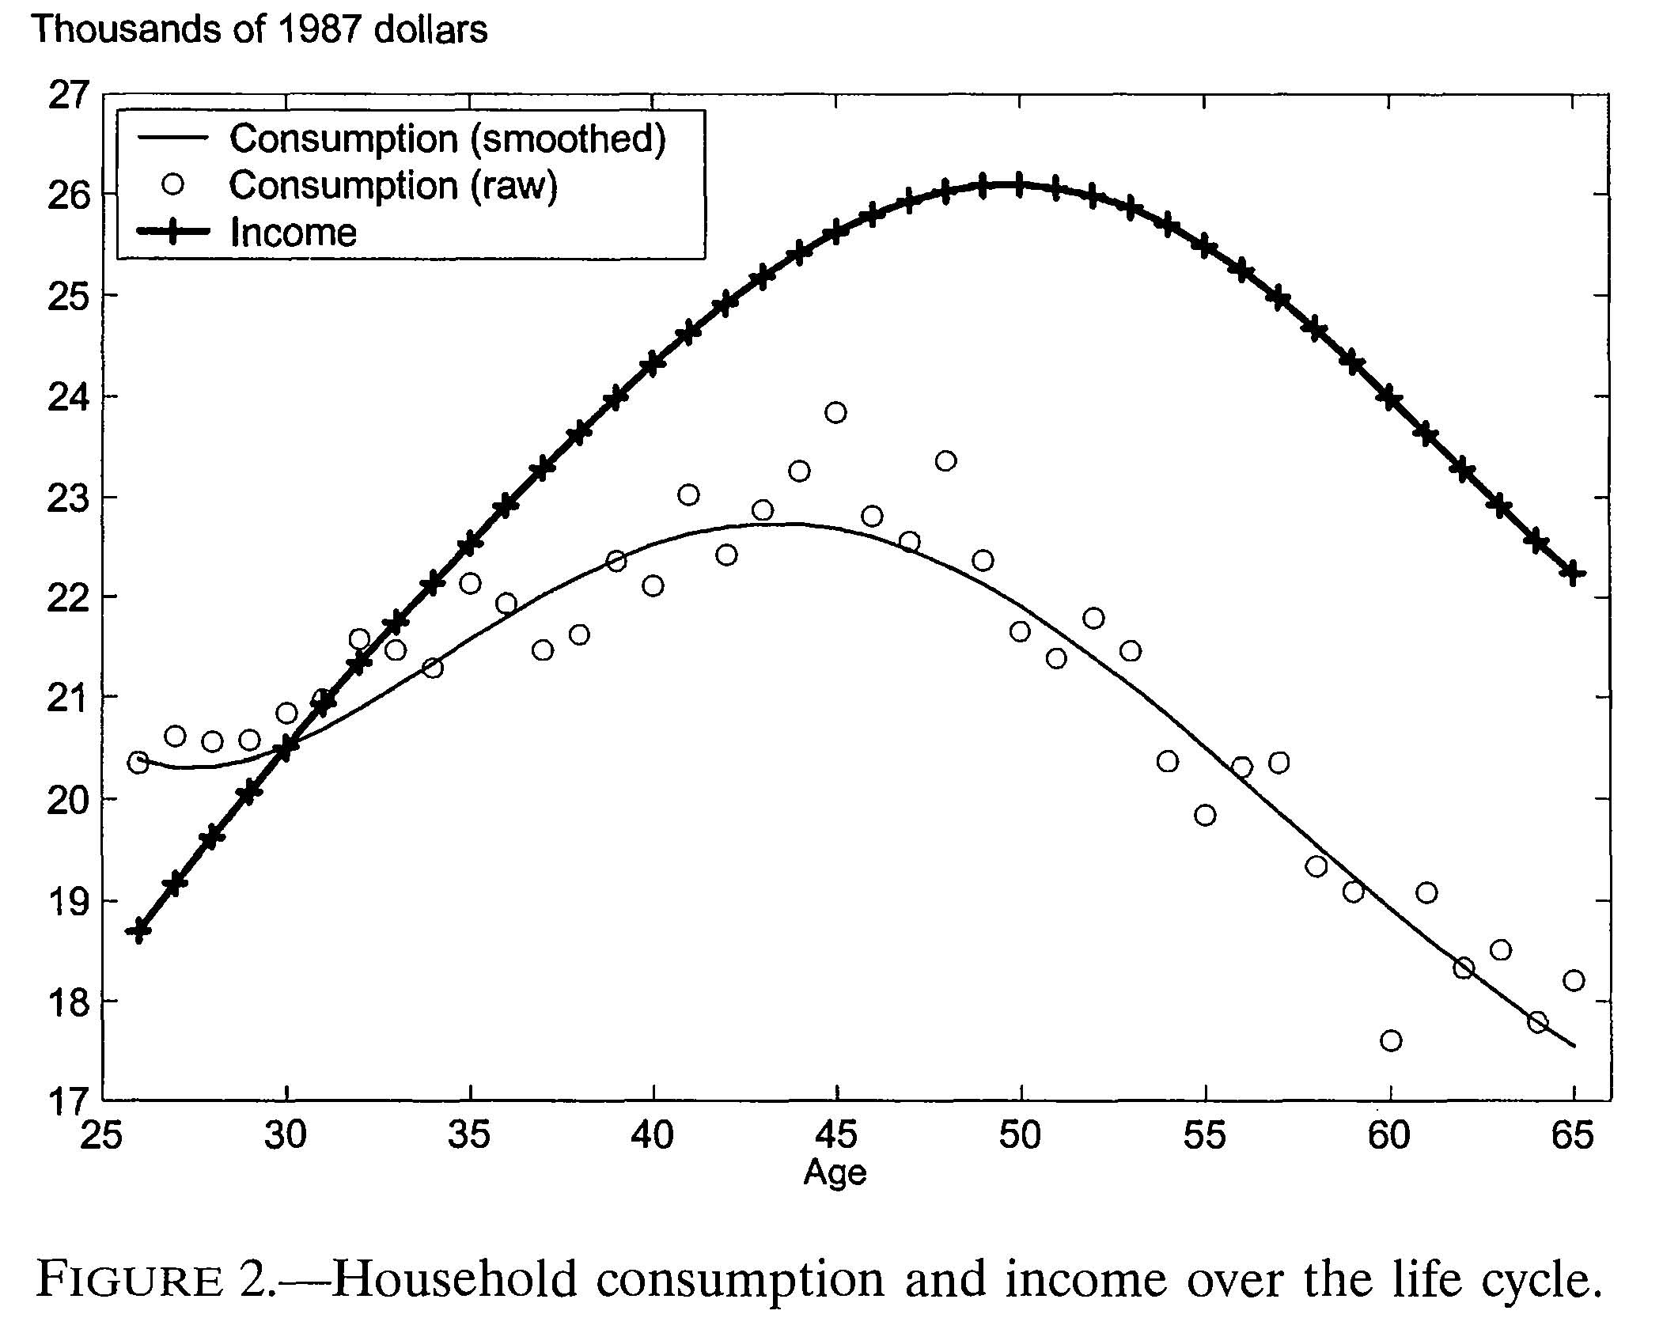
Does the Model Fit the Data?
Gourinchas and Parker (2002)

Slide 38
Does the Model Fit the Data?
No
What does it miss?
Model implies a constant growth rate of consumption (Euler equation)
Data show a hump shaped pattern of consumption over the life cycle
Consumption profile seems to mimic income profile, while model says it shouldn’t

Slide 39
What Is Wrong with the Model?
People are not forward looking?
Well, they do save for retirement
People’s preferences change over time?
Need more consumption when have young children (Gourinchas-Parker try to take this into account)
People can’t borrow against future income?
Young people want to build up buffer stock of savings (“rainy day fund”)?

Slide 40
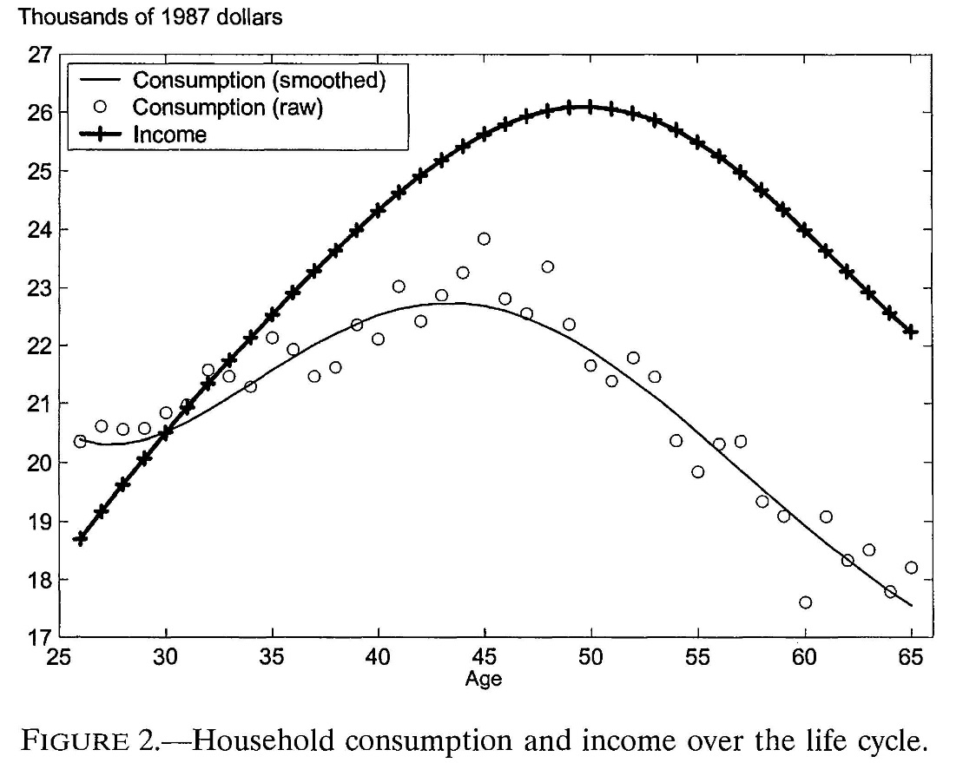
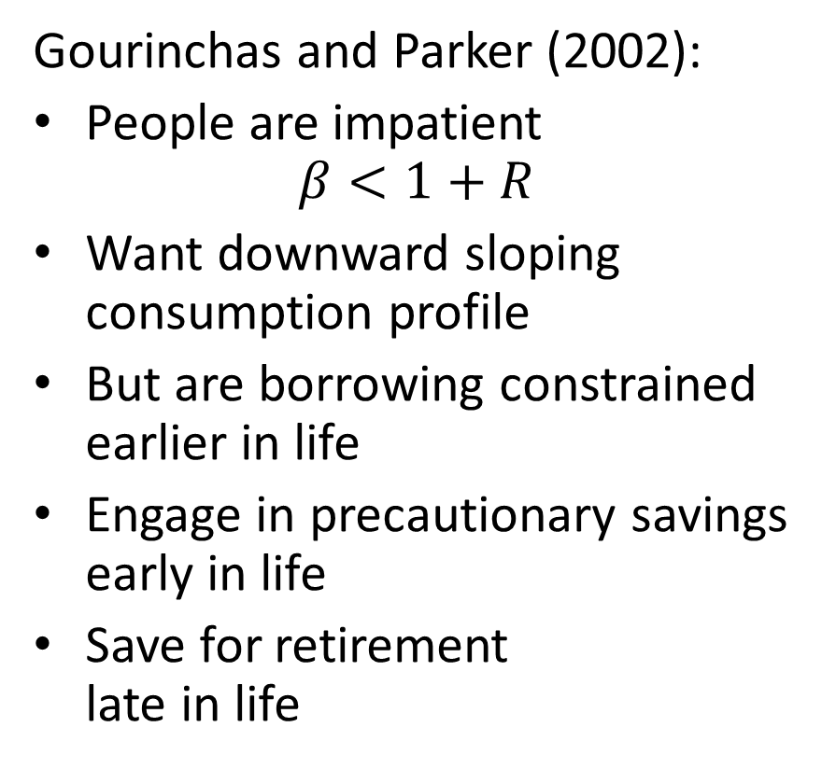
How to Make Sense of Evidence?
Gourinchas and Parker (2002):
People are impatient $β<1+R$
Want downward sloping consumption profile
But are borrowing constrained earlier in life
Engage in precautionary savings early in life
Save for retirement late in life
Gourinchas and Parker (2002)

Slide 41
Consumption-Saving
Three important ideas:
Consumption smoothing
Diminishing marginal utility implies that households should borrow when income is low and save when income is high
Borrowing constraints
Prevent households from smoothing consumption as much as they would like
Precautionary savings
Even when income is low, might want to build up buffer stock of savings as a precaution against future setbacks

Slide 42
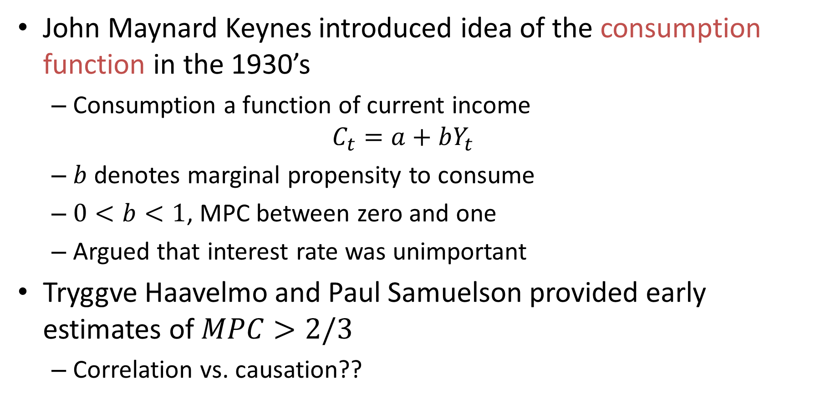
History of Thought
John Maynard Keynes introduced idea of the consumption function in the 1930’s
Consumption a function of current income
$$C_{t}=a+bY_{t}$$
$b$ denotes marginal propensity to consume
$0<b<1$, MPC between zero and one
Argued that interest rate was unimportant
Tryggve Haavelmo and Paul Samuelson provided early estimates of $MPC>2/3$
Correlation vs. causation??

Slide 43
History of Thought
Keynes’ consumption function implied:
Savings rate should rise as country gets richer
Some economists worried that there wouldn’t be enough profitable investment to absorb increase in savings. This would lead to stagnation.
In 1940’s Simon Kuznetz gathered data on GDP and consumption back to 1860’s.
Consumption turned out to be stable as a share of GDP. Savings rate did not seem to rise as economy grew

Slide 44
History of Thought
Dorothy Brady and Rose D. Friedman (1947):
Re-analyzed budget study data
Consumption function shifts up over time as average income increases
Margret Reid (unpublished):
Re-analyzed budget study data
Introduced the concept of “permanent component of income”
“dealt a fatal blow to this extraordinarily simple view of the savings process” (i.e. the Keynesian consumption function)
--- Modigliani (1986)

Slide 45
History of Thought
In the 1950’s Franco Modigliano (and co-authors) proposed the life-cycle hypothesis:
Consumers smooth consumption relative to income (e.g., save for retirement)
Consumers are forward-looking
Savings rate not related to level of income but rather current income relative to average income over life
Savings rate doesn’t rise with life-time income

Slide 46
History of Thought
In 1957, Milton Friedman proposed the permanent income effect (developed with Brady, Rose Friedman, and Reid)
Consumption not related to current income but rather “permanent income”
MPC out of “windfall” much lower than what Keynesians say, perhaps about 1/3
Why 1/3 as opposed to 1/45? (Today we use the term permanent income hypothesis for a model that implies MPC = 1/45)

Slide 47
History of Thought
Empirical Evidence in 1950’s and 1960’s:
Spending out of unanticipated payments in 1950 to U.S. veterans holding National Service Life Insurance was between 0.3 and 0.5
Spending out of reparations payments by Germany to Israelis in 1957-58 was about 0.2

Slide 48
History of Thought
In 1978, Robert Hall writes down model much like ours and argues for a MPC of 0.05.
Also, consumption should be a random walk (with trend because of interest rate)
Only unanticipated changes income should affect consumption (anticipated changes should already be factored into consumption since people are forward-looking)
In 1982, Hall and Mishkin (1982) estimate MPC to consume of 0.2 and conclude model is wrong because MPC is too high.

Slide 49
History of Thought
Since 1980:
Economists incorporate borrowing constraints and precautionary savings due to uncertainty about the future into model
This raises MPC in the model back up to 0.2-0.4
Key contributers: Stephen Zeldes, Christopher Carrol, Pierre-Olivier Gourinchas and Jonathan Parker.

