Slide 1
Lecture 6A Malthus and Pre-Industrial Stagnation Macroeconomics (Quantitative) Econ 101B
Jón Steinsson
University of California, Berkeley

Slide 2
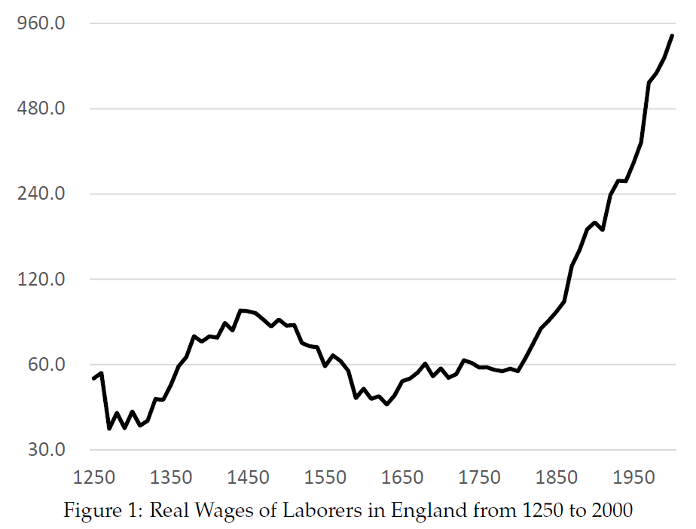
Growth Is A Modern Phenomenon
Real wages stagnant before 1800
Sizable fluctuations before 1800, but not growth
Growth begin around 1800 in Britain (and then spread)
18th and 19th century Britain is a major turning point in history which we now refer to as the Industrial Revolution

Slide 3
Key Questions About Origins of Growth
Why was there no growth before the Industrial Revolution?
Why did the Industrial Revolution happen?
Why did it happen in 18th and 19th century?
Why did it happen in Britain?
Why did the Industrial Revolution result in modern sustained growth? (Why didn’t it peter out like earlier “golden ages”?)

Slide 4
Why No Growth Before the Industrial Revolution?
Despotism: Those that grew rich got attacked by poorer neighbors
Lack of freedom: Slavery and serfdom widespread. Cage of norms impedes occupational freedom.
Vested interests favoring status quo: Powerful forces working against innovation and change
Population dynamics: Higher wages lead to population growth, which pushed down wages

Slide 5
Malthus’ Idea
In 1798, Thomas Malthus published an essay titled An Essay on the Principle of Population
Argued that sustained growth in real wages was impossible in the long run
If real wages increased, this would lead to an increase in population that would only stop when wages had been bid down to subsistence
Notes:
This basic idea was evident in the writings of Smith and Ricardo as well (see Wrigley). But Malthus’ work focused on it and it is primarily associated with Malthus today.

Slide 6
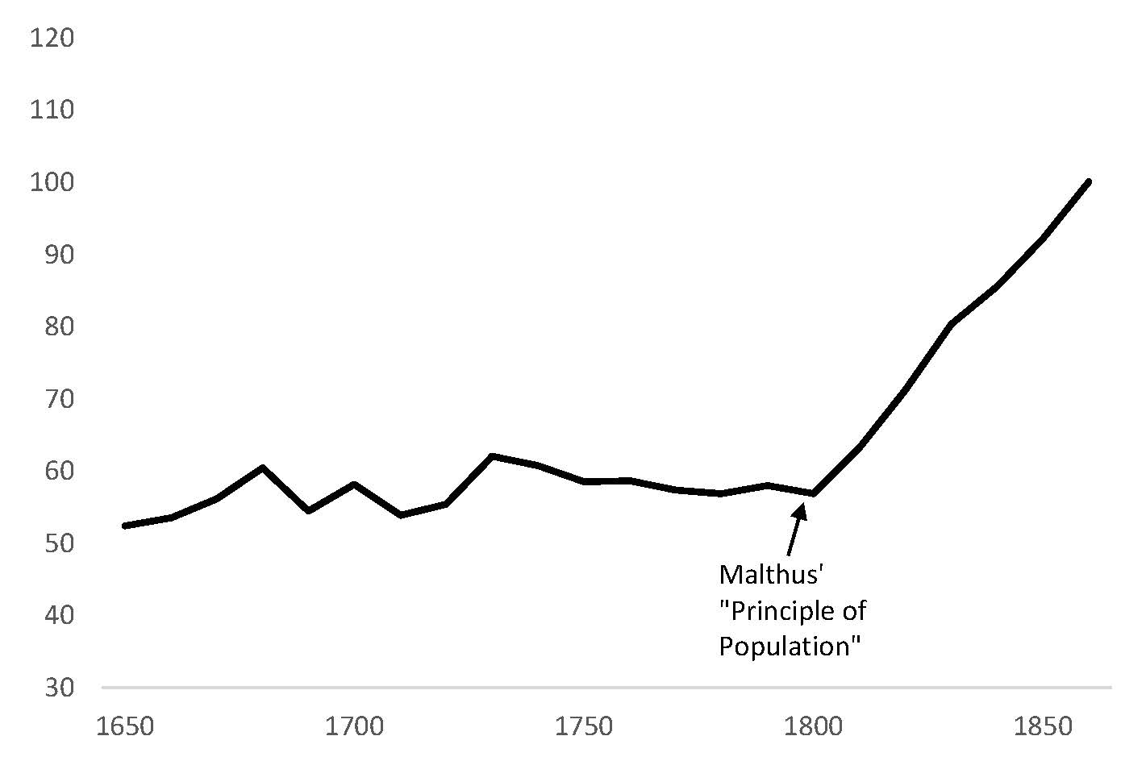
Malthus’ Unfortunate Timing
Source: Clark (2010)

Slide 7
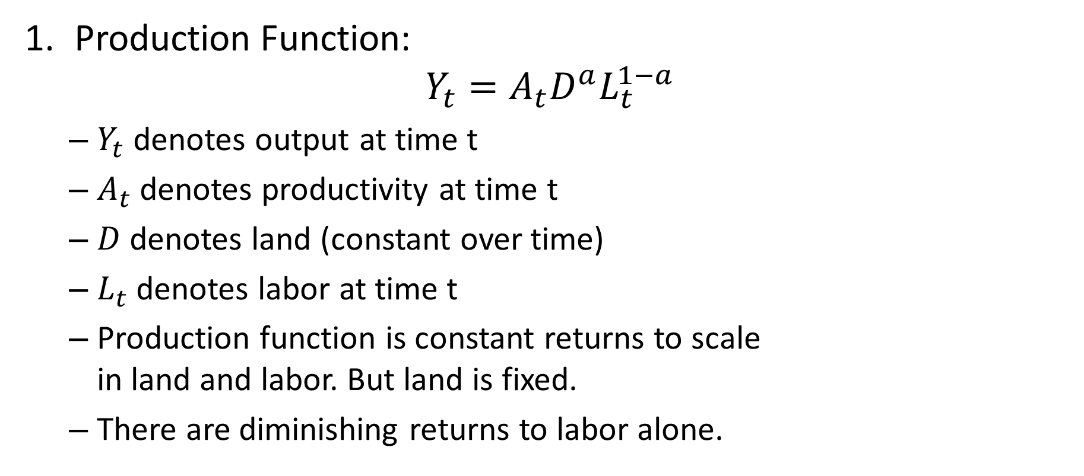
Malthus Model: Production
Production Function:
$$Y_{t}=A_{t}D^{a}L_{t}^{1−a}$$
$Y_{t}$ denotes output at time t
$A_{t}$ denotes productivity at time t
$D$ denotes land (constant over time)
$L_{t}$ denotes labor at time t
Production function is constant returns to scale in land and labor. But land is fixed.
There are diminishing returns to labor alone.

Slide 8
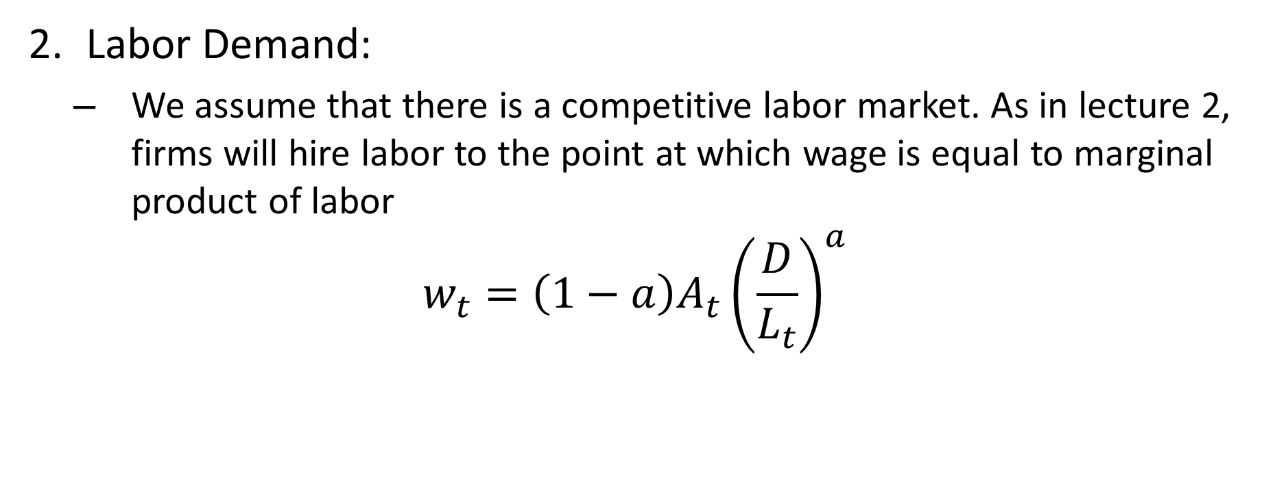
Malthus Model: Labor Demand
Labor Demand:
We assume that there is a competitive labor market. As in lecture 2, firms will hire labor to the point at which wage is equal to marginal product of labor
$$w_{t}=\left(1−a\right)A_{t}{\left(\frac{D}{L_{t}}\right)}^{a}$$

Slide 9
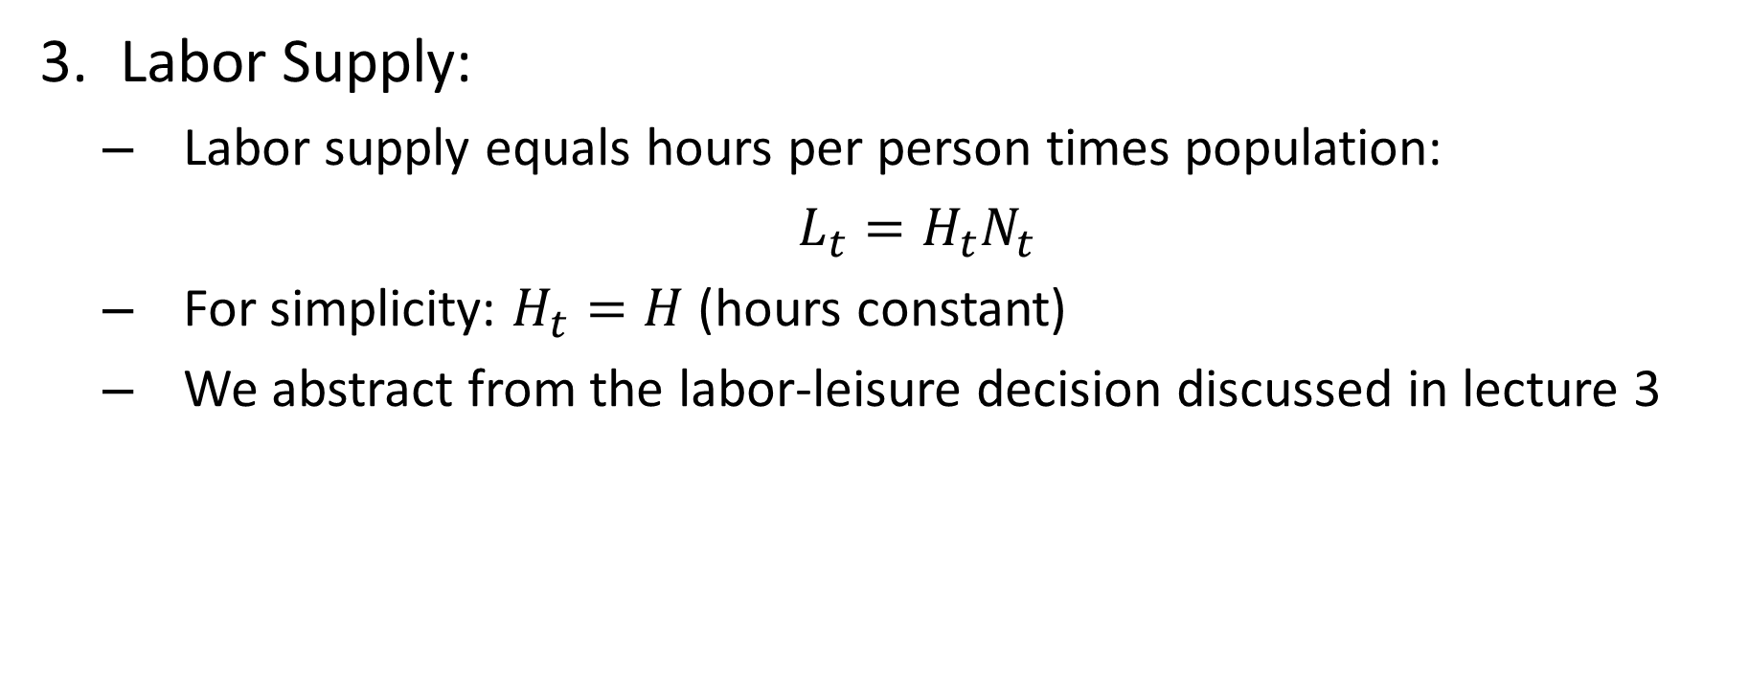
Malthus Model: Labor Supply
Labor Supply:
Labor supply equals hours per person times population:
$L_{t}=H_{t}N_{t}$
For simplicity: $H_{t}=H$ (hours constant)
We abstract from the labor-leisure decision discussed in lecture 3

Slide 10
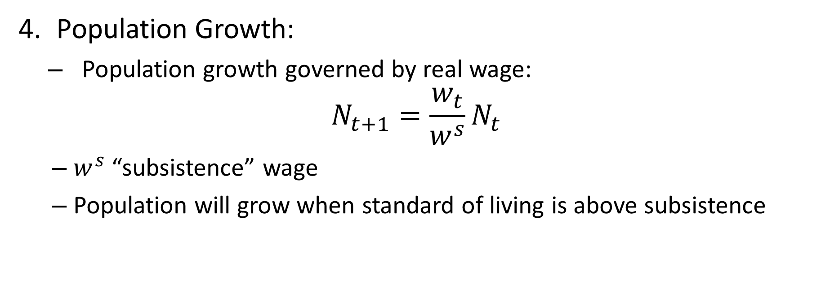
Malthus Model: Population Growth
Population Growth:
Population growth governed by real wage:
$$N_{t+1}=\frac{w_{t}}{w^{s}}N_{t}$$
$w^{s}$ “subsistence” wage
Population will grow when standard of living is above subsistence

Slide 11
Malthus Model: Population Growth
People have a natural tendency to continually produce children
Absent “checks” on this, population will grow
“Positive checks” increase death rate (war, disease, severe labor, poverty)
“Preventive checks” reduce birth rate (birth control, delayed marriage, infrequent coitus)
Simplest formulation: Abject poverty only check that is sufficiently strong to stop population growth

Slide 12
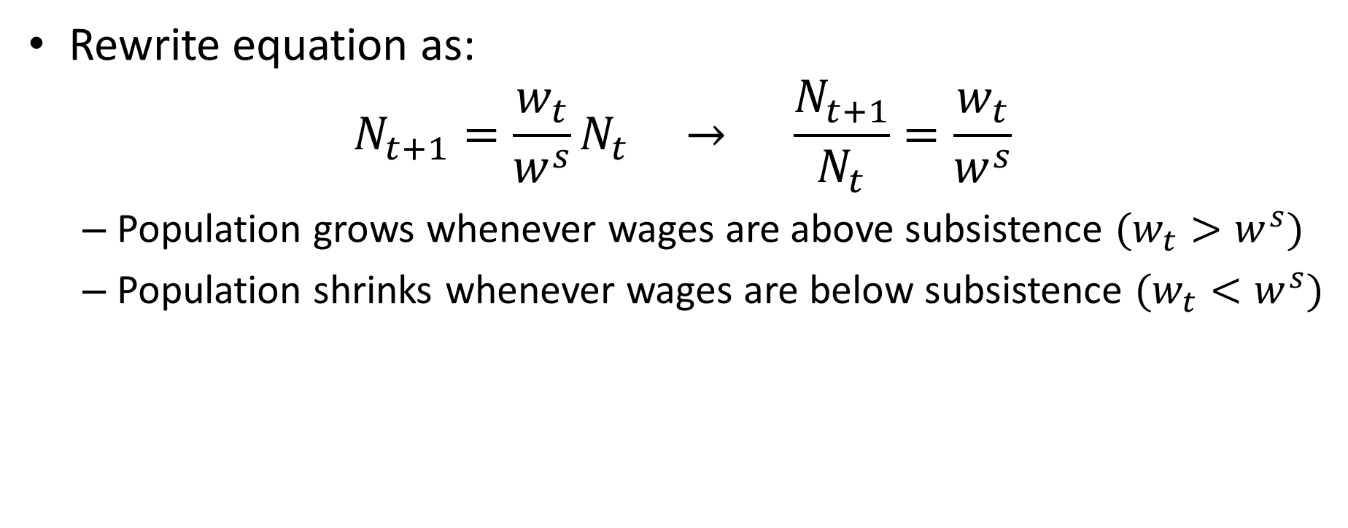
Malthus Model: Population Growth
Rewrite equation as:
$$N_{t+1}=\frac{w_{t}}{w^{s}}N_{t} → \frac{N_{t+1}}{N_{t}}=\frac{w_{t}}{w^{s}}$$
Population grows whenever wages are above subsistence $(w_{t}>w^{s})$
Population shrinks whenever wages are below subsistence $(w_{t}<w^{s})$

Slide 13
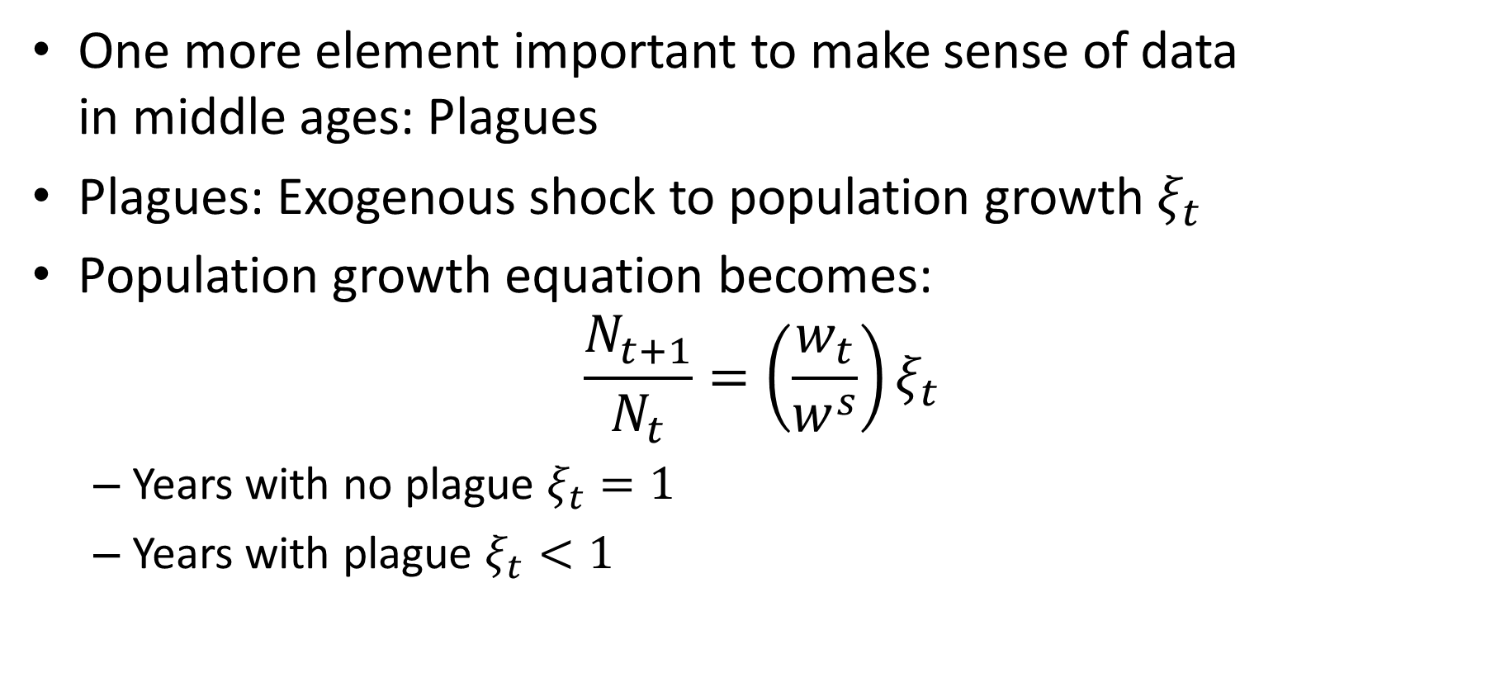
Malthus Model: Plagues
One more element important to make sense of data in middle ages: Plagues
Plagues: Exogenous shock to population growth $ξ_{t}$
Population growth equation becomes:
$$\frac{N_{t+1}}{N_{t}}=\left(\frac{w_{t}}{w^{s}}\right)ξ_{t}$$
Years with no plague $ξ_{t}=1$
Years with plague $ξ_{t}<1$

Slide 14
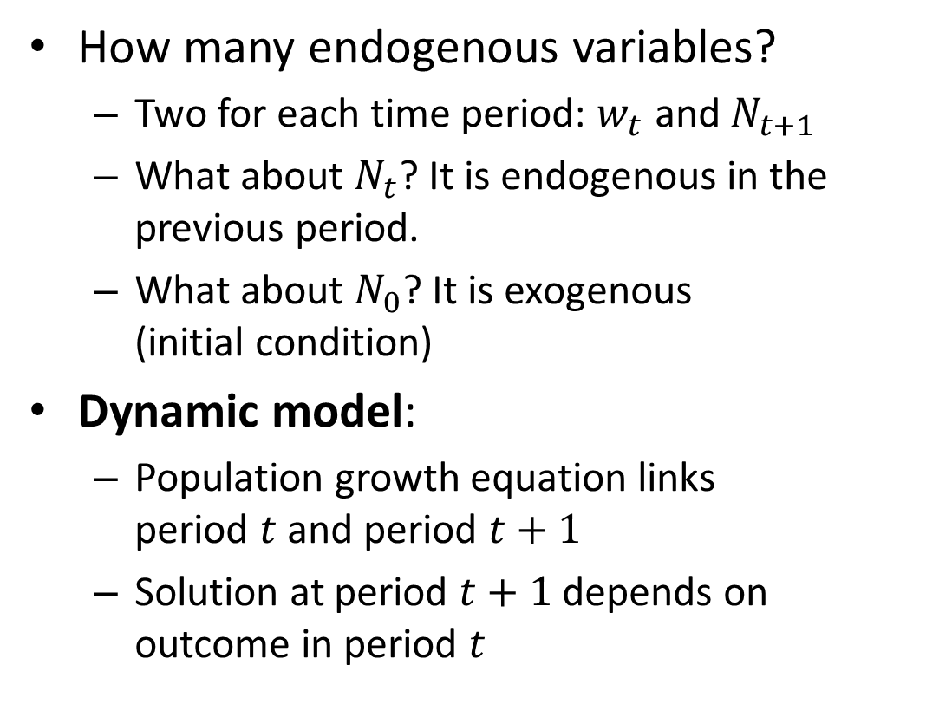

The Malthus Model: Key Equations
$$w_{t}=\left(1−a\right)A_{t}{\left(\frac{D}{{HN}_{t}}\right)}^{a}$$
$$\frac{N_{t+1}}{N_{t}}=\left(\frac{w_{t}}{w^{s}}\right)ξ_{t}$$
How many endogenous variables?
Two for each time period: $w_{t}$ and $N_{t+1}$
What about $N_{t}$? It is endogenous in the previous period.
What about $N_{0}$? It is exogenous (initial condition)
Dynamic model:
Population growth equation links period $t$ and period $t+1$
Solution at period $t+1$ depends on outcome in period $t$

Slide 15
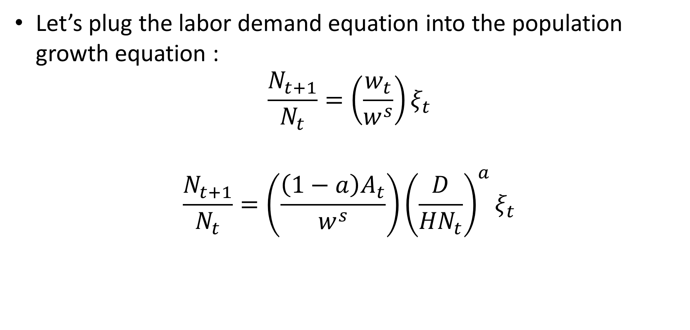
Population Dynamics
Let’s plug the labor demand equation into the population growth equation :
$$\frac{N_{t+1}}{N_{t}}=\left(\frac{w_{t}}{w^{s}}\right)ξ_{t}$$
$$\frac{N_{t+1}}{N_{t}}=\left(\frac{\left(1−a\right)A_{t}}{w^{s}}\right){\left(\frac{D}{{HN}_{t}}\right)}^{a}ξ_{t}$$

Slide 16
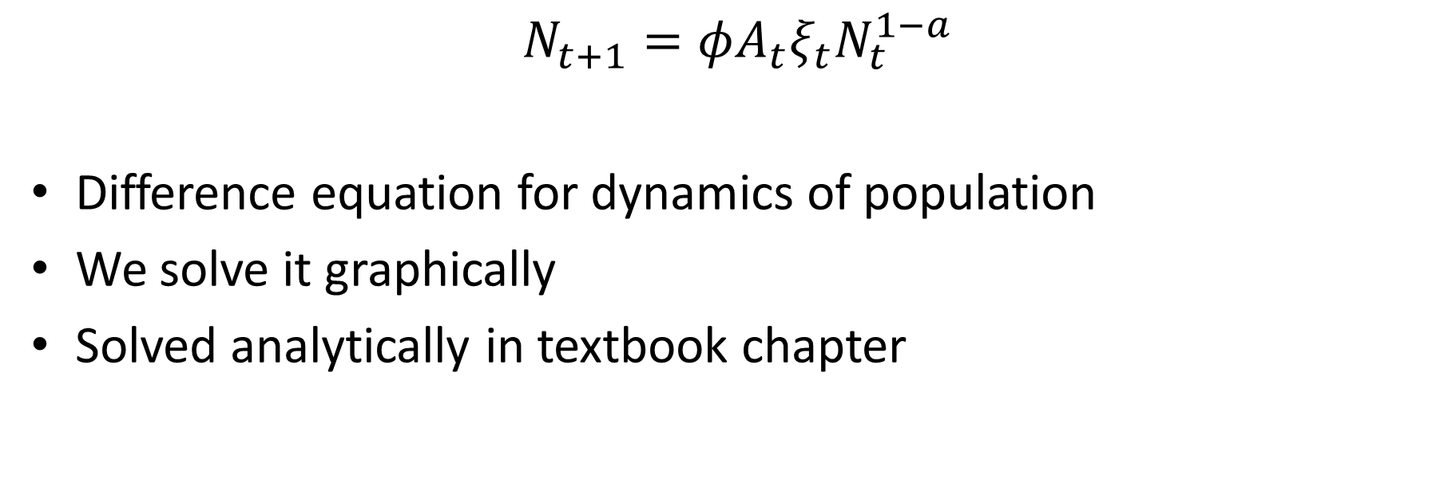
Population Dynamics
$$N_{t+1}=φA_{t}ξ_{t}N_{t}^{1−a}$$
Difference equation for dynamics of population
We solve it graphically
Solved analytically in textbook chapter

Slide 17
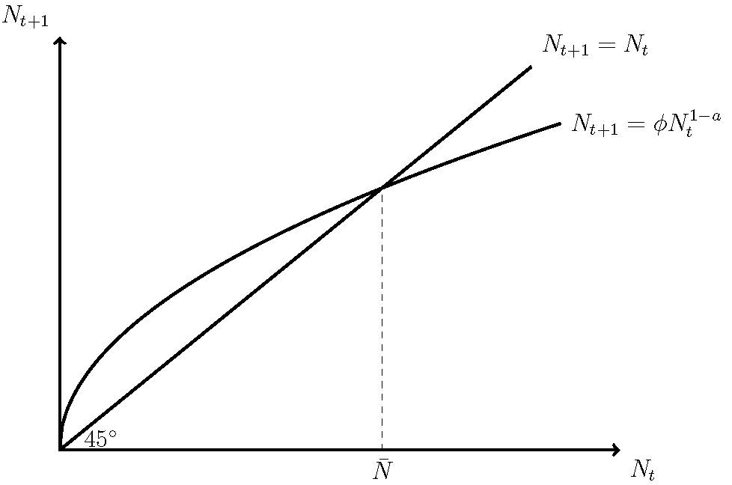
Population Dynamics

Slide 18
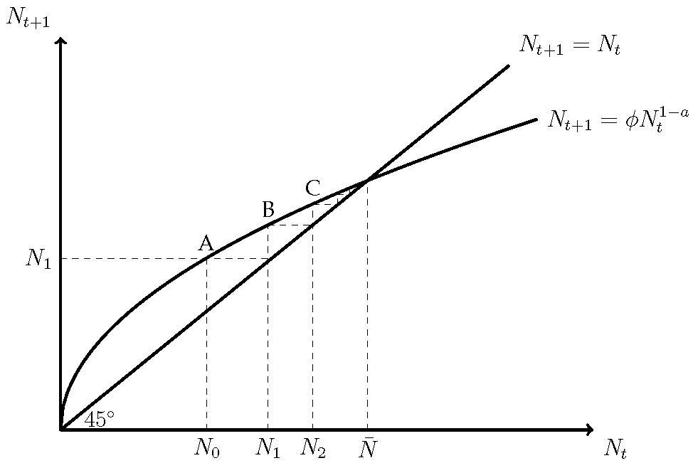
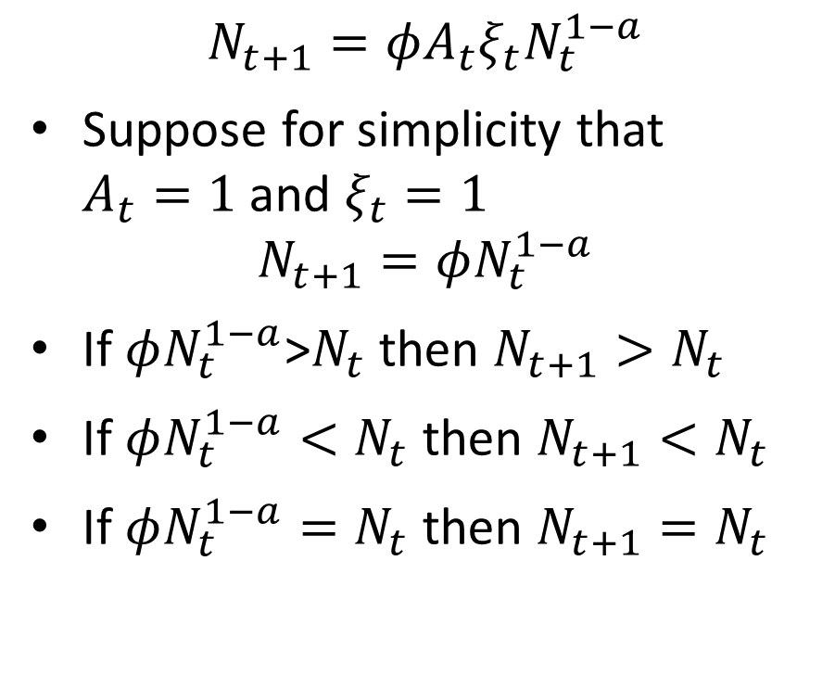
Population Dynamics
$$N_{t+1}=φA_{t}ξ_{t}N_{t}^{1−a}$$
Suppose for simplicity that $A_{t}=1$ and $ξ_{t}=1$
$$N_{t+1}=φN_{t}^{1−a}$$
If $φN_{t}^{1−a}$>$N_{t}$ then $N_{t+1}>N_{t}$
If $φN_{t}^{1−a}<N_{t}$ then $N_{t+1}<N_{t}$
If $φN_{t}^{1−a}=N_{t}$ then $N_{t+1}=N_{t}$

Slide 19
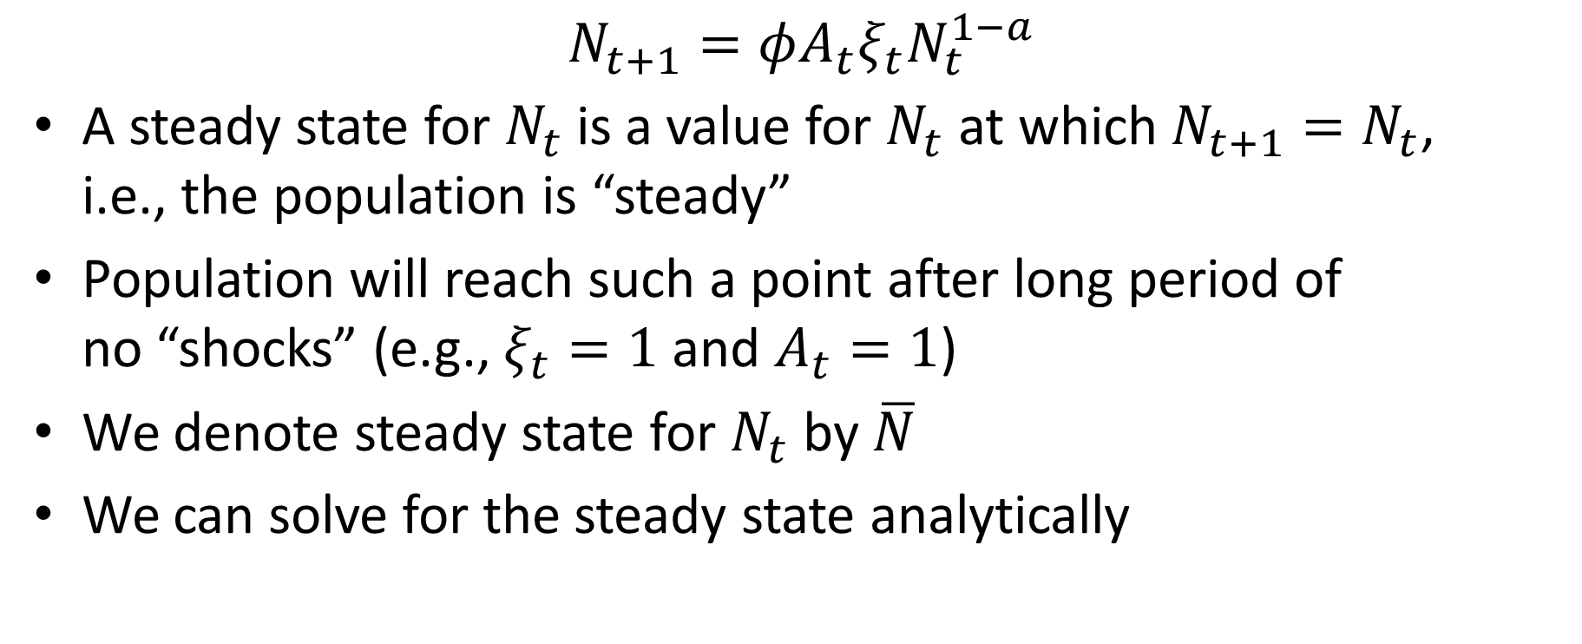
Steady State Population
$$N_{t+1}=φA_{t}ξ_{t}N_{t}^{1−a}$$
A steady state for $N_{t}$is a value for $N_{t}$ at which $N_{t+1}=N_{t}$, i.e., the population is “steady”
Population will reach such a point after long period of no “shocks” (e.g., $ξ_{t}=1$ and $A_{t}=1$)
We denote steady state for $N_{t}$ by $\overline{N}$
We can solve for the steady state analytically

Slide 20
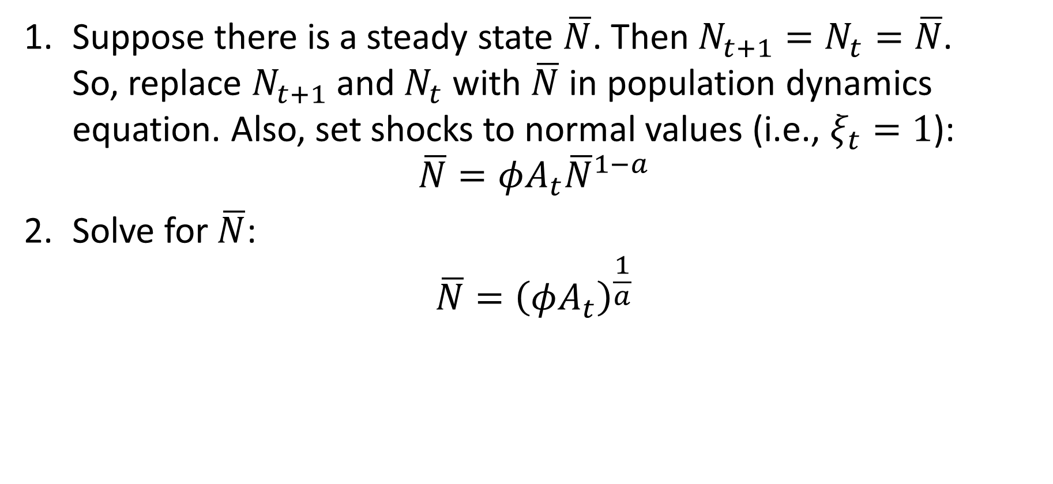
Solving for Steady State
Suppose there is a steady state $\overline{N}$. Then $N_{t+1}=N_{t}=\overline{N}$. So, replace $N_{t+1}$ and $N_{t}$ with $\overline{N}$ in population dynamics equation. Also, set shocks to normal values (i.e., $ξ_{t}=1$):
$$\overline{N}=φA_{t}{\overline{N}}^{1−a}$$
Solve for $\overline{N}$:
$$\overline{N}={\left(φA_{t}\right)}^{\frac{1}{a}}$$

Slide 21
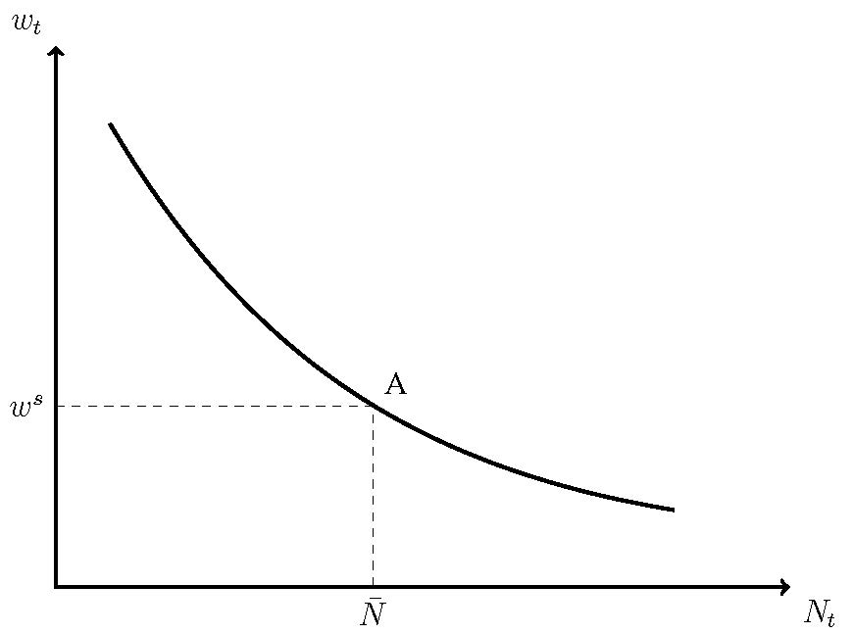

Real Wages in the Malthus Model
Labor demand:
$$w_{t}=\left(1−a\right)A_{t}{\left(\frac{D}{{HN}_{t}}\right)}^{a}$$

Slide 22
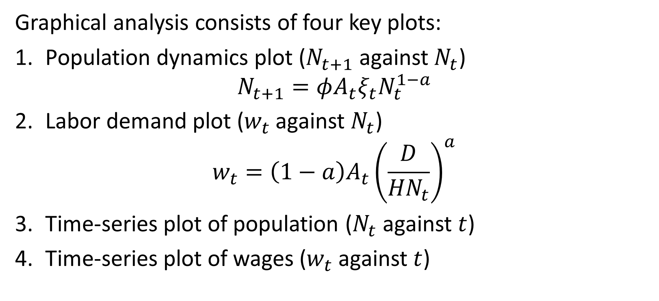
The Malthus Model
Graphical analysis consists of four key plots:
Population dynamics plot ($N_{t+1}$ against $N_{t}$)
$$N_{t+1}=φA_{t}ξ_{t}N_{t}^{1−a}$$
Labor demand plot ($w_{t}$ against $N_{t}$)
$$w_{t}=\left(1−a\right)A_{t}{\left(\frac{D}{{HN}_{t}}\right)}^{a}$$
Time-series plot of population ($N_{t}$ against $t$)
Time-series plot of wages ($w_{t}$ against $t$)

Slide 23

Responses to Shocks
What happens to population and wages in the short run and long run after these shocks:
Black Death ($ξ_{t}<1$)?
Increase in technology ($A_{0}>1$)?

Slide 24
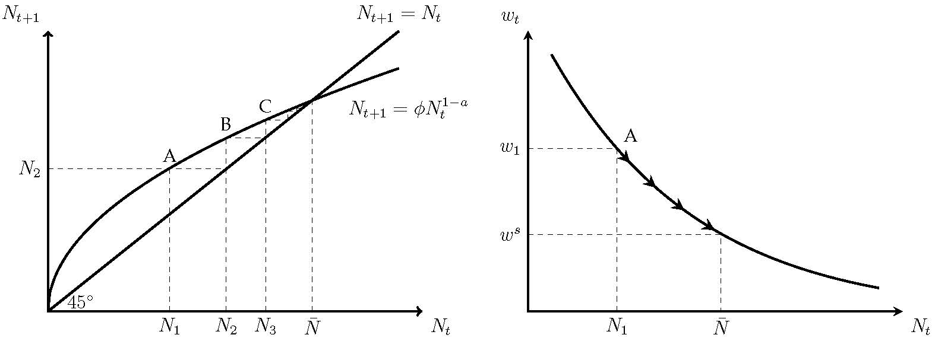
Black Death

Slide 25
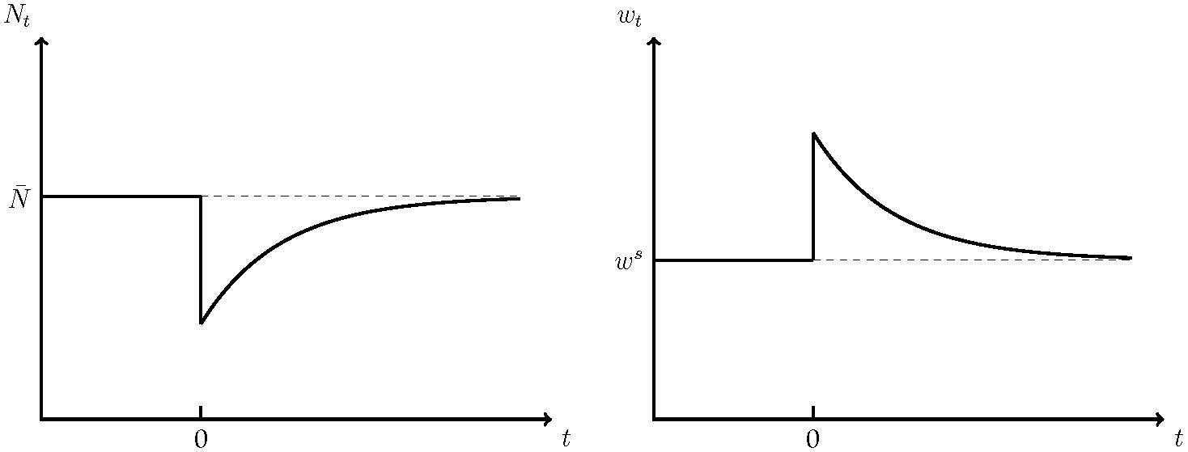
Black Death

Slide 26
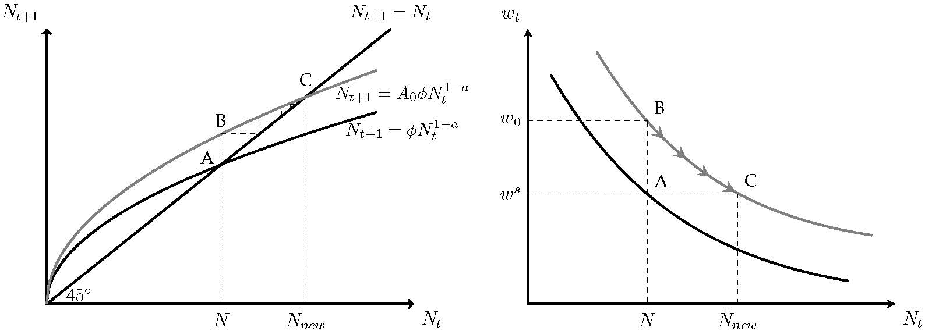
Increase in Productivity

Slide 27
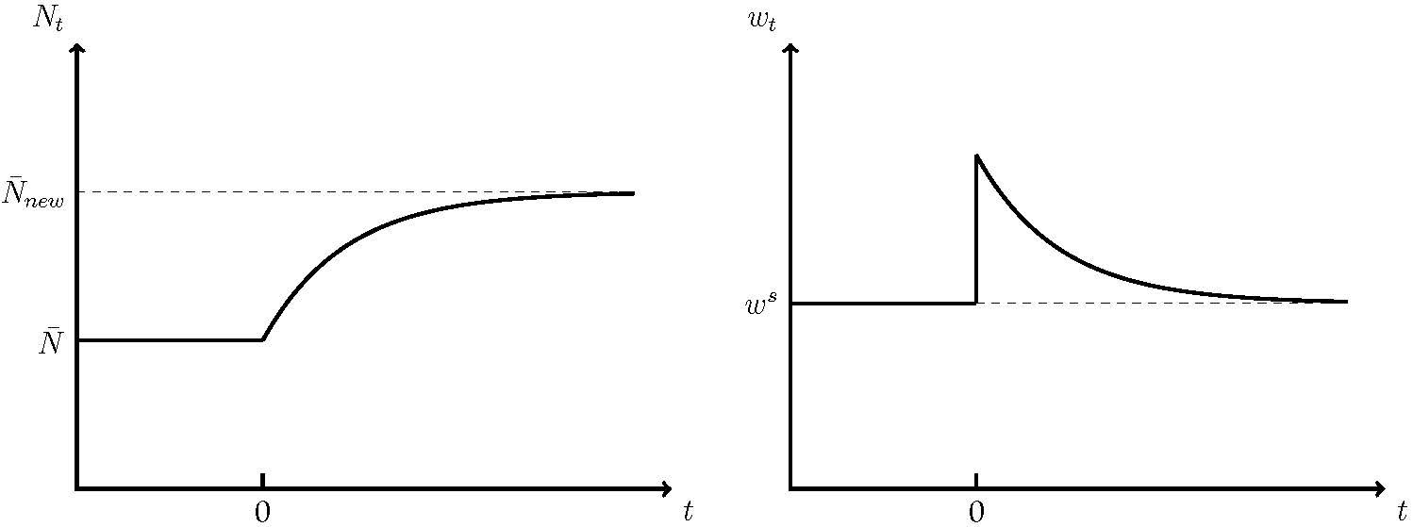
Increase in Productivity

Slide 28
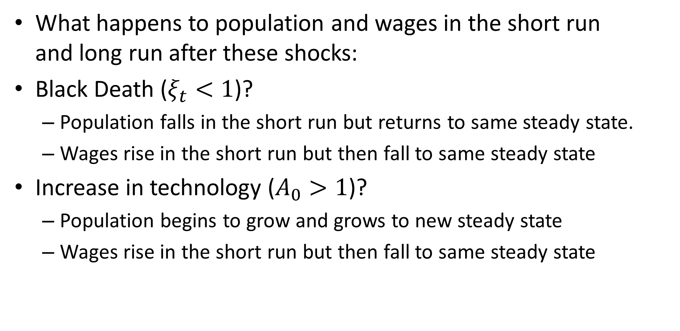
Responses to Shocks
What happens to population and wages in the short run and long run after these shocks:
Black Death ($ξ_{t}<1$)?
Population falls in the short run but returns to same steady state.
Wages rise in the short run but then fall to same steady state
Increase in technology ($A_{0}>1$)?
Population begins to grow and grows to new steady state
Wages rise in the short run but then fall to same steady state

Slide 29
Wages in England 1250-1860
Can we use the Malthus model to make sense of the evolution of real wages in England from 1250 onward?
Two striking facts:
No growth (same in 1750 as in 1250)
Big rise (1300-1450) and then fall (1450 to 1640)
Malthus model suggests that evolution of the population may help us understand changes in real wages

Slide 30
Real Wages of Laborers in England 1250-1450
Source: Clark (2010)

Slide 31
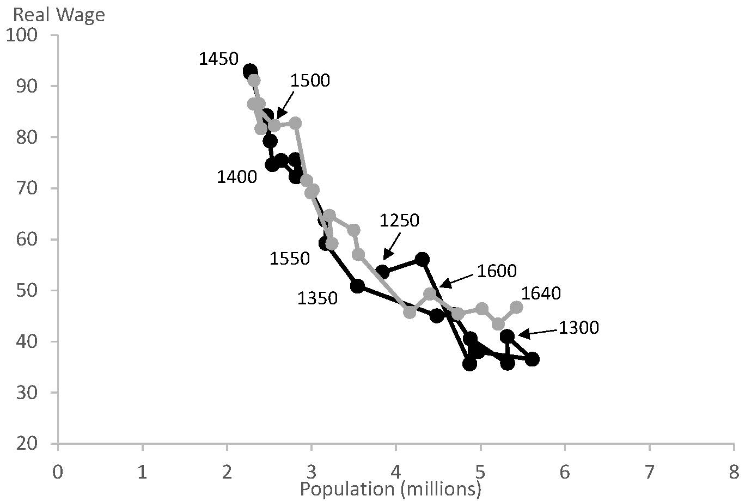
Real Wages of Laborers in England 1250-1640
Source: Clark (2010)

Slide 32
Real Wages of Laborers in England 1250-1640
1250-1310:
Population rises and real wages fall
1310-1450:
Population falls and real wages rise
Black Death in 1340s. Waves of plagues afterwards
1450-1640:
Population rises and real wages fall
Economy “recovers” from plagues

Slide 33
Success of Malthus Model
Big rise and fall of real wages may have seemed puzzling before
Malthus model provides an explanation:
Real wages rose as plagues halved the population
Real wages fell as population recovered

Slide 34
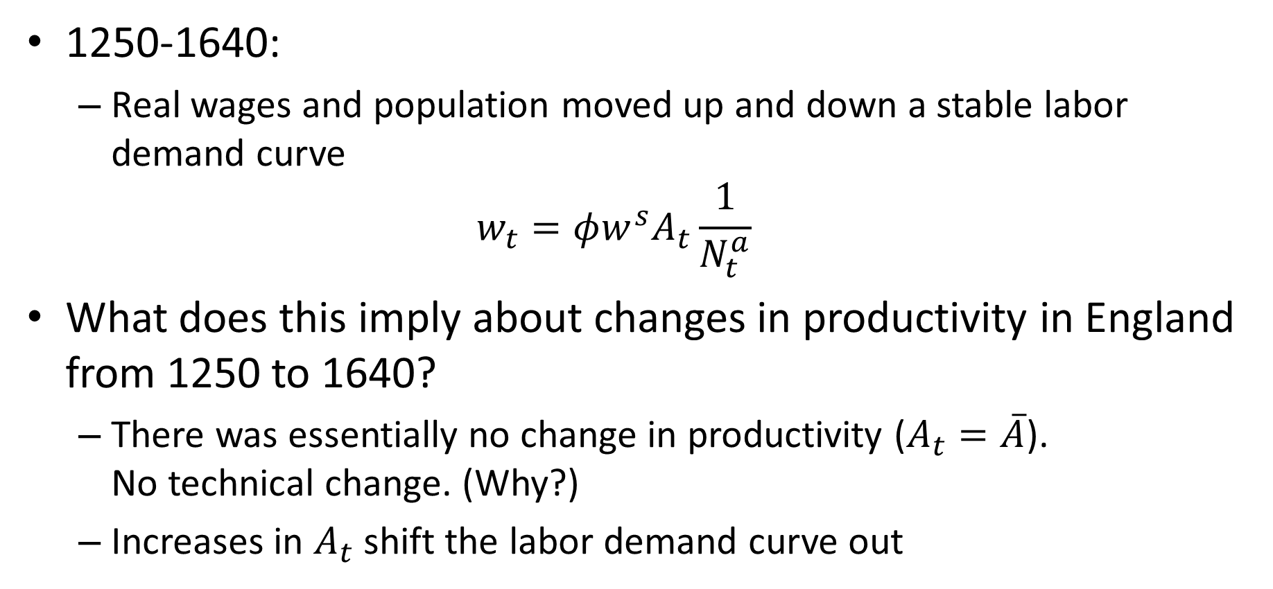
Technical Change in England 1250-1640
1250-1640:
Real wages and population moved up and down a stable labor demand curve
$$w_{t}=φw^{s}A_{t}\frac{1}{N_{t}^{a}}$$
What does this imply about changes in productivity in England from 1250 to 1640?
There was essentially no change in productivity ($A_{t}=\overline{A}$). No technical change. (Why?)
Increases in $A_{t}$ shift the labor demand curve out

Slide 35
Real Wages of Laborers in England 1300-1640
Source: Clark (2010)

Slide 36
Something Changed Around 1650
Source: Clark (2009)

Slide 37
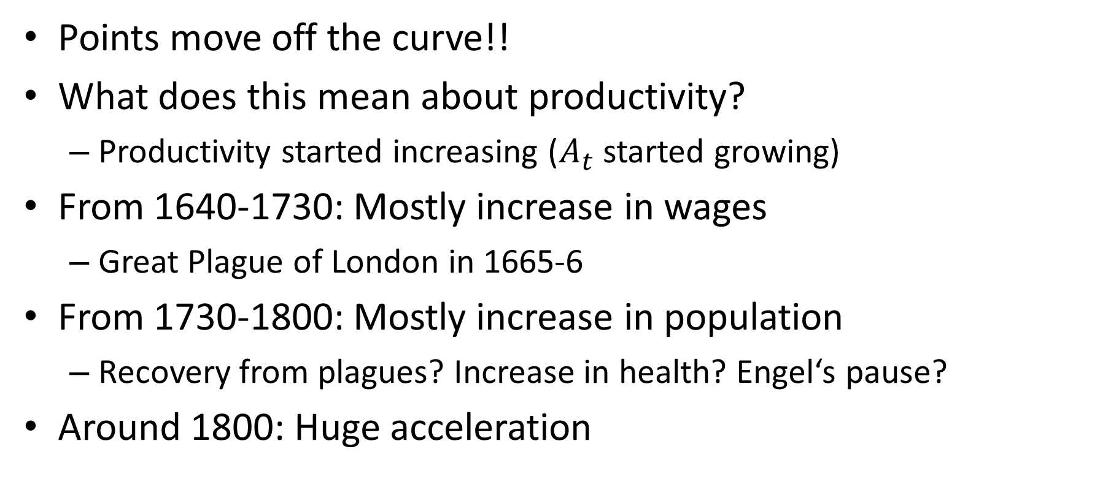
Something Changed Around 1650
Points move off the curve!!
What does this mean about productivity?
Productivity started increasing ($A_{t}$ started growing)
From 1640-1730: Mostly increase in wages
Great Plague of London in 1665-6
From 1730-1800: Mostly increase in population
Recovery from plagues? Increase in health? Engel‘s pause?
Around 1800: Huge acceleration

Slide 38
Real Wages of Laborers in England 1290-1860

Slide 39
Malthus’ Unfortunate Timing
Malthus sometimes get a bad rap
Prediction that wages were doomed to stay at subsistence turned out to be wrong after his writing
But his theory was arguably correct for all of history up until his writing!!
What changed after 1800?

Slide 40
Why Is World No Longer Malthusian?
Technological growth overwhelmed Malthusian forces
Population forces Malthus emphasized are slow
Fast enough technology growth my overwhelm them
Land less important in production
Existence of a fix factor of production (land) important for logic of Malthus model
Land became much less important after 1800 due to invention of the steam engine
Land no longer needed to produce energy

Slide 41
Why is World No Long Malthusian?
Demographic Transition
Data on birth rates and death rates support Malthus’ model quite well up until 1825
After 1825, relationship between birth rates and real wages assumed by Malthus breaks down (and particularly after 1880)

Slide 42
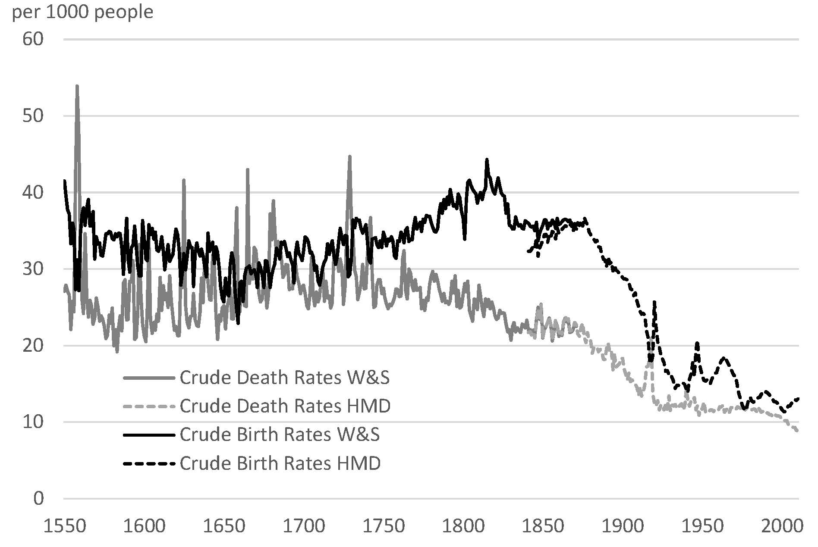
Demographic Transition in England

Slide 43
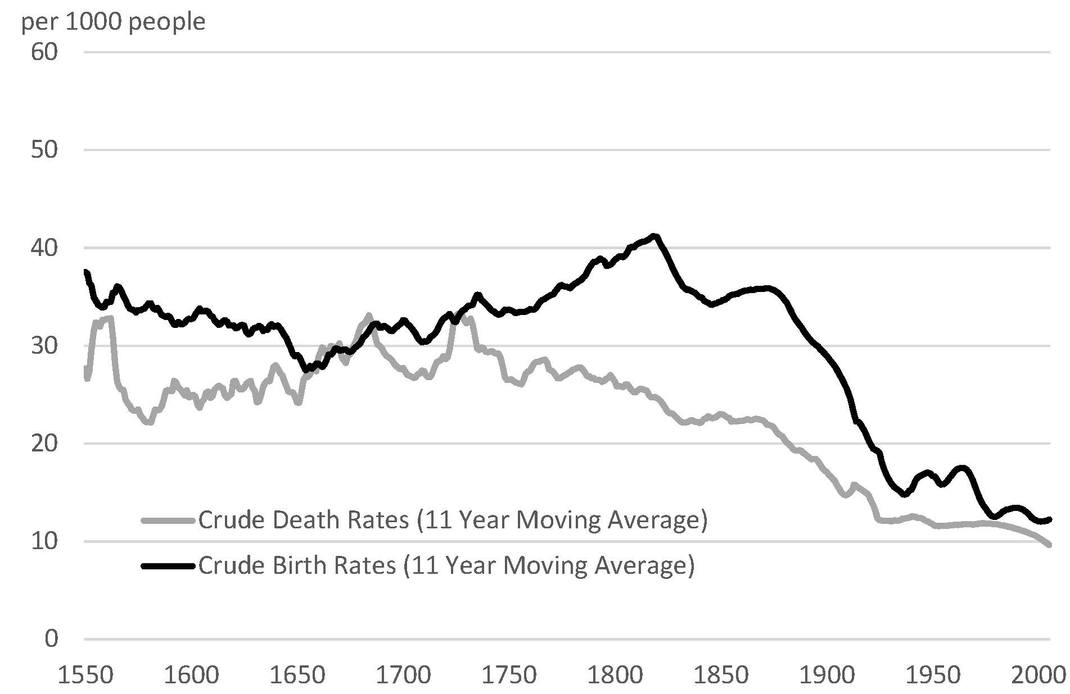
Demographic Transition in England

Slide 44
Demographic Transition
High wages no longer associated with high population growth in England
Same pattern observed for all countries when they develop
Why did birth rates fall?
Improved contraceptive methods
Trade-off between quantity and “quality” of children?
Women’s empowerment

