Slide 1
Lecture 7 Capital Accumulation and Growth Macroeconomics (Quantitative) Econ 101B
Jón Steinsson
University of California, Berkeley

Slide 2
The Rise of Capital
Pre-Industrial times:
Land important factor of production
Quantity of land fixed
Major impediment to growth
Industrial Revolution: Land intensity falls …
Fossil fuels replace firewood / animal power
Food share of consumption falls
… importance of capital rises
Wave of machines are invented
Capital is fundamentally different from land
It can be accumulated through investment!
1800 - 1950:
Industrial nations (UK, US, France, Germany, etc.) accumulated a great deal of capital and grew rapidly
Stalinist Soviet Union: Five year plans emphasize capital accumulation and growth takes off
Many other regions lag behind

Slide 3
Capital Accumulation and Growth
Widely held belief in 1950s:
Capital accumulation is key to growth (the “elixir” in Easterly’s words)
Krugman and Easterly readings discuss this history
Common development advice:
To grow faster, poor countries must increase investment rate
Does this make sense theoretically?
Robert Solow addressed this question in a seminal 1956 article

Slide 4
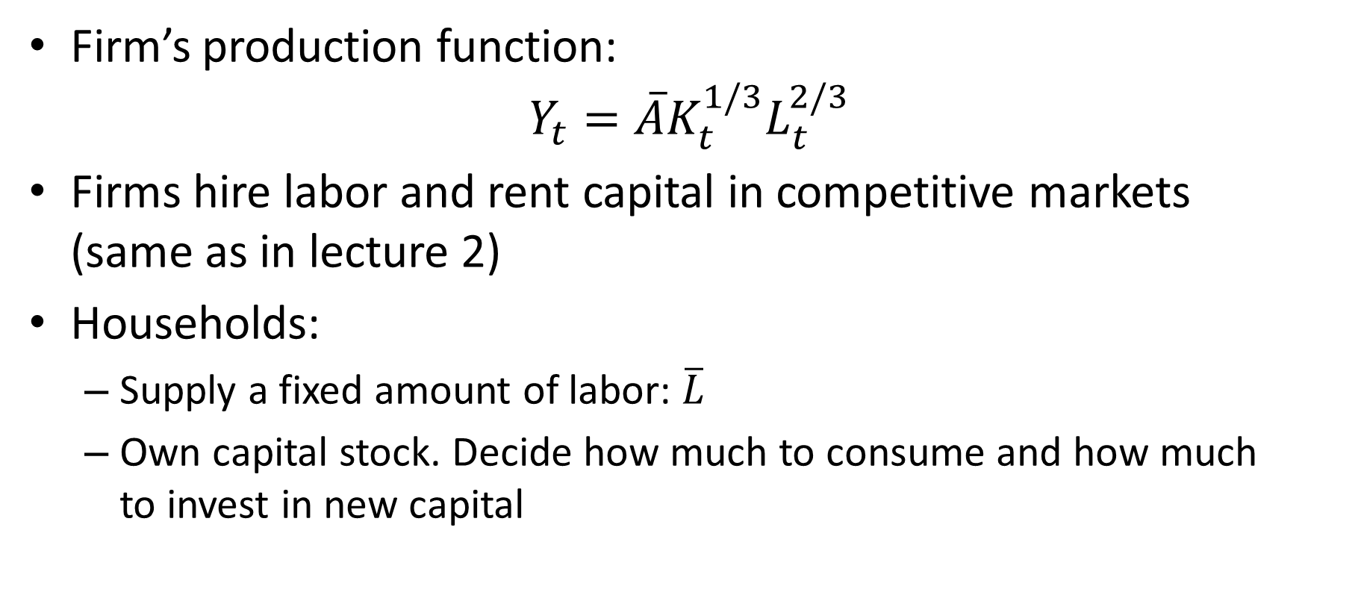
Production
Firm’s production function:
$$Y_{t}=\overline{A}K_{t}^{1/3}L_{t}^{2/3}$$
Firms hire labor and rent capital in competitive markets (same as in lecture 2)
Households:
Supply a fixed amount of labor: $\overline{L}$
Own capital stock. Decide how much to consume and how much to invest in new capital

Slide 5
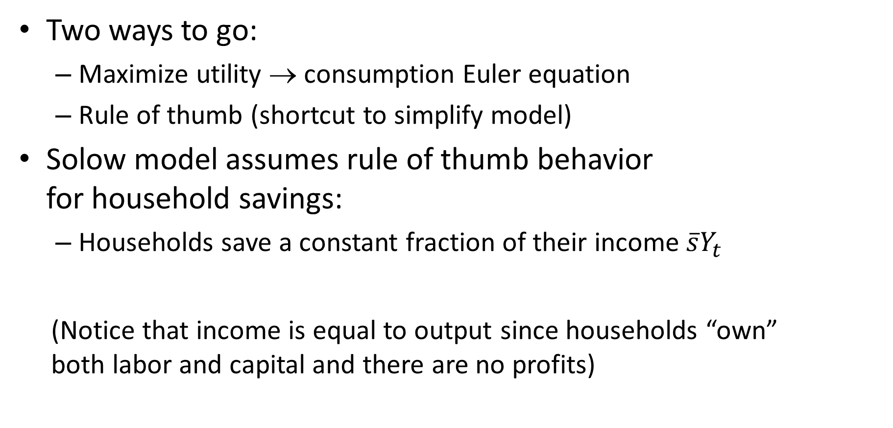
Consumption-Savings Decision
Two ways to go:
Maximize utility → consumption Euler equation
Rule of thumb (shortcut to simplify model)
Solow model assumes rule of thumb behavior for household savings:
Households save a constant fraction of their income $\overline{s}Y_{t}$
(Notice that income is equal to output since households “own” both labor and capital and there are no profits)

Slide 6
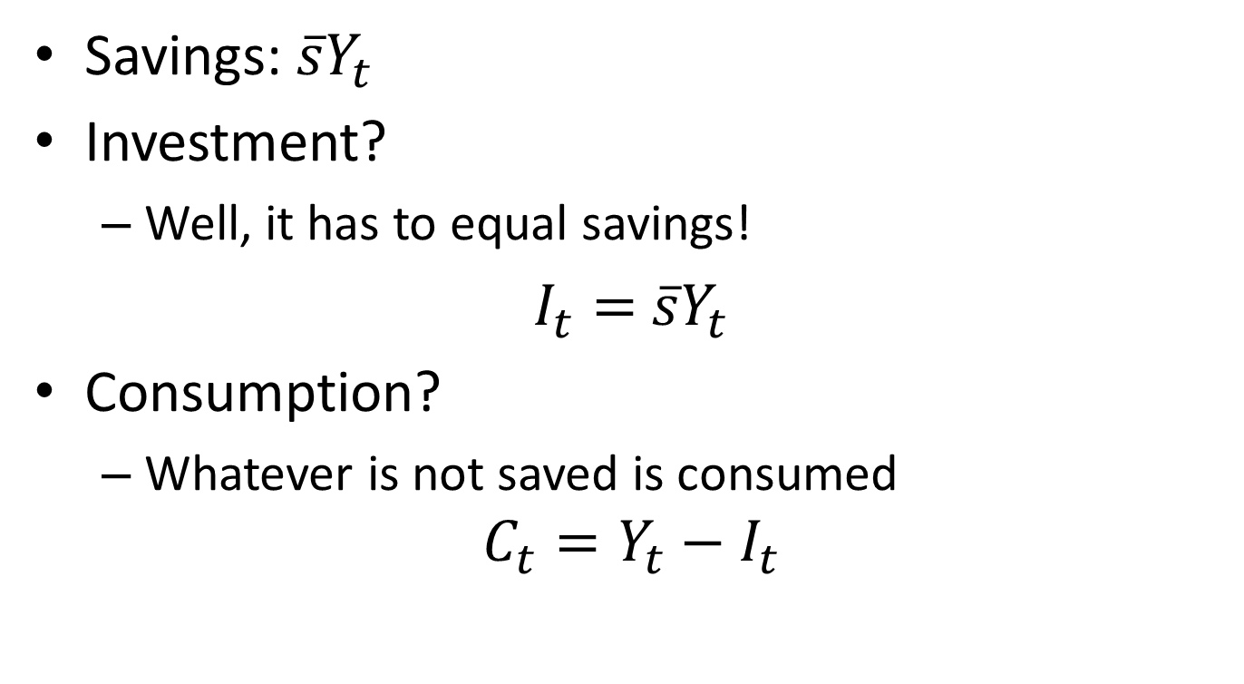
Savings, Investment and Consumption
Savings: $\overline{s}Y_{t}$
Investment?
Well, it has to equal savings!
$I_{t}=$ $\overline{s}Y_{t}$
Consumption?
Whatever is not saved is consumed
$$C_{t}=Y_{t}−I_{t}$$

Slide 7
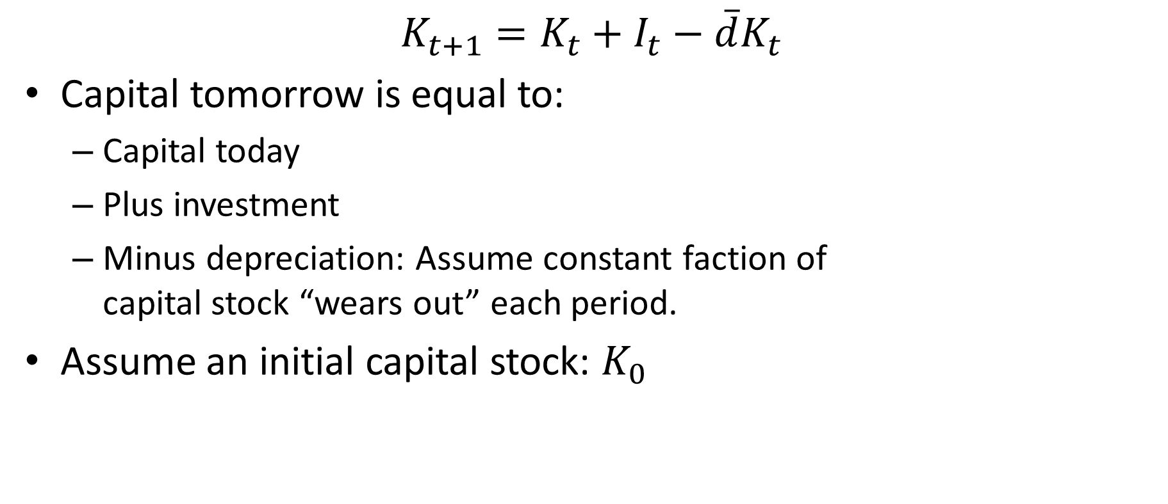
Capital Accumulation
$$K_{t+1}=K_{t}+I_{t}−\overline{d}K_{t}$$
Capital tomorrow is equal to:
Capital today
Plus investment
Minus depreciation: Assume constant faction of capital stock “wears out” each period.
Assume an initial capital stock: $K_{0}$

Slide 8
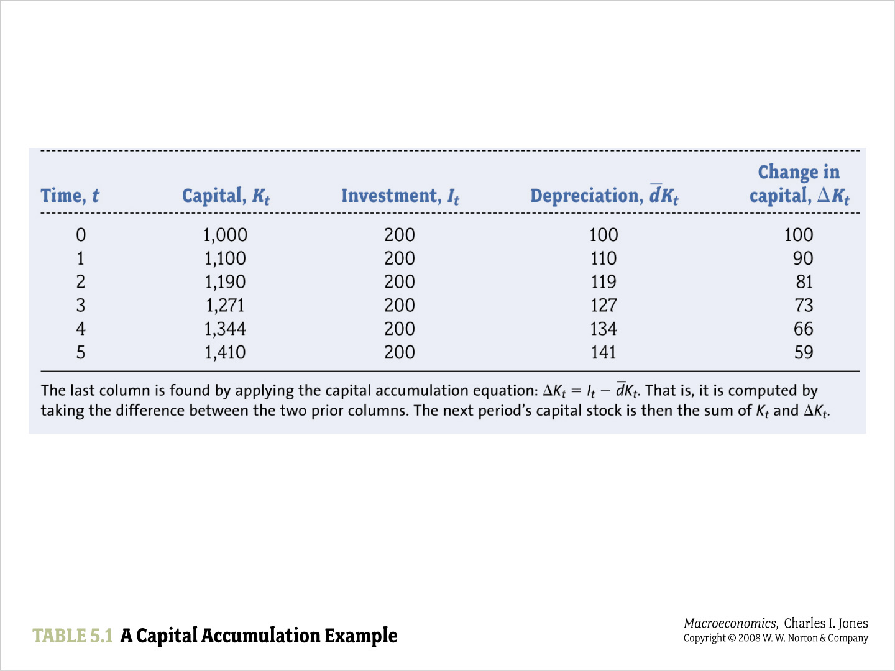

Slide 9
Dynamic Model
The Solow model is a dynamic model (like Malthus model)
Describes evolution of economy over time (not just at one moment)
Five equations for each point in time

Slide 10
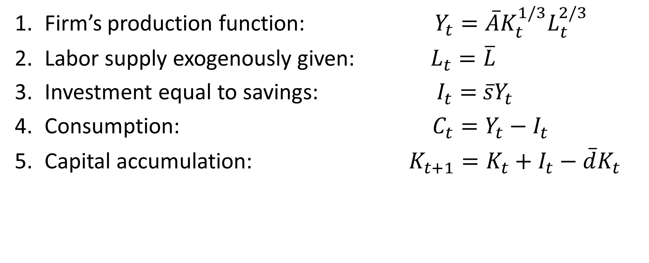
The Solow Model
Firm’s production function: $Y_{t}=\overline{A}K_{t}^{1/3}L_{t}^{2/3}$
Labor supply exogenously given: $L_{t}=\overline{L}$
Investment equal to savings: $I_{t}=$ $\overline{s}Y_{t}$
Consumption: $C_{t}=Y_{t}−I_{t}$
Capital accumulation: $K_{t+1}=K_{t}+I_{t}−\overline{d}K_{t}$

Slide 11
What about Labor and Capital Demand?
We didn’t talk about:
Wage
Rental rate on capital
Think of them as being in the background
Not needed to solve rest of model
Two more equations and two more endogenous variables (labor demand and capital demand)

Slide 12
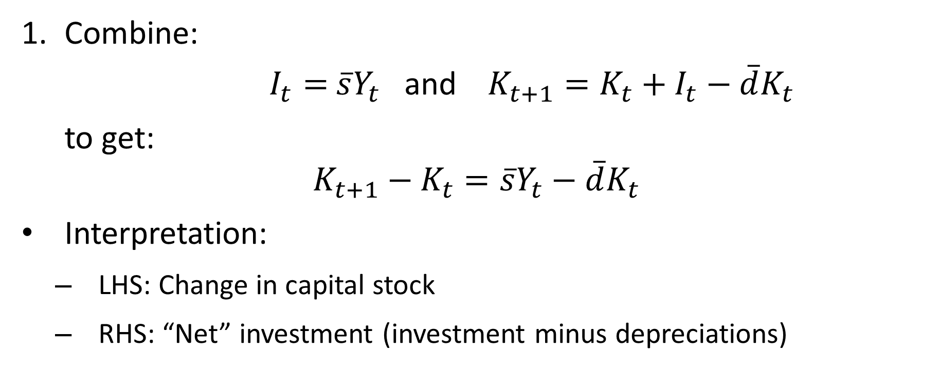
Solving the Solow Model
Combine:
$I_{t}=$ $\overline{s}Y_{t}$ and $K_{t+1}=K_{t}+I_{t}−\overline{d}K_{t}$
to get:
$$K_{t+1}−K_{t}=\overline{s}Y_{t}−\overline{d}K_{t}$$
Interpretation:
LHS: Change in capital stock
RHS: “Net” investment (investment minus depreciations)

Slide 13

Solving the Solow Model
Combine:
$$K_{t+1}−K_{t}=\overline{s}Y_{t}−\overline{d}K_{t}$$
and
$Y_{t}=\overline{A}K_{t}^{1/3}L_{t}^{2/3}$ as well as $L_{t}=\overline{L}$
to get:
$$K_{t+1}−K_{t}=\overline{s}\overline{A}{\overline{L}}^{2/3}K_{t}^{1/3}−\overline{d}K_{t}$$

Slide 14
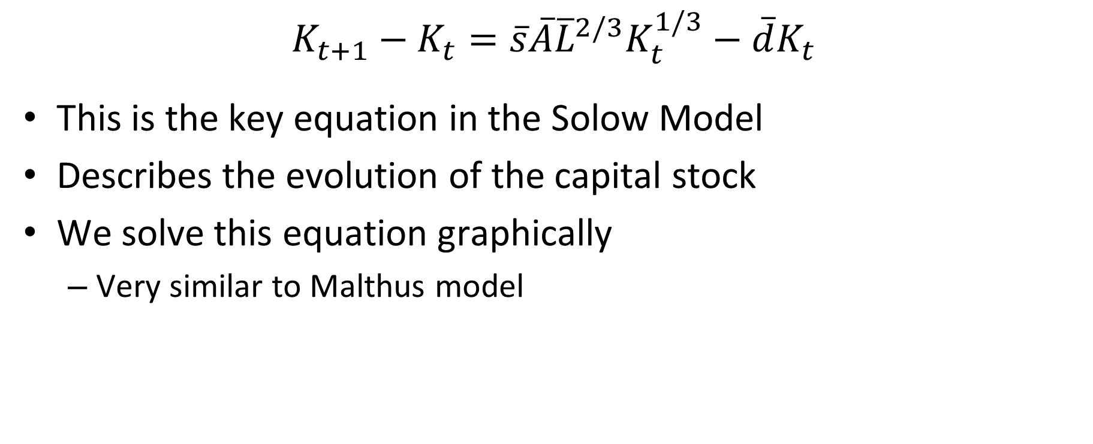
Evolution of Capital in Solow Model
$$K_{t+1}−K_{t}=\overline{s}\overline{A}{\overline{L}}^{2/3}K_{t}^{1/3}−\overline{d}K_{t}$$
This is the key equation in the Solow Model
Describes the evolution of the capital stock
We solve this equation graphically
Very similar to Malthus model

Slide 15

Drawing the Solow Graph
Investment:
$$I_{t}=\overline{s}Y_{t}=\overline{s}\overline{A}{\overline{L}}^{2/3}K_{t}^{1/3}$$
Depreciation:
$$\overline{d}K_{t}$$

Slide 16
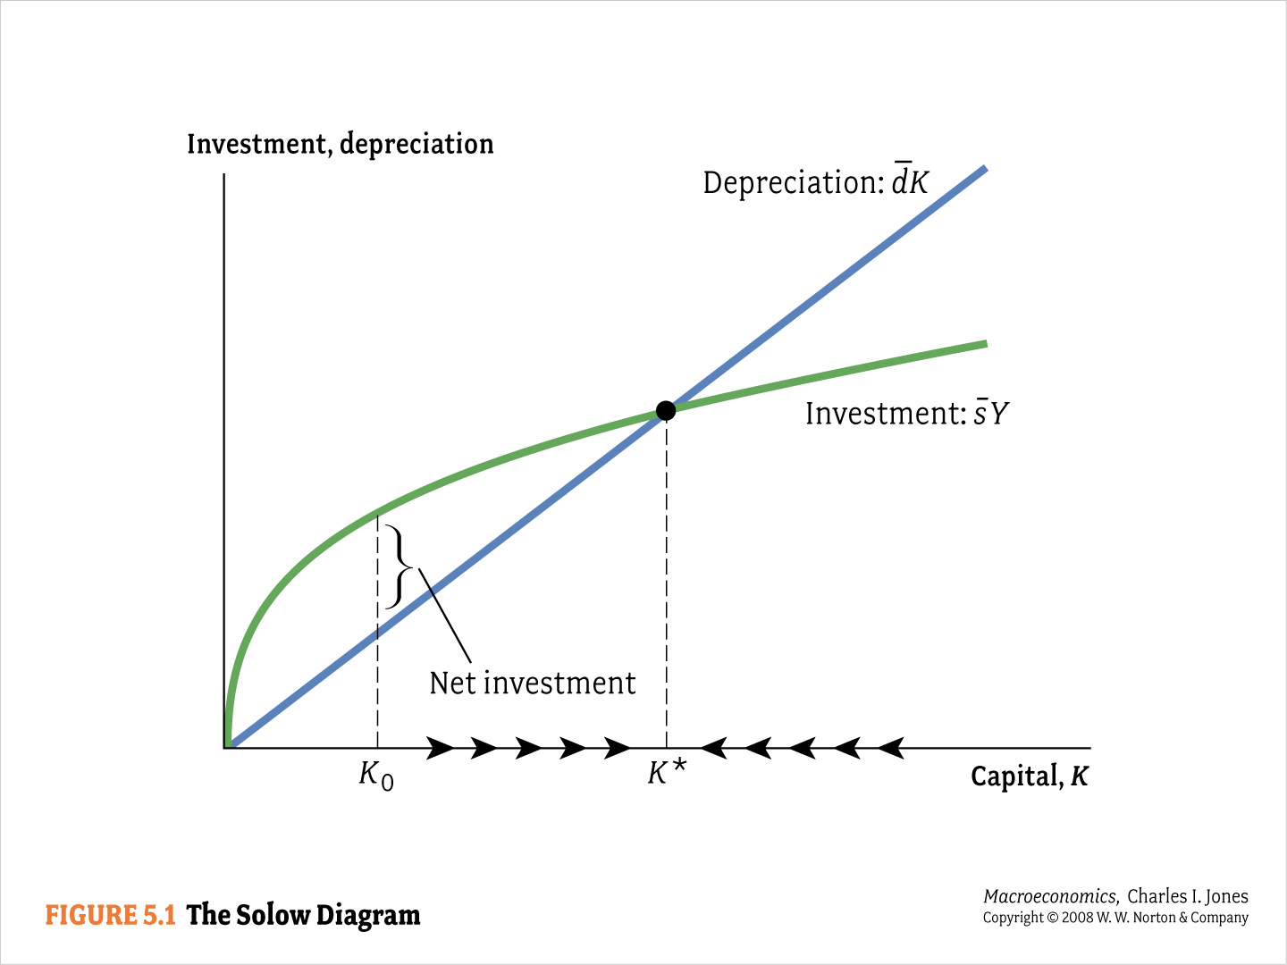

Slide 17



Economy starts at K₀:
Investment, Depreciation
We see that the orange line is above the green at K0:
Investment is greater than depreciation
So ∆Kt > 0 because
Then since ∆Kt > 0, Kt increases from K0 to K1 > K0
Capital, Kt
K0
K1

Slide 18
Now imagine if we start at a K₀ here:
Investment, Depreciation
At K0, the green line is above the orange line
Saving = investment is now less than depreciation
So ∆Kt < 0 because
Then since ∆Kt < 0, Kt decreases from K0 to K1 < K0
Capital, Kt
K1
K0

Slide 19
Transition Dynamics and Steady State
Investment, Depreciation
No matter where we start, we’ll transition to K*!
At this value of K, dKt = sYt, so
Capital, Kt
K*

Slide 20
Evolution of Capital
If investment is greater than depreciation, capital stock rises.
Capital continues to rise until investment and depreciation are equal. At this point capital stock stops growing
Growth process is referred to as transition dynamics
Point at which capital stops growing is called the steady state

Slide 21
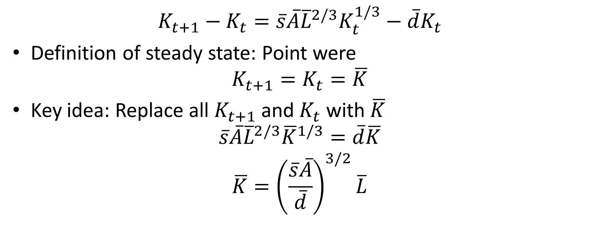
Solving for Steady State Capital
$$K_{t+1}−K_{t}=\overline{s}\overline{A}{\overline{L}}^{2/3}K_{t}^{1/3}−\overline{d}K_{t}$$
Definition of steady state: Point were
$$K_{t+1}=K_{t}=\overline{K}$$
Key idea: Replace all $K_{t+1}$ and $K_{t}$ with $\overline{K}$
$$\overline{s}\overline{A}{\overline{L}}^{2/3}{\overline{K}}^{1/3}=\overline{d}\overline{K}$$
$$\overline{K}={\left(\frac{\overline{s}\overline{A}}{\overline{d}}\right)}^{3/2}\overline{L}$$

Slide 22

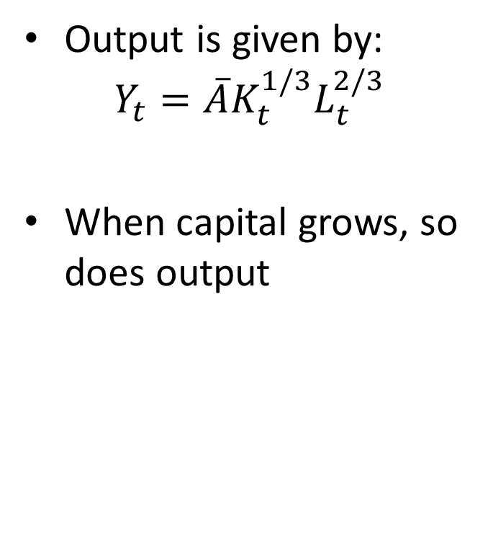
Output in the Solow Model
Output is given by:
$$Y_{t}=\overline{A}K_{t}^{1/3}L_{t}^{2/3}$$
When capital grows, so does output
Y*
K*
Capital, Kt

Slide 23
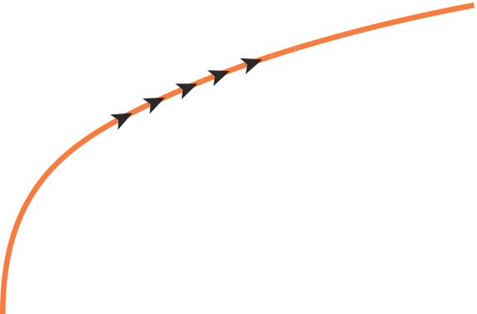
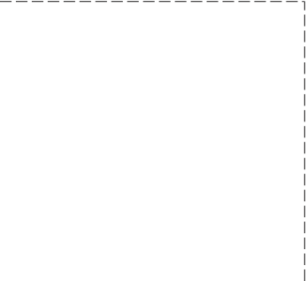
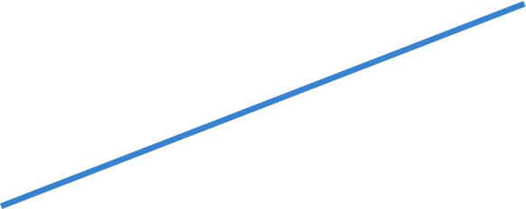
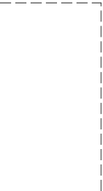

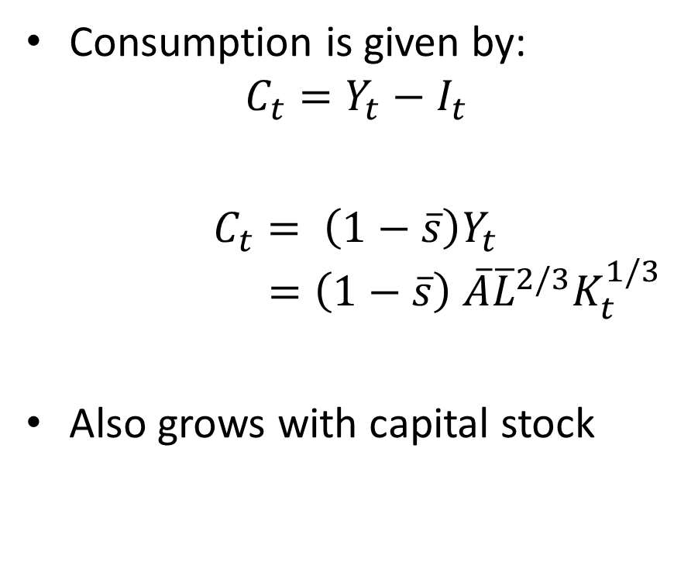
Consumption in the Solow Model
Investment, depreciation,
and output
Consumption is given by:
$$C_{t}=Y_{t}−I_{t}$$
$C_{t}= \left(1−\overline{s}\right)Y_{t}$ $=\left(1−\overline{s}\right)$ $\overline{A}{\overline{L}}^{2/3}K_{t}^{1/3}$
Also grows with capital stock
Output: Y
Y*
Consumption
Y0
Depreciation: d K
Investment: s Y
K0
K*
Capital, K

Slide 24
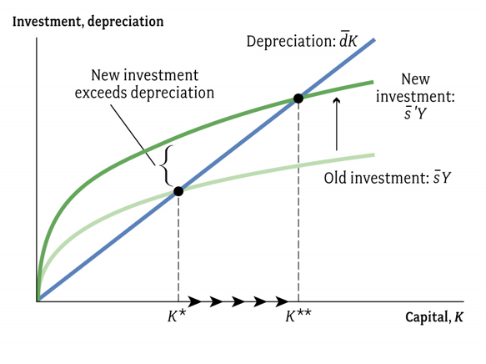
Increase in the Savings Rate
Start in a steady state
Suppose savings rate increases
Perhaps due to change in tax policy or government exploitation
How does the economy respond to such a “shock”?

Slide 25
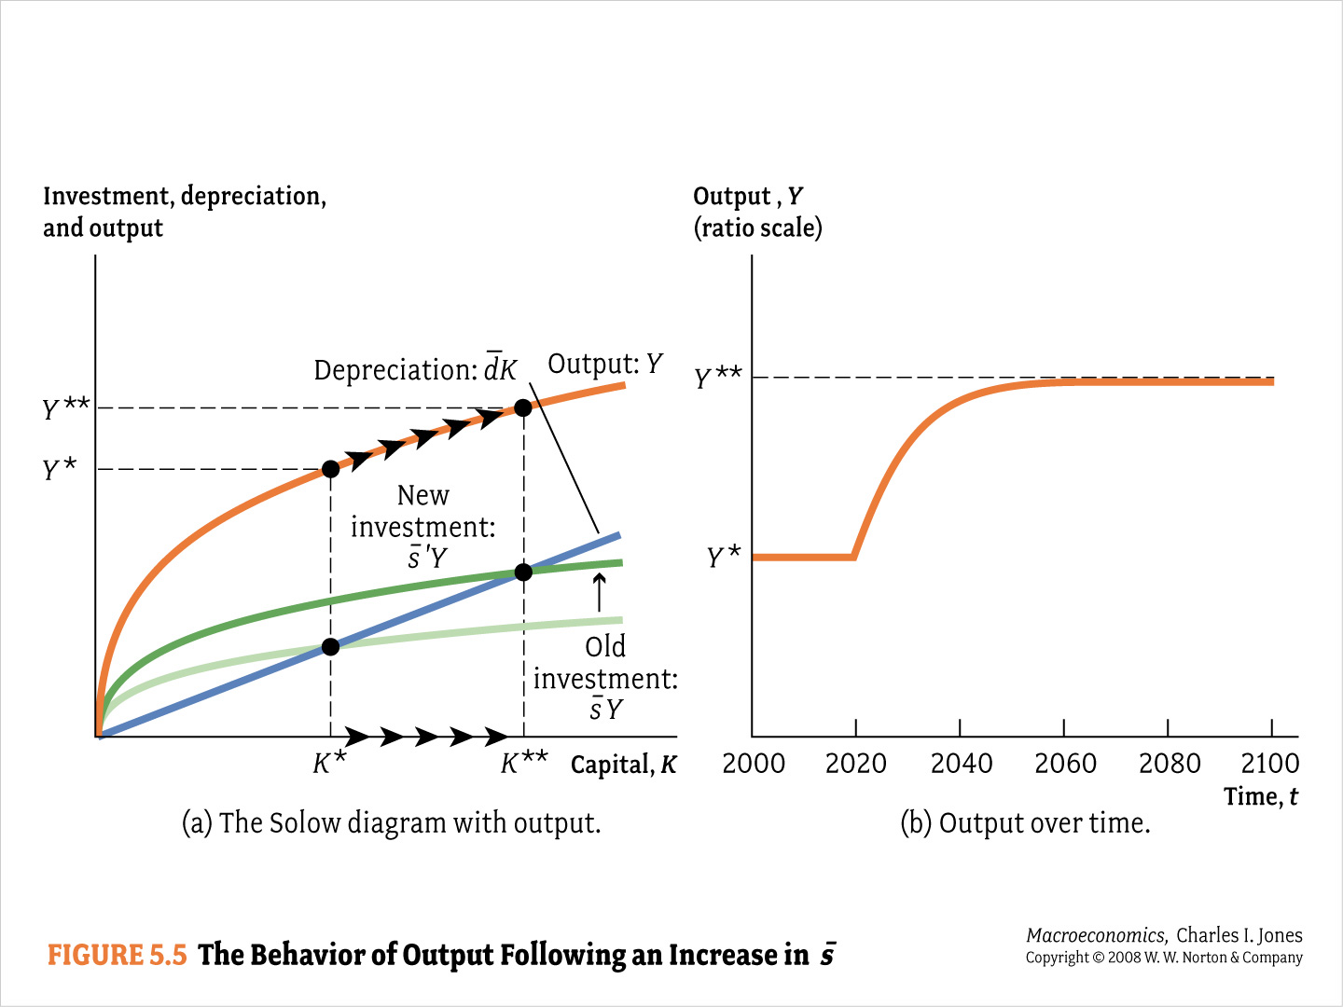

Slide 26
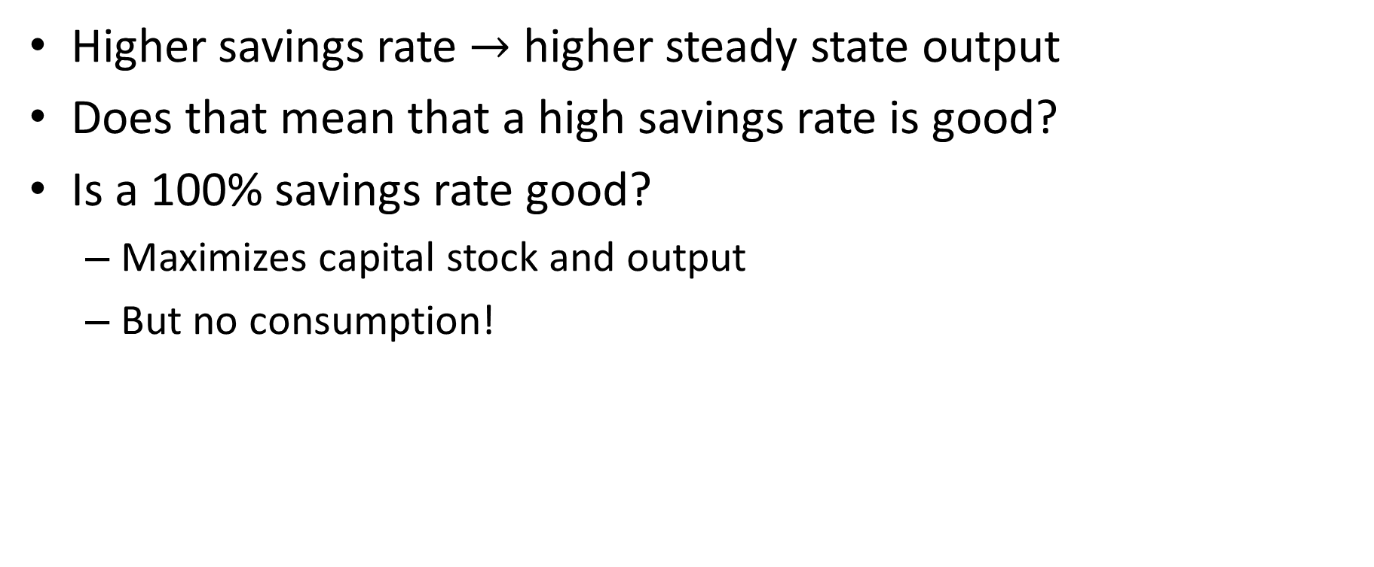
Optimal Capital Accumulation
Higher savings rate $→$ higher steady state output
Does that mean that a high savings rate is good?
Is a 100% savings rate good?
Maximizes capital stock and output
But no consumption!

Slide 27
Optimal Saving Rate
Suppose a policymaker can choose the savings rate.
What savings rate should they choose?
The rate that maximized output?
No. The rate that maximizes consumption!
Steady state value of capital that maximizes consumption: Golden rule level of capital

Slide 28
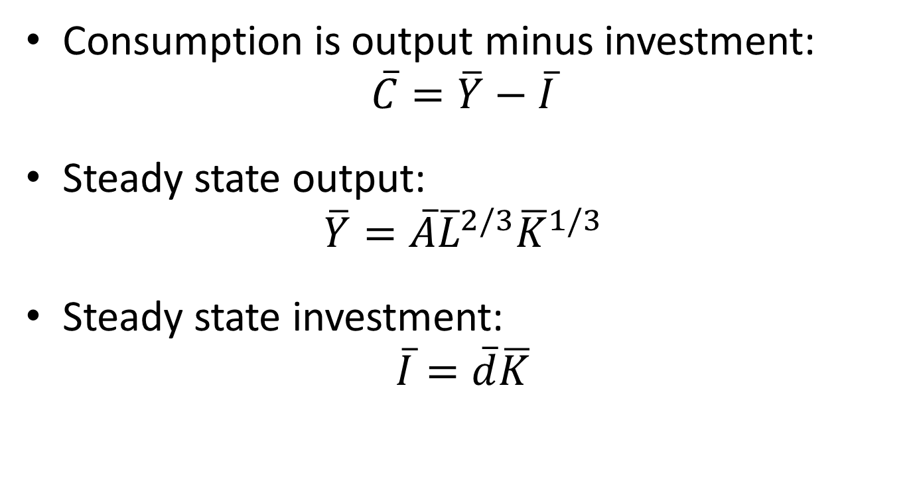
Golden Rule Level of Capital
Consumption is output minus investment:
$$\overline{C}=\overline{Y}−\overline{I}$$
Steady state output:
$$\overline{Y}=\overline{A}{\overline{L}}^{2/3}{\overline{K}}^{1/3}$$
Steady state investment:
$$\overline{I}=\overline{d}\overline{K}$$

Slide 29
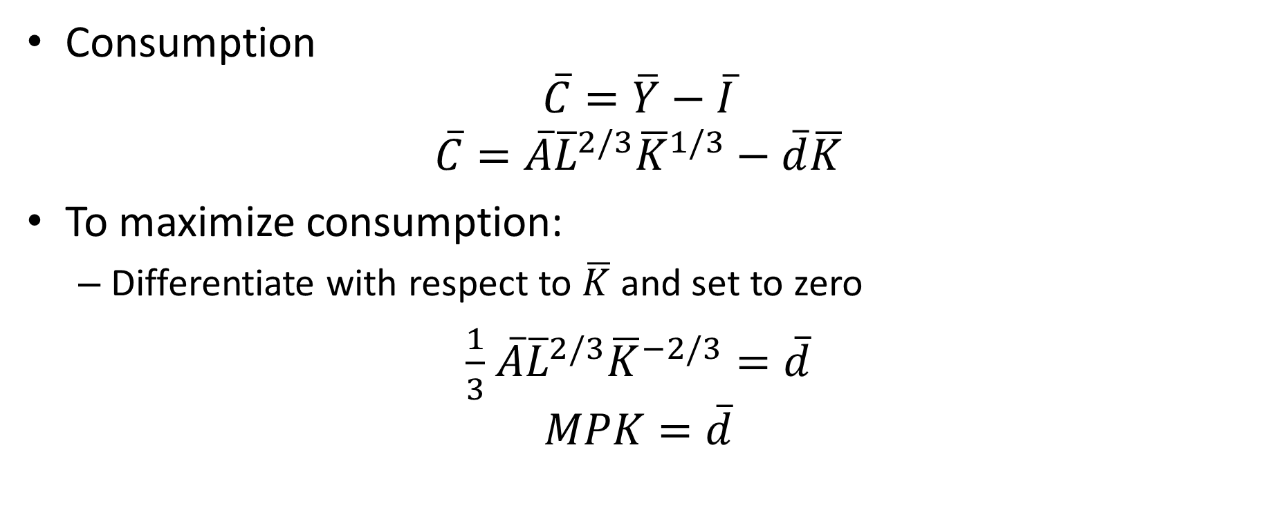
Deriving the Golden Rule
Consumption
$$\overline{C}=\overline{Y}−\overline{I}$$
$$\overline{C}=\overline{A}{\overline{L}}^{2/3}{\overline{K}}^{1/3}−\overline{d}\overline{K}$$
To maximize consumption:
Differentiate with respect to $\overline{K}$ and set to zero
$\frac{1}{3}$ $\overline{A}{\overline{L}}^{2/3}{\overline{K}}^{−2/3}=\overline{d}$
$$MPK=\overline{d}$$

Slide 30




Golden Rule Level of Capital
Steady state Output, Investment
$$\overline{I}=\overline{d}\overline{K}$$
$$\overline{Y}=\overline{A}{\overline{L}}^{2/3}{\overline{K}}^{1/3}$$
$$\overline{C}$$
Steady state capital
$${\overline{K}}_{gold}$$

Slide 31
Oversaving?
Many countries worry that savings are too low
Some countries have very high savings rates:
China for last 15 years
Soviet Union in mid 20th century
China and Soviet Union may be / have been “on the wrong side of the Golden Rule”

Slide 32
Moving to the Golden Rule
Consider a situation in which an economy starts off in a steady state with too much capital
Derive transition
Consider a situation in which an economy starts off in a steady state with too little capital
Derive transition
Key difference:
When economy begins above the Golden Rule, reaching Golden rule produces higher consumption at all points in time.
When economy begins below the Golden Rule, reaching Golden rule requires initially reducing consumption to increase consumption later on.

Slide 33
Growth in the Solow Model
What does the Solow model teach us about long run growth?
There is no long run growth in the Solow Model!!
Capital, output and consumption settle down to constant steady state values
A central lesson from the Solow Model:
Capital accumulation cannot serve as an engine for long run growth

Slide 34
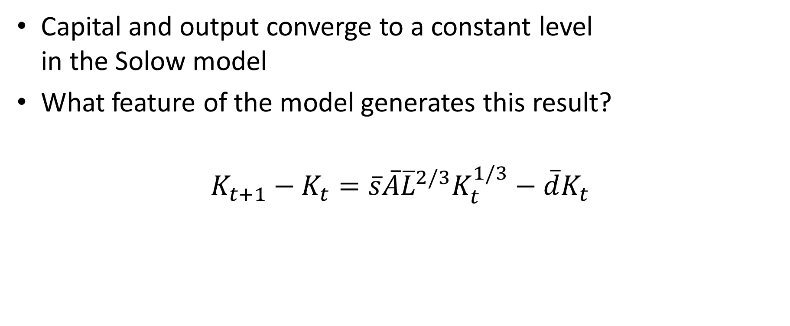
Why Is There a Steady State?
Capital and output converge to a constant level in the Solow model
What feature of the model generates this result?
$$K_{t+1}−K_{t}=\overline{s}\overline{A}{\overline{L}}^{2/3}K_{t}^{1/3}−\overline{d}K_{t}$$

Slide 35
Diminishing Returns to Capital
Diminishing returns to investment in capital
Depreciation is linear (constant returns)
Eventually investment returns can’t keep up with depreciation
This results in growth converging to zero (i.e. a steady state for capital, output etc.)

Slide 36
Investment and Growth
Development economics of the 1950’s:
Arthur Lewis: Surplus labor model
Army of surplus labor in country side
Capital only constraint on output
Output proportional to growth since “surplus labor” can be soaked up from country side
Aka Harrod-Domar model (Domar never endorsed this)

Slide 37
Harrod-Domar/Surplus Labor Model
Hugely influential at World Bank etc.
Policy implication:
To double growth one just needs to double investment
Common belief: Poor can’t save/borrow enough
Policy implication:
“Financing gap”: Difference between national savings and “required investment.” Foreign aid can fill this gap.
“Empirical evidence”: Soviet takeoff
But Soviet Union differed in many other ways from poor countries

Slide 38
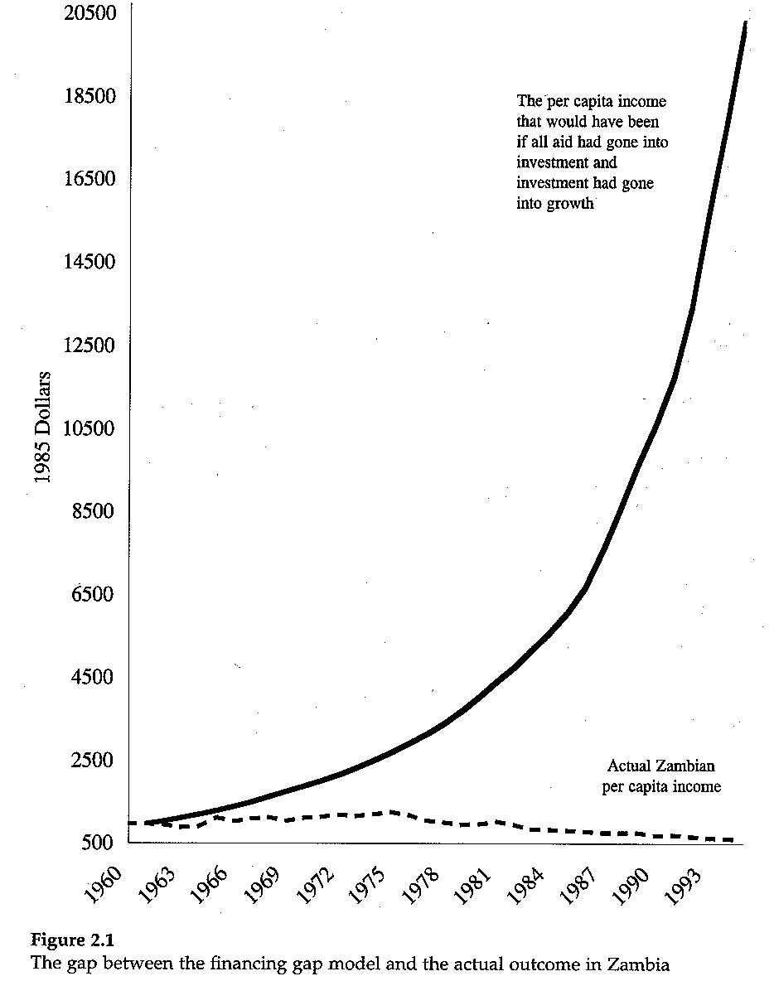
Investment: Elixir of Growth? Or Not?
Easterly:
Harrod-Domar/Surplus Labor model doesn’t fit the facts.
Investment neither sufficient nor necessary for growth
Surplus labor idea not reasonable
If there is lots of surplus labor, wages will fall and firms will use more labor intensive production methods

Slide 39
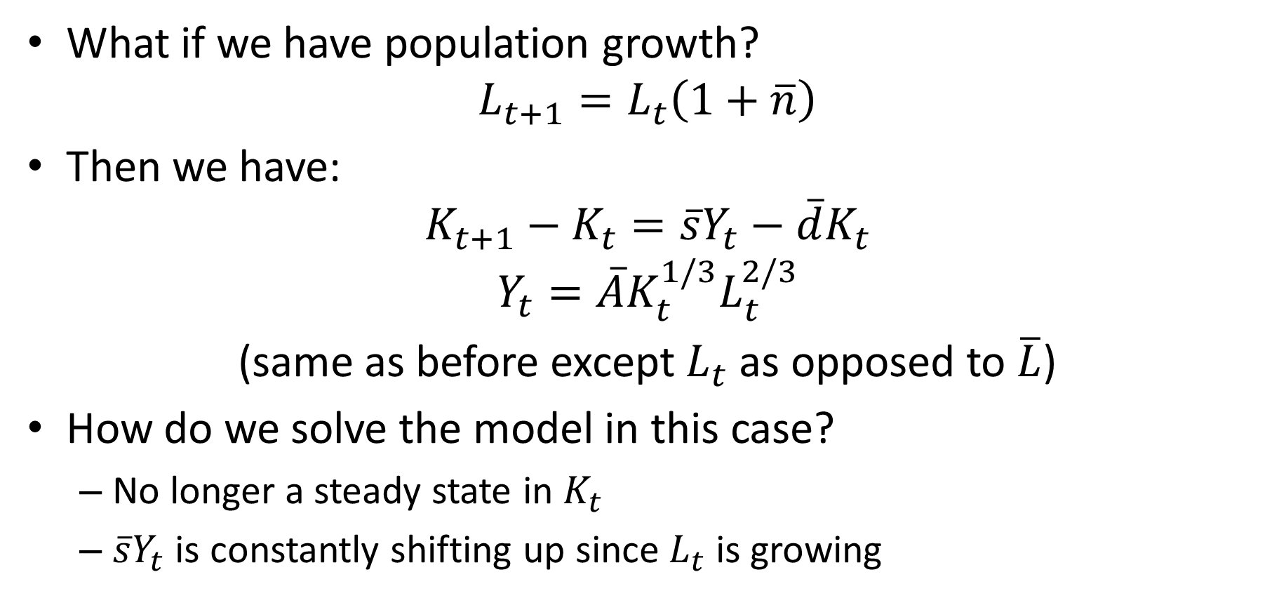
Population Growth in Solow Model
What if we have population growth?
$$L_{t+1}=L_{t}\left(1+\overline{n}\right)$$
Then we have:
$$K_{t+1}−K_{t}=\overline{s}Y_{t}−\overline{d}K_{t}$$
$$Y_{t}=\overline{A}K_{t}^{1/3}L_{t}^{2/3}$$
(same as before except $L_{t}$ as opposed to $\overline{L}$)
How do we solve the model in this case?
No longer a steady state in $K_{t}$
$\overline{s}Y_{t}$ is constantly shifting up since $L_{t}$ is growing

Slide 40
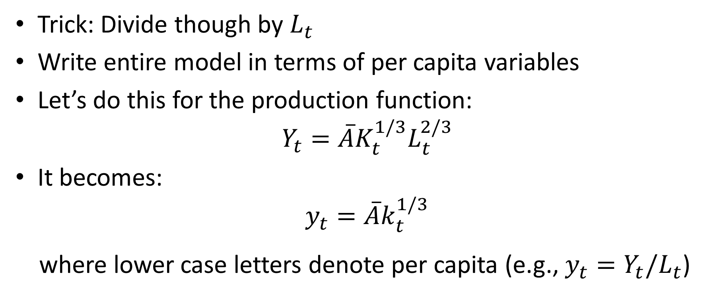
Solving the Model with Pop Growth
Trick: Divide though by $L_{t}$
Write entire model in terms of per capita variables
Let’s do this for the production function:
$$Y_{t}=\overline{A}K_{t}^{1/3}L_{t}^{2/3}$$
It becomes:
$$y_{t}=\overline{A}k_{t}^{1/3}$$
where lower case letters denote per capita (e.g., $y_{t}=Y_{t}/L_{t}$)

Slide 41
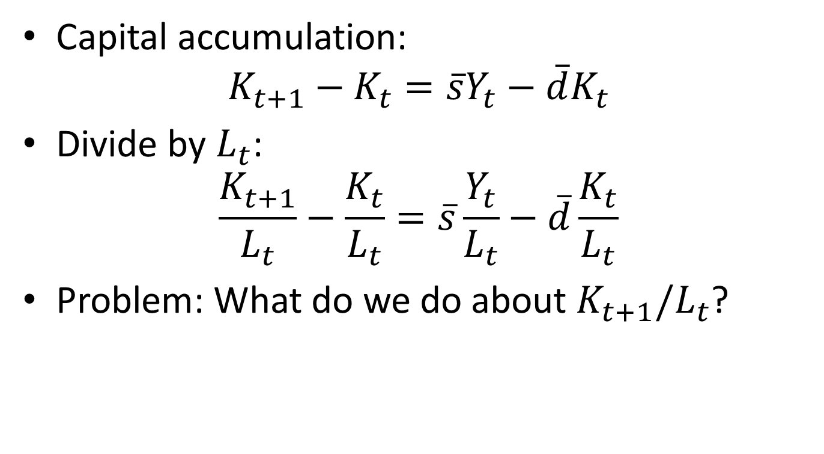
Solving the Model with Pop Growth
Capital accumulation:
$$K_{t+1}−K_{t}=\overline{s}Y_{t}−\overline{d}K_{t}$$
Divide by $L_{t}$:
$$\frac{K_{t+1}}{L_{t}}−\frac{K_{t}}{L_{t}}=\overline{s}\frac{Y_{t}}{L_{t}}−\overline{d}\frac{K_{t}}{L_{t}}$$
Problem: What do we do about $K_{t+1}/L_{t}$?

Slide 42
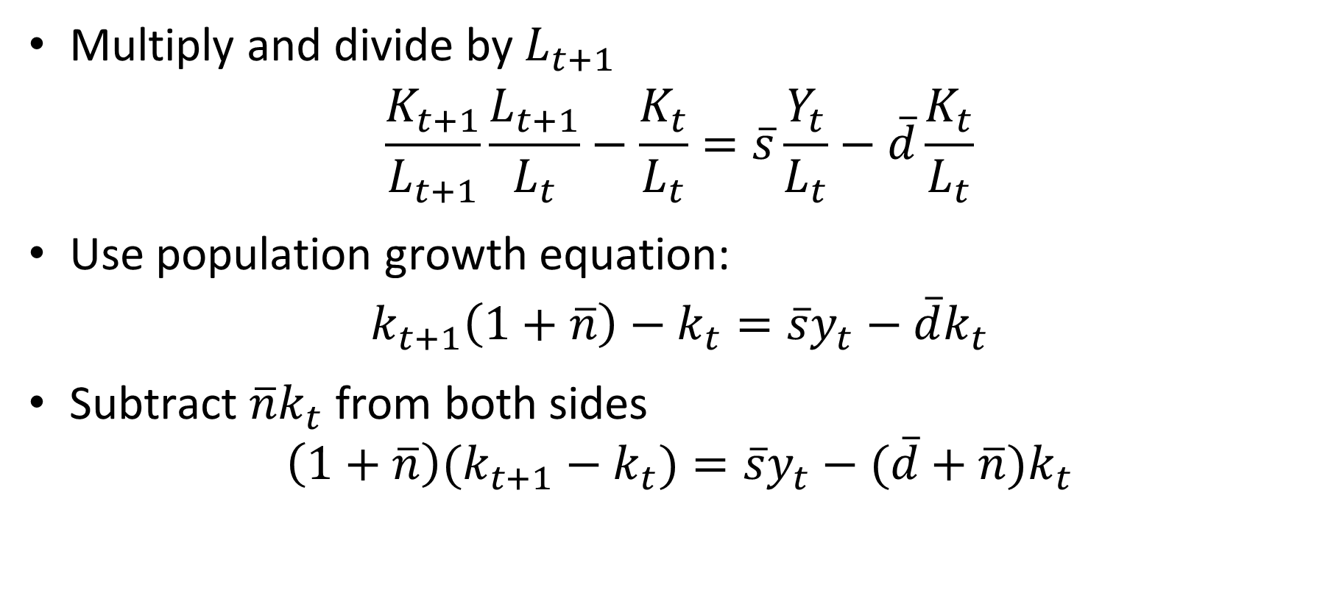
Solving the Model with Pop Growth
Multiply and divide by $L_{t+1}$
$$\frac{K_{t+1}}{L_{t+1}}\frac{L_{t+1}}{L_{t}}−\frac{K_{t}}{L_{t}}=\overline{s}\frac{Y_{t}}{L_{t}}−\overline{d}\frac{K_{t}}{L_{t}}$$
Use population growth equation:
$$k_{t+1}\left(1+\overline{n}\right)−k_{t}=\overline{s}y_{t}−\overline{d}k_{t}$$
Subtract $\overline{n}k_{t}$ from both sides
$$\left(1+\overline{n}\right)(k_{t+1}−k_{t})=\overline{s}y_{t}−(\overline{d}+\overline{n})k_{t}$$

Slide 43
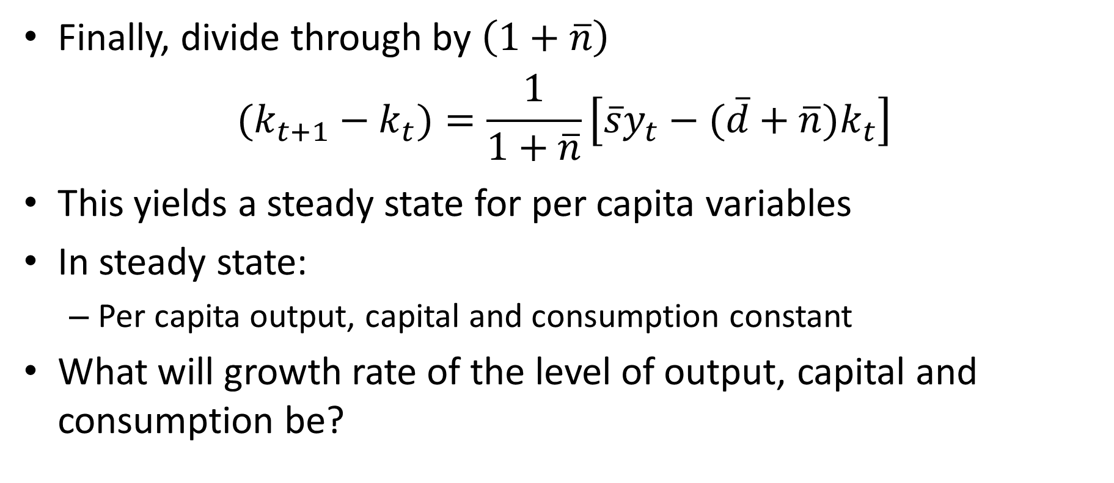
Per Capita Steady State
Finally, divide through by $\left(1+\overline{n}\right)$
$$(k_{t+1}−k_{t})=\frac{1}{1+\overline{n}}\left[\overline{s}y_{t}−(\overline{d}+\overline{n})k_{t}\right]$$
This yields a steady state for per capita variables
In steady state:
Per capita output, capital and consumption constant
What will growth rate of the level of output, capital and consumption be?

Slide 44
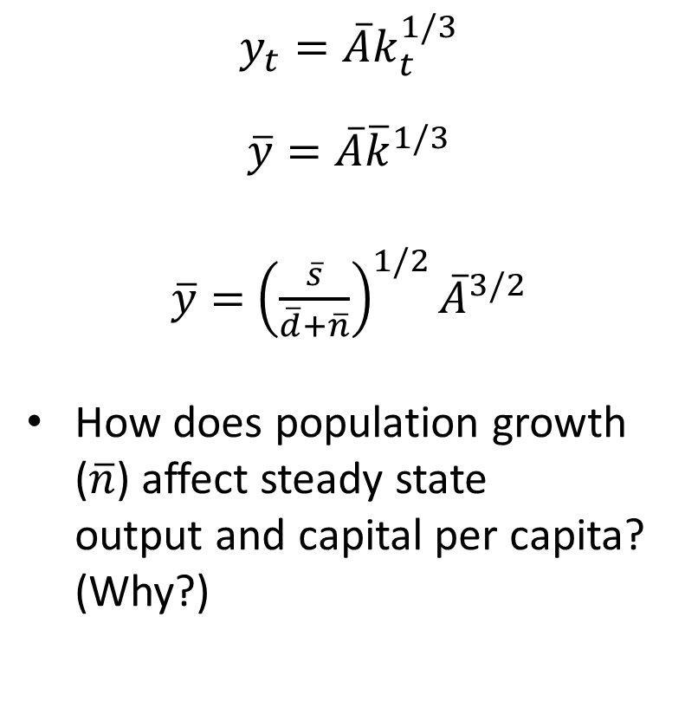
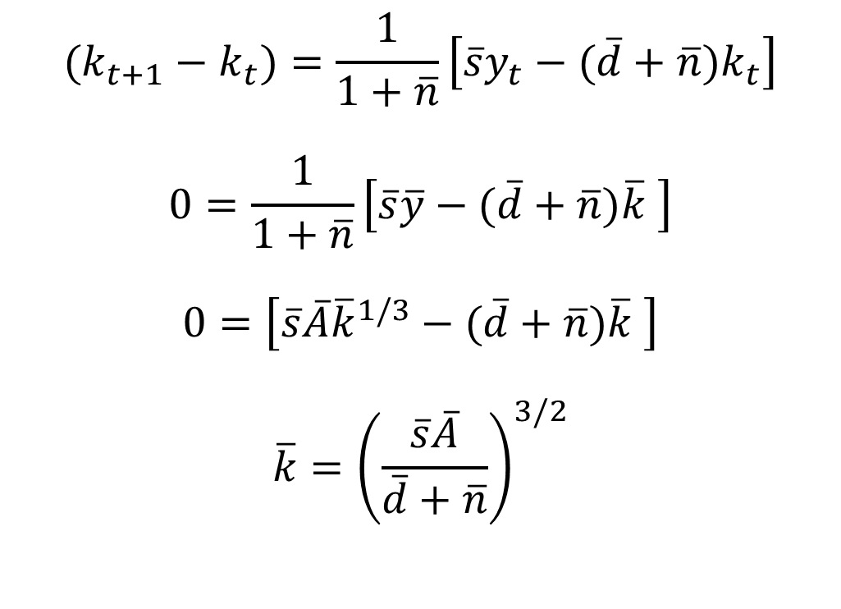
Steady State with Population Growth
$$(k_{t+1}−k_{t})=\frac{1}{1+\overline{n}}\left[\overline{s}y_{t}−(\overline{d}+\overline{n})k_{t}\right]$$
$$0=\frac{1}{1+\overline{n}}\left[\overline{s}\overline{y}−(\overline{d}+\overline{n})\overline{k} \right]$$
$$0=\left[\overline{s}\overline{A}{\overline{k}}^{1/3}−(\overline{d}+\overline{n})\overline{k} \right]$$
$$\overline{k}={\left(\frac{\overline{s}\overline{A}}{\overline{d}+\overline{n}}\right)}^{3/2}$$
$$y_{t}=\overline{A}k_{t}^{1/3}$$
$$\overline{y}=\overline{A}{\overline{k}}^{1/3}$$
$\overline{y}=$ ${\left(\frac{\overline{s}}{\overline{d}+\overline{n}}\right)}^{1/2}{\overline{A}}^{3/2}$
How does population growth ($\overline{n}$) affect steady state output and capital per capita? (Why?)

Slide 45
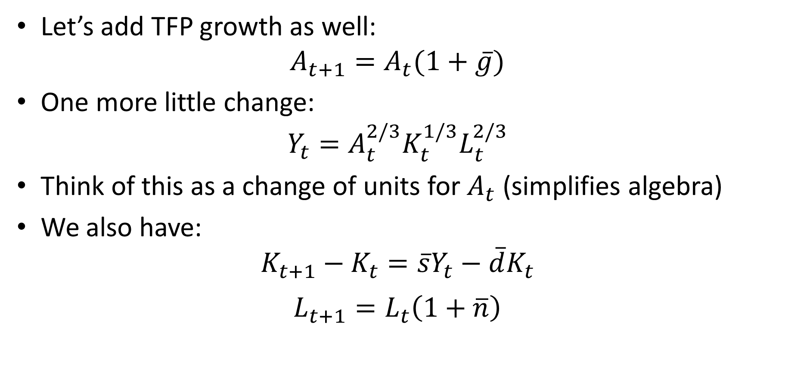
Growth in TFP
Let’s add TFP growth as well:
$$A_{t+1}=A_{t}(1+\overline{g})$$
One more little change:
$$Y_{t}=A_{t}^{2/3}K_{t}^{1/3}L_{t}^{2/3}$$
Think of this as a change of units for $A_{t}$ (simplifies algebra)
We also have:
$$K_{t+1}−K_{t}=\overline{s}Y_{t}−\overline{d}K_{t}$$
$$L_{t+1}=L_{t}\left(1+\overline{n}\right)$$

Slide 46
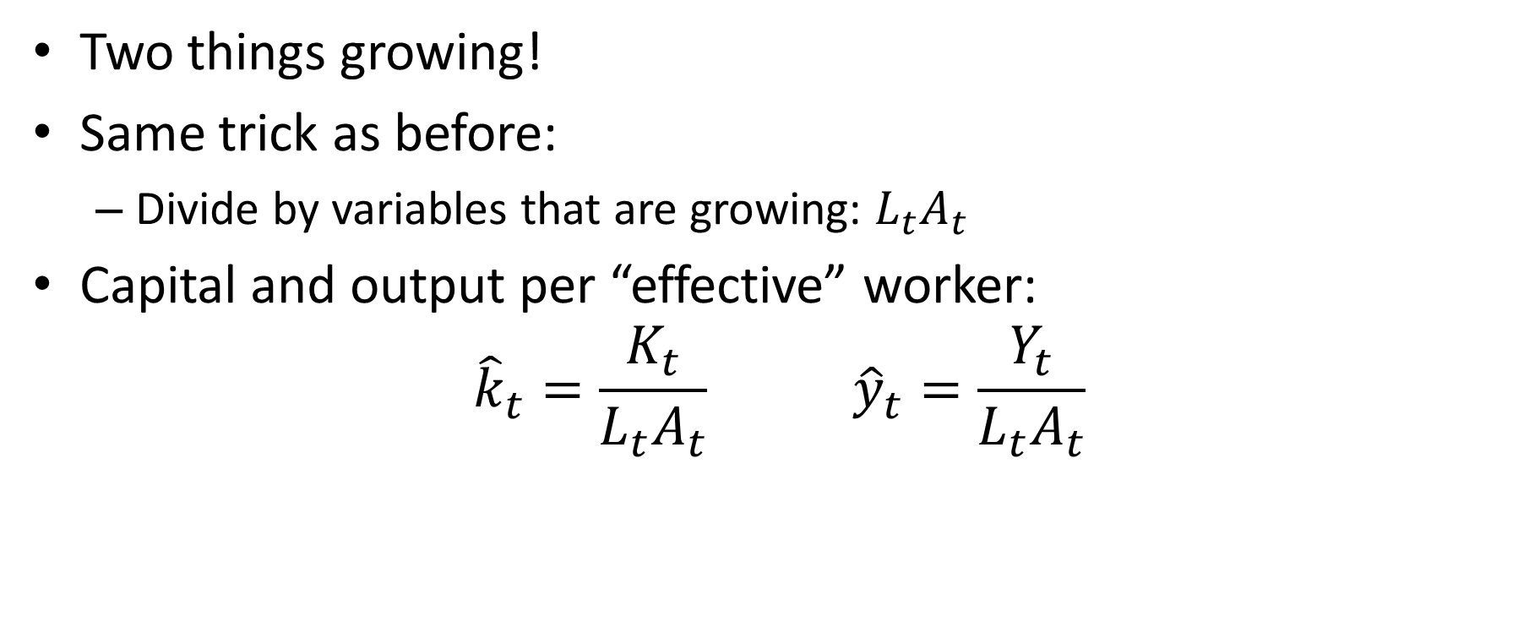
How Do We Solve This Model?
Two things growing!
Same trick as before:
Divide by variables that are growing: $L_{t}A_{t}$
Capital and output per “effective” worker:
$${\hat{k}}_{t}=\frac{K_{t}}{L_{t}A_{t}} {\hat{y}}_{t}=\frac{Y_{t}}{L_{t}A_{t}}$$

Slide 47

Write Model in Per Effective Worker Variables
Similar algebra as before yields:
$${\hat{y}}_{t}={\hat{k}}_{t}^{1/3}$$
$${\hat{k}}_{t+1}−{\hat{k}}_{t}=\frac{1}{\left(1+\overline{n}\right)\left(1+\overline{g}\right)}\left[\overline{s}{\hat{y}}_{t}−\left(\overline{d}−1+\left(1+\overline{n}\right)\left(1+\overline{g}\right)\right){\hat{k}}_{t}\right]$$

Slide 48
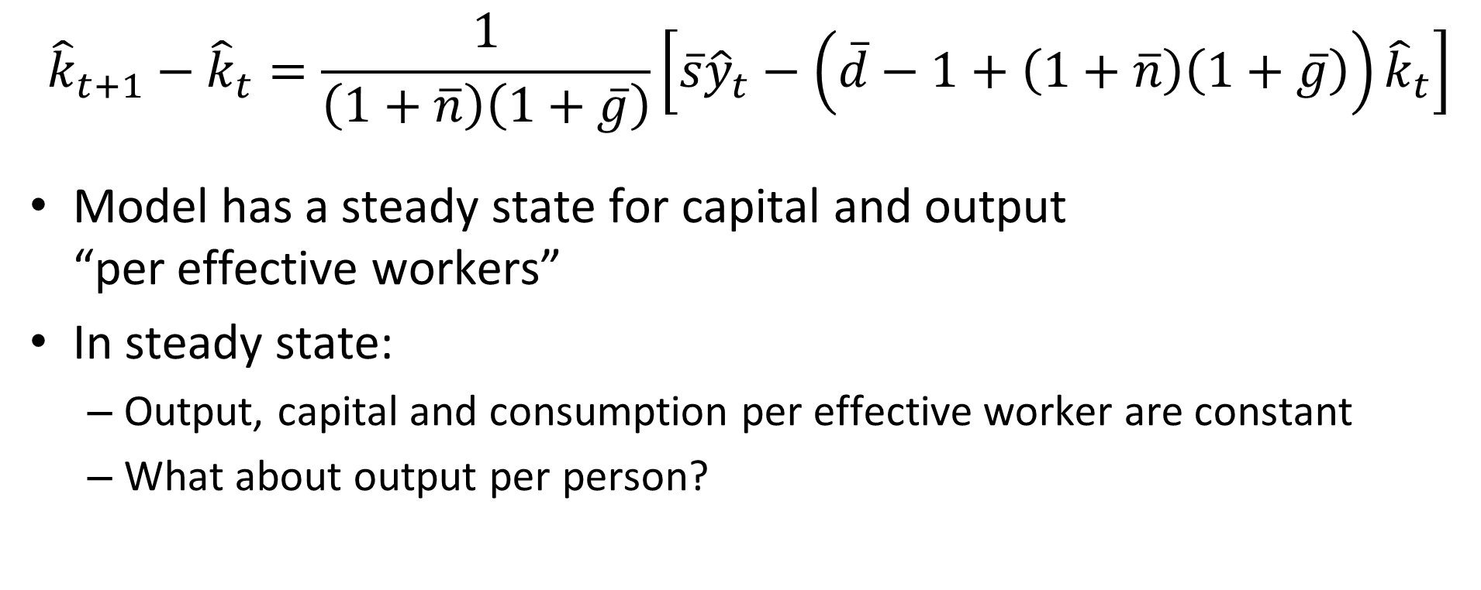
Steady State per Effective Worker
$${\hat{k}}_{t+1}−{\hat{k}}_{t}=\frac{1}{\left(1+\overline{n}\right)\left(1+\overline{g}\right)}\left[\overline{s}{\hat{y}}_{t}−\left(\overline{d}−1+\left(1+\overline{n}\right)\left(1+\overline{g}\right)\right){\hat{k}}_{t}\right]$$
Model has a steady state for capital and output “per effective workers”
In steady state:
Output, capital and consumption per effective worker are constant
What about output per person?

Slide 49

Growth in Per Capita Income
$${\hat{y}}_{t}=\frac{Y_{t}}{A_{t}L_{t}}$$
Implies:
$$g_{{\hat{y}}_{t}}=g_{Y/L}−g_{A}$$
0$=g_{Y/L}−g_{A}$
$$g_{Y/L}=g_{A}$$

Slide 50
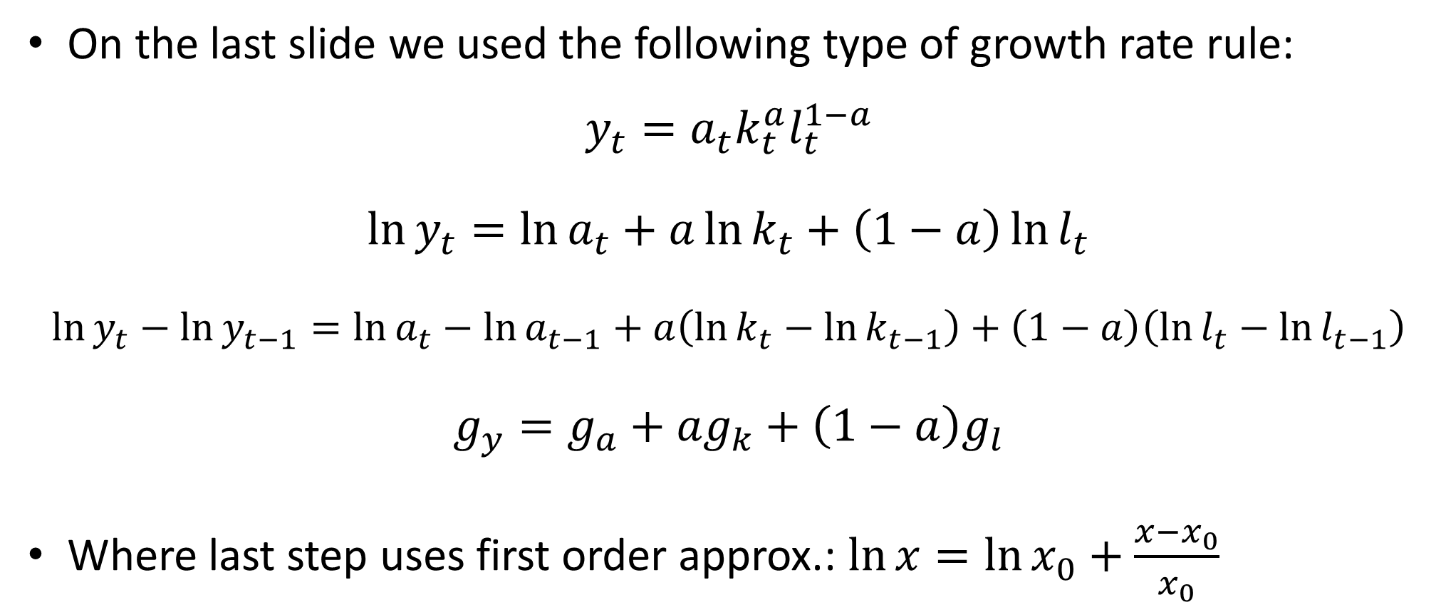
Growth Rates
On the last slide we used the following type of growth rate rule:
$$y_{t}=a_{t}k_{t}^{a}l_{t}^{1−a}$$
$$\ln{y_{t}}=\ln{a_{t}}+a\ln{k_{t}}+\left(1−a\right)\ln{l_{t}}$$
$$\ln{y_{t}}−\ln{y_{t−1}}=\ln{a_{t}}−\ln{a_{t−1}}+a\left(\ln{k_{t}}−\ln{k_{t−1}}\right)+\left(1−a\right)\left(\ln{l_{t}}−\ln{l_{t−1}}\right)$$
$$g_{y}=g_{a}+ag_{k}+\left(1−a\right)g_{l}$$
Where last step uses first order approx.: $\ln{x}=\ln{x_{0}}+\frac{x−x_{0}}{x_{0}}$

Slide 51
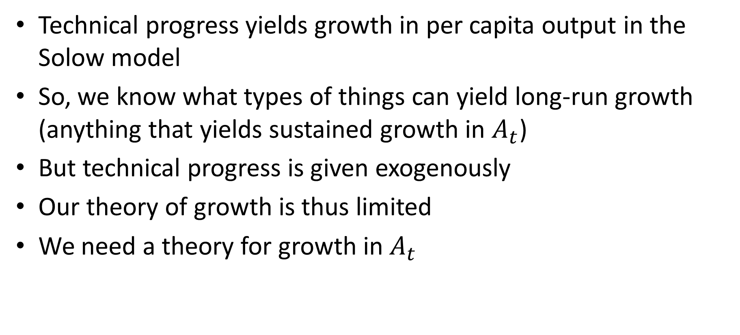
Exogenous Growth
Technical progress yields growth in per capita output in the Solow model
So, we know what types of things can yield long-run growth (anything that yields sustained growth in $A_{t}$)
But technical progress is given exogenously
Our theory of growth is thus limited
We need a theory for growth in $A_{t}$

Slide 52
Growth in the Solow Model
Capital accumulation cannot serve as engine for long run growth (due to diminishing return to capital)
But perhaps the “long run” is really far off from a practical point of view
Perhaps capital accumulation can play a big role for growth for quite some time
Let’s look at “growth miracles” and see if they are due to capital accumulation or TFP growth

Slide 53
Growth “Miracle” of Asian “Tigers”
Growth of Asian “Tigers” 1966-1990:
Is their growth driven by TFP growth or growth in factor inputs?
Young (1995): Tyranny of Numbers
Korea | 10.3%
Taiwan | 9.4%
Singapore | 8.7%
Hong Kong | 7.3%

Slide 54
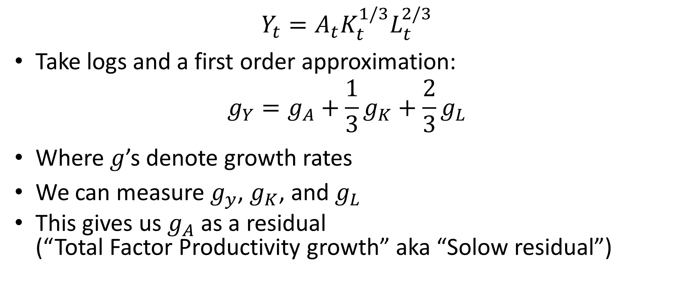
Growth Accounting
$$Y_{t}=A_{t}K_{t}^{1/3}L_{t}^{2/3}$$
Take logs and a first order approximation:
$$g_{Y}=g_{A}+\frac{1}{3}g_{K}+\frac{2}{3}g_{L}$$
Where $g$’s denote growth rates
We can measure $g_{y}$, $g_{K}$, and $g_{L}$
This gives us $g_{A}$ as a residual (“Total Factor Productivity growth” aka “Solow residual”)

Slide 55
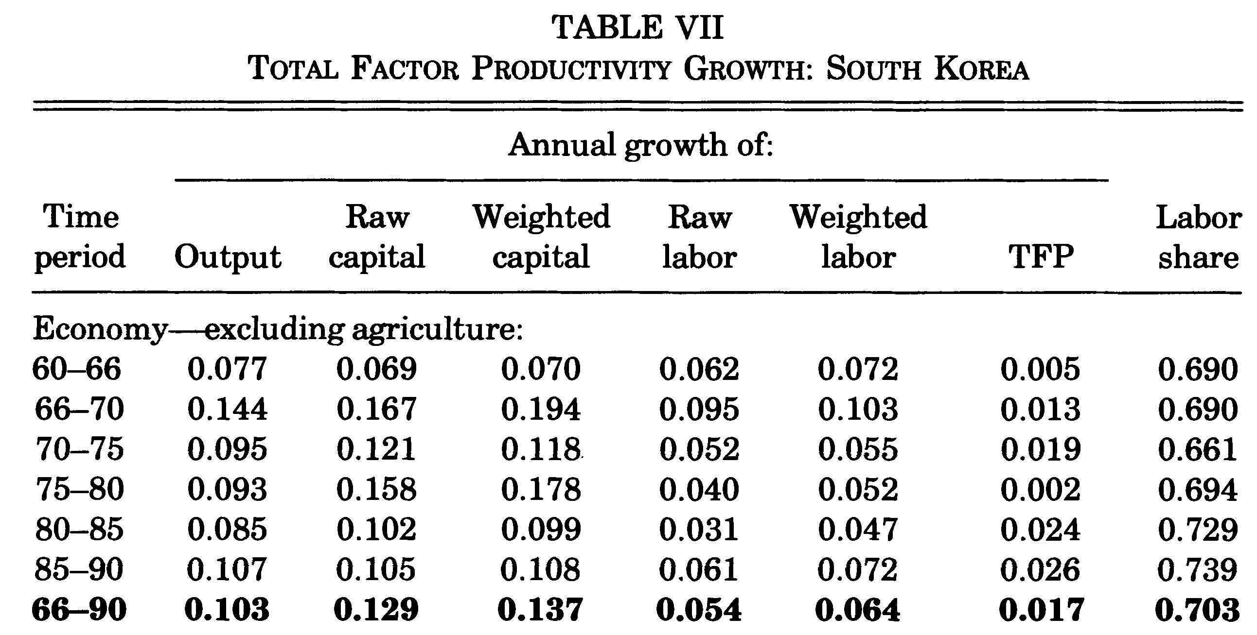

Slide 56
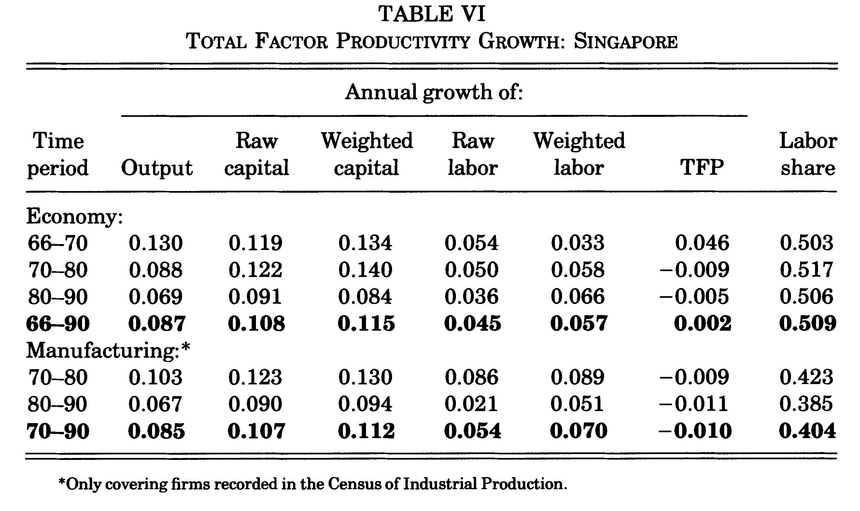

Slide 57
Was it a Miracle?
Young (1995):
Growth driven primarily by growth in factor inputs
TFP growth unremarkable
Young’s study came as a shock
Many people’s reaction was that it was bad for some reason that growth was due to factor input growth
Krugman (1994) questions sustainability based on the logic of the Solow model

Slide 58
Was It a Miracle?
Is it any less of an achievement?
Asian Tigers were able to increase capital stock and labor supply by huge amounts
Many other countries weren’t
Why were they able to do this while other weren’t?

Slide 59
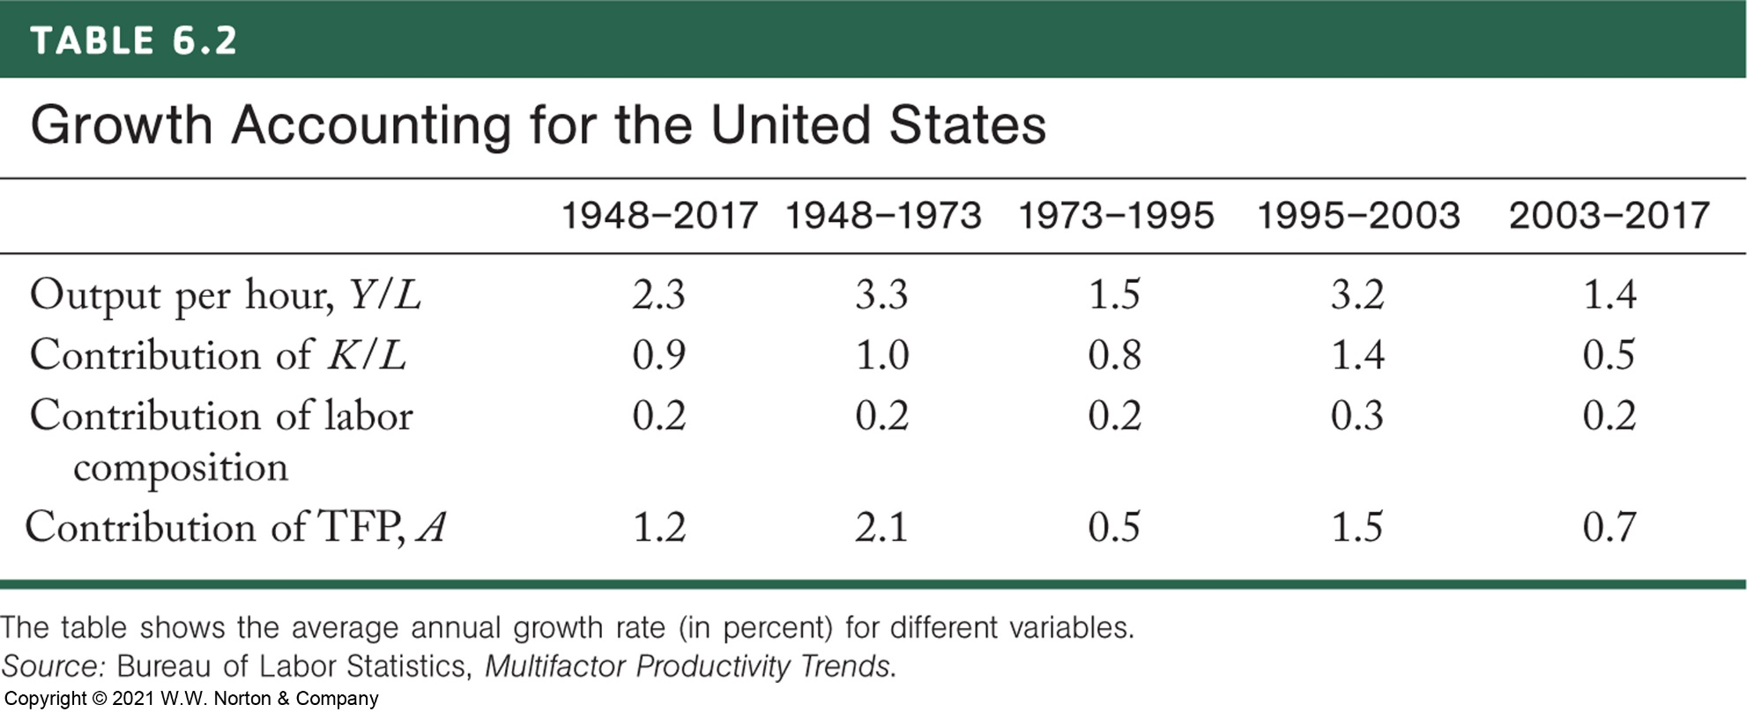

Slide 60
TFP Growth in the U.S.
TFP growth accounts for more than 50% of growth in U.S. GDP per capita since WWII
Most of the rest comes from K/L
TFP growth much more important proportionally in U.S. than in case of Asian Tigers

Slide 61
TFP Growth in the U.S.
1948-1973: Rapid TFP growth
Post-1973: Productivity slowdown
Late 1980’s and early 1990’s: “Productivity Paradox”
Major innovations in computing, fiber optics, etc.
Continued slow growth in TFP
Solow: “You can see the computer age every-where these days, except in the productivity statistics.”
Productivity speedup in mid 1990’s
“New Economy” (internet, email made computers useful)
Paul David (1990): Delays between major innovation and productivity growth common. E.g. steam engine and electric dynamo.
2003-present: Second productivity slowdown

Slide 66
Growth Miracles in the Solow Model
What does the Solow model suggest as an explanation for high growth rates of e.g. Asian Tigers?
In the Solow Model:
Countries below their steady state grow fast
Further below, faster you grow
Countries above their steady state grow slow (contract)
Perhaps this may explain differences in growth rates across countries (e.g., fast growing East Asian Tigers)

Slide 67
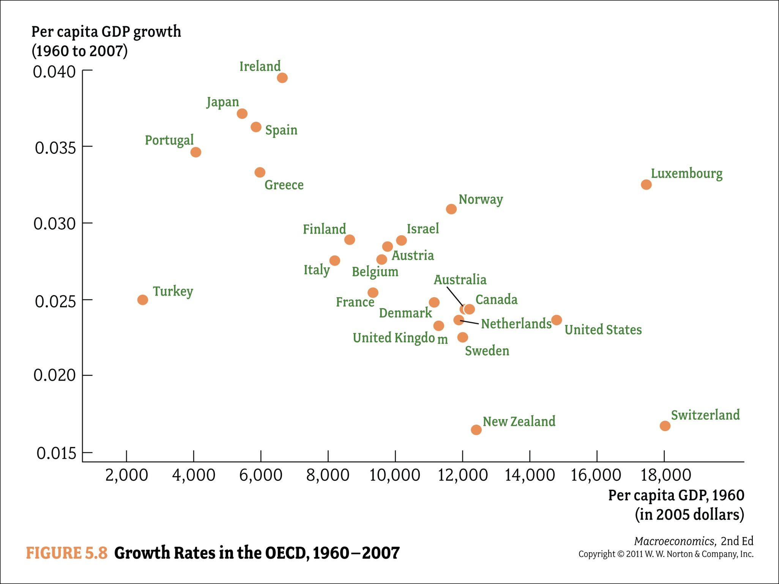

Slide 68
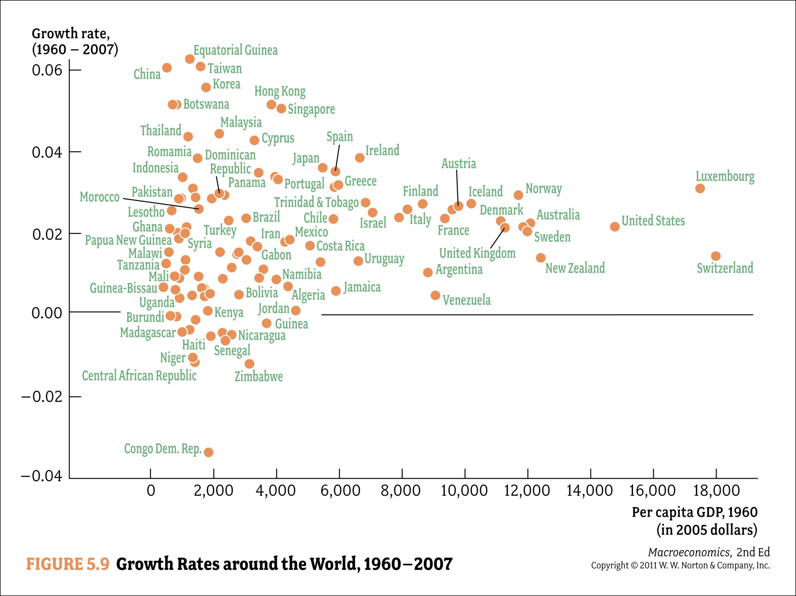

Slide 69
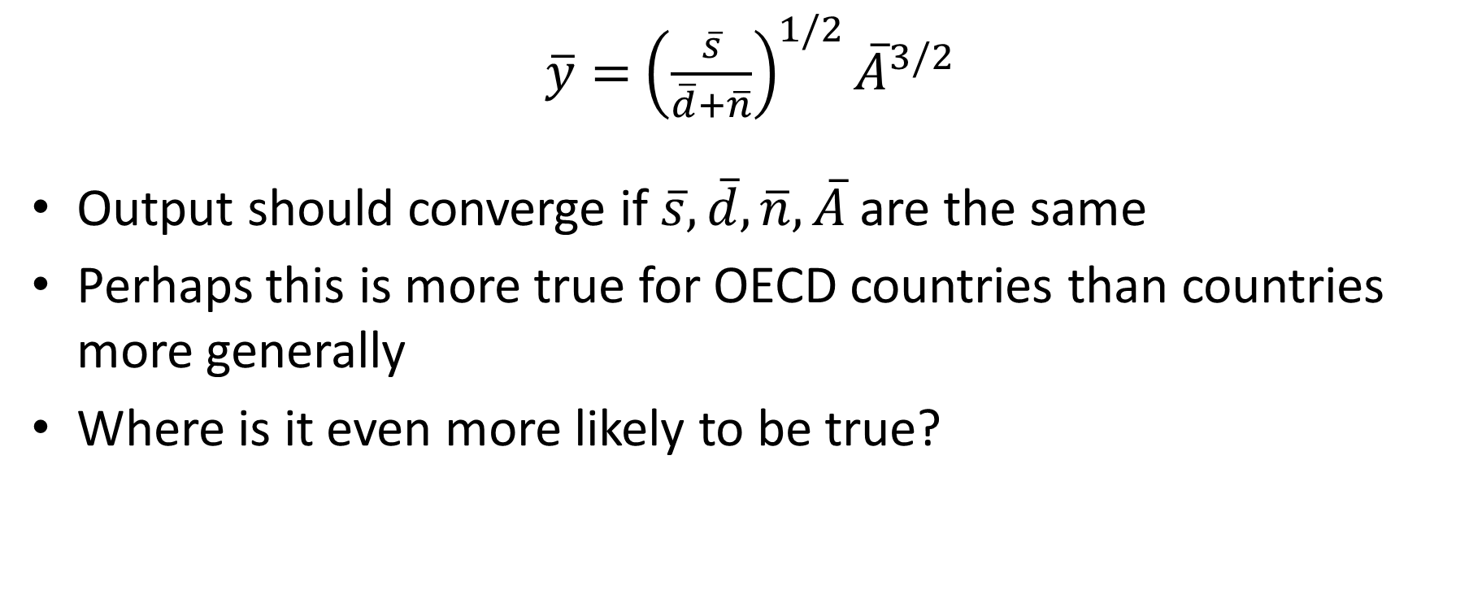
Convergence in the Solow Model
$\overline{y}=$ ${\left(\frac{\overline{s}}{\overline{d}+\overline{n}}\right)}^{1/2}{\overline{A}}^{3/2}$
Output should converge if $\overline{s}, \overline{d},\overline{n},\overline{A}$ are the same
Perhaps this is more true for OECD countries than countries more generally
Where is it even more likely to be true?

Slide 70
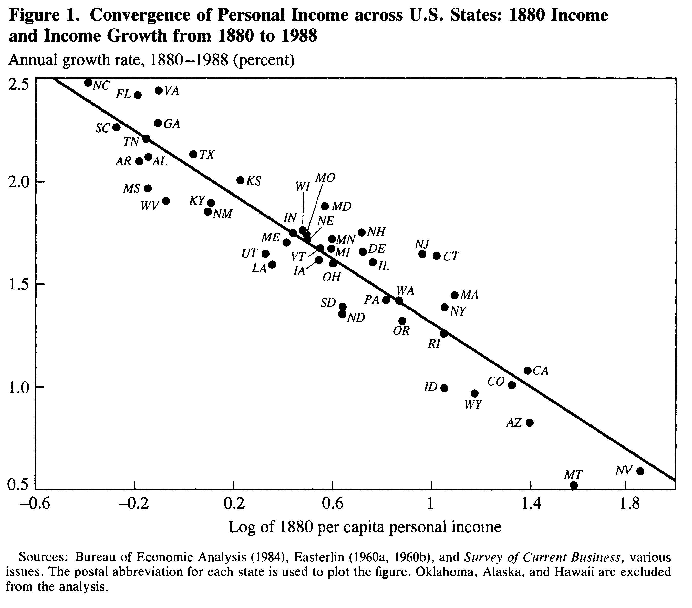
Barro and Sala-I-Martin (1991): Convergence Across States and Regions

Slide 71
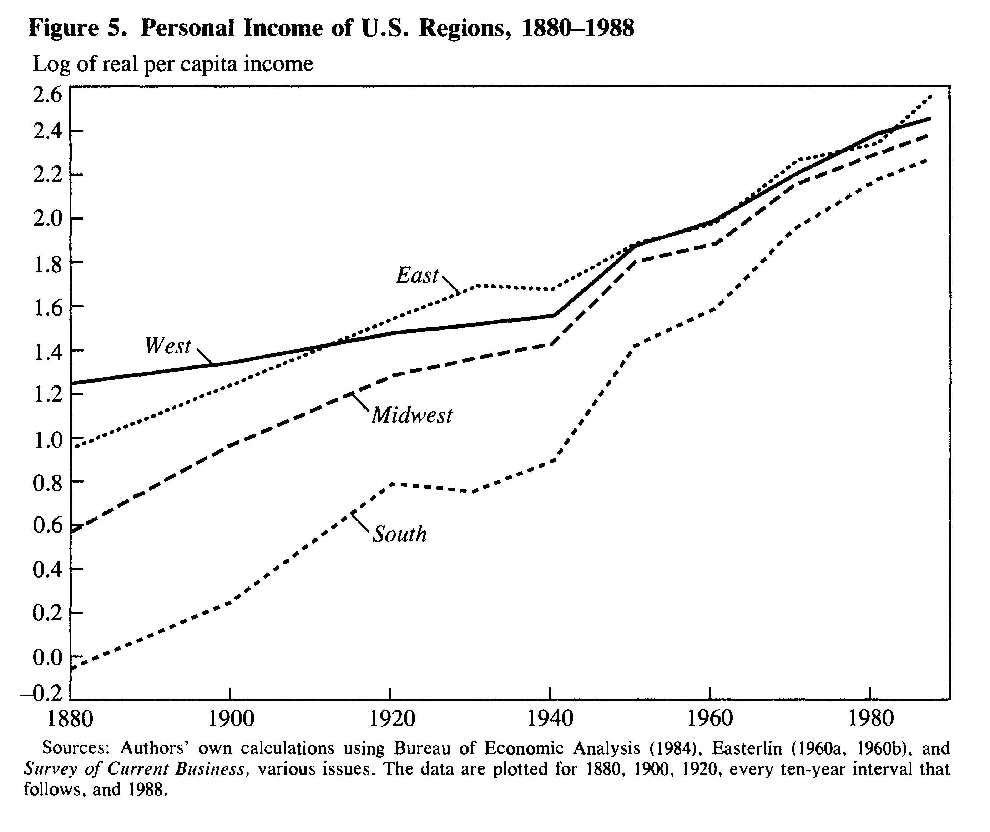
Barro and Sala-I-Martin (1991): Convergence Across States and Regions

Slide 72
Convergence
Strong convergence across
OECD countries 1960-2000
U.S. states 1880-1990
European regions 1950-1990
Japanese prefectures 1955-1990
(Barro and Sala-I-Martin, 1999, Economic Growth)

Slide 73
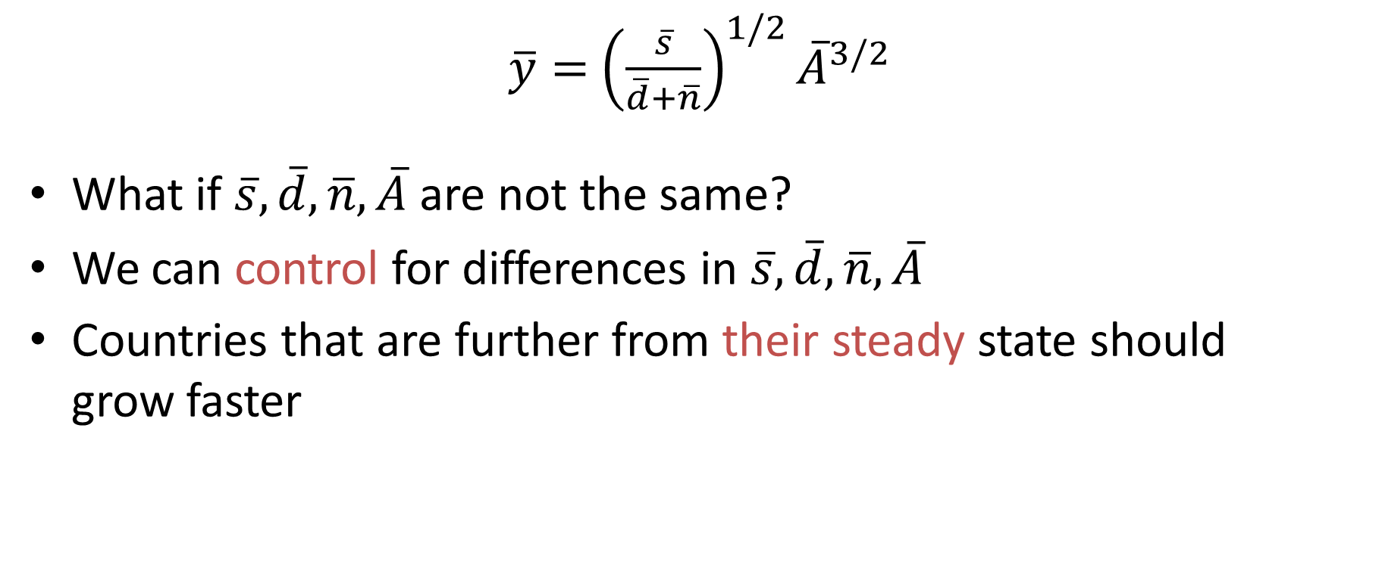
Conditional Convergence
$\overline{y}=$ ${\left(\frac{\overline{s}}{\overline{d}+\overline{n}}\right)}^{1/2}{\overline{A}}^{3/2}$
What if $\overline{s}, \overline{d},\overline{n},\overline{A}$ are not the same?
We can control for differences in $\overline{s}, \overline{d},\overline{n},\overline{A}$
Countries that are further from their steady state should grow faster

Slide 74
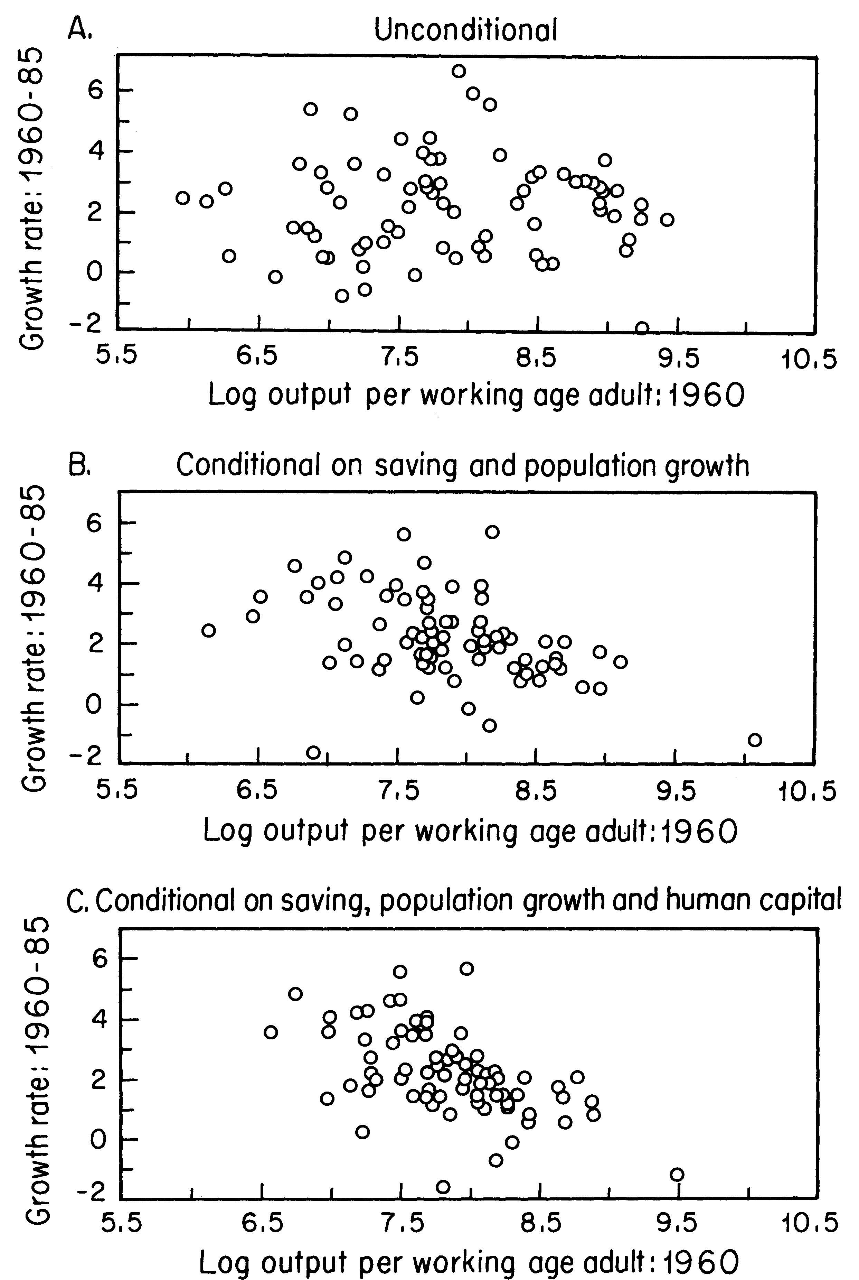
Mankiw, Romer and Weil (1992): A Contribution to the Empirics of Economic Growth

Slide 75

Solow Model and Key Questions
What determines the growth of the “frontier”?
(Solow model?)
Why are some countries so far behind the frontier?
(Solow model?)

Slide 76
Solow Model and Key Questions
Growth in the frontier
Capital accumulation not a source of long run growth
Growth in the frontier due to changes in productivity
Behind the frontier
Temporarily below due to history but converging
Lower steady state (Why?)

