Slide 1
Lecture 8 Ideas and Growth Macroeconomics (Quantitative) Econ 101B
Jón Steinsson
University of California, Berkeley

Slide 2
Ideas and Growth
What drives modern economic growth?
Solow model: Capital Accumulation is not fundamental engine of growth
What about accumulation of knowledge?
For knowledge to succeed where capital failed, there must be something fundamentally different about knowledge

Slide 3
Objects Versus Ideas
Objects:
Raw material of the universe
Goods, services, capital, labor, land, barrels of oil, a particular lightbulb, a particular lawnmower, a particular oral rehydration pill, etc.
Ideas:
Instructions for using the raw material of the universe
How to make fire from sticks, how to make plastic from petroleum, how to make paper from trees, calculus, double-entry accounting, just-in-time inventory management, oral rehydration therapy, Beethoven’s 3rd symphony, etc.

Slide 4
What Is Special About Ideas?
Objects are rivalrous
One person’s use of an object reduces ability of other people to use that same object.
E.g.: Computers, Accountants, Land
Rivalry gives rise to scarcity
Ideas are non-rivalrous
My use of calculus to solve a problem does not affect anyone else’s ability to use calculus (at the same time)
Ideas are infinitely reusable

Slide 5
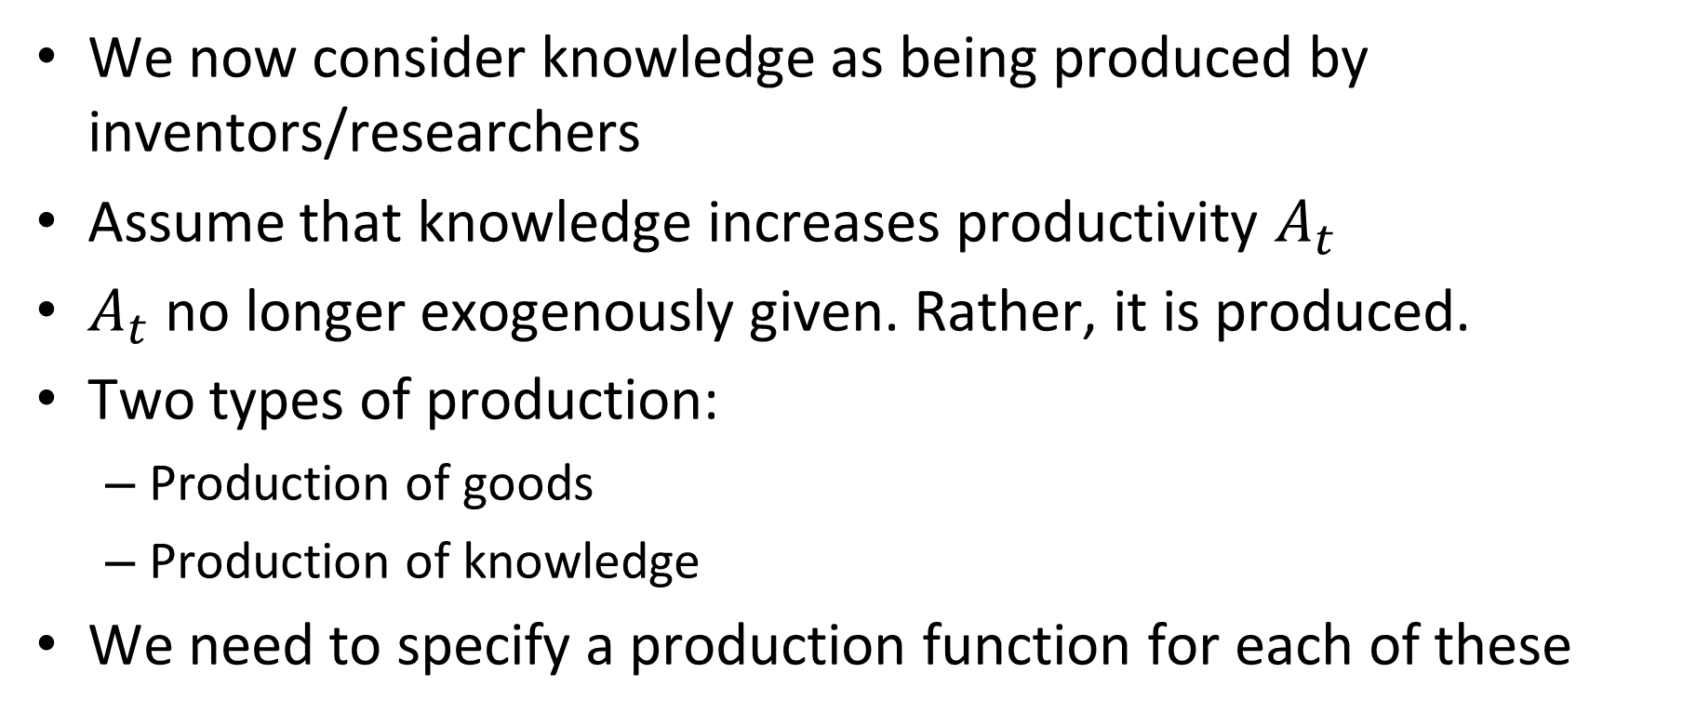
Ideas and the Production Function
We now consider knowledge as being produced by inventors/researchers
Assume that knowledge increases productivity $A_{t}$
$A_{t}$ no longer exogenously given. Rather, it is produced.
Two types of production:
Production of goods
Production of knowledge
We need to specify a production function for each of these

Slide 6
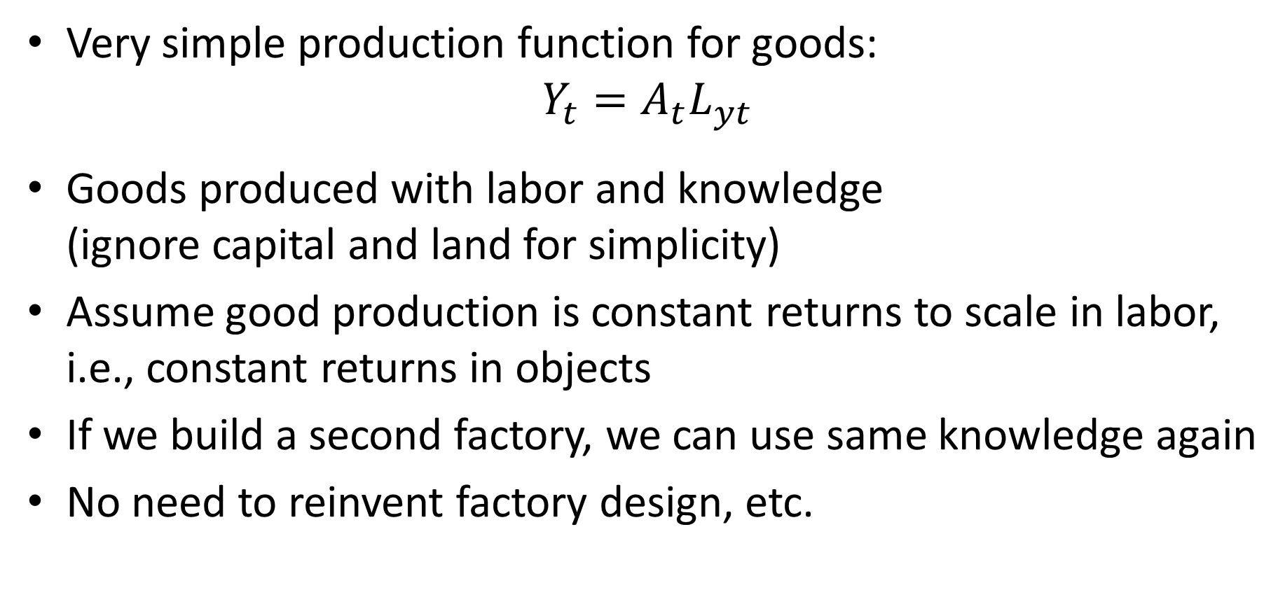
Production of Goods
Very simple production function for goods:
$$Y_{t}=A_{t}L_{yt}$$
Goods produced with labor and knowledge (ignore capital and land for simplicity)
Assume good production is constant returns to scale in labor, i.e., constant returns in objects
If we build a second factory, we can use same knowledge again
No need to reinvent factory design, etc.

Slide 7
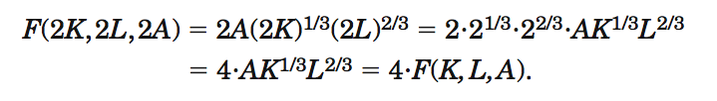
Returns to Scale
Since production of goods is constant returns to objects, it is increasing returns to objects + ideas
Growth in ideas outside logic of replication argument
Replication argument: constant returns to objects
But we have growth in knowledge on top of that

Slide 8
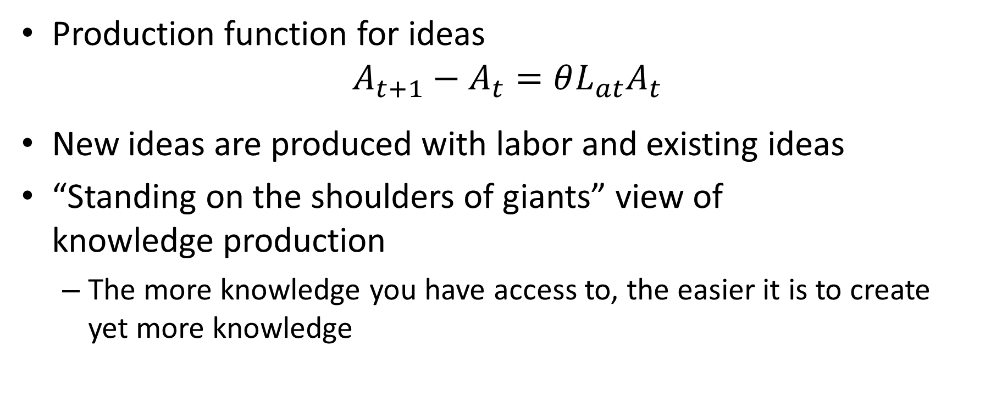
Production of Ideas
Production function for ideas
$$A_{t+1}−A_{t}=θL_{at}A_{t}$$
New ideas are produced with labor and existing ideas
“Standing on the shoulders of giants” view of knowledge production
The more knowledge you have access to, the easier it is to create yet more knowledge

Slide 9
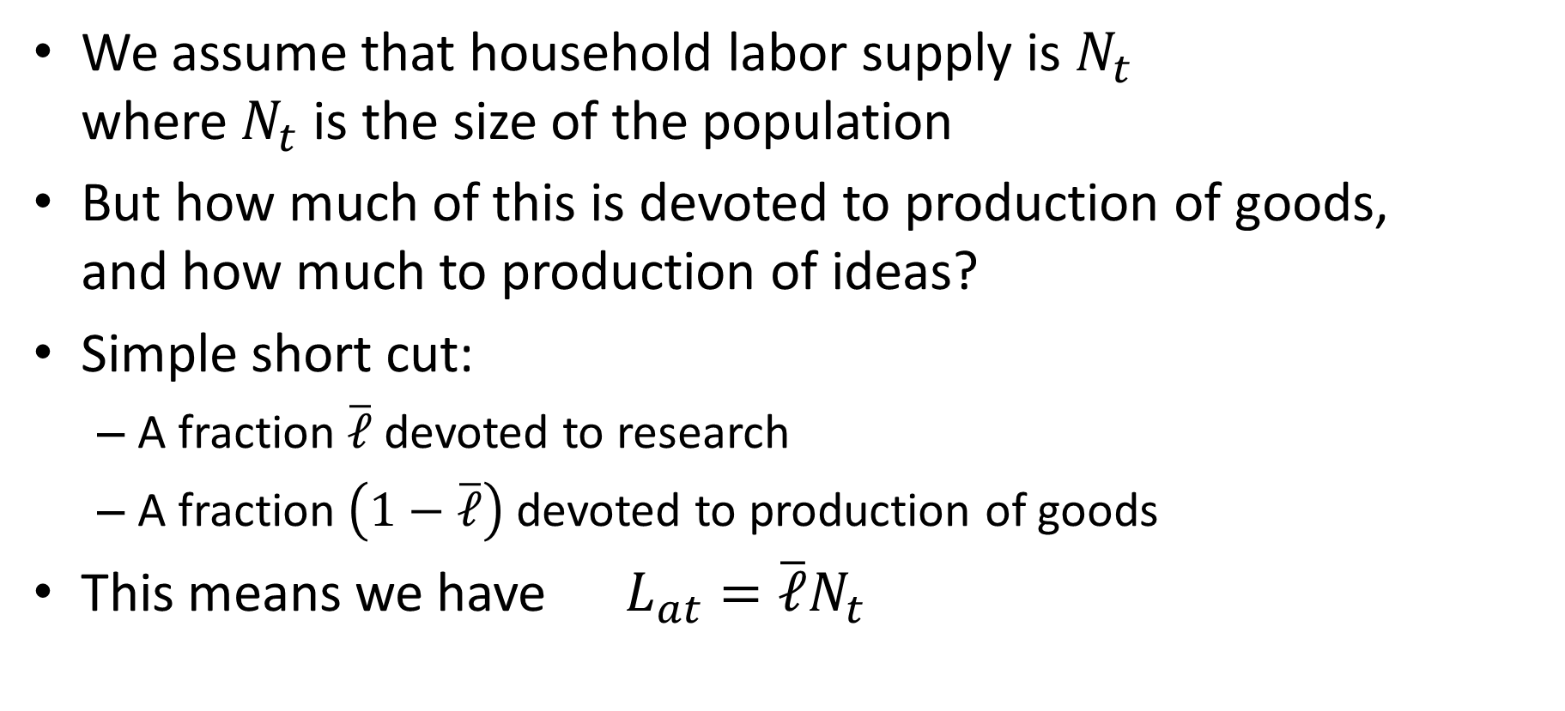
Allocation of Labor
We assume that household labor supply is $N_{t}$ where $N_{t}$ is the size of the population
But how much of this is devoted to production of goods, and how much to production of ideas?
Simple short cut:
A fraction $\overline{ℓ}$ devoted to research
A fraction $\left(1−\overline{ℓ}\right)$ devoted to production of goods
This means we have $L_{at}=\overline{ℓ}N_{t}$

Slide 10
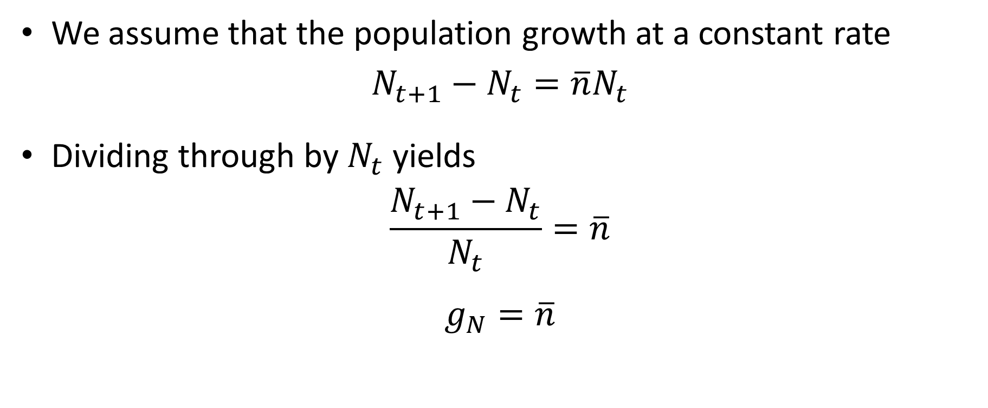
Population Growth
We assume that the population growth at a constant rate
$$N_{t+1}−N_{t}=\overline{n}N_{t}$$
Dividing through by $N_{t}$ yields
$$\frac{N_{t+1}−N_{t}}{N_{t}}=\overline{n}$$
$$g_{N}=\overline{n}$$

Slide 11
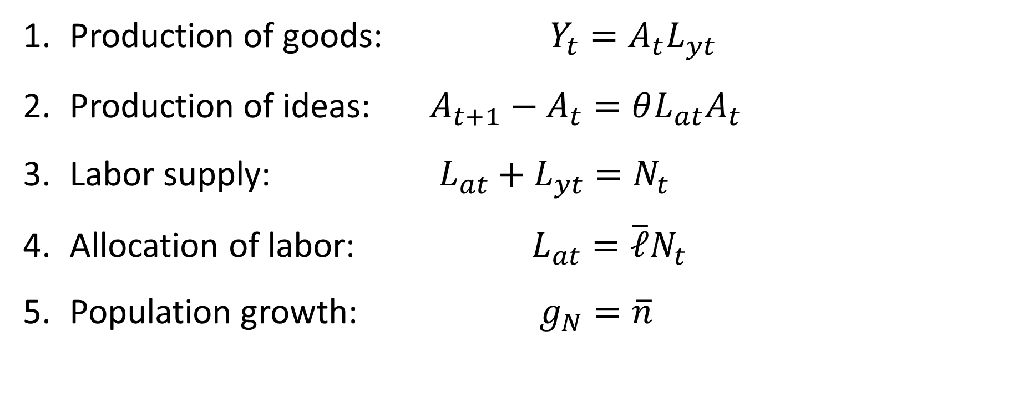
Romer Model
Production of goods: $Y_{t}=A_{t}L_{yt}$
Production of ideas: $A_{t+1}−A_{t}=θL_{at}A_{t}$
Labor supply: $L_{at}+L_{yt}=N_{t}$
Allocation of labor: $L_{at}=\overline{ℓ}N_{t}$
Population growth: $g_{N}=\overline{n}$

Slide 12
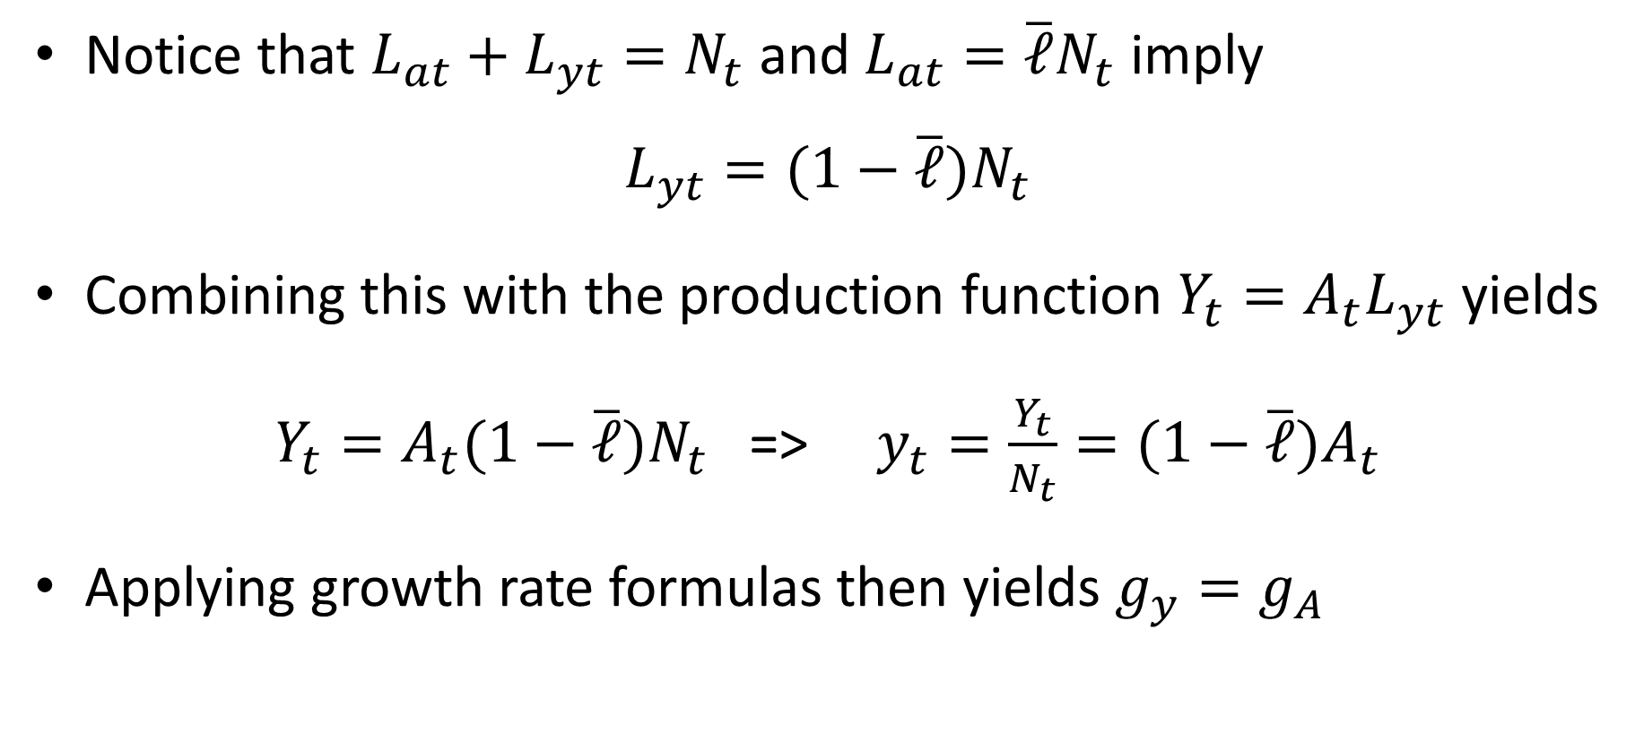
Solving Romer Model
Notice that $L_{at}+L_{yt}=N_{t}$ and $L_{at}=\overline{ℓ}N_{t}$ imply
$$L_{yt}=(1−\overline{ℓ})N_{t}$$
Combining this with the production function $Y_{t}=A_{t}L_{yt}$ yields
$Y_{t}=A_{t}(1−\overline{ℓ})N_{t}$ => $y_{t}=\frac{Y_{t}}{N_{t}}=(1−\overline{ℓ})A_{t}$
Applying growth rate formulas then yields $g_{y}=g_{A}$

Slide 13
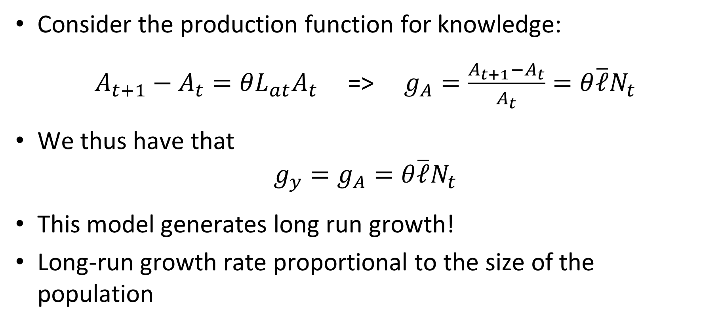
Solving Romer Model
Consider the production function for knowledge:
$A_{t+1}−A_{t}=θL_{at}A_{t}$ => $g_{A}=\frac{A_{t+1}−A_{t}}{A_{t}}=θ\overline{ℓ}N_{t}$
We thus have that
$$g_{y}=g_{A}=θ\overline{ℓ}N_{t}$$
This model generates long run growth!
Long-run growth rate proportional to the size of the population

Slide 14
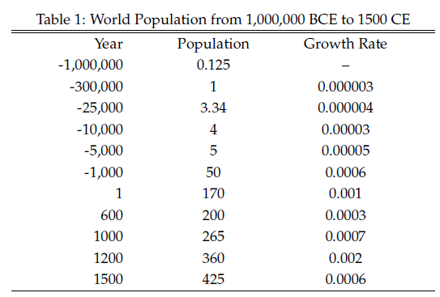
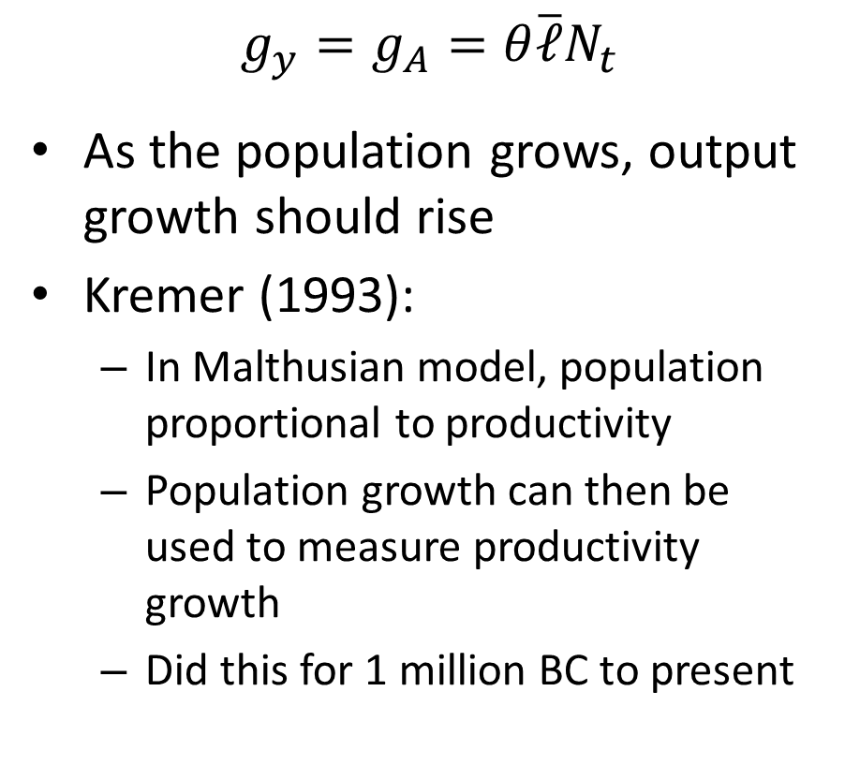
Scale Effects I
$$g_{y}=g_{A}=θ\overline{ℓ}N_{t}$$
As the population grows, output growth should rise
Kremer (1993):
In Malthusian model, population proportional to productivity
Population growth can then be used to measure productivity growth
Did this for 1 million BC to present

Slide 15
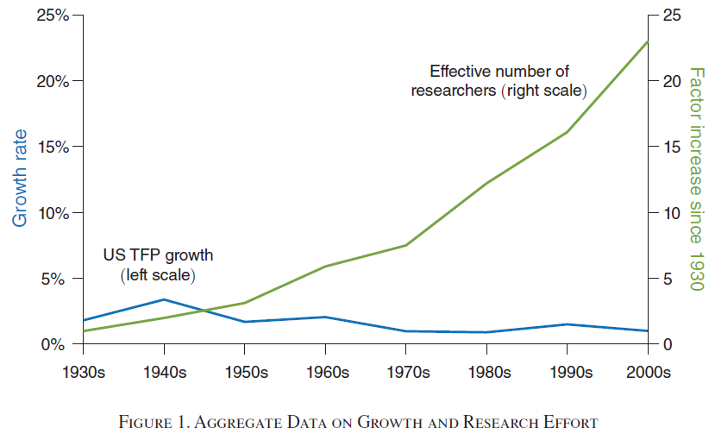
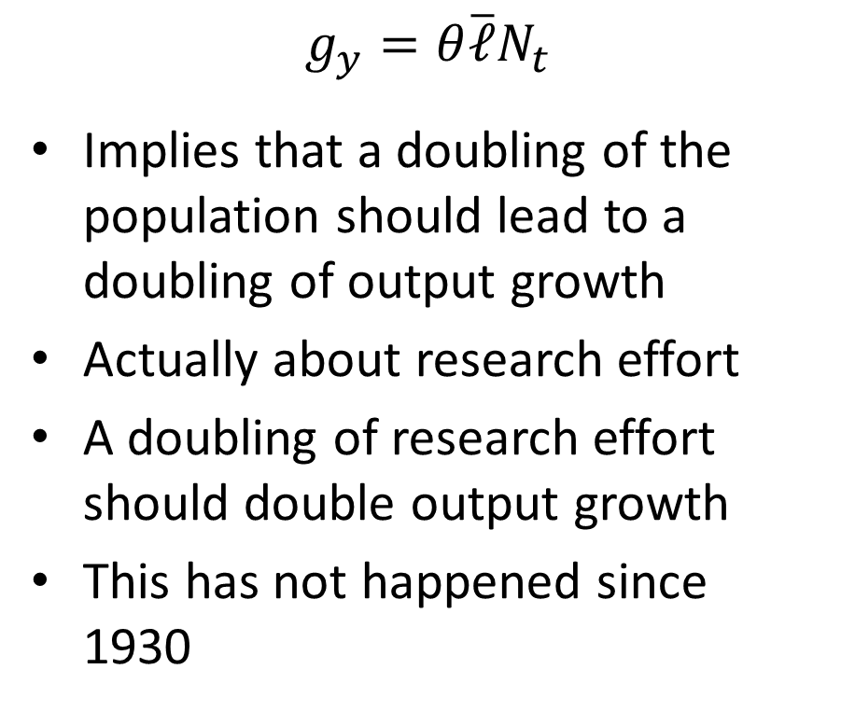
Scale Effects II
$$g_{y}=θ\overline{ℓ}N_{t}$$
Implies that a doubling of the population should lead to a doubling of output growth
Actually about research effort
A doubling of research effort should double output growth
This has not happened since 1930
Source: Bloom, Jones, Van Reene, Webb (2020)

Slide 16
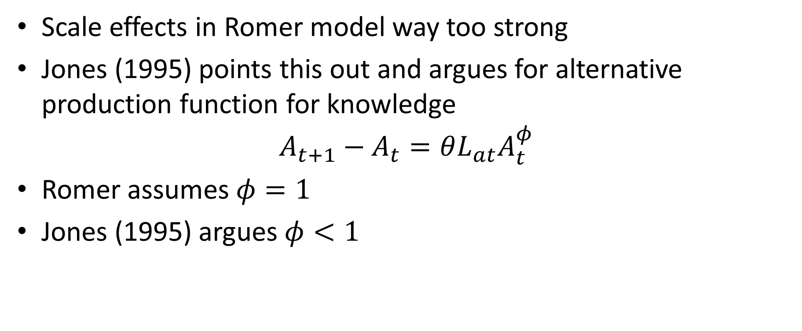
Weaker Scale Effects
Scale effects in Romer model way too strong
Jones (1995) points this out and argues for alternative production function for knowledge
$$A_{t+1}−A_{t}=θL_{at}A_{t}^{φ}$$
Romer assumes $φ=1$
Jones (1995) argues $φ<1$

Slide 17
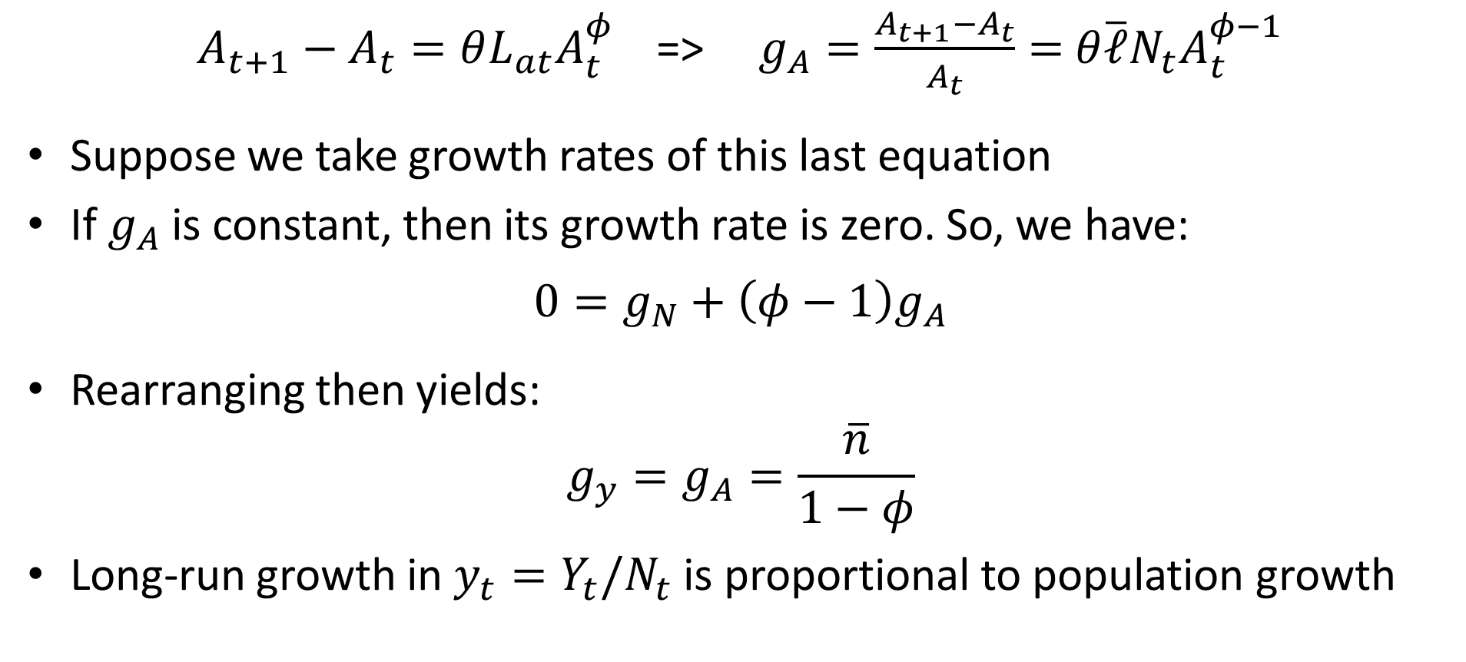
Jones Model
$A_{t+1}−A_{t}=θL_{at}A_{t}^{φ}$ => $g_{A}=\frac{A_{t+1}−A_{t}}{A_{t}}=$ $θ\overline{ℓ}N_{t}A_{t}^{φ−1}$
Suppose we take growth rates of this last equation
If $g_{A}$ is constant, then its growth rate is zero. So, we have:
$$0=g_{N}+\left(φ−1\right)g_{A}$$
Rearranging then yields:
$$g_{y}=g_{A}=\frac{\overline{n}}{1−φ}$$
Long-run growth in $y_{t}=Y_{t}/N_{t}$ is proportional to population growth

Slide 18
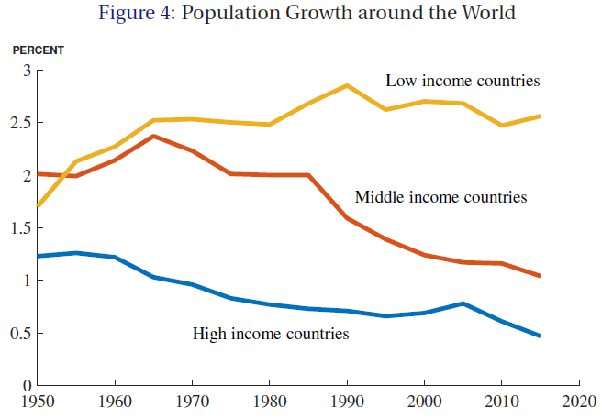
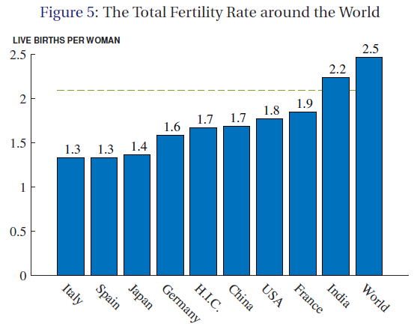
Will Growth Peter Out?
Source: Jones (2022)
Data from 2015-2022. Fertility has fallen since.

Slide 19
Might Growth Speed Up?
Finding Einsteins:
Traditionally most people have not been able to reach their potential as producers of ideas/knowledge
Extreme poverty, cast/class restrictions, discrimination
How many Einsteins / Doudnas have we missed
Perhaps machines can replace labor in knowledge production
Even if we have less people, we can have more machines producing knowledge
Automation of ideas could even yield “singularity” (explosive growth)

Slide 20
Innovation Policy
What government policies do we have to encourage knowledge production?
Grant patents to inventors
Subsidize basic research
Key questions:
Why do we need these policies? (What is the market failure?)
What are the downsides of these policies?

Slide 21
Production of a New Drug
Consider the production of a new drug
Drug development costs $800 million
Once invented: Constant returns to scale
Standard replication argument
To double production: Build another identical factory
Once invented: Marginal cost: $10
How do we bring about efficient use of drug?

Slide 22
Efficient Use of New Drug
How do we bring about efficient use of drug?
Price must equal marginal cost!
A competitive market would bring this about
What is the problem with this?
Inventor can’t recoup initial $800 million investment
Inventor will thus not spend resources inventing
Conclusion: Policy of placing new knowledge in the “public domain” and relying on competitive markets yields insufficient incentives to create knowledge
What is the market failure?

Slide 23
Market Failure in Market for Ideas
If we don’t grant property rights over ideas:
This is the market failure
Inventor can’t capture full benefits of his/her efforts and thus has insufficiently strong incentives to engage in research
Outcome: Too little knowledge production
If we do grant property rights over ideas:
Owner becomes a monopolist
Will price product above marginal cost
Outcome: Too little use of existing knowledge

Slide 24
Market Failure in Market for Ideas
Imagine we could grant property rights in a special way:
We have a technology that guarantees that no one else can use invention without inventing it from scratch (no backward engineering)
In other words: Imagine that we can make invention fully excludable
But everyone else is free to reinvent invention at a cost of $800 million (i.e., not a patent)
Now what is the market failure?

Slide 25
Market Failure in Market for Ideas
Will we get perfect competition?
No!!
With perfect competition: price = marginal cost
Firms can’t recoup initial investment
Firms will stop entering market before we get to perfect competition.
We will have an “oligopolistic” market

Slide 26
Market for Ideas in Practice
Full excludability is not realistic
Backward engineering always possible
In practice non-excludability a serious issue
Incentives to invest too low

Slide 27
Realistic policy options
Laissez faire
Insufficient incentives to invest
Grant “patents” (temporary monopoly)
Enforces temporary full excludability
But: Price > marginal cost
Inefficiently low use of invention
Government subsidies for research
Who decides what to fund?

Slide 28
Economics of Patents
Benefit:
Provide an incentive for knowledge production.
Cost:
Price = Marginal Benefit > Marginal Cost
Example: HIV drugs in the late 1990s
Had been invented. Marginal cost very low.
Prices much higher than marginal costs
Many people in poor countries could pay marginal cost but not price. Priced out of the market.
Huge loss in welfare (Many people died!)
Alternative: Prizes (Michael Kremer, QJE 1998)
Notes:
See also Kremer JEP paper

Slide 29
Prizes
Why not just pay inventors for useful inventions?
But who would decide how much to pay?
Perhaps we can get “the market” to decide. (How?)
Hold an auction:
Highest bidder gets patent with 5% probability
With 95% probability government pays highest bid to inventor and releases knowledge to public domain

Slide 30
Case Against Patents
Boldrin and Levine (2013)
Explosion in number of patents:
1983: 59,715, 2003: 189,597, 2010: 244,341
Scant evidence of increase in productivity
Anecdotally, many recent patents are trivial
Perhaps filed to be able to extract fees from others or create a barrier to entry
First mover advantage perhaps enough of an incentive to innovate

Slide 31
Defensive Patenting: Smartphones
Apple and Microsoft large incumbents with huge patent portfolios
Google a new innovative entrant
Google purchased Motorola Mobility for patent portfolio
Main use of patent portfolio arguably to threaten counter-suits if Apple and Microsoft sue
If all companies have lots of patents and all are successful in the market no one can sue because others can counter-sue
Patents are just an added cost to innovation (and barrier to entry for small poor firms)

