Slide 1
Lecture 9: Barriers to Riches Macroeconomics (Quantitative) Econ 101B
Jón Steinsson
University of California, Berkeley

Slide 2
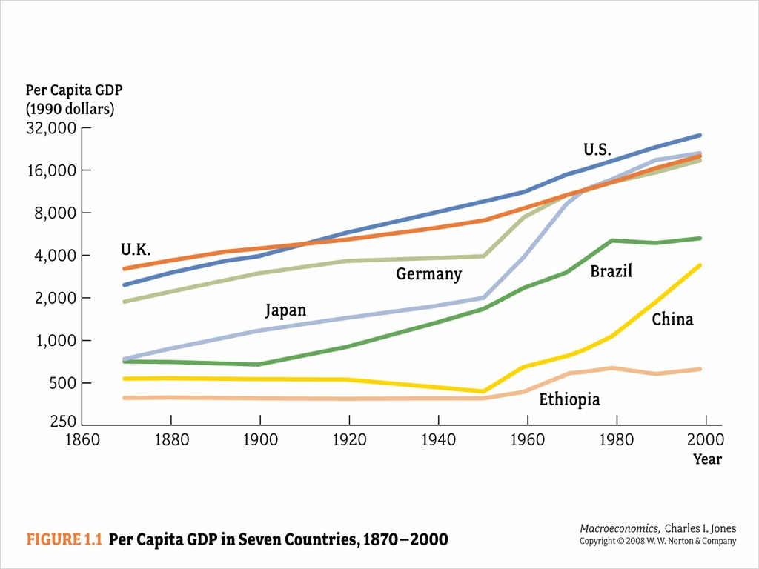
Two Key Questions about Growth
What determines the growth of the “frontier”?
(Market for Ideas)
Why are some countries so far behind the frontier?
(Barriers to Riches)

Slide 3
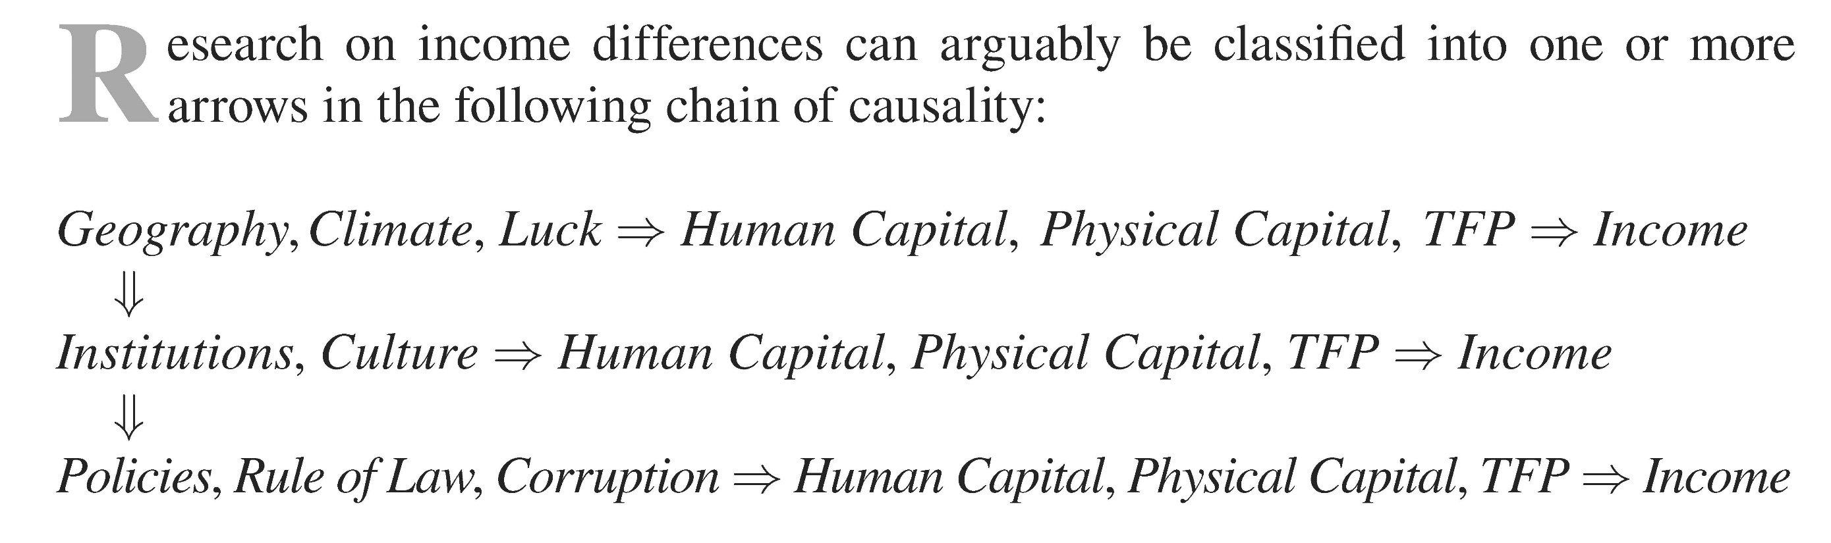
Proximate vs. Fundamental Causes

Slide 4
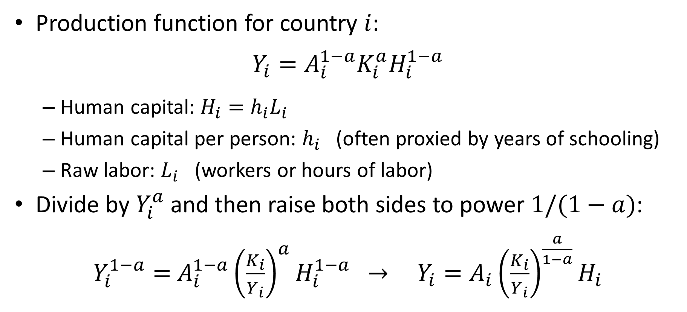
Development Accounting
Production function for country $i$:
$$Y_{i}=A_{i}^{1−a}K_{i}^{a}H_{i}^{1−a}$$
Human capital: $H_{i}=h_{i}L_{i}$
Human capital per person: $h_{i}$ (often proxied by years of schooling)
Raw labor: $L_{i}$ (workers or hours of labor)
Divide by $Y_{i}^{a}$ and then raise both sides to power $1/(1−a)$:
$Y_{i}^{1−a}=$ $A_{i}^{1−a}{\left(\frac{K_{i}}{Y_{i}}\right)}^{a}H_{i}^{1−a}$ $→$ $Y_{i}=A_{i}{\left(\frac{K_{i}}{Y_{i}}\right)}^{\frac{a}{1−a}}H_{i}$

Slide 5
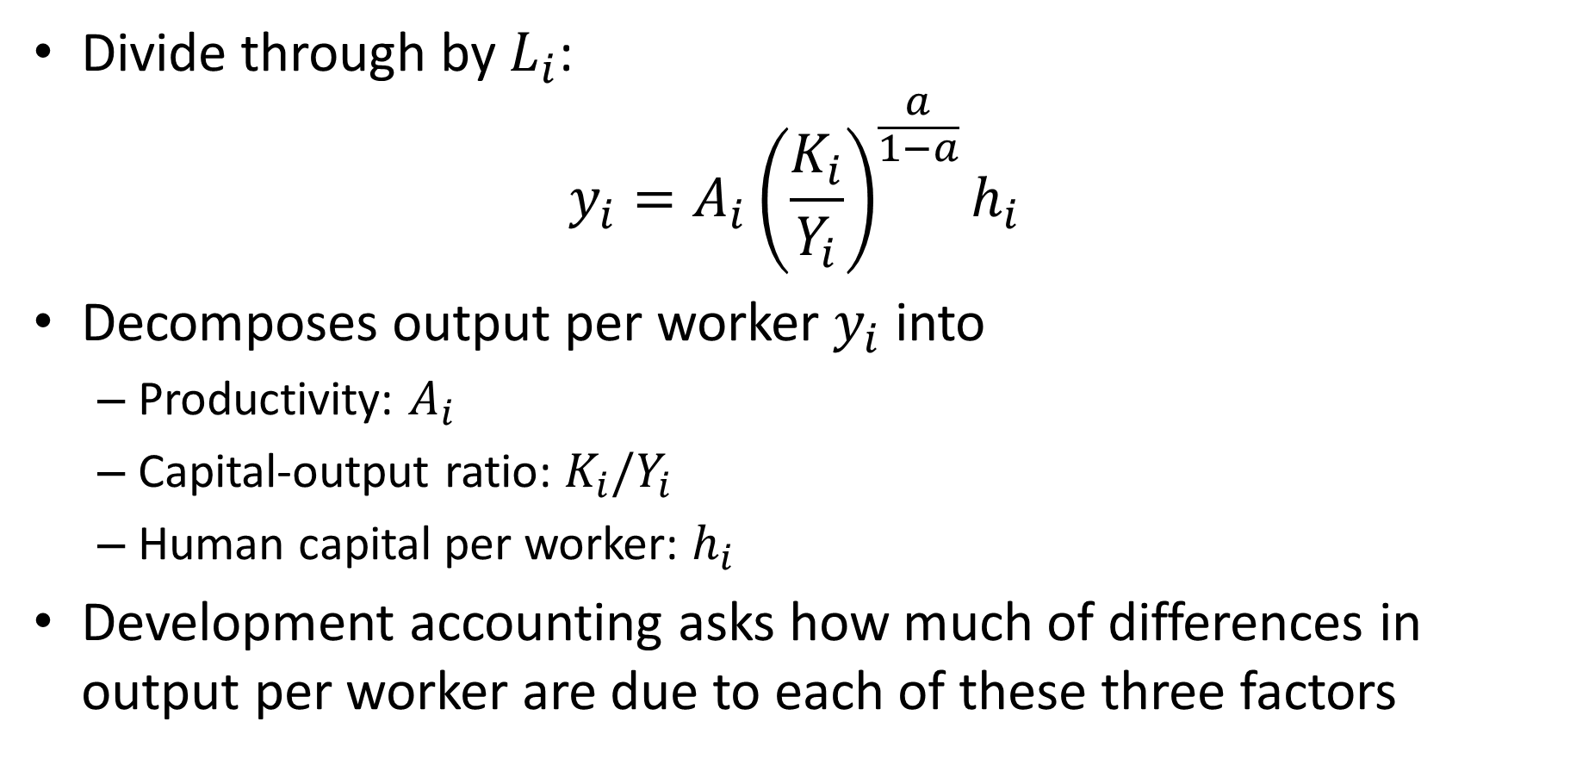
Development Accounting
Divide through by $L_{i}$:
$$y_{i}=A_{i}{\left(\frac{K_{i}}{Y_{i}}\right)}^{\frac{a}{1−a}}h_{i}$$
Decomposes output per worker $y_{i}$ into
Productivity: $A_{i}$
Capital-output ratio: $K_{i}/Y_{i}$
Human capital per worker: $h_{i}$
Development accounting asks how much of differences in output per worker are due to each of these three factors

Slide 6
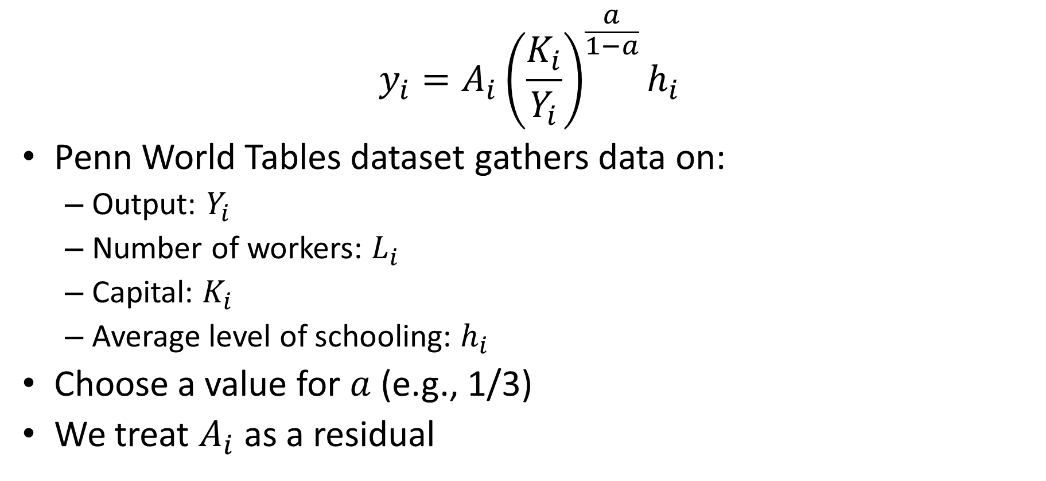
Development Accounting
$$y_{i}=A_{i}{\left(\frac{K_{i}}{Y_{i}}\right)}^{\frac{a}{1−a}}h_{i}$$
Penn World Tables dataset gathers data on:
Output: $Y_{i}$
Number of workers: $L_{i}$
Capital: $K_{i}$
Average level of schooling: $h_{i}$
Choose a value for $a$ (e.g., 1/3)
We treat $A_{i}$ as a residual

Slide 7
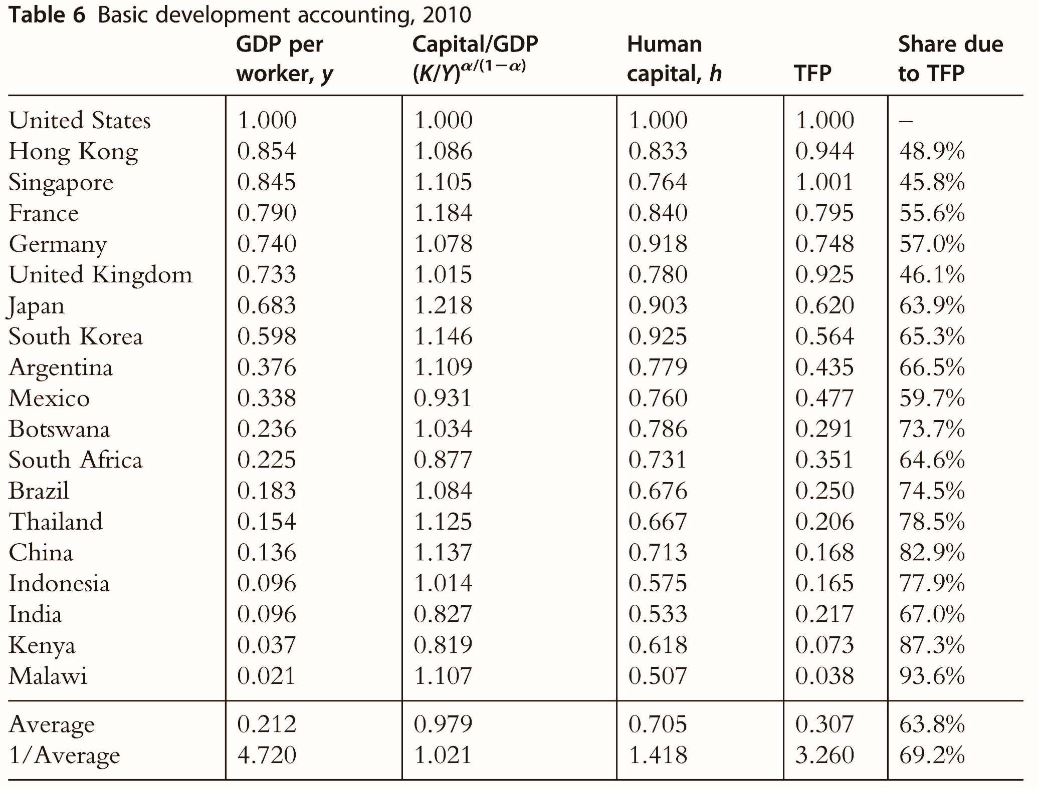
Source:
Jones (2016)

Slide 8
Development Accounting
Difference in output per worker across countries factor of 50
None of this is due to low capital-output ratio
Poor countries seem not to be poor because they lack capital
Factor of 2 due to difference in human capital
Lack of education plays some role in poor countries being poor
Factor of 25 due to difference in productivity
Productivity (“measure of our ignorance”) explains bulk of difference

Slide 9
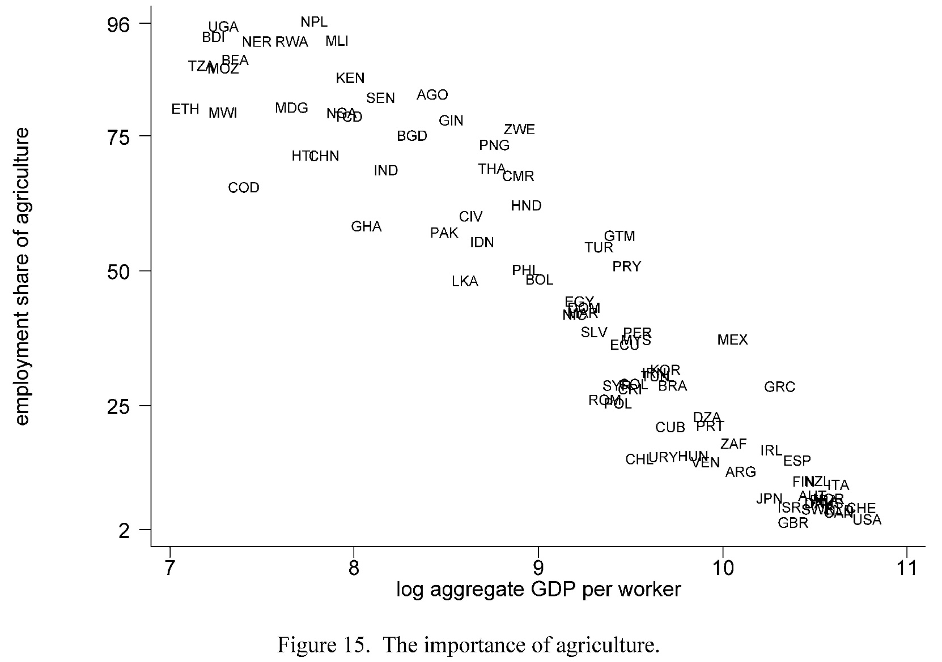
Agriculture and Development
Most people in poor countries work in agriculture
Classic view of development: Reallocation out of agriculture into “modern” sectors
But what is holding that back?
Source: Caselli (2005)

Slide 10
Agriculture and Development: Two Views
Unproductive urban sector is the problem
Urban sector can’t absorb labor
Urban sector unproductive or can’t grow fast enough
People in country-side are “army of surplus labor”
Unproductive agricultural sector is the problem
Labor needed to produce food (“food problem”)
Agricultural sector can’t shed labor
Unclear which of these stories is more important

Slide 11
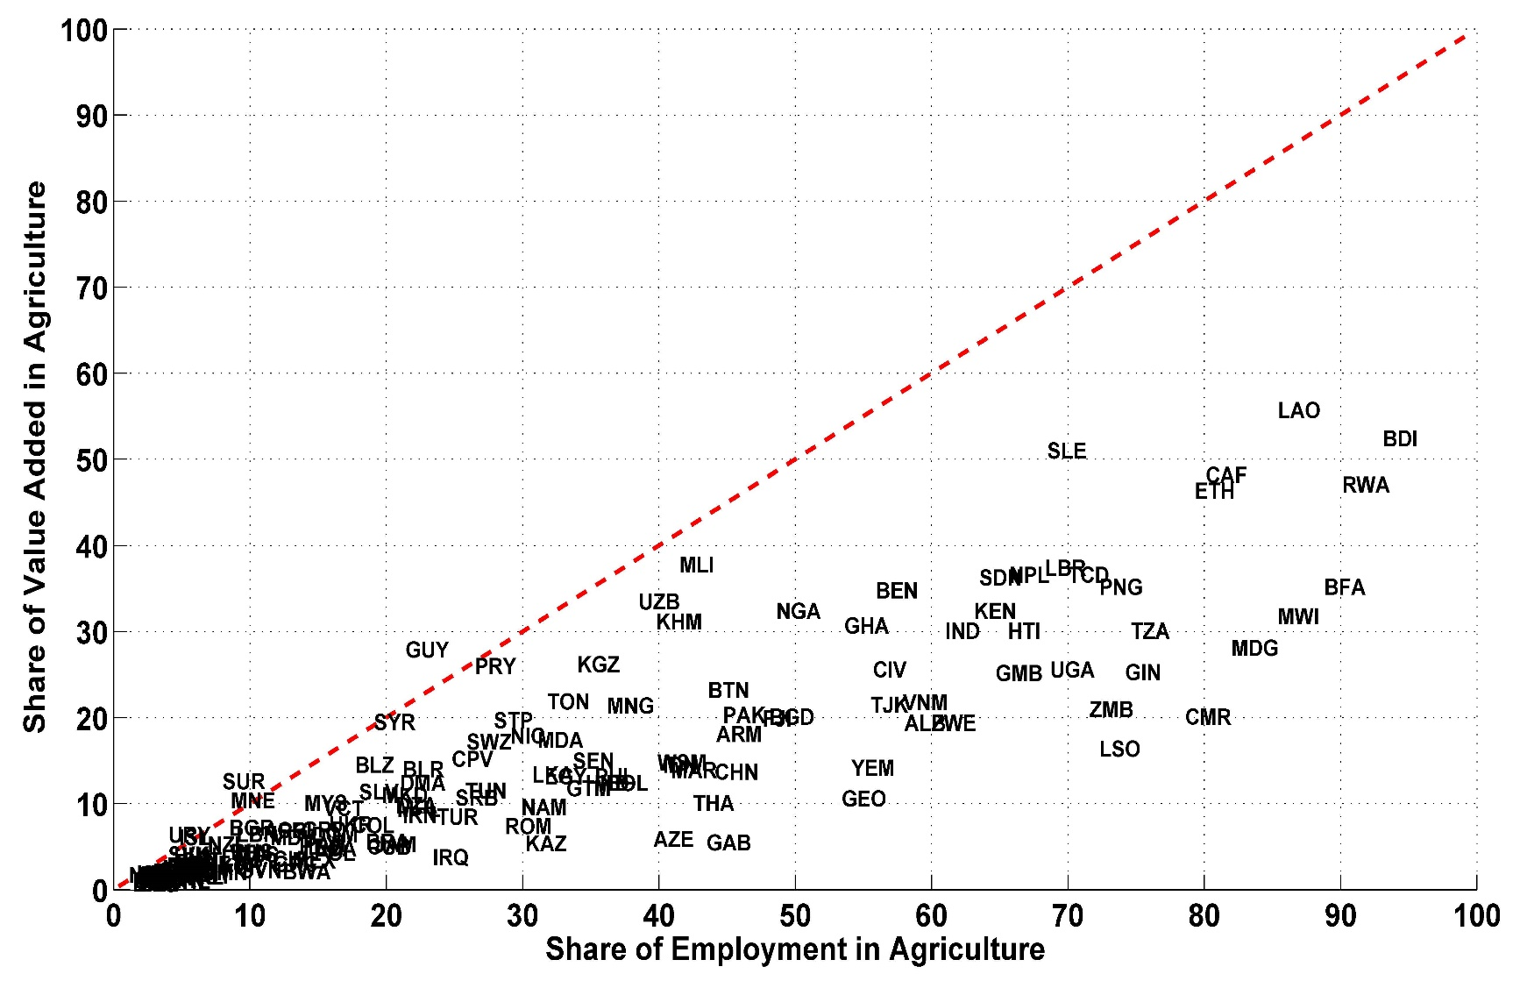
Agricultural Productivity Gap
Value added per worker is much lower in agriculture than in other sectors
Why don’t workers leave the agricultural sector?
Poor countries employ most workers in sector that they are particularly unproductive in
Deviation from comparative advantage
Source: David Lagakos

Slide 12
Barriers to Riches
Proximate Causes:
Not capital
Education perhaps factor of 2
Mostly “productivity” (whatever that is)
Most people in poor countries work in unproductive agriculture
Fundamental Causes:
Geography
Trade
Institutions
Luck (e.g., leaders)
Culture
Religion
Etc.

Slide 13
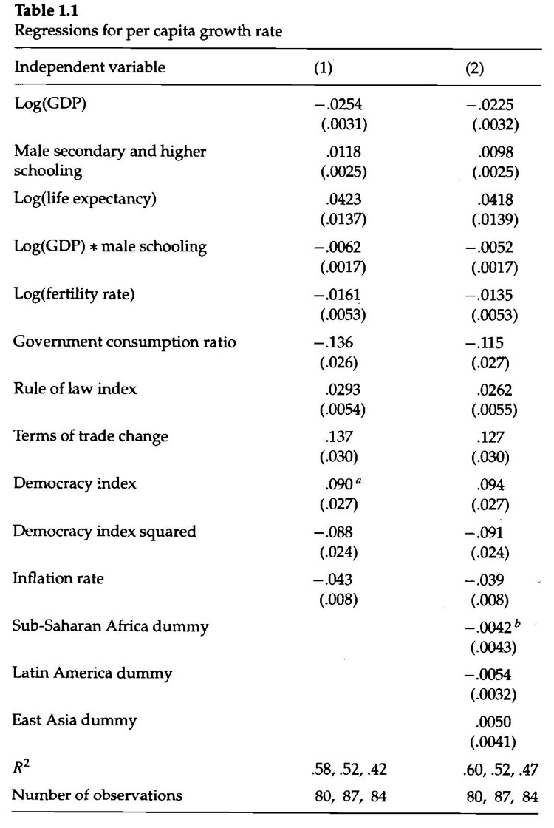
Simple Regressions
Cross-country regressions of growth on various candidate causes
But everything else not equal
Reverse causality:
Does democracy cause growth?
Or prosperity cause democracy?
Omitted variables bias:
Omitted factor that causes both growth and variable of interest

Slide 14
Fundamental Causes of Growth
Convincing evidence needs to be based on exogenous variation in candidate cause
Variation not related to any other potential cause
Very hard to find exogenous variation in fundamental causes
Need to look for “natural experiments”
Literature includes many creative approaches
Here I present a few examples

Slide 15
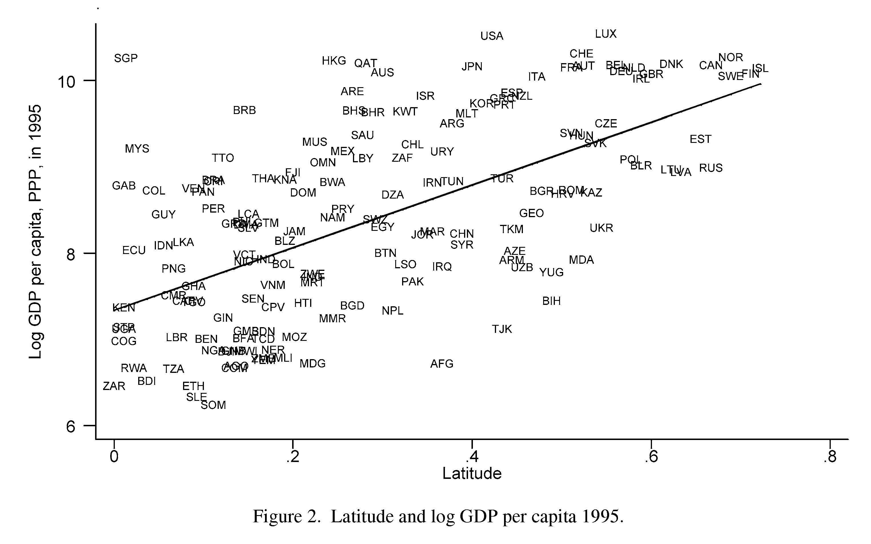
Geography Clearly Exogenous
Countries closer to the equator are poorer on average
But why?

Slide 16
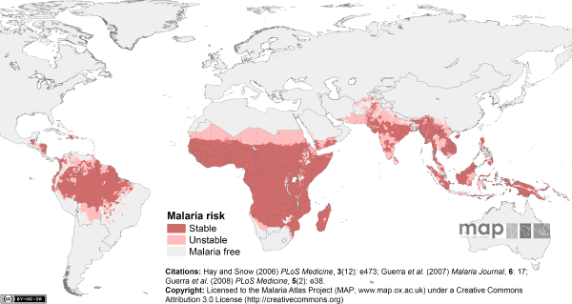
Growth and Disease

Slide 17
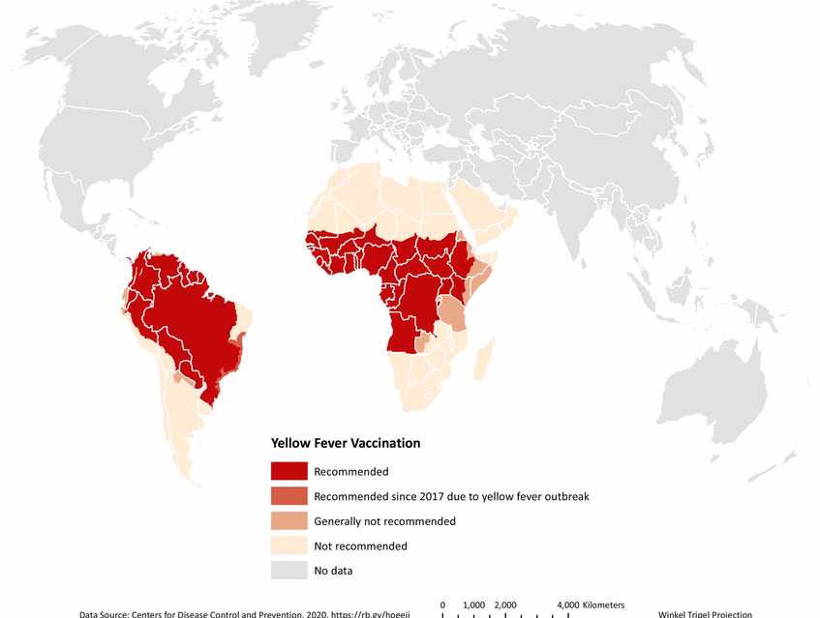
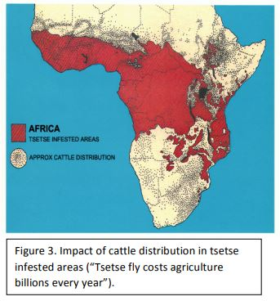
Growth and Disease
Yellow Fever
Sleeping Sickness

Slide 18
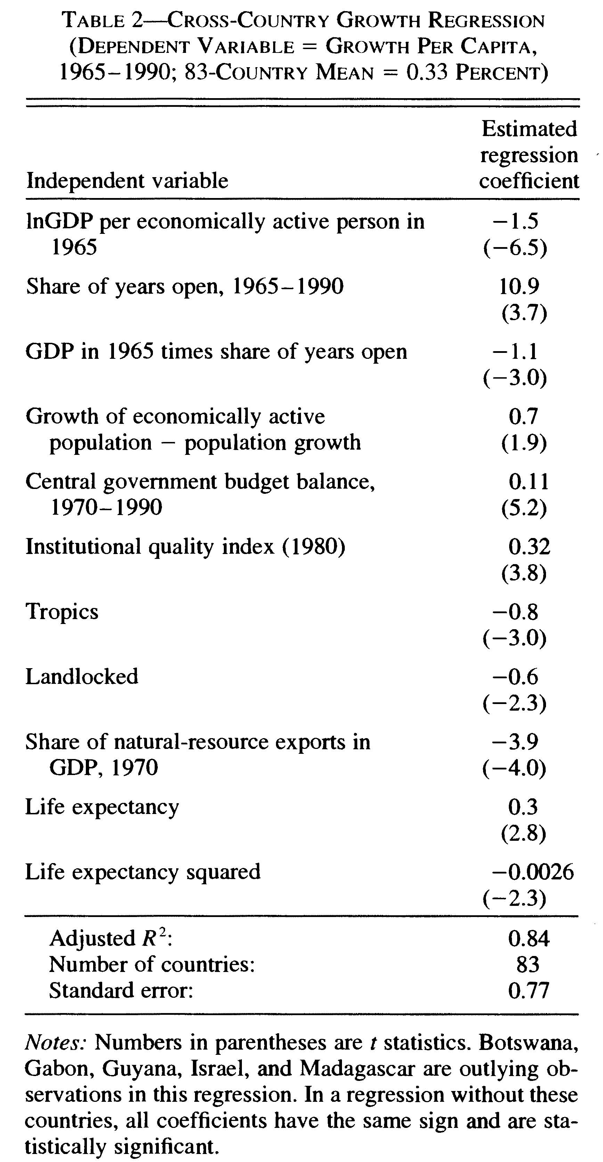
Geography and Growth
Channels:
Disease
Access to trade
Natural resource curse
Source: Sachs and Warner (1997)

Slide 19
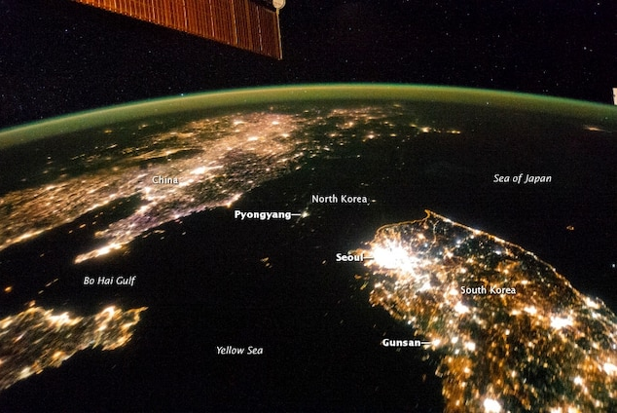
Institutions and Growth
Long line of thought arguing that good institutions cause high income
Secure property rights, rule of law, constraints on the executive
Where do we find exogenous variation in institutions?
West vs. East Germany (1945-1989)
South vs. North Korea (post-1953)
Suggest capitalism is good for growth

Slide 20
Institutions and Growth
How can we find other exogenous variation in institutions?
Institutions often have long term historical roots
Institutions often have very long-lasting effects
We consider two examples:
Long-term effect of Mining Mita in Peru and Bolivia
Long-term effect of early colonial institutions

Slide 21
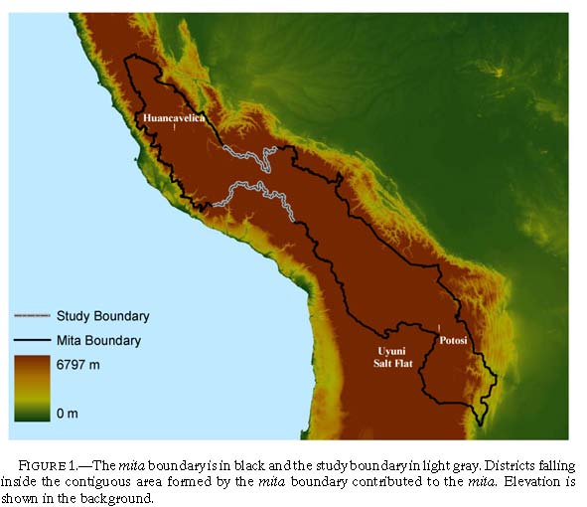
Long Term Effects of Peru’s Mining Mita
Melissa Dell (2010): Peru’s mining mita as a natural experiment for outcomes today
Mita: Forced labor institution in Peru and Bolivia under Spanish colonial rule
In effect from 1573 to 1812
One-seventh of adult male population required to work in Potosi silver mines and Huancavelica mercury mine

Slide 22
Peru’s Mining Mita
Dell asks: What are the effects of mining mita on people living in this region today?
How can we figure this out?
Compare people in this region versus rest of Peru and Bolivia?
But other things may also differ (e.g., altitude, fertility of soil, etc.)
What about looking right around the edges!

Slide 23
Peru’s Mining Mita
If other factors change “smoothly,” then we can compare area right inside catchment zone with area right outside
Everything else should be approximately constant
Only thing that differs is “exposure” to mita
Method is called Regression Discontinuity Design (RD or RDD)

Slide 24
Peru’s Mining Mita
But perhaps catchment boundary is chosen to be at a cliff or some other place where other things change discontinuously
Dell only studies part of catchment boundary
Makes sure a bunch of other things are similar on both sides

Slide 25
Peru’s Mining Mita
Dell then looks at:
Household consumption today
% of children with stunted growth today
Compares areas right inside with areas right outside mita zone
Recall, mita ended in 1812

Slide 26
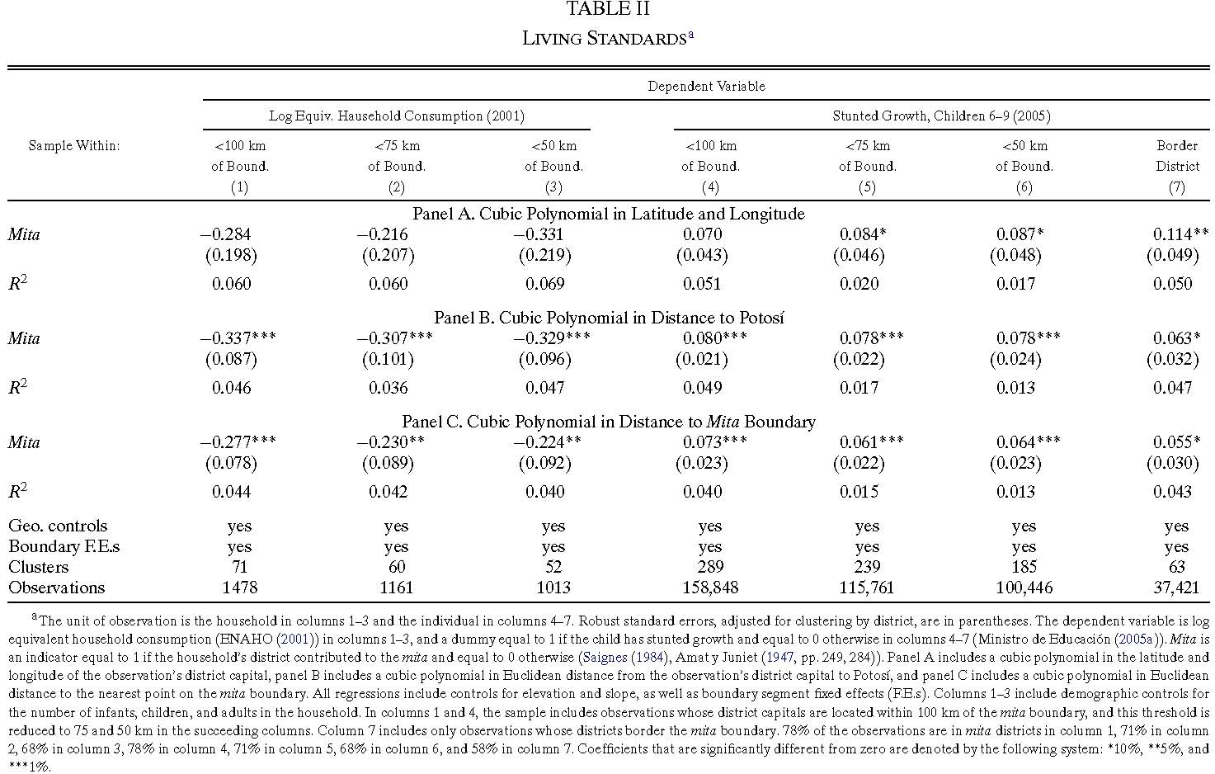

Slide 27
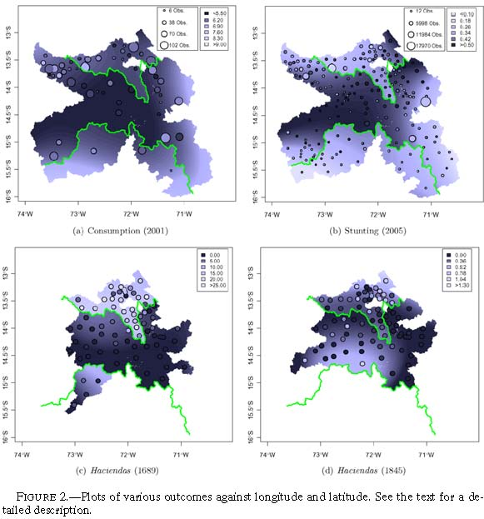
Notes:
Lower two are concentrations of Haciendas in two different years. Haciendas are rural estates with attached labor force. Elites at Haciendas pushed for education and public goods provision. Landed elites opposed yielding their forced laborer for a year to mines. So, Haciendas didn’t form in Mita area.

Slide 28
Peru’s Mining Mita
Dell argues that long-term effects of mita come through land tenure and public goods
Haciendas – rural estates with attached labor force – primarily outside mita
Colonial policy encouraged communal land tenure inside mita
Security of land rights better outside mita area after mita ended
Haciendas elite pushed for public goods such as roads

Slide 29
Colonization as a Natural Experiment
Starting in 15th century Europeans conquered much of the rest of the world
Imposed new institutions
Imposed different institutions in different places
Acemoglu, Johnson, Robinson (2001, 2002) argue that this can be viewed as a natural experiment to assess the effect of institutions on prosperity

Slide 30
Reversal of Fortunes
In 1500:
Mughals in India, Aztecs and Incas in Americas among richest civilizations (outside Europe)
North-East U.S., New Zealand, Australia much less developed
Today:
Lands of Mughals, Aztecs and Incas among poorer societies
U.S., New Zealand, Australia among richest

Slide 31
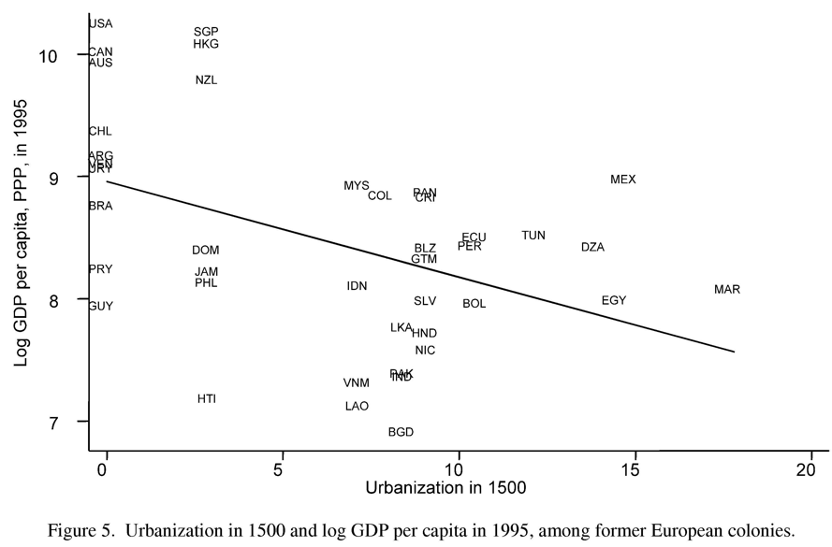
Reversal of Fortunes
Systematic phenomenon?
How to measure income in 1500?
Urbanization: Only societies with a certain level of development can sustain large urban centers
Puzzling from perspective of geography story
Acemoglu, Johnson, Robinson (2005)

Slide 32
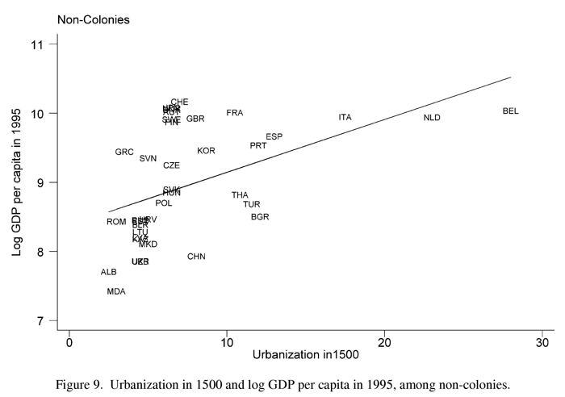
No Reversal For Non-Colonies
Countries that were not colonized by Europeans did not see reversal of fortunes
Acemoglu, Johnson, Robinson (2005)

Slide 33
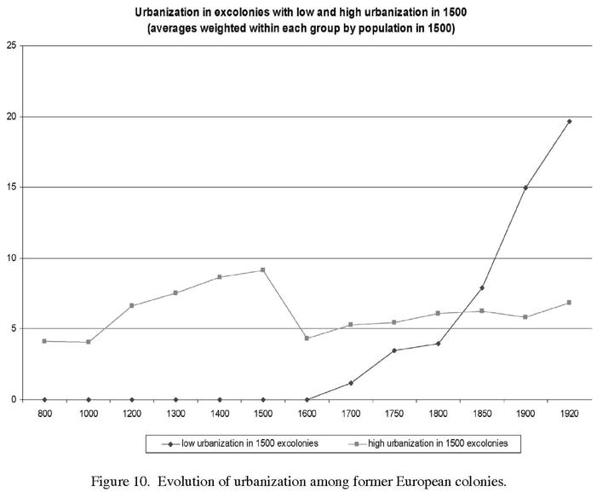
Timing of Reversal
High urbanization regions faced large decline after 1500 (exploitation)
Low urbanization regions saw gradual rise that took off in 19th century
Only at time of industrialization did low urbanization regions really take off
Acemoglu, Johnson, Robinson (2005)

Slide 34
Institutions and Reversal
AJR argue that Europeans set up “worse” (more extractive) institutions in regions with higher urbanization
Institutions very persistent
This eventually caused reversal of fortunes
Why did Europeans set up worse institutions in the tropics?

Slide 35
Why Different Institutions?
Where there was wealth to steal it had appeal to set up institutions that facilitated “extracting resources”
Gold, silver, sugar, people to exploit.
Where there was little wealth and few people it made less sense to try to “extract resources”.

Slide 36
Why Different Institutions?
Different disease environment
Europeans have poor immunity against tropical diseases
High mortality of European settlers in certain areas meant low levels of settlement in those areas
Where Europeans didn’t settle, they set up worse institutions
Where they did settle, they set up better institutions
Institutions persisted
Disease environment 200 years back affects outcomes today through institutions

Slide 37
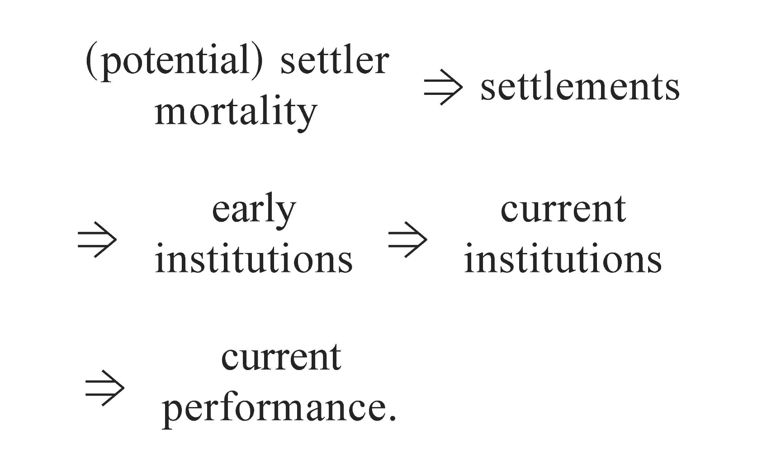
AJR’s Theory
Source: Acemoglu, Johnson, Robinson (2001)

Slide 38
Settler Mortality as an Instrument
AJR propose to use settler mortality as an instrument for current institutions
Two conditions must hold for this to be a valid instrument
Relevance: Settler mortality must be correlated with current institutions. (It is. See next slide)
Exogeneity: Settler mortality cannot be correlated with any other cause of current prosperity (i.e., it should only affect current prosperity thought current institutions)
Threat to exogeneity?

Slide 39
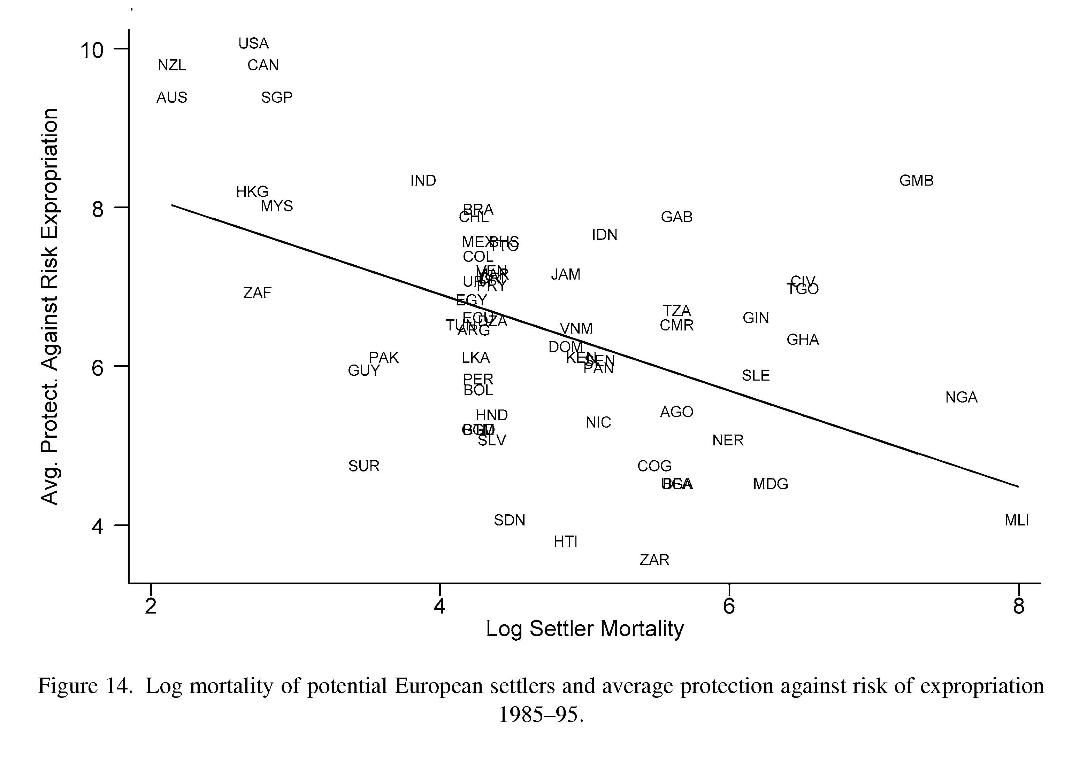
Settler Mortality and Current Institutions
Settler mortality is correlated with current institutions
Places with low settler mortality have better current institutions (as measured by protection against risk of expropriation)

Slide 40
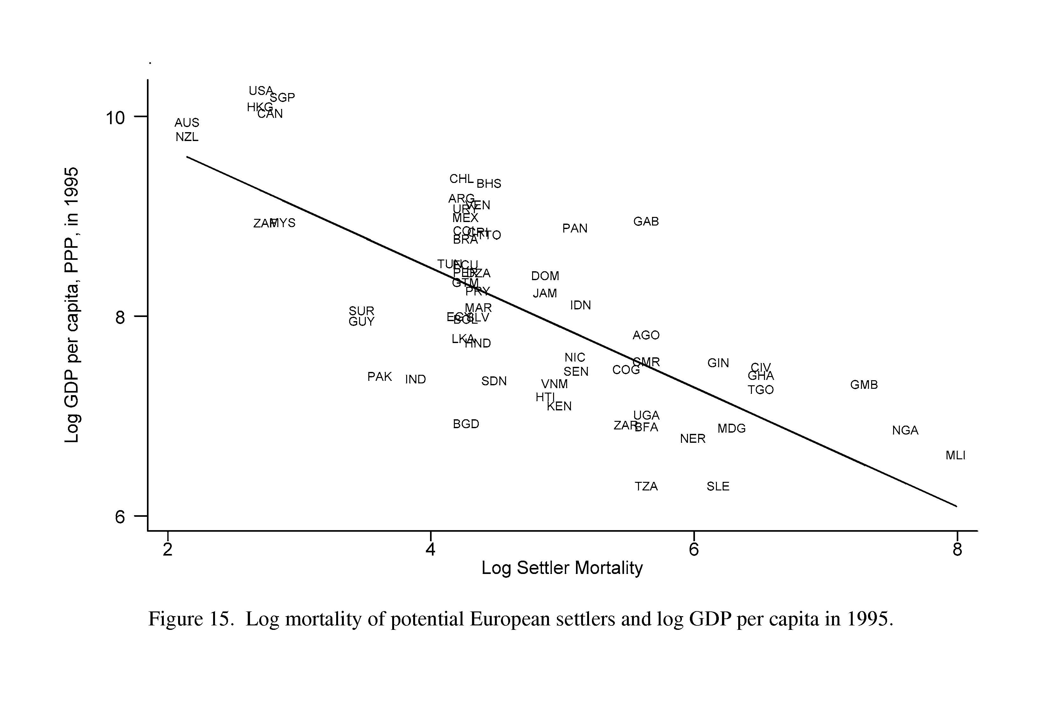
Settler Mortality and Current Prosperity
Settler mortality is strongly related to current prosperity
If exogeneity holds, this correlation is only due to affect on current institutions
In this case, it provides evidence for institutions affecting prosperity
Effect is very large (can explain bulk of income differences)

Slide 41
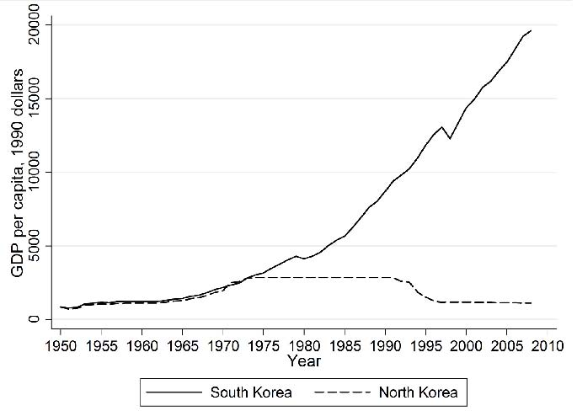
Institutions or Just Luck?
North vs. South Korea often used as an example of institutions mattering
But how convincing is this example?
Perhaps difference is largely luck in the form of leaders of different quality
Notes:
Park Chung-hee was in office from Dec 1963 to Oct 1979.

Slide 42
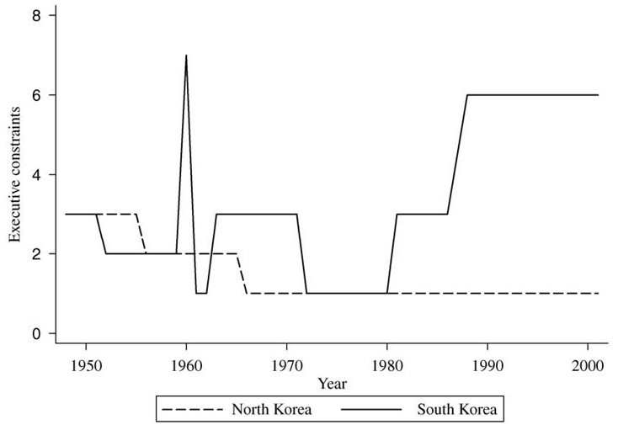
Did South Korea Have Better Institutions?
Not clear South Korea had better institutions
They were a dictatorship just like North Korea
But their dictator (Park Chung-hee, 1961-1979) chose different policies than North Korea’s (Kim Il Sung, 1948-1994)

Slide 43
Do Leaders Matter for Growth?
Differing views:
Tolstoy: Historical figures mere ex post justifications for events out of any individual’s influence
Marx: “materialist dialectic”. Social and economic forces trump individuals
John Keegan: The political history of the twentieth century can be found in the biographies of six men: Lenin, Stalin, Hitler, Mao, Roosevelt and Churchill.

Slide 44
Do Leaders Matter for Growth?
Claim: National leaders cause changes in growth in the countries they govern.
How can we bring evidence to bear on this causal question?
Look at whether changes in leaders are systematically associated with changes in growth?
But leadership transitions are not random
Leader my be ousted because growth is bad (reverse causality)

Slide 45
Do Leaders Matter for Growth?
We need to find a natural experiment
Are there any leadership transitions that are random from the perspective of growth?
Jones and Olken (2005):
Look at leadership transitions due to death of leaders while in office
Deaths from natural causes and accidents (exclude assassinations)
In these cases, the timing of the transition is random

Slide 46
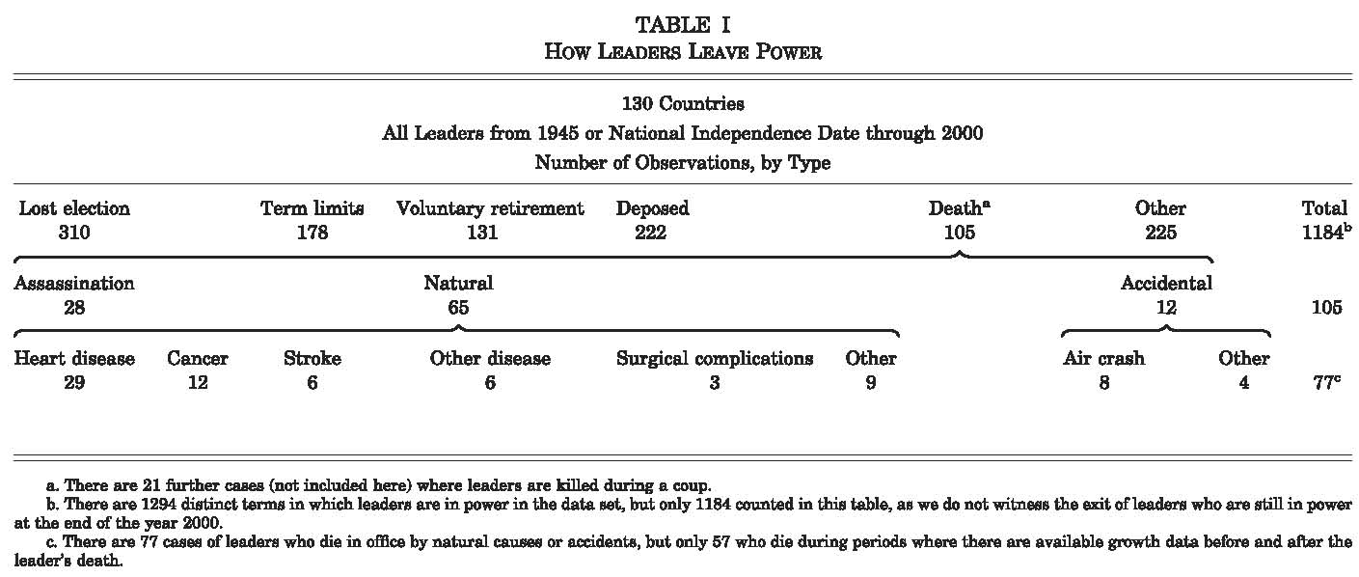
Source: Jones and Olken (2005)

Slide 47
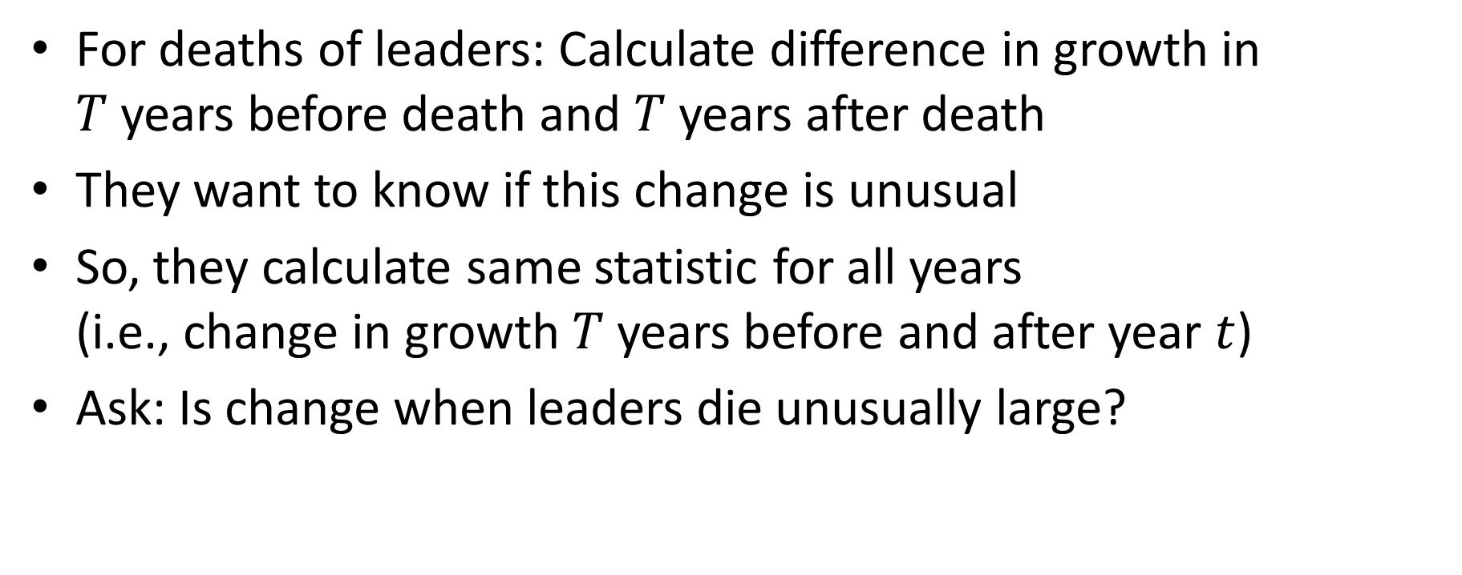
How Do We Measure Effect?
For deaths of leaders: Calculate difference in growth in $T$ years before death and $T$ years after death
They want to know if this change is unusual
So, they calculate same statistic for all years (i.e., change in growth $T$ years before and after year $t$)
Ask: Is change when leaders die unusually large?

Slide 48
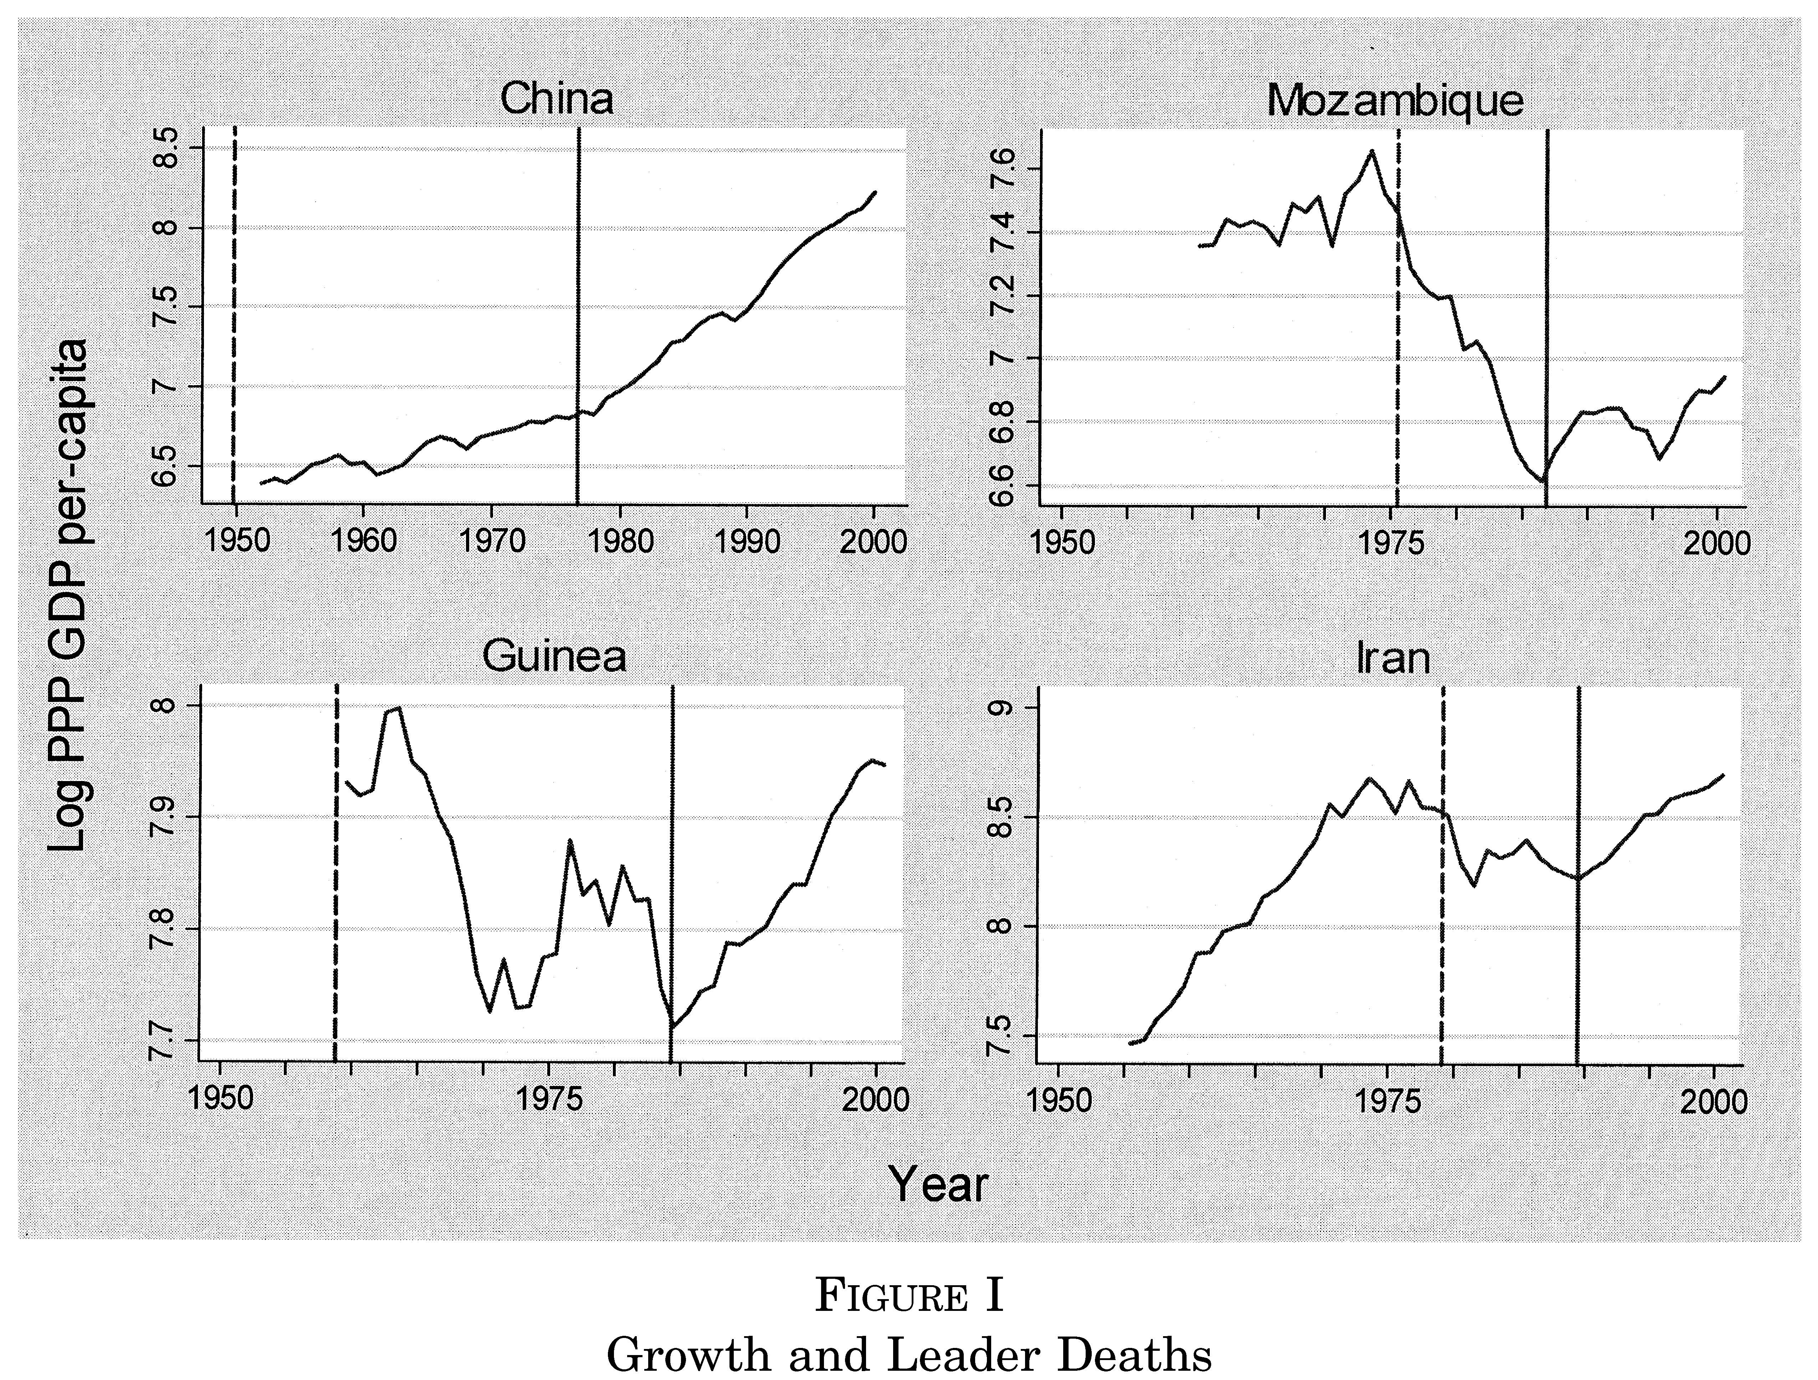
A Few Dramatic Examples
China: Mao (Great Leap Forward, Cultural Revolution)
Mozambique: Samora Machel (Communist, nationalized all private land, Portuguese fled)
Guinea: Sekou Toure (totalitarian violent purges)
Iran: Ayatollah Khomeini (opposed peace in Iran-Iraq war)
Notes:
China: Transition from Mao to Deng Xiaoping. Average growth under Mao was 1.7%. Average growth under Deng was 5.9%
Mozambique: Samora Machel in office from 1975 to 1986. One party communist state. Nationalized all private land. Portuguese settlers fled. After Machel’s death Joaquin Chissano moved country towards market oriented policies.
Guinea: Sekou Toure rule characterized by totalitarianism and violent purges. Died in emergency heart surgery in 1984.
Iran: Ayatollah Khomeini’s rule marked by bloody Iran-Iraq war.

Slide 49
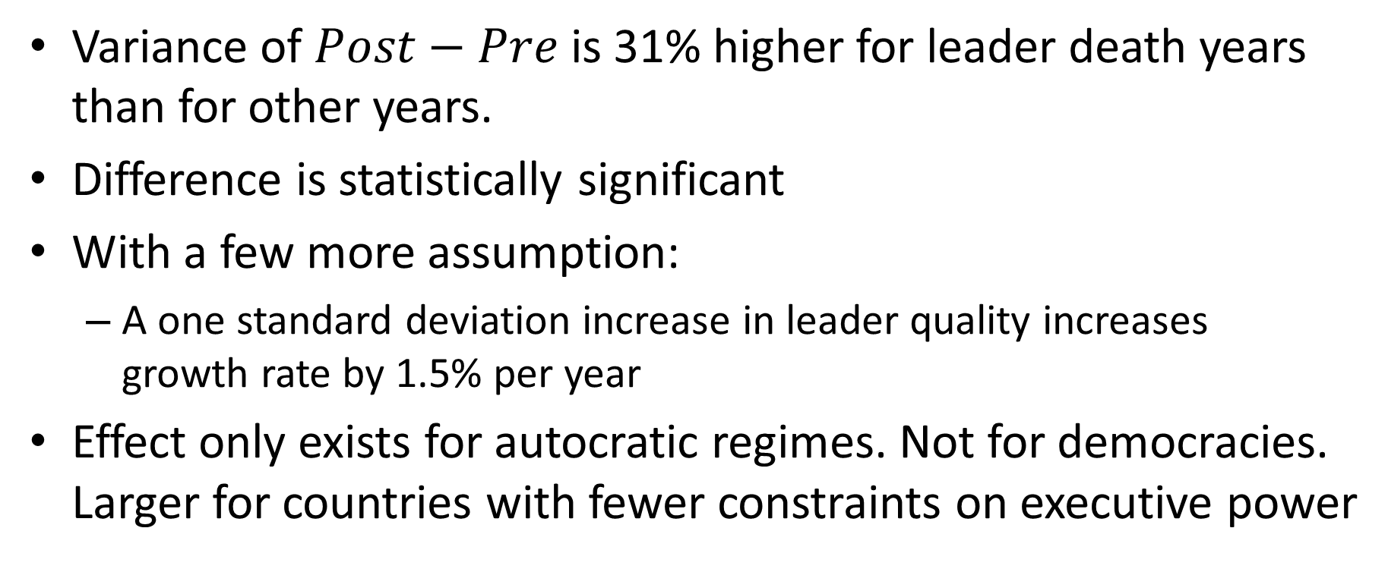
Systematic Results
Variance of $Post−Pre$ is 31% higher for leader death years than for other years.
Difference is statistically significant
With a few more assumption:
A one standard deviation increase in leader quality increases growth rate by 1.5% per year
Effect only exists for autocratic regimes. Not for democracies. Larger for countries with fewer constraints on executive power
Notes:
Result challenged by Johnson et al. (NBER WP 2009). Result regarding autocratic regimes versus democracies seems least robust to changes in Penn World Tables

