Slide 1
Lecture 11: Money and Banking Macroeconomics (Quantitative) Econ 101B
Jón Steinsson
University of California, Berkeley

Slide 2
Credit as Money
Early monetary systems used coins, cattle, cowrie shells, etc. as money
Past millenium saw a shift to the use of credit as money
Today, most forms of money are a credit instrument – i.e., someone’s liability (usually a bank’s liability)
Card payments:
You are paying with bank deposits
Funds transferred from your bank account to merchant‘s bank account
Bank notes are a bank liability
Even coins are a bank liability today

Slide 3
Banks and the Modern Payment System
Banks are a crucial part of modern monetary system
Virtually all money is a bank liability today
When we pay for things, we do this with bank liabilities
Card systems (retail/internet)
Automated Clearinghouse (ACH) (Payroll/utility bills/mortgage payments)
Checks
Apple Pay, Google Pay, Venmo, PayPal, etc. (Pix in Brazil, UPI in India)
Large-value payment systems: Fedwire (“wire transfers”), CHIPS
Let’s look at how a typical payment works

Slide 4
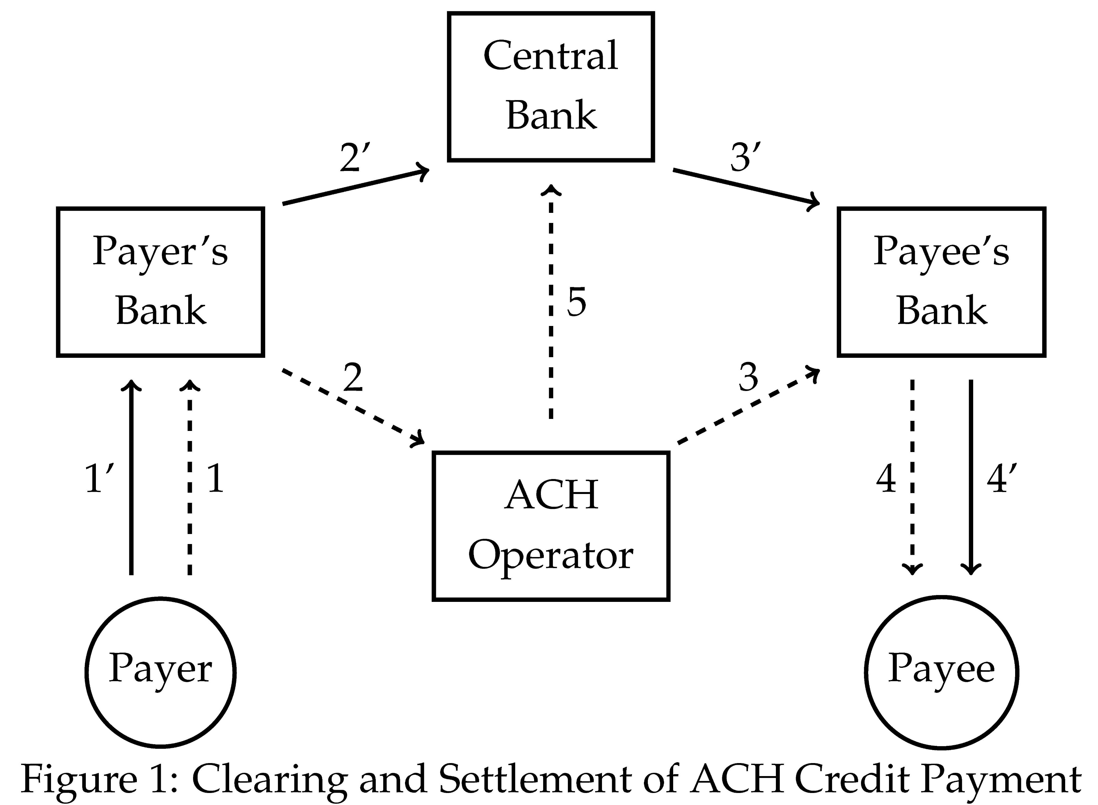
How Modern Payments Work

Slide 5
Evolution of Payments
How did our modern payment system come to be?
Took hundreds of years of innovation
Bills of exchange used by merchants to avoid shipping coins between cities
Bank of Amsterdam was first “modern” high value payment system
Paper money developed in China and Europe
These are discussed in sections 3-5 of textbook chapter (we skip)

Slide 6
Defining the Money Supply
In an economy with only coins: Sum of the value of coins
In an modern economy: Less is obvious
Conceptually we want money supply to be:
Value of assets that are used as a medium of exchange
Checking accounts primary medium of exchange today
But what about savings accounts and money market accounts?
Not directly used, but easy to transfer. Should they count?

Slide 7
Defining the Money Supply
Money supply: Sum of bank notes and deposits in the hands of the public
Ignore distinction between checking and savings accounts
Roughly current definition of M1
“In the hands of the public”:
Bank notes in bank vaults don’t count
Suppose you deposit $100 in bank (money supply doesn’t change)
Deposits of banks at other banks don’t count

Slide 8
Monetary Base
Deposits are promises to pay something
That something is the monetary base
Completely different concept than money supply
Monetary base today: Currency and bank reserves
Held by public and by banks
Monetary base in 17th-19th century: gold and silver specie
Held by public and by banks
Sometimes also called “high-powered” money or “outside” money

Slide 9
Banks and the Money Supply
Banks create money when they make loans
Money supply increases one-for-one when a bank makes a loan

Slide 10
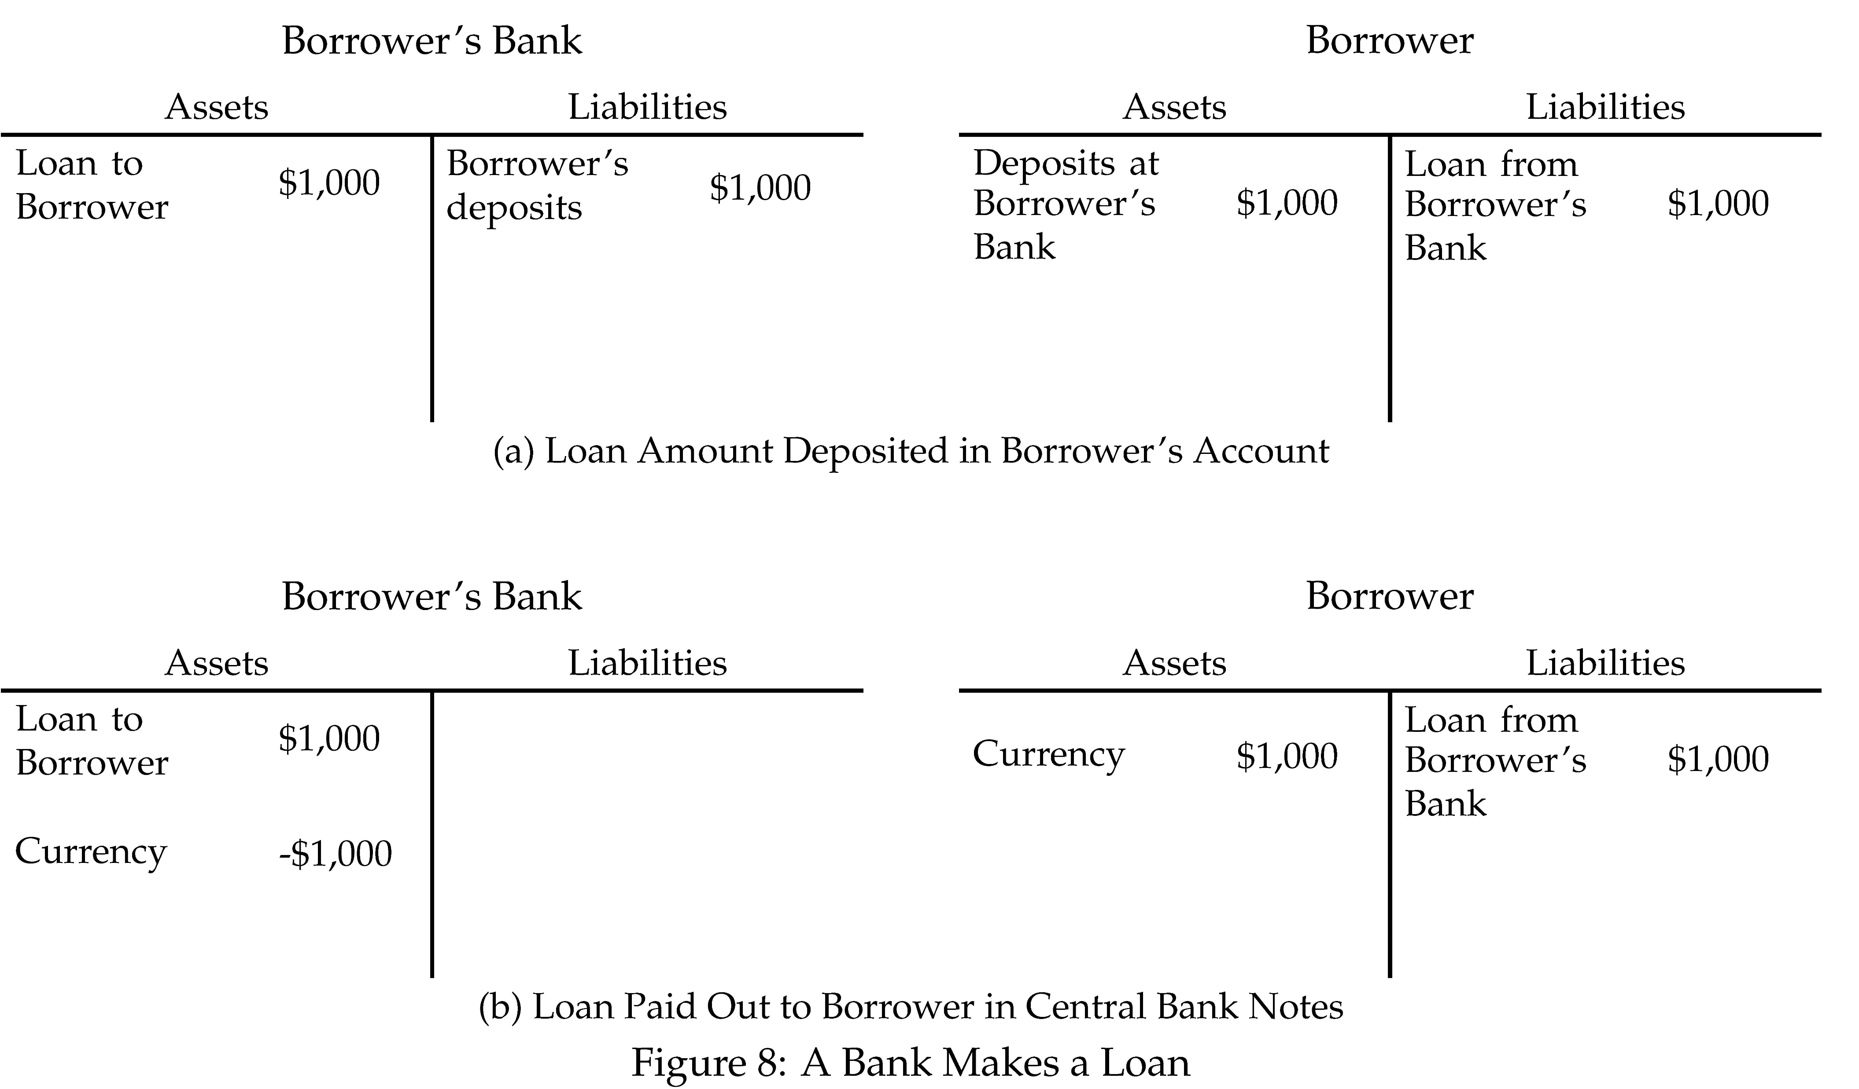

Slide 11
Banks Create Money with Loans
Many find this fact shocking
Confers dangerous powers on banks?
How can we control money supply and keep price level stable if money can “flow from the fountain pens” of commercial bankers?
Read chapter for fuller discussion of this
Most other transactions don’t affect money supply

Slide 12
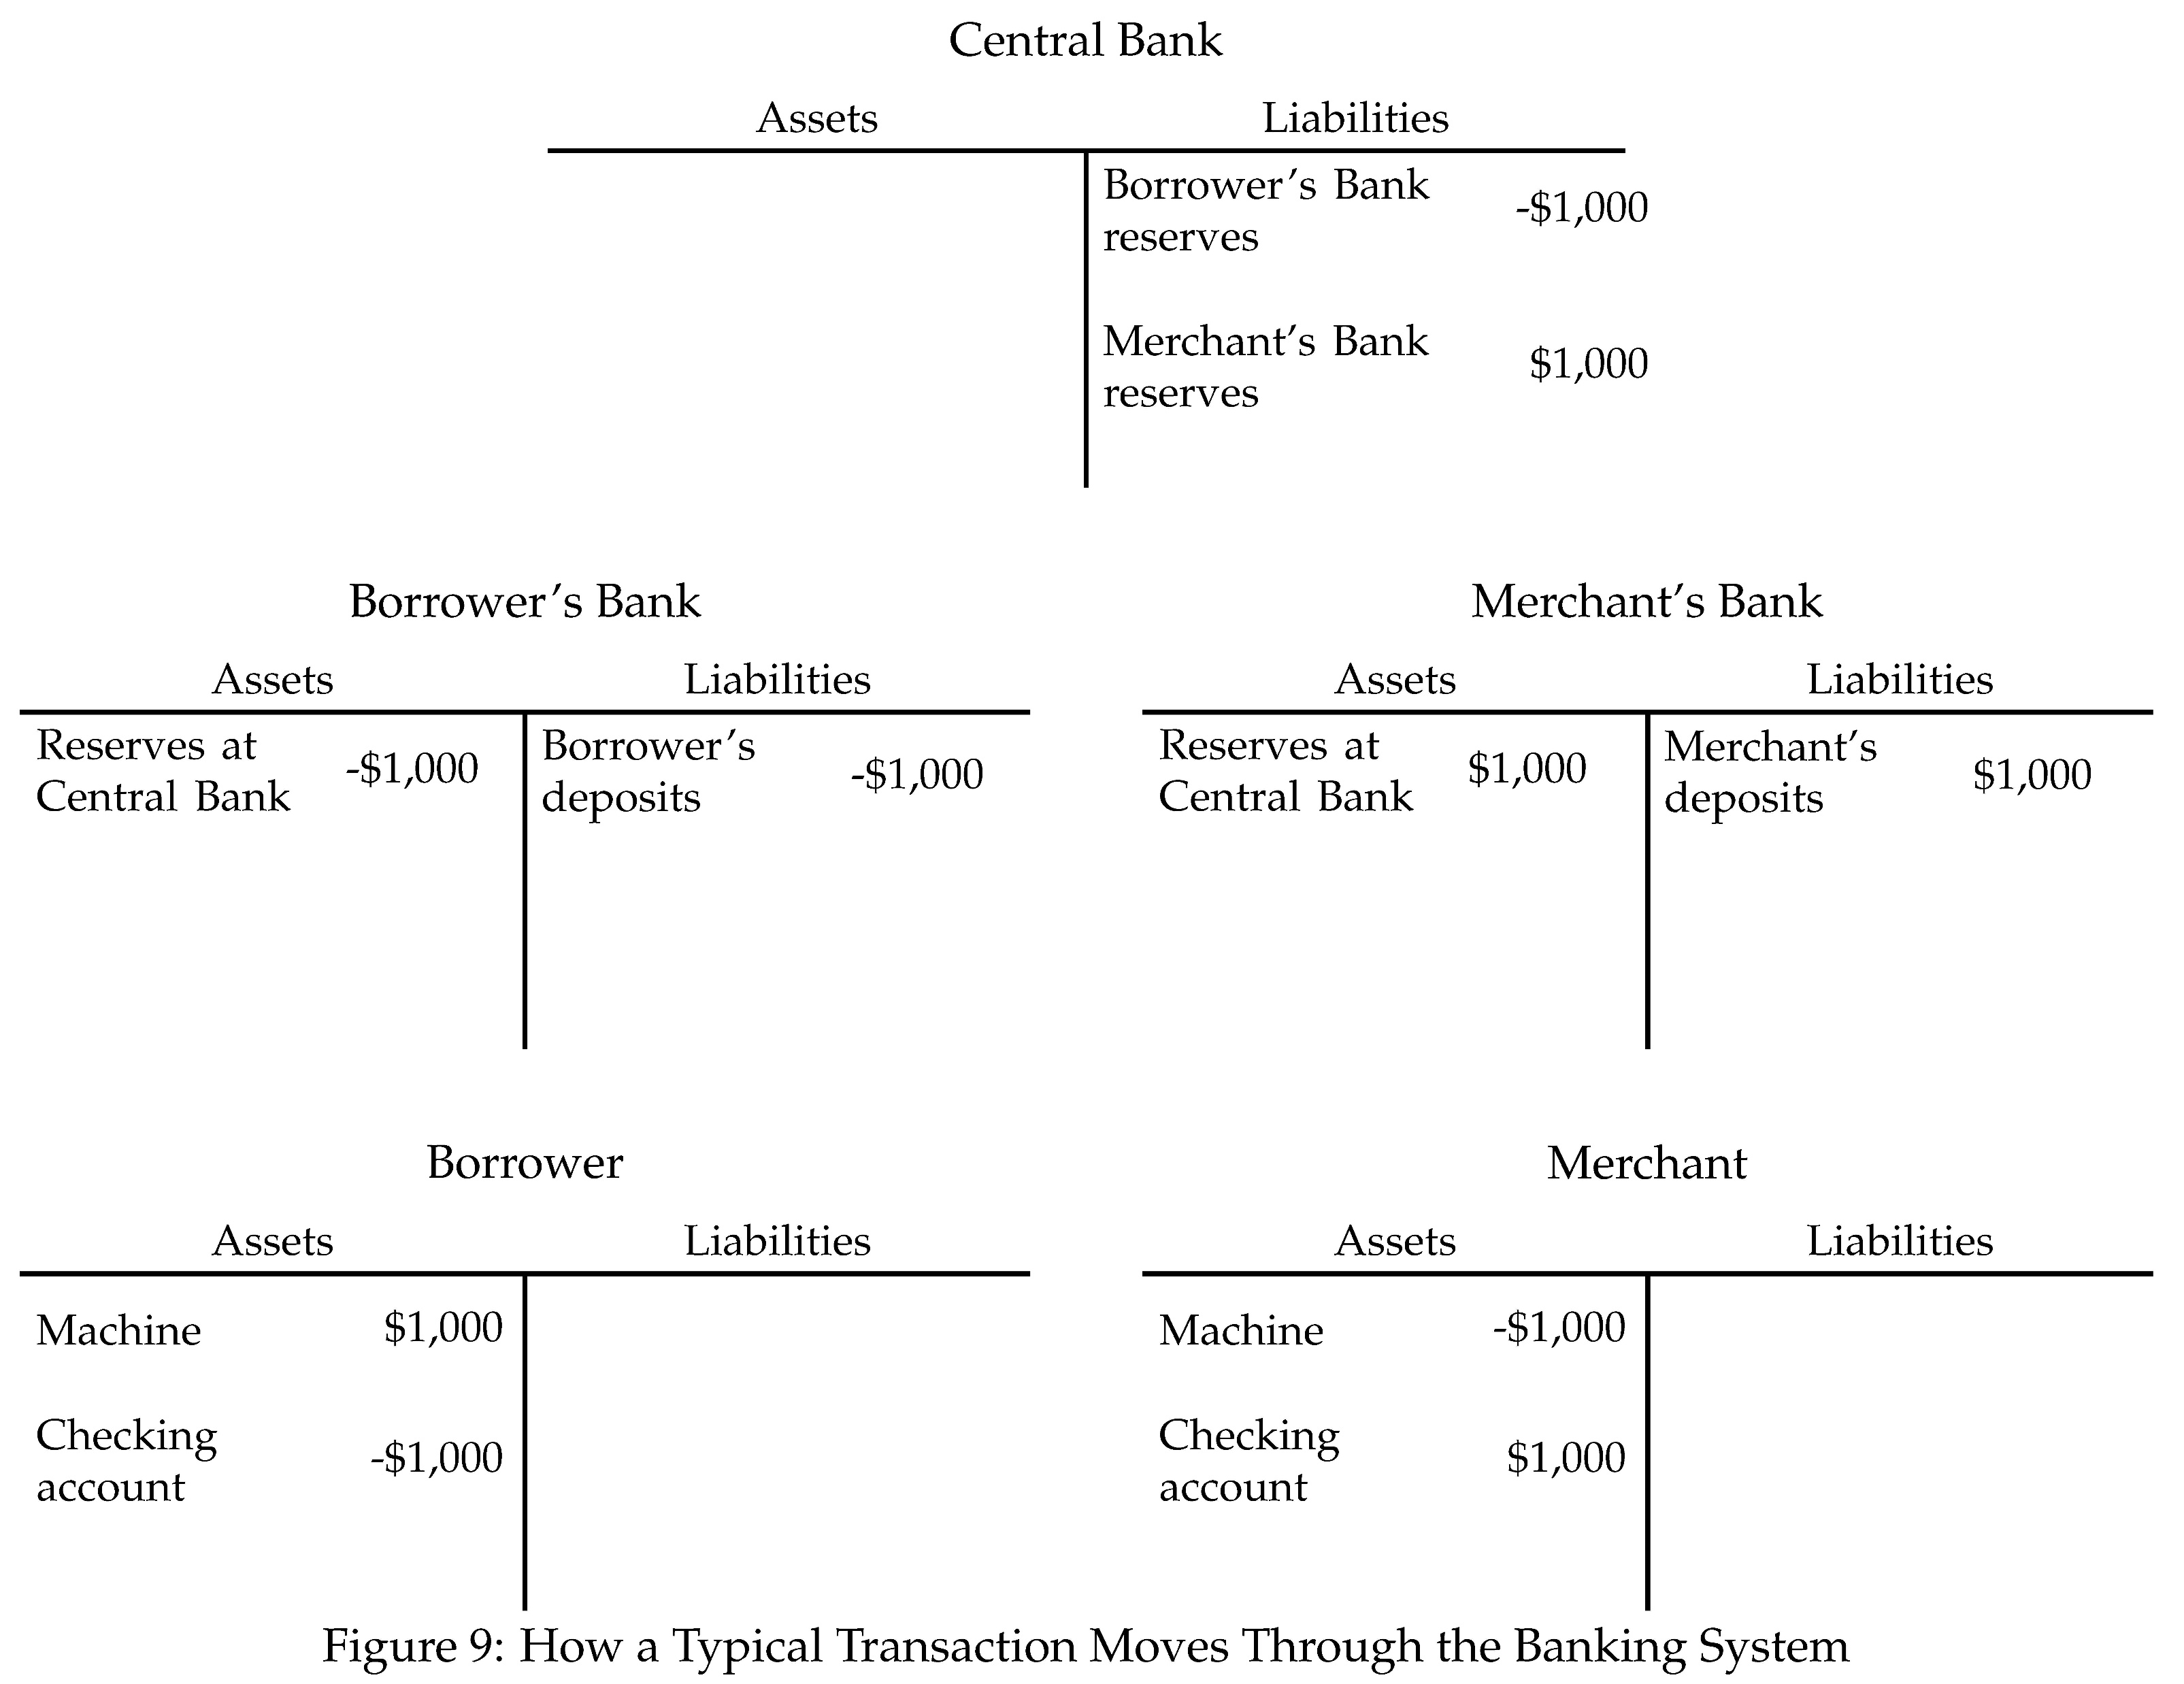

Slide 13
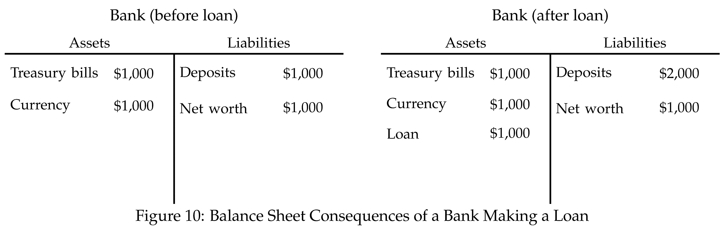
Fractional Reserve Banking
Most banks have more deposits than they have cash reserves
They practice fractional reserve banking

Slide 14
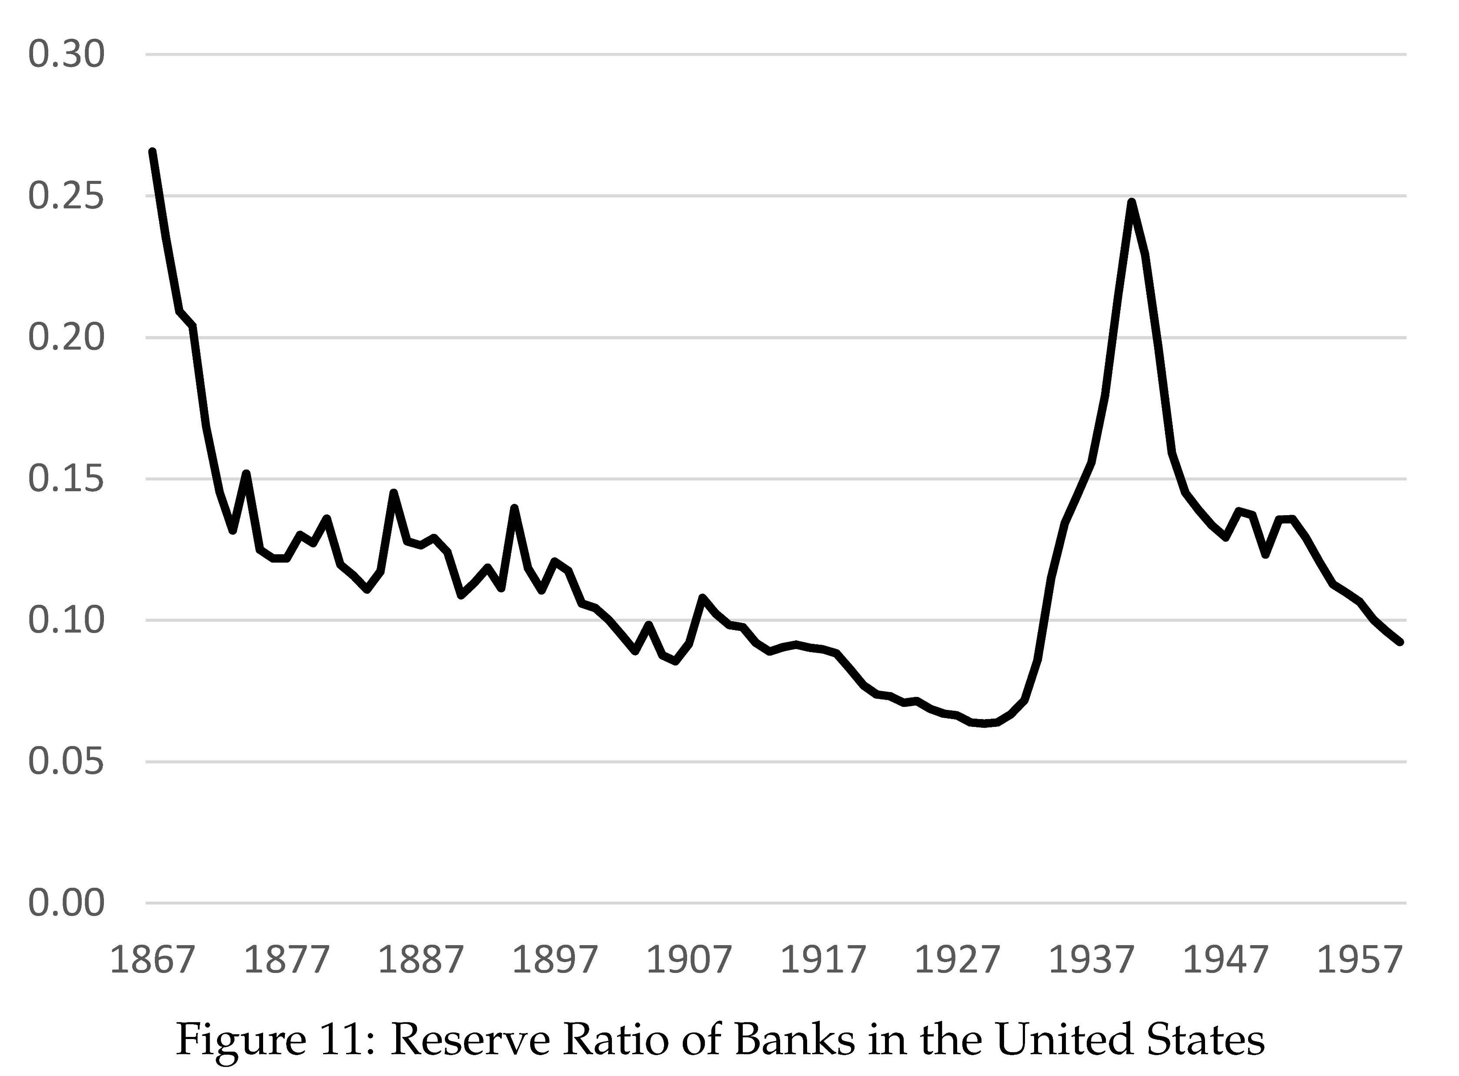

Slide 15
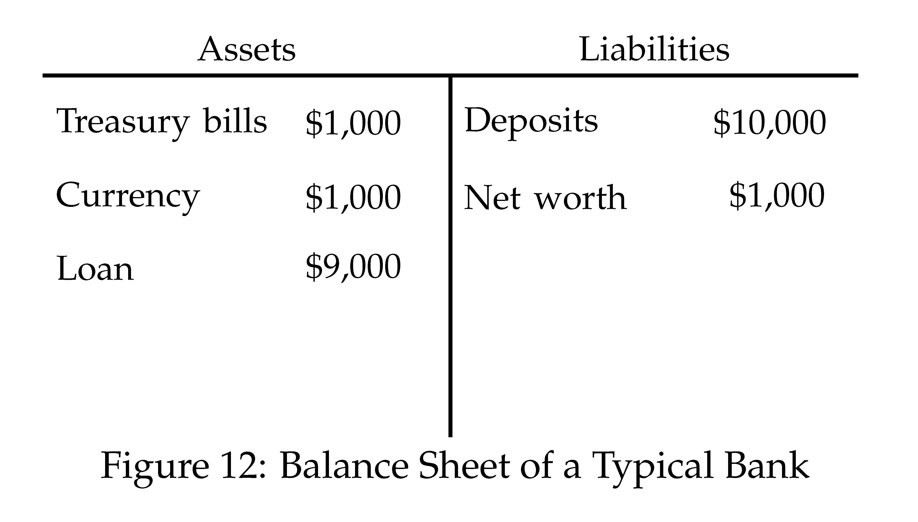
Fractional Reserve Banking
Typical bank around 1900 had a reserve ratio of about 10%
Banks create a lot of money!!
This means that they multiply the monetary base

Slide 16
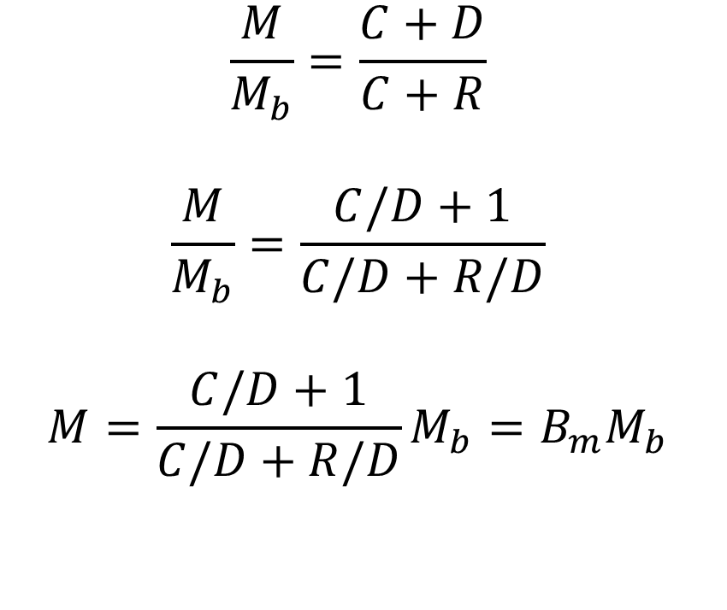
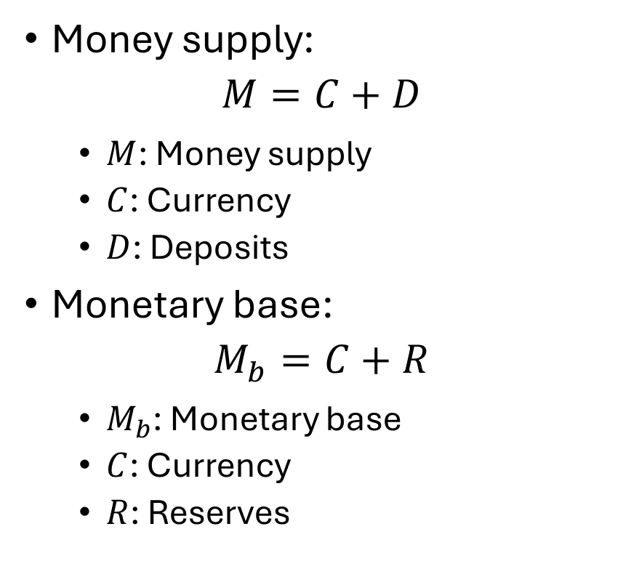
Money Multiplier
Money supply:
$$M=C+D$$
$M$: Money supply
$C$: Currency
$D$: Deposits
Monetary base:
$$M_{b}=C+R$$
$M_{b}$: Monetary base
$C$: Currency
$R$: Reserves
$$\frac{M}{M_{b}}=\frac{C+D}{C+R}$$
$$\frac{M}{M_{b}}=\frac{C/D+1}{C/D+R/D}$$
$$M=\frac{C/D+1}{C/D+R/D}M_{b}=B_{m}M_{b}$$

Slide 17
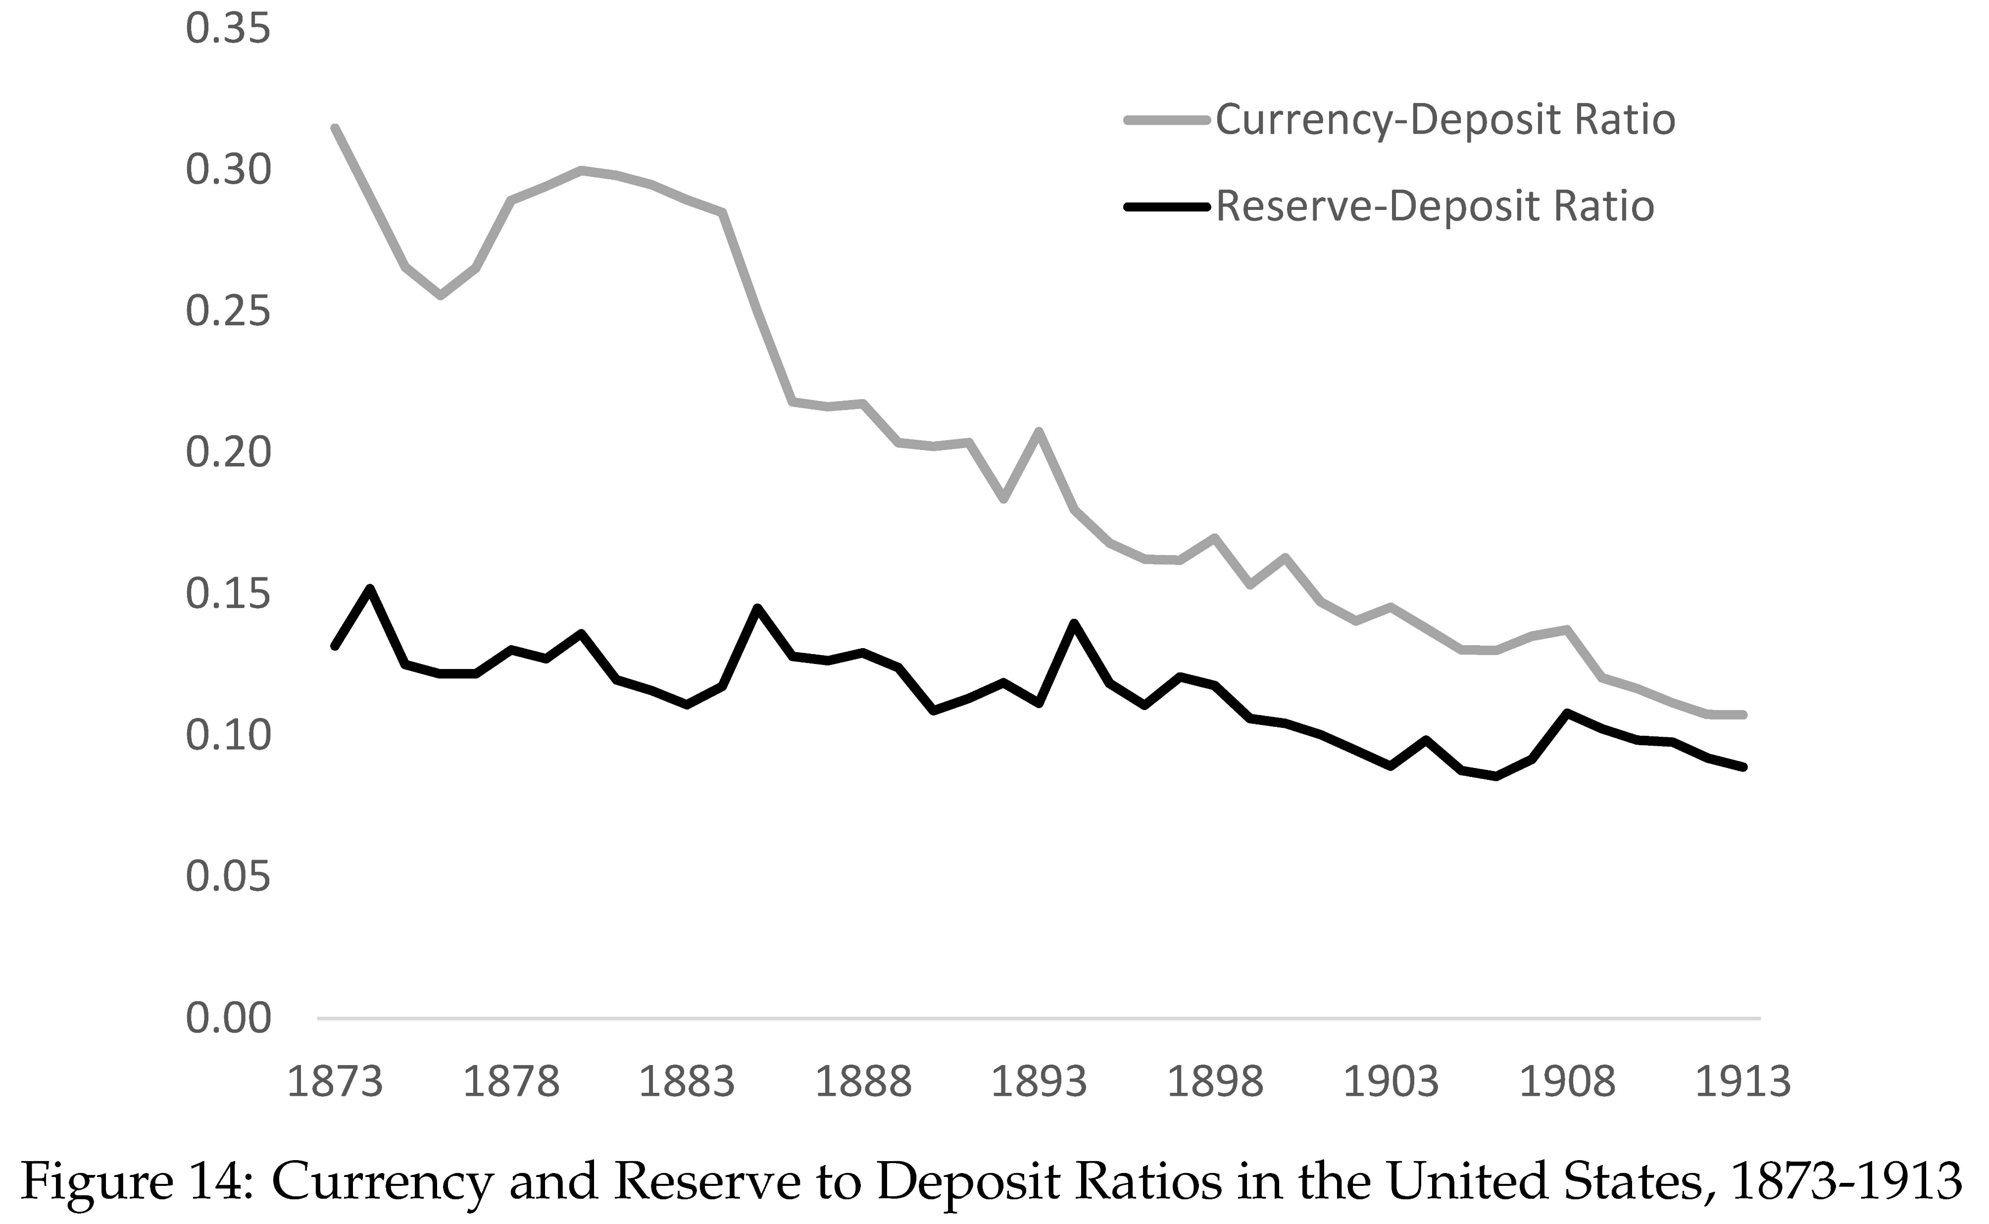
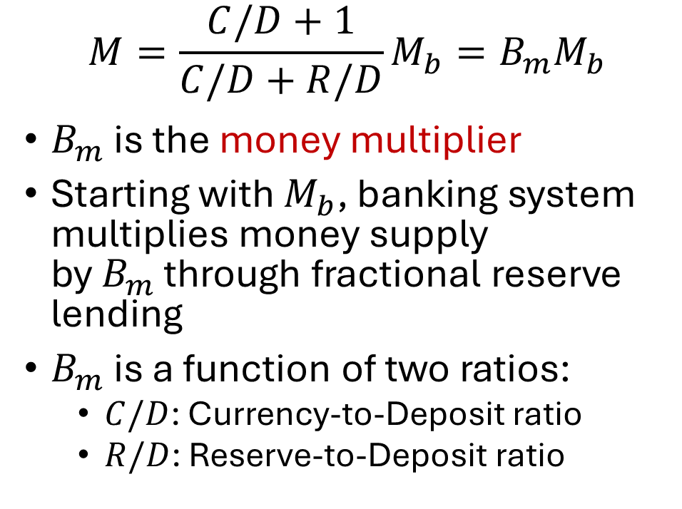
Money Multiplier
$$M=\frac{C/D+1}{C/D+R/D}M_{b}=B_{m}M_{b}$$
$B_{m}$ is the money multiplier
Starting with $M_{b}$, banking system multiplies money supply by $B_{m}$ through fractional reserve lending
$B_{m}$ is a function of two ratios:
$C/D$: Currency-to-Deposit ratio
$R/D$: Reserve-to-Deposit ratio

Slide 18
Fractional Reserves and Bank Leverage
Typical bank around 1900 had a reserve ratio of about 10%
This bank is leveraged 11 to 1
Leverage: Assets over net worth
Suppose the assets of this bank fell in value by 1%. How much would its net worth fall?

Slide 19
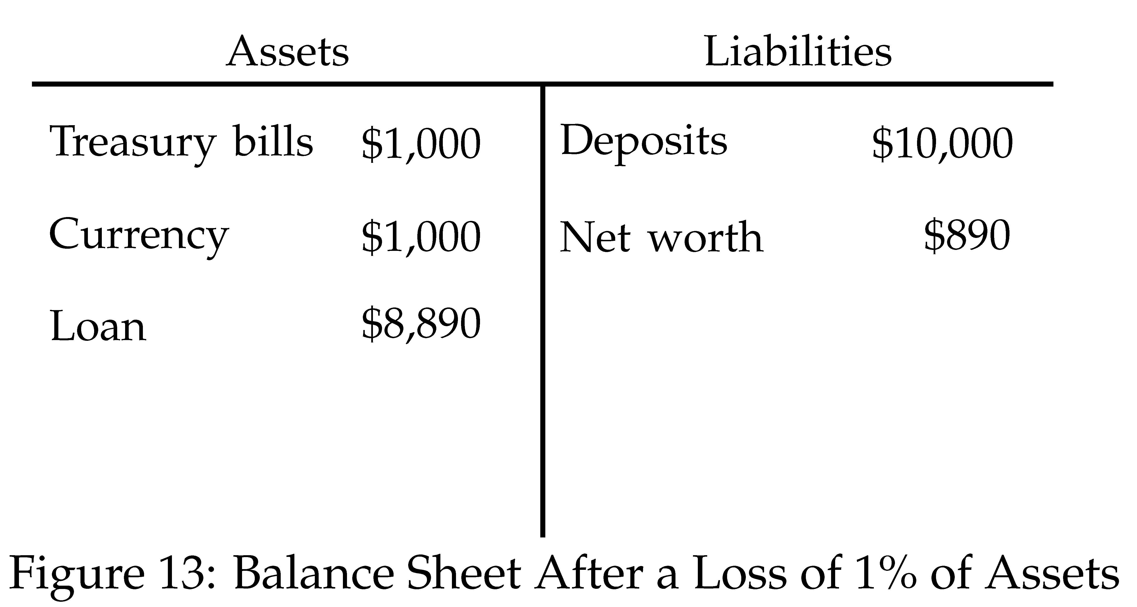
Bank Leverage and Risk
Leverage is intimately connected to risk
Suppose value of bank assets falls by 1%
Net worth falls by 11%
The more leveraged, the more sensitive net worth is to percent losses on assets
Leverage ratio of Goldman Sachs in 2008 was about 26

Slide 20
Bank Maturity Mismatch
All banks – even the best capitalized – are fragile
Basic reason:
Short-term liabilities (deposits)
Long-term assets (loans)
Why this maturity mismatch?
Banks’ most important roles:
Assist costumers in making payments (calls for demand deposits)
Finance investments (issue long-term loans)
Banks create vast amounts of liquidity
Transform illiquid loans into liquid deposits

Slide 21
Bank Fragility
Bank maturity transformation very valuable
But it also makes banks fragile
If depositors lose confidence in bank and want money back, bank can get in trouble fast (assets illiquid)
Depositors know this and may be scared it could happen
Loss of confidence can be self-fulfilling prophesy
To understand this better, we need a little bit of game theory

Slide 22
Prisoner’s Dilemma
Police have arrested two people, but have insufficient evidence unless at least one confesses
Prisoners held in separate cells and cannot communicate
Police explain to each one:
If you confess, they don’t: You go free, they get 10 years
If they confess, you don’t: You get 10 years, they go free
If both confess: Both get 5 years
If neither confess: Both get 1 year
Prisoners know that they face the same choice

Slide 23
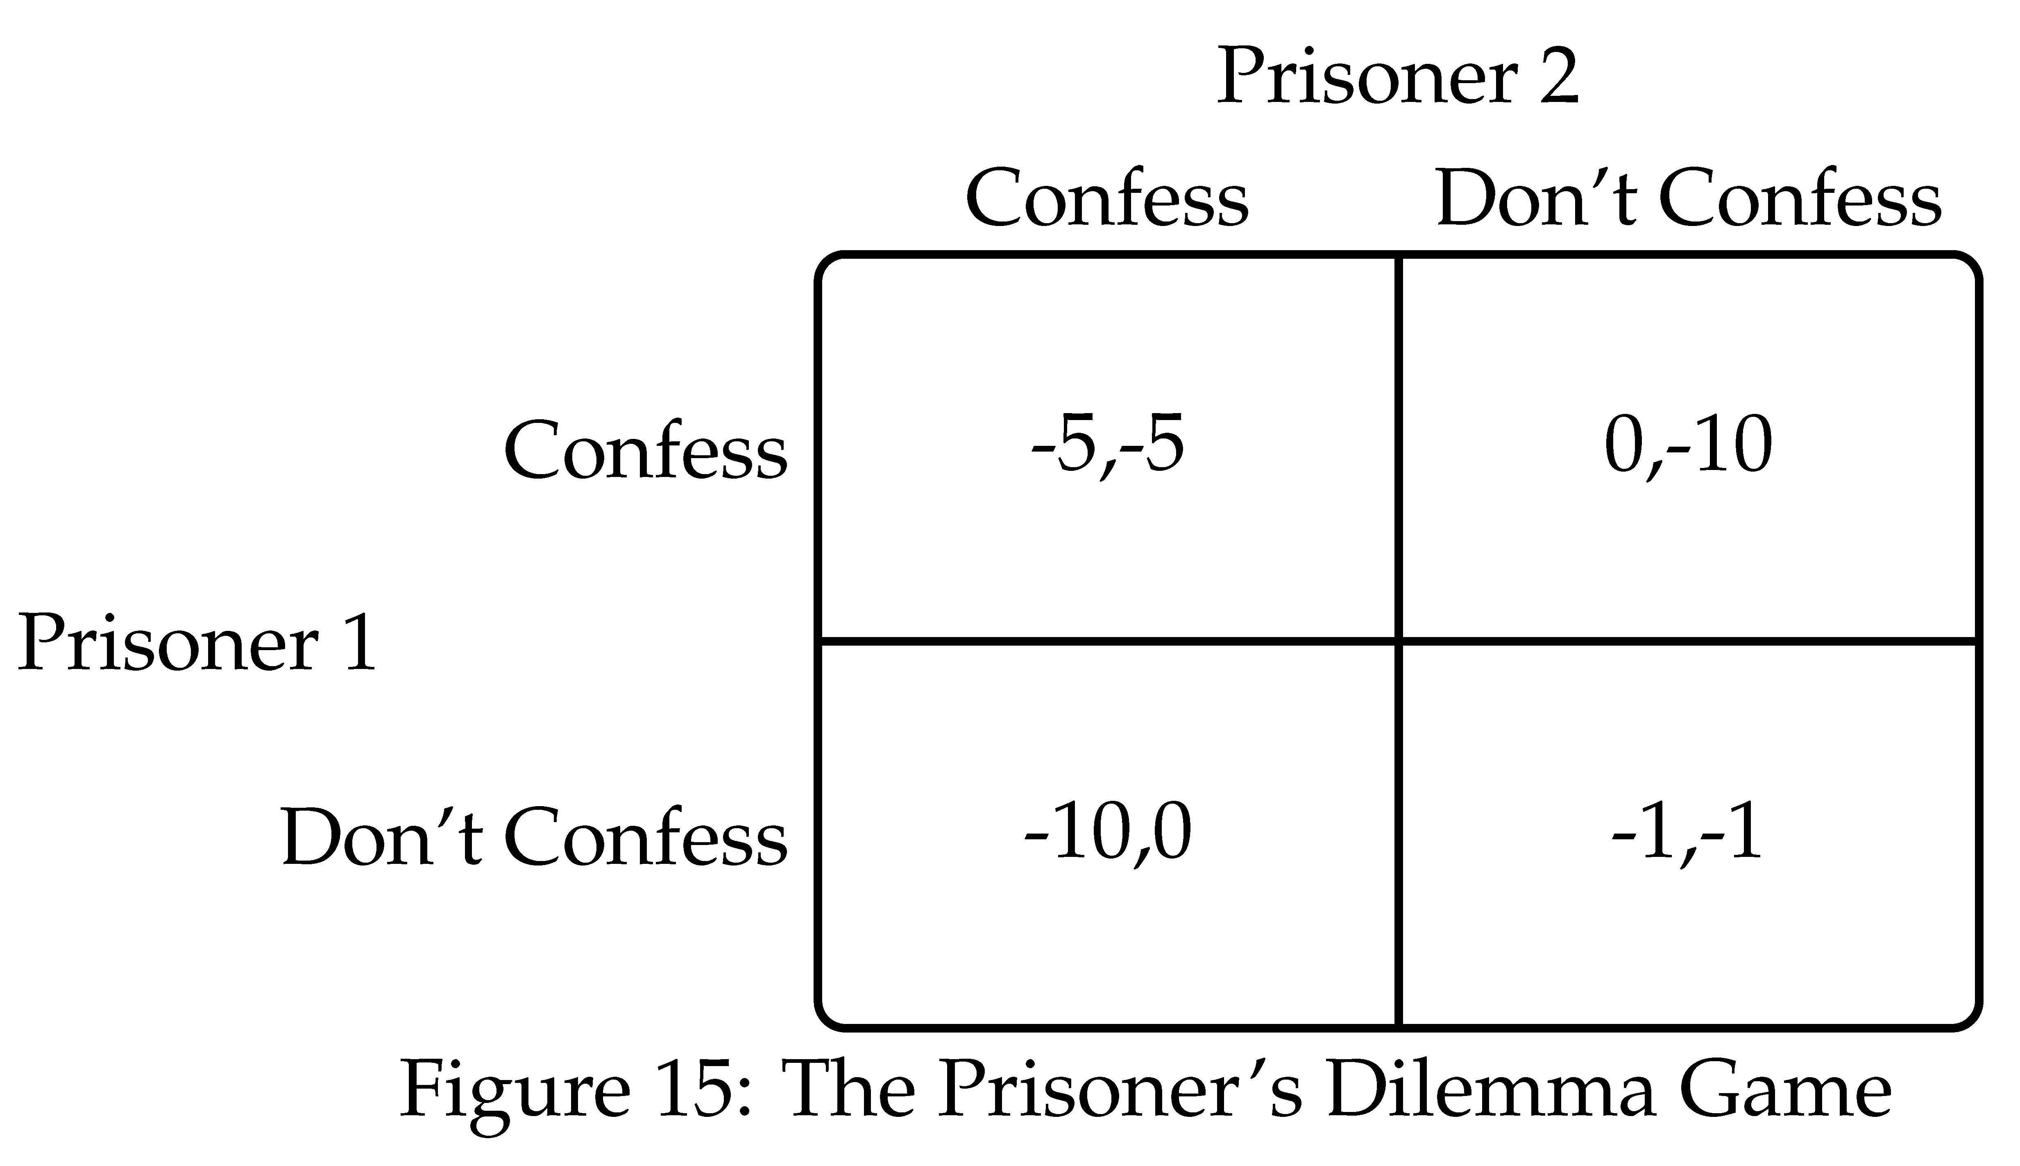

Slide 24
Prisoner’s Dilemma Game
Nash Equilibrium: Each player plays a “best response” given what other players play
Prisoner’s dilemma game has a single Nash Equilibrium
Confess, Confess
But (Confess, Confess) is much worse outcome than (Don’t confers, Don’t confess)
Mutual cooperation would benefit both, but is not in their individual self interest

Slide 25
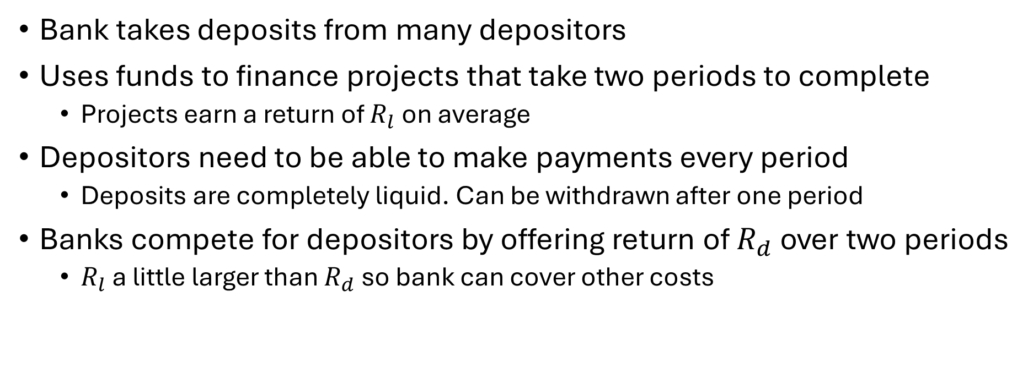
Diamond Dybvig Model of Bank Runs
Bank takes deposits from many depositors
Uses funds to finance projects that take two periods to complete
Projects earn a return of $R_{l}$ on average
Depositors need to be able to make payments every period
Deposits are completely liquid. Can be withdrawn after one period
Banks compete for depositors by offering return of $R_{d}$ over two periods
$R_{l}$ a little larger than $R_{d}$ so bank can cover other costs

Slide 26
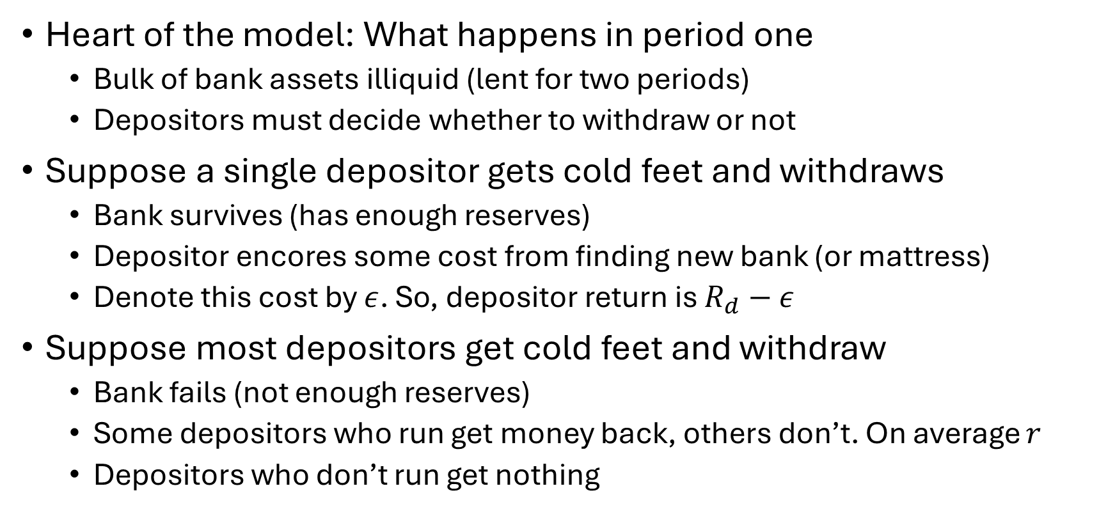
Diamond Dybvig Model of Bank Runs
Heart of the model: What happens in period one
Bulk of bank assets illiquid (lent for two periods)
Depositors must decide whether to withdraw or not
Suppose a single depositor gets cold feet and withdraws
Bank survives (has enough reserves)
Depositor encores some cost from finding new bank (or mattress)
Denote this cost by $ε$. So, depositor return is $R_{d}−ε$
Suppose most depositors get cold feet and withdraw
Bank fails (not enough reserves)
Some depositors who run get money back, others don’t. On average $r$
Depositors who don’t run get nothing

Slide 27
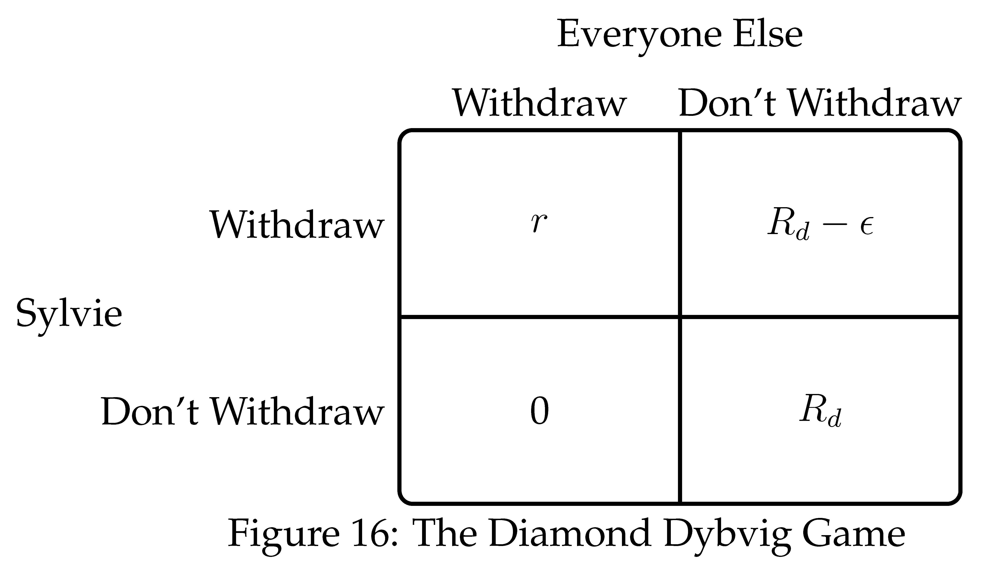

Slide 28
Diamond Dybvig Model of Bank Runs
Two (symmetric) Nash equilibria:
If everyone else runs, Sylvia should run
If no one else runs, Sylvia should not run
Fear of run can become self-fulfilling
If you believe everyone else will run, your best response is to run
It is only because you think others are going to run that you decide to run

Slide 29
Banking Panics
Bank runs can trigger generalized panics
Panics in history:
England: 1672, 1763, 1772, 1793, 1796, 1811, 1825, 1847, 1857, 1866
U.S.: 1814, 1833, 1837, 1857, 1873, 1893, 1907, 1930-33
Panics contribute to deep recessions
Among most severe economic calamities in capitalist economies
Preventing panics one of most important public policy problems

Slide 30
Suspension of Convertibility
Bank can close its doors to depositors seeking withdrawal
Milder versions: count slowly, restrict amount
Widespread suspensions in U.S. in 1893, 1907, 1933
Buys time to:
Raise funds
Convince the public bank is sound
Allow panic to subside
Creates a dual monetary system: currency vs. deposits
Deposits trade at a time varying discount
Payment difficulties (e.g., firms making payroll)

Slide 31
Lender of Last Resort
A central bank with unlimited resources can stop a banking panic by acting as a lender of last resort
Suppose central bank commits to lend enough to bank that it can withstand any amount of depositor withdrawals
This eliminates the run equilibrium
No longer optimal for Sylvie to run even if others run
Bank will not fail even if others run
Mere announcement (if credible) can prevent runs from happening
Bagehot’s principles (1873): In a crisis …
1. Lend freely, 2. At a penalty rate, 3. Against good collateral

Slide 32
Moral Hazard and Last Resort Lending
Banks will act less prudently if they know central bank will help them out in a crisis
This is called moral hazard
Moral hazard is a side effect of insurance
Central bank is providing banks with insurance against runs
Some argue:
Last resort lending is bad policy because it makes for more crises
If government commits not to bail out banks, they will not get in trouble
But is such a commitment credible?

Slide 33
Penalty Rate and Good Collateral
Bagehot’s principles (1873): In a crisis …
1. Lend freely, 2. At a penalty rate, 3. Against good collateral
Penalty rate:
Compensation for providing “insurance” to banks
Last resort lending is risky, compensation for taking risks
Good collateral:
Central bank should limit lending to deserving banks. But how?
Define deserving as banks that have good collateral.
Banks in liquidity crisis vs. solvency crisis

Slide 34
Liquidity Crisis vs. Solvency Crisis
Liquidity problem:
Bank fundamentally solvent
Faces a run and needs liquidity (assets illiquid)
Has good collateral for central bank to lend against
Central bank will make money on emergency loans
Solvency problem:
Bank fundamentally insolvent
Assets worth less than liabilities
Doesn’t have enough good collateral
Central bank would lose money if they bailed bank out
Fiscally costly bailouts should be decided on by elected officials

Slide 35
Liquidity Crisis vs. Solvency Crisis
But how should bank assets be valued?
Crisis leads to fire sale of assets
Value of assets falls below “fundamental” value
Fundamental value: value when crisis subsides
Should central bank value assets at fundamental value or market value?
Hard to figure out fundamental value
“Fog of war” makes these decisions hard in a crisis

Slide 36
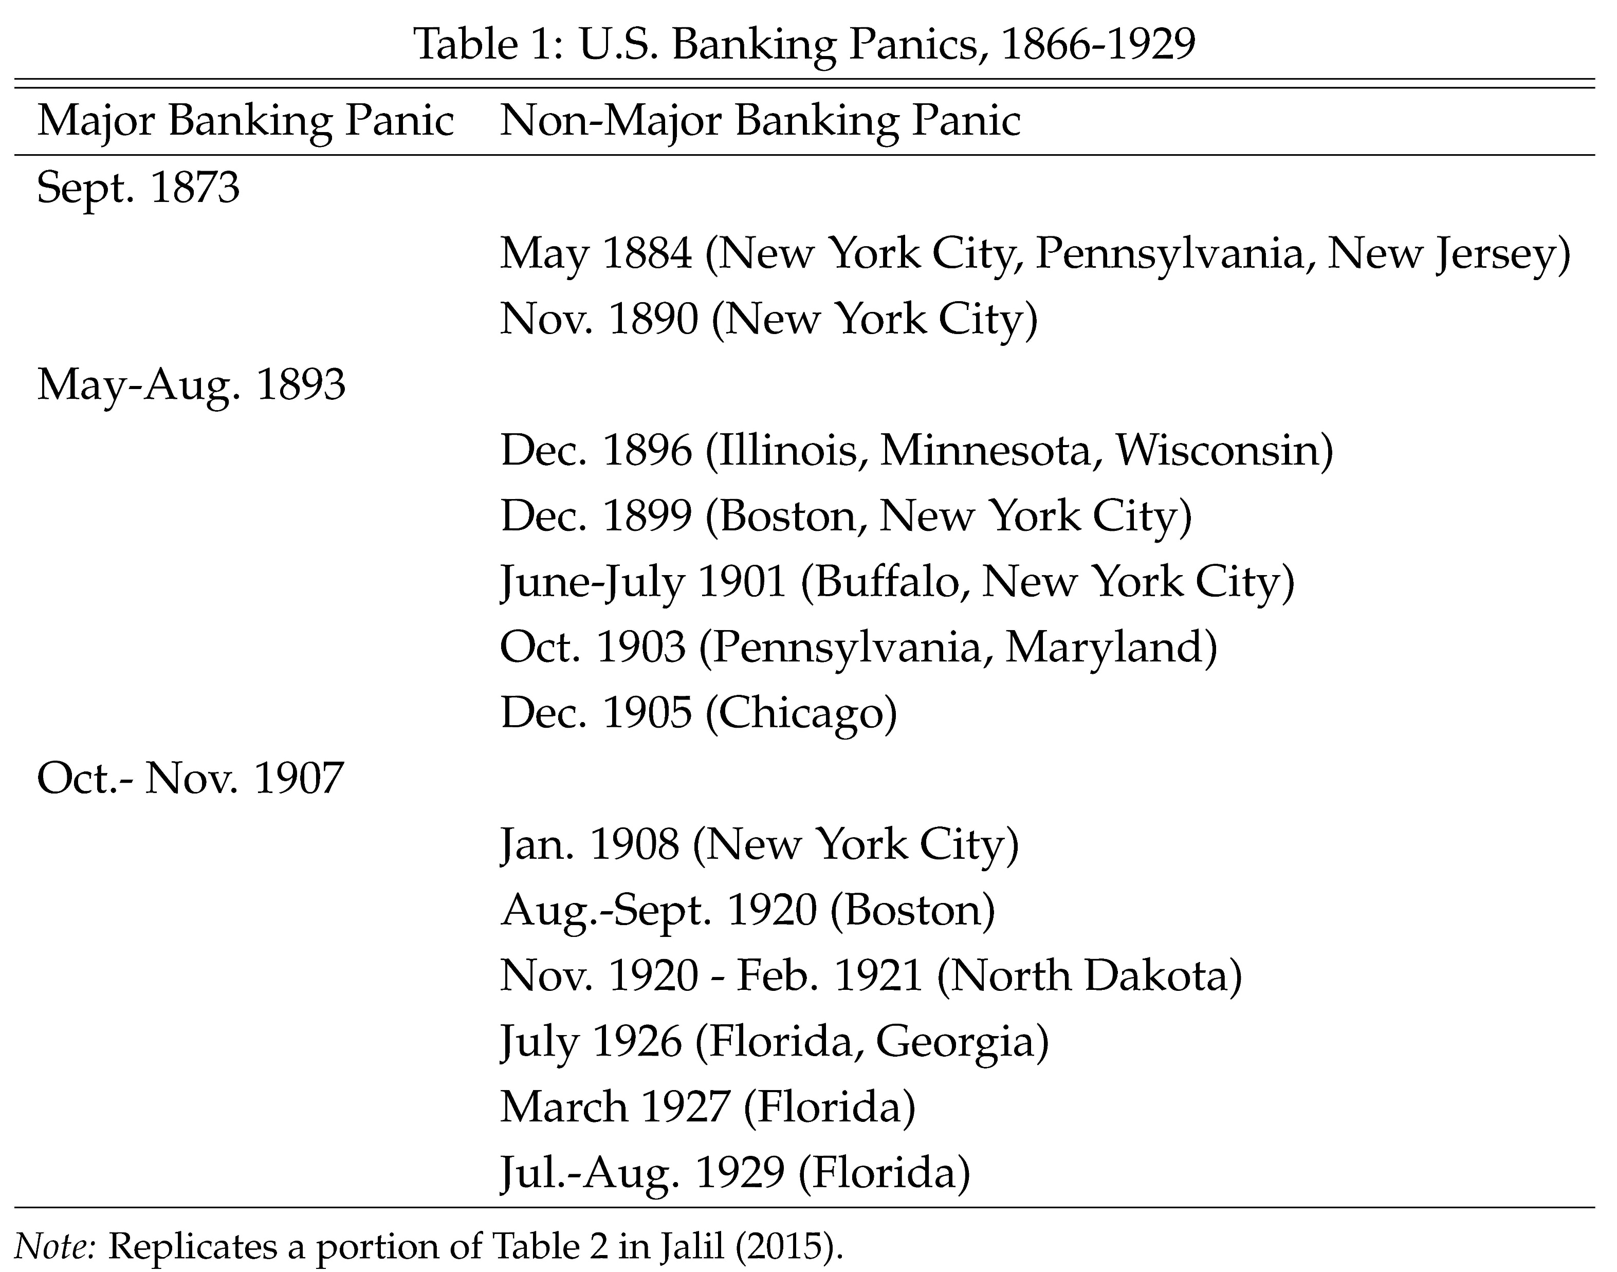
Persistence of Banking Panics in U.S.
No more panics in England after 1866
Regular panics in U.S. for another 70 years
Why?

Slide 37
Persistence of Banking Panics in U.S.
Absence of a central bank
U.S had no central bank from 1836 (Jackson’s veto) to 1913 (Fed established)
No lender of last resort
Unit banking
No interstate banking until 1970s / No branching in many states
Banks small and undiversified. Especially fragile.
Canada had national branch banks and no banking crises

Slide 38
Deposit Insurance
U.S. had a lender of last resort after 1913, but experiences massive banking crisis during Great Depression
Fed failed to act
U.S. instituted federal deposit insurance in 1933
Deposit insurance eliminates the run equilibrium in Diamond-Dybvig model
Sylvia doesn’t want to run (even if others do) because her deposits are insured
Ushered in “quiet period” of financial stability

Slide 39
Bank Regulation
Core problem: Bank runs
Direct policy response: Last resort lending and despot insurance
Knock on problem: Moral hazard
Policy response to moral hazard: capital and liquidity regulation
Also: Deposit financing too cheap due to tax incentives (profits net of interest payment on debt are taxed).

Slide 40
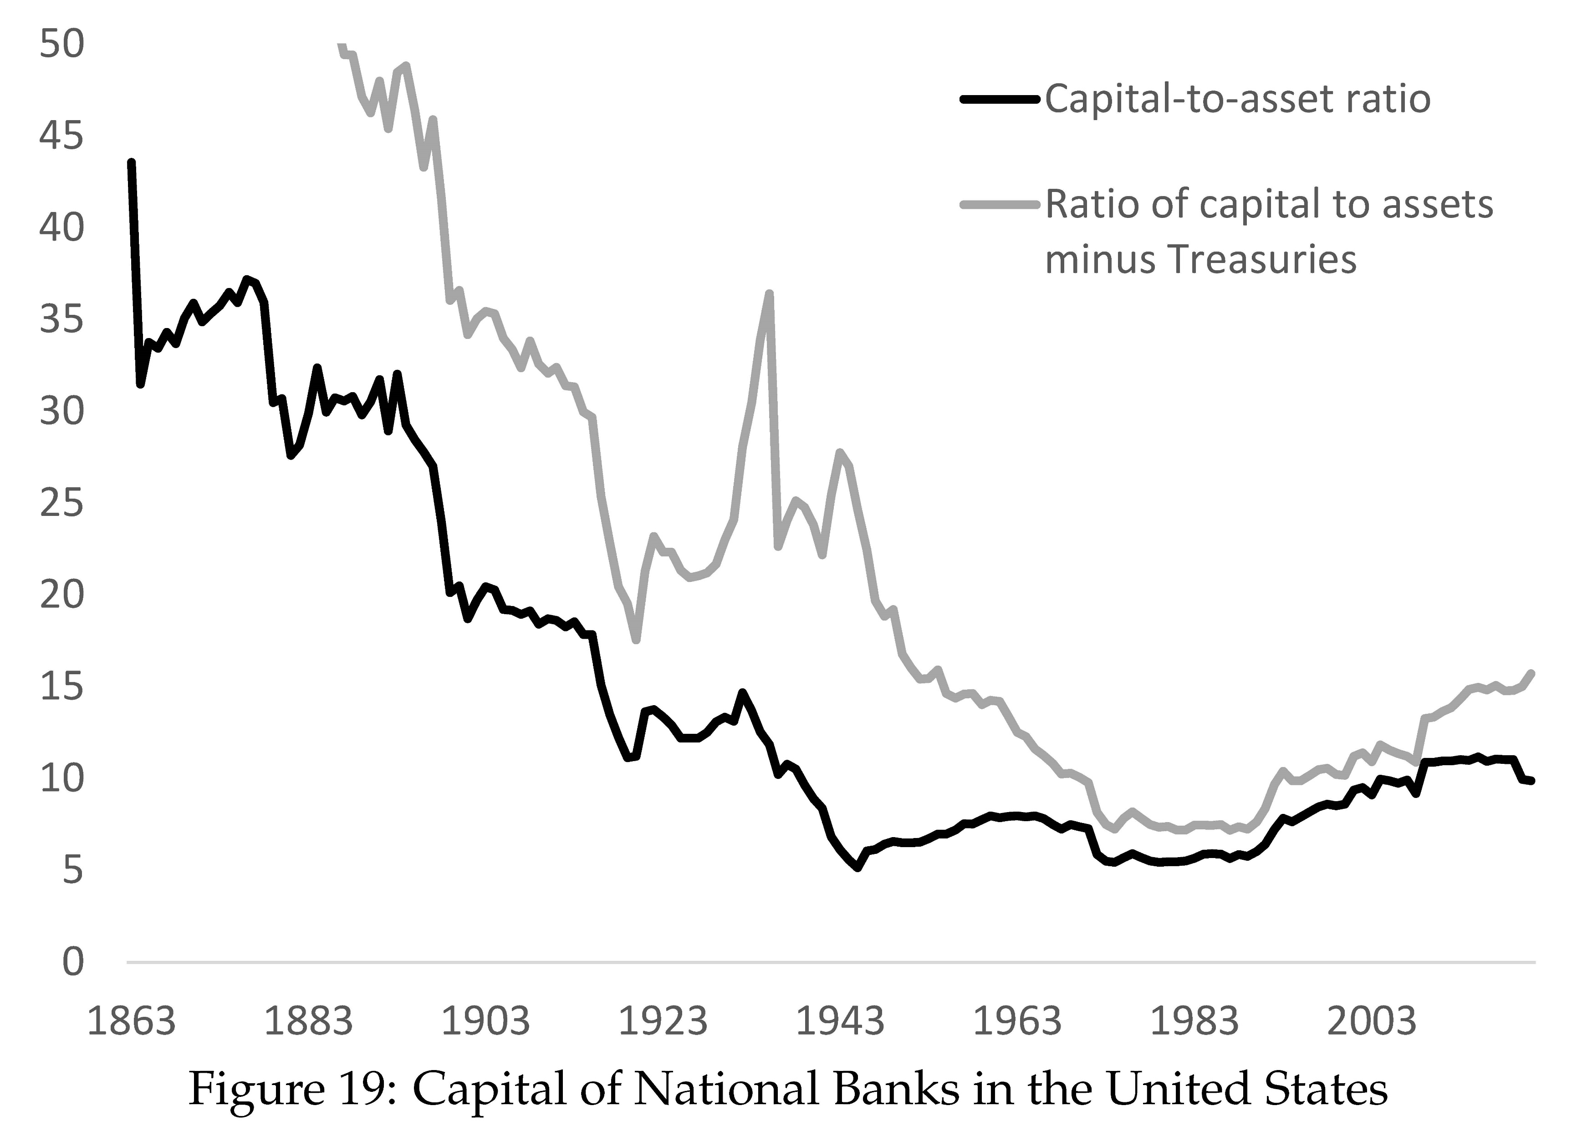

Slide 41
Basel I
1988 G-10 agreement on capital regulation
Minimum capital ratios:
4% Tier 1 capital ratio
8% Total capital ratio
Capital relative to risk-weighted assets
Risk weights:
0%: Cash, central government debt
10%: Public sector debt
20%: Claims on other banks
50%: Residential mortgages
100% Commercial and industrial loans

Slide 42
Basel II
Focus on improving risk weights
Large banks could use internal models to assess risk
Trading accounts involve a lot of hedging
Use of internal models allowed banks to take account of hedging
Better risk weights supposed to reduce regulatory arbitrage
E.g., Package mortgages into securities, sell off high trances, hold lowest trances (which have most of the risk), lower capital requirement
Downside: Internal risk models biased

Slide 43
Financial Crisis – Basel III
Financial crisis of 2007-09 led to calls for more stringent capital requirements
Response: Basel III and Dodd-Frank in U.S.
Higher capital ratios
More detailed risk weights (some higher than 100%)
Leverage ratios (un-risk-weighted capital ratios)
G-SIBs (Globally systemically important banks due to “too big to fail”)
Stress tests (forward looking, central bank model)

Slide 44
