Slide 1
Lecture 12: Business Cycles Macroeconomics (Quantitative) Economics 101B
Jón Steinsson
University of California, Berkeley

Slide 2
Long Run Versus Short Run
Classical economics:
Emphasizes self-equilibrating forces (supply=demand, long-run monetary neutrality)
In the long run, these forces bring about good outcomes
But economies are buffeted by shocks that result in serious pathologies such as high inflation and high unemployment
Great Depression, Early 1980s recession, 2007-2009 financial crisis

Slide 3
Long Run Versus Short Run
But this “long run” is a misleading guide to current affairs. “In the long run” we are all dead. Economists set themselves too easy, too useless a task if in tempestuous seasons they can only tell us that when the storm is long past the ocean is flat again.
- John Maynard Keynes

Slide 4
Long Run Versus Short Run
(Keynesian) Macroeconomics:
Born as separate sub-discipline in the Great Depression
Obvious that long-run forces not working well
Increased focus on workings of the economy in the short run
Increased focus on “business cycles” and crises

Slide 5
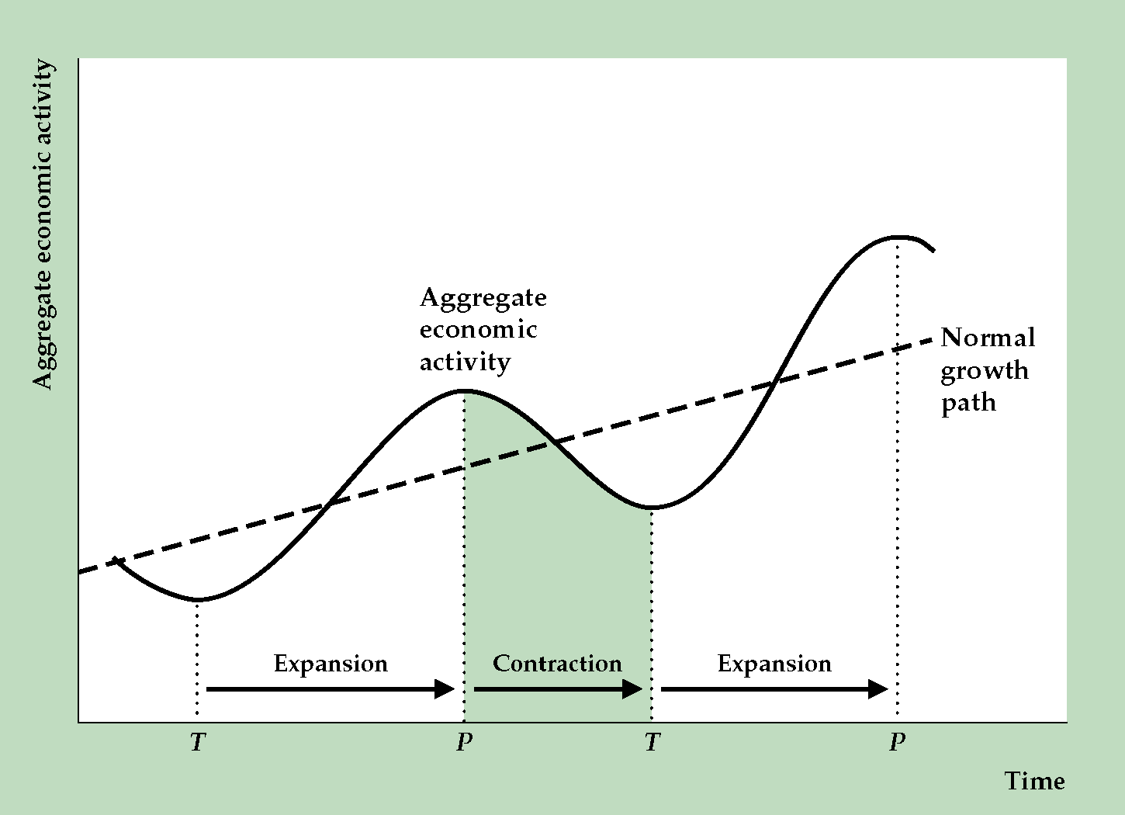
Business Cycles
Output fluctuates around a trend
Fluctuations called business cycles
Recurrent but not periodic
Last approximately from 2 to 10 years
Phases:
Expansion phase (trough to peak)
Contraction phase (peak to trough)
“Official” arbiter:
Business Cycle Dating Committee of the National Bureau of Economic Research

Slide 6
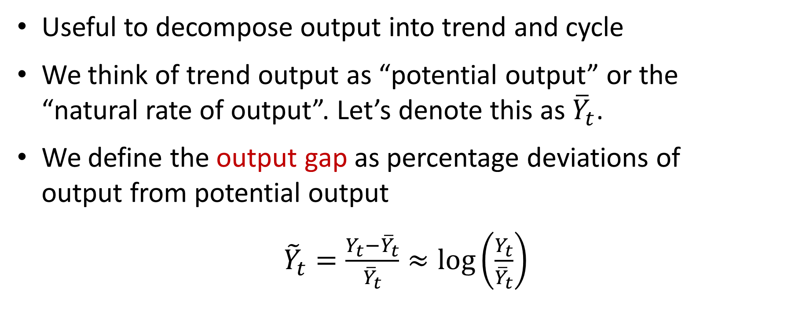
Trend and Cycle
Useful to decompose output into trend and cycle
We think of trend output as “potential output” or the “natural rate of output”. Let’s denote this as ${\overline{Y}}_{t}$.
We define the output gap as percentage deviations of output from potential output
${\tilde{Y}}_{t}=\frac{Y_{t}−{\overline{Y}}_{t}}{{\overline{Y}}_{t}}≈\log\left(\frac{Y_{t}}{{\overline{Y}}_{t}}\right)$

Slide 7
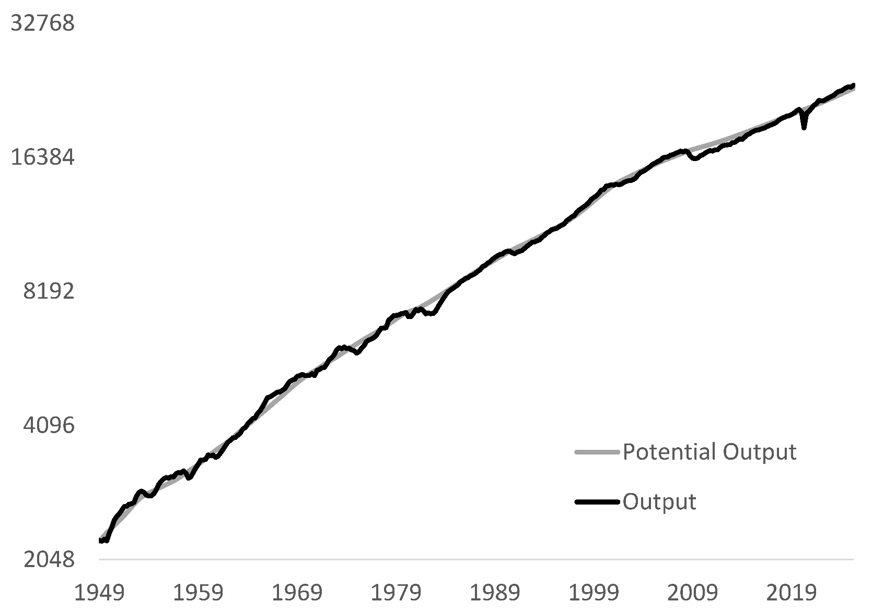
The Trend: Potential Output
Here I plot output (real GDP) and potential output as estimated by the Congressional Budget Office
Difference looks small relative to growth in output
These differences are recessions and booms

Slide 8
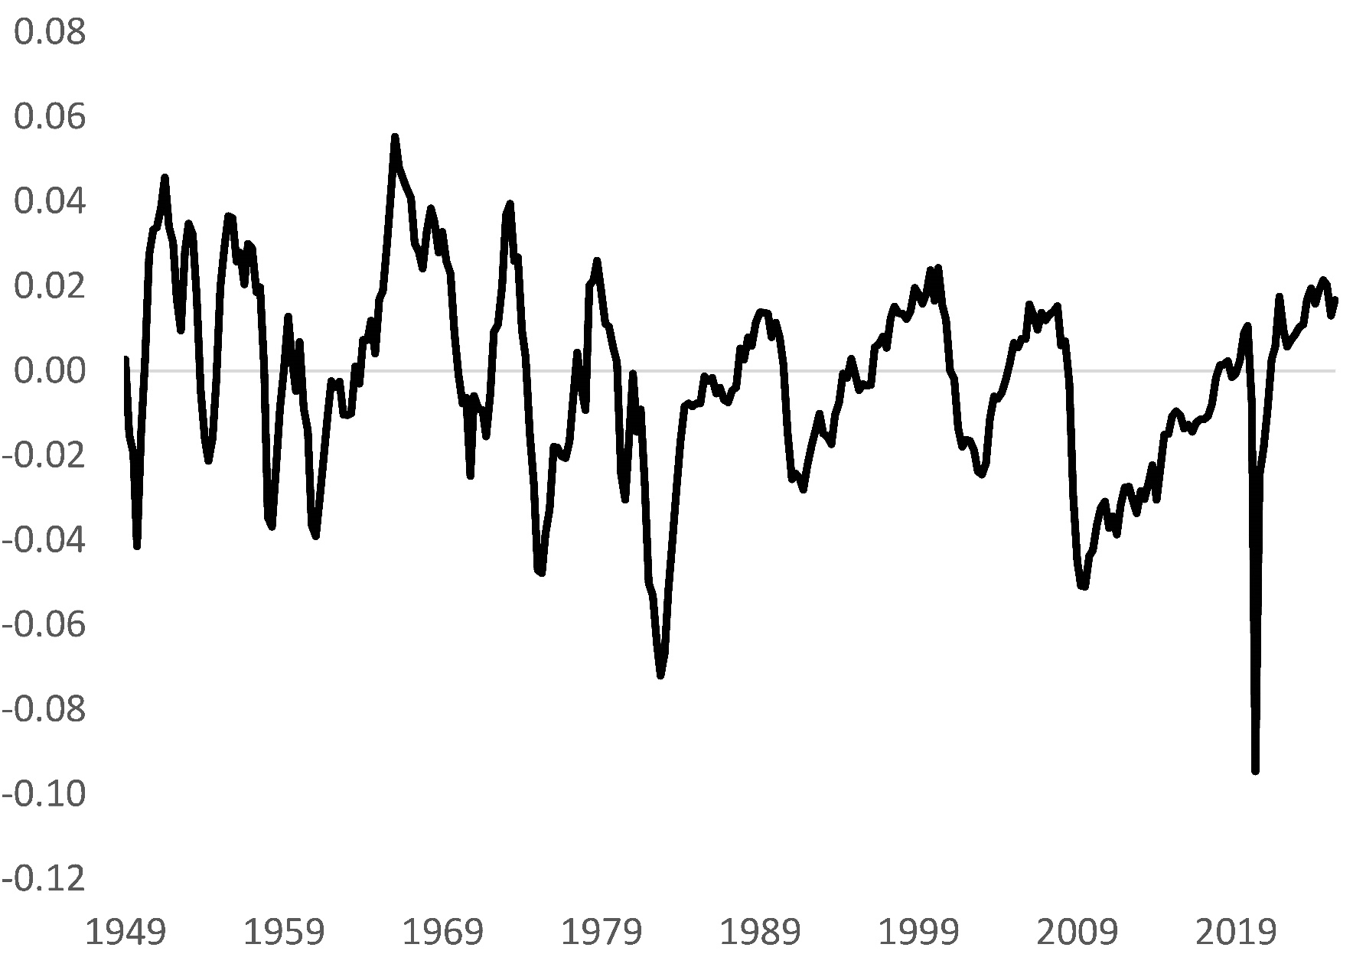
The Business Cycle
Here I plot the output gap measured as the difference between log output and log potential output (from CBO)
Recessions cause up to 10% fall in output relative to potential

Slide 9
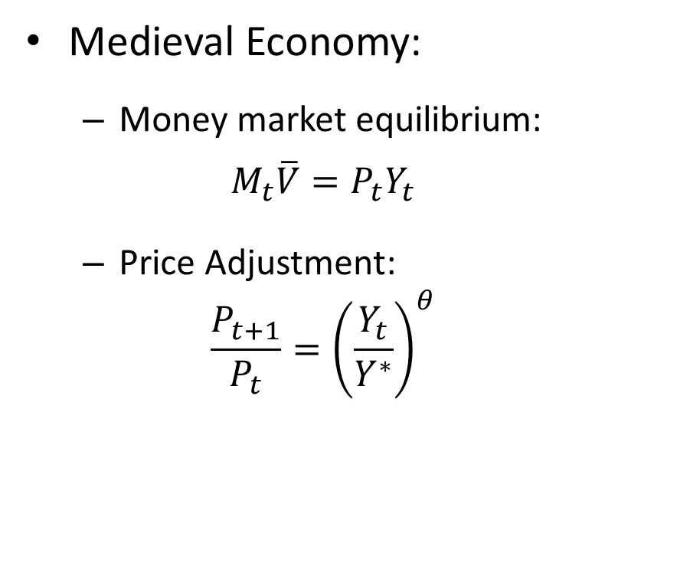
Our First “Business Cycle” Model
Medieval Economy:
Money market equilibrium:
$$M_{t}\overline{V}=P_{t}Y_{t}$$
Price Adjustment:
$$\frac{P_{t+1}}{P_{t}}={\left(\frac{Y_{t}}{Y^{∗}}\right)}^{θ}$$
Many things missing:
No trend growth
No steady state inflation
No unemployment
No interest rate
No monetary policy
No fiscal policy
Etc.

Slide 10
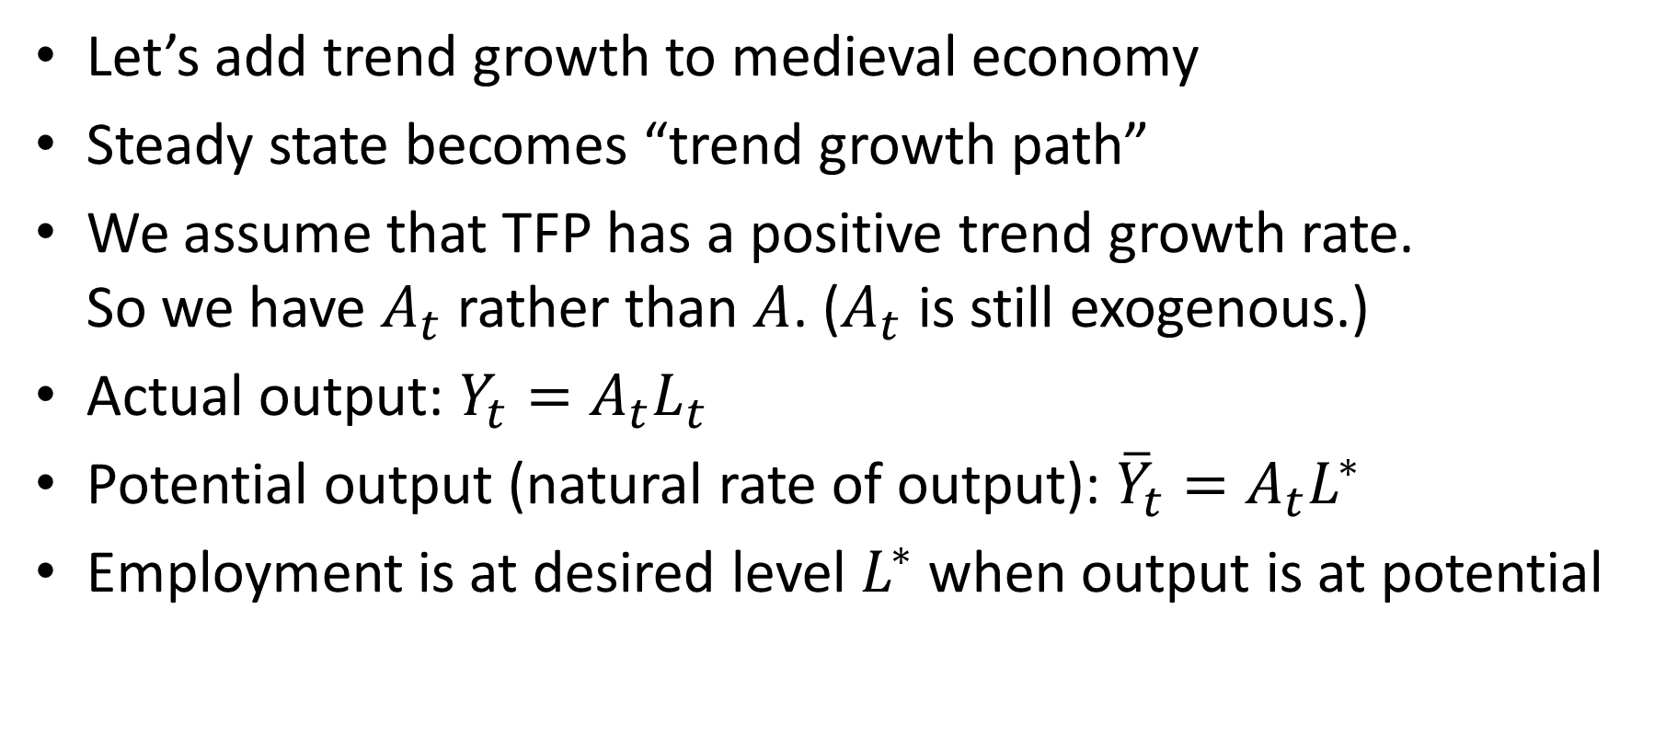
Add Trend Growth
Let’s add trend growth to medieval economy
Steady state becomes “trend growth path”
We assume that TFP has a positive trend growth rate. So we have $A_{t}$ rather than $A$. ($A_{t}$ is still exogenous.)
Actual output: $Y_{t}=A_{t}L_{t}$
Potential output (natural rate of output): ${\overline{Y}}_{t}=A_{t}L^{∗}$
Employment is at desired level $L^{∗}$ when output is at potential

Slide 11
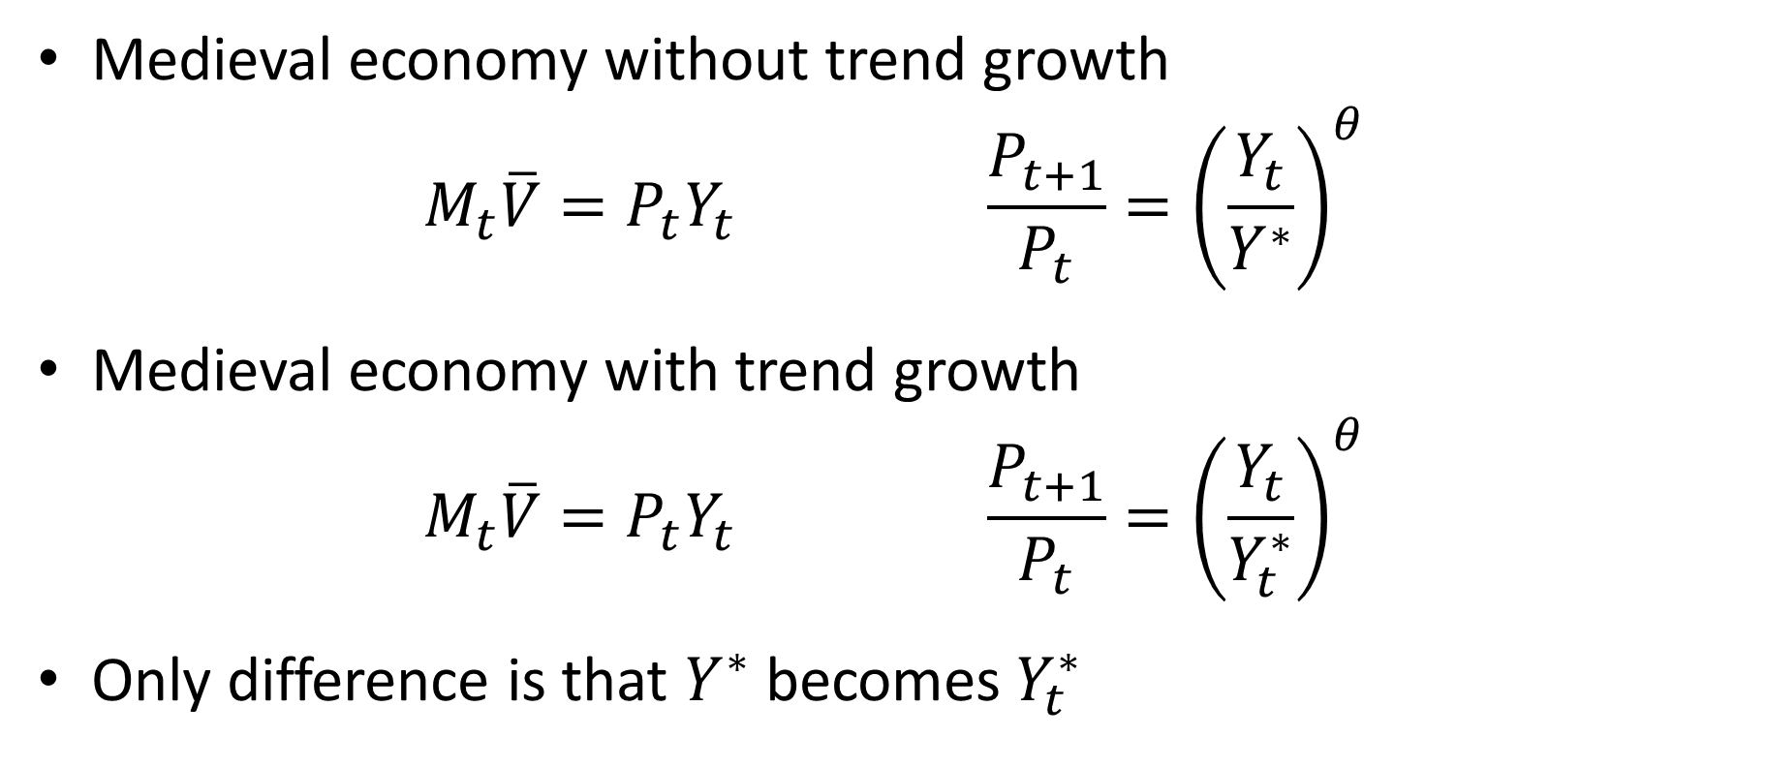
Medieval Economy with Trend Growth
Medieval economy without trend growth
$$M_{t}\overline{V}=P_{t}Y_{t} \frac{P_{t+1}}{P_{t}}={\left(\frac{Y_{t}}{Y^{∗}}\right)}^{θ}$$
Medieval economy with trend growth
$$M_{t}\overline{V}=P_{t}Y_{t} \frac{P_{t+1}}{P_{t}}={\left(\frac{Y_{t}}{Y_{t}^{∗}}\right)}^{θ}$$
Only difference is that $Y^{∗}$ becomes $Y_{t}^{∗}$

Slide 12
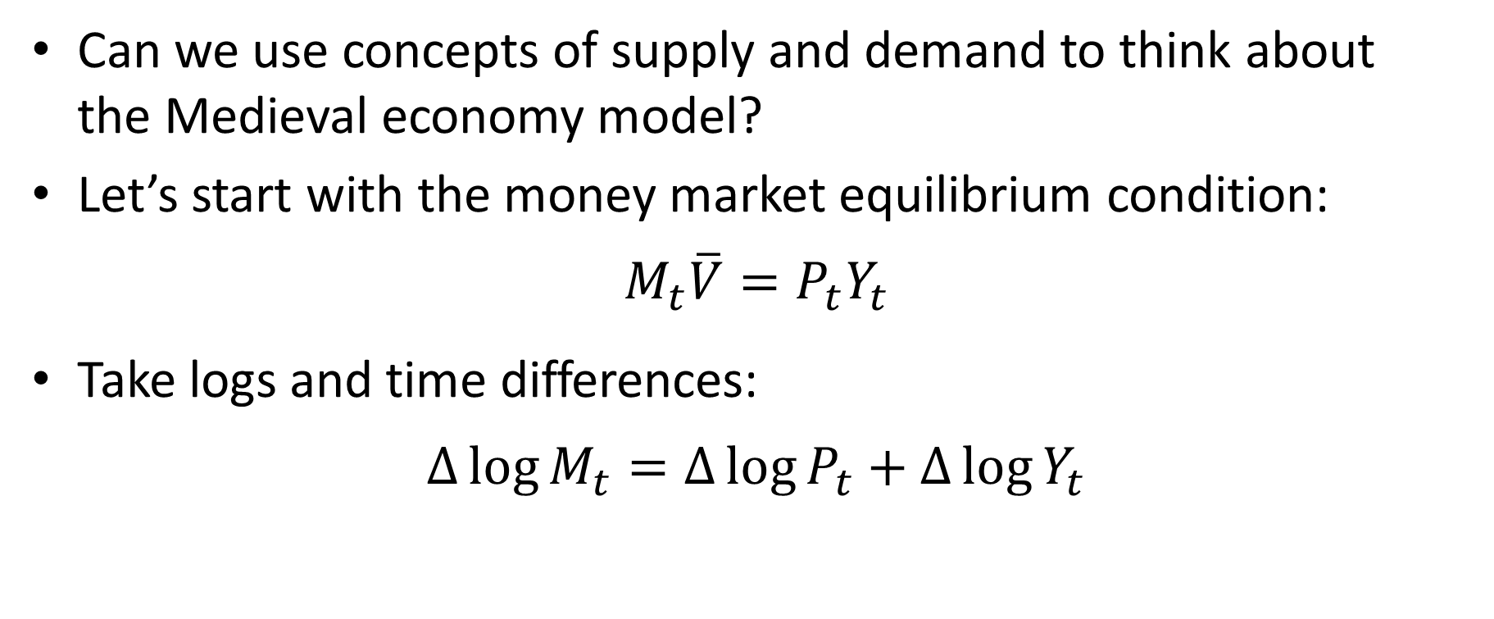
Business Cycle Model
Can we use concepts of supply and demand to think about the Medieval economy model?
Let’s start with the money market equilibrium condition:
$$M_{t}\overline{V}=P_{t}Y_{t}$$
Take logs and time differences:
$$∆\log{M_{t}}=∆\log{P_{t}}+∆\log{Y_{t}}$$

Slide 13
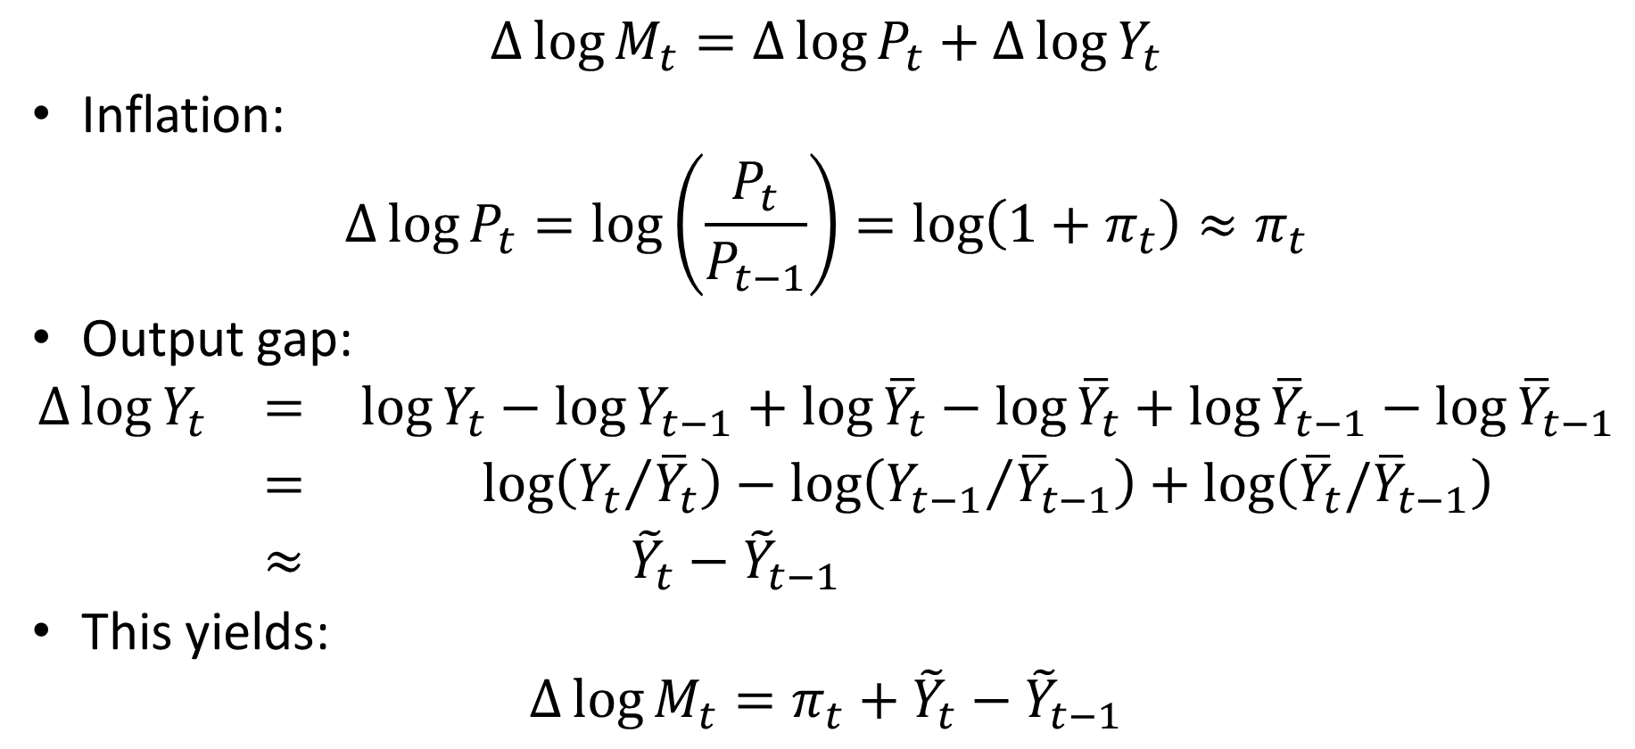
Money Market Equilibrium
$$∆\log{M_{t}}=∆\log{P_{t}}+∆\log{Y_{t}}$$
Inflation:
$$∆\log{P_{t}}=\log\left(\frac{P_{t}}{P_{t−1}}\right)=\log\left(1+π_{t}\right)≈π_{t}$$
Output gap:
$$\begin{matrix}∆\log{Y_{t}} & = & \log{Y_{t}}−\log{Y_{t−1}}+\log{{\overline{Y}}_{t}}−\log{{\overline{Y}}_{t}}+\log{{\overline{Y}}_{t−1}}−\log{{\overline{Y}}_{t−1}} \\ & = & \log\left({Y_{t}}/{{\overline{Y}}_{t}}\right)−\log\left({Y_{t−1}}/{{\overline{Y}}_{t−1}}\right)+\log\left({\overline{Y}}_{t}/{\overline{Y}}_{t−1}\right) \\ & ≈ & {\tilde{Y}}_{t}−{\tilde{Y}}_{t−1} \end{matrix}$$
This yields:
$$∆\log{M_{t}}=π_{t}+{\tilde{Y}}_{t}−{\tilde{Y}}_{t−1}$$
We drop this term. Think
of it as a constant that
doesn’t contribute anything
interesting to the analysis

Slide 14
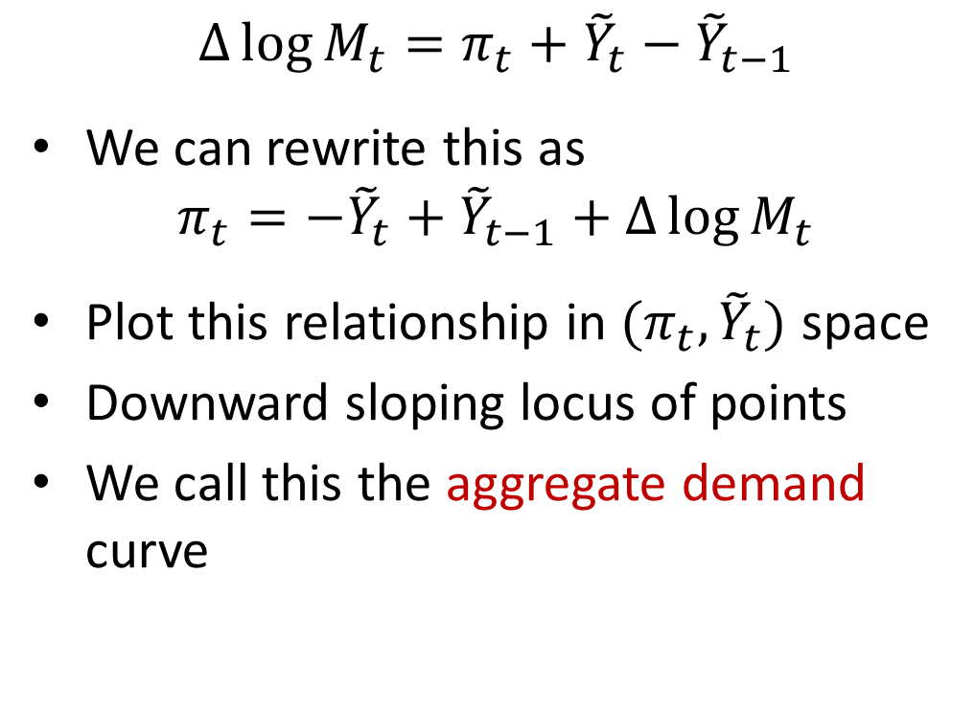
Money Market Equilibrium as Aggregate Demand
$$∆\log{M_{t}}=π_{t}+{\tilde{Y}}_{t}−{\tilde{Y}}_{t−1}$$
We can rewrite this as
$$π_{t}=−{\tilde{Y}}_{t}+{\tilde{Y}}_{t−1}+∆\log{M_{t}}$$
Plot this relationship in $(π_{t},{\tilde{Y}}_{t})$ space
Downward sloping locus of points
We call this the aggregate demand curve
Inflation
AD
Output gap

Slide 15
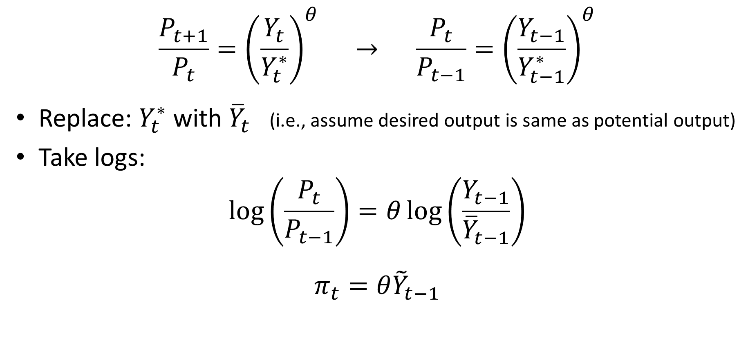
Price Setting Equation
$$\frac{P_{t+1}}{P_{t}}={\left(\frac{Y_{t}}{Y_{t}^{∗}}\right)}^{θ} → \frac{P_{t}}{P_{t−1}}={\left(\frac{Y_{t−1}}{Y_{t−1}^{∗}}\right)}^{θ}$$
Replace: $Y_{t}^{∗}$with ${\overline{Y}}_{t}$ (i.e., assume desired output is same as potential output)
Take logs:
$$\log\left(\frac{P_{t}}{P_{t−1}}\right)=θ\log\left(\frac{Y_{t−1}}{{\overline{Y}}_{t−1}}\right)$$
$$π_{t}=θ{\tilde{Y}}_{t−1}$$

Slide 16
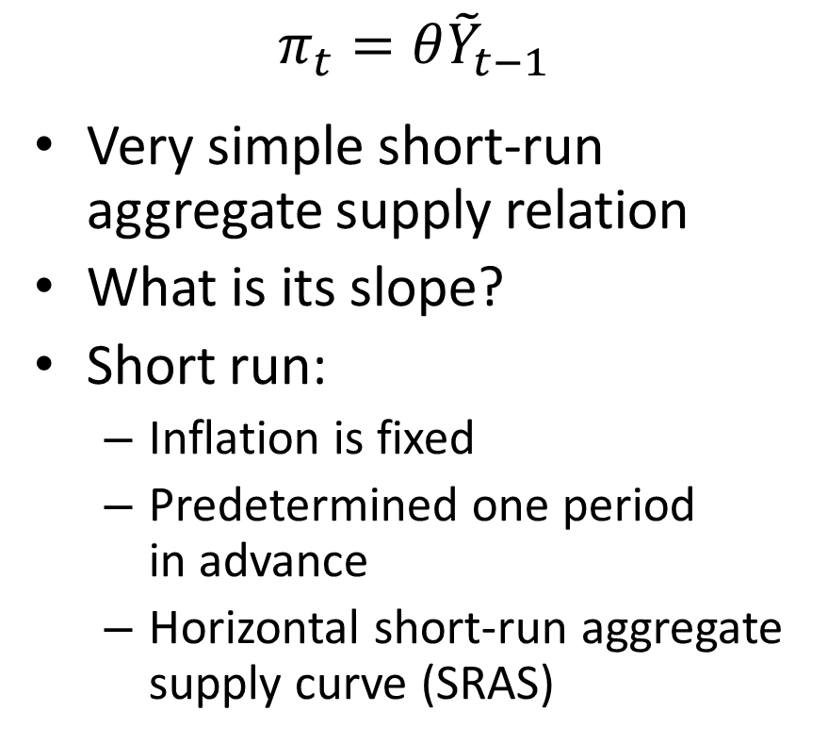
Short Run Aggregate Supply
$$π_{t}=θ{\tilde{Y}}_{t−1}$$
Very simple short-run aggregate supply relation
What is its slope?
Short run:
Inflation is fixed
Predetermined one period in advance
Horizontal short-run aggregate supply curve (SRAS)
Inflation
SRAS
Output gap

Slide 17


Short Run Equilibrium
Inflation
$$π_{t}$$
SRAS
AD
$${\tilde{Y}}_{t}$$
Output gap

Slide 18
Output Gap and Unemployment
Measuring output gap is tricky!
Trend productivity growth varies over time
Productivity slowdown in 1970s
Productivity speedup between 1995-2004
Hard to know exactly how to draw a trend line for output
Alternative: Look at unemployment

Slide 19
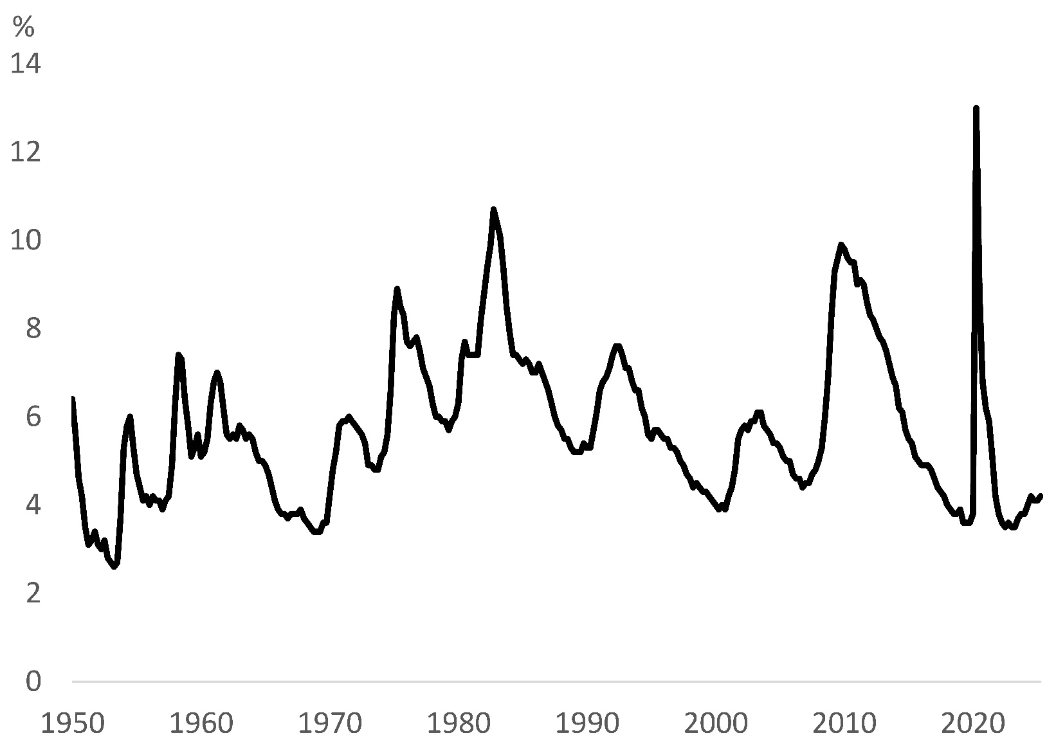
Unemployment Rate
Unemployment rate rises during recessions and falls during expansions
No trend
But what is the “natural rate” of unemployment?
Should we aim for zero unemployment?

Slide 20
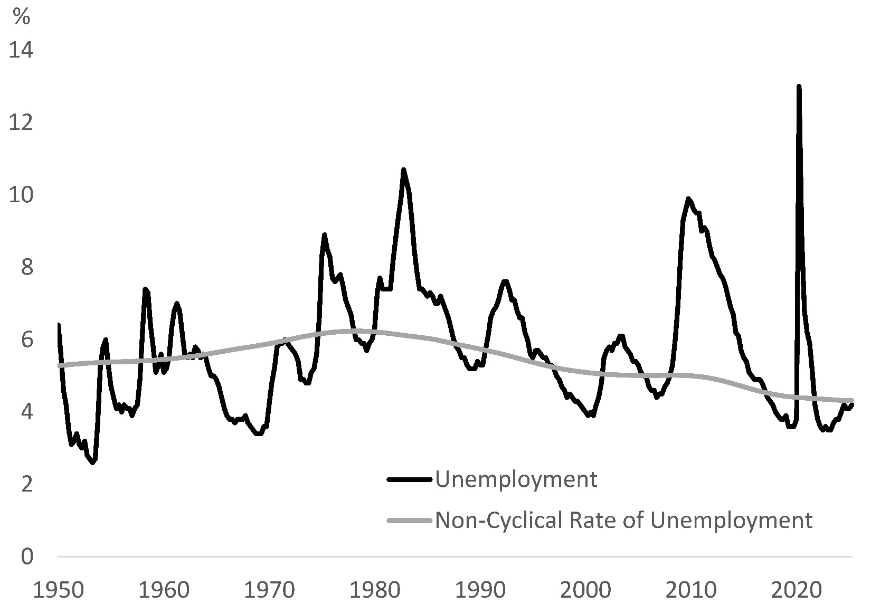
Natural Rate of Unemployment
People quit and are fired
Takes time for them to search for new jobs
Natural rate of unemployment reflects this “frictional” unemployment
Here I plot CBO estimate of “non-cyclical” unemployment
Is natural rate really that high?

Slide 21
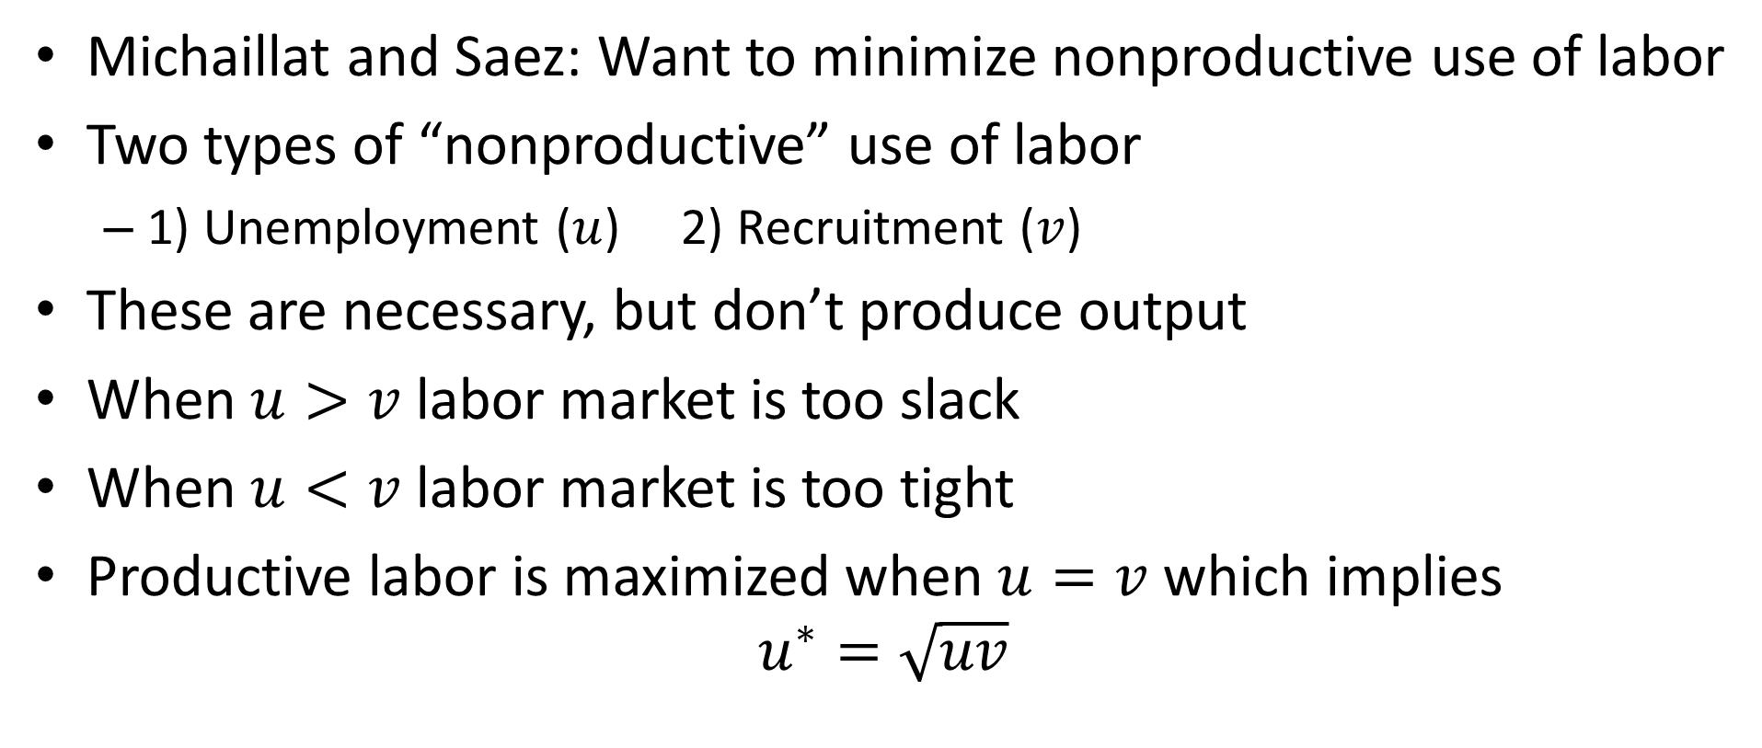
Full Employment Rate of Unemployment
Michaillat and Saez: Want to minimize nonproductive use of labor
Two types of “nonproductive” use of labor
1) Unemployment ($u$) 2) Recruitment ($v$)
These are necessary, but don’t produce output
When $u>v$ labor market is too slack
When $u<v$ labor market is too tight
Productive labor is maximized when $u=v$ which implies
$$u^{∗}=\sqrt{uv}$$

Slide 22
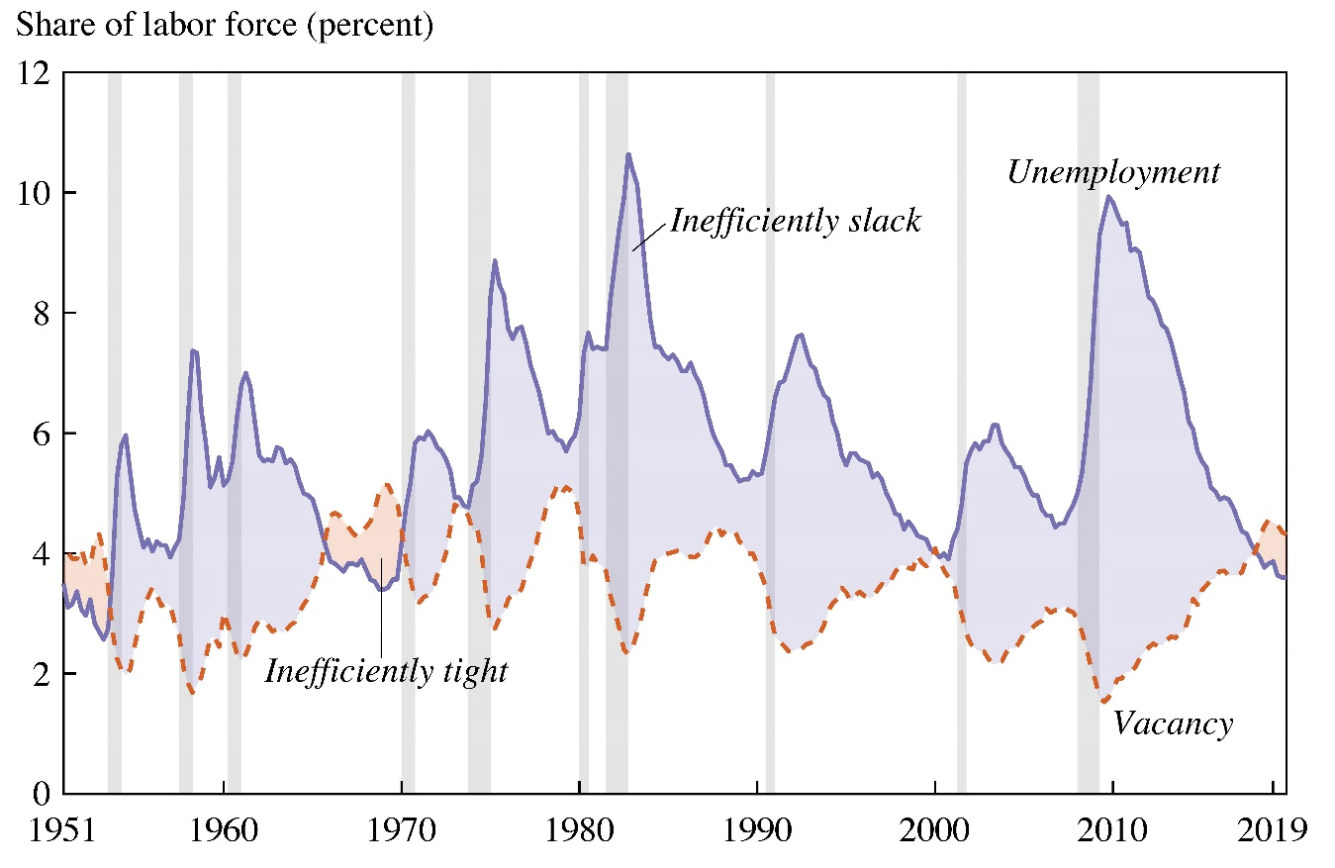
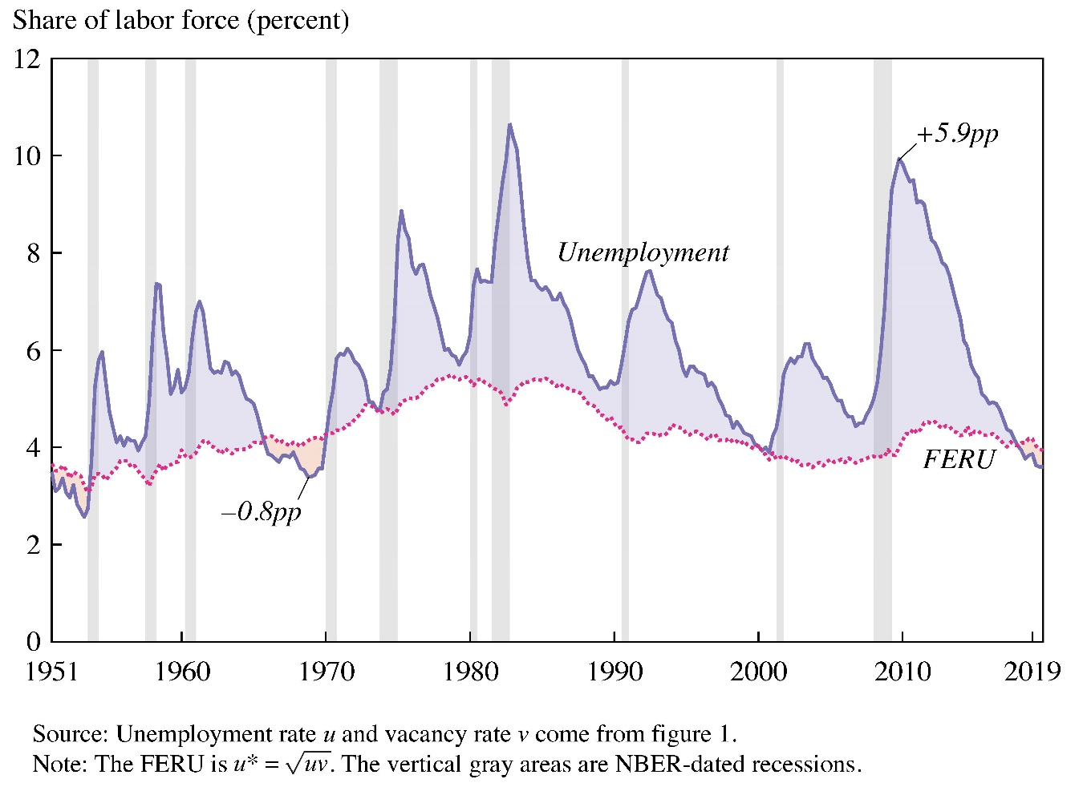
Full Employment Rate of Unemployment

Slide 23
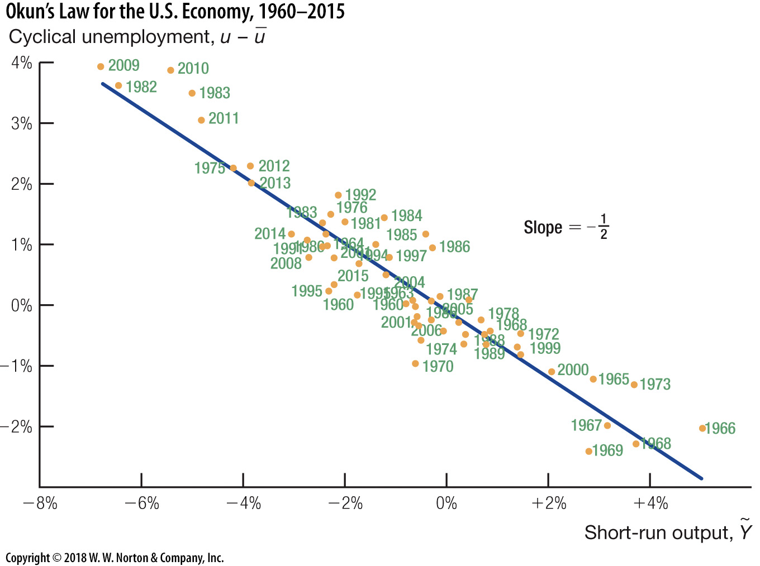
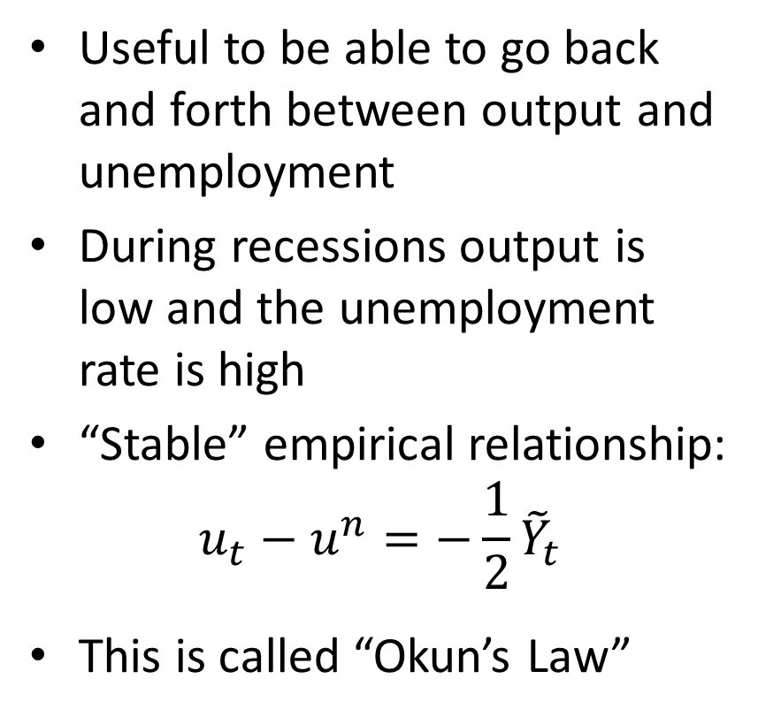
Okun’s Law
Useful to be able to go back and forth between output and unemployment
During recessions output is low and the unemployment rate is high
“Stable” empirical relationship:
$$u_{t}−u^{n}=−\frac{1}{2}{\tilde{Y}}_{t}$$
This is called “Okun’s Law”

