Slide 1
Lecture 13: Interest Rates and Money Demand: The LM Curve Macroeconomics (Quantitative) Economics 101B
Jón Steinsson
University of California, Berkeley

Slide 2
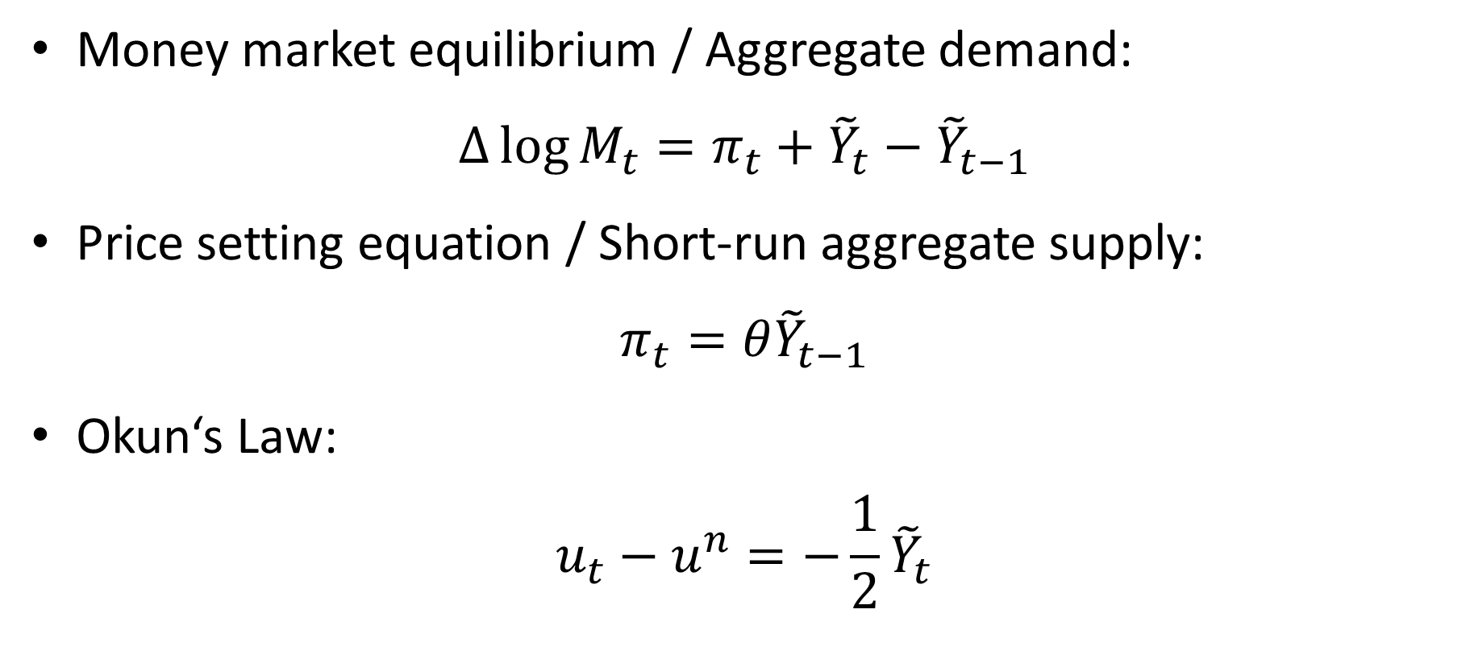
Where Do We Stand
Money market equilibrium / Aggregate demand:
$$∆\log{M_{t}}=π_{t}+{\tilde{Y}}_{t}−{\tilde{Y}}_{t−1}$$
Price setting equation / Short-run aggregate supply:
$$π_{t}=θ{\tilde{Y}}_{t−1}$$
Okun‘s Law:
$$u_{t}−u^{n}=−\frac{1}{2}{\tilde{Y}}_{t}$$

Slide 3
Next Step
Modernize our model of aggregate demand
In medieval model, aggregate demand depends only on money holdings. Rather simplistic.
Now we make demand depend on: Interest rates
But before we do that, we should discuss interest rates and asset returns

Slide 4
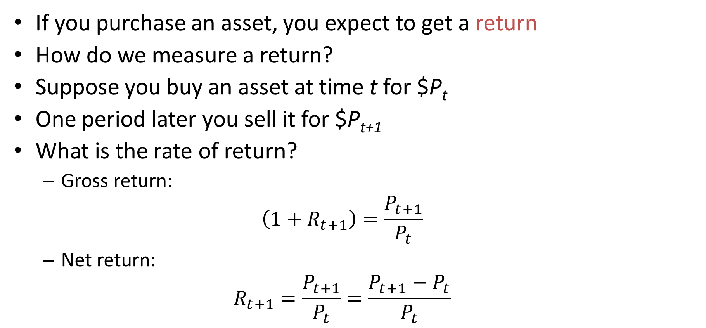
Asset Returns
If you purchase an asset, you expect to get a return
How do we measure a return?
Suppose you buy an asset at time t for $P_{t}
One period later you sell it for $P_{t+1}
What is the rate of return?
Gross return:
$$\left(1+R_{t+1}\right)=\frac{P_{t+1}}{P_{t}}$$
Net return:
$$R_{t+1}=\frac{P_{t+1}}{P_{t}}=\frac{P_{t+1}−P_{t}}{P_{t}}$$

Slide 5
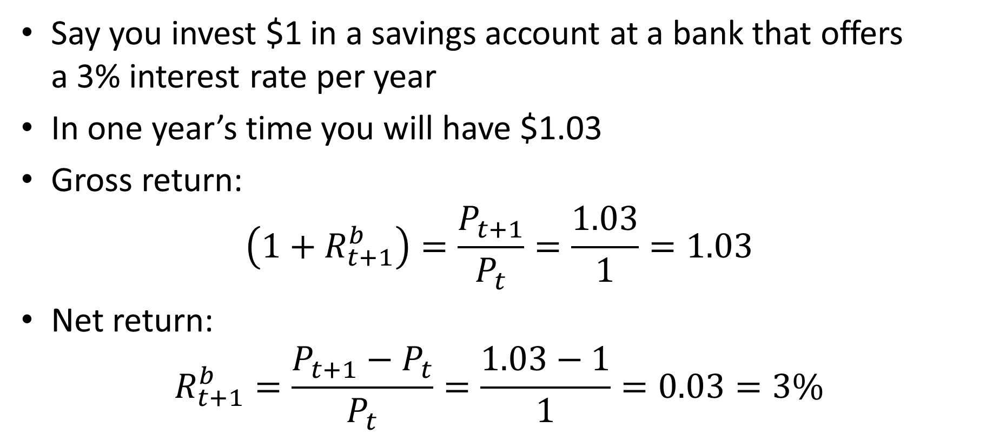
Interest Rate at the Bank
Say you invest $1 in a savings account at a bank that offers a 3% interest rate per year
In one year’s time you will have $1.03
Gross return:
$$\left(1+R_{t+1}^{b}\right)=\frac{P_{t+1}}{P_{t}}=\frac{1.03}{1}=1.03$$
Net return:
$$R_{t+1}^{b}=\frac{P_{t+1}−P_{t}}{P_{t}}=\frac{1.03−1}{1}=0.03=3\%$$

Slide 6
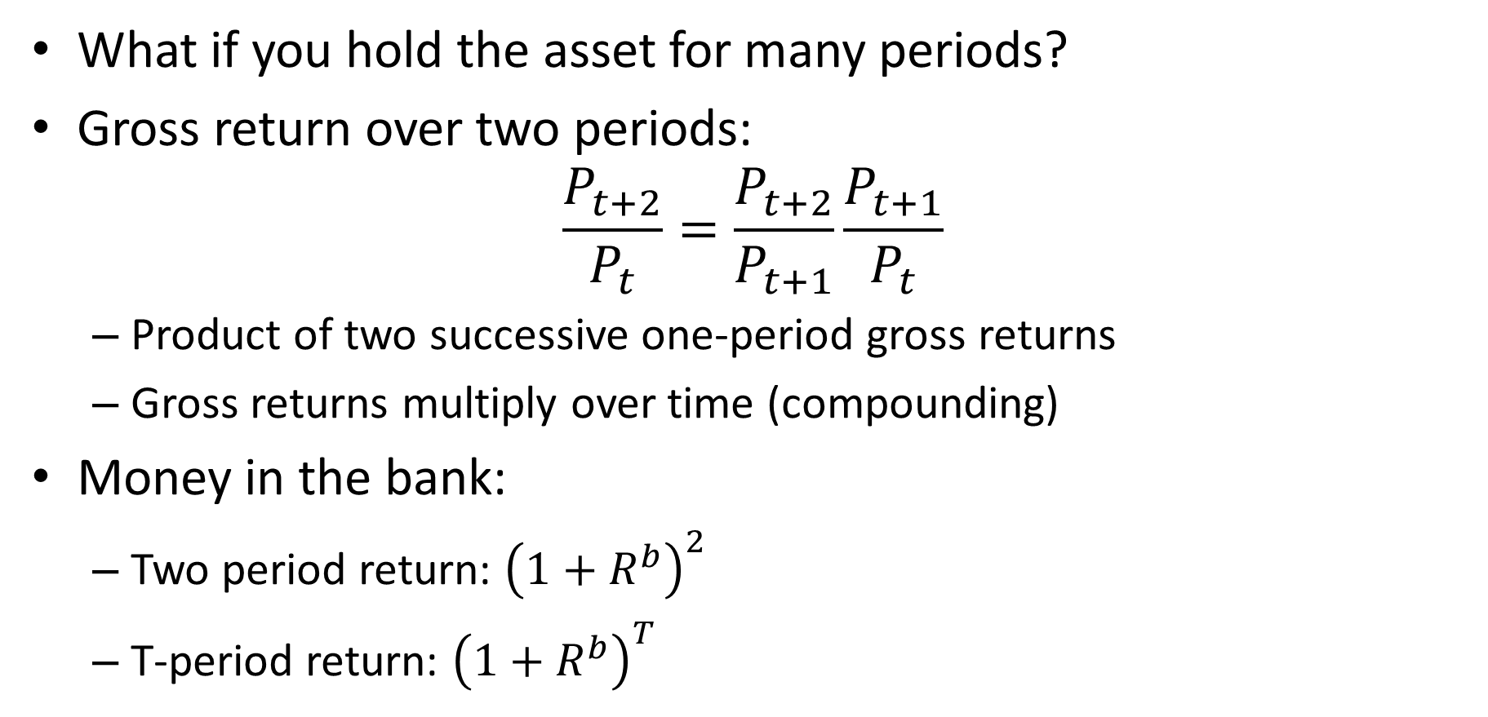
Returns over Many Periods
What if you hold the asset for many periods?
Gross return over two periods:
$$\frac{P_{t+2}}{P_{t}}=\frac{P_{t+2}}{P_{t+1}}\frac{P_{t+1}}{P_{t}}$$
Product of two successive one-period gross returns
Gross returns multiply over time (compounding)
Money in the bank:
Two period return: ${\left(1+R^{b}\right)}^{2}$
T-period return: ${\left(1+R^{b}\right)}^{T}$

Slide 7
Compound Interest
Suppose you had invested $100 in the stock market (S&P500) in January 1950 and held it until January 2025 reinvesting all dividends
In January 2025, you would have $26,568
This is a 7.72% compounded annual rate of return: 1.0772⁷⁵≈265
Simple interest: 75x$0.0772=$5.79
Compound interest is $265-$6=$259

Slide 8
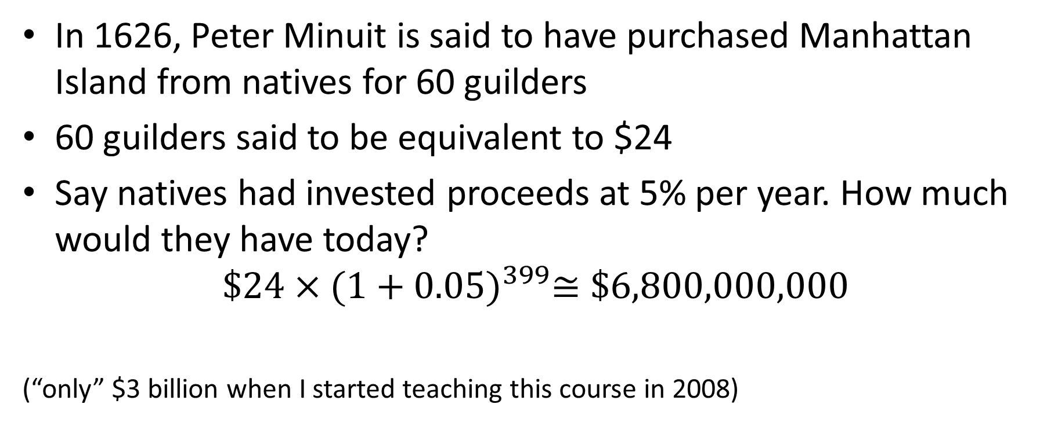
Power of Compound Interest
In 1626, Peter Minuit is said to have purchased Manhattan Island from natives for 60 guilders
60 guilders said to be equivalent to $24
Say natives had invested proceeds at 5% per year. How much would they have today?
$$\$24×{(1+0.05)}^{399}≅\$6,800,000,000$$
(“only” $3 billion when I started teaching this course in 2008)

Slide 9
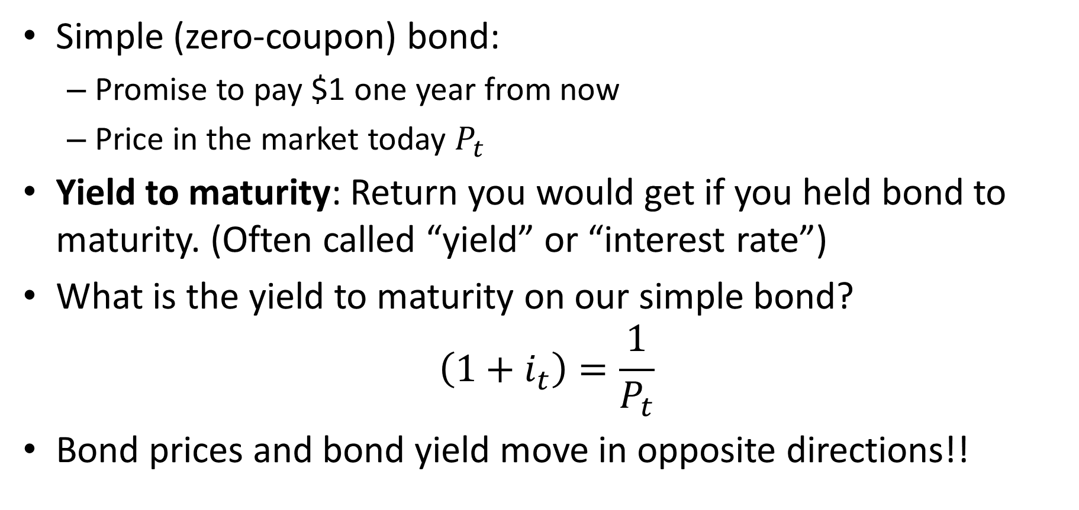
Interest Rates and Bond Prices
Simple (zero-coupon) bond:
Promise to pay $1 one year from now
Price in the market today $P_{t}$
Yield to maturity: Return you would get if you held bond to maturity. (Often called “yield” or “interest rate”)
What is the yield to maturity on our simple bond?
$$\left(1+i_{t}\right)=\frac{1}{P_{t}}$$
Bond prices and bond yield move in opposite directions!!

Slide 10
Nominal vs. Real Returns
Nominal returns:
Returns measured in dollars
Not “corrected” for inflation
Dollar today buys less “stuff” than a dollar did 10 years ago
Might be interested in returns in terms of “stuff”
Real returns:
Returns “corrected” for inflation
Prices of asset at different time deflated by overall price index for that time
Asset prices measured in “year 2020” dollars (for example)

Slide 11
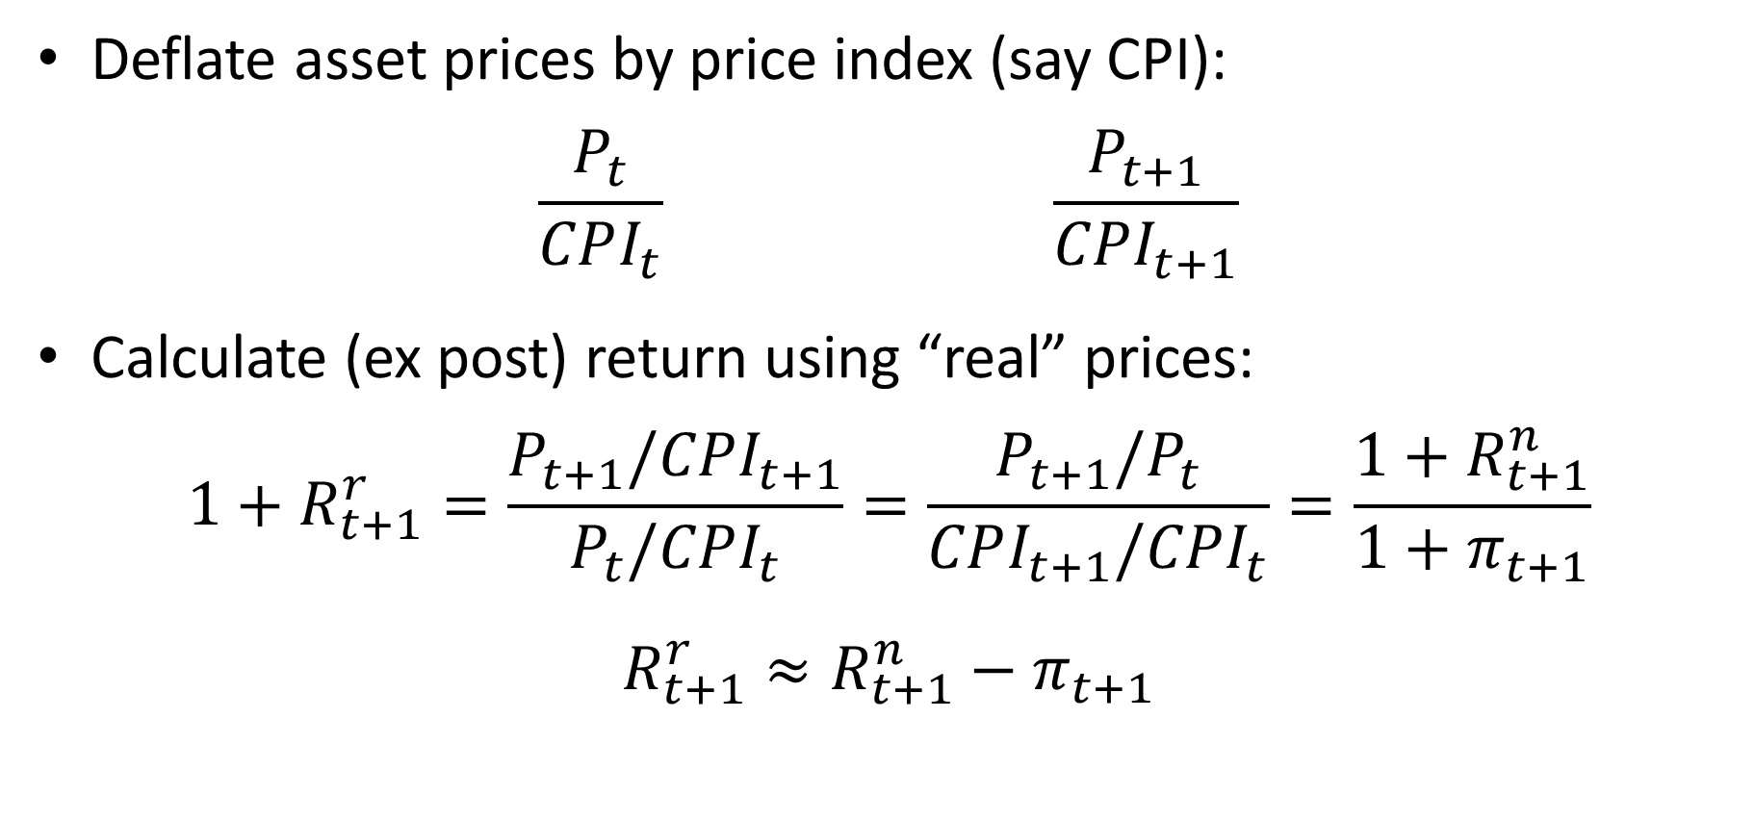
Real Returns
Deflate asset prices by price index (say CPI):
$$\frac{P_{t}}{CPI_{t}} \frac{P_{t+1}}{CPI_{t+1}}$$
Calculate (ex post) return using “real” prices:
$$1+R_{t+1}^{r}=\frac{P_{t+1}/CPI_{t+1}}{P_{t}/CPI_{t}}=\frac{P_{t+1}/P_{t}}{CPI_{t+1}/CPI_{t}}=\frac{1+R_{t+1}^{n}}{1+π_{t+1}}$$
$$R_{t+1}^{r}≈R_{t+1}^{n}−π_{t+1}$$

Slide 13
$175,000
$17,700

Slide 14
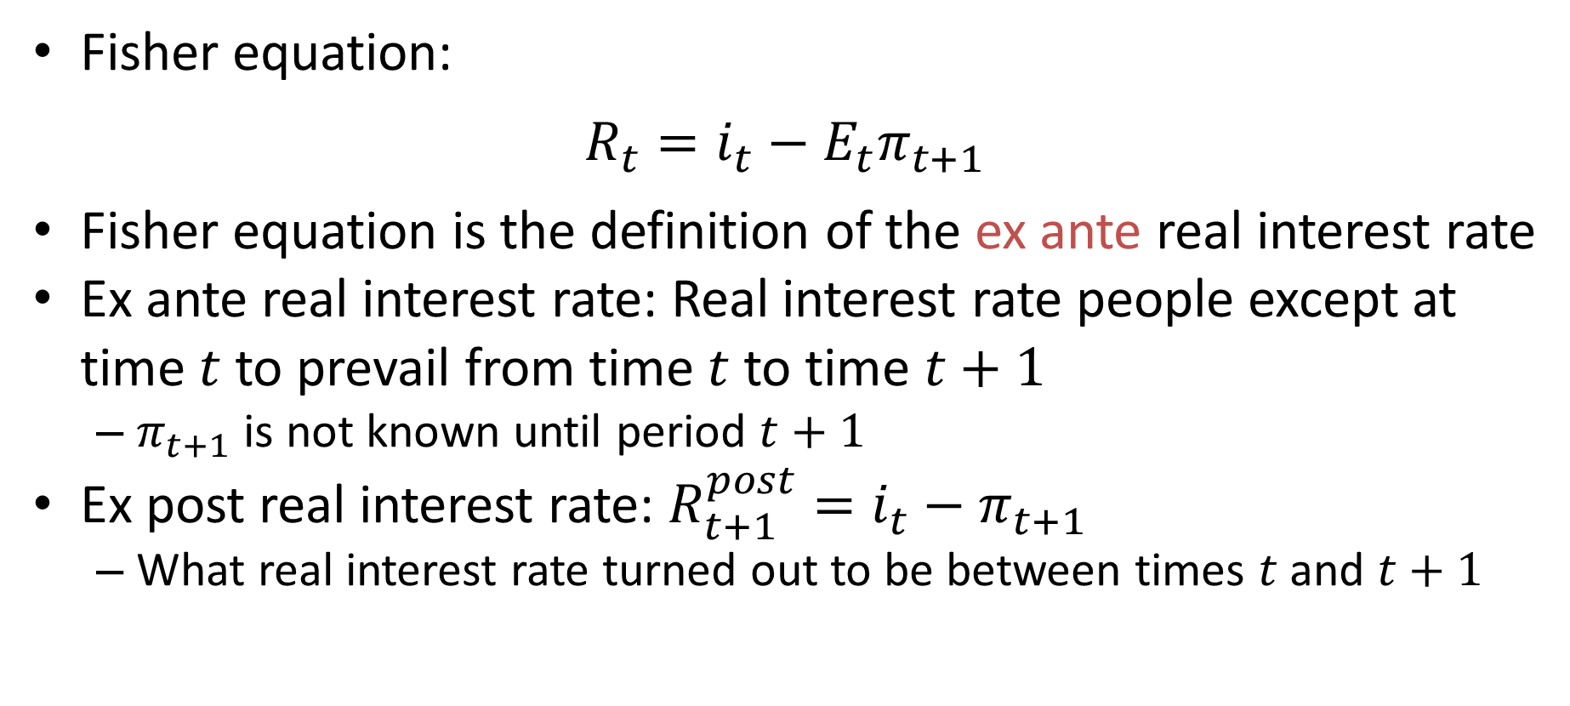
Fisher Equation
Fisher equation:
$$R_{t}=i_{t}−E_{t}π_{t+1}$$
Fisher equation is the definition of the ex ante real interest rate
Ex ante real interest rate: Real interest rate people except at time $t$ to prevail from time $t$ to time $t+1$
$π_{t+1}$ is not known until period $t+1$
Ex post real interest rate: $R_{t+1}^{post}=i_{t}−π_{t+1}$
What real interest rate turned out to be between times $t$ and $t+1$

Slide 15
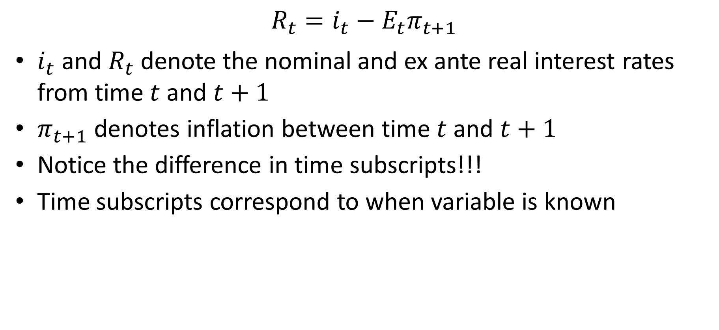
Tricky Notation
$$R_{t}=i_{t}−E_{t}π_{t+1}$$
$i_{t}$ and $R_{t}$ denote the nominal and ex ante real interest rates from time $t$ and $t+1$
$π_{t+1}$ denotes inflation between time $t$ and $t+1$
Notice the difference in time subscripts!!!
Time subscripts correspond to when variable is known

Slide 16
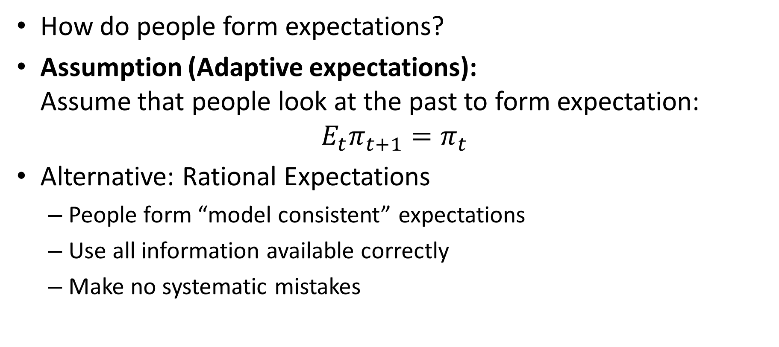
Expectations Formation
How do people form expectations?
Assumption (Adaptive expectations): Assume that people look at the past to form expectation:
$$E_{t}π_{t+1}=π_{t}$$
Alternative: Rational Expectations
People form “model consistent” expectations
Use all information available correctly
Make no systematic mistakes

Slide 17

Real Interest Rate
Ex ante real interest rate
$$R_{t}=i_{t}−E_{t}π_{t+1}$$
With adaptive expectations, this becomes
$$R_{t}=i_{t}−π_{t}$$

Slide 18
Real versus Nominal
The difference between real and nominal is a crucial aspect of being reasonably informed about macro events
Common to see people confused about this:
E.g.: “Interest rates have trended down for thirty years. Why hasn’t investment surged?”
Or: “We earned much higher returns in the 1970’s than now”

Slide 20
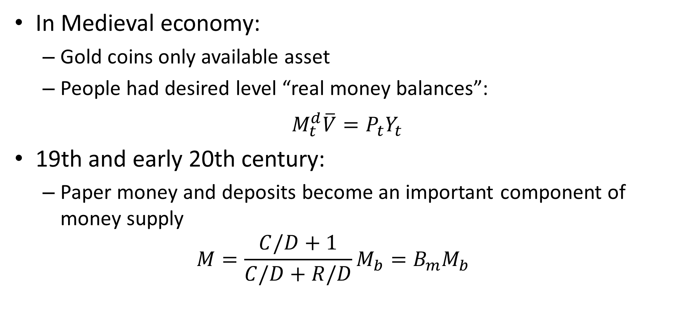
Modernizing Money Demand
In Medieval economy:
Gold coins only available asset
People had desired level “real money balances”:
$$M_{t}^{d}\overline{V}=P_{t}Y_{t}$$
19th and early 20th century:
Paper money and deposits become an important component of money supply
$$M=\frac{C/D+1}{C/D+R/D}M_{b}=B_{m}M_{b}$$

Slide 21
Modernizing Money Demand
People have access to other stores of value than money
Face a trade-off between holding money and other stores of value such as real estate, stocks, bond, etc.
What is the nature of this trade-off?
What are the benefits of holding money relative to other assets?
What are the costs of holding money relative to other assets?

Slide 22
Modernizing Money Demand
Benefits of holding money:
Money is more “liquid”
I.e., more convenient for making payments
Cost of holding money:
Money does not pay interest (or pays less interest)
Stocks, bonds, real estate have higher average returns than checking accounts

Slide 23
Modernizing Money Demand
Consider the trade-off between bonds and money
The nominal interest rate is the opportunity cost of holding money
The higher is the nominal interest rate, the lower is demand for money
We need to incorporate nominal interest rate into our model of money demand

Slide 24
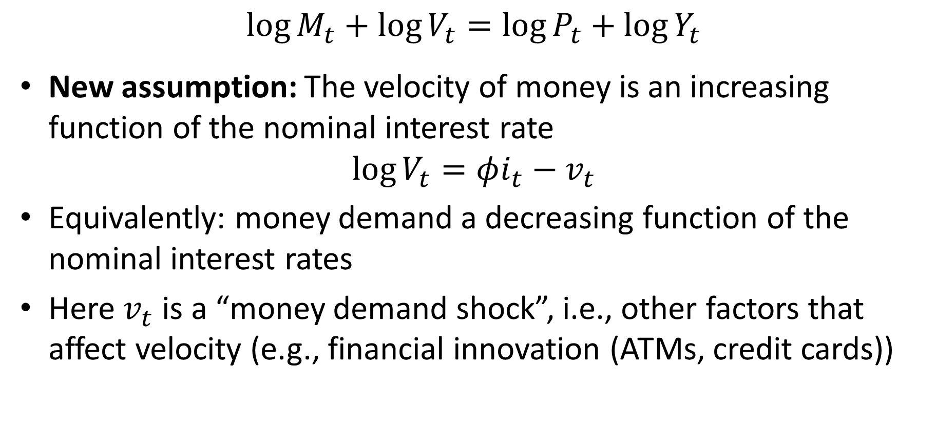
Modernizing Money Demand
$$\log{M_{t}}+\log{V_{t}}=\log{P_{t}}+\log{Y_{t}}$$
New assumption: The velocity of money is an increasing function of the nominal interest rate
$$\log{V_{t}}=φi_{t}−v_{t}$$
Equivalently: money demand a decreasing function of the nominal interest rates
Here $v_{t}$ is a “money demand shock”, i.e., other factors that affect velocity (e.g., financial innovation (ATMs, credit cards))

Slide 25
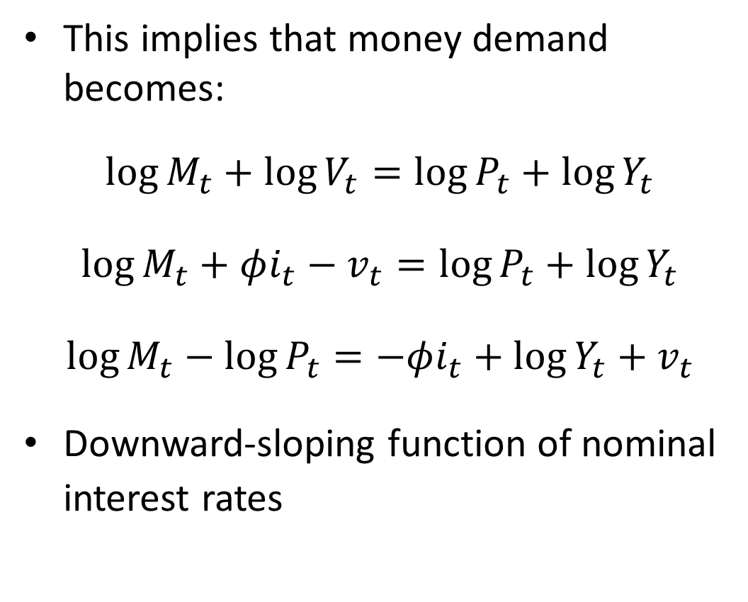
Modern Money Demand
This implies that money demand becomes:
$$\log{M_{t}}+\log{V_{t}}=\log{P_{t}}+\log{Y_{t}}$$
$$\log{M_{t}}+φi_{t}−v_{t}=\log{P_{t}}+\log{Y_{t}}$$
$$\log{M_{t}}−\log{P_{t}}=−φi_{t}+\log{Y_{t}}+v_{t}$$
Downward-sloping function of nominal interest rates
Nominal Interest rate
M^{d}
Money

Slide 26
Money Supply
Modern economy: Central bank can vary the money supply at will
In particular: Central Bank can set money supply at each point in time to achieve any interest rate it desires
Central bank can effectively control the nominal interest rate by varying money supply
Nominal Interest rate
i₁
i₂
M^{d}
M₁
M₂
Money

Slide 27
Money Demand Shocks
Money demand shocks shift the money demand curve
Unless central bank offsets this, will affect interest rate
In 19th century, interest rates would rise during harvest time due to increase in money demand
No central bank to offset
Money supply not “elastic”
Nominal Interest rate
M^{s}
i₂
i₁
M^{d’}
M^{d}
Money

Slide 28
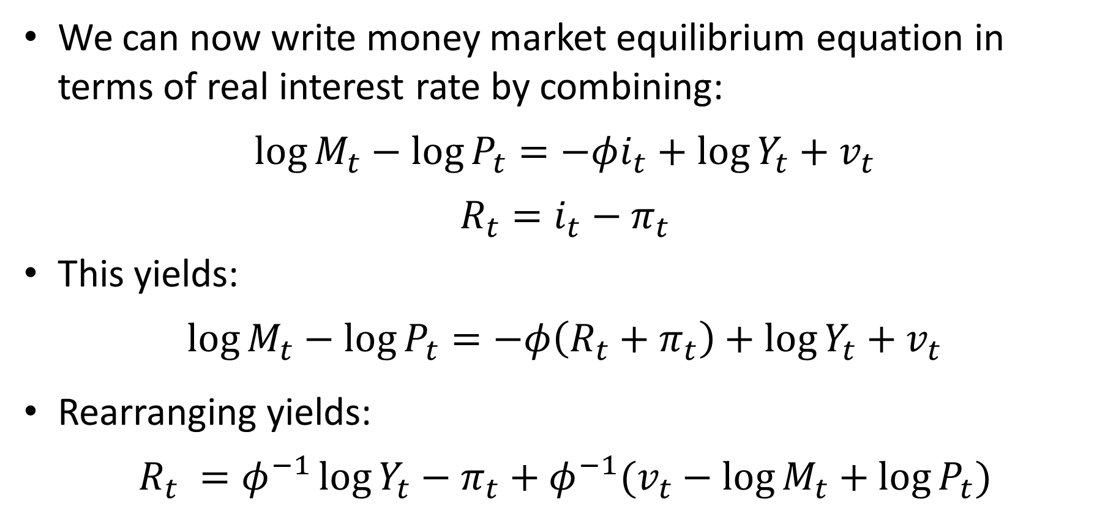
Money Market Equilibrium
We can now write money market equilibrium equation in terms of real interest rate by combining:
$$\log{M_{t}}−\log{P_{t}}=−φi_{t}+\log{Y_{t}}+v_{t}$$
$$R_{t}=i_{t}−π_{t}$$
This yields:
$$\log{M_{t}}−\log{P_{t}}=−φ\left(R_{t}+π_{t}\right)+\log{Y_{t}}+v_{t}$$
Rearranging yields:
$$R_{t} =φ^{−1}\log{Y_{t}}−π_{t}+φ^{−1}(v_{t}−\log{M_{t}}+\log{P_{t}})$$

Slide 29
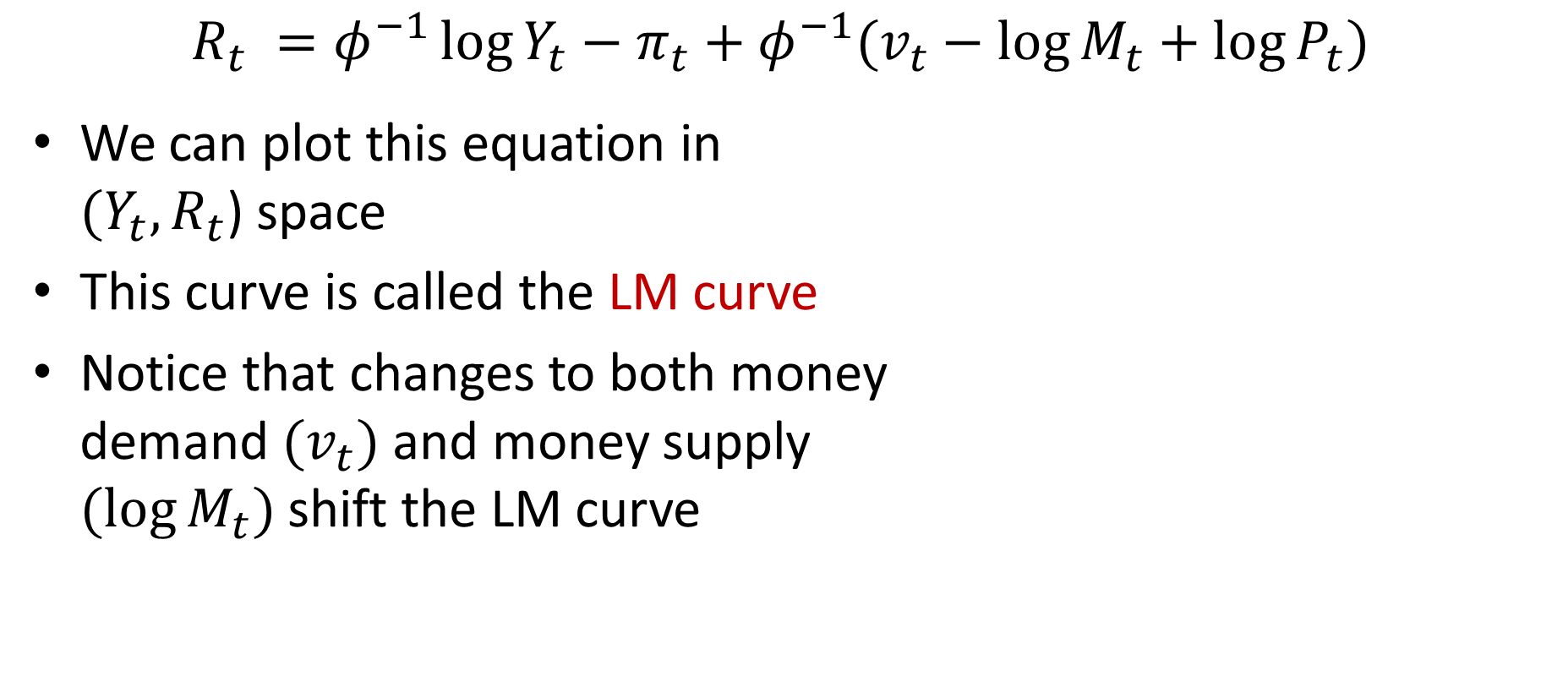
LM Curve
$$R_{t} =φ^{−1}\log{Y_{t}}−π_{t}+φ^{−1}(v_{t}−\log{M_{t}}+\log{P_{t}})$$
We can plot this equation in $(Y_{t},R_{t}$) space
This curve is called the LM curve
Notice that changes to both money demand $(v_{t})$ and money supply $(\log{M_{t}})$ shift the LM curve
R
LM
Y

