Slide 1
Lecture 14: Interest Rates and the Goods Market Macroeconomics (Quantitative) Economics 101B
Jón Steinsson
University of California, Berkeley

Slide 2
Keynes’ Consumption Function
Keynes (1936, p. 96):
“The fundamental psychological law, upon which we are entitled to depend with great confidence both a priori and from our knowledge of human nature and from detailed facts of experience, is that men are disposed, as a rule and on average, to increase their consumption as their income increases, but not by as much as the increase in their income.”

Slide 3
Keynes’ Consumption Function
Keynes (1936, p. 93-94):
“The usual type of short-period fluctuation in the rate of interest is not likely, however, to have much direct influence on spending either way. There are not many people who will alter their way of living because the rate of interest has fallen from 5 to 4 per cent, if their aggregate income is the same as before.”

Slide 4
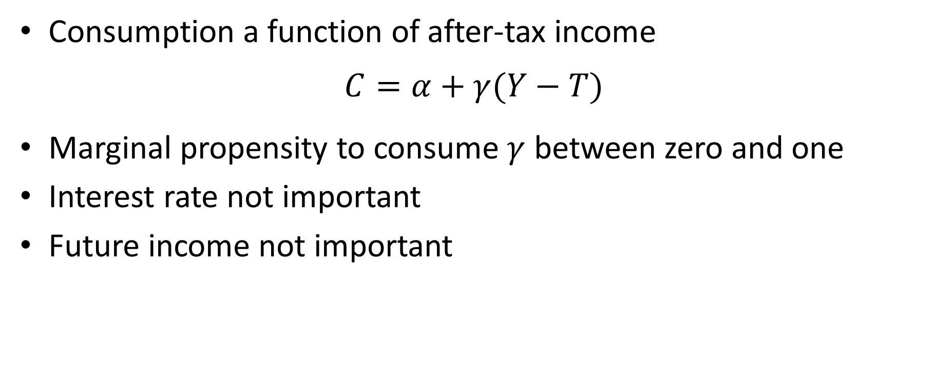
Keynes’ Consumption Function
Consumption a function of after-tax income
$$C=α+γ(Y−T)$$
Marginal propensity to consume $γ$ between zero and one
Interest rate not important
Future income not important

Slide 5
Introspection about Consumption
Suppose you received a surprise one-time $1,000 scholarship
How much would you spend within a year? (on goods and services, not paying down debt)
How about a one-time $10,000 scholarship?
How about a one-time $100,000 scholarship?

Slide 6
Introspection about Consumption
Suppose interest rate rose by 1 percentage point
How much more would you save over a year as a fraction of your annual consumption?

Slide 7
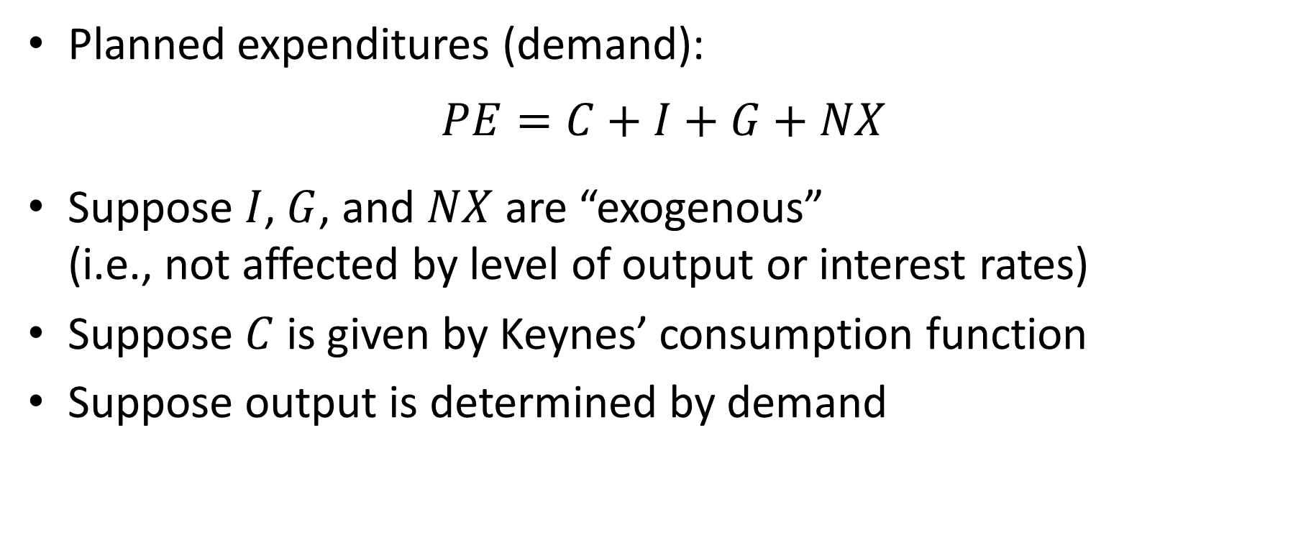
Keynesian Cross
Planned expenditures (demand):
$$PE=C+I+G+NX$$
Suppose $I$, $G$, and $NX$ are “exogenous” (i.e., not affected by level of output or interest rates)
Suppose $C$ is given by Keynes’ consumption function
Suppose output is determined by demand

Slide 8
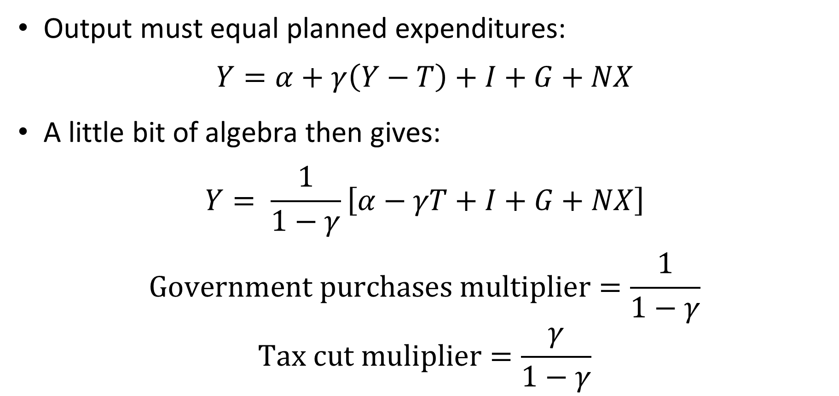
Keynesian Cross
Output must equal planned expenditures:
$$Y=α+γ\left(Y−T\right)+I+G+NX$$
A little bit of algebra then gives:
$$Y= \frac{1}{1−γ}\left[α−γT+I+G+NX\right]$$
$$\text{Government} \text{purchases} \text{multiplier}=\frac{1}{1−γ}$$
$$\text{Tax} \text{cut} \text{muliplier}=\frac{γ}{1−γ}$$

Slide 9
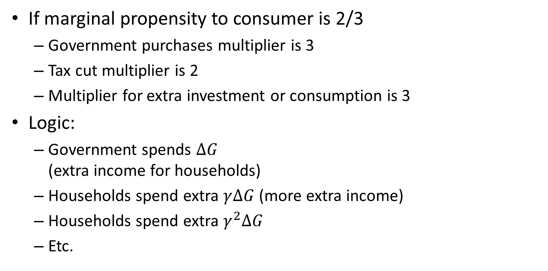
Keynesian Cross
If marginal propensity to consumer is 2/3
Government purchases multiplier is 3
Tax cut multiplier is 2
Multiplier for extra investment or consumption is 3
Logic:
Government spends $∆G$ (extra income for households)
Households spend extra $γ∆G$ (more extra income)
Households spend extra $γ^{2}∆G$
Etc.

Slide 10
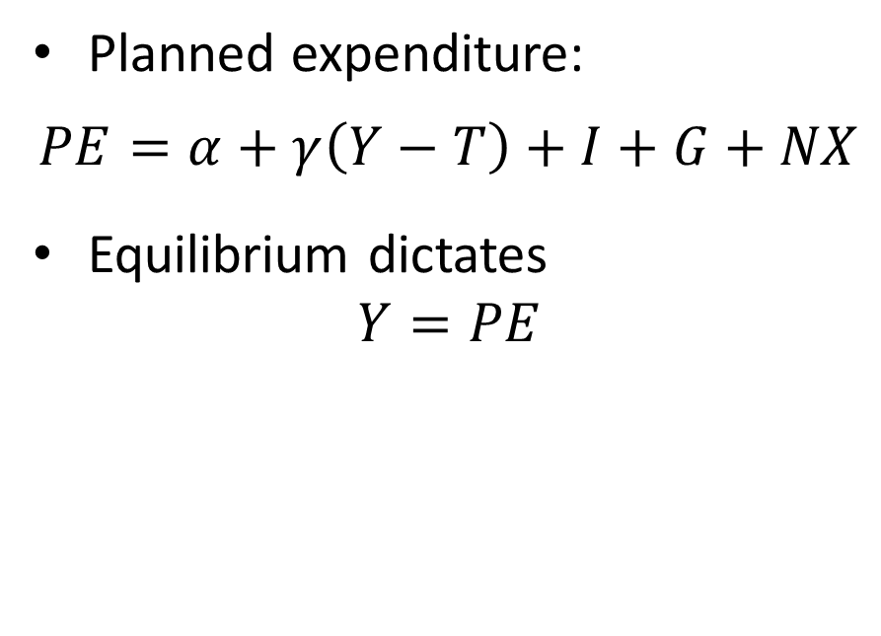
Keynesian Cross
Planned
Expenditures
Planned expenditure:
$$PE=α+γ\left(Y−T\right)+I+G+NX$$
Equilibrium dictates
$$Y=PE$$
C
B
A
45°
Output

Slide 11
Keynesian Cross
Keynesian economics in its simplest form
Very strong assumptions:
Consumption and investment not affected by interest rates (or future income)
Prices not affected by changes in output
We next consider a slightly more sophisticated version, where demand depends on the interest rate

Slide 12
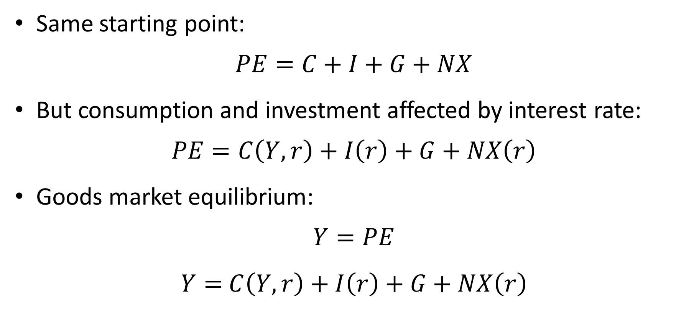
The IS Curve
Same starting point:
$$PE=C+I+G+NX$$
But consumption and investment affected by interest rate:
$$PE=C\left(Y,r\right)+I\left(r\right)+G+NX\left(r\right)$$
Goods market equilibrium:
$$Y=PE$$
$Y=$ $C\left(Y,r\right)+I\left(r\right)+G+NX\left(r\right)$

Slide 13
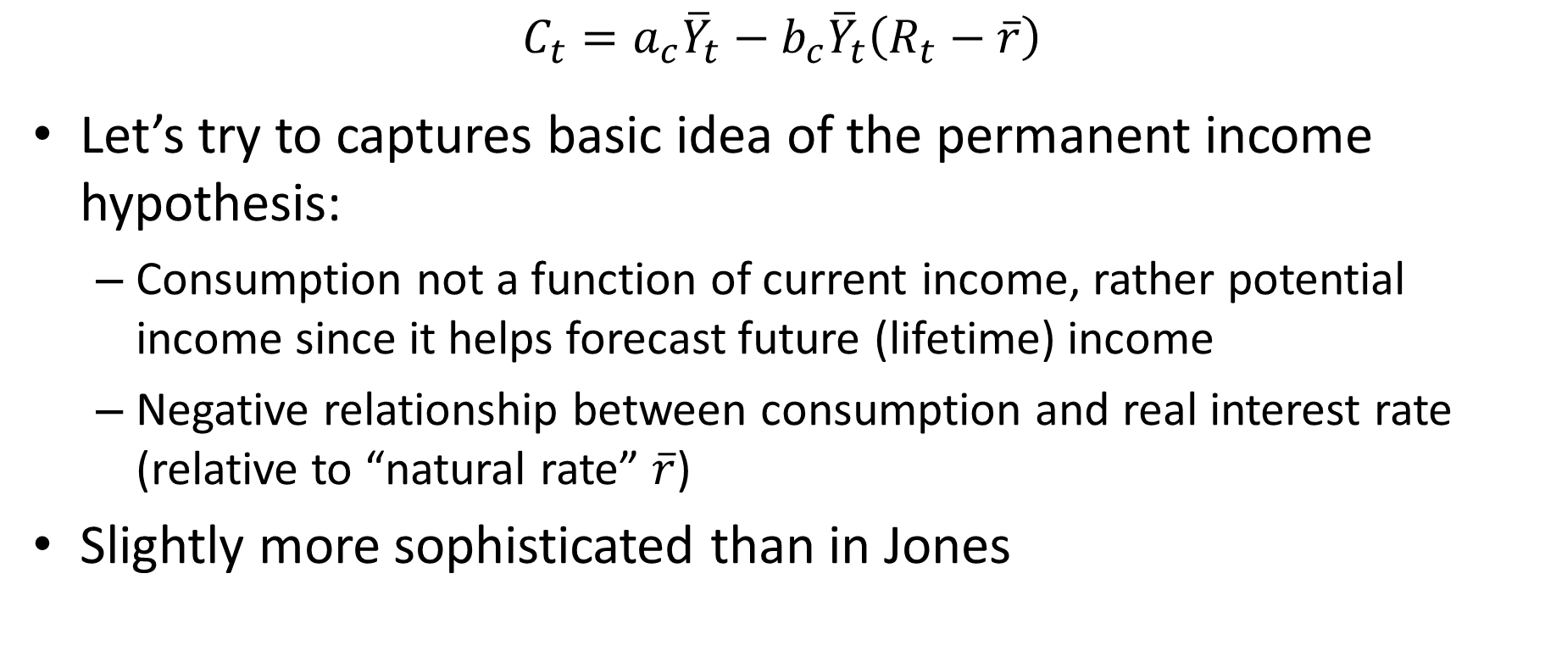
Consumption
$$C_{t}=a_{c}{\overline{Y}}_{t}−b_{c}{\overline{Y}}_{t}\left(R_{t}−\overline{r}\right)$$
Let’s try to captures basic idea of the permanent income hypothesis:
Consumption not a function of current income, rather potential income since it helps forecast future (lifetime) income
Negative relationship between consumption and real interest rate (relative to “natural rate” $\overline{r}$)
Slightly more sophisticated than in Jones

Slide 14
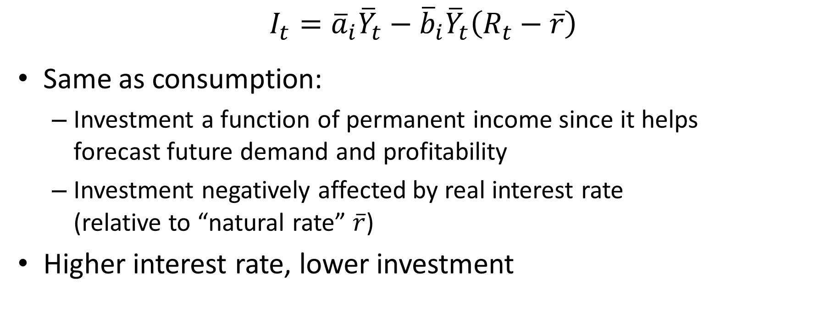
Investment
$$I_{t}={\overline{a}}_{i}{\overline{Y}}_{t}−{\overline{b}}_{i}{\overline{Y}}_{t}\left(R_{t}−\overline{r}\right)$$
Same as consumption:
Investment a function of permanent income since it helps forecast future demand and profitability
Investment negatively affected by real interest rate (relative to “natural rate” $\overline{r}$)
Higher interest rate, lower investment

Slide 15
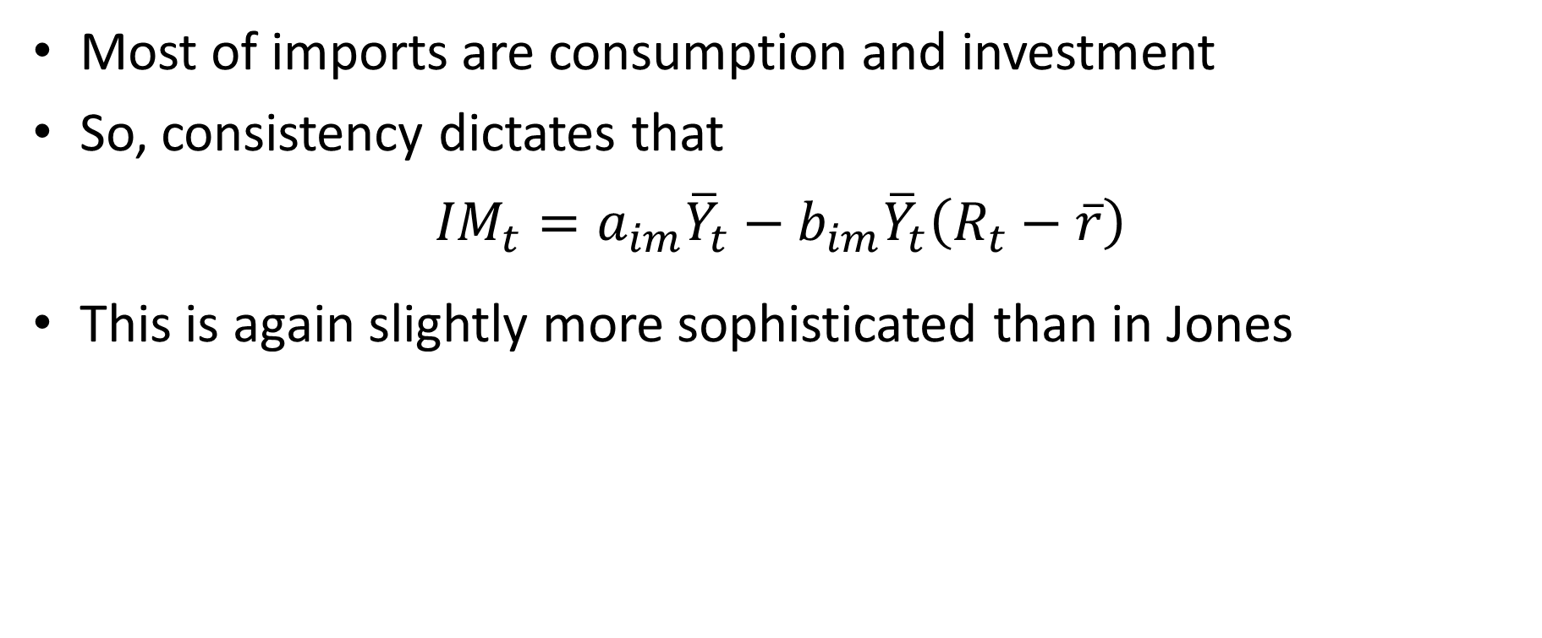
Imports
Most of imports are consumption and investment
So, consistency dictates that
$${IM}_{t}=a_{im}{\overline{Y}}_{t}−b_{im}{\overline{Y}}_{t}\left(R_{t}−\overline{r}\right)$$
This is again slightly more sophisticated than in Jones

Slide 16

Government Spending and Exports
Government spending:
Assumed to be exogenous
$$G_{t}={\overline{a}}_{g}{\overline{Y}}_{t}$$
Exports:
Assumed to be exogenous
$${EX}_{t}={\overline{a}}_{ex}{\overline{Y}}_{t}$$

Slide 17
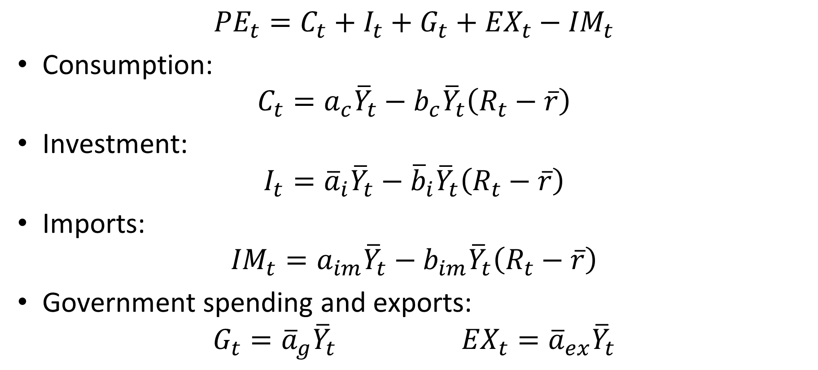
Planned Expenditure
$${PE}_{t}=C_{t}+I_{t}+G_{t}+{EX}_{t}−{IM}_{t}$$
Consumption:
$$C_{t}=a_{c}{\overline{Y}}_{t}−b_{c}{\overline{Y}}_{t}\left(R_{t}−\overline{r}\right)$$
Investment:
$$I_{t}={\overline{a}}_{i}{\overline{Y}}_{t}−{\overline{b}}_{i}{\overline{Y}}_{t}\left(R_{t}−\overline{r}\right)$$
Imports:
$${IM}_{t}=a_{im}{\overline{Y}}_{t}−b_{im}{\overline{Y}}_{t}\left(R_{t}−\overline{r}\right)$$
Government spending and exports:
$$G_{t}={\overline{a}}_{g}{\overline{Y}}_{t} {EX}_{t}={\overline{a}}_{ex}{\overline{Y}}_{t}$$

Slide 18
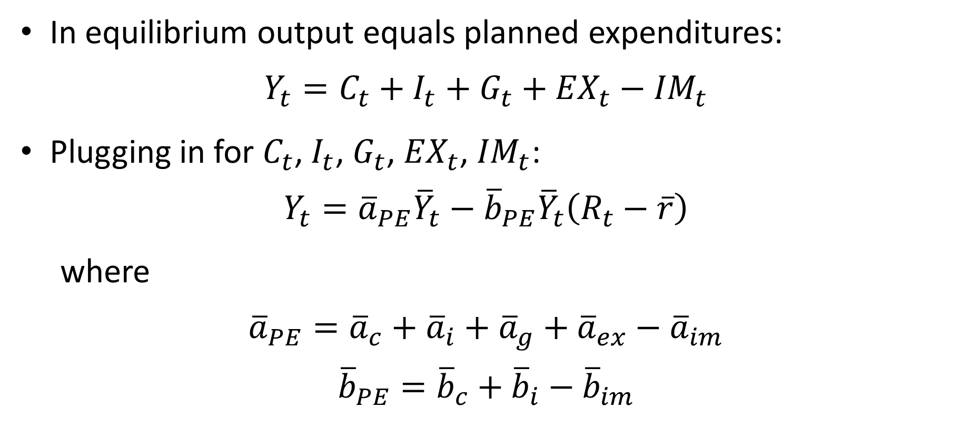
IS Curve
In equilibrium output equals planned expenditures:
$$Y_{t}=C_{t}+I_{t}+G_{t}+{EX}_{t}−{IM}_{t}$$
Plugging in for $C_{t}$, $I_{t}$, $G_{t}$, ${EX}_{t}$, ${IM}_{t}$:
$$Y_{t}={\overline{a}}_{PE}{\overline{Y}}_{t}−{\overline{b}}_{PE}{\overline{Y}}_{t}\left(R_{t}−\overline{r}\right)$$
where
$${\overline{a}}_{PE}={\overline{a}}_{c}+{\overline{a}}_{i}+{\overline{a}}_{g}+{\overline{a}}_{ex}−{\overline{a}}_{im}$$
$${\overline{b}}_{PE}={\overline{b}}_{c}+{\overline{b}}_{i}−{\overline{b}}_{im}$$

Slide 19
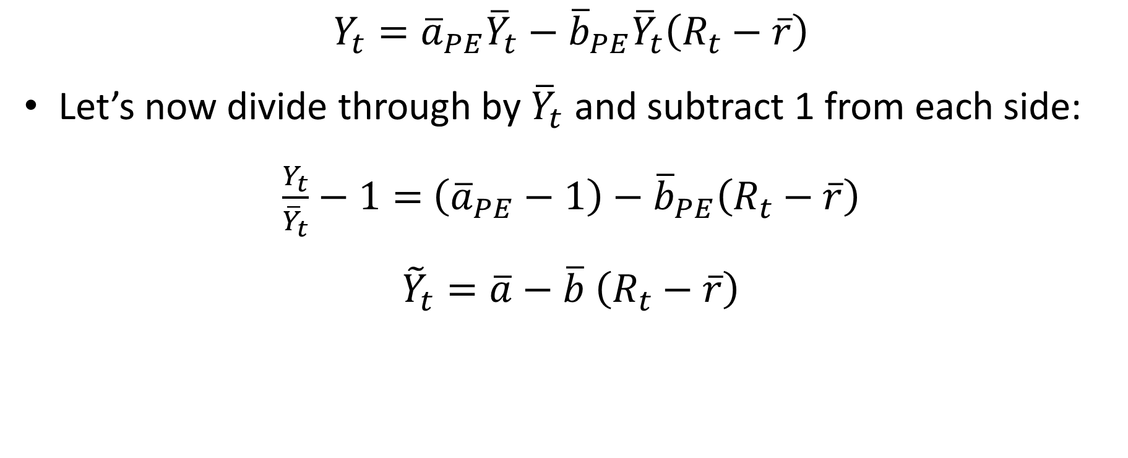
IS Curve
$$Y_{t}={\overline{a}}_{PE}{\overline{Y}}_{t}−{\overline{b}}_{PE}{\overline{Y}}_{t}\left(R_{t}−\overline{r}\right)$$
Let’s now divide through by ${\overline{Y}}_{t}$ and subtract 1 from each side:
$\frac{Y_{t}}{{\overline{Y}}_{t}}−1=$ $\left({\overline{a}}_{PE}−1\right)−{\overline{b}}_{PE}\left(R_{t}−\overline{r}\right)$
${\tilde{Y}}_{t}=\overline{a}−\overline{b}$ $\left(R_{t}−\overline{r}\right)$

Slide 20
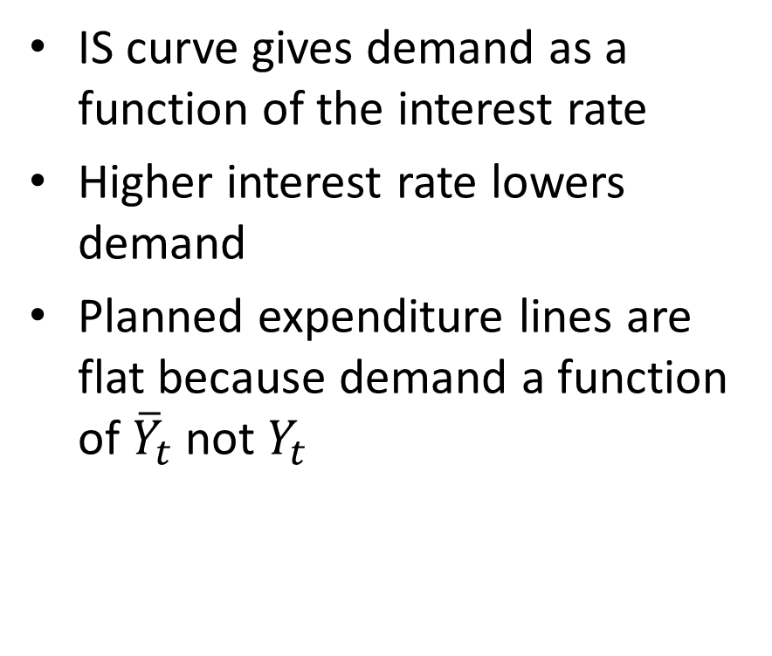
IS Curve
PE
IS curve gives demand as a function of the interest rate
Higher interest rate lowers demand
Planned expenditure lines are flat because demand a function of ${\overline{Y}}_{t}$ not $Y_{t}$
R₁
R₂ > R₁
R
Y
IS
Y₂
Y₁
Y

Slide 21
“One-Line” Intuition
How changes in interest rates affect the demand for goods, and thus output
Negative relationship between R and Y
R ↓ ⇒ C^{d} ↑ and I^{d} ↑ ⇒ Y↑

Slide 22
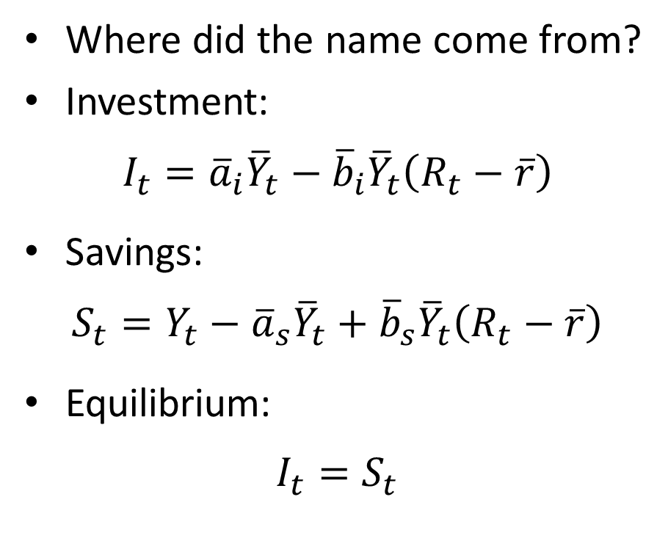
IS Curve
Where did the name come from?
Investment:
$$I_{t}={\overline{a}}_{i}{\overline{Y}}_{t}−{\overline{b}}_{i}{\overline{Y}}_{t}\left(R_{t}−\overline{r}\right)$$
Savings:
$$S_{t}=Y_{t}−{\overline{a}}_{s}{\overline{Y}}_{t}+{\overline{b}}_{s}{\overline{Y}}_{t}\left(R_{t}−\overline{r}\right)$$
Equilibrium:
$$I_{t}=S_{t}$$
R
S
I
I, S

Slide 23
IS Curve
R
S
S’
R
R₁
R₂
I
IS
Y₁
Y₂
I, S
Y
Increase in output from Y₁ to Y₂>Y₁

Slide 24
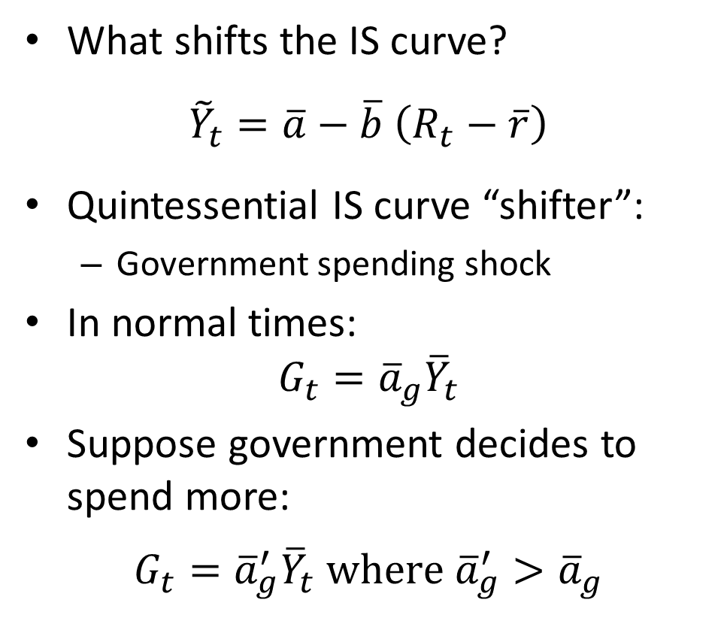
IS Curve Shocks
What shifts the IS curve?
${\tilde{Y}}_{t}=\overline{a}−\overline{b}$ $\left(R_{t}−\overline{r}\right)$
Quintessential IS curve “shifter”:
Government spending shock
In normal times:
$$G_{t}={\overline{a}}_{g}{\overline{Y}}_{t}$$
Suppose government decides to spend more:
$$G_{t}={\overline{a}}_{g}^{′}{\overline{Y}}_{t} \text{where} {\overline{a}}_{g}^{′}>{\overline{a}}_{g}$$
Interest rate
R
IS
IS’
Y
Y’
Output gap

Slide 25
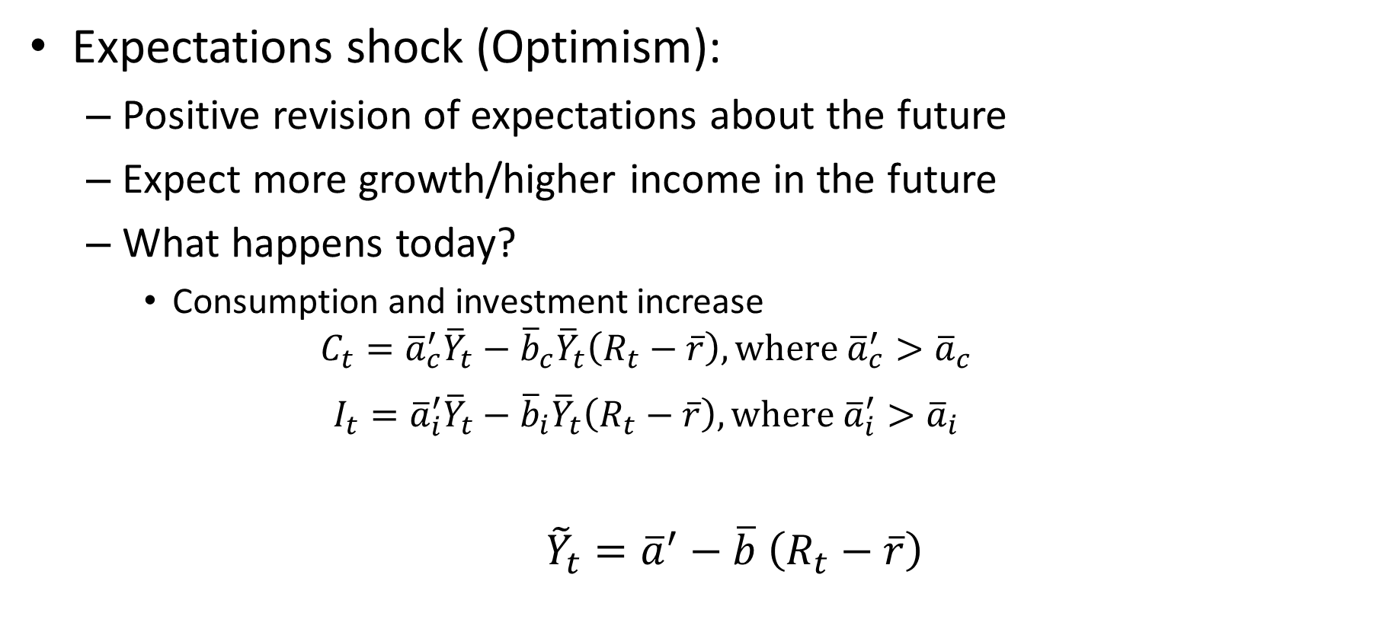
IS Curve Shocks
Expectations shock (Optimism):
Positive revision of expectations about the future
Expect more growth/higher income in the future
What happens today?
Consumption and investment increase
$$C_{t}={\overline{a}}_{c}^{′}{\overline{Y}}_{t}−{\overline{b}}_{c}{\overline{Y}}_{t}\left(R_{t}−\overline{r}\right), \text{where}{ \overline{a}}_{c}^{′}>{\overline{a}}_{c}$$
$$I_{t}={\overline{a}}_{i}^{′}{\overline{Y}}_{t}−{\overline{b}}_{i}{\overline{Y}}_{t}\left(R_{t}−\overline{r}\right), \text{where}{ \overline{a}}_{i}^{′}>{\overline{a}}_{i}$$
${\tilde{Y}}_{t}={\overline{a}}^{′}−\overline{b}$ $\left(R_{t}−\overline{r}\right)$

Slide 26
What Shifts the IS Curve?
Δ government spending (G)
Δ lump sum taxes (T)
Δ expected future income or output
Δ wealth
Δ investment for reasons other than change in R (i.e. autonomous shock to I)
Δ consumption for reasons other than change in R (i.e. , "autonomous" shock to C)

Slide 27
IS Curve and Credit Constraints
In above derivation:
Consumption, investment, etc. functions of potential output, not actual output
Theoretical justification: Permanent income hypothesis
Liquidity constraints:
Some consumers can’t borrow against future income
Are credit constrained

Slide 28
IS Curve and Credit Constraints
What will credit constrained households do if they get extra income?
Spend it!
They would like to borrow and consume more
If their income rises temporarily, they spend the extra income
These households are said to live “hand-to-mouth”

Slide 29
Credit Constraints and the MPC
Marginal propensity to consume (MPC):
If you get an extra dollar, how much do you spend (over say a 3 month period)
In permanent income hypothesis model, the MPC is very low (close to zero)
Credit constrained agents have a very high MPC

Slide 30
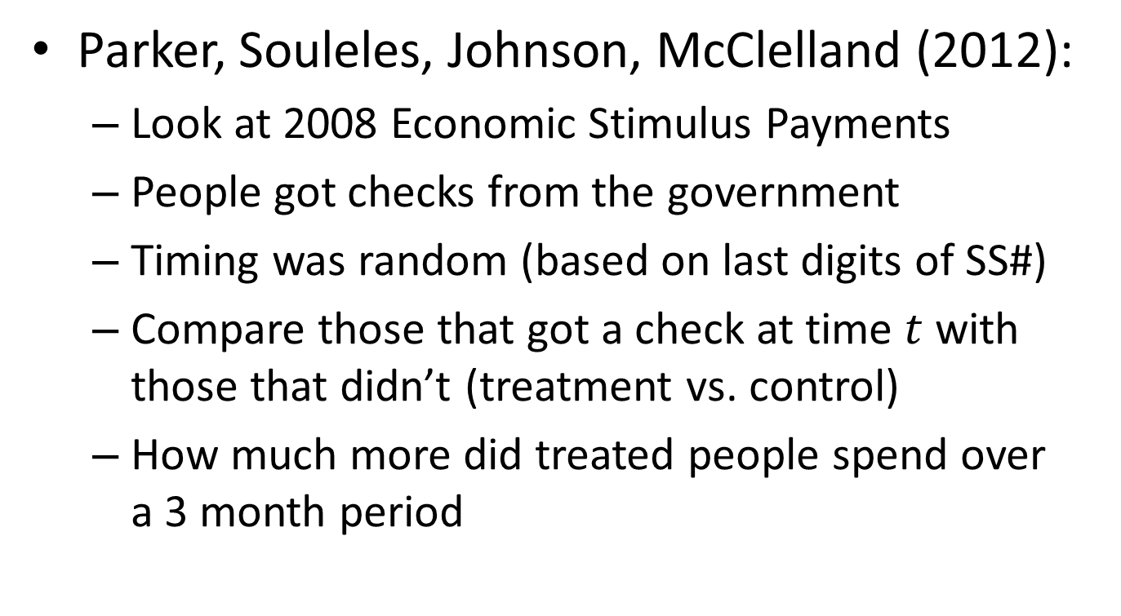
Measuring the MPC
Parker, Souleles, Johnson, McClelland (2012):
Look at 2008 Economic Stimulus Payments
People got checks from the government
Timing was random (based on last digits of SS#)
Compare those that got a check at time $t$ with those that didn’t (treatment vs. control)
How much more did treated people spend over a 3 month period

Slide 31
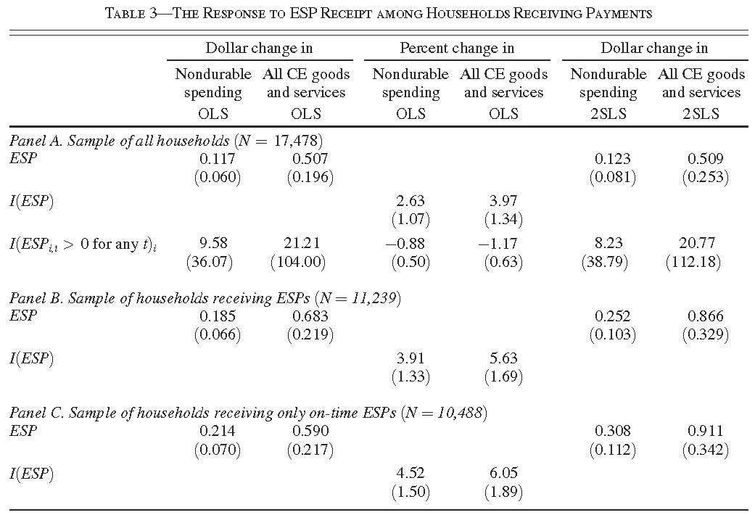
Source: Parker, Souleles, Johnson, McClelland (2012)

Slide 32
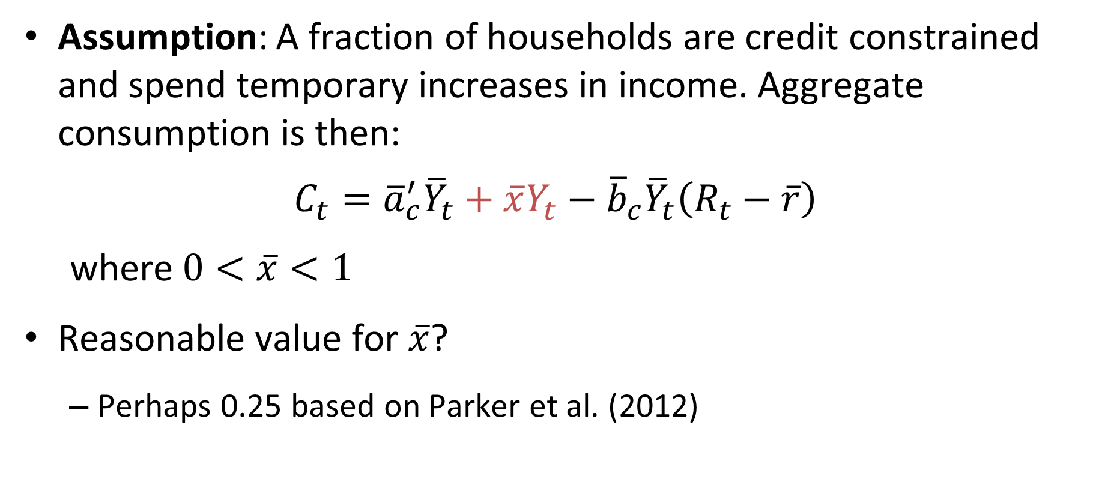
Hand-to-Mouth Consumers
Assumption: A fraction of households are credit constrained and spend temporary increases in income. Aggregate consumption is then:
$$C_{t}={\overline{a}}_{c}^{′}{\overline{Y}}_{t}+\overline{x}Y_{t}−{\overline{b}}_{c}{\overline{Y}}_{t}\left(R_{t}−\overline{r}\right)$$
where$0<\overline{x}<1$
Reasonable value for $\overline{x}$?
Perhaps 0.25 based on Parker et al. (2012)

Slide 33
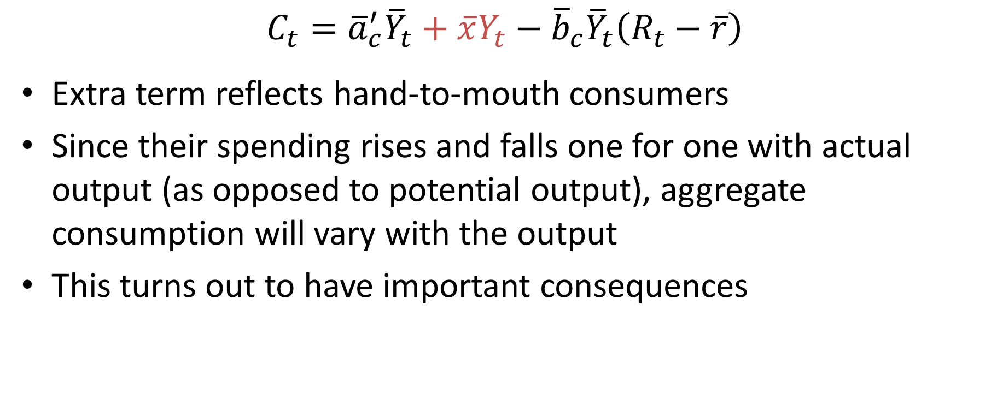
Hand-to-Mouth Consumers
$$C_{t}={\overline{a}}_{c}^{′}{\overline{Y}}_{t}+\overline{x}Y_{t}−{\overline{b}}_{c}{\overline{Y}}_{t}\left(R_{t}−\overline{r}\right)$$
Extra term reflects hand-to-mouth consumers
Since their spending rises and falls one for one with actual output (as opposed to potential output), aggregate consumption will vary with the output
This turns out to have important consequences

Slide 34
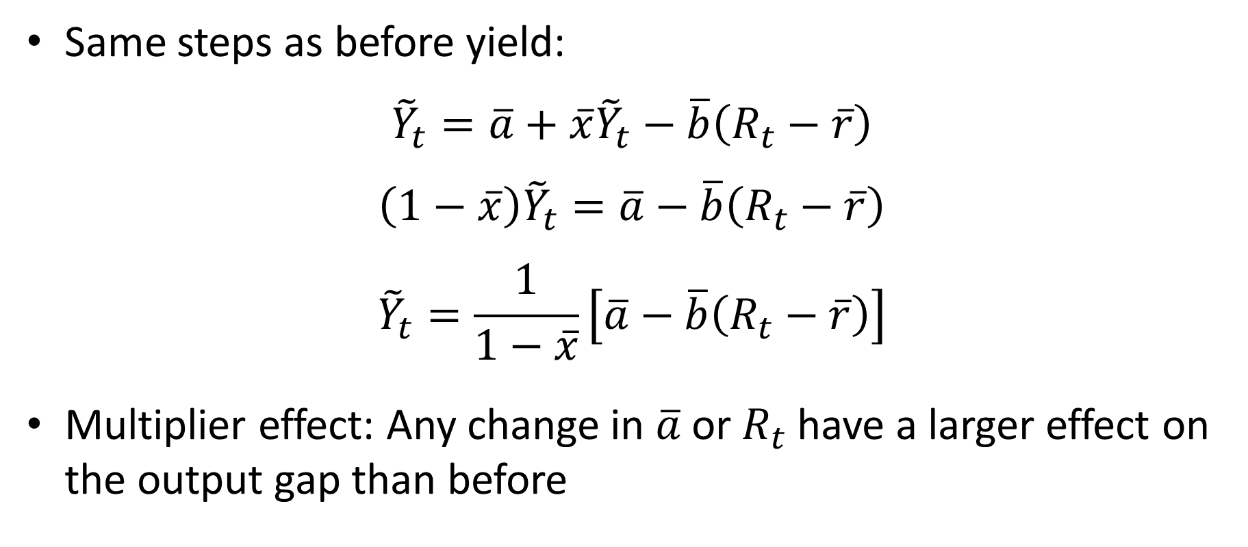
IS Curve with Hand-to-Mouth Consumers
Same steps as before yield:
$${\tilde{Y}}_{t}=\overline{a}+\overline{x}{\tilde{Y}}_{t}−\overline{b}\left(R_{t}−\overline{r}\right)$$
$$\left(1−\overline{x}\right){\tilde{Y}}_{t}=\overline{a}−\overline{b}\left(R_{t}−\overline{r}\right)$$
$${\tilde{Y}}_{t}=\frac{1}{1−\overline{x}}\left[\overline{a}−\overline{b}\left(R_{t}−\overline{r}\right)\right]$$
Multiplier effect: Any change in $\overline{a}$or $R_{t}$have a larger effect on the output gap than before

Slide 35
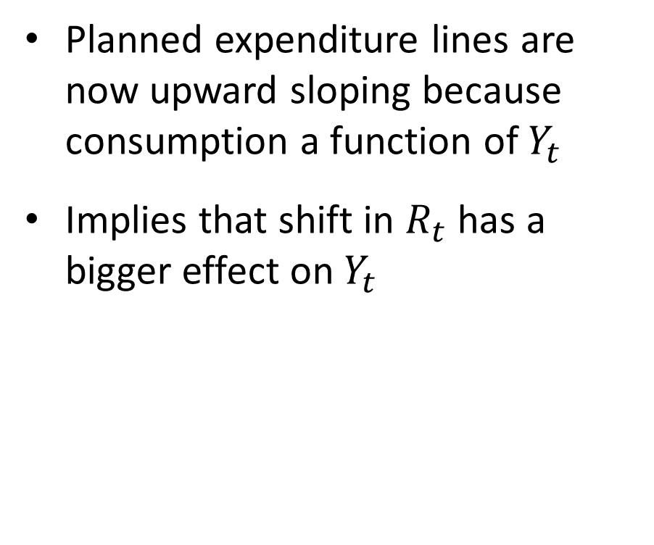
IS Curve with Hand-to-Mouth Consumers
PE
R₁
R₂ > R₁
Planned expenditure lines are now upward sloping because consumption a function of $Y_{t}$
Implies that shift in $R_{t}$ has a bigger effect on $Y_{t}$
R
Y
IS
Y₂
Y₁
Y

Slide 36
Multiplier Effect
What is the intuition for the multiplier effect?
Say foreign demand falls by 1%
Without multiplier: Output falls by 1%
With multiplier:
Fall in output implies a fall in the income of hand-to-mouth consumers
They reduce their consumption.
This further reduces output, and on and on

Slide 37
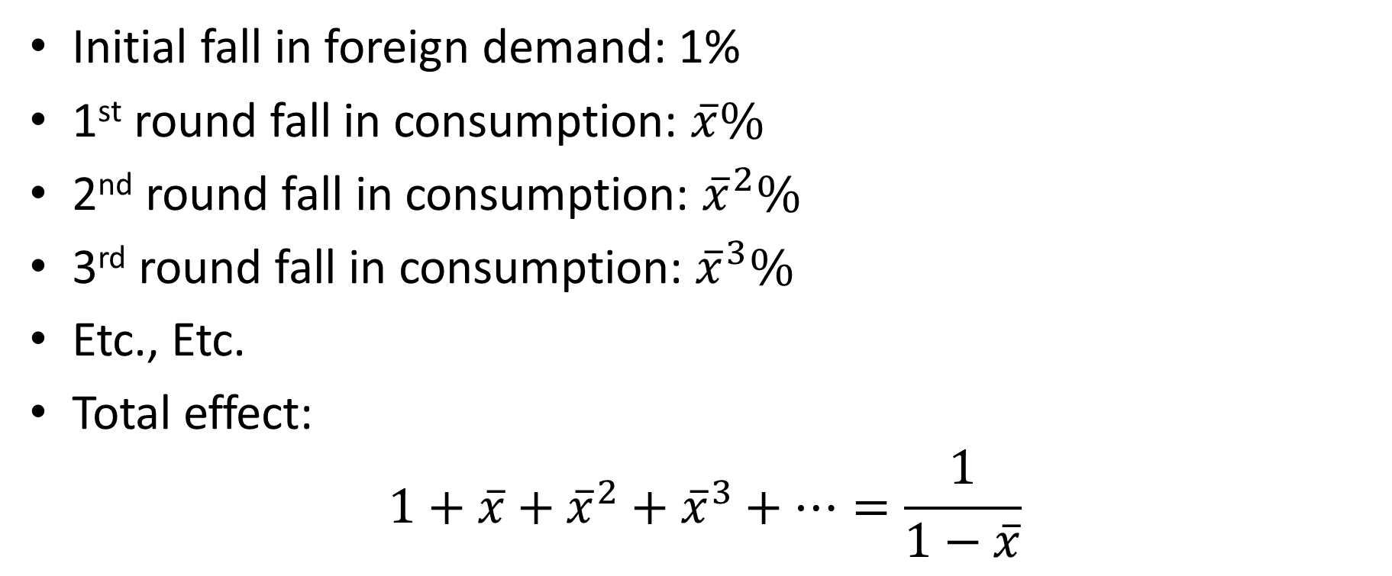
Multiplier Effect
Initial fall in foreign demand: 1%
1st round fall in consumption: $\overline{x}\%$
2nd round fall in consumption: ${\overline{x}}^{2}\%$
3rd round fall in consumption: ${\overline{x}}^{3}\%$
Etc., Etc.
Total effect:
$$1+\overline{x}+{\overline{x}}^{2}+{\overline{x}}^{3}+…=\frac{1}{1−\overline{x}}$$

Slide 38
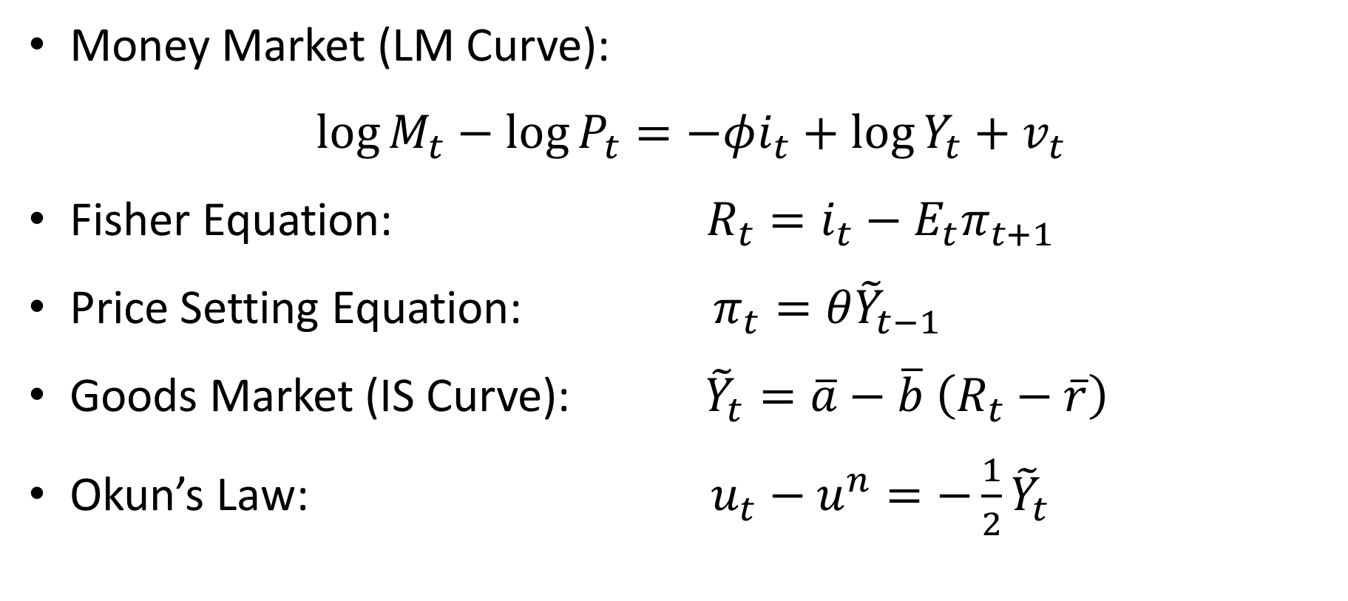
Where Do We Stand?
Money Market (LM Curve):
$\log{M_{t}}−\log{P_{t}}=−φi_{t}+\log{Y_{t}}+v_{t}$
Fisher Equation: $R_{t}=i_{t}−E_{t}π_{t+1}$
Price Setting Equation: $π_{t}=θ{\tilde{Y}}_{t−1}$
Goods Market (IS Curve): ${\tilde{Y}}_{t}=\overline{a}−\overline{b}$ $\left(R_{t}−\overline{r}\right)$
Okun’s Law: $u_{t}−u^{n}=−\frac{1}{2}{\tilde{Y}}_{t}$

Slide 39

IS-LM Model
Short-run model
Determines output gap and real interest rate
Inflation predetermined (unaffected by output)
Money market shocks shift the LM curve
Goods market shocks shift the IS curve
R
LM
IS
$$\tilde{Y}$$

