Slide 1
Lecture 15: The Great Depression Macroeconomics (Quantitative) Econ 101B
Jón Steinsson
University of California, Berkeley

Slide 2
The Great Depression
Perhaps the worst economic calamity of all time

Slide 3
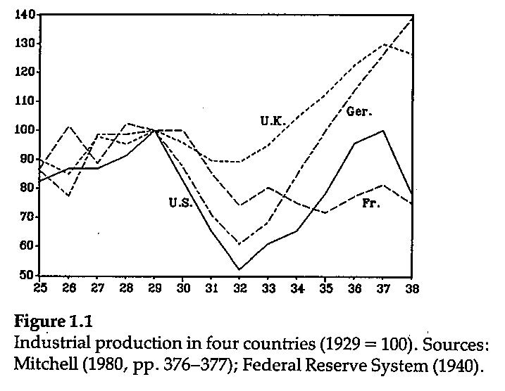
Source: Temin (1989)

Slide 4
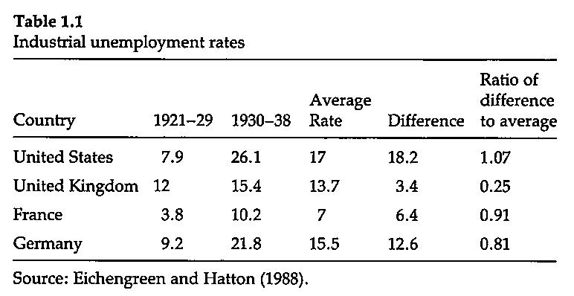
Source: Temin (1989)

Slide 5
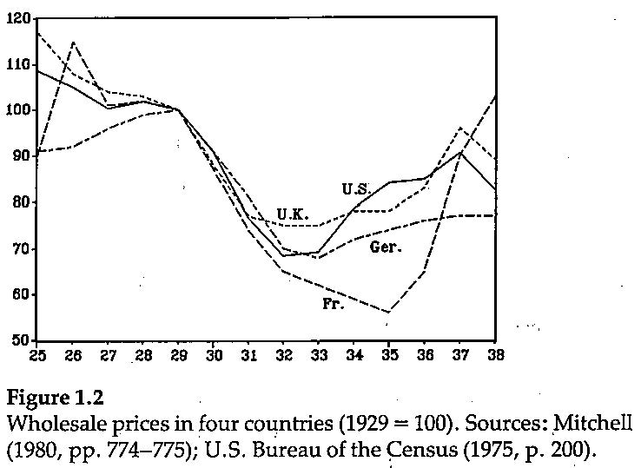
Source: Temin (1989)

Slide 6
Key Questions
What caused the initial downturn?
Why did this downturn become such a colossal calamity?

Slide 7
Source: Robert Shiller’s website

Slide 8

What Caused the Great Depression
IS curve shock?
Stock market crash of October 1929
Also, massive volatility in stock market created uncertainty about the future
Consumers / firms adopt wait and see attitude
R
LM
A
B
IS
IS’
$$\tilde{Y}$$

Slide 9

What Caused the Great Depression
LM curve shock?
Tight monetary policy in U.S. in 1928/29 to counteract stock market boom
Tight monetary policy globally because of gold standard constraints
R
LM’
LM
IS
$$\tilde{Y}$$

Slide 10
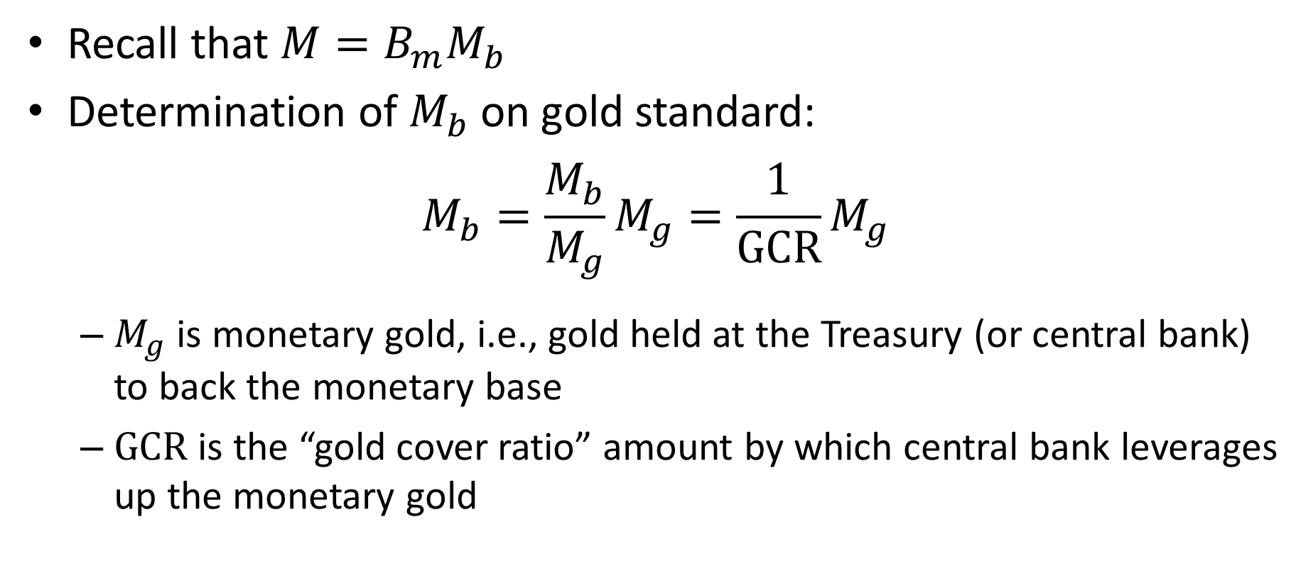
Money Supply on the Gold Standard
Recall that $M=B_{m}M_{b}$
Determination of $M_{b}$ on gold standard:
$$M_{b}=\frac{M_{b}}{M_{g}}M_{g}=\frac{1}{\text{GCR}}M_{g}$$
$M_{g}$ is monetary gold, i.e., gold held at the Treasury (or central bank) to back the monetary base
$\text{GCR}$ is the “gold cover ratio” amount by which central bank leverages up the monetary gold

Slide 11
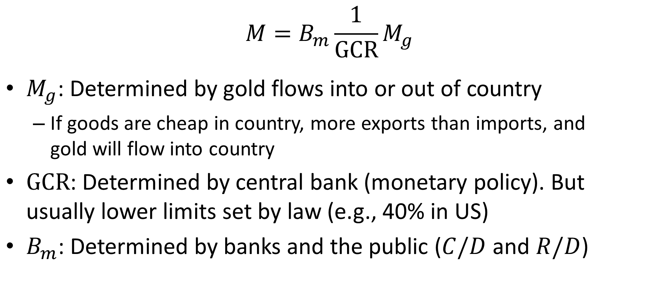
Money Supply on the Gold Standard
$$M=B_{m}\frac{1}{\text{GCR}}M_{g}$$
$M_{g}$: Determined by gold flows into or out of country
If goods are cheap in country, more exports than imports, and gold will flow into country
$\text{GCR}$: Determined by central bank (monetary policy). But usually lower limits set by law (e.g., 40% in US)
$B_{m}$: Determined by banks and the public ($C/D$ and $R/D$)

Slide 12
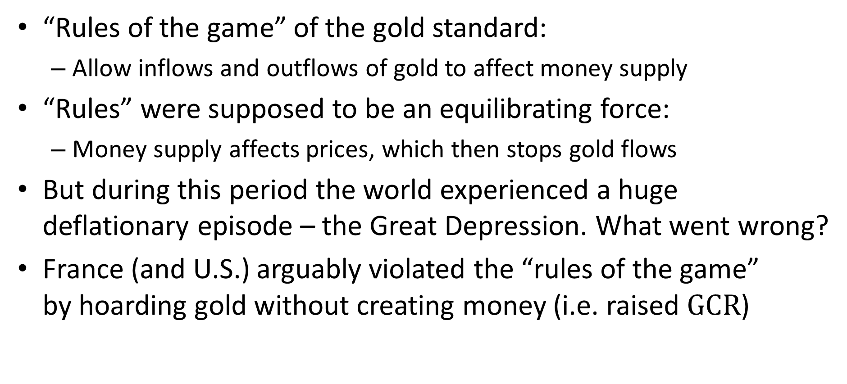
Did France Cause the Great Depression?
“Rules of the game” of the gold standard:
Allow inflows and outflows of gold to affect money supply
“Rules” were supposed to be an equilibrating force:
Money supply affects prices, which then stops gold flows
But during this period the world experienced a huge deflationary episode – the Great Depression. What went wrong?
France (and U.S.) arguably violated the “rules of the game” by hoarding gold without creating money (i.e. raised $\text{GCR}$)

Slide 13
Monetary Policy in France and U.S.
High inflation in 1923-1926 lead to great conservatism in French monetary policy in the years leading up to Great Depression
They wanted to avoid another such experience
France experienced large gold inflows, which they allowed to raise gold cover ratio
France liquidated holdings of sterling which raised the gold cover ratio

Slide 14
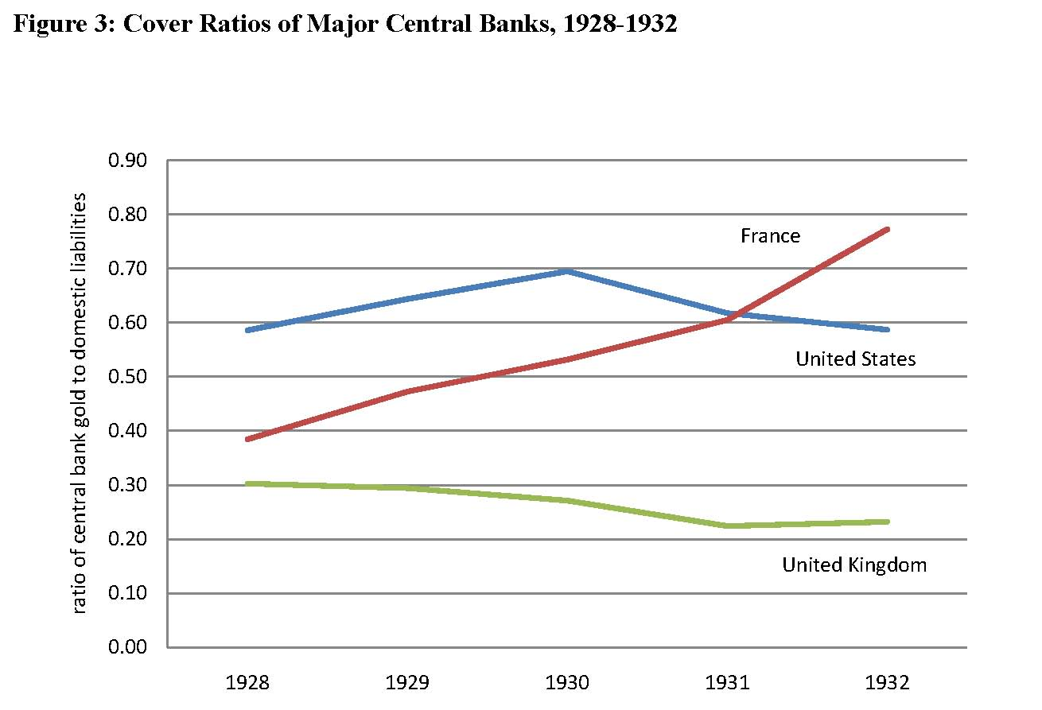
Source: Irwin (2010)

Slide 15
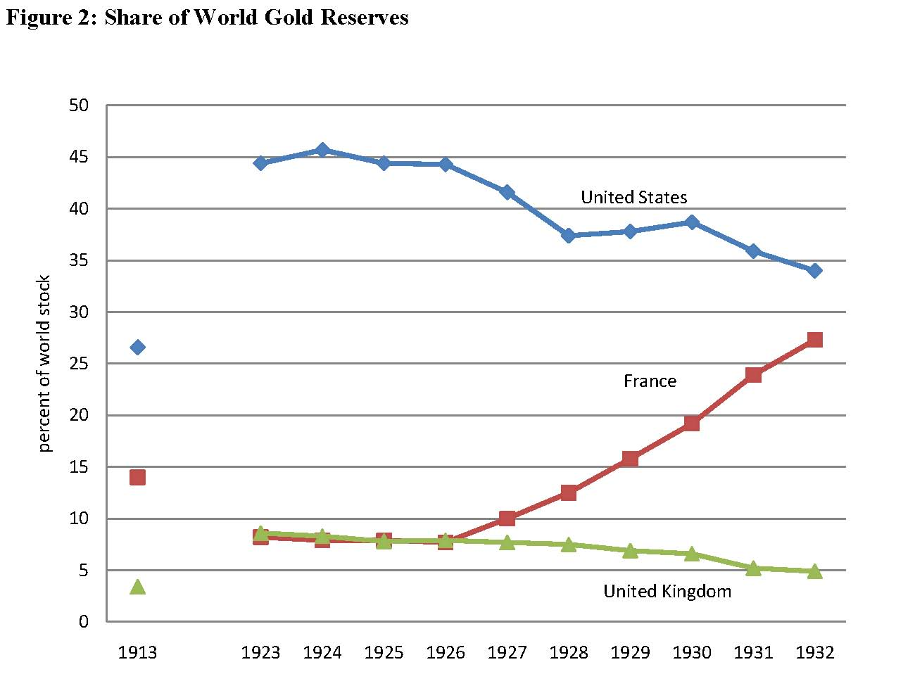
Source: Irwin (2010)

Slide 16
Monetary Policy in U.S. and Germany
U.S. and Germany also worried about holding sterling as reserves and liquidated holdings (i.e. raised gold cover ratios)
Generally, lack of trust across countries led to scramble for gold by all central banks, which worsened aggregate shortage of gold

Slide 17
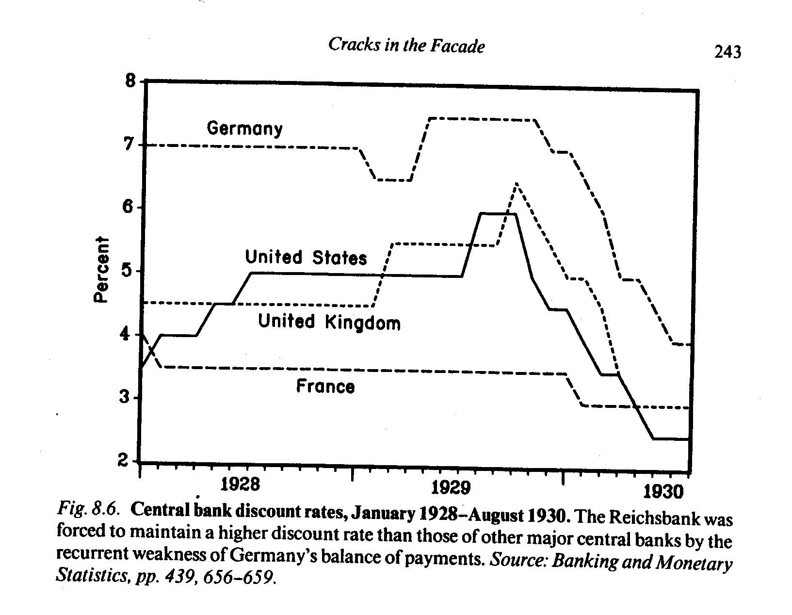
Monetary Policy in 1928-1929
Loss of gold forced U.K. to raise interest rates
Higher interest rates meant to entice investors to send money to Britain
Higher interest rates also deflationary (reduce spending by households and firms)
U.S. Fed raised interest rates as well
Worried about boom on Wall Street
Worried about outflow of gold to France
Source: Eichengreen (1992)

Slide 18
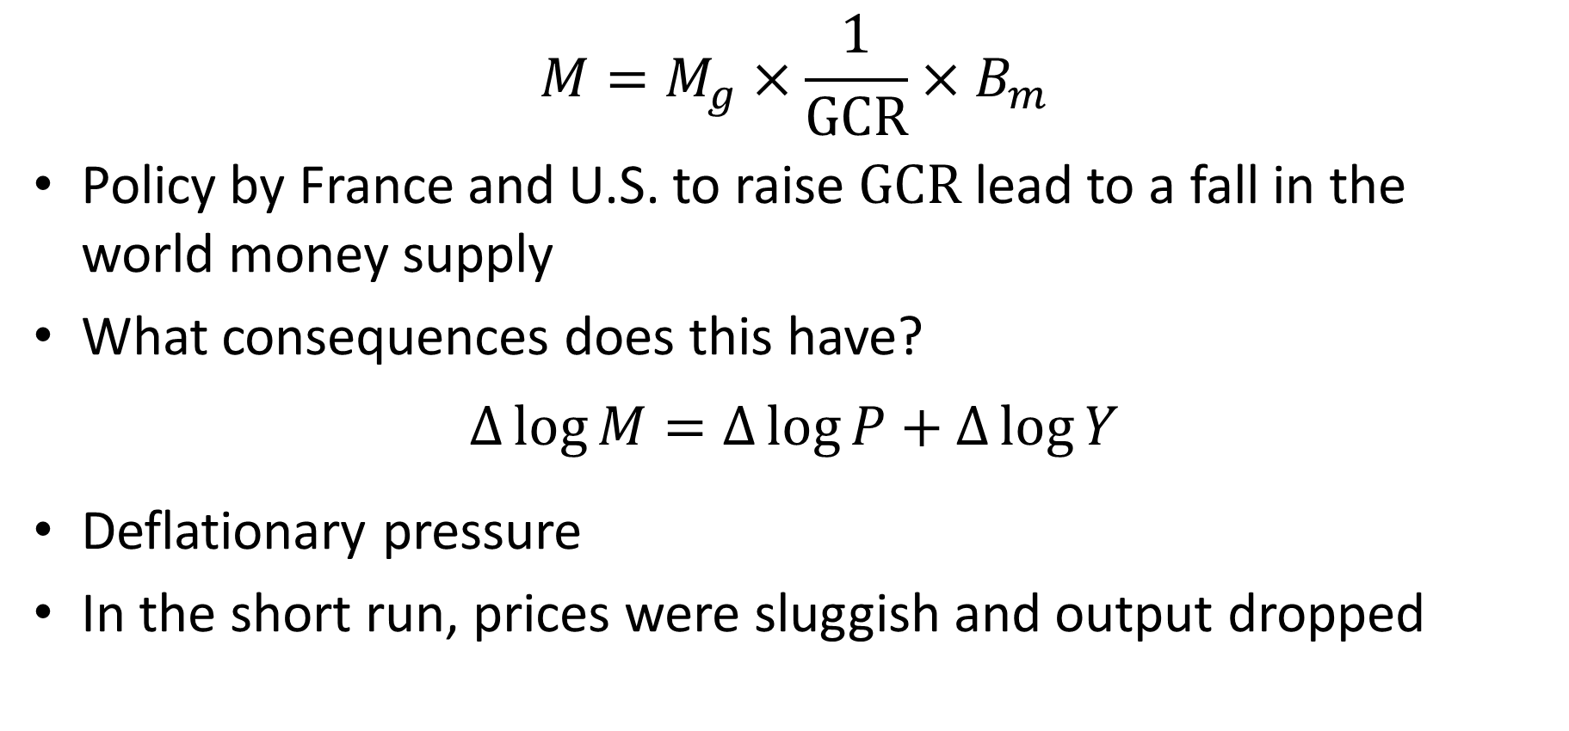
Deflationary Monetary Policy
$$M=M_{g}×\frac{1}{\text{GCR}}×B_{m}$$
Policy by France and U.S. to raise $\text{GCR}$ lead to a fall in the world money supply
What consequences does this have?
$$∆\log{M}=∆\log{P}+∆\log{Y}$$
Deflationary pressure
In the short run, prices were sluggish and output dropped

Slide 19
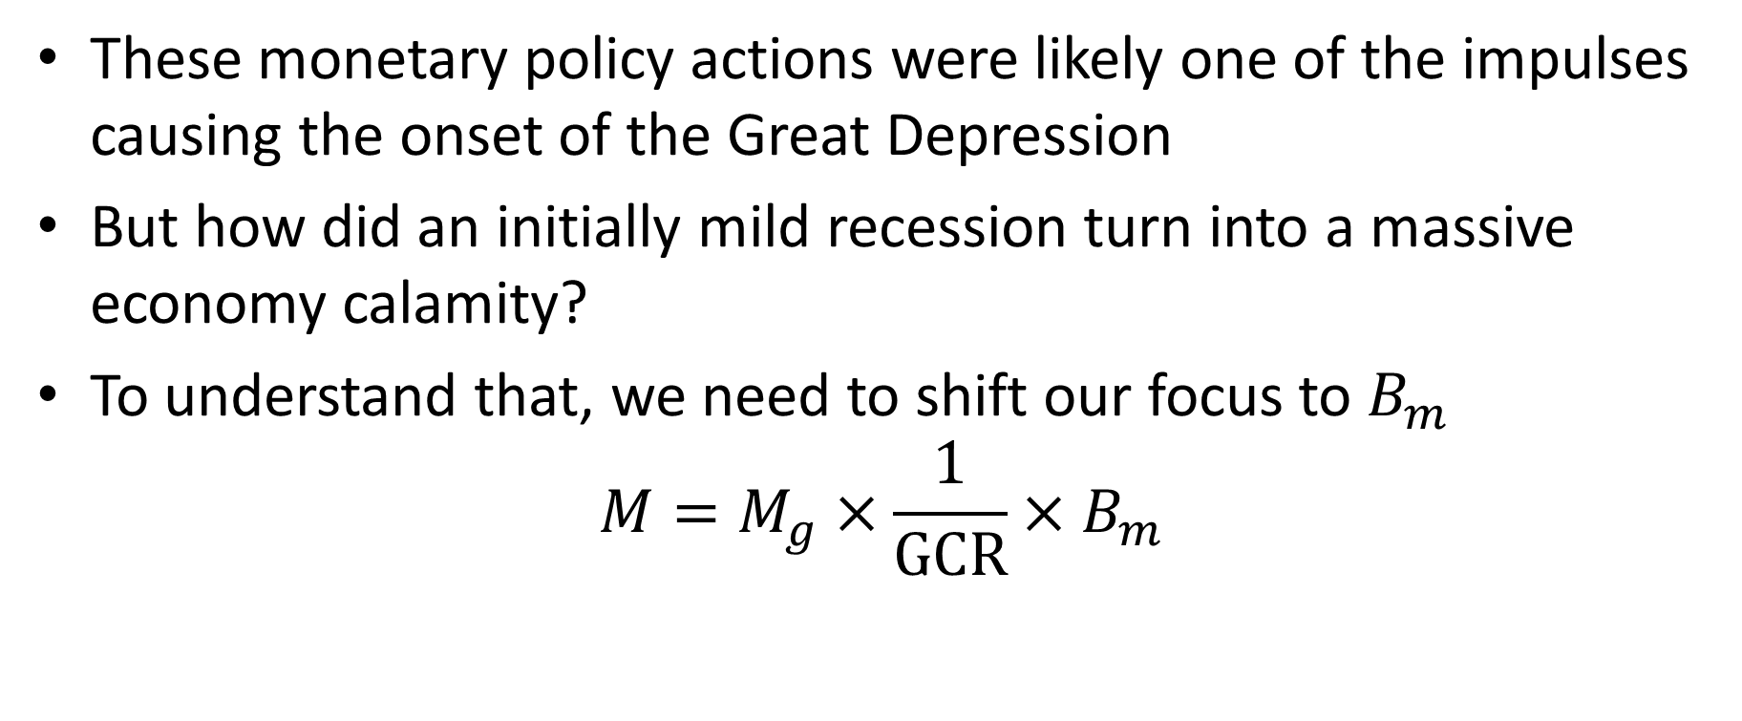
From Recession to Depression
These monetary policy actions were likely one of the impulses causing the onset of the Great Depression
But how did an initially mild recession turn into a massive economy calamity?
To understand that, we need to shift our focus to $B_{m}$
$$M=M_{g}×\frac{1}{\text{GCR}}×B_{m}$$

Slide 20
Bank Crises During the Great Depression
Three large bank panics:
November 1930 to January 1931: 800 banks fail
September 1931 to October 1931: 800 banks fail
December 1932 to March 1933: 4000 banks fail
State and then general bank holiday
Number of banks fell from 24,000 to 14,000 between 1929 and 1933

Slide 21
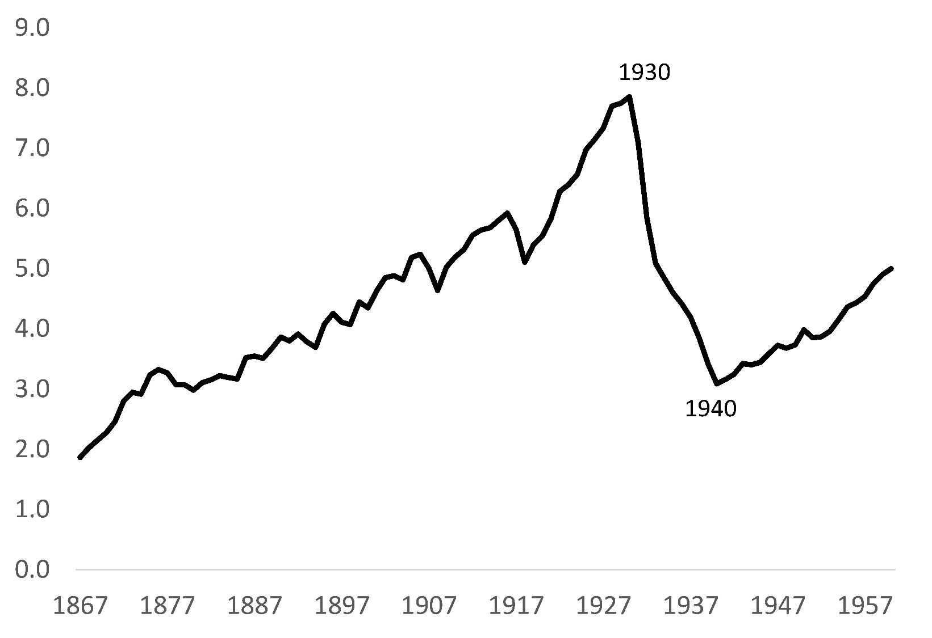
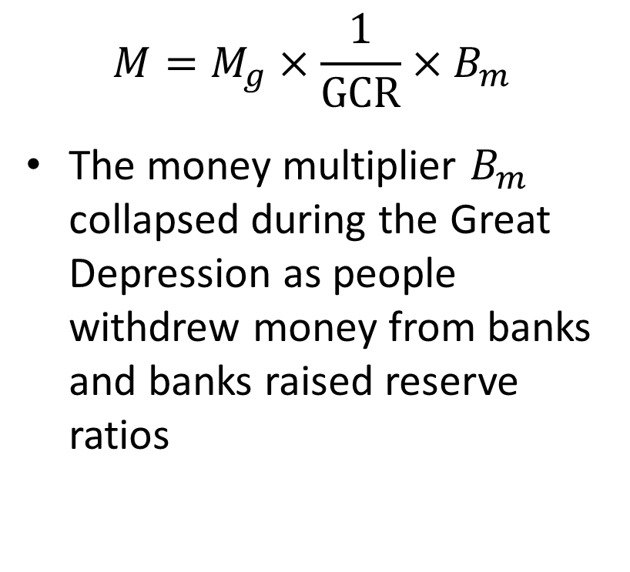
Collapse of Money Multiplier
$$M=M_{g}×\frac{1}{\text{GCR}}×B_{m}$$
The money multiplier $B_{m}$ collapsed during the Great Depression as people withdrew money from banks and banks raised reserve ratios
Source: Friedman and Schwartz (1963)

Slide 22
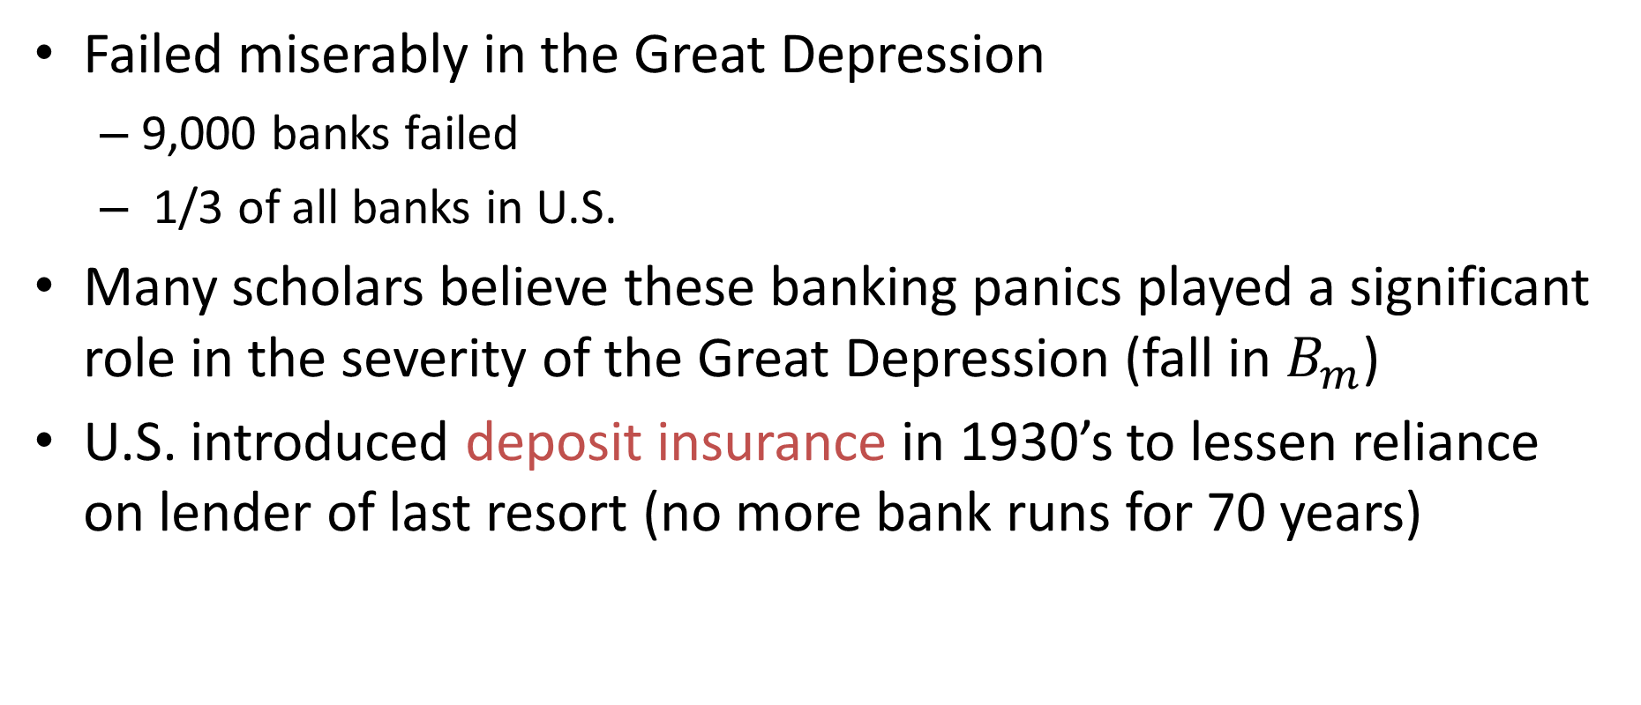
Fed as a Lender of Last Resort
Failed miserably in the Great Depression
9,000 banks failed
1/3 of all banks in U.S.
Many scholars believe these banking panics played a significant role in the severity of the Great Depression (fall in $B_{m}$)
U.S. introduced deposit insurance in 1930’s to lessen reliance on lender of last resort (no more bank runs for 70 years)

Slide 23
Massive Monetary Policy Mistake
I would like to say to Milton and Anna: Regarding the Great Depression. You’re right, we did it. We’re very sorry. But thanks to you, we won’t do it again
Ben Bernanke
Governor of Federal Reserve
November 8, 2002

Slide 24
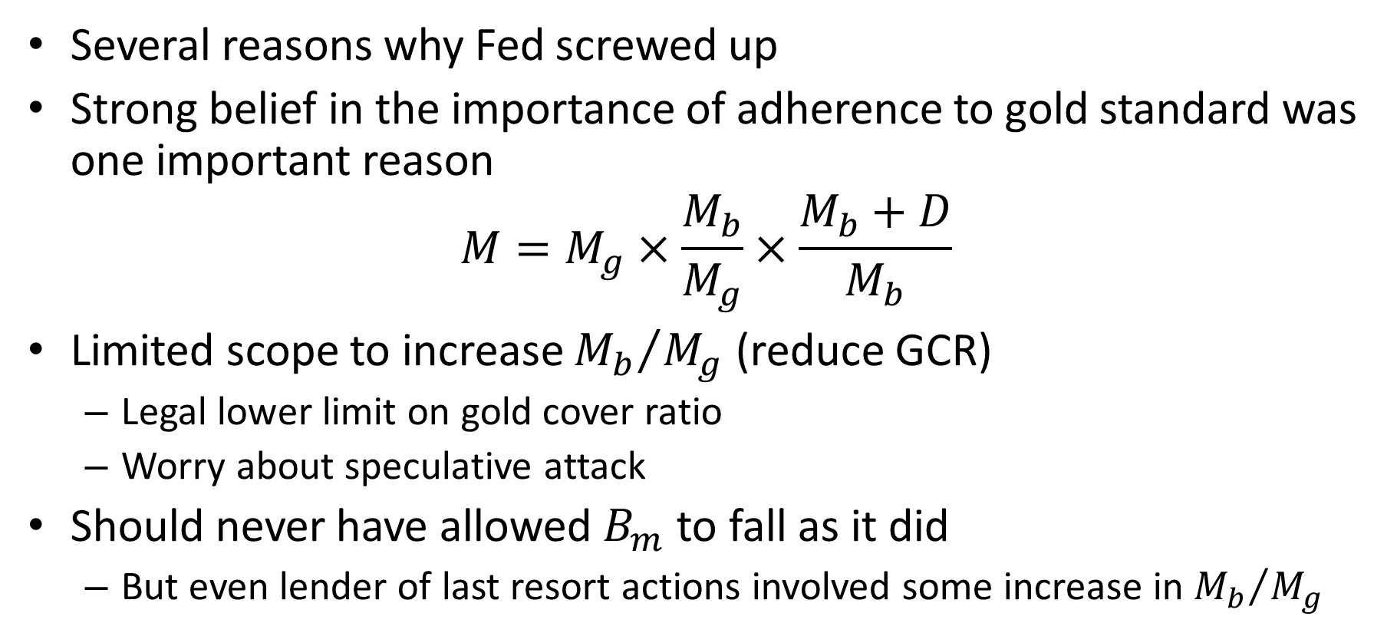
Gold Standard as Root Cause
Several reasons why Fed screwed up
Strong belief in the importance of adherence to gold standard was one important reason
$$M=M_{g}×\frac{M_{b}}{M_{g}}×\frac{M_{b}+D}{M_{b}}$$
Limited scope to increase ${M_{b}}/{M_{g}}$ (reduce GCR)
Legal lower limit on gold cover ratio
Worry about speculative attack
Should never have allowed $B_{m}$ to fall as it did
But even lender of last resort actions involved some increase in ${M_{b}}/{M_{g}}$

Slide 25

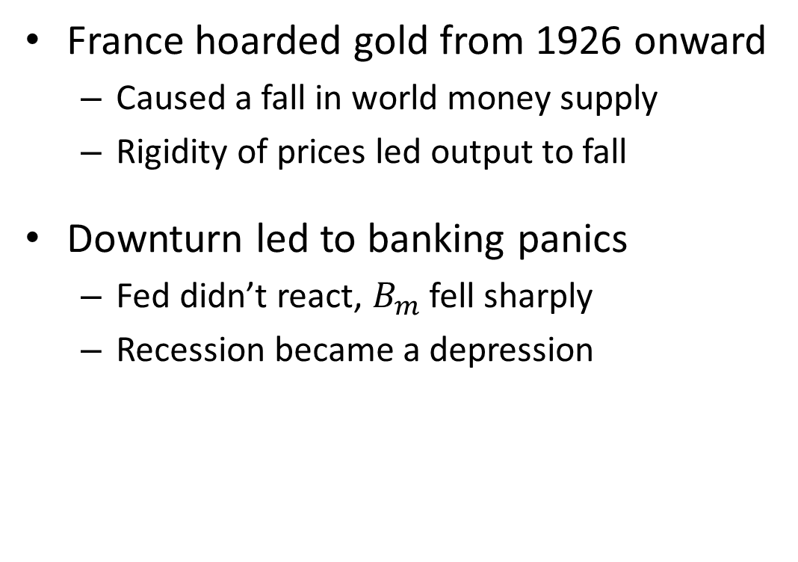
Monetary Narrative of Great Depression
France hoarded gold from 1926 onward
Caused a fall in world money supply
Rigidity of prices led output to fall
Downturn led to banking panics
Fed didn’t react, $B_{m}$ fell sharply
Recession became a depression
$$∆\log{M_{t}}=∆\log{P_{t}}+∆\log{Y_{t}}$$
$$M=M_{g}×\frac{1}{\text{GCR}}×B_{m}$$

Slide 26
Correlation versus Causation
How do we know correlation runs from money to output as opposed to reverse causation or some third factor?
Narrative above based on detailed historical research
But we don’t have a treatment group and a control group to compare
Unfortunately, no parallel universes some with Great Depressions some not

Slide 27
Four Natural Experiments
Bernanke argues that Friedman and Schwartz identify four natural experiments:
Changes in money stock occurs for reasons largely unrelated to the contemporaneous behavior of prices and output
Since movements in money are “exogenous” one can interpret response of economy as reflecting cause and effect

Slide 28
Four Natural Experiments
Tight monetary policy in 1928-29
Sterling Crisis of 1931
Fed raises rates after Britain forced off gold
Easing in spring of 1932
Congress pressured Fed to ease. They did. Economy started improving. Congress adjourned in July. Fed went back to old ways. Economy resumed collapse
Run on the dollar
Speculation about whether Roosevelt would take dollar off gold standard. Slow run on dollar and banks

Slide 29
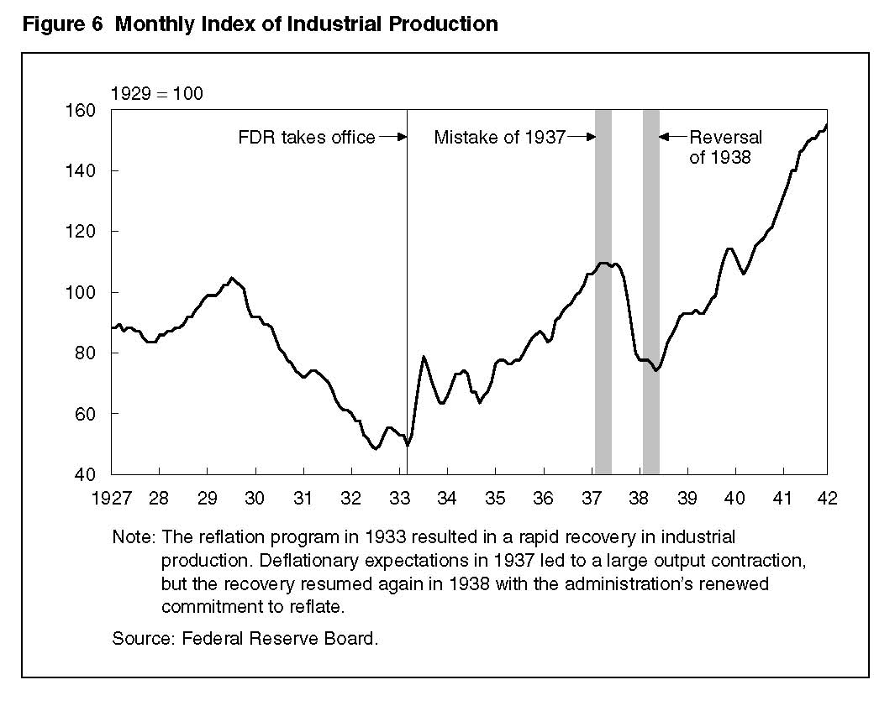
Source: Eggertsson and Pugsley (2007)

Slide 30
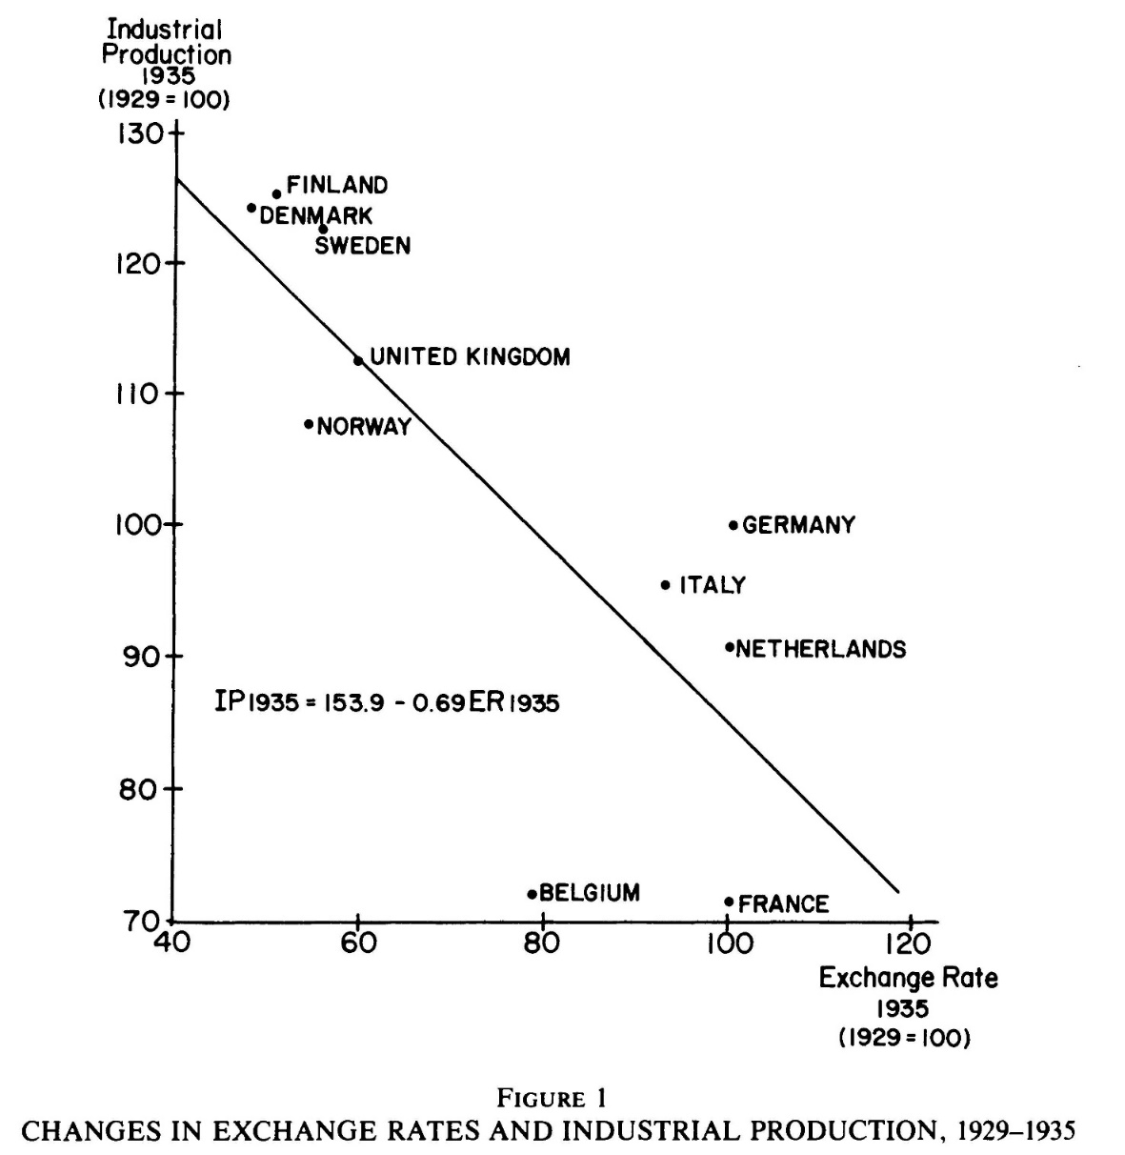
International Evidence
Countries that exited gold standard earlier experienced less severe Depression and recovered earlier
Correlation versus causation?
What is most obvious “confounding factor”?
Countries that leave gold standard are more likely to have been hit harder initially (since speculators pray on weak countries)
This confounding factor actually strengthens the case
Source: Eichengreen and Sachs (1985)

Slide 31
Speculative Attacks
Summer and fall of 1931:
Series of speculative attacks on currencies that were on the gold standard
Culminated in Britain going off the gold standard in September of 1931
Speculative attacks on currencies with fixed exchange rates have been common ever since
Often very traumatic events!
Let’s try to understand these events a bit better

Slide 32
The Sterling Crisis
In May 1931, the Austrian bank Credit-Anstalt failed and was bailed out by the Austrian government.
This led investors to doubt Austria’s ability to maintain the gold standard and flee.
Austria responded by:
Seeking foreign loans (didn’t get enough)
Raising interest rates, raising taxes, cutting spending
Eventually, suspended convertibility (and imposed capital controls)

Slide 33
Crisis Spreads
The Credit-Anstalt crisis quickly spread to Hungary and more importantly Germany
Germany suspends convertibility in September (and imposed capital controls)
Many other countries also suspend convertibility and imposed capital controls around this time for similar reasons (e.g., Australia, Canada, Brazil, and Argentina)

Slide 34
Sterling Comes Under Attack
The next country investors started to worry about was Britain (the center of the financial system at the time)
Crisis had weakened Britain’s Balance of Payments
Relied heavily on investment income from abroad
Capital controls imposed by other countries eliminated that income from country after country
Speculators started worrying about sustainability of Britain’s peg to gold – run on sterling

Slide 35
Britain’s response
British government tried similar tactics as Austria:
Asked for loans from other countries
Raised interest rates
But was overwhelmed by speculative attack and suspended convertibility on September 19 1931

Slide 36
The Sterling Crisis
The fact that Britain went off gold in the fall of 1931 was a watershed moment
British Treasury official is taking a bath
Aid bursts in and says:
“We’re off the gold standard”
Astonished official says:
“I did not think that was possible.”

Slide 37
Crisis Spreads to U.S.
After Britain fell, speculators began worrying that the U.S. might also leave the gold standard.
Run on the U.S. dollar
Fed reacted by raising interest rates sharply
This "worked." The speculative attack subsided
However, consequences for economy were (arguably) dire

Slide 38
Speculative Attacks
Sterling crisis illustrates that gold standard is a system of fixed exchange rates
Countries with a fixed exchange rate are subject to speculative attacks
Speculative attacks can be self-fulfilling for similar (but slightly more involved) reasons as bank runs can be

Slide 39
More Game Theory
To understand this better, it is helpful to introduce a few more concepts from game theory
We look at dynamic games
Define a precise notion of credibility

Slide 40
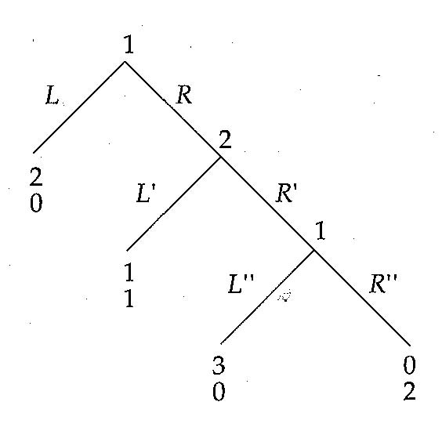
Dynamic Games
How do we solve this game?
Backward-induction:
Begin at the “end” of the game and work backward
Stage 3:
Player 1 (P1) prefers L’’
Stage 2:
P2 knows P1 will play L’’
So, P2 plays L’
State 1:
P1 knows P2 will play L’
So, P1 plays L
Gibbons (1992): Game Theory For Applied Economists, pages 59-61

Slide 41
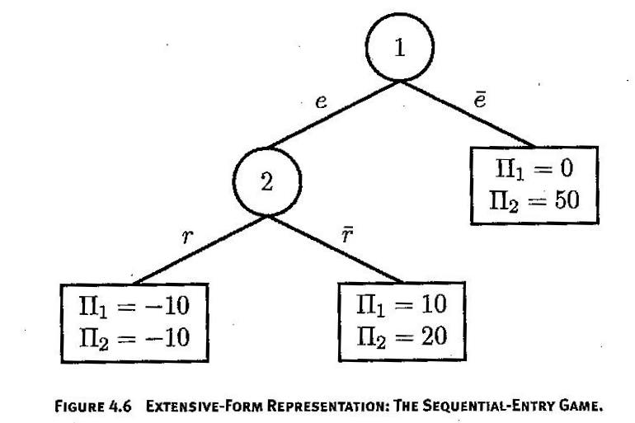
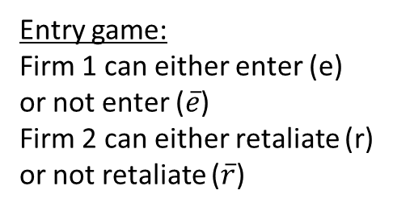
Dynamic Games
Entry game:
Firm 1 can either enter (e)
or not enter ($\overline{e}$)
Firm 2 can either retaliate (r)
or not retaliate ($\overline{r}$)
Cabral (2000): Introduction to Industrial Organization

Slide 42
Dynamic Games
Entry game:
Firm 1 can either enter (e)
or not enter ($\overline{e}$)
Firm 2 can either retaliate (r)
or not retaliate ($\overline{r}$)
Cabral (2000): Introduction to Industrial Organization

Slide 43
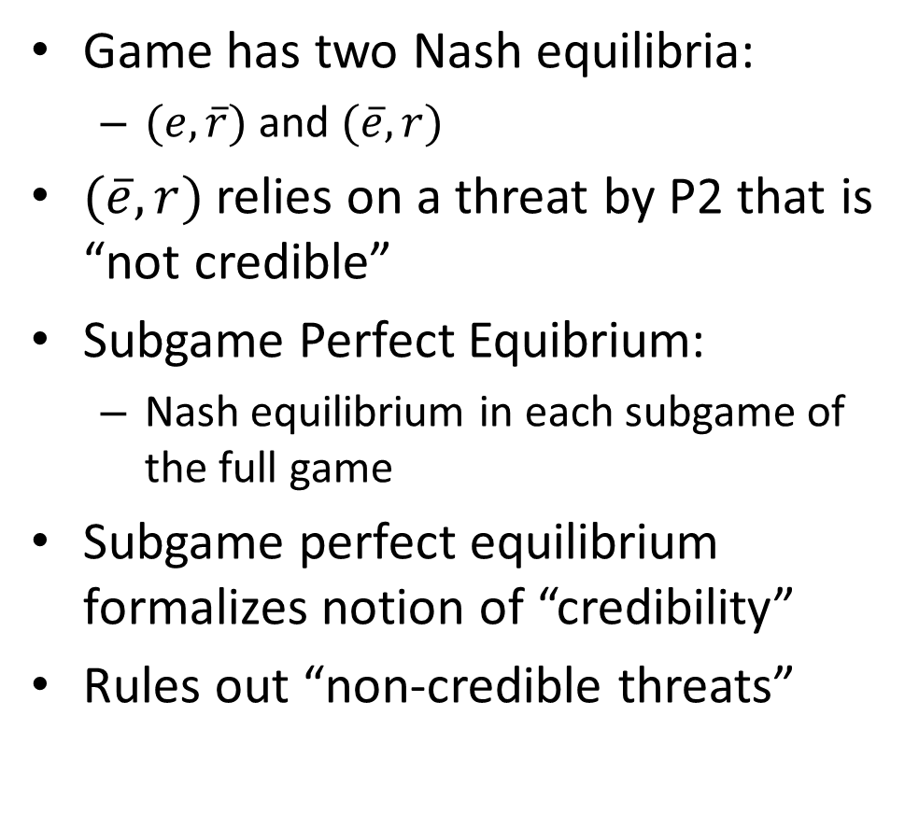
Subgame Perfect Equilibrium
Game has two Nash equilibria:
$(e,\overline{r})$ and $(\overline{e},r)$
$(\overline{e},r)$ relies on a threat by P2 that is “not credible”
Subgame Perfect Equibrium:
Nash equilibrium in each subgame of the full game
Subgame perfect equilibrium formalizes notion of “credibility”
Rules out “non-credible threats”

Slide 44
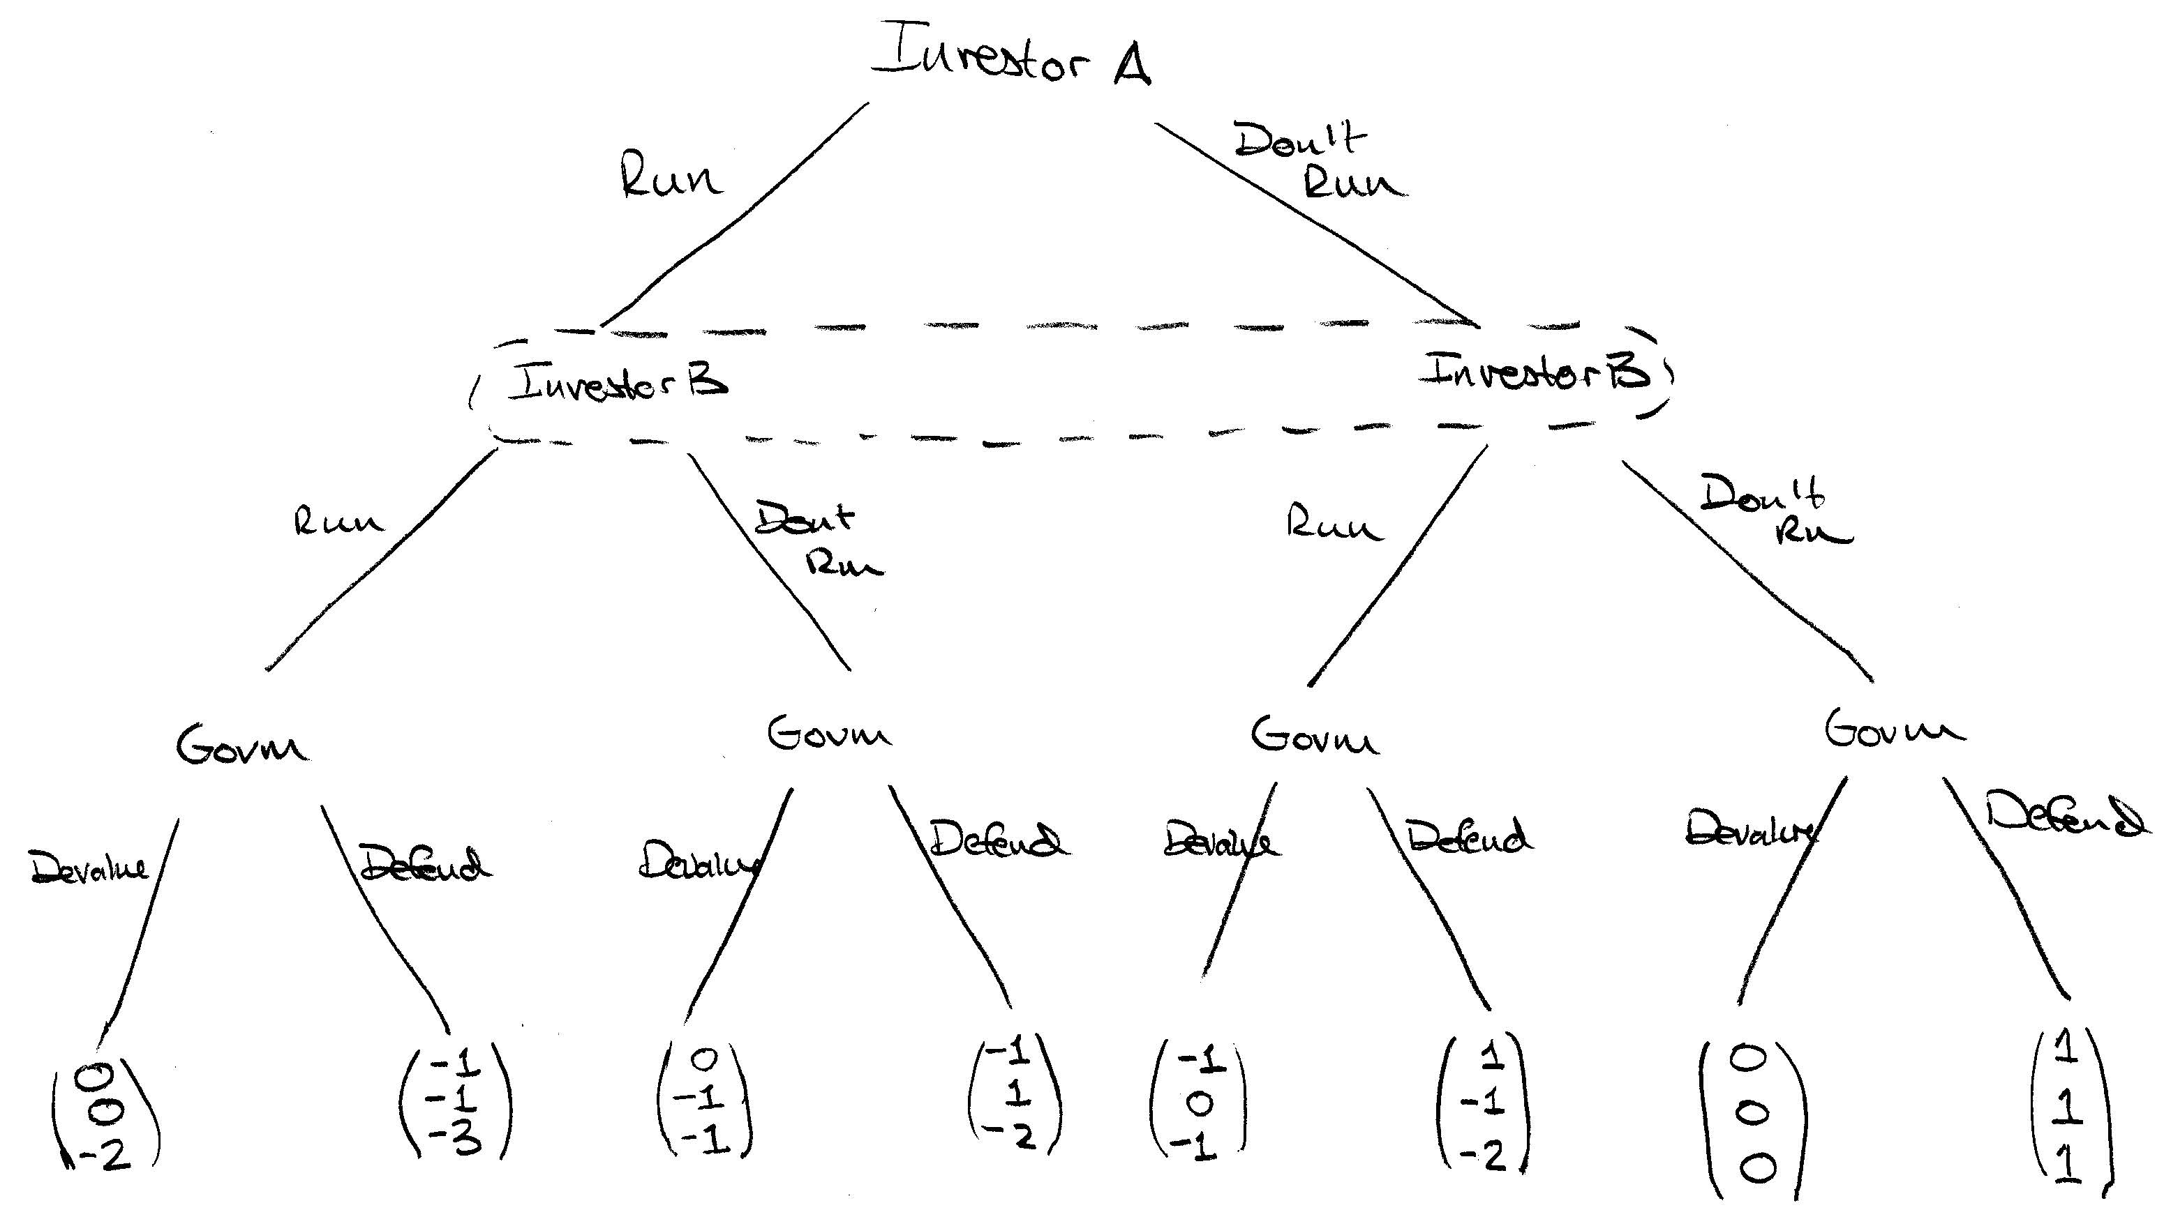
Currency Attack Model

Slide 45
Currency Attack Model
Two investors who act simultaneously
Bubble around Investor B is meant to denote that they doesn’t know at which node they are
This means they must do same thing at both nodes
Government acts last and knows at which node it is when it acts.
It can therefore act differently at different nodes
Government’s strategy is four actions (one for each node)

Slide 46
Currency Attack Model
Let’s solve for subgame perfect equilibria by backward induction
Optimal government action is:
Devalue if either A or B run (and also if they both do)
Defend if neither A nor B runs
Given this strategy by government, model simplifies to …

Slide 47
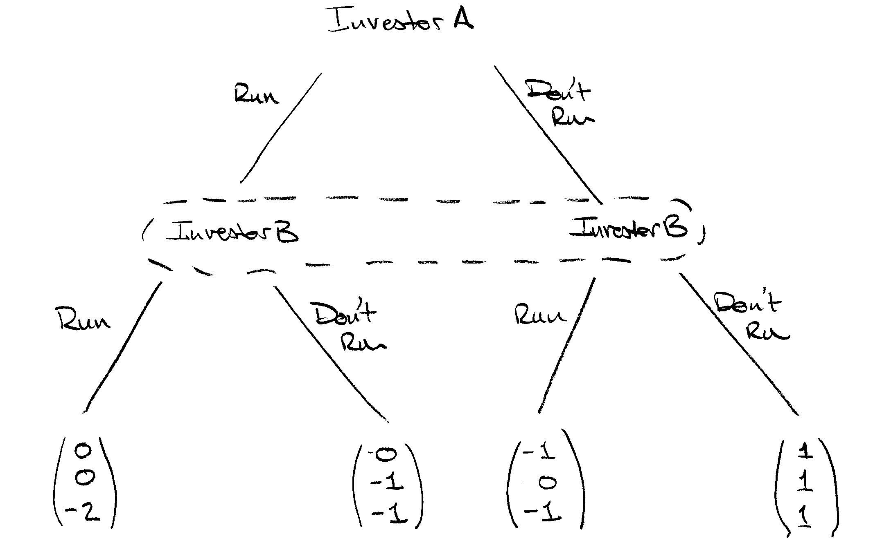
Currency Attack Model

Slide 48
Currency Attack Model
This simplified model is equivalent to Diamond-Dybvig bank run model
Model has two Nash equilibria:
(Don’t Run, Don’t Run)
(Run, Run)
Just like in bank run case, (Run, Run) equilibrium is bad for everyone, but is nevertheless an equilibrium

Slide 49
Currency Attack Model
How can this outcome be avoided?
Government can try to convince speculators that it is strong and can defend the currency
Consider the following alternative situation in which the government is either:
“Strong” in the sense of being able to defend at low cost (perhaps because it has lots of reserves)
Places high value on maintaining the gold standard

Slide 50
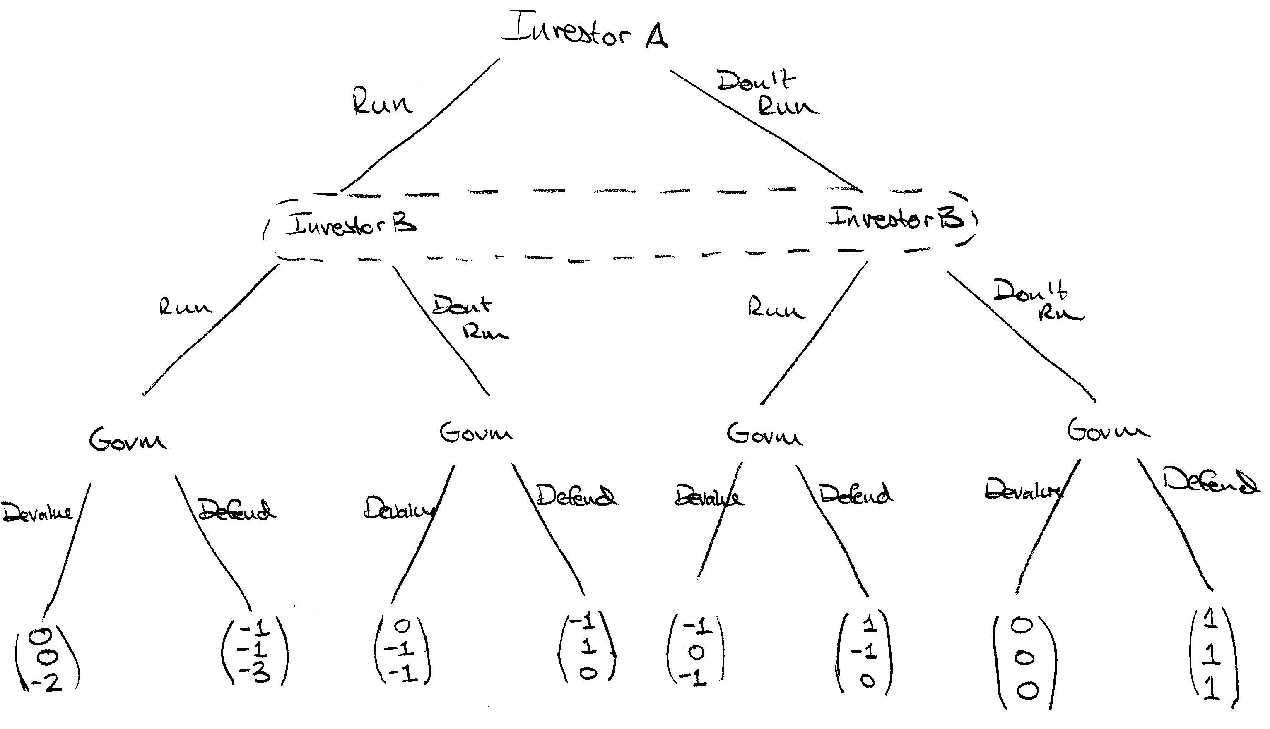
Currency Attack Model

Slide 51
Currency Attack Model
Only change is that it is less costly for government to defend against a “small” run
New optimal government strategy:
Default if both A and B run
Defend otherwise
Given this strategy by government, model simplifies to …

Slide 52
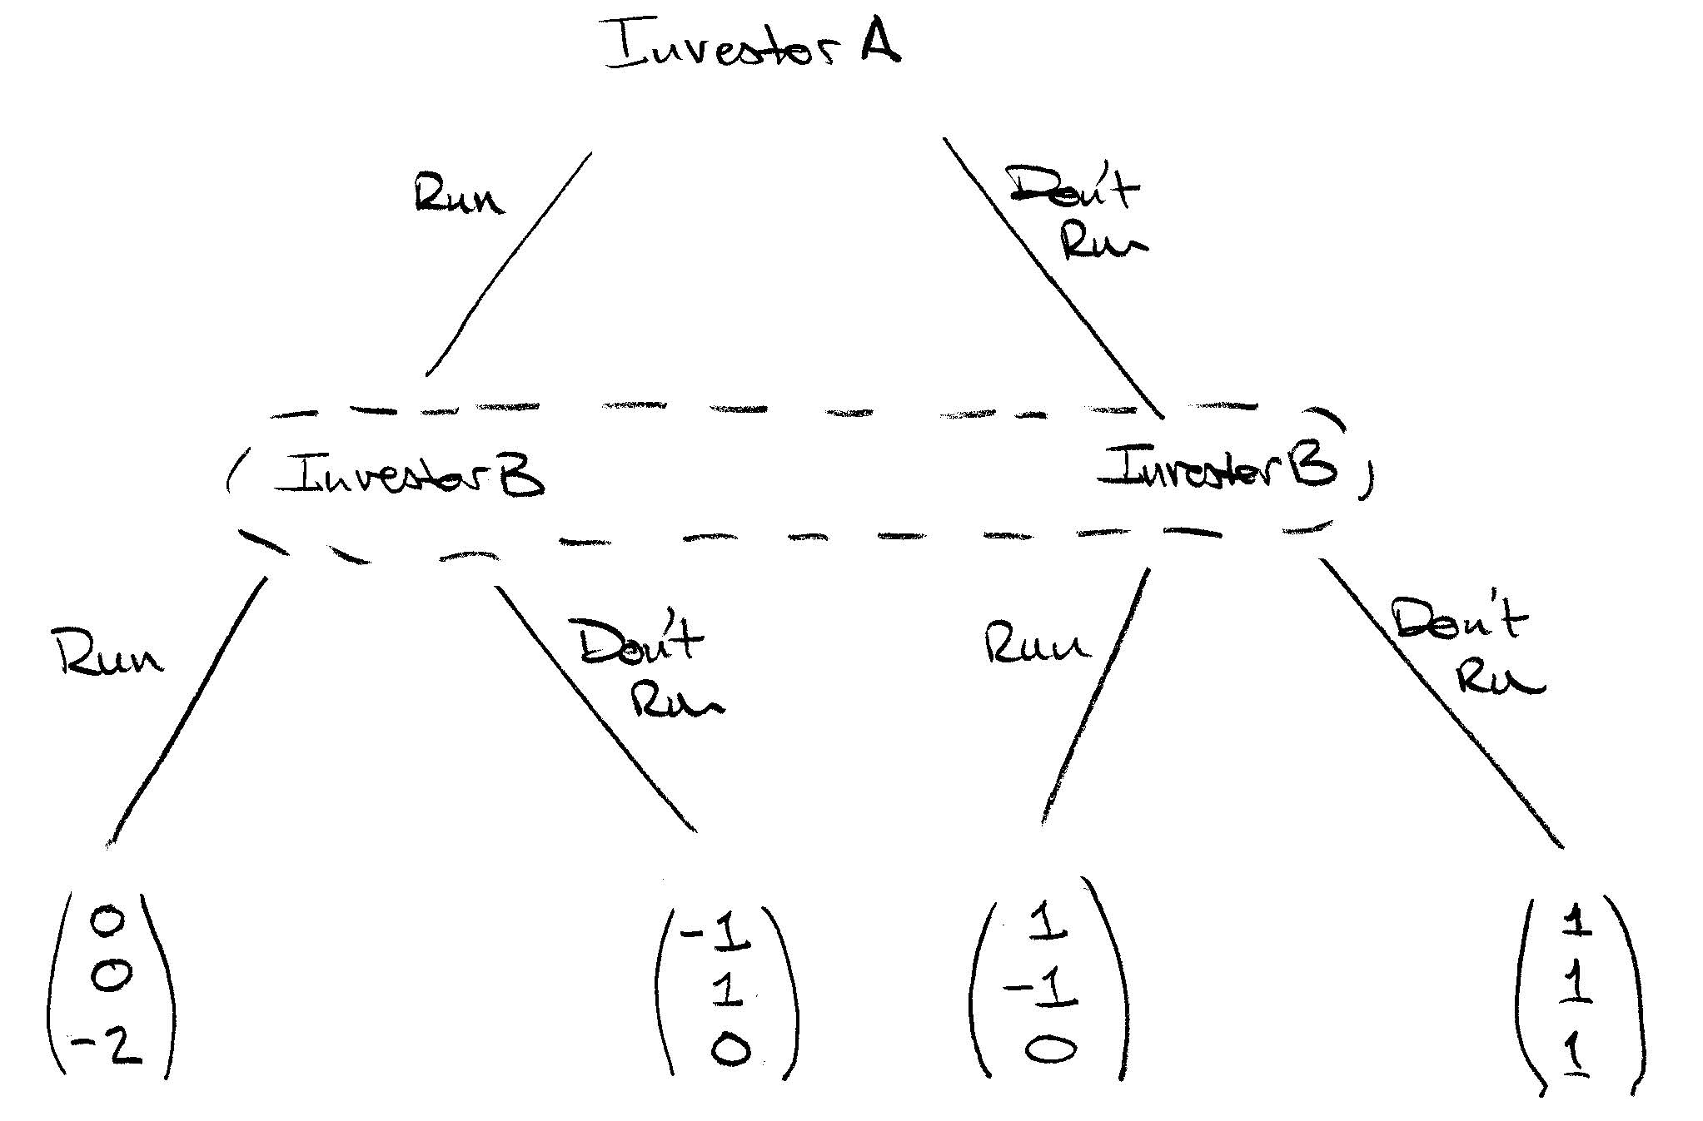
Currency Attack Model

Slide 53
Currency Attack Model
This version has a single Nash equilibrium:
(Don’t Run, Don’t Run)
It is actually a dominant strategy for both investors not to run
Each investor knows that the government is “strong” enough to withstand the other running
So, each one doesn’t have to run only because the other is running

Slide 54
Speculative Attacks
Countries on a fixed exchange rate can face speculative attacks
This happened to many countries in the Great Depression
Has happened frequently in the last 50 years
E.g., UK 1992, Mexico 1994, Thailand 1997, Argentina 2001, etc.

Slide 55
Value of Maintaining Fixed Rate
Value of maintaining a fixed rate is unclear
In most cases, there is short term pain:
High interest rates
A recession
But then there may be longer term gains:
Investors more willing to invest in the country because they are confident currency will not loose value
Lower interest rates
Hard to value long term gains

Slide 56
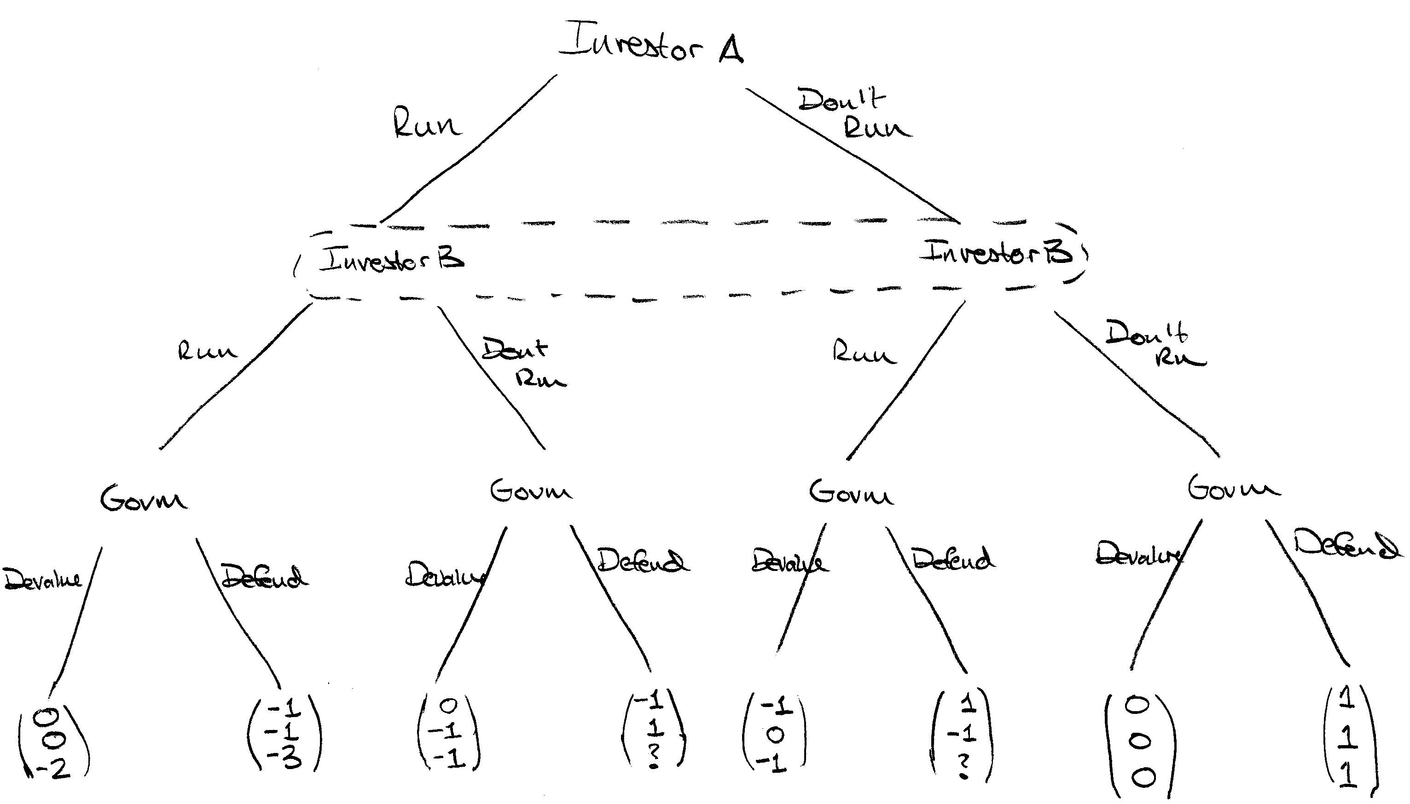
Will Government Defend?
Uncertainty about government “strength”

Slide 57
Speculation and Credibility
If a fixed exchange rate has high credibility, speculators will act to stabilize exchange rate
Suppose exchange rate falls a bit for some reason
Speculators, expecting that it will rise back, see this as an opportunity to buy currency
Thus speculators help currency move back to fixed rate (central bank needs not do much since speculators do all the heavy lifting)

Slide 58
Speculation and Credibility
However, if a fixed exchange rate has low credibility, speculators will act to destabilize exchange rate
Suppose exchange rate falls a bit for some reason
Speculators will see this as a sign of weakness and perhaps start expecting further decline
They will thus sell the currency contributing to the further decline
In this case, central bank must do a lot more trading to maintain fixed rate (perhaps more than it can or is willing to do)

Slide 59
Gold Standard and Credibility
Argument for going back on gold today: Gold standard would take away ability of Fed/Treasury to create inflation
Is this convincing?
Only if we can credibly commit not to go off the gold standard when things get tough
Not clear that this is possible
What would prevent us from going off gold again when things are tough?

Slide 60
Gold Standard and Credibility
Classical gold standard worked well because it was very credible
Overwhelming political support
Devaluing unthinkable
Interwar gold standard much weaker
Less political support due to rise of left wing politics
Post WWII fixed exchange rates unstable:
Bretton Woods, ERM crisis of 1992, Asian financial crisis of 1997-8, Mexican Tequila crisis of 1994-5, Argentina 2001-2, etc., etc.

Slide 61
Fixed Exchange Rate and Credibility
Ex ante:
Want to commit to maintain fixed rate even in bad times. Why?
This lowers expected inflation and thereby interest rates. (Italy back in 1990’s)
Country more desirable destination for investment.
Ex post (e.g., recession, gov. debt crisis):
Want to renege and devalue. Why?
This creates inflation and thereby lowers real wages (increases competitiveness) and real value of debts (Greece/Italy/Spain/Portugal around 2012)

