Slide 1
Lecture 16: The Phillips Curve and the Great Inflation Macroeconomics (Quantitative) Economics 101B
Jón Steinsson
University of California, Berkeley

Slide 2
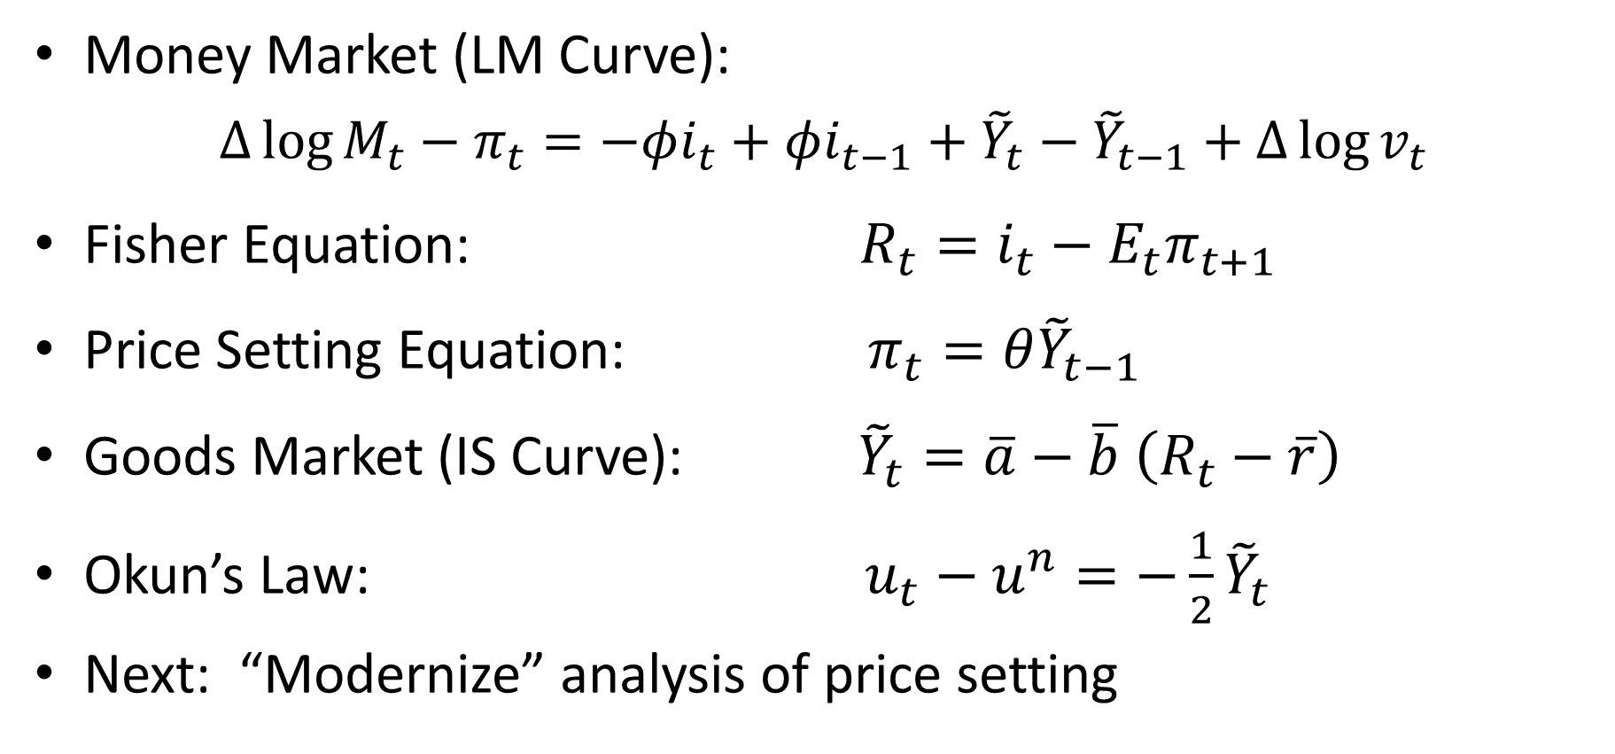
Where Do We Stand?
Money Market (LM Curve):
$∆\log{M_{t}}−π_{t}={−φi_{t}+φi_{t−1}+\tilde{Y}}_{t}−{\tilde{Y}}_{t−1}+Δ\log{v_{t}}$
Fisher Equation: $R_{t}=i_{t}−E_{t}π_{t+1}$
Price Setting Equation: $π_{t}=θ{\tilde{Y}}_{t−1}$
Goods Market (IS Curve): ${\tilde{Y}}_{t}=\overline{a}−\overline{b}$ $\left(R_{t}−\overline{r}\right)$
Okun’s Law: $u_{t}−u^{n}=−\frac{1}{2}{\tilde{Y}}_{t}$
Next: “Modernize” analysis of price setting

Slide 3
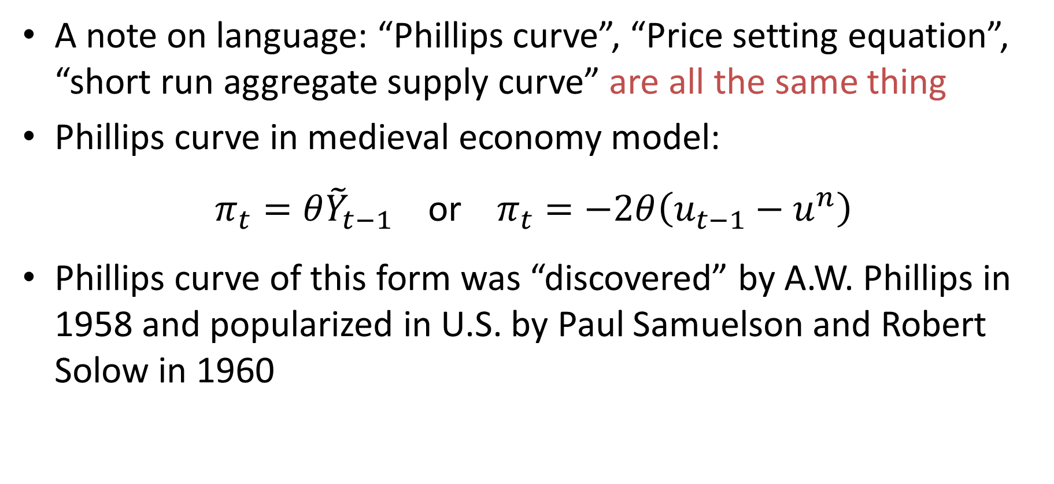
The Phillips Curve
A note on language: “Phillips curve”, “Price setting equation”, “short run aggregate supply curve” are all the same thing
Phillips curve in medieval economy model:
$π_{t}=θ{\tilde{Y}}_{t−1}$ or $π_{t}=−2θ\left(u_{t−1}−u^{n}\right)$
Phillips curve of this form was “discovered” by A.W. Phillips in 1958 and popularized in U.S. by Paul Samuelson and Robert Solow in 1960

Slide 4
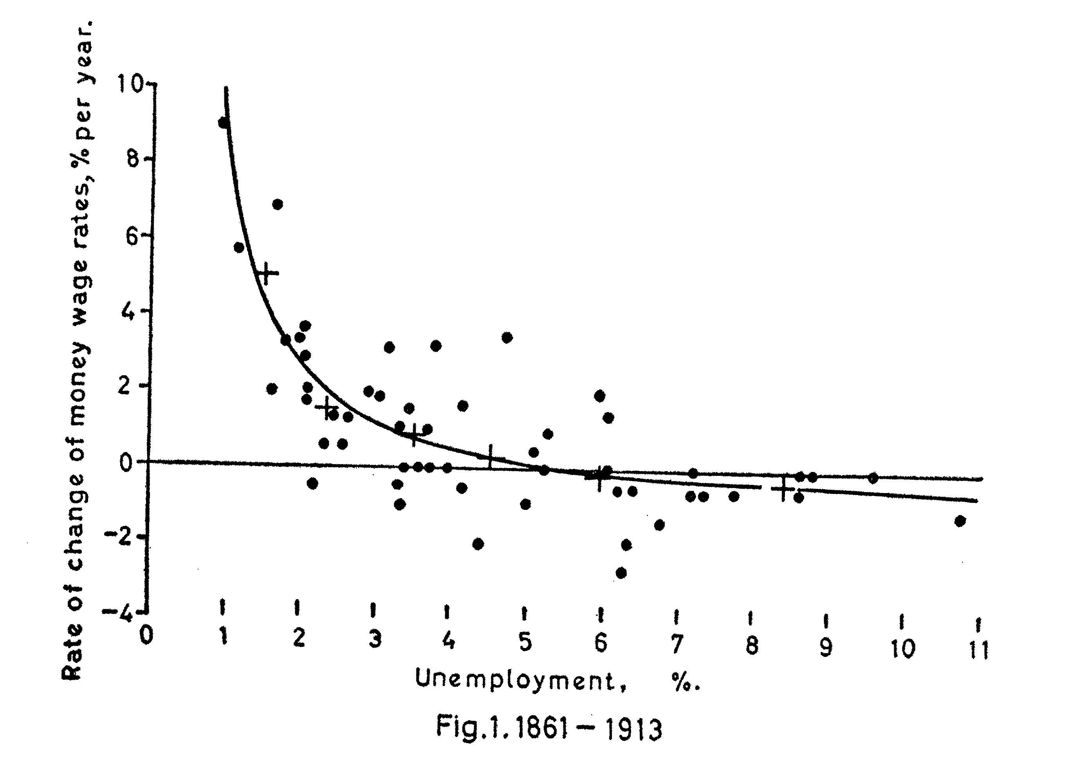
Inflation and Unemployment in U.K.

Slide 5
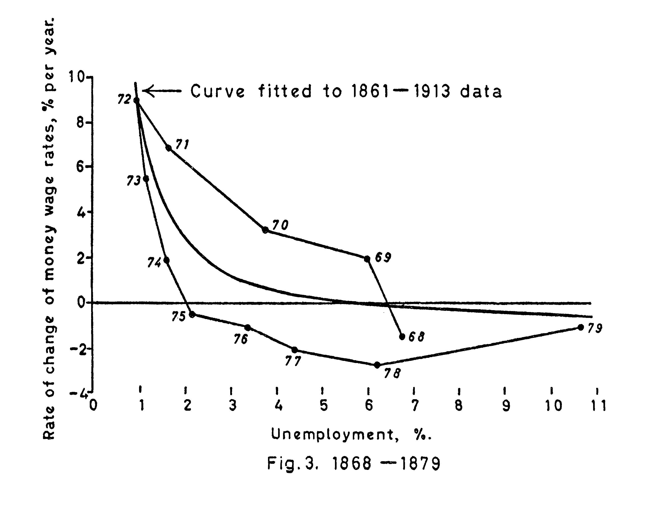
Inflation and Unemployment in U.K.

Slide 6
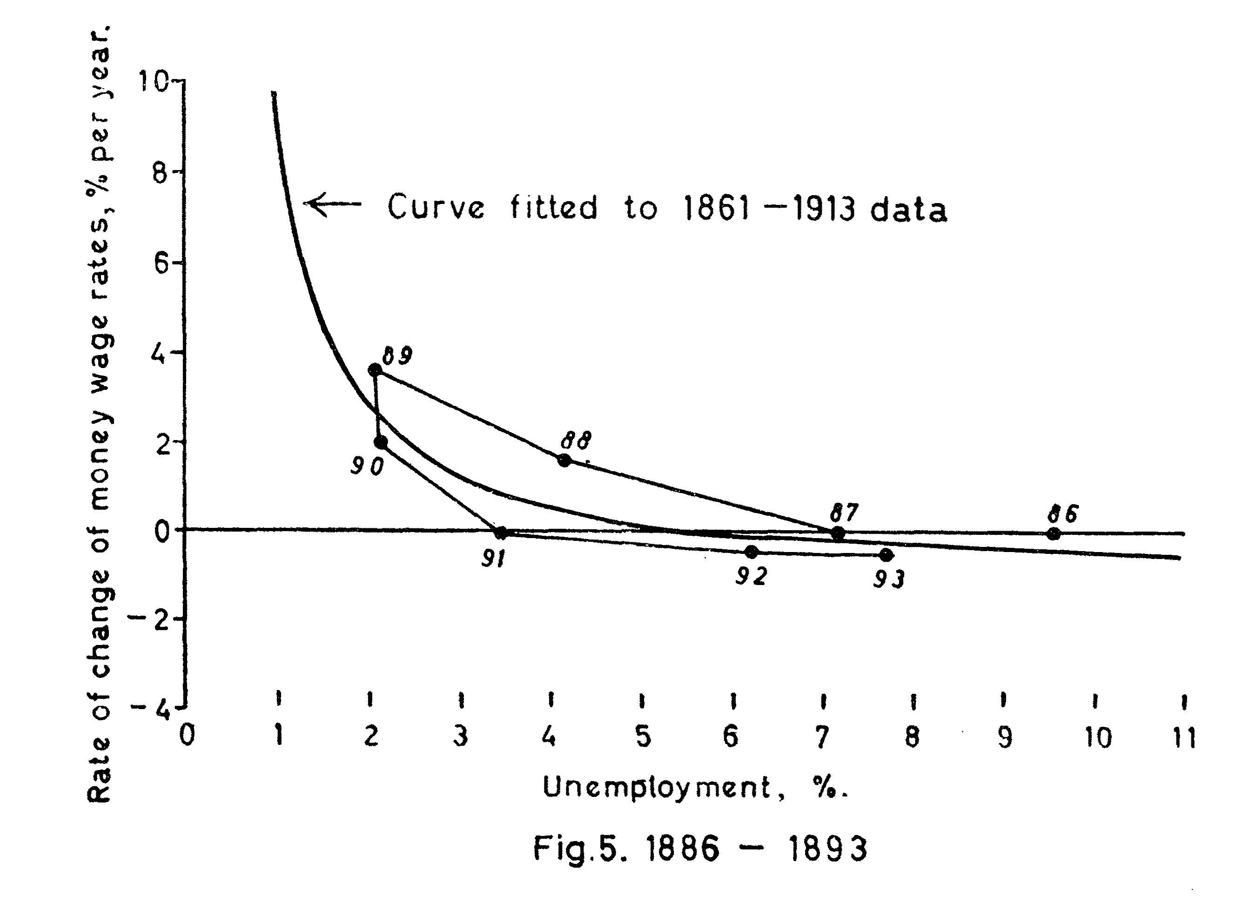
Inflation and Unemployment in U.K.

Slide 7
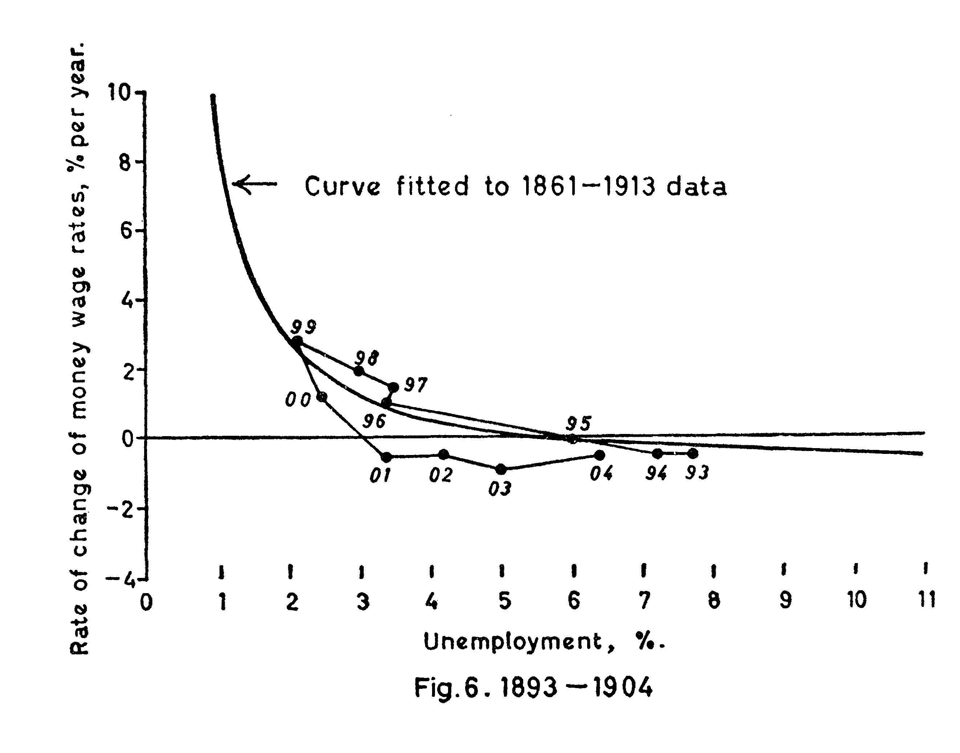
Inflation and Unemployment in U.K.

Slide 8
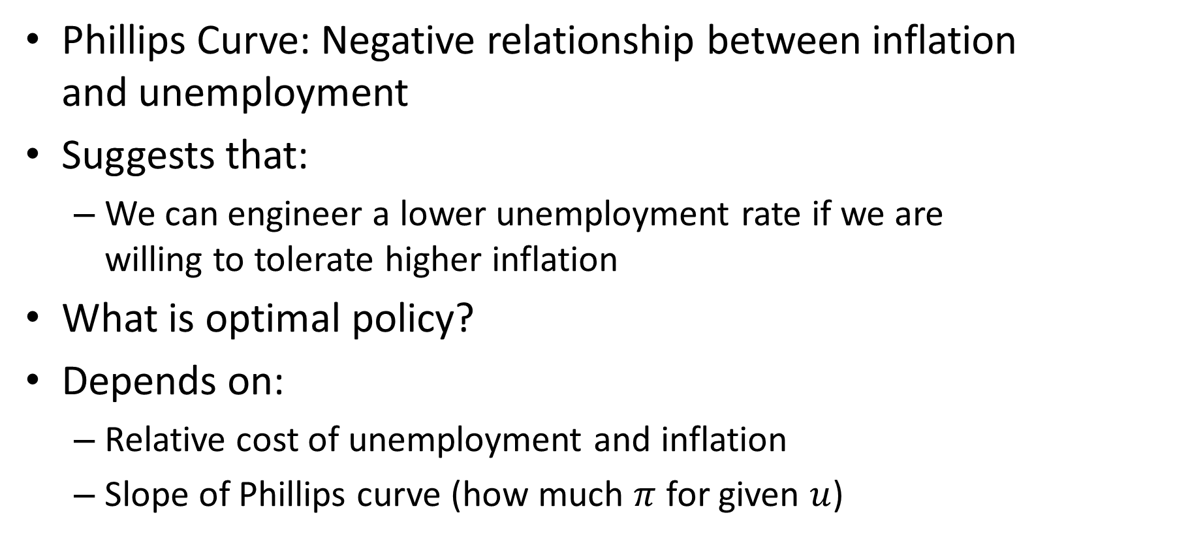
Phillips Curve and Monetary Policy
Phillips Curve: Negative relationship between inflation and unemployment
Suggests that:
We can engineer a lower unemployment rate if we are willing to tolerate higher inflation
What is optimal policy?
Depends on:
Relative cost of unemployment and inflation
Slope of Phillips curve (how much $π$ for given $u$)

Slide 9
U.S. in the 1960’s
“Guns and butter”:
Vietnam war and Great Society
Inflation rose
Many argued:
Low price to pay for lower unemployment
Phillips curve thinking had major influence on policy

Slide 10
U.S. in the 1960’s

Slide 11





U.S. 1960’s through the Lens of Medieval Economy
Start with steady state with low $∆\log{M}$
Raise money growth: $∆\log{M^{′}}>∆\log{M}$
Response of economy:
Dynamics:
$$∆\log{M_{t}}=π_{t}+{\tilde{Y}}_{t}−{\tilde{Y}}_{t−1}$$
$$π_{t}=θ{\tilde{Y}}_{t−1}$$
Steady State:
$$\overline{π}=∆\log{M}$$
$$\overline{π}=θ\overline{\tilde{Y}}$$

Slide 12

Phillips Curve in Medieval Model
Short run:
$$π_{t}=θ{\tilde{Y}}_{t−1}$$
Long run (steady state):
$$\overline{π}=θ\overline{\tilde{Y}}$$
And combined with Okun’s law:
$$\overline{π}=−2θ\left(\overline{u}−u^{n}\right)$$

Slide 13
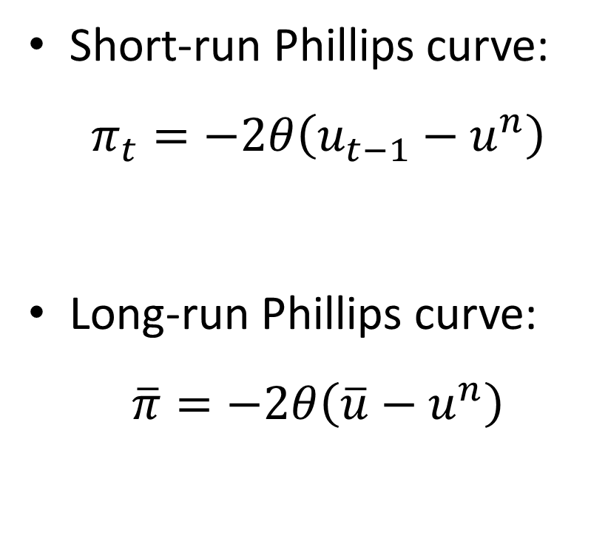
Long-Run Phillips Curve in Medieval Model
Short-run Phillips curve:
$π_{t}=−2θ\left(u_{t−1}−u^{n}\right)$
Long-run Phillips curve:
$\overline{π}=−2θ\left(\overline{u}−u^{n}\right)$
Inflation
SRPC
LRPC
u^{n}
Unemployment

Slide 14
Price Setting
Does the long run Phillips curve in the Medieval model make sense?
Idea behind price setting equation:
Shop keeper wants to work a certain amount (natural rate of output/unemployment)
If demand is too high on a particular day, she raises her price for the next day
Worked well in middle ages model with stable price level
But now we are in a world with steady inflation

Slide 15
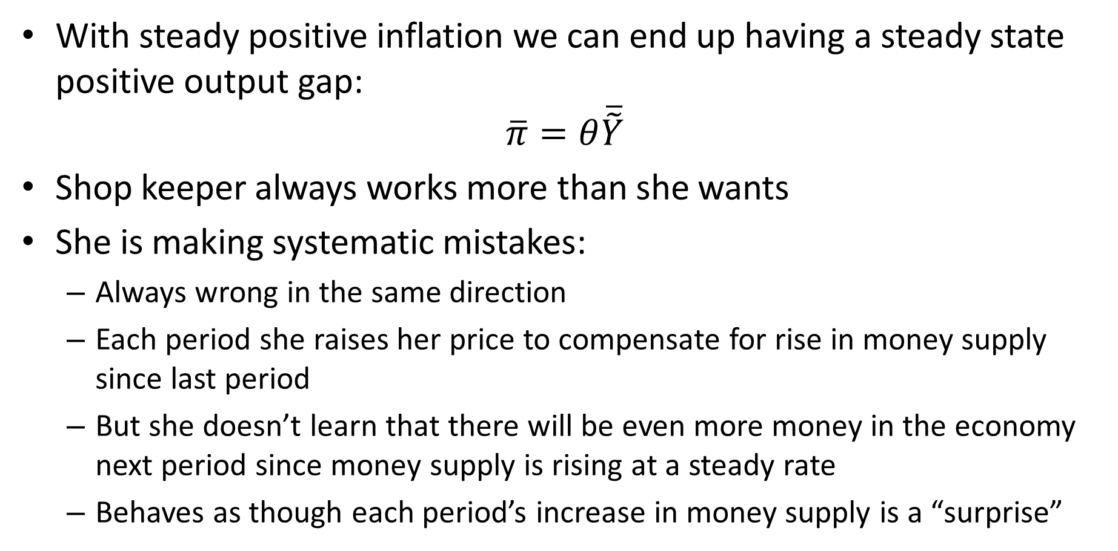
Price Setting
With steady positive inflation we can end up having a steady state positive output gap:
$$\overline{π}=θ\overline{\tilde{Y}}$$
Shop keeper always works more than she wants
She is making systematic mistakes:
Always wrong in the same direction
Each period she raises her price to compensate for rise in money supply since last period
But she doesn’t learn that there will be even more money in the economy next period since money supply is rising at a steady rate
Behaves as though each period’s increase in money supply is a “surprise”

Slide 16
Price Setting
Abraham Lincoln:
“You can fool some of the people all of the time, and all of the people some of the time, but you can not fool all of the people all of the time.”
Medieval price setting equation violates this
Not a very satisfying theory of price setting in an economy with steady non-zero inflation

Slide 17
Expectation’s Augmented Phillips Curve
In 1968, Milton Friedman and Edmund Phelps independently argued:
Phillips curve trade off will break down
People will come to expect higher inflation and will take this into account when setting prices
This will shift Phillips curve up if policy makers try to exploit it

Slide 18
U.S. in 1960’s

Slide 19
Friedman and Phelps Were Right!!

Slide 20
U.S. in 1970’s
Policy-makers tried to maintain unemployment below “natural” rate
Phillips curve started to shift up
Inflation
Unemployment

Slide 21
Big Mistake
Many economists in the 60’s and 70’s looked at the plots in Phillips’ paper and believed in a permanent trade-off between inflation and output
It turns out that they got things terribly wrong
U.S. economy spiraled out of control
They argued: Here is a correlation, let’s exploit it!
But they didn’t understand the causation behind the correlation properly
In this case, the correlation would break down when policymakers tried to exploit it because expectations changed

Slide 22
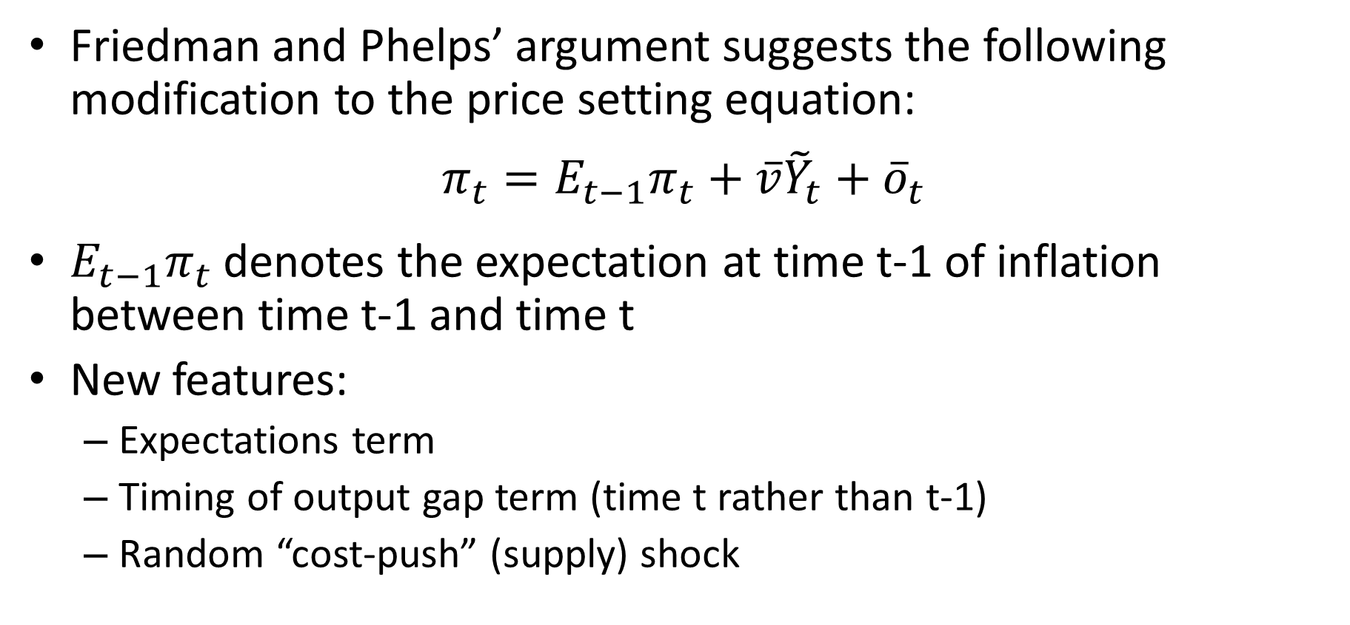
Expectations Augmented Phillips Curve
Friedman and Phelps’ argument suggests the following modification to the price setting equation:
$$π_{t}=E_{t−1}π_{t}+\overline{v}{\tilde{Y}}_{t}+{\overline{o}}_{t}$$
$E_{t−1}π_{t}$ denotes the expectation at time t-1 of inflation between time t-1 and time t
New features:
Expectations term
Timing of output gap term (time t rather than t-1)
Random “cost-push” (supply) shock

Slide 23
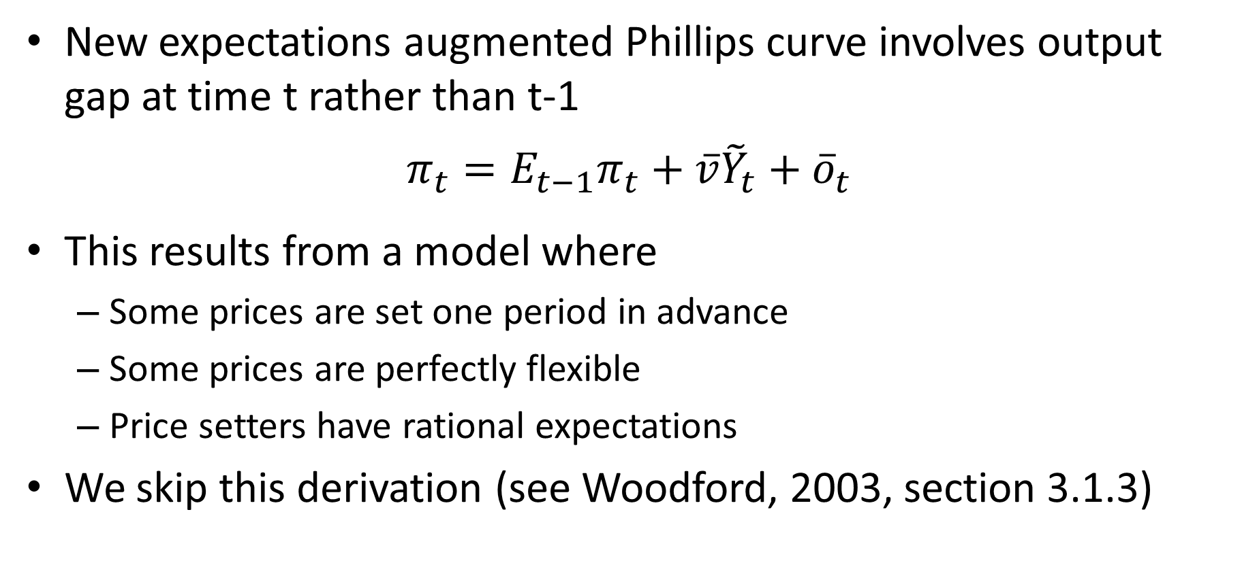
Timing of Output Gap Term
New expectations augmented Phillips curve involves output gap at time t rather than t-1
$$π_{t}=E_{t−1}π_{t}+\overline{v}{\tilde{Y}}_{t}+{\overline{o}}_{t}$$
This results from a model where
Some prices are set one period in advance
Some prices are perfectly flexible
Price setters have rational expectations
We skip this derivation (see Woodford, 2003, section 3.1.3)

Slide 24
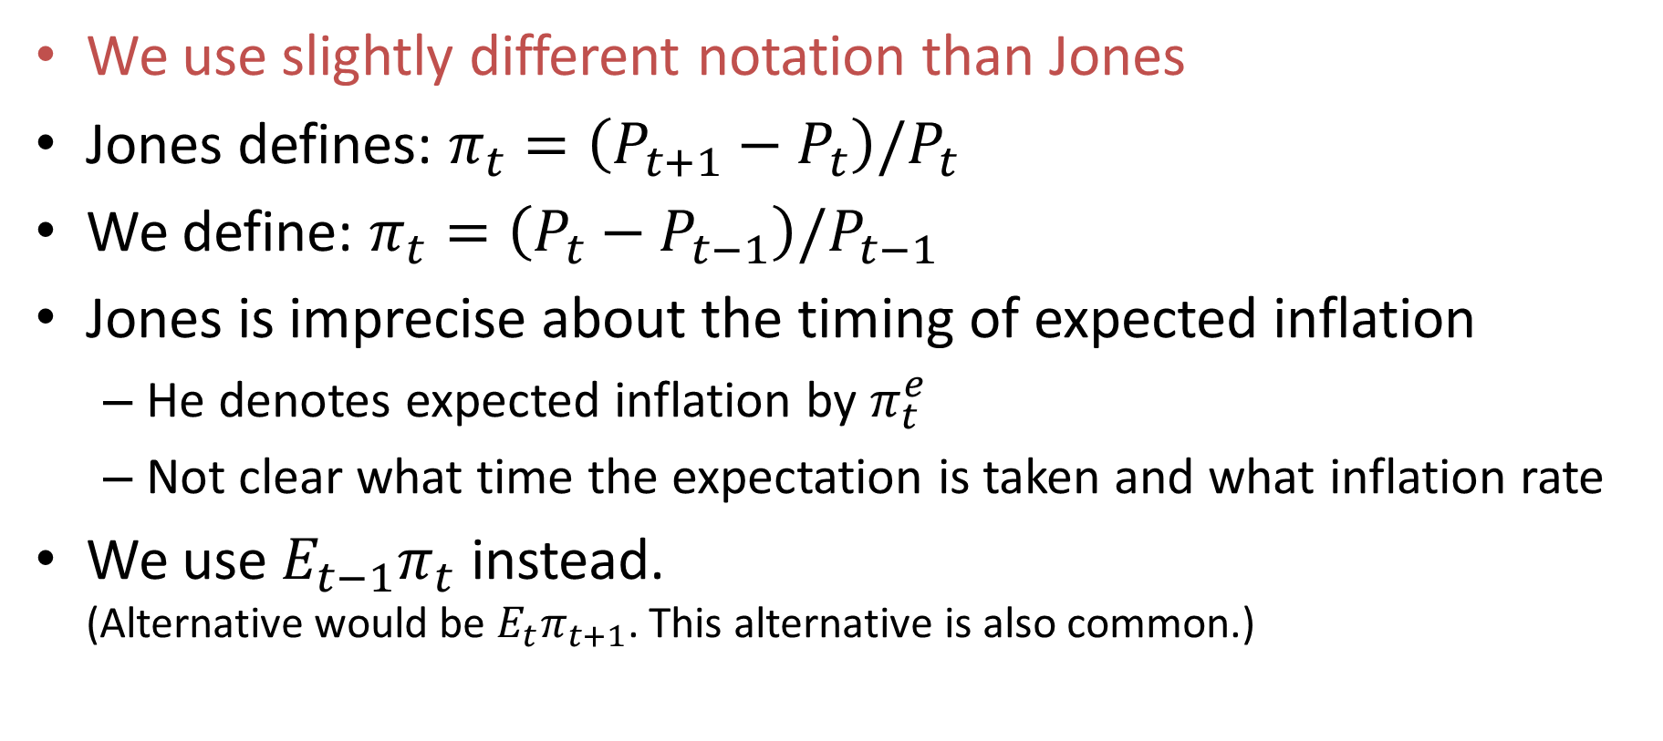
Jones’ Notation Versus Our Notation
We use slightly different notation than Jones
Jones defines: $π_{t}=\left(P_{t+1}−P_{t}\right)/P_{t}$
We define: $π_{t}=\left(P_{t}−P_{t−1}\right)/P_{t−1}$
Jones is imprecise about the timing of expected inflation
He denotes expected inflation by $π_{t}^{e}$
Not clear what time the expectation is taken and what inflation rate
We use $E_{t−1}π_{t}$ instead. (Alternative would be $E_{t}π_{t+1}$. This alternative is also common.)

Slide 25
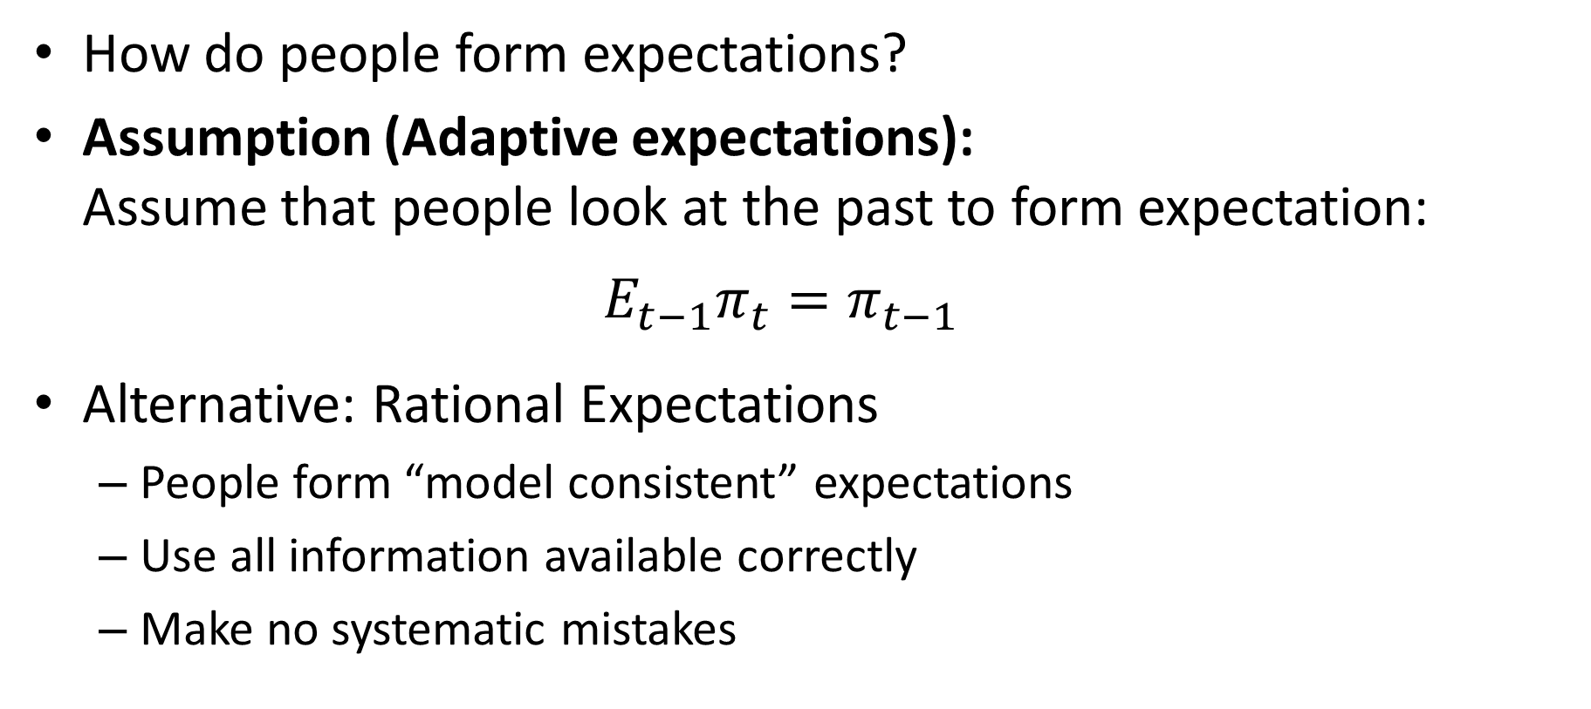
Expectations Formation
How do people form expectations?
Assumption (Adaptive expectations): Assume that people look at the past to form expectation:
$$E_{t−1}π_{t}=π_{t−1}$$
Alternative: Rational Expectations
People form “model consistent” expectations
Use all information available correctly
Make no systematic mistakes

Slide 26
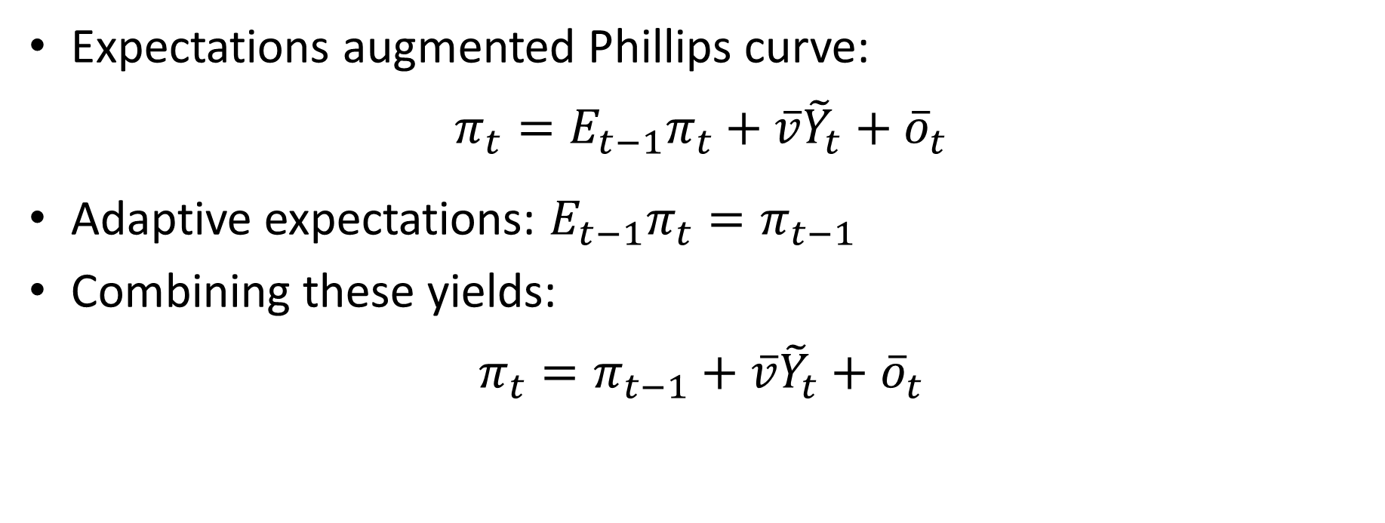
Expectations Augmented Phillips Curve
Expectations augmented Phillips curve:
$$π_{t}=E_{t−1}π_{t}+\overline{v}{\tilde{Y}}_{t}+{\overline{o}}_{t}$$
Adaptive expectations: $E_{t−1}π_{t}=π_{t−1}$
Combining these yields:
$$π_{t}=π_{t−1}+\overline{v}{\tilde{Y}}_{t}+{\overline{o}}_{t}$$

Slide 27
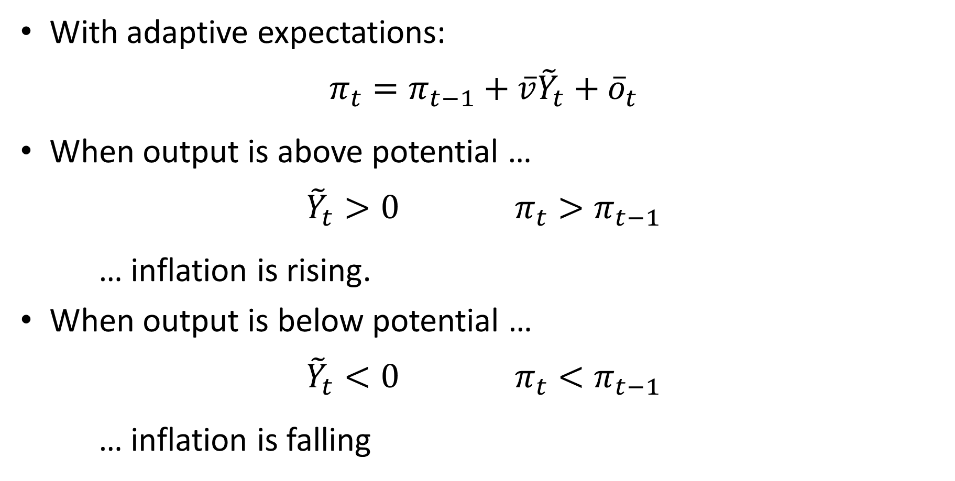
Expectations Augmented Phillips Curve
With adaptive expectations:
$$π_{t}=π_{t−1}+\overline{v}{\tilde{Y}}_{t}+{\overline{o}}_{t}$$
When output is above potential …
$${\tilde{Y}}_{t}>0 π_{t}>π_{t−1}$$
… inflation is rising.
When output is below potential …
$${\tilde{Y}}_{t}<0 π_{t}<π_{t−1}$$
… inflation is falling

Slide 28


Expectations Augmented Phillips Curve
$$π_{t}=π_{t−1}−2\overline{v}\left(u_{t}−u^{n}\right)+{\overline{o}}_{t}$$
When $u_{t}<u^{n}$
When $u_{t}>u^{n}$
Inflation
Inflation
Unemployment
Unemployment

Slide 29

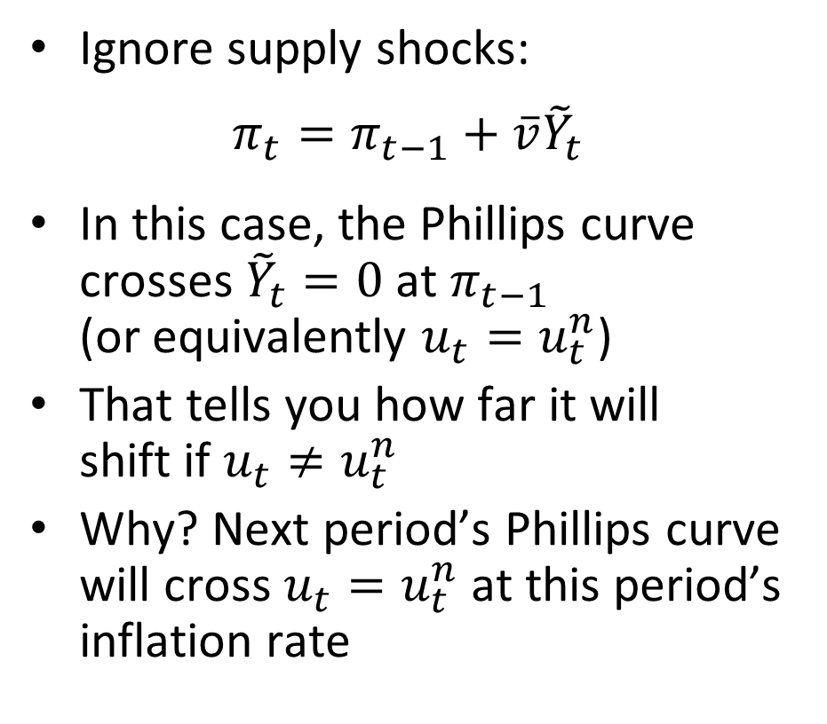
Expectations Augmented Phillips Curve
Ignore supply shocks:
$$π_{t}=π_{t−1}+\overline{v}{\tilde{Y}}_{t}$$
In this case, the Phillips curve crosses ${\tilde{Y}}_{t}=0$ at $π_{t−1}$ (or equivalently $u_{t}=u_{t}^{n}$)
That tells you how far it will shift if $u_{t}≠u_{t}^{n}$
Why? Next period’s Phillips curve will cross $u_{t}=u_{t}^{n}$ at this period’s inflation rate
Inflation
$$π_{t−1}$$
Unemployment

Slide 30
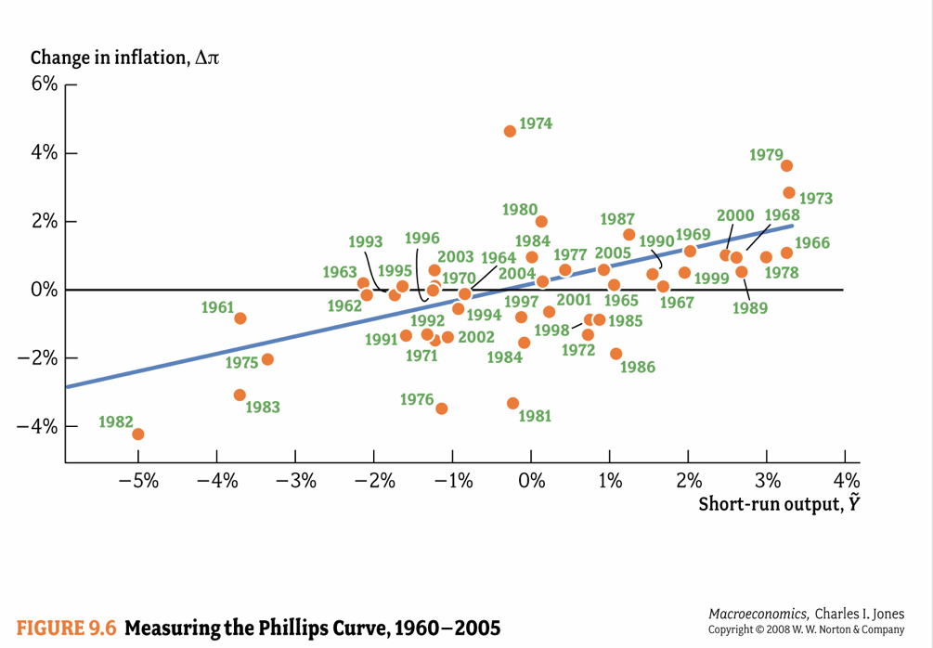

Slide 31
The NAIRU
An alternative term for the “natural rate” of unemployment is the “NAIRU”
“Non-accelerating inflation rate of unemployment”
Rate of unemployment that is consistent with stable inflation
This concept captures the fact that:
Inflation rises when unemployment is below the NAIRU or natural rate
Inflation falls when unemployment is above the NAIRU or natural rate
Strictly speaking it should be NIIRU or “nonincreasing inflation rate of unemployment”

Slide 32
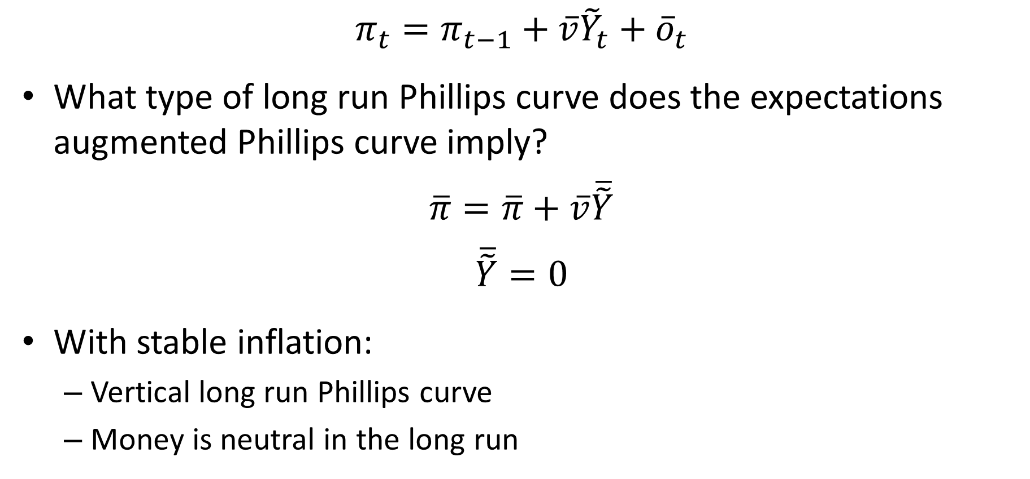
Long Run Phillips Curve
$$π_{t}=π_{t−1}+\overline{v}{\tilde{Y}}_{t}+{\overline{o}}_{t}$$
What type of long run Phillips curve does the expectations augmented Phillips curve imply?
$$\overline{π}=\overline{π}+\overline{v}\overline{\tilde{Y}}$$
$$\overline{\tilde{Y}}=0$$
With stable inflation:
Vertical long run Phillips curve
Money is neutral in the long run

Slide 33
Stagflation in 1970s
Rising inflation in late-60s and 1970s
Stagflation: Rising inflation and rising unemployment
Causes:
Oil shocks (1973 and 1979)
Unanchored inflation expectations

Slide 34

High Inflation of the 1970s
Nixon 1971: Wage and price controls
Failure
Ford 1974:
Inflation “public enemy number one”
WIN: Whip inflation now
Carter:
“Persistent high inflation threatens the economic security of our country“
Oct 1979: Appoints Paul Volcker Chairman of Fed

Slide 35
The Volcker Disinflation
Real Interest Rate
AS
FE
Inflation
FE
B,C,D
π₀
A
R₁
MP’
π₁
B
R₀
E
MP
C
A
π₂
E
π₂
D
IS
Y₁
Y₀
Y₁
Y₀
Output gap
Output gap
Volcker raised interest rates massively. This led to a deep recession. Inflation came down relatively quickly. Output was then allowed to rise back to potential.

Slide 36
The Sacrifice Ratio
Sacrifice ratio: Percentage of a year's real GDP foregone to permanently reduce inflation by one percentage point
In the late 1970’s economists believed that sacrifice ratio was high
Okun (1978) predicted a sacrifice ratio of 10!
I.e., to bring inflation down from 12% to 2% would entail a loss of an entire year’s worth of output!
Led many economists to be skeptical that it was worth the cost to bring down inflation
Notes:
36

Slide 37
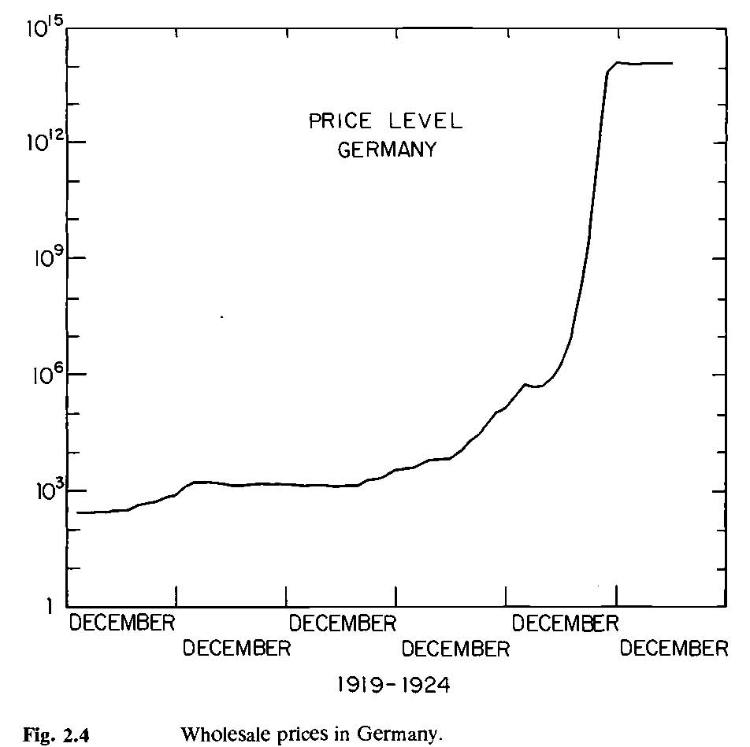
Rational Expectations Revolution
Thomas Sargent challenged this idea
In a famous article titled “The End of Four Big Inflations”
Pointed out that:
In hyperinflations, inflation is 1,000s% per year (e.g., roughly 25,000% in Germany in late 1923)
Hyperinflations always end abruptly! (in late November 1923 in German case)
Source: Sargent (1982)

Slide 38
Sacrifice Ratio
Hyperinflations always end abruptly
Inflation goes from 1,000s% to 0% overnight
If sacrifice ratio is 10, cost should be 10,000s% of output
In fact, costs are close to zero (perhaps even negative, i.e., net benefits)
How can this be?

Slide 39
Credible Announcements
Sacrifice ratio is not some fundamental unchangeable feature of reality
Its size depends on how the government goes about reducing inflation
If the government is able to make a credible commitment to dramatically lower inflation:
Inflationary expectations will fall rapidly
Phillips curve will shift down rapidly
Sacrifice ratio will be small

Slide 40
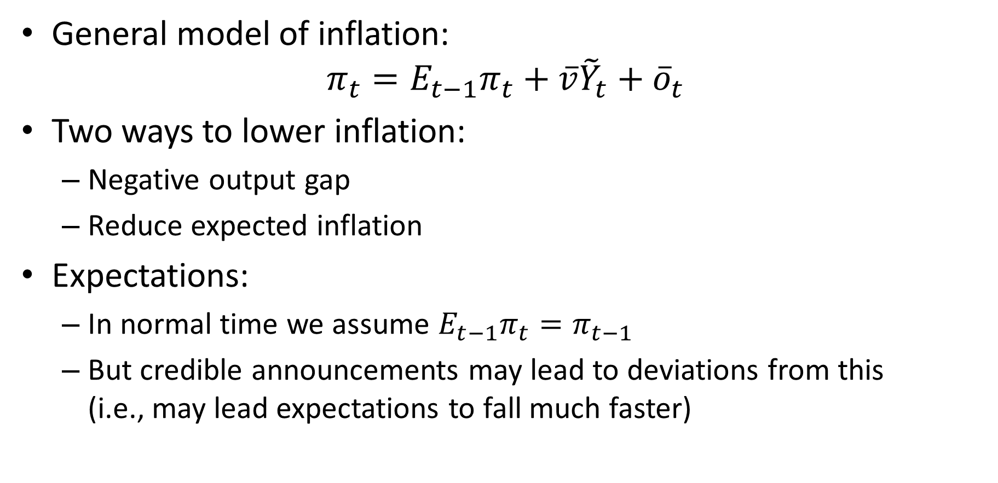
The Role of Expectations
General model of inflation:
$$π_{t}=E_{t−1}π_{t}+\overline{v}{\tilde{Y}}_{t}+{\overline{o}}_{t}$$
Two ways to lower inflation:
Negative output gap
Reduce expected inflation
Expectations:
In normal time we assume $E_{t−1}π_{t}=π_{t−1}$
But credible announcements may lead to deviations from this (i.e., may lead expectations to fall much faster)

Slide 41
Sargent’s Argument
To bring down inflation at low cost, the Fed should:
Make a clear commitment to low inflation
Act decisively to convince the public that they were serious about bringing down inflation
Easier said than done given low credibility of Fed after many failed attempts to lower inflation in the 1970s
But this is what Volcker did

Slide 42
My Research on the Phillips Curve
Hazell, Herreno, Nakamura, Steinsson (2020):
1/3 of fall in inflation during Volcker disinflation due to negative output gap
2/3 of fall in inflation during Volcker disinflation due to shifts in inflationary expectations

Slide 43
Volcker Disinflation (1980-84)
Historical estimate of sacrifice ratio for U.S. ≈ 2.4
1 percentage point drop in inflation costs 2.4% of one year's GDP (could be spread out over time)
Reduced inflation from ≈ 12.1 % to 3.3% (8.8 pct points)
Caused severe recession (unemployment up to 9.5%)
Total output loss estimated ≈ 16% of a year's GDP
Sacrifice ratio for that episode = 16/8.8 = 1.8
Y
time
Notes:
43

Slide 44
Hyperinflation
Common definition: >500% per year
Examples:
France during Revolution
Germany, Austria, Hungary, Poland after WWI
China in 1948-49
Argentina, Brazil, Bolivia in 1980’s
Zimbabwe in 2007-09
Venezuela in 2016-22

Slide 45
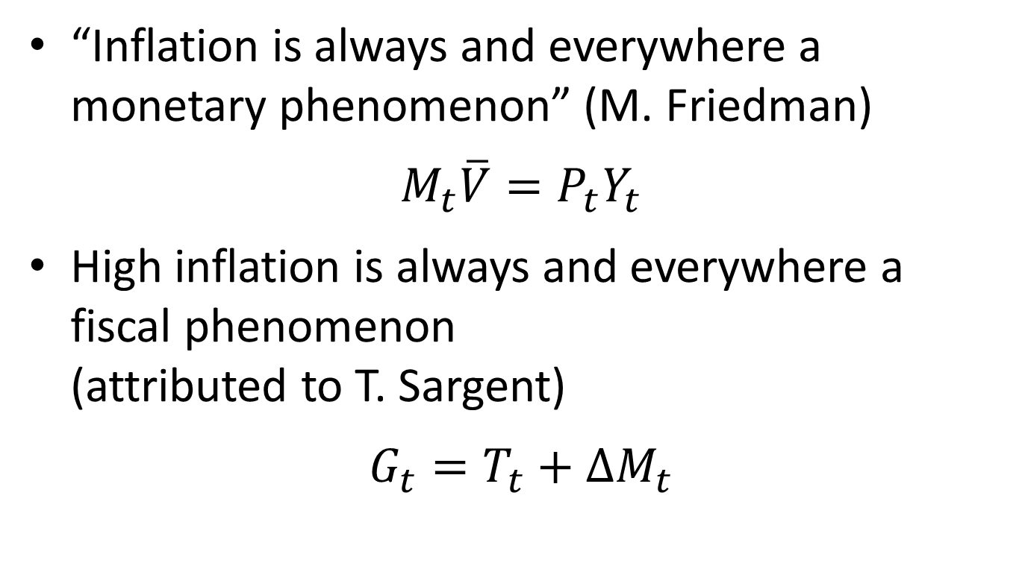
Monetary Policy and Fiscal Policy
“Inflation is always and everywhere a monetary phenomenon” (M. Friedman)
$$M_{t}\overline{V}=P_{t}Y_{t}$$
High inflation is always and everywhere a fiscal phenomenon (attributed to T. Sargent)
$$G_{t}=T_{t}+∆M_{t}$$

Slide 46
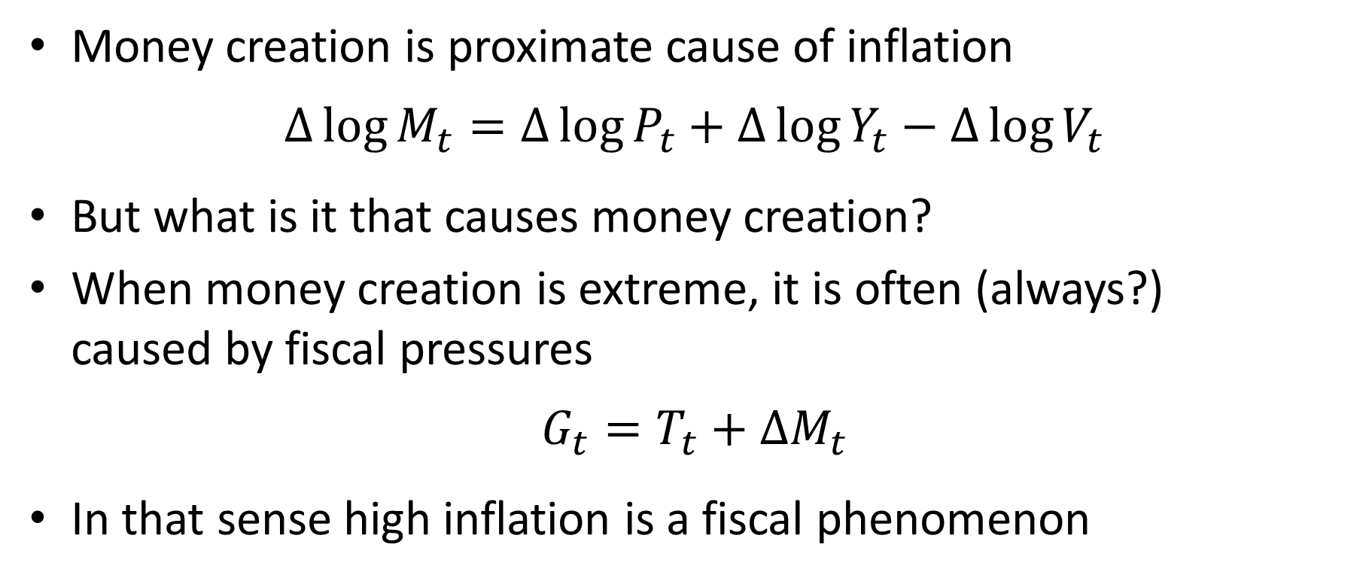
Cause of Inflation
Money creation is proximate cause of inflation
$$∆\log{M_{t}}=∆\log{P_{t}}+∆\log{Y_{t}}−∆\log{V_{t}}$$
But what is it that causes money creation?
When money creation is extreme, it is often (always?) caused by fiscal pressures
$$G_{t}=T_{t}+∆M_{t}$$
In that sense high inflation is a fiscal phenomenon

Slide 47
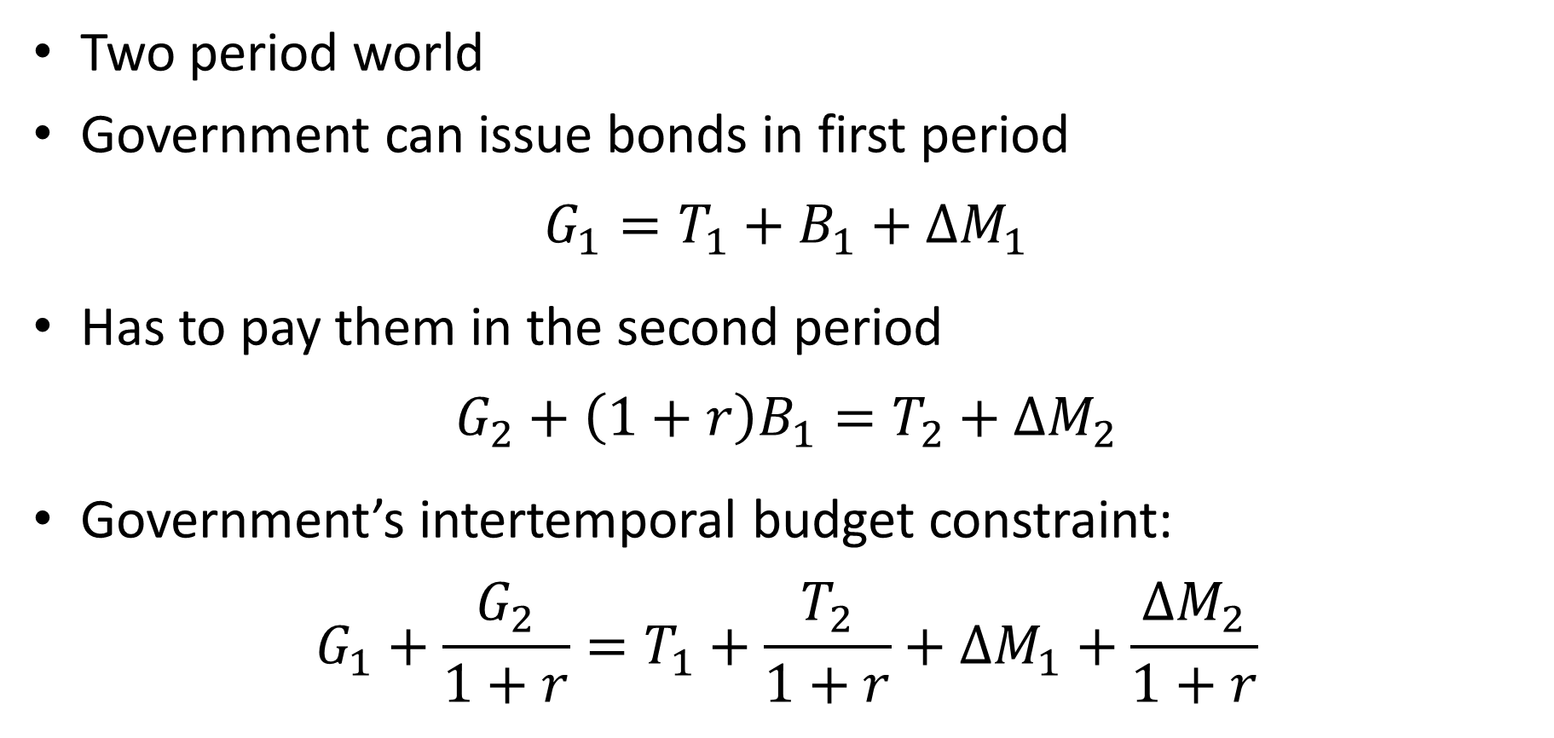
Do Bonds Help?
Two period world
Government can issue bonds in first period
$$G_{1}=T_{1}+B_{1}+∆M_{1}$$
Has to pay them in the second period
$$G_{2}+\left(1+r\right)B_{1}=T_{2}+∆M_{2}$$
Government’s intertemporal budget constraint:
$$G_{1}+\frac{G_{2}}{1+r}=T_{1}+\frac{T_{2}}{1+r}+∆M_{1}+\frac{∆M_{2}}{1+r}$$

Slide 48
Do Bonds Help?
Even if governments can issue bonds in the short run, there are ultimately only two ways to pay for its spending:
Levy taxes
Print money
But in the real world, there is always another period. Why can’t the government keep rolling over (ever increasing amounts of) debt?
Who is going to want to hold all this debt?
Eventually government can’t find buyers for all of it
At that point, game is up (problem set 6)

Slide 49
How Do Hyperinflations End?
What kind of policy is best in a hyperinflation:
Gradual reduction of the inflation?
Shock therapy (attempt at abrupt end)?
Why does shock therapy make sense?
Rapidly change people’s expectations
Avoid prolonged recession
In theory, if policy is perfectly credible and highly salient to everyone, everyone will stop raising prices immediately
In fact, this seems to be what happens

Slide 50
Shock Therapy
What does the shock therapy consist of?
Crucial element: Fiscal reform
Root cause more spending than tax collection
How is it done?
Different in different cases
Sometimes involves institutional change that insulates central bank from political pressure (bars govnm from “borrowing” from central bank)
This forces government to cut spending or raise revenue

Slide 51
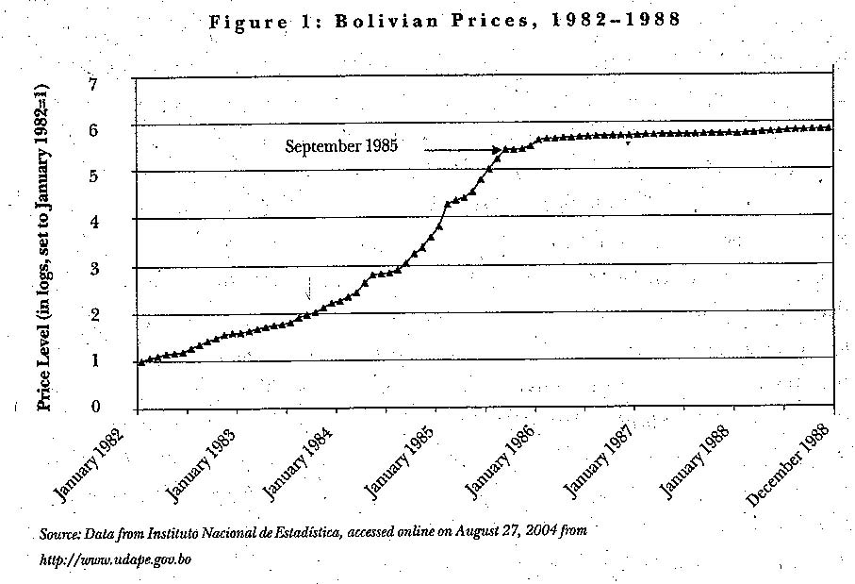
Bolivian Hyperinflation
Inflation was really high:
Aug-84 to Aug-85: 20,000 %
Peaked at 60,000% per year towards end
Ended abruptly:
Comprehensive stabilization plan on Aug 29th 1985
Within 10 days inflation was gone
Sachs: End of Poverty

Slide 52
Bolivia: Why did it happen?
1978-1985: Great deal of political instability
Coups, electoral stalemates, etc.
1980 onward: Adverse external shocks
High world interest rates (Bolivia had borrowed a lot in the 1970’s)
Falling prices for Bolivia’s exports
1982-1985: Weak government
Unable to balance the budget due to social and political pressures

Slide 53
Jeffrey Sachs to the Rescue
August 1985: New government
They hire Jeffrey Sachs to advise them
Sachs recommendation:
“Shock therapy”: End the hyperinflation all at once
“No hyperinflation had ever been stopped [gradually]”
Key: Raise the price of oil!!
Hmmm … stop a hyperinflation by raising a price?!?
Does this make sense?

Slide 54
Jeffrey Sachs to the Rescue
Government revenues depended heavily on oil taxes from state oil company
State oil company set oil prices in pesos and changed them only every few months
In between price changes, foreign currency price of oil plummeted destroying the budget
Gas price in Bolivia in Aug-85: $0.03 per liter
World gas price in Aug-85: $0.28 per liter

