Slide 1
Lecture 17: Monetary Policy Macroeconomics (Quantitative) Economics 101B
Jón Steinsson
University of California, Berkeley

Slide 2
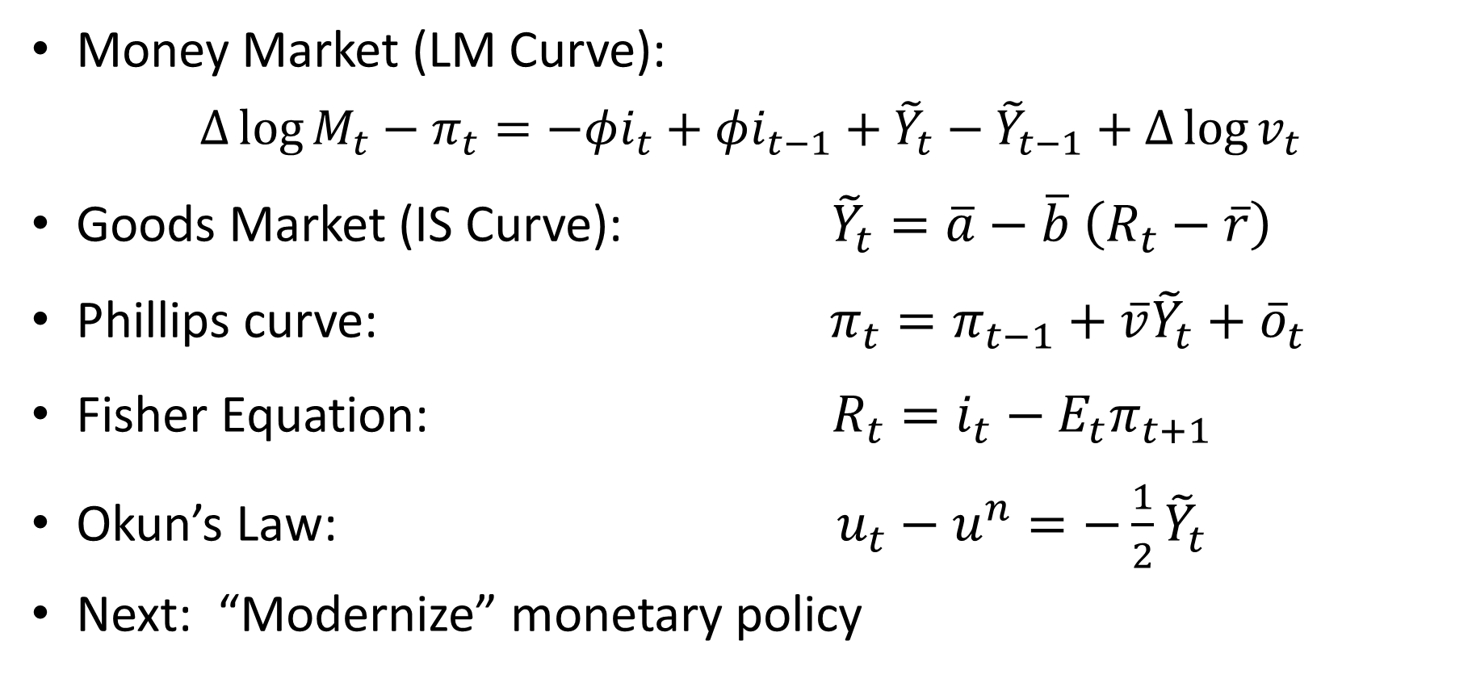
Where Do We Stand?
Money Market (LM Curve):
$∆\log{M_{t}}−π_{t}={−φi_{t}+φi_{t−1}+\tilde{Y}}_{t}−{\tilde{Y}}_{t−1}+Δ\log{v_{t}}$
Goods Market (IS Curve): ${\tilde{Y}}_{t}=\overline{a}−\overline{b}$ $\left(R_{t}−\overline{r}\right)$
Phillips curve: $π_{t}=π_{t−1}+\overline{v}{\tilde{Y}}_{t}+{\overline{o}}_{t}$
Fisher Equation: $R_{t}=i_{t}−E_{t}π_{t+1}$
Okun’s Law: $u_{t}−u^{n}=−\frac{1}{2}{\tilde{Y}}_{t}$
Next: “Modernize” monetary policy

Slide 3
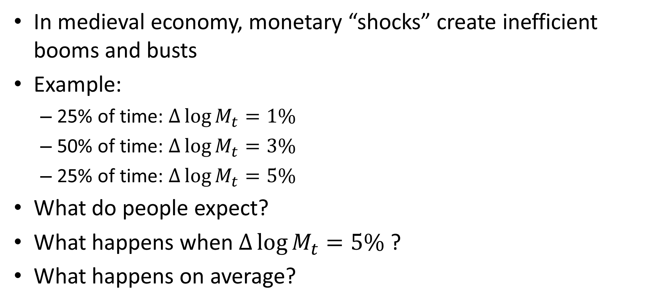
Monetary Policy
In medieval economy, monetary “shocks” create inefficient booms and busts
Example:
25% of time: $∆\log{M_{t}}=1\%$
50% of time: $∆\log{M_{t}}=3\%$
25% of time: $∆\log{M_{t}}=5\%$
What do people expect?
What happens when $∆\log{M_{t}}=5\%$ ?
What happens on average?

Slide 4
Optimal Monetary Policy
Monetary authority can’t systematically fool people => can’t systematically lower unemployment
Random variation in money reduces welfare
What is optimal monetary policy?
Can’t possibly be to create inefficient fluctuations
Milton Friedman: “Monetarism”
Fed should conduct policy such that money growth is constant (i.e. eliminate any monetary surprises)
Set money growth rate to be consistent with stable prices

Slide 5
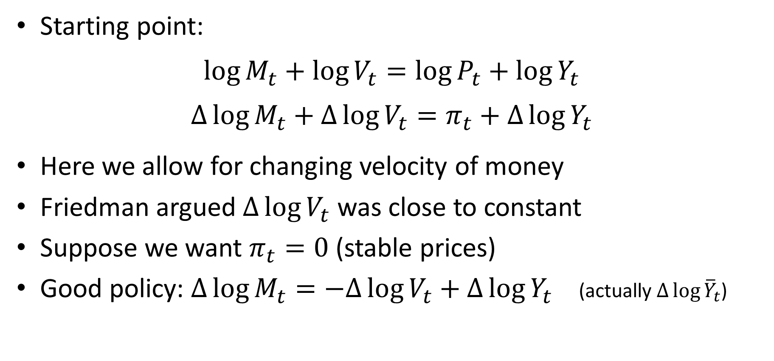
Monetarism
Starting point:
$$\log{M_{t}}+\log{V_{t}}=\log{P_{t}}+\log{Y_{t}}$$
$$∆\log{M_{t}}+∆\log{V_{t}}=π_{t}+∆\log{Y_{t}}$$
Here we allow for changing velocity of money
Friedman argued $∆\log{V_{t}}$ was close to constant
Suppose we want $π_{t}=0$ (stable prices)
Good policy: $∆\log{M_{t}}=−∆\log{V_{t}}+∆\log{Y_{t}}$ (actually $∆\log{{\overline{Y}}_{t}}$)

Slide 6
Monetarism in Practice
Perhaps Monetarism is
a simple but good way of
conducting monetary
policy!!
1960-1980:
Stable 3.5% growth in Velocity

Slide 7
Monetarism in Practice
1960-1980:
Stable 3.5% growth in Velocity
Post-1980:
Velocity becomes
highly unstable

Slide 8

Money Demand Shocks
Suppose central bank fixes the money supply (or money growth)
Money demand shocks will affect output and inflation
Increase in money demand shifts LM curve back
Decrease in money demand shifts LM curve down
LM’
R
LM
B
A
IS
$$\tilde{Y}$$

Slide 9
Money Demand Shocks
Makes no sense to have money demand shocks affect output and inflation
Good monetary policy should
“Accommodate” money demand shocks
Vary money supply to completely offset changes in money demand
Doing this will insulate economy from money demand shocks

Slide 10
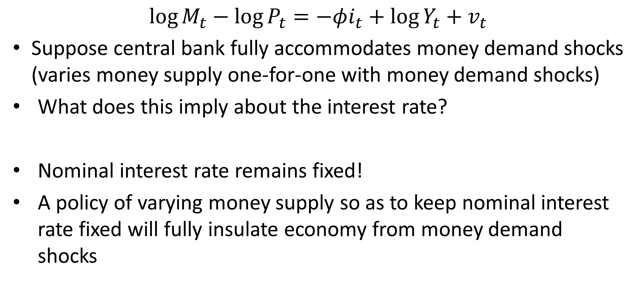
Money Demand Shocks
$$\log{M_{t}}−\log{P_{t}}=−φi_{t}+\log{Y_{t}}+v_{t}$$
Suppose central bank fully accommodates money demand shocks (varies money supply one-for-one with money demand shocks)
What does this imply about the interest rate?
Nominal interest rate remains fixed!
A policy of varying money supply so as to keep nominal interest rate fixed will fully insulate economy from money demand shocks

Slide 11
Monetary Policy
What does it mean for monetary policy to “do nothing”?
Traditional view: Not change the money supply (or money growth rate)
Alternative view: Maintain a fixed value of the nominal interest rate
I.e., vary money supply in response to variation in money demand such that nominal interest rate is fixed

Slide 12
Monetary Policy
Central Bank can choose the money supply to achieve any nominal interest rate it wants
We can think of the Central Bank as directly choosing the nominal interest rate
In the real world monetary policy is actually conducted in this way:
Federal Reserve thinks of its policy variable as the Federal Funds Rate (the over-night nominal interest rate on the interbank market)
European Central Bank thinks of its policy variable as the rate on one week repurchase agreements

Slide 13
Federal Funds Rate Target

Slide 14
FOMC
Federal Open Market Committee of Federal Reserve sets monetary policy in the United States
7 Governors + 12 Presidents of Regional Feds (only 5 Presidents vote at each time)
8 scheduled meeting per year
Sometimes unscheduled meeting (e.g., in crisis)
Set target range for federal funds rate and interest on reserves
Make statement about future course of economy and monetary policy (forward guidance)

Slide 15
Open Market Operations
How does the Federal Reserve go about setting the federal funds rate?
Traditionally, it would conduct “open market operations”
If it wished to increase the fed funds rate it would sell Treasury bills on the “open market” in exchange for money
This would reduce the amount of money in circulation and increase the interest rate
Nominal Interest rate
M^{s’}
M^{s}
M^{d}
Money

Slide 16
Interest on Reserves
Since 2008, the Fed has paid interest on bank reserves
Fed floods the system with reserves (i.e., banks have more reserves than they want)
Banks are thus forced to hold excess reserves at the Fed
Interest on reserves then determines interest rate on safe, short-term assets in the economy (Why?)

Slide 17
Determination of Interest Rates
Two assets banks can hold:
Reserves
Treasury bills
Both safe and short term
Must pay (roughly) the same return
Suppose Treasuries paid a higher interest rate
Everyone would want them rather than reserves
This would bid up their price and thereby bid down their return
Slight difference in returns can arise due to differences in liquidity

Slide 18
Monetary Policy
Bottom line:
When thinking about the modern conduct of monetary policy, we ignore the money market and just assume that the Central Bank sets the nominal interest rate directly

Slide 19
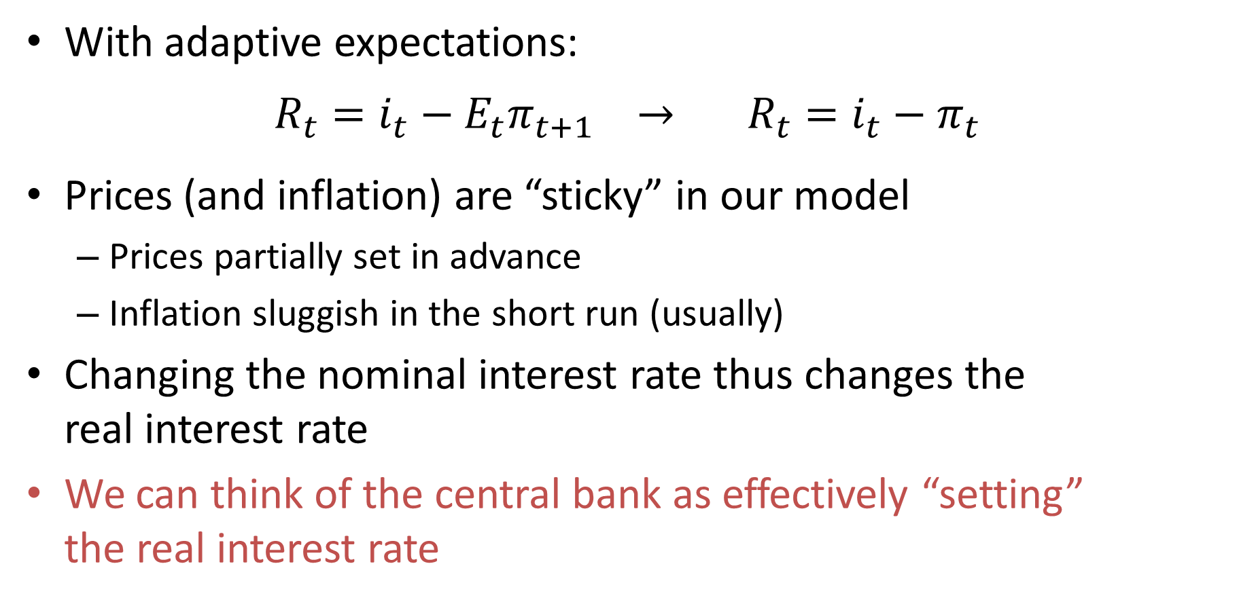
The MP Curve
With adaptive expectations:
$$R_{t}=i_{t}−E_{t}π_{t+1} → R_{t}=i_{t}−π_{t}$$
Prices (and inflation) are “sticky” in our model
Prices partially set in advance
Inflation sluggish in the short run (usually)
Changing the nominal interest rate thus changes the real interest rate
We can think of the central bank as effectively “setting” the real interest rate

Slide 20
The MP Curve
We think of central bank as setting real interest rate
A horizontal line in “real interest rate –output gap” space
We call this curve the MP curve (stands for monetary policy)
Replaces the LM curve
Real Interest Rate
R_{t}
MP
Output gap

Slide 21
Two Ways to Think about Monetary Policy
Fix money supply:
Fix interest rate:
R
R
LM
R_{t}
MP
IS
IS
Y
Y

Slide 22
Short Run: IS-MP Diagram
Together, IS curve and MP curve determine output and the real interest rate
Central Bank can “choose” output gap by varying real interest rate
Real Interest Rate
R₁
MP
R₂
MP’
IS
Output gap

Slide 23
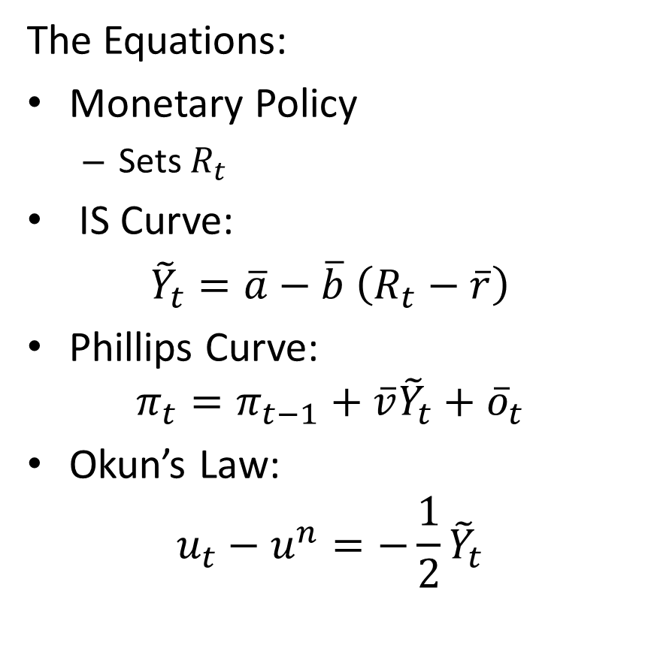
The Full Modern Business Cycle Model
The Equations:
Monetary Policy
Sets $R_{t}$
IS Curve:
${\tilde{Y}}_{t}=\overline{a}−\overline{b}$ $\left(R_{t}−\overline{r}\right)$
Phillips Curve:
$$π_{t}=π_{t−1}+\overline{v}{\tilde{Y}}_{t}+{\overline{o}}_{t}$$
Okun’s Law:
$$u_{t}−u^{n}=−\frac{1}{2}{\tilde{Y}}_{t}$$
The Logic:
Central Bank sets real interest rate (MP curve)
=>
(IS Curve)
Affects output gap
=>
(Phillips Curve)
Affects Inflation
(and shifts next period Phillips curve)
Okun’s law just allows us to go back and forth between output and unemployment

Slide 24
Modern Business Cycle Model
Next Period Phillips Curve
Real Interest Rate
FE
Inflation
FE
Phillips curve
π₊₁
π
MP
IS
0
Y
0
Y
Output gap
Output gap
FE: Full Employment

Slide 25
Two Views of Phillips Curve
Inflation
FE
Inflation
FE
Phillips curve
Phillips curve
0
Output gap
Unemployment

Slide 26
Optimal Monetary Policy
Friedman’s View/Neo-Classical View:
Avoid destabilizing surprises
All monetary policy can hope to do is avoid creating inefficient instability
Keynesian view:
Monetary policy can do more!!
Monetary policy should actively “undo” other shocks
Money demand shocks, “aggregate demand shocks”, shocks to expectations about the future (animal spirits)
Monetary policy should aim to stabilize economy

Slide 27
Stabilization of Demand Shock
Real Interest Rate
FE
Inflation
FE
Phillips curve
C
MP’
A
B
MP
IS
IS’
0
0
Output gap
Output gap
In response to demand shocks, monetary policy can (in principle) stabilize both output and inflation
FE: Full Employment

Slide 28
Stabilization of Supply Shock
Real Interest Rate
FE
Inflation
FE
AS’
?
AS
B
MP’
A
?
?
MP
B
A
?
IS
0
Y
0
Output gap
Output gap
In response to supply shock, monetary policy faces a trade-off: Either high inflation (point A) or a recession (point B)
FE: Full Employment
AS: Aggregate Supply (Phillips Curve)

Slide 29
Optimal Stabilization Policy
Demand shocks:
Offset aggressively
No trade-off between output and inflation stabilization
Supply shocks:
Less clear. May want to act less aggressively (“look through”) (Why?)
Because there is a trade-off between output and inflation stabilization.
Optimal reaction depends on weight placed different objectives
Optimal reaction also depends on degree of anchoring of inflation expectations

Slide 30
Goals of Monetary Policy
U.S.: Dual mandate:
Maximum employment
Stable prices
ECB: Stable prices primary objective

Slide 31
Goals of Monetary Policy
U.S. Federal Reserve:
“(…) maintain long-run growth of the monetary and credit aggregates commensurate with the economy’s long-run potential to increase production, so as to promote effectively the goals of maximum employment, stable prices and moderate long term interest rates.”
Humphrey-Hawkins Act (1978)
European Central Bank:
“ ... the primary objective of the ESCB shall be to maintain price stability ...” (Year-on-year increase in the harmonized index of consumer prices of below 2% for the euro area as a whole)
“ Without prejudice to the objective of price stability, it shall support the general economic policies in the Community...”
Notes:
31

Slide 32
Goals of Monetary Policy
Why such an emphasis on stable prices?
What are the costs of inflation?

Slide 33
What Are the Costs of Inflation?
Typical Layman’s view:
“Rising prices mean that I can buy less and less stuff. … Inflation is making me poorer.”
What is wrong with this argument?
Wages also go up
“Every year I get a raise, but prices go up and that takes some of my raise away.”
Implicit assumption: Would get same raise even if there was no inflation

Slide 34
Money Illusion
Money Illusion:
Tendency of individuals to pay primary attention to nominal prices rather than real prices
Notion that inflation affects real wages and real prices
Most people:
Sell very few goods. Acutely aware of price (wage).
Regard rise in them as just reward as opposed to part of general inflation of prices and wages

Slide 35
Costs of Inflation
Most people believe costs of inflation are large
Many economists believe costs of moderate inflation are small (although views differ quite a bit)
Shiller (1997) survey:
“biggest gripe about inflation” was “inflation hurts my real buying power, it makes me poorer”
77% of public agrees
12% of economists agree

Slide 36
Costs of Inflation
Shiller (1997) survey:
“Do you agree that preventing high inflation is an important national priority, as important as preventing drug abuse or preventing deterioration in the quality of our schools
52% of public but 18% of economists agree fully
“I think that if my pay went up I would feel more satisfaction in my job, more sense of fulfillment, even if prices went up just as much.”
49% of public but 8% of economists agree fully or partially

Slide 37
Cost of Expected Inflation
Say every year the price level rose by 10% (expected and stable)
People will incorporate expected inflation into contracts they right
Interest rates will reflect expected inflation
Wage contracts and wage negotiations will reflect expected inflation
So, perhaps this is just a wash?

Slide 38
Cost of Expected Inflation
What are the costs of steady expected inflation?
Real value of money falling. People economize on money holdings. Need to make more trips to the ATM (“Shoe leather costs”)
Firms must change their price tags and menus more often (Menu costs). Pay more attention to prices.
If prices and wages are sticky, relative prices (and wages) get out of whack. Relative prices/wages fall between changes.
Many provisions of tax law ignore inflation. (e.g., capital gains tax and interest deductions)
Some people’s wages will fall (if they were “too high” to begin with, e.g., because their productivity or effort had fallen). (Individual cost, not societal cost)

Slide 39
Cost of Expected Inflation
Many economists are skeptical that it is possible to have moderate inflation that is stable
Friedman: “Zero inflation is a politically feasible objective; 10 percent inflation is not. That is the verdict of history.”
High inflation has tended to be volatile
But is this a law of nature or simply because high inflation periods have been associated with wars and bad economic policies

Slide 40
Costs of Unexpected Inflation
Uncertainty makes financial planning difficult
Real value of nominal contracts becomes risky
Could write contracts in real terms (index the payments to inflation). This is costly.
People are risk averse and dislike uncertainty
Redistributes wealth arbitrarily

Slide 41
Inflation and Wealth Redistribution
Many contracts specify nominal payments
Inflation affects real value of these payments
Bonds:
Promise to pay $1 in a year
How much is this worth in terms of “stuff”
Redistribution:
Those that own nominal assets (are “long” nominal assets) loose from inflation
Those that owe nominal assets (are “short” nominal assets) gain from inflation

Slide 42
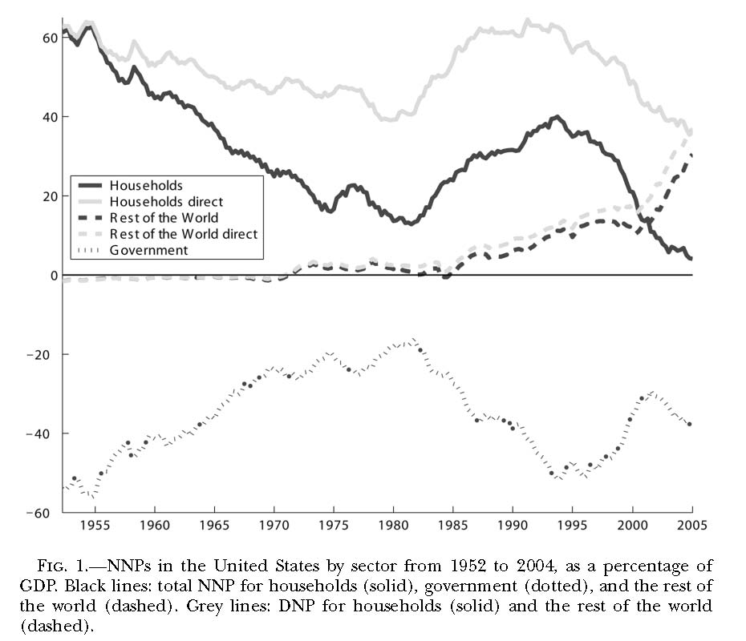
Doepke and Schneider (2006): Inflation and
the Redistribution of Nominal Wealth

Slide 43
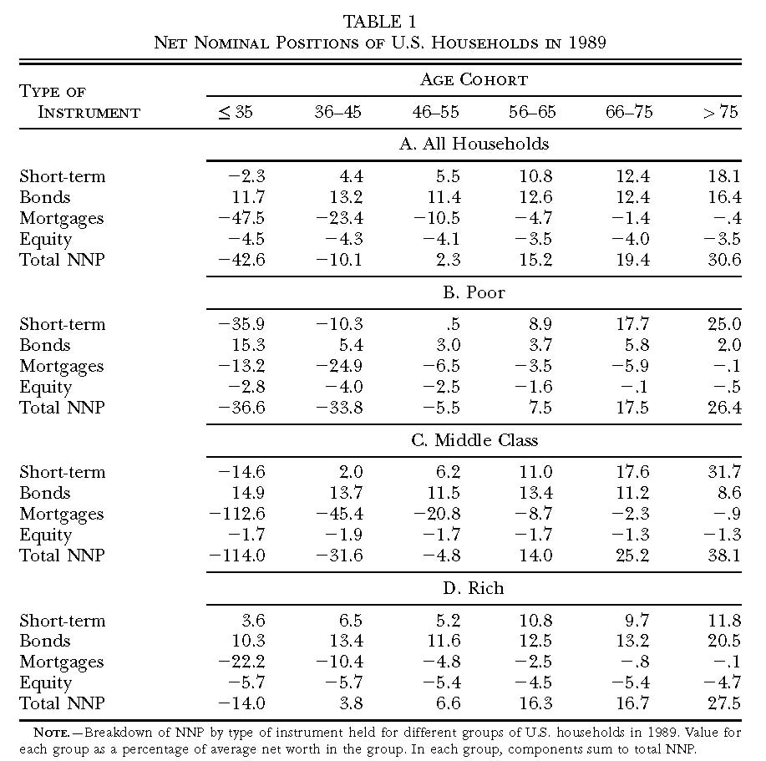
Doepke and Schneider (2006)

Slide 44
Monetary Framework
How should central banks go about attaining its goals?
Frameworks tried in the past:
Commodity standard (e.g., gold standard)
Fixed exchange rate
Monetarism
By late 80’s clear that all of these have significant downsides
New idea: Inflation targeting

Slide 45
Inflation Targeting
Key idea: Vary interest rates so as to bring inflation to a pre-announced target level in the medium run
Early inflation targeting countries:
New Zealand, Australia, Canada, Sweden
Now many, many countries practice inflation targeting
Fed formally adopted a 2% inflation target in 2012

Slide 46
Inflation Targeting
Goal to achieve stability (stable growth) of overall level of prices rather than one particular price (such as gold or foreign exchange)
More flexible than gold standard or fixed exchange rate
Only meant to be achieved over the medium term
So, after a supply shock central bank can balance competing objectives (unemployment and inflation)

Slide 47
Why Target 2% Inflation?
Most inflation targeting countries target 2% inflation (or something close to that). Why?
Measures of inflation are likely biased upward by something like 2%
A little inflation gives more room to bring about negative real rates if needed without hitting zero lower bound on nominal interest rates (more on this below)
A little inflation may “grease the wheels of the labor market”

Slide 48
Inflation Greases the Wheels of the Labor Market
Suppose wages are downward rigid and inflation is zero
Suppose, furthermore, that firms are overly optimistic and set wages too high (or economy hit by bad shock that requires wages to fall)
Since wages can’t fall, result will be unemployment
Inflation would erode real wages and solve problem over time

Slide 49
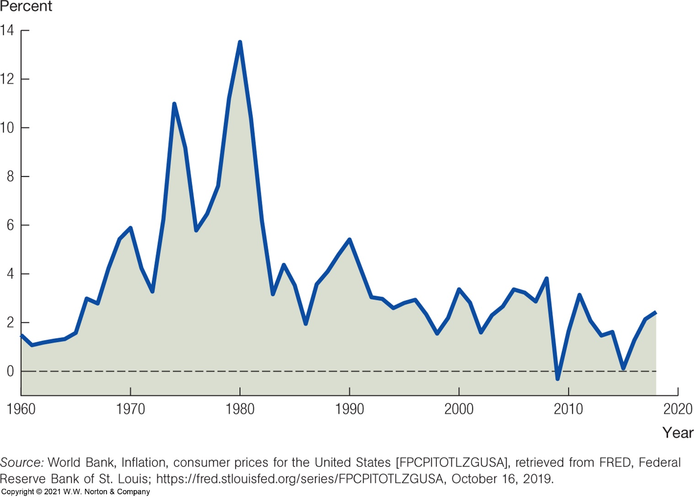
Inflation in the U.S.

Slide 50
Inflation Bias of Monetary Policy
Why was inflation high in the 1970s?
Mistaken belief that policy makers could exploit a permanent Phillips curve trade-off
Political pressure to create a short-term boom
Suppose central bank creates surprise boom
Short term gain: boom
Long term cost: Higher inflation forever
Very tempting for politicians facing reelection
Government may also want lower interest rates to reduce interest payments on government debt

Slide 51
Government’s Temptation
Government faces following temptation:
Create boom today (with loose monetary policy)
Promise to maintain low inflation in the future
If promise is believed
inflationary expectations will not change
Short term boom, but no shift in Phillips curve
But is promise credible?
No. Tomorrow, govt wants to do the same thing again
So, government faces a commitment problem (aka a “time inconsistency problem”)

Slide 52
Overcoming Inflation Bias
How do we overcome Government’s commitment problem?
Policy “rules” to tie central bank’s hands
Central bank independence

Slide 53
Policy Rules
Examples of constraints on policy:
Fixed exchange rate
“Taylor rule” (discussed below)
Limiting policy discretion was also an important motivation for inflation targeting
Public target (embarrassing to miss it)
Central bank must justify actions in terms of how they contribute to reaching target
In some cases, if they miss, need to send report to Parliament

Slide 54
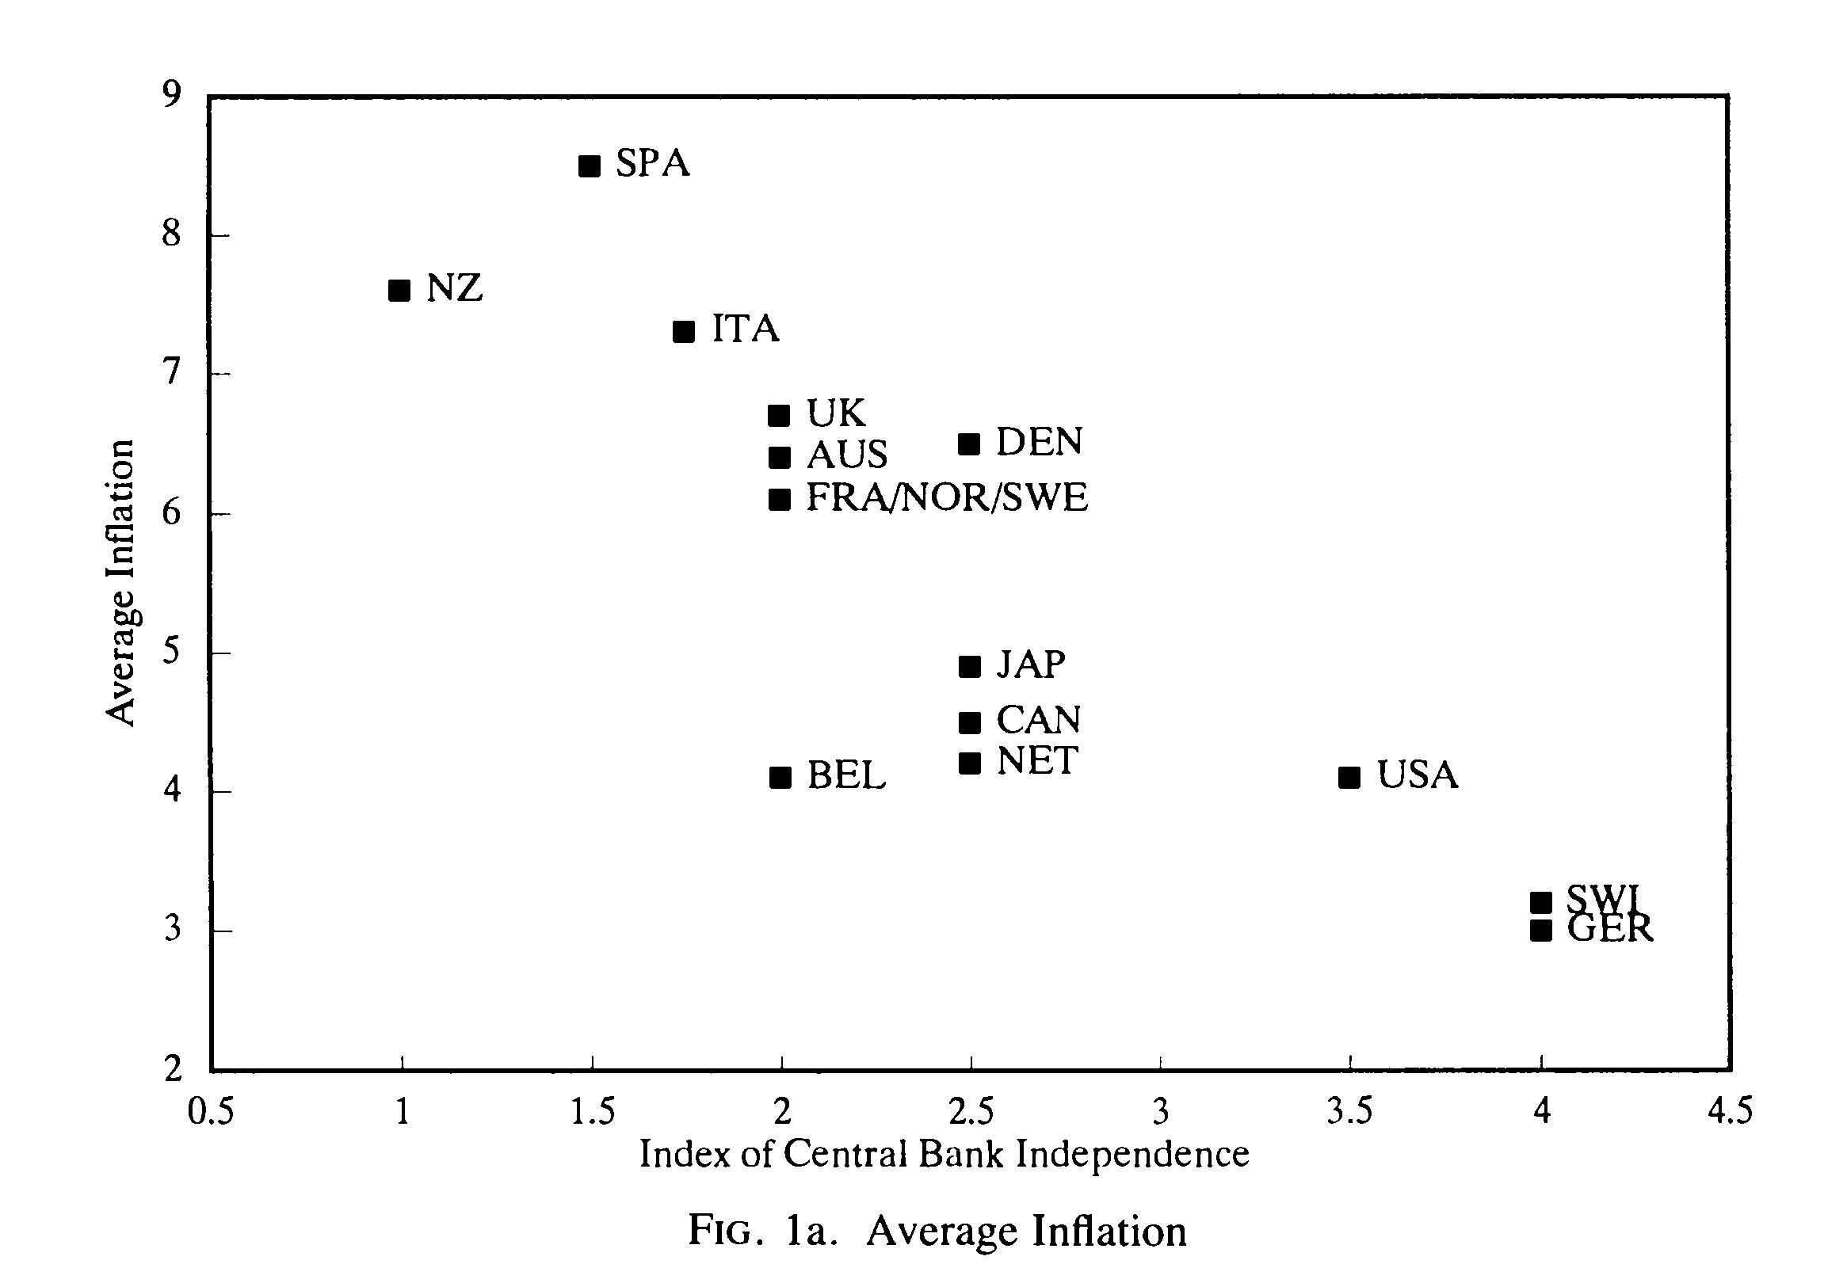
Central Bank Independence
Politicians are “too” myopic because of reelection risk (care too much about short run)
Role of the Fed: “Take the punch bowl away when the party is starting to heat up”
Easier if monetary policy is:
Isolated from political pressure
In the hands of technocrats that value good inflation outcomes (“conservative” central banker)
Alesina and Summers (1993)

Slide 55
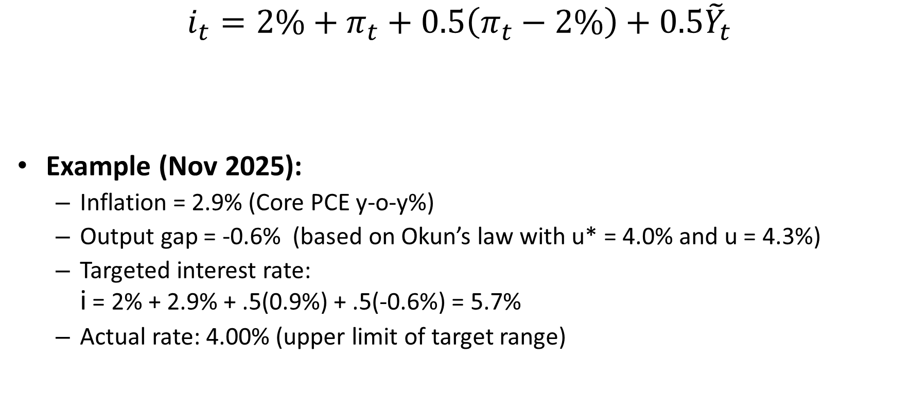
The Taylor Rule
$$i_{t}=2\%+π_{t}+0.5\left(π_{t}−2\%\right)+0.5{\tilde{Y}}_{t}$$
Example (Nov 2025):
Inflation = 2.9% (Core PCE y-o-y%)
Output gap = -0.6% (based on Okun’s law with u* = 4.0% and u = 4.3%)
Targeted interest rate: i = 2% + 2.9% + .5(0.9%) + .5(-0.6%) = 5.7%
Actual rate: 4.00% (upper limit of target range)
Equil. real interest rate: 2%
Target inflation rate: 2%
Notes:
55

Slide 56
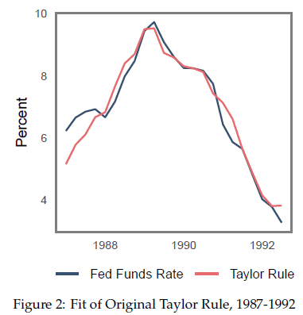
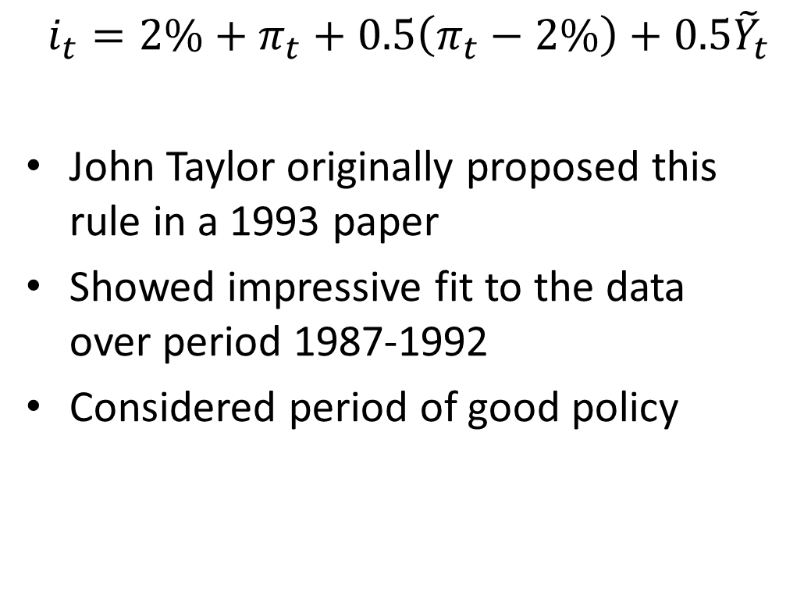
The Taylor Rule
$$i_{t}=2\%+π_{t}+0.5\left(π_{t}−2\%\right)+0.5{\tilde{Y}}_{t}$$
John Taylor originally proposed this rule in a 1993 paper
Showed impressive fit to the data over period 1987-1992
Considered period of good policy

Slide 57
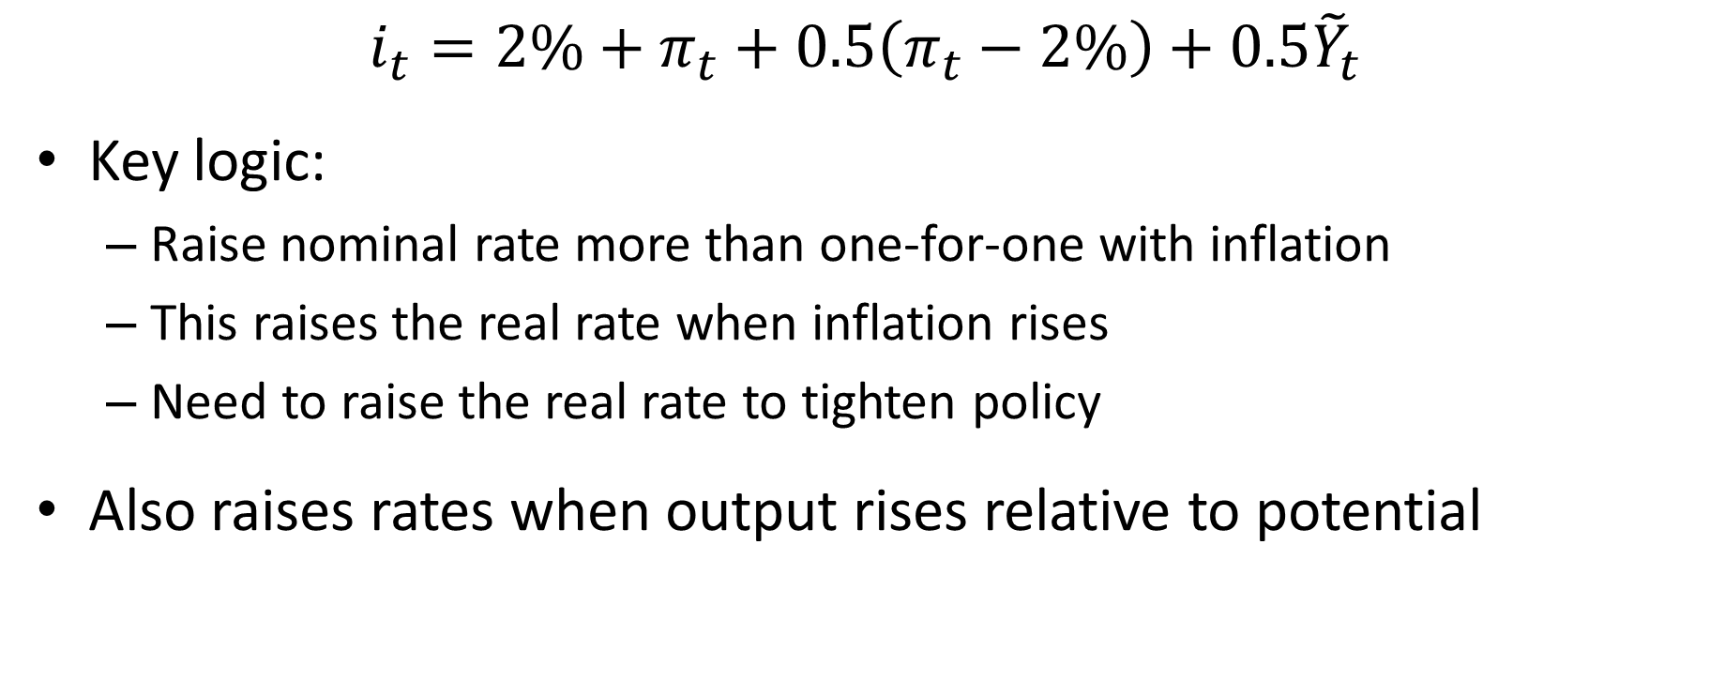
The Taylor Rule
$$i_{t}=2\%+π_{t}+0.5\left(π_{t}−2\%\right)+0.5{\tilde{Y}}_{t}$$
Key logic:
Raise nominal rate more than one-for-one with inflation
This raises the real rate when inflation rises
Need to raise the real rate to tighten policy
Also raises rates when output rises relative to potential

Slide 58
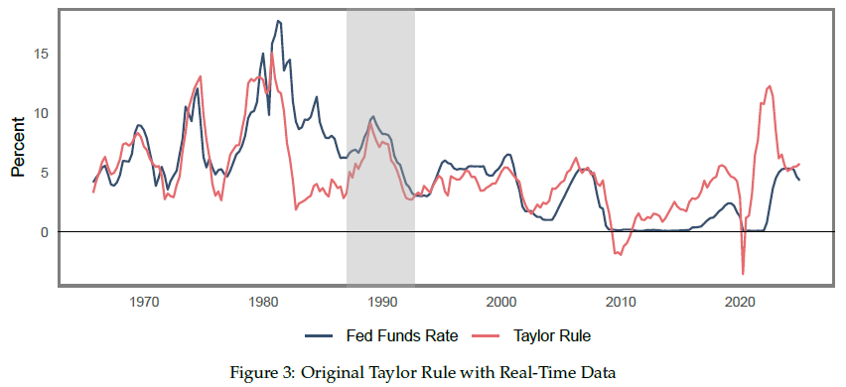
The Taylor Rule
Source: Nakamura, Riblier, Steinsson (2025)

Slide 59
Why the Huge Taylor Rule Deviation after Covid?
Large shift in demand from goods to services.
Acts like a shift in the Phillips curve
Fed “looked through” this supply shock
Inflation expectations were quite well anchored
Fed behind the curve

Slide 60
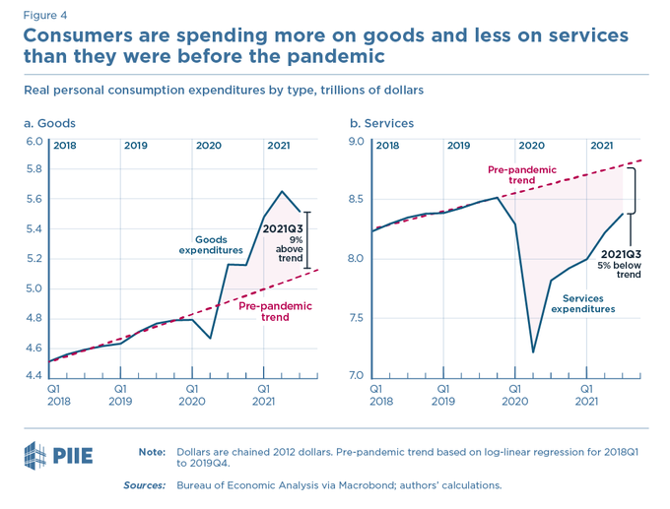
Source: Furman (2021)

Slide 61
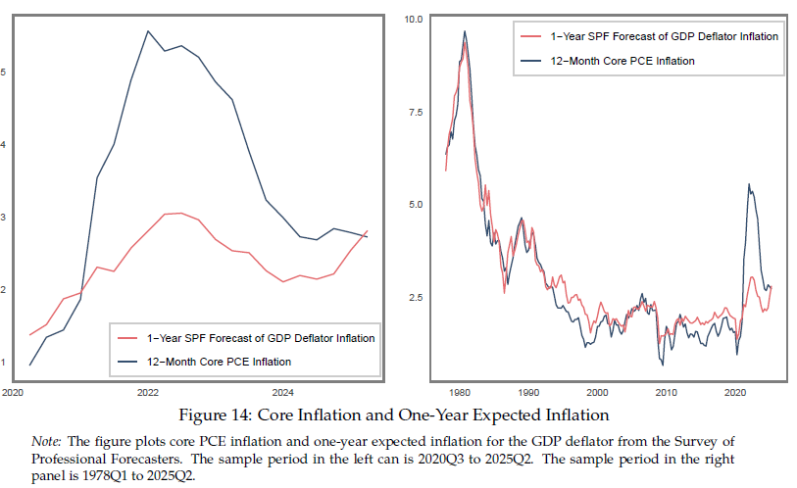
Source: Nakamura, Riblier, Steinsson (2025)

Slide 62
The Taylor Rule
Desirable properties
Stabilizes the economy
Balances inflation and unemployment costs
Simple / Transparent
But too rigid to be applied in practice?
Does not incorporate information about which shocks are hitting economy
Ignores problems at the zero lower bound
Notes:
62

Slide 63
Zero Lower Bound
Standard monetary policy in a recession:
Lower interest rates enough to bring about full employment
Fall of 2008: Serious financial crisis and output falling rapidly
On Dec. 16 2008, Fed lowered nominal interest rates to 0-0.25% (essentially zero)
Similar situation in March of 2020 due to Covid
Nominal interest rates can’t go below zero (Why?)

Slide 64
Zero Lower Bound
Traditional argument:
Money pays zero interest
If interest rates are below zero, people will simply hold money (cash)
So, interest rates can’t go below zero
But it is inconvenient/costly to hold actual cash
Theft an important concern when amounts are large
Need warehouse, security, etc.
In practice, several European countries pushed rates below zero in 2010s

Slide 65
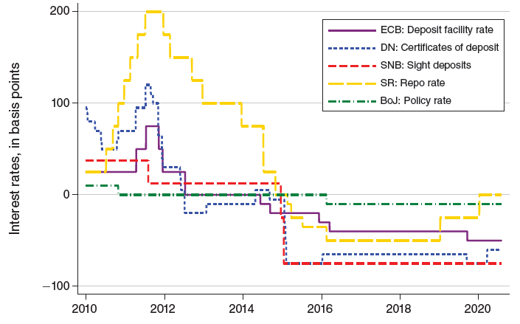
Negative Rates in Europe/Japan
Denmark, ECB, Switzerland, Sweden, and Japan lowered policy rate to negative territory for several years
Lowest rate: -0.75%
Perhaps there is an effective lower bound (ELB) at some rate
We don’t know how low rates can go
Source: Ulate (2021)

Slide 66
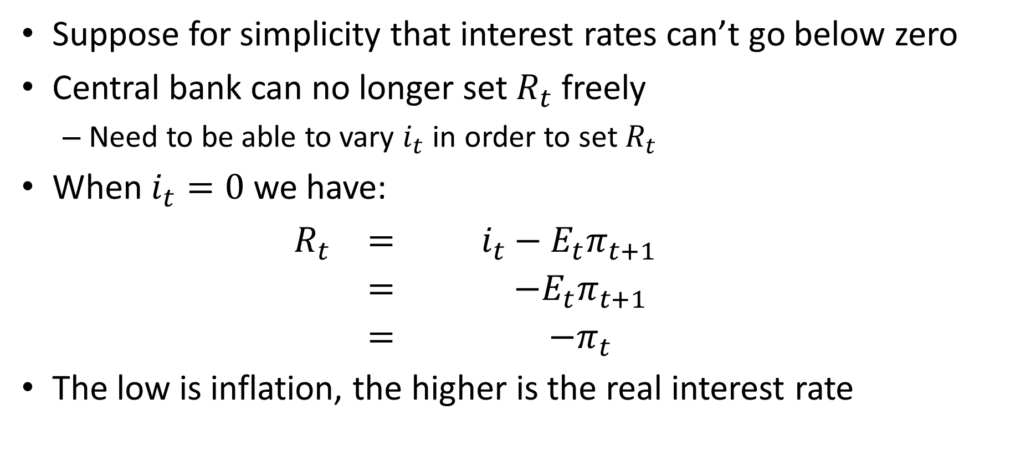
MP Curve at Zero Lower Bound
Suppose for simplicity that interest rates can’t go below zero
Central bank can no longer set $R_{t}$ freely
Need to be able to vary $i_{t}$ in order to set $R_{t}$
When $i_{t}=0$ we have:
$$\begin{matrix}\begin{matrix}R_{t} & = & i_{t}−E_{t}π_{t+1} \\ & = & −E_{t}π_{t+1} \\ & = & −π_{t}\end{matrix}\end{matrix}$$
The low is inflation, the higher is the real interest rate

Slide 67
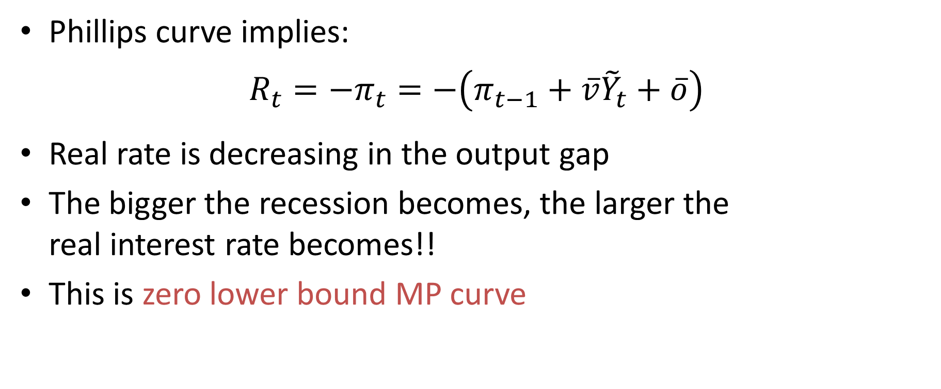
MP Curve at Zero Lower Bound
Phillips curve implies:
$$R_{t}=−π_{t}=−\left(π_{t−1}+\overline{v}{\tilde{Y}}_{t}+\overline{o}\right)$$
Real rate is decreasing in the output gap
The bigger the recession becomes, the larger the real interest rate becomes!!
This is zero lower bound MP curve

Slide 68
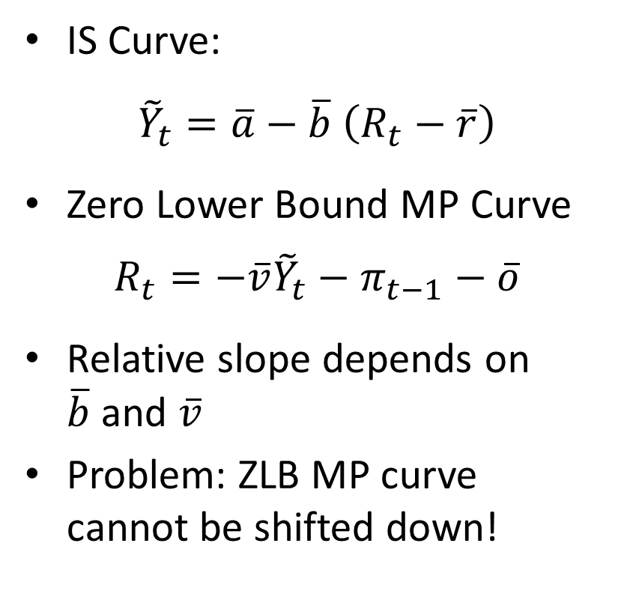
MP Curve at Zero Lower Bound
IS Curve:
${\tilde{Y}}_{t}=\overline{a}−\overline{b}$ $\left(R_{t}−\overline{r}\right)$
Zero Lower Bound MP Curve
$$R_{t}=−\overline{v}{\tilde{Y}}_{t}−π_{t−1}−\overline{o}$$
Relative slope depends on $\overline{b}$ and $\overline{v}$
Problem: ZLB MP curve cannot be shifted down!
Real Interest Rate
FE
ZLB MP
IS
0
Output gap

Slide 69
Policy Options at Zero Lower Bound
Quantitative Easing
Normally Fed targets short term safe interest rate
In crisis interest rate spreads between safe and less safe bonds rose
Fed responded by purchasing riskier bonds to lower interest rates on these bonds (e.g., mortgage backed securities)
Lower interest rates on mortgage backed securities lower interest rates on mortgages and thereby stimulate spending

Slide 71
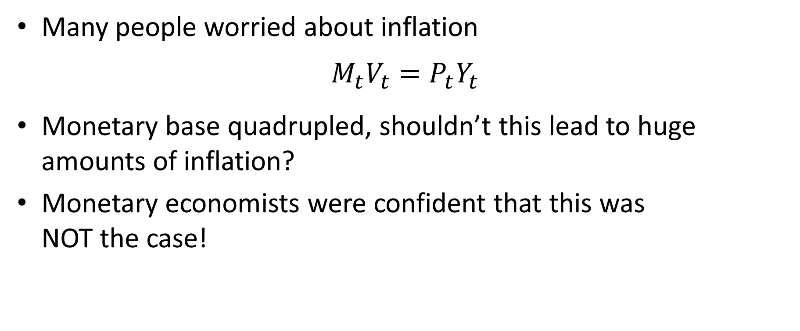
Huge Increase in Monetary Base
Many people worried about inflation
$$M_{t}V_{t}=P_{t}Y_{t}$$
Monetary base quadrupled, shouldn’t this lead to huge amounts of inflation?
Monetary economists were confident that this was NOT the case!

Slide 72
Monetary base = currency + bank reserves at Fed
M1 = currency + deposits
M2 = M1 + savings accounts

Slide 73
Money in the Great Recession
Huge increase in monetary base reflection of Fed large scale asset purchases
Did not lead to increase in the money supply (M1, M2) (Why?)
Banks happy to hold extra reserves at Fed
Reserves very safe asset
Interest rates on other safe assets close to zero. So why not?
Reserves now pay interest (since 10/6/2008)
Reserves no longer return dominated asset

Slide 74
Value of Theory
Huge increase in monetary base caused lots of confusion on the part of many people (lots of worries about high inflation)
Monetary economists (including Bernanke) saw through this an kept their cool

Slide 75
Policy Options at Zero Lower Bound
Forward Guidance
Statements about future path of policy
Intended to lower longer term interest rates
Lower long rates => lower mortgage rates => higher spending
Fed statement in August 2011: Keep rates close to zero “at least through mid-2013”
Fed statement in January 2012: Keep rates close to zero “at least through late 2014”

Slide 76
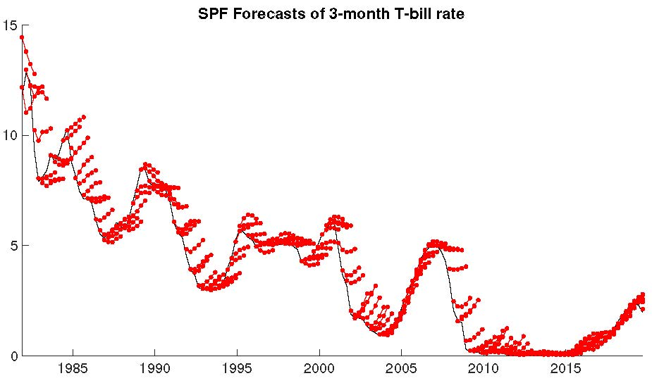

Slide 77
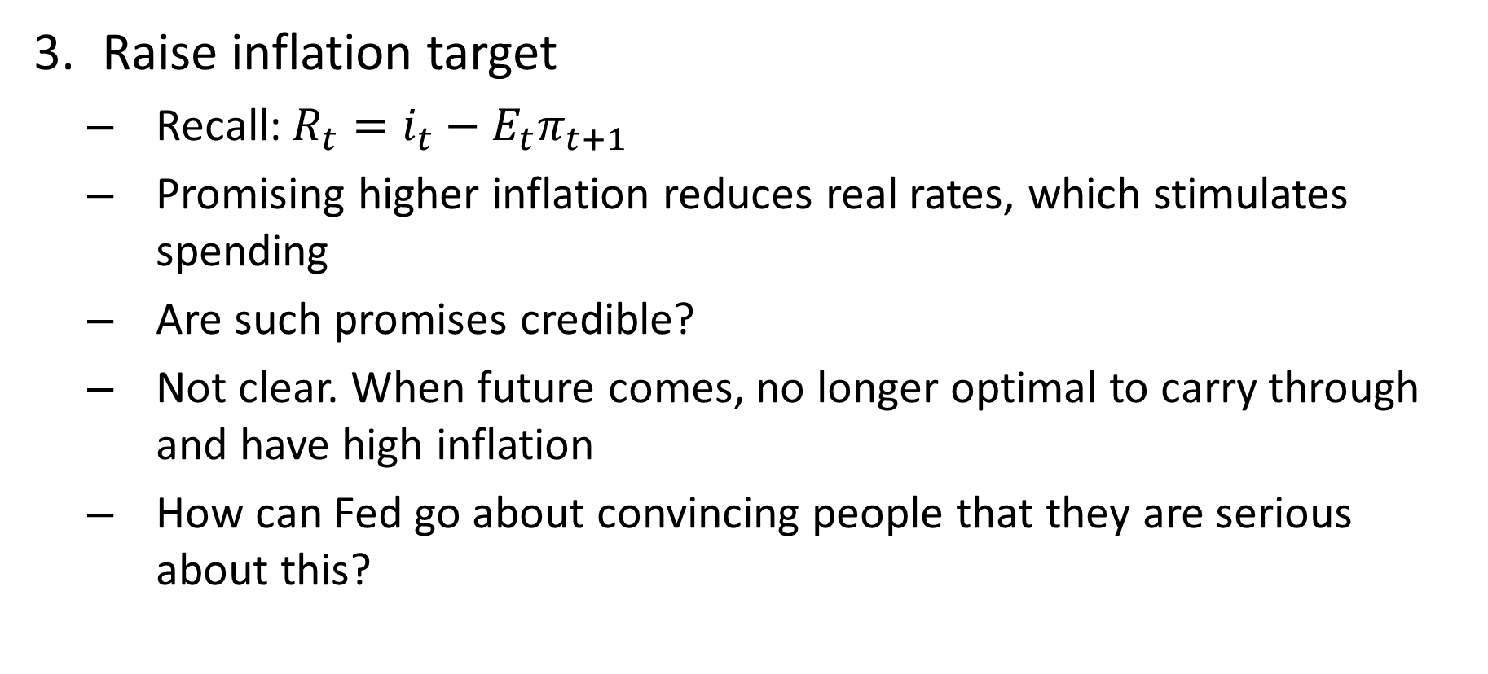
Policy Options at Zero Lower Bound
Raise inflation target
Recall: $R_{t}=i_{t}−E_{t}π_{t+1}$
Promising higher inflation reduces real rates, which stimulates spending
Are such promises credible?
Not clear. When future comes, no longer optimal to carry through and have high inflation
How can Fed go about convincing people that they are serious about this?
Notes:
77

