Slide 1
Lecture 18: Fiscal Policy Macroeconomics (Quantitative) Economics 101B
Jón Steinsson
University of California, Berkeley

Slide 2
Fiscal Policy
Main tools of stabilization policy:
Monetary policy
Fiscal policy
Types of fiscal policy:
Automatic stabilizers (e.g., unemployment insurance)
Fiscal stimulus checks
Countercyclical government spending (purchases)

Slide 3
Stimulus Checks vs. Government Purchases
Stimulus checks:
Transfer from taxpayers to recipients
What is MPC of recipients?
Taxpayers may spend less
Government purchases
Government purchases goods and services
No issue of MPC (government’s “MPC” is 1 on these funds)
Government purchases often referred to as government spending or fiscal stimulus

Slide 4
Monetary Policy vs. Government Purchases
Common view: Monetary policy is stabilization policy of choice during normal times.
Central bank nimbler than Congress
Less political
However: If monetary policy hits the ZLB, fiscal stimulus becomes more important

Slide 5
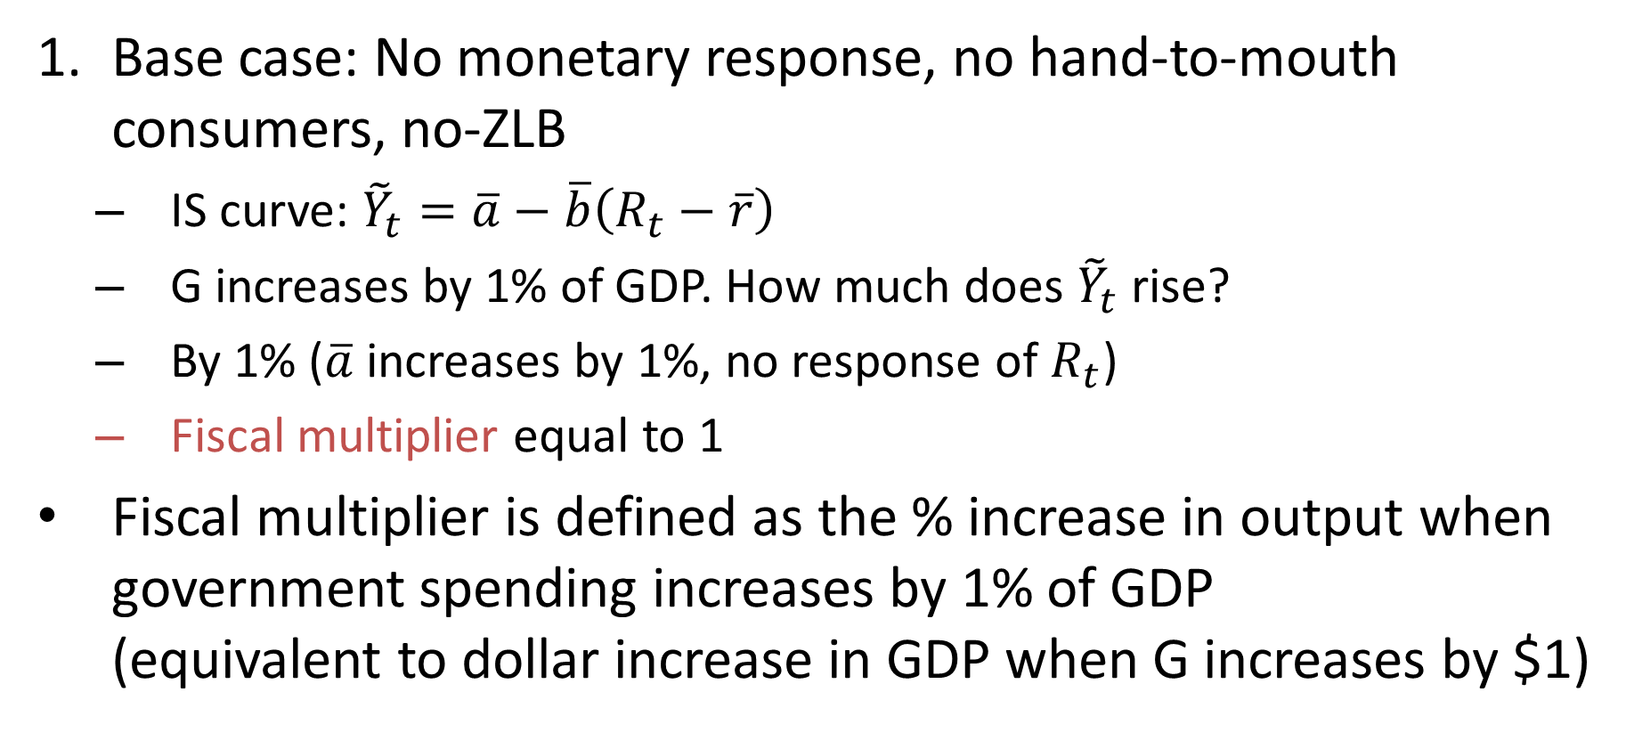
Fiscal Stimulus in Keynesian Model
Base case: No monetary response, no hand-to-mouth consumers, no-ZLB
IS curve: ${\tilde{Y}}_{t}=\overline{a}−\overline{b}\left(R_{t}−\overline{r}\right)$
G increases by 1% of GDP. How much does ${\tilde{Y}}_{t}$ rise?
By 1% ($\overline{a}$ increases by 1%, no response of $R_{t}$)
Fiscal multiplier equal to 1
Fiscal multiplier is defined as the % increase in output when government spending increases by 1% of GDP (equivalent to dollar increase in GDP when G increases by $1)

Slide 6
Fiscal Stimulus (Not ZLB)
Real Interest Rate
FE
Inflation
FE
Phillips curve
B
MP
A
B
A
IS
IS’
0
0
Output gap
Output gap
FE: Full Employment

Slide 7
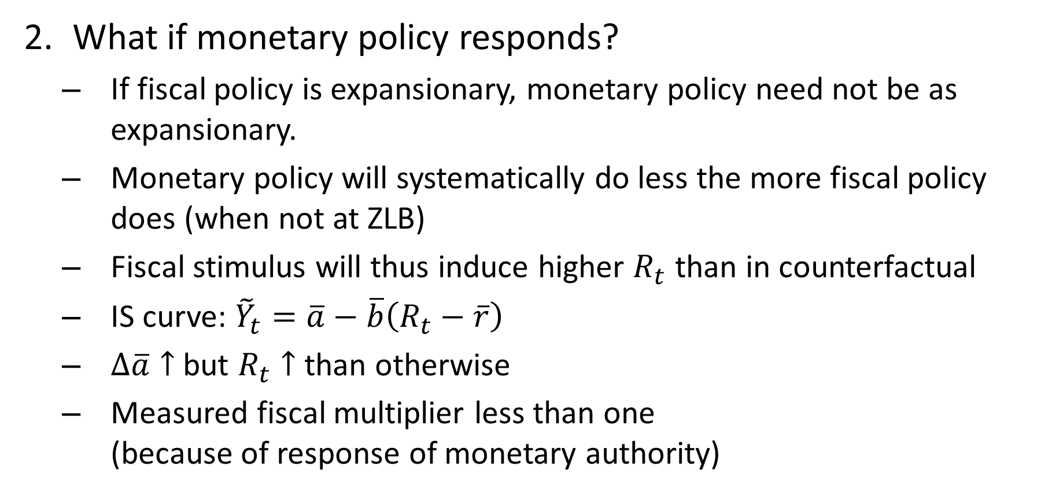
Fiscal Stimulus in a Keynesian Model
What if monetary policy responds?
If fiscal policy is expansionary, monetary policy need not be as expansionary.
Monetary policy will systematically do less the more fiscal policy does (when not at ZLB)
Fiscal stimulus will thus induce higher $R_{t}$ than in counterfactual
IS curve: ${\tilde{Y}}_{t}=\overline{a}−\overline{b}\left(R_{t}−\overline{r}\right)$
$∆\overline{a}↑$ but $R_{t}↑$ than otherwise
Measured fiscal multiplier less than one (because of response of monetary authority)

Slide 8
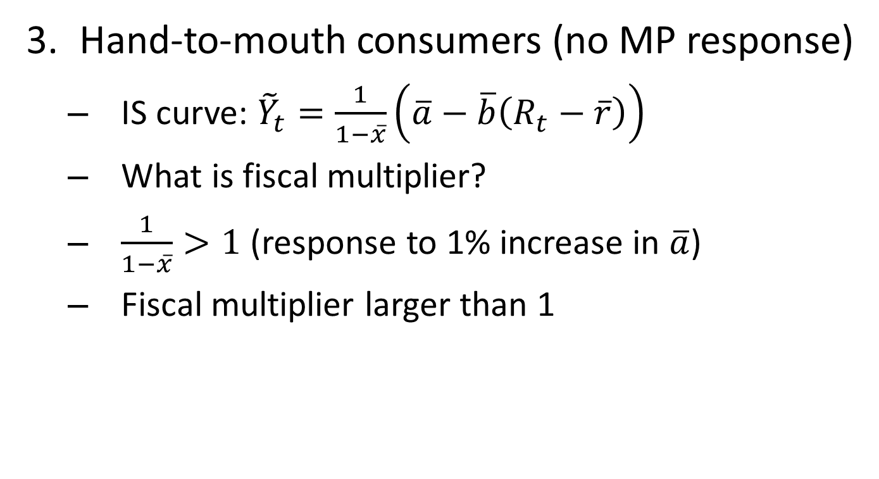
Fiscal Stimulus in Keynesian Model
Hand-to-mouth consumers (no MP response)
IS curve: ${\tilde{Y}}_{t}=\frac{1}{1−\overline{x}}\left(\overline{a}−\overline{b}\left(R_{t}−\overline{r}\right)\right)$
What is fiscal multiplier?
$\frac{1}{1−\overline{x}}>1$ (response to 1% increase in $\overline{a}$)
Fiscal multiplier larger than 1

Slide 9
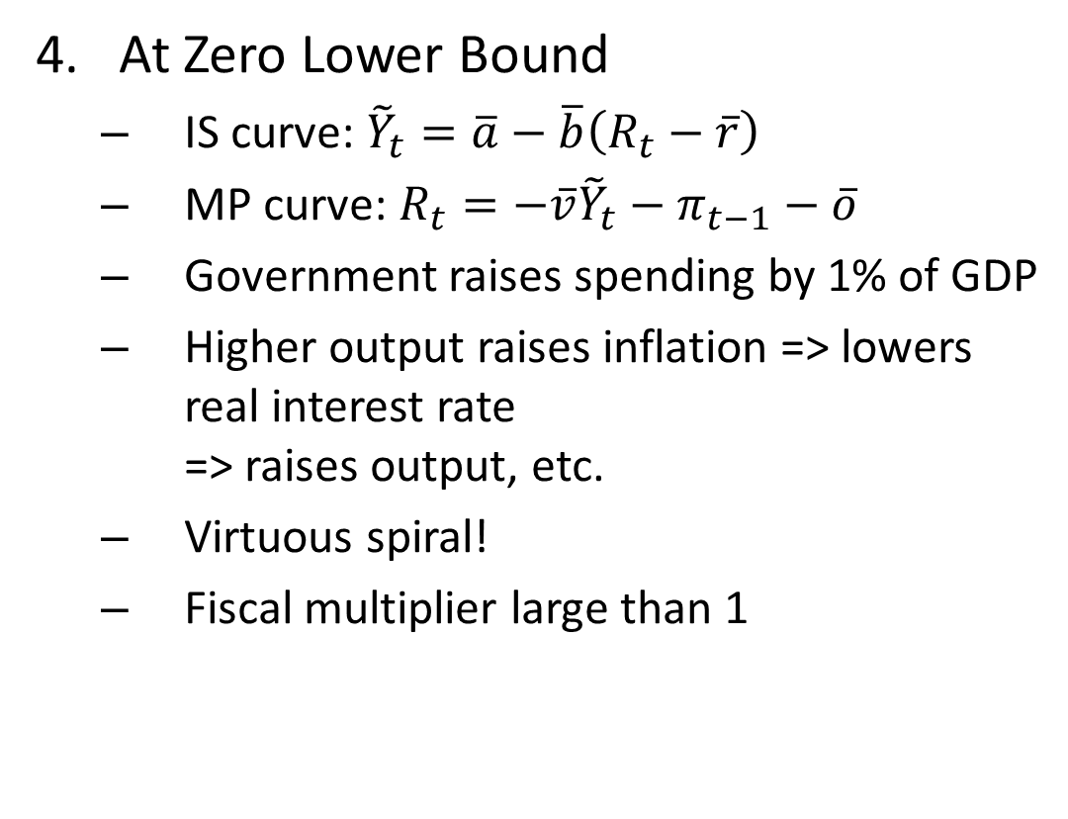
Fiscal Stimulus in Keynesian Model
At Zero Lower Bound
IS curve: ${\tilde{Y}}_{t}=\overline{a}−\overline{b}\left(R_{t}−\overline{r}\right)$
MP curve: $R_{t}=−\overline{v}{\tilde{Y}}_{t}−π_{t−1}−\overline{o}$
Government raises spending by 1% of GDP
Higher output raises inflation => lowers real interest rate => raises output, etc.
Virtuous spiral!
Fiscal multiplier large than 1
Real Interest Rate
FE
ZLB MP
IS’
IS
0
Output gap

Slide 10
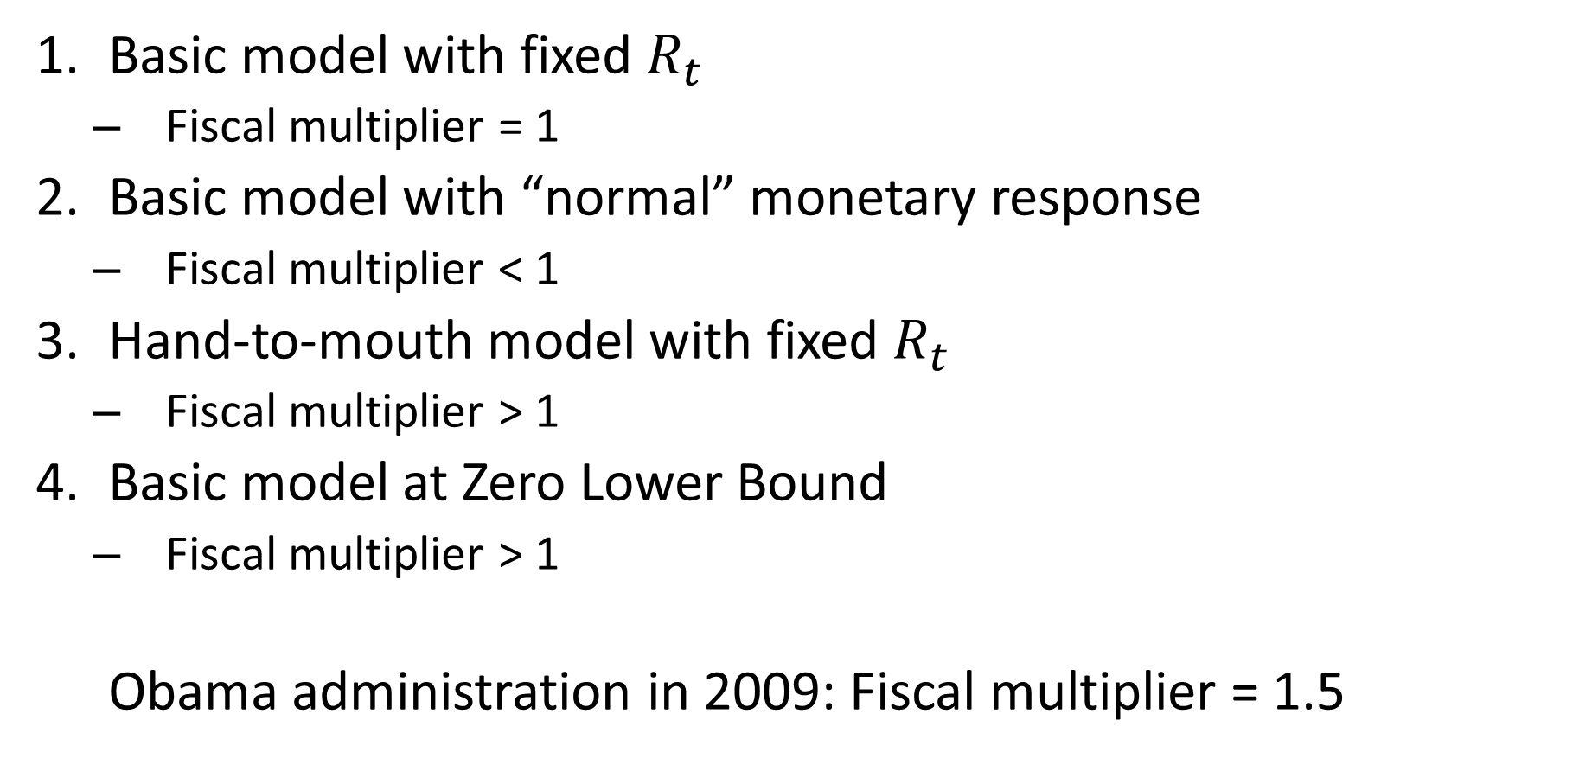
Keynesian Fiscal Stimulus
Basic model with fixed $R_{t}$
Fiscal multiplier = 1
Basic model with “normal” monetary response
Fiscal multiplier < 1
Hand-to-mouth model with fixed $R_{t}$
Fiscal multiplier > 1
Basic model at Zero Lower Bound
Fiscal multiplier > 1
Obama administration in 2009: Fiscal multiplier = 1.5

Slide 11
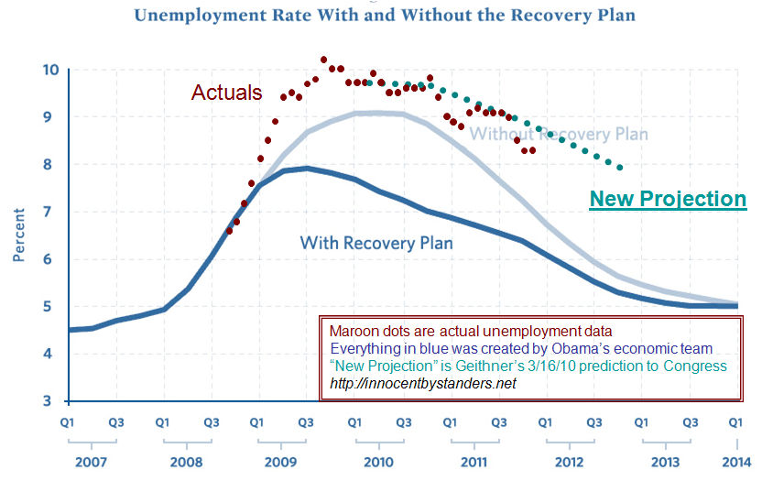

Slide 12
Neo-Classical View of Fiscal Stimulus
Government takes away people’s stuff (i.e., taxes them to buy some of the output)
People are poorer. What do they do?
Consume less of goods
And less of leisure (work more)
Positive multiplier due to negative wealth effect
Multiplier less than one since people don’t increase effort enough to get to old level of consumption

Slide 13
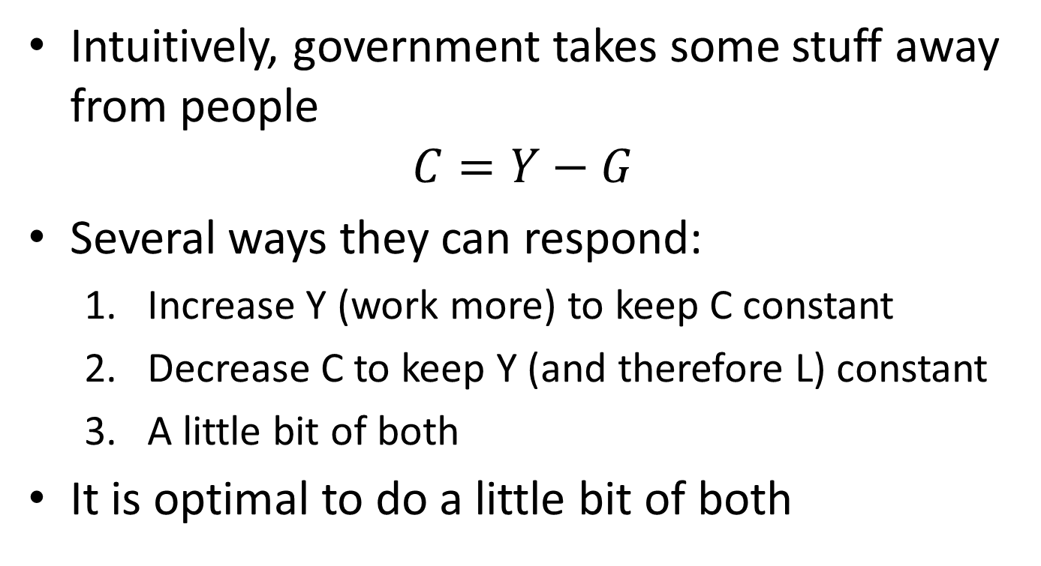
Neo-Classical View of Fiscal Stimulus
Intuitively, government takes some stuff away from people
$$C=Y−G$$
Several ways they can respond:
Increase Y (work more) to keep C constant
Decrease C to keep Y (and therefore L) constant
A little bit of both
It is optimal to do a little bit of both

Slide 14
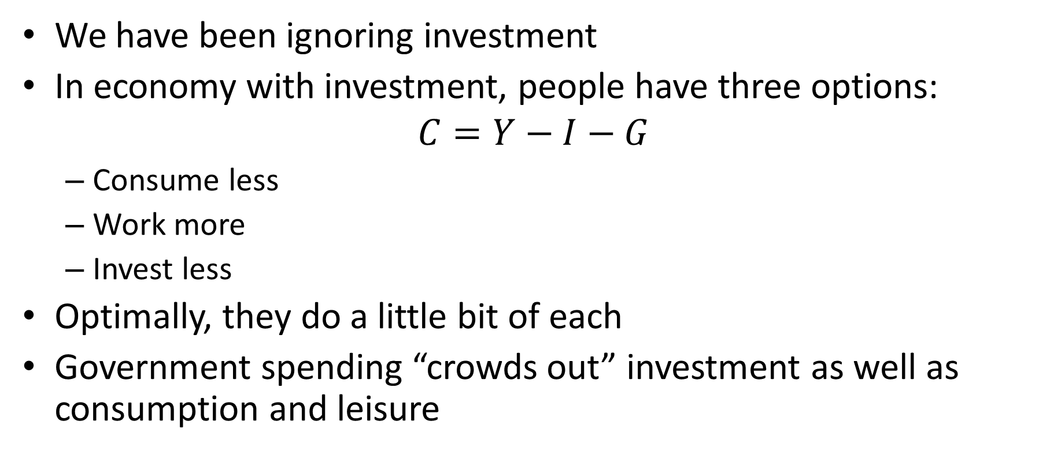
Neo-Classical Fiscal Stimulus with Investment
We have been ignoring investment
In economy with investment, people have three options:
$$C=Y−I−G$$
Consume less
Work more
Invest less
Optimally, they do a little bit of each
Government spending “crowds out” investment as well as consumption and leisure

Slide 15
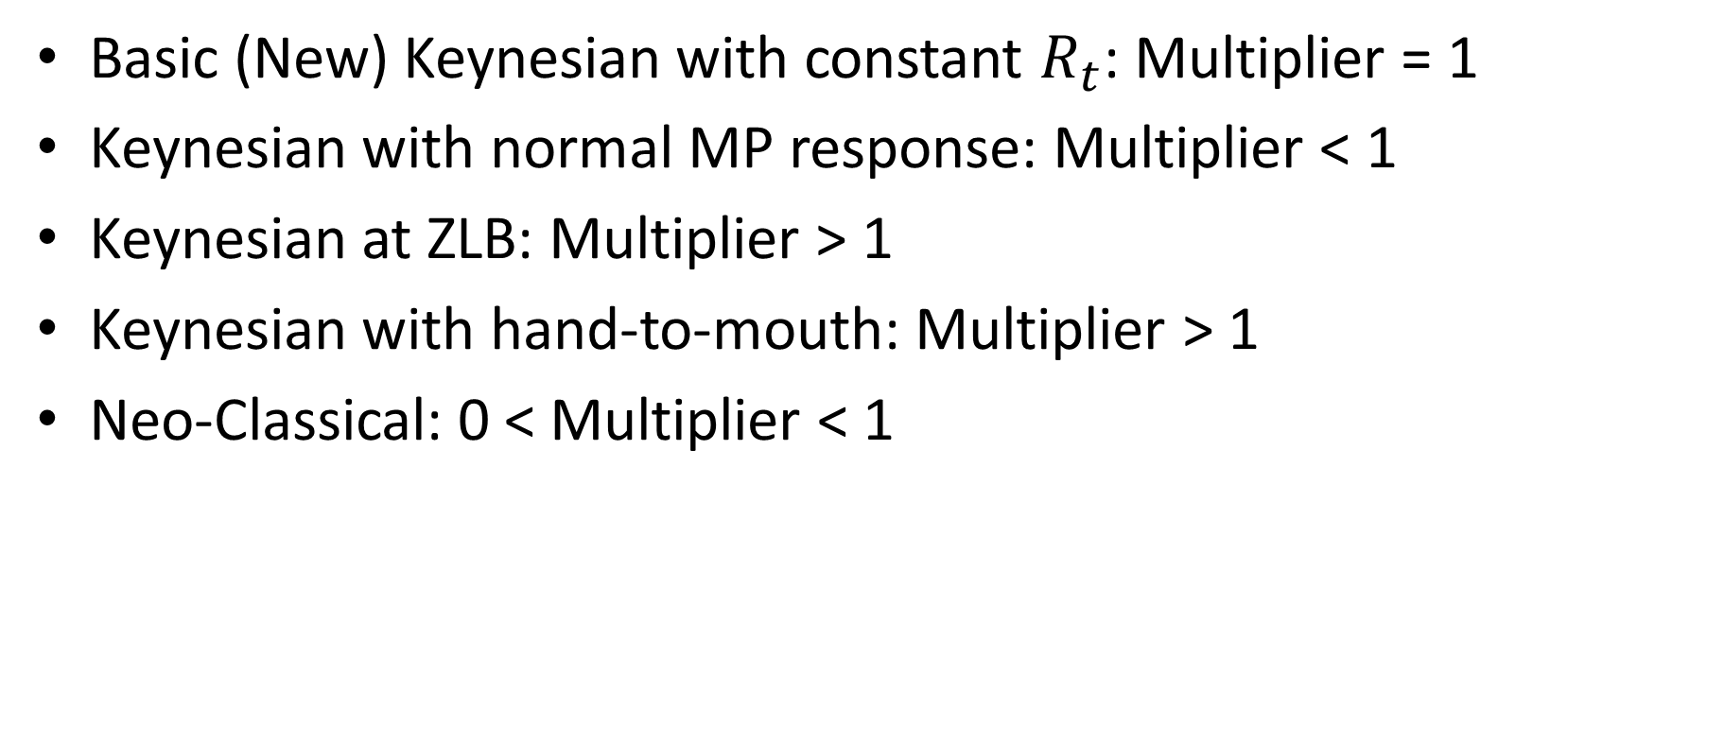
Fiscal Stimulus
Basic (New) Keynesian with constant $R_{t}$: Multiplier = 1
Keynesian with normal MP response: Multiplier < 1
Keynesian at ZLB: Multiplier > 1
Keynesian with hand-to-mouth: Multiplier > 1
Neo-Classical: 0 < Multiplier < 1

Slide 16
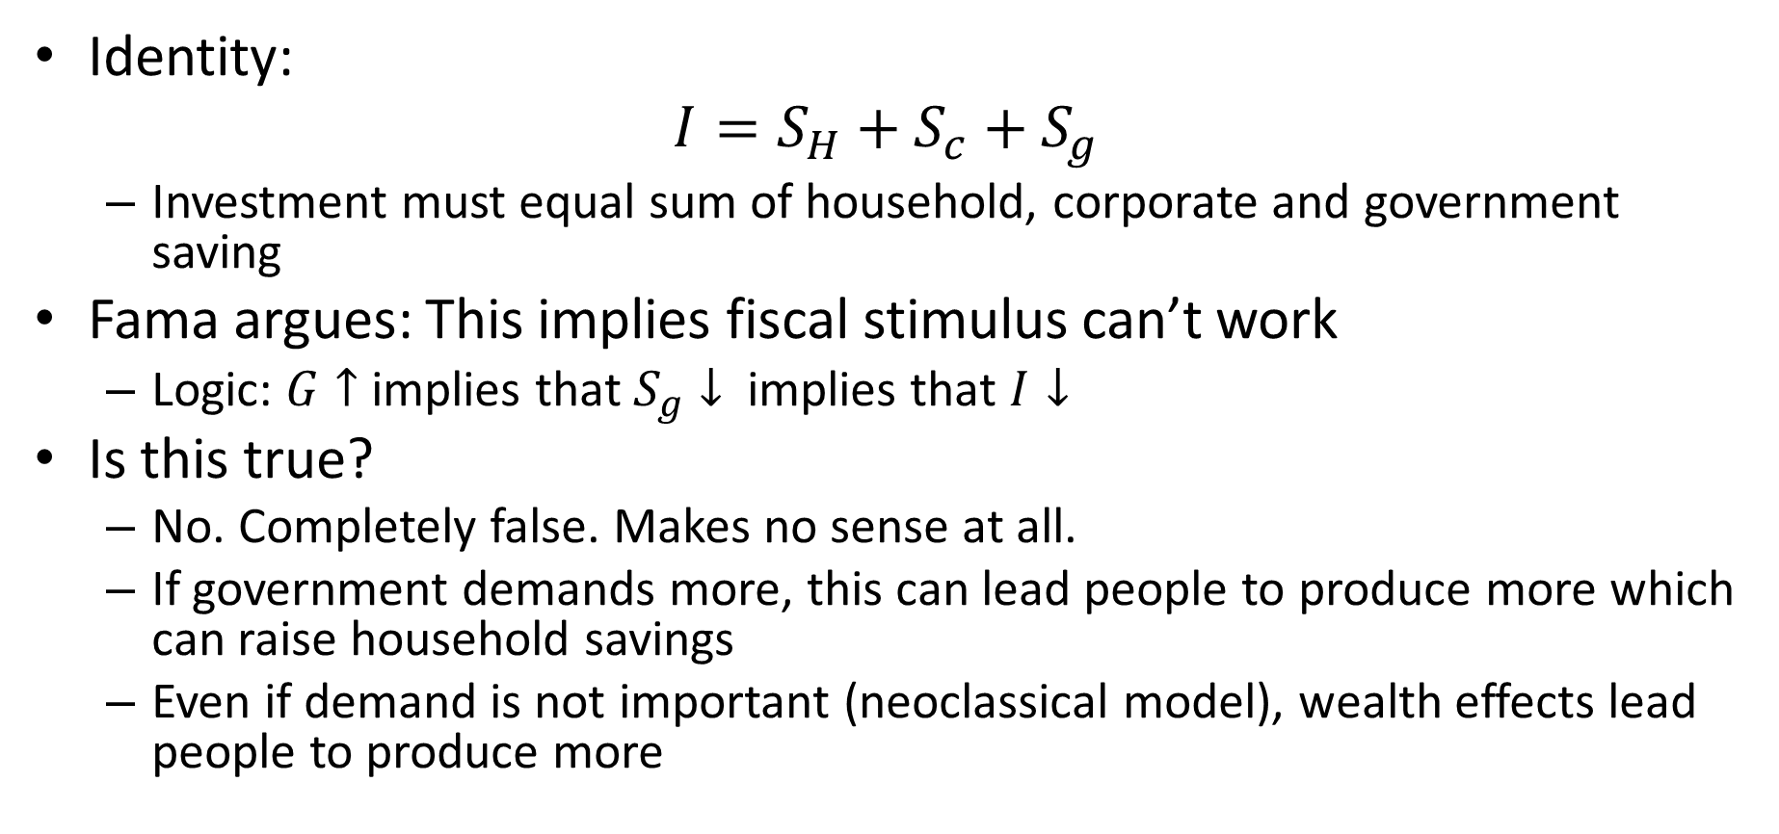
Fama (2009)
Identity:
$$I=S_{H}+S_{c}+S_{g}$$
Investment must equal sum of household, corporate and government saving
Fama argues: This implies fiscal stimulus can’t work
Logic: $G↑$ implies that $S_{g}↓$ implies that $I↓$
Is this true?
No. Completely false. Makes no sense at all.
If government demands more, this can lead people to produce more which can raise household savings
Even if demand is not important (neoclassical model), wealth effects lead people to produce more

Slide 17
Barro (2009)
Skeptical that multiplier can be greater than one
“In addition to the free airplane or bridge, we also have more goods and services left over to raise private consumption or investment”
“If this mechanism is genuine, one might ask why the government should stop with only $1 trillion of added purchases”
Responses: Long run versus short run / ZLB

Slide 18
Fiscal Multiplier: Empirics
How large is the fiscal multiplier?
How can we tell empirically?
Simple minded approach:
Look at correlation between changes in spending and changes in GDP
But a correlation is not the same as causation!
What are potential “confounding effects”?
When economy is sagging (federal) government tries to stimulate economy with spending (downward bias)
When economy is booming (state and local) governments spend more (upward bias)

Slide 19
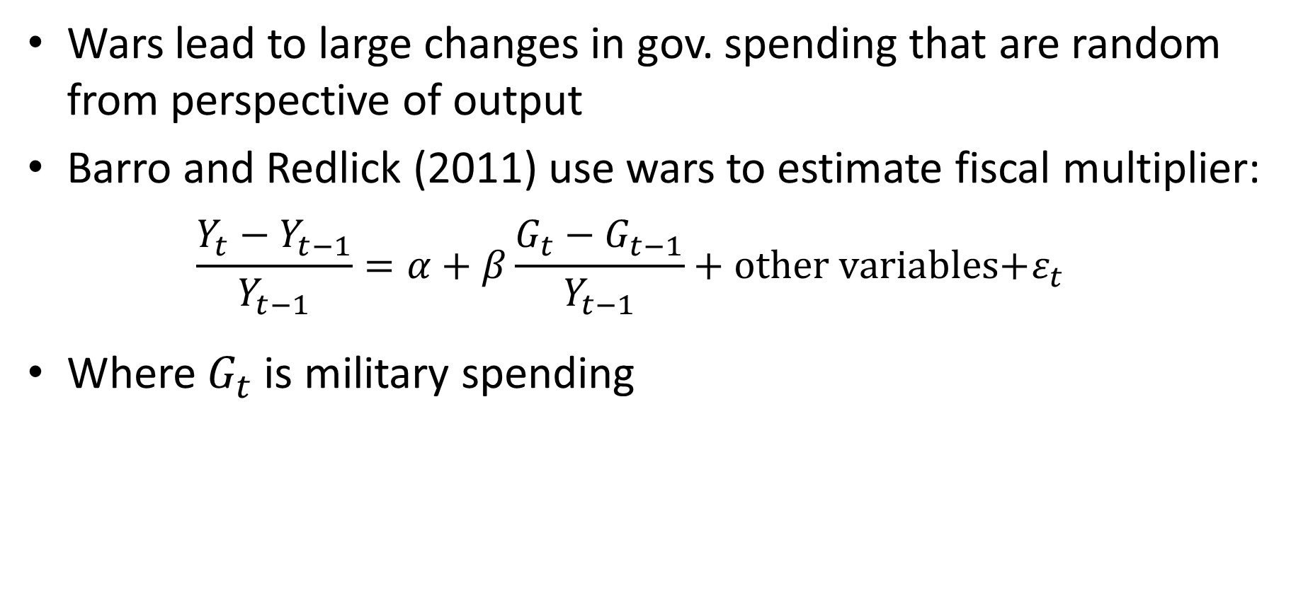
Natural Experiments: Wars
Wars lead to large changes in gov. spending that are random from perspective of output
Barro and Redlick (2011) use wars to estimate fiscal multiplier:
$$\frac{Y_{t}−Y_{t−1}}{Y_{t−1}}=α+β\frac{G_{t}−G_{t−1}}{Y_{t−1}}+\text{other} \text{variables}\text{+}ε_{t}$$
Where $G_{t}$ is military spending

Slide 20
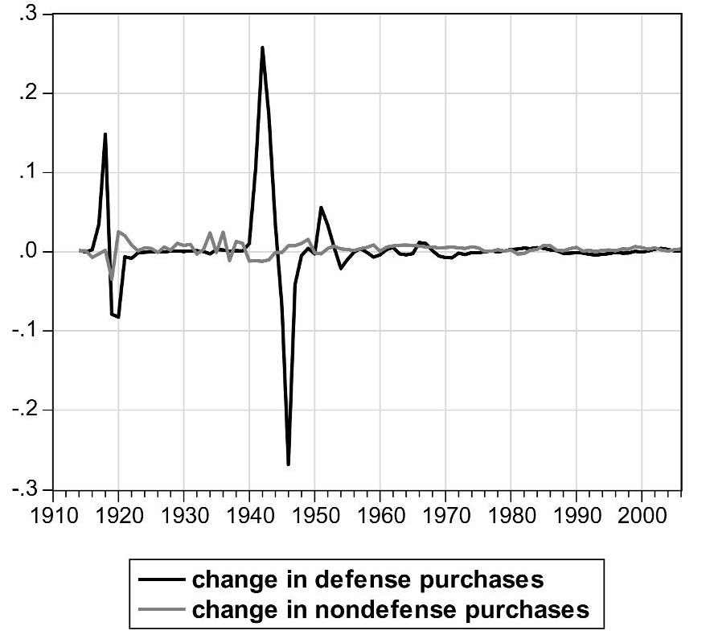
Table: Changes in Defense Spending
 | Year | DG |  |  | Year | DG
 |  | (% GDP) |  |  |  | (% GDP)
WWI |  |  |  | Korea
 | 1917 | 3.5 |  |  | 1951 | 5.6
 | 1918 | 14.9 |  |  | 1952 | 3.3
 | 1919 | -7.9 |  |  | 1953 | 0.5
 | 1920 | -8.2 |  |  | 1952 | -2.1
WWII |  |  |  | Vietnam
 | 1941 | 10.6 |  |  | 1966 | 1.2
 | 1942 | 25.8 |  |  | 1967 | 1.1
 | 1943 | 17.2
 | 1944 | 3.6 |  | Reagan
 | 1945 | -7.1 |  |  | 1982-1985 | 0.4-0.5
 | 1946 | -25.8 |  | Bush II
 |  |  |  |  | 2002-2004 | 0.3-0.4

Slide 21
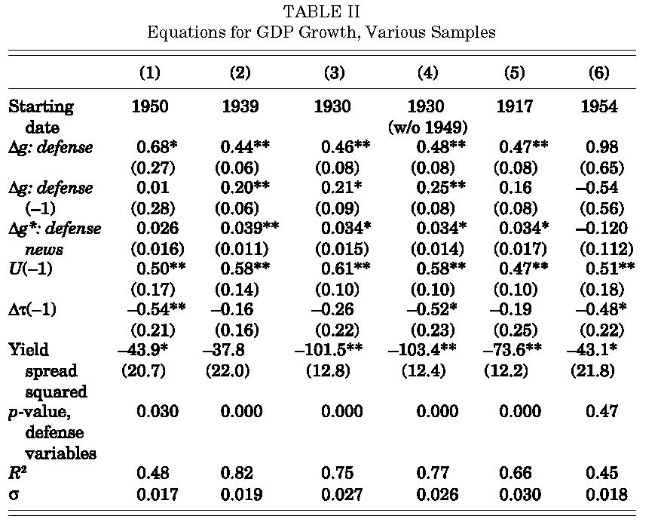
Barro and Redlick (2011)

Slide 22
Fiscal Multipliers in Wars
War multiplier: 0.6-0.7
Why might war multiplier be different from “fiscal stimulus” multipliers?
Large wars feature “command-and-control”
Rationing of consumer products (downward bias in multiplier)
Patriotism / mandated production(upward bias in multiplier)
Bottlenecks in large wars

Slide 23
Regional Evidence on Fiscal Stimulus
Major problems with war estimates:
There are only so many wars! (imprecise estimates)
Confounding effects: Patriotism, rationing, etc.
US states have different amounts of military production
Perhaps we can look at whether states with a lot of military production do better than states with little military production when there is a military buildup (Nakamura and Steinsson, 2014)

Slide 24
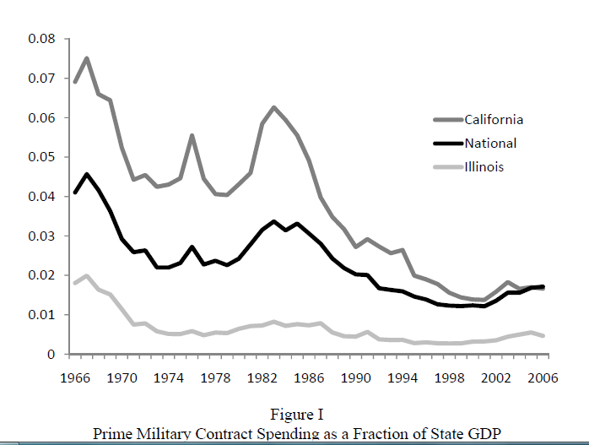
Regional Variation in Military Spending
California much more sensitive to aggregate variation in military spending than Illinois
We can ask, does GDP in CA rise relative to GDP in IL when US military spending increases
Nakamura and Steinsson (2014)

Slide 25
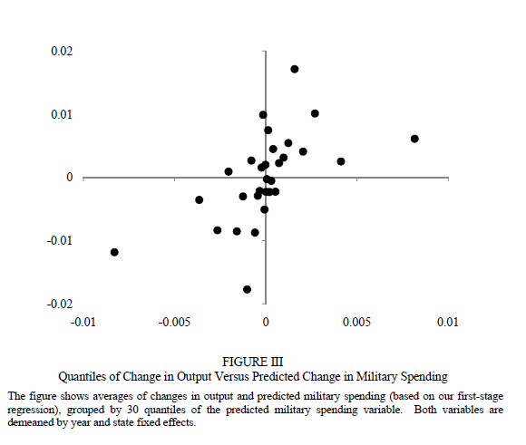
Regional Variation in Military Spending
Turns out it does
Most points in SW and NE quadrants indicating positive relationship between systematic military spending and state GDP
Nakamura and Steinsson (2014)

Slide 26
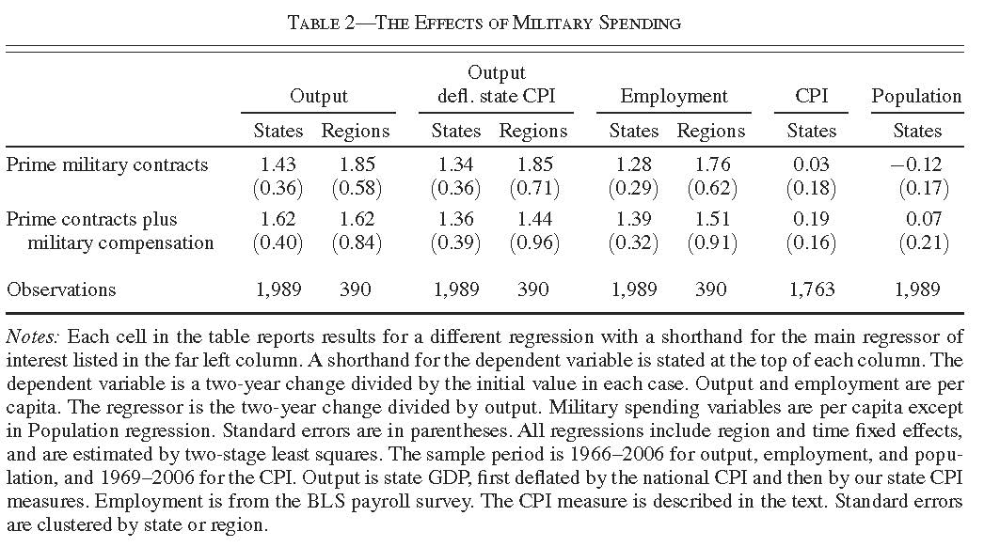
Nakamura and Steinsson (2014)

Slide 27
Regional Variation in Military Spending
We find a “relative multiplier” of 1.5
I.e., when military spending goes up by 1% of GDP in CA relative to IL, output goes up by 1.5% in CA relative to IL
But how do we interpret this?
Not the same as aggregate multiplier
No response of “relative” monetary policy or tax policy
States don’t pay for spending

Slide 28
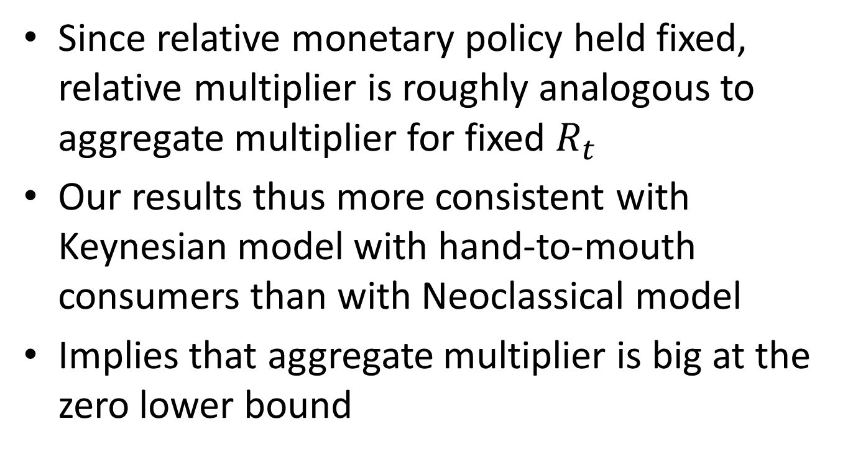
Interpretation of Relative Multiplier
Since relative monetary policy held fixed, relative multiplier is roughly analogous to aggregate multiplier for fixed $R_{t}$
Our results thus more consistent with Keynesian model with hand-to-mouth consumers than with Neoclassical model
Implies that aggregate multiplier is big at the zero lower bound

Slide 29
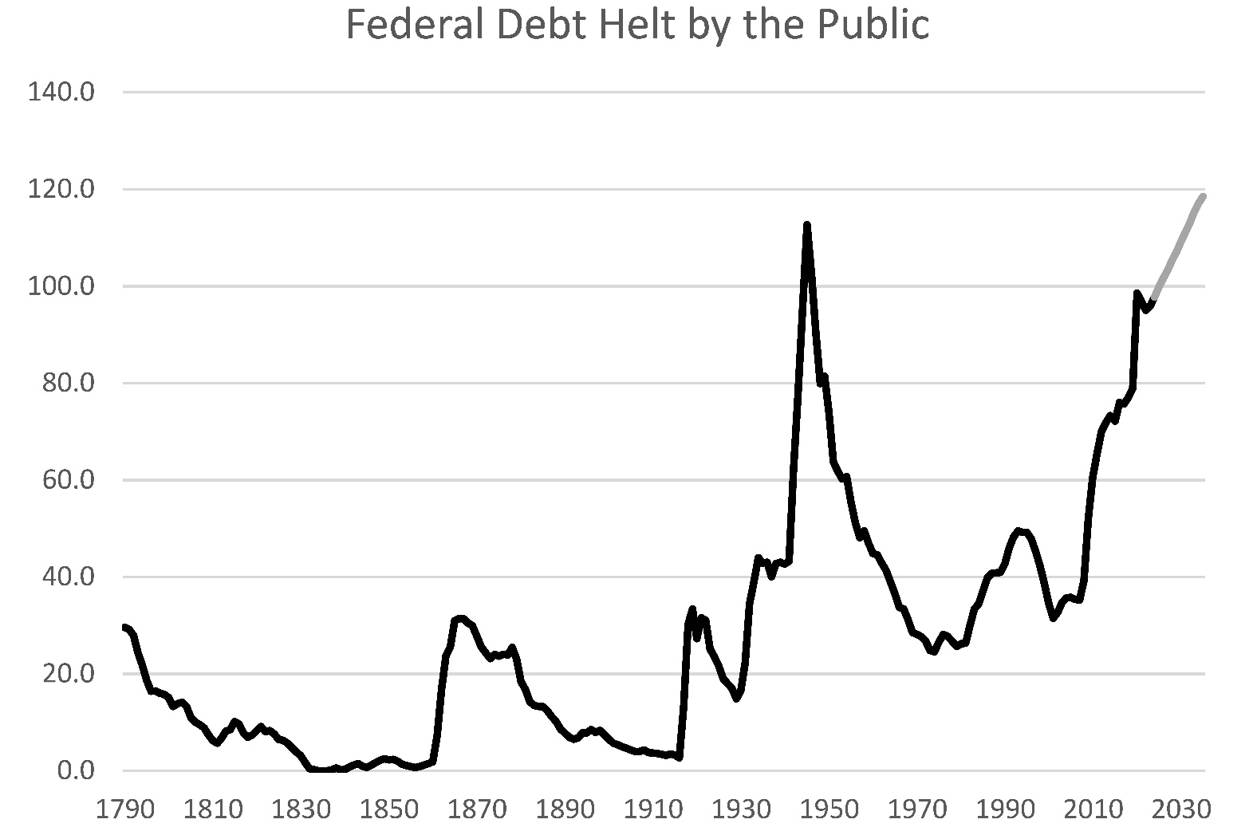
Exploding Government Debt?
US government debt has risen rapidly as a fraction of GDP in recent years
Almost as high as at the end of WWII
Is this dangerous?
Source: Congressional Budget Office

Slide 30
Fiscal Space
There is a limit to how much debt governments can issue
At some point, markets will not buy more debt
Because the don’t think the government will be able to repay
Fiscal space: Amount of debt a government can issue before hitting its “borrowing limit”

Slide 31
Fiscal Space
Hard to know how high the borrowing limit is
Probably different for different countries
“Screwed-up countries” often default when debt hits something like 60% of GDP
“Advanced countries” can have debt of at least 120% of GDP without defaulting

Slide 32
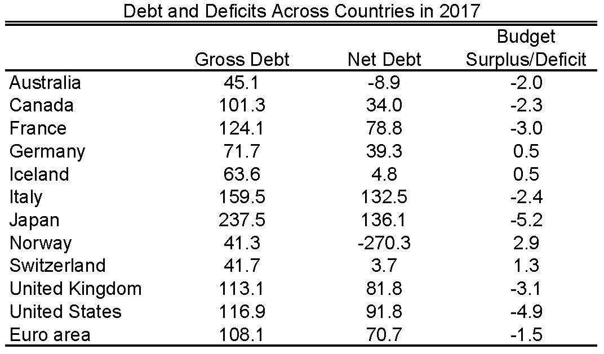
Source: OECD

Slide 33
Fiscal Space and Fiscal Stimulus
When crisis strikes, fiscal space determines how much fiscal stimulus country can do
Say debt limit is 120% of GDP
Country that starts with 120% of GDP in debt can’t do any fiscal stimulus (must actually do austerity if GDP falls)
Country that starts with 40% of GDP in debt can do lots of fiscal stimulus
Fiscal space is very valuable in a crisis!!

