Slide 1
Malthus and Pre-Industrial Stagnation
Jón Steinsson
Columbia University

Slide 2
Long Run Growth
Remarkable transformation of standards of living over last 200 years
In contrast, prior to 1800, standards of living were stagnant
Best “hard” evidence: Gregory Clark (2005)
Data on real wages of building workers in England back to 1209

Slide 3
Source: Clark (2005)

Slide 4
Evidence on Real Wages
Real wages trendless before 1800
Some fluctuations, but no trend
Sustained growth begins around 1800 in Britain (and then spreads from there)
18th and 19th century Britain is a major turning point in history which we now refer to as the Industrial Revolution

Slide 5
Key Questions About Origins of Growth
Why was there no growth before the Industrial Revolution?
Why did the Industrial Revolution happen?
Why did it happen in 18th and 19th century?
Why did it happen in Britain?
Why did the Industrial Revolution result in modern sustained growth? (Why didn’t it peter out?)

Slide 6
Why No Growth Before the Industrial Revolution?
Despotism: Those that grew rich got attacked by poorer neighbors (risk of expropriation lead to huge defense costs which retarded incentives to grow)
Vested interests: Advancement of knowledge was slow because of powerful forces working against innovators and defending status quo
Population dynamics: Higher wages lead to population growth, which pushed down wages

Slide 7
Malthus’ Idea
In 1798, Thomas Malthus published an essay titled An Essay on the Principle of Population
Argued that sustained growth in real wages was impossible in the long run:
If real wages increased, this would lead to an increase in population that would only stop when wages had been bid down to subsistence
This is where economics got the nickname: “The Dismal Science”
Notes:
This basic idea was evident in the writings of Smith and Ricardo as well (see Wrigley). But Malthus’ work focused on it and it is primarily associated with Malthus today.

Slide 8
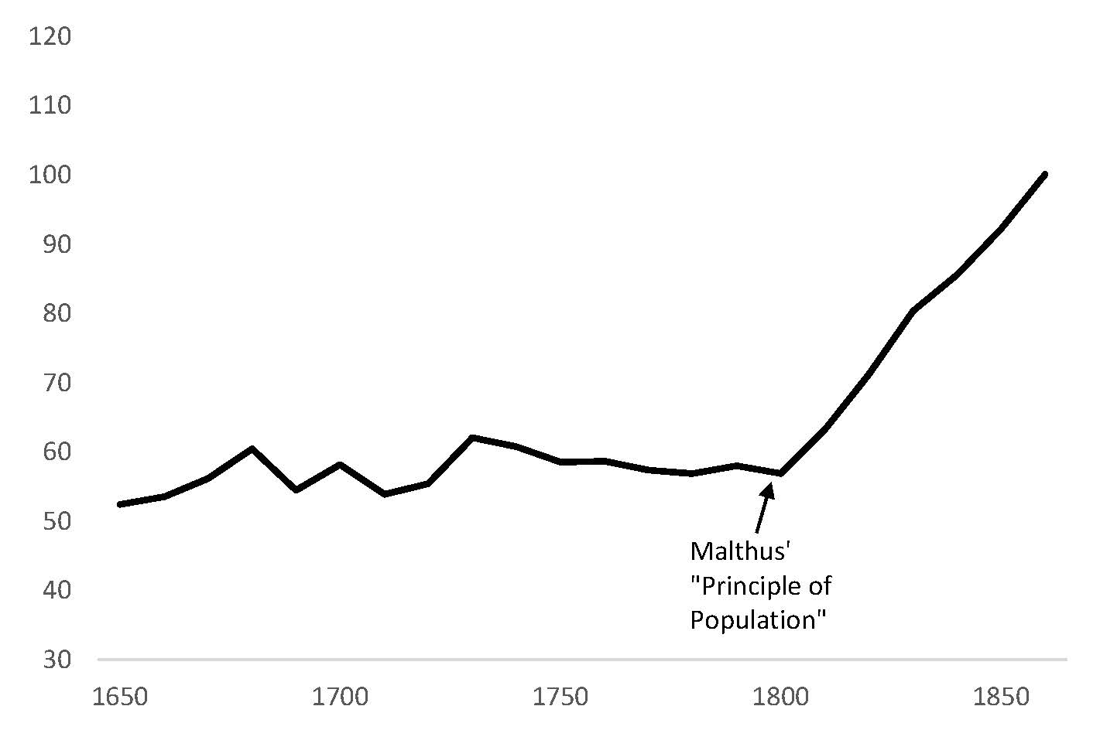
Malthus’ Unfortunate Timing
Source: Clark (2005)

Slide 9
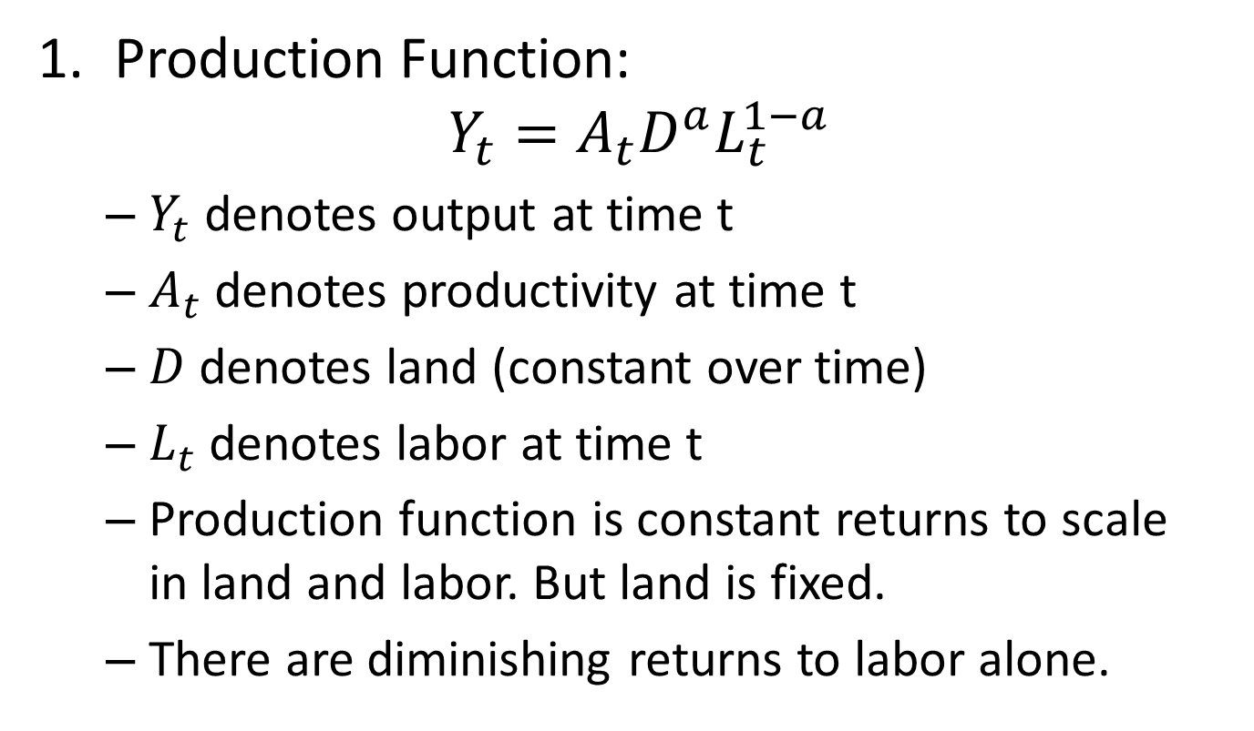
Malthus Model: Production
Production Function:
$$Y_{t}=A_{t}D^{a}L_{t}^{1−a}$$
$Y_{t}$ denotes output at time t
$A_{t}$ denotes productivity at time t
$D$ denotes land (constant over time)
$L_{t}$ denotes labor at time t
Production function is constant returns to scale in land and labor. But land is fixed.
There are diminishing returns to labor alone.

Slide 10
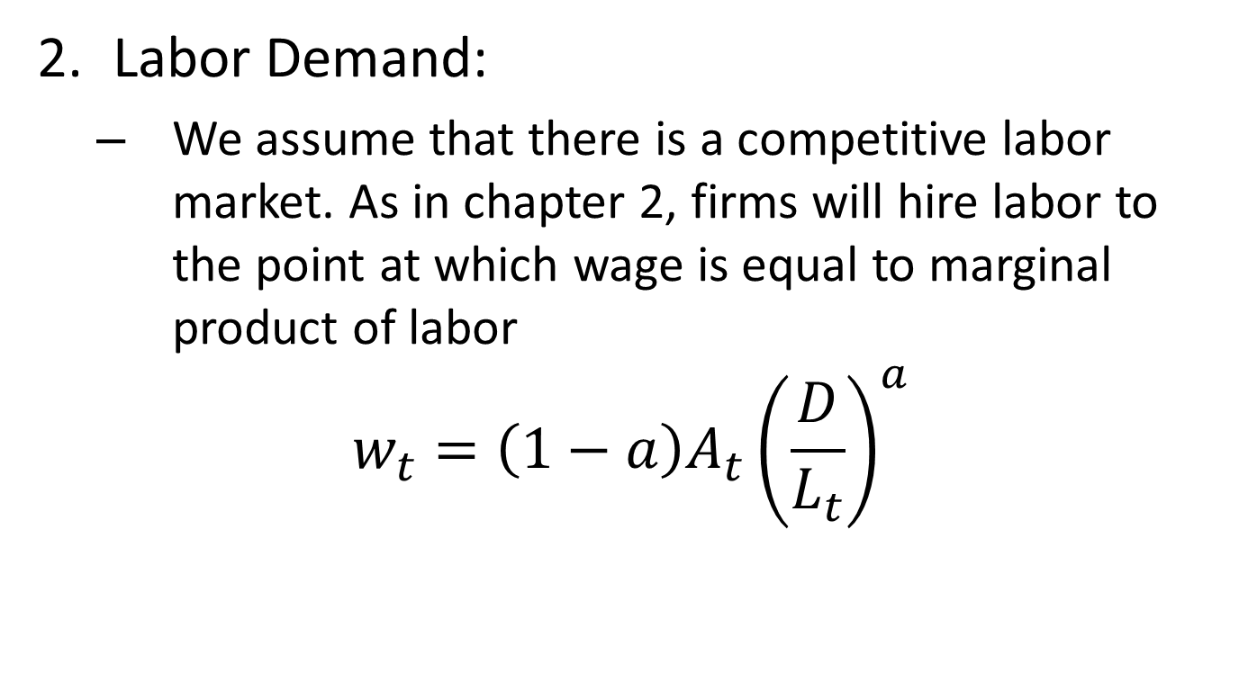
Malthus Model: Labor Demand
Labor Demand:
We assume that there is a competitive labor market. As in chapter 2, firms will hire labor to the point at which wage is equal to marginal product of labor
$$w_{t}=\left(1−a\right)A_{t}{\left(\frac{D}{L_{t}}\right)}^{a}$$

Slide 11
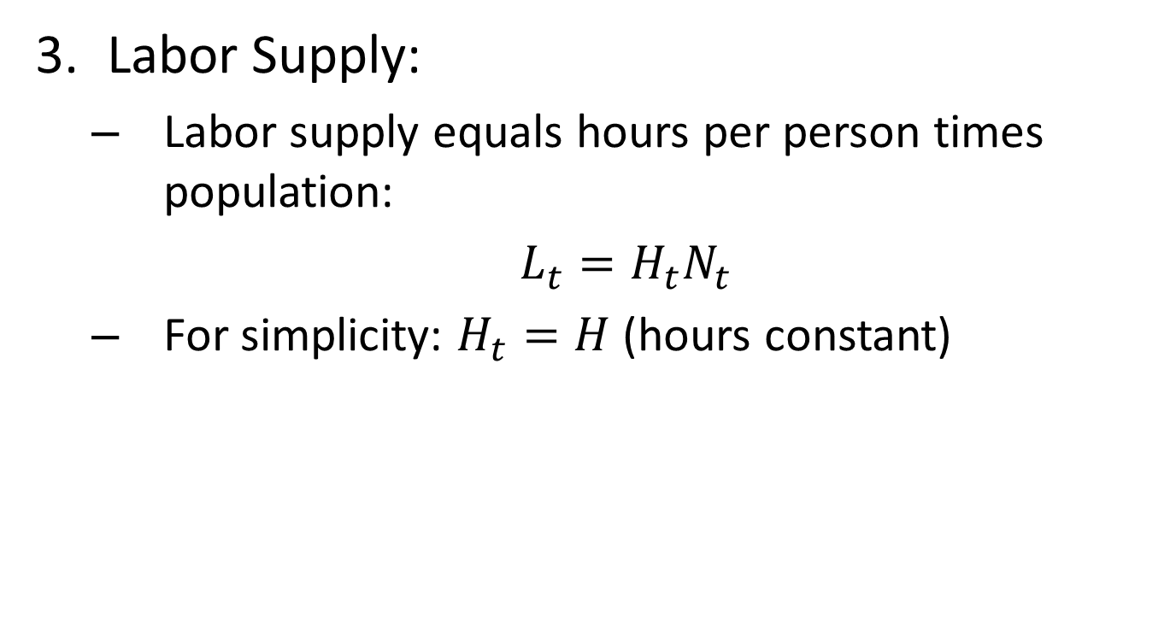
Malthus Model: Labor Supply
Labor Supply:
Labor supply equals hours per person times population:
$L_{t}=H_{t}N_{t}$
For simplicity: $H_{t}=H$ (hours constant)

Slide 12
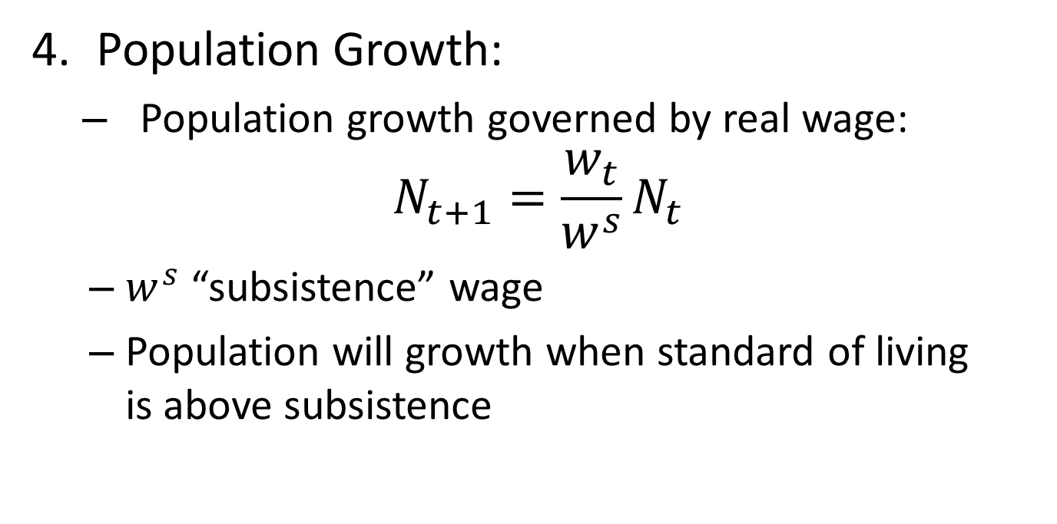
Malthus Model: Population Growth
Population Growth:
Population growth governed by real wage:
$$N_{t+1}=\frac{w_{t}}{w^{s}}N_{t}$$
$w^{s}$ “subsistence” wage
Population will growth when standard of living is above subsistence

Slide 13
Malthus Model: Population Growth
People have a natural tendency to continually produce children
Absent “checks” on this, population will grow
“Positive checks” increase death rate (war, disease, severe labor, poverty)
“Preventive checks” reduce birth rate (birth control, delayed marriage, infrequent coitus)
Simplest formulation: Abject poverty only check that is sufficiently strong to stop population growth

Slide 14
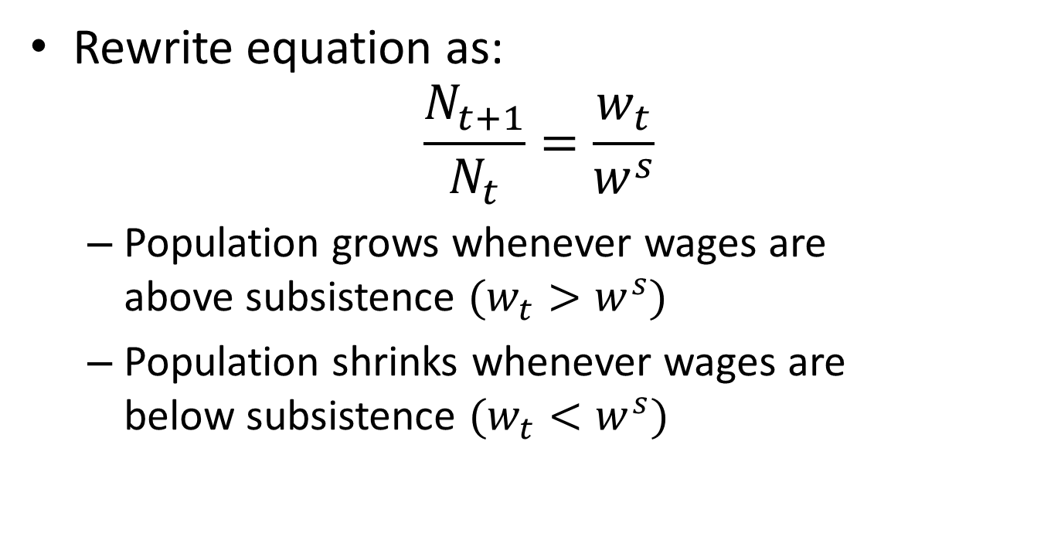
Malthus Model: Population Growth
Rewrite equation as:
$$\frac{N_{t+1}}{N_{t}}=\frac{w_{t}}{w^{s}}$$
Population grows whenever wages are above subsistence $(w_{t}>w^{s})$
Population shrinks whenever wages are below subsistence $(w_{t}<w^{s})$

Slide 15
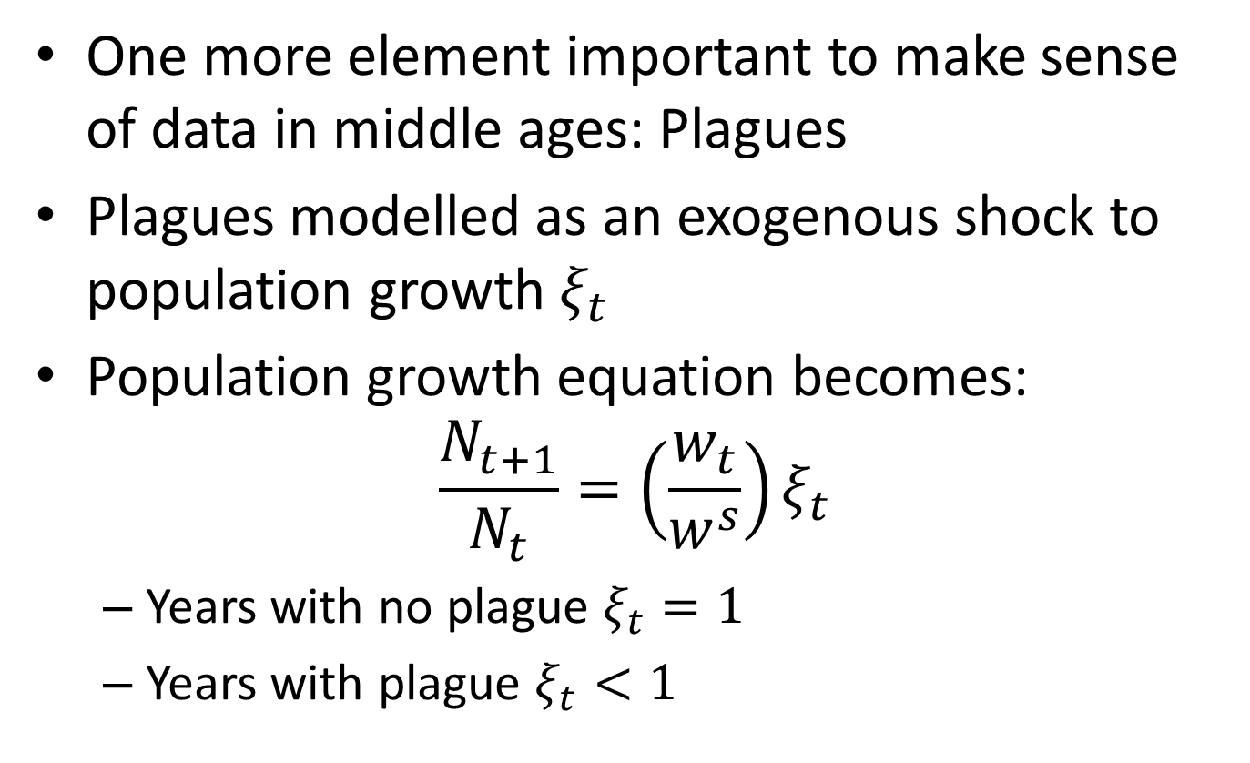
Malthus Model: Plagues
One more element important to make sense of data in middle ages: Plagues
Plagues modelled as an exogenous shock to population growth $ξ_{t}$
Population growth equation becomes:
$$\frac{N_{t+1}}{N_{t}}=\left(\frac{w_{t}}{w^{s}}\right)ξ_{t}$$
Years with no plague $ξ_{t}=1$
Years with plague $ξ_{t}<1$

Slide 16
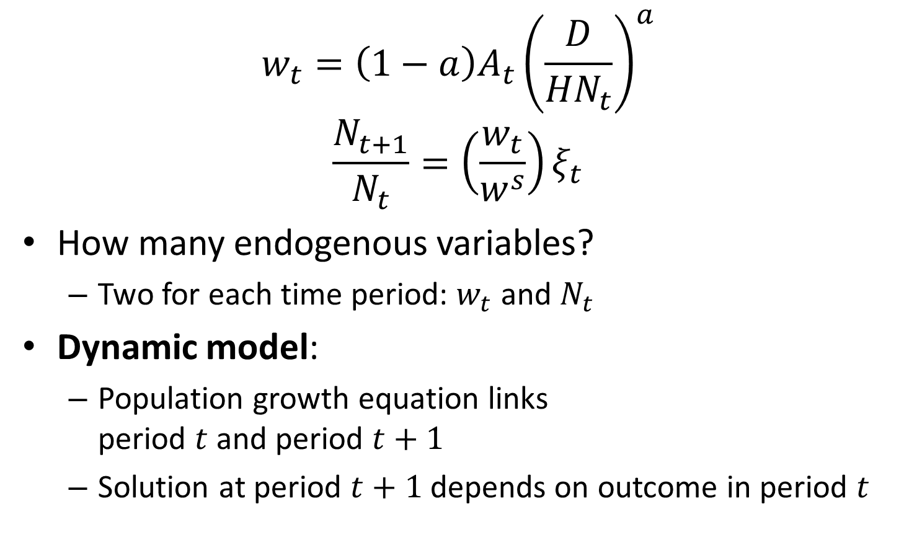
The Malthus Model: Key Equations
$$w_{t}=\left(1−a\right)A_{t}{\left(\frac{D}{{HN}_{t}}\right)}^{a}$$
$$\frac{N_{t+1}}{N_{t}}=\left(\frac{w_{t}}{w^{s}}\right)ξ_{t}$$
How many endogenous variables?
Two for each time period: $w_{t}$ and $N_{t}$
Dynamic model:
Population growth equation links period $t$ and period $t+1$
Solution at period $t+1$ depends on outcome in period $t$

Slide 17
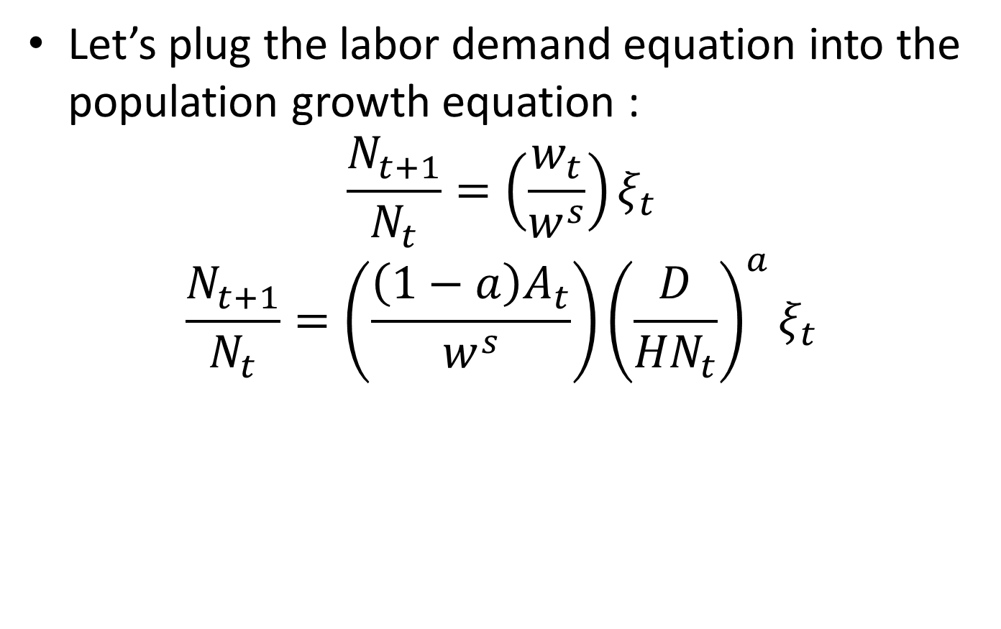
Population Dynamics
Let’s plug the labor demand equation into the population growth equation :
$$\frac{N_{t+1}}{N_{t}}=\left(\frac{w_{t}}{w^{s}}\right)ξ_{t}$$
$$\frac{N_{t+1}}{N_{t}}=\left(\frac{\left(1−a\right)A_{t}}{w^{s}}\right){\left(\frac{D}{{HN}_{t}}\right)}^{a}ξ_{t}$$

Slide 18
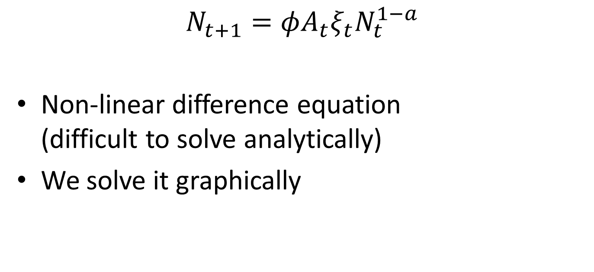
Population Dynamics
$$N_{t+1}=φA_{t}ξ_{t}N_{t}^{1−a}$$
Non-linear difference equation (difficult to solve analytically)
We solve it graphically

Slide 19
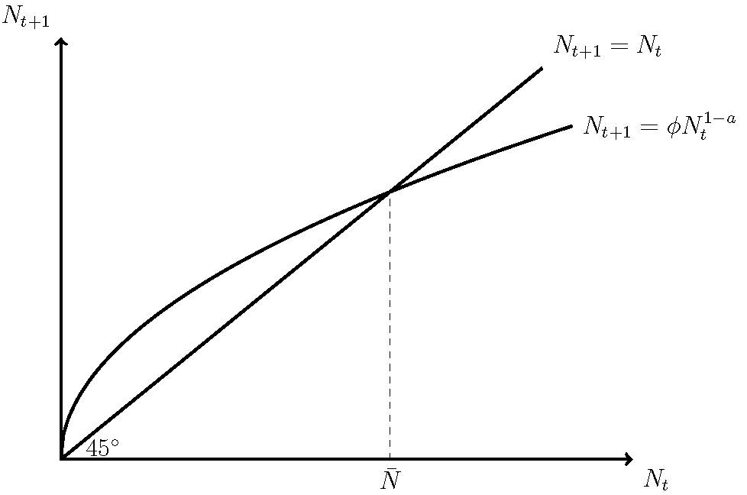
Population Dynamics

Slide 20
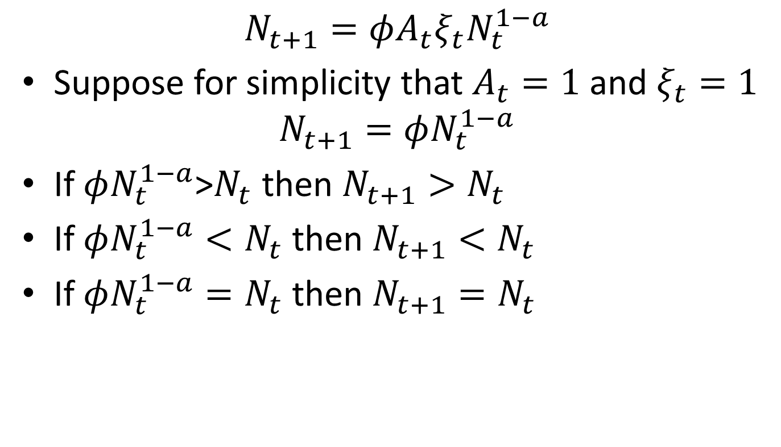
Population Dynamics
$$N_{t+1}=φA_{t}ξ_{t}N_{t}^{1−a}$$
Suppose for simplicity that $A_{t}=1$ and $ξ_{t}=1$
$$N_{t+1}=φN_{t}^{1−a}$$
If $φN_{t}^{1−a}$>$N_{t}$ then $N_{t+1}>N_{t}$
If $φN_{t}^{1−a}<N_{t}$ then $N_{t+1}<N_{t}$
If $φN_{t}^{1−a}=N_{t}$ then $N_{t+1}=N_{t}$

Slide 21
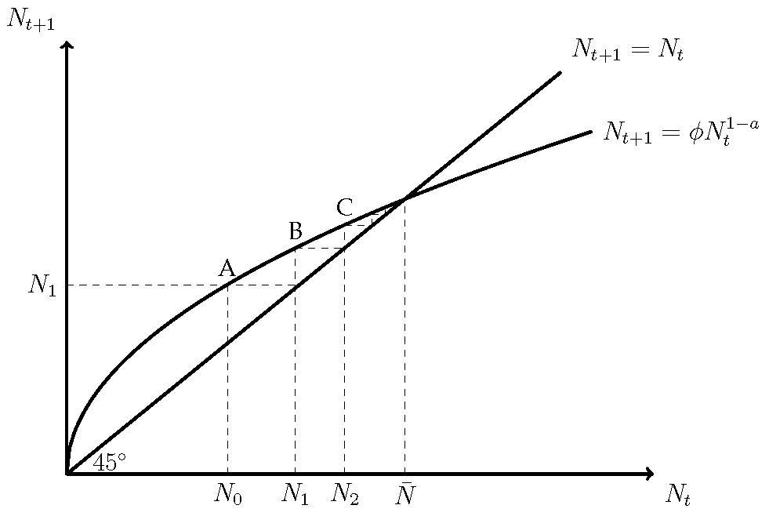
Convergence to Steady State

Slide 22
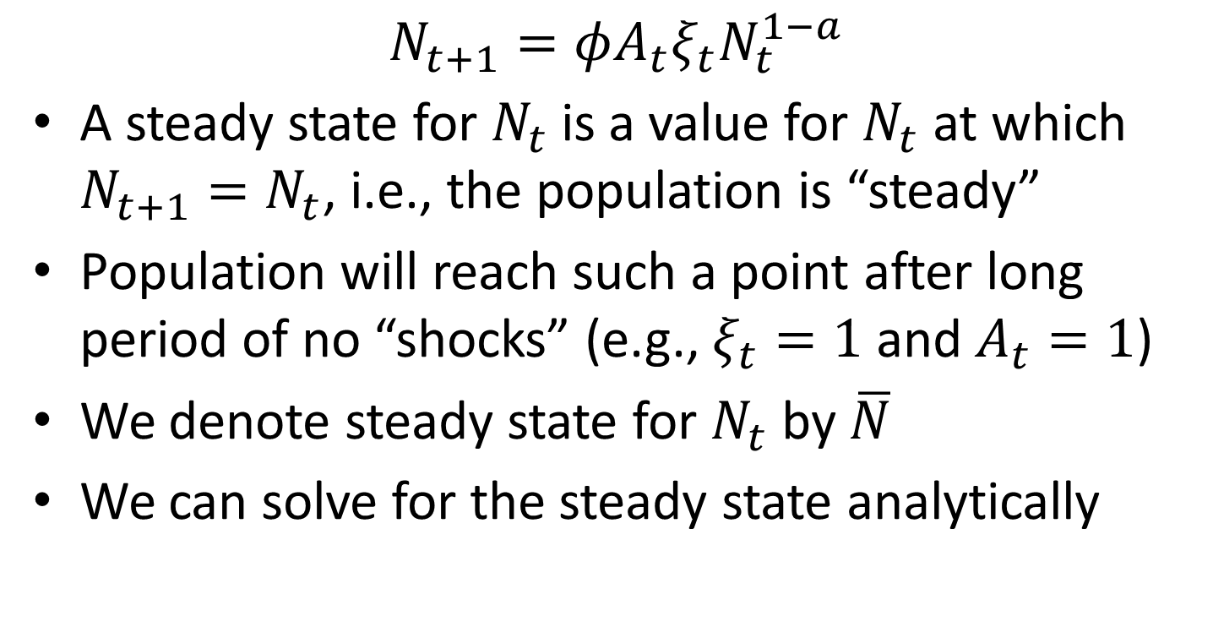
Steady State Population
$$N_{t+1}=φA_{t}ξ_{t}N_{t}^{1−a}$$
A steady state for $N_{t}$is a value for $N_{t}$ at which $N_{t+1}=N_{t}$, i.e., the population is “steady”
Population will reach such a point after long period of no “shocks” (e.g., $ξ_{t}=1$ and $A_{t}=1$)
We denote steady state for $N_{t}$ by $\overline{N}$
We can solve for the steady state analytically

Slide 23
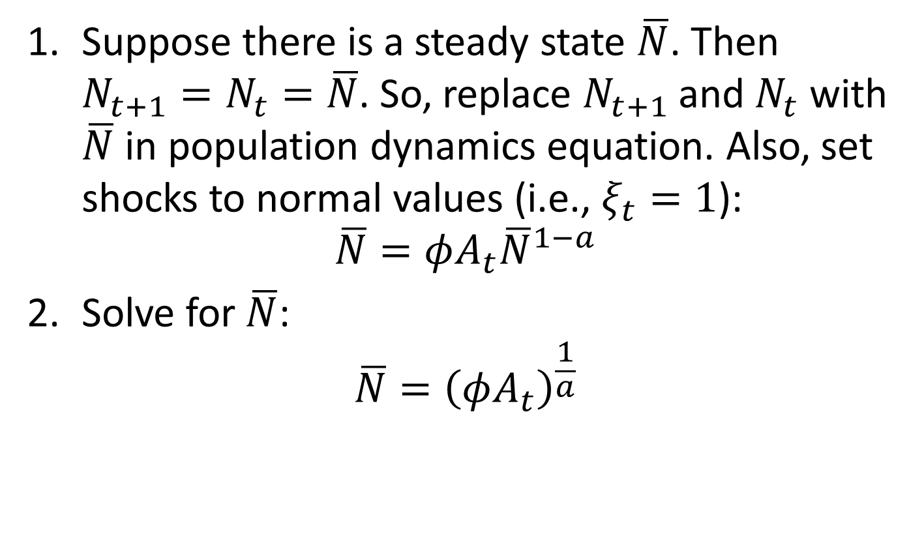
Solving for Steady State
Suppose there is a steady state $\overline{N}$. Then $N_{t+1}=N_{t}=\overline{N}$. So, replace $N_{t+1}$ and $N_{t}$ with $\overline{N}$ in population dynamics equation. Also, set shocks to normal values (i.e., $ξ_{t}=1$):
$$\overline{N}=φA_{t}{\overline{N}}^{1−a}$$
Solve for $\overline{N}$:
$$\overline{N}={\left(φA_{t}\right)}^{\frac{1}{a}}$$

Slide 24
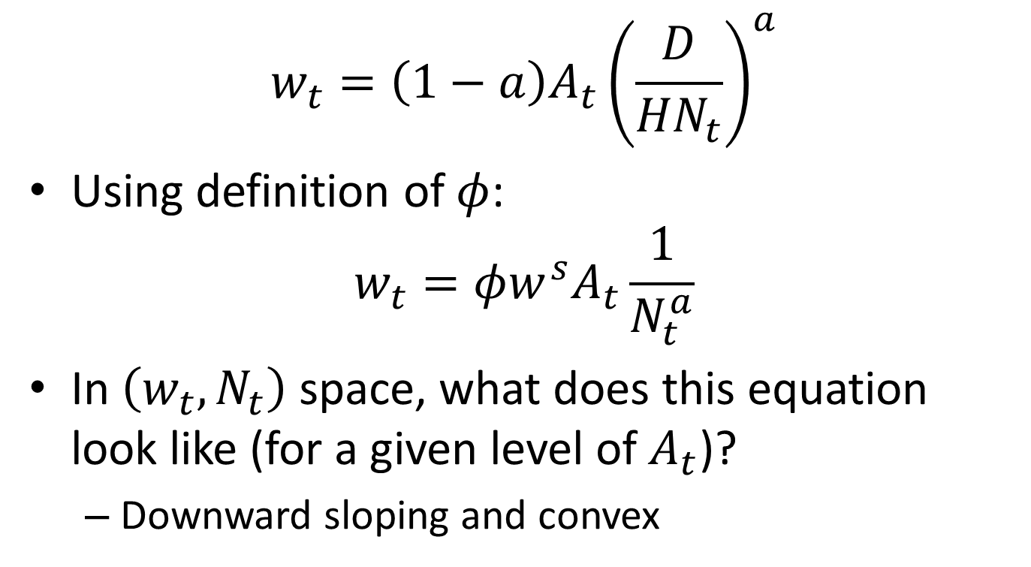
Wages and Population
$$w_{t}=\left(1−a\right)A_{t}{\left(\frac{D}{{HN}_{t}}\right)}^{a}$$
Using definition of $φ$:
$$w_{t}=φw^{s}A_{t}\frac{1}{N_{t}^{a}}$$
In $\left(w_{t},N_{t}\right)$ space, what does this equation look like (for a given level of $A_{t}$)?
Downward sloping and convex

Slide 25
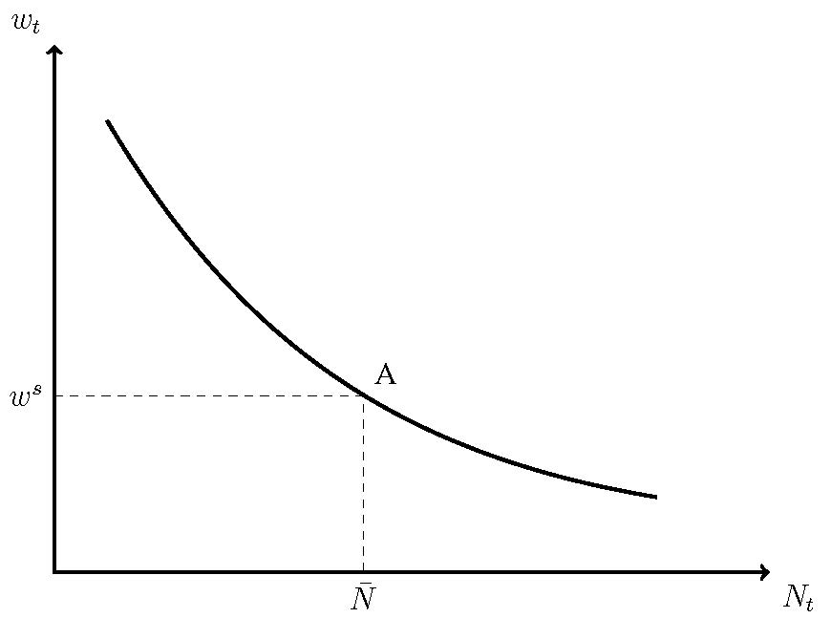
Labor Demand

Slide 26
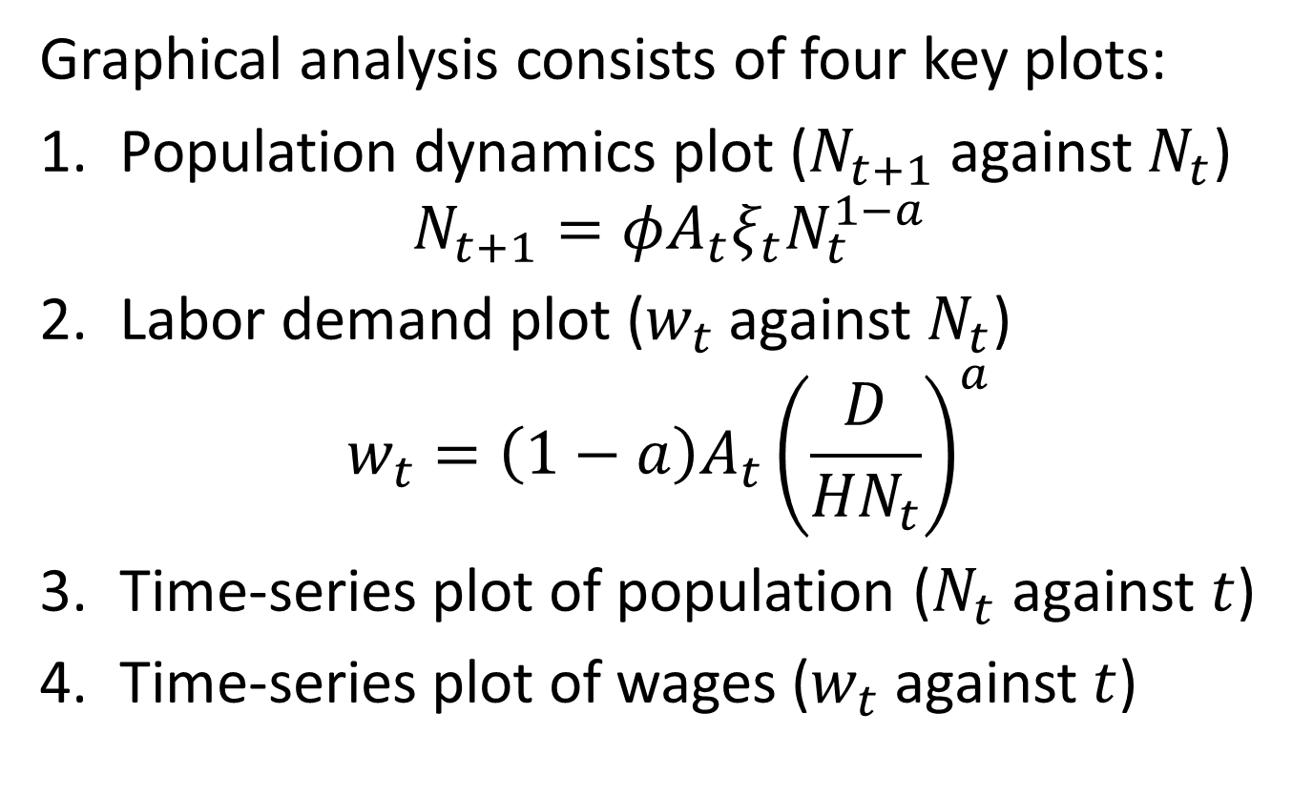
The Malthus Model
Graphical analysis consists of four key plots:
Population dynamics plot ($N_{t+1}$ against $N_{t}$)
$$N_{t+1}=φA_{t}ξ_{t}N_{t}^{1−a}$$
Labor demand plot ($w_{t}$ against $N_{t}$)
$$w_{t}=\left(1−a\right)A_{t}{\left(\frac{D}{{HN}_{t}}\right)}^{a}$$
Time-series plot of population ($N_{t}$ against $t$)
Time-series plot of wages ($w_{t}$ against $t$)

Slide 27
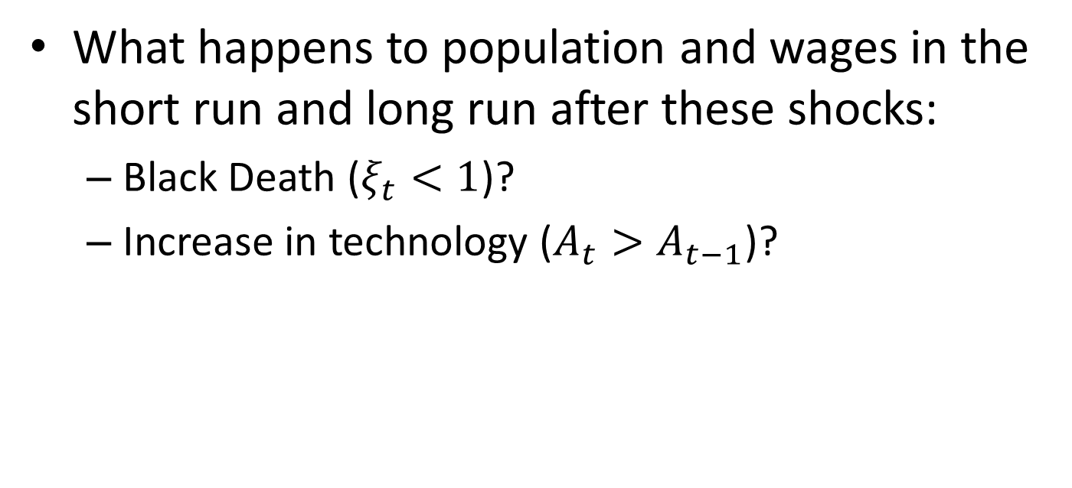
Responses to Shocks
What happens to population and wages in the short run and long run after these shocks:
Black Death ($ξ_{t}<1$)?
Increase in technology ($A_{t}>A_{t−1}$)?

Slide 28
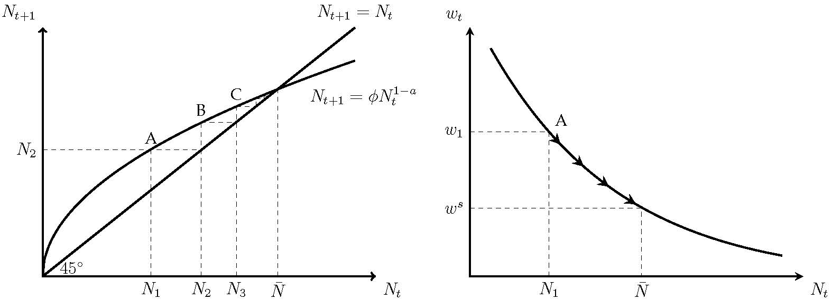
Black Death

Slide 29
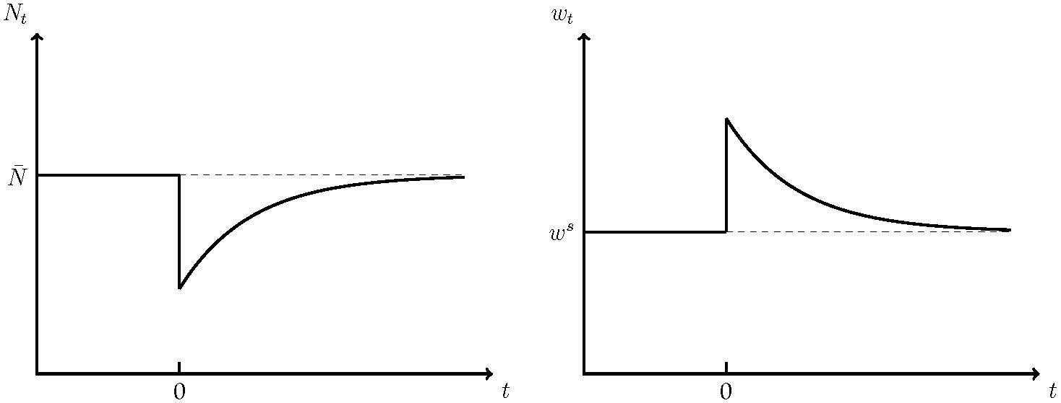
Black Death

Slide 30
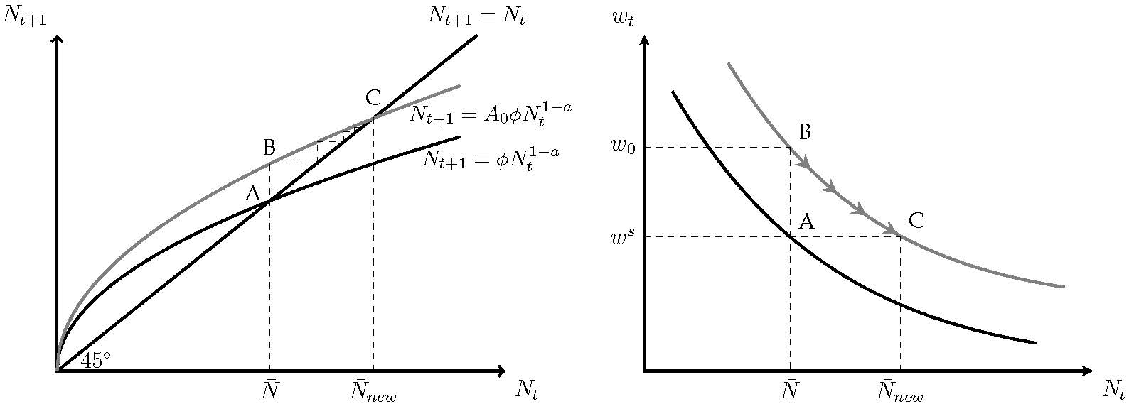
Increase in Productivity

Slide 31
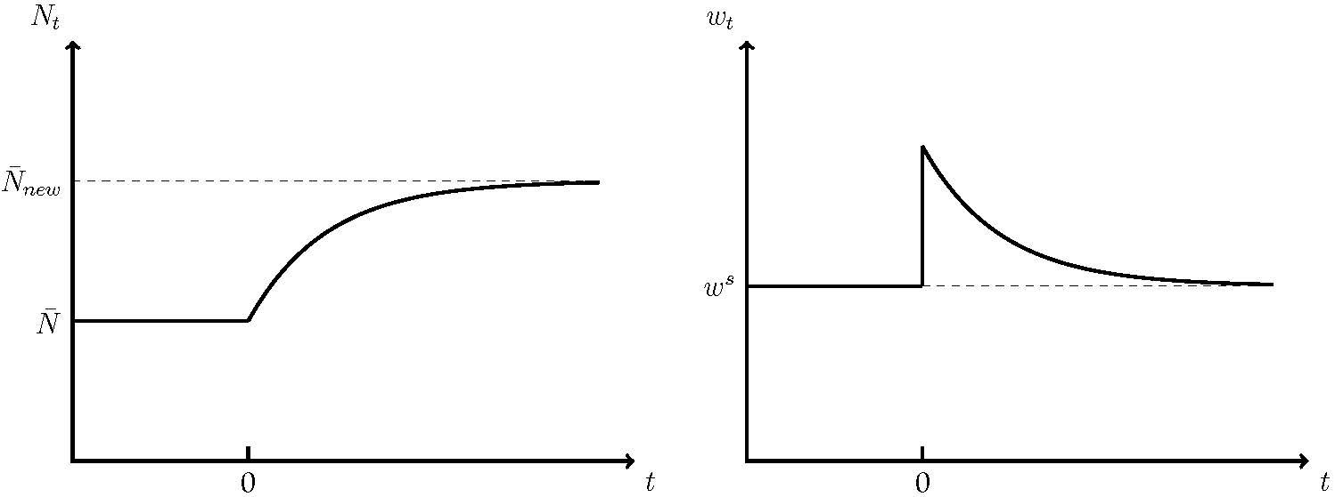
Increase in Productivity

Slide 32
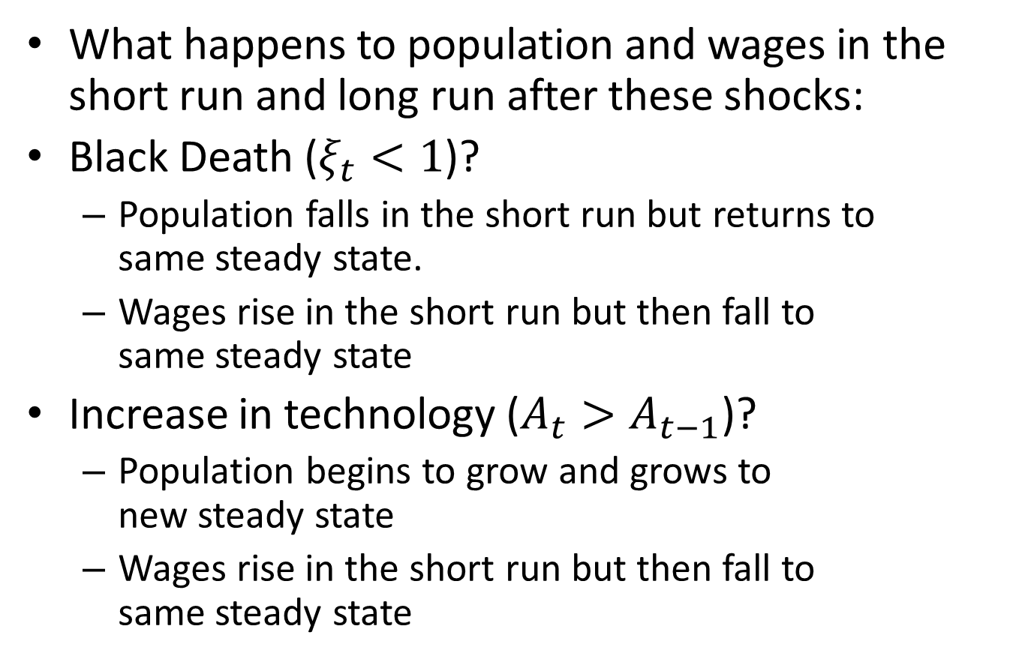
Responses to Shocks
What happens to population and wages in the short run and long run after these shocks:
Black Death ($ξ_{t}<1$)?
Population falls in the short run but returns to same steady state.
Wages rise in the short run but then fall to same steady state
Increase in technology ($A_{t}>A_{t−1}$)?
Population begins to grow and grows to new steady state
Wages rise in the short run but then fall to same steady state

Slide 33
Growth Before 1500
Different meanings of “growth”:
Growth in individual income and wellbeing
Growth in GDP per person
Growth in productivity
Malthus model highlights difference:
Increase in productivity does not lead to higher real wages in the long run
Increase in productivity leads to larger population

Slide 34
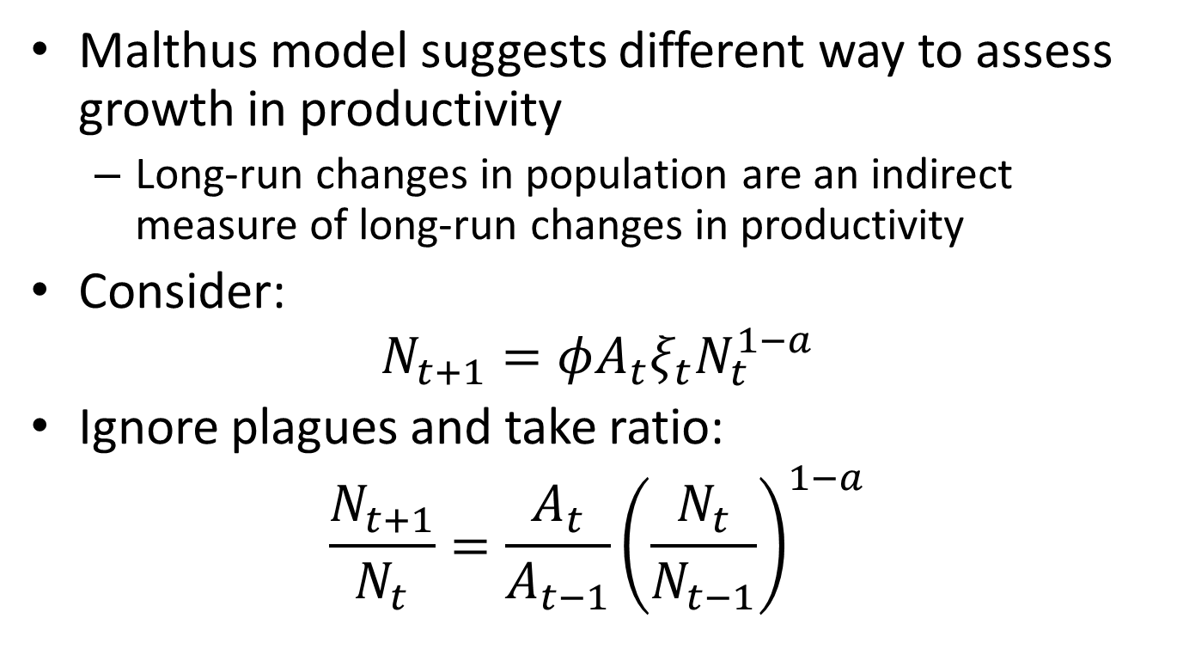
Growth in Productivity Before 1500
Malthus model suggests different way to assess growth in productivity
Long-run changes in population are an indirect measure of long-run changes in productivity
Consider:
$$N_{t+1}=φA_{t}ξ_{t}N_{t}^{1−a}$$
Ignore plagues and take ratio:
$$\frac{N_{t+1}}{N_{t}}=\frac{A_{t}}{A_{t−1}}{\left(\frac{N_{t}}{N_{t−1}}\right)}^{1−a}$$

Slide 35
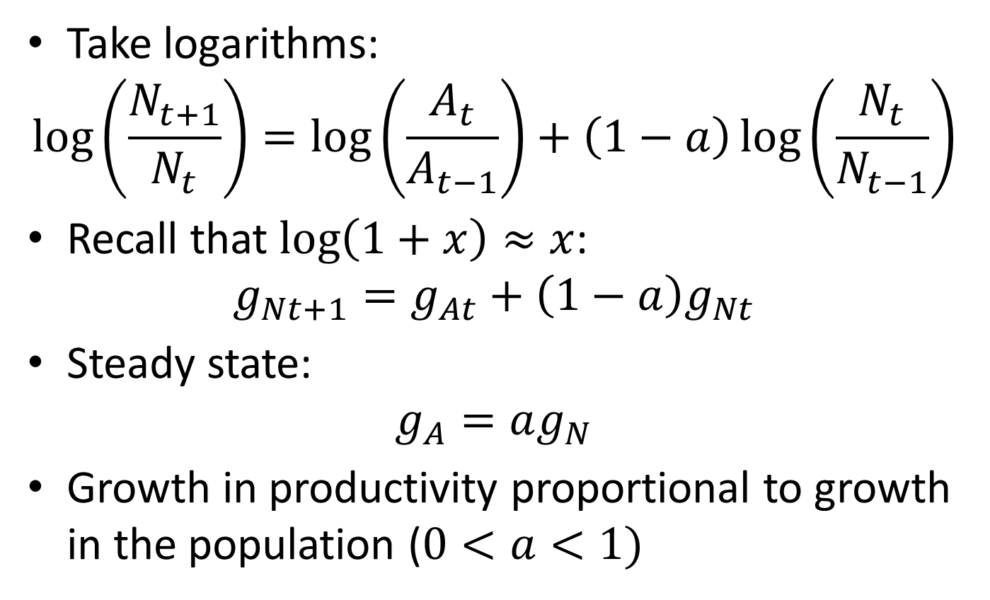
Growth in Productivity Before 1500
Take logarithms:
$$\log\left(\frac{N_{t+1}}{N_{t}}\right)=\log\left(\frac{A_{t}}{A_{t−1}}\right)+\left(1−a\right)\log\left(\frac{N_{t}}{N_{t−1}}\right)$$
Recall that $\log\left(1+x\right)≈x$:
$$g_{Nt+1}=g_{At}+\left(1−a\right)g_{Nt}$$
Steady state:
$$g_{A}=ag_{N}$$
Growth in productivity proportional to growth in the population ($0<a<1)$

Slide 36
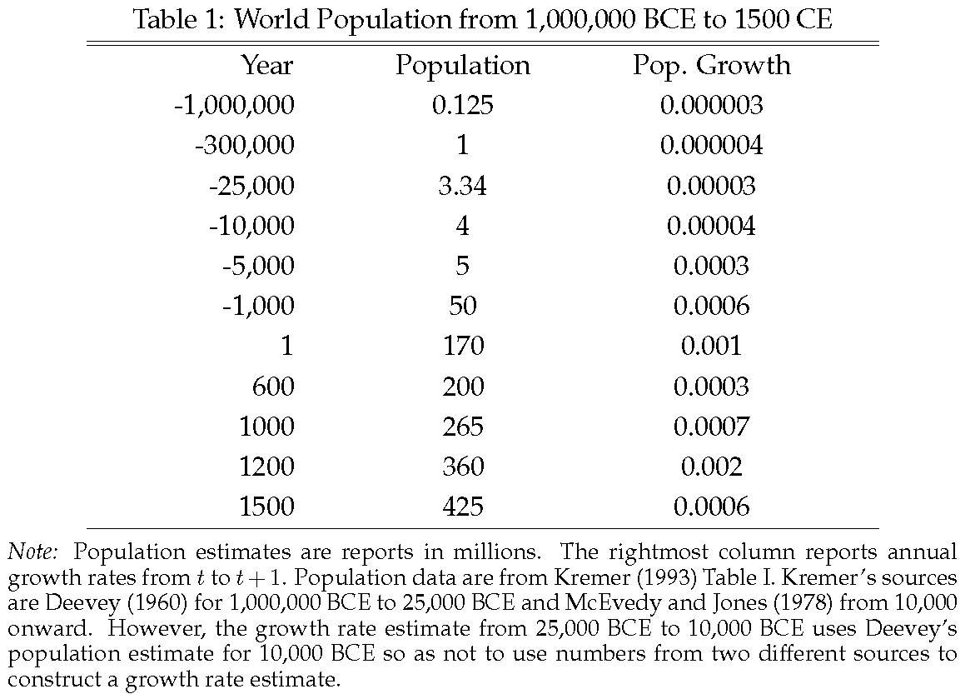

Slide 37
Wages in England 1250-1860
Can we use the Malthus model to make sense of the evolution of real wages in England from 1250 onward?

Slide 38
Source: Clark (2005)

Slide 39
Wages in England 1250-1850
Two striking facts:
No growth (same in 1750 as in 1250)
Big rise (1300-1450) and then fall (1450 to 1640)
Malthus model suggests that evolution of the population may help us understand changes in real wages
Let’s look at a scatter plot of real wages and the population in England over time

Slide 40
Real Wages of Laborers in England 1250-1450
Source: Clark (2010)

Slide 41
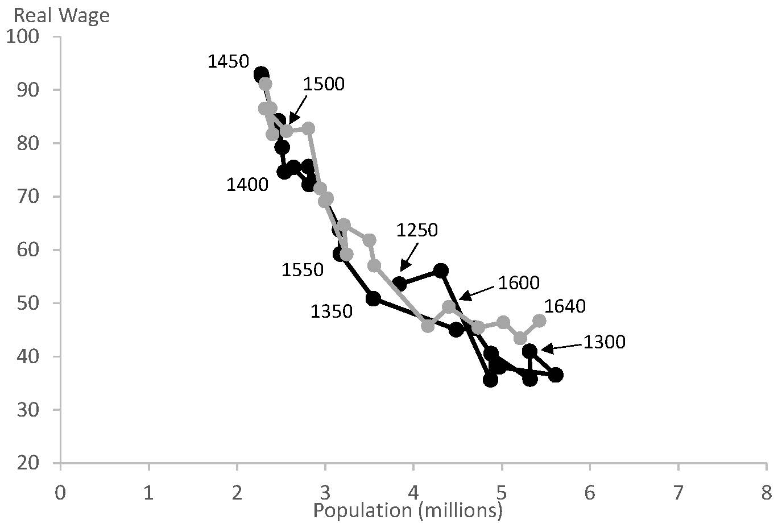
Real Wages of Laborers in England 1250-1640
Source: Clark (2010)

Slide 42
Real Wages of Laborers in England 1250-1640
1250-1310:
Population rises and real wages fall
1310-1450:
Population falls and real wages rise
Black Death in 1340s. Waves of plagues afterwards
1450-1640:
Population rises and real wages fall
Economy “recovers” from plagues

Slide 43
Success of Malthus Model
Big rise and fall of real wages may have seemed puzzling before
Malthus model provides an explanation:
Real wages rose as plagues halved the population
Real wages fell as population recovered

Slide 44
Why Did Recovery Take So Long?
There were many plagues after 1350
Black Death may have caused a decrease in birth rates
European Marriage Pattern:
Women married at 25 as opposed to 20
Significant fraction never married
Voigtlander and Voth (2013):
Black Death lead to shift to pastoral farming
Women have comparative advantage at pastoral farming

Slide 45
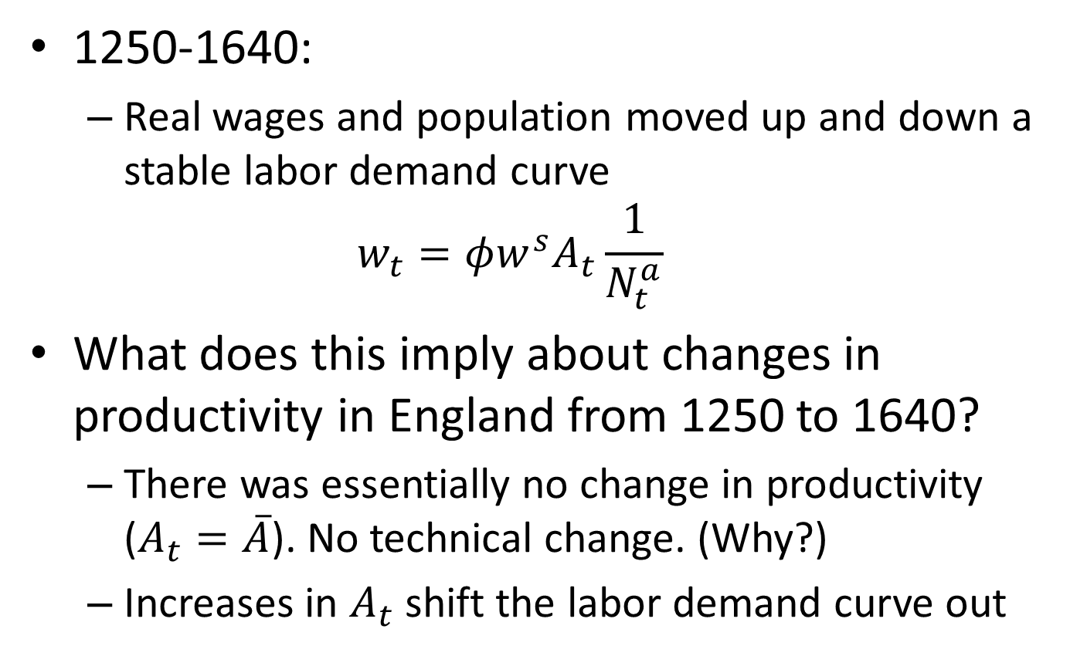
Technical Change in England 1250-1640
1250-1640:
Real wages and population moved up and down a stable labor demand curve
$$w_{t}=φw^{s}A_{t}\frac{1}{N_{t}^{a}}$$
What does this imply about changes in productivity in England from 1250 to 1640?
There was essentially no change in productivity ($A_{t}=\overline{A}$). No technical change. (Why?)
Increases in $A_{t}$ shift the labor demand curve out

Slide 46
Real Wages of Laborers in England 1300-1640
Source: Clark (2010)

Slide 47
Something Changed Around 1650
Source: Clark (2009)

Slide 48
Something Changed Around 1650
Points move off the curve!!
What does this mean about productivity?
Productivity started increasing ($A_{t}$ started growing)
From 1640-1730: Mostly increase in wages
Great Plague of London in 1665-6
From 1730-1800: Mostly increase in population
Recovery from plagues? Increase in health? Engel‘s pause?
Around 1800: Huge acceleration

Slide 49
Real Wages of Laborers in England 1290-1860

Slide 50
Malthus’ Unfortunate Timing
Malthus sometimes get a bad rap
Prediction that wages were doomed to stay at subsistence turned out to be wrong after his writing
But his theory was arguably correct for all of history up until his writing!!
What changed after 1800?

Slide 51
Why Is World No Longer Malthusian?
Technological growth overwhelmed Malthusian forces
Population forces Malthus emphasized are slow
Fast enough technology growth my overwhelm them
Land less important in production
Existence of a fix factor of production (land) important for logic of Malthus model
Land became much less important after 1800 due to invention of the steam engine
Land no longer needed to produce energy

Slide 52
Why is World No Long Malthusian?
Demographic Transition
Data on birth rates and death rates support Malthus’ model quite well up until 1825
After 1825, relationship between birth rates and real wages assumed by Malthus breaks down (and particularly after 1880)

Slide 53
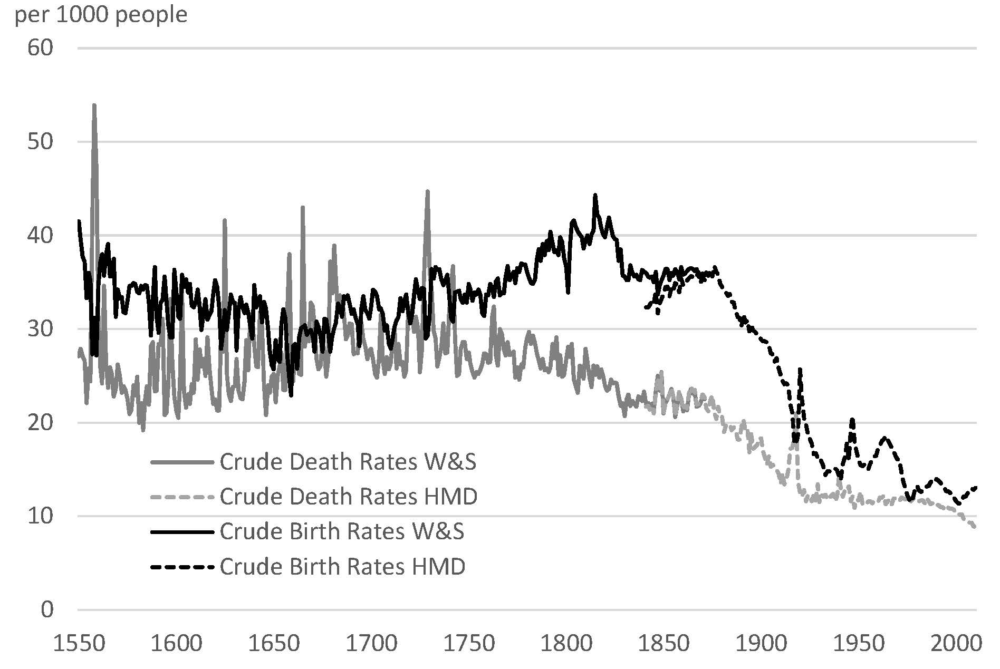
Demographic Transition in England

Slide 54
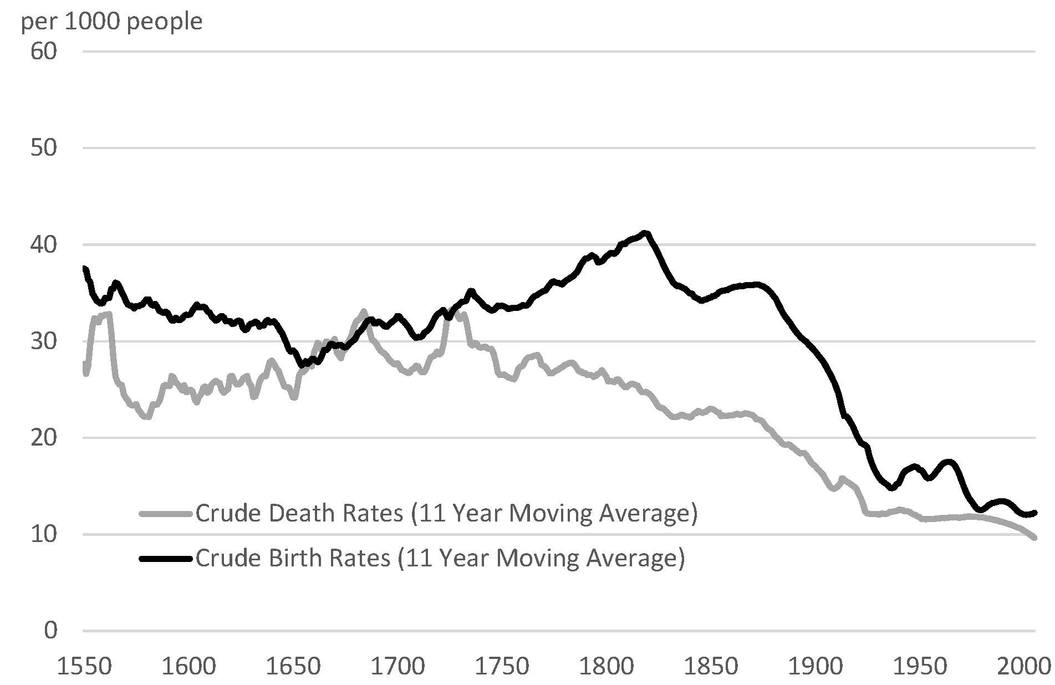
Demographic Transition in England

Slide 55
Demographic Transition
High wages no longer associated with high population growth in England
Same pattern observed for all countries when they develop
Why did birth rates fall?
Improved contraceptive methods
Trade-off between quantity and “quality” of children?
Women’s empowerment

Slide 56
Malthus and Economic Policy
Malthus wrote is essay as a response to argument that better laws could eradicate poverty
Malthus thought policies that optimists advocated might accentuate social evils

Slide 57
Malthus and the Poor Laws
Particularly critical of English Poor Laws
“though they may have alleviated a little the intensity of individual misfortune, they have spread the general evil over a much larger surface”
Poor Laws weakened natural checks on population growth and thereby lowered wages
Larger population equally poor or poorer
“Malthusian argument” against poor relief influential
Poor Laws amended in 1834 (made less generous)

Slide 58
The Dismal Science
The implications of Malthus’ model for economic policy is extremely depressing
Consider birth and death rates:
Birth rates higher when wages are higher (e.g., can afford to marry earlier, more fertile)
Death rates lower when wages are higher (e.g., poverty yields higher death rate of children)
Steady state is where birth rate equals death rate (otherwise population will rise or fall)

Slide 59
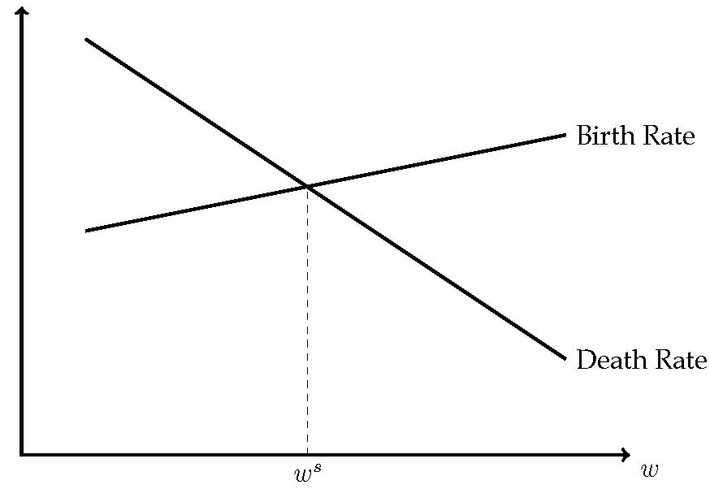

Slide 60
Economic Policy in Malthus Model
Any economic policy that doesn’t shift birth- or death-rate curve has no effect on material well-being of poor in the long run
Material well-being determined by crossing of birth- and death-rate curves
If neither shift, long-run steady state unchanged
Consequence:
Only way to reduce poverty in the long run is to reduce the birth rate or increase the death rate

Slide 61
Redistribution Towards the Poor
In the short run: Increases income of the poor
Increase in “after-transfer” wages
Shifts economy to the right on birth-rate/death-rate plot
Leads to population growth
Economy converges to a new steady state where “after-transfer” wage is the same as before
In the long run: Bigger population equally poor

Slide 62
Redistribution Away from Poor
Suppose elite taxes the poor (not uncommon before 1800)
In the short run: After-tax wages fall
This leads population to fall
In the long run:
After-tax wages same as before
Smaller population of poor people
Ruling class enjoys more wealth (cathedrals, palaces, monuments, art, etc.)

Slide 63
Improvement in Public Health
This shifts the death-rate curve down
Population expands
Wages fall to new lower steady state
Long run: Larger population of poorer people

Slide 64
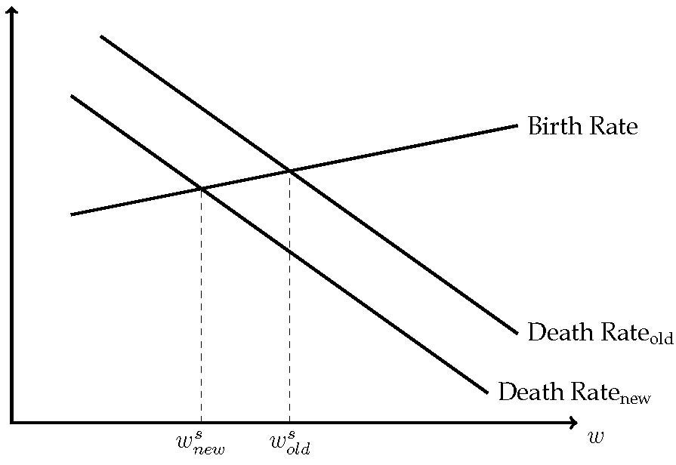

Slide 65
Wages and Cleanliness
Pre-industrial evidence suggests wages were higher in Europe than China and Japan. Why?
Relative squalor of European living conditions?
Japanese were particularly clean. This may have caused them to be particularly poor.
Also, high intensity of warfare in Europe between 1400 and 1700

