Slide 1
Money and Banking
Jón Steinsson
University of California, Berkeley

Slide 2
Credit as Money
Early monetary systems used coins, cattle, cowrie shells, etc. as money
Past millenium saw a shift to the use of credit as money
Today, most forms of money are a credit instrument – i.e., someone’s liability (usually a bank’s liability)
Card payments:
You are paying with bank deposits
Funds transferred from your bank account to merchant‘s bank account
Bank notes are a bank liability
Even coins are a bank liability today

Slide 3
The Modern Payment System
Retail payment systems:
Card systems (Visa, Mastercard, etc)
Point-of-sale transactions (grocery store, other retail), internet
Automated Clearinghouse (ACH)
Payroll, utility bills, mortgage payments, etc.
Checks
Apple Pay, Google Pay, Venmo, PayPal, etc.
(Pix in Brazil, UPI in India)
Large-value payment systems:
Fedwire (“wire transfers”)
CHIPS

Slide 4
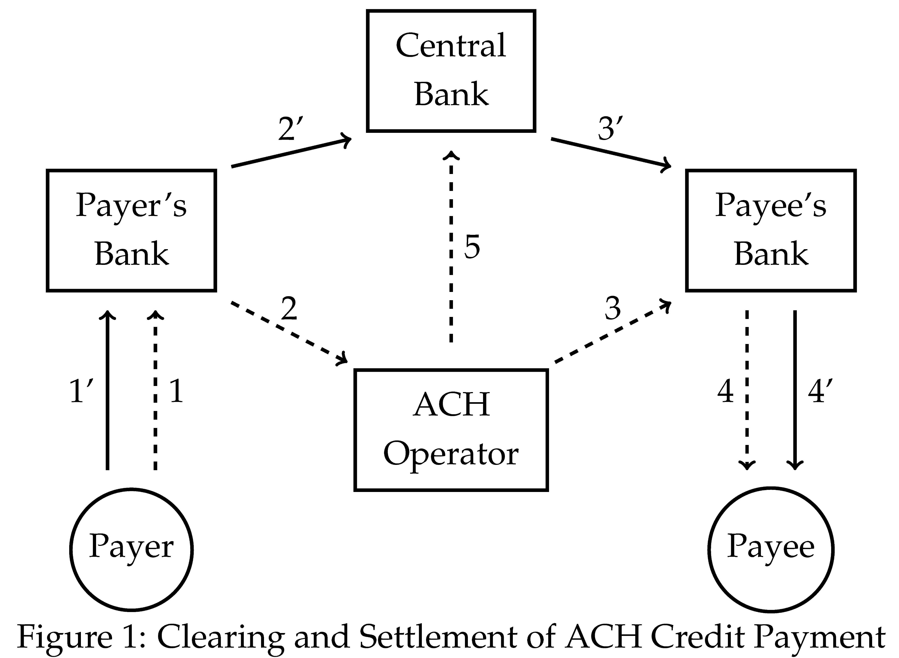
How Modern Payments Work

Slide 5
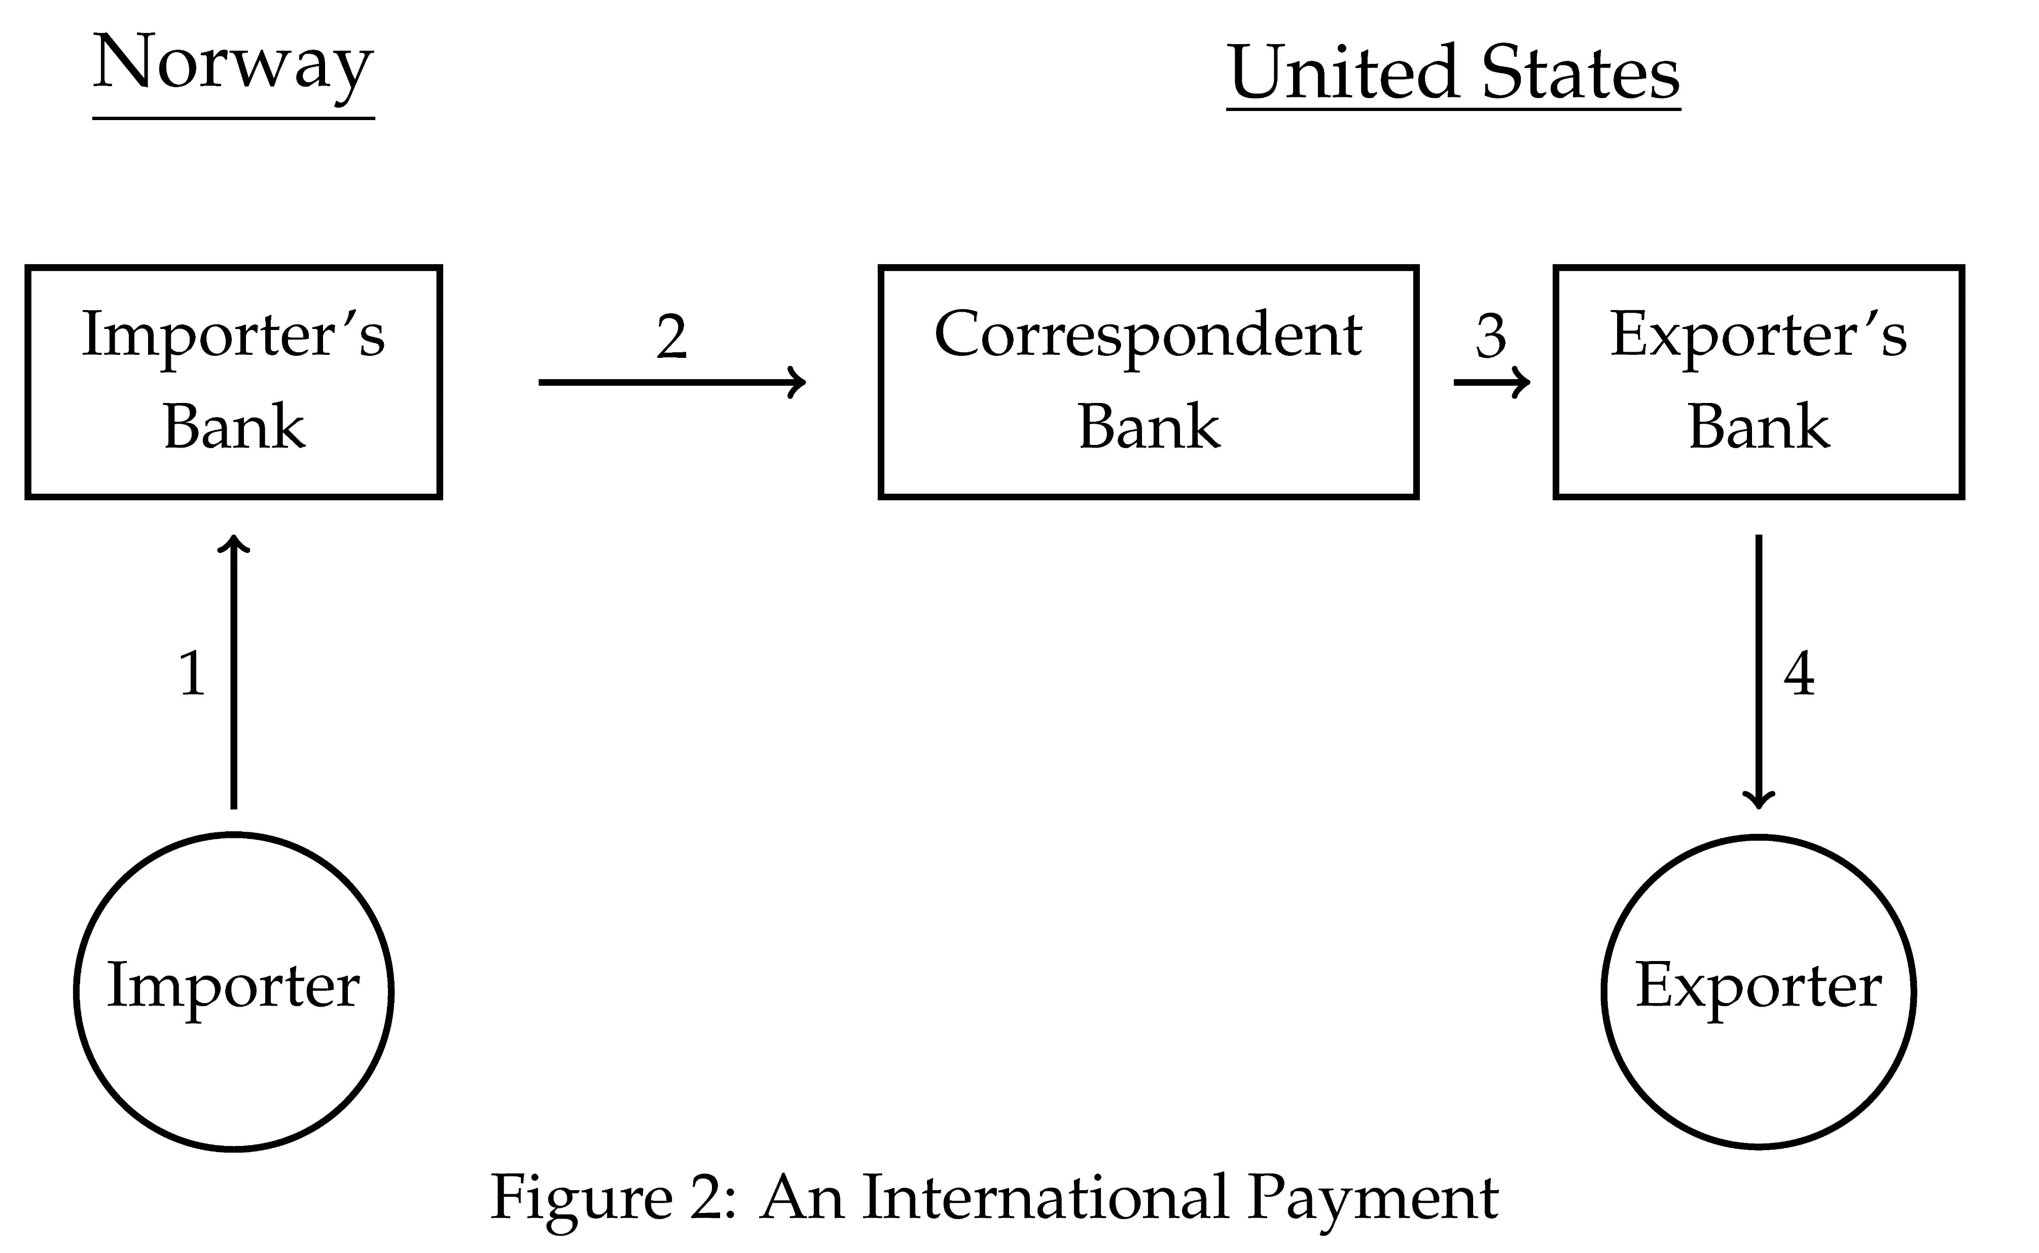
International Payments

Slide 6
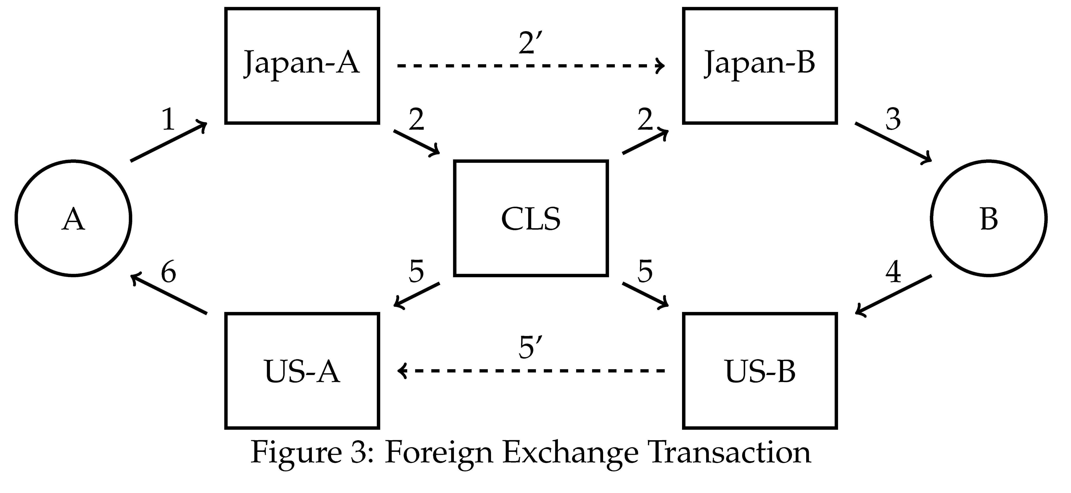
Foreign Currency Transactions
A buying USD for JPY from B -- Herstatt risk

Slide 7
Evolution of Payments
How did our modern payment system come to be?
Took hundreds of years of innovation
We next discuss some of the key developments

Slide 8
The Bill of Exchange
How did merchants make payment in long-distance trade?
Transporting coins long distances costly and risky
Strong incentive to avoid transporting coins
Bill of exchange invented to reduce need to transport coins

Slide 9
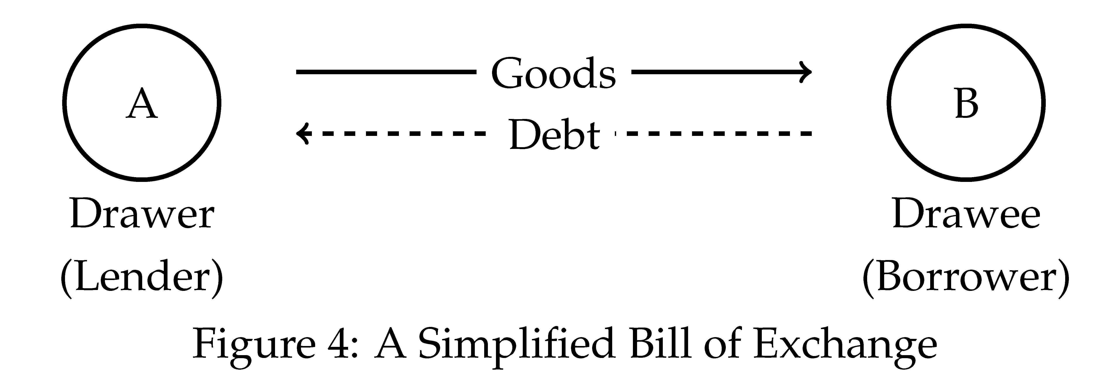

Slide 10
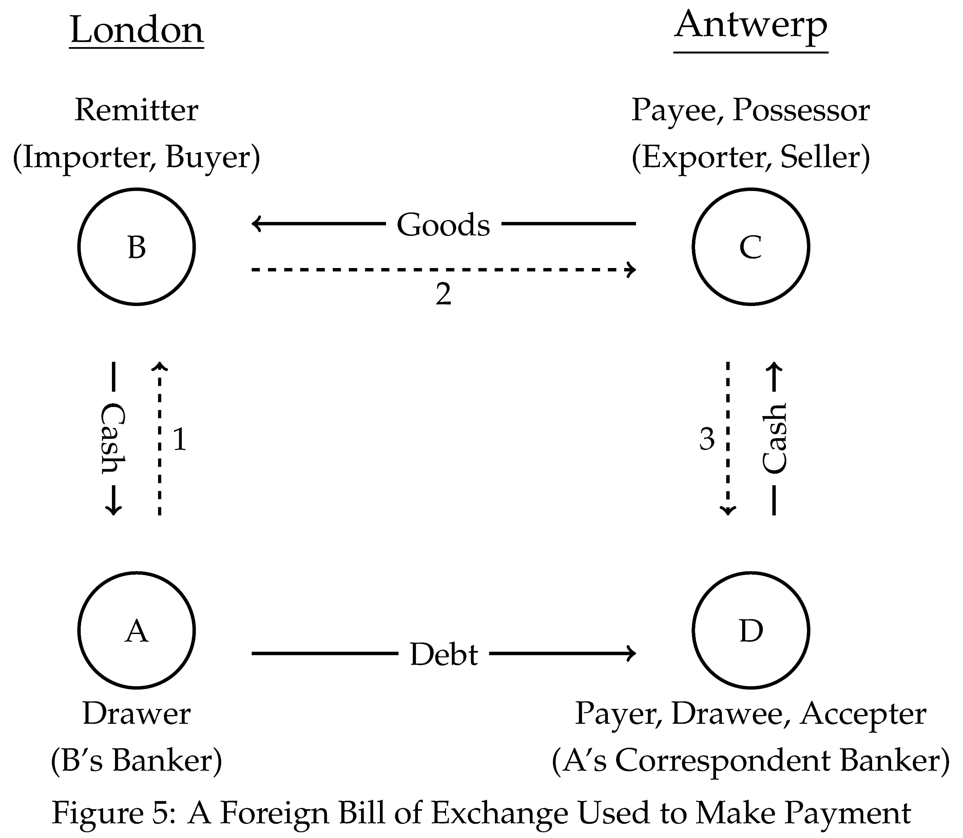

Slide 11
Bill of Exchange
Bill of exchange is a “please pay them” instrument
Drawer (A) request that drawee (D) pay the payee (C) or bearer
Becomes an “I owe you” when drawee “accepts” it
Drawee may “protest” (like a check “bouncing”)
Payment either “on sight” or “at usance”
Usance between London and Amsterdam was one month
In modern times, checks are “please pay them” instruments
As are payment requests in payment systems

Slide 12
What Does Bill of Exchange Accomplish?
B is able to pay C without sending coins to Antwerp
Relies on A’s balances (or credit) with D
Other bills will go the other way (from Antwerp to London)
Potentially improving balance of A with D
If trade between London and Antwerp is balanced, no coins need flow between the cities
In effect, bills going one way net out bills going the other
More generally, other merchants and other cities result in additional netting and less shipment of coins

Slide 13
Hiding Interest Payments
Usury laws restricted lending at interest
Merchants and bankers resorted to sophisticated mechanisms to hide interest payments
Bills of exchange were one such mechanism
Using bills of exchange for credit involved a pair of bills going back and forth
Interest was “hidden” in exchange rates

Slide 14
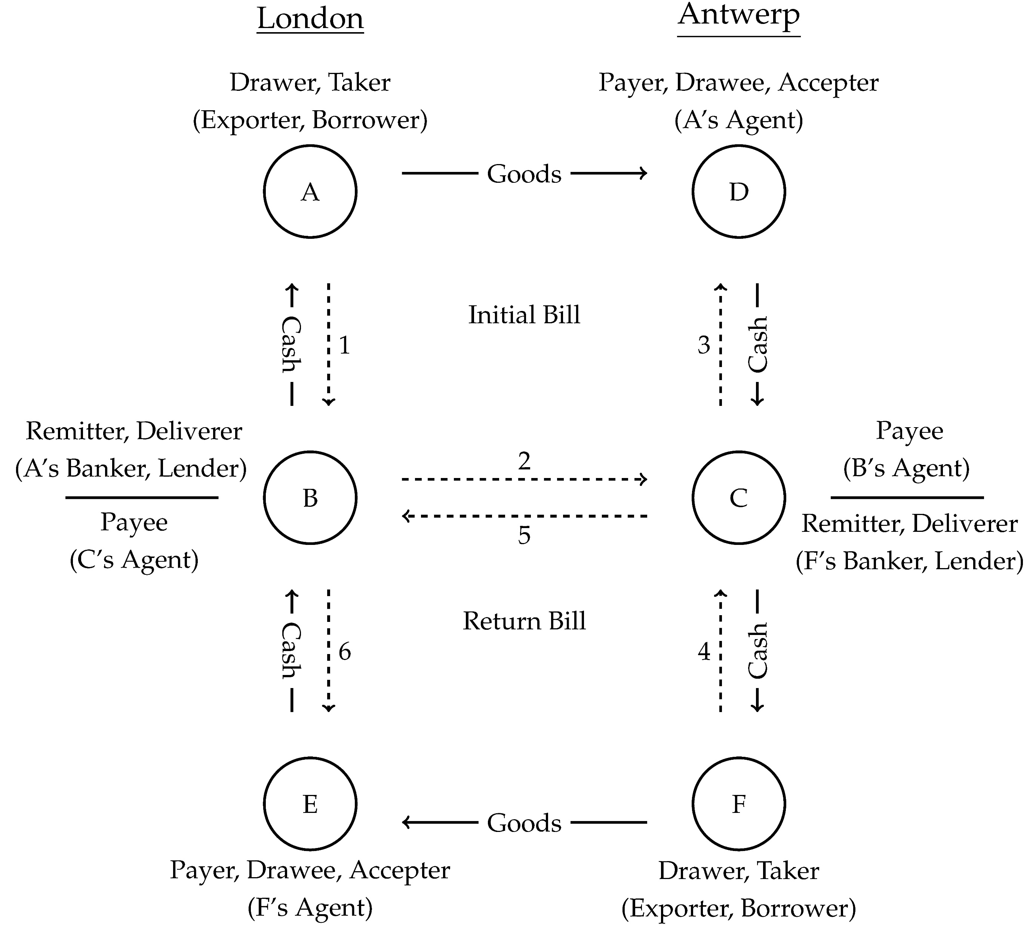

Slide 15
Bills of Exchange as a Credit Instruments
B has effectively lent out money for 2 months
Twice the one-month “usance” between London and Antwerp
Must be compensated for this (time value and risk)
Interest hidden in exchange rates
Currency worth more locally than abroad (e.g., in 1564)
London rate: 22s 6d Flemish pounds per pounds sterling
Antwerp rate: 22s 2d Flemish pounds per pounds sterling
Recall monetary system: £1 = 20s = 240d

Slide 16
Bills of Exchange as a Credit Instrument
Suppose B purchases £100 sterling bill from A
D will then pay C £112 10s 6d Flemish pounds
£100 sterling converted to Flemish pounds at Antwerp exchange rate of 22s 2d
C will purchase £112 10s 6d Flemish pound bill from F
B will collect £101 10s 1d sterling from E
£112 10s 6d Flemish pounds converted to sterling at London exchange rate of 20s 6d
B’s return from exchange/reexchange: £1 10s 1d
This amounts to 9.4% rate of return over 2 months

Slide 17
Discounting of Bills
Bills of exchange meant that most inter-city trade was conducted with “paper money” (i.e. bills of exchange)
But bills did not “circulate” because “discounting” them was not allowed (usury laws again)
Discounting: Selling IOY for less than face value
If bill sold before usance, buyer needed to be compensated
Trading off current money for future money
Usury laws weaken after Reformation and discounting begins
i.e., bills start to circulate

Slide 18
Local Transactions
Bills of exchange economized on inter-city transfers of coins
But what about local merchant transactions (e.g., between C and D)
Use of coins involved several problems:
Counting, weighing, assaying
Risk of robbery
Which coins to accept!

Slide 19
Myriad of Local Coins
Many types of coins circulated locally
Duch Republic officially recognized 25 gold and 14 silver high-denomination coins
Varied in weight and quality
Creditors would seek to pay in lighter coins (Gresham’s Law)
Settlement asset of bills of exchange not well defined

Slide 20
Public Deposit Banks
A number of cities chartered public deposit banks
Role: Serve as central clearing house (large-value payment system)
How it was intended to work:
Merchants deposit coins (carefully valued)
Bills settled by transferring deposits at bank
Ledger-based payment systems
Banks not meant to lend (only clearinghouse)
Many cities succumbed to temptation to borrow from bank
Many banks failed due to such fiscal exploitation

Slide 21
Bank of Amsterdam
Far and away most successful early public deposit bank
Established in 1609
Core function: Settlement of bills of exchange
Rapidly became “clearinghouse for world trade”
Huge quantities of bills of exchange “drawn on Amsterdam” and settled at Bank of Amsterdam due to efficient settlement

Slide 22
Bank of Amsterdam
Guaranteed quality of coins upon withdrawal
Implication: Created a settlement asset of known quality
Only accepted good coins “by tale” (count)
Other coins accepted by weight and sent to Mint for recoining

Slide 23
Bank of Amsterdam
Charged a 1.5% fee upon withdrawal (to cover minting costs)
To avoid incurring withdrawal fee brokers would exchange “bank money” for “current money”
Exchange rate would usually fluctuate between 0.985 and 1.000 current florin per bank florin – i.e., split profit from avoiding withdrawal fee

Slide 24
Debasement
Debasement of coins was a persistent problem in Amsterdam
Occurred due to competition among similar coins
Producers of each had an incentive to make their coin slightly lighter than it was supposed to be (rixdollar vs. patagon)
Creditors disliked debasements (devalued debts)
In 1641, Bank of Amsterdam decoupled value of bank florins from that of current florins
Patagon coin valued at 2.4 bank florins
But patagon coin was valued at 2.5 current florins
Made value of bank florins independent of future debasement

Slide 25
Agio
Two units of account in Amsterdam
Bank florins
Current florins
Exchange rate between them called agio
Agio was quoted as percentage premium on bank money
I.e., 4% meant that 1.04 current florins could buy 1 bank florin
Agio was typically about 4%, slightly lower than legal difference
Meant that parties split gains from avoiding Bank withdrawal fee

Slide 26
Bank’s Golden Age
Bank’s success relied on avoiding fiscal exploitation
Made modest loans to city and Dutch East India Company
74% reserve ratio in 1669
Invasion by France in 1672 caused heavy withdrawals
Bank had ample reserves
Other public banks suspended convertibility
Middleburg, Rotterdam, Hamburg
Episode enhanced bank’s reputation

Slide 27
Eliminated Right to Withdraw
Sometime after 1683 bank eliminated right to withdraw
First “fiat” currency?
Not really
Maintained huge reserves
Adam Smith argued would reintroduce “convertibility” in a crisis
Managed exchange rate with current florins in narrow range
More like a modern currency on a fixed exchange rate (target zone) with a huge foreign currency reserve

Slide 28
Demise
1683 to 1780 golden age for Bank of Amsterdam
All changed with Fourth Anglo-Dutch War (1780-1784)
City broke down and exploited bank massively
Reserve ratio fell from 84% to 34%
Confidence and agio began to sag
French invasion in 1794 final blow
Bank hobbled along for a while but was wound up in 1819

Slide 29
Sophisticated Barter and Local Credit
Most people lived on farms and rarely handled coins
Engaged in “sophisticated barter”
Would take goods produced to trading post / general store and exchange them for goods needed for consumption (think of Pa’s trips to town in Little House on a Prairie)
Local merchants might engage in sophisticated barter on a larger scale with wholesale merchants
Merchants would also provide credit to their customers
All of this dramatically reduced need for coins in local transactions

Slide 30
Paper Money in China
Earliest known paper money in Song China around 1,000 CE
Paper and printing invented earlier in China than Europe
Severe shortage of gold and silver in China
Base metal coins more common (more inconvenient)
First paper money in Sichuan where iron money was used
“A housewife would have to bring a pound and a half of iron coin to the marketplace to buy a pound or salt.” (van Glahn, 2005)
Periods of stability and instability.
Back to silver money after Mongol rule crumbled in 1350s.

Slide 31
Paper Money in Europe
Bills of exchange began circulating in 16th and 17th centuries
Not great paper money:
Initially by endorsement, later “bearer clause”
Fixed maturity (traded at a discount)
Bespoke (Not in convenient denominations, handwritten, not standardized)
In some regions: only commercial bills (“real” bills) allowed

Slide 32
Paper Money in Sweden
Sweden used copper coins
“Almost inconceivably cumbrous” (Heckscher, 1934)
Most common denomination weighed 3.2kg
1656: Chartered Stockholms Banco
1660: Issued bank notes (in a crisis)
Proved very popular (go figure)
1663: Expanded lending massively, faced a run, and failed in 1668

Slide 33
Goldsmith Banking in England
Goldsmiths engaged in coin exchange and kept strong rooms
Had comparative advantage in storing coins for merchants
“from being a bailee of money was but a short step to the accepting of demand deposits with full authority to make use of such deposits as loans to customers” (Richards, 1929)
Issued notes as receipts and these came to circulate
Finally, “some ingenious goldsmith conceived of the epoch-making notion of giving notes, not only to those who had deposited metal, but to those who came to borrow it, and so founded modern banking” (Withers, 1916)

Slide 34
Stop of the Exchequer
English Exchequer issued paper “orders” between 1667 and 1672
Early form of paper government money
In 1672, England went to war with Holland
King needed to use tax revenue for war
Stopped payment on existing Exchequer orders
Caused a financial crisis (run on goldsmith bankers who had lent to crown)
Many goldsmith bankers failed (or almost failed)

Slide 35
Bank of England
No public deposit bank in England in the 17th century
Perhaps due to fear of Royal confiscation (Tower incident, Stop)
English merchants at disadvantage relative to Dutch
Finally in 1694, Bank of England founded
Main business initially:
Lend money to government
Issue paper money (relatively high denomination until 1790s)
Later (19th century) it pioneered:
Interest rate management
Last resort lending

Slide 36
Paper Money in 19th Century England
London: Bank of England notes gradually replaced notes from goldsmith bankers
Agricultural South: Bank notes of country bankers
Industrial North: Bills of exchange drawn on London bankers
Country banks in the north would issue bills of exchange on London bankers rather than notes
Would circulate by endorsement

Slide 37
Paper Money in America
Colonies in North America suffered from “shortage” of coins
Export of English coins prohibited.
Main coins Spanish “piece of eight” and Portuguese “joes”
Exports yielded specie. Imports drained specie.
Fundamental difficulty:
Expensive to use coins. Coin used domestically could not be used for imports
Growing demand for coins in fast growing colonies called for current account surplus.
But high growth in colonies yielded high import demand
Strong incentive to find ways to economize on use of coins

Slide 38
Bills of Credit
Form of paper money first issued in Massachusetts in 1690
Formally backed by taxes or collateral (real estate)
Meant to be retired on fixed schedule, but often not
Mostly replaced use of coins in New England in early 1700s
Issuance yielded seiniorage revenue
Mostly issued in times of war to pay military expenditures
Could boost output in short run and raise prices in the long run

Slide 39
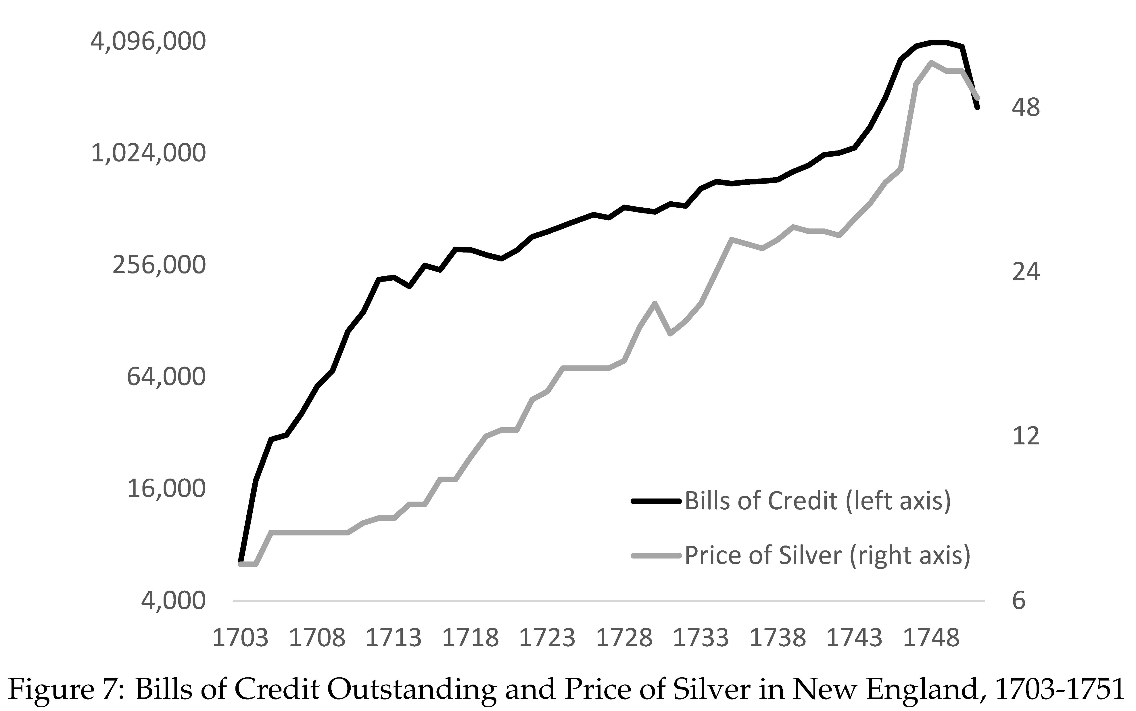
Depreciation in 1730’s 5% per year. King George’s War in 1744 (War of Austrian Succession).

Slide 40
Paper Money and Inflation in America
High inflation in the 1740s led Massachusetts to return to silver in 1750.
Middle colonies experienced less inflation
They issued a lot during French-Indian War (Seven Years War) in 1750s. Yet little inflation
Federal Government issued bills of credit during Revolution (Continentals)
Depreciated rapidly. Virtually worthless at end of war.
US Constitution banned bills of credit and state and national level

Slide 41
Defining the Money Supply
Conceptually money supply is:
Value of assets that are used as a medium of exchange
In an economy with only coins: Sum of the value of coins
In an economy using paper documents as money: Less is obvious
Where to draw the line between documents that count as money and ones that don‘t

Slide 42
Defining the Money Supply
Checking accounts primary medium of exchange today
Card transactions (including Apple Pay, Google Pay)
But what about savings accounts and money market accounts
Not directly used, but easy to transfer
Should they count?

Slide 43
Defining the Money Supply
Money supply: Sum of specie, bank notes, and deposits in the hands of the public
Ignore distinction between checking and savings accounts
Roughly current definition of M1
“In the hands of the public”:
Specie and bank notes in bank vaults doesn’t count
Suppose you deposit $100 in bank (money supply doesn’t change)
Deposits of banks at other banks don’t count

Slide 44
Monetary Base
Deposits are promises to pay something
That something is the monetary base
Completely different concept than money supply
Monetary base today: Currency and bank reserves
Held by public and by banks
Monetary base in 17th-19th century: gold and silver specie
Held by public and by banks
Sometimes also called high-powered money or outside money

Slide 45
Banks and the Money Supply
Banks create money when they make loans
Money supply increases one-for-one when a bank makes a loan

Slide 46
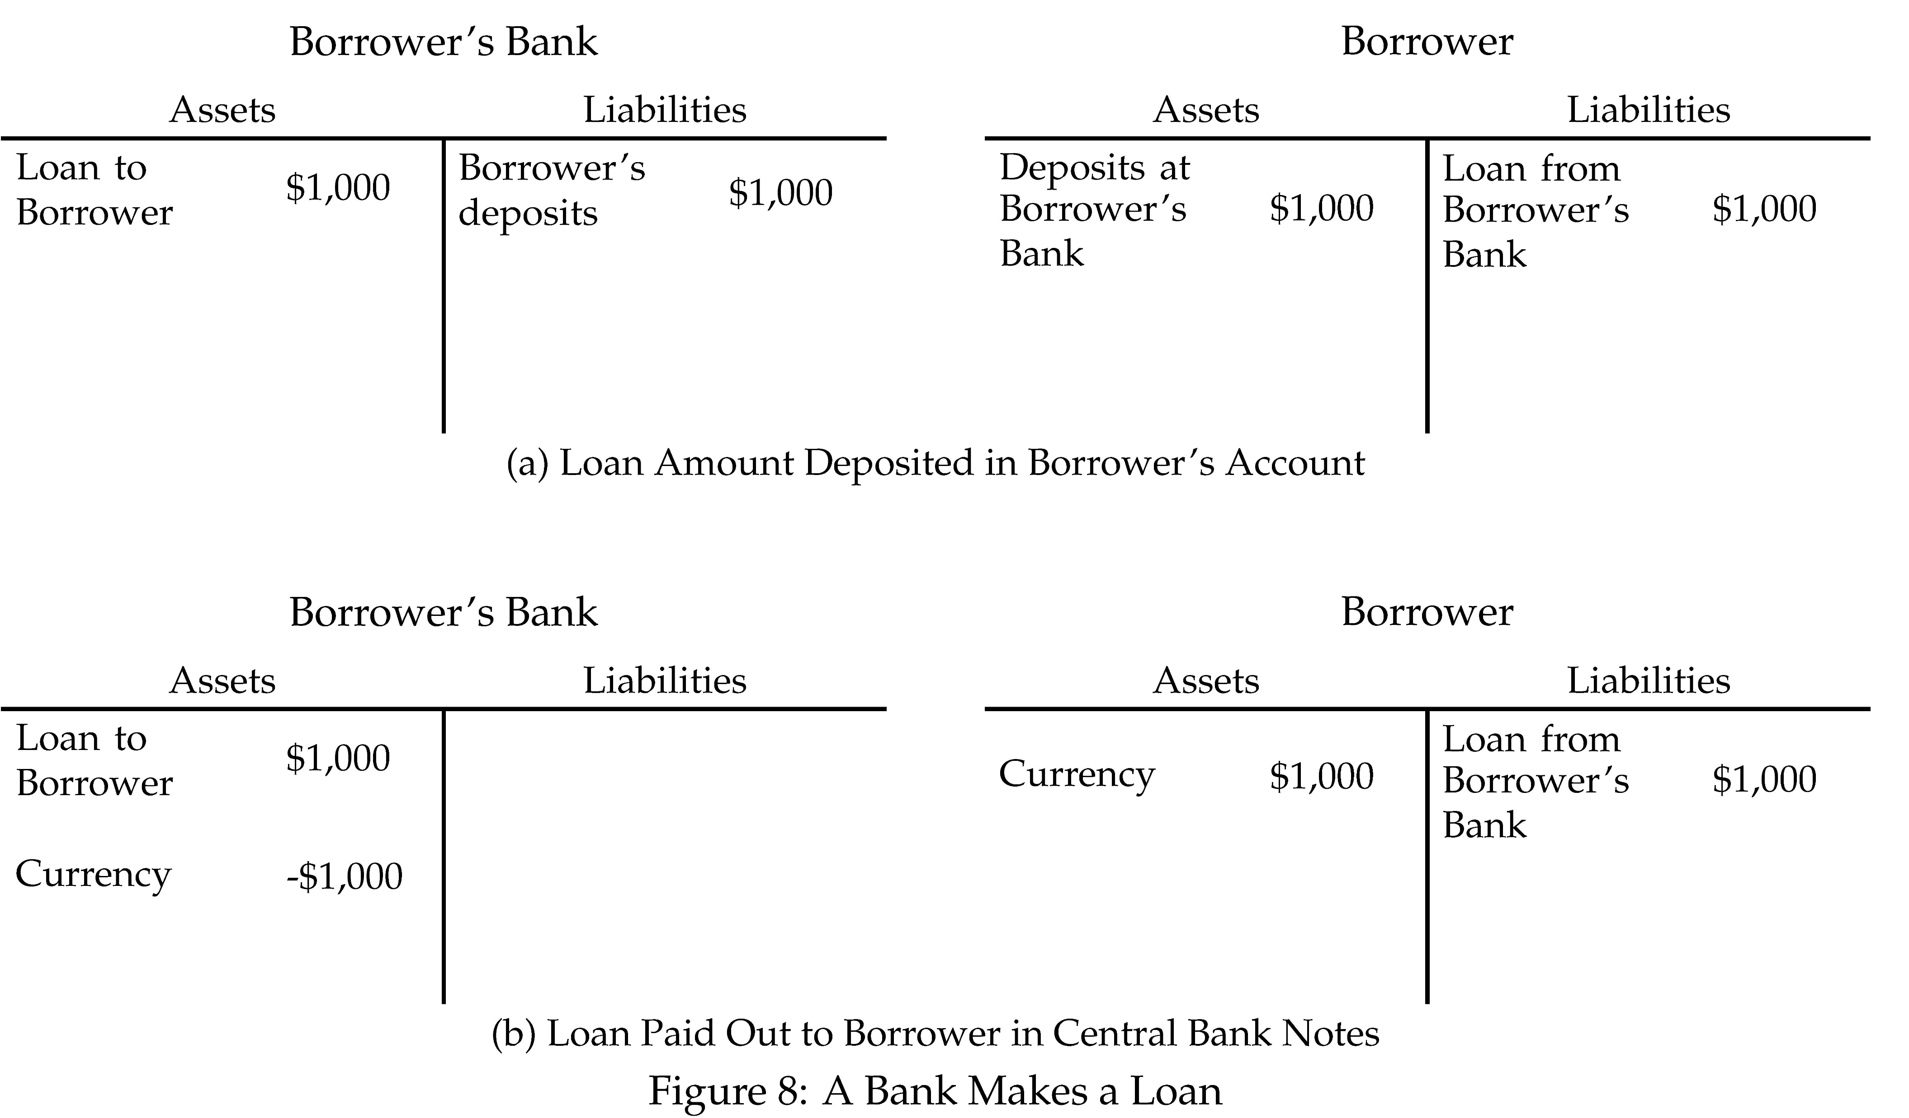

Slide 47
Banks Create Money with Loans
Many find this fact shocking
Confers dangerous powers on banks?
How can we control money supply and keep price level stable if money can “flow from the fountain pens” of commercial bankers?
Most other transactions don’t affect money supply

Slide 48
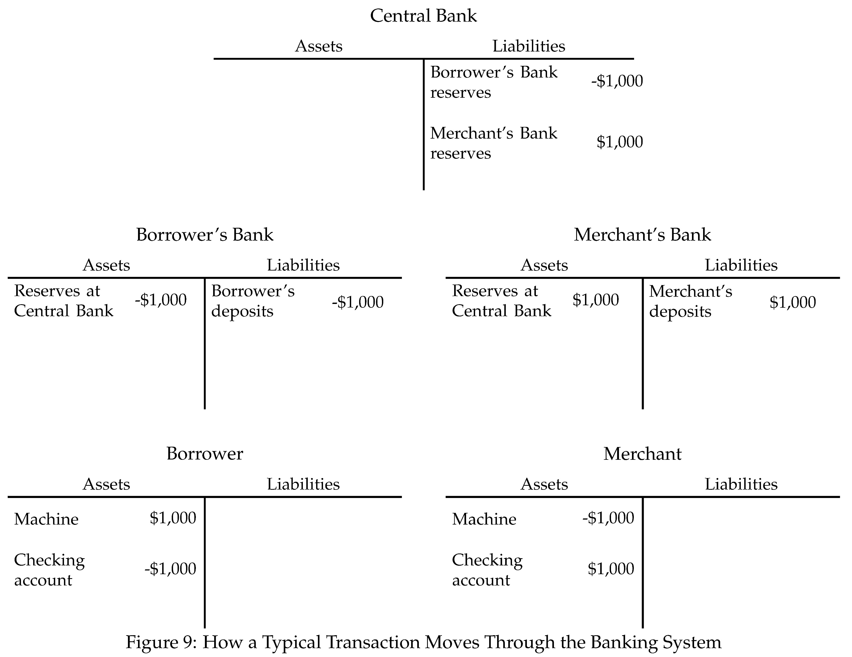

Slide 49
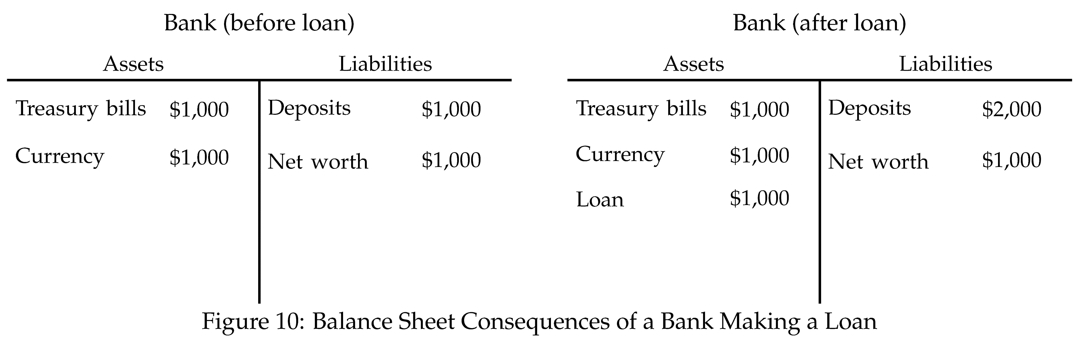
Fractional Reserve Banking

Slide 50
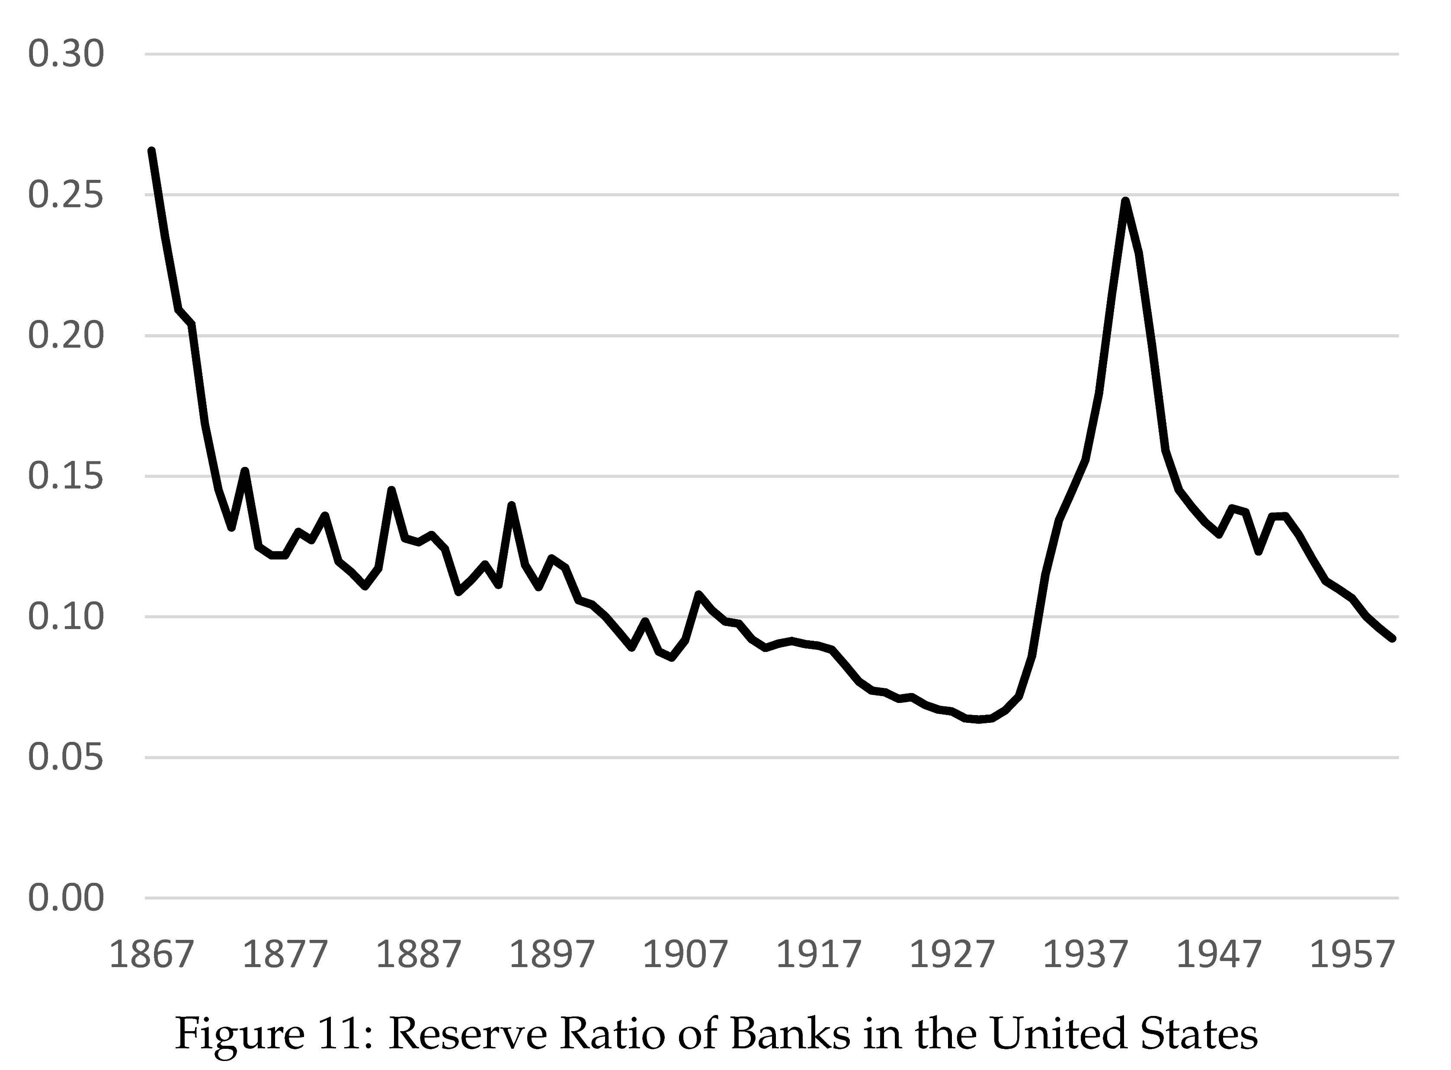

Slide 51
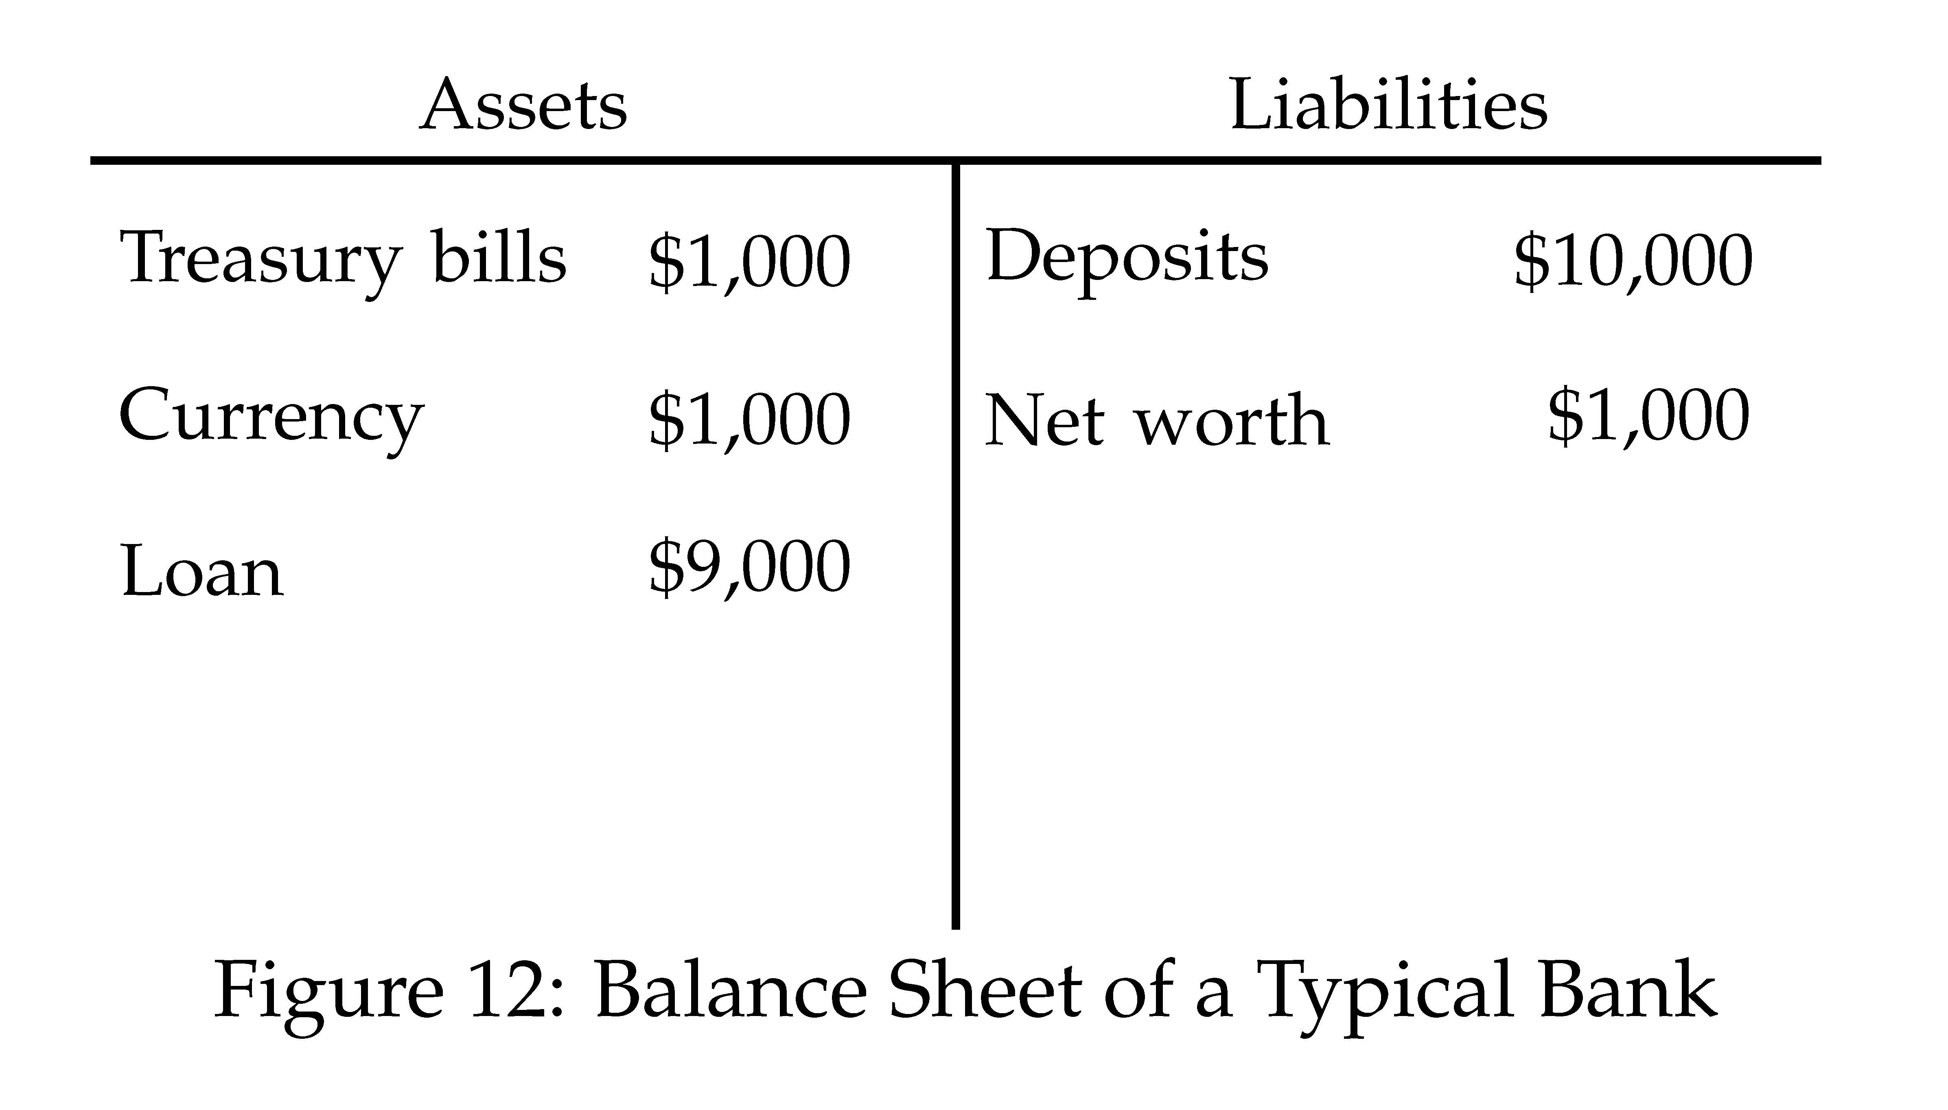
Fractional Reserves and Bank Leverage
Typical bank around 1900 had a reserve ratio of about 10%
This bank is leveraged 11 to 1
Leverage: Assets over net worth

Slide 52
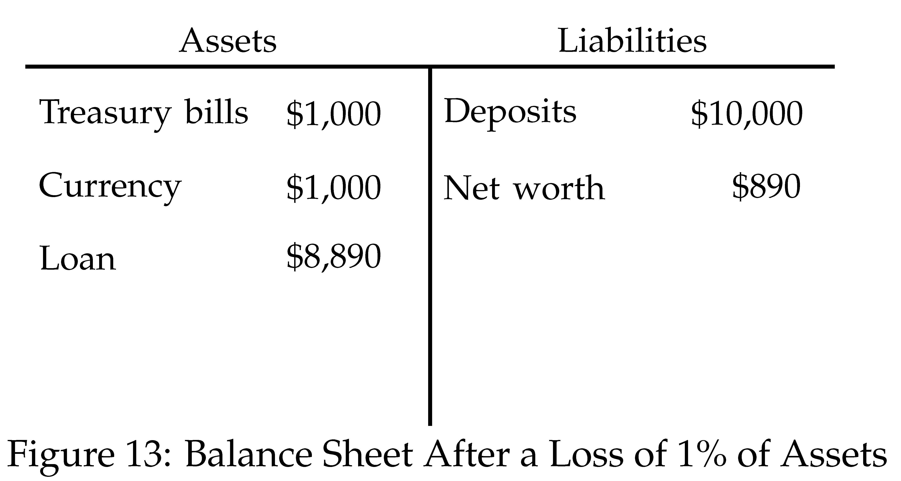
Bank Leverage and Risk
Leverage is intimately connected to risk
Suppose value of bank assets falls by 1%
Net worth falls by 11%
The more leveraged, the more sensitive net worth is to percent losses on assets

Slide 53
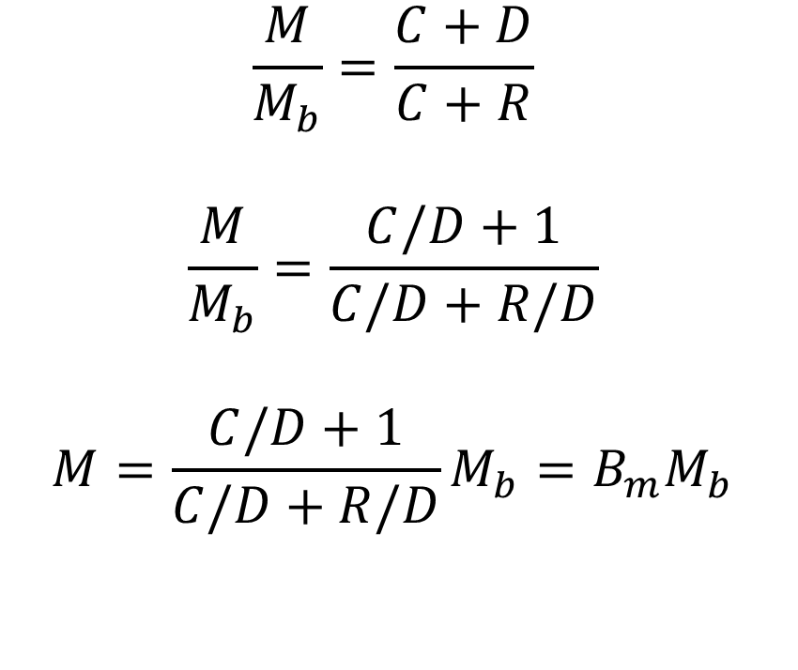
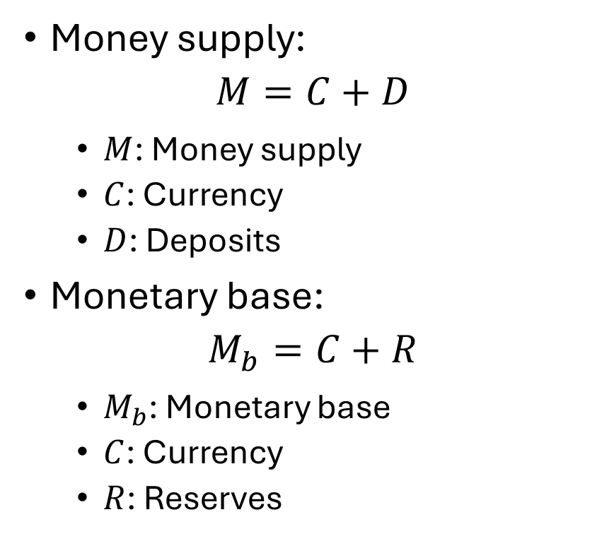
Money Multiplier
Money supply:
$$M=C+D$$
$M$: Money supply
$C$: Currency
$D$: Deposits
Monetary base:
$$M_{b}=C+R$$
$M_{b}$: Monetary base
$C$: Currency
$R$: Reserves
$$\frac{M}{M_{b}}=\frac{C+D}{C+R}$$
$$\frac{M}{M_{b}}=\frac{C/D+1}{C/D+R/D}$$
$$M=\frac{C/D+1}{C/D+R/D}M_{b}=B_{m}M_{b}$$

Slide 54
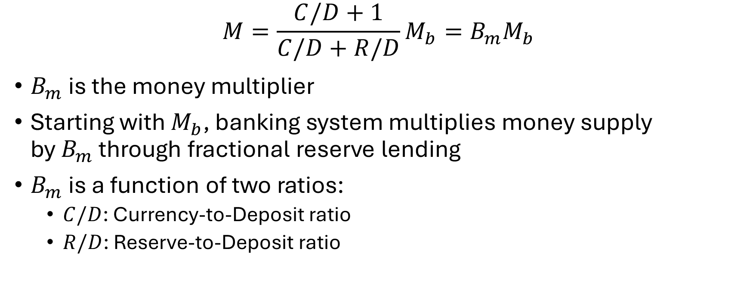
Money Multiplier
$$M=\frac{C/D+1}{C/D+R/D}M_{b}=B_{m}M_{b}$$
$B_{m}$ is the money multiplier
Starting with $M_{b}$, banking system multiplies money supply by $B_{m}$ through fractional reserve lending
$B_{m}$ is a function of two ratios:
$C/D$: Currency-to-Deposit ratio
$R/D$: Reserve-to-Deposit ratio

Slide 55
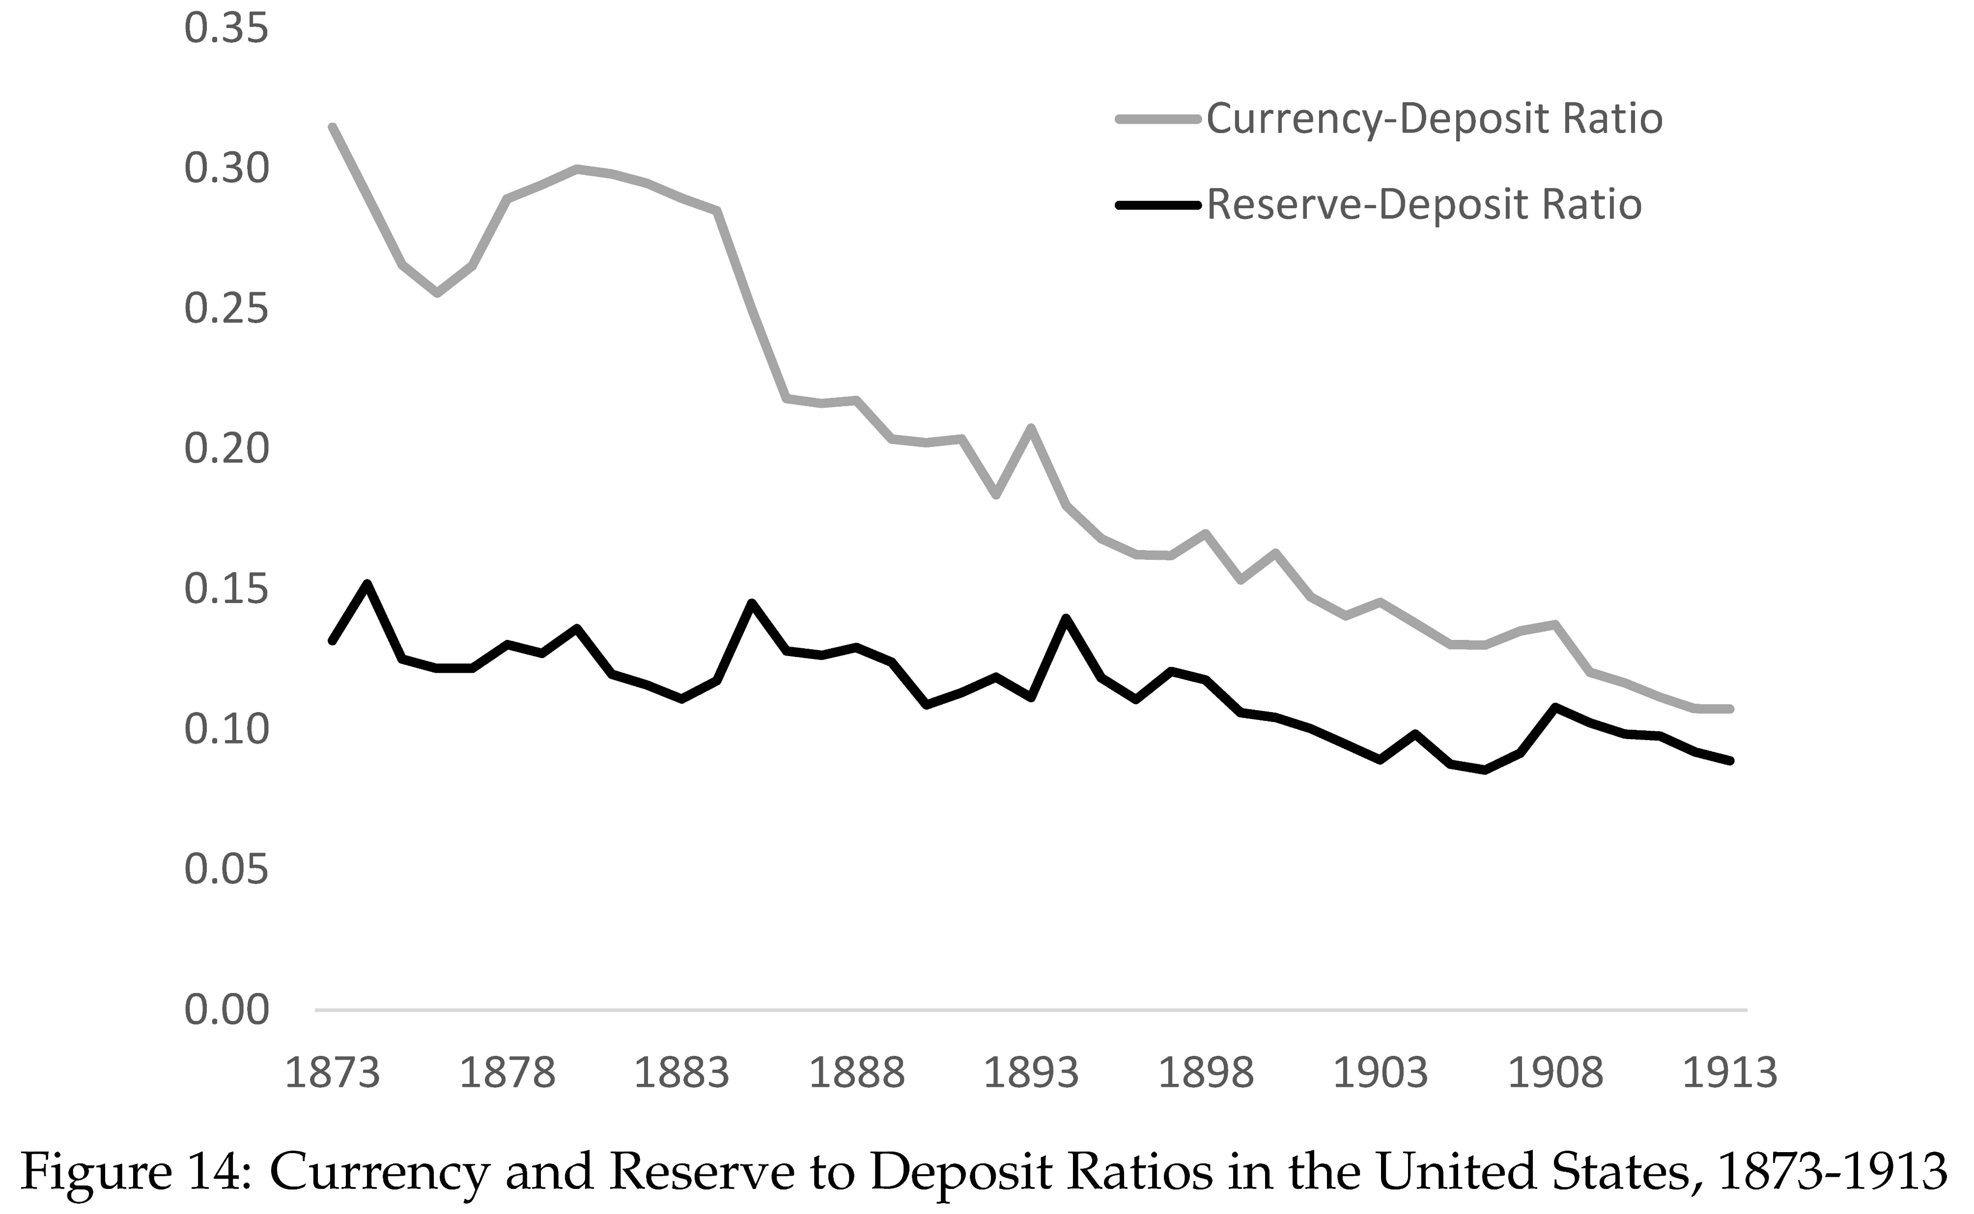

Slide 56
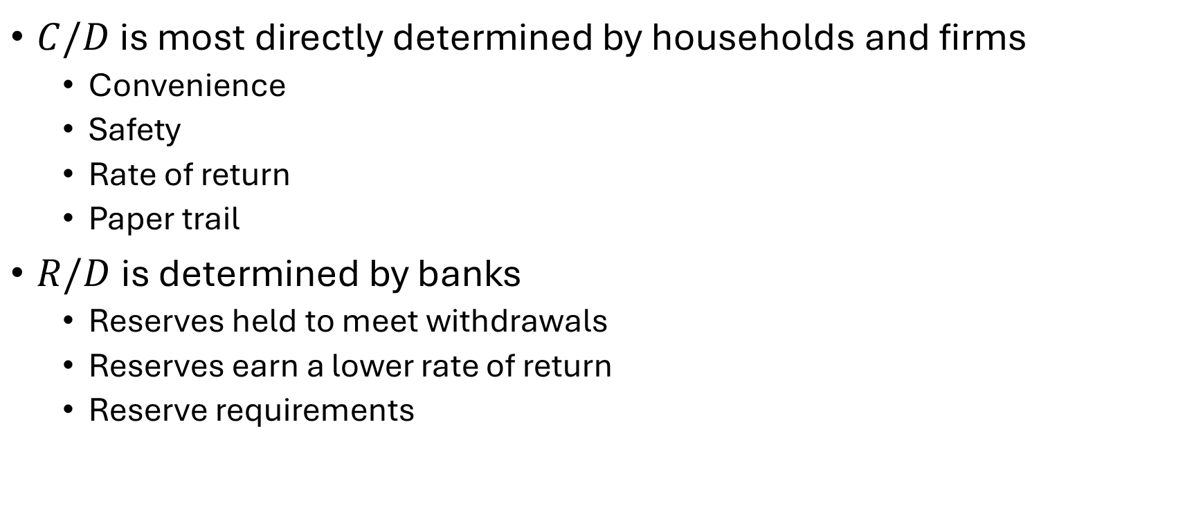

Determinants of $C/D$ and $R/D$
$C/D$ is most directly determined by households and firms
Convenience
Safety
Rate of return
Paper trail
$R/D$ is determined by banks
Reserves held to meet withdrawals
Reserves earn a lower rate of return
Reserve requirements

Slide 57
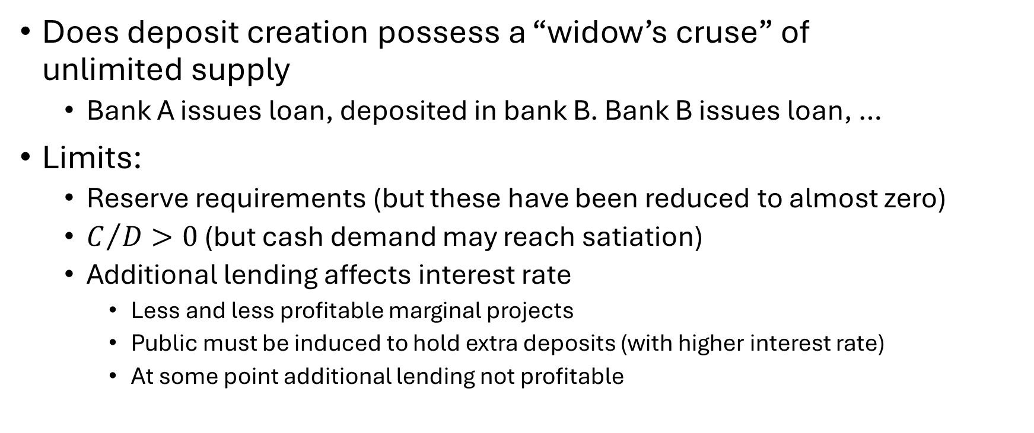
Widow’s Cruse?
Does deposit creation possess a “widow’s cruse” of unlimited supply
Bank A issues loan, deposited in bank B. Bank B issues loan, …
Limits:
Reserve requirements (but these have been reduced to almost zero)
$C/D>0$ (but cash demand may reach satiation)
Additional lending affects interest rate
Less and less profitable marginal projects
Public must be induced to hold extra deposits (with higher interest rate)
At some point additional lending not profitable

Slide 58
Bank Maturity Mismatch
All banks – even the best capitalized – are fragile
Basic reason:
Short-term liabilities (deposits)
Long-term assets (loans)
Why this maturity mismatch?
Banks’ most important roles:
Assist costumers in making payments (calls for demand deposits)
Finance investments (issue long-term loans)
Banks create vast amounts of liquidity
Transform illiquid loans into liquid deposits

Slide 59
Bank Fragility
Bank maturity transformation very valuable
But it also makes banks fragile
If depositors lose confidence in bank and want money back, bank can get in trouble fast (assets illiquid)
Depositors know this and may be scared it could happen
Loss of confidence can be self-fulfilling prophesy
To understand this better, we need a little bit of game theory

Slide 60
Prisoner’s Dilemma
Police have arrested two people, but have insufficient evidence unless at least one confesses
Prisoners held in separate cells and cannot communicate
Police explain to each one:
If you confess, they don’t: You go free, they get 10 years
If they confess, you don’t: You get 10 years, they go free
If both confess: Both get 5 years
If neither confess: Both get 1 year
Prisoners know that they face the same choice

Slide 61
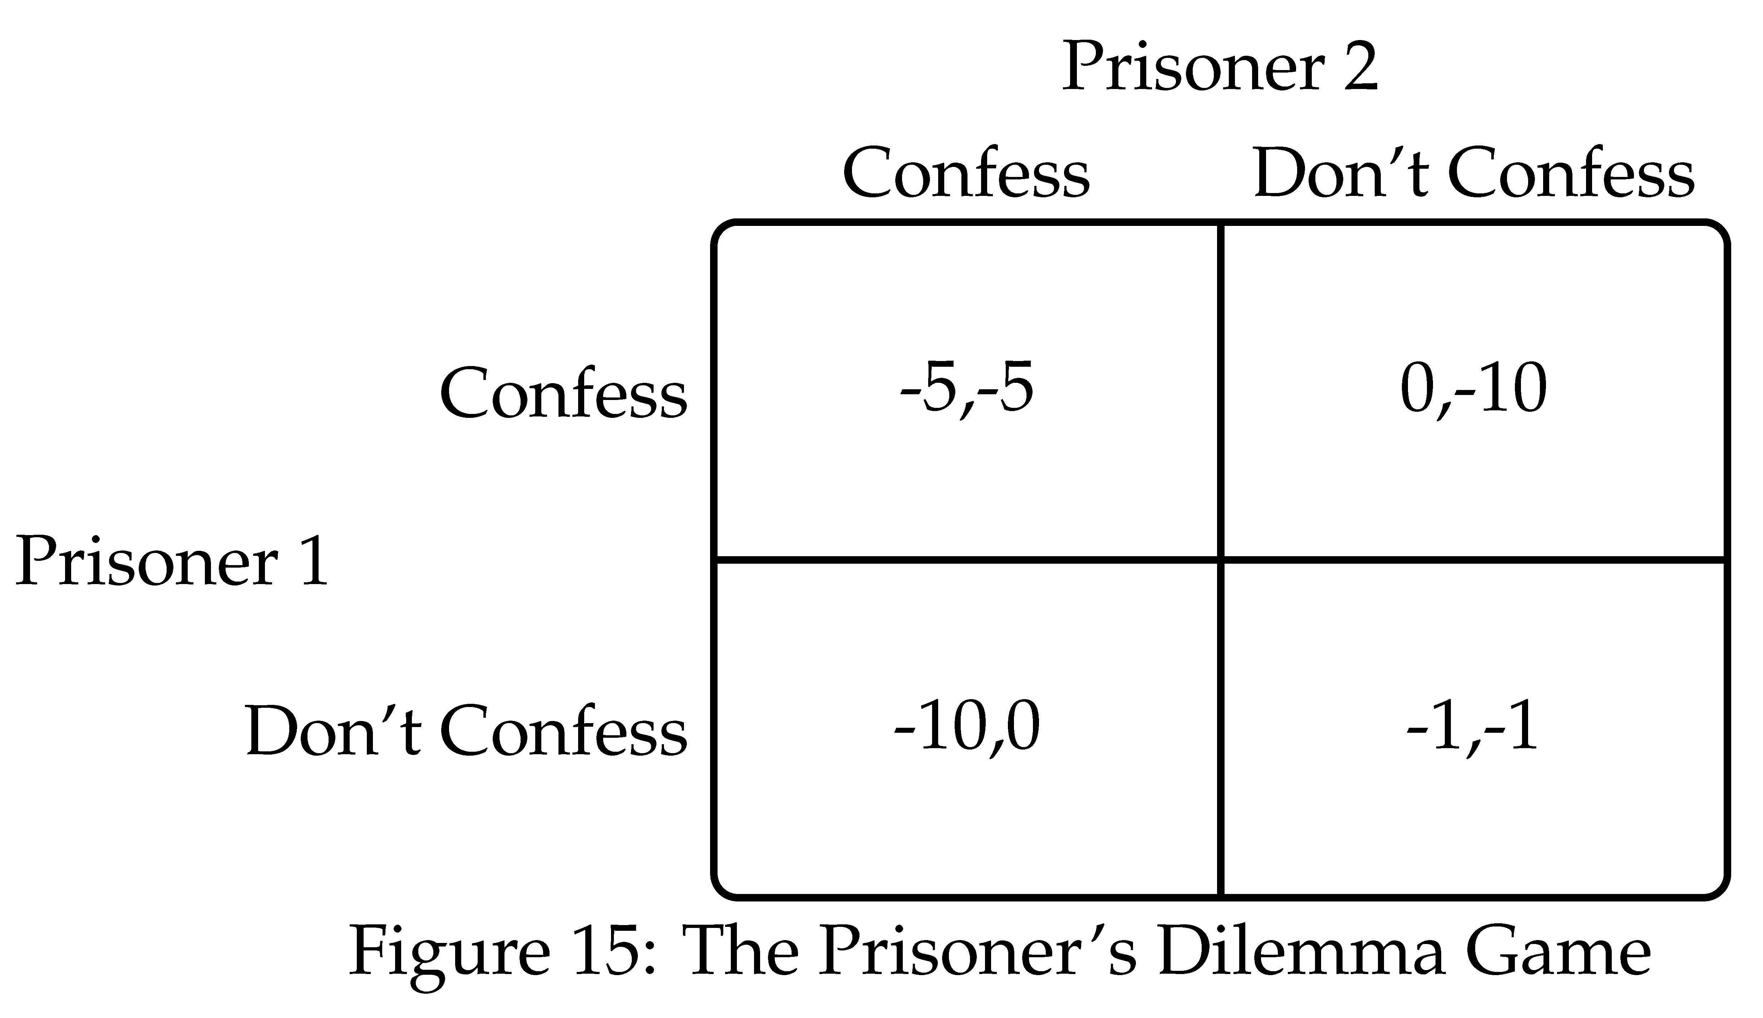

Slide 62
Prisoner’s Dilemma Game
Nash Equilibrium: Each player plays a “best response” given what other players play
Prisoner’s dilemma game has a single Nash Equilibrium
Confess, Confess
But (Confess, Confess) is much worse outcome than (don’t confers, don’t confess)
Mutual cooperation would benefit both, but is not in their individual self interest

Slide 63
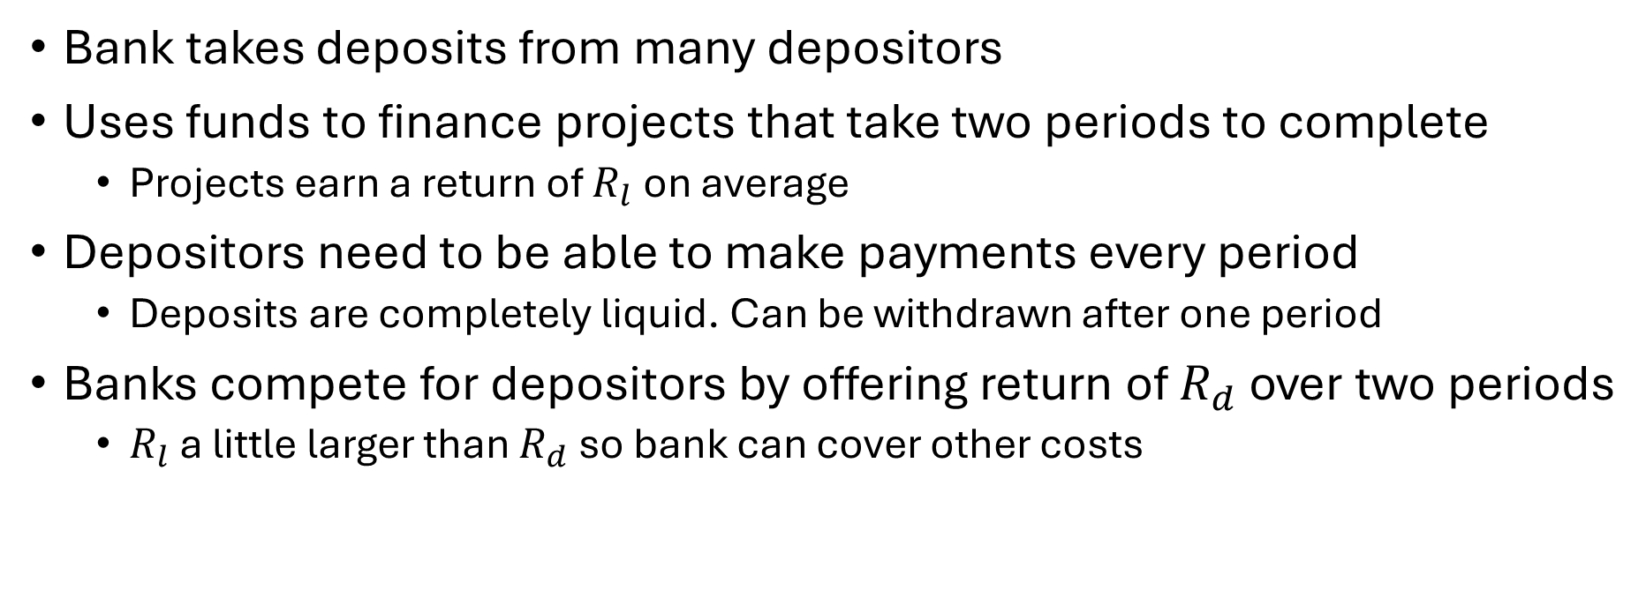
Diamond Dybvig Model of Bank Runs
Bank takes deposits from many depositors
Uses funds to finance projects that take two periods to complete
Projects earn a return of $R_{l}$ on average
Depositors need to be able to make payments every period
Deposits are completely liquid. Can be withdrawn after one period
Banks compete for depositors by offering return of $R_{d}$ over two periods
$R_{l}$ a little larger than $R_{d}$ so bank can cover other costs

Slide 64
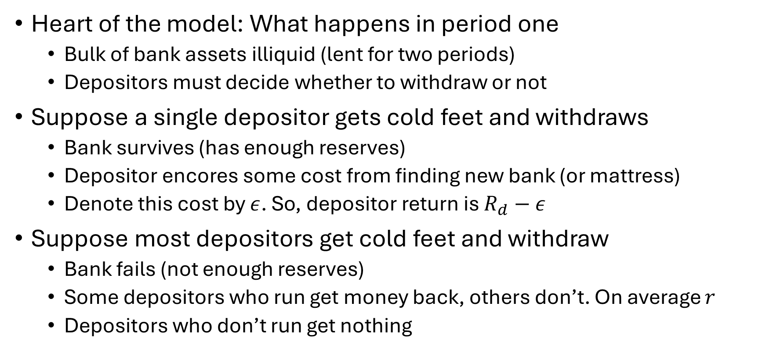
Diamond Dybvig Model of Bank Runs
Heart of the model: What happens in period one
Bulk of bank assets illiquid (lent for two periods)
Depositors must decide whether to withdraw or not
Suppose a single depositor gets cold feet and withdraws
Bank survives (has enough reserves)
Depositor encores some cost from finding new bank (or mattress)
Denote this cost by $ε$. So, depositor return is $R_{d}−ε$
Suppose most depositors get cold feet and withdraw
Bank fails (not enough reserves)
Some depositors who run get money back, others don’t. On average $r$
Depositors who don’t run get nothing

Slide 65
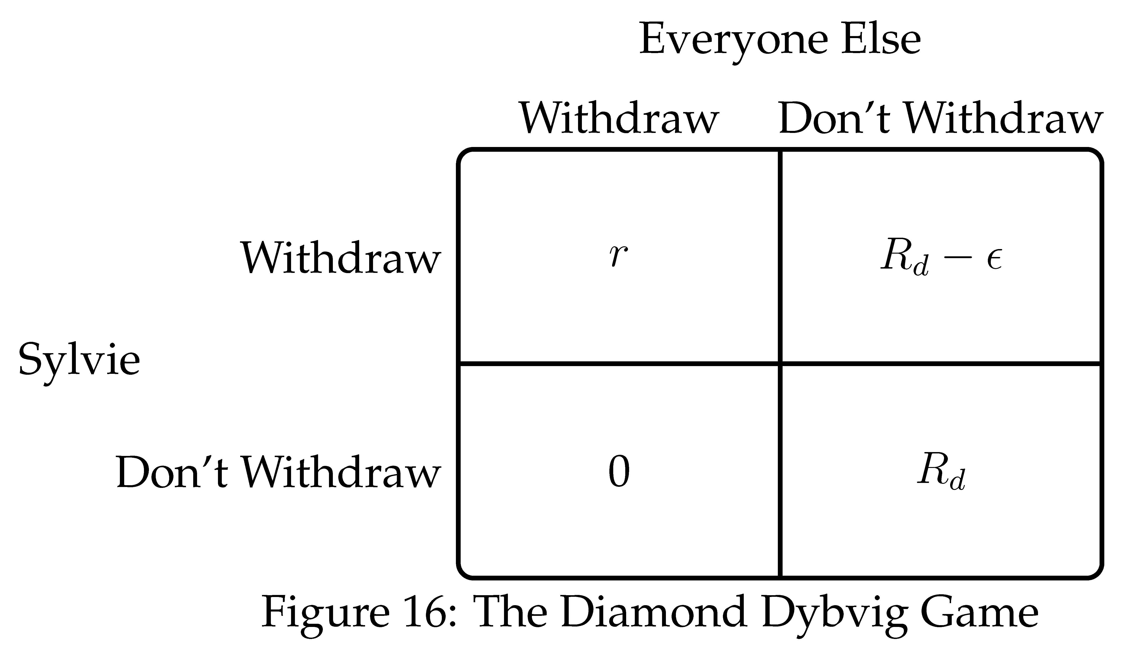

Slide 66
Diamond Dybvig Model of Bank Runs
Two (symmetric) Nash equilibria:
If everyone else runs, Sylvia should run
If no one else runs, Sylvia should not run
Fear of run can become self-fulfilling
If you believe everyone else will run, your best response is to run
It is only because you think others are going to run that you decide to run

Slide 67
Banking Panics
Bank runs can trigger generalized panics
Panics in history:
England: 1672, 1763, 1772, 1793, 1796, 1811, 1825, 1847, 1857, 1866
U.S.: 1814, 1833, 1837, 1857, 1873, 1893, 1907, 1930-33
Panics contribute to deep recessions
Among most severe economic calamities in capitalist economies
Preventing panics one of most important public policy problems

Slide 68
Tools to Arrest Bank Runs
Suspension of Convertibility
Lender of Last Resort
Deposit Insurance

Slide 69
Suspension of Convertibility
Bank can close its doors to depositors seeking withdrawal
Milder versions: count slowly, restrict amount
Widespread suspensions in U.S. in 1893, 1907, 1933
Buys time to:
Raise funds
Convince the public bank is sound
Allow panic to subside
Creates a dual monetary system: currency vs. deposits
Deposits trade at a time varying discount
Payment difficulties (e.g., firms making payroll)

Slide 70
Lender of Last Resort
A central bank with unlimited resources can stop a banking panic by acting as a lender of last resort
Suppose central bank commits to lend enough to bank that it can withstand any amount of depositor withdrawals
This eliminates the run equilibrium
No longer optimal for Sylvie to run if others run
Bank will not fail even if others run
Mere announcement (if credible) can prevent runs from happening

Slide 71
Bagehot’s Principles
What is a sensible lender of last resort policy?
Bagehot’s principles (1873):
Lend freely
At a penalty rate
Against good collateral

Slide 72
Character of a Banking Crisis
Nature of banking crisis similar 200 years ago as today:
Customers of banks lose confidence and begin withdrawing funds
Financial instruments simpler 200 years ago, but basic character the same
Financial system in England in early 19th century:
Country banks
London banks (and bill brokers)
Bank of England

Slide 73
Character of a Banking Crisis
Consider a period of moderate alarm where:
Customers of country banks demand gold for country bank notes
Country banks respond by drawing down deposits at London banks and selling financial assets (bills of exchange) to London banks
This transfers gold drain to London banks
They respond by drawing down their deposits at Bank of England and discounting bills of exchange at Bank of England
Transfers drain to Bank of England
What should Bank of England do?

Slide 74
Bank of England in a Crisis
Bank of England was a private bank (with some special privileges)
If it viewed itself as any other bank, it would restrict lending and seek to shore up its reserves like all other banks
But is all banks try to shore up reserves there is no source of gold to accommodate increased demand from the public
Fundamental problem: Increased aggregate demand for gold
Unless someone is willing to supply gold (or substitute) banks facing a drain will deplete reserves and fail which may spark a panic

Slide 75
Bank of England in 1825
Dynamics as described above
Bank of England refused to act
Dozens of banks forced to suspend convertibility
Eventually full-blown panic
Finally, Bank of England compelled to act
Lend freely gold and its own bank notes (gold substitute)
This ended panic and restored confidence
Acted with (gradually less) reluctance in panics of 1847, 1857, 1866

Slide 76
Bagehot’s Argument
Bank of England should as a matter of policy stand ready to lend freely in a crisis
Knowledge of this policy would prevent crises
“In wild periods of alarm, one failure makes many, and the best way to prevent the derivative failures is to arrest the primary failure which causes them.” (Bagehot, 1873/1999, p. 51)

Slide 77
Moral Hazard and Last Resort Lending
Banks will act less prudently if they know central bank will help them out in a crisis
This is called moral hazard
Moral hazard is a side effect of insurance
Central bank is providing banks with insurance against runs
Some argue:
Last resort lending is bad policy because it makes for more crises
If government commits not to bail out banks, they will not get in trouble
But is such a commitment credible?

Slide 78
Penalty Rate and Good Collateral
Why lend at penalty rate and against good collateral?
Penalty rate:
Compensation for providing “insurance” to banks
Last resort lending is risky, compensation for taking risks
Good collateral:
Central bank should limit lending to deserving banks. But how?
Define deserving as banks that have good collateral.
Banks in liquidity crisis vs. solvency crisis

Slide 79
Liquidity Crisis vs. Solvency Crisis
Liquidity problem:
Bank fundamentally solvent
Faces a run and needs liquidity (assets illiquid)
Has good collateral for central bank to lend against
Central bank will make money on emergency loans
Solvency problem:
Bank fundamentally insolvent
Assets worth less than liabilities
Doesn’t have enough good collateral
Central bank would lose money if they bailed bank out
Fiscally costly bailouts should be decided on by elected officials

Slide 80
Liquidity Crisis vs. Solvency Crisis
But how should bank assets be valued?
Crisis leads to fire sale of assets
Value of assets falls below “fundamental” value
Fundamental value: value when crisis subsides
Should central bank value assets at fundamental value or market value?
Hard to figure out fundamental value
“Fog of war” makes these decisions hard in a crisis

Slide 81
Hankey vs. Bagehot
Bagehot wrote in aftermath of Overend, Gurney & Co. crisis of 1866
Thomas Hankey (former governor of BoE) responded violently:
“the most mischievous [argument] ever broached”
Hankey wanted Bank of England to act just like any other bank
All banks should keep their own reserve
Currency School vs. Banking School

Slide 82
Peel’s Act of 1844
Intended to prevent Bank of England from acting as lender of last resort
Divided bank into:
Issue department (only issue £14 million + specie)
Banking department (conduct regular banking business)
Was meant to prevent panics
Panic in 1847 (act suspended), panic in 1857 (act suspended), panic in 1866 (act suspended)
After this clear Bank of England would always act
No more panic for over a century

Slide 83
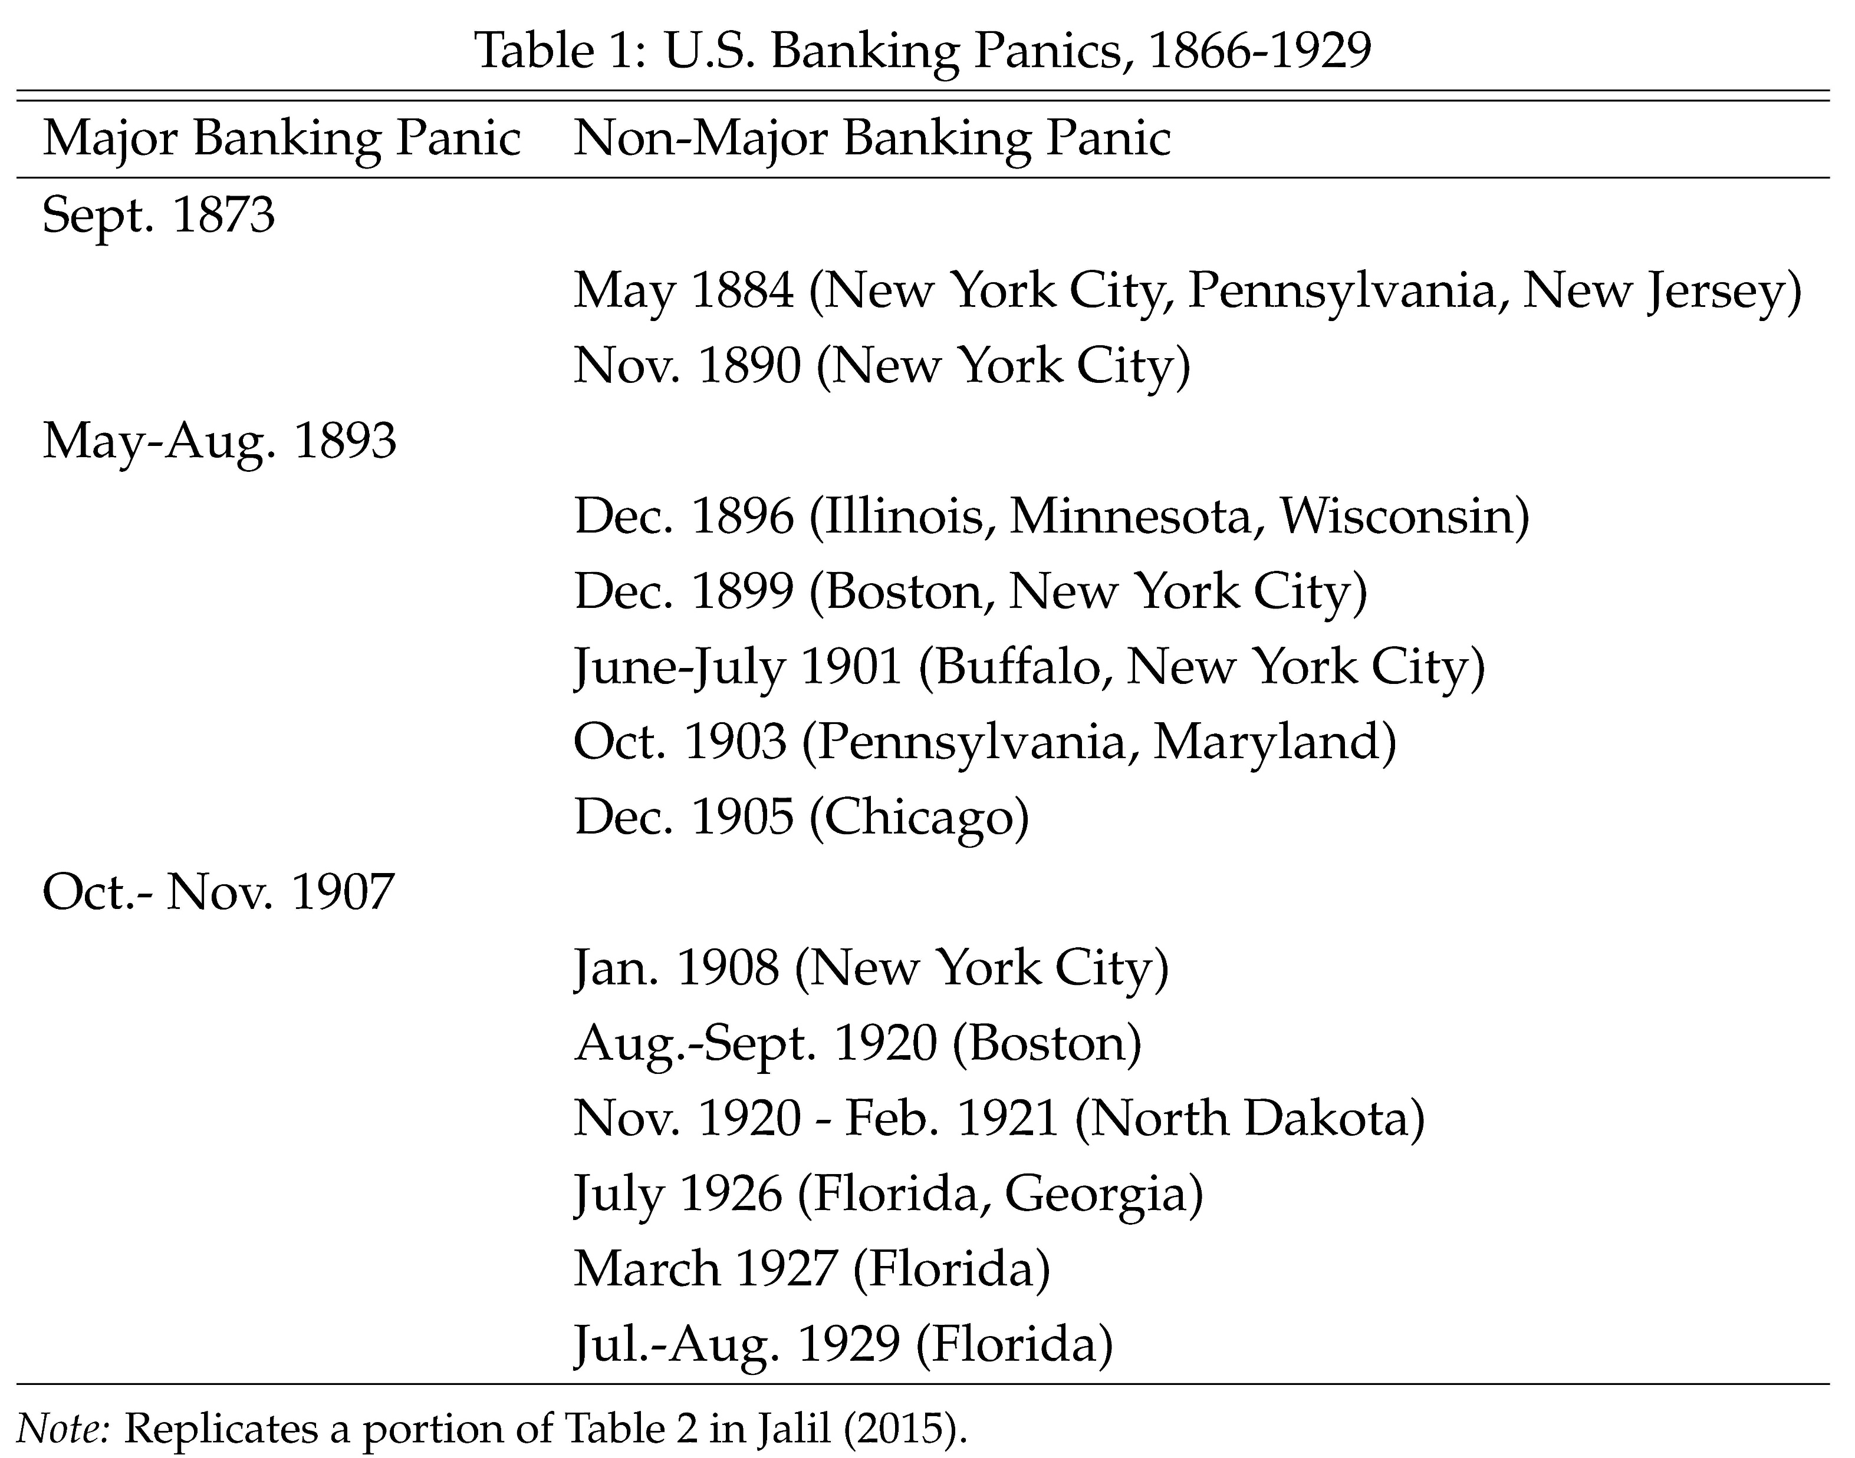
Persistence of Banking Panics in U.S.
No more panics in England after 1866
Regular panics in U.S. for another 70 years
Why?

Slide 84
Persistence of Banking Panics in U.S.
Absence of a central bank
Unit banking

Slide 85
Early Central Banks in U.S
(First) Bank of the United States
Chartered in 1791 by Alexander Hamilton
Bitterly opposed by Thomas Jefferson, James Madison, and anti-federalists
Not renewed in 1811 (opposition from state banks)
Severe financial problems in War of 1812
(Second) Bank of the United States
Chartered in 1816
Congress voted to recharter in 1832
Andrew Jackson vetoed rechartering
No central bank (no lender of last resort) until 1913

Slide 86
Jackson’s Veto
“In popular accounts the Bank of the United States is most often presented as an embodiment of the “money power,” a vague but immense evil, overcome by Andrew Jackson and his agrarian followers. It would be truer to say that it was a victim of the “money power,” which used Andrew Jackson, states’ rights, and agrarian sentiment to destroy it. (Hammond, 1957, p. 287)

Slide 87
Second Bank
Why did “money power” (i.e., state banks) hate the Second Bank?
Functions of the Second Bank:
Restore and maintain a uniform currency
Act as fiscal agent of the federal government
Facilitate internal and external exchanges (i.e., payment system)
In all of these roles, Second Bank disciplined and competed with state banks.

Slide 88
Second Bank: Uniform currency
Robust note issuance
Policy of redeeming notes of state banks on weekly basis
Prevented state banks from overissuing notes
Since note issuance was profitable, they resented this
Also, notes of Second Bank were superior (had more uniform value throughout country) and were gradually replacing state bank notes

Slide 89
Second Bank: Facilitating Exchanges
U.S huge country far from Europe
Trade between regions and countries took time
Regions specialized:
South and West produced agricultural good / timber for Northeast / Europe
Northeast produced manufacturing goods for South / Europe
Important practical problems:
Avoiding transportation of specie / bank notes
Financing trade during transit
Bills of exchange made this possible

Slide 90
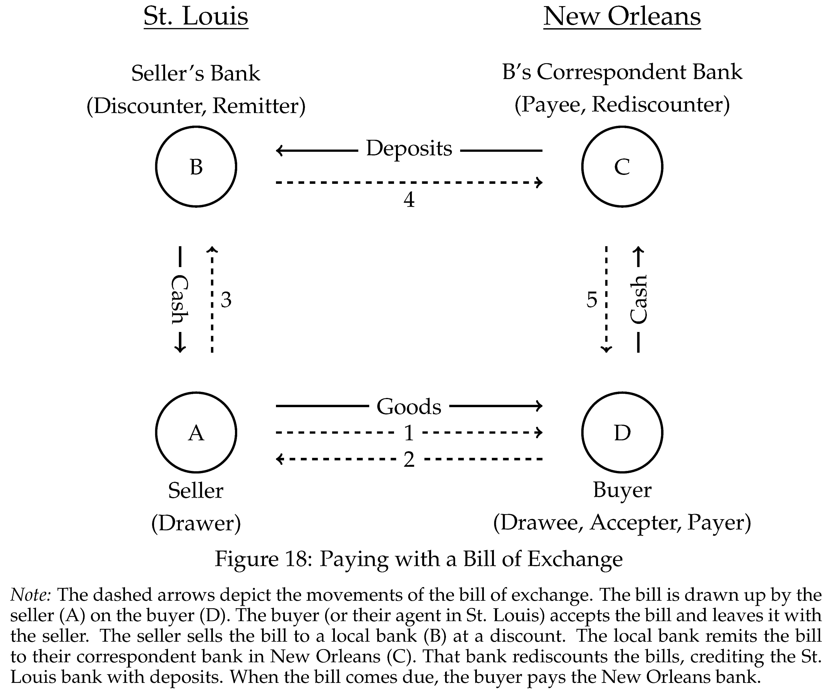

Slide 91
Second Bank: Facilitating Exchanges
Facilitating trade was a major business of banks
Degree of development varied across regions
Second Bank focused on less developed areas (South / West)
Improved payment system and trade credit
But unwelcome competition for state banks

Slide 92
Bank War
Hammond argues that Martin Van Buren was instrumental in bringing about downfall of Second Bank
Martin Van Buren
Jackson’s Vice President
Former banker and powerbroker in New York
Former Governor of New York
New York banking community biggest beneficiary
Wall Street (New York) rather than Chestnut Street (Philadelphia)

Slide 93
Second Bank Ahead of Its Time
Second Bank acted aggressively to:
Prevent banking panic in 1825
Improve domestic and international payment system
On both accounts far ahead of Bank of England
Perhaps this is why it stoked more opposition than Bank of England
Nicolas Biddle was a good central banker, but bad politician

Slide 94
Unit Banks and Banking Panics
No interstate banking in U.S. prior to 1970s (except for First and Second Banks)
Banks in many states not allowed to open branches: “unit banks”
Unit banks poorly diversified
Exposed to booms and busts in land prices, crop failures, shocks to local crop prices, etc.
Highly fragile institutions and prone to fail
Canada had branch banking and never (since 1839) experienced a banking panic (Scotland, Australia, antebellum South other examples)

Slide 95
Deposit Insurance
U.S. had a lender of last resort after 1913, but experiences massive banking crisis during Great Depression
Fed failed to act
U.S. instituted federal deposit insurance in 1933
Deposit insurance eliminates the run equilibrium in Diamond-Dybvig model
Sylvia doesn’t want to run (even if others do) because her deposits are insured
Ushered in “quiet period” of financial stability

Slide 96
Bank Regulation
Core problem: Bank runs
Direct policy response: Last resort lending and despot insurance
Knock on problem: Moral hazard
Policy response to moral hazard: capital and liquidity regulation
Also: Deposit financing too cheap due to tax incentives (profits net of interest payment on debt are taxed).

Slide 97
Early Bank Regulation
Early bank regulation: reserve requirements
National banking Act of 1864:
Banks in reserve cities: 25% reserves
Country banks: 15% reserves
State banks had lower reserve requirements
Frequent crises. System did not work well.

Slide 98
Chicago Plan, 100% Money, Narrow Banking
After Great Depression: Movement to abolish fractional reserve banking
Banks vulnerable to runs because of fractional reserve
Only full proof solution: 100% reserves
Prominent proponents: “Chicago Plan” and Irving Fisher (“100% money”)
Debated but ultimately rejected
Side effect: Banks could not use deposits to finance lending
All lending financed by equity or long-term debt
Banks no longer an engine of liquidity
Two institutions:
Narrow bank: Takes deposits and holds reserves (no lending)
Lending bank: Makes loans financed by equity and long-term debt

Slide 99
Narrow Banking vs. Capital Regulation
Narrow Banking:
100% reserve requirement for run-prone liabilities
100% equity requirement for lending
Which of these is more important?
If banks are well capitalized, moral hazard limited
Perhaps regulation should focus on making banks well capitalized

Slide 100
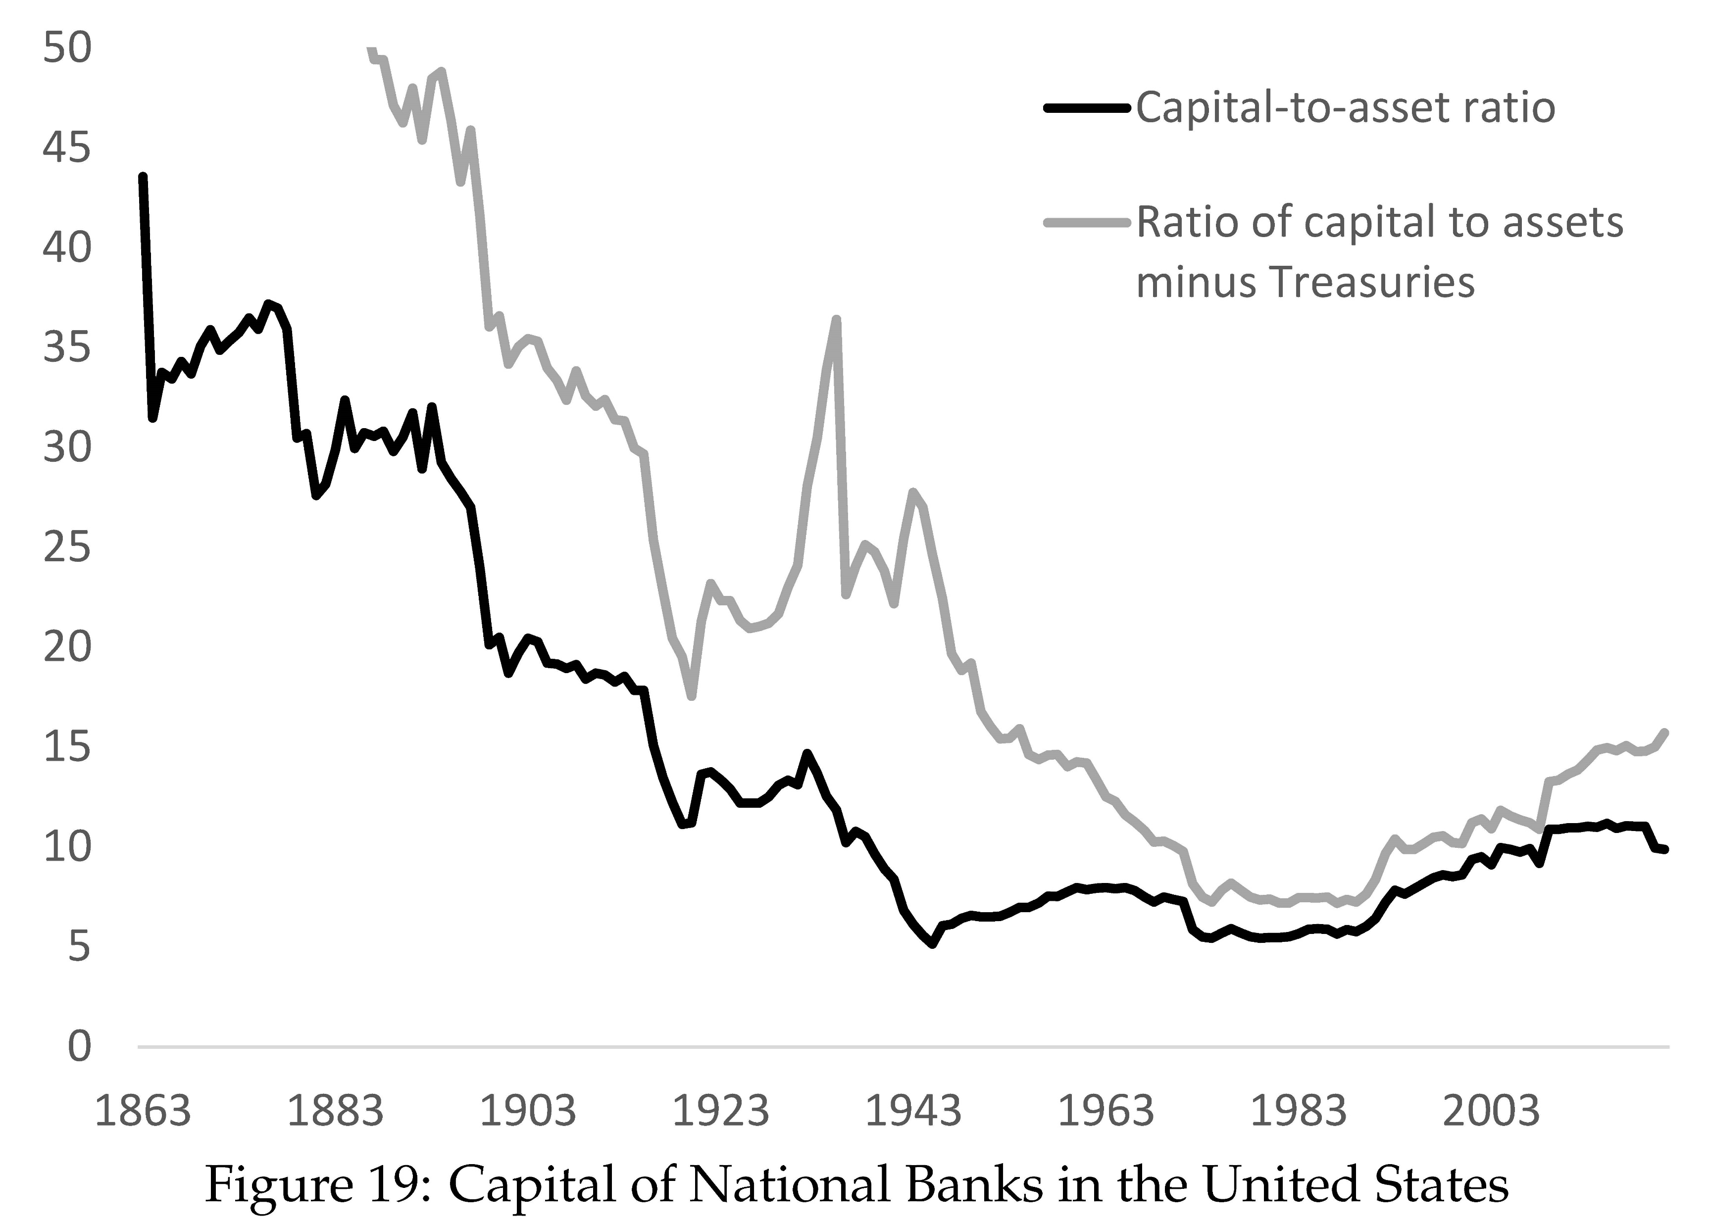

Slide 101
Early U.S. Capital Regulation
Bank supervision in 1950s largely qualitative
Fed Board: “it is impossible to develop any formula which eliminates the need for the exercise of sound judgement in determining the adequacy of capital of any given bank” (1952)
Lacked legal authority
Fed lost 1959 court case on revoking Fed membership due to inadequate capital
OCC lost 1983 course case over bank closure due to inadequate capital
Several high-profile bank failures + S&L crisis in 1970s and 1980s

Slide 102
Basel I
1988 G-10 agreement on capital regulation
Minimum capital ratios:
4% Tier 1 capital ratio
8% Total capital ratio
Capital relative to risk-weighted assets
Risk weights:
0%: Cash, central government debt
10%: Public sector debt
20%: Claims on other banks
50%: Residential mortgages
100% Commercial and industrial loans

Slide 104
Basel II
Focus on improving risk weights
Large banks could use internal models to assess risk
Trading accounts involve a lot of hedging
Use of internal models allowed banks to take account of hedging
Better risk weights supposed to reduce regulatory arbitrage
E.g., Package mortgages into securities, sell off high trances, hold lowest trances (which have most of the risk), lower capital requirement
Downside: Internal risk models biased

Slide 105
Financial Crisis – Basel III
Financial crisis of 2007-09 led to calls for more stringent capital requirements
Response: Basel III and Dodd-Frank in U.S.
Higher capital ratios
More detailed risk weights (some higher than 100%)
Leverage ratios (un-risk-weighted capital ratios)
G-SIBs (Globally systemically important banks due to “too big to fail”)
Stress tests (forward looking, central bank model)

Slide 106
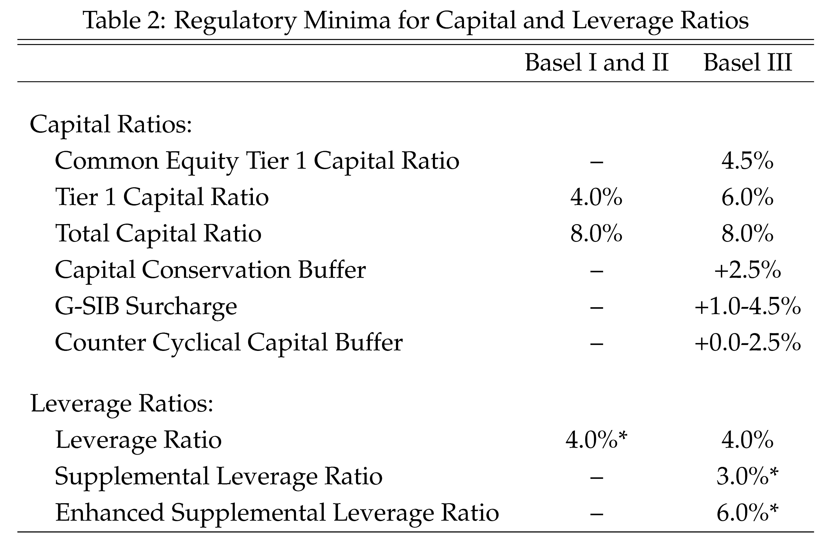

Slide 107
Private Money and Free Banking
Virtually universal that government monopolizes money
Is this justified?
Might private sector be able to supply money as well or better?
Two questions:
Should there be competition over the monetary standard?
Conditional on monetary standard, should there be free entry into creating such money?

Slide 108
Government Monetary Standard?
Most of last millennium: monetary standard defined in terms of metals
U.S. Coinage act of 1792:
U.S. Dollar is 371.25 grains (24.06g) of pure silver or 24.75 grains (1.60g) of pure gold (bimetallic standard)
Why should government make such a definition?
Solve a coordination problem
Similar to defining weights and measures

Slide 109
Fiat Monetary Standard
In 20th century monetary standard delinked from metals
Purely fiat monetary standard
Associated with high inflation in many countries
Failure of the government to supply stable monetary standard
Perhaps fiat monetary standard not compatible with stability
These worried most prevalent in 1970s and 1980s

Slide 110
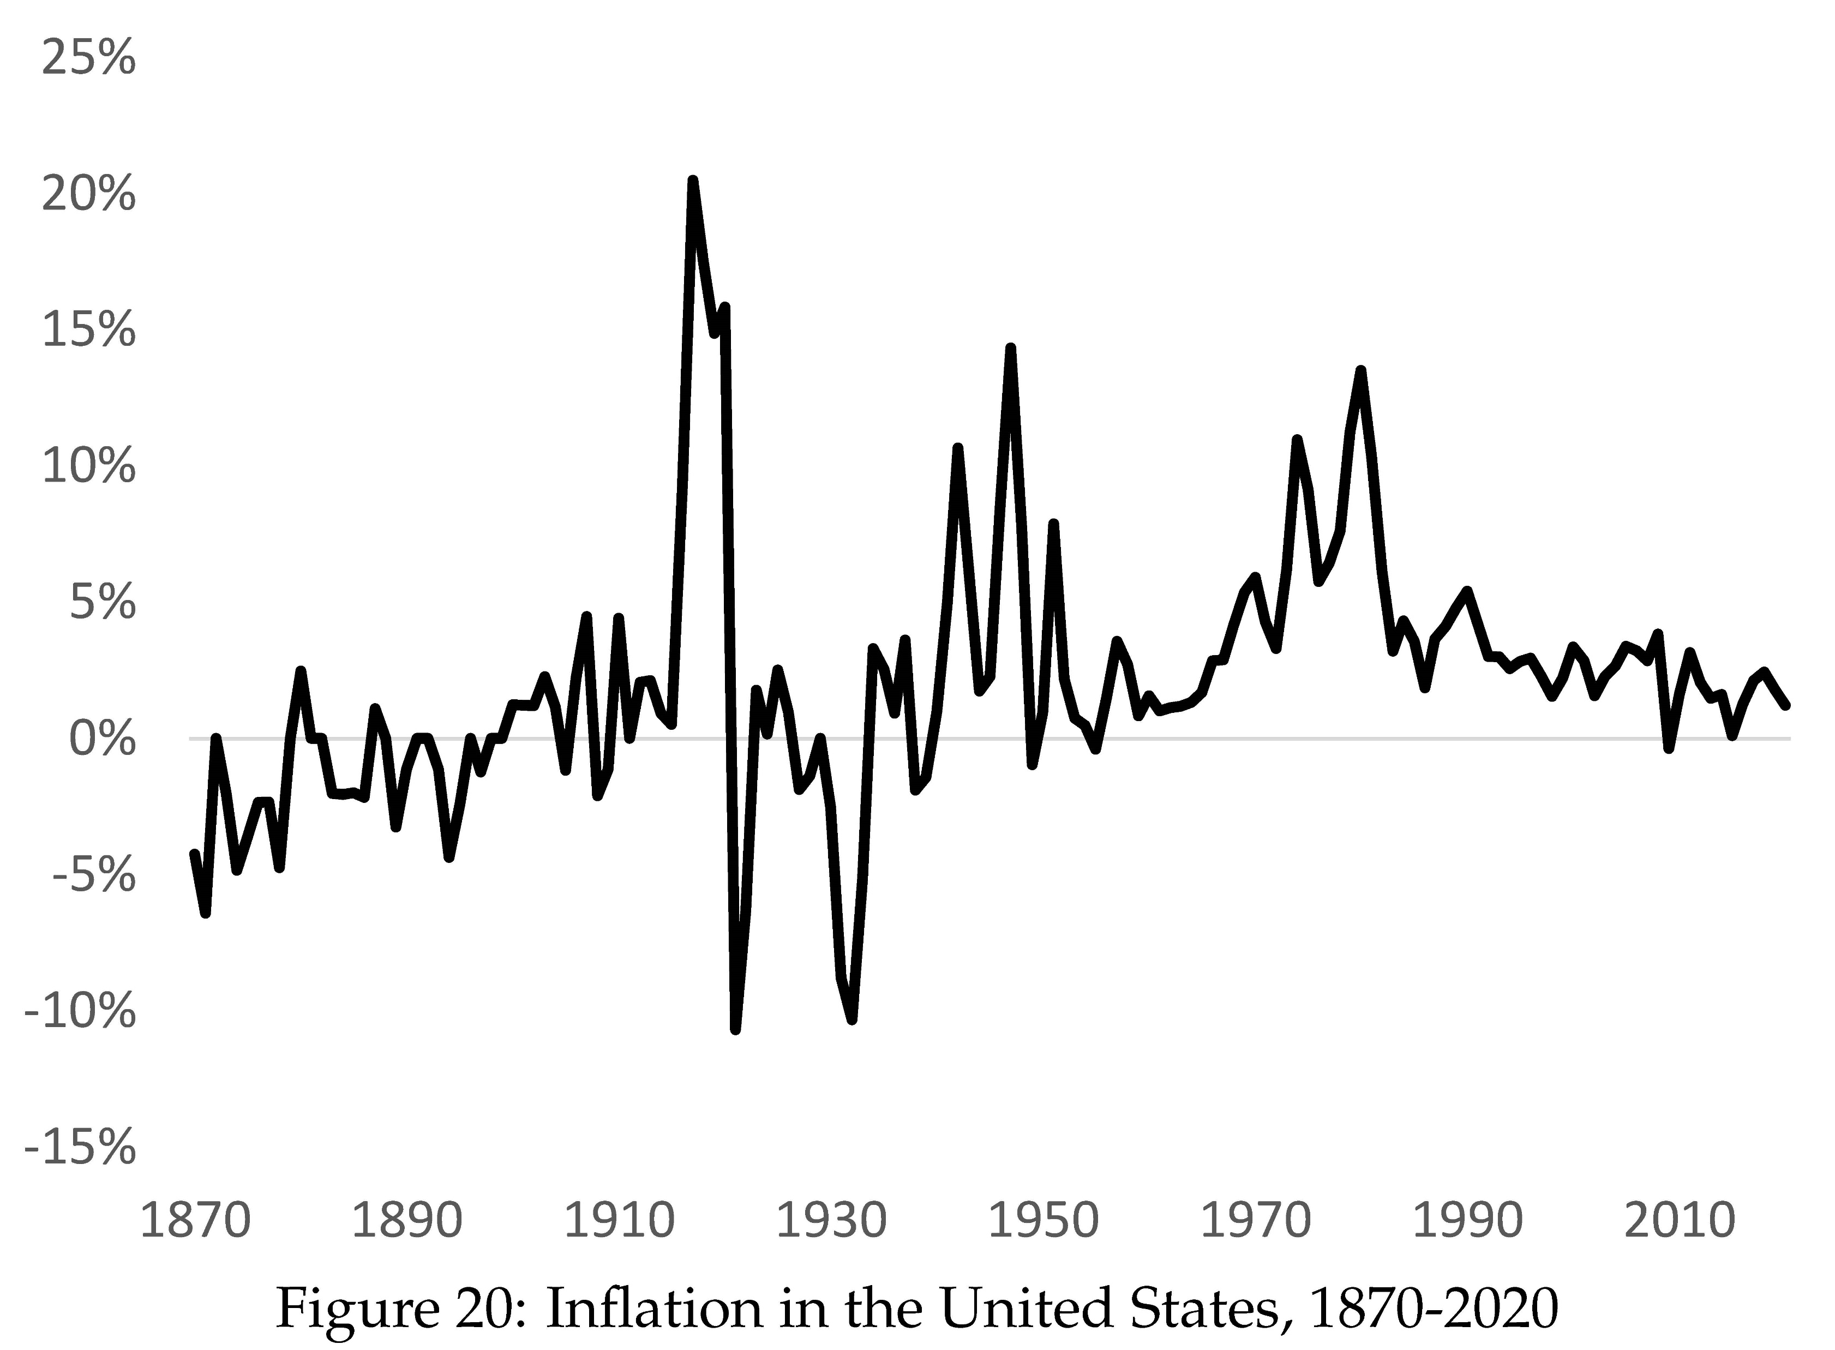

Slide 111
Private Fiat Monetary Standard
Hayek (1978) and others argued for denationalization of money
Fundamental problem:
Virtually costless to issue fiat currency
If valued, strong incentive to issue more
Overissue will undermine credibility of currency
Issuer will want to avoid overissue to grow use of currency
But once currency mature, incentive to overissue stronger
Competition over monetary standard raises transactions costs since people must keep track of exchange rates

Slide 112
Advantages of Government
Not purely motivated by profits
Perhaps better situated to resist overissue?
Independent central banks
Do sometimes massively overissue (hyperinflations)
Can mandate that taxes paid in their currency
Pay wages of government workers
Pay social security payments
Etc.

Slide 113
Free Banking
What institutions should be allowed to issue paper money
Early on, private banks issued paper money
Gradually, governments restricted which institutions could issue paper money
Some countries allowed free entry into note issue:
Scotland in 18th and early 19th century
U.S. between 1837 and 1863
In 20th century, central banks sole issuers of currency (but “free” entry into issuing deposits)

Slide 114
Free Banking in America
In early 19th century forming a corporation was a privilege
Granted by government with special legislation
Limited entry made charters valuable
Governments partly funded by sale of such privileges
Political groups lined pockets and strengthened coalitions by granting charters to allies (Wallis, 2006)
Corrupt and unpopular

Slide 115
Free Banking in America
In New York, Martin Van Buren’s Albany Regency granted bank charters to political allies
After panic of 1837, Whig party gained power
Passes general incorporation acts
One sphere was banking: free entry into banking (“free banking”)
A number of other states followed
Free banking didn’t manage to create a uniform currency

Slide 116
No Questions Asked Money
Purpose of money to lower transactions costs
Money should circulate at par ($1 should fetch $1)
Should be true even in a crisis
But bank notes are a credit instrument
Promise to pay specie in 19th century
For money to circulate at par it must be riskless
But credit instruments are usually risky
And banks are subject to runs
Not trivial to create ‘no questions asked’ paper money

Slide 117
Free Banking Laws
Banks must secure notes with bonds deposited with state
If bank refused to redeem note, state sold bonds to pay notes
Backing notes with bonds 1-for-1 supposed to make notes save
But what type of bonds?
Michigan law: Allowed backing by mortgages valued at par rather than market value
Gave rise to wildcat banking

Slide 118
Wildcat Banks
Set up far from population “where only wildcats roam”
Made it hard to redeem notes
Worst cases:
Banker issues notes against bonds worth less than notes (fraudulent mortgage – mortgage with face value higher than land value)
Banker sells notes to the public
Pockets the proceeds and skips town
New York law better designed
Notes backed by state bonds valued at market price
Limited wildcat banking

Slide 119
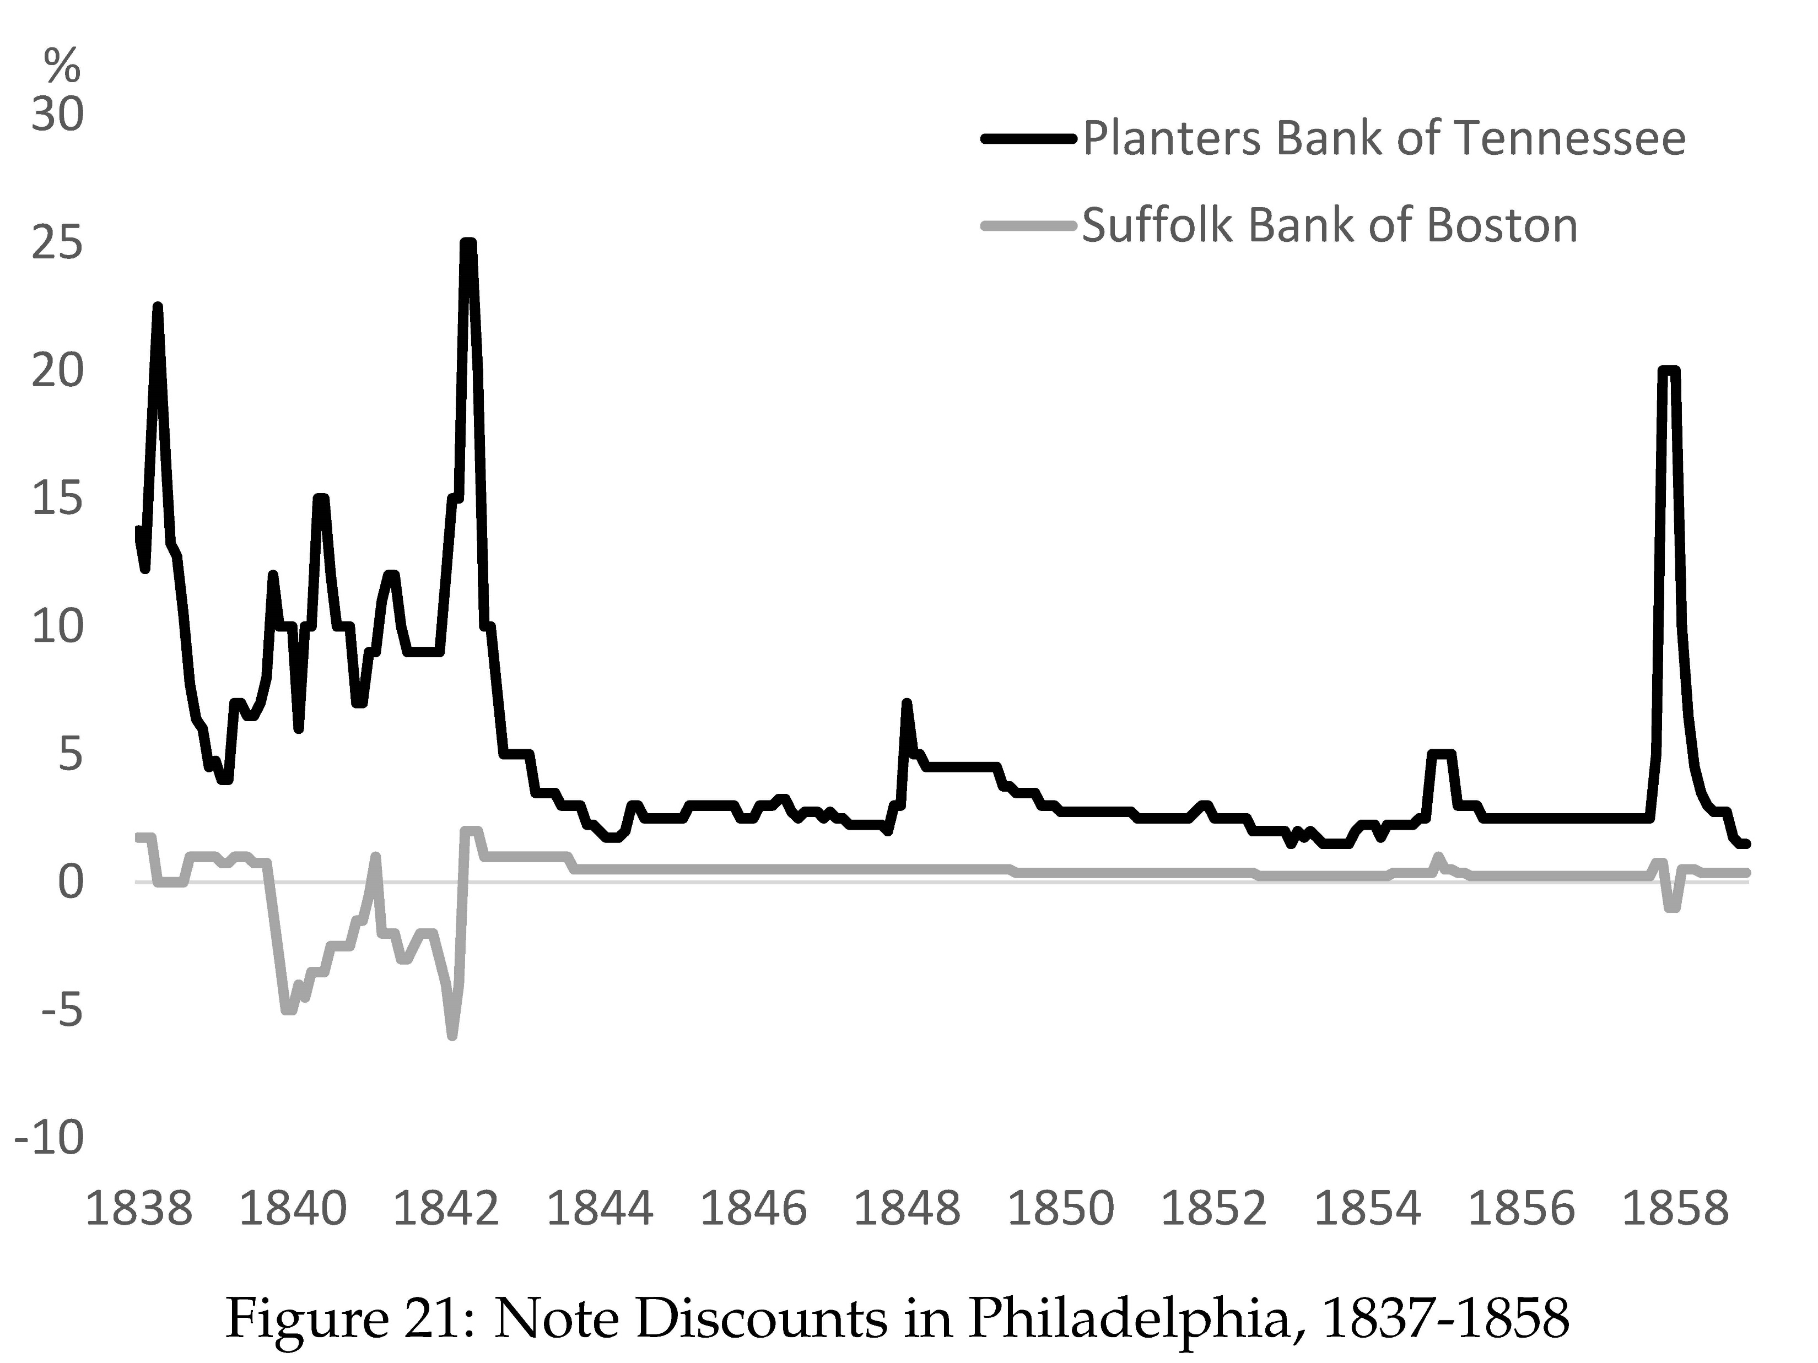

Slide 120
Uniform Currency
Notes from local banks traded at par
Notes from other cities traded at discount
Merchants looked up value of notes in “banknote detector” manuals
Discounts varied by distance and cost of travel
Discounts spiked during crises
States defaulted on bonds
Banks in trouble because they owned lots of state bonds to back notes

Slide 121
National Banking Acts of 1863-64
Expanded free banking to entire nation
Bank notes of national banks backed by Treasuries
Uniform collateral
State bank notes taxed out of existence
All national banks required to take notes from all other national banks at par
Created a uniform currency in U.S.

Slide 122
Are Central Banks Necessary?
Core functions of central banks in fiat currency system:
Issue and manage the currency (monetary policy)
Operate central nodes of payment system
Act as a lender of last resort
Someone must issue fiat currency
This is central bank
Need not be a government

Slide 123
Are Central Banks Necessary?
On commodity standard, not as obvious central bank is necessary
Perhaps Mint simply stands ready to exchange specie for coin
This is what governments did before banking
Does banking call for central bank?
Arguably bank runs call for lender of last resort
Critics of central banking do not agree

Slide 124
Are Central Banks Necessary?
Critics argue laissez faire banking system would be more stable than advocates of central banking fear
Presence of central bank induces banks to take more risk (moral hazard)
Banks much better capitalized in 19th century (before central banking)
But many other things have changed
Banking systems of England and U.S. unstable due to unit banking
Banking systems in other countries much more stable (because they allowed for branch banking)

Slide 125
Are Central Banks Necessary?
Private arrangements would arise (e.g. Clearinghouses)
But clearinghouses suffer from conflict between strong and weak banks
Will provide less support than is optimal
Not-for-profit central bank arguably essential to internalize positive externality of avoiding failures
Impossible to commit not to support banking system in a crisis
Perhaps possible 150 years ago
Note possible today
Moral hazard and insufficient private preparedness inevitable

