Slide 1
Money, Inflation, and Output: A Quantity-Theoretic Introduction
Jón Steinsson
University of California, Berkeley

Slide 2
Monetary Economics
The role of money in the economy is one of the most mysterious aspects of economics
Key questions:
What gives money value?
Why does its value change over time?
How and why does monetary policy affect output and employment?
Keynesian economics / financial crises
But we start with a parable

Slide 3
Great Babysitting Co-op Crisis
Capitol Hill Babysitting Co-op
150 couples
Exchange babysitting services
Use coupons (“scrip”) to keep track of things
Coupons are the “money” in the babysitting economy
Each coupon pays for ½ hour of baby sitting
“Constitutionally fixed” price

Slide 4
“Money” in the Babysitting Economy
Early on:
Couples got 20 coupons upon entry
Must give back 20 coupons upon exit
Everything worked well for a while
But … quantity of coupons fell over time:
Some coupons lost in washing machine
Dues exceeded expenses
Each couple had less and less coupons

Slide 5
Crisis in Babysitting Economy
Each couple felt it didn’t have enough coupons and started to try to acquire more
Everyone wanted to sit, but no one wanted to go out
Does this work in the aggregate?
No! For someone to sit, someone else must go out.
So, the baby-sitting economy fell into recession. There was a fall in GBP (Gross Babysitting Product)
Lots of workers wanted to work but no one wanted buy what they produced

Slide 6
Crisis in the Babysitting Economy
Being a bunch of lawyers, they:
Passed a bylaw: Everyone must go out at least every six months.
Didn’t work
Finally, they resorted to monetary policy:
Everyone got 10 additional pieces of scrip
Each new couple gets 30 upon entering
Must give back 20 upon leaving
Miraculously: Gross Babysitting Product boomed!!

Slide 7
New Problem in Babysitting Economy
Balance of money supply:
New system implied that turnover of couples increased “money supply”
Dues and natural loss decreases money supply
If there is “too much” turnover, couples will have more coupons than they need
How do they react to this?
Everyone wants to go out.
No one wants to sit
Goods shortages

Slide 8
Lessons from the Babysitting Economy
Too little money: Recession (too little demand)
Too much money: Shortages (too much demand)
Goldilocks economy:
Just the right amount of money
Balance between desire to produce and desire to consume
What is the market failure?

Slide 9
What is Money?
Lay English: “That person has a lot of money”
“That person is wealthy”
In Economics:
“Money” has more specific meaning
Roughly: The asset that people use as a medium of exchange (whatever they use to make payment) and unit of account (post prices and wages in terms of)

Slide 10
Many Things Have Been Used As Money
Cowrie shells, cattle, tobacco, beaver skins, etc.
Island Yap: Large Stone wheels
Iceland in Viking times:
Word for money same as word for sheep: “fé”
Money in viking times:
1 cow = 6 sheep (with wool and young)
1 sheep = 20 “forearms” of woven wool
1 “forearm” of woven wool = 2 fish
Precious metals: Gold, silver, bronze, etc.
Prisons: Cigarettes
Pieces of green paper with picture of G.W.

Slide 11
Traditional Functions of Money
Medium of Exchange
People can pay for things they purchase using money
Unit of Account
People generally quote prices and wages in terms of units of money (e.g., in dollar in the U.S. today)
Store of Value
People may hold money so as to be able to buy something tomorrow or later

Slide 12
Money in the U.S. Today
Unit of Account:
Prices and wages are posted in “US dollars”
US dollar is clearly the unit of account in the US
Medium of Exchange:
Complicated! Coins and bills not only medium of exchange
Debit cards, checks, credit cards, Venmo, Paypal, etc.
In most cases a bank deposit is real medium of exchange
Store of value:
Coins and bills not important store of value (don’t pay interest)
Many other better stores of value (stocks, bonds, real estate, etc.)

Slide 13
The Purpose of Money
Money is a device to lower transactions costs
Instructive to start by thinking about money in a “primitive” society (i.e., one that involves little trade and specialization)
Helps us think about basic properties of monetary economics
We will then add more and more “modern” elements until we arrive at a fully modern setting

Slide 14
Society of Yeomen Farmers
Each household is self-sufficient in everything
Produce everything they consume
Make their own food, clothing, shelter, etc.
No trade
What is the role of money in such a society?
Money has no role!
If there is no trade, no need for money
Money is a device for lowering transactions costs

Slide 15
Society of Yeomen Farmers
At some point someone realizes they are particularly good at making, say, shoes
Specializes in making shoes
Sells shoes to others in exchange for other things
Over time, more and more people specialize
Important question arises:
How will trade work?

Slide 16
Specialization and Trade
Baker makes bread, Shoemaker makes shoes, Janitor cleans, Teacher teaches, etc.
How does trade work?
Barter trade: Baker and shoemaker exchange bread for shoes
Problem: If teacher wants bread but baker doesn’t want a math lesson, no scope for trade.
Lack of double coincidence of wants
What needs to happen?

Slide 17
Something Becomes Money
Shoemaker may take bread as payment for shoes even if she doesn’t want bread (Why?)
Bread may thus becomes “money”
Bread not ideal money (Why?)
Baker can solve this problem by issuing bread tokens
Pieces of paper that entitle bearer to one loaf of bread
Bread tokens circulate and become medium of exchange, i.e., become money

Slide 18
Bread Tokens as Money
What are potential problems with this?
Counterfeiting! (Huge problem through the ages)
Baker may issue “too many” tokens (issuing tokens likely to be highly profitable)
Baker may “default” on tokens (i.e., not be able to deliver loaves of break on demand)
If people doubt baker’s ability to deliver, the may rush to convert tokens into bread (i.e., run on the baker (financial crisis))
Value of tokens depends on people’s confidence in baker

Slide 19
What Characteristics Should Money Have?
Durable
Easily measured
Easily transferable
Easily divisible
Have stable value
The point of “money” is to lower transaction costs

Slide 20
Stable Quantity of Money
Many people think that stable quantity is a desirable characteristic for money
E.g., Satoshi Nakamoto (creator of bitcoin)
Not clear that this is true
Stable value is what we are really after!
If demand for money fluctuates, while quantity is fixed, then price of money will fluctuate (e.g., bitcoin)
This will mean value is not stable

Slide 21
Why Gold and Silver?
Gold and Silver were dominant forms of money for many centuries. Why?
They are durable
Easily measured (Especially after advent of coinage)
Easily transferable (high value relative to volume and weight)
Stable value?

Slide 22
Our First Monetary / Business Cycle Model
Goal: Understand influence of money on output and inflation
Complicated subject. We do this in steps.
First model: Medieval Economy
Contains certain central ideas in simple form
Leaves out many aspects of reality
We will add these one-by-one over the next few weeks

Slide 23
Money and Transactions
Only medium of exchange: gold coins
All payments made with gold coins
Gold is only asset people accept as payment in transactions
In every transaction, gold coins much change hands
People hold money to be able to engage in transactions
Just like scrip in babysitting economy
Transactions based demand for gold coins

Slide 24
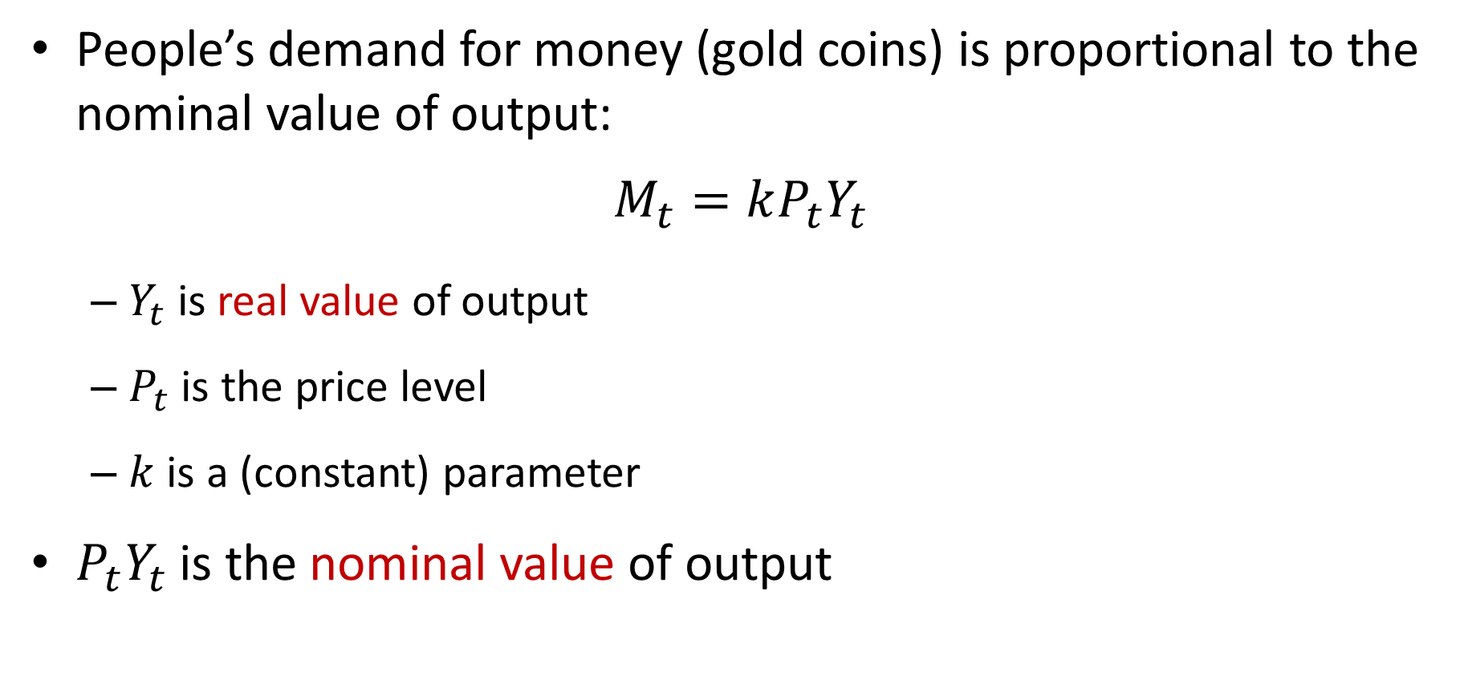
Demand for Money
People’s demand for money (gold coins) is proportional to the nominal value of output:
$$M_{t}=kP_{t}Y_{t}$$
$Y_{t}$ is real value of output
$P_{t}$ is the price level
$k$ is a (constant) parameter
$P_{t}Y_{t}$ is the nominal value of output

Slide 25
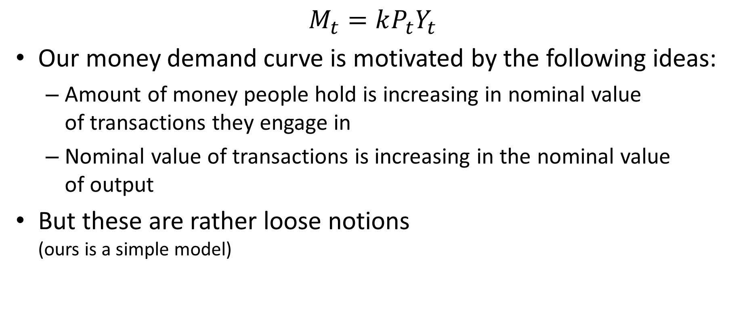
Demand for Money
$$M_{t}=kP_{t}Y_{t}$$
Our money demand curve is motivated by the following ideas:
Amount of money people hold is increasing in nominal value of transactions they engage in
Nominal value of transactions is increasing in the nominal value of output
But these are rather loose notions (ours is a simple model)

Slide 26
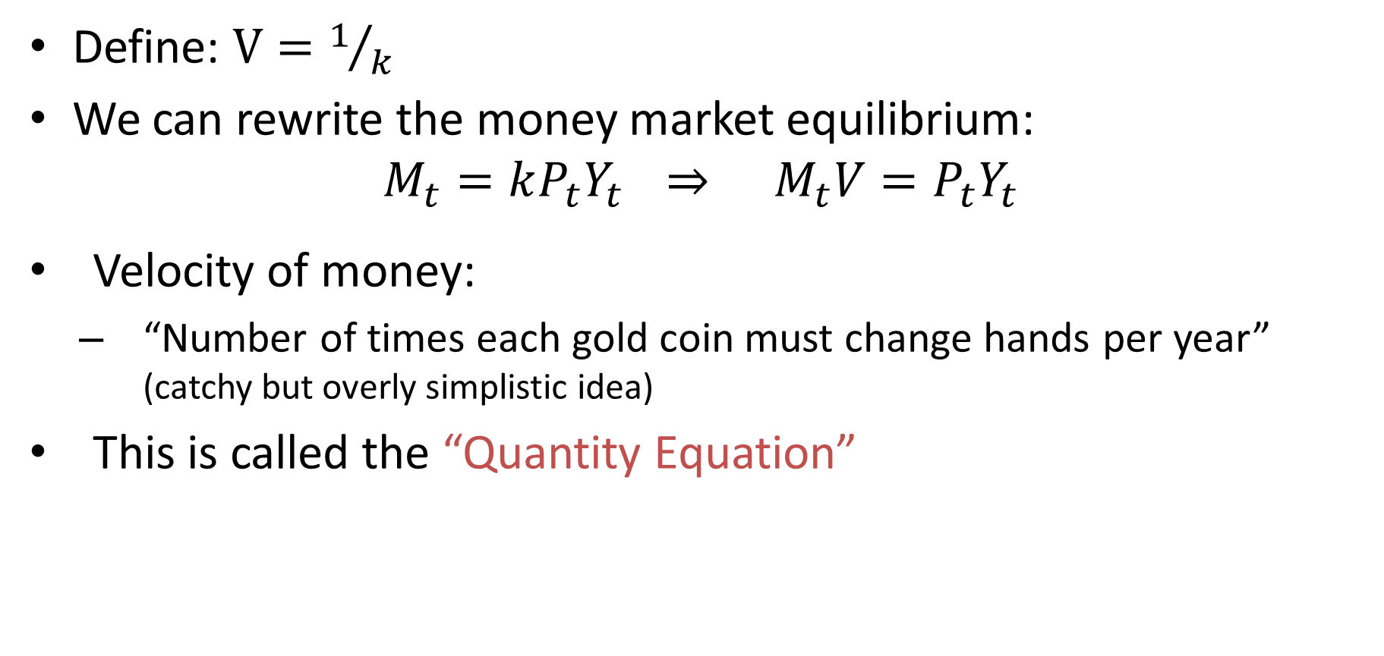
Quantity Equation
Define: $V=1/k$
We can rewrite the money market equilibrium:
$$M_{t}=kP_{t}Y_{t} \overset{⇒}{} M_{t}V=P_{t}Y_{t}$$
Velocity of money:
“Number of times each gold coin must change hands per year” (catchy but overly simplistic idea)
This is called the “Quantity Equation”

Slide 27
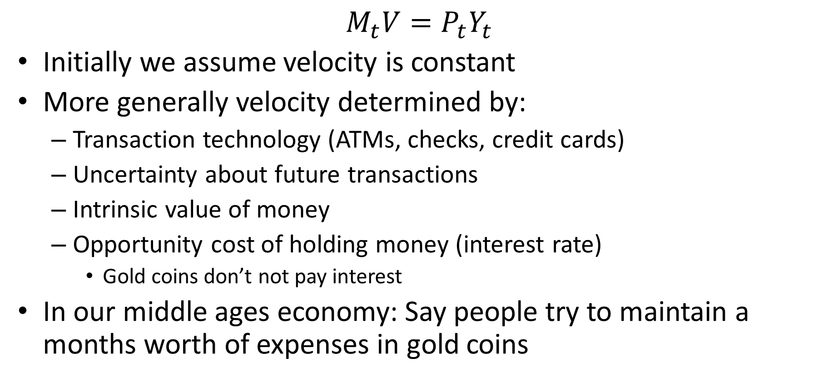
What Determines Velocity?
$$M_{t}V=P_{t}Y_{t}$$
Initially we assume velocity is constant
More generally velocity determined by:
Transaction technology (ATMs, checks, credit cards)
Uncertainty about future transactions
Intrinsic value of money
Opportunity cost of holding money (interest rate)
Gold coins don’t not pay interest
In our middle ages economy: Say people try to maintain a months worth of expenses in gold coins

Slide 28
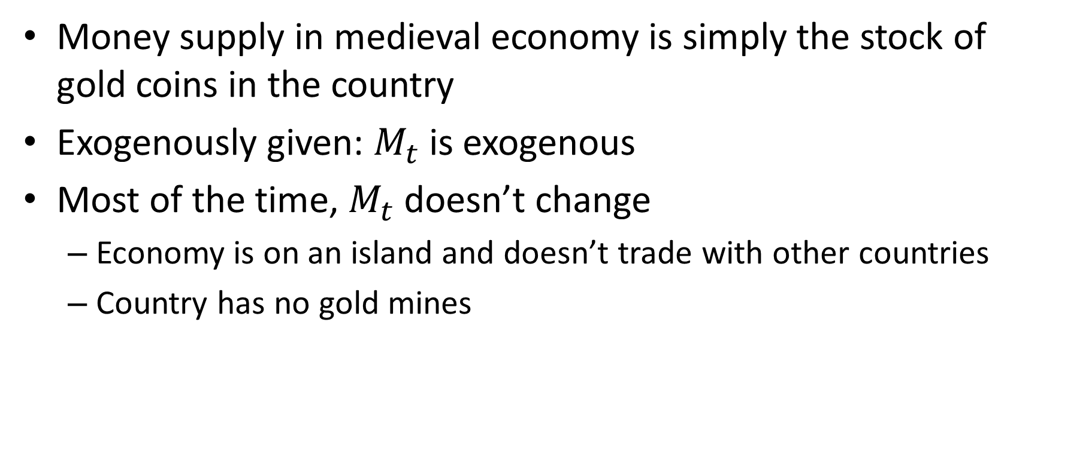
Supply of Money
Money supply in medieval economy is simply the stock of gold coins in the country
Exogenously given: $M_{t}$ is exogenous
Most of the time, $M_{t}$ doesn’t change
Economy is on an island and doesn’t trade with other countries
Country has no gold mines

Slide 29
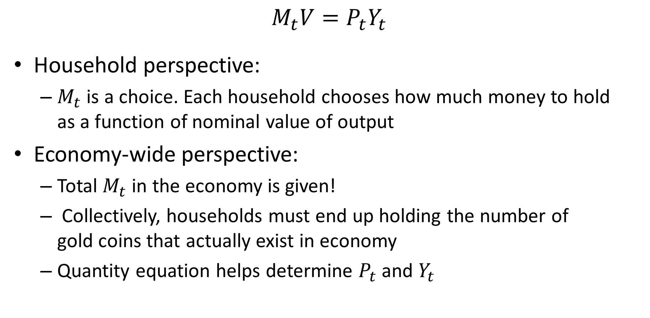
Two Perspectives
$$M_{t}V=P_{t}Y_{t}$$
Household perspective:
$M_{t}$ is a choice. Each household chooses how much money to hold as a function of nominal value of output
Economy-wide perspective:
Total $M_{t}$ in the economy is given!
Collectively, households must end up holding the number of gold coins that actually exist in economy
Quantity equation helps determine $P_{t}$ and $Y_{t}$

Slide 30
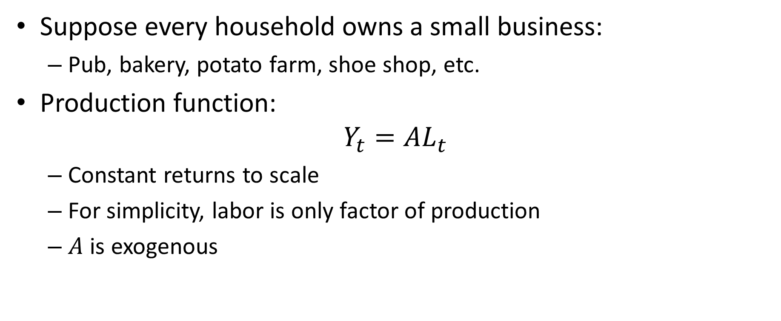
Production in the Medieval Economy
Suppose every household owns a small business:
Pub, bakery, potato farm, shoe shop, etc.
Production function:
$$Y_{t}=AL_{t}$$
Constant returns to scale
For simplicity, labor is only factor of production
$A$ is exogenous

Slide 31
Labor Supply in the Middle Ages
Businesses post a price at the beginning of each period (before they observe demand)
They then service all customers that demand their goods
If demand is high, they have to work more
These are key assumptions of Keynesian models (prices set in advance and firms meet demand)
Implies that output is determined by demand in the short run

Slide 32
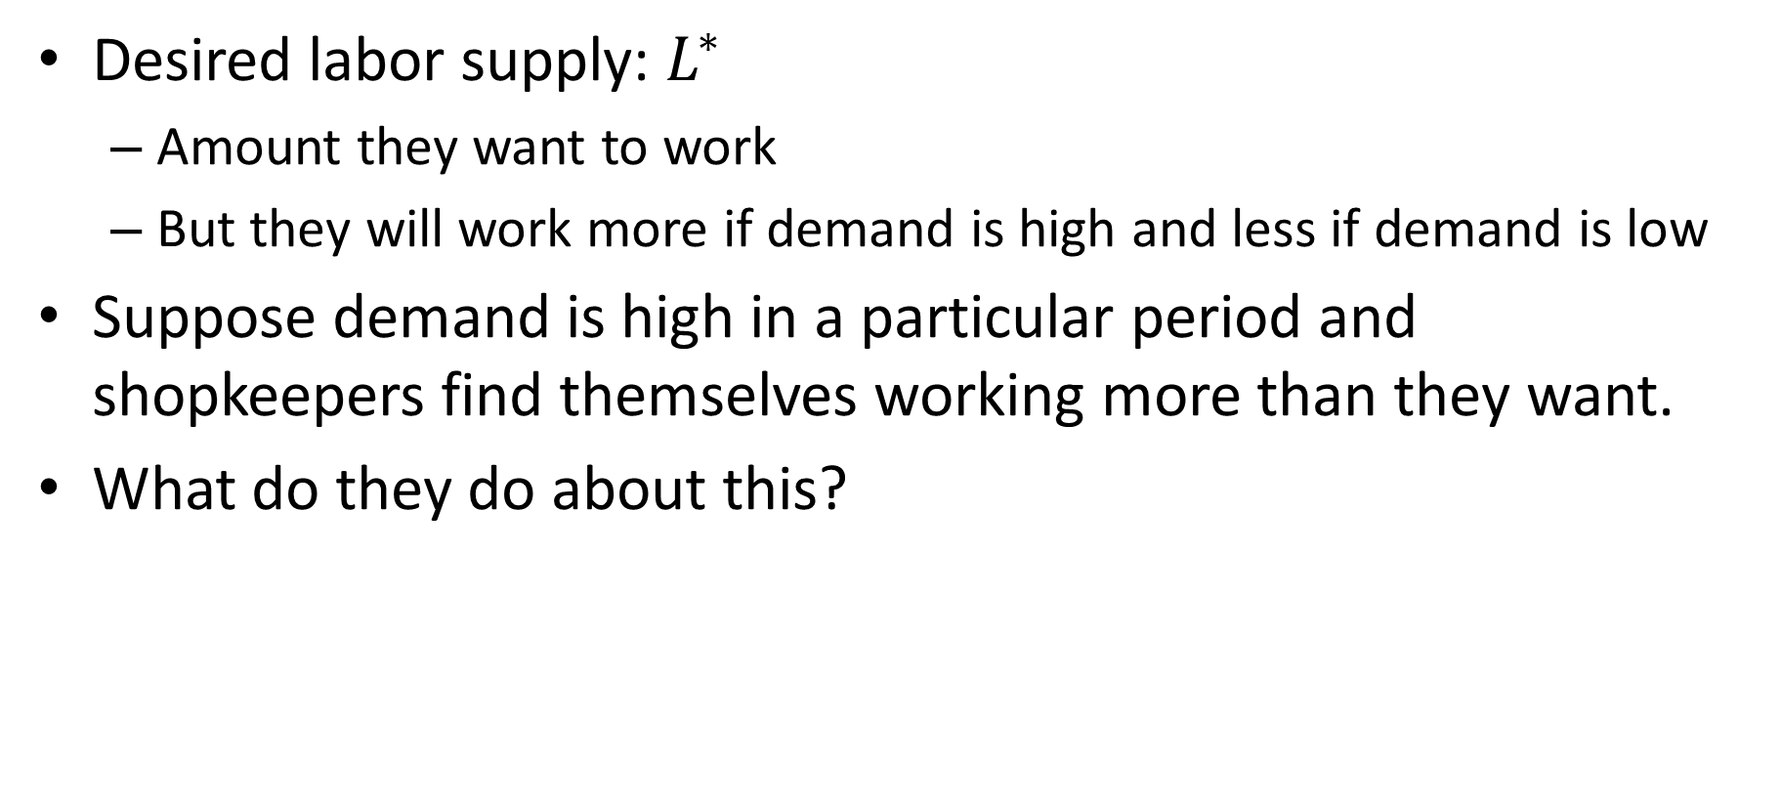
Demand Management in Middle Ages
Desired labor supply: $L^{∗}$
Amount they want to work
But they will work more if demand is high and less if demand is low
Suppose demand is high in a particular period and shopkeepers find themselves working more than they want.
What do they do about this?

Slide 33
Price Adjustment in the Middle Ages
At the end of the period they take stock and think about whether they should change their price
They are not sure why demand was high
Maybe just some temporary thing
Maybe a permanent thing
If demand is temporary they don’t want to change prices. But if it is permanent they should change their price

Slide 34
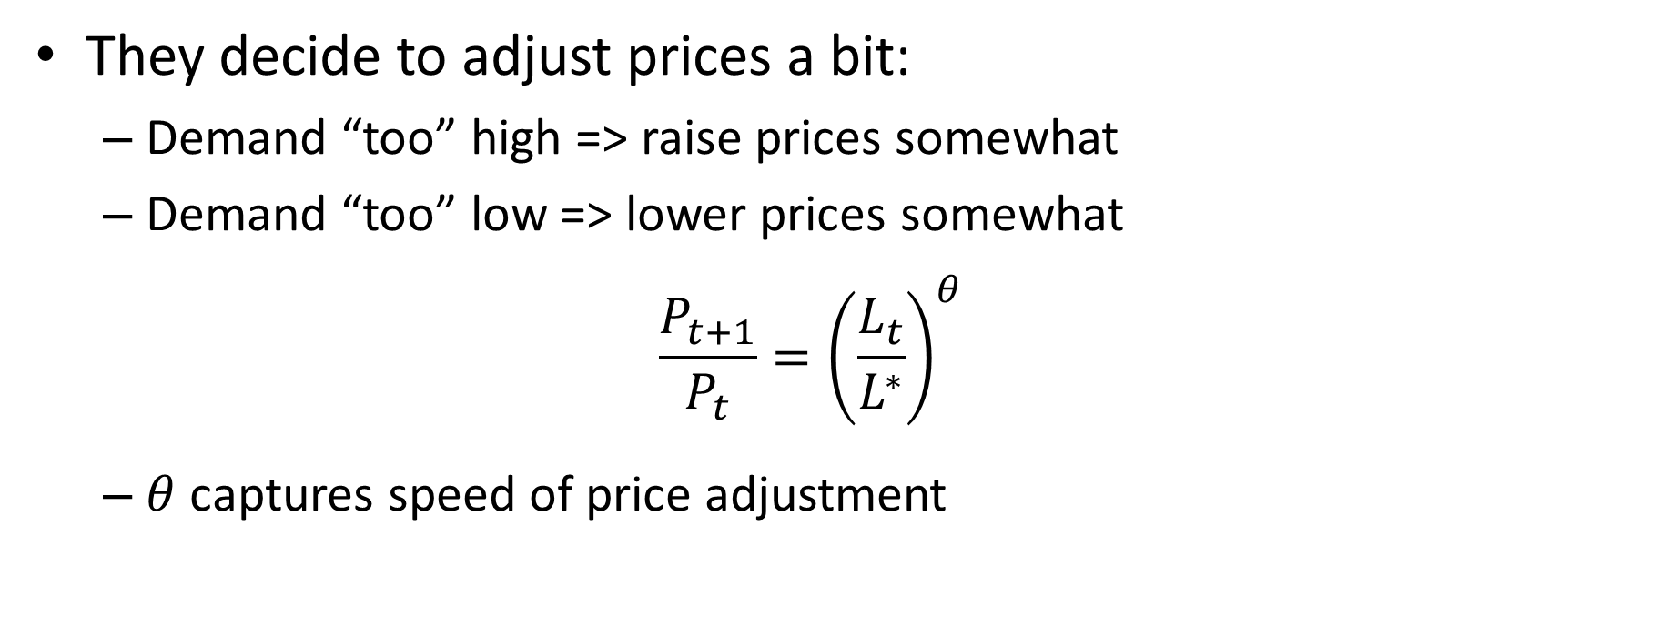
Price Adjustment in the Middle Ages
They decide to adjust prices a bit:
Demand “too” high => raise prices somewhat
Demand “too” low => lower prices somewhat
$$\frac{P_{t+1}}{P_{t}}={\left(\frac{L_{t}}{L^{∗}}\right)}^{θ}$$
$θ$ captures speed of price adjustment

Slide 35
Reasons for Stickiness of Prices
In reality, prices are “sticky” for many reasons:
Imperfect attention: Firms have other things to worry about than the money supply
Costs of changing prices (“menu costs”)
Fear of antagonizing customers
Worry that competitors will not change price (coordination problem)

Slide 36
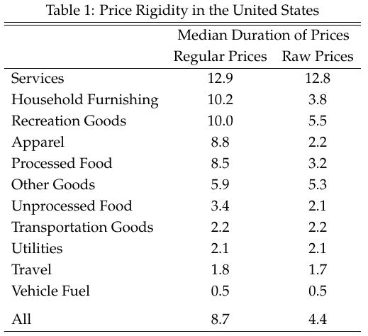
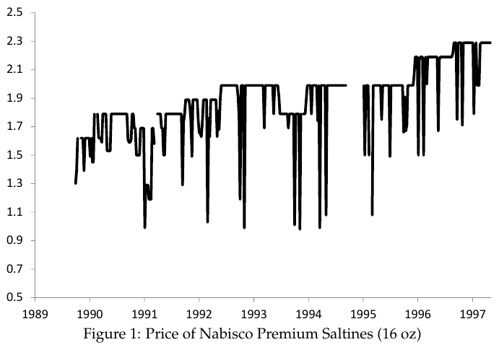
Price Rigidity Evidence

Slide 37
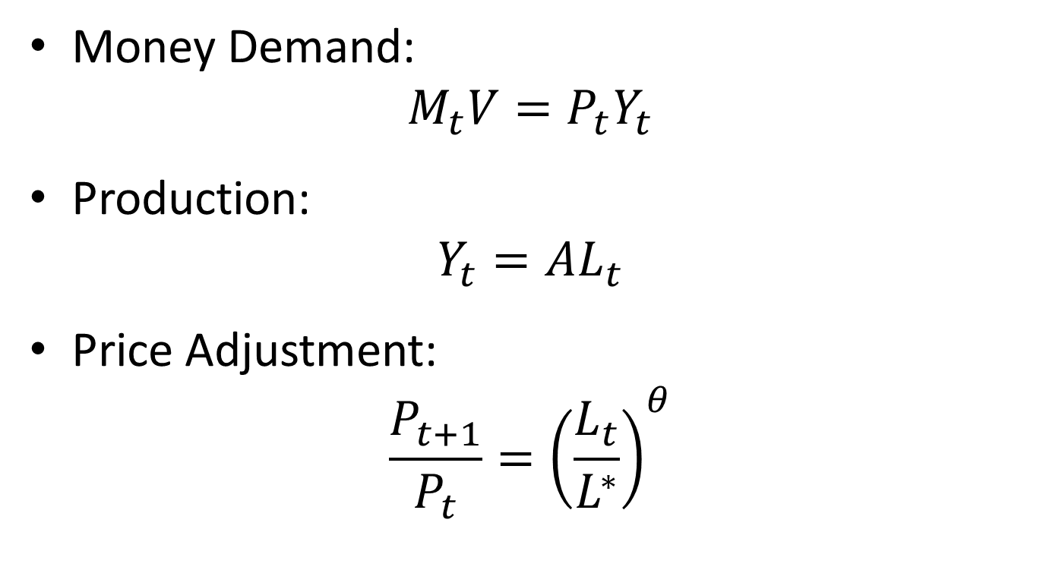
Model of Medieval Economy
Money Demand:
$$M_{t}V=P_{t}Y_{t}$$
Production:
$$Y_{t}=AL_{t}$$
Price Adjustment:
$$\frac{P_{t+1}}{P_{t}}={\left(\frac{L_{t}}{L^{∗}}\right)}^{θ}$$

Slide 38
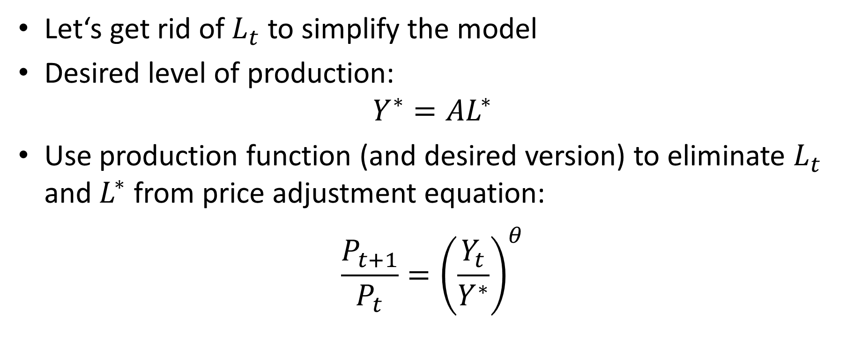
Simplifying the Model
Let‘s get rid of $L_{t}$ to simplify the model
Desired level of production:
$$Y^{∗}=AL^{∗}$$
Use production function (and desired version) to eliminate $L_{t}$ and $L^{∗}$ from price adjustment equation:
$$\frac{P_{t+1}}{P_{t}}={\left(\frac{Y_{t}}{Y^{∗}}\right)}^{θ}$$

Slide 39
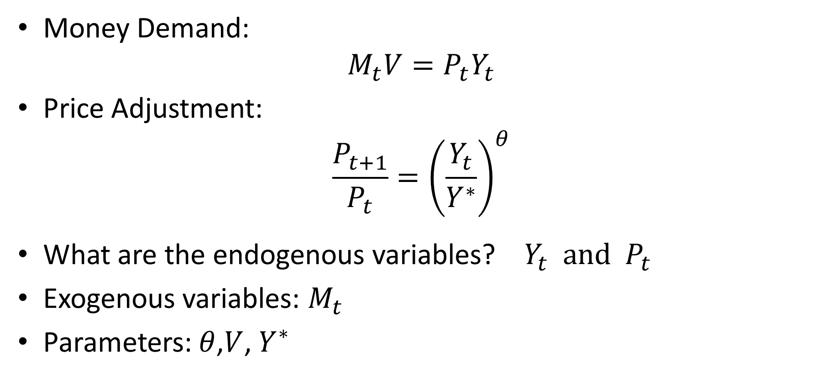
Model of Medieval Economy
Money Demand:
$$M_{t}V=P_{t}Y_{t}$$
Price Adjustment:
$$\frac{P_{t+1}}{P_{t}}={\left(\frac{Y_{t}}{Y^{∗}}\right)}^{θ}$$
What are the endogenous variables? $Y_{t} \text{and} P_{t}$
Exogenous variables: $M_{t}$
Parameters: $θ$,$V$, $Y^{∗}$

Slide 40
Vikings Bring Back Gold Plunder
Say our medieval economy sends off a ship of vikings to plunder gold from unsuspecting monasteries in a neighboring country
Vikings bring back shipload of gold coins
What happens to the economy?
What happens in the very short run?
What happens over time?
What is the result of this in the long run?

Slide 41
Vikings Bring Back Gold Plunder
At first: Vikings go on a spending spree
Gold coins slowly diffuse through the economy
Everyone has more gold coins than before
People have more gold coins than they want
So, what do they do?
Try to spend them. Boom time!!
On aggregate this doesn’t help
If one person spends someone else gets a gold coin
“Too much money chasing too few goods”

Slide 42
Boom Time in the Middle Ages
Producers face increased demand for their goods
How do they respond to this?
Prices start to rise
How much do prices rise?
How does this affect the boom in output?
Not clear
Helpful to use our formal model

Slide 43
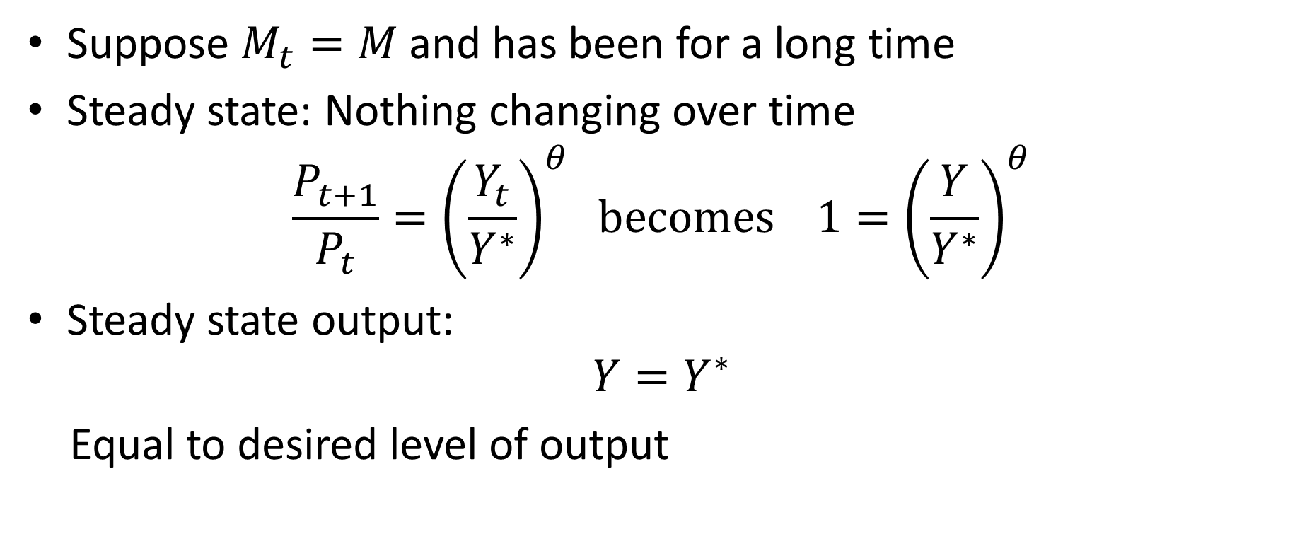
Steady State Before Viking Voyage
Suppose $M_{t}=M$ and has been for a long time
Steady state: Nothing changing over time
$$\frac{P_{t+1}}{P_{t}}={\left(\frac{Y_{t}}{Y^{∗}}\right)}^{θ} \text{becomes} 1={\left(\frac{Y}{Y^{∗}}\right)}^{θ}$$
Steady state output:
$$Y=Y^{∗}$$
Equal to desired level of output

Slide 44
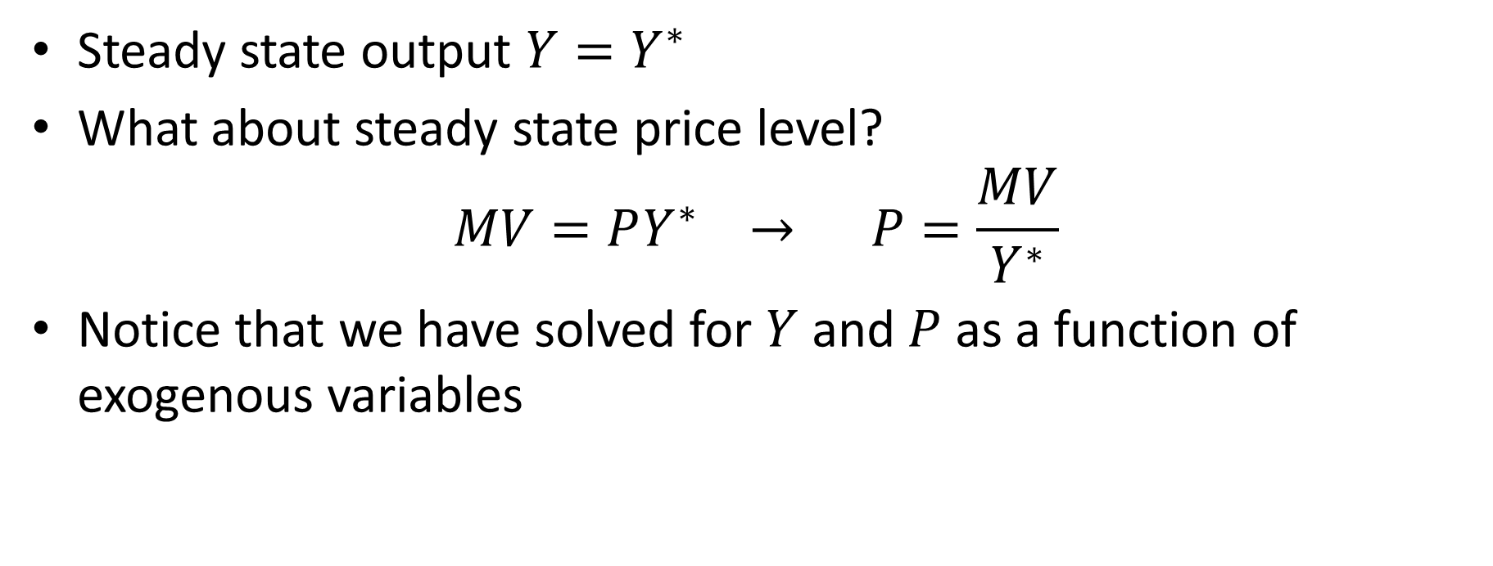
Steady State Before Viking Voyage
Steady state output $Y=Y^{∗}$
What about steady state price level?
$$MV=PY^{∗} → P=\frac{MV}{Y^{∗}}$$
Notice that we have solved for $Y$ and $P$ as a function of exogenous variables

Slide 45
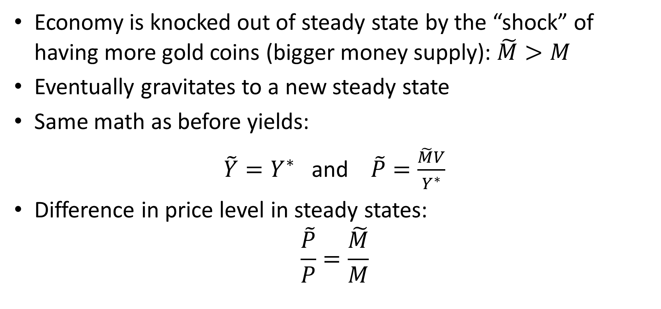
Viking Voyage Raises Money Supply
Economy is knocked out of steady state by the “shock” of having more gold coins (bigger money supply): $\tilde{M}>M$
Eventually gravitates to a new steady state
Same math as before yields:
$\tilde{Y}=Y^{∗}$ and $\tilde{P}=\frac{\tilde{M}V}{Y^{∗}}$
Difference in price level in steady states:
$$\frac{\tilde{P}}{P}=\frac{\tilde{M}}{M}$$

Slide 46
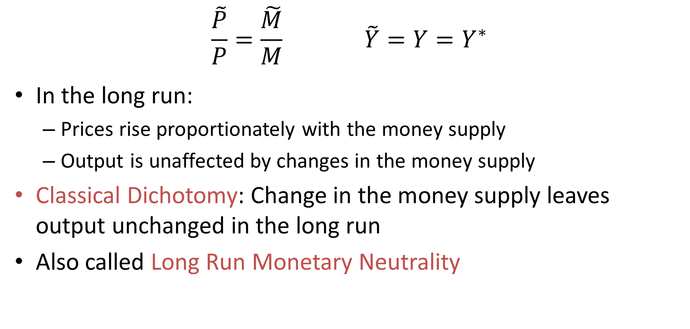
Long-Run Change in Prices
$$\frac{\tilde{P}}{P}=\frac{\tilde{M}}{M} \tilde{Y}=Y=Y^{∗}$$
In the long run:
Prices rise proportionately with the money supply
Output is unaffected by changes in the money supply
Classical Dichotomy: Change in the money supply leaves output unchanged in the long run
Also called Long Run Monetary Neutrality

Slide 47
Long Run Monetary Neutrality
If the money supply doubles, in the long run:
Prices will double
Output unaffected
Why?: Only relative prices matter
Labor supply is a function of “real wage”, i.e., how much stuff you get for working an extra hour
Investment is a function of “real interest rate”, i.e. how much extra stuff you get for lending money
Nominal variables are determined by money supply

Slide 48
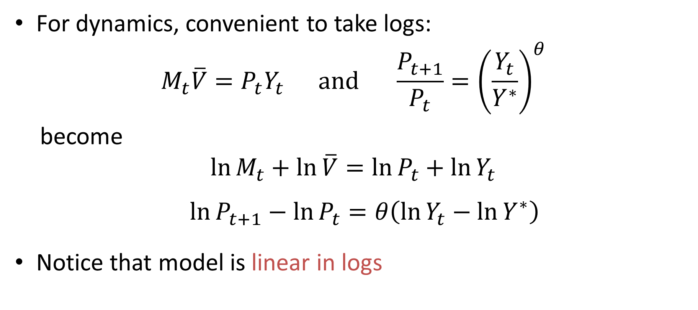
What About the Short Run?
For dynamics, convenient to take logs:
$$M_{t}\overline{V}=P_{t}Y_{t} \text{and} \frac{P_{t+1}}{P_{t}}={\left(\frac{Y_{t}}{Y^{∗}}\right)}^{θ}$$
become
$$\ln{M_{t}}+\ln{\overline{V}}=\ln{P_{t}}+\ln{Y_{t}}$$ $\ln{P_{t+1}}−\ln{P_{t}}=θ\left(\ln{Y_{t}}−\ln{Y^{∗}}\right)$
Notice that model is linear in logs

Slide 49
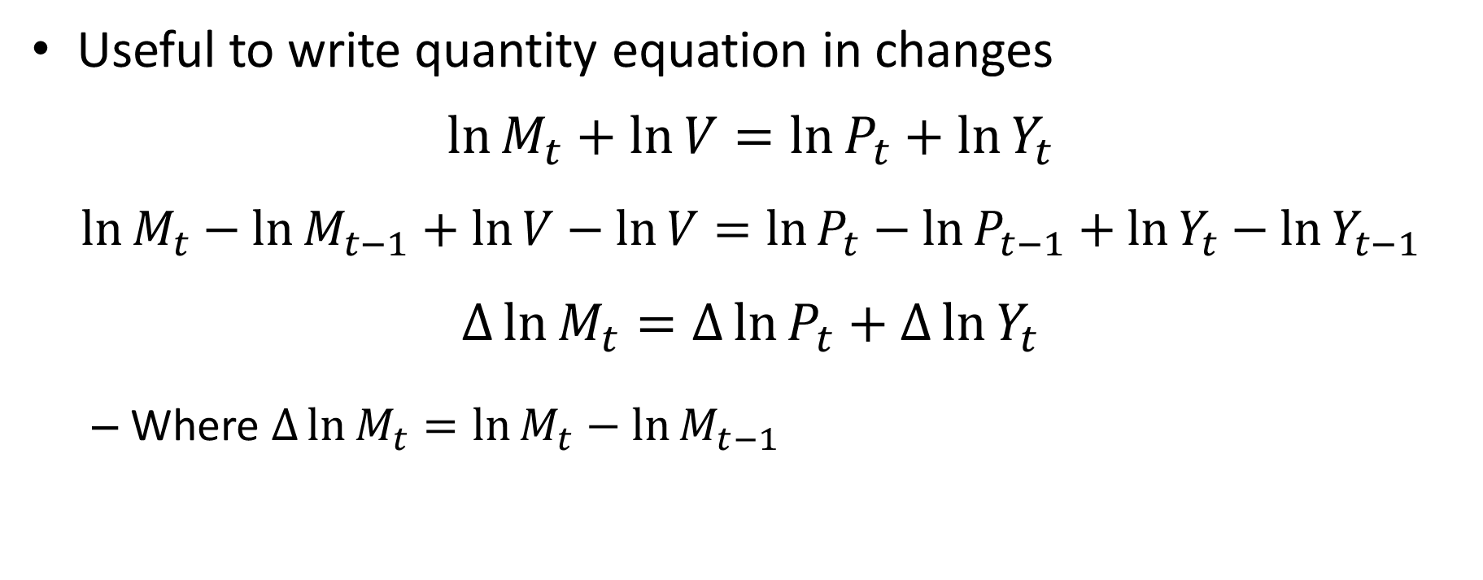
Quantity Equation in Changes
Useful to write quantity equation in changes
$$\ln{M_{t}}+\ln{V}=\ln{P_{t}}+\ln{Y_{t}}$$
$$\ln{M_{t}}−\ln{M_{t−1}}+\ln{V}−\ln{V}=\ln{P_{t}}−\ln{P_{t−1}}+\ln{Y_{t}}−\ln{Y_{t−1}}$$
$$∆\ln{M_{t}}=∆\ln{P_{t}}+∆\ln{Y_{t}}$$
Where $∆\ln{M_{t}}=\ln{M_{t}}−\ln{M_{t−1}}$

Slide 50
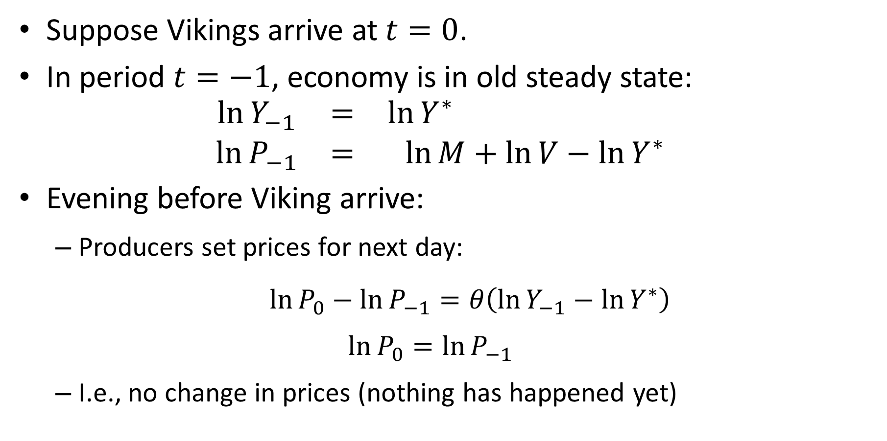
Day Before Arrival of Gold
Suppose Vikings arrive at $t=0$.
In period $t=−1$, economy is in old steady state:
$$\begin{matrix}\ln{Y_{−1}} & = & \ln{Y^{∗}} \\ \ln{P_{−1}} & = & \ln{M}+\ln{V}−\ln{Y^{∗}}\end{matrix}$$
Evening before Viking arrive:
Producers set prices for next day:
$\ln{P_{0}}−\ln{P_{−1}}=θ\left(\ln{Y_{−1}}−\ln{Y^{∗}}\right)$
$$\ln{P_{0}}=\ln{P_{−1}}$$
I.e., no change in prices (nothing has happened yet)

Slide 51
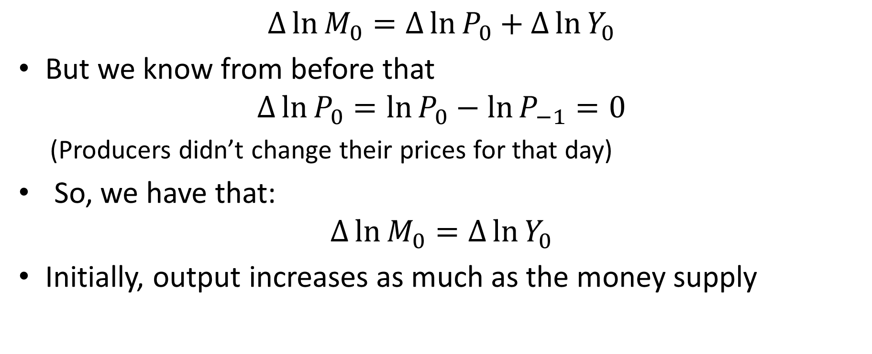
Day Gold Arrives
$$∆\ln{M_{0}}=∆\ln{P_{0}}+∆\ln{Y_{0}}$$
But we know from before that
$$∆\ln{P_{0}}=\ln{P_{0}}−\ln{P_{−1}}=0$$
(Producers didn’t change their prices for that day)
So, we have that:
$$∆\ln{M_{0}}=∆\ln{Y_{0}}$$
Initially, output increases as much as the money supply

Slide 52
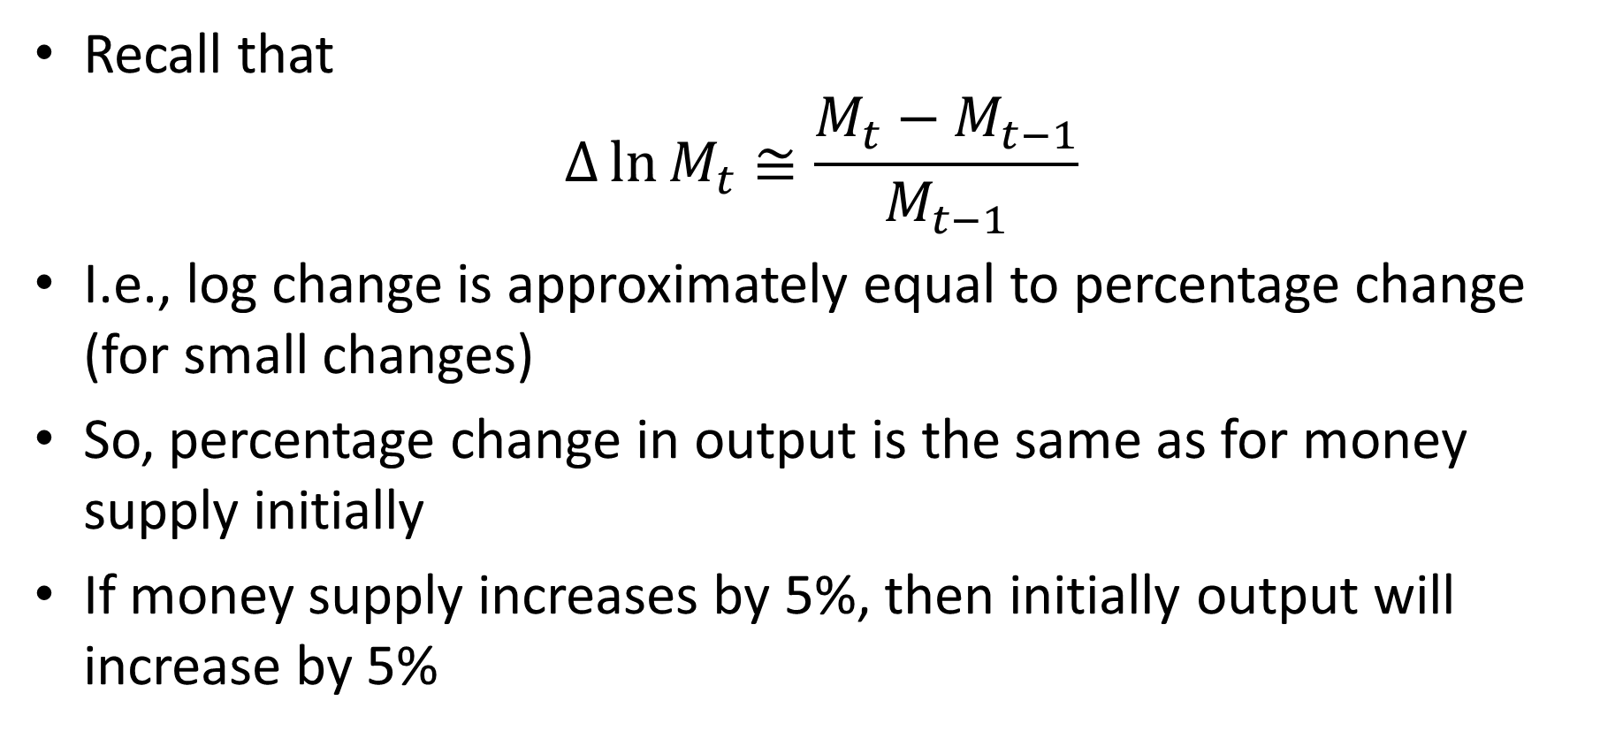
Day Gold Arrives
Recall that
$$∆\ln{M_{t}}≅\frac{M_{t}−M_{t−1}}{M_{t−1}}$$
I.e., log change is approximately equal to percentage change (for small changes)
So, percentage change in output is the same as for money supply initially
If money supply increases by 5%, then initially output will increase by 5%

Slide 53
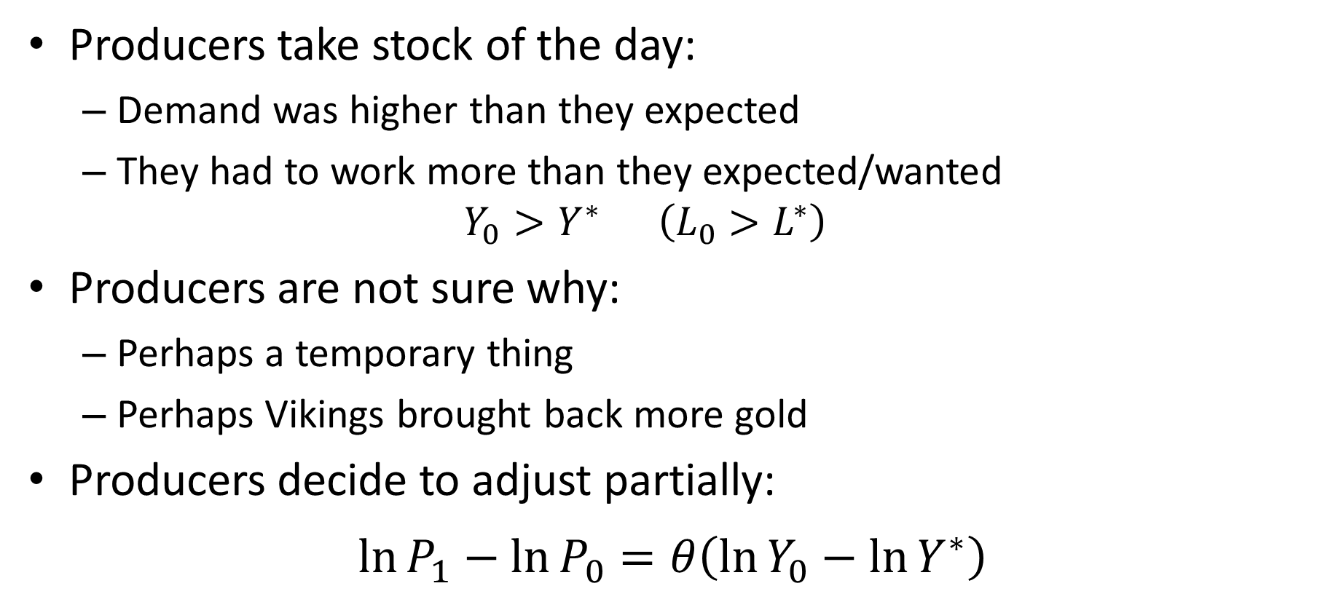
Evening of Day Gold Arrives
Producers take stock of the day:
Demand was higher than they expected
They had to work more than they expected/wanted
$$Y_{0}>Y^{∗} \left(L_{0}>L^{∗}\right)$$
Producers are not sure why:
Perhaps a temporary thing
Perhaps Vikings brought back more gold
Producers decide to adjust partially:
$$\ln{P_{1}}−\ln{P_{0}}=θ\left(\ln{Y_{0}}−\ln{Y^{∗}}\right)$$

Slide 54
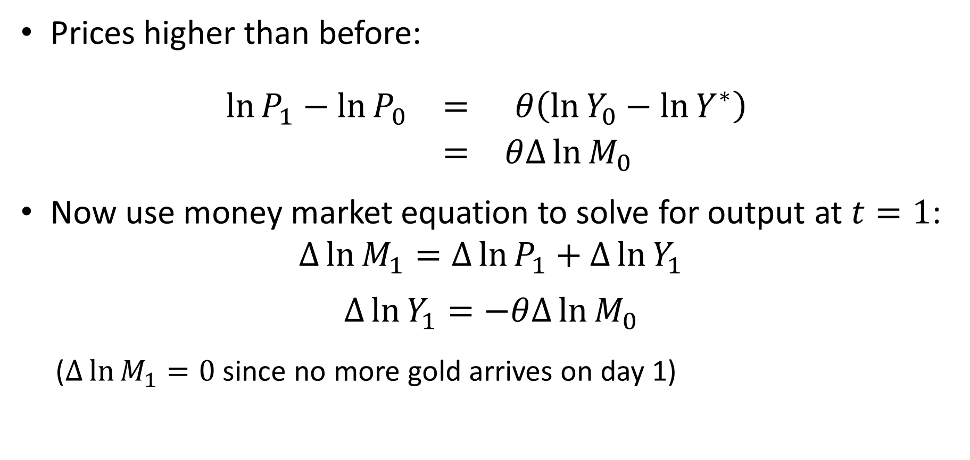
Next Day
Prices higher than before:
$$\begin{matrix}\ln{P_{1}}−\ln{P_{0}} & = & θ\left(\ln{Y_{0}}−\ln{Y^{∗}}\right) \\ & = & θ∆\ln{M_{0}} \end{matrix}$$
Now use money market equation to solve for output at $t=1$: $∆\ln{M_{1}}=∆\ln{P_{1}}+∆\ln{Y_{1}}$
$$∆\ln{Y_{1}}=−θ∆\ln{M_{0}}$$
($∆\ln{M_{1}}=0$ since no more gold arrives on day 1)

Slide 55
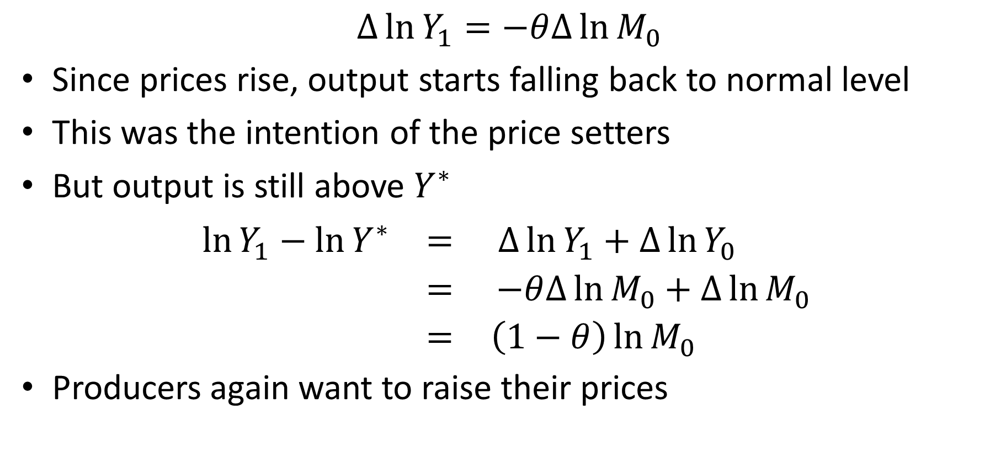
Next Day
$$∆\ln{Y_{1}}=−θ∆\ln{M_{0}}$$
Since prices rise, output starts falling back to normal level
This was the intention of the price setters
But output is still above $Y^{∗}$
$$\begin{matrix}\ln{Y_{1}}−\ln{Y^{∗}} & = & ∆\ln{Y_{1}}+∆\ln{Y_{0}} \\ & = & −θ∆\ln{M_{0}}+∆\ln{M_{0}} \\ & = & \left(1−θ\right)\ln{M_{0}} \end{matrix}$$
Producers again want to raise their prices

Slide 56

Dynamics over Time
We can use equations:
$$\ln{M_{t}}+\ln{\overline{V}}=\ln{P_{t}}+\ln{Y_{t}}$$ $\ln{P_{t+1}}−\ln{P_{t}}=θ\left(\ln{Y_{t}}−\ln{Y^{∗}}\right)$
to trace out dynamics over time

Slide 57
Dynamics of Economy after Bounty Arrives

Slide 58
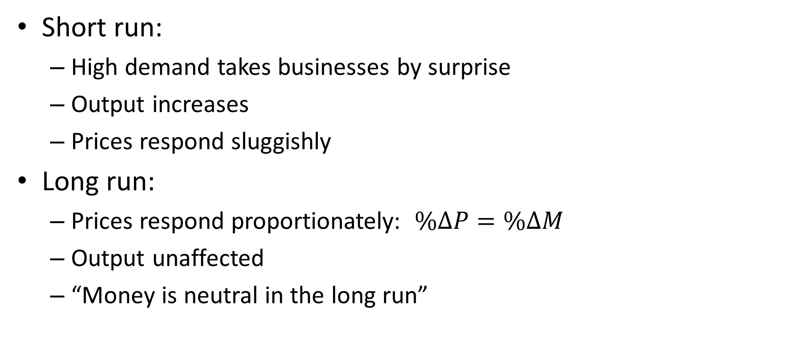
Response to Monetary Shock in Medieval Economy
Short run:
High demand takes businesses by surprise
Output increases
Prices respond sluggishly
Long run:
Prices respond proportionately: $\%∆P=\%∆M$
Output unaffected
“Money is neutral in the long run”

Slide 59
Did the Gold Plunder Make People Better Off?
In the short run?
Boom in output
But they had to work more to create the output
Actually, they worked more than they wanted
In the long run?
Output the same as before
Prices higher
Striking gold is good for the individual but perhaps not for society as a whole.

Slide 60
Change in the Supply of Gold Coins
Neoclassical Economics:
All prices rise immediately (by same fraction as money supply)
Output unchanged
Money “neutral” (no effect on output)
Keynesian Economics:
Prices slow to react
Output responds to monetary shocks

Slide 61
Three Historical Episodes
The Price Revolution
The Big Problem of Small Change
The Crime of 1873

Slide 62
Does Gold have Stable Value?
Gold and silver were used as money for many centuries in large parts of the world
Today most countries opperate fiat currencies
I.e., currencies not backed by anything
Many people say we should return to the gold standard today!
Argue that this will yield a currency with more stable value
Key question:
Did gold and silver have stable value?

Slide 63
Price Level in England 1200-1490
Source: Allen (2001)

Slide 64
Price Revolution
Source: Allen (2001)

Slide 65
American Treasure
In metric tons of silver. Glassman and Redish (1985) estimate stock of gold and silver
In Europe in 1492 to be worth about 3,500 metric tons of silver

Slide 66
Popular Culprits for Inflation
During Price Revolution, many believe inflation is due to:
Middlemen, speculators, and monopoly profits
Such discussion often fails to understand difference between one particlar price being high and the overall price level being high
Monopoly power leads to a high relative price of a paricular product, not a high overall price level

Slide 67
Debasement of Sterling
Source: Allen (2001)

Slide 68
The Big Problem of Small Change
Important challenge:
How to maintain coins of different value in circulation simultaneously
Silver coins:
(Reasonably) good for everyday transactions
Bulky for merchant trade
Gold coins:
Way too valuable for everyday transactions
Good for merchant trade

Slide 69
Bimetallism
Bimetallism is a monetary system based on a combination of silver and gold coins
Benefit: Coins with a wide range of value
Drawback: Difficult to maintain silver and gold coins in circulation simultaneously
Why difficult?

Slide 70
Difficulties with Bimetallism
Two reasons why it was difficult to maintain gold and silver coins in circulation simultaneously:
The relative price of silver vs. gold changed over time
Silver coins were clipped and got worn (silver content fell)
Suppose market price of gold for silver is 13 (i.e., 13g of silver buy 1g of gold)
If silver and gold coins are minted with this weight ratio, both will circulate

Slide 71
Undervalued Coins
Suppose market price of gold rises to 14-to-1 vs. silver
Gold becomes “undervalued” at the Mint
You get 13 pennies per gram of gold at the Mint
You get 14 pennies worth of silver per gram of gold on the market!
Consequence:
No one brings gold to the Mint
Gold coins start being exported / melted down
Eventually no more gold coins!

Slide 72
Undervalued Coins
Another problem:
Silver coins are clipped or get worn
Silver coins no longer 1g. Rather (say) 0.8g
Consequences:
Profitable to create counterfeit “worn” coins (i.e., 0.8g coins)
Value of coins falls to reflect lower weight
But then market price of silver in pence rises above price at the mint
New silver coins become undervalued at the Mint
Eventually sovereign decides to debase

Slide 73
Big Problem of Small Change
Huge problem for hundreds of years
One example: In 1717 Isaac Newton as Master of the Mint, overvalued gold coins (undervalued silver coins)
Consequence: Chronic shortage of small change (silver coins) in Britain throughout 18th century

Slide 74
Big Problem of Small Change
Solution: Adopt token coins
I.e., coins worth more than their metallic content
Britain did this first in 1816 (U.S. in 1853, France in 1865)
Why not earlier?
Widespread metallist fallacy
Needed high quality coins to avoid counterfeiting
Needed government to guarantee value of coins

Slide 75
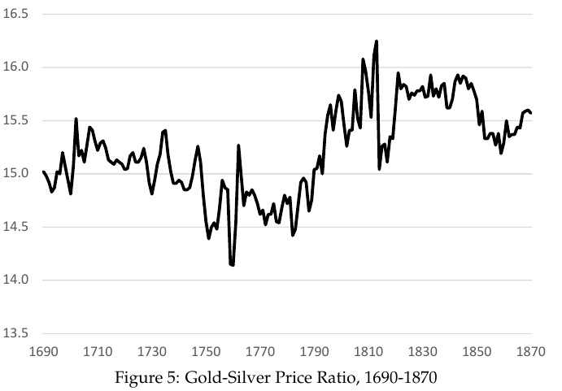
Money in America
U.S. on a bimetallic standard from 1792 until Civil War
Until 1834: Gold-silver ratio at U.S. Mint 15-1 (gold undervalued)
After 1834: Gold-silver ratio at U.S. Mint 16-1 (silver undervalued)
Free coinage: U.S. Mint stands ready to convert all specie (gold and silver) individuals bring to the mint into legal-tender coins

Slide 76
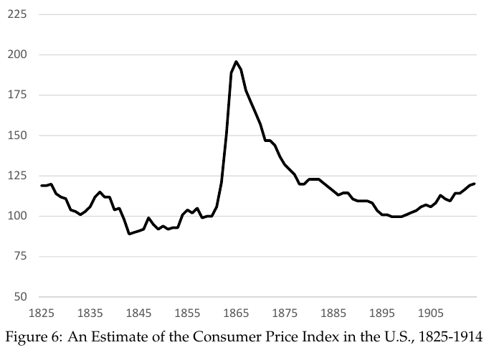
The Civil War
Enormous government spending on the war
How to finance this spending?
U.S. introduced government paper money: “Greenbacks”
Paid soldiers and paid for war materials with greenbacks
Greenbacks had no gold or silver backing
No explicit promise of redemption in specie

Slide 77
Back to a Gold Standard
Wartime inflation doubled price level (in Greenbacks)
After war: Widespread desire to return to a commodity standard (“sound money”)
Many people think:
We went off the gold standard and we had a lot of inflation. So, being off gold standard causes inflation.
Is this a sound argument?

Slide 78
Back to Gold Standard
Resumption Act of 1875:
Full convertibility of paper money into gold and vice-versa (at pre-war rate)
Should take place Jan 1, 1879
Many other countries adopted gold at similar time
Britain (de facto 1717)
France (1865), Germany (1873)
1870s-1914: International Gold Standard

Slide 79
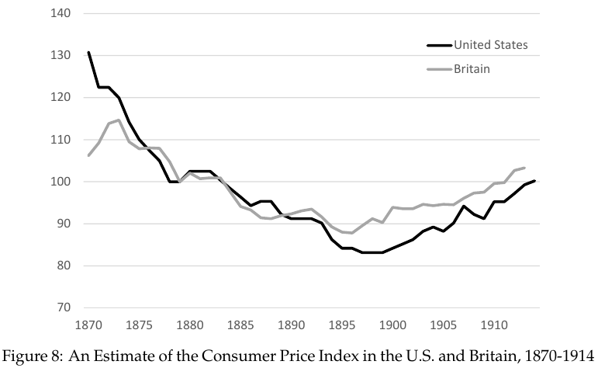
U.S. Experience on the Gold Standard
U.S. goes back on the gold standard in 1879
Does this yield price stability
Actually, huge deflation!
Why?

Slide 80
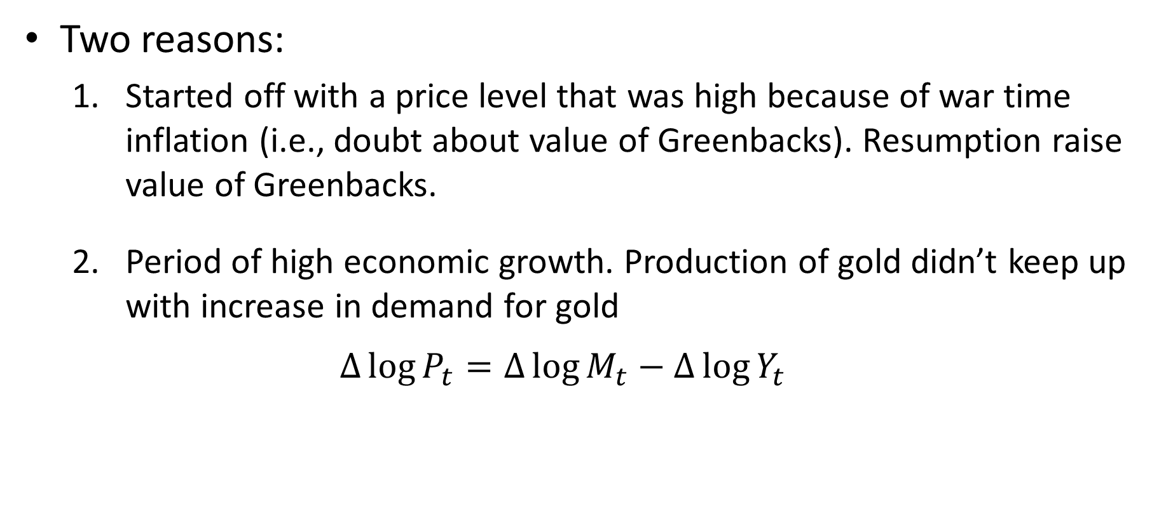
U.S. Experience with Gold Standard
Two reasons:
Started off with a price level that was high because of war time inflation (i.e., doubt about value of Greenbacks). Resumption raise value of Greenbacks.
Period of high economic growth. Production of gold didn’t keep up with increase in demand for gold
$$∆\log{P_{t}}=∆\log{M_{t}}−∆\log{Y_{t}}$$

Slide 81
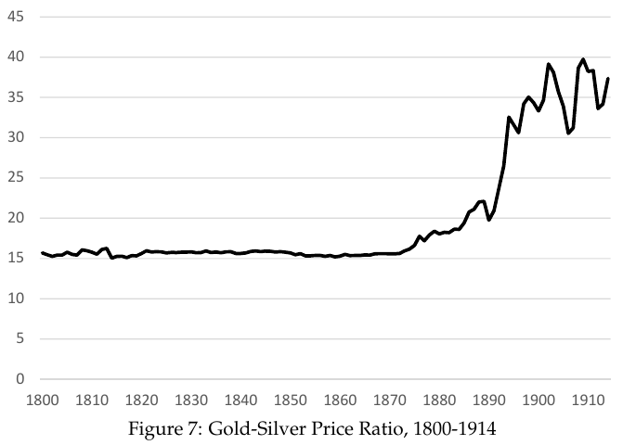
Politics of U.S. Gold Standard
Persistent deflation. Largely unanticipated.
How did this matter? Who gains and looses?
Good for creditors (bankers in New York)
Bad for debtors (farmers)
“Crime” of 1873?
Demonetization of silver
Value of silver fell dramatically in 1880s

Slide 82
Crime of 1873
What difference did this make?
U.S. likely would have switched to a silver standard if not for “crime” of 1873
This would have reduced/eliminated deflation
Perhaps even lead to substantial inflation
Although this is not clear since U.S. being on silver standard would have changes demand for silver and raised its price relative to what happened

Slide 83
Politics of U.S. Gold Standard
Deflation implied that monetary policy was the major election issue in the presidential election of 1896
William Jennings Bryan: “You shall not crucify mankind upon a cross of gold”
Bryan lost. Lost by bigger margin in 1900.
Movement petered out
What solved the “problem”?

Slide 84
From Deflation to Inflation
Large discoveries of gold in South Africa
Invention of cyanide process for extracting gold from low-grade ore
William Jennings Bryan’s presidential hopes were undone by Scottish chemists and S. African miners

Slide 85
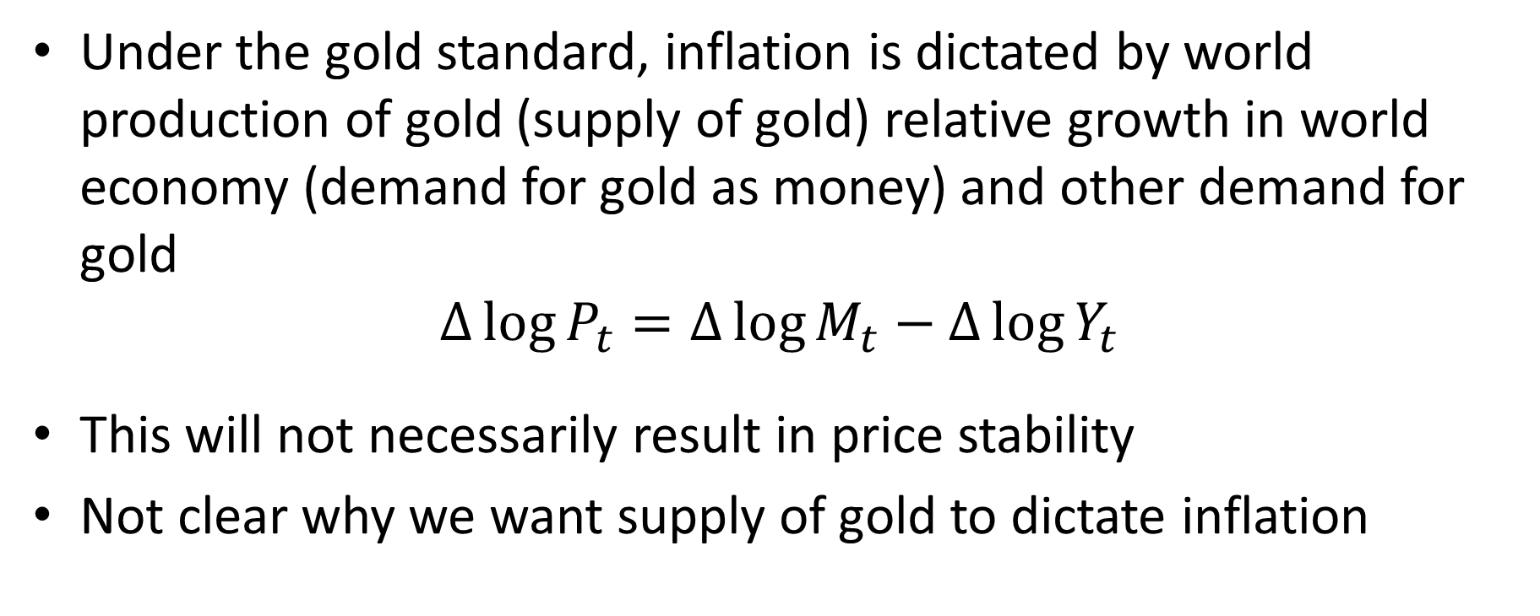
Lesson About Gold Standard
Under the gold standard, inflation is dictated by world production of gold (supply of gold) relative growth in world economy (demand for gold as money) and other demand for gold
$$∆\log{P_{t}}=∆\log{M_{t}}−∆\log{Y_{t}}$$
This will not necessarily result in price stability
Not clear why we want supply of gold to dictate inflation

