Slide 1
Production
Jón Steinsson
University of California, Berkeley

Slide 2
A Model of Production
Economists use mathematical models to describe and understand the world
In this lecture, we take our first steps in this direction

Slide 3
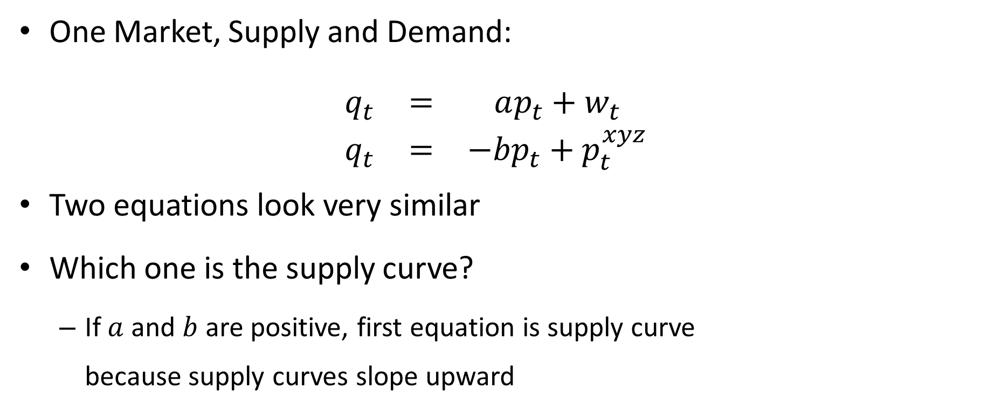
Simple Canonical Model
One Market, Supply and Demand:
$$\begin{matrix}q_{t} & = & ap_{t}+w_{t} \\ q_{t} & = & −bp_{t}+p_{t}^{xyz}\end{matrix}$$
Two equations look very similar
Which one is the supply curve?
If $a$ and $b$ are positive, first equation is supply curve because supply curves slope upward

Slide 4
Components of a Model
Endogenous variables
Exogenous variables and parameters
Equations that relate these variable to each other

Slide 5
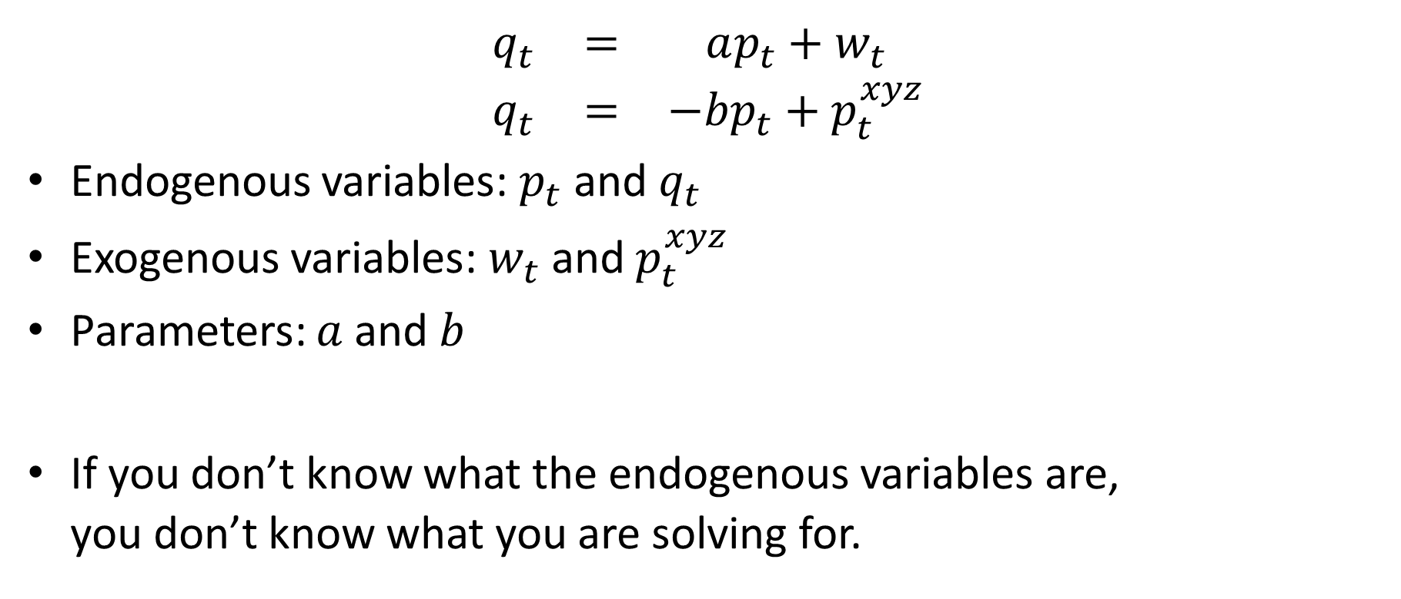
Components of a Model
$$\begin{matrix}q_{t} & = & ap_{t}+w_{t} \\ q_{t} & = & −bp_{t}+p_{t}^{xyz}\end{matrix}$$
Endogenous variables: $p_{t}$ and $q_{t}$
Exogenous variables: $w_{t}$ and $p_{t}^{xyz}$
Parameters: $a$ and $b$
If you don’t know what the endogenous variables are, you don’t know what you are solving for.

Slide 6
General Equilibrium Model
In macro, we usually study general equilibrium models
A model is a general equilibrium model if price and quantity in all markets are endogenous variables
Today we will study our first general equilibrium model with three markets:
Labor market, capital market, goods market

Slide 7
Roadmap
Simple general equilibrium models will consist of:
Demand and supply curves for each market
Important caveat #1: Only relative prices matter
This implies that we can set one of the prices equal to 1
We call this the numeraire
Important caveat #2: Walras’ Law
If all but one market is in equilibrium, then the last one is necessarily also in equilibrium.
This implies that we only need to write down equations for all but one of the markets

Slide 8
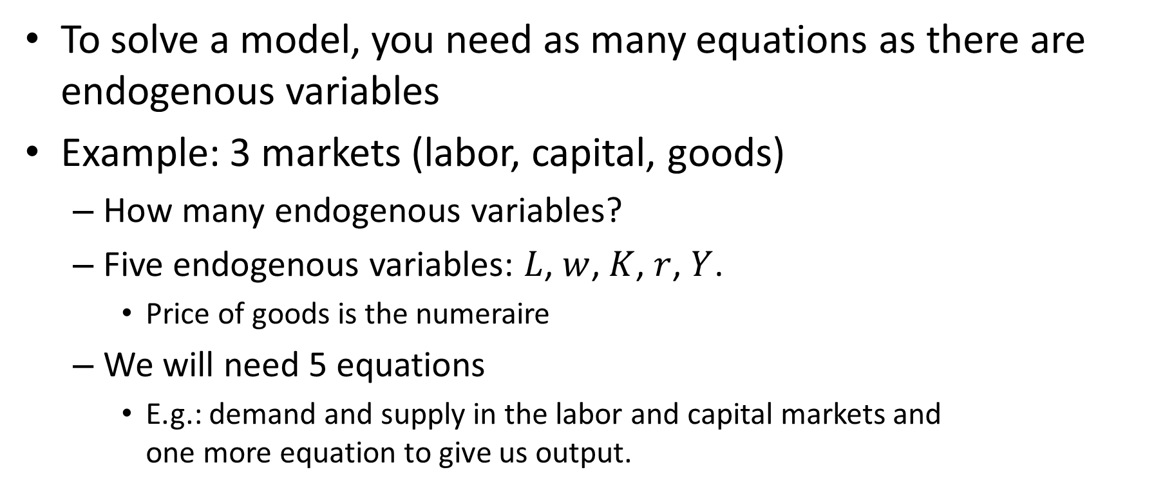
Roadmap
To solve a model, you need as many equations as there are endogenous variables
Example: 3 markets (labor, capital, goods)
How many endogenous variables?
Five endogenous variables: $L$, $w$, $K$, $r$, $Y$.
Price of goods is the numeraire
We will need 5 equations
E.g.: demand and supply in the labor and capital markets and one more equation to give us output.

Slide 9
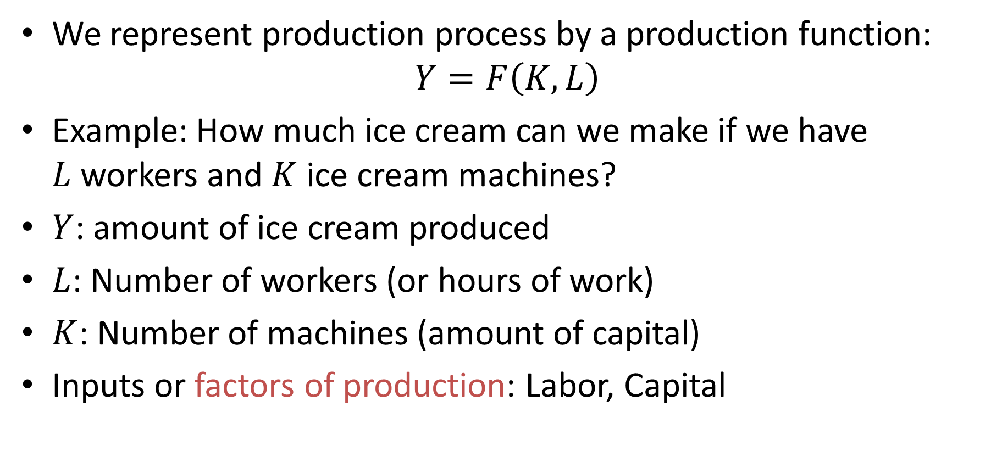
Production Function
We represent production process by a production function:
$$Y=F\left(K,L\right)$$
Example: How much ice cream can we make if we have $L$ workers and $K$ ice cream machines?
$Y$: amount of ice cream produced
$L$: Number of workers (or hours of work)
$K$: Number of machines (amount of capital)
Inputs or factors of production: Labor, Capital

Slide 10
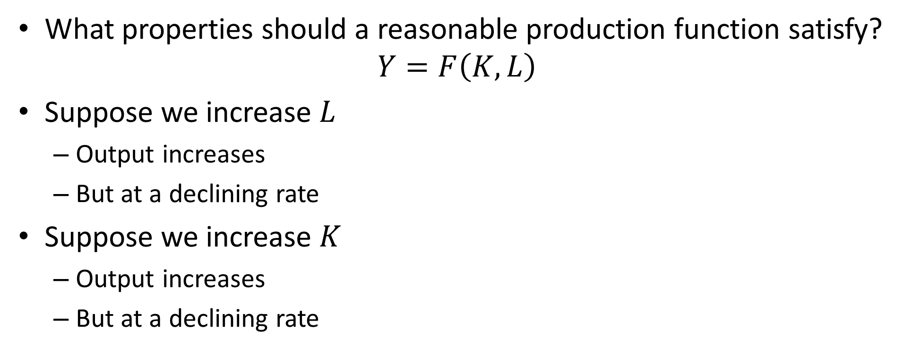
Properties of Production Functions
What properties should a reasonable production function satisfy?
$$Y=F\left(K,L\right)$$
Suppose we increase $L$
Output increases
But at a declining rate
Suppose we increase $K$
Output increases
But at a declining rate

Slide 11
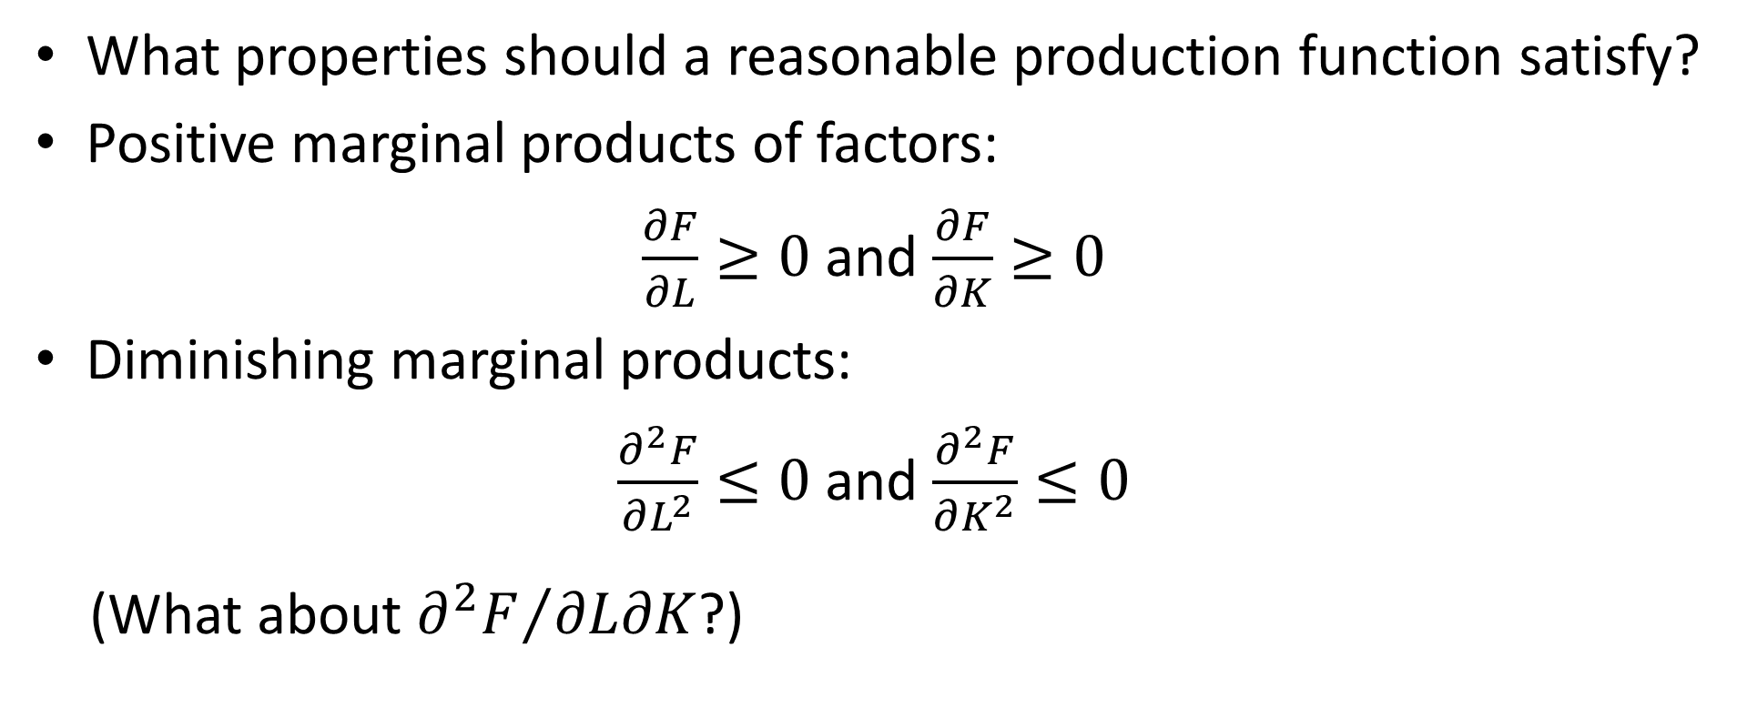
Properties of Production Functions
What properties should a reasonable production function satisfy?
Positive marginal products of factors:
$\frac{∂F}{∂L}≥0$ and $\frac{∂F}{∂K}≥0$
Diminishing marginal products:
$\frac{∂^{2}F}{∂L^{2}}≤0$ and $\frac{∂^{2}F}{∂K^{2}}≤0$
(What about ${∂^{2}F}/{∂L∂K}$?)

Slide 12
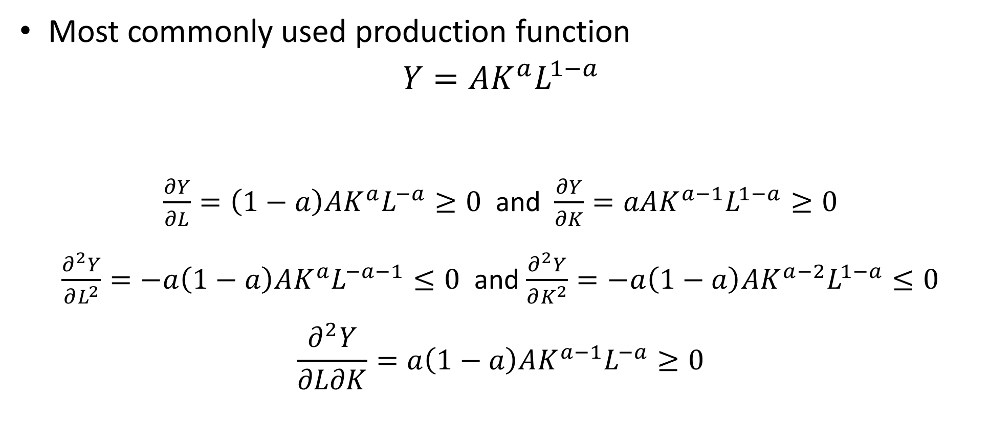
Cobb-Douglas Production Function
Most commonly used production function
$$Y=AK^{a}L^{1−a}$$
$\frac{∂Y}{∂L}=\left(1−a\right)AK^{a}L^{−a}≥0$ and $\frac{∂Y}{∂K}=aAK^{a−1}L^{1−a}≥0$
$\frac{∂^{2}Y}{∂L^{2}}=−a\left(1−a\right)AK^{a}L^{−a−1}≤0$ and $\frac{∂^{2}Y}{∂K^{2}}=−a\left(1−a\right)AK^{a−2}L^{1−a}≤0$
$$\frac{∂^{2}Y}{∂L∂K}=a\left(1−a\right)AK^{a−1}L^{−a}≥0$$

Slide 13
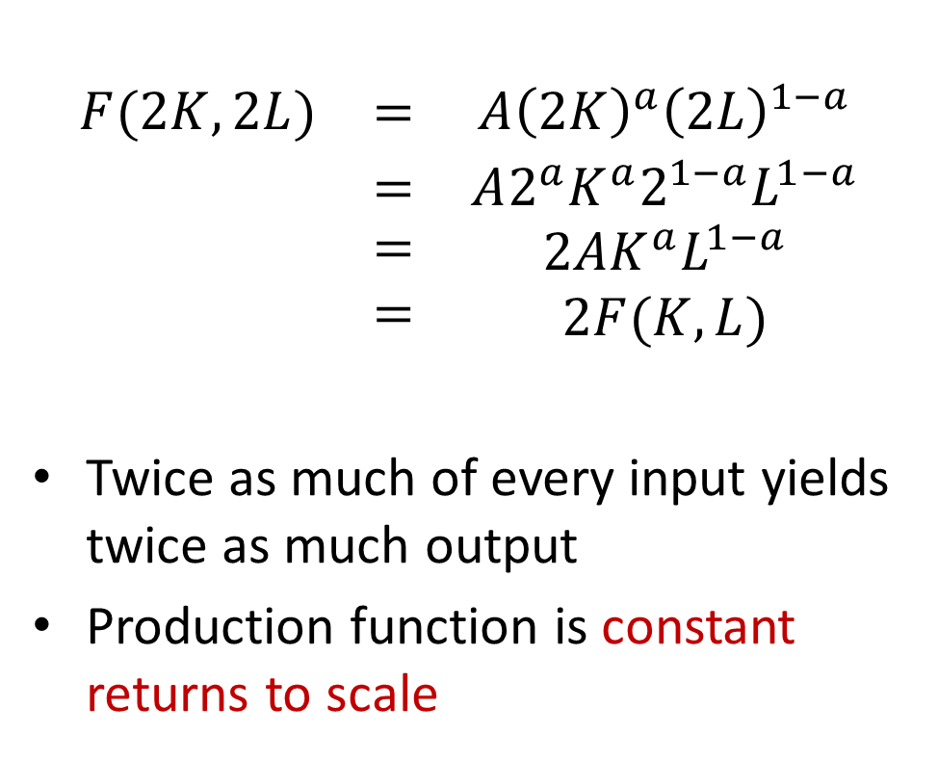
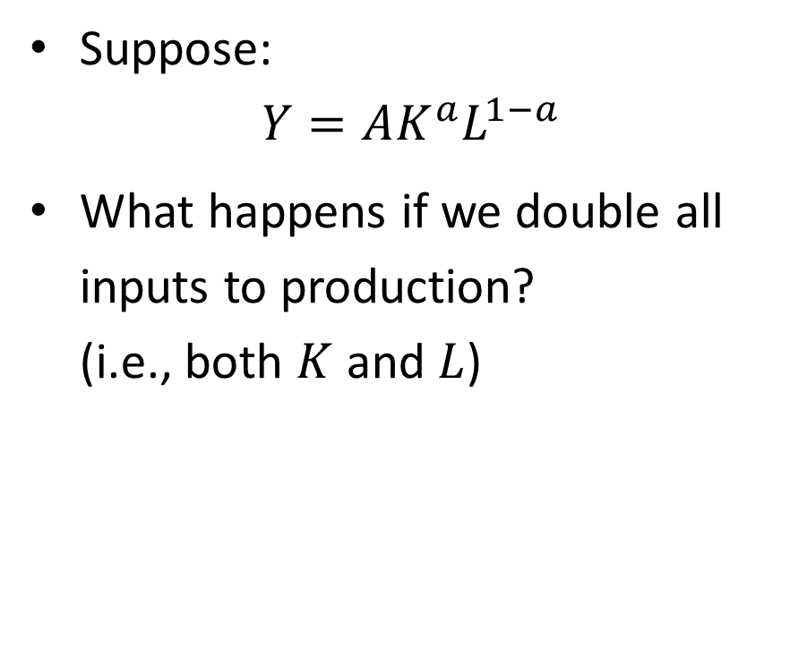
Returns to Scale
Suppose:
$$Y=AK^{a}L^{1−a}$$
What happens if we double all inputs to production? (i.e., both $K$ and $L$)
$$\begin{matrix}F(2K,2L) & = & A{\left(2K\right)}^{a}{\left(2L\right)}^{1−a} \\ & = & A2^{a}K^{a}2^{1−a}L^{1−a} \\ \begin{matrix} \\ \end{matrix} & \begin{matrix}= \\ =\end{matrix} & \begin{matrix}2AK^{a}L^{1−a} \\ 2F(K,L)\end{matrix}\end{matrix}$$
Twice as much of every input yields twice as much output
Production function is constant returns to scale

Slide 14
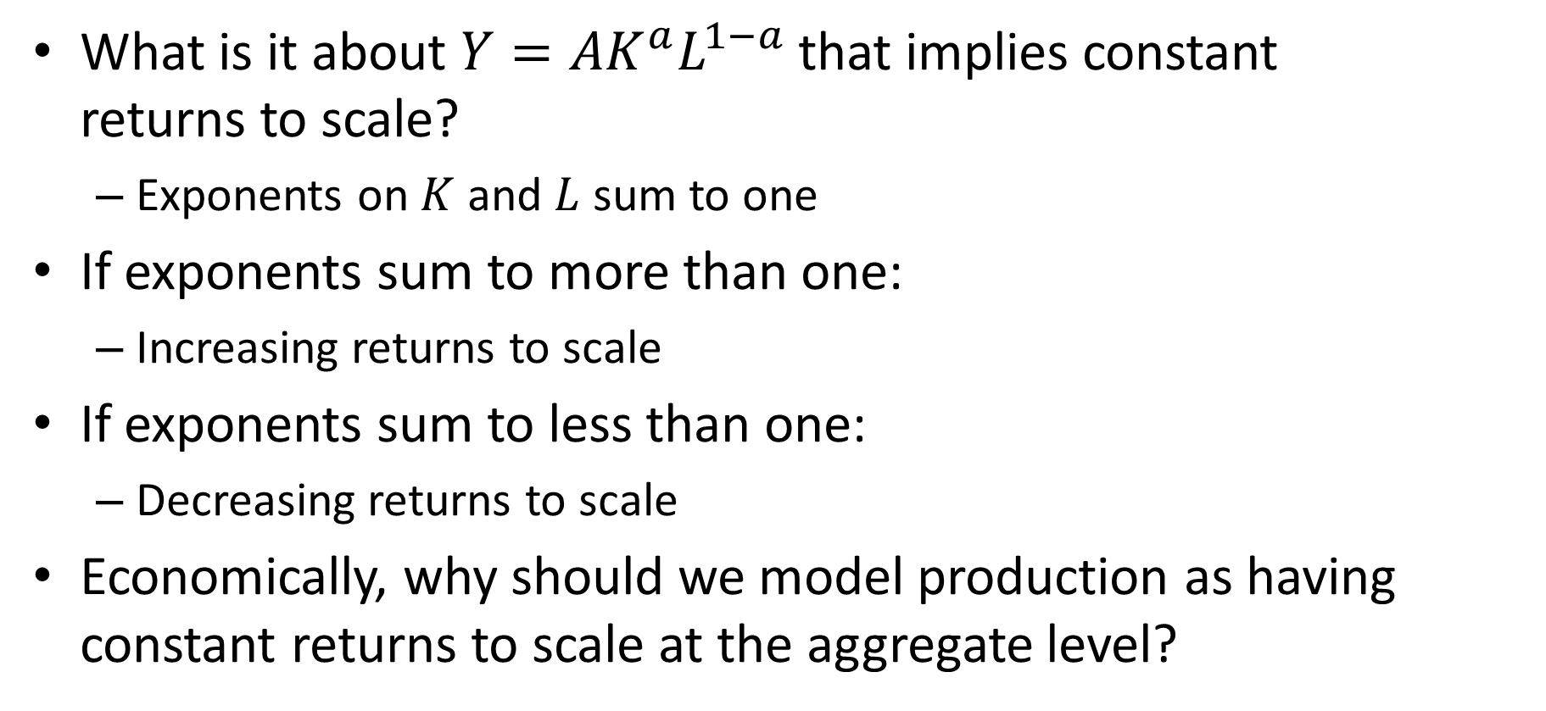
Returns to Scale
What is it about $Y=AK^{a}L^{1−a}$ that implies constant returns to scale?
Exponents on $K$ and $L$ sum to one
If exponents sum to more than one:
Increasing returns to scale
If exponents sum to less than one:
Decreasing returns to scale
Economically, why should we model production as having constant returns to scale at the aggregate level?

Slide 15
Replication Argument
Replication argument:
If you build two identical factories. You should get twice as much output as from one.
Counter-arguments?
Micro level scale economies that are not fully exhausted
Fixed factors: Some inputs cannot be doubled. E.g., land.
Not strictly speaking about the production function itself.
But has similar implications (diminishing returns to remaining factors)
Externalities: There may be either positive or negative spillovers between factories.

Slide 16
Behavior of Firms
How should we model the behavior of firms?
Usual assumptions in economics:
Individuals maximize utility
Firms maximize profits
Tricky for firms. … What is a firm?
Shareholders put up money and “own” the firm
Managers hired by shareholders
Employees hired by managers
Money borrowed from creditors
Conflicts of interest left and right!!

Slide 17
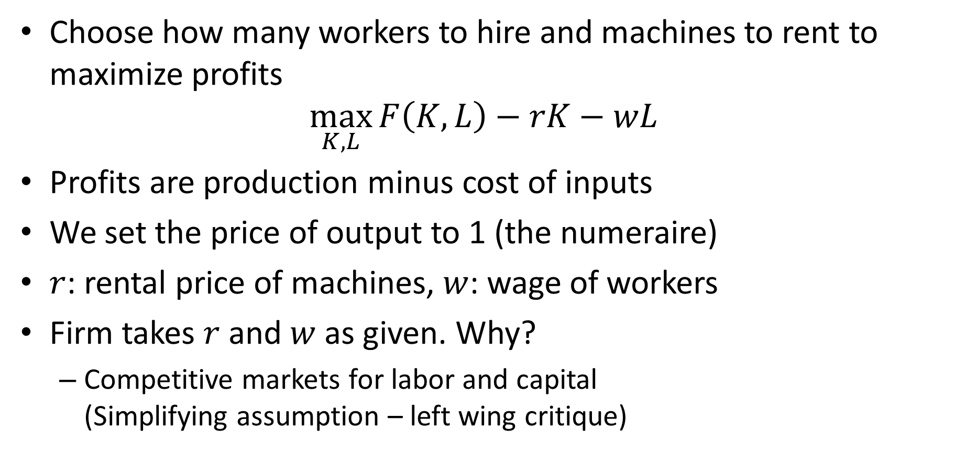
Firm’s Problem
Choose how many workers to hire and machines to rent to maximize profits
$$\max_{K,L}{F\left(K,L\right)−rK−wL}$$
Profits are production minus cost of inputs
We set the price of output to 1 (the numeraire)
$r$: rental price of machines, $w$: wage of workers
Firm takes $r$ and $w$ as given. Why?
Competitive markets for labor and capital (Simplifying assumption – left wing critique)

Slide 18
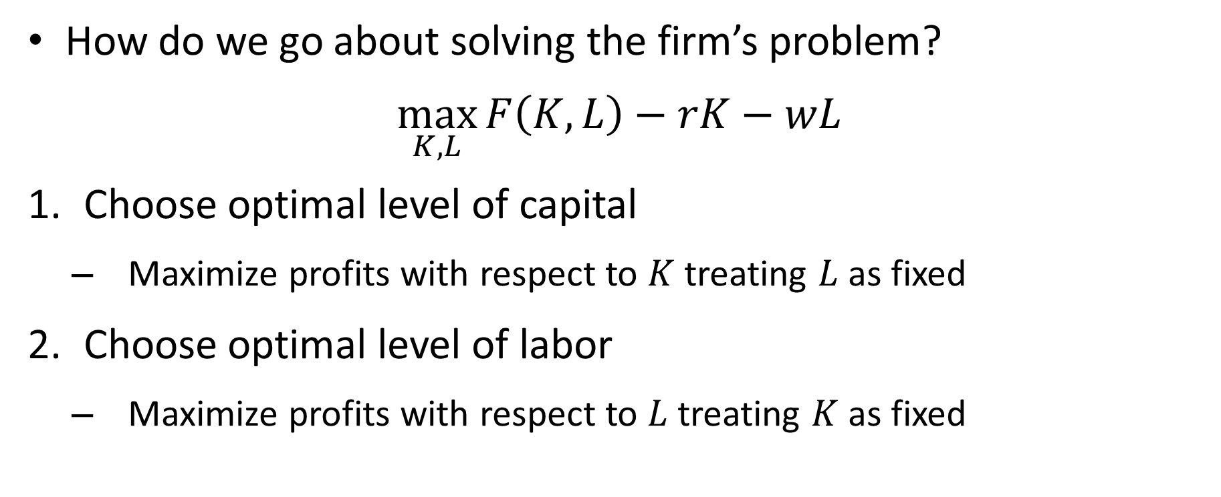
Firm’s Problem: Solution
How do we go about solving the firm’s problem?
$$\max_{K,L}{F\left(K,L\right)−rK−wL}$$
Choose optimal level of capital
Maximize profits with respect to $K$ treating $L$ as fixed
Choose optimal level of labor
Maximize profits with respect to $L$ treating $K$ as fixed

Slide 19
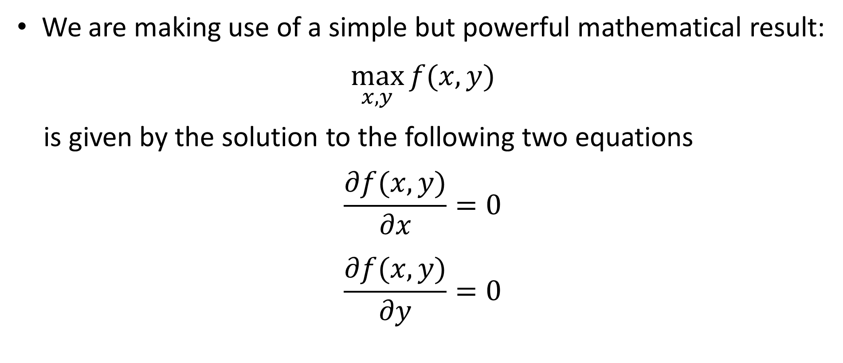
Firm’s Problem: Solution
We are making use of a simple but powerful mathematical result:
$$\max_{x,y}{f(x,y)}$$
is given by the solution to the following two equations
$$\frac{∂f(x,y)}{∂x}=0$$
$$\frac{∂f(x,y)}{∂y}=0$$

Slide 20

Firm’s Problem: Solution
$$\max_{K,L}{F\left(K,L\right)−rK−wL}$$
We start by plugging in for $F\left(K,L\right)$:
$$\max_{K,L}{AK^{a}L^{1−a}−rK−wL}$$

Slide 21
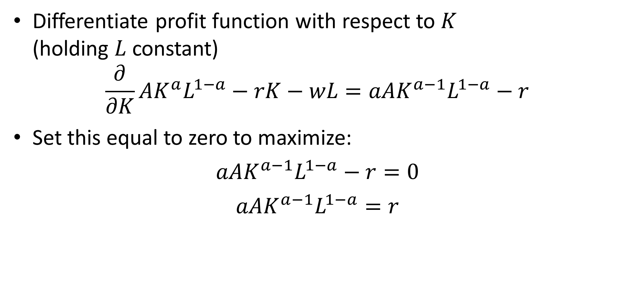
Optimal Choice of Capital by Firm
Differentiate profit function with respect to $K$ (holding $L$ constant)
$$\frac{∂}{∂K}AK^{a}L^{1−a}−rK−wL=aAK^{a−1}L^{1−a}−r$$
Set this equal to zero to maximize:
$$aAK^{a−1}L^{1−a}−r=0$$
$$aAK^{a−1}L^{1−a}=r$$

Slide 22
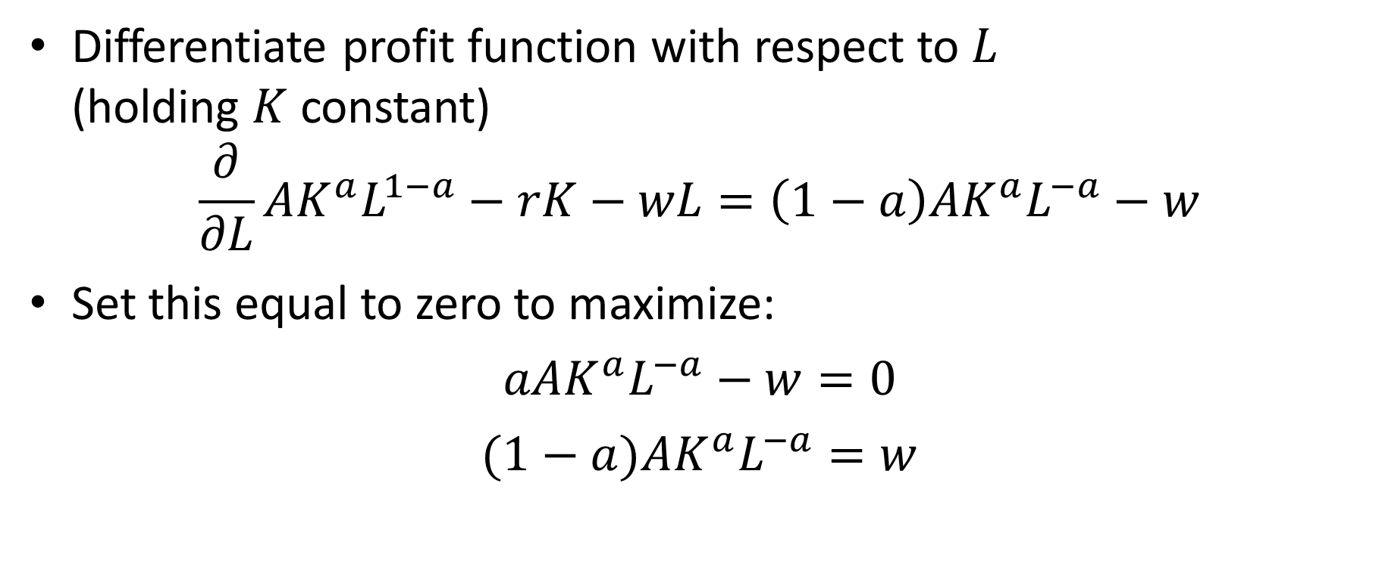
Optimal Choice of Labor by Firm
Differentiate profit function with respect to $L$ (holding $K$ constant)
$$\frac{∂}{∂L}AK^{a}L^{1−a}−rK−wL=\left(1−a\right)AK^{a}L^{−a}−w$$
Set this equal to zero to maximize:
$$aAK^{a}L^{−a}−w=0$$
$$(1−a)AK^{a}L^{−a}=w$$

Slide 23
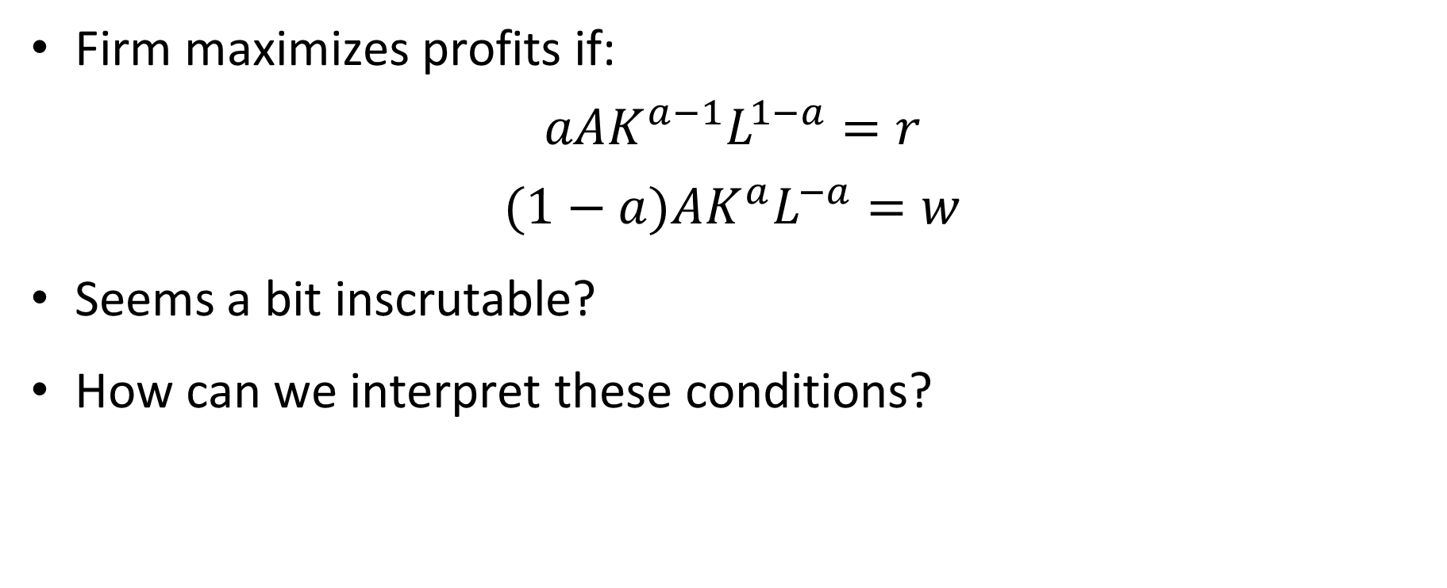
Firm’s Problem: Solution
Firm maximizes profits if:
$$aAK^{a−1}L^{1−a}=r$$
$$(1−a)AK^{a}L^{−a}=w$$
Seems a bit inscrutable?
How can we interpret these conditions?

Slide 24
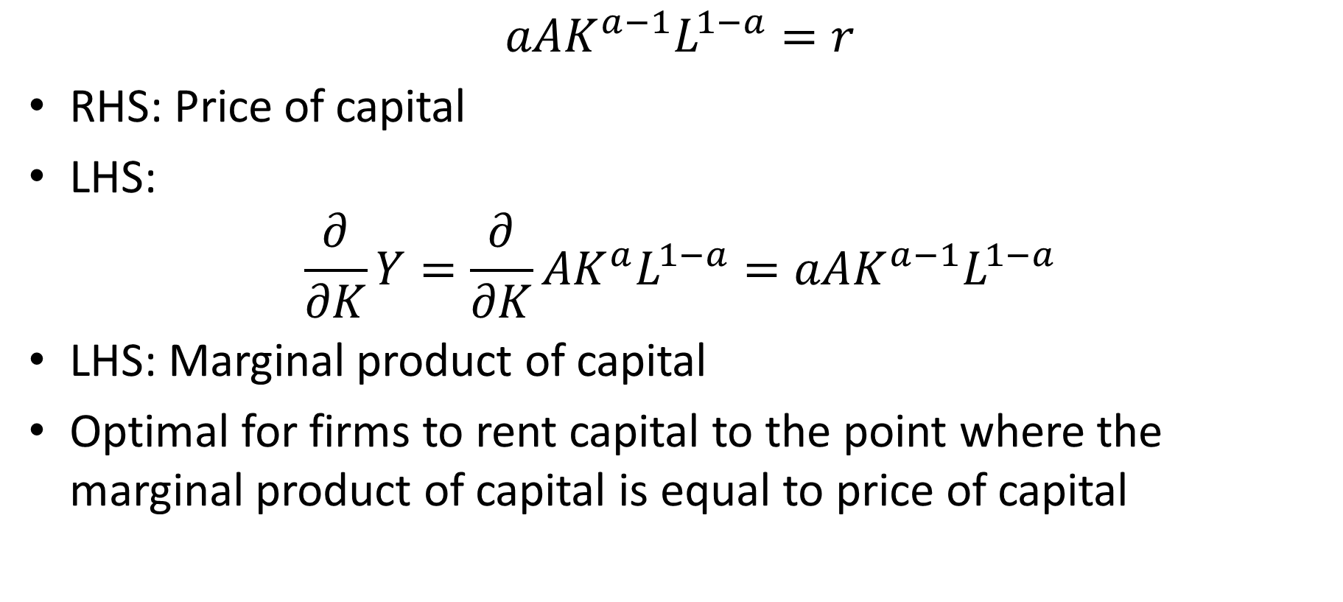
Firm’s Optimal Choice of Capital
$$aAK^{a−1}L^{1−a}=r$$
RHS: Price of capital
LHS:
$$\frac{∂}{∂K}Y=\frac{∂}{∂K}AK^{a}L^{1−a}=aAK^{a−1}L^{1−a}$$
LHS: Marginal product of capital
Optimal for firms to rent capital to the point where the marginal product of capital is equal to price of capital

Slide 25
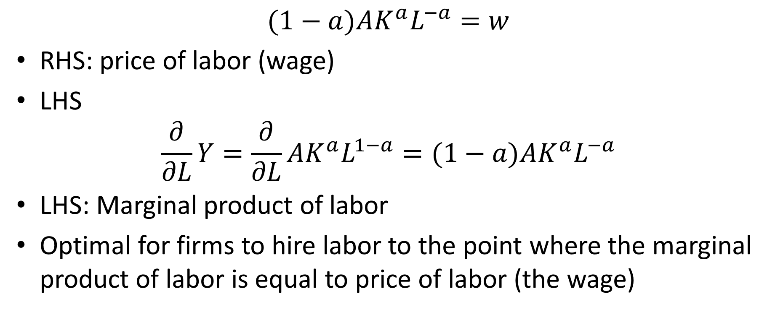
Firm’s Optimal Choice of Labor
$$(1−a)AK^{a}L^{−a}=w$$
RHS: price of labor (wage)
LHS
$$\frac{∂}{∂L}Y=\frac{∂}{∂L}AK^{a}L^{1−a}=(1−a)AK^{a}L^{−a}$$
LHS: Marginal product of labor
Optimal for firms to hire labor to the point where the marginal product of labor is equal to price of labor (the wage)

Slide 26
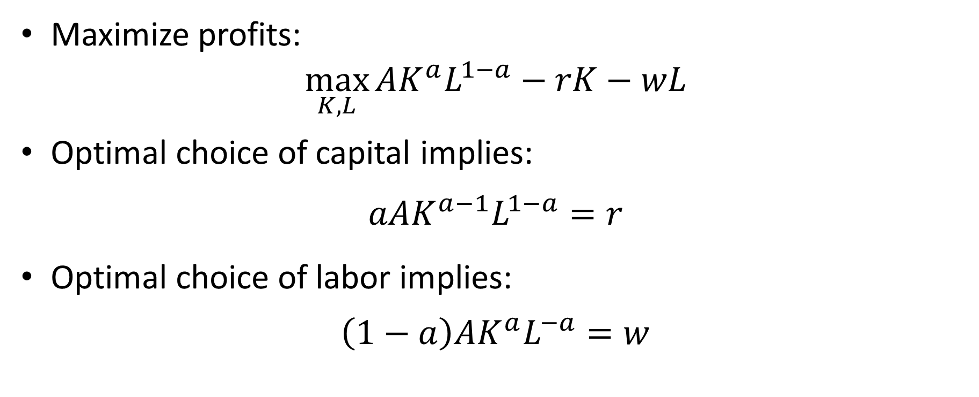
Firm’s Problem
Maximize profits:
$$\max_{K,L}{AK^{a}L^{1−a}−rK−wL}$$
Optimal choice of capital implies:
$$aAK^{a−1}L^{1−a}=r$$
Optimal choice of labor implies:
$$\left(1−a\right)AK^{a}L^{−a}=w$$

Slide 27
Math vs. Economics
We can derive optimal behavior by firms in two ways:
Mathematically
Differentiate profits with respect to capital holding labor fixed
Differentiate profits with respect to labor holding capital fixed
By economic reasoning:
Firm sets MPK equal to price of capital
Firm sets MPL equal to price of labor

Slide 28
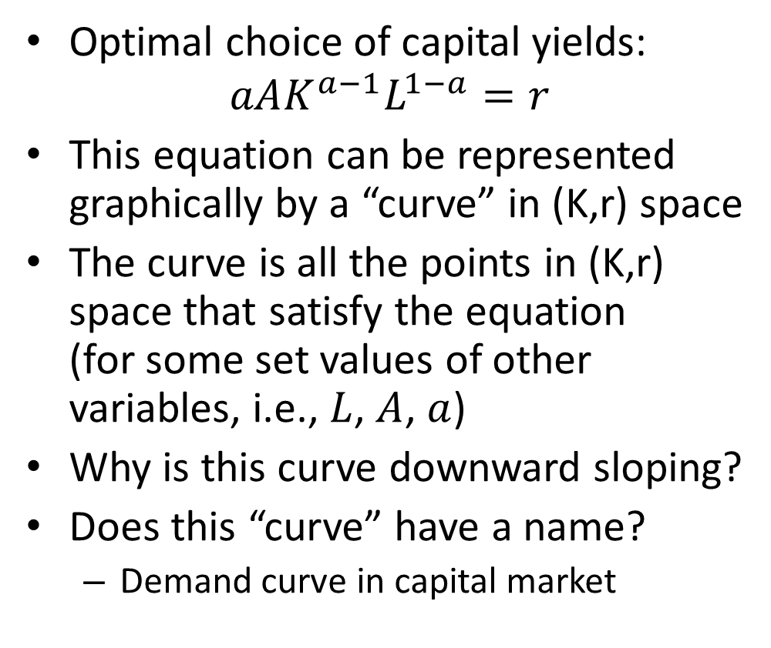
Firm Behavior
Optimal choice of capital yields:
$$aAK^{a−1}L^{1−a}=r$$
This equation can be represented graphically by a “curve” in (K,r) space
The curve is all the points in (K,r) space that satisfy the equation (for some set values of other variables, i.e., $L$, $A$, $a$)
Why is this curve downward sloping?
Does this “curve” have a name?
Demand curve in capital market
r
K

Slide 29
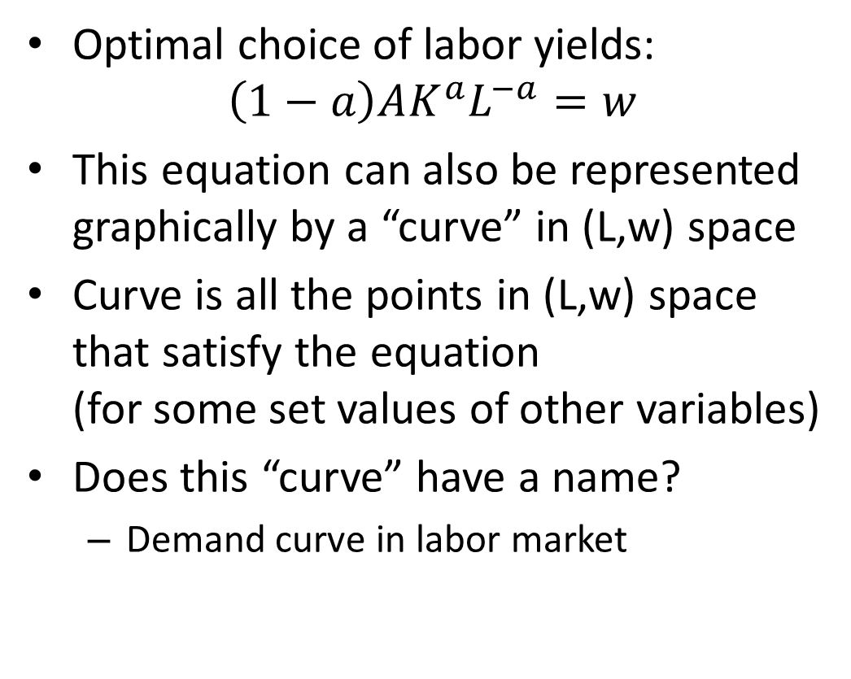
Firm Behavior
Optimal choice of labor yields:
$$\left(1−a\right)AK^{a}L^{−a}=w$$
This equation can also be represented graphically by a “curve” in (L,w) space
Curve is all the points in (L,w) space that satisfy the equation (for some set values of other variables)
Does this “curve” have a name?
Demand curve in labor market
w
L

Slide 30
Power of Competition
We assume labor market is perfectly competitive
This implies that workers are paid their marginal product
Workers paid value of what they produce at the margin (value of what last worker produces)
Why aren’t they paid less? (Why don’t firms exploit the workers?)
Each firm is held in check by competition with other firms in the labor market (if one pays less, another firm will find it profitable to hire away that firm’s workers)
Notes:
Marxist might think: From each according to his ability, to each according to his need

Slide 31
Power of Competition
But perhaps perfect competition is not a realistic assumption
Perhaps we only make this assumption because it simplifies the math
And then we forget that we make it
And we start to think markets are efficient in the real world
And we might even forget about the very possibility that markets might not be competitive
Daniel Kahneman called this “theory-induced blindness”

Slide 32
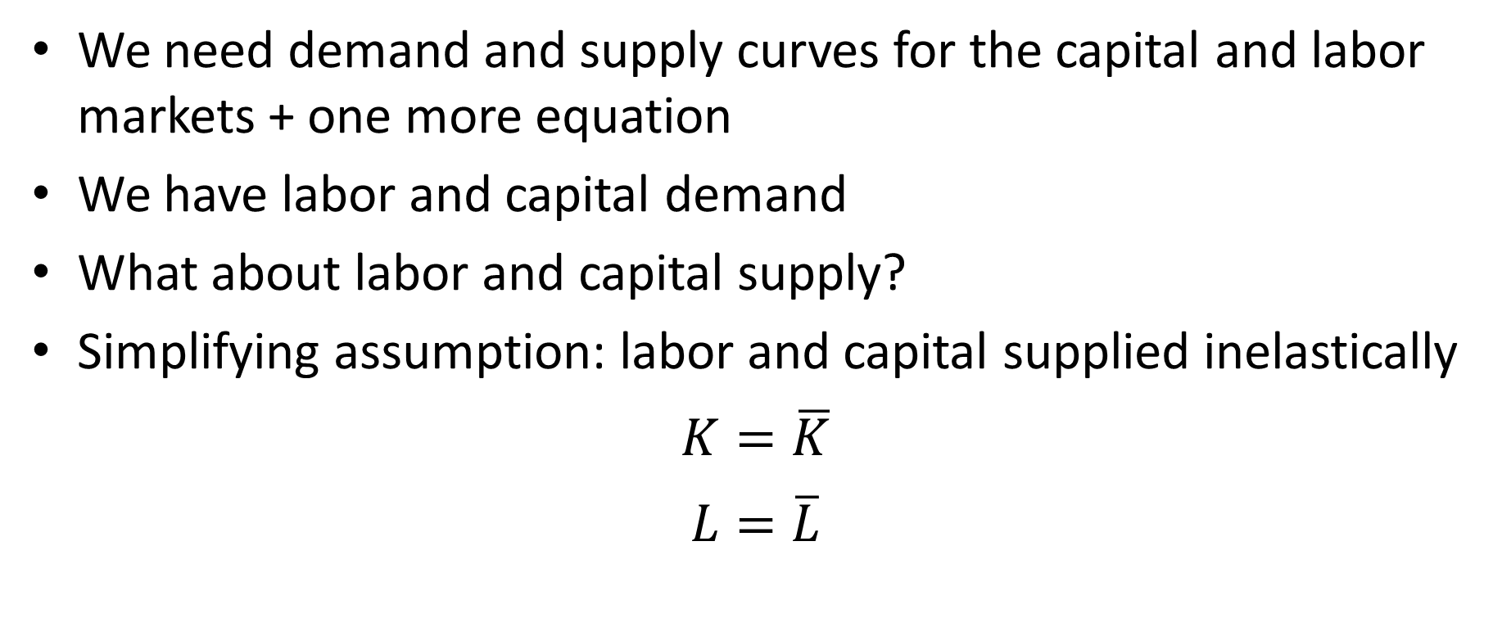
Completing the Model
We need demand and supply curves for the capital and labor markets + one more equation
We have labor and capital demand
What about labor and capital supply?
Simplifying assumption: labor and capital supplied inelastically
$$K=\overline{K}$$
$$L=\overline{L}$$

Slide 33

Completing the Model
Last equation: Something that gives output as a function of other variables
We can use production function:
$$Y=AK^{a}L^{1−a}$$

Slide 34

Model
Five equations:
$$aAK^{a−1}L^{1−a}=r$$
$$\left(1−a\right)AK^{a}L^{−a}=w$$
$$K=\overline{K}$$
$$L=\overline{L}$$
$$Y=AK^{a}L^{1−a}$$
Five endogenous variables: $K$, $L$, $r$, $w$, $Y$

Slide 35
An Equilibrium
In economics, the solution to a model is called an equilibrium
What happens when things play out in the markets under consideration (“when markets clear”)
Model: System of five equations with five unknowns
“Solving” the model:
Solving for endogenous variables as functions only of exogenous variables and parameters
Rewriting the system with the endogenous variables on one side of the equations and only exogenous variables and parameters on the other side.

Slide 36

Equilibrium
“Trivial” solution in our case:
$K=\overline{K}$
$L=\overline{L}$
$r=aA{\overline{K}}^{a−1}{\overline{L}}^{1−a}$
$w=\left(1−a\right)A{\overline{K}}^{a}{\overline{L}}^{−a}$
$Y=A{\overline{K}}^{a}{\overline{L}}^{1−a}$

Slide 37
Factor Shares
Revenue firms receive is paid out as:
Wages to workers
Returns to capital
Pure profits
Accounting measures divide revenue up somewhat differently
Firms raise funds through:
Debt
Equity
Accounting measures view:
interest payments as a cost
Returns to equity as a part of profits
Economics:
Interest payments on debt a part of returns to capital
Competitive return on equity part of return to capital

Slide 38
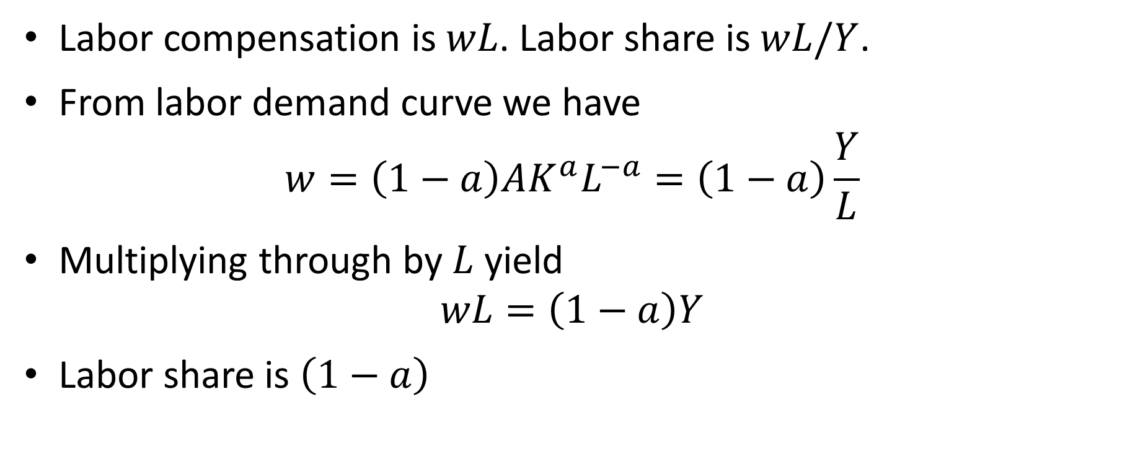
Labor Share in Our Model
Labor compensation is $wL$. Labor share is $wL/Y$.
From labor demand curve we have
$$w=\left(1−a\right)AK^{a}L^{−a}=\left(1−a\right)\frac{Y}{L}$$
Multiplying through by $L$ yield
$$wL=\left(1−a\right)Y$$
Labor share is $\left(1−a\right)$

Slide 39
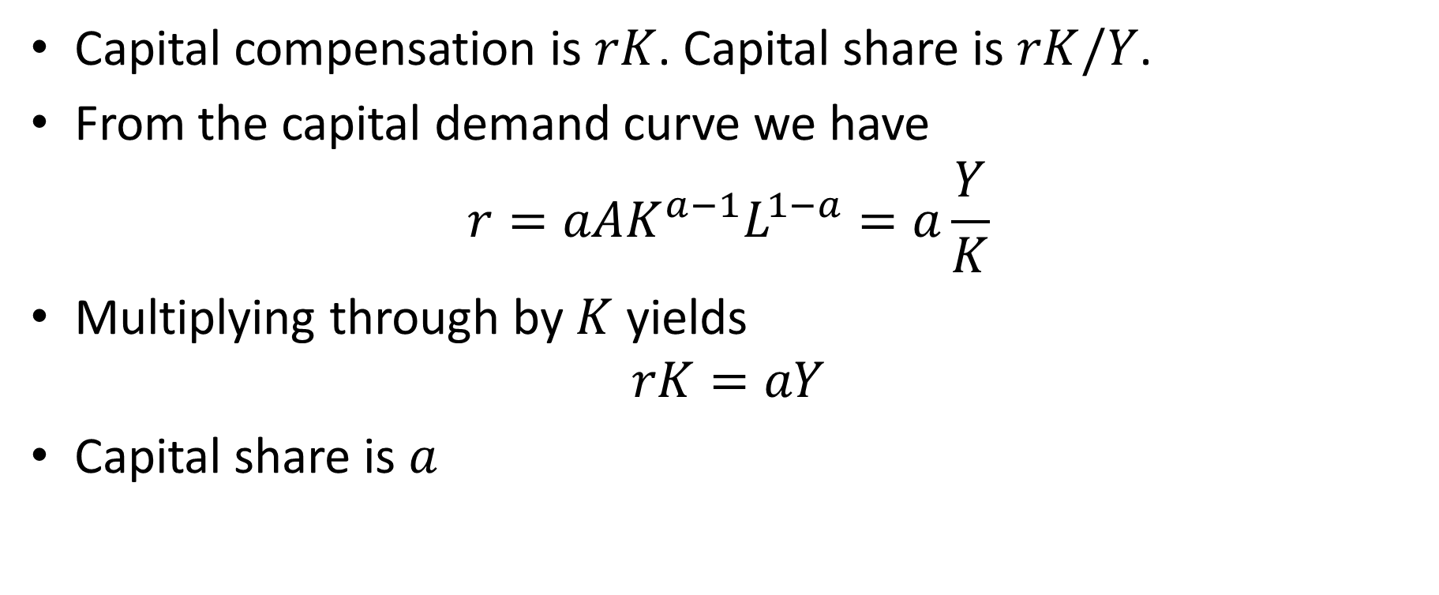
Capital Share in Our Model
Capital compensation is $rK$. Capital share is $rK/Y$.
From the capital demand curve we have
$$r=aAK^{a−1}L^{1−a}=a\frac{Y}{K}$$
Multiplying through by $K$ yields
$$rK=aY$$
Capital share is $a$

Slide 40
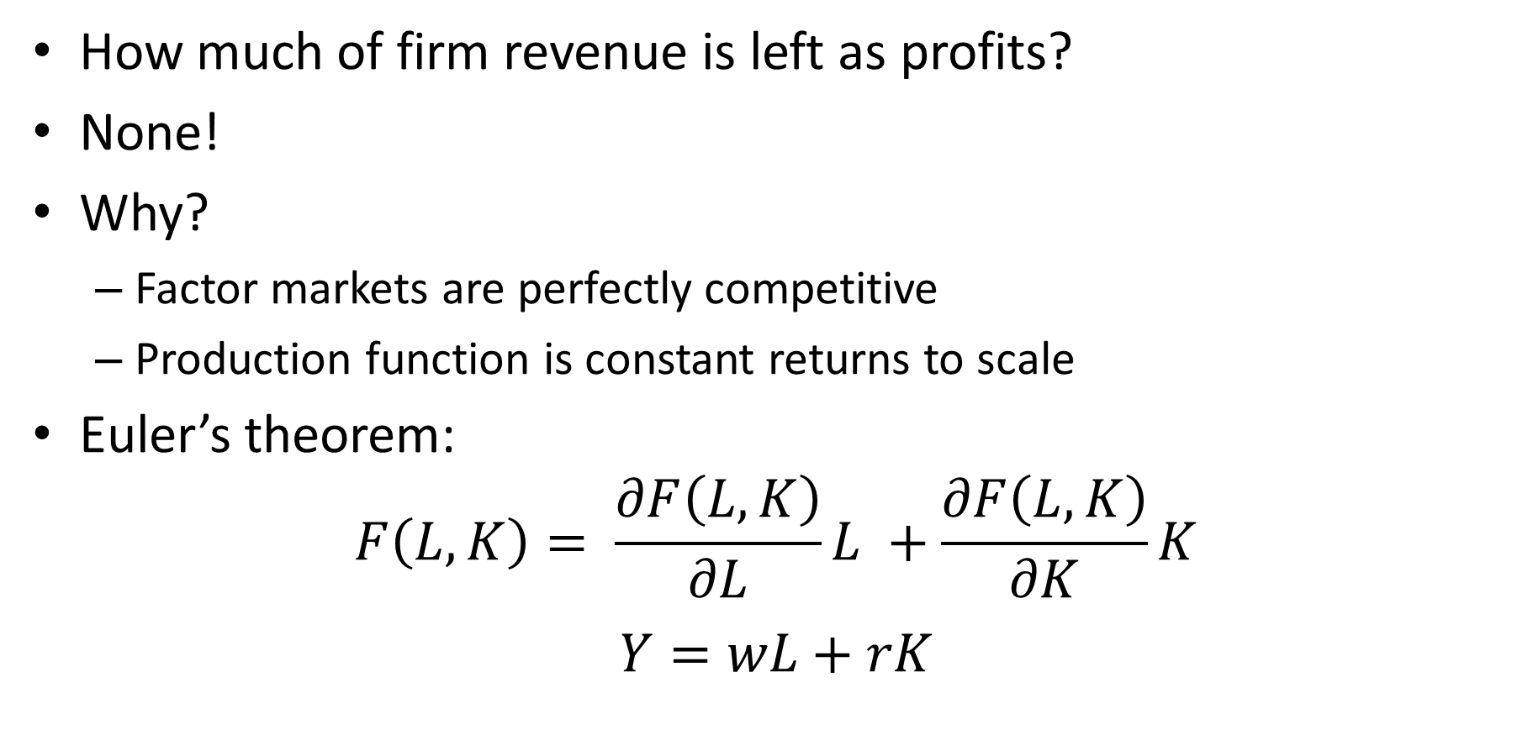
Profit Share
How much of firm revenue is left as profits?
None!
Why?
Factor markets are perfectly competitive
Production function is constant returns to scale
Euler’s theorem:
$$F\left(L,K\right)= \frac{∂F\left(L,K\right)}{∂L}L +\frac{∂F\left(L,K\right)}{∂K}K$$
$$Y=wL+rK$$

Slide 41
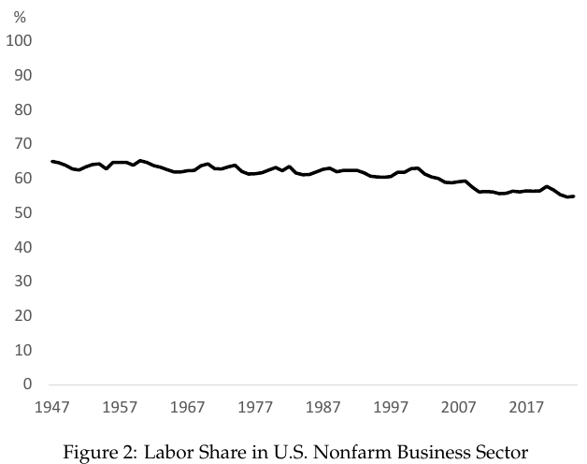
Why Cobb-Douglas
Cobb-Douglas is tractable
Arguably more important is that Cobb-Douglas implies constant factor shares
Factor share have in fact been remarkably close to constant since WWII

Slide 42
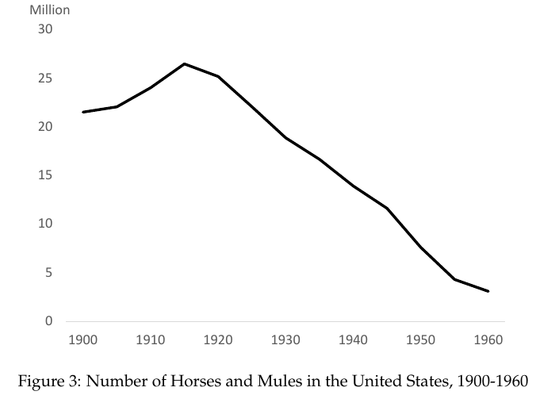
Worries about Labor-Saving Technology
Worries ever since Industrial Revolution that machines will take our jobs
Labor share constant despite huge amounts of labor-saving technology
Stark contrast with horses
But is our luck about to run out?

Slide 43
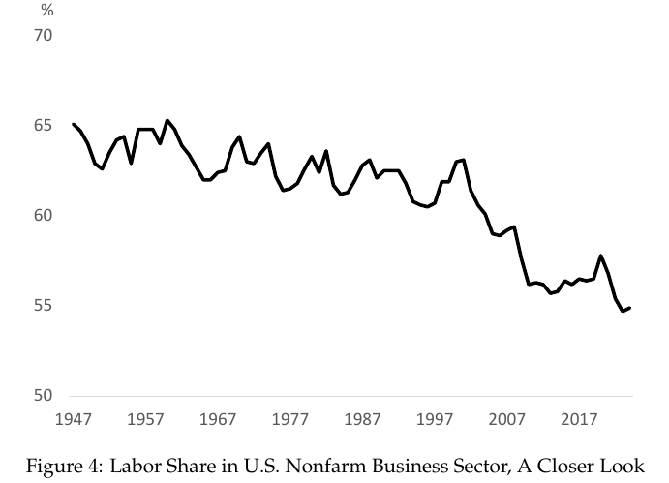
Is the Labor Share Falling?
Closer looks reveals downward trend in labor share
Are machines finally doing us in?

Slide 44
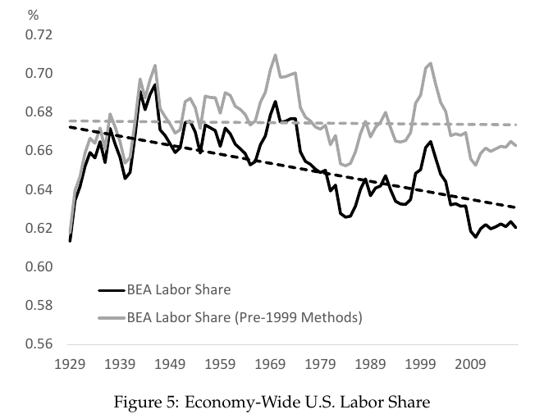
Is the Labor Share Falling?
Recent research has argued that apparent fall in labor share is due to mismeasurement
Labor share using pre-1999 methods has not fallen
Difference: Reclassification of intellectual property as capital
But aren’t the new methods better?

Slide 45
Is Labor Share Falling?
We are interested in welfare of workers and owners of capital
How much they can afford to consume
GDP not appropriate for this:
Owners of capital must maintain capital (can’t consumer that part)
Must also build new capital (can’t consume that part)
Net domestic product (NDP) more appropriate for labor share calculations (takes out depreciation)
Role of high depreciation capital has been increasing (e.g., software) which helps explain downward trend for labor share of GDP

Slide 46
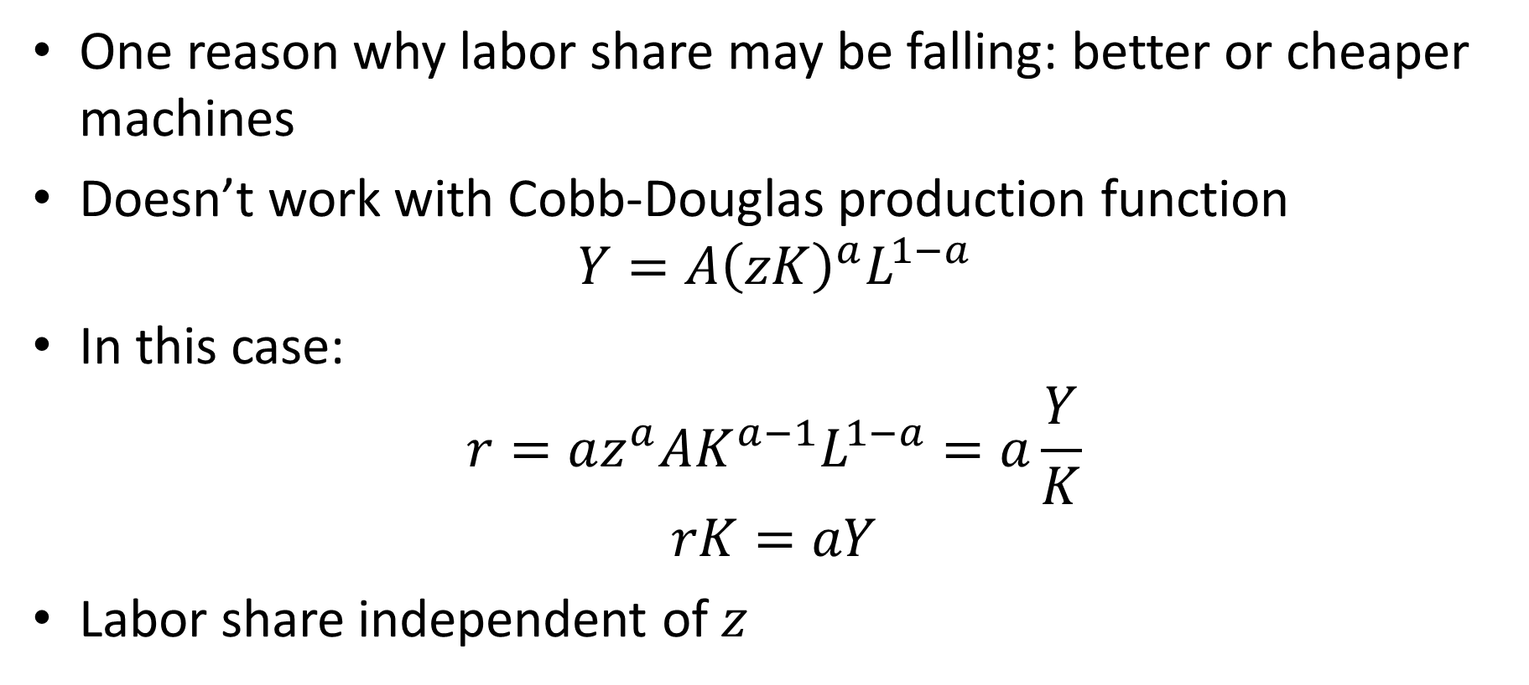
Better and Cheaper Machines?
One reason why labor share may be falling: better or cheaper machines
Doesn’t work with Cobb-Douglas production function
$$Y=A{\left(zK\right)}^{a}L^{1−a}$$
In this case:
$$r=az^{a}AK^{a−1}L^{1−a}=a\frac{Y}{K}$$
$$rK=aY$$
Labor share independent of $z$

Slide 47
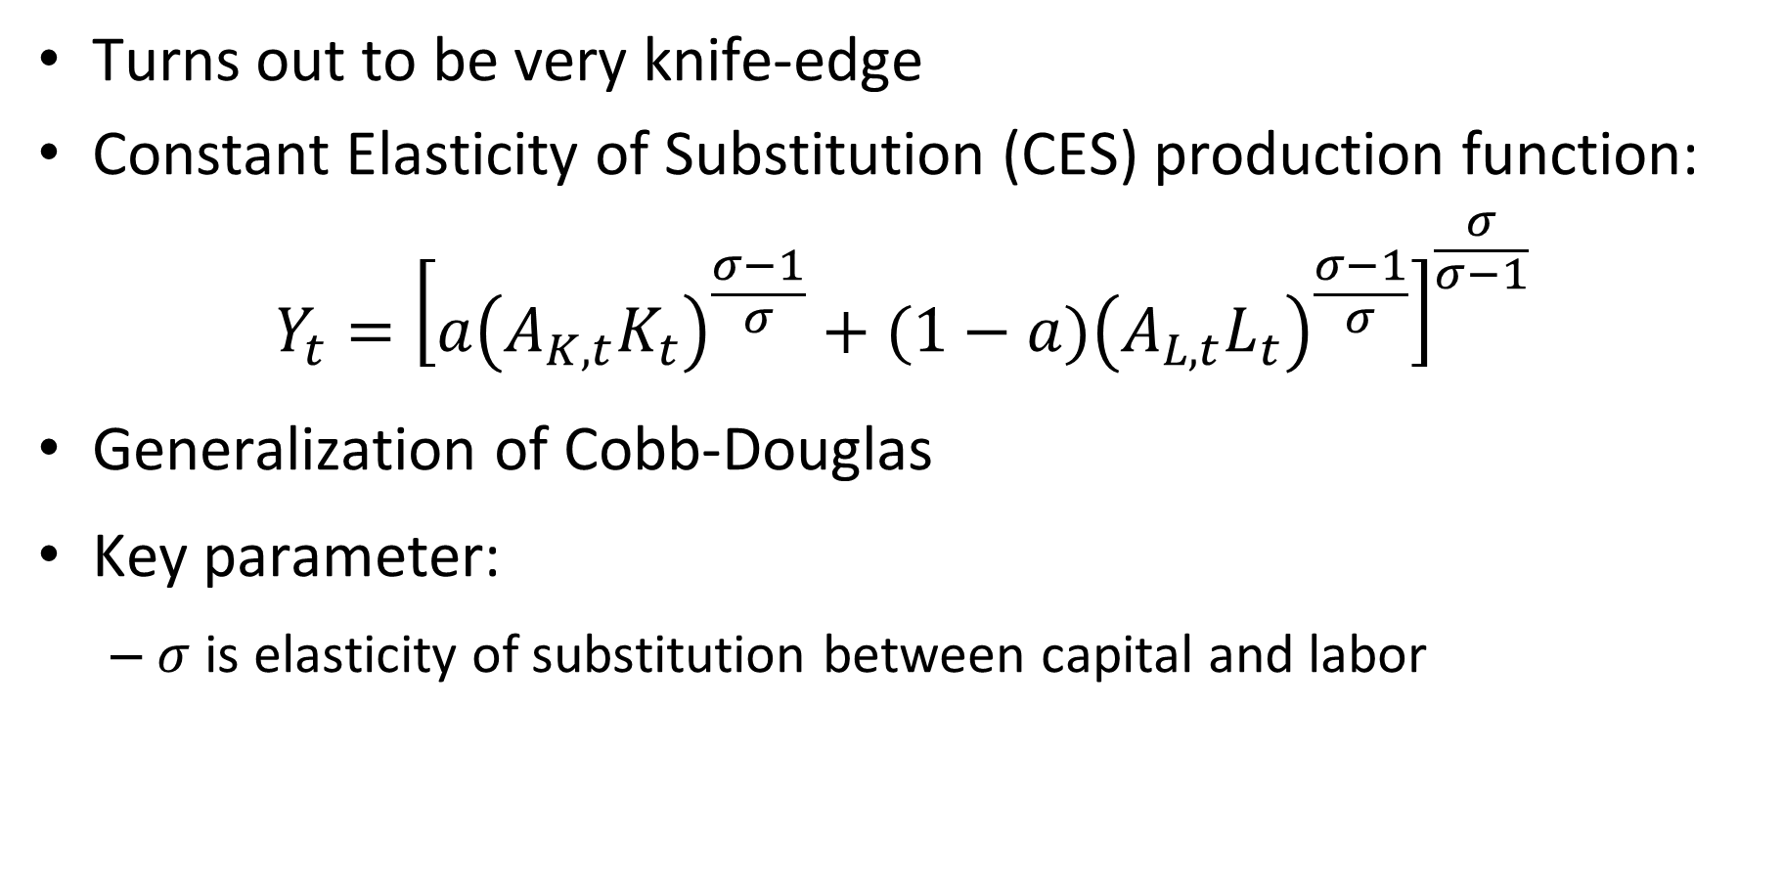
More General Production Function
Turns out to be very knife-edge
Constant Elasticity of Substitution (CES) production function:
$$Y_{t}={\left[a{\left(A_{K,t}K_{t}\right)}^{\frac{σ−1}{σ}}+(1−a){\left(A_{L,t}L_{t}\right)}^{\frac{σ−1}{σ}}\right]}^{\frac{σ}{σ−1}}$$
Generalization of Cobb-Douglas
Key parameter:
$σ$ is elasticity of substitution between capital and labor

Slide 48
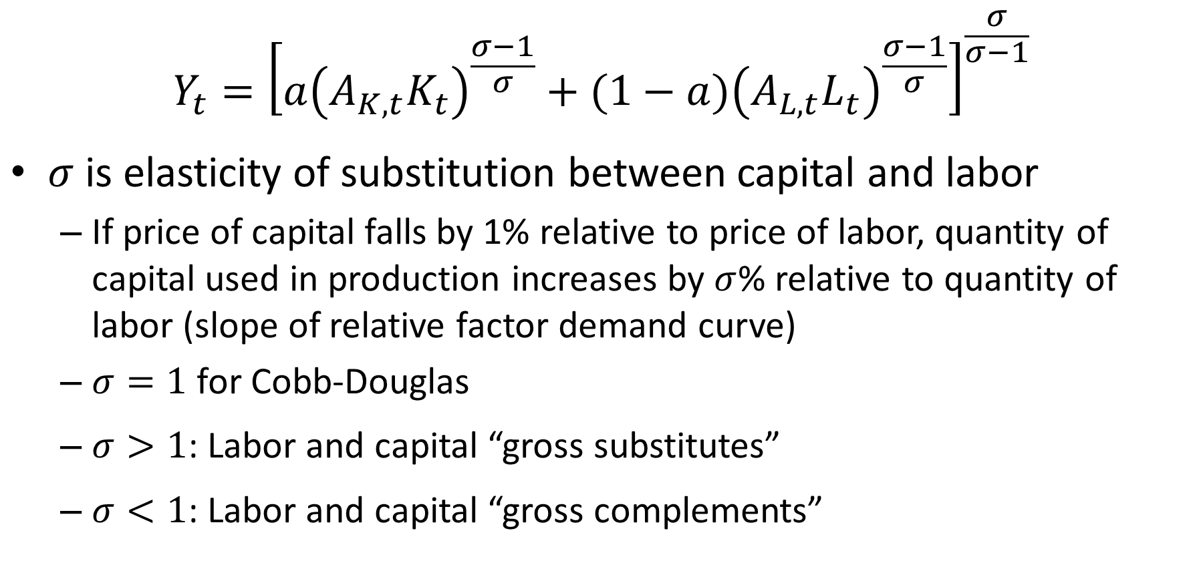
Elasticity of Substitution
$$Y_{t}={\left[a{\left(A_{K,t}K_{t}\right)}^{\frac{σ−1}{σ}}+(1−a){\left(A_{L,t}L_{t}\right)}^{\frac{σ−1}{σ}}\right]}^{\frac{σ}{σ−1}}$$
$σ$ is elasticity of substitution between capital and labor
If price of capital falls by 1% relative to price of labor, quantity of capital used in production increases by $σ$% relative to quantity of labor (slope of relative factor demand curve)
$σ=1$ for Cobb-Douglas
$σ>1$: Labor and capital “gross substitutes”
$σ<1$: Labor and capital “gross complements”

Slide 49
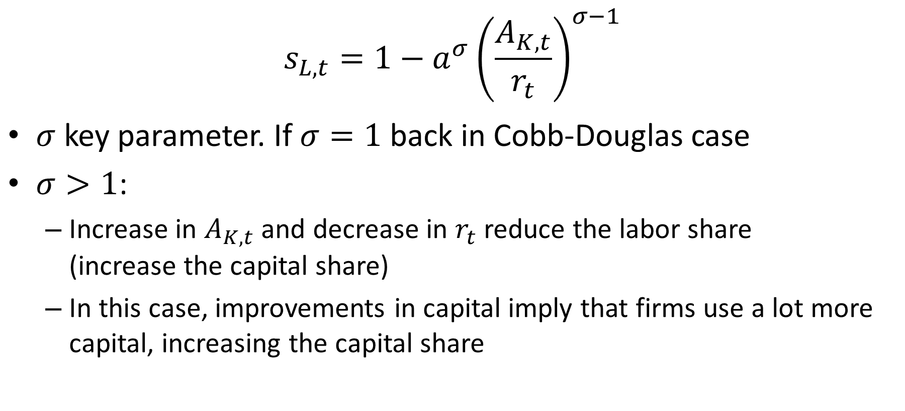
Labor Share in CES Case
$$s_{L,t}=1−a^{σ}{\left(\frac{A_{K,t}}{r_{t}}\right)}^{σ−1}$$
$σ$ key parameter. If $σ=1$ back in Cobb-Douglas case
$σ>1$:
Increase in $A_{K,t}$ and decrease in $r_{t}$ reduce the labor share (increase the capital share)
In this case, improvements in capital imply that firms use a lot more capital, increasing the capital share

Slide 50
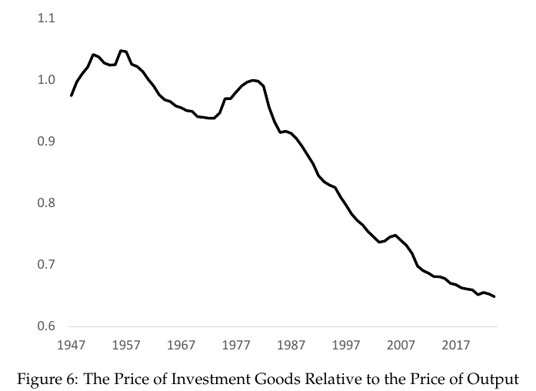
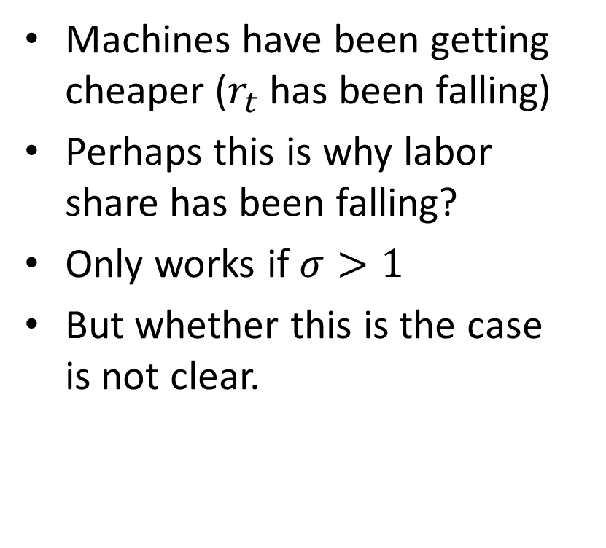
Better and Cheaper Machines
Machines have been getting cheaper ($r_{t}$ has been falling)
Perhaps this is why labor share has been falling?
Only works if $σ>1$
But whether this is the case is not clear.

Slide 51
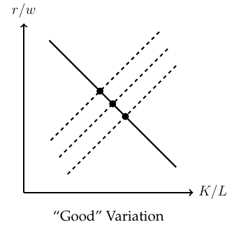
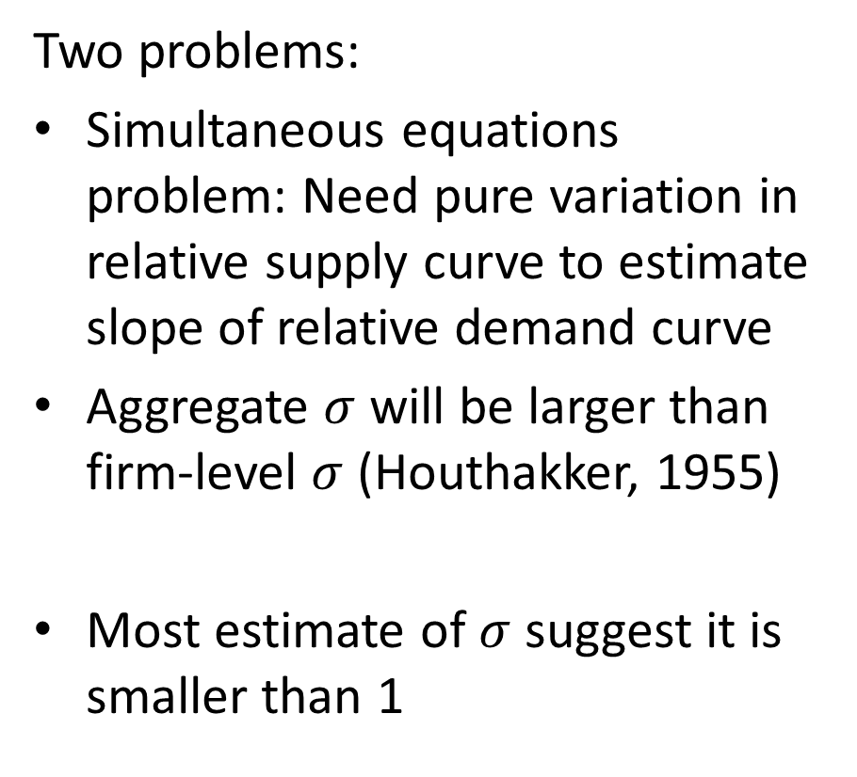

Estimating $σ$ is Hard
Two problems:
Simultaneous equations problem: Need pure variation in relative supply curve to estimate slope of relative demand curve
Aggregate $σ$ will be larger than firm-level $σ$ (Houthakker, 1955)
Most estimate of $σ$ suggest it is smaller than 1

Slide 52
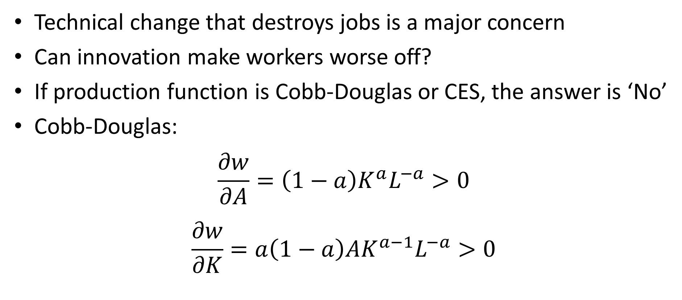
Can Innovation Hurt Workers?
Technical change that destroys jobs is a major concern
Can innovation make workers worse off?
If production function is Cobb-Douglas or CES, the answer is ‘No’
Cobb-Douglas:
$$\frac{∂w}{∂A}=\left(1−a\right)K^{a}L^{−a}>0$$
$$\frac{∂w}{∂K}=a\left(1−a\right)AK^{a−1}L^{−a}>0$$

Slide 53
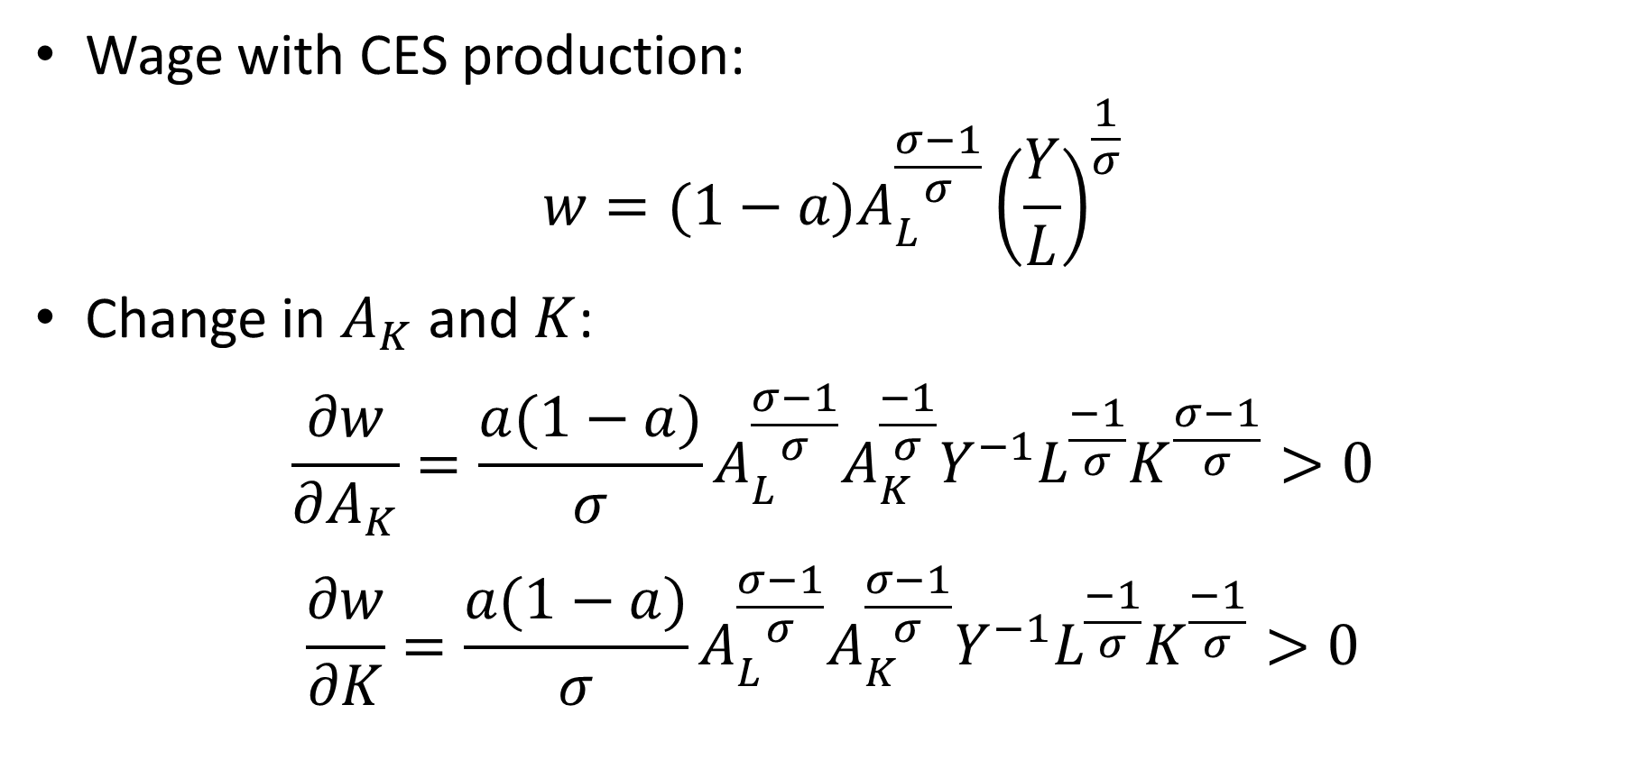
Wages and Technology with CES
Wage with CES production:
$$w=(1−a)A_{L}^{\frac{σ−1}{σ}}{\left(\frac{Y}{L}\right)}^{\frac{1}{σ}}$$
Change in $A_{K}$ and $K$:
$$\frac{∂w}{∂A_{K}}=\frac{a(1−a)}{σ}A_{L}^{\frac{σ−1}{σ}}A_{K}^{\frac{−1}{σ}}Y^{−1}L^{\frac{−1}{σ}}K^{\frac{σ−1}{σ}}>0$$
$$\frac{∂w}{∂K}=\frac{a(1−a)}{σ}A_{L}^{\frac{σ−1}{σ}}A_{K}^{\frac{σ−1}{σ}}Y^{−1}L^{\frac{−1}{σ}}K^{\frac{−1}{σ}}>0$$

Slide 54
Technology Displacing Workers
Both Cobb-Douglas and CES imply that technology and capital make workers better off
Don’t make contact with notion that technology may displace workers
We need a different type of production function for this

Slide 55
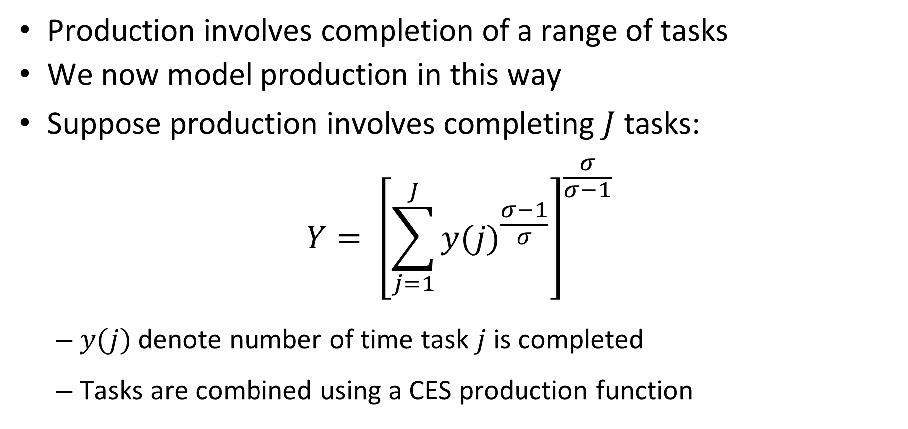
Task-Based Production Function
Production involves completion of a range of tasks
We now model production in this way
Suppose production involves completing $J$ tasks:
$$Y= {\left[\sum_{j=1}^{J}{{y(j)}^{\frac{σ−1}{σ}}}\right]}^{\frac{σ}{σ−1}}$$
$y(j)$ denote number of time task $j$ is completed
Tasks are combined using a CES production function

Slide 56
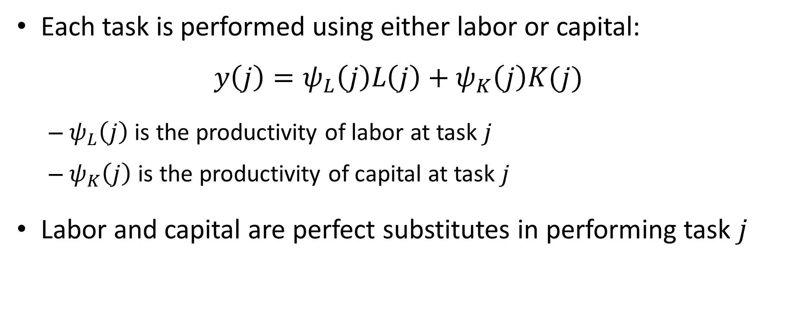
Task-Based Production Function
Each task is performed using either labor or capital:
$$y\left(j\right)=ψ_{L}\left(j\right)L\left(j\right)+ψ_{K}\left(j\right)K(j)$$
$ψ_{L}\left(j\right)$ is the productivity of labor at task $j$
$ψ_{K}\left(j\right)$ is the productivity of capital at task $j$
Labor and capital are perfect substitutes in performing task $j$

Slide 57
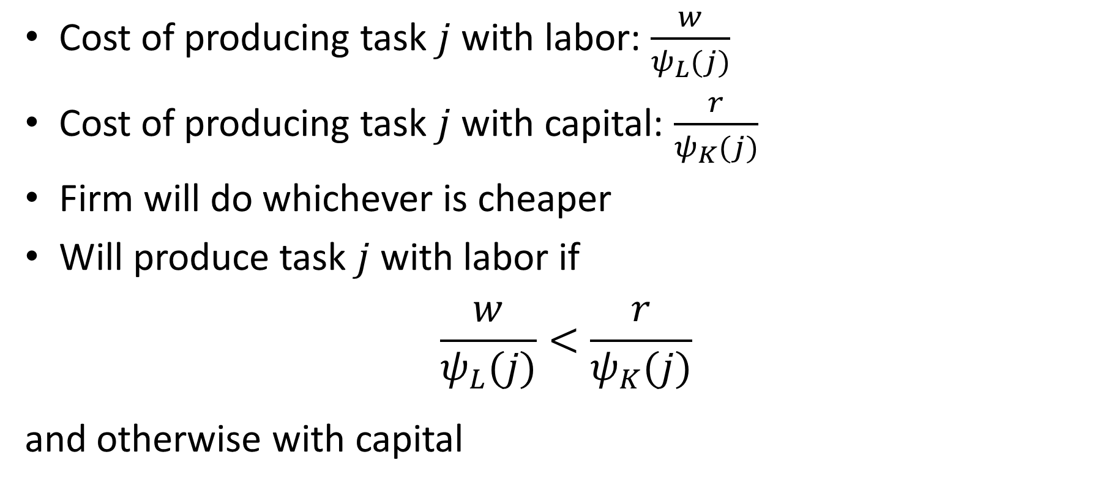

How Is Task $j$ Performed?
Cost of producing task $j$ with labor: $\frac{w}{ψ_{L}(j)}$
Cost of producing task $j$ with capital: $\frac{r}{ψ_{K}(j)}$
Firm will do whichever is cheaper
Will produce task $j$ with labor if
$$\frac{w}{ψ_{L}(j)}<\frac{r}{ψ_{K}(j)}$$
and otherwise with capital

Slide 58
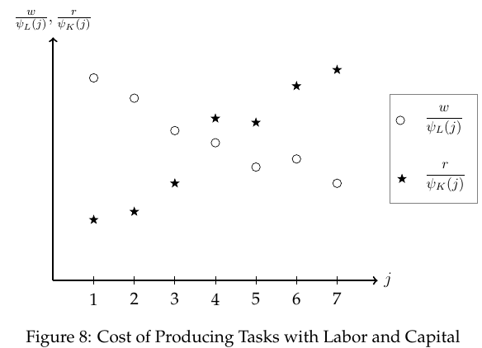
Task-Based Production: An Example
Good produced with 7 tasks
Ordered by comparative advantage of labor
Tasks 1, 2, 3 performed by capital
Tasks 4, 5, 6, 7, performed by labor

Slide 59
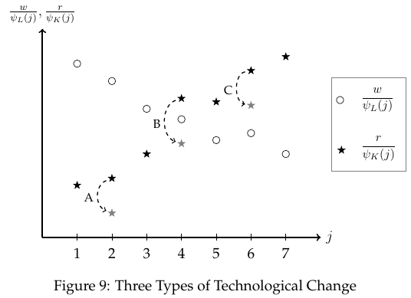
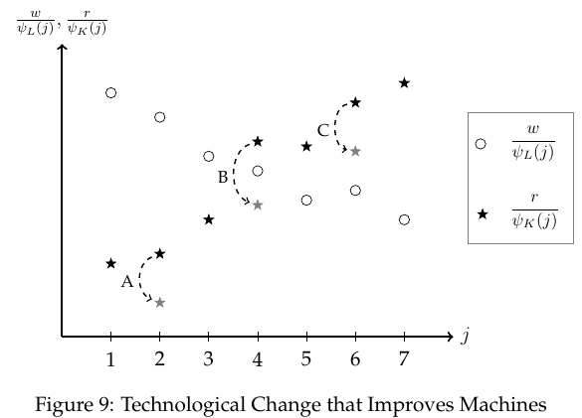
Three Kinds of Technical Progress
Innovation A:
Cost of performing task 2 falls
Machines perform task both before and after innovation
No workers lose their jobs
Cost of producing good falls
Raises real wages of workers (purchasing power of wages)
Workers better off
Pure productivity effect

Slide 60
Three Kinds of Technical Progress
Innovation C:
Machine better at performing task 6
But still worse than labor
Labor performs task both before and after innovation
Innovation has no immediate effect on the economy

Slide 61
Three Kinds of Technical Progress
Innovation B:
Machine becomes better at performing task 4
Firm switches from labor to capital for task 4
Workers lose their jobs
This displacement effect hurts workers
Also has a productivity effect like innovation A

Slide 62
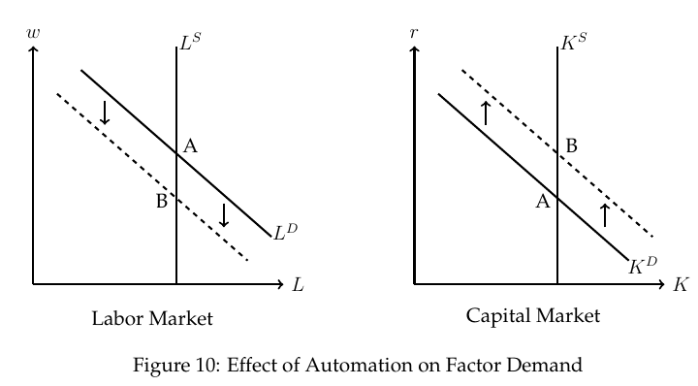
Displacement Effect Lowers Wages
Automation of task 4 reduces labor demand and increases capital demand
Real wages fall
Rental rate on capital increases

Slide 63
Aggregate Effect of Large Innovations
Innovation can cause enormous cost reductions:
18th century: Cost of spinning cotton fell by more than two orders of magnitude
20th century: Cost of computing fell by more than six orders of magnitude
21st century: AI/robotics will dramatically reduce costs for various tasks
How do such huge innovations affect aggregate output?

Slide 64

Aggregate Effect of Large Innovations
Depends critically on how substitutable tasks are in production:
$$Y_{t}={\left[a{\left(A_{K,t}K_{t}\right)}^{\frac{σ−1}{σ}}+(1−a){\left(A_{L,t}L_{t}\right)}^{\frac{σ−1}{σ}}\right]}^{\frac{σ}{σ−1}}$$
Think of $A_{K,t}K_{t}$ as bundle of tasks performed by capital
Suppose $A_{K,t}→∞$ (but $A_{L,t}$ unchanged).
How does this affect $Y_{t}$?

Slide 65

Weak Links
Suppose $σ=1/2$.
Then $\frac{σ−1}{σ}=−1$ and production function becomes
$$\frac{1}{Y_{t}}=\frac{a}{A_{K,t}K_{t}}+\frac{1−a}{A_{L,t}L_{t}}$$
If $A_{K,t}K_{t}→∞$ then $\frac{a}{A_{K,t}K_{t}}→0$. So:
$$Y_{t}=\frac{A_{L,t}L_{t}}{1−a}$$
Capital becomes infinitely productive. But output remains finite.
Labor is a “weak link” (bottleneck)
Since it is hard to substitute capital for labor, economy runs into rapidly diminishing returns to capital

Slide 66

Weak Links

Slide 67


Aggregate Effect of Large Innovations
How much $Y_{t}$ increases depends on initial cost share of tasks exposed to innovation $s_{K,t}$
Let ${\tilde{Y}}_{t}$ denote output when $A_{K,t}K_{t}→∞$
Increase in output from infinitely productive capital:
$$\frac{{\tilde{Y}}_{t}}{Y_{t}}={\left(\frac{1}{1−s_{K,t}}\right)}^{\frac{σ}{1−σ}}$$

Slide 68

Will Technology Make Labor Irrelevant
Two forces:
Automation of tasks:
This tends to lower the labor share of income
Continued improvement of machines at what they already do
If $σ<1$, this tends to raise the labor share
Task prices fall faster than quantity rises
This is an example of Baumol’s disease
Not clear that first force will be stronger than second

Slide 69

Evolution of Work since Industrial Revolution
Virtually all tasks performed by labor in 1800 have been automated
Most tasks performed by labor in 1900 have been automated
New tasks have sprung up!
Always hard to imagine what new tasks will spring up in the future

Slide 70

Age of Automation
Current moment feels extreme in terms of disruption from AI/robotics
But it is actually not as disruptive as early 20th century (e.g., mechanization of agriculture)

