Slide 1
Business Cycles
Jón Steinsson
University of California, Berkeley

Slide 2
Economic Fluctuations
Genesis: seven years of famine followed by seven years of plenty
Prior to Industrial Revolution:
Most fluctuations due to weather, disease, and warfare
After Industral Revolution:
Money and finance become important
Labor disputes become important (strikes)
Fluctuations in confidence becomes important?
Fluctuations in the supply of fossil fuels become important

Slide 3
Is the Economy Self-Equilibrating?
The classical view of economic fluctuations:
Economy self-equilibrating
Will “bob to the surface, like a cork held under water” of its own accord
Little need for intervention by the government
This view is called laissez faire
Great Depression dealt a massive blow to this view
Output collapsed and unemployment soared
Went on for years. Didn’t look like economy was bobbing to the surface
Many looked towards planned socialism as an alternative
Keynes (1936): General Theory of Employment, Interest and Money
Argued for active government management of aggregate demand

Slide 4
Long Run versus Short Run
But this long run is a misleading guide to current affairs. In the long run we are all dead. Economists set themselves too easy, too useless a task if in tempestuous seasons they can only tell us that when the storm is long past the ocean is flat again.
- John Maynard Keynes (1923)

Slide 5
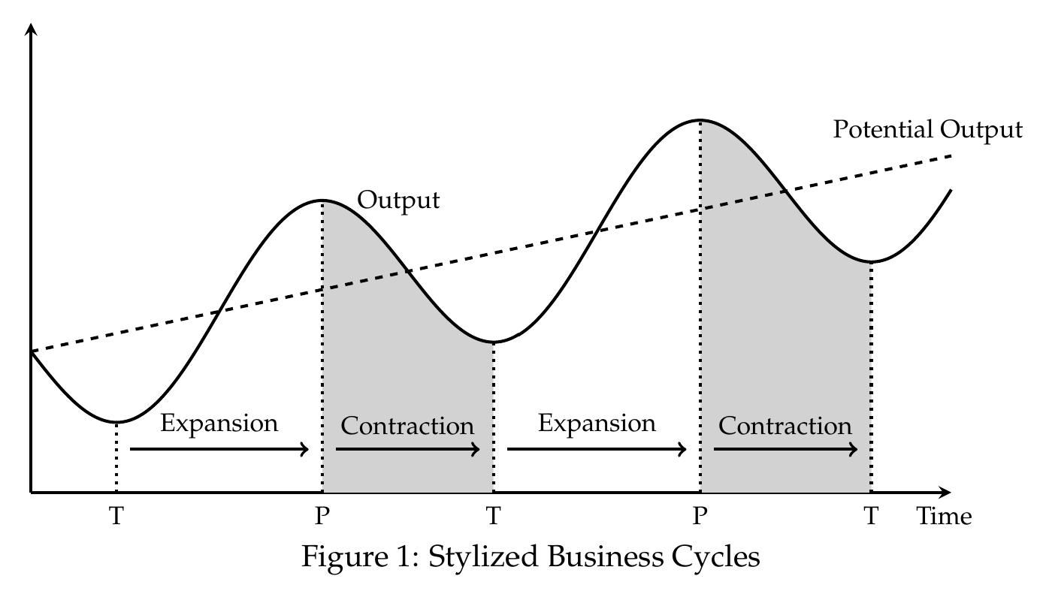
Business Cycles

Slide 6
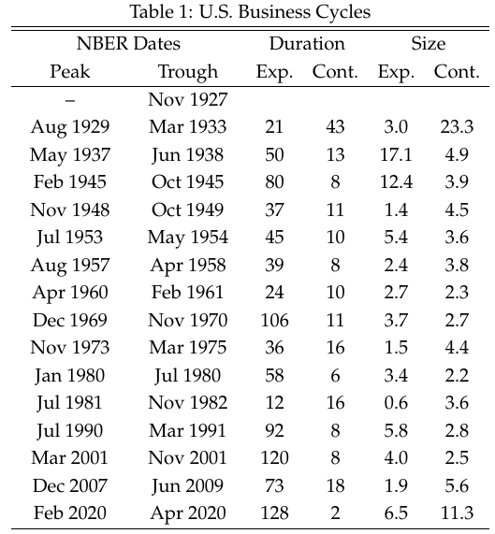
Duration and Size of Business Cycles
Business cycles are not regular
Duration and size vary a great deal
Average duration of expansions: 5 years
Average duration of contractions: 1 year

Slide 7
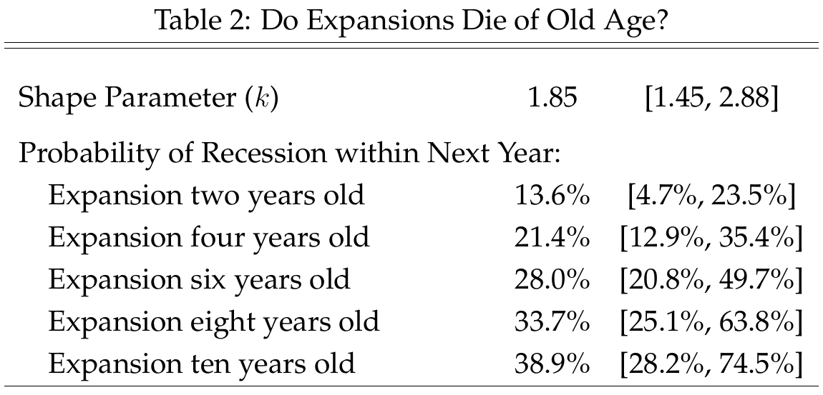
Do Expansions Die of Old Age?
Do expansions end due to a buildup of imbalances and distortions?
Can ask: Are expansions more likely to end the older they get
Answer: A little bit
May be a fluke (three expansions ended after about 10 years)

Slide 8
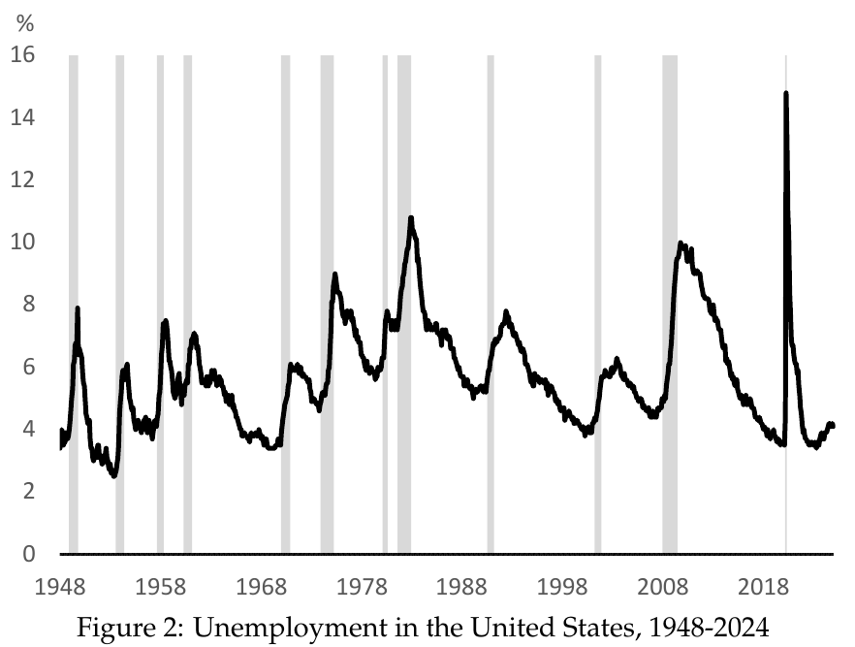
Unemployment and the Size of Business Cycles
Unemployment rises during recessions and falls during expansions
Useful indicator of the business cycle
Both increase and persistence important for severity of recession

Slide 9
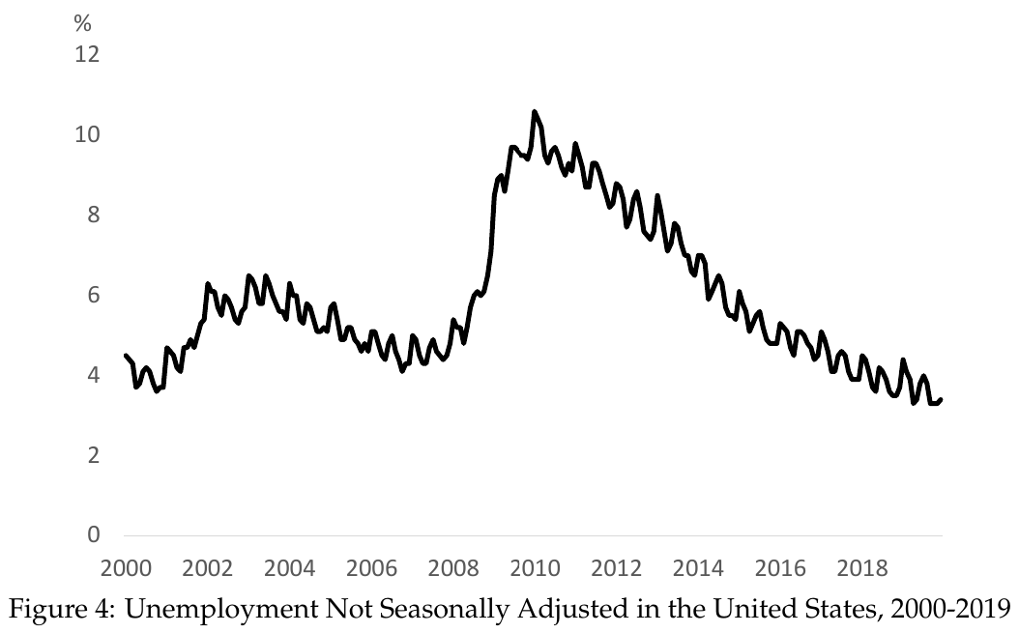
The Seasonal Cycle
Economy experiences sizable seasons cycle
Activity rises and drops twice over the year
Most economic data you see has been seasonally adjusted

Slide 10
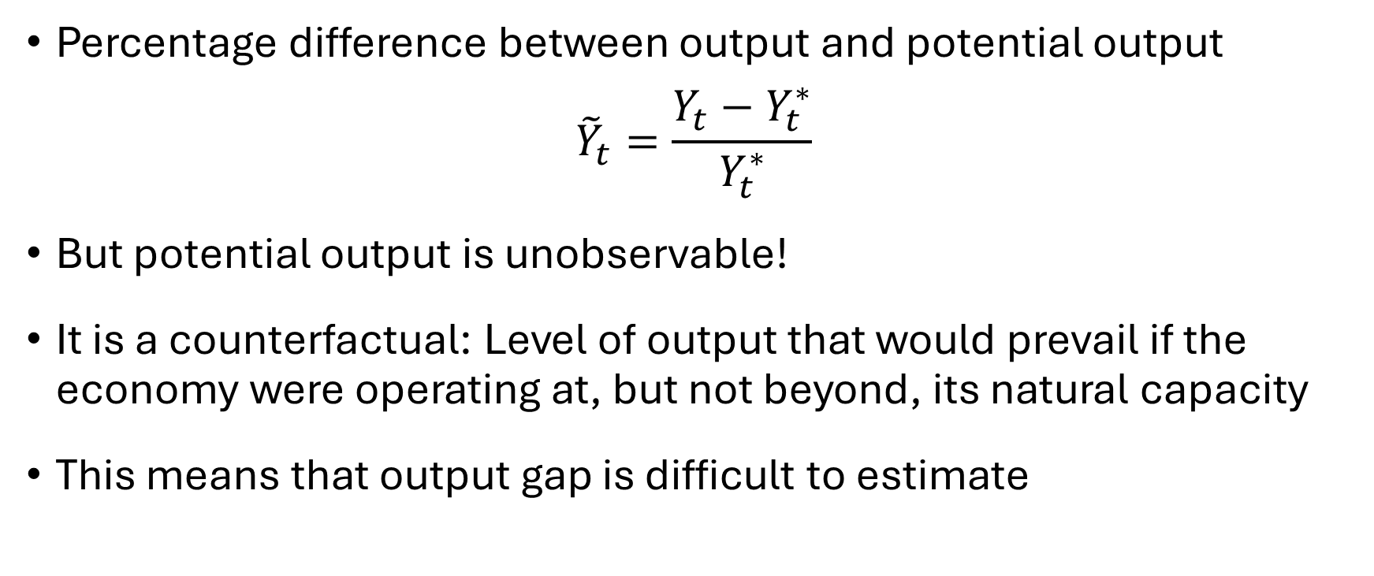
Output Gap
Percentage difference between output and potential output
$${\tilde{Y}}_{t}=\frac{Y_{t}−Y_{t}^{∗}}{Y_{t}^{∗}}$$
But potential output is unobservable!
It is a counterfactual: Level of output that would prevail if the economy were operating at, but not beyond, its natural capacity
This means that output gap is difficult to estimate

Slide 11
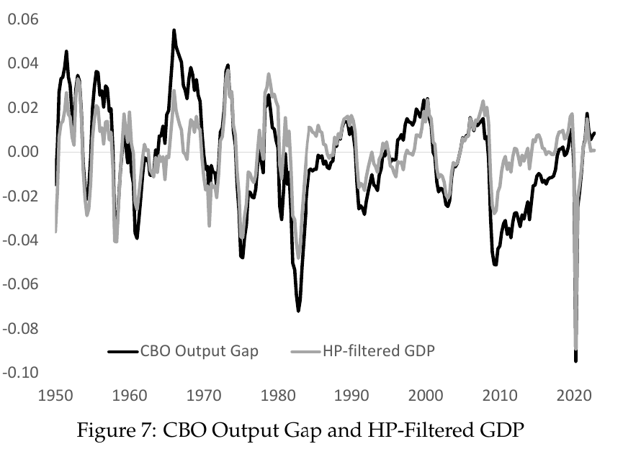
Estimates of the Output Gap
Two estimates of the U.S. output gap
HP-filter (flexible trend line)
Estimate constructed by CBO using production function method

Slide 12
Natural Rate of Unemployment
Analog of potential output for unemployment
But why is it not zero? How an unemployment be “natural”?
Every month many workers quit or are fired (for various reasons)
It takes time to find another job (don’t just want any job)
This means always some workers unemployed looking for work even when economy is doing well

Slide 13
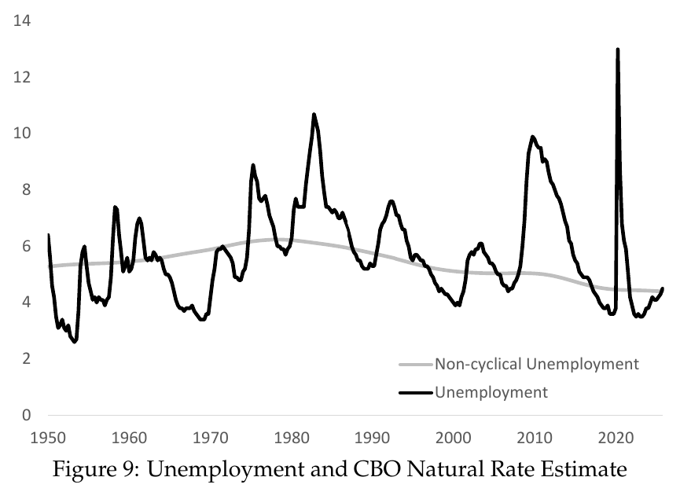
Natural Rate of Unemployment
CBO’s estimate has hovered between 4% and 6.5%
Peaked around 1980
Perhaps because of entry of baby-boom generation into labor market
Young people have higher unemployment rates

Slide 14
Natural Rate View vs. Plucking View
According to CBO, U fluctuates symmetrically around U*
This is the natural rate view
Is this reasonable?
Is unemployment below natural rate half the time?
Plucking view: Natural rate is minimum attainable level

Slide 15
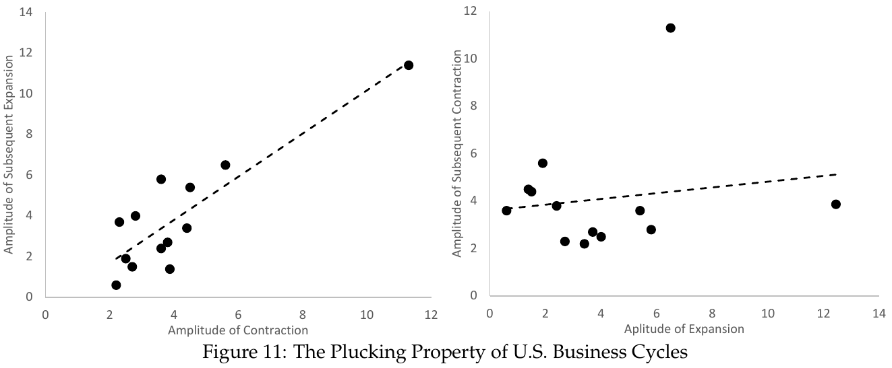
Evidence for Plucking View

Slide 16
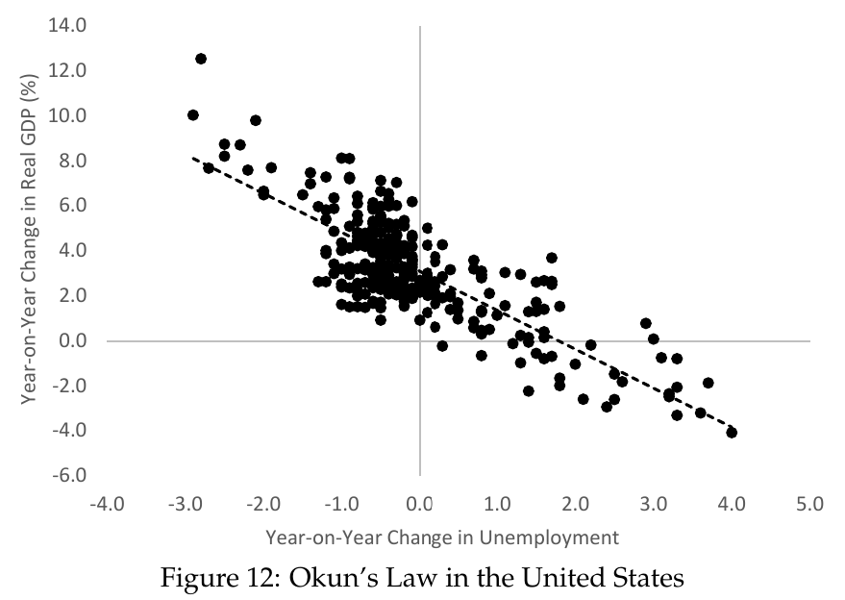
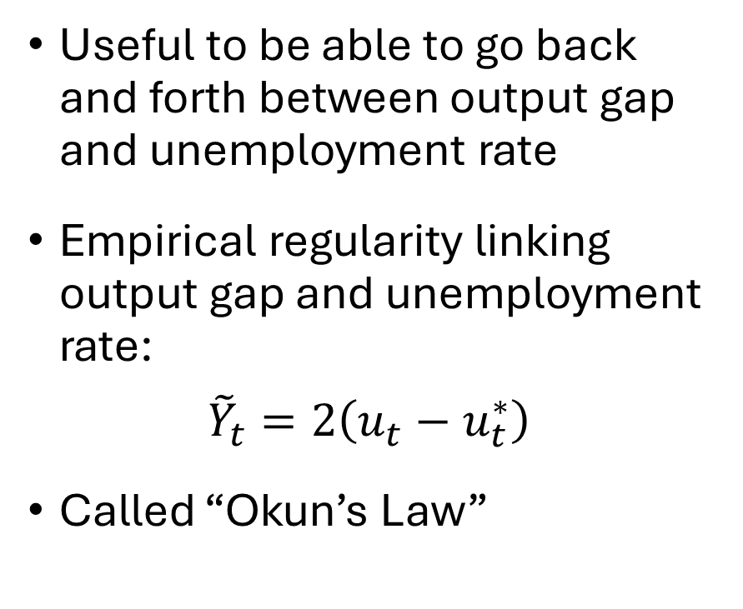
Okun’s Law
Useful to be able to go back and forth between output gap and unemployment rate
Empirical regularity linking output gap and unemployment rate:
$${\tilde{Y}}_{t}=2\left(u_{t}−u_{t}^{∗}\right)$$
Called “Okun’s Law”

Slide 17
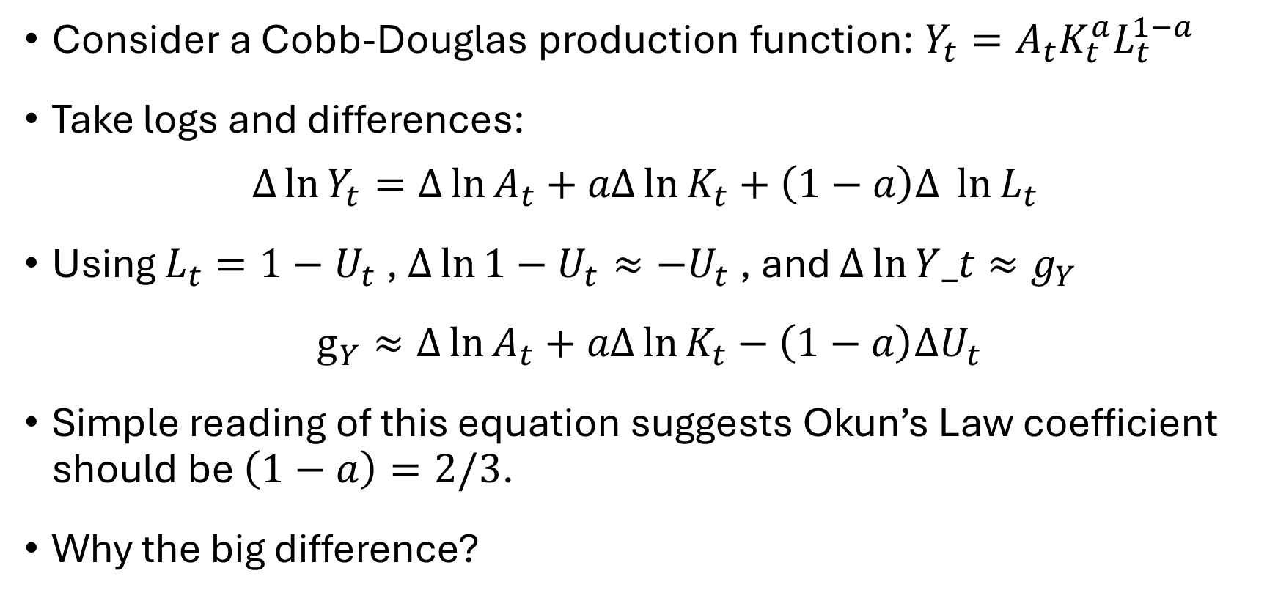
Why Is the Okun’s Law Coefficient So Large?
Consider a Cobb-Douglas production function: $Y_{t}=A_{t}K_{t}^{a}L_{t}^{1−a}$
Take logs and differences:
$$∆\ln{Y_{t}}=Δ\ln{A_{t}}+aΔ\ln{K_{t}}+\left(1−a\right)Δ \ln{L_{t}}$$
Using $L_{t}=1−U_{t}$ , $Δ\ln{1−U_{t}}≈−U_{t}$ , and $Δ\ln{Y_t}≈g_{Y}$
$g_{Y}≈Δ\ln{A_{t}}+aΔ\ln{K_{t}}−\left(1−a\right)ΔU_{t}$
Simple reading of this equation suggests Okun’s Law coefficient should be $\left(1−a\right)=2/3$.
Why the big difference?

Slide 18
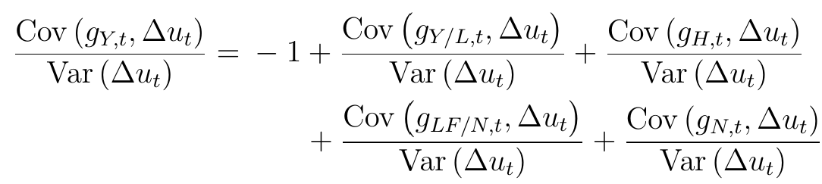
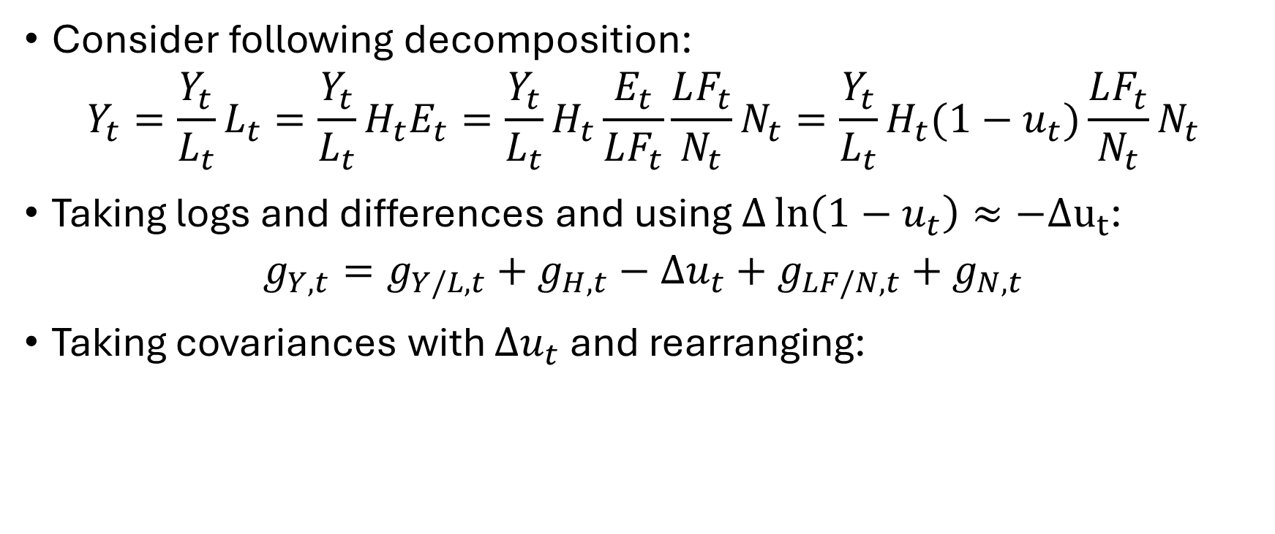
Why Is the Okun’s Law Coefficient So Large?
Consider following decomposition:
$$Y_{t}=\frac{Y_{t}}{L_{t}}L_{t}=\frac{Y_{t}}{L_{t}}H_{t}E_{t}=\frac{Y_{t}}{L_{t}}H_{t}\frac{E_{t}}{LF_{t}}\frac{LF_{t}}{N_{t}}N_{t}=\frac{Y_{t}}{L_{t}}H_{t}(1−u_{t})\frac{LF_{t}}{N_{t}}N_{t}$$
Taking logs and differences and using $Δ\ln\left(1−u_{t}\right)≈−Δu_{t}$:
$$g_{Y,t}=g_{Y/L,t}+g_{H,t}−Δu_{t}+g_{LF/N,t}+g_{N,t}$$
Taking covariances with $Δu_{t}$ and rearranging:

Slide 19
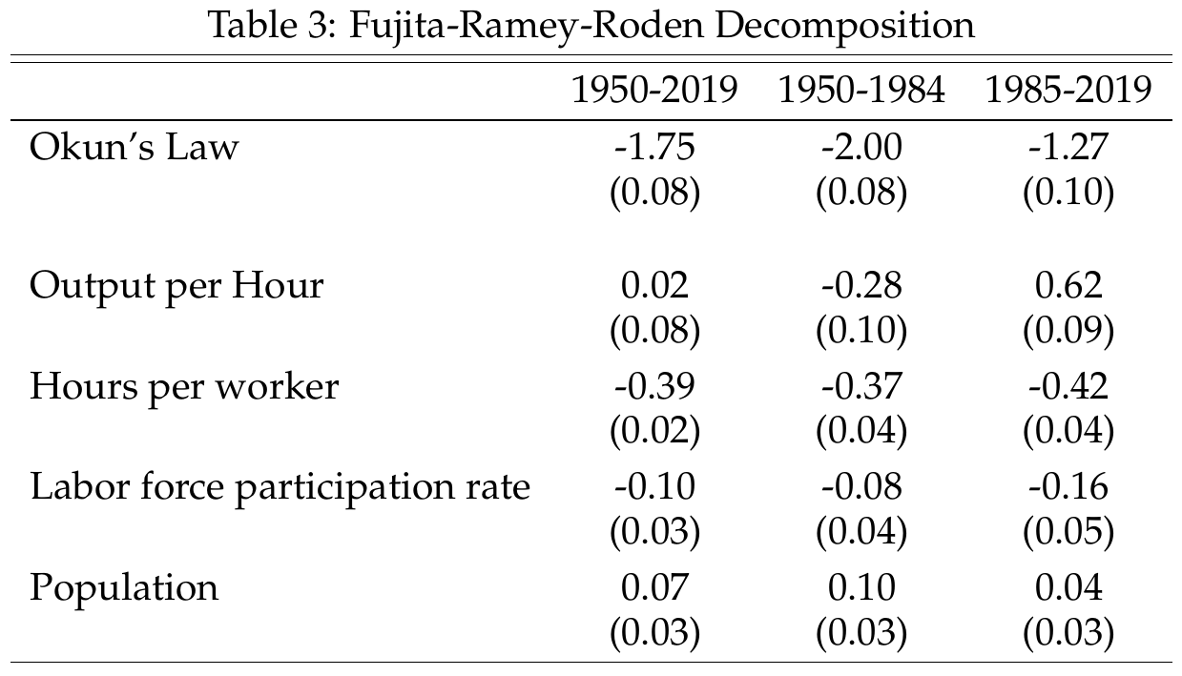
Why Is the Okun’s Law Coefficient So Large?
Population and LFP not important
Hour worked contribute about 0.40
Labor productivity varies by subsample. Close to zero over full sample.
But earlier simple approach implies coefficient of 1/3

Slide 20
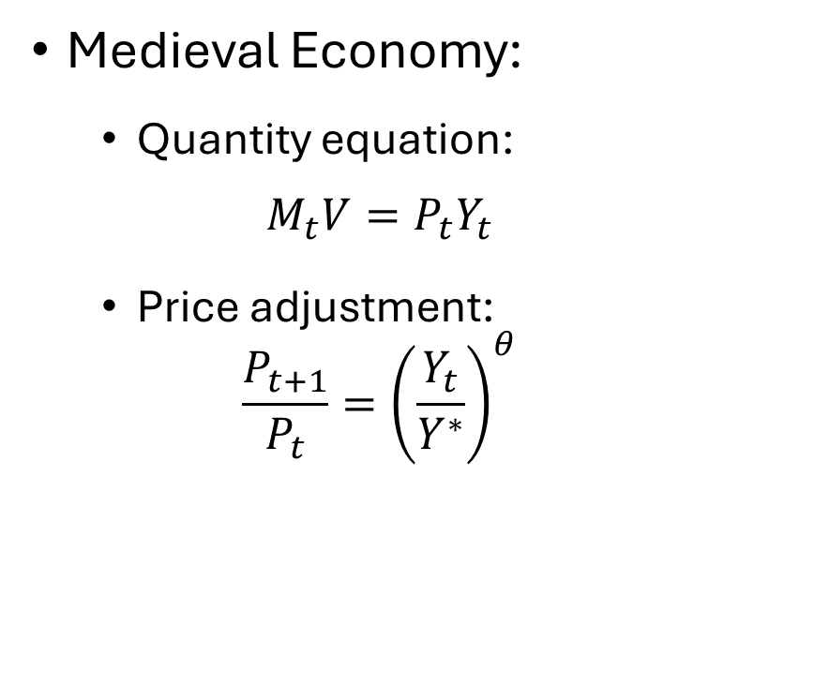
Our First “Business Cycle” Model
Medieval Economy:
Quantity equation:
$$M_{t}V=P_{t}Y_{t}$$
Price adjustment:
$$\frac{P_{t+1}}{P_{t}}={\left(\frac{Y_{t}}{Y^{∗}}\right)}^{θ}$$
Many things missing:
No trend growth
No steady state inflation
No unemployment
No interest rate
No monetary policy
No fiscal policy
Etc.

Slide 21
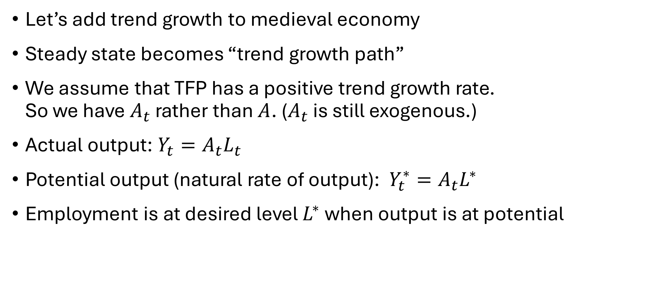
Add Trend Growth
Let’s add trend growth to medieval economy
Steady state becomes “trend growth path”
We assume that TFP has a positive trend growth rate. So we have $A_{t}$ rather than $A$. ($A_{t}$ is still exogenous.)
Actual output: $Y_{t}=A_{t}L_{t}$
Potential output (natural rate of output): $Y_{t}^{∗}=A_{t}L^{∗}$
Employment is at desired level $L^{∗}$ when output is at potential

Slide 22
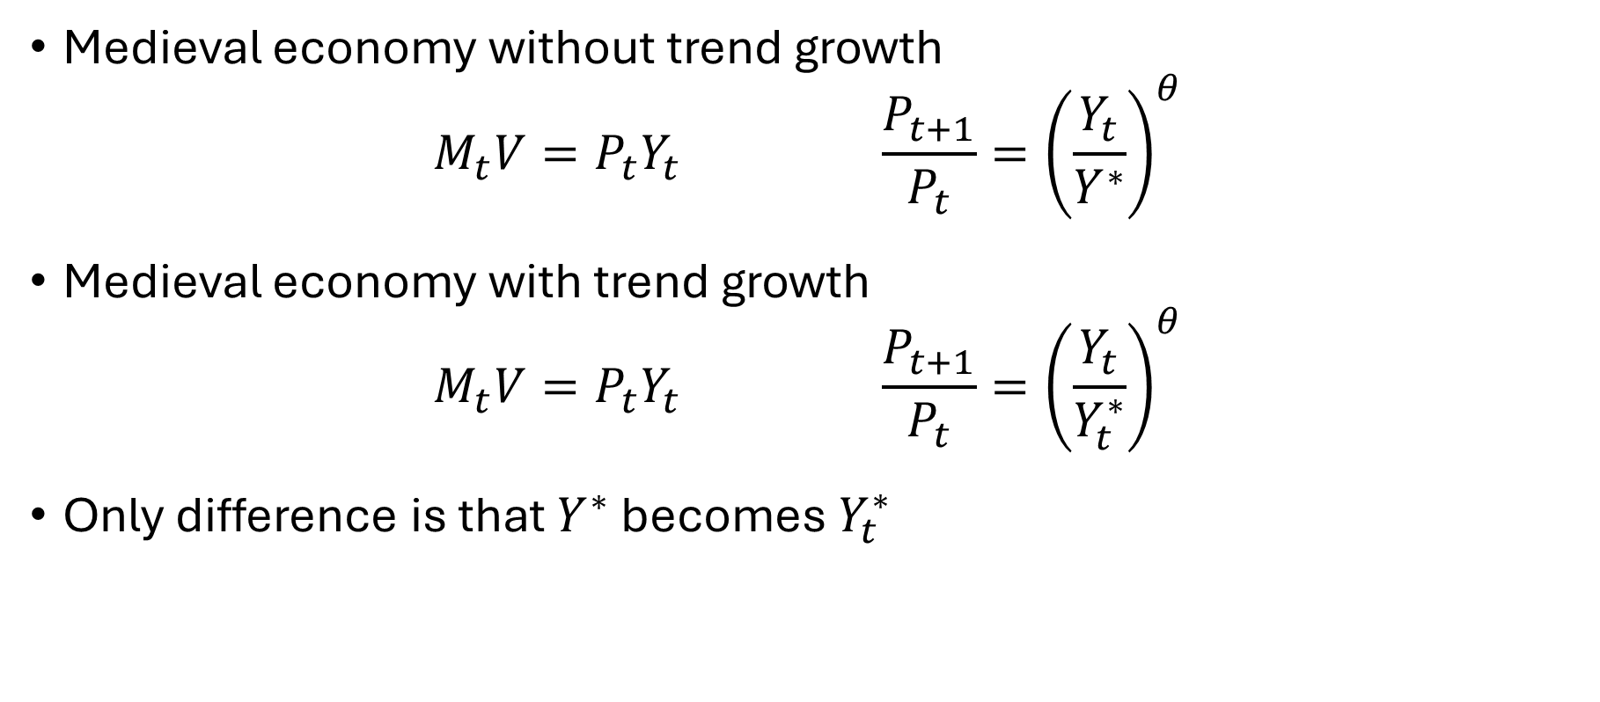
Medieval Economy with Trend Growth
Medieval economy without trend growth
$$M_{t}V=P_{t}Y_{t} \frac{P_{t+1}}{P_{t}}={\left(\frac{Y_{t}}{Y^{∗}}\right)}^{θ}$$
Medieval economy with trend growth
$$M_{t}V=P_{t}Y_{t} \frac{P_{t+1}}{P_{t}}={\left(\frac{Y_{t}}{Y_{t}^{∗}}\right)}^{θ}$$
Only difference is that $Y^{∗}$ becomes $Y_{t}^{∗}$

Slide 23
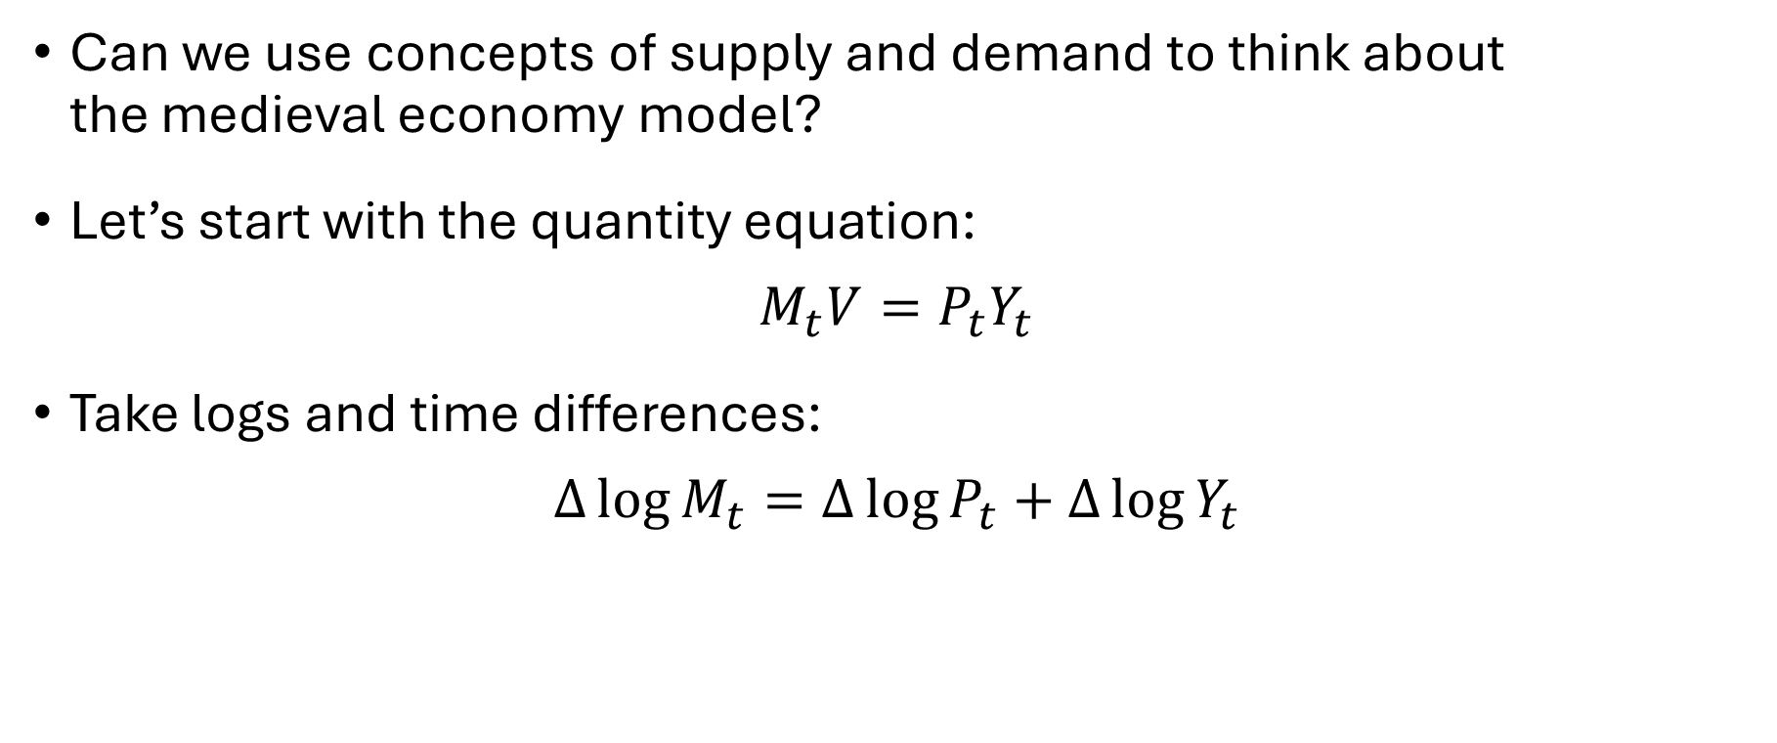
Business Cycle Model
Can we use concepts of supply and demand to think about the medieval economy model?
Let’s start with the quantity equation:
$$M_{t}V=P_{t}Y_{t}$$
Take logs and time differences:
$$∆\log{M_{t}}=∆\log{P_{t}}+∆\log{Y_{t}}$$

Slide 24
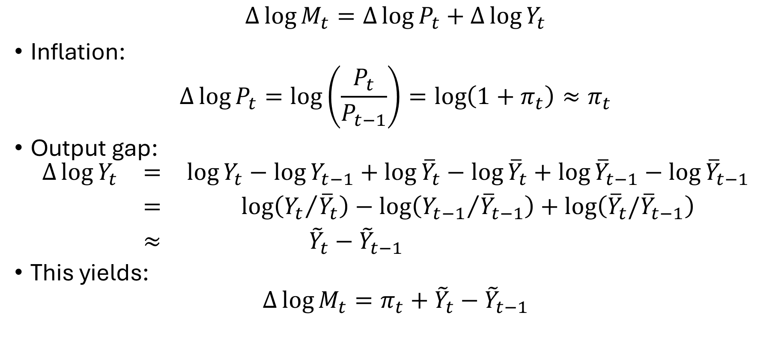
Money Market Equilibrium
$$∆\log{M_{t}}=∆\log{P_{t}}+∆\log{Y_{t}}$$
Inflation:
$$∆\log{P_{t}}=\log\left(\frac{P_{t}}{P_{t−1}}\right)=\log\left(1+π_{t}\right)≈π_{t}$$
Output gap:
$$\begin{matrix}∆\log{Y_{t}} & = & \log{Y_{t}}−\log{Y_{t−1}}+\log{{\overline{Y}}_{t}}−\log{{\overline{Y}}_{t}}+\log{{\overline{Y}}_{t−1}}−\log{{\overline{Y}}_{t−1}} \\ & = & \log\left({Y_{t}}/{{\overline{Y}}_{t}}\right)−\log\left({Y_{t−1}}/{{\overline{Y}}_{t−1}}\right)+\log\left({\overline{Y}}_{t}/{\overline{Y}}_{t−1}\right) \\ & ≈ & {\tilde{Y}}_{t}−{\tilde{Y}}_{t−1} \end{matrix}$$
This yields:
$$∆\log{M_{t}}=π_{t}+{\tilde{Y}}_{t}−{\tilde{Y}}_{t−1}$$
We drop this term. Think
of it as a constant that
doesn’t contribute anything
interesting to the analysis

Slide 25
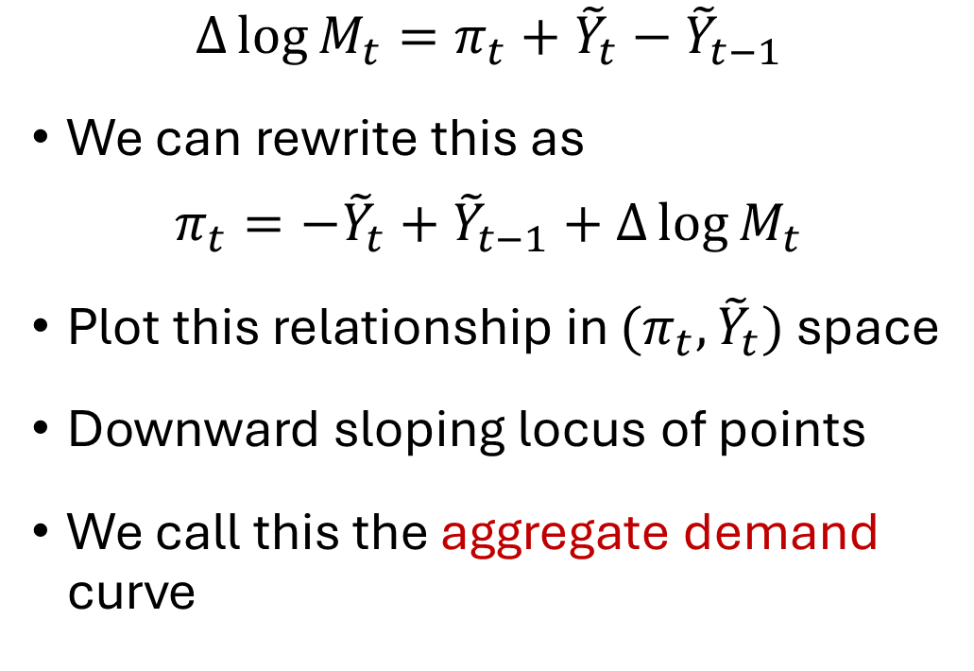
Quantity Equation as Aggregate Demand
$$∆\log{M_{t}}=π_{t}+{\tilde{Y}}_{t}−{\tilde{Y}}_{t−1}$$
We can rewrite this as
$$π_{t}=−{\tilde{Y}}_{t}+{\tilde{Y}}_{t−1}+∆\log{M_{t}}$$
Plot this relationship in $(π_{t},{\tilde{Y}}_{t})$ space
Downward sloping locus of points
We call this the aggregate demand curve
Inflation
AD
Output gap

Slide 26

Price Setting Equation
Lag equation by one period:
$$\frac{P_{t+1}}{P_{t}}={\left(\frac{Y_{t}}{Y_{t}^{∗}}\right)}^{θ} → \frac{P_{t}}{P_{t−1}}={\left(\frac{Y_{t−1}}{Y_{t−1}^{∗}}\right)}^{θ}$$
Take logs:
$$\log\left(\frac{P_{t}}{P_{t−1}}\right)=θ\log\left(\frac{Y_{t−1}}{Y_{t−1}^{∗}}\right)$$
$$π_{t}=θ{\tilde{Y}}_{t−1}$$

Slide 27
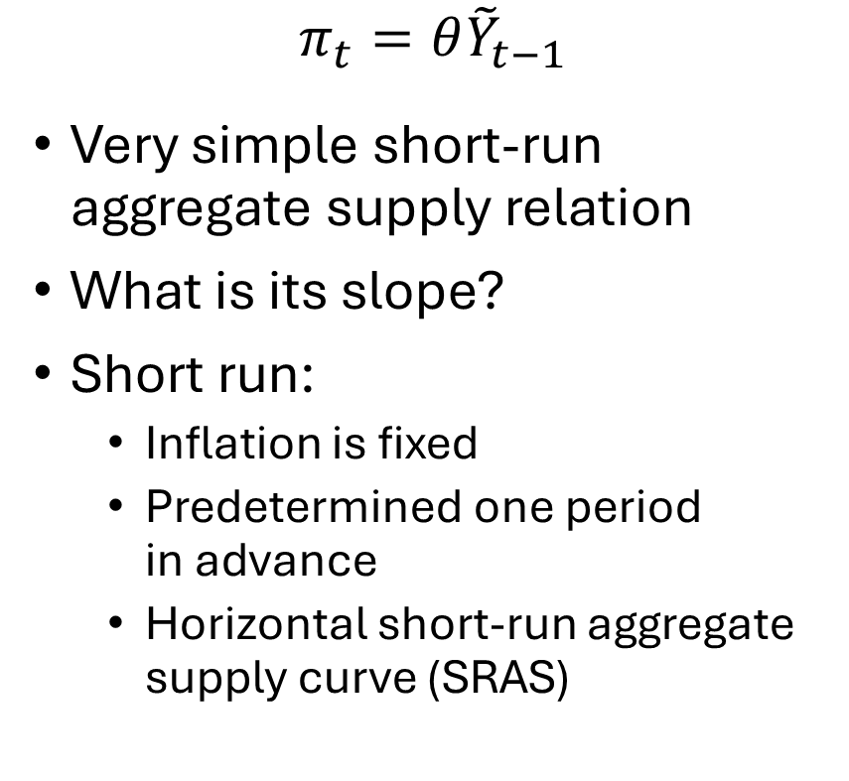
Short Run Aggregate Supply
$$π_{t}=θ{\tilde{Y}}_{t−1}$$
Very simple short-run aggregate supply relation
What is its slope?
Short run:
Inflation is fixed
Predetermined one period in advance
Horizontal short-run aggregate supply curve (SRAS)
Inflation
SRAS
Output gap

Slide 28


Short Run Equilibrium
Inflation
$$π_{t}$$
SRAS
AD
$${\tilde{Y}}_{t}$$
Output gap

