Slide 1
Lecture 1 Introduction Macroeconomics (Quantitative) Econ 101B
Jón Steinsson
University of California, Berkeley

Slide 2
State of the Economy Today
How is the U.S economy doing right now?
Very well, better than average
About average
Not well, less well than average
Terribly

Slide 3
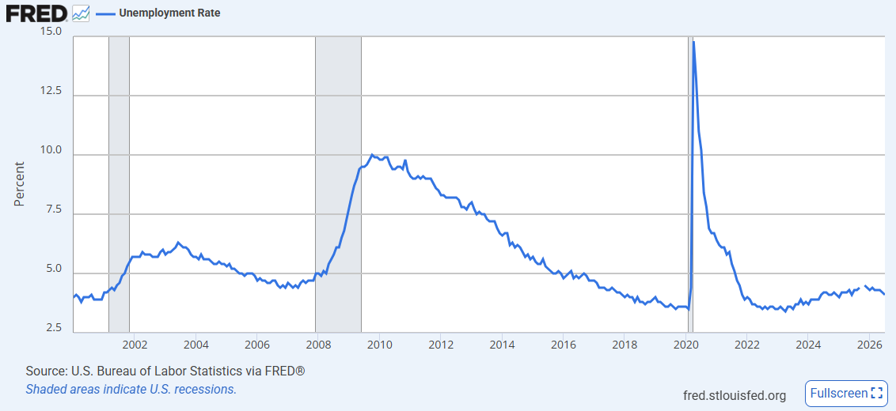
Unemployment Rate
Unemployment rate in July 2026: 4.1%

Slide 4
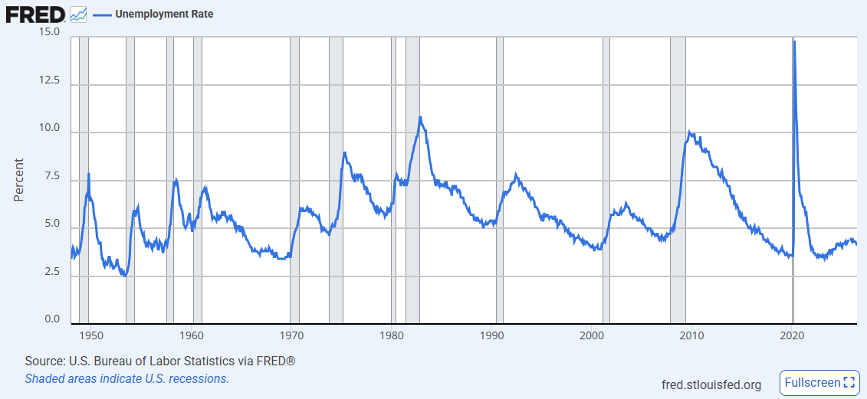
Unemployment Rate – Long View

Slide 5
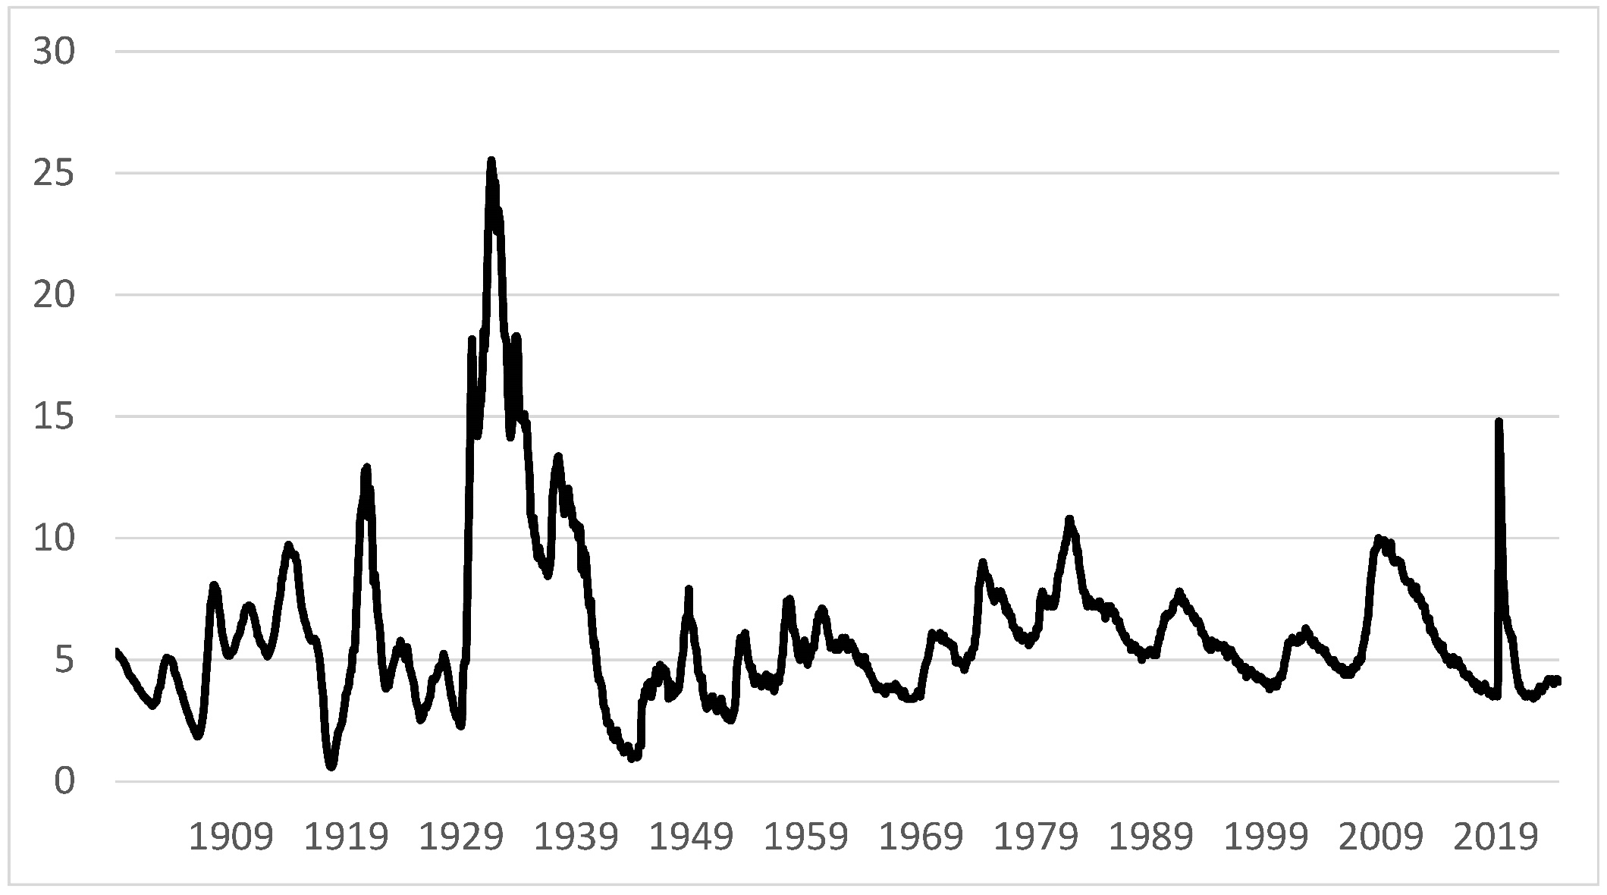
Unemployment Rate – Very Long View
Source: BLS and Petrosky-Nadeau and Zhang (2020)

Slide 6
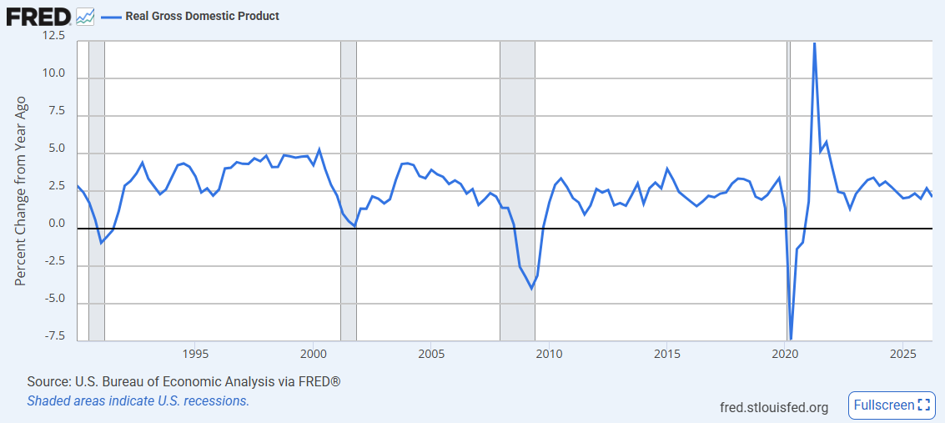
Real GDP Growth

Slide 7
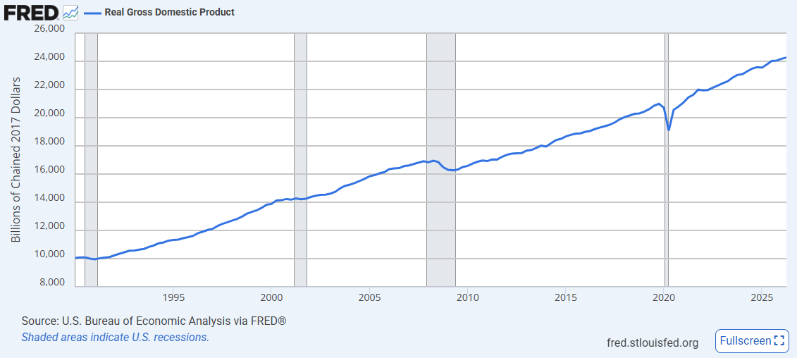
Real GDP

Slide 8
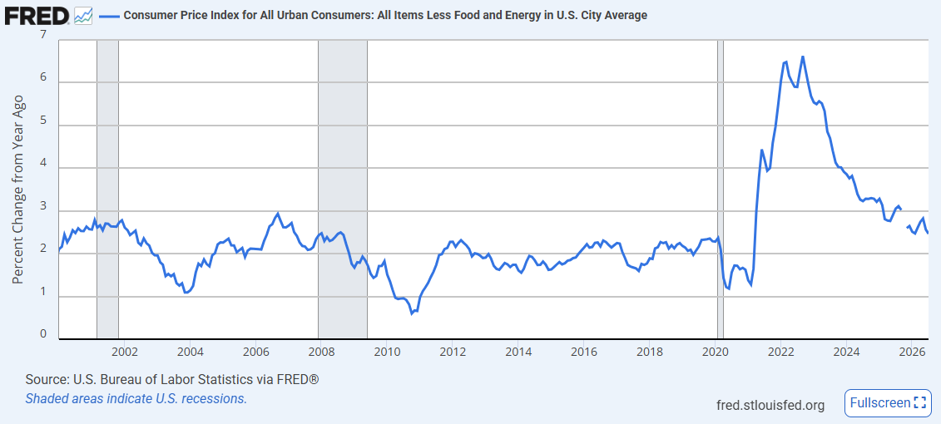
Core CPI Inflation (less food and energy)
Core CPI Inflation in June 2025: 2.5%
(percentage change from a year earlier)

Slide 9
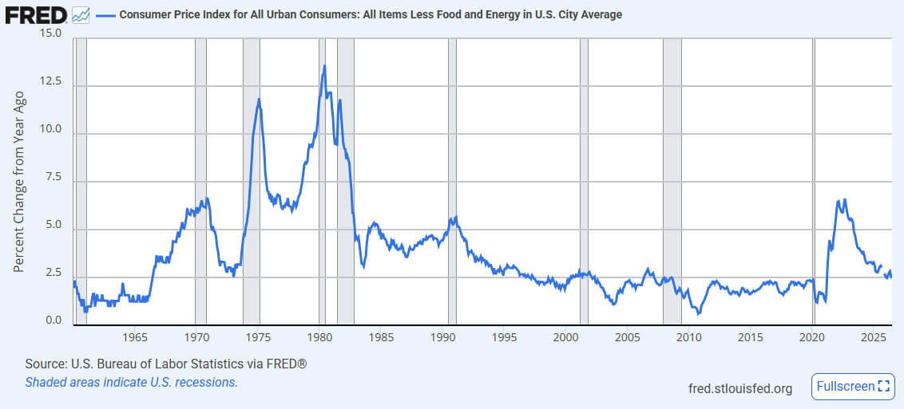
Core CPI Inflation – Longer View

Slide 10
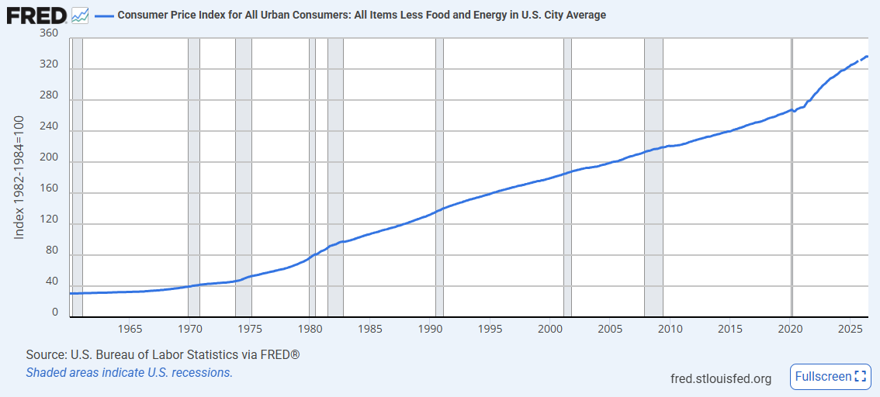
Core CPI Level

Slide 11
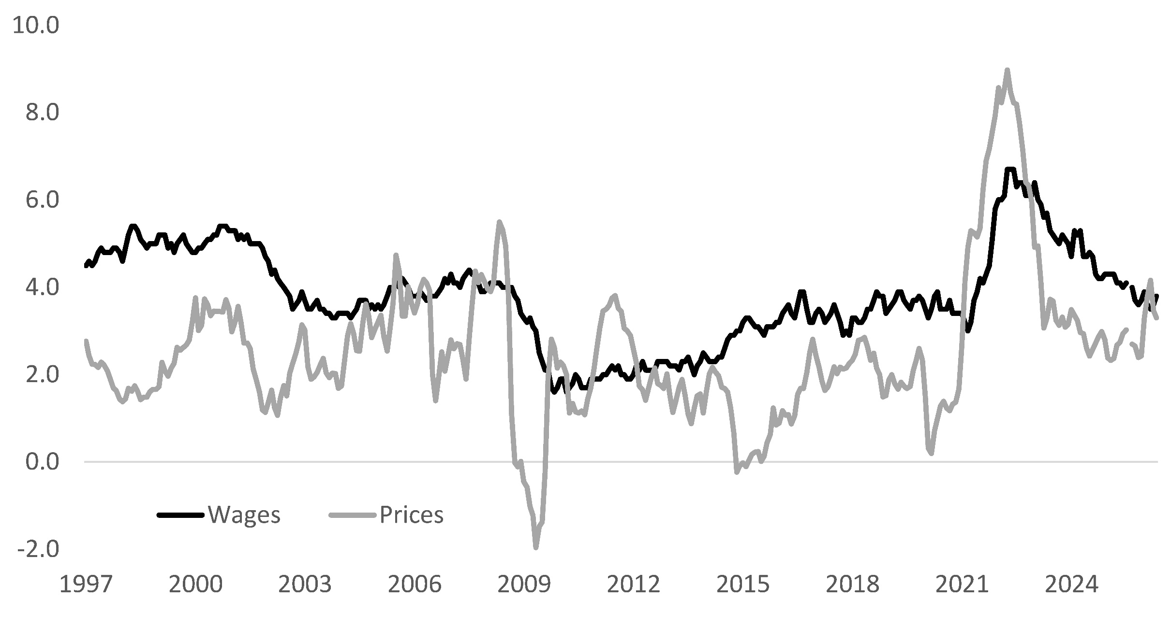
Real Wage Growth

Slide 12
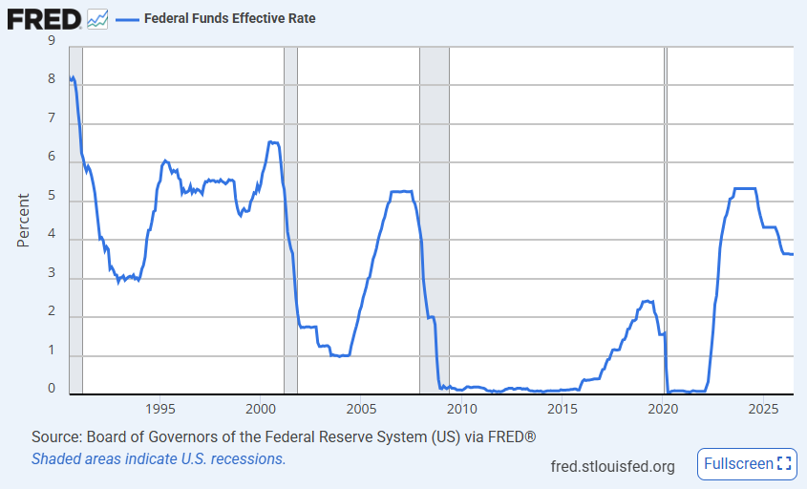
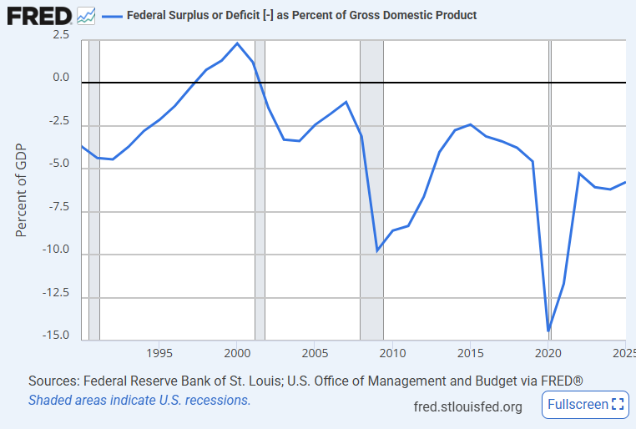
Monetary and Fiscal Policy

Slide 13
State of the Economy Today
Unemployment pretty low
Middling GDP growth
Inflation back down to low level
Strong real wage growth (until very recently)
Economy is doing very well

Slide 14
Gaining Perspective
One goal of the class:
Understand better current economic situation
Ongoing policy debate
Another goal: Gain a broader perspective
Recessions and booms more generally
Long run economic growth / Differences in income across countries
Inflation / Hyperinflation
Financial crises

Slide 15
Great Recession

Slide 16
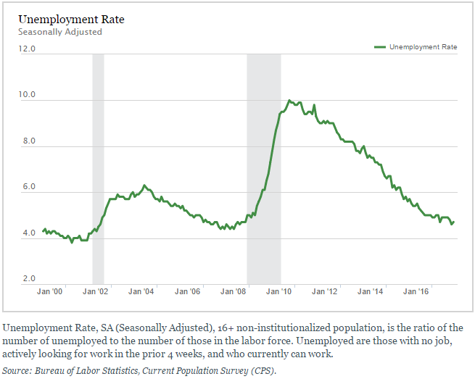

Slide 17
Policy Response
Federal Reserve lowered interest rates to zero
Bush/Obama administrations passed large “fiscal stimulus” bills
Massive increase of federal deposit insurance
Lehman Brothers let go bankrupt
Large Wall Street ``bailouts’’ (Fannie Mae, Freddy Mac, AIG, big banks)

Slide 18
State of Macro Knowledge
Krugman (2009):
How did economists get it so wrong? (i.e., how could we let this happen?)
“mistook beauty, clad in impressive-looking mathematics, for truth”
“blindness of the very possibility of catastrophic failures in a market economy.”

Slide 19
Great Recession vs. Great Depression
Christina Romer (Chair, CEA, 2009-2010): “I feel strongly that the shocks that hit the U.S. economy last fall [fall of 2008] were at least as large as those in 1929.”
Household wealth:
-17% in 2008 vs -3% in 1929
AAA-BAA spread:
338bp in Dec-2008 vs. 219bp in Dec-1930

Slide 21
Notes:
Why is our outcome now so much better? In particular, is it better policy? Is that because we understand things better? I.e., has macroeconomics as a body of knowledge helped us avoid another Great Depression?

Slide 22
The State of Macro
Romer, Sep 24th 2009:
“The accomplishment of walking the American economy back from the edge of the second Great Depression is real and deserves to be celebrated.”
Krugman, Sep 6th 2009:
“It’s hard to believe now, but not long ago economists were congratulating themselves over the success of their field.”

Slide 23
Ben Bernanke at Milton Friedman’s 90th Birthday Celebration
“I would like to say to Milton and Anna: Regarding the Great Depression. You're right, we did it. We're very sorry. But thanks to you, we won't do it again.”
Ben Bernanke
Chairman of Federal Reserve Board, 2006-2014
[then Governor at Federal Reserve Board]
November 8th 2002

Slide 24
Key Questions about Recessions/Crises
Why do they happen?
Irrational exuberance gone bad?
Policy mistakes?
Fundamental “shocks”?
Perhaps “self-fulfilling prophesies”?
Can good policy prevent recessions/crises?
What we do about them?
Major policy responses:
Monetary policy
Fiscal policy
Does it make sense to use fiscal stimulus? What kind?
Does it make sense to “bail out” banks? How? Why?

Slide 25
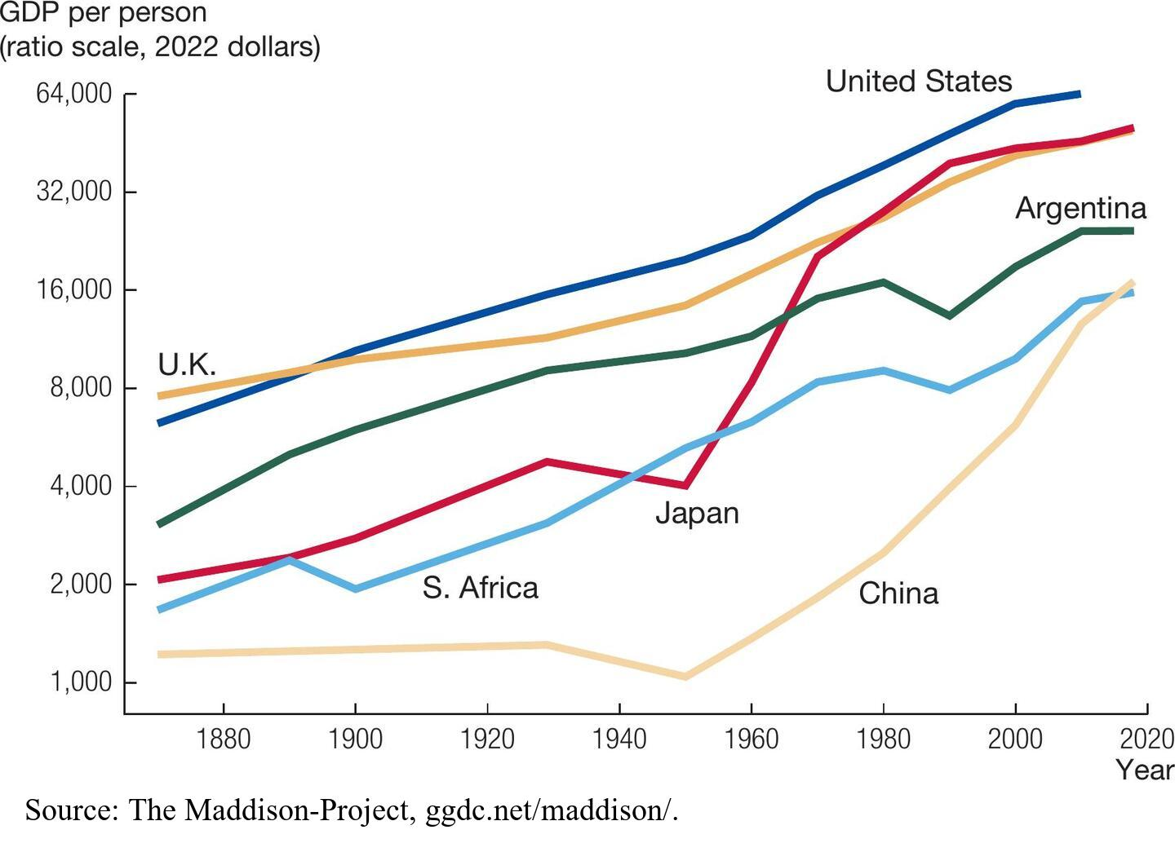
Economic Growth

Slide 26
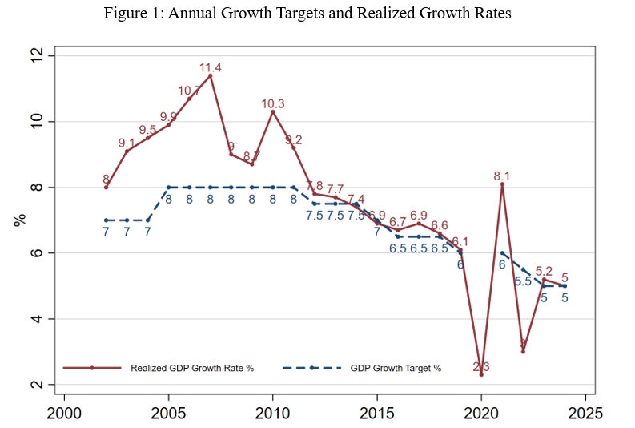
GDP Growth in China. Source: Chang, Wang, Wiong (BPEA 2025)

Slide 27
Consumption Growth in China. Source: Nakamura, Steinsson, Liu (2016)

Slide 28
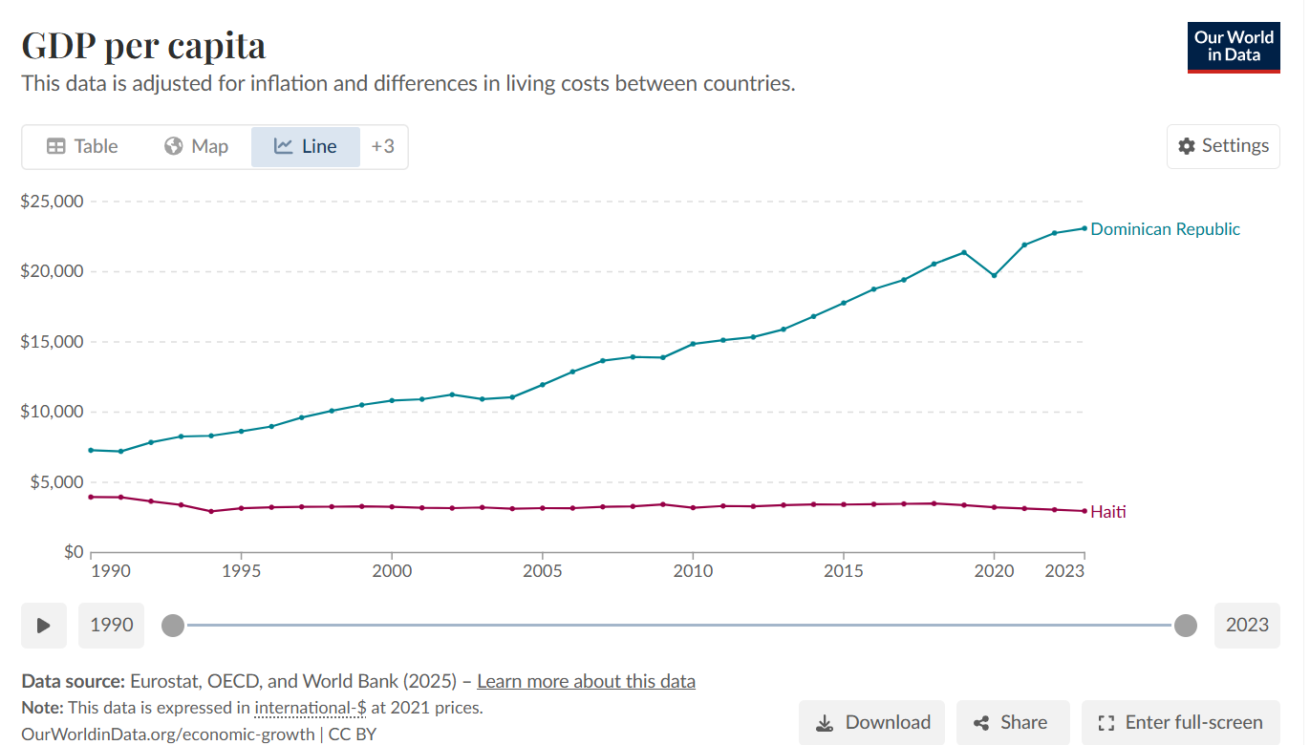

Slide 29
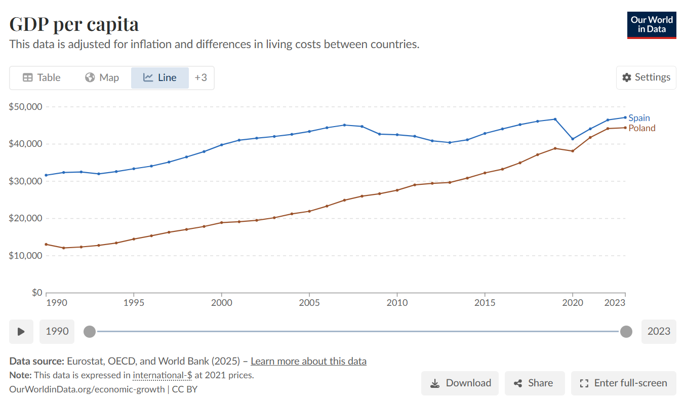

Slide 30
Long Term Growth
Robert Lucas (1988):
Per capita growth for period 1960-80:
India: 1.4% (doubles every 50 years)
Egypt: 3.4% (doubles every 21 years)
Indonesia: 7.5% (doubles every 9 years)
“Is there some action a government of India could take that would lead the Indian economy to grow like Indonesia’s or Egypt’s?”
“The consequences for human welfare involved in questions like these are simply staggering: Once one starts to think about them, it is hard to think about anything else.”

Slide 31
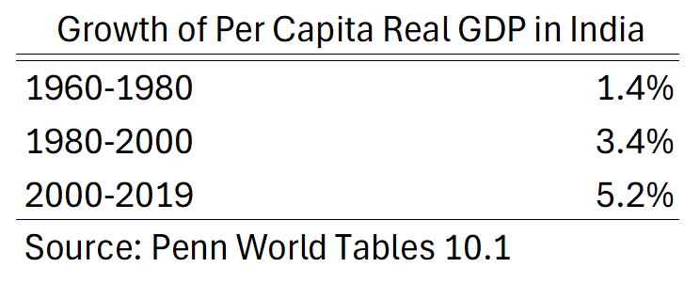

Slide 32
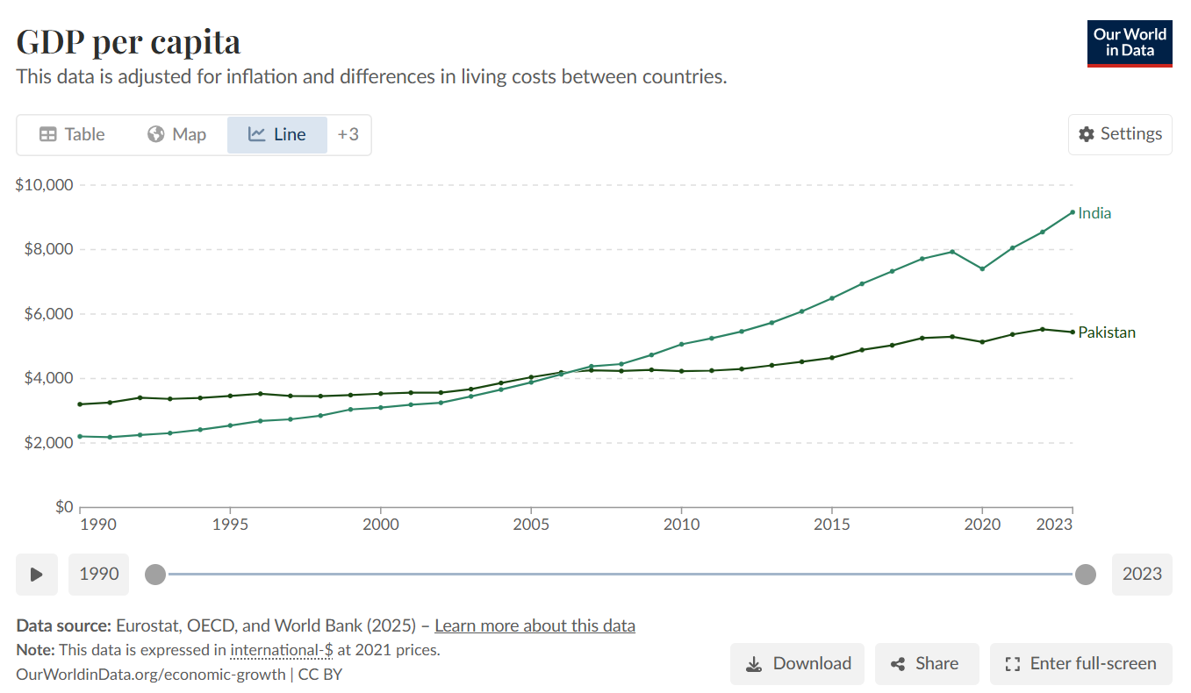

Slide 33
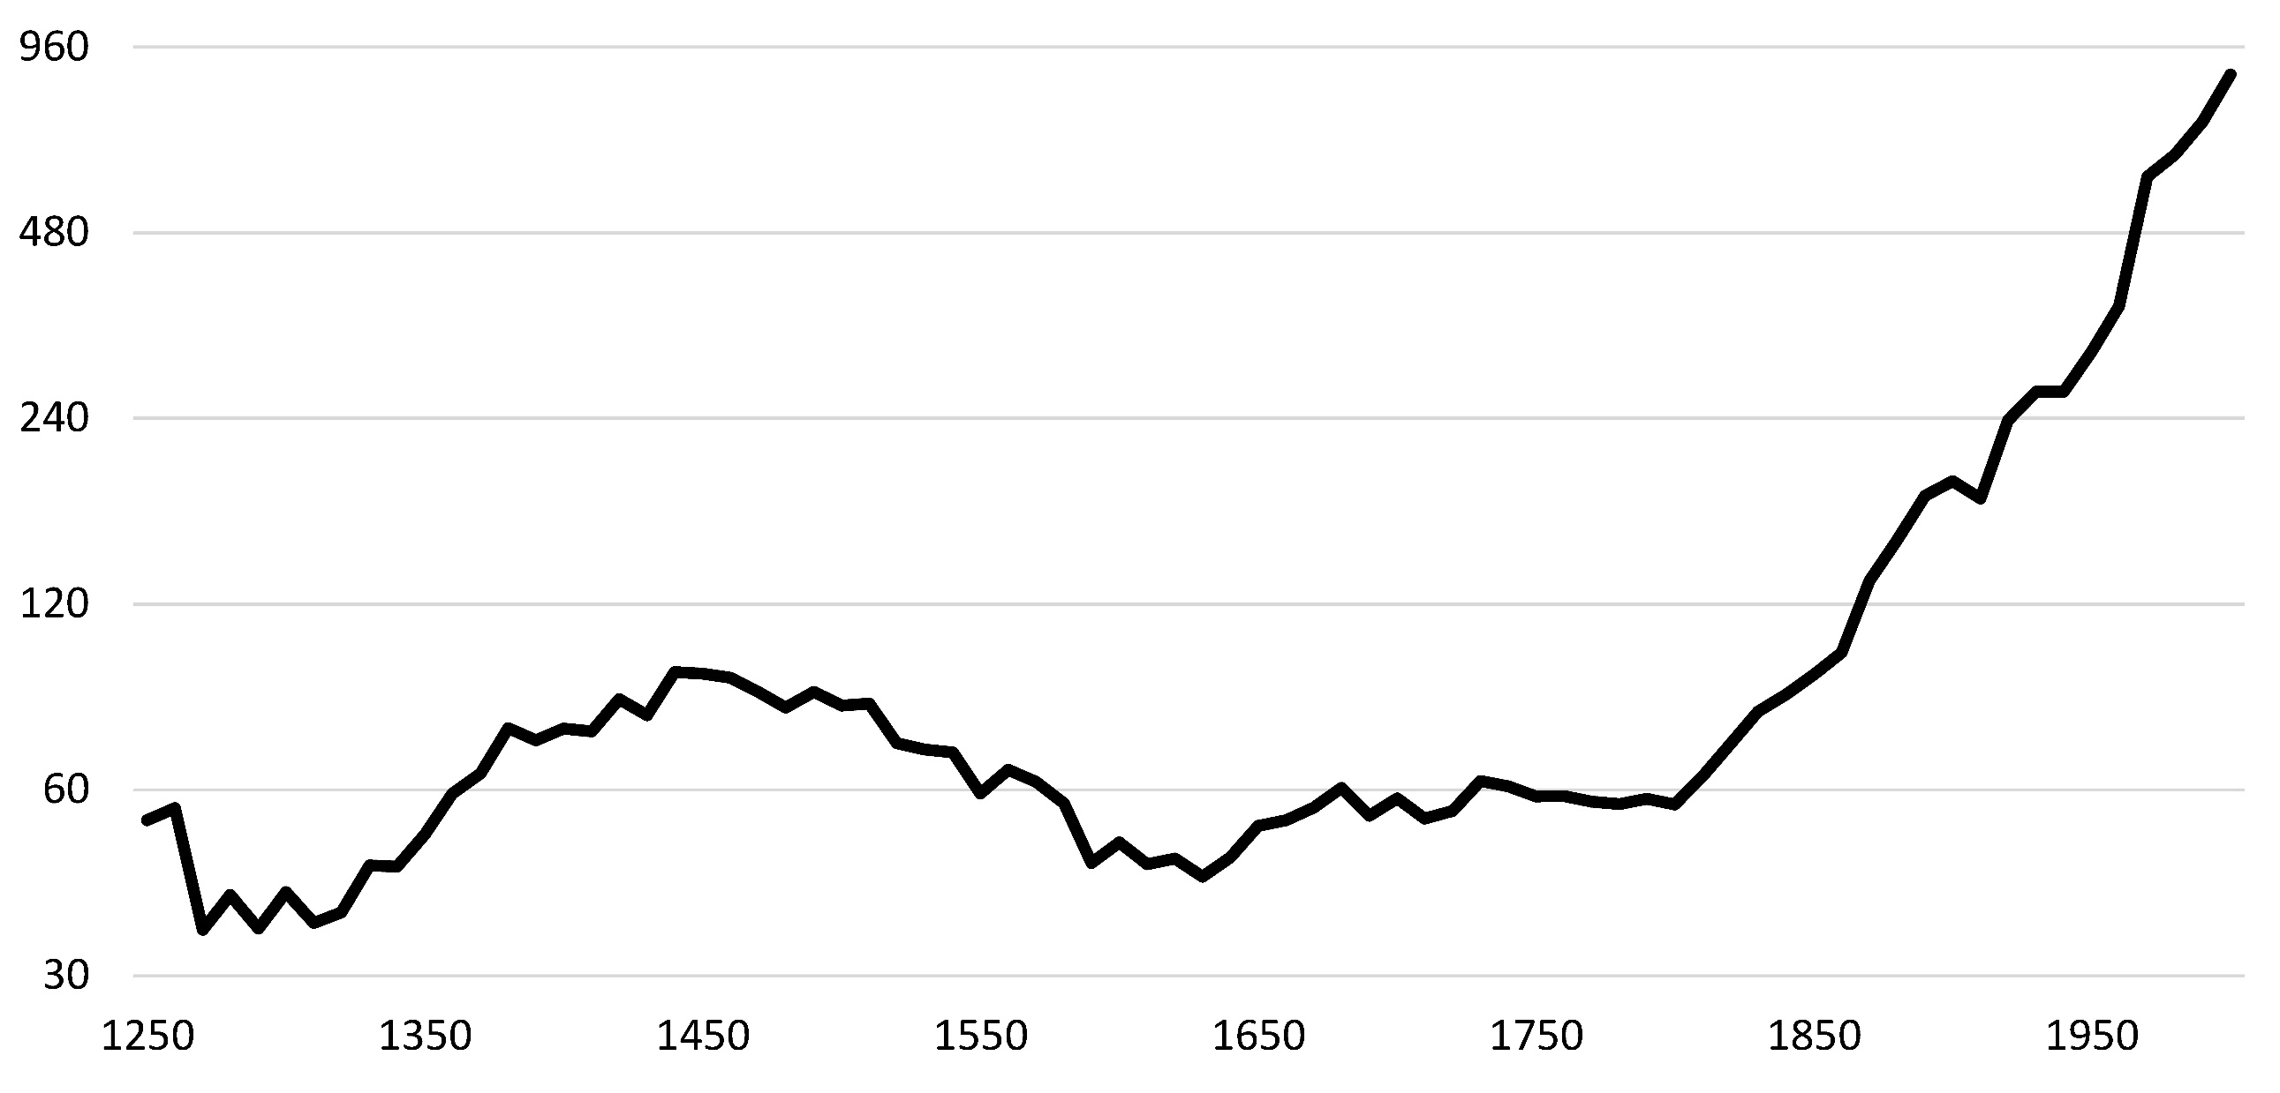
Growth Is a Modern Phenomenon
Real Wages of Laborers in Building Industry in England from Clark (2005, 2010)

Slide 34
How Will the Next 50 Years Compare?
Bernanke (2013):
Compares 1963 with 2013
Most things the same (except internet, cellphones, microwave ovens) (since then, we have social media, ChatGPT)
Then compares 1913 with 1963
Fundamental differences (few people had electricity, telephones, cars. No radio, airplanes, antibiotics, etc.)
Is innovation running out of steam?
Bernanke doesn’t think so.
Others at the time worried it was (e.g., Gordon, 2016)

Slide 35
AI and Our Economic Future
AI may be the most transformative technology of our lifetimes
Last 250 years: Steam engine, internal combustion engine, electric motor, transistor, internet, etc.
Is AI fundamentally different?
Will it lead growth to accelerate?
Or more of the same?
Is it just the engine of growth for our era?
How long will it take for AI to transform the world?
Will it take all our jobs?

Slide 36
Key Questions About Growth:
Why do growth rates differ so much across countries? (China grew 3-4 times faster than the U.S. over last decades)
What is the source of economic growth? (Why are we about 10 times richer than Americans a century ago?)
Why are some countries 50 times poorer than others?
How did modern economic growth begin?
Will it continue?

Slide 37
Future Economic Growth
What will be the average rate of growth of GDP per capita in the U.S. from 2025-2075
<1%
1-2%
2-3%
3-5%
>5%

Slide 38
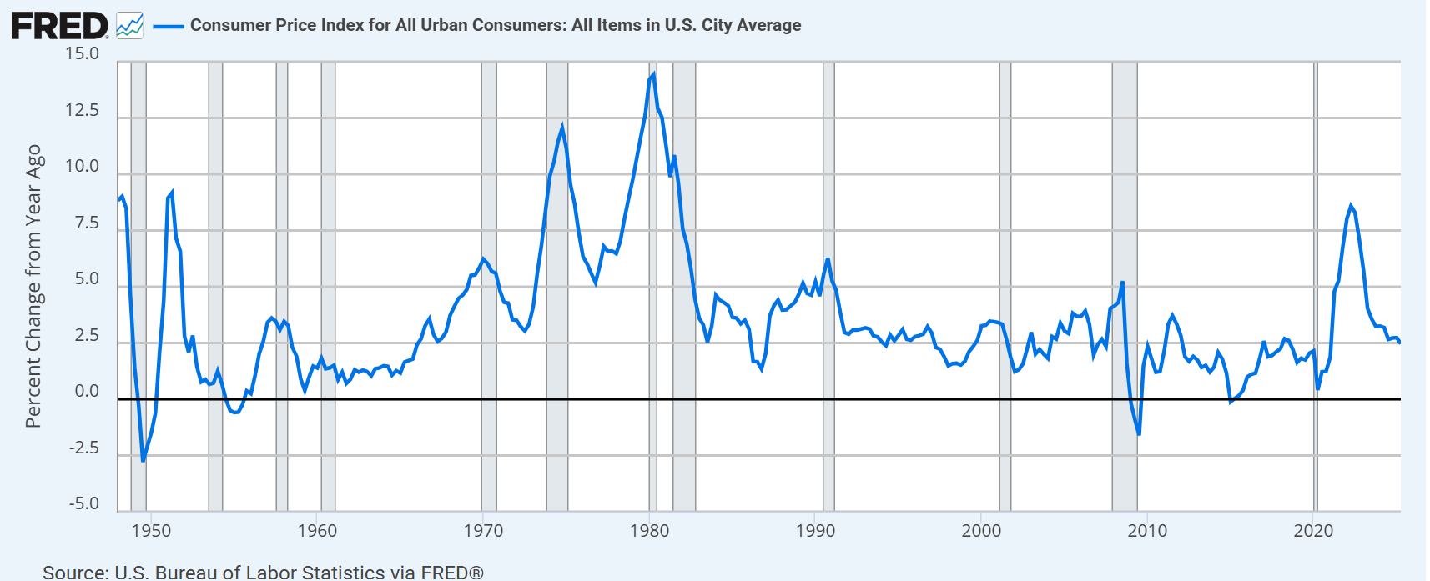
Inflation

Slide 39
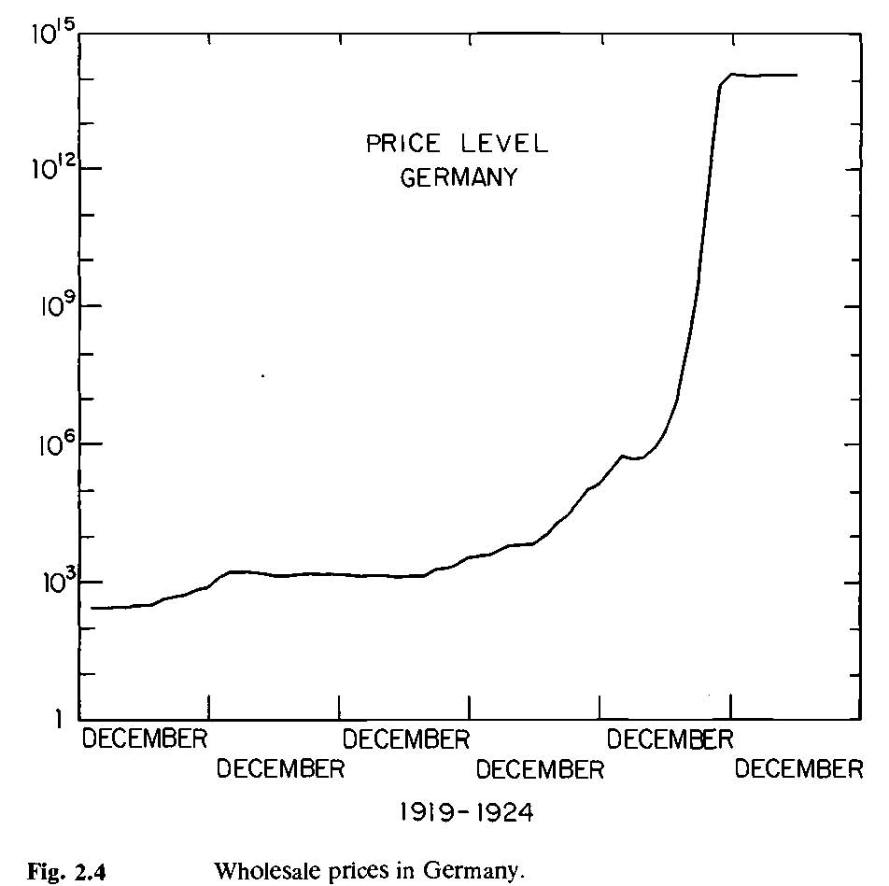
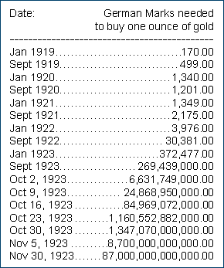

Slide 40
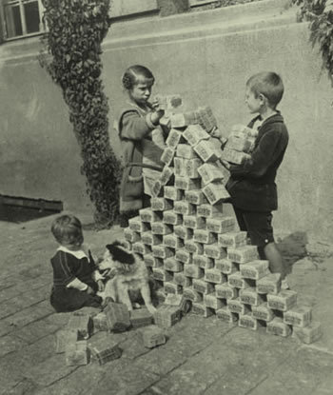

Slide 41
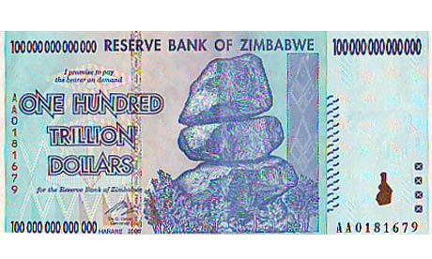
Zimbabwe rolls out Z$100 trillion note
BBC News
January 16th, 2009
Old banknotes such as this, once considered near worthless when in circulation,
are enjoying a resurgence in value with tourists eager to buy notes as curiosities. …
The IMF says the [inflation] rate peaked at the end of 2008 at 500 billion percent.
The Scotsman
January 5th, 2010

Slide 42
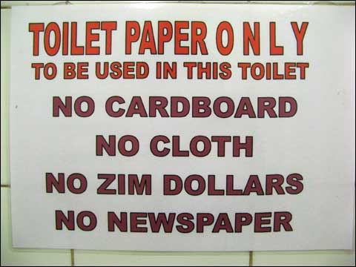

Slide 43
Key Questions About Inflation:
What determines the rate of inflation?
Why did inflation in the U.S. rise to double digit levels in the 1970’s?
Why do some countries experience hyperinflations?
How should a country deal with deflation?
How costly is inflation (and deflation)?

Slide 44
How Can This Class Help You Answer Key Questions?
We will discuss empirical evidence that may affect your thinking about these issues and we will discuss how to interpret this evidence
We will develop theory (i.e., a powerful language) that will help you think about these issues and explain the empirical evidence

Slide 45
The Interplay of Theory and Facts
Theory
Facts help us decide
what types of models
to construct
Theory helps us decide
what to measure
Facts
Notes:
Science is an interplay between two activities: 1) the production of facts, 2) the explanation of facts with theory. These two activities are intimately tied together. It is impossible to advance knowledge on one of these fronts significantly without a good understanding of both. Random facts are not interesting. And random theories are not interesting either.

Slide 46
Thinking Like An Economist
A correlation does not imply a causal relationship
Example: Countries with more complex tax systems have higher income per capita
Example: Teenagers that start to use alcohol later are less likely to have drug problems later in life
The power of competition
Competitive markets lead to an efficient outcome
Government intervention can be justified by a “market failure”. (What is the market failure?)

Slide 47
Left Wing Critique
Mainstream economics is hopelessly biased in favor of the rich and powerful (i.e., capitalists)
Neoclassical economics is a tool of the powerful to exploit the powerless

Slide 48
Left Wing Critique
I have some sympathy for this view
Models with “perfect markets” are easier to solve
Hence, they are a common benchmark
Models are meant to be a stylized version of reality, but are often an idealized version of reality
We use them so much we forget that their conclusions depend on strong assumptions that may not accurately reflect the real world
Important (but hard) to not let this bias one’s thinking

Slide 49
Defense of Mainstream Economics
Left wing critics often have a rosy view of reality:
“From each according to their ability, to each according to their need”
Basic premise of mainstream economics:
People respond to incentives

Slide 50
Defense of Mainstream Economics
Central idea of mainstream economics:
Competition restrains exploitation
Sometimes competition fails.
Some economists have too rosy a view of market competition
But throwing out neoclassical economics is like throwing out the baby with the bathwater

