Slide 1
A comparison of Evolutionary algorithm operators using a Genetic Cars Simulation
By Jon

Slide 2
My Project
My project is to create a Evolutionary Algorithm for a pre-existing framework.
The pre-existing framework is Javescript simulation run on a internet browser. Example: https://rednuht.org/genetic_cars_2/

Slide 3
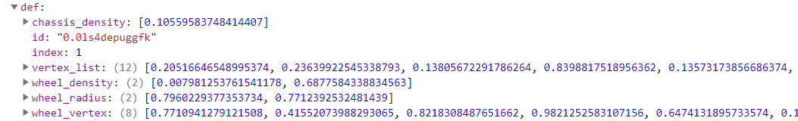
Car Data example
A cars data consist of 5 Arrays with varying lengths. I treat the 5 arrays as the main datapoints.
Car Data Example

Slide 4
Selection operators Implementation
Roulette-wheel selection (fitness proportionate), A cars fitness determines the chance of a car being chosen such as the fittest car having the highest percentage chance of being chosen compared to the weakest car.
Tournament selection – A set of cars are randomly chosen from the population and put into another array, the fittest car in this new array is chosen as a parent.
Uniform random selection – All cars in the population has a equal chance of being chosen.
Tournament selection getting the strongest and weakest – Like tournament but 1 parent is the weakest car in the population and the other is the strongest.

Slide 5
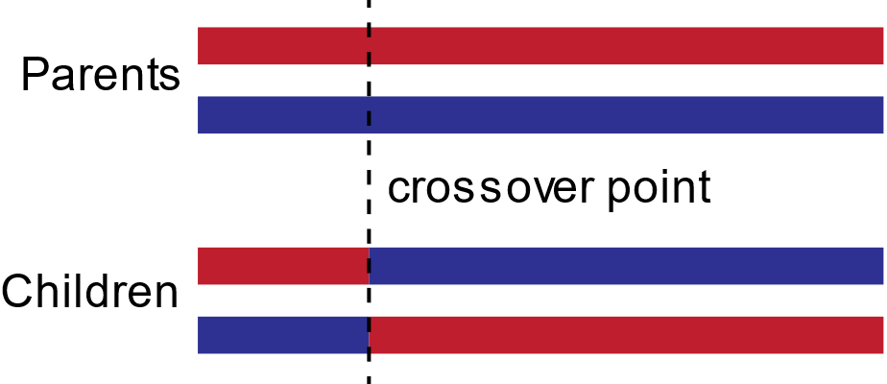
Crossover operators implementation
One-point crossover – only 1 point is chosen in the data
Two-point crossover
Crossover example
Ref: R0oland (2013). OnePointCrossover. [image] Available at: https://commons.wikimedia.org/wiki/File:OnePointCrossover.svg [Accessed 6 Mar. 2019].

Slide 6
Mutation operators implementation
1 Mutation – only 1 mutation happens
Multi-mutation – Multiple mutations effect a car depending on the criteria, the criteria what I’m using is that the bottom half of the population has 3 mutations instead of the normal 1.

Slide 7
Elitism implementation
The car/s with the highest fitness in the population are passed through to the next generation without any mutation altering the cars data, It is also possible for Elitism to use other criteria to pass a car to the next generation.

Slide 8
Cluster Re-scoring
There are 5 clusters for a cars 5 data points. A cars data point is put into the clusters and the cluster is ordered highest to lowest so a cars data point will be surrounded by similar numbers.
K-nearest neighbour is used to get the surrounding cars scores in a cluster, and the scores are averaged and added to the cars original score.

Slide 9
What I’m currently doing?
Testing different version of the Evolutionary algorithm using a preliminary 10 test runs and averaging the data, this will increase adding an extra 20 runs to get a more accurate average.
I’ve currently got 53 sets of data, with varying different operators and selection pressure.

Slide 10
Baseline Roulette-Selection With no elites

Slide 11
Selection Pressure Increase 1 elites

Slide 12
Selection Pressure Increase 3 elites

Slide 13
Selection Pressure Increase 9 elites

Slide 14
Baseline Tournament Selection With no elites

Slide 15
Selection pressure increase 1 elites

Slide 16
Selection pressure increase 3 elites

Slide 17
Selection pressure increase 9 elites

