Slide 1

En mobildatabase som ikke er SQLite
https://s3.amazonaws.com/static.realm.io/downloads/press/Realm+Press-Kit.zip

Slide 2

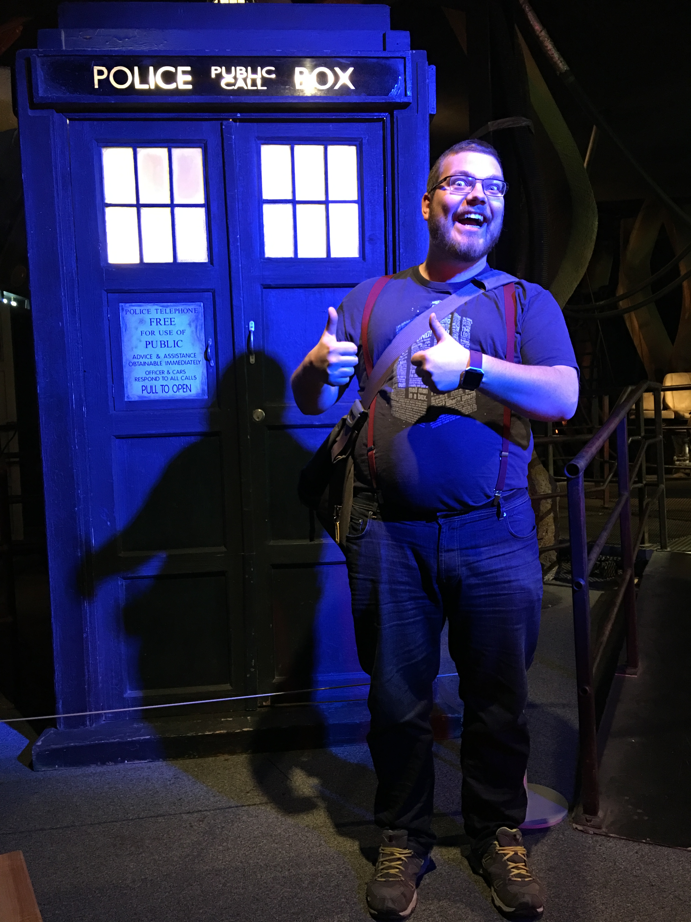
Jon Stødle
Jobb | Sykehuspartner HF
Alder | 26
Sivilstatus | Samboer
Opphavssted | Julebygda
Teknologi | .Net, Xamarin

Slide 3


Realm Mobile Database
Realm Mobile Platform
https://thenounproject.com/term/database/887255/
https://thenounproject.com/term/cloud-database/30496/

Slide 4

Realm Mobile Database
Realm Mobile Platform
GRATIS
ELLER
$1500/MÅNED
https://en.wikipedia.org/wiki/Open-source_software#/media/File:Opensource.svg

Slide 5
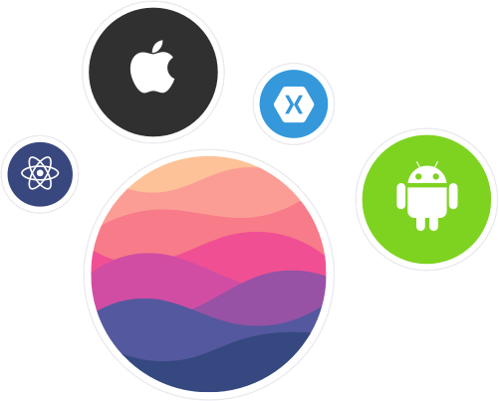
https://realm.io/about/

Slide 6
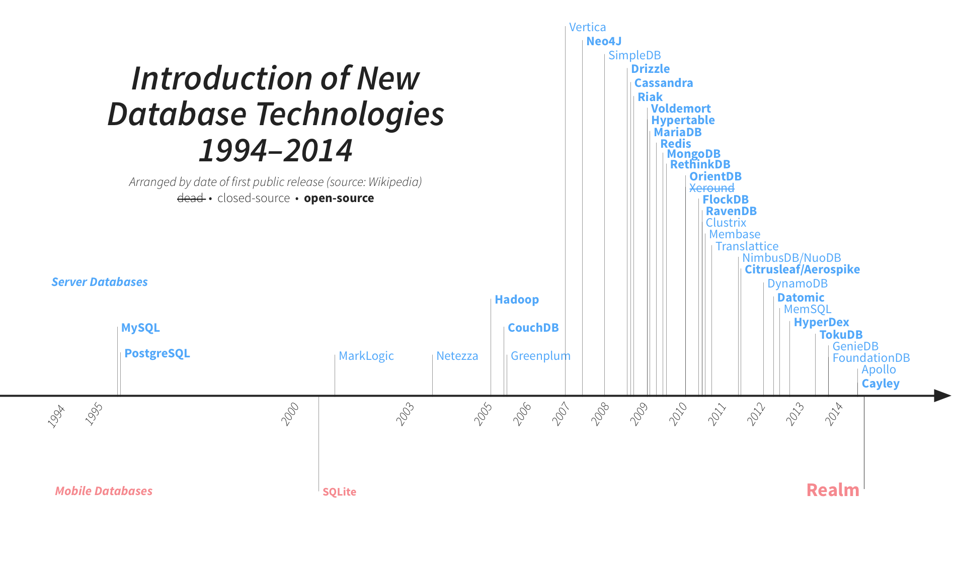
https://realm.io/news/introducing-realm/

Slide 7

≠
https://s3.amazonaws.com/static.realm.io/downloads/press/Realm+Press-Kit.zip
https://commons.wikimedia.org/wiki/File:SQLite370.svg

Slide 8

Objektdatabase
https://thenounproject.com/term/graph/642304

Slide 9


https://thenounproject.com/term/lightning/547981/

Slide 10
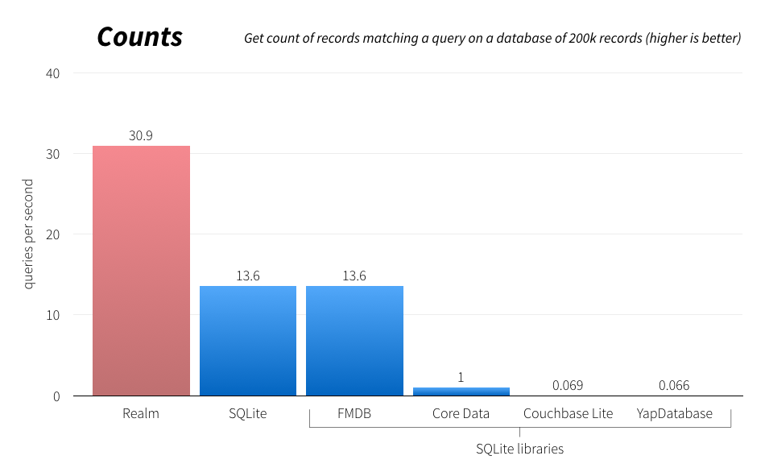
https://realm.io/news/introducing-realm/

Slide 11

https://realm.io/news/introducing-realm/

Slide 12
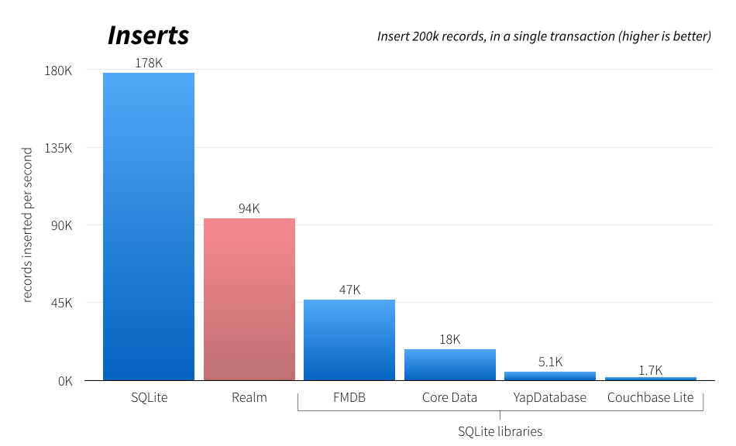
https://realm.io/news/introducing-realm/

Slide 13
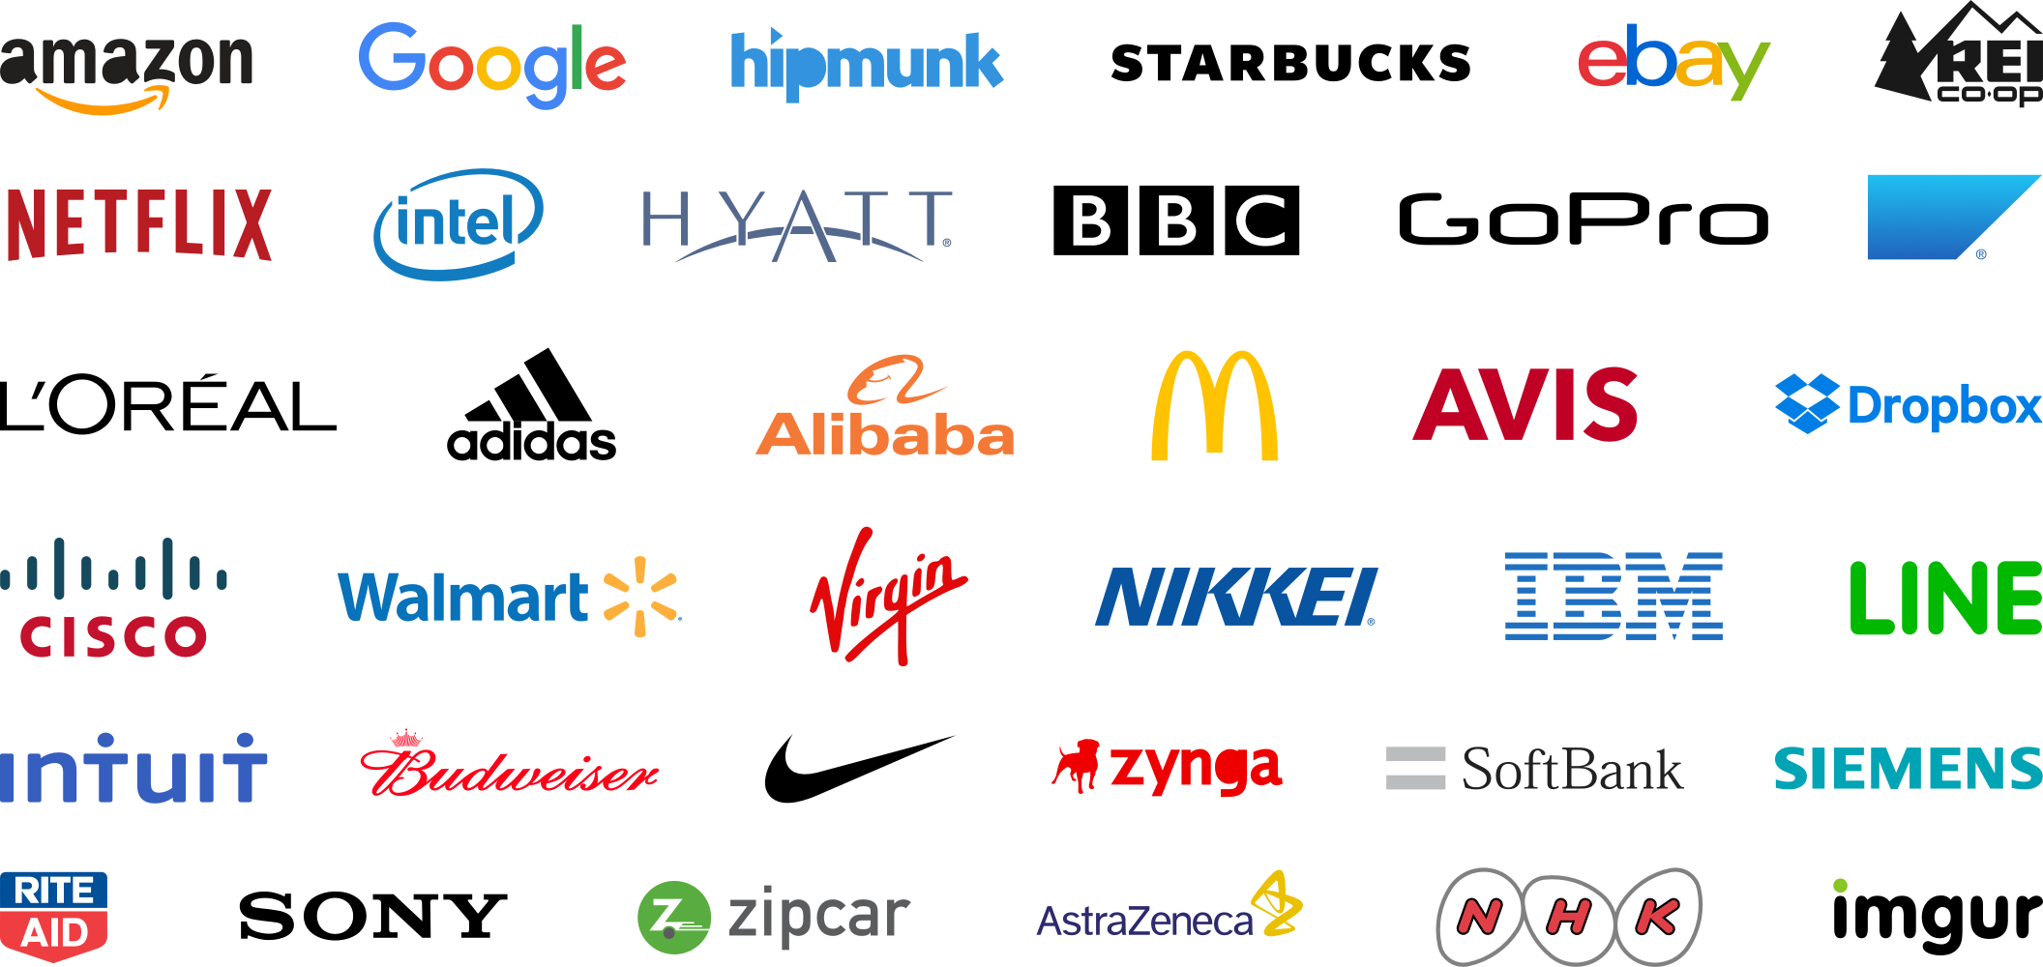
https://realm.io/about/

Slide 14
Demo

