Slide 1
Best neighbourhood with least crime in scarborough, canada
By jon tinsley

Slide 2
Low levels of crime are an attractive factor for families deciding to move
Generally, parents will perform due diligence when moving to a new area. They want to make sure they are moving to an area with as low crime as possible.
However, it can be hard to find out which areas are the safe areas in a neighbourhood you do not know, and one that you do not know nayone to have ever lived in.
This is where data science can help!

Slide 3
Data acquisition and cleaning
Neighbourhood data was obtained from FourSquare and Wikipedia (https://en.wikipedia.org/wiki/List_of_postal_codes_of_Canada:_M)
Crime data will be sourced from Neighbourhood Crime Rates 2020 (Neighbourhood Crime Rates 2020 (torontopolice.on.ca).
Geojson data will be sourced from toronto-geojson/toronto_crs84.geojson at master · jasonicarter/toronto-geojson (github.com)
atitude and longitude data was gathered from https://cocl.us/Geospatial_data and read using the read_csv function of pandas.

Slide 4
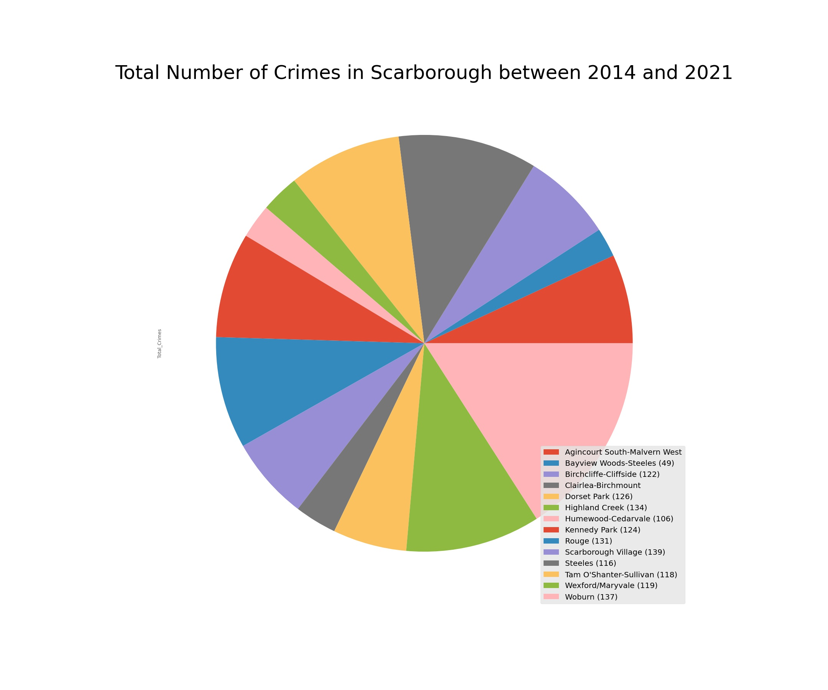
Exploratory data analysis 1: pie chart of crime levels of Scarborough areas

Slide 5
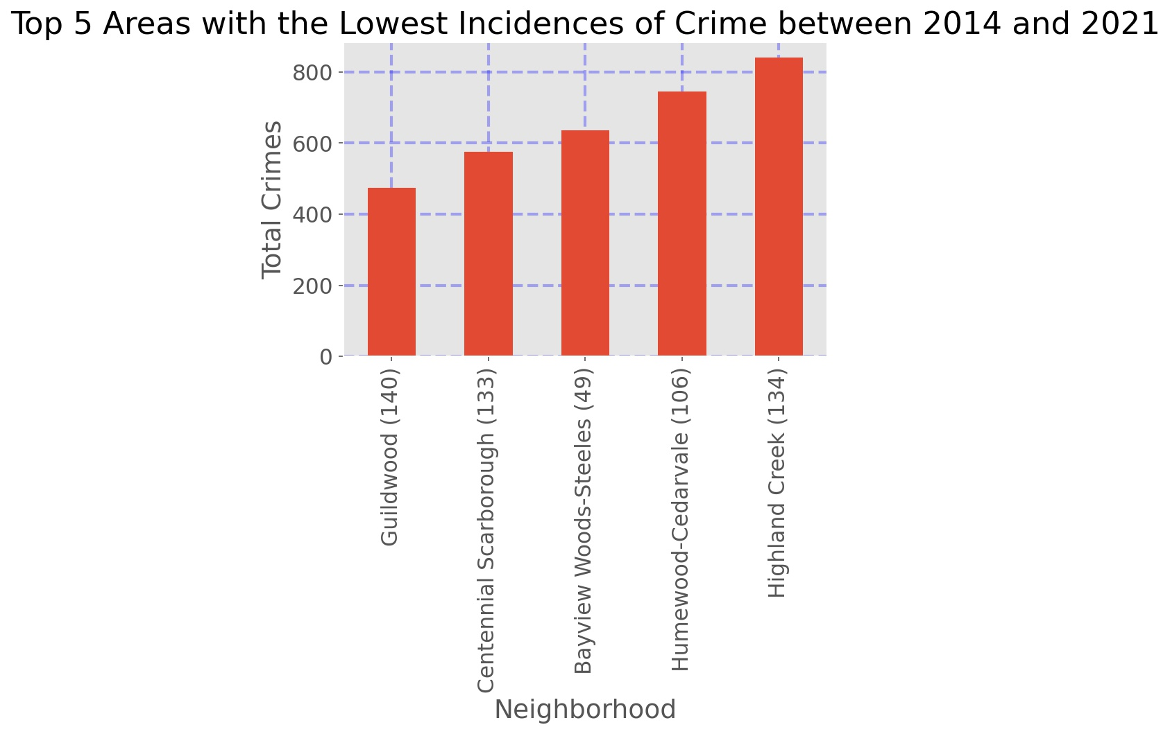
Exploratory data analysis 2: top 5 safest areas

Slide 6
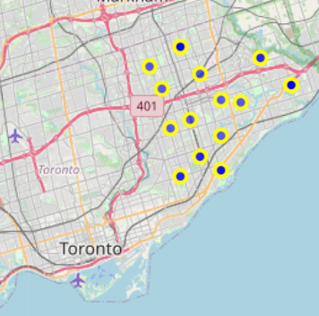
Neighbourhoods in Scarborough

Slide 7
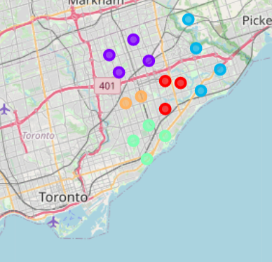
K-means clusters of neighbourhoods in scarborough showing those belonging to same area

Slide 8
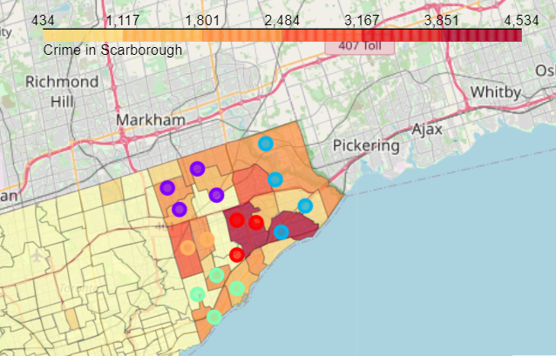
Choropleth showing crime per neighbourhood and k-means cluster-defined area

Slide 9
Conclusion and future direction
Areas of Scarborough, Toronto, Canada with relatively lower levels of crime were identified using Python
This was visualised on to a choropleth map, which showed how neighbourhoods were clustered into an area via K-means machine learning
More insights on the rate of crime per year, and how this changes over time would add to the informative power of the report
Future directions: the direction of change of crime rate could be modelled to find which areas are trending upwards for crime and which are trending downwards.

