Slide 1
a
2/3
b
1/1
2/4
1/2
c
3/3
e
2/2
1/1
d
a
1
A
 | A | B | C | D
a | 1 | 3 | 4
b |  | 3 |  | 2
c | 4 | 3 | 2 | 1
d |  |  | 1 | 2
4
3
b
3
B
2
4
3
c
2
C
1
1
d
2
D

Slide 2
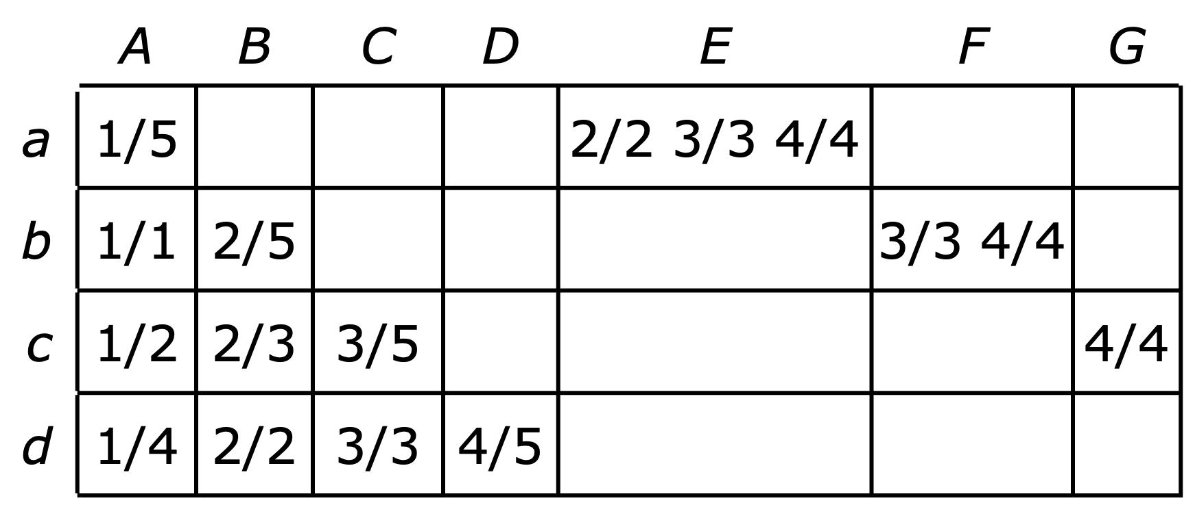
 | A | B | C | D | E | F | G
a | 1/5 |  |  |  | 2/2 3/3 4/4
b | 1/1 | 2/5 |  |  |  | 3/3 4/4
c | 1/2 | 2/3 | 3/5 |  |  |  | 4/4
d | 1/4 | 2/2 | 3/3 | 4/5
 | A | B | C | D | E | F | G
a | 1 |  |  |  | 2,3,4
b | 1 | 2 |  |  |  | 3,4
c | 1 | 2 | 3 |  |  |  | 4
d | 1 | 2 | 3 | 4
 | A | B | C | D | E | F | G
a | 1/5 |  |  |  | 2/2,3/3,4/4
b | 1/1 | 2/5 |  |  |  | 3/3,4/4
c | 1/2 | 2/3 | 3/5 |  |  |  | 4/4
d | 1/4 | 2/2 | 3/3 | 4/5

Slide 3
 | A | B | C | D | E | F | G | H | I | J | K | L | M
a | 1/9 |  |  |  |  |  |  | 2/2 3/3 4/4 5/5 6/6 7/7
b | 1/8 | 2/9 |  |  |  |  |  |  | 3/3 4/4 5/5 6/6 7/7
c | 1/2 | 2/8 | 3/9 |  |  |  |  |  |  | 4/4 5/5 6/6 7/7
d | 1/1 | 2/2 | 3/8 | 4/9 |  |  |  |  |  |  | 5/5 6/6 7/7
e | 1/3 | 2/4 | 3/5 | 4/8 | 5/9 |  |  |  |  |  |  | 6/6 7/7
f | 1/6 | 2/3 | 3/4 | 4/5 | 5/8 | 6/9 |  |  |  |  |  |  | 7/7
g | 1/7 | 2/6 | 3/3 | 4/4 | 5/5 | 6/8 | 7/9
 | A | B | C | D | E | F | G | H | I | J | K | L | M
a | 9 |  |  |  |  |  |  | 2-7
b | 8 | 9 |  |  |  |  |  |  | 3-7
c | 2 | 8 | 9 |  |  |  |  |  |  | 4-7
d | 1 | 2 | 8 | 9 |  |  |  |  |  |  | 5-7
e | 3 | 4 | 5 | 8 | 9 |  |  |  |  |  |  | 6-7
f | 6 | 3 | 4 | 5 | 8 | 9 |  |  |  |  |  |  | 7
g | 7 | 6 | 3 | 4 | 5 | 8 | 9

Slide 4
a₁
1
a
1
A
flow range
1
A₁
3
2
a₂
4
1
1
E
1–2
A₂
1–2
1
b₁
1
b
2
B
1–2
1
3
1
E₁
2
t
4
s
b₂
1
F
1
1
2
1–2
E₂
2
c
3
C
c₁
4
1–2
1
1
1
G
c₂
B₁
2
1
d
3
D
1
4
d₁
B₂
1
1
d₂

Slide 5
 | A | B | C | D | E | F | G | H | I | J | K | L | M
a | 9 |  |  |  |  |  |  | 2-7
b | 8 | 9 |  |  |  |  |  |  | 3-7
c | 2 | 8 | 9 |  |  |  |  |  |  | 4-7
d | 1 | 2 | 8 | 9 |  |  |  |  |  |  | 5-7
e | 3 | 4 | 5 | 8 | 9 |  |  |  |  |  |  | 6-7
f | 6 | 3 | 4 | 5 | 8 | 9 |  |  |  |  |  |  | 7
g | 7 | 6 | 3 | 4 | 5 | 8 | 9
1,x
n+1,n+x
x+1,2x+1
2x+2,n

Slide 6
a
2
b
1
2
1
c
3
e
2
1
d
a
1
A
 | A | B | C | D
a
b
c
d
1
2
1
2
1
b
3
B
2
3
2
2
1
c
2
C
2
2
1
1
1
3
3
3
d
3
D

