Slide 1
first: 7
 | 1 | 2 | 3 | 4 | 5 | 6 | 7 | 8 | 9 | 10
next: | –1 | 0 | 8 | –1 | 3 | –1 | 5 | 2 | –1 | –1
 | 1 | 2 | 3 | 4 | 5 | 6 | 7 | 8 | 9 | 10 | 11 | 12
next | 6 | 7 | 0 | 0 | 12 | 3 | 0 | 0 | 0 | 0 | 9 | 10
prev | 3 | 7 | 6 | 4 | 10 | 1 | 2 | 8 | 11 | 12 | 9 | 5

Slide 2
edges |  | left | right
 | 1 | a | b
 | 2 | a | c
 | 3 | d | a
 | 4 | b | e
 | 5 | c | d
 | 6 | e | d
a
2
1
3
b
4
first_endpoint | a | 2
 | b | 8
 | c | 5
 | d | 13
 | e | 9
7
8
2
4
5
3
9
c
e
12
10
5
6
6
11
d
13
adjLists
 | 2 | 3 | 4 | 5 | 6 | 7 | 8 | 9 | 10 | 11 | 12 | 13
next | 7 | 0 | 0 | 10 | 0 | 4 | 3 | 12 | 0 | 6 | 0 | 11
prev | 4 | 8 | 7 | 10 | 11 | 2 | 3 | 12 | 5 | 13 | 9 | 6

Slide 3
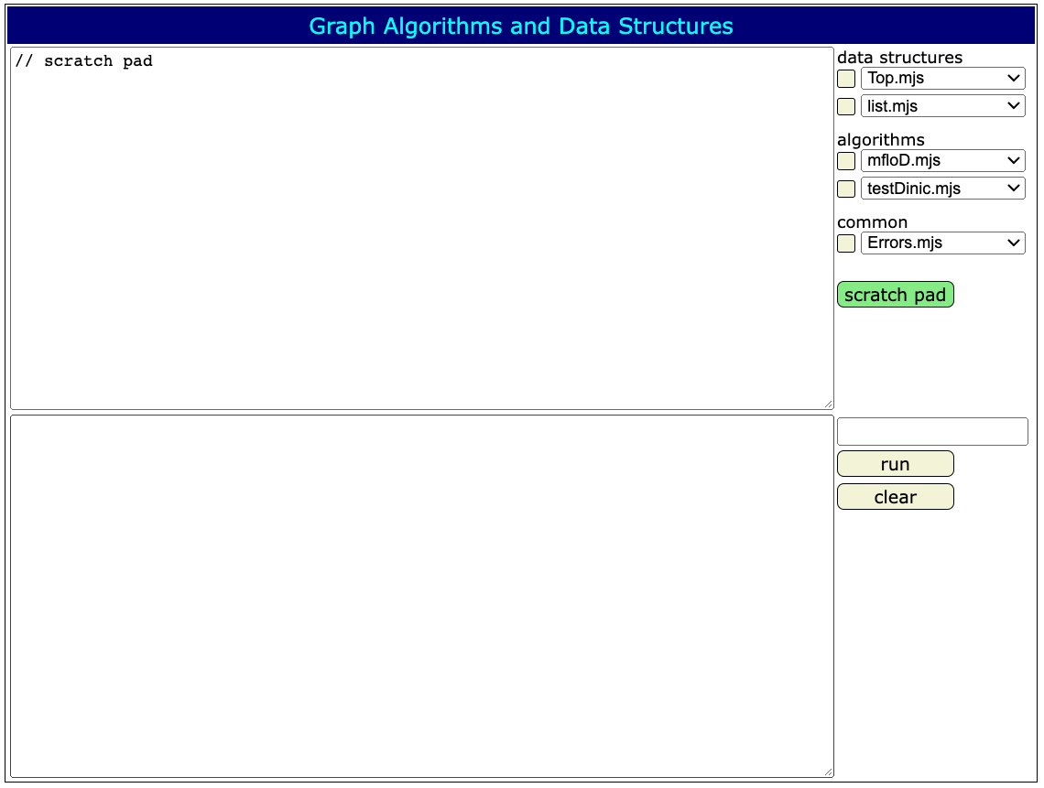

Slide 4
disjoint sets
{a,c,f }, {b,e}, {d}, {g,i}, {h}
c
e
d
i
h
forest
a
f
b
g
vector of parent pointers
a b c d e f g h i
p:
c
e
c
d
e
c
i
h
i

Slide 5
rank(a)=k rank(b)=k
rank(b)=k+1
b
a
b
a
≥2^{k}
≥2^{k}
≥2^{k}
≥2^{k}
≥2^{k+1}

Slide 6
Δ(y)=rank(p(y))–rank(y) ≥Δ(x)/2
y
x
Δ′(x)≥1.5Δ(x)
x
y
Δ(x)=rank(p(x))–rank(x)

Slide 7
rank=22
e
rank=17
d
rank=5
c
rank=3
b
rank=2
a
0 1
2 3
4 .. 7
8 .. 15
16 .. 31
32 .. 63
64 .. 128
block(4)

Slide 8
rank=22
e
rank=17
d
rank=13
c
rank=7
b
rank=4
a
block₁(4)
0 1
2 3
4 .. 7
8 .. 15
16 .. 31
32 .. 63
64 .. 128
0 .. 3
4 .. 15
16 .. 65,536
block₂(1)

Slide 9
block₁( )
block₁( )
block₂( j)
block₂( j+1)

Slide 10
block_{i–1} (A_{i}(j–1))
block_{i–1} (A_{i}(j))
A_{i–1}(A_{i}(j–1))
. . .
A_{i–1}(A_{i}(j))
A_{i}(j)
A_{i}(j+1)
block_{i}( j)
block_{i}( j+1)

