Slide 1
mcflow1
cap@cost/flow
a
5@2/5
c
6@1/5
4@2/4
3@5/0
s
2@1/0
5@6/1
t
3@1/0
5@3/3
b
d
4@–1/4
6@4/3

Slide 2
cap@cost/flow
a
5@2/5
c
6@1/5
4@2/4
5,3/0
1,2/0
6,5/1
t
1,3/0
3,5/3
b
d
–1,4/4
4,6/3
P
C
s
v
x
v
<n

Slide 3
mcflow3
cap@cost/flow
–5
5
path: c,t
–5
1
5@–2/5
a
5@–2/5
c
a
c
4@2/0
6@1/0
4@2/4
6@1/0
3@5/0
3@5/0
t
8
s
2@1/0
5@6/0
t
–4
8
s
2@1/0
5@6/0
0
3@2/0
3@2/0
5@3/0
b
d
4@–1/4
5@3/0
b
d
4@–1/4
6@4/0
0
6@4/0
–4
0
–4
path: s,a
0
1
path: s,b,d
0
1
a
5@–2/5
c
a
5@–2/5
c
6@1/5
4@2/4
6@1/5
4@2/4
3@5/0
3@5/0
3
s
2@1/0
5@6/0
t
0
0
s
2@1/0
5@6/0
t
0
3@2/0
3@2/0
5@3/0
b
d
4@–1/4
5@3/3
b
d
4@–1/4
0
6@4/0
–4
6@4/3
–1
0
path: c,d
0
0
a
5@–2/5
c
6@1/5
4@2/4
3@5/0
0
s
2@1/0
5@6/1
t
0
3@2/0
5@3/3
b
d
4@–1/4
0
6@4/3
0

Slide 4

BIRD KEY YACHT CLUB SARASOTA BAY CUP REGATTA

Slide 5
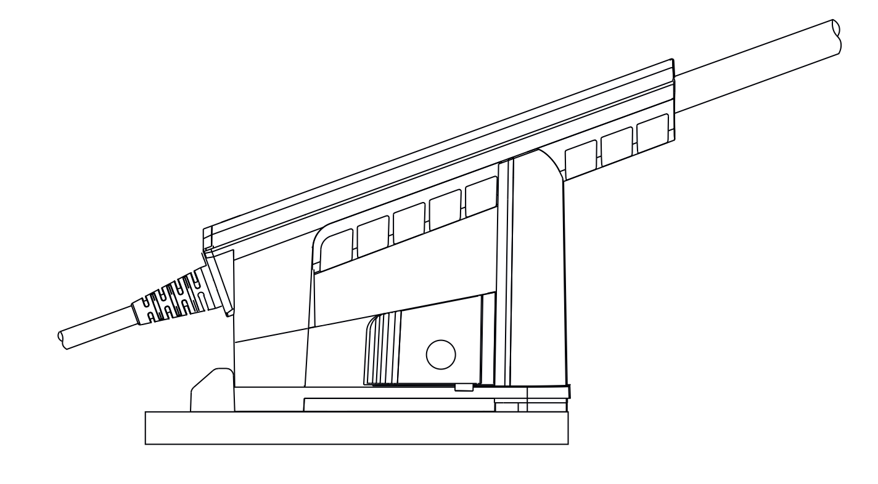
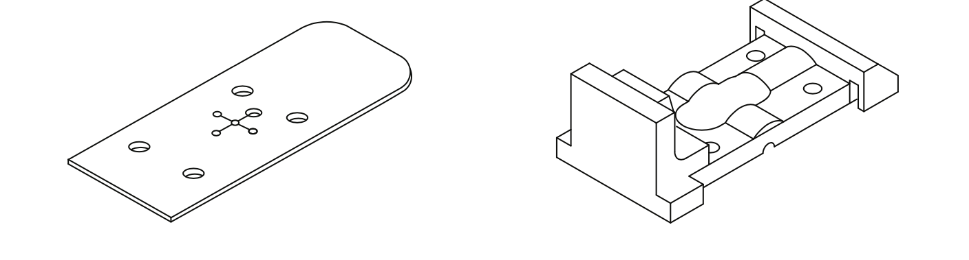

Slide 6
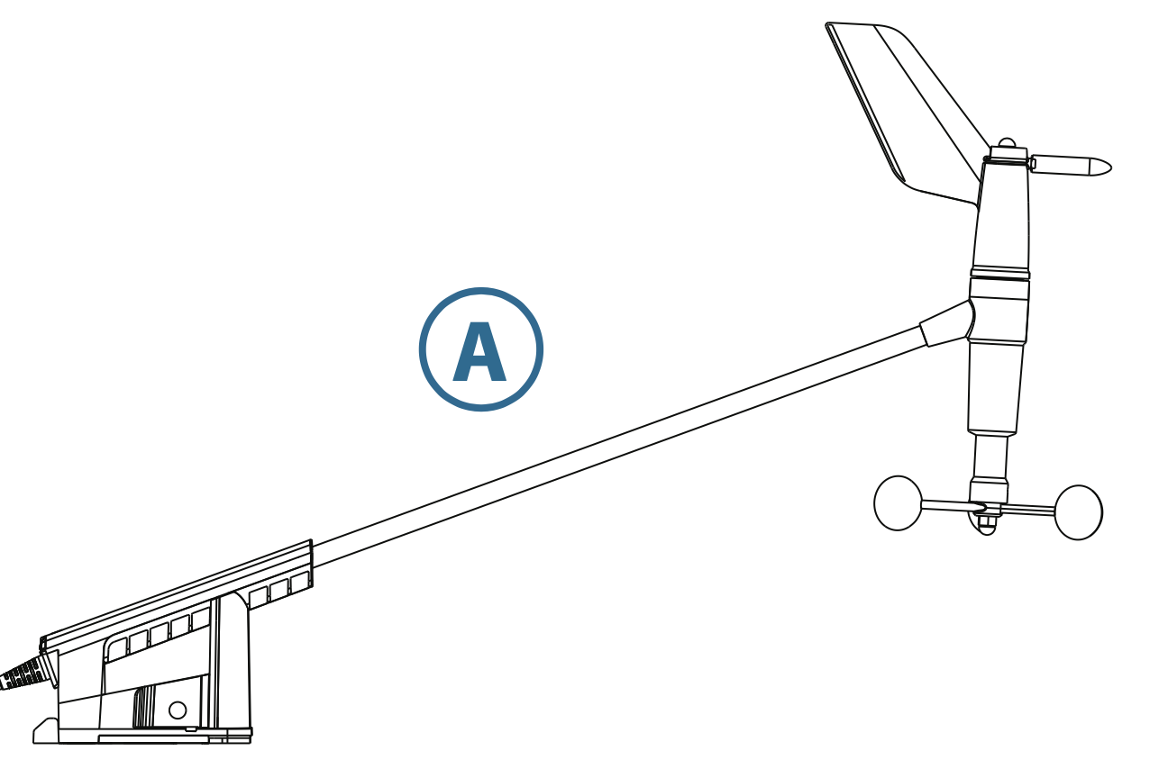
zip ties

