Slide 1

BCOG 100
Perception and Action
Lecture 8.1 — The Problems That Senses Solve
Notes:
This module is about how senses recover a world from physical signals that never fully determine it. It is also about how an animal’s own movement both disturbs its senses and helps them.
This first lecture is the computational level. It asks what problems a moving animal’s senses have to solve, and why. Every procedure that might solve those problems waits for the next lecture, and every receptor, pathway and brain structure waits for the third.
The animal is still the fish we followed in Module 7, in a stream where eels hunt. But much of what is known about how senses work comes from mammals, monkeys and people. So in this module we go where the evidence is, well ahead of where our evolutionary story has reached. Human senses are worth studying for their own sake, and unlike much of what we have covered so far, they have changed a lot since the ancestor humans share with fish. The fish stays with us, and we come back to it whenever a point can be made with a fish.

Slide 2
To Start: One Wave at Each Ear
In your group, three minutes.
Picture a busy kitchen, eyes closed. A pan drops, someone is talking, and water is running. Each ear receives one wave, the sum of all of it.
How can anyone tell there are three things, and what each one is? What can the ears not tell, that the eyes could?
Notes:
This is the first of the guiding questions at the start of the reading, put in everyday form.
Groups usually start with what makes each sound distinct. The voice has a pitch, the water hisses, the pan clangs and keeps ringing. That last one is worth holding on to. Sound carries information about what made it. A dropped pan and a dropped book sound different because they are different things: metal keeps ringing, and a book goes quiet almost at once.
The harder part of the question is the word *sum*. Nothing reaches the ear as three separate sounds. Each ear receives a single pressure wave, with the voice, the water and the pan already added together. Many different combinations of sources could have produced that same wave. So pulling the three apart is not a matter of reading them off. It has to be worked out.
The second question usually brings out exact position and layout. The ears can tell that something is happening out of sight, but the eyes say where things are, and how surfaces are laid out, with far more precision.
Hold on to both answers. This lecture is about what each sense can and cannot recover, and why none of them gets the answer handed to it.

Slide 3
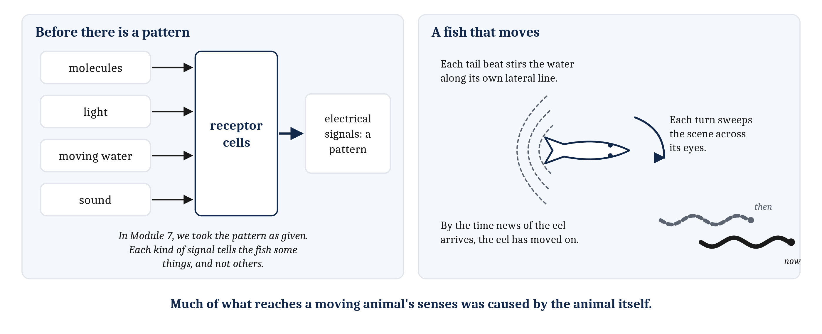
What We Set Aside in Module 7
Receptors have to make a pattern before a brain can use one. And a moving animal causes much of what reaches its own senses.
Notes:
In Module 7, the smell of an eel arrived as a pattern of activity in the fish’s olfactory bulb, and we asked what the fish could do with that pattern. We took the pattern as given.
But before there was a pattern, molecules carried by the current had to reach receptor cells in the fish’s nose, and those cells had to turn the molecules into electrical signals. Light, sound and the push of moving water have to be turned into signals too, by other kinds of cells. And each kind of signal can tell the fish some things about the world, and not others.
We also treated the fish as if it were holding still. It is not. To follow a smell upstream, the fish swims. Every beat of its tail stirs the water along its sides, where the lateral line feels it. Every turn of its body sweeps the whole scene across its eyes. So at any moment, much of what reaches the fish’s senses was caused by the fish itself. And when the eel does appear, the signals that tell the fish where the eel is are already a little out of date.
Those are the two subjects of this module. First, the senses that deliver patterns to the brain. Second, the movement of the animal that has those senses. The point of putting them in one module is that they turn out to be hard to separate.

Slide 4
What Each Signal Carries
None of a sense’s information is direct. Each signal carries some facts and not others, because of how it travels.
Signal | How it travels | Carries well | Leaves out
Light | Fast, in straight lines | The layout of surfaces at a distance, and precise direction | Anything behind an obstacle; everything, in the dark
Sound | Around obstacles, in the dark, from every direction at once | That something is happening, even out of sight, and what made it | Direction is not laid out; it has to be computed from the two ears
Chemicals | Slowly, drifting with the current, lingering | What something is | Where it is, except poorly
Touch and the lateral line | Contact with the body, or moving water within a body length or two | What is touching, and movement close by | Anything farther away
Notes:
A sense lets an animal find out about things it is not touching, or cannot see inside. It does this through a physical signal that those things have shaped. An eel reflects light, disturbs the water, and sheds molecules into the current. Each of those signals carries information about the eel, but none of it is direct. What in the world caused a signal has to be recovered from the signal.
Different signals carry different facts, because they travel in different ways. Light moves fast and in straight lines, so it carries the layout of surfaces at a distance, with great precision about direction. But anything in the way blocks it. Sound bends around obstacles and works in the dark, so it is well suited to saying that something is happening, even out of sight. And it carries the makeup of what made it: heavy things ring low, metal keeps ringing, wood goes quiet. Chemicals move slowly and linger, drifting with the current. So they carry *what* something is far better than *where* it is.
Touch is the exception to sensing at a distance. It reports only what is in contact with the body. The **lateral line**, the line of sensory organs along a fish’s sides, extends something like touch a short way into the water, a body length or two.
In Module 4, we introduced transduction, the conversion of an event in the world into a change in membrane voltage, for touch and smell. Light and sound are transduced too, by their own receptor cells, which we describe in the third lecture. The consequence matters now. A sense can only report what its physical signal carries, and only to the extent its receptors respond to it.
So the fish uses each sense for a different job. Smell says an eel has been somewhere upstream. The lateral line says something is moving close by. Vision says where, exactly, something is.

Slide 5
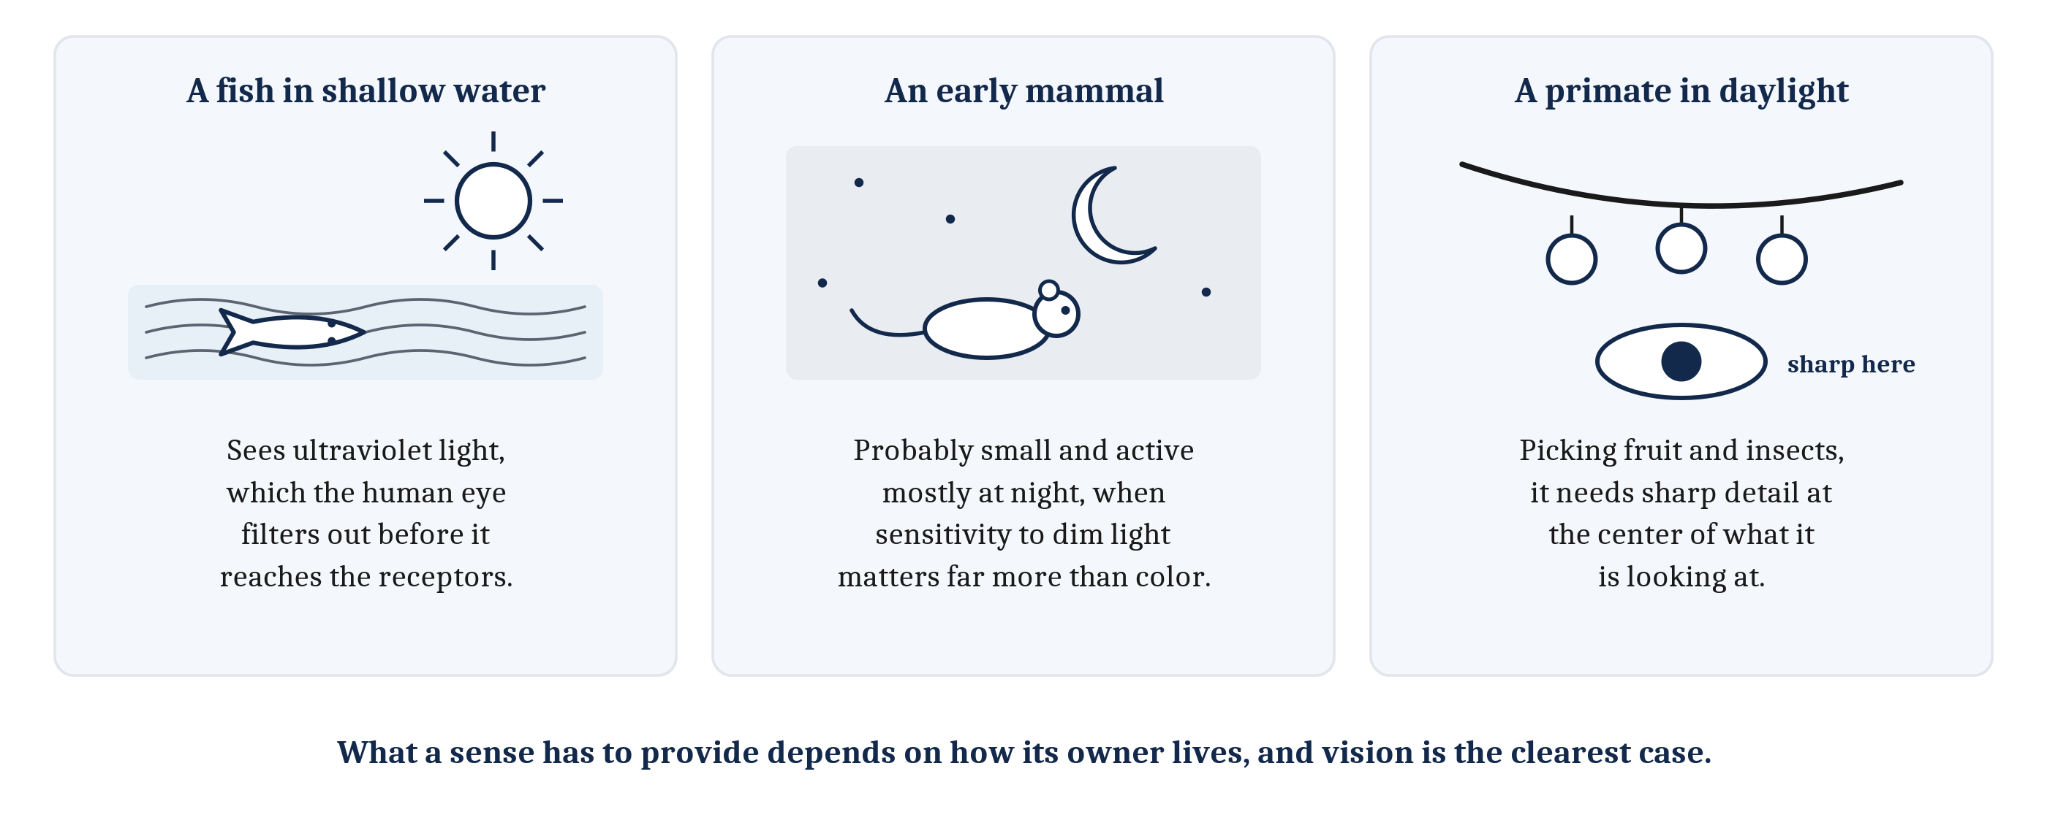
What an Eye Must Deliver Depends on Its Owner
What a sense has to provide depends on how its owner lives.
Notes:
Physics sets what a signal can carry. But what a sense has to deliver also depends on how its owner lives, and vision is the clearest case.
Many fish in shallow water can see ultraviolet light, which the human eye filters out before it reaches the receptors. Early mammals were probably small animals active mostly at night, when sensitivity to dim light matters far more than color. A primate picking fruit and insects in daylight needs sharp detail at the center of what it is looking at.
These are three different answers to the question of what an eye is for. None of them is the best eye in general. Each is good for a way of life.
In the third lecture, we take up how these different eyes came about, including which kinds of color receptor were lost along the way, and how new ones arose. For now, the point is computational. Before asking how an eye works, we have to ask what its owner needs it to deliver.

Slide 6
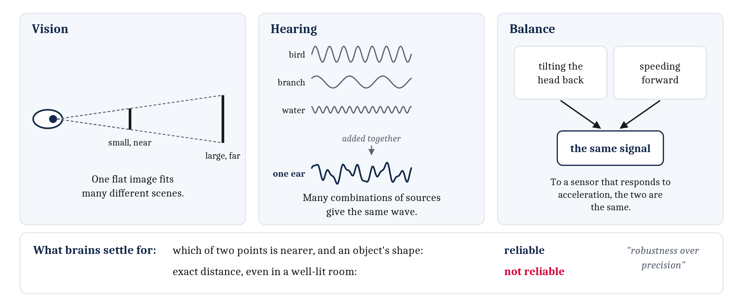
Never Enough Information
An ill-posed problem: the information available does not settle a single answer. Every sense faces a version of it.
Notes:
In Module 1, we saw that vision faces an **ill-posed problem**. A flat image on the retina could have been produced by many different arrangements of objects, and nothing in the image alone settles which one was there. A small object close by and a large one far away can cast exactly the same image. Every sense faces some version of this.
Take hearing, which the busy kitchen in the opening discussion raised. Each ear receives one pressure wave, the sum of every sound reaching it. Recovering the separate sources from one summed wave is ill-posed in exactly the same sense, since many combinations of sources produce the same wave. And hearing has a difficulty vision does not. In vision, a near object hides the one behind it, so the parts that stay visible are usually intact. In hearing, nothing is hidden, but every source is spread across the whole mixture.
The organs of balance give a third case. They contain sensors that respond to gravity and to acceleration. To any sensor that responds to acceleration, tilting the head back and accelerating forward produce the same signal. A motion-simulator ride uses this on purpose. The seat tilts slowly backward, and the rider feels pressed into it as if speeding forward.
So what do brains recover, when the information cannot settle the answer? Not everything. They settle for what can be deduced from the signal. People judge very reliably which of two points is nearer, and they judge an object’s shape well, if sometimes a little deeper or flatter than it is. They do not judge exact distances reliably, even in a well-lit room with every cue available. In one researcher’s phrase, vision prefers “robustness over precision”.
That is a sensible bargain. The fish needs to know that the eel is closer than the weed, and which way it is moving. It does not need the distance in centimeters. What a sense delivers is shaped by what the animal needs to do next.

Slide 7
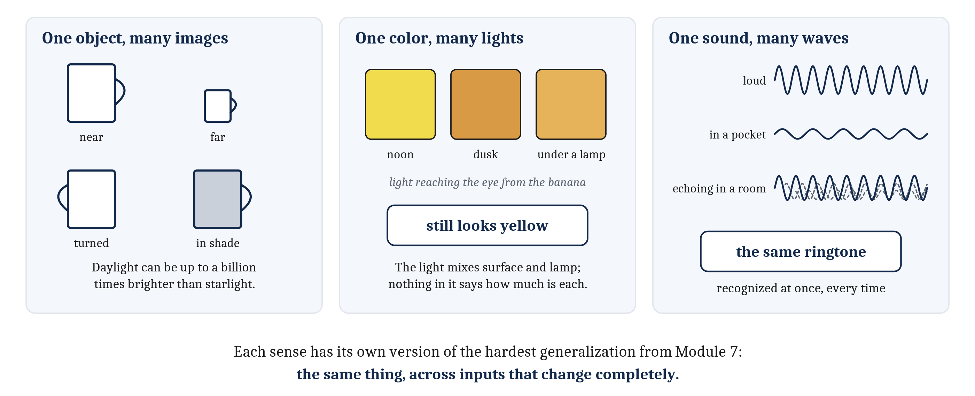
The Same Thing, Again
Recognizing the same thing across inputs that change completely is a problem every sense faces, in its own version.
Notes:
In Module 7, the hardest generalization was recognizing the same thing across variation that changes its inputs completely, like recognizing an object seen from a new angle. Each sense has its own version of that problem.
In vision, one object casts very different images from the front and the side, near and far, in shade and in sunlight. On top of that, the overall amount of light varies enormously. Daylight can be up to a billion times brighter than starlight.
Color poses the problem too. The light reaching the eye from a surface depends on the surface and on the light falling on it, mixed together. The light reaching the eye from a banana changes a great deal between noon and dusk, and between daylight and a lamp. Yet the banana keeps looking yellow. This is *color constancy*, and it is invariance applied to color. It is also ill-posed, in the same sense as the last slide. Nothing in the light from the banana alone says how much of it is due to the banana and how much to the lamp.
Hearing has the same problem. A phone’s ringtone can be loud or quiet. It can be muffled in a pocket, a purse, or under a pillow. The room changes it too, as the sound echoes off the walls. A listener still recognizes every one of those at once as the same sound.
Recognizing a kind of object, or a kind of sound, is the categorization problem from Module 7. We take up how vision and hearing handle their own versions of it in the next lecture.

Slide 8
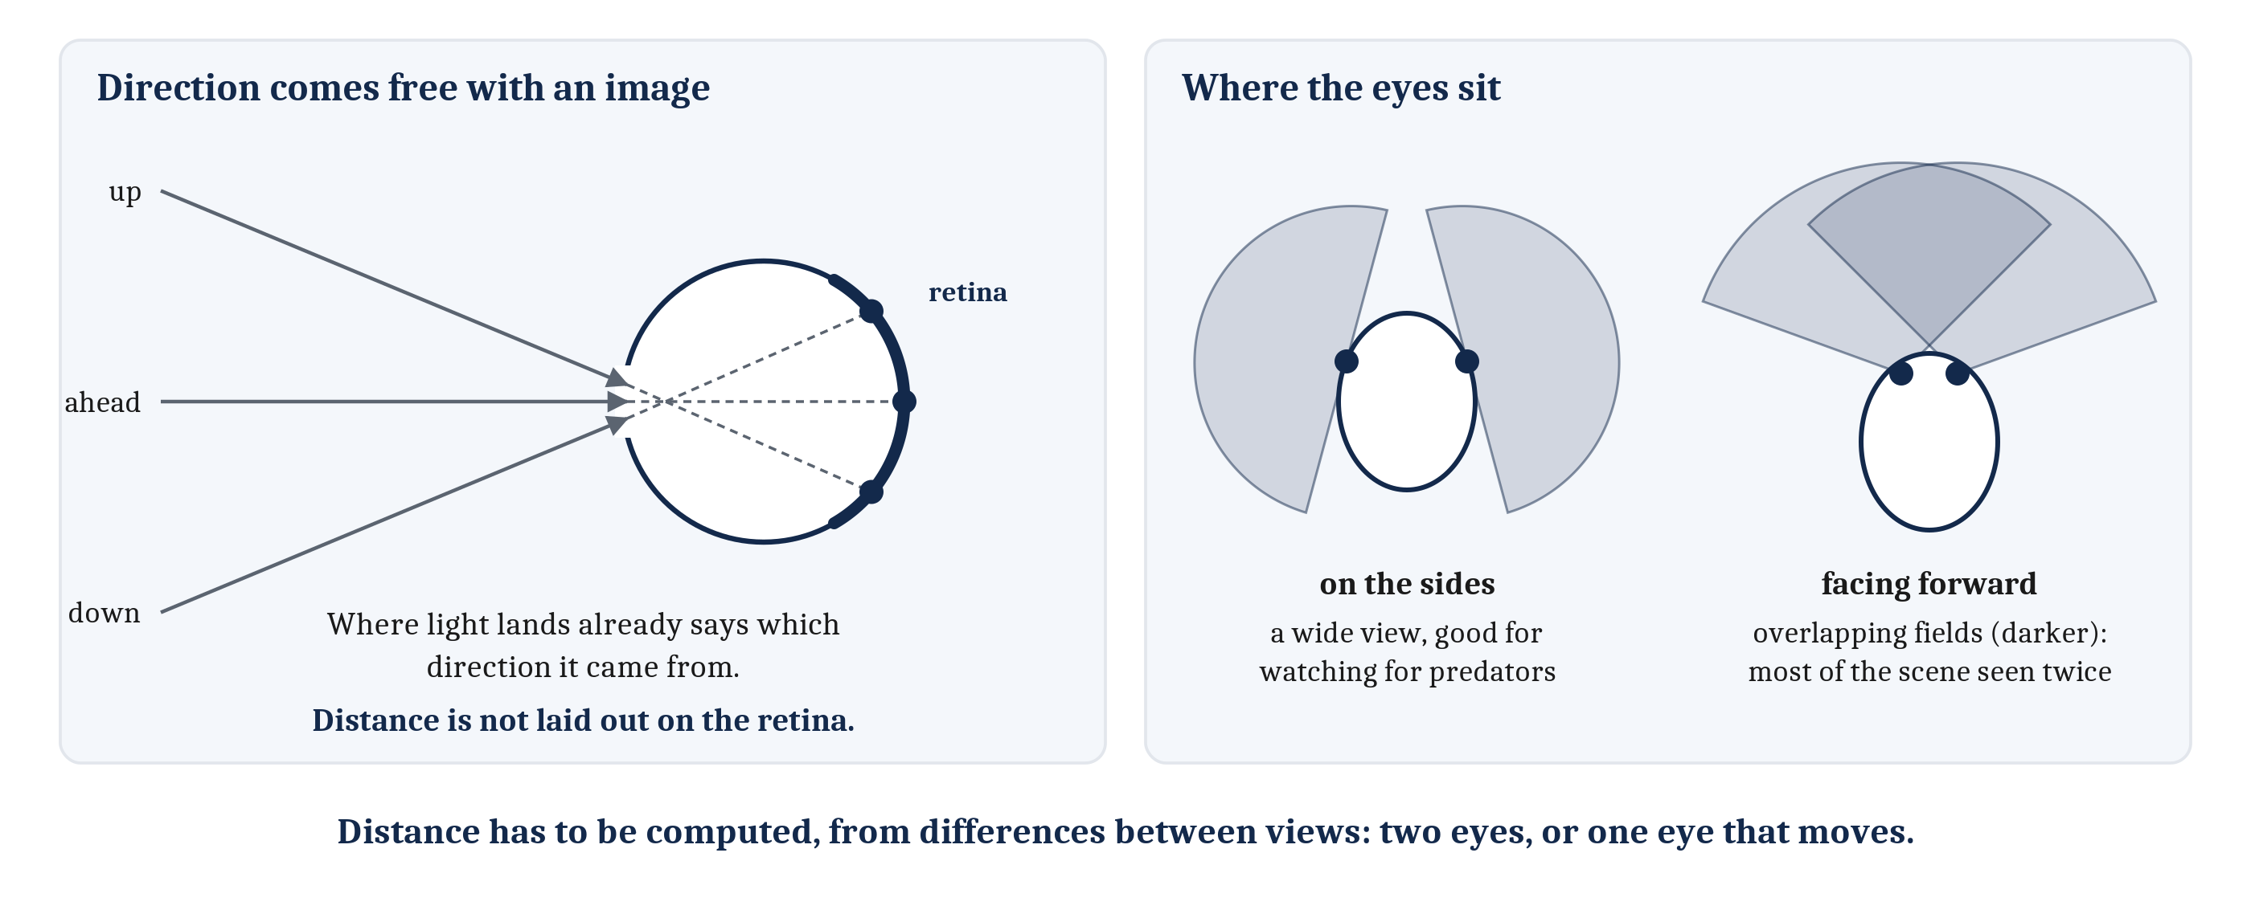
Where Things Are: Direction Comes Free
An image gives direction with no further computation. Distance is not on the retina, so it has to be computed, from differences between views.
Notes:
So far, we have focused mostly on *what* something is. Just as important is *where* it is, and here the senses differ in an instructive way.
The retina gives direction almost for free. An eye forms an image, so light from each direction falls on a different place on the retina. Where the light falls already says which direction it came from, with no further computation. Touch works the same way: which receptors in the skin are pressed says where on the body the touch fell.
Distance is another matter. It is not laid out anywhere on the retina, so it has to be computed. The information for it lies in differences between views. Two eyes see a scene from slightly different places, and one eye that moves sees it from different places over time.
How much two eyes can provide depends on where they sit. Eyes on the sides of the head together cover a wide view, which is good for watching for predators. Eyes that both face forward give up much of that view. In exchange, their fields overlap, so most of the scene is seen twice. Two such views carry the most information about depth at close range, within arm’s reach, which is where a primate’s hands do their work.
We take up how differences between views are turned into depth in the next lecture.

Slide 9
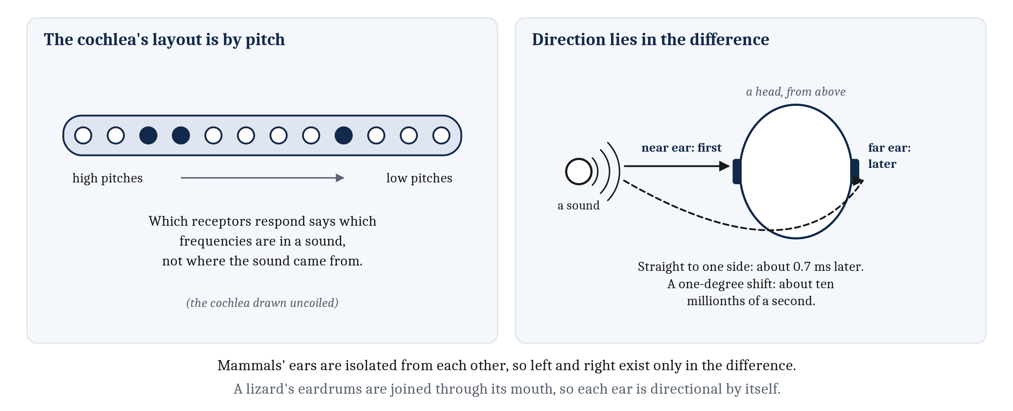
Hearing Has to Compute Even Direction
The cochlea, the mammalian organ of hearing, lays out its receptors by pitch, not by direction. Direction lies in differences between the two ears.
Notes:
Hearing has to compute direction, much more than vision does.
The **cochlea** is the organ of hearing in the inner ear of mammals. It is a fluid-filled tube, coiled like a snail shell in most mammals. Birds and reptiles have a shorter, uncoiled version, and fish have no cochlea at all, hearing with other organs of the inner ear. Like the retina, the cochlea lays its receptor cells out in a map. But this map is organized by pitch, not by direction. Which receptors respond says which frequencies are in a sound, not where the sound came from.
So the information about direction has to come from somewhere else, and it lies in the differences between what arrives at the two ears. A sound straight off to one side reaches the far ear only about seven tenths of a millisecond after the near one. Yet people can notice a sound move by about one degree, which changes that timing difference by roughly ten millionths of a second. That is the scale hearing works at.
Animals differ in how their ears are joined. A lizard’s two eardrums are connected through its mouth, so each ear is directional by itself. A mammal’s ears are acoustically isolated from each other, so for a mammal, left and right exist only in the difference between them.
How a nervous system could measure a difference of a few millionths of a second is one of the next two lectures’ best puzzles.

Slide 10
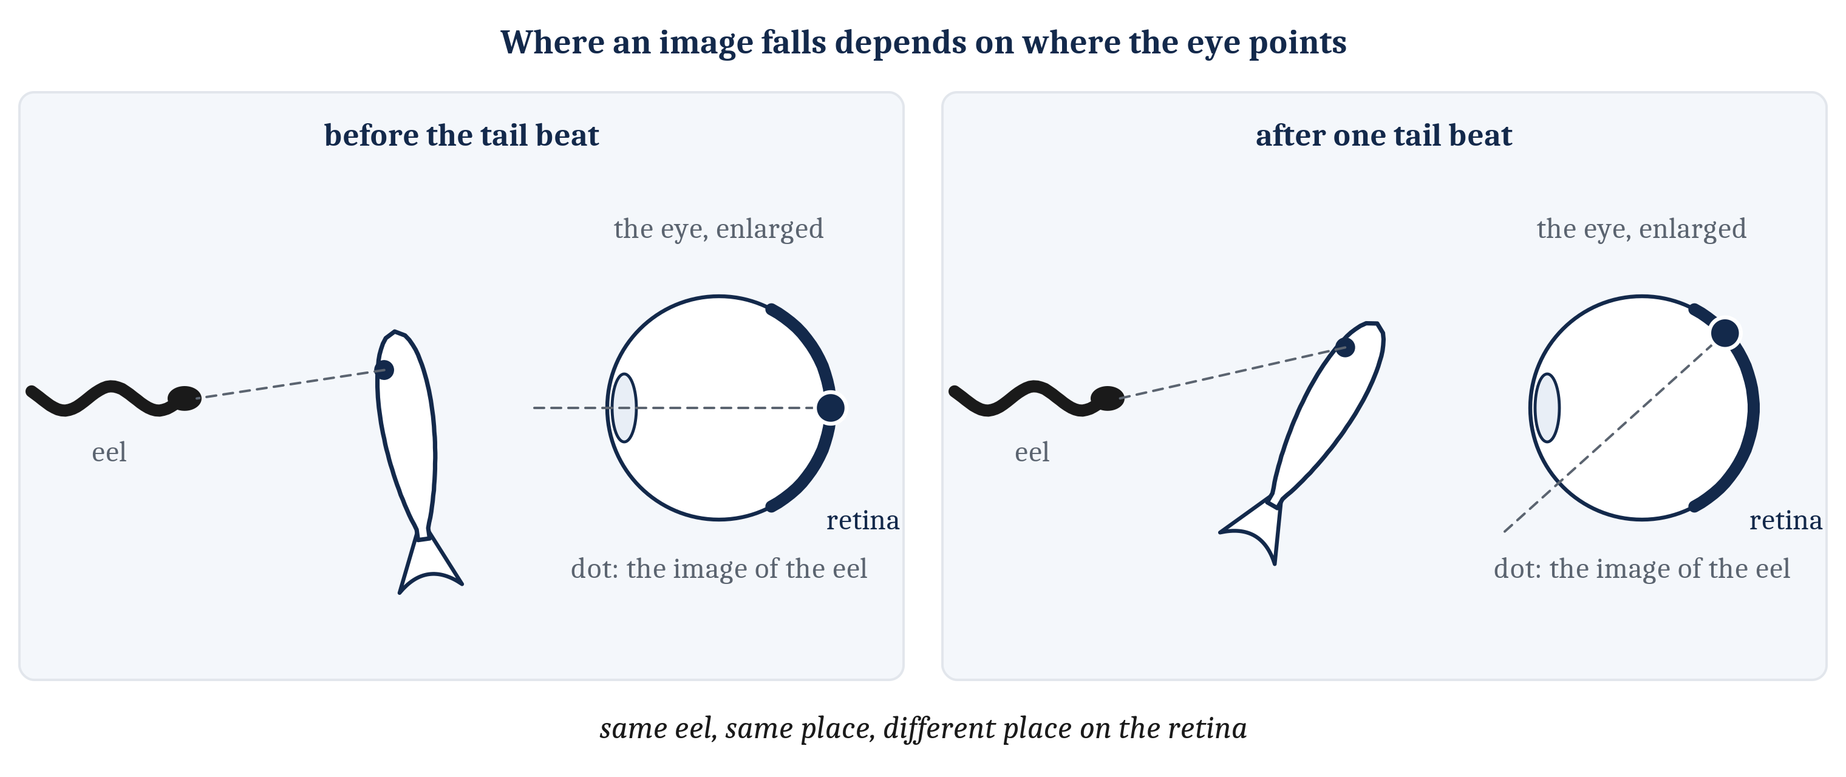
Direction on the Eye Is Not Direction in the World
Where an image falls gives its direction relative to the eye. Every movement of eye, head or body moves the image.
Notes:
There is one more complication, and with it the problem passes from the senses to the animal’s own movement.
Where an image falls on the retina gives its direction relative to the eye, not relative to the world. Every movement of the eye, the head, or the body moves the image across the retina. After one beat of the fish’s tail, the image of the eel falls on different cells, although the eel has not moved at all.
So before the position of an image means anything about the position of the eel, it has to be combined with where the eye was pointing. A place on the retina is a fact about the eel and the eye together.
That makes the next problem unavoidable. The fish moves all the time, and much of what its senses report is about its own movement rather than the world’s.

Slide 11
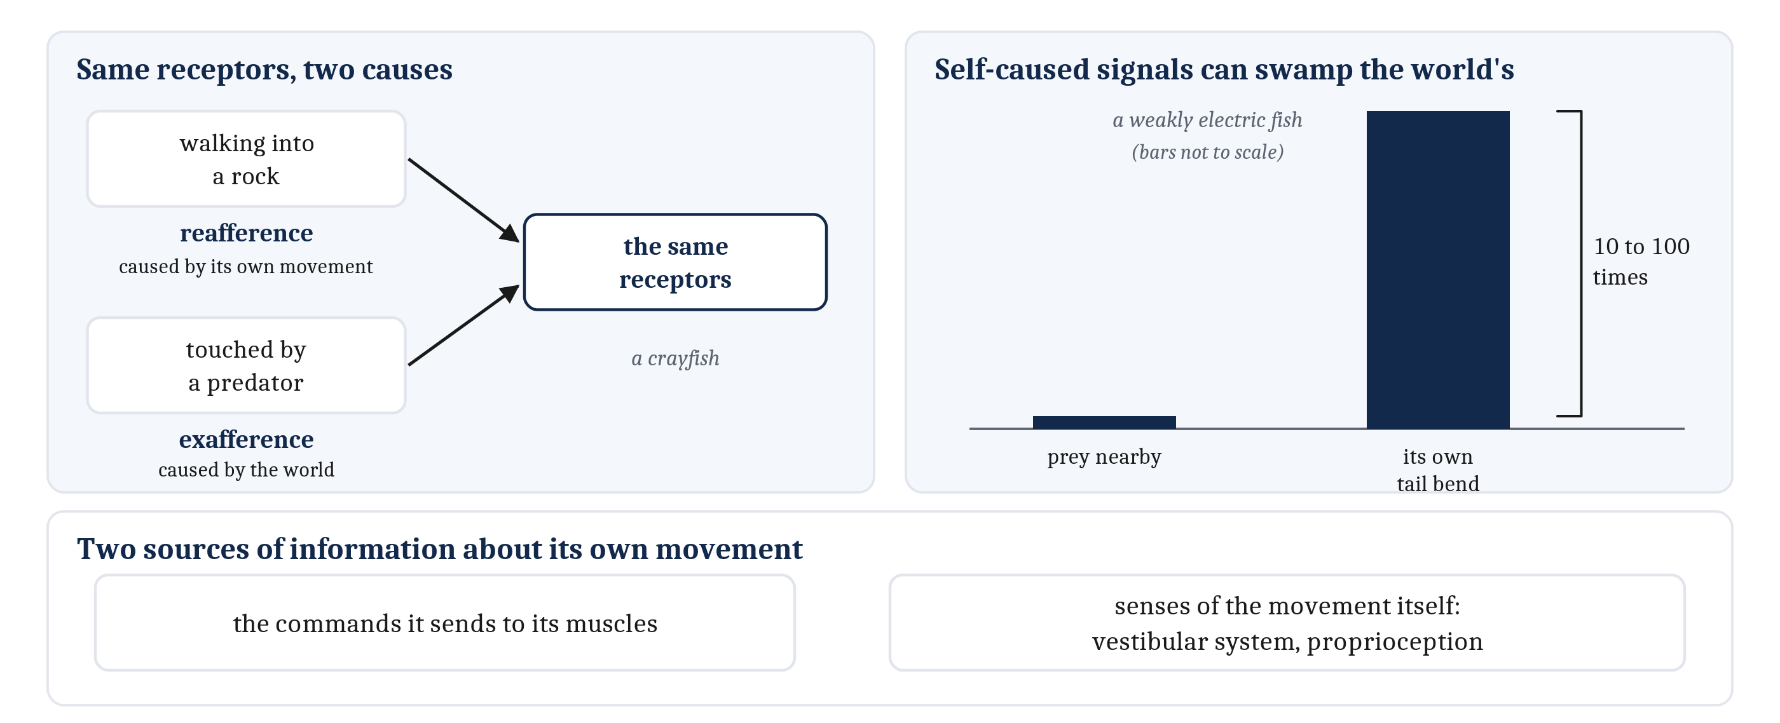
Signals of One’s Own Making
Reafference: sensation caused by the animal’s own movement. Exafference: sensation caused by the world, independent of what the animal does.
Notes:
In Module 6, we noted that a moving animal has to tell its own doings from the world’s, and left the question of how for this module. The two kinds of sensation have names. Sensation caused by the animal’s own movement is **reafference**. Sensation caused by the world, independent of what the animal is doing, is **exafference**.
The scale of the problem is easy to underestimate. Some fish sense weak electric fields with receptors in their skin, and use them to find prey hidden in mud. In one such fish, an ordinary bend of its own tail changes the electrical input along its body ten to a hundred times more than a small prey animal nearby does. Primate eyes jump to a new position about three times a second, and each jump sweeps the whole image across the retina. And a voice is loudest in its owner’s own ears. In every one of these cases, the self-caused signal can drown out the signal from the world.
Vertebrates were not the first animals to face this, or the first with ways of handling it. A crayfish walking into a rock and a crayfish touched by a predator stimulate the same receptors. Crayfish and flies both treat their own movement differently from the world’s. In Module 6, we placed the problem’s origin in the Cambrian, when fast animals with jointed bodies and image-forming eyes began producing self-caused signals in floods.
To separate its own doings from the world’s, an animal has two sources of information about its own movement. One is the commands it sends to its muscles. The other is a pair of senses that respond to the movement itself. The **vestibular system**, the organs of balance in the inner ear, senses rotation and acceleration of the head. **Proprioception** is the sense of the body’s own position and movement, from receptors in the muscles, tendons and joints.
We take up how either source is used in the next lecture.

Slide 12
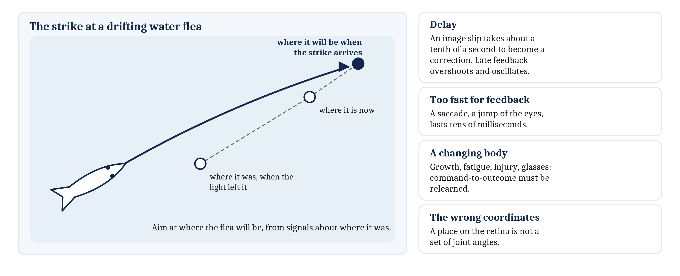
A Slow Body
A body acts on old information, keeps changing, and gets its signals in the wrong coordinates. A saccade, a quick jump of the eyes, is over before feedback could arrive.
Notes:
Having a body brings three more problems.
The first is delay. News that the image has slipped across the retina takes about a tenth of a second to turn into a correction. A nervous system that waited for that news would always be correcting an error that had already changed. Engineers know this problem well. Feedback that arrives late tends to overshoot and oscillate, because each correction responds to a situation that no longer exists. So keeping the eyes steady while the head turns cannot wait for vision. And some movements are over before feedback could arrive at all. A **saccade** is a quick jump of the eyes to a new target, and it lasts only tens of milliseconds. If the target moves during the jump, it is too late to correct, and a second saccade is needed.
The second is that the body keeps changing. Heads and eyeballs grow. Muscles tire, and some weaken with age or injury. Glasses change how the world lines up on the retina. So the mapping from a command to its outcome has to keep being relearned.
The third is coordinates. A target appears at some place on the retina. Reaching for it requires a set of angles at the shoulder, elbow and wrist. One description has to be turned into the other, and the turning depends on where the eyes and head are pointing at that moment.
All three arise at once when the fish strikes at a drifting water flea. The strike has to be aimed at where the flea will be. The fish’s signals report only where the flea was, and they report it relative to the fish’s eye. Somewhere in its nervous system, the fish has to turn old, eye-centered signals into a current, body-centered command.

Slide 13
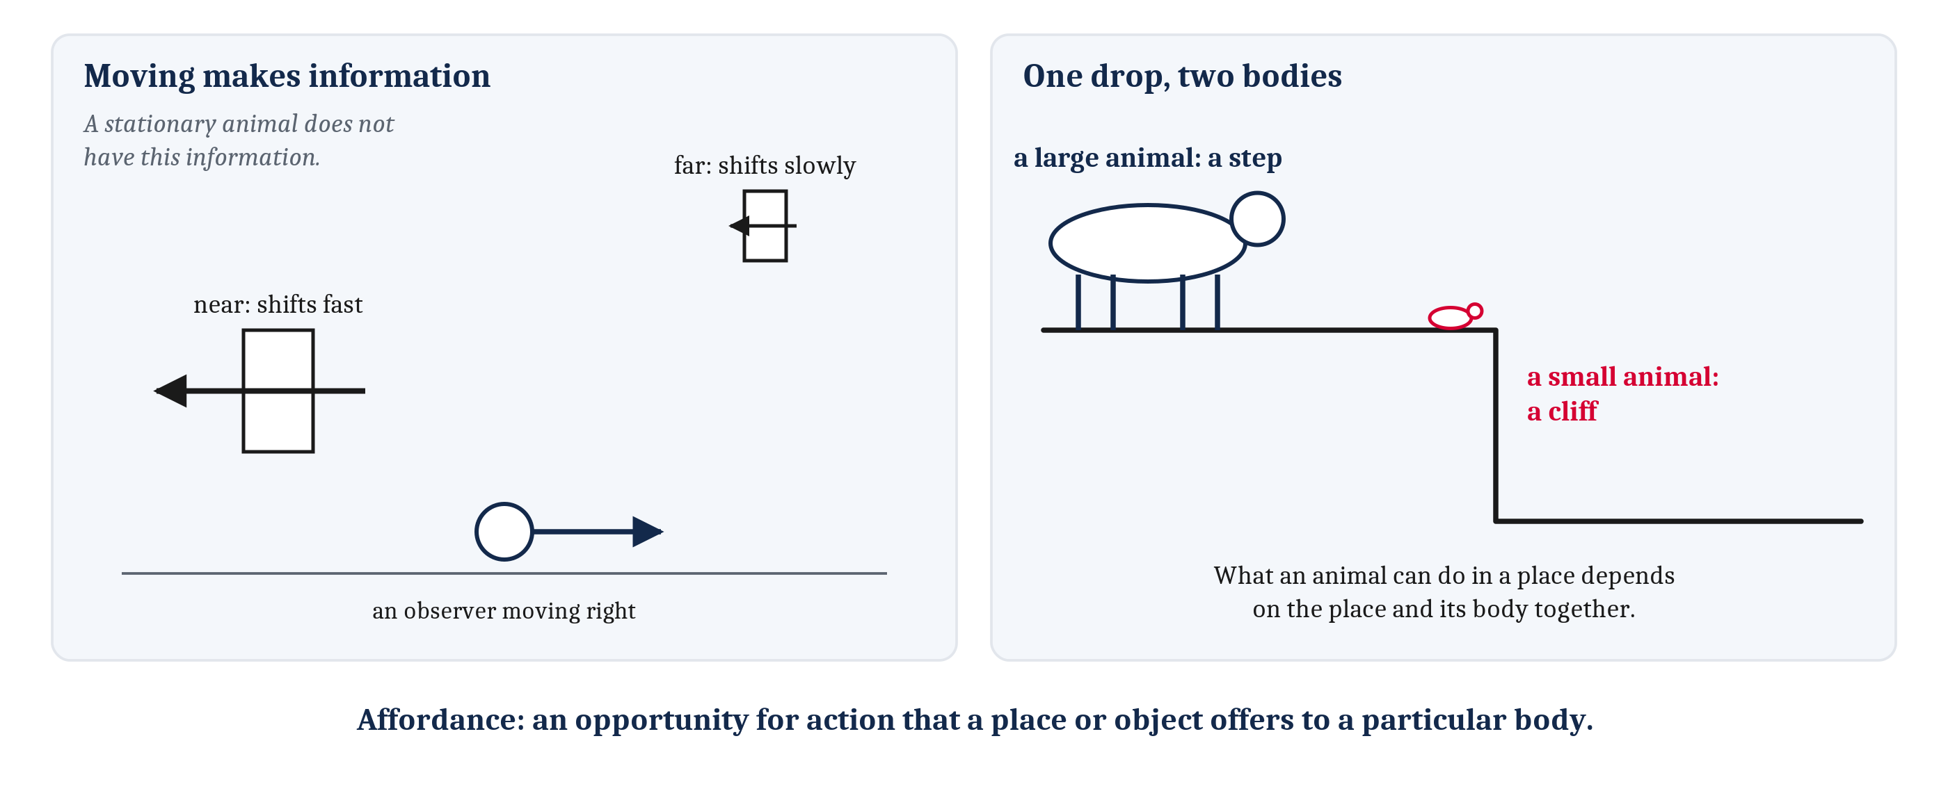
Moving in Order to Perceive
Movement also makes information. An affordance is an opportunity for action that a place or object offers to a particular body.
Notes:
Movement is not only a source of trouble. In Module 6, we noted that an animal can act on the world and see what comes back. Moving changes what reaches the senses, and it changes it in lawful ways. As an animal moves, near things shift across its eyes faster than far ones, and the water flowing past its body changes shape as it passes objects. So movement makes information available that a stationary animal does not have. (The observer in the drawing looks straight ahead. When an observer fixates one point instead, as in the depth-cue drawing in the next lecture, things beyond that point drift the other way.)
Perception is shaped by action in a further way. What an animal can do in a place depends on the place and on its body together. The same drop is a small step to a large animal, and a cliff to a small one. A gap is passable for one body and not for another. Psychologists call such a fact an **affordance**: an opportunity for action that a place or object offers to a particular body.
Perceiving an affordance is a separate problem from the affordance itself, and perceived affordances can be recalibrated with practice. A new wheelchair user learns quickly which gaps are wide enough.
James Gibson, the psychologist who introduced the word, also argued that perceiving the world needs no interpretation, because the information in the senses is enough. We do not take that view, in the reading or here, for the reason we gave with the ill-posed problem: the signals reaching the senses never fully settle what produced them. The idea of affordances is useful without the larger claim.
That joins the two halves of this lecture. The flood of self-caused signals and the information gained by moving are the same fact, seen from two sides. A moving animal produces most of what it senses. That is a problem to solve, and it is also how much of the sensing gets done.

Slide 14
A Camera That Holds Still
In your group, four minutes.
Many phone cameras steady a video when the hand holding them shakes, but not when a dog runs across the picture.
How could the phone tell the two apart? Which of the fish’s two sources of information about its own movement does the phone have, and which does it lack?
And what about a slow, deliberate pan across a room?
Notes:
We can try out reafference on a device most people carry.
The shake and the running dog both move the image across the camera’s sensor. In the terms we have been using, the shake is reafference, caused by the movement of the camera itself, and the dog is exafference, caused by the world. The image alone does not fully settle which is which, though motion of the whole frame is a strong hint, and some phones use it.
So the phone needs information about its own movement. Many phones carry a motion sensor that measures how the phone itself is turning, and use it to steady the picture. That is the phone’s version of the second source, a sense of the movement itself, like the vestibular system. What the phone lacks is the first source. It sends no commands to the hand that moves it, so it cannot know a movement is coming before it happens. A robot carrying its own camera would have both.
The pan is the interesting case. A deliberate pan is self-caused too, yet nobody wants it removed, because it is movement made in order to see more: the change it causes is the point, not noise. That is the idea of moving in order to perceive. How animals use their two sources of information about their own movement is a question for the next lecture.

Slide 15
Image Sources (1 of 2)
Slide | Image | File | License | Source
3 | Two things set aside in Module 7 | fig-set-aside.png | CC BY 4.0 | Jon Willits — drawn for this lecture · own work
5 | Eyes for different lives | fig-lives.png | CC BY 4.0 | Jon Willits — drawn for this lecture · own work
6 | Three senses, three ill-posed problems | fig-ill-posed.png | CC BY 4.0 | Jon Willits — drawn for this lecture · own work
7 | Each sense's own invariance problem | fig-same-thing.png | CC BY 4.0 | Jon Willits — drawn for this lecture · own work
8 | Direction free, distance computed | fig-eyes-where.png | CC BY 4.0 | Jon Willits — drawn for this lecture · own work
9 | Hearing computes direction | fig-ears-where.png | CC BY 4.0 | Jon Willits — drawn for this lecture · own work
10 | Where an image falls depends on where the eye points | fig-where-on-the-eye.png | CC BY 4.0 | Jon Willits — drawn for the Module 8 reading · own work
11 | Self or world | fig-self-or-world.png | CC BY 4.0 | Jon Willits — drawn for this lecture · own work

Slide 16
Image Sources (2 of 2)
Slide | Image | File | License | Source
12 | The strike at a water flea | fig-slow-body.png | CC BY 4.0 | Jon Willits — drawn for this lecture · own work
13 | Moving makes information; one drop, two bodies | fig-step-or-cliff.png | CC BY 4.0 | Jon Willits — drawn for this lecture · own work

