Slide 1

BCOG 100
Perception and Action
Lecture 8.2 — Recovering a World from Moving Senses
Notes:
In the first lecture of this module, we stated problems. A signal never settles its causes. Each sense has its own version of recognizing the same thing again. Hearing has to compute even direction. And a moving animal causes much of what reaches its own senses, acts on old information, and gets its signals in the wrong coordinates.
This lecture is the algorithmic level. It is about procedures that could solve those problems: what is represented, and by what steps. Every procedure here could in principle run in a nervous system or in a computer. How real nervous systems carry them out, with receptors, neurons and circuits, is the third lecture.
One theme runs all the way through. Many of the procedures need the animal to move, or to know how it moved. Recovering a world and moving through it turn out not to be separate problems.

Slide 2
To Start: Why Can No One Tickle Themselves?
In your group, three minutes.
Why can no one tickle themselves?
The eyes jump to a new place about three times a second, and every jump sweeps the whole image across the retina. Why does the world not seem to jump?
Notes:
This is one of the guiding questions at the start of the reading, and we answer it near the end of this lecture.
Groups usually reach the same first answer to both halves: we know it is coming. That is a good answer, and the interesting work is in making it precise. Knowing it is coming could mean two different things. It could mean the response is simply switched off whenever we move. Or it could mean the nervous system expects a particular sensation, and takes that expectation away from what actually arrives.
Those two ideas make different predictions, and one of the most elegant experiments in this module was designed to tell them apart. Hold both ideas in mind until then.

Slide 3
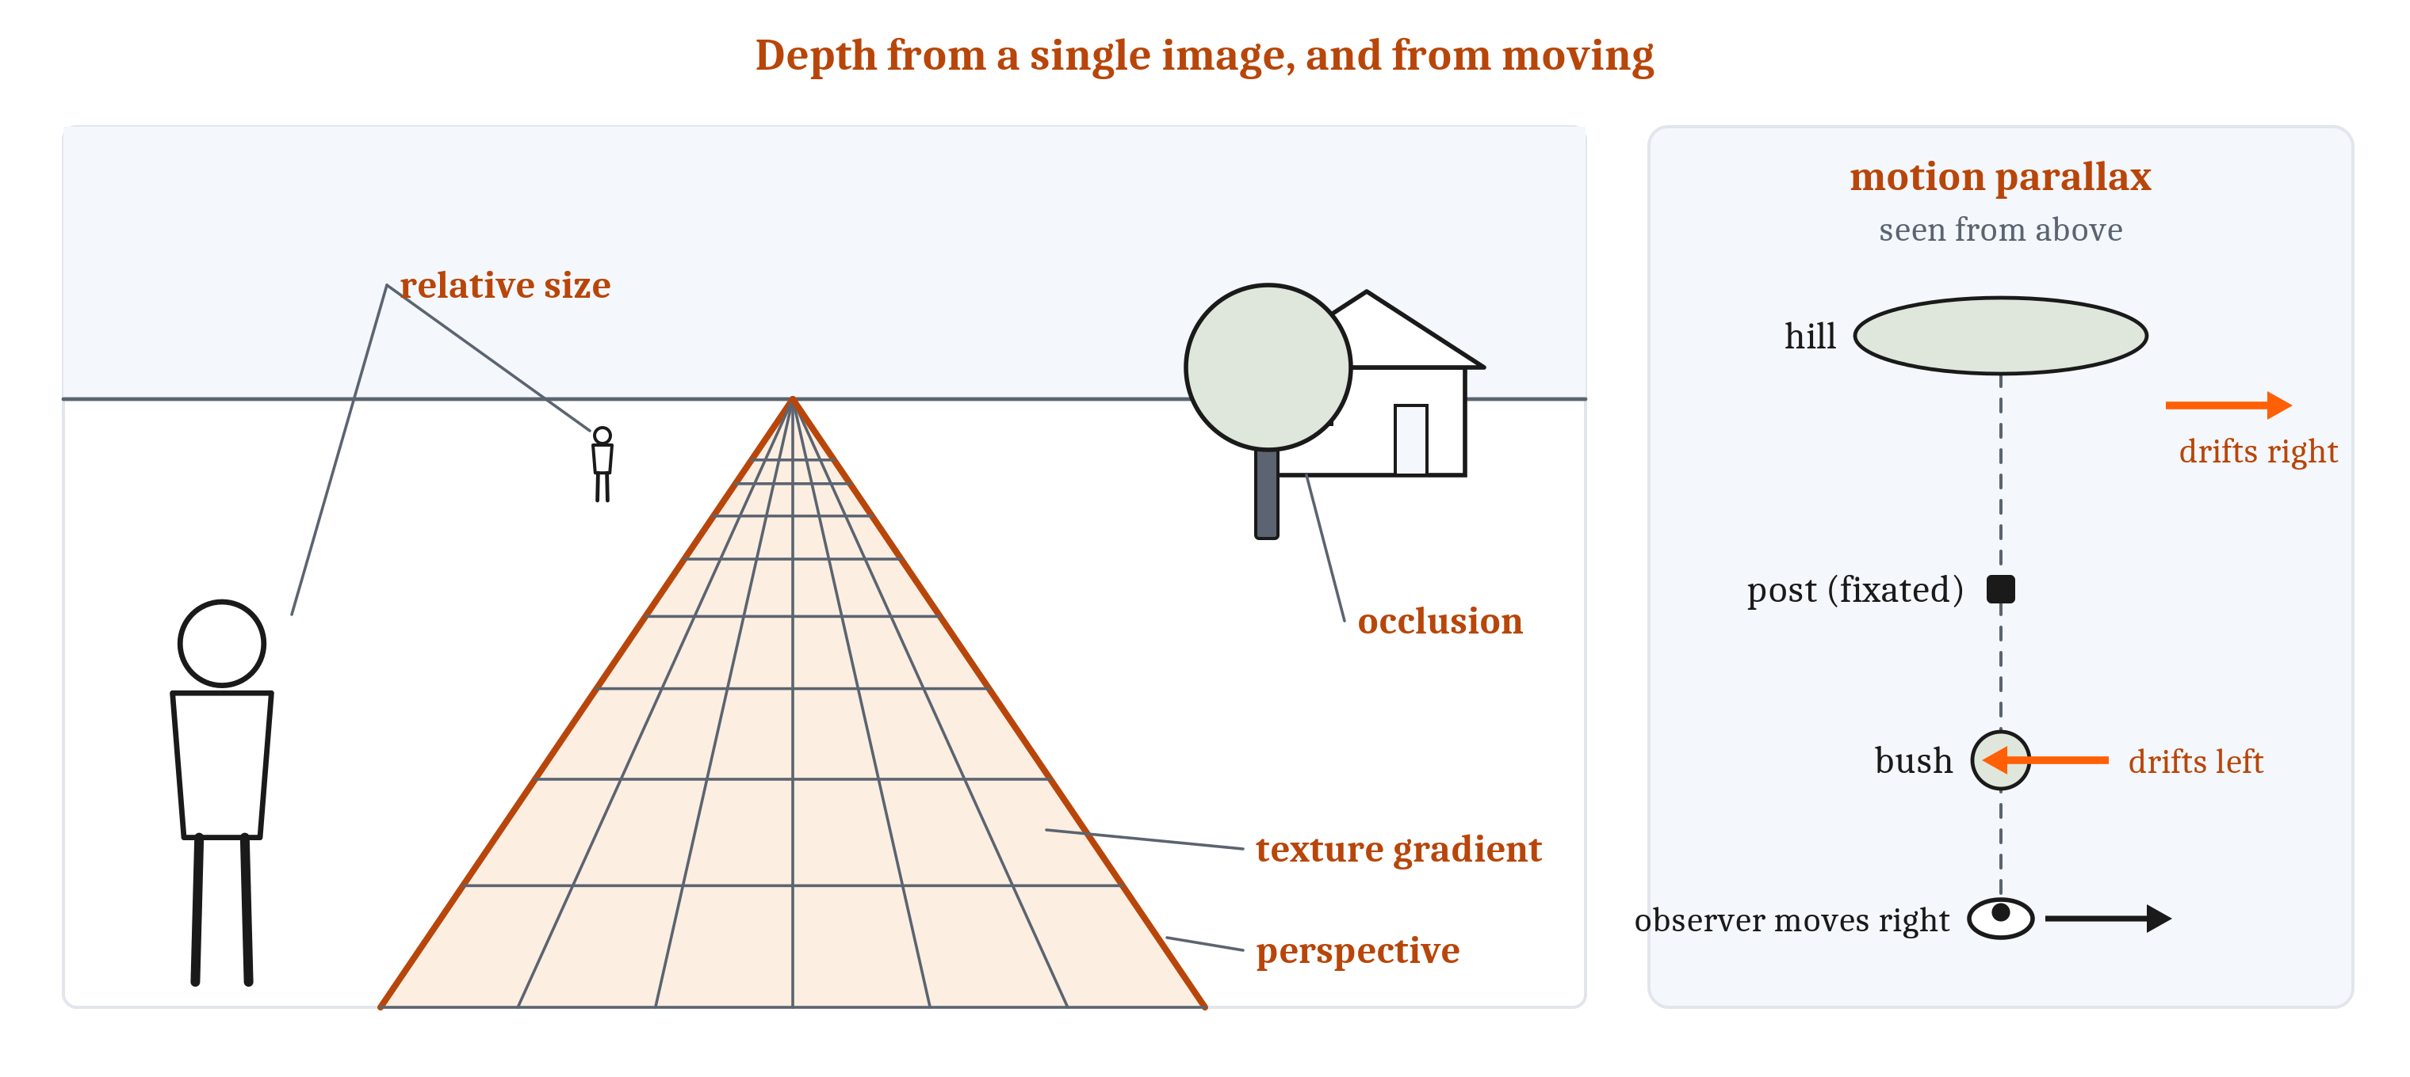
Depth from Flat Images
A depth cue indicates distance, given an assumption that is usually true. Motion parallax, near things drifting faster than far ones as the observer moves, needs movement.
Notes:
If a flat image fits many scenes, how does vision recover depth at all? It relies on assumptions that are usually true about the world. Each such assumption gives a **depth cue**: a feature of the signal that, given the assumption, indicates how far away something is.
Some cues are present in a single image. A near object hides part of a far one. Of two objects assumed to be the same size, the one casting the smaller image is farther away. A textured surface, like grass or a tiled floor, shows its texture growing finer with distance. Parallel lines, like the edges of a road, converge toward the horizon. And shading shows how a surface curves, given an assumption about where the light comes from. The light-from-above discs from Module 1 are an assumption caught working: turn the picture over, and bumps become dents.
Other cues come from comparing two images. One comparison is between the two eyes, which we turn to next. The other is between views over time. When an observer moves while looking at one point, things beyond that point drift along with the observer, and nearer things drift the opposite way, faster the nearer they are. That is **motion parallax**, and only a moving observer has it.
So the cues that compare images need either two sensors or one sensor that moves. Recovering the world and moving through it are not separate problems.
Some animals move in order to sense. An octopus bobs its head up and down, which gives one eye motion parallax. Fish in lightless caves stir the water and feel how it flows around objects, and they swim faster past landmarks they have not met before. A weakly electric fish produces an electric field of its own and senses how nearby objects distort it. These are cases of **active sensing**: producing movement, or energy, in order to sense. Even ordinary looking needs movement. An image held perfectly still on the retina fades from view within seconds.

Slide 4
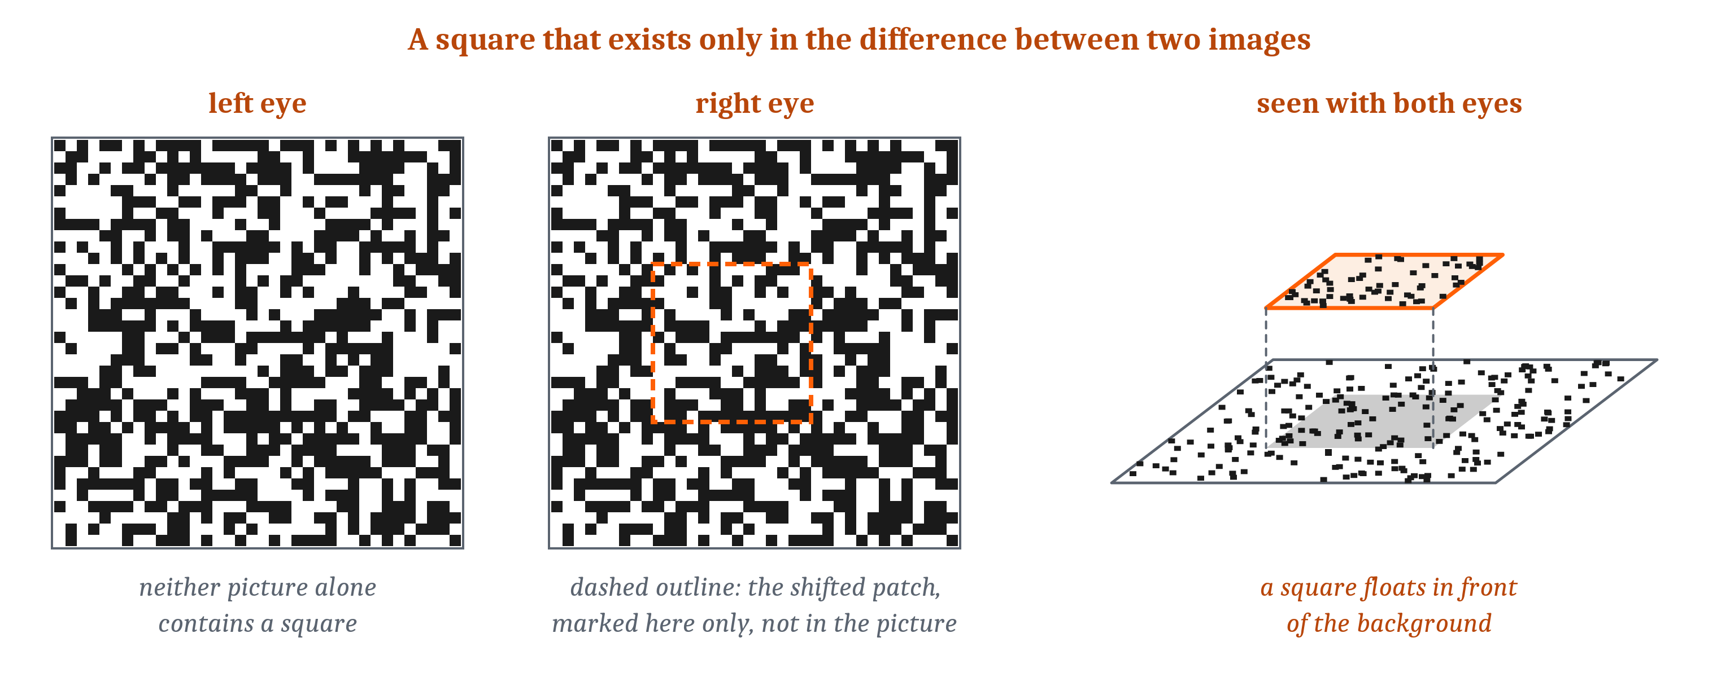
Two Eyes, One Matching Problem
Binocular disparity: the mismatch between where a point falls in the two eyes. The correspondence problem: pairing each point with its partner first.
Notes:
The two eyes sit a few centimeters apart, so they see a scene from slightly different positions. A point at exactly the distance the eyes are pointing at falls on corresponding places in the two retinas. A point nearer or farther falls on places that do not quite correspond. The size and direction of that mismatch is **binocular disparity**, and it carries information about depth.
A simple demonstration shows it. Hold a pencil at arm’s length and a finger about halfway to the face. Look at the pencil, and the finger doubles. Look at the finger, and the pencil doubles. Only a thin band of depth around the point being looked at fuses into one image. Everything else is double, although people rarely notice.
Stereo vision does not need to recognize objects first. In a random-dot stereogram, each eye sees a field of random dots, and in one field a square patch has been shifted slightly sideways. Neither field alone contains a square. Viewed together, one per eye, a square floats in front of the background. The square exists only in the disparity.
The same demonstration shows what makes stereo hard. Before disparity can be measured, each point in one eye’s image has to be paired with its partner in the other. That is the **correspondence problem**. In a random-dot field every dot looks like every other dot, so there are many possible pairings, and most are wrong. Repeating patterns are worse. Patterned wallpaper can be fused at the wrong pairing, and then it seems to float at the wrong distance.
How the brain solves the correspondence problem is still debated. The proposed solutions are models, not known mechanisms.

Slide 5
Color from Comparisons
Color begins with a comparison between kinds of receptor. Constancy needs more than one surface’s light, and neither proposed procedure is settled.
What has to be recovered | What is compared | Where it stands
Wavelength | Receptors tuned to different wavelengths: three kinds in humans, like a camera’s three filters | Needed: one receptor cannot tell dim light of one wavelength from brighter light of another
Constancy, by scene comparison | Each surface against the rest of the scene: if all the light turns reddish, every surface sends more red | Proposed; an early ratio version did not work everywhere; white balance is a cruder version
Constancy, by learning | The light from a surface against what similar light, in similar surroundings, has usually signified | Proposed
Notes:
Stereo recovers depth by comparing the two eyes. Color also begins with a comparison, this time between kinds of receptor. A receptor that reports only how much light it caught cannot say what wavelength the light had, because a dim light of one wavelength and a brighter light of another can produce the same response. So seeing color requires comparing receptors tuned to different wavelengths. Three kinds, compared, give human beings their color vision. A digital camera does the same with three kinds of filter over its sensor.
Comparing receptors is not enough for constancy, though. The banana under the lamp still sends the eye different light from the banana at noon. In a famous set of demonstrations in the 1950s, a collage of colored papers was lit so that a patch that looked green sent the eye exactly the light that a brown patch had sent before. The green patch still looked green. So the color of a surface is judged from more than the light coming from that surface.
Two kinds of procedure have been proposed. One compares each surface with the rest of the scene. If the light on the whole scene turns reddish, every surface sends back more red, so a surface’s color can be read from how it differs from its surroundings. An early version computed ratios of light across the whole scene, and it did not work in all circumstances. A camera’s automatic white balance is a cruder version of the same comparison. The other procedure is learned. On this account, the color a surface appears to have reflects what similar light, in similar surroundings, has usually signified in past experience.
Neither account is settled.

Slide 6
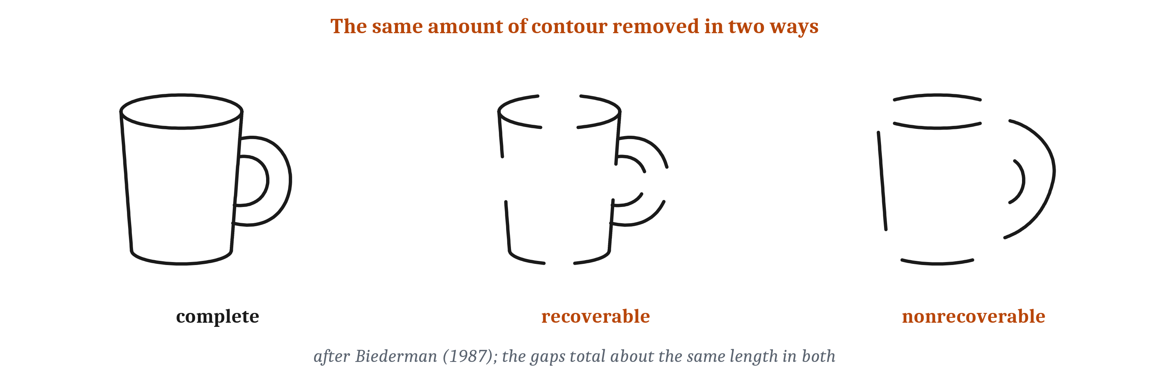
Recognizing Objects: Parts or Views?
Brains achieve tolerance, not perfect invariance. Two accounts of how, now usually seen as ends of a continuum of tasks.
Notes:
Color constancy is one case of the invariance problem from Module 7. Recognizing an object from any angle is that problem at its hardest. Strictly, what brains achieve is tolerance, in the sense we defined in Module 7: recognition survives a great deal of change in the image, but not all of it. There are two broad accounts of how.
The first is recognition by parts. On this account, objects are recognized as arrangements of a small set of simple volumes, each called a **geon**: bricks, cylinders, cones, wedges, about three dozen in all. A cup, on this account, is a curved cylinder with a smaller curved cylinder attached to its side. Geons are told apart by features of their edges that rarely arise by accident of viewpoint. A straight edge in an image almost always comes from a straight edge in the world, and parallel edges from parallel edges. So the features that identify a geon survive most changes of viewpoint.
The test that made this account famous removed the same amount of contour from drawings in two ways. When the gaps left each part recoverable, people named the objects. When the gaps hid the places where parts join, people failed almost completely, even with five seconds to look.

Slide 7
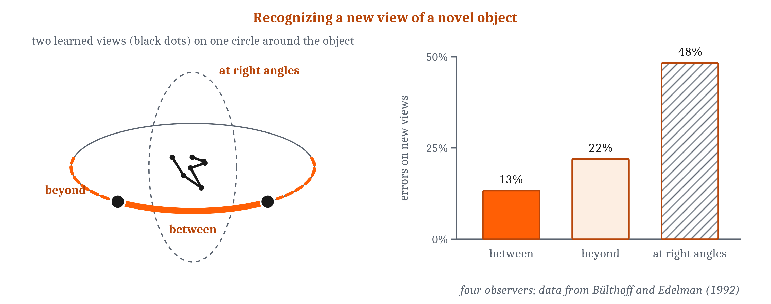
Recognizing Objects: Parts or Views?
Brains achieve tolerance, not perfect invariance. Two accounts of how, now usually seen as ends of a continuum of tasks.
Notes:
The second account is recognition by views. On this account, an object is stored as a set of views, and a new view is recognized by how close it is to the stored ones. People who learned novel twisted-wire shapes from a few views recognized new views between the learned ones quite well, views beyond them less well, and views at right angles worst. Monkeys trained for months showed the same pattern, and monkeys trained on three to five views spread around an object recognized it from any angle around the axis on which it had been turned. One proposal combines many units, each tuned to one view, into one unit that responds to all of them, as pooling did for position in Module 7. That proposal is a model rather than a finding.
The two accounts are now usually seen as ends of a continuum of tasks. Telling which of several similar objects is in view depends heavily on viewpoint. Recognizing a kind of object that differs from others in its parts, like a mug against a bucket, depends on it much less.

Slide 8
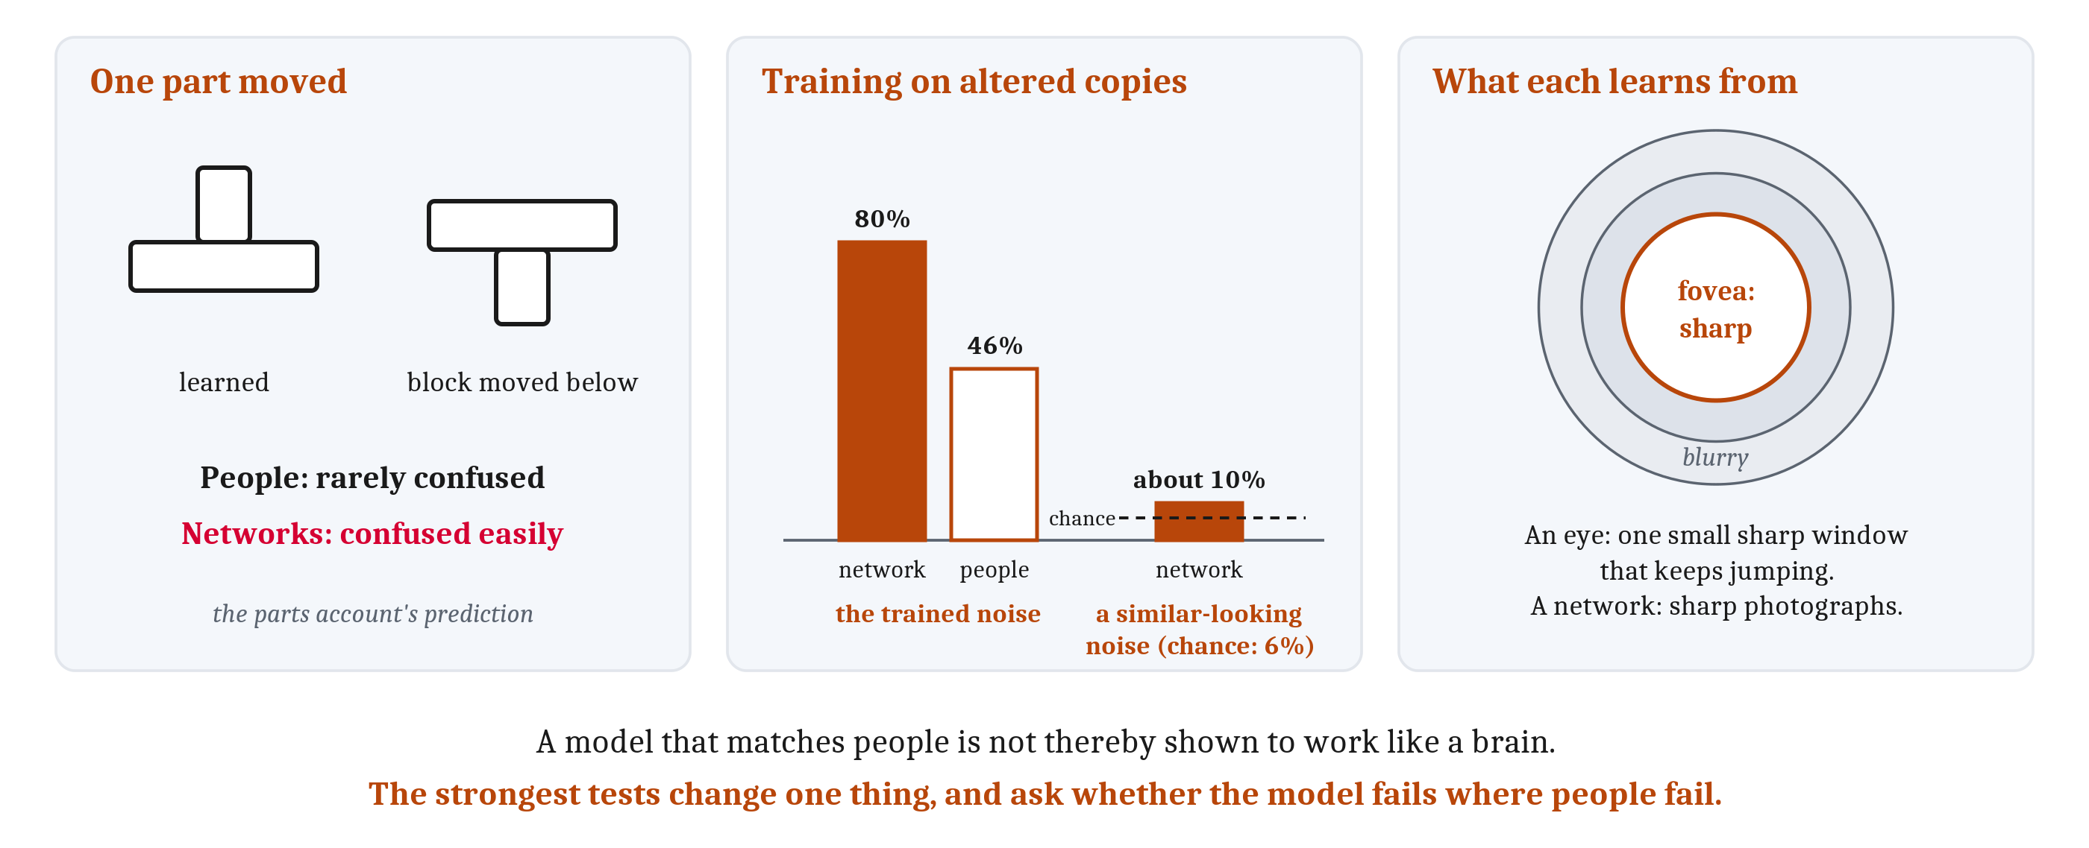
What Networks Share with Us, and What They Do Not
Networks fail where the parts account predicts. Training on altered copies gave tolerance to those alterations, and very little beyond.
Notes:
Deep networks give a third angle on object recognition. A network here means an artificial neural network, units and weighted connections run on a computer.
Networks trained only to name objects in photographs turn out to be sensitive to the same accident-proof edge features the parts account relies on, without being given them. But they fall short exactly where the parts account makes its prediction. People who learned simple line objects rarely confused them with versions in which one part had moved from above another part to below it. Networks confused those versions easily. And networks trained on photographs show little sign of representing three-dimensional shape or how parts are arranged.
Networks also bear on the question we left open in Module 7: is training on altered copies of images enough to explain tolerance? A network trained on images sprinkled with one kind of noise beat people on that noise, 80% correct against their 46%. On a second kind of noise that looks similar to a person, the same network scored about 10%, close to the 6% expected by chance. Training on altered copies gave tolerance to the trained alterations and very little beyond. People handle distortions they have never met.
Part of the difference may lie in what each system learns from. A network learns from sharp photographs. A primate eye gets fine detail only from the **fovea**, a small region at the center of gaze. Just six degrees from the line of sight, the ability to see detail has fallen by about three quarters. So at any moment, most of what the eye sees is blurry, with one sharp window that keeps jumping around. Networks trained on a mixture of sharp and blurry images relied more on shape, resisted noise better, and matched early visual cortex better. Self-produced movement matters too: kittens and infants avoid a visible drop only after moving under their own power, not after being carried. In the reading, we add an inference of our own, beyond these studies: a moving animal collects many views of each object, varied as the world varies them, which is the kind of experience that gave the monkeys their recognition from any angle.
Last, what a match shows. A digital clock predicts a mechanical clock’s time perfectly and works nothing like it. So a network that matches human answers, or even brain activity, is not thereby shown to work like a brain. The strongest tests change one thing and ask whether the model fails where people fail. The contour test on the last slide was a test of that kind.

Slide 9
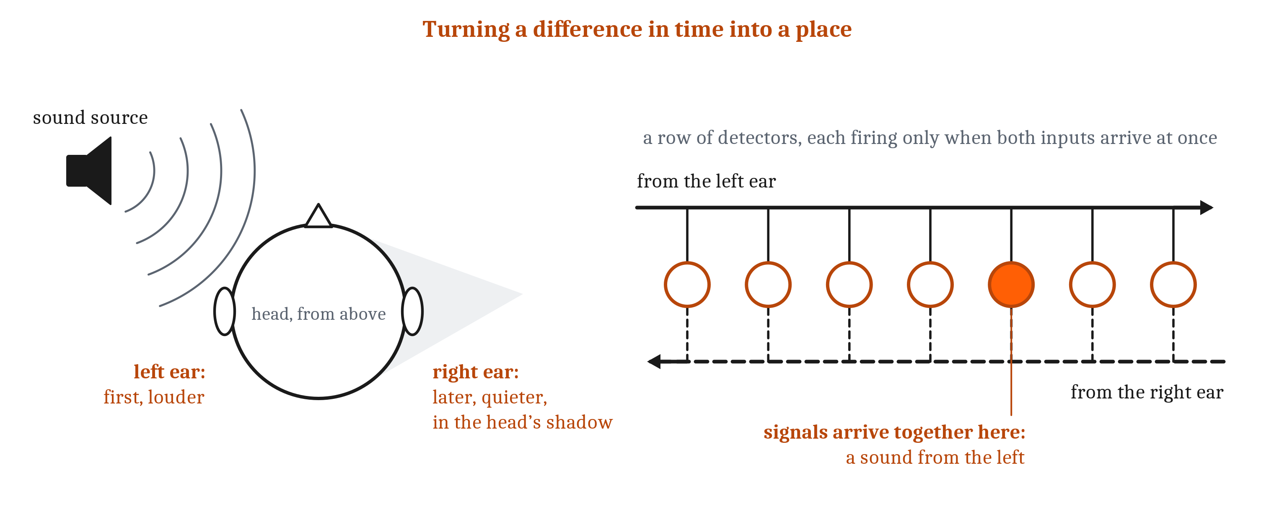
Where a Sound Comes From
The interaural time difference (the near ear hears first) and interaural level difference (the head shadows the far ear). A delay line turns a time difference into a place.
Notes:
Vision recovers distance by comparing the two eyes. Hearing uses the same kind of comparison, between the two ears, to recover direction.
It has three main cues. The near ear hears a sound first, which gives an **interaural time difference**. The head casts an acoustic shadow over the far ear, so the sound is a little quieter there, which gives an **interaural level difference**. The shadow matters mainly for high pitches, because low pitches bend around the head. So low pitches are located mainly by timing, and high pitches mainly by level. The third cue comes from the folds of the outer ear, which filter a sound differently depending on where it comes from. They mainly help tell up from down and front from back, which the two differences between the ears leave ambiguous. Since every person’s ears are shaped differently, these cues have to be learned.
The timing differences are tiny: a one-degree shift changes the timing difference by about ten millionths of a second. Two kinds of procedure have been proposed for measuring that. One turns a difference in time into a place. Signals from the two ears travel toward each other along a row of detectors, and each detector responds only when signals from both sides arrive at once. A sound from straight ahead gives signals that meet in the middle. A sound from the left gives the left ear’s signal a head start, so it travels farther along the row before the two meet. Where they meet stands for one time difference, and so one direction. Because travel time does the measuring, this is called a delay line.
The other procedure needs no map at all. It reads direction from the balance of activity between two broad channels, each favoring one side. Which procedure a given animal uses turns on the details of its neurons, which we take up in the third lecture.
Distance is only partly available to hearing. Loudness signals distance only for sounds whose loudness the listener already knows, just as image size signals distance only for objects of known size. And echoes from walls arrive from every direction, yet rarely confuse a listener about where a sound came from, because the first sound to arrive dominates the judgment.

Slide 10
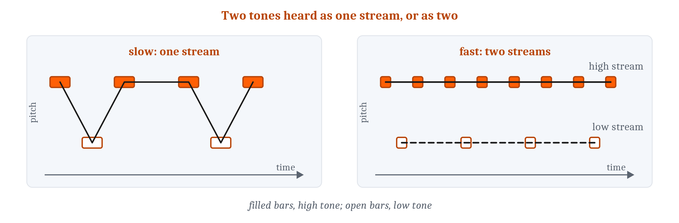
Same Source? Same Cause?
Auditory scene analysis groups one mixed wave into its sources. Cue combination weights each source of evidence by its reliability.
Notes:
Recall the busy kitchen from the first lecture: one wave at each ear, with every source added in.
**Auditory scene analysis** is grouping the components of one mixed wave into the sources that made them. Because the problem is ill-posed, it can only be solved by relying on how real sources usually behave. Parts of a sound that start together usually come from one source. A voice or a bird’s call produces frequencies that are all whole-number multiples of one lowest frequency, and components related that way are heard as one sound, which is why two voices at different pitches separate more easily than two at the same pitch. A component that starts slightly early tends to pop out as a separate tone.
Grouping works across time as well. Two tones alternating slowly are heard as one melody hopping up and down. Speed them up, and they split into two streams, high and low. A galloping pattern of tones, listened to for a while, flips between one stream and two, the way some drawings flip between two readings. Location is a weak cue for grouping sounds at one moment, but a strong one for following one talker over time, and blocking one ear makes a crowded conversation much harder. Even pitch is constructed: remove the lowest frequency, and listeners still hear its pitch, an inference about the source. Vision groups by similar principles, but with the difference from the first lecture: a hidden visual object needs completing, while each sound has to be pulled out of the whole mixture. Speech adds categories set by a language, and waits for Module 13.

Slide 11
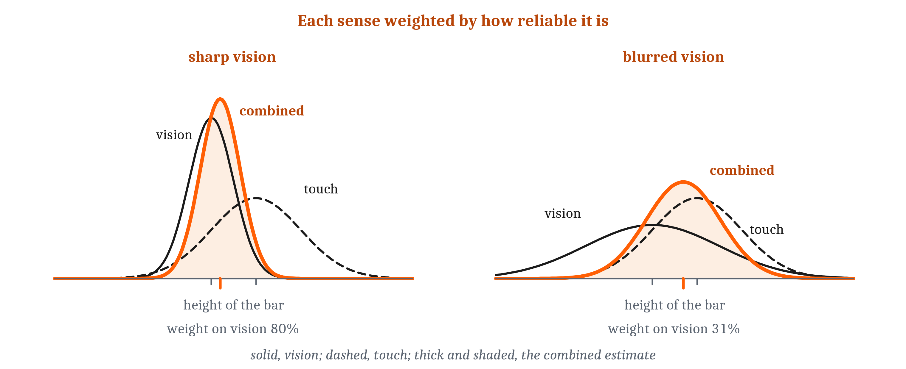
Same Source? Same Cause?
Auditory scene analysis groups one mixed wave into its sources. Cue combination weights each source of evidence by its reliability.
Notes:
Combining senses is the same kind of problem, and it is two problems. The first is deciding whether two signals share a cause, which is scene analysis across the senses. A flash and a click from the same place at the same moment probably do. The second arises when signals share a cause but disagree. People judged the height of a bar they could both see and feel, with the two made to disagree slightly. Judgments fell between the two, weighted by how reliable each sense was. As vision was made noisier, it counted for less, and the combined judgment was more precise than either sense alone. That is **cue combination**. People combine their senses nearly as well as the best possible weighting, though not perfectly.
The ventriloquist works the same way. Vision is usually far more precise about location, so the voice seems to come from the puppet. Blur a flash enough and the relation reverses: a click captures the flash. Set sight and sound far enough apart and capture stops, because they no longer seem to share a cause. And one sense can resolve another’s ambiguity. The canals of the inner ear sense rotation, which tilting the head produces and accelerating does not, so they settle the tilt-or-acceleration problem from the first lecture.

Slide 12
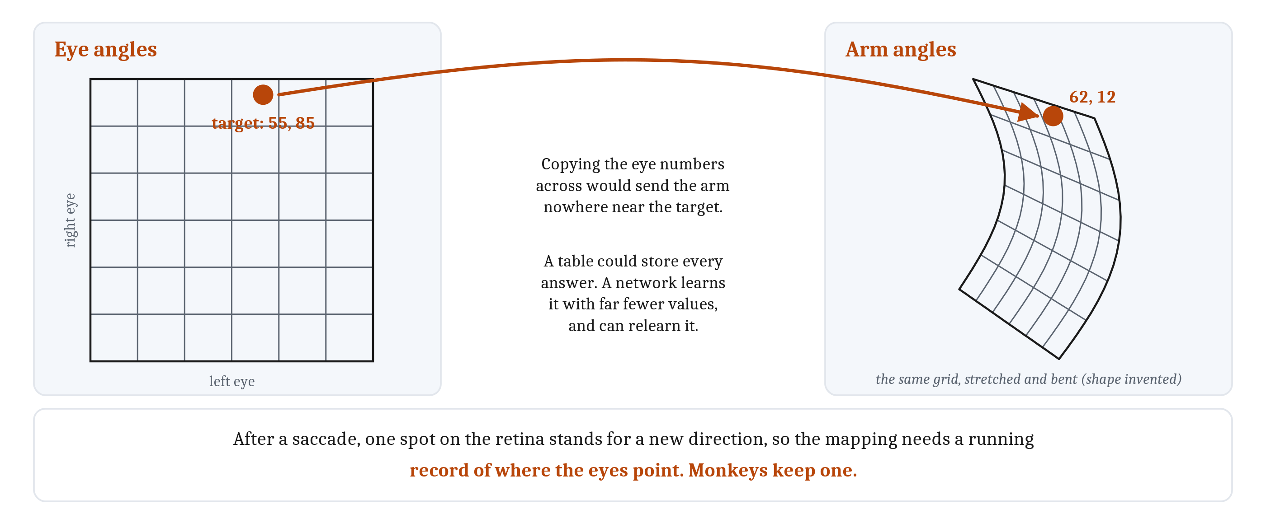
From Eye to Arm
Acting needs a mapping between coordinate systems that share no numbers, and the mapping changes every time the eyes move.
Notes:
In the first lecture, the last problem on our list was coordinates. A target seen at one place on the retina has to be reached with a particular set of joint angles, and the two descriptions share no numbers.
A simulated crab makes this concrete. It describes a target by the angles of its two eyes, and its arm by the angles of two joints. A target at eye angles of 55 and 85 calls for arm angles of 62 and 12. Copying the eye numbers straight across would send the arm nowhere near the target. So the crab needs a mapping from one set of coordinates to the other.
The mapping can be pictured as a rubber sheet. Draw a grid over the space of eye angles, then stretch and bend the sheet until every point lands on the arm angles that reach it. A table storing the answer for every point would do the job. A network can learn the same mapping with far fewer stored values, by adjusting its weights, and it can relearn the mapping when the body changes.
In a real animal there is one more complication. The mapping changes with every movement of the eyes and head, because after a saccade the same spot on the retina stands for a different direction in the world. So the transformation needs a running record of where the eyes are pointing. Monkeys keep one. When a monkey’s eyes were pushed off course just after a target flashed, its next saccade still landed on the flash. Its brain combined where the flash had fallen on the retina with where the eyes had since gone.
That record can come from a copy of the eye-movement command or from sensors in the eye muscles, the two sources of information about movement from the first lecture. The fish’s strike at a water flea needs all of this at once.

Slide 13
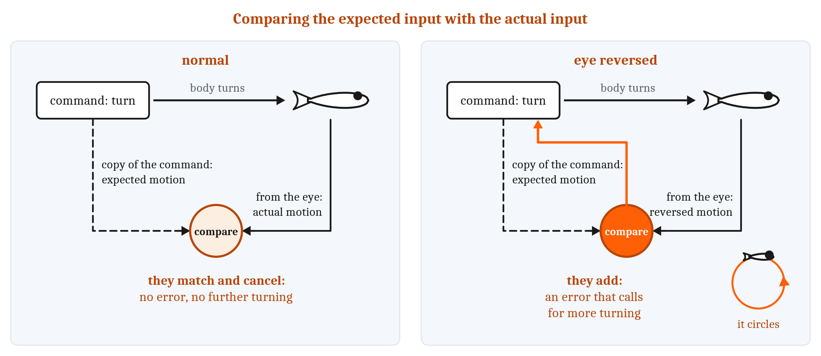
A Copy of the Command
Reverse an eye, and expected and actual motion add instead of canceling. An efference copy is a copy of a command kept for the comparison; corollary discharge is now used almost interchangeably.
Notes:
The opening question about a world that holds still has a simpler version in a fly. A fly inside a drum painted with vertical stripes turns to follow the drum when the drum rotates. But when the fly turns on its own inside a still drum, its eyes receive exactly the same sweep of stripes, and it does not turn back to follow them. Why not?
There are two possible answers. The response to visual motion could be switched off whenever the animal moves. Or the animal could expect the motion its own turn will produce, and subtract that expectation from what its eyes report. If they match, nothing is left over, and nothing needs a response.
In 1950, two research groups told these apart, and both did it by reversing an eye. One group rotated a hoverfly’s head half a turn, so its eyes saw left and right reversed. In plain surroundings it walked normally. Inside a still, striped drum, it circled. The other rotated one eye of a small pufferfish, and the fish swam in tight circles until the eye was turned back.
Switching off predicts normal behavior, since a switched-off response does not care which way the eye faces. Subtraction predicts what the animals did. With the eye reversed, expected and actual motion no longer cancel. They add. Every turn produces an error that calls for more turning, and the animal spins. So there is a comparison between what an animal expects and what it senses, and these experiments showed it without recording a single neuron.
A copy of the movement command kept for the comparison is an **efference copy**. The researcher who ran the fish experiment, working independently, called the same kind of signal a **corollary discharge**, and the two terms are now used almost interchangeably. The pufferfish kept circling with both balance organs removed, so its expectation could not have come from sensing the movement, which is what led to the idea of a copy of the command. The fly’s expectation could also have come from sensors in its legs.
A copy of the command can be used in two ways. It can dim a sense during movement, as a fish’s lateral line is turned down while it swims, and a person’s hearing while they speak. That suits brief, simple self-caused signals. Or it can predict a specific consequence and subtract it, which suits complex, long-lasting ones. Alongside either, an animal can measure its own movement directly, and real nervous systems use prediction and measurement at once.

Slide 14
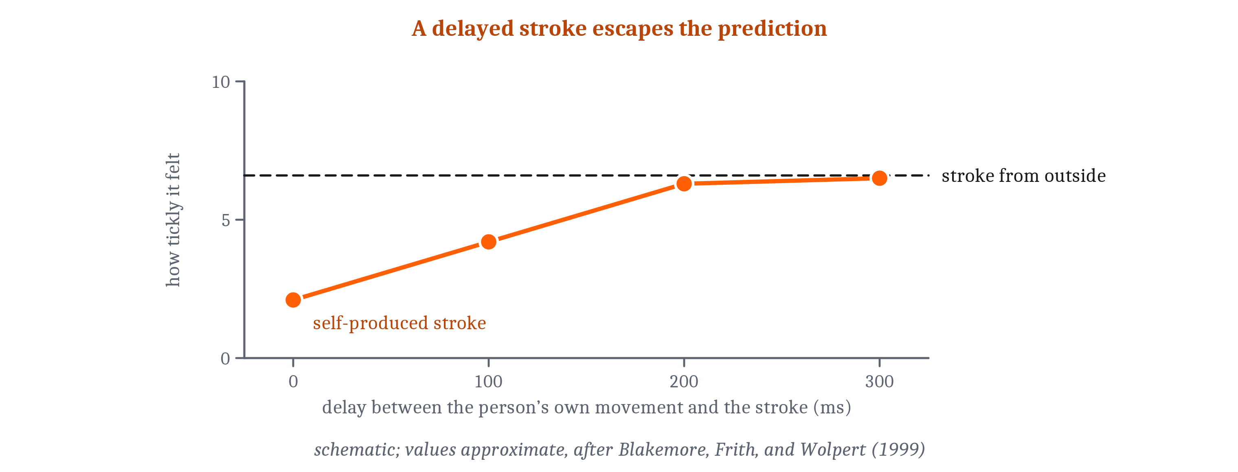
Predicting One’s Own Sensations
A forward model predicts what a command will do to body and senses. An inverse model runs from a wanted outcome to the command.
Notes:
A **forward model** predicts what a movement command will do to the body and the senses, before the senses report. The difference between the prediction and what actually arrives is information about the world. An **inverse model** runs the other way, from a wanted outcome to the command that will produce it.
This also explains why no one can tickle themselves. In one experiment, people moved a handle with one hand, and a robot arm following the handle stroked the palm of their other hand with foam. Self-produced strokes felt much less tickly than the same strokes made by the robot alone. Then a delay was added between the handle and the stroke. The longer the delay, the ticklier the stroke, and at a fifth of a second it felt as tickly as one from outside. The prediction is precise in time, and a stroke that arrives late no longer matches it.
The subtraction has a side effect. Two people took turns pressing on each other’s finger, each trying to press exactly as hard as they had just been pressed. The force grew by about 38% each turn, because each person’s own press, partly subtracted, felt weaker than it was.
The same prediction is the second half of the answer. Every saccade sweeps the image across the retina, yet the world does not seem to jump. Press gently on the outer corner of one eyelid, with the other eye closed, and the eye moves with no command, and the world does seem to jump. If the eye muscles are paralyzed and a person tries to look right, the world seems to jump right; if the eye is pushed right with no command, it jumps left; in an ordinary movement both happen and cancel. The usual explanation is a corollary discharge with some help from eye-muscle sensors, which is well supported rather than settled.
There is a direct parallel in AI. A learned model that predicts the consequences of an agent’s own actions is what many machine-learning researchers call a world model. Whether current AI systems build genuine internal models of the world is debated, as we noted in Module 1. A forward model is one precise version of what such a model would be.
A forward model also helps with delay. Predicting a command’s consequences gives an estimate of where the body is now, more current than the senses’ last report, and the nervous system can steer by it. In one model of eye tracking, steering only by visual feedback a tenth of a second old was unstable, and adding a loop that used a copy of the command made it stable. A second answer to delay is a faster sense. The reflex that keeps the eyes steady as the head turns starts within about 10 to 15 milliseconds, driven by the balance organs instead of vision.
Some corrections are too fast to notice at all. If a target jumps during a saccade, people do not see it move, yet their reaching hand bends toward the new position partway through the reach, and they cannot stop the correction even when asked to.

Slide 15
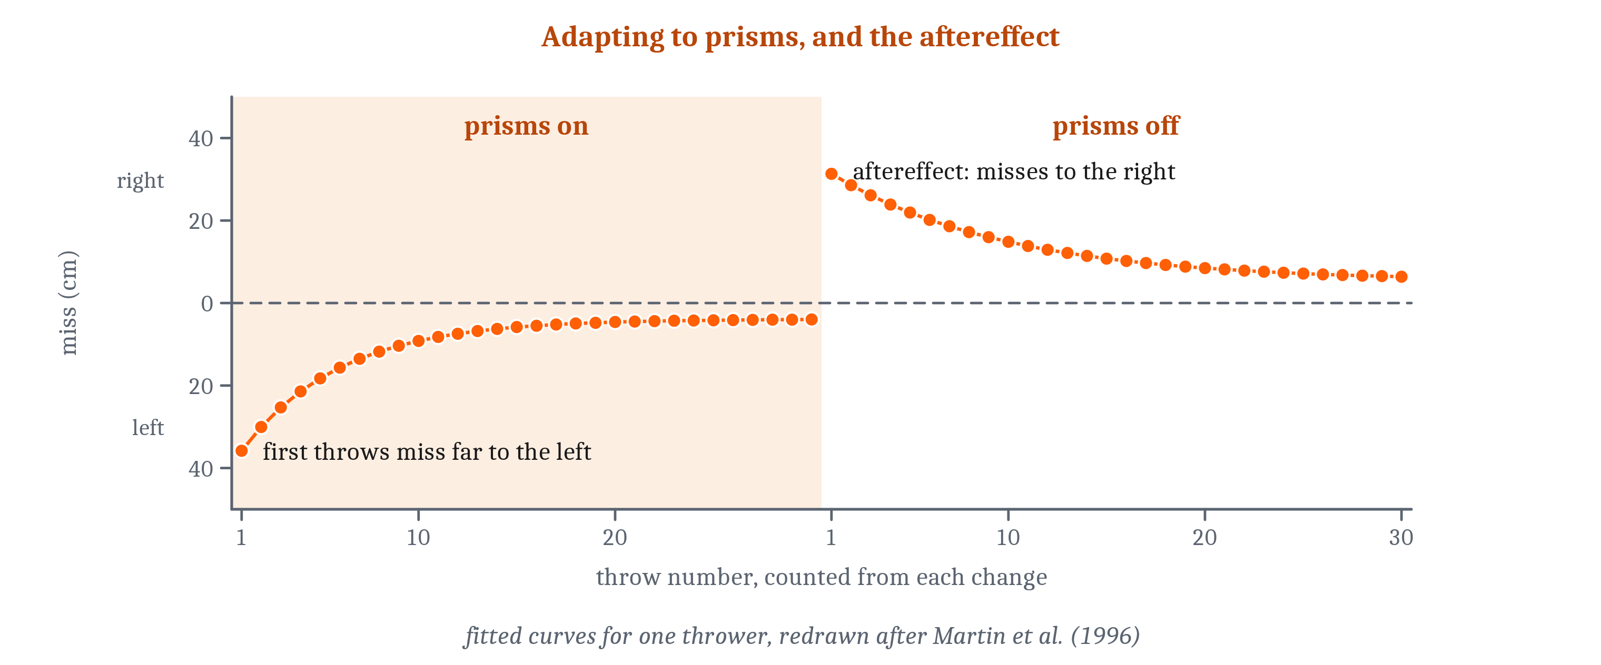
Learning the Model from Mismatch
The model is learned from prediction error. The aftereffect, a miss the other way once the distortion is removed, shows that a stored mapping changed.
Notes:
A forward model has to be learned, and it has to keep being relearned, because the body keeps changing. The learning signal is the difference between the predicted and the actual sensation. That is the prediction error we described in Module 5, and the logic is that of the delta rule: adjust in proportion to how far the prediction was off.
Prisms show the learning clearly. People threw balls at a target two meters away while wearing goggles with prisms that shifted their view about seventeen degrees to one side. Their first throws missed by about half a meter. With each throw the miss shrank, and on average it halved roughly every six throws, though people differed widely in how fast they adapted.
Then the prisms came off, and the first throws missed by most of the original amount in the opposite direction, before recovering again. That opposite miss, the **aftereffect**, is the evidence that a stored mapping had changed. The throwers had not simply learned to aim off to one side. Their nervous systems had changed the mapping from what they saw to how they threw, and the change stayed in place after the reason for it was gone. This is the rubber sheet from the eye-to-arm slide, being relearned.
The eye has its own version. Magnifying glasses make the image slip across the retina with each turn of the head, because the steadying reflex was set for unmagnified vision. Over hours to days the reflex grows stronger until the slip disappears. Take the glasses off, and the new setting persists for a while: the same kind of aftereffect.
All of this is what a whole animal or person does. The cells that learn from the mismatch, and the circuits they sit in, are the third lecture.

Slide 16
Is a World Model a Forward Model?
In your group, four minutes.
Several AI companies now announce “world models”. Some are systems trained on video to predict what a scene will show next, given an action.
Is a system like that a forward model? What would it need to predict, and from what?
If one matched people well on some test, what test would give the strongest evidence about whether it works the way a brain does?
Notes:
We can set the forward model beside a claim that turns up often in technology news.
On the first question, the definition does most of the work. A forward model predicts what a movement command will do to the body and the senses. A system that predicts the next frames of a scene, given the action taken, is predicting the sensory consequences of an action, so it has the shape of a forward model. Groups often notice two differences worth pressing on. An animal’s forward model predicts the consequences of its own commands, for its own body, and is relearned whenever that body changes. And the animal uses the prediction for something: to cancel its own signals, and to steer ahead of its delays. Whether a system trained on video does either is a fair question to ask of any announcement.
The second question runs the clock argument. A system that matches human answers is not thereby shown to work like a brain, any more than a digital clock works like a mechanical one. The strongest tests change one thing and check whether the system fails where people fail. For a forward model, a natural test is a reversal like the 1950 experiments, or a delay like the tickle experiment: change the relation between action and consequence, and see whether the system’s predictions break the way an animal’s do, and whether it relearns, with an aftereffect.
Whether current AI systems build genuine internal models of the world is debated, and we do not settle it here.

Slide 17
Image Sources (1 of 2)
Slide | Image | File | License | Source
3 | Depth cues | fig-depth-cues.png | CC BY 4.0 | Jon Willits — drawn for the Module 8 reading · own work
4 | A random-dot stereogram | fig-random-dot.png | CC BY 4.0 | Jon Willits — drawn for the Module 8 reading · own work
6 | Recoverable and nonrecoverable contour | fig-recoverable-contour.png | CC BY 4.0 | Jon Willits — drawn for the Module 8 reading · own work
6 | Errors on new views | fig-view-generalization.png | CC BY 4.0 | Jon Willits — drawn for the Module 8 reading, data from Bülthoff and Edelman (1992) · own work
7 | Networks and people | fig-networks.png | CC BY 4.0 | Jon Willits — drawn for this lecture · own work
8 | Timing differences, and a delay line | fig-itd-delay-line.png | CC BY 4.0 | Jon Willits — drawn for the Module 8 reading · own work
9 | Streaming | fig-streaming.png | CC BY 4.0 | Jon Willits — drawn for the Module 8 reading · own work
9 | Cue combination | fig-cue-combination.png | CC BY 4.0 | Jon Willits — drawn for the Module 8 reading · own work

Slide 18
Image Sources (2 of 2)
Slide | Image | File | License | Source
10 | A mapping from eye angles to arm angles | fig-eye-to-arm.png | CC BY 4.0 | Jon Willits — drawn for this lecture · own work
11 | Expected and actual motion | fig-reafference.png | CC BY 4.0 | Jon Willits — drawn for the Module 8 reading · own work
12 | Tickliness and delay | fig-tickle.png | CC BY 4.0 | Jon Willits — drawn for the Module 8 reading, schematic after Blakemore, Frith, and Wolpert (1999) · own work
13 | Throwing through prisms | fig-prism.png | CC BY 4.0 | Jon Willits — drawn for the Module 8 reading, after Martin and colleagues (1996) · own work

