Slide 1

BCOG 100
Vertebrate Neural Architecture
Lecture 6.3 — The Vertebrate Brain, and How It Is Built
Notes:
This is the implementational level, and it comes in two halves.
The first half is a tour of the parts, from the spinal cord up. Every capacity we have met since Module 3 now gets an address: arousal, valence, internal states, learning from reward, choosing among actions. All of them were taught as circuits and signals with no location. Here they get one.
The second half asks how that plan gets built in an embryo. Module 2 introduced Tinbergen's four questions, and one of them is ontogeny: how a trait develops within an individual. The answer turns out to be a small set of rules, not a plan.
And at the end we come back to one of the reading's opening questions. Every capacity in this book now has an address. Why is having one so much less than an explanation?

Slide 2
To Start: Why Release Rather Than Switch On?
In your group, three minutes.
In the last lecture, choosing an action turned out to be releasing it, not switching it on.
What does that mean, in a sentence?
And why is there no walking organ, no eating organ, no talking organ?
Notes:
This replaces a recap, and it asks for the last lecture's central idea in the room's own words.
The answer to the first question: in a vertebrate, nothing is switched on to produce a movement. Every motor program is held back by default, because the output cells of the basal ganglia fire steadily and inhibit the brainstem centers that would run each program. Choosing an action is lifting that hold for one of them.
The answer to the second: walking, eating and talking compete for the same muscles and the same body. Parts that ran each of them independently would pull in different directions. Shared machinery, with something to settle which program is released, is what works when one body has to do one thing at a time.
Keep the second answer in mind for the next slide, because it turns out to be true near the top of the nervous system and false near the bottom.

Slide 3
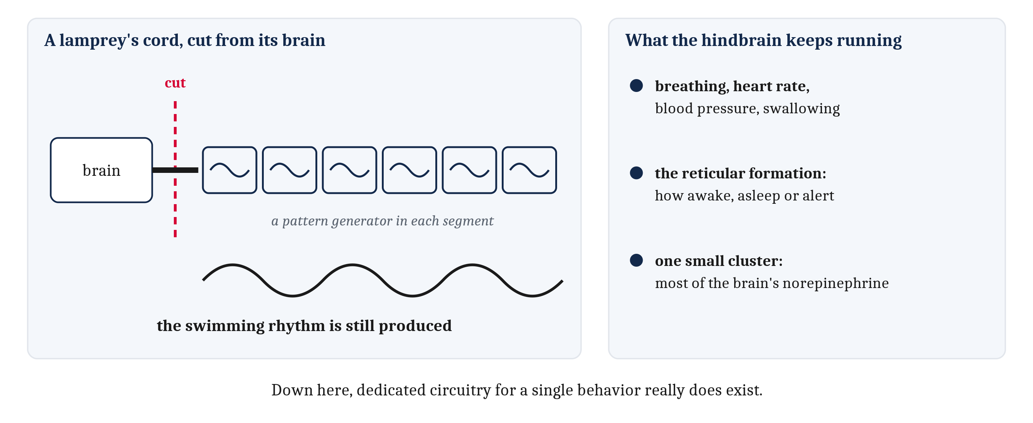
Hindbrain and Spinal Cord: Running the Body
The oldest-looking parts do the jobs that cannot stop. A central pattern generator makes a rhythm with no rhythmic input; the reticular formation sets how awake an animal is.
Notes:
The parts of the brain that look oldest do the jobs that cannot stop.
The spinal cord carries signals between brain and body, and it also runs a good deal of behavior by itself. The wave that travels down a swimming lamprey is made by circuits in the cord, segment by segment. Each is a **central pattern generator**: a circuit that produces a rhythmic output without a rhythmic input to drive it. The proof is on the left of the figure. Cut the connection between a lamprey's cord and its brain, and the swimming rhythm can still be produced.
The hindbrain continues from the cord and controls what keeps an animal alive: breathing, heart rate, blood pressure and swallowing. The cranial nerves leave from here and from the midbrain in front of it, serving the face, mouth, ears and eyes.
Two capacities from Module 4 get addresses here. The **reticular formation** is a loose network of cells running the length of the brainstem that sets how awake an animal is and takes it in and out of sleep. That is arousal, located. And most of the brain's norepinephrine comes from one small cluster of cells in the hindbrain, whose fibers reach nearly everywhere. Module 4 called norepinephrine the arousal dial. This is where the dial is turned.
Now the concession, which runs against the last lecture. Down here, dedicated circuitry for a particular behavior really does exist. Breathing has its own pattern generator, and so do chewing, swallowing and locomotion. Each is stereotyped, each has to keep running while everything else changes, and each has a circuit of its own. That is the *keep going* half of the first conflict from the first lecture, built into anatomy. Higher up, where actions are chosen rather than generated, the arrangement is shared machinery with a selector.

Slide 4
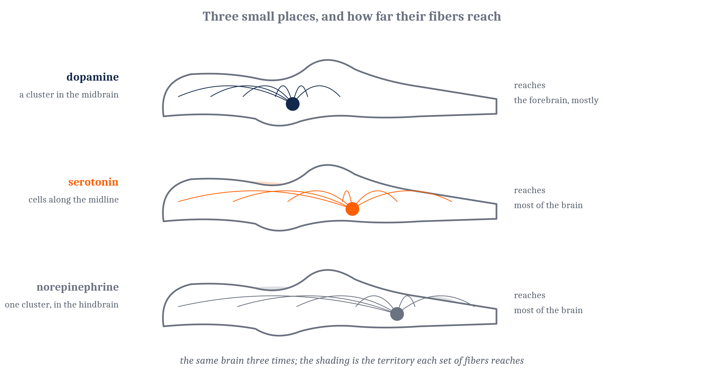
The Midbrain: Orienting, and Where the Broadcasts Start
The tectum aims by finding a place on a map. And the broad projections of the last lecture start in a few small clusters.
Notes:
The roof of the midbrain is the tectum. It holds maps of the space around the animal, built from what the eyes report and, in many animals, from hearing and touch as well. The maps are in register, so a position in one is the same position in the others. And what the tectum does with a position is turn the animal toward it: the eyes, the head, and in a fish the whole body.
That is Module 4's problem of aiming, solved again at a larger scale, and the contrast is worth stating exactly. Module 4's worm aimed by comparing a signal now against a signal a moment ago, with no map anywhere in it. A vertebrate aims by finding a place on a map and orienting to it. The difference is the map, not the accuracy. It is also where the frog's retina sent most of its output in Module 2. In mammals the tectum is called the superior colliculus, and it still turns the eyes.
The midbrain is also where broadcasts start, and the figure shows the three sources. The dopamine neurons sit in two clusters in the midbrain, with fibers running forward into the striatum and the pallium. The serotonin neurons sit in a series of clusters along the midline of the brainstem. Add the hindbrain's norepinephrine cluster from the last slide, and that is three of the four molecules on Module 4's valence and arousal plane. All three sources are small, old, and positioned to reach almost everything. The broad projections of the last lecture start in a few little places, and their territories overlap without being identical.
One more midbrain structure. The periaqueductal gray does for defense what the tectum does for orienting. It organizes whole defensive responses: freezing, fleeing, and the dulled pain that comes with either. Stimulating it in a rat produces the entire defensive pattern, not a fragment of it.

Slide 5
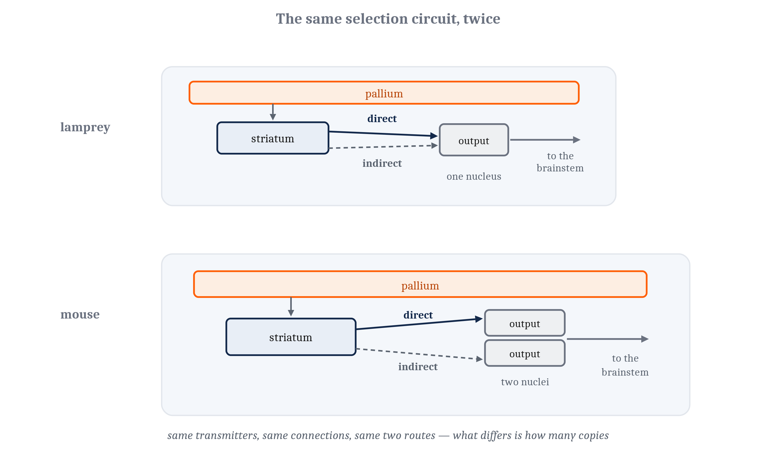
The Forebrain's Old Core
Homeostasis from the hypothalamus, selection from the basal ganglia, and valence from the amygdala, the last in jawed vertebrates.
Notes:
Three structures at the base and center of the forebrain are the organs of capacities we have already met.
The hypothalamus keeps internal conditions near their set points: temperature, water balance, blood sugar, salt. It has cells that detect how far each condition has drifted and circuits that correct it. Some of the correction is behavioral, which is why an animal short of water goes looking for water. Some is physiological, through the pituitary gland hanging below it, which releases hormones into the blood. The general name for keeping internal conditions within limits is **homeostasis**. Module 4's internal states, which set how a circuit treats the same input, are regulated from here.
The basal ganglia sit deeper, wrapped around the sides of the forebrain. Their input stage, the striatum, receives signals from almost the whole pallium and from the thalamus, with the dopamine fibers arriving among them. Habits and goal-directed actions lean toward different ends of the striatum. The figure shows the comparison from the last lecture: the lamprey's selection circuit matches a mouse's part for part, and the mouse's output stage is divided in two where the lamprey has one.
The **amygdala** is a cluster of nuclei at the front and base of the forebrain, and it evaluates what matters, quickly, before much else has happened. Populations of its neurons respond selectively to good outcomes, and others to bad ones, intermingled in the same tissue. That is valence, located. Reptiles, birds and jawed fishes have an amygdala-like region with similar circuitry.
The phylogeny needs care. Whether a lamprey has an amygdala-like region is not settled, so the amygdala claim is a claim about jawed vertebrates. The selection circuit is different: it matches a mammal's part for part.

Slide 6
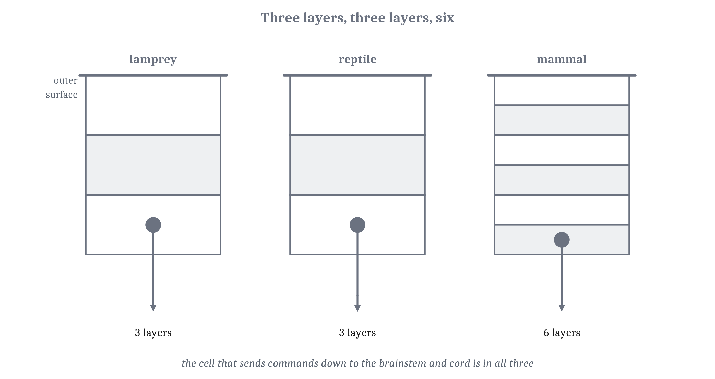
The Pallium, and the Thalamus That Serves It
Every vertebrate has a pallium, built differently in each. Almost everything that reaches it passes through the thalamus.
Notes:
Every vertebrate has a pallium, and what it is made of differs from one to another.
In a lamprey the pallium is thin, with three layers. It already has output cells that reach the basal ganglia, the tectum, the brainstem and the spinal cord. It already receives visual signals relayed through the thalamus, and smell arriving directly. The figure makes the point about the output cell: it is present in the lamprey, in the reptile and in the mammal alike.
That lamprey result deserves a hedge, and the chapter gives it. The evidence is recent and comes largely from one laboratory. Its resemblance to a mammal's cortex should be held as a promising result, not a settled one.
In mammals the pallium grew enormously and acquired six layers. That is the neocortex.
The thalamus sits above the hypothalamus, in the middle of the forebrain, and almost everything that reaches the pallium passes through it. It is also where the loops of the last lecture return, relaying the output of the basal ganglia and the cerebellum back up. It is not a passive relay station.
The hippocampus is an old region of the pallium, curled along its inner edge. It is named here and taken up in its own module.
One vocabulary rule for the rest of the book. *Pallium* is the structure in any vertebrate. *Neocortex* is the six-layered mammalian form. *Cortex* on its own is loose usage for the neocortex, and this book does not apply the word *cortex* to a fish.

Slide 7
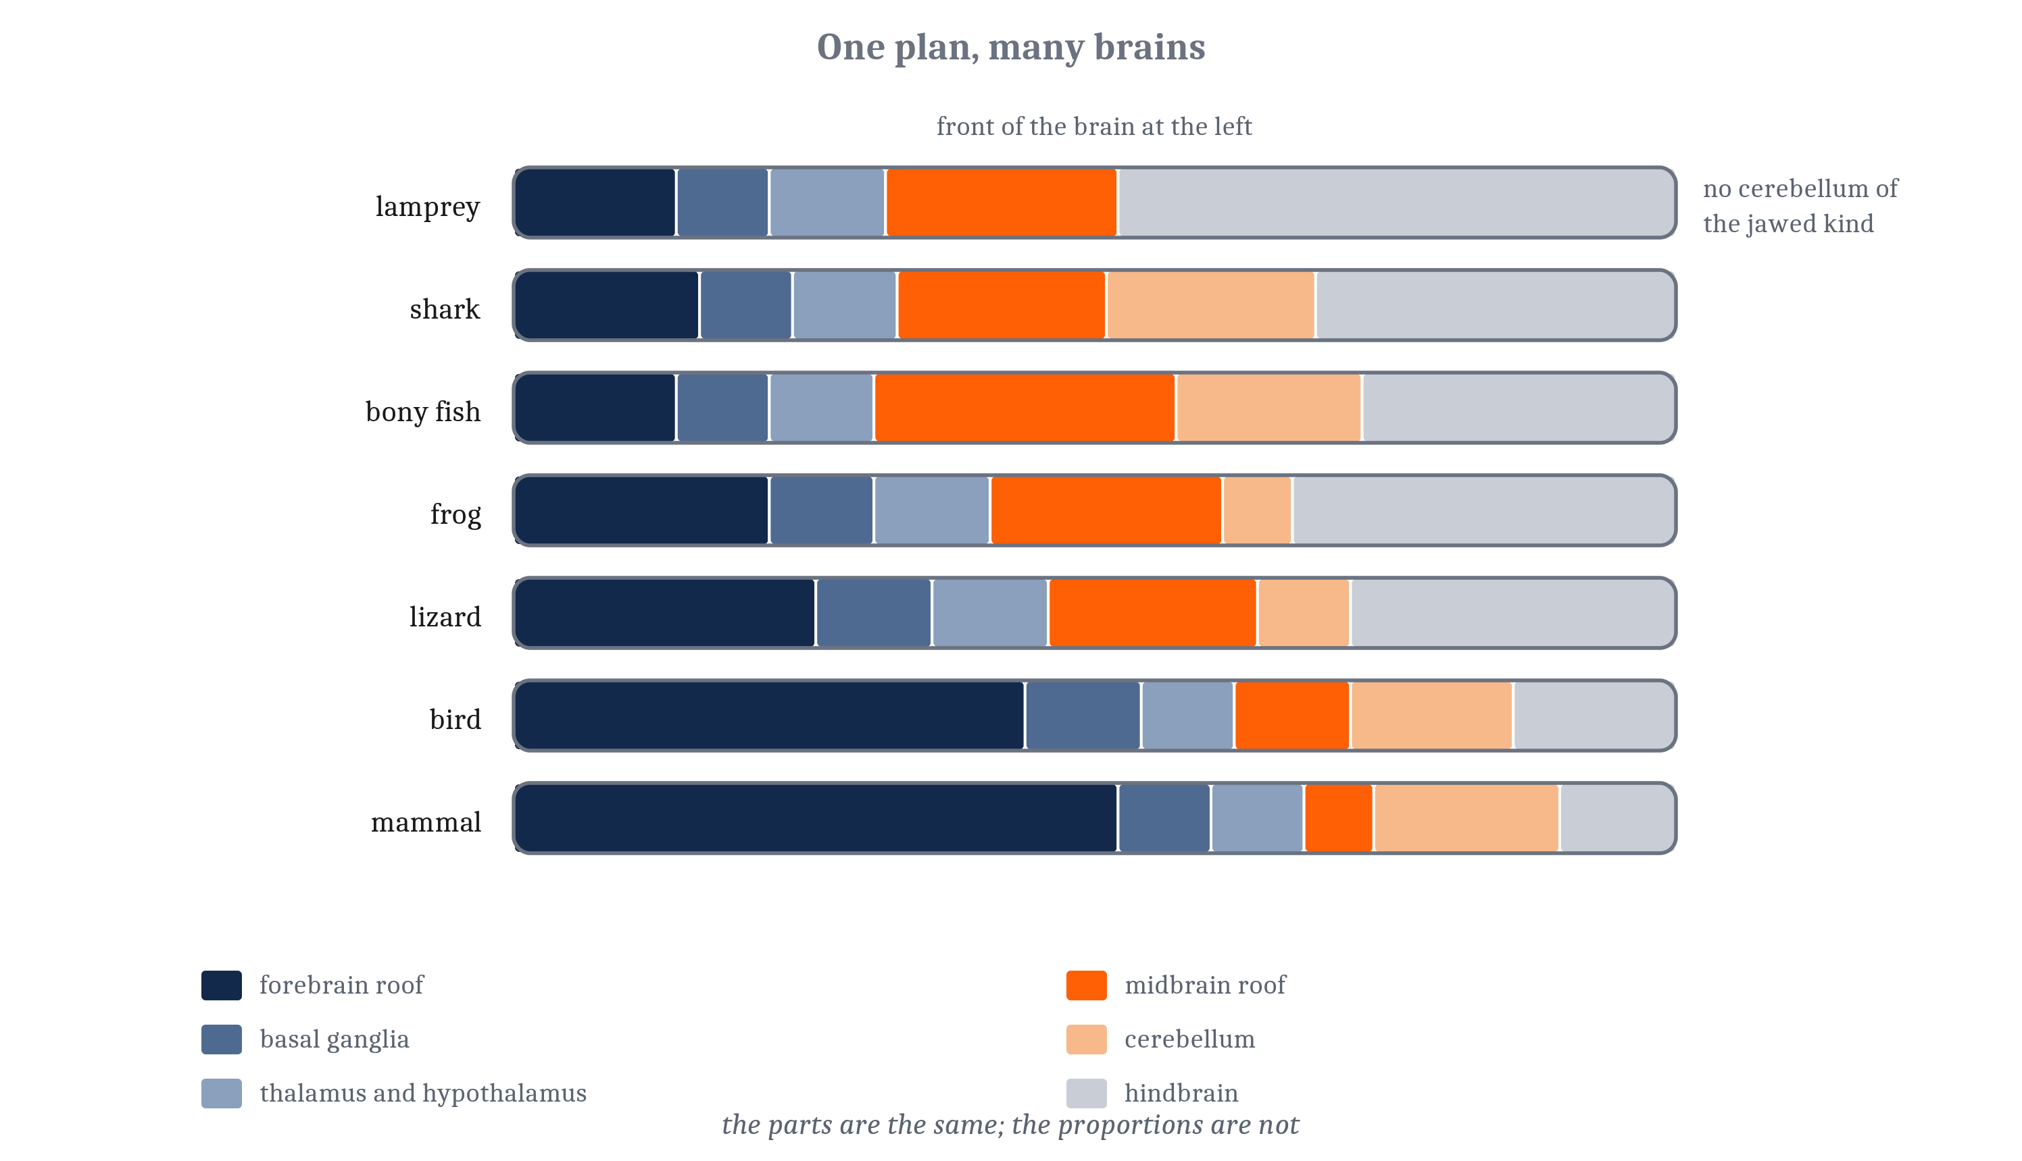
One Plan, Elaborated Many Times Over
The same parts, in the same order, from lamprey to mammal. What changed is proportion and number, and it changed in parallel, not in one climb.
Notes:
Set a lamprey's brain beside a mouse's and the same parts are there, in the same order, with one exception. What changed is mostly proportion and number. The inference behind that, from the first lecture, is that a structure present in the lamprey was most probably present in the common ancestor of living vertebrates.
The list of what came later is short. The cerebellum arrived with or shortly before the jawed fishes, then enlarged independently in sharks, bony fishes, birds and mammals. The output nucleus of the basal ganglia divided in two in mammals, which is why a mammal's indirect pathway has more stops. More basal ganglia units were added. The front of the forebrain acquired many more distinct cell groups: six in a lamprey, sixty-six in a rat. And the pallium acquired six layers in mammals, along with kinds of inhibitory neuron a lamprey lacks. One surprise runs the other way: the tectum is already layered in a lamprey, and has more layers in fishes and birds than in mammals.
Brains also got bigger, and more than once. Across living vertebrates, brain size for a given body size varies about thirtyfold. Relative size increased independently in some members of every major group: sharks, bony fishes, birds and mammals. Larger brains generally have more distinct parts, not just more of the same tissue.
So the vertebrate plan was elaborated many times over, in parallel. It was not climbed once, toward mammals. The figure is not a ladder.
The bird pallium is the clearest case. It is large, in some species it supports behavior as flexible as a mammal's, and it is organized in clusters rather than layers. Whether its parts correspond to parts of the mammalian neocortex has been argued for decades. That shows how hard Module 2's homology can be to establish across lineages separated for three hundred million years.

Slide 8
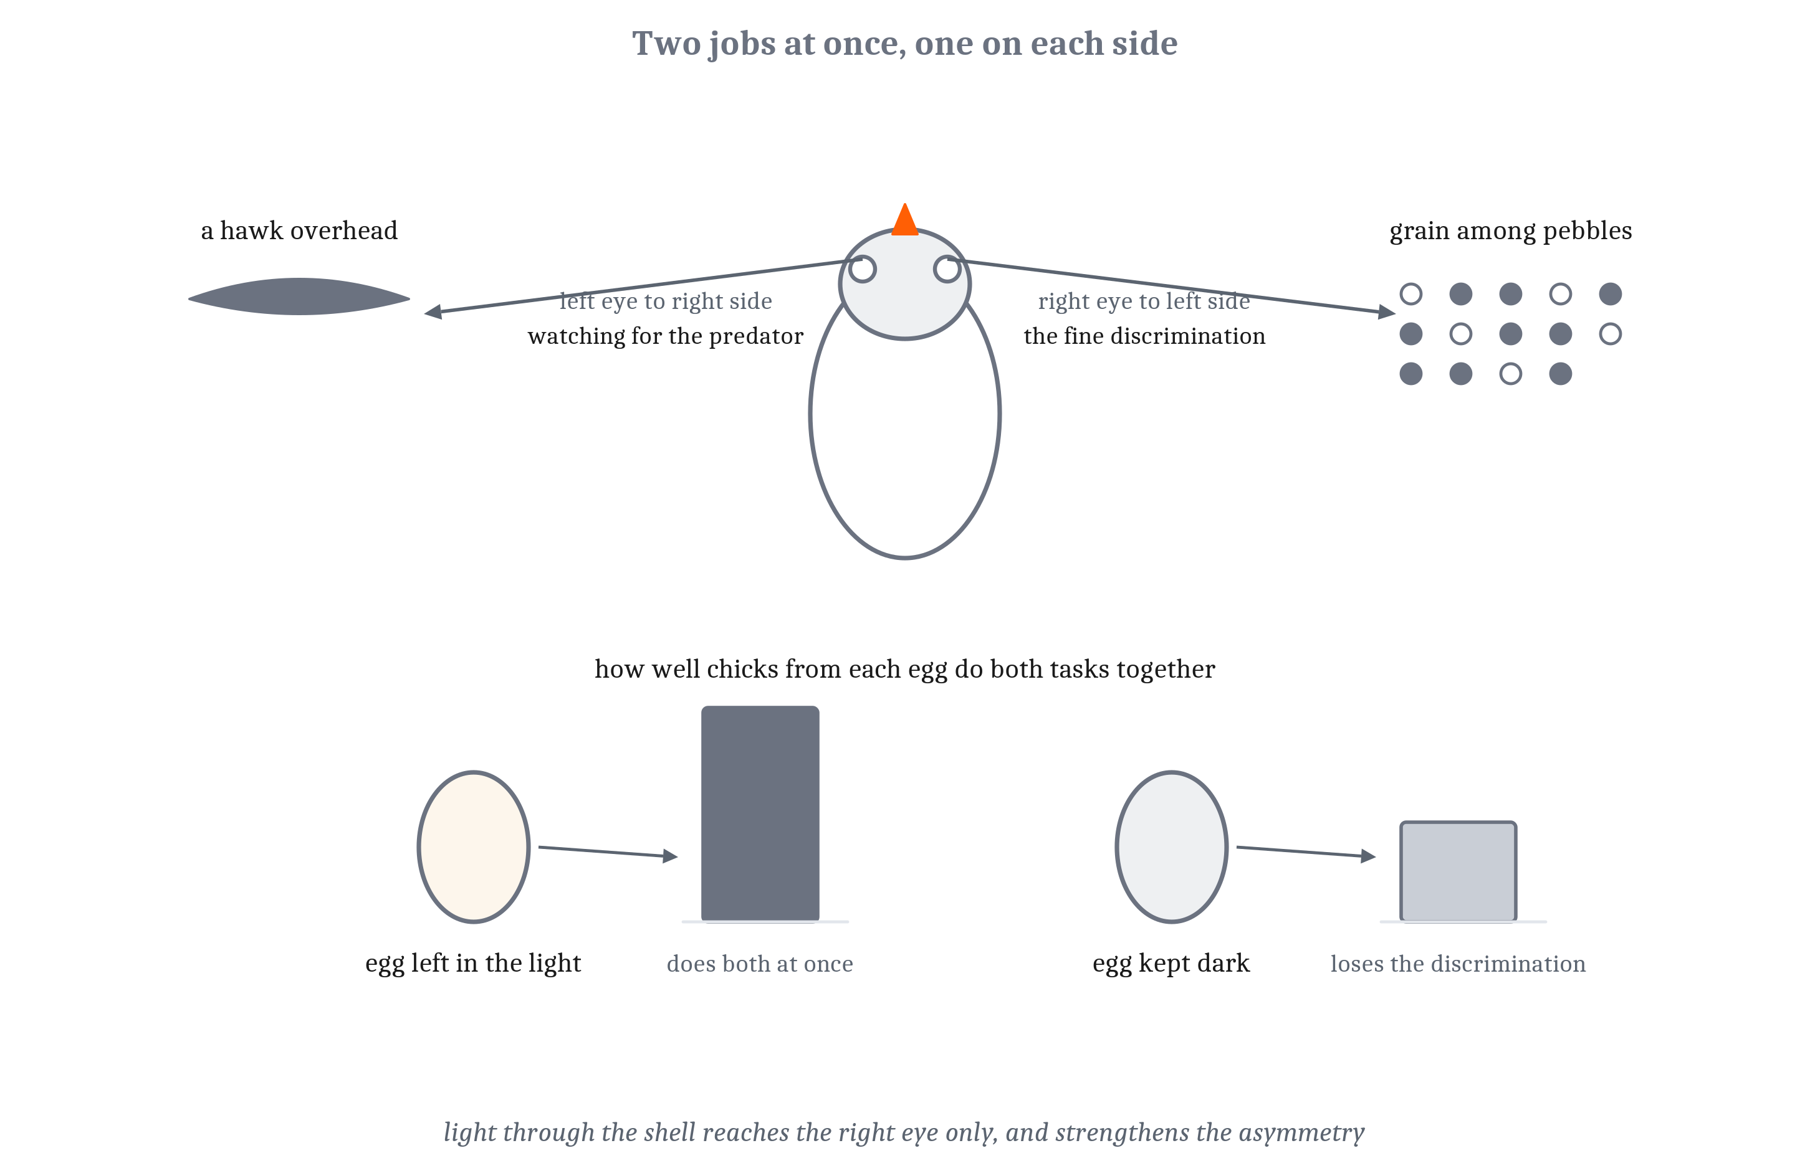
Two Halves
Lateralization: the two sides of a brain doing different things. The chick shows why an individual benefits. Why a whole population leans the same way is a separate question.
Notes:
A vertebrate brain is paired. Nearly every structure named so far comes in two, one on each side, and for most of them the two sides are near mirror images. But the departures from symmetry are real, widespread, and old. **Lateralization** is a difference between what the left and right sides of a brain do.
The domestic chick is the case worked out in most detail. A chick uses its right eye, and so mainly its left hemisphere, to peck out grain among pebbles, which takes a fine discrimination. It uses its left eye, and mainly its right hemisphere, to watch for a predator overhead. In the egg, the embryo lies turned so that only its right eye gets light through the shell, and eggs left in the light develop a stronger asymmetry than eggs kept dark.
Here is the result. Chicks from lit eggs do better at both jobs at once: they find the grain and spot the hawk. Chicks from dark eggs do just as well at either task alone, but get worse at the grain when they must watch for the predator at the same time. That is the first lecture's argument about competing demands at a smaller scale, with an experiment attached.
Now the part that is easy to miss: there are two questions here. The chick result explains why an individual chick is lateralized. It says nothing about why most chicks lean the same way, since how well one animal divides its own work has nothing to do with which side its neighbors favor. Population alignment even has a cost: a predator can learn which way a population escapes. The proposed answer is social. When animals must coordinate, matching the majority is worth more than being unpredictable. Across sixteen fish species, the schooling ones were lateralized as populations, and several solitary ones only as individuals. That account is contested, and it is taught as a proposal with support, not a settled result.
The halves also have to be connected. The **corpus callosum** is the great bridge between the hemispheres in placental mammals, roughly two hundred million fibers. Birds, fishes and non-placental mammals use smaller connections instead. The chick has no corpus callosum, and neither does the lamprey.
And the familiar claims about logical and creative hemispheres are not supported by the evidence.

Slide 9
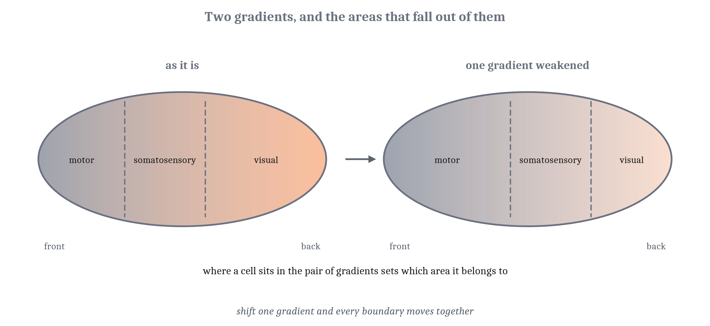
Rules, Not a Blueprint
No genome lists which cell goes where. It holds a few rules run locally: read a gradient, listen to the neighbors, follow a cue, compete for a limited supply.
Notes:
A human brain has on the order of eighty-six billion neurons and many trillions of connections. There is no list anywhere of which cell goes where and what it connects to, and a genome holds nowhere near enough information for one. What it holds instead is a small set of rules, applied over and over by cells that can only respond to their surroundings: read a gradient, listen to the neighbors, follow a cue, and compete for a limited supply. Run in the right order, those rules build a brain reliable enough that its parts can be named, and different in its details from one individual to the next.
The first product is a tube. A strip of cells, the **neural plate**, rises into folds that lean in and fuse, turning the plate into the hollow **neural tube** every vertebrate nervous system is built from. As the folds meet, cells at their very edges leave and migrate through the body. That is the neural crest from the first lecture, building most of the peripheral nervous system and much of the face and skull. The vertebrate head is assembled by cells that leave the nervous system on their way to becoming it.
The front of the tube swells into three bulbs, which are the forebrain, midbrain and hindbrain. What decides which bulb a cell belongs to, and what it becomes, is where it sits. Signals released from opposite sides of the tube spread and fall off with distance. A molecule that carries position this way is a *morphogen*. Cells read the mixture they receive and switch on a matching set of genes, which is why the spinal cord's motor neurons all sit toward the belly side and its sensory relay cells toward the back.
The clearest case is the cortex, in the figure. Two signals form opposing gradients across the sheet that will become cortex. Where a cell sits in that pair determines whether it joins motor, somatosensory or visual cortex. Change one gradient in a mouse, and every boundary moves together. There is no list of cortical areas anywhere. There are two gradients, and the areas fall out of them.

Slide 10
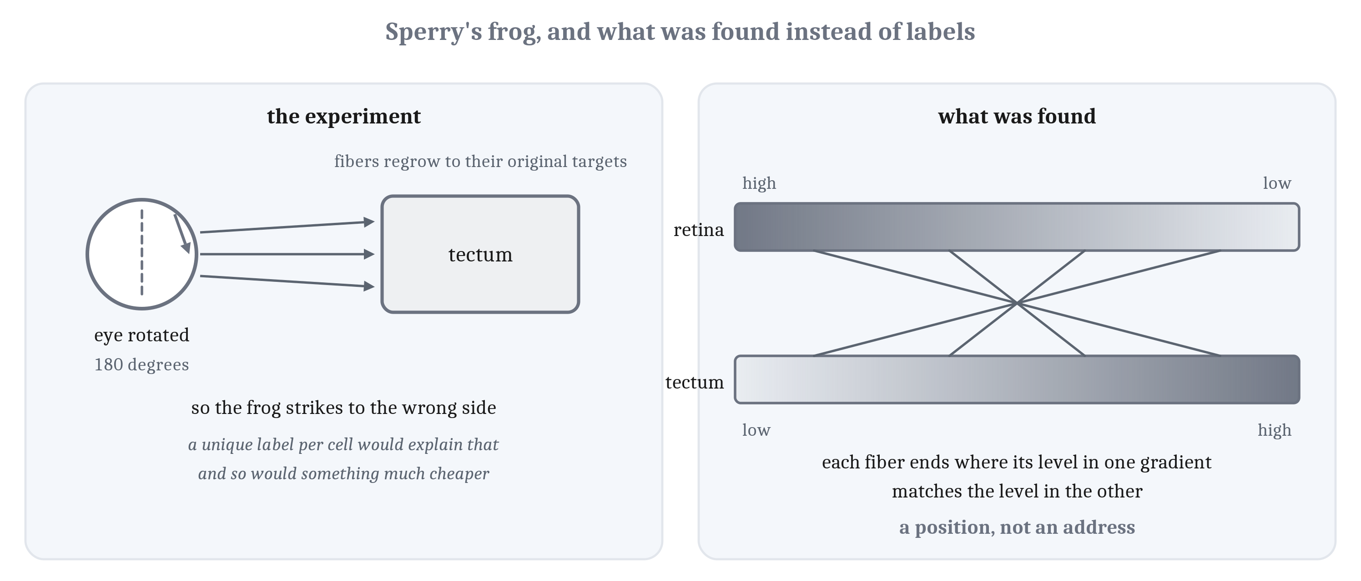
Made, Moved, Steered, and Culled
A neuron's birthday sets its layer. An axon finds its target by a position, not an address. Too many neurons are made, and the target settles which survive.
Notes:
Three more rules, each shortened here and told in full in the reading.
Made and moved. The cells lining the hollow center of the tube are the progenitors of everything the brain will contain. They are **radial glia**, and their long fibers stretch from the center out to the surface of the growing wall. They are both the source of the neurons and the scaffold: a newborn neuron climbs its parent's fiber. **Neurogenesis**, the production of new neurons, is nearly all finished before birth in humans. Each wave of neurons climbs past the waves already in place, so the cortex is built from the inside out. The deepest layer is laid down first, and a neuron's birthday determines its layer. Most neurons are not made where they end up, and the cortex's inhibitory neurons travel in sideways from a different region entirely.
Steered. The tip of a growing axon is a **growth cone**, which samples what it touches and pulls toward some molecules and away from others. The same molecule can attract or repel depending on the receptor the growth cone carries, which is one reason a few cues produce a lot of wiring. Roger Sperry rotated a frog's eye and let the cut optic nerve regrow. The axons found their original targets, so the frog struck to the wrong side of a fly. That result stands. His interpretation, that each target cell carries its own chemical label, does not. That would be a blueprint, one address per cell. What was found instead is the right panel of the figure: opposing gradients, so each axon has a position rather than an address. A gradient takes very little information to specify, and it scales. Activity then sharpens the map, as Module 5 described.
Culled. Far more neurons are made than survive, and in many regions half or more die. Targets release small amounts of a survival signal, and neurons that get enough persist. Remove a chick embryo's developing limb, and the motor neurons that would have served it die. Graft on an extra limb, and more survive than usual. The control that matters: the extra survivors are not new cells but cells that would otherwise have died. So the supply of survival signal, not a count kept anywhere, sets the number. Overproduce, then let the target settle it. After that, experience strengthens some connections and removes others, which is Module 5's critical periods.

Slide 11
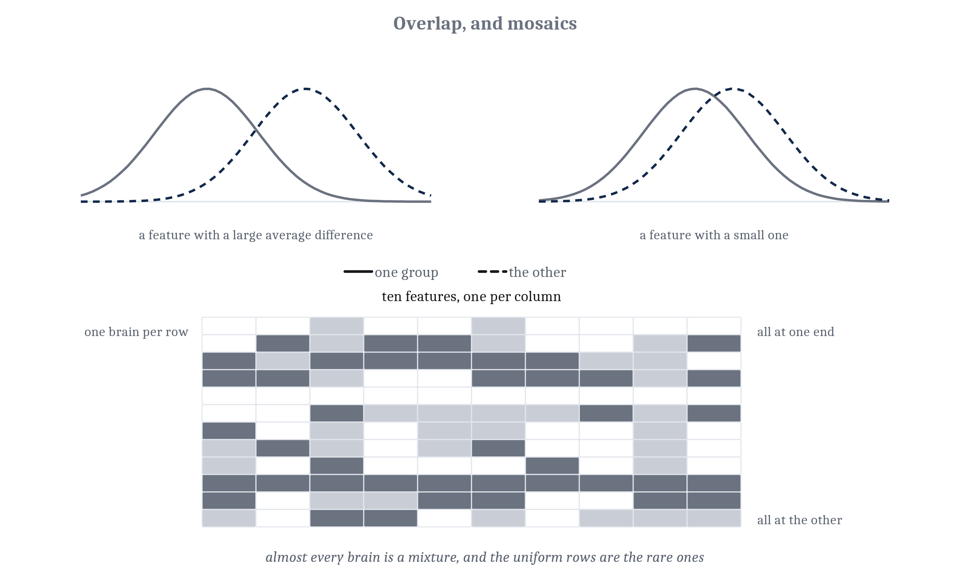
Sex Differences as Development
Each region responds to signals in its own way, so the mechanism predicts a mosaic, not two kinds of brain. Across more than fourteen hundred human brains, that is what was found.
Notes:
Sex differences in vertebrate brains are real and common, and the largest and most reliable are in circuits that serve reproduction. They follow from the same developmental processes as everything else in this lecture.
Two terms. An *organizational effect* is a permanent change in how a circuit is built, produced by a hormone early in life. An *activational effect* is a reversible change in how a circuit runs, produced by a hormone in adulthood.
The rat case is the last slide's competition and cell death, with a hormone acting on it. One small cluster of cells in the hypothalamus is three to five times larger in males than in females, and it is present in both. What makes it larger is that early hormone exposure prevents cells there from dying. A neighboring cluster, which controls the cycle leading to ovulation, is larger in females, and in males the same hormone causes cell death there. One signal, opposite effects a short distance apart, because each region responds in its own way. In other places the same hormone builds new synapses. And some sex-specific mechanisms exist to cancel differences, so that two animals reach the same behavior by different routes. Sameness of outcome does not imply sameness of mechanism.
Now the prediction. If each region is shaped by its own mix of signals, a whole brain should not come in two versions. It should be a mosaic, with some features toward one end of the range and others toward the other, in a combination unique to that individual. That was tested in more than fourteen hundred human brains. Even the features with the largest average difference overlapped extensively. And almost no brain was consistent across features: depending on the dataset, between none and about a tenth were, while a much larger share had some features at each end. Mechanism predicts a mosaic, and the mosaic is what we find.
Both halves of the summary have to be said together. Sex differences in the brain are real, they matter for medicine, and ignoring them has done harm, since a great deal of research has used males only. And they do not add up to two kinds of brain, and they license nothing about any individual's abilities. One more limit: in any human measurement, biological sex and a lifetime of different social experience are intertwined, and no imaging study separates them.

Slide 12
An Address Is Not an Account
Structures and functions map many to many. Neither list below is a list of separate functions done by separate parts.
Structure | Jobs it has been credited with
Amygdala | Learning that something predicts a threat; learning that something predicts a reward; responding to whatever is salient, good or bad; adjusting attention; influencing what is remembered
Striatum | Releasing one action and holding back others; learning which actions lead to reward; habits, as behavior becomes automatic; keeping track of how well things are going
Notes:
Every capacity we have met since Module 3 now has a location. Arousal has one, valence has one, choosing among actions has one. The temptation is to treat the location as the explanation. It is not.
The amygdala is the worked case. In Module 1 it drove the whole cascade of a frightening moment: the heart rate, the freezing, the turn of attention. That claim still holds. What fails are two steps beyond it: from *drives the threat response* to *is where fear lives*, and from *one region* to *one function*.
Three findings break those steps. The amygdala is needed for learning about rewards, not only threats. Its reward-tuned and threat-tuned neurons are mixed together in the same tissue, so this is not two neighboring structures mistaken for one. And the circuits that produce a defensive response are not the circuits that produce the feeling of being afraid. The researcher who did more than anyone to establish the amygdala's role in threat now rejects the phrase *fear center*. None of this contradicts Module 1, which was careful to describe a cascade rather than a feeling.
So structures and functions map many to many, as the last lecture's reverse-inference slide said: one structure takes part in many capacities, and one capacity draws on many structures. Both halves matter. The table is the first half. Module 1 taught multiple realizability, the same function on different physical arrangements, and this is the same looseness inside a single brain.
That is why reverse inference is a mistake rather than a shortcut. Naming the address of a capacity is the beginning of an account of it, not the end.

Slide 13
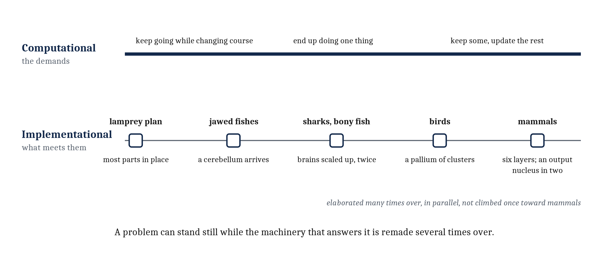
Old Problems, New Parts
The computational level barely moved. The implementational level was rebuilt again and again. So finding an arrangement does not tell us which demand it answers.
Notes:
Nothing in this module was a new problem. An animal that has to keep breathing while it changes course, end up doing one thing when several are proposed, and keep some of what it learns while updating the rest faces the same demands we met in Modules 4 and 5. What changed is what meets them.
That is the promise from the start of the module, kept. The three levels came apart. The computational level has barely moved: the demands on a Cambrian animal are the demands on a lamprey and on a mouse, and would be the demands on anything that moves through a world with other animals in it. The implementational level was rebuilt over and over: a cerebellum with the jawed fishes, an output nucleus divided in two, a pallium with six layers in one lineage and clusters in another, the whole plan scaled up independently in several groups. A problem can stand still for half a billion years while the machinery that answers it is remade several times.
That has a consequence for inference. If one demand can be met by many arrangements, finding an arrangement does not tell us which demand it answers. Separate structures are one solution; a single network settling among constraints is another; which one an animal took is answered by looking. It is Module 2's caution about adaptation, arriving now from inside a brain.
The thesis holds. The structures are new, and the parts they are built from are not. The genes that mark position, the kinds of cells neurons are, the growth cone's rules, the rules of overproduction and competition, and even the learning rules were all in place before there were vertebrates. What the cerebellum and basal ganglia add is not a new kind of synapse but a way of getting a particular signal delivered to one. And every capacity now has an address, and an address is not an account.
One thing is left. Of everything in the module, the pallium grew most. In mammals it became a large, nearly uniform sheet, running one kind of circuit across its whole extent, with the same six layers whether the signals arrive from the eyes, the skin or the ears. We have said where it is, what it is made of, and how it is laid down. We have not said what it computes. A structure that does the same thing everywhere is either doing something very general, or doing nothing in particular. Which one, and what such a sheet can extract from a stream of signals, is Module 7.

Slide 14
Headlines About the Brain's "Centers"
In your group, four minutes.
Headlines regularly announce that a feeling, a trait or a habit has been found in one part of the brain.
Invent or recall one. What inference is it making?
What would a study have to show to earn the word center?
Notes:
This question answers the last guiding question of the reading, on something the room will meet again outside the course.
A typical headline reports that a region lit up during some experience, and names the region as that experience's center. The inference is reverse inference: the region was active during the task, so the region is where the task lives. It fails for the reasons on the last two slides. A region active during many things licenses little on its own, and one structure takes part in many capacities while one capacity draws on many structures.
What would it take to earn the word? More than activity. At minimum, the region would have to be active during that experience and not during a great many others, damage to it would have to remove that capacity and little else, and the capacity would have to depend on it rather than on a network it belongs to. Very few regions pass all three, and the amygdala, the most famous candidate, does not.
A good ending point for the room: an address is where an explanation starts. The headline treats it as where the explanation stops.
If the room is quiet, offer a concrete one: a region said to be the brain's "love center" because it is active while people look at photographs of a partner.

Slide 15
Image Sources (1 of 2)
Slide | Image | File | License | Source
3 | What cannot stop | fig-cpg.png | CC BY 4.0 | Jon Willits — drawn for this lecture · own work
4 | Three small places, and how far their fibers reach | fig-brainstem-sources.png | CC BY 4.0 | Jon Willits — drawn for the Module 6 reading · own work
5 | The same selection circuit, twice | fig-lamprey-vs-mouse-bg.png | CC BY 4.0 | Jon Willits — drawn for the Module 6 reading · own work
6 | Three layers, three layers, six | fig-pallium-layers.png | CC BY 4.0 | Jon Willits — drawn for the Module 6 reading · own work
7 | One plan, many brains | fig-one-plan-many-brains.png | CC BY 4.0 | Jon Willits — drawn for the Module 6 reading · own work
8 | Two jobs at once, one on each side | fig-chick-dual-task.png | CC BY 4.0 | Jon Willits — drawn for the Module 6 reading · own work
9 | Two gradients, and the areas that fall out of them | fig-arealization.png | CC BY 4.0 | Jon Willits — drawn for the Module 6 reading · own work
10 | Sperry's frog, and what was found instead of labels | fig-sperry.png | CC BY 4.0 | Jon Willits — drawn for the Module 6 reading · own work

Slide 16
Image Sources (2 of 2)
Slide | Image | File | License | Source
11 | Overlap, and mosaics | fig-mosaic.png | CC BY 4.0 | Jon Willits — drawn for the Module 6 reading · own work
13 | One level stood still while another was rebuilt | fig-levels-came-apart.png | CC BY 4.0 | Jon Willits — drawn for this lecture · own work

