Slide 1

BCOG 100
Neural Circuits, Affect, and Valence
Lecture 4.1 — The First Nervous Systems and Their Value
Notes:
Module 3 was about one cell. It ended at a cell type, and it ended there deliberately: we had an account of what a neuron is, what it computes, and what it costs to run, and no account at all of what neurons do in company.
This module is about company. What happens when neurons are wired to one another.

Slide 2
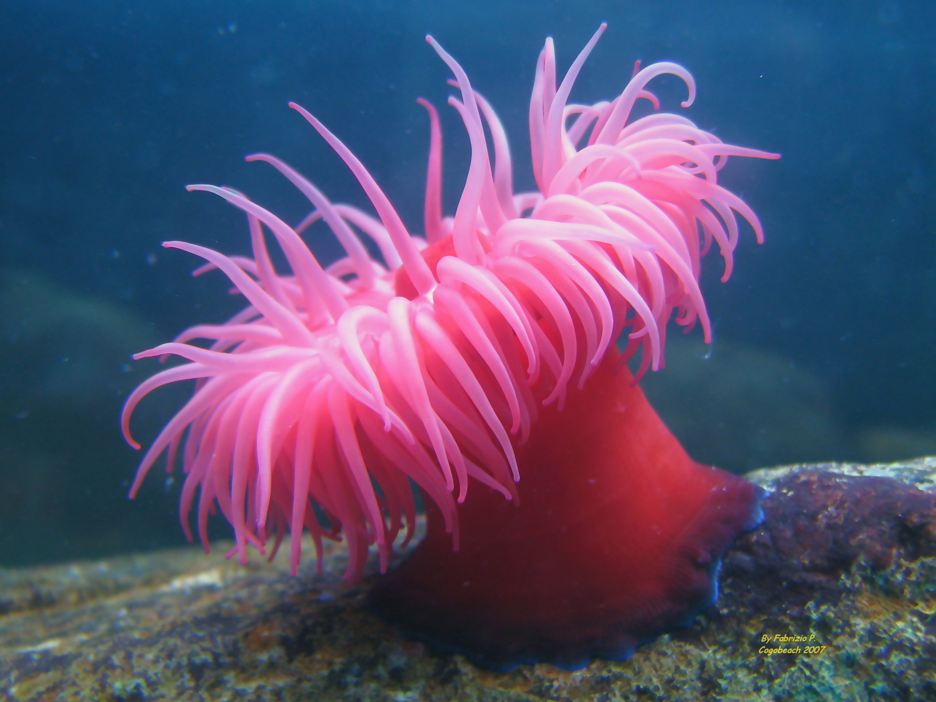
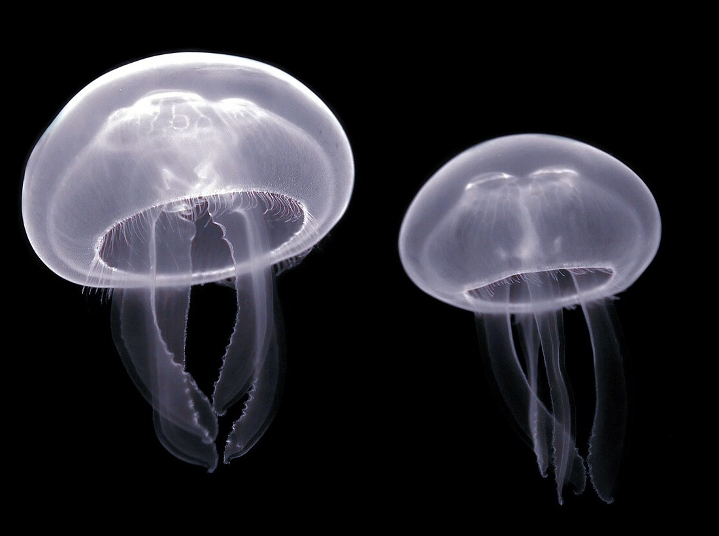
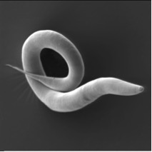
As Life Got More Complex, New Options Opened Up
A sea anemone, a moon jelly, a nematode worm. Three animals alive right now, and three different answers to what a body can do about the world. One of those answers is steering.
Notes:
Three animals, all alive right now, all photographed rather than drawn. They are worth a moment before we say anything at all about neurons.
On the left, a sea anemone. It is anchored to a rock and it stays there. It has a nerve net spread through its body wall and its tentacles, and it can shut its whole self at once, which is a real feat of coordination. It is not going anywhere.
In the middle, two moon jellies. Also a nerve net, also no brain, and these do move — the bell contracts as one and the animal travels. But travelling is not the same as travelling toward something. A moon jelly goes where the water goes.
On the right, a nematode worm about a millimeter long, under an electron microscope. It has a front end, and it points that front end at what it wants.
That is the whole of the idea for today, and I want to state it before it gets complicated. As animal bodies got more complex, new options opened up. Not better animals — every one of these three is a success, all three are still here, and the worm is not an improved jellyfish. New options. The option this module is about is the last one on the slide: aiming.
Now the claim the whole module exists to make mechanical. One neuron settles one small question. An arrangement of neurons steers an animal, decides what is worth approaching, and holds a state that outlasts the moment that caused it. Value, goals, and moods are not properties a neuron has. They are properties an arrangement has.
That is a strong claim and it is easy to nod along to without noticing what it rules out. So this lecture builds up to it slowly, by walking through animals that had no nervous systems at all, then animals that had one and could not aim it, and then the animals that could — which is very nearly these three photographs, read left to right.

Slide 3
One Capacity, Three Questions
The second module built this way, and the rhythm now holds to the end of the course. One capacity, three sections in the reading, three meetings, one per level.
Level | The question it asks | Discipline | This module's example: the steering circuit
Computational | What problem is being solved, and why does solving it matter? | Evolution and ecology | Steering — aiming a body at something, and away from something else
Algorithmic | What is represented, and by what procedure? | Cognitive psychology and AI | Weights, thresholds, recurring wiring patterns, and the valence–arousal pair
Implementational | By what physical means, and at what cost? | Neuroscience | Nerve nets condensing into ganglia, a worm whose wiring diagram is complete, and neuromodulators released into the tissue
Notes:
This is the table Module 1 gave us and Module 3 reprinted, with a new example in the last column. Module 4's example is the steering circuit, and the three meetings on it divide the way the reading does. This lecture asks what problem steering solves. The second asks what arrangement of neurons computes it. The third finds those arrangements in real tissue and real chemistry.
Before the walk starts, the claim worth having in hand. A single neuron really can weigh competing inputs. Give it an excitatory input from one smell and an inhibitory input from another, and its rate climbs with the first and falls with the second. That arithmetic fits inside one cell and Module 3 accounted for all of it.
What does not fit inside the cell is the meaning. A rate is only a rate. It becomes approach because of what the cell is wired to — and the identical cell, wired to the opposite muscles, would produce avoidance instead.
So the thing we are looking for this module is not in the cell. Keep that in mind through the first half of the lecture, because the animals we start with do not have it, and the reason they do not have it is not that their neurons are worse.

Slide 4
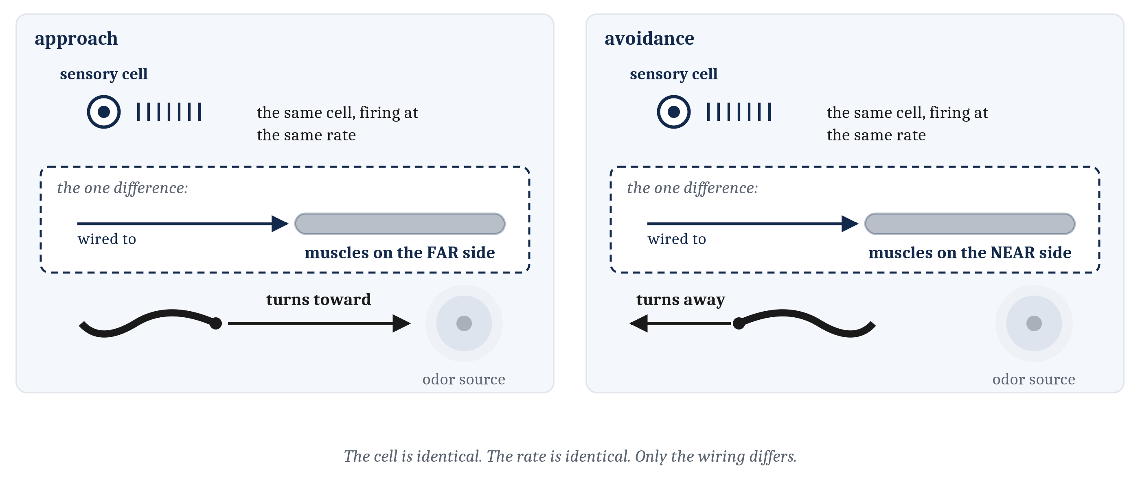
The Same Cell, the Opposite Behavior
A rate is only a rate. It becomes approach because of what the cell is wired to — and the identical cell, wired to the opposite muscles, produces avoidance.
Notes:
Here is the claim as a picture, because it is the one idea in this module that is worth more than the rest put together.
Both panels show the same animal with the same sensory cell in its head, detecting the same chemical, firing at the same rate. Everything about the cell is identical. What differs is one thing: which muscles the cell is wired to.
On the left, the cell drives the muscles on the far side of the body, the animal turns toward the chemical, and we would call that approach. On the right, the cell drives the muscles on the near side, the animal turns away, and we would call that avoidance.
Nothing about the chemical changed. Nothing about the sensory cell changed. What we would want to call the animal's *verdict* about that chemical — good, worth having, worth moving toward — changed completely, and it changed because of the arrangement.
That is why the rest of the module looks where it looks. If value lived in the molecule, chemistry would be the place to study it. If value lived in the sensory cell, Module 3 would already have found it. It lives in the wiring, which means that to understand value we have to understand arrangements of neurons, and that is what the next two lectures are.

Slide 5
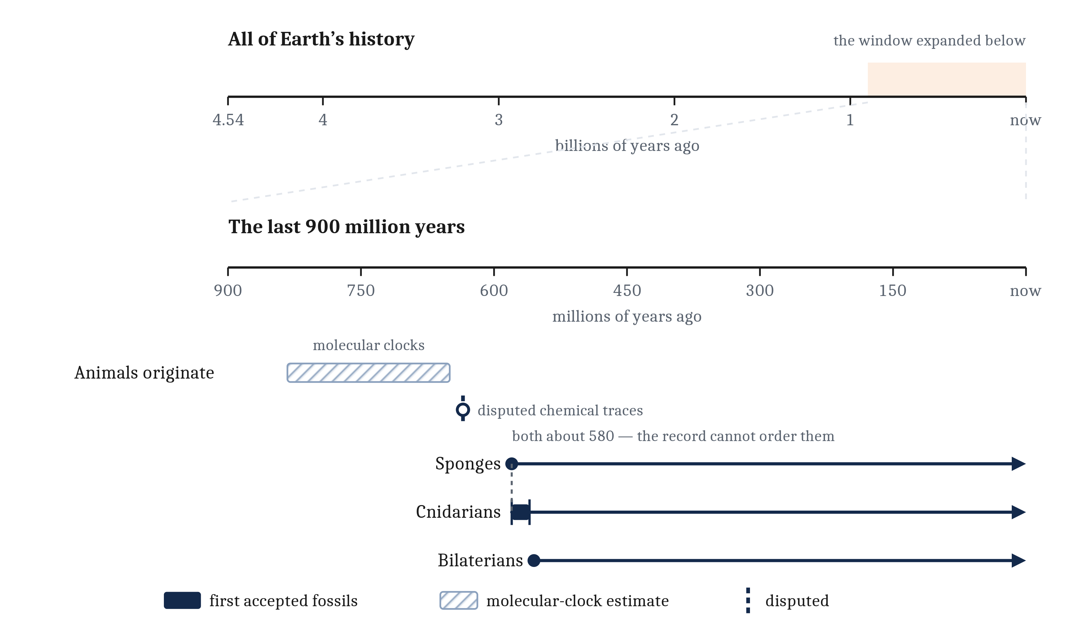
What a Computational Question Asks, and the Warning That Comes With It
The computational question asks what problem is being solved, and why solving it was worth what it cost. Walking forward through the animal tree reads very easily as walking up it. It is not one.
Notes:
Marr's computational level asks what problem is being solved. In the first lecture of Module 3 we settled how that question works for a living thing: there is no designer, so the only answer that does not appeal to magic is a historical one. Asking what a nervous system is for is asking what selective pressure favored building one.
That logic is unchanged here, so I want to spend the slide on the warning instead, because this lecture needs it more than Module 3 did.
This lecture walks forward through animal groups. Sponges, then cnidarians, then bilaterians. That is a walk through time and it reads almost irresistibly as a walk upward, with something better at each step. It is not.
Look at the three lines on the figure. They branch, and then all three of them run to the right-hand edge. A jellyfish is not a rough draft of a worm. A worm is not a rough draft of a fish. A fish is not a rough draft of us. Each of those groups is a lineage that has been solving its own problems for as long as any of the others, and every one of them is still here.
Now the dates, while the figure is up, because three of them are hedged on purpose. The marks drawn as bands are bands deliberately. The origin of animals comes from molecular clocks rather than from fossils, and that band runs about 185 million years wide — the width is the finding. Do not read any single number inside it as the age of animals.
The sponge and cnidarian dates land close enough to each other that the fossil record cannot settle which of the two came first. There are chemical traces that might push sponges back to something like 635 million years, but whether sponges left those traces is disputed, and the figure marks it in a register that says so.
The third line starts at about 555 million years, and the wording matters. That is the oldest widely accepted bilaterian *body* fossil. Body fossil, because older trace fossils exist — burrows and tracks — and they are a different kind of evidence.

Slide 6
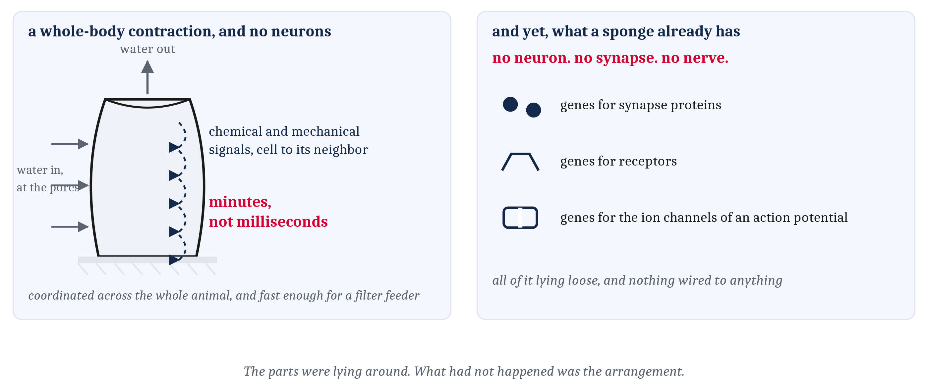
Bodies, and Behavior, Came First
A sponge has no neuron, no synapse, no nerve, and no ordinary muscle — and it behaves anyway. The step to a nervous system is the arrangement, not the invention of a new chemistry.
Notes:
The tempting picture is a first nervous system arriving in a body that was waiting for one. That picture is wrong in both halves, and sponges are how we see it.
Sponges are animals. They are multicellular, they develop from an embryo, and as adults they are anchored to a surface for life, drawing water in through their pores and filtering food out of it. They have no neurons, no synapses, no nerves, and no muscle of the ordinary kind. Nothing in a sponge would count as a nervous system by any definition anyone has offered.
And a sponge behaves. Irritate one and it slowly closes its pores and contracts its whole body, squeezing water and debris out through its opening. Researchers have taken to calling it a sneeze, which is as good a word as any.
The timing is the interesting part. That contraction is coordinated across the entire animal, and it takes minutes rather than milliseconds, because the signal is passed from each cell to its neighbors chemically and mechanically rather than along anything dedicated. Module 3's argument, in a live animal: slow cell-to-cell signaling is a real way to coordinate a body, and for an animal fixed to a rock that eats by filtering, minutes is fast enough.
Now the part that surprised me when I first read it. Sponges carry much of the molecular equipment a neuron is built from — genes for the proteins that make synapses, for receptors, and for the ion channels that do the physical work of an action potential. All of it, and no neurons to put it in. Placozoans, another group with no neurons at all, coordinate their feeding with cells that release peptides onto their neighbors, and those cells look more and more like something a neuron could be made out of.
So the pieces were lying around. What had not happened was the arrangement: cells specialized for signaling and for nothing else, connected to particular partners rather than to whichever cell they happen to touch, and carrying signals one way. A circuit rather than a puddle.

Slide 7
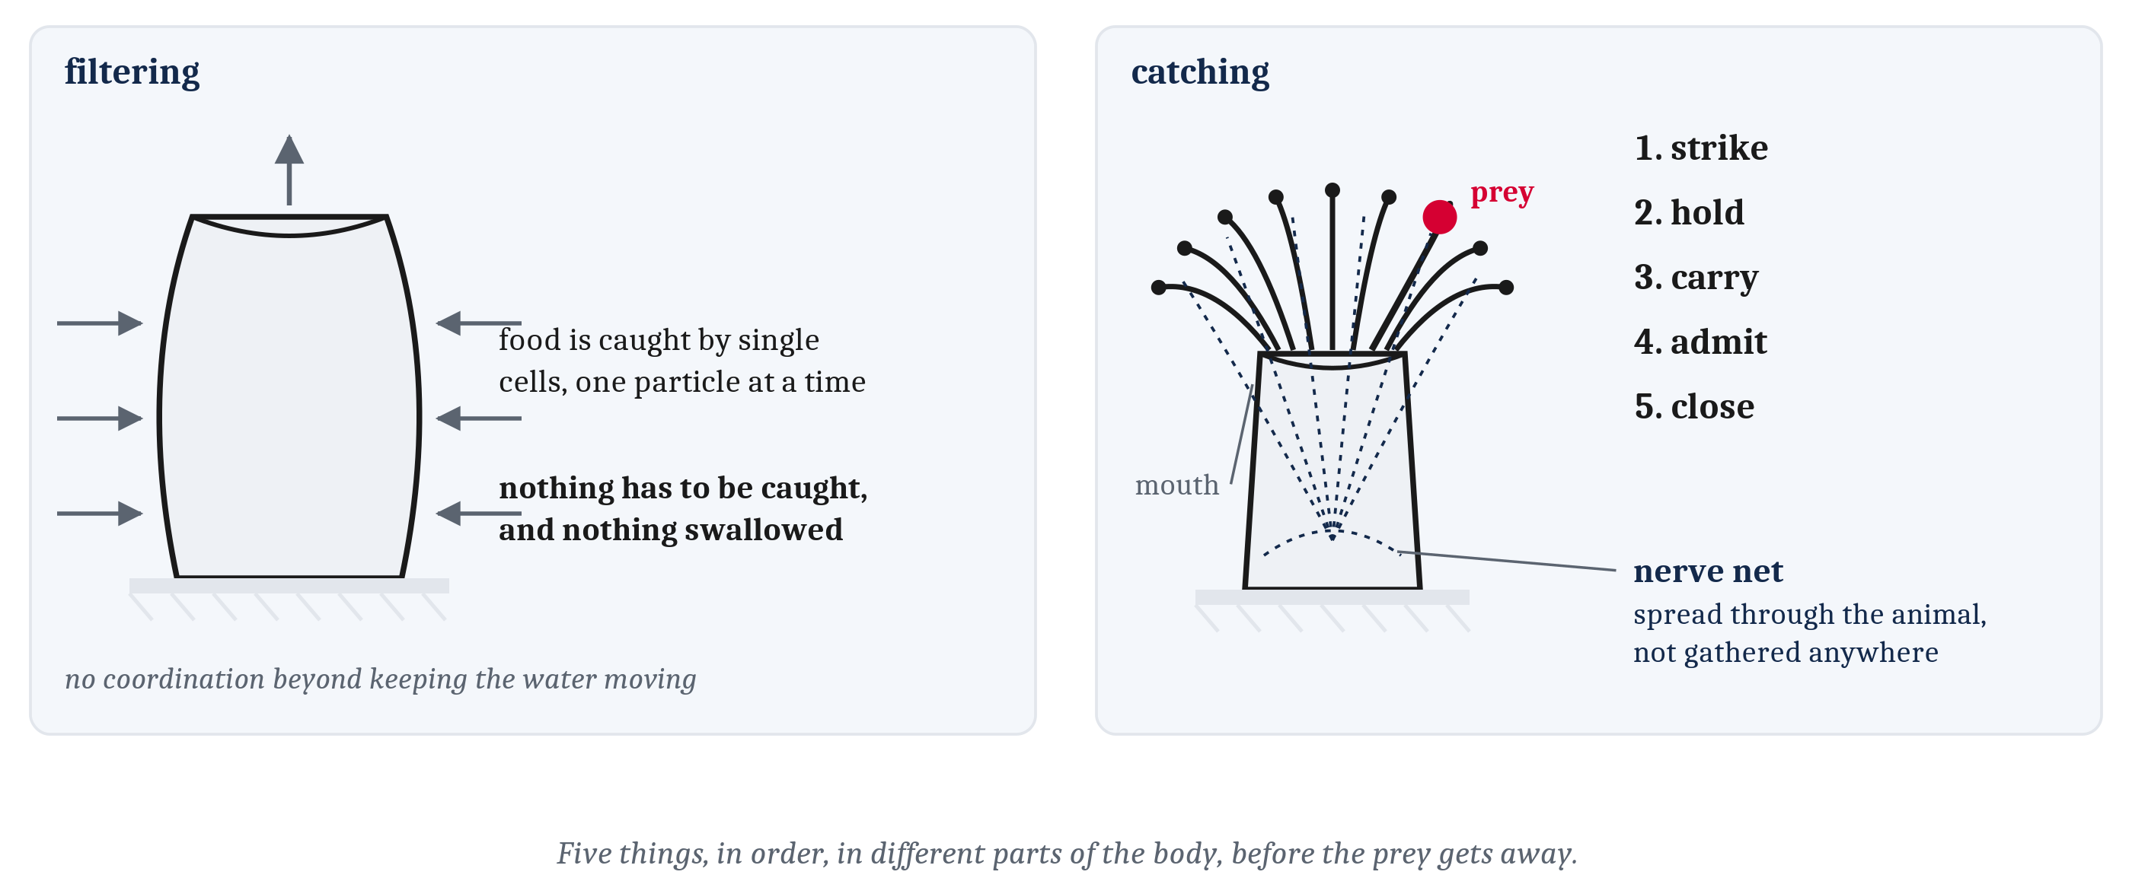
A Mouth to Operate
Filtering asks for no coordination beyond keeping the water moving. Catching does. A nerve net — neurons spread through the body wall, each connected to its neighbors — beat the diffusion limit.
Notes:
A sponge is missing a second thing besides a nervous system, and the two are related. It has no mouth. Water comes in through pores spread over the whole body and food is captured by individual cells, one particle at a time, so nothing has to be caught and nothing has to be swallowed.
A mouth, at its simplest, is one opening leading into a cavity where food is broken down, with cells near the opening specializing for opening and closing it and cells deeper along the cavity specializing for digestion. Now put a ring of stinging tentacles around that opening, which is what some of the earliest animals with mouths had — the first corals and sea anemones.
Look at what catching demands that filtering does not. Prey has to be struck. It has to be held. It has to be carried to the opening. It has to be admitted. And the opening has to close behind it. Five things, in order, in different parts of the body, fast enough that the prey does not get away.
Module 3 gave us the reason that cannot be done by diffusion: chemicals spreading through tissue are far too slow across any distance worth calling a distance. The earliest arrangement that beat that limit is the nerve net — neurons distributed through the body wall, each connected to its neighbors, spread through the animal rather than gathered anywhere in particular. It was not a brain and it did not look like one.
Here is the observation this whole argument turns on. Cnidarians — jellyfish, sea anemones, corals, and the freshwater hydra — still run on nerve nets, and several of them never travel at all. An anemone is fixed to rock. Corals and hydra stay in one place for most or all of their lives. So the earliest nerve nets we can reconstruct were running in animals that stayed put, which suggests the first nervous systems were probably not for getting anywhere. An animal anchored to a rock still has a great deal to coordinate: tentacles that have to fire together, a body wall that has to contract as one, a mouth that has to open at the right moment and close afterward. All of it is whole-body coordination in the service of eating, and none of it involves travel.
That inference deserves reasonable confidence and not more. Researchers disagree about what the first neurons were selected for — one account says they arose to coordinate a contractile body surface, which is movement of a body rather than movement through a world, and another says they arose to control the beating cilia of swimming larvae, which is much closer to locomotion. It is also a live question whether nerve nets evolved once or twice, because comb jellies have one built differently enough that it may be an independent invention. What is not in dispute is the shape of the sequence: bodies coordinated slowly without neurons, then bodies coordinated quickly with them, and mouths arrived somewhere during that transition.

Slide 8
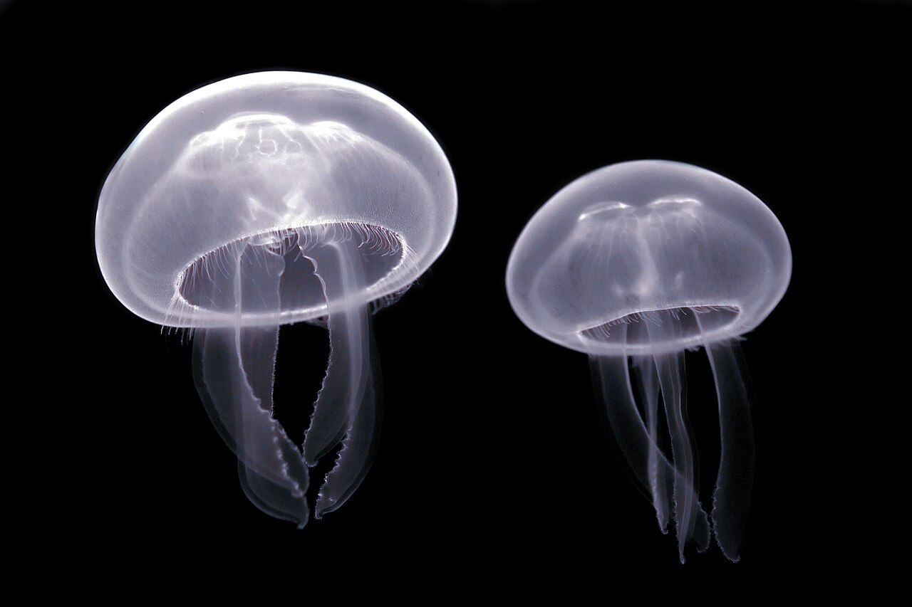
The Bell Contracts as One Thing
A wave crossing the net reaches every part of the ring within a few thousandths of a second. Having a nervous system is not the same as having a brain, and neither is the same as making a decision.
Notes:
Free-swimming jellyfish put the nerve net to a more demanding use than anchored animals do, so it is worth working one act of theirs carefully.
When a moon jelly swims, its bell contracts — all of it at once — and the animal is pushed through the water. Simultaneity is the requirement, and it is a mechanical requirement rather than an elegance: a contraction that traveled around the bell in sequence would waste most of its force, squeezing water sideways instead of pushing it down. The muscles around the whole rim have to shorten at the same time. A wave of activity crossing the net reaches every part of that ring within a few thousandths of a second, and the bell squeezes as one thing.
Now notice how little machinery the arrangement requires. There is no brain. There is no one place where a decision is made, or from which orders are sent. Cnidarian nerve nets are not perfectly uniform, and I do not want to oversell the point, but what matters is that a net can coordinate a whole body with nothing in it that resembles a center. The nervous system here is the arrangement itself, spread through the tissue it moves.
Which lets us pull apart three things that are very easy to run together. Having a nervous system is not the same as having a brain. And neither of those is the same as making a decision. This animal has the first and not the second, and nothing in the bell contraction requires the third.
A nerve net gets a body to act as one body, quickly. That is the first thing a nervous system was ever for.

Slide 9
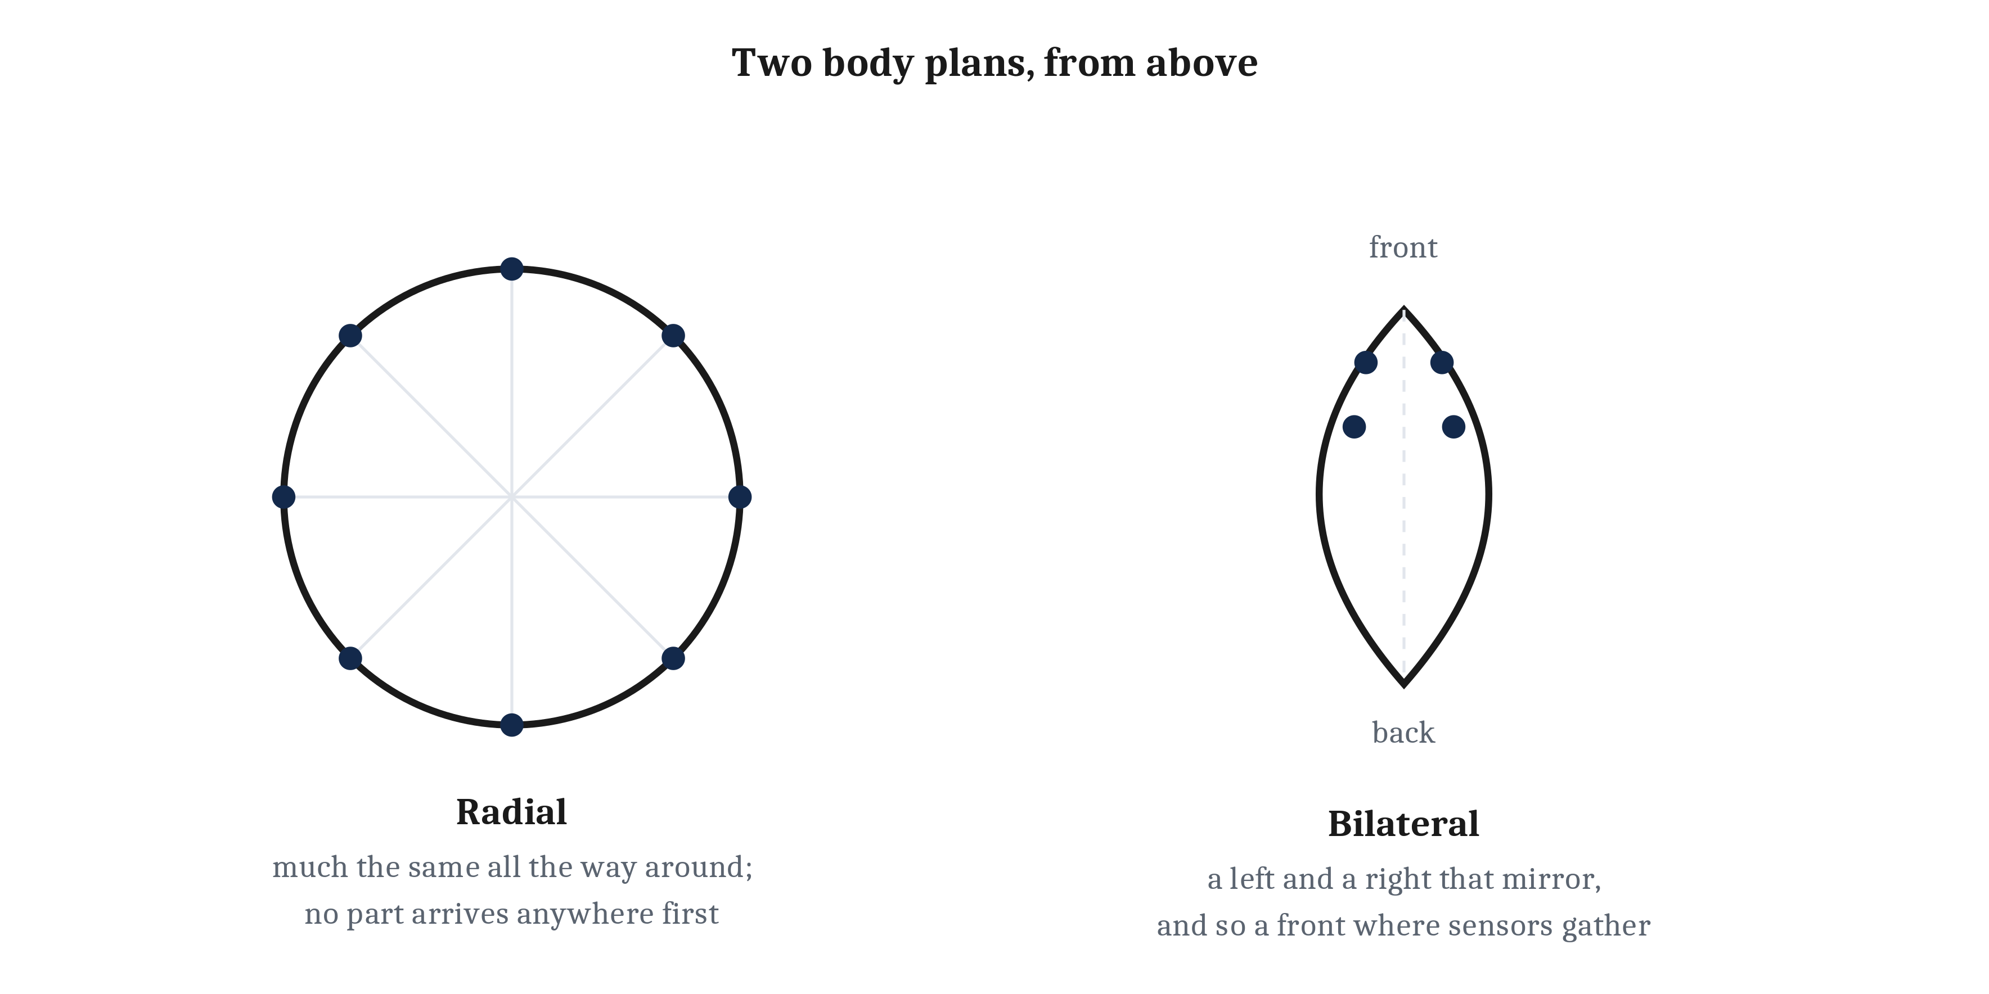
Coordination in Time, Without Direction in Space
Radial symmetry is a body plan built around a central axis and much the same all the way around, so no part of it ever arrives anywhere first — and therefore there is no privileged place for sensors to gather.
Notes:
Nerve nets let animals coordinate their bodies quickly. They also have a limit, and the limit is not about nerves at all.
A moon jelly's body has radial symmetry: it is built around a central axis and is much the same all the way around. Turn the animal a few degrees and nothing about it has changed. That has a consequence which is easy to miss. An animal built that way has no front, no back, no left and no right. No part of it always arrives anywhere first. And if no part arrives first, there is no privileged place for sensors to gather, because there is no best place to put them.
Think about what follows for what the animal can do. It can contract its bell and rise. It can relax and sink. It can sense light, gravity, and the chemistry of the water around it, and it can pulse more often or less often in response. That is a real behavioral repertoire.
What it cannot do is answer the question *which way*. It goes somewhere. It does not go somewhere in particular.
Jellyfish bodies have coordination in time without direction in space. And I want to block the ladder reading one more time here, because this is where it bites hardest: that is not a failure and it is not a small way to live. Cnidarians have been doing exactly this for something on the order of six hundred million years, in every ocean and at every depth. Whole-body coordination without steering is a successful strategy.
The limitation is real all the same, and it gives us the question for the rest of the lecture. How does an animal move in a particular direction, on purpose?

Slide 10
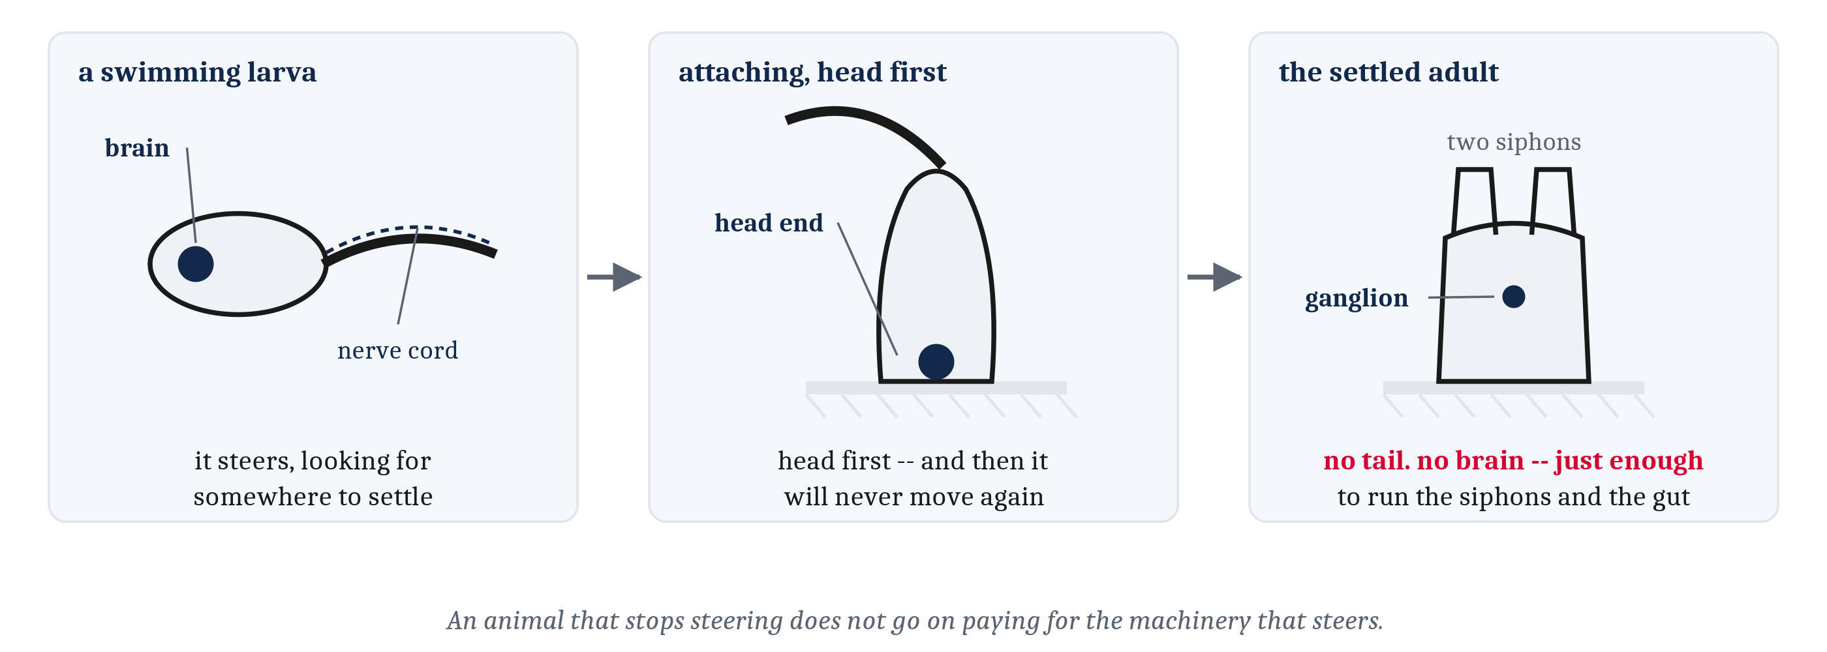
A Front — and What Having One Costs
Bilateral symmetry gives an animal a front, and the end that arrives first is the useful place for sensors and for the neurons they report to. Steering is moving forward, turning, and letting what the front end detects decide which way the turn goes.
Notes:
Bilateral symmetry is a body plan with a left and a right that mirror one another and — far more consequentially — a front and a back. Nearly every animal most people could name is built that way: worms, insects, snails, fish, birds, and us.
The front is what matters, and the argument is almost embarrassingly simple. An animal with a front has an end that arrives first. The end that arrives first is the useful place to put sensors, because that is where news of the world shows up earliest. And it is also the useful place to put the neurons those sensors report to, because a verdict reached near the sensors is a verdict reached sooner. What the tissue at the front is actually made of is the third lecture's subject, and I am deliberately leaving it there.
What the arrangement makes possible is steering: moving forward, turning, and letting what the front end detects decide which way the turn goes. An animal that steers does not merely move. It moves toward some things and away from others. Steering is this module's evolutionary addition in exactly the sense Module 2 gave that phrase — a capacity that solved a problem, and that everything downstream is built on top of.
Two checks on the claim. The first is that human beings keep arriving at the same design: cars, boats, aircraft, and submarines are all bilaterally symmetric with a designated front, because forward-plus-turn is a simple and general arrangement for getting somewhere.
The second is better, because it runs the story backward. A sea squirt begins life as a swimming larva with a nerve cord and a small brain at the front, and it steers, moving through the water looking for somewhere to settle. Once it finds a surface it attaches head-first and rebuilds itself into a filter feeder that will never move again. Its tail and its brain are broken down into molecules useful for other purposes. What remains is a much reduced ganglion — enough to run the siphons and the gut.
Sea squirts are chordates, not early animals, and I want to be clear about that because the misreading is tempting. This is not a picture of an early animal losing a brain it never fully had. It is a late animal giving up a brain it has. The moral is about cost: an animal that stops steering does not need to go on paying for the machinery that steers.

Slide 11
What Steering Demands
Steering is not free. Four demands, and the rest of the module is organized around them — we state them here, build the arrangements in the next lecture, and find them in tissue in the one after.
Demand | What steering requires | Built in 4.2 as | Found in 4.3 in
Evaluate | Sort what is sensed into good, bad, and neither — no direction can be preferred without a reason to prefer it | The labeled line | The worm's sensory neurons
Combine | Weigh several cues at once, both by how strong each one is and by which combination of them is present | Weights, thresholds, and logic units | The worm's steering circuit
Sharpen and commit | Turn a near-tie into a clear difference, then collapse many competing votes into exactly one action | Lateral and mutual inhibition | The two ends of the circuit
Modulate | Let the animal's own state change the verdict, and let a state outlast the event that caused it | Feedback loops | The neuromodulators
Notes:
This is the hinge of the lecture and the index for the module, so it is worth slowing down on.
Steering is not free. An animal that aims itself has to do four things that a jellyfish drifting on a current never has to do. It has to evaluate what it senses. It has to combine signals that disagree with one another. It has to sharpen and commit — which means turning a near-tie into a clear difference, and then collapsing the result into a single action. And it has to let its own condition modulate every one of those judgments.
Read the last two columns as a promise rather than as content. Everything in this lecture is a statement about what has to be computed. Not one word of it says how. The arrangements in the third column are the next lecture's whole job, and the tissue in the fourth column is the lecture after that.
I am making that boundary explicit because it is the most common way to go wrong with Marr's levels, and it is easy to go wrong with it in the direction of feeling like you have understood something you have not. Naming a demand is not meeting it. By the end of this lecture we will have four named demands and no mechanisms whatsoever, and that is the correct state to be in.
The rest of the lecture takes the four demands one at a time.

Slide 12
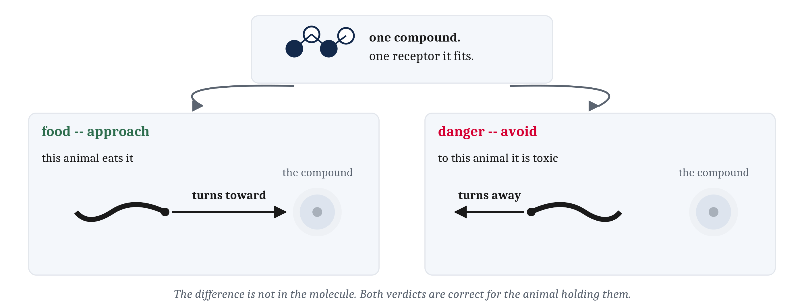
Evaluate: Where Good and Bad Come From
Valence is the tag a nervous system attaches to what it senses, marking a thing as worth moving toward or away from. There is no goodness in the molecule — and none in the sensory cell that detects it either.
Notes:
Before an animal can move toward anything, something has to make one direction preferable to another. So the first demand is the one that makes the other three worth having.
Take a chemical drifting past a worm's head. Nothing about that chemical's shape, nothing about its concentration, and nothing about the receptor it happens to fit makes it good or bad. It is a molecule. It has a structure and that is all it has.
It is worth deciding for yourself, before reading on, whether you can name anything about a compound that would settle the question, because people do not always agree about this and the disagreement is the interesting part.
The answer the chapter gives is that the verdict is not about the compound at all. It depends on what the animal is, on what it eats, and on what eats it. The same compound that means food to one species could mean danger to another, and both verdicts are correct for the animal holding them.
Valence is the name for the tag a nervous system attaches — marking a thing as worth moving toward, or worth moving away from. It is the first thing steering requires, and what it provides is the two directions a steering animal can take with respect to anything it detects: approach and avoidance. A worm climbing a gradient of food odor is approaching. The same worm turning away from something that would damage it is avoiding. In both cases the animal is acting on a verdict it assigned rather than on a property it found.
Now the strongest form of the claim, and the form to hold on to. There is no goodness in the molecule. And there is none in the sensory cell that detects the molecule either. Value comes into existence somewhere in the arrangement of cells between the sensor and the animal's muscles — which is the claim the first figure in this lecture made, arriving now with a name on it.

Slide 13
Combine: Two Ways Cues Have to Be Put Together
Combination has a quantitative face — graded strengths weighed against each other — and a relational one, where what matters is which combination is present. A truth table states the second exactly; the mapping it states is the circuit's target function, and a piece of nervous system that computes one of these relations is a logic gate.
Cue A | Cue B | A AND B | A OR B | A AND NOT B
absent | absent | do not act | do not act | do not act
absent | present | do not act | act | do not act
present | absent | do not act | act | act
present | present | act | act | do not act
Notes:
In a laboratory a stimulus can be presented on its own. Out in the world several arrive at once and they often imply different things, so steering demands that many signals become one direction of travel. A cue, for the rest of this module, is something an animal can sense that carries information about what is out there.
Combination has two faces and they are worth keeping apart, because the next lecture builds different machinery for each.
The quantitative face is a trade-off. *C. elegans*, the millimeter-long soil worm from Module 3, avoids copper, because copper is toxic to it. Put food on the far side of a strip of copper and you have a real conflict — and it resolves the way a trade-off resolves rather than the way a rule resolves. Make the attractant stronger and more worms cross. Make the copper more concentrated and fewer do. Nothing there is a yes-or-no decision. Two graded quantities are set against each other and the behavior follows whichever wins.
The relational face is different. Consider three things an animal might need to do. Feed only when there is food odor *and* the water is not too warm. Flee when there is a shadow *or* a sudden vibration, either one being enough on its own. Advance when there is food odor *and not* the scent of something that eats it.
Those are AND, OR, and AND NOT. They are primitive operators in symbolic logic and they are the basis of digital electronics and of computers — but I want to reverse the usual order of credit, because long before any of that they arrived as demands on behavior.
The table is how we will write those demands from here on. A truth table lists every combination of the conditions and, beside each one, what the outcome should be. It beats a sentence because it says what happens in every case, including the cases nobody thought to mention. We will call the mapping it states the target function, and a piece of nervous system that computes one of these relations a logic gate.
One thing the table does not do, and it is the firewall for this whole lecture: a truth table says what has to be done and says nothing whatever about how. Naming the target before knowing the mechanism is ordinary business at the computational level. Module 3 did exactly the same thing, saying what neurons had to accomplish several pages before accounting for how they accomplish it.

Slide 14
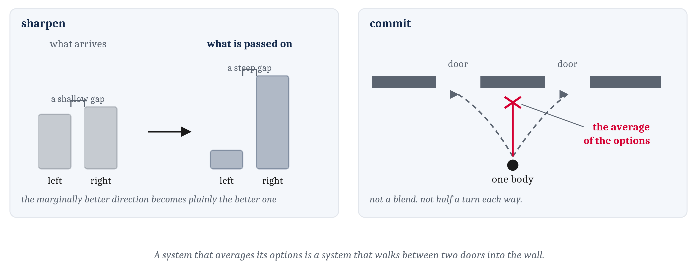
Sharpen, and Then Commit
A nervous system that reported a near-tie faithfully would hand the muscles a near-tie. Sharpening takes a shallow gap in and produces a steep one out — and then committing follows from a fact about bodies rather than a fact about information.
Notes:
The third demand is about the quality of a decision rather than its content, and it has two parts.
Take sharpening first. Suppose a food odor is very slightly stronger on the left than on the right. A nervous system that reported that difference faithfully would hand the muscles a near-tie, and a near-tie is a poor instruction. What sharpening does is take a shallow gap in the input and produce a steep gap in the output, so that the marginally better direction becomes plainly the better one. An animal that exaggerates a difference that way can act more decisively, and sooner, than one that does not — and I will keep the hedge the chapter keeps, which is that this is something a nervous system might do rather than something every nervous system does.
Committing is the other part, and its justification is different in kind. It does not follow from anything about information. It follows from a fact about bodies. A worm has one body and the body can go in one direction. So however many cues were weighed and combined, the result has to be a single action.
And it has to be a single action in a fairly strict sense. Not a blend of two actions. Not half a turn to the left together with half a turn to the right, which would carry the animal somewhere that neither cue recommended. The picture worth keeping is the one on the right: a system that averages its options is a system that walks between two doors into the wall.
One warning about the next lecture while this is fresh. Several of the arrangements we build there include neurons whose main job is to quiet other neurons, and that looks strange the first time you meet it — a nervous system spending cells on shutting cells up. This slide is the reason. Machinery for suppression is exactly what a body needs when it has to make a choice and silence the alternatives.

Slide 15
Modulate: The Same Animal, the Same Molecule, the Opposite Behavior
An internal state is the animal's own condition — hunger, injury, fatigue — and the fourth demand is that this condition reach into the evaluation and change the verdict.
The worm's condition | The cue | The verdict
Hungry | Food odor across a copper strip | Worth crossing
Just eaten | The same odor, the same copper | Little to gain
Recently fed | Carbon dioxide | Avoid it
Some hours without food | The same carbon dioxide | Avoid it far less
Under some conditions | The same carbon dioxide | Drawn toward it
Notes:
The first three demands quietly assume that an animal's verdicts are fixed. Very few verdicts are fixed.
A worm that has just eaten gains little by crossing a strip of copper. An odor that was worth a burn an hour ago is not worth one now. So valence depends on something besides the world. Valence depends on the animal's own condition — hunger, injury, fatigue, whatever the animal was doing a moment ago. An internal state is that condition, and the fourth demand is that internal state be able to reach into the evaluation and change the verdict.
Every row of the table is *C. elegans*, which is what makes the table worth reading across rather than down. The animal never changes. The cue in the middle column never changes either. Only the verdict on the right changes, and what changes it is the condition on the left.
The copper rows are the trade-off from the combine slide, now with a state attached to it. Food on the far side of a strip of copper is worth the crossing to a hungry worm. The same food, across the same copper, is not worth it to a worm that has just fed.
The carbon dioxide rows are the clean experimental case, and they are the ones to carry out of this slide. *C. elegans* normally avoids carbon dioxide. A worm that has gone some hours without food avoids it far less. Under some conditions the worm is drawn toward it instead. Same animal, same molecule, opposite behavior — which is the title of the slide and is meant literally.
And the reversal is a sensible thing to do rather than a malfunction. Carbon dioxide can mark decaying material, and decaying material is where other worthwhile things gather. A well-fed worm has no reason to go and look. A hungry worm does.
Notice what the fourth demand is not. It is not a demand for a fifth kind of cue. Hunger is not another smell arriving alongside the carbon dioxide and being weighed against it. Hunger changes what the carbon dioxide is worth. That is a different operation from combining, and the next lecture builds different machinery for it.
That is the fourth demand in its plain form. There is a second requirement hiding underneath it, and the next slide is about that one.

Slide 16
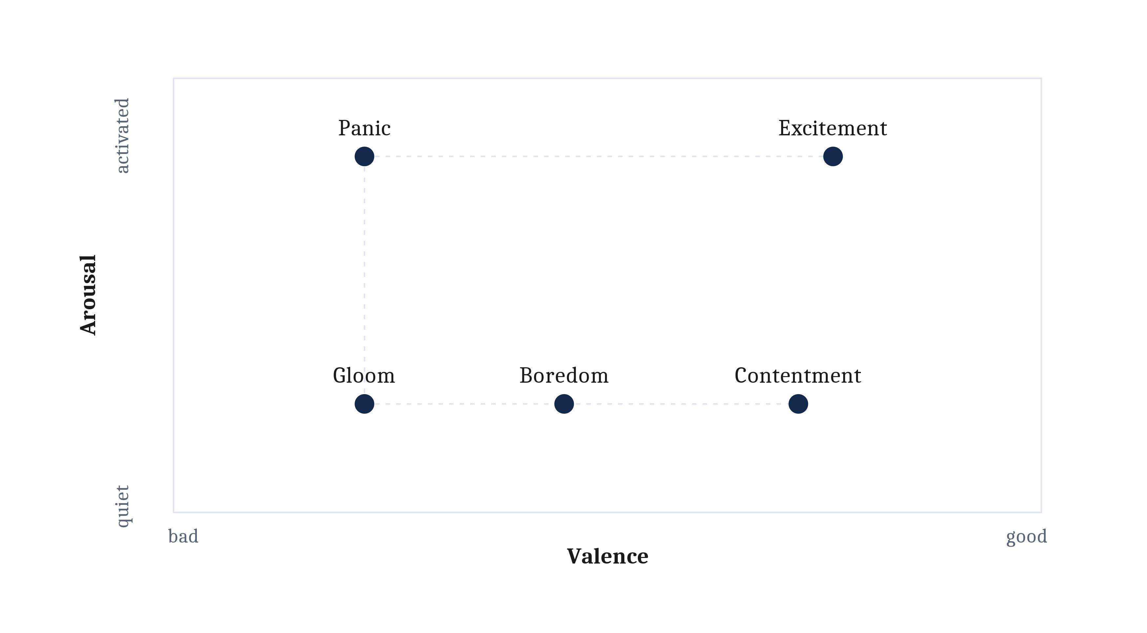
Affect: A State That Outlasts Its Cause
Affect is an internal state that outlasts its cause and biases behavior over a stretch of time. Arousal is how activated an animal is, and with valence it gives a two-dimensional space.
Notes:
The demand on the last slide has a second requirement hiding underneath it, and the second requirement is the subtler of the two.
Sensory evidence is fleeting. A predator's scent arrives and disperses. A food spot goes empty. An animal whose behavior tracked only what its sensors report at this instant would stop fleeing the moment the smell thinned, and stop searching the moment the last morsel was gone.
Both of those would be mistakes, and it is worth being precise about whose mistake. Neither is a mistake about what the sensors said. The sensors are reporting correctly. The problem is that the world stops supplying evidence long before the thing the evidence was about goes away. The predator is still out there after its scent has dispersed.
So it is better to enter a state that outlasts the event which caused it, and that keeps shaping behavior after the evidence is gone.
That is what affect is, in this chapter's sense. An internal state that outlasts its cause and biases what an animal does over a stretch of time, rather than at a single instant.
Notice how mechanical that definition is, and notice how little it says about feeling. The silence is deliberate. The definition is built so that a worm can satisfy it, and a worm is the test case the chapter has in mind. Whether there is anything it is like to be in such a state is a real question and a hard one, and this definition does not answer that question in either direction. Hold the question open. Do not let the word settle it.
That restraint is worth one more sentence, because the temptation runs the other way and it runs hard. The everyday words for affective states — panic, gloom, contentment — all arrive with a feeling attached in ordinary use. The chapter is borrowing those words as labels for positions in a space, and borrowing nothing else with them.
Now the space itself. Two quantities describe a surprising amount of affect. Not all of it, and the chapter is careful about that, but a surprising amount. Valence we already have, from the evaluate slide. The second quantity is arousal: how activated an animal is, how vigorously and how readily the animal will react to anything at all. Put valence and arousal on two axes, and an affective state becomes a position in a space rather than an item on a list.
Read the figure by contrasts rather than by points. Panic and gloom share a negative valence and differ in arousal. Contentment and boredom sit at much the same arousal and differ in valence.
And panic and excitement sit at much the same arousal too, differing in nothing but whether things are going well. That is the pair that separates the two dimensions most cleanly, and it is the one to keep. Anyone carrying the assumption that high arousal is a bad sign has to account for excitement.
One connection back to Module 3 before we leave this. A persistent state is partly an accounting decision. Reacting hard is metabolically expensive, so an animal that stays keyed up is spending energy and an animal that stops responding is conserving energy. How long a state ought to outlast its cause is therefore not only a question about information. It is also a question about a budget, which is the same kind of question Module 3 asked about what it costs to run a neuron at all.
The chemistry that holds a state like this one is the third lecture's.

Slide 17
Where Do These Sit?
Place each state in the valence–arousal space. Where does the room disagree?
Waiting for a grade to post
The last mile of a long run
Scrolling at one in the morning
Homesick
Ten minutes into a lecture on something everyone already knows
Then: which of these outlasts its cause the longest?
Notes:
OPTIONAL SLIDE. This is the one to drop if the hour is running short. Nothing after it depends on it, and the machine slide follows from the affect space whether or not we stop here.
Turn to someone near you and place each of these in the space. Two axes, five states, a few minutes.
[Take answers on two or three of them. Listen for the disagreements rather than the agreements — the disagreements are the content.]
Three things usually come out of this, and all three are in the reading.
The first is that valence is easy and arousal is hard. Nobody argues about whether being homesick is negative. Rooms do argue about whether being homesick is quiet or activated, and that argument is usually an argument about which version of homesick each person is imagining.
The second is that the two dimensions come apart in real cases. The last mile of a long run and waiting for a grade to post can land at the same height and on opposite sides. That is the panic-and-excitement pair from the figure, arriving out of somebody's own life instead of off a diagram.
The third is the one worth pressing on, and it is the reason the last state on the list is a joke at my expense. Some of these do not fit the space cleanly. The chapter says in advance that they will not — valence and arousal describe a surprising amount of affect, not all of it. If the room can say what a state has that the two axes miss, that is a real observation about a real limit, and not a failure to understand the diagram.
Then the closing question, which is the definition of affect doing some work. Which of these outlasts its cause the longest? Being homesick outlasts its cause by weeks. Scrolling at one in the morning barely outlasts the phone going face down. A state that ends the moment its cause ends is not really affect at all. It is a response.

Slide 18
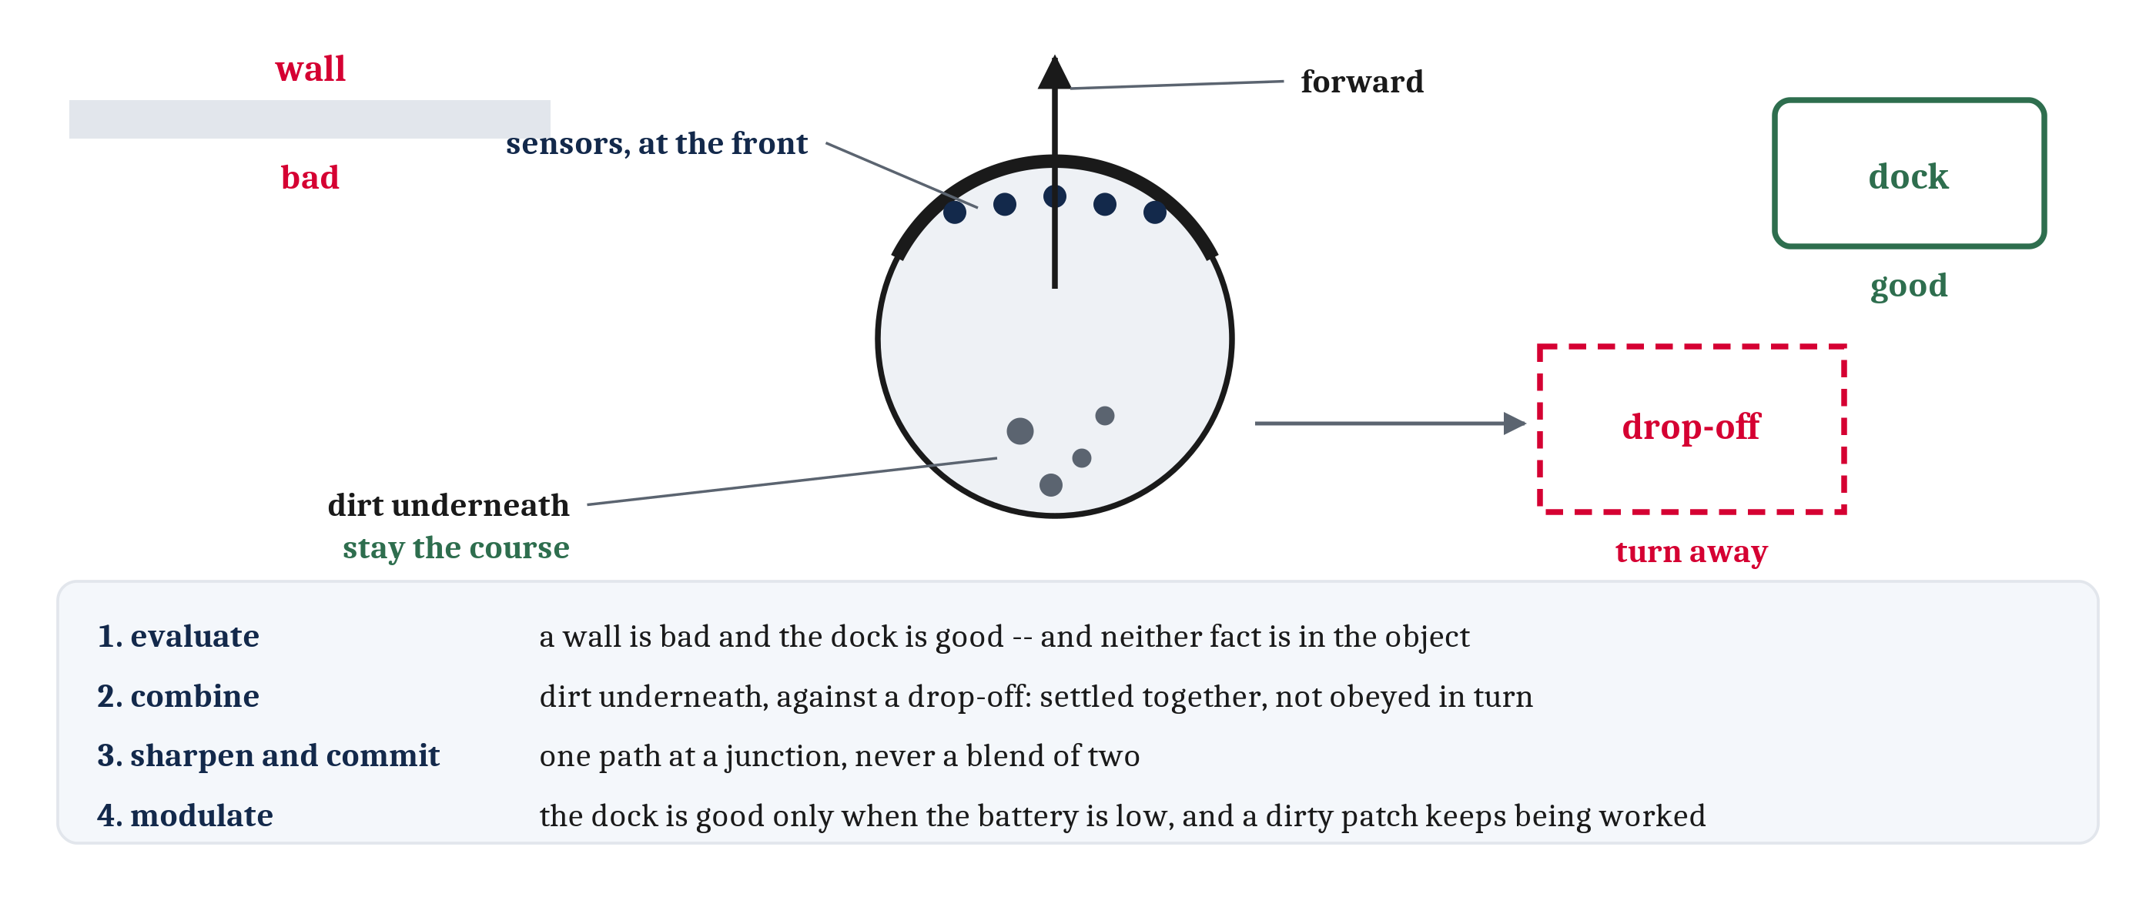
A Machine That Steers
A robot vacuum meets all four demands, and it is not trying to be an animal. The four demands belong to the problem rather than to biology.
Notes:
In Module 3 we set a single artificial neuron beside a single real one, and found the resemblance close at the algorithmic level and nonexistent at the implementational one. Here the comparison goes up a level, from a cell to a whole agent with a job to do.
A robot vacuum is a fair example precisely because it is not trying to be an animal. It is a disc that has to cover a floor and find its way back to its dock. Run the four demands against it.
Body plan and steering first. The body is round, but the machine has a front — a bumper, a direction of travel, and its sensors clustered at that end. It goes forward and it turns, and what the leading end detects settles which way the turn goes. That is the bilaterian arrangement showing up in a machine.
Evaluate. A wall is bad and the dock is good, and neither of those facts is in the wall or in the dock. They are in how the machine is wired to respond to them.
Combine. Dirt detected underneath is a reason to stay the course; a detected drop-off at the top of a stairway is a reason to turn away. The two have to be settled against each other rather than obeyed one after the other.
Modulate, and persistence with it. The dock is good only when the battery is low. And a machine that has detected a dirty patch keeps working that patch for a while after its sensor has stopped reporting dirt, which is a state outlasting its cause.
None of that makes a robot vacuum like a worm. What it shows is that the four demands belong to the problem rather than to biology. Anything that has to get somewhere useful in a world it only partly senses will meet them.
One honest qualification, because this looks like a textbook case of something it is not. In Module 2 we called it convergence when one problem produces much the same solution in lineages that did not share it. This is not quite that, because the robotics tradition the machine comes from turned to animals deliberately, after years of building machines that planned a route from a stored map and found the world changed faster than they could plan. So the resemblance is partly borrowed rather than independently arrived at. I would rather say so than let the example do more work than it can. And the borrowing is itself a kind of evidence: the demands were legible enough in real animals that engineers could read them off and build with them.
So, the four demands, once more. An animal that steers has to evaluate what it senses, combine cues that disagree, sharpen faint differences and commit to one action, and let its own state modulate all of it. Every one of those is a statement about what has to be computed. Not one of them says what is represented, or by what procedure. That is the next lecture, where we take the four in the order they were raised and meet each one with an arrangement of neurons.

Slide 19
Image Sources (1 of 2)
Slide | Image | File | Licence | Source
2 | Beadlet anemone, Actinia equina | fig-sea-anemone.jpeg | GFDL 1.2 or later | Attrattorestrano at Italian Wikipedia · https://commons.wikimedia.org/wiki/File:Actinia_equina2.JPG
2 | Moon jellies, Aurelia aurita (cropped from the original) | fig-moon-jelly-crop.jpg | CC BY-SA 3.0 | Luc Viatour, www.lucnix.be · https://commons.wikimedia.org/wiki/File:Aurelia_aurita_(Cnidaria)_Luc_Viatour.jpg
2 | Caenorhabditis elegans, scanning electron micrograph | fig-c-elegans-sem.jpg | CC BY-SA 4.0 | Antje Thomas, Schulenburg Lab, Kiel · https://commons.wikimedia.org/wiki/File:Electron_micrograph_of_%27%27Caenorhabditis_elegans%27%27.jpg
4 | The same cell, the opposite behavior | fig-same-cell-opposite-behavior.png | CC BY 4.0 | Jon Willits — drawn for this lecture · own work
5 | The chapter's evolutionary window | fig-animal-timeline.png | CC BY 4.0 | Jon Willits — drawn for the Module 4 reading · own work
6 | Bodies before neurons | fig-bodies-before-neurons.png | CC BY 4.0 | Jon Willits — drawn for this lecture · own work
7 | Filtering, and catching | fig-filtering-vs-catching.png | CC BY 4.0 | Jon Willits — drawn for this lecture · own work
8 | A moon jelly | fig-moon-jelly.jpg | CC BY-SA 3.0 | Luc Viatour, www.lucnix.be · https://commons.wikimedia.org/wiki/File:Aurelia_aurita_(Cnidaria)_Luc_Viatour.jpg

Slide 20
Image Sources (2 of 2)
Slide | Image | File | Licence | Source
9 | Two body plans, drawn from above | fig-body-plans.png | CC BY 4.0 | Jon Willits — drawn for the Module 4 reading · own work
10 | The sea squirt gives up what it no longer uses | fig-sea-squirt.png | CC BY 4.0 | Jon Willits — drawn for this lecture · own work
12 | One compound, two verdicts | fig-one-compound-two-verdicts.png | CC BY 4.0 | Jon Willits — drawn for this lecture · own work
14 | Sharpen, and commit | fig-sharpen-and-commit.png | CC BY 4.0 | Jon Willits — drawn for this lecture · own work
16 | The two dimensions of affect | fig-valence-arousal.png | CC BY 4.0 | Jon Willits — drawn for the Module 4 reading · own work
18 | Four demands, in a machine | fig-machine-that-steers.png | CC BY 4.0 | Jon Willits — drawn for this lecture · own work

