Slide 1

BCOG 100
Neural Circuits, Affect, and Valence
Lecture 4.2 — Circuits That Compute Value
Notes:
The first lecture of this module ended with four demands and no mechanisms at all. An animal that steers has to evaluate what it senses, combine cues that disagree, sharpen faint differences and commit to one action, and let its own state modulate all of it.
That was deliberate. Every one of those is a statement about what has to be computed, and none of them says how.
This lecture is the how. We take the four demands in the order they were raised and build, for each one, an arrangement of neurons that meets it.
Two things are worth knowing before we start. The first is that the answer turns out to be small: a handful of wiring patterns do nearly all of the work. The second is that by the end of this lecture we will have met every demand, and every arrangement that meets one will share a single limitation — which is the door into Module 5.

Slide 2
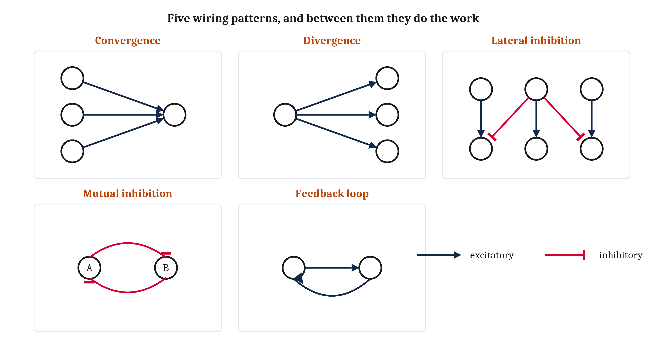
From a Unit to a Wiring Diagram
Connection is a matter of wiring, not of proximity — two cells pressed together may have nothing to do with each other. So a nervous system can be drawn, and the drawing reasoned about without knowing anything about the cells.
Notes:
The algorithmic question asks what a system represents, and what procedure it runs on those representations. So we need something to run a procedure on, and that is where Module 3 turns out to have already done us a favor.
Module 3 established that flow within a cell runs one way, and — more importantly — that connection is a matter of wiring rather than of being nearby. Two neurons whose cell bodies are pressed against each other may have nothing whatever to do with one another, while another neuron's axon may reach clear across an animal to make a connection.
That is the permission slip for everything in this lecture. Because connection is wiring, a nervous system can be drawn as a diagram. And once it is a diagram, we can reason about what it computes without knowing anything at all about the cells it is made of.
Two terms, then. A **neural circuit** is a set of neurons connected in a specific pattern, doing something together that no one of them does alone. And a **circuit motif** is a wiring pattern that turns up again and again — in different animals, and in different parts of the same brain — because it computes something generally useful.
Here is the claim I want you to be skeptical of for the next forty minutes, and then check at the end. Almost everything in this lecture is built out of the five motifs on this slide. Not five hundred. Five. Motifs stand to circuits roughly as letters stand to words, and there are not many letters.
We will take them one at a time. But you are seeing the whole vocabulary now, on purpose, so that each one arrives as a member of a set rather than as another thing to remember.

Slide 3
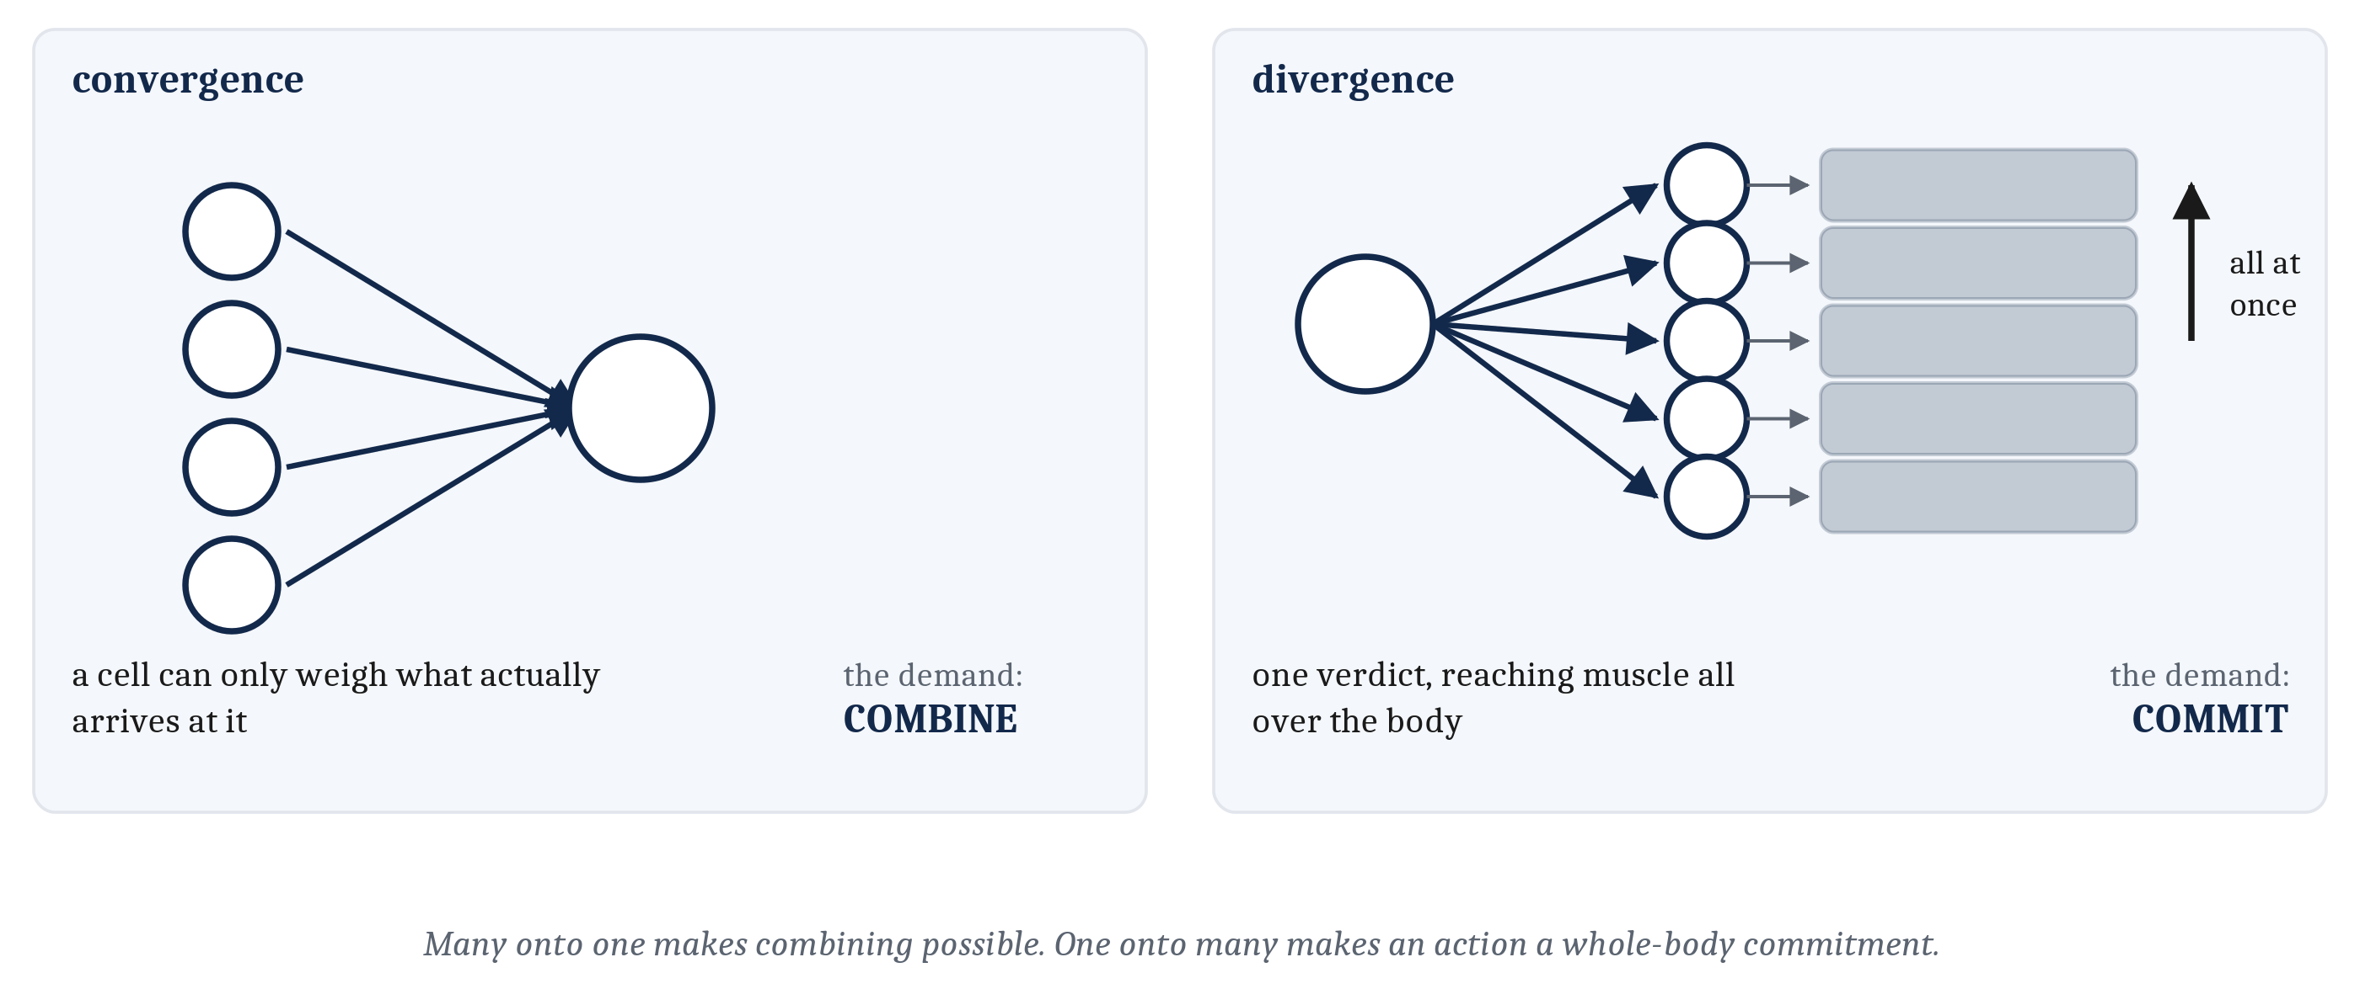
The Two Simplest Motifs
Convergence — many cells onto one — is what makes combining possible, because a cell can only weigh what actually arrives at it. Divergence — one cell onto many — is what makes an action a whole-body commitment rather than a local twitch.
Notes:
The two simplest motifs come first, and each one attaches to a demand.
**Convergence** is when many cells project onto one cell. That is what makes the second demand, combination, possible at all — and the reason is almost too obvious to state, which is why it is worth stating. A cell can only weigh and combine information that actually arrives at that cell.
Notice what that does to a question we asked in Module 3. There, we described a neuron summing whatever reached it, and the interesting part was the summing. Here the interesting part is the other half: what should be arranged to reach it. Convergence is a design question, not an arithmetic one.
**Divergence** is the reverse — one cell projecting onto many. That is how a single verdict can reach muscle all over the body at once. It is what makes coordination possible, and it is what lets an action be a whole-body commitment rather than a local twitch.
The worm makes that concrete in one sentence. A worm that reverses does not reverse in one segment. It coordinates its whole body to do so at the same moment, and divergence is how one decision gets everywhere it needs to be.

Slide 4
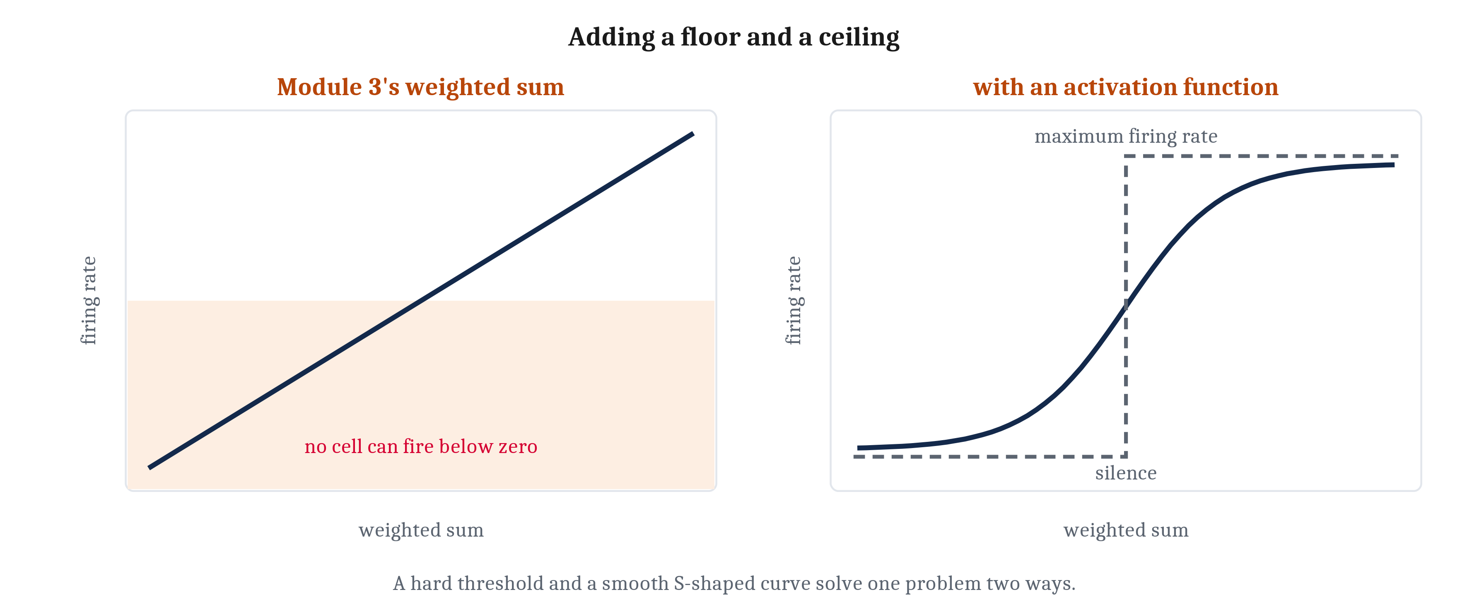
The Floor and the Ceiling
A cell cannot fire less often than never, and cannot fire faster than its refractory period allows. So the weighted sum cannot be the final answer: it passes through an activation function — a hard threshold function, or a smooth sigmoid function.
Notes:
Before we can wire units together we have to fix something we left broken in Module 3, and I flagged it then as a debt we would pay here.
Module 3 wrote the neuron as an equation — a weighted sum of its inputs — and then showed you two places where that equation says something impossible. Make the inhibitory input strong enough and the weighted sum goes negative. But no cell can fire a negative number of times per second. And a linear equation has no maximum at all, while any real physical neuron has some maximum firing rate.
Those are not modeling inconveniences. They are two physical facts about cells. A real cell has a floor and a ceiling that a bare sum does not: it cannot fire less often than never, and it cannot fire faster than its refractory period allows.
So the sum cannot be the final answer. It has to pass through one more step — a function that takes the total and squashes it into the range the cell can actually produce. That step is an **activation function**.
Two of them run through the rest of this lecture. A **threshold function** has a hard boundary: below the threshold the unit is silent, at or above it the unit fires, and there is nothing in between. A **sigmoid function** is softer — an S-shaped curve that behaves like a threshold at the extremes and grades smoothly in the middle. The name means nothing more than S-shaped, so do not let it intimidate you.
Both buy the same two things, a floor and a ceiling. What they cost differs, and the trade is worth naming because we spend it on the very next slide. The smooth curve is closer to what a real neuron does. The hard step is easier to compute logic with. Neither is simply better, and which one you reach for is a claim about what matters for the question you are asking — which is Module 3's point about models, arriving again.
One last thing, and it is a reassurance. Nothing else about the unit changes. Inputs still arrive as rates. Connections still carry weights with signs. The weighted sum still happens. We have added one step at the end.
From here on I will say **unit** rather than neuron when I mean the abstract computing element, and save neuron for the cell. The distinction is going to matter.

Slide 5
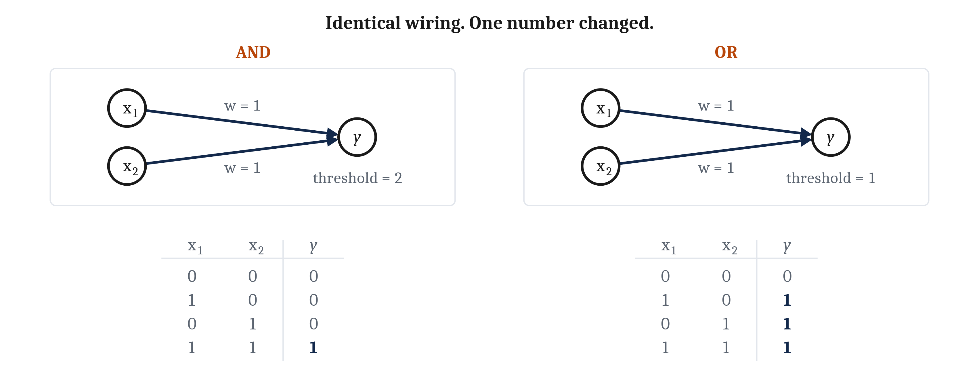
Two Numbers Make a Logic Gate
Two excitatory inputs, each with a weight of 1. Threshold 2 and the unit computes AND. Threshold 1 and it computes OR. Nothing about the wiring changed — only the threshold.
Notes:
A bounded activation function does more than keep a unit's output inside the range a real cell can produce. It also turns the unit into a logic gate, and the reason is worth seeing rather than being told.
A unit that fires only when its weighted inputs pass a threshold is a unit answering a yes-or-no question about a combination of conditions. That is exactly the shape of the truth tables we wrote in the first lecture of this module.
So take a unit, call it y, and give it two excitatory inputs, x1 and x2, each with a weight of 1. Set the threshold at 2. Either input on its own contributes 1, which does not reach 2, so y stays silent. Both together contribute 2, which does, so y fires. The unit computes *AND*.
Now leave both weights exactly where they are and set the threshold to 1 instead. Either input on its own now reaches the threshold. So do both together. The same unit computes *OR*.
I want to be heavy-handed about what just happened, because it is the whole point. Nothing about the wiring changed. The units are identical. The weights are identical. One number moved.
And notice what this does to the relationship between the two levels. In the first lecture we wrote a truth table as a specification — a computation a steering organism needs. Here the same truth table is the outcome that an arrangement of units produces. That is Module 1's claim that the three levels are separable but not independent, seen from about as close up as it gets.

Slide 6
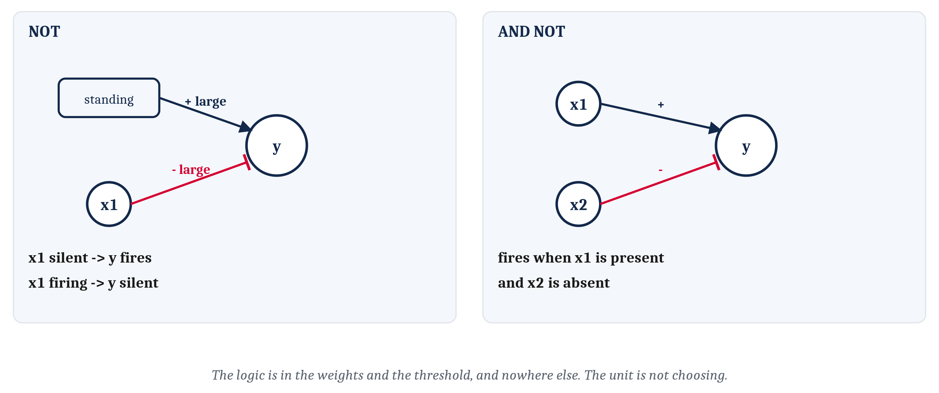
This, and Not That
An inhibitory input is a connection with a negative weight. Standing excitation cancelled by one gives NOT; wired alongside an excitatory input it gives AND NOT. The unit is not choosing, and does not know what AND means.
Notes:
That leaves *NOT*, and it needs one thing we already have from Module 3: an inhibitory connection is simply a connection carrying a negative weight.
So give our unit y a standing excitation — an input strong enough to fire it on its own, with nothing else happening. Then give it one inhibitory input, x1, whose negative weight is large enough to cancel that excitation. Now y fires whenever x1 is silent, and falls quiet whenever x1 is firing. That is *NOT*.
Wire that inhibition alongside an excitatory input and you get *this and not that* — which, if you remember, is precisely one of the problems we said a steering animal faces. Advance when there is food odor and not the scent of something that eats you.
So: the truth table we wrote down in the first lecture is satisfied by a simple wiring diagram and two numbers. That is the payoff of the whole stretch.
Now the part I want to close off before anyone forms the thought, because it is the most natural wrong idea in this material. The unit y is not choosing anything. It does not know what *AND* means. It has no representation of logic, no rule written down inside it, nothing that could be called understanding the operation it performs.
The logic is in the weights and the threshold, and nowhere else. Set them one way and the unit computes one function. Set them another way and the same unit computes a different one. This is the lesson of the Braitenberg lab arriving in a new costume — the behavior that looked like it needed an inner life turned out to be in the arrangement of the parts.

Slide 7
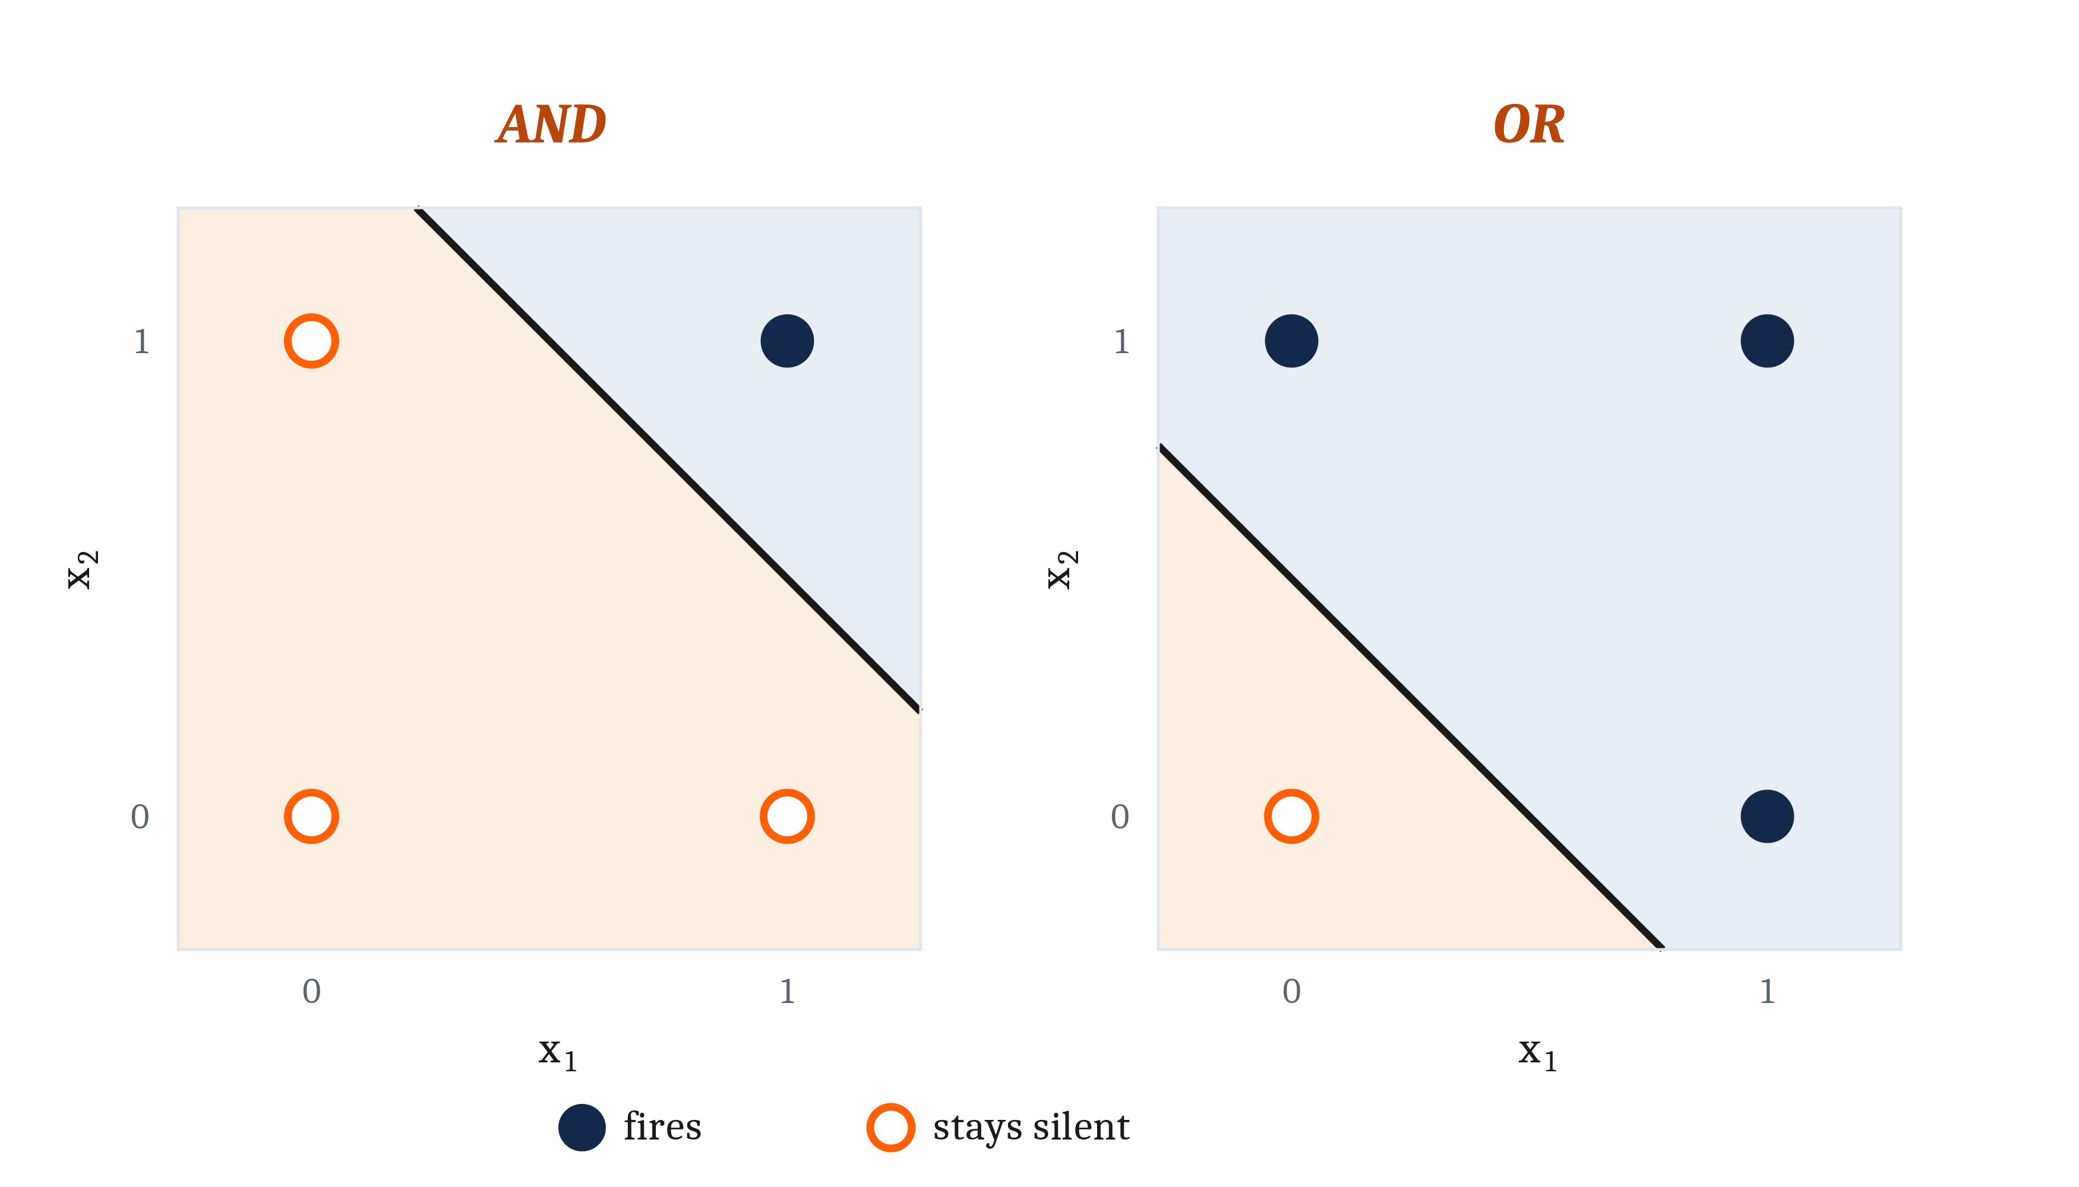
What a Unit Computes, as a Picture
Put the two inputs on a pair of axes and every combination is a point on a plane. A unit with a threshold or sigmoid activation function necessarily divides that space with a single line — its decision boundary.
Notes:
There is a second way to see what a unit computes, and for some of you it will be the one that makes it click.
Put the two inputs on a pair of axes. x1 along the bottom, x2 up the side. Now every possible combination of their values is a point on a plane. The four combinations we have been working with are the four corners: (0,0), (0,1), (1,0) and (1,1).
Color-code each corner by whether the output unit is supposed to be firing there. Blue for yes, orange for no. For *AND*, only the (1,1) corner is blue and the other three are orange. For *OR*, only the (0,0) corner is orange and the other three are blue.
Then do one more thing, which is what makes the picture worth having: color the whole background, not just the four corners. Now you can see what the circuit does for any input at all, including the ones between the corners.
And a boundary appears. That is not a coincidence and it is not an artifact of the drawing. A neural circuit with one output unit using a threshold or a sigmoid activation function will *necessarily* divide the space with a single line, saying yes on one side and no on the other. That line is the unit's **decision boundary**, and where it sits is decided entirely by the weights.
Look at the two boundaries and notice they are parallel. *AND* and *OR* agree about (0,0), where the circuit should be off, and about (1,1), where it should be on. They disagree about the two middle corners. So going from one to the other does not require tilting the line at all. It only has to slide.

Slide 8
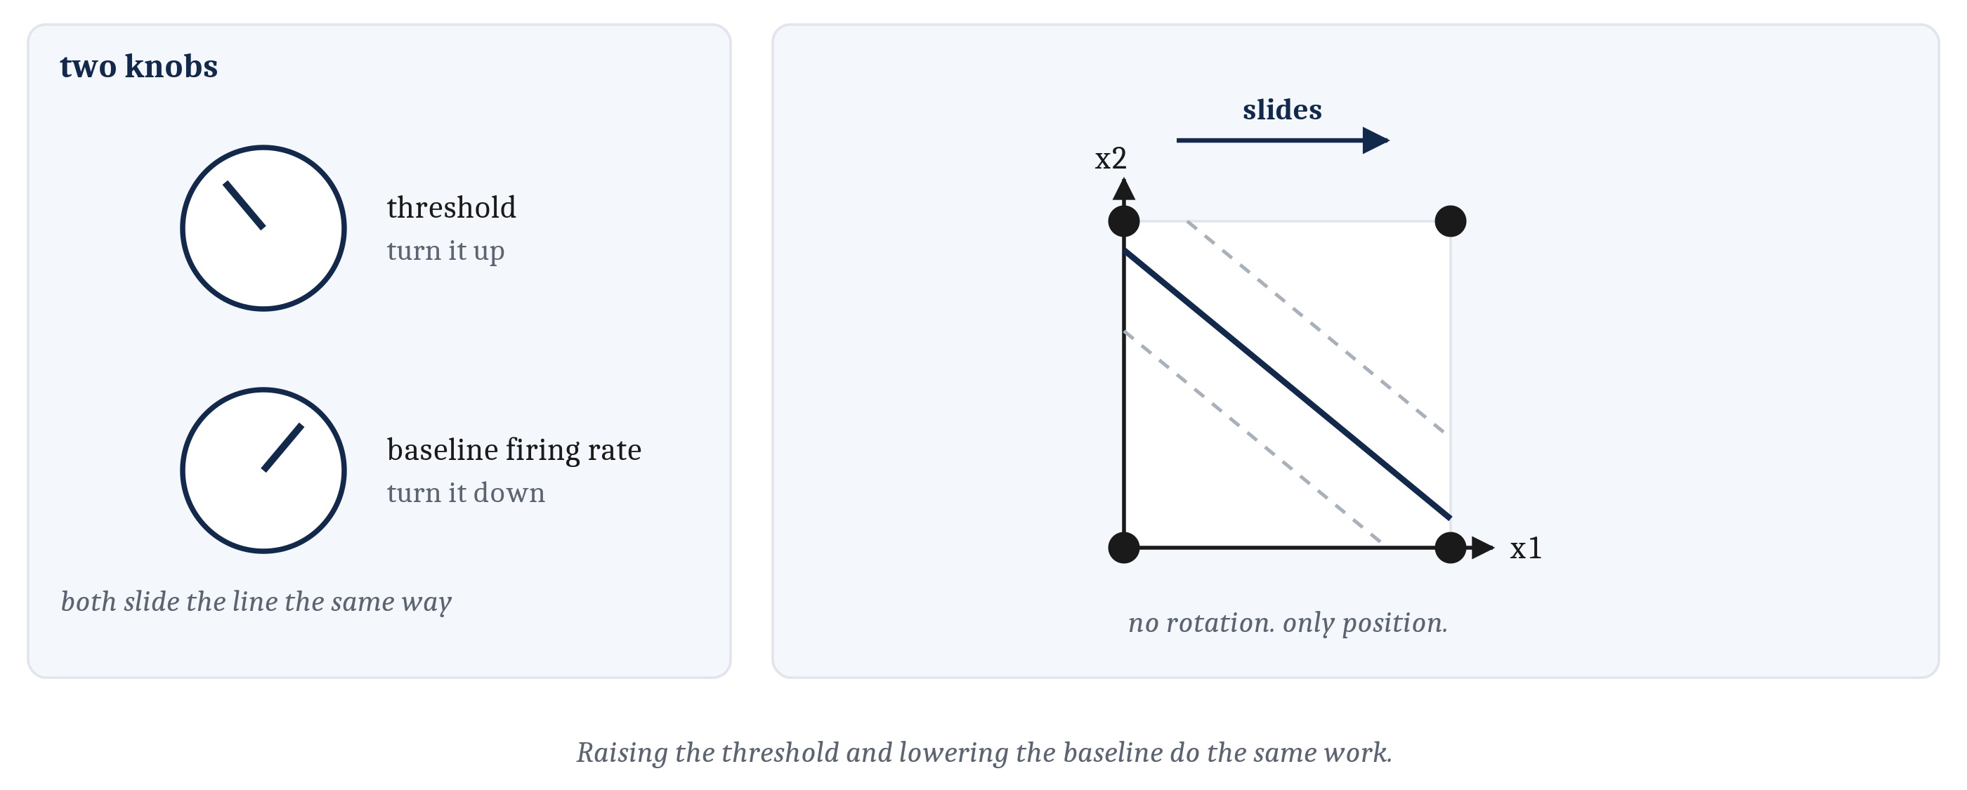
Two Knobs That Slide the Same Line
A shift with no rotation is a change of intercept — the baseline firing rate. So raising the threshold and lowering the baseline do the same work. And one straight line is a limited thing.
Notes:
A shift in a line with no rotation and no change of slope has a name: it is a change in the intercept. And in our equation the intercept is b-zero, which Module 3 gave us as the baseline firing rate of the unit.
Which means something slightly surprising, and this is the hardest idea in this lecture, so I want to spend a moment on it. Raising the threshold and lowering the baseline firing rate do the same work. They are two knobs that slide the same line. You can get from the *AND* circuit to the *OR* circuit by moving either one.
That is worth holding onto, because it is the first time in this course that two things which sound like completely different kinds of adjustment turn out to be the same adjustment described twice.
Now the limitation, and I am going to name it even though the reading does not.
A single straight line is a limited thing. There are computations organisms genuinely need that no single line can produce, no matter how you set the weights and the threshold — not because we have not been clever enough, but because the geometry forbids it. The classic case is called XOR: fire when one input or the other is present, but not when both are. Try to draw one straight line that puts (0,1) and (1,0) on one side and (0,0) and (1,1) on the other. You cannot. There is no such line.
I am naming it and then leaving it, deliberately. The solution is not a cleverer line, it is more than one unit — and how neural systems actually deal with problems of this shape is Module 7, where we will do it properly. For now the useful thing is to know the ceiling exists, and that we have just hit it.

Slide 9
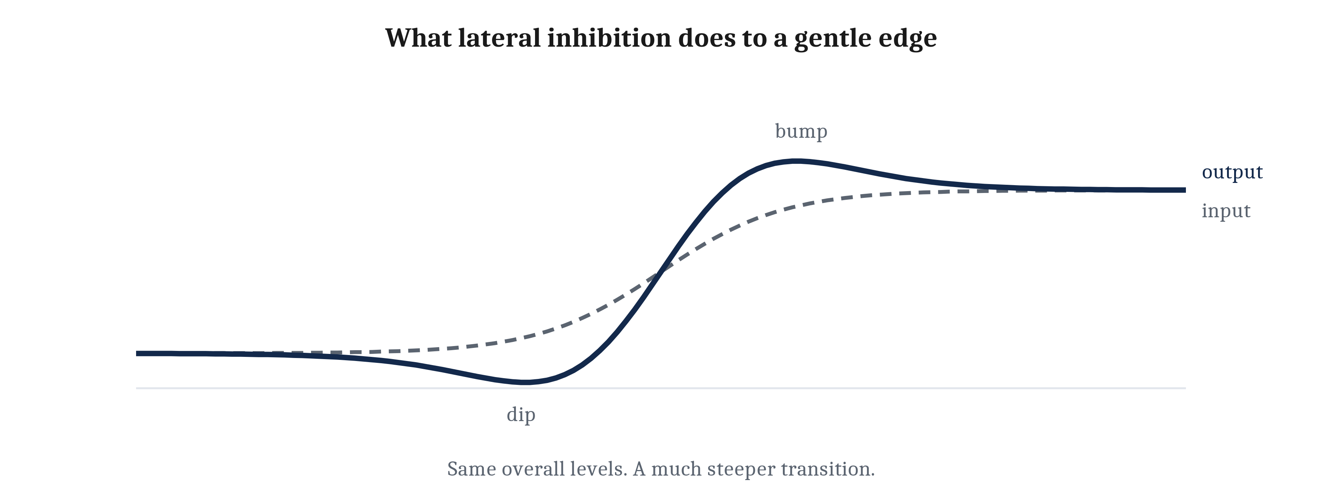
Lateral Inhibition: Reporting the Difference
A row of units, each inhibiting its neighbors in proportion to its own activity. The one that is slightly ahead inhibits harder than it is inhibited, so its lead grows: a shallow step in, a steep step out.
Notes:
Back to the motif list, and to the third demand. In the first lecture we said a nervous system sometimes needs to exaggerate a small difference. Here is the wiring pattern that does it.
Take a row of units, each receiving its own input. Now wire each one to inhibit its neighbors, in proportion to how active it is.
Follow what happens when the input is slightly stronger at one end. The unit receiving that stronger input inhibits the units beside it slightly harder than they inhibit it back. So they fall a little. So they inhibit it a little less. So it climbs. Its lead grows, and a shallow step in the input comes out as a steep one in the output. That arrangement is called **lateral inhibition**.
Here is why I like this one: you can check it against your own experience right now. An edge between a light region and a darker one looks crisper to you than the light arriving from it actually warrants. That is not a metaphor. It is this circuit, in your retina.
The units on the bright side of the edge are inhibited less than their neighbors, because their neighbors are dimmer. The units on the dark side are inhibited more, because their neighbors are brighter. So the bright side is reported brighter and the dark side darker than either really is.
And that gives us the sentence I would most like you to leave with. Your nervous system is not reporting the light. It is reporting the difference, amplified. It is biased, on purpose, toward finding the edges of objects — and it will show you an edge that is sharper than the one that is there.

Slide 10
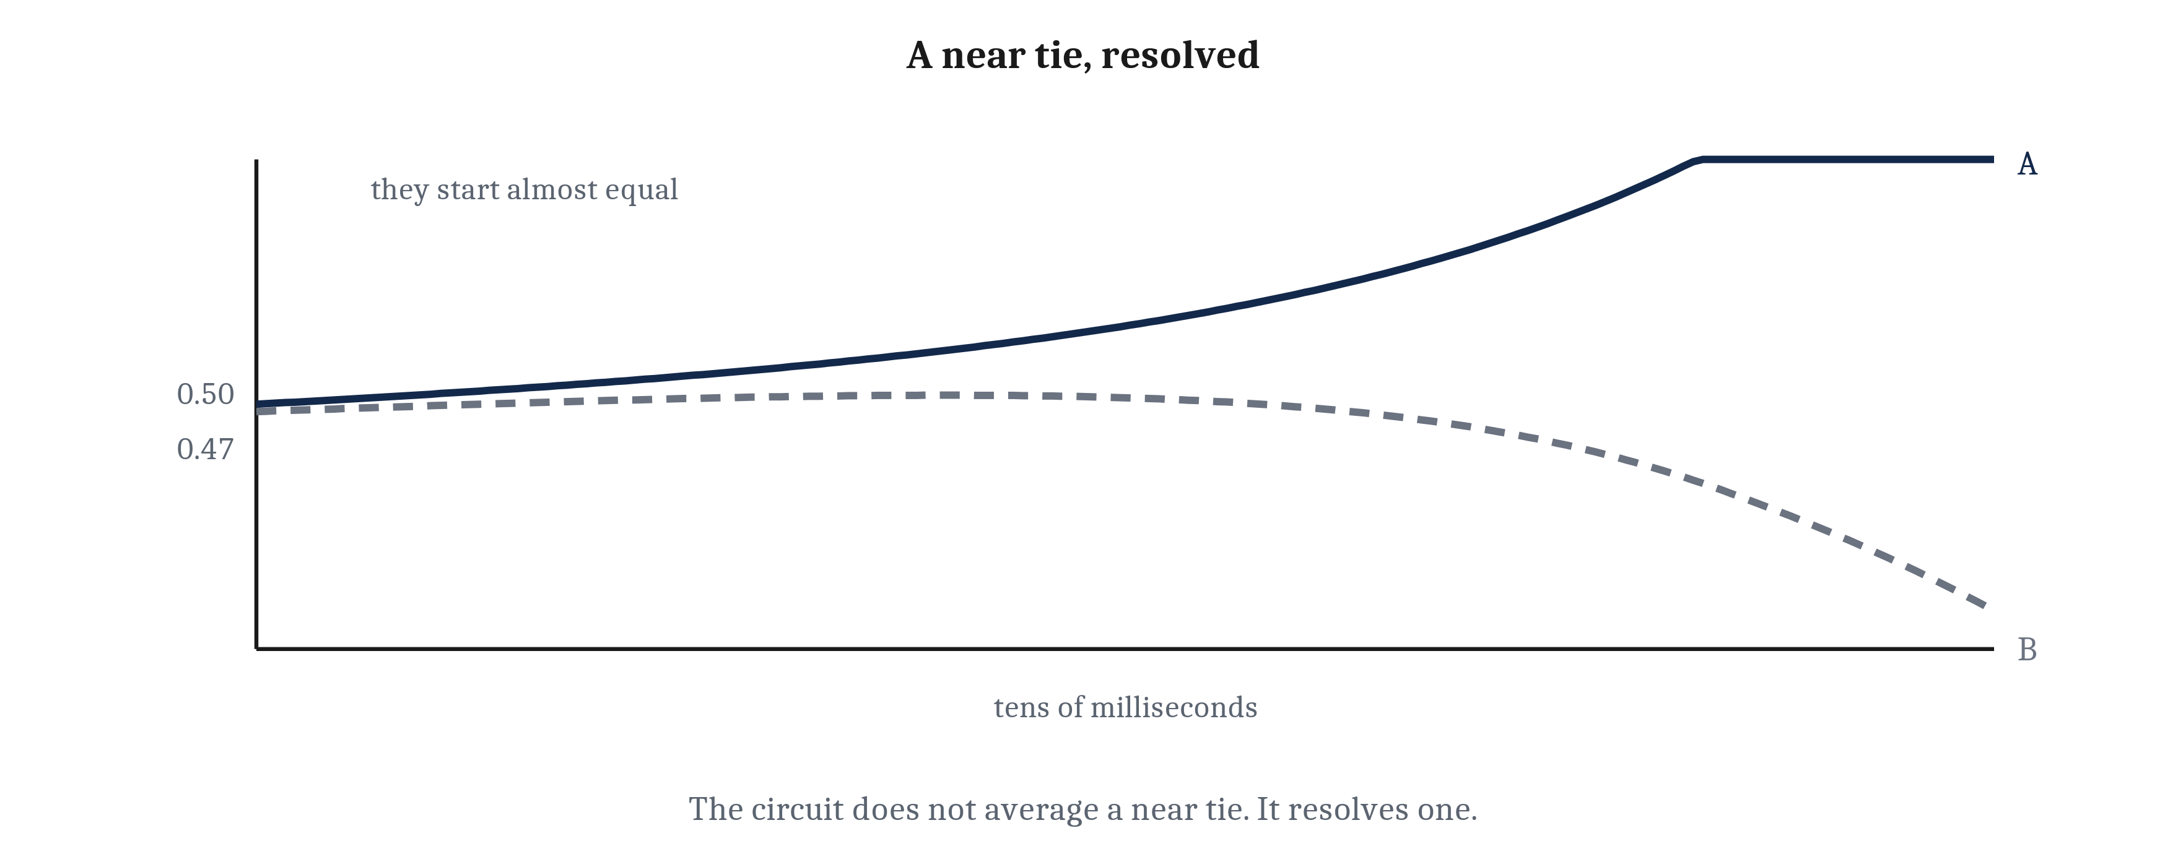
Mutual Inhibition, and Choosing Exactly One
Two units, each inhibiting the other. From a near tie the lead runs away, and within a few tens of milliseconds one is firing and the other is silent. Mutual inhibition forces winner-take-all.
Notes:
The fourth motif answers what we called the hardest demand. One body has to go in the direction of its top choice, not in the average direction of all its choices.
The circuit is almost embarrassingly simple: two units, each inhibiting the other.
Walk what happens from a near tie. Both units are receiving nearly equal input. Whichever is momentarily ahead — and something always is — inhibits its rival a little harder. The rival's activity falls. So the rival inhibits back a little less. So the leader climbs further. So it inhibits harder still. The lead runs away, and within a short time one unit is firing and the other is silent. That arrangement is **mutual inhibition**, and the outcome it forces is called **winner-take-all**.
Now the part that matters. Given a near tie, this circuit does not average the two options. It also does not report that the contest was close. It chooses. An animal that needed exactly one action gets exactly one action — and the fact that the evidence was nearly balanced is discarded along the way. That is a cost, and it is a cost worth paying if you have one body.
Two things to connect. First, notice the shape of that argument, because you have seen it before. Module 3 explained the all-or-nothing action potential as a positive feedback runaway: sodium entering the cell opens channels that admit more sodium, so that once the loop starts there is no intermediate setting available. Mutual inhibition is the same runaway one level up — built out of cells rather than channels, and producing a decision rather than a spike.
Second, this answers a question Module 3 left open and did not answer. Why should activity that is so sparse — only a small fraction of cells strongly active at any moment — carry information well? Here is why. A circuit that suppresses everything except the winner produces a sparse pattern, because that sparse pattern *is* the decision. The silence of the losing units is not an absence of information. It is the result.

Slide 11
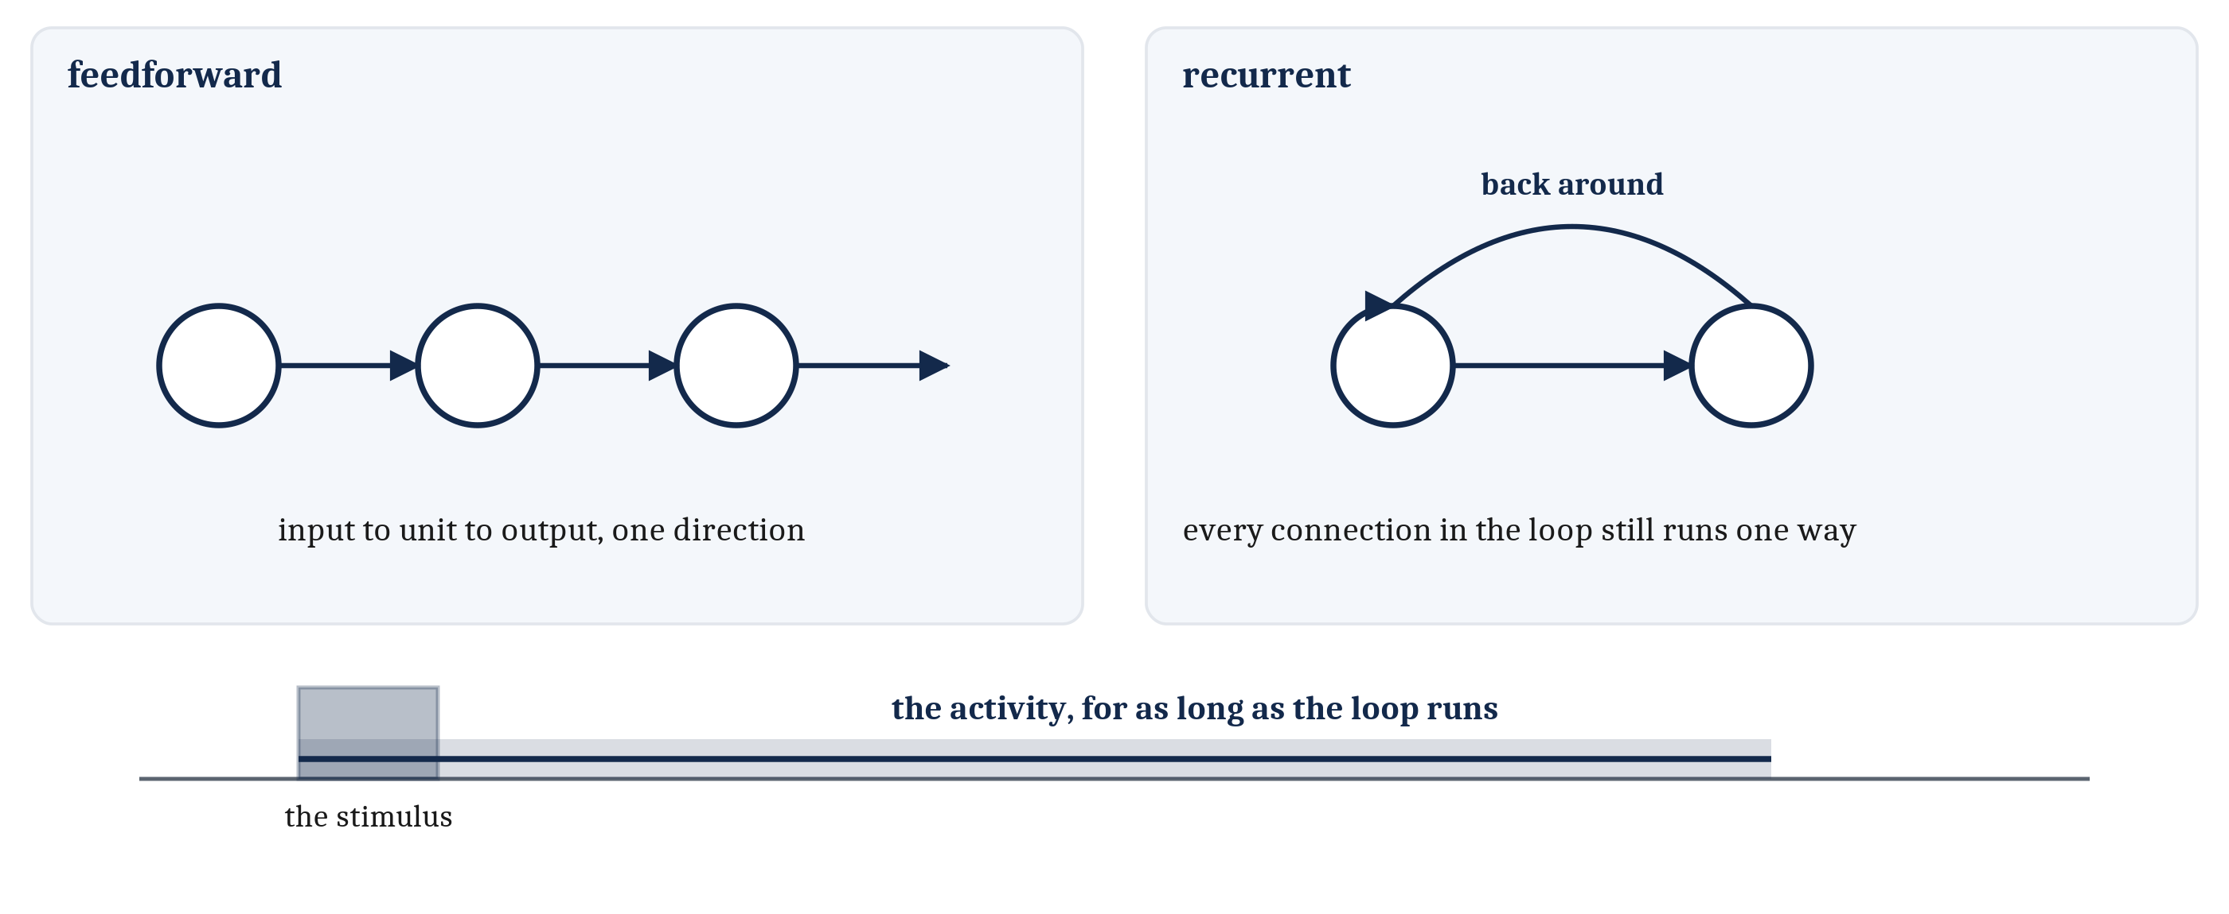
A State Can Be a Circuit That Is Still Running
Everything so far ran one way — feedforward. A feedback or recurrent connection runs a unit's output back toward its own input. The stimulus lasts a moment; the activity lasts as long as the loop runs.
Notes:
The fourth demand was for states that outlast whatever caused them, and we need one more motif for it.
Notice that every arrangement so far has run in one direction — input to unit to output. Connections of that kind are **feedforward**, and I am defining the word only now because there was nothing to contrast it with until this moment.
Nothing stops a unit's output from running back toward its own input, either directly or around a longer path through other units. A connection that does that is a **feedback connection**, also called a **recurrent connection**, because activity can run around the loop again and again.
Head off the obvious objection before it settles in, because it is a good objection. Did we not just say flow runs one way? We did, and the loop does not retreat from it. Each connection *within* the loop still runs in one direction. A neuron's output still leaves by its axon and arrives on another cell's dendrites. The loop is built out of one-way links; it is the path that comes back around, not any individual connection.
What the loop buys is persistence. A unit that excites something that excites it back can keep itself going after the input that started it has stopped. The stimulus lasts a moment. The activity lasts as long as the loop keeps running.
And that has a consequence I find genuinely surprising every time I come back to it. An internal state does not have to be stored anywhere. There need be no record, no trace, nothing written down. A state can simply be a circuit that is still running, minutes after the thing that set it off has gone.
There is another way to hold a state — in a changed connection rather than in ongoing activity — and the difference between the two turns out to matter a great deal. That is Module 10's, and I am leaving it there.

Slide 12
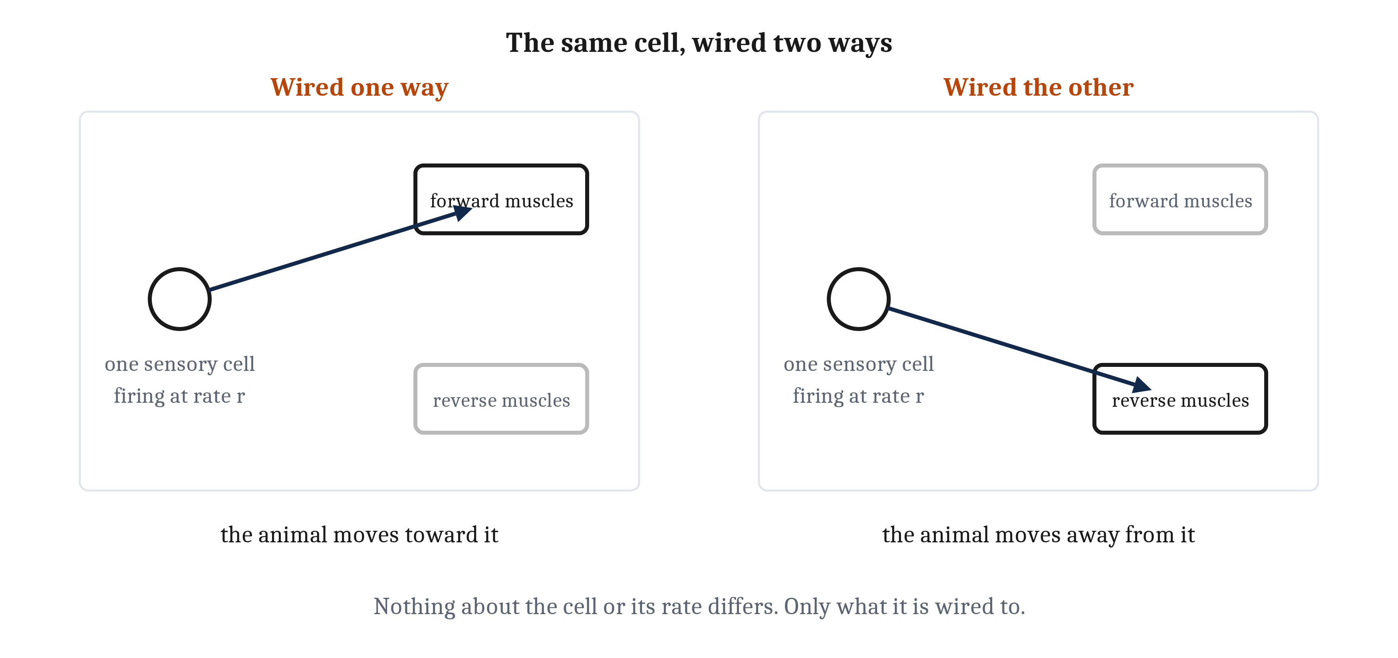
Where Valence Lives
A sensory neuron carries a rate, and nothing else — a food cell and a toxin cell can be identical in every respect a downstream cell could measure. What makes one a good-detector is what it is wired to.
Notes:
Now we can answer the question the first lecture raised and deliberately left open. We said good and bad are assigned rather than found. We never said where the assignment comes from.
The answer is simpler than most people expect, and a little unsettling, so do not read past it.
A sensory neuron does not carry a good signal. It carries a rate — so many spikes per second, more of them when the thing it responds to is stronger. And nothing about that rate says whether the thing is worth approaching.
Push it harder. Two sensory cells, one responding to a food molecule and one to a toxin, can produce output that is identical in every respect a downstream cell could measure. Same rate. Same timing. Nothing in the signal distinguishes them.
So what makes one cell a good-detector? What it is wired to, and nothing else. Route a sensory cell's output to the machinery that drives the animal forward, and it is a positive-valence cell. Route the identical cell to the machinery that drives withdrawal, and the very same cell is now a negative-valence cell.
An arrangement like that is called a *labeled line* — and the name is slightly wrong in a way worth fixing. The label is not on the line. It is at the far end of it, in the thing the line connects to.
Which gives us the claim this module has been building toward since its first slide: valence is a fact about the wiring diagram. We said it in Module 3's close, that value is a property of an arrangement rather than of a cell. You did it with your own hands in the Braitenberg lab, where crossing two wires reversed the behavior with every part unchanged.
So, at the level of neural circuitry, there is no good signal. There is no bad signal. There is no pleasure molecule and no pain molecule. There is a cell, and there is where its output goes.
Hold onto the four words *at the level of circuitry*, because the next lecture is going to spend an hour on molecules that shape value, and that is not a contradiction. It is a different level.

Slide 13
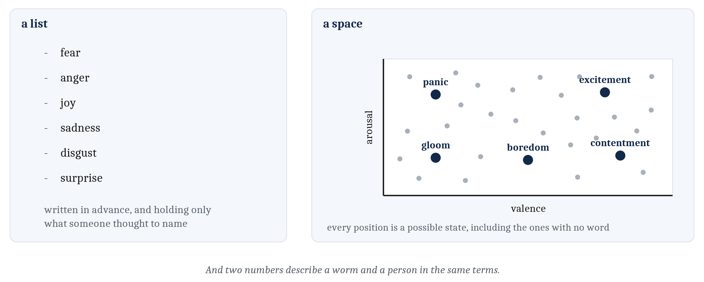
Why a Space, and Not a List
Algorithmically, an affective state is two numbers — how good or bad things are, and how activated the animal is — and what it does next is a function of its position. A list holds only what someone thought to name.
Notes:
In the first lecture we put affect on a plane and placed states on it. I presented that as a description. Algorithmically, it is a claim about representation, and it is worth making the claim explicit.
Here is the plainest form of it. An animal's affective state is two numbers. One for how good or bad things are. One for how activated the animal is. And what the animal does next is a function of its position in that space.
Now the design question, because the answer is what makes the representation do any work. Why a space rather than a list of named states? Why not simply have a state called fear, a state called contentment, and so on?
Two reasons. A list has to be written in advance, and it can only ever hold what someone thought to name. A space does not. Every position in the space is a possible state — including the positions between the labeled points, including the ones no language has a word for. You have certainly been in a few of those.
And the second reason is one this course cares about a great deal. Two numbers describe a worm and a person in the same terms. A list of human emotion words could not do that, and a course built on comparing minds across species needs a description that travels.
One hedge, and I want to be honest about it rather than let the tidiness carry you away. The claim is about representation and nothing more. How many dimensions human emotional life actually needs is argued about, and two is certainly on the low side. What we are claiming is that thinking of circuits as defining spaces — for decisions, for preferences, for internal states — buys us a great deal of understanding about behavior.

Slide 14
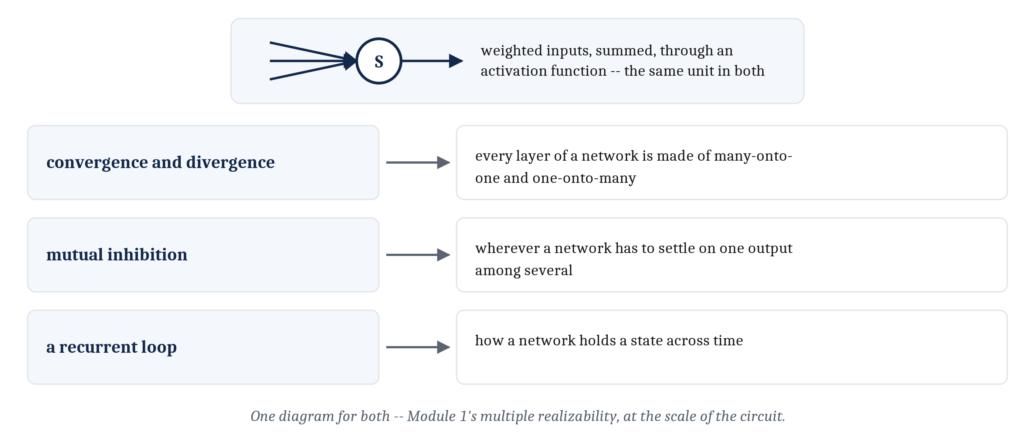
The Same Motifs in Silicon
An artificial network is also built from units that take weighted inputs, sum them, and pass the total through an activation function — and it is wired into the same patterns. One diagram serves both.
Notes:
In Module 3 we set one artificial neuron beside one real one and found the resemblance close at the algorithmic level and nonexistent at the implementational one. We can now make that comparison at the scale of the circuit — and it continues to hold, surprisingly well.
Start with the unit. An artificial neural network is also built from units that take weighted inputs, sum them, and pass the total through an activation function. That is the same three-step description we repaired earlier in this lecture, and it is not an analogy — it is the same arithmetic.
Then the motifs, one at a time. Convergence and divergence are what every layer of such a network is made of; a fully connected layer is nothing but many-onto-one and one-onto-many, stacked. Mutual inhibition turns up wherever a network has to settle on one output among several. And recurrent connections are how a network holds a state across time — the same trick, for the same reason.
So one diagram serves for both biological and artificial systems. That is worth naming: it is another instance of Module 1's multiple realizability, arriving this time at the scale of the circuit rather than the cell. The same computation, running on cells or on silicon, described by the same drawing.

Slide 15
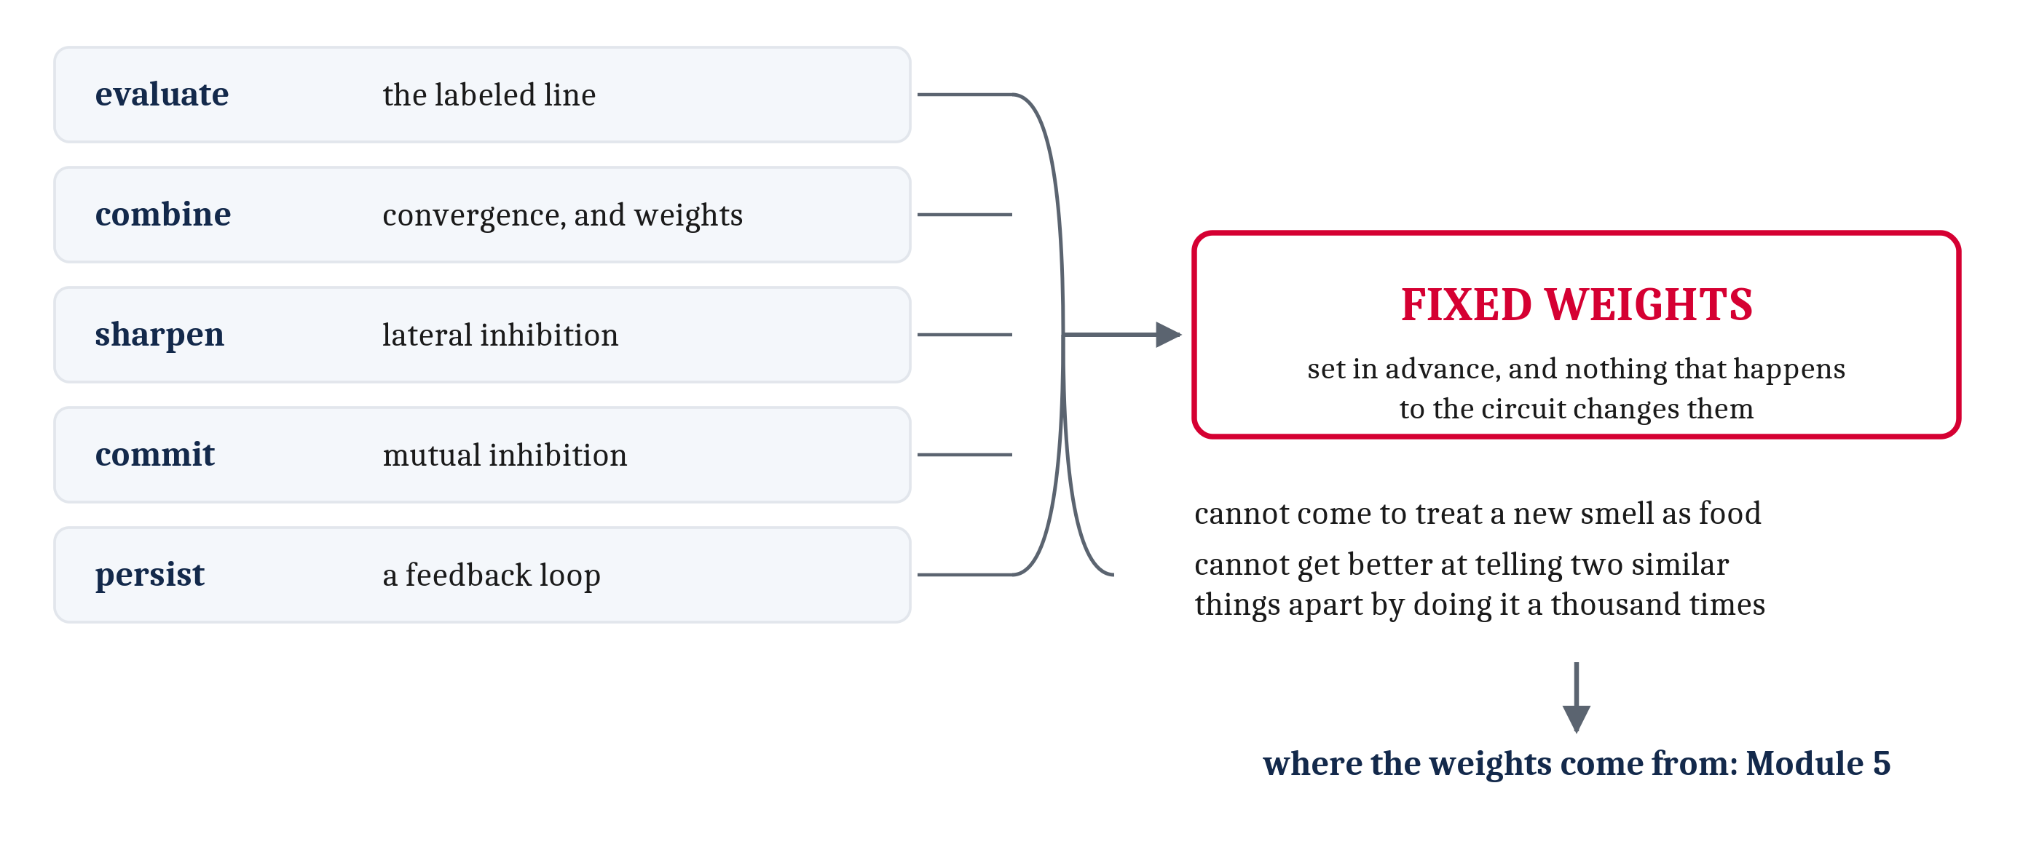
What a Fixed Circuit Cannot Do
Every demand raised in the first lecture now has a wiring pattern that meets it. And every one of those arrangements has fixed weights — set in advance, unchanged by anything that happens to the circuit.
Notes:
Take the audit. Evaluate, combine, sharpen, commit, persist. Every demand we raised in the first lecture of this module now has a wiring pattern that instantiates it. That is a real achievement and I do not want to undersell it.
Now turn on it, because every one of those arrangements shares a single property, and once you see it you cannot unsee it. The weights are fixed. The numbers were set in advance, and nothing that happens to the circuit changes them.
That is a real limit, because a circuit with fixed weights can only ever do what its weights were set to do. Two concrete things it cannot do. It cannot come to treat a new smell as food. And it cannot get better at telling two similar things apart by doing it a thousand times.
Scale that up to a whole animal and the consequence is stark. An animal built entirely out of fixed-weight arrangements would meet the world with a fixed repertoire, and would meet it the same way on the thousandth encounter as on the first.
And one thing said plainly, because the tidy version of this is false. The fixed weights are ours, not the animals'. Holding them still is a simplification we are making on purpose, because a circuit is very much easier to understand while its numbers hold still. Real animals learn, and that includes the small ones in this module.
Where those weights come from, and how they can change within a single lifetime, is Module 5. I would like you to arrive at that module already feeling the problem rather than being told there is one.
Two other doors were left open along the way. What a single decision boundary cannot separate, which we hit on the geometry slide, is Module 7. And whether a state is held in running activity or in a changed connection is Module 10.
One concession to close on. Everything in this lecture has been arrows and numbers on a page. Not one word of it says what any of it is made of in a real animal. So the next lecture asks three questions. Which cells? In what physical arrangement? And what allows a state to last an hour rather than a second?

Slide 16
Image Sources (1 of 2)
Slide | Image | File | Licence | Source
2 | The five circuit motifs | fig-motifs.png | CC BY 4.0 | Jon Willits — drawn for the Module 4 reading · own work
3 | Convergence and divergence, and the demand each serves | fig-convergence-divergence.png | CC BY 4.0 | Jon Willits — drawn for this lecture · own work
4 | The weighted sum, before and after an activation function | fig-activation-function.png | CC BY 4.0 | Jon Willits — drawn for the Module 4 reading · own work
5 | The AND unit and the OR unit | fig-logic-units.png | CC BY 4.0 | Jon Willits — drawn for the Module 4 reading · own work
6 | NOT, and this-and-not-that | fig-not-and-not.png | CC BY 4.0 | Jon Willits — drawn for this lecture · own work
7 | The AND boundary and the OR boundary | fig-decision-boundary.png | CC BY 4.0 | Jon Willits — drawn for the Module 4 reading · own work
8 | Two knobs, one line | fig-two-knobs.png | CC BY 4.0 | Jon Willits — drawn for this lecture · own work
9 | A gentle edge, sharpened | fig-lateral-inhibition.png | CC BY 4.0 | Jon Willits — drawn for the Module 4 reading · own work

Slide 17
Image Sources (2 of 2)
Slide | Image | File | Licence | Source
10 | Two traces separating from a near tie | fig-winner-take-all.png | CC BY 4.0 | Jon Willits — drawn for the Module 4 reading · own work
11 | Feedforward, and a loop | fig-loops.png | CC BY 4.0 | Jon Willits — drawn for this lecture · own work
12 | The same cell, wired two ways | fig-labeled-line.png | CC BY 4.0 | Jon Willits — drawn for the Module 4 reading · own work
13 | A list of names, and a space of positions | fig-space-not-list.png | CC BY 4.0 | Jon Willits — drawn for this lecture · own work
14 | The motifs, matched to their uses in artificial networks | fig-motifs-in-silicon.png | CC BY 4.0 | Jon Willits — drawn for this lecture · own work
15 | Every demand met, and the one limit they share | fig-fixed-weights.png | CC BY 4.0 | Jon Willits — drawn for this lecture · own work

