Slide 1

BCOG 100
Neural Circuits, Affect, and Valence
Lecture 4.3 — The Biology That Runs It
Notes:
The second lecture of this module ended with a concession and three questions. The concession was that everything in it had been arrows and numbers on a page — not one word about what any of it is made of in a real animal.
The three questions were these. Which cells? In what physical arrangement? And what allows a state to last an hour rather than a second?
This lecture answers all three, and it also keeps a promise I made in passing. I told you that at the level of neural circuitry there is no pleasure molecule and no pain molecule, and then asked you to hold onto the words *at the level of circuitry*, because we would spend an hour on molecules that shape value. This is that hour.
Two things to expect. The first is that we are going to look at one animal in real detail — a worm whose complete wiring diagram has been known for decades. The second is that the wiring diagram turns out not to be enough, and what it is missing is the most interesting thing in this lecture.

Slide 2
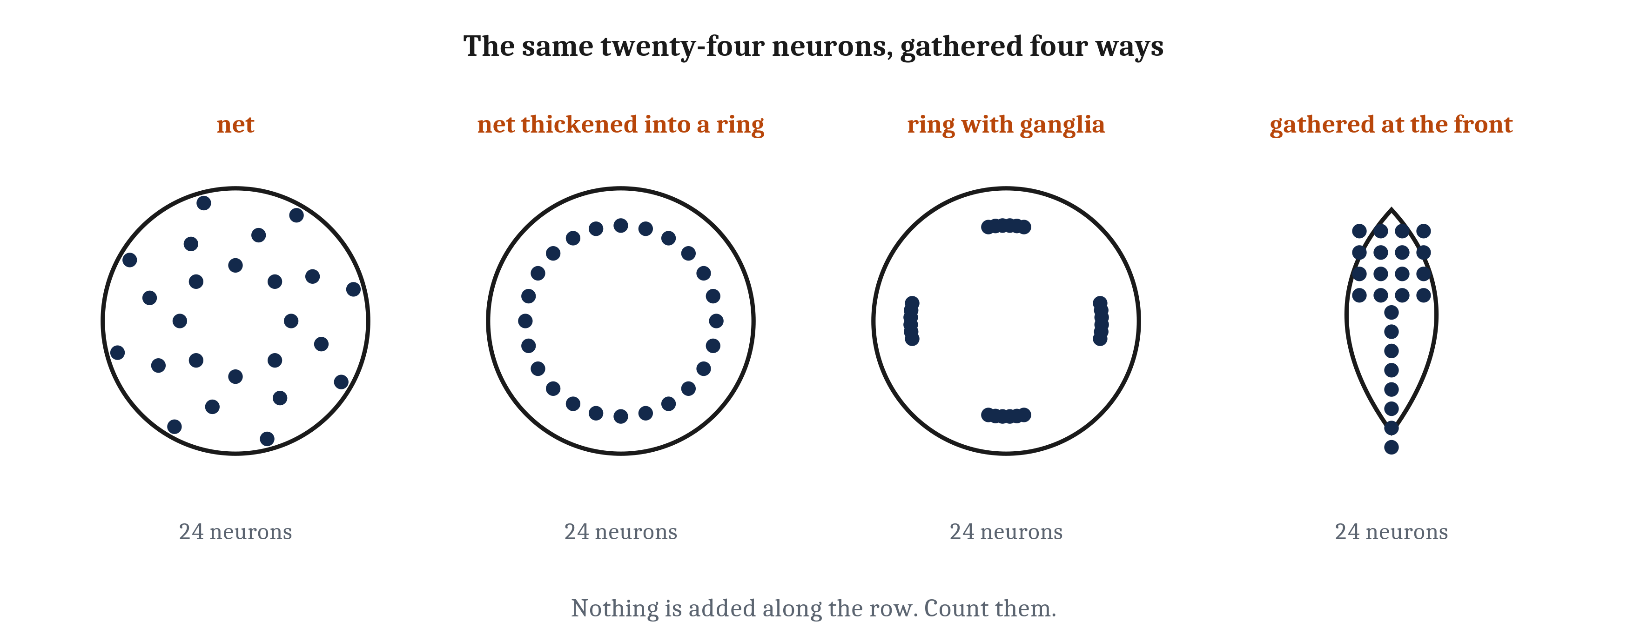
Why the Brain Is in the Head
A net thickens into a nerve ring, then into a ganglion — a center without being a brain. In bilaterians the largest ganglia end up at the front, with the sensors: cephalization. Nothing is added along the row.
Notes:
The implementational question asks what physically does the work, and what the doing costs. We have the capability from the first lecture and the arrangements from the second. Now the tissue.
Start with the simplest arrangement, which we have already met: a nerve net, neurons spread through the body wall, each connected to its neighbors, with nothing at the center. Here is a consequence you can picture. Cut a jellyfish in half and both halves keep pulsing. There is no center to remove.
Now the fact that everything else in this slide is built on. A nerve net is not perfectly even. In many cnidarians, and in the worm, the net thickens in places.
Take the thickening a step further and you get a **nerve ring** — a band of nerve net running around the body, denser than the net around it. Take it further still and the cell bodies gather into a **ganglion**, a cluster concentrated in one spot. I want to be careful about what a ganglion is, because the word sounds grander than the thing. A ganglion is a center without being a brain. It is somewhere a great many connections happen to be, and therefore somewhere a great deal of processing happens to get done.
Then add the bilaterian fact from the first lecture. In animals with a front, the largest ganglia end up at the front, with the sensors — because the end that arrives first is where both the sensing and the deciding are most efficiently done. That concentration has a name, **cephalization**, and it is the physical answer to a question that sounds childish and is not: why is the brain in the head?
Look along the row once more, because the caption is making an argument. Nothing is *added* from left to right. It is the same nervous system, gathered.

Slide 3
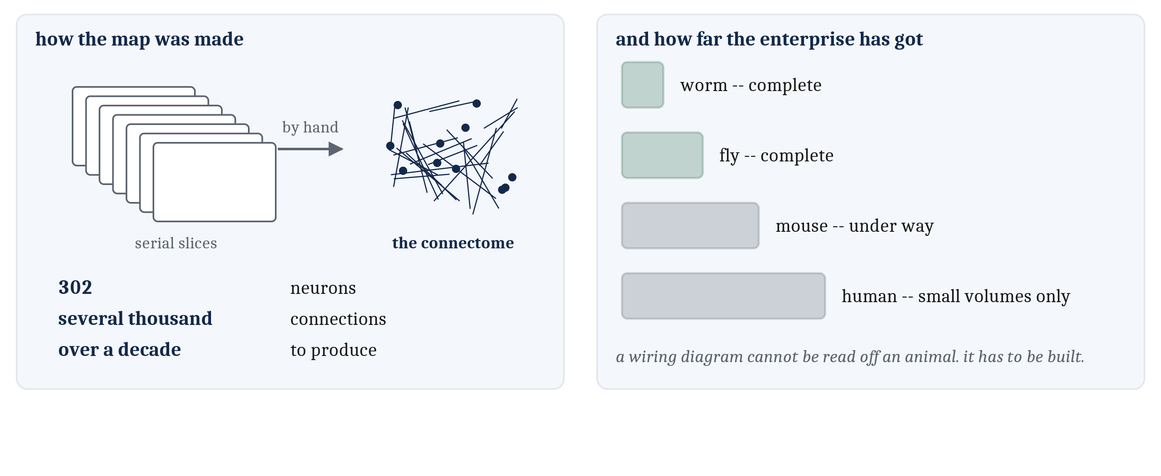
One Animal We Know Completely
302 neurons in the adult hermaphrodite, and every connection between them reconstructed by hand from electron micrographs of serial slices. A connectome is that: every cell, and every connection.
Notes:
For the rest of this lecture we work one animal, and it is the worm from Module 3: *C. elegans*, a millimeter long, with exactly 302 neurons in the adult hermaphrodite form.
Module 3 left you with three things this worm does that one cell could not account for. Weighing a good smell against a bad one. Crossing a barrier that hurts to reach food. And behaving differently when hungry. The first two get their mechanism on the next two slides; the third gets it later in this lecture.
What makes the worm worth all this attention is one fact. Its wiring diagram is complete. Every neuron, every connection, reconstructed — and the word for that is a **connectome**: a complete wiring diagram of a nervous system, every cell and every connection between them.
Now the part that I think is underappreciated. That map was built by hand, from thousands of electron micrographs of serial slices through the animal. All 302 neurons and all several thousand connections. It took over a decade.
Sit with the ratio for a second. Over a decade, for 302 cells. The enterprise has a name, *connectomics*, and it has moved on — a fly has been done, mouse and human work is under way — but the human work is in small volumes rather than whole brains, and those maps are enormously larger.
The lesson is the one the numbers force. A wiring diagram cannot simply be read off an animal. It has to be built, slice by slice.

Slide 4
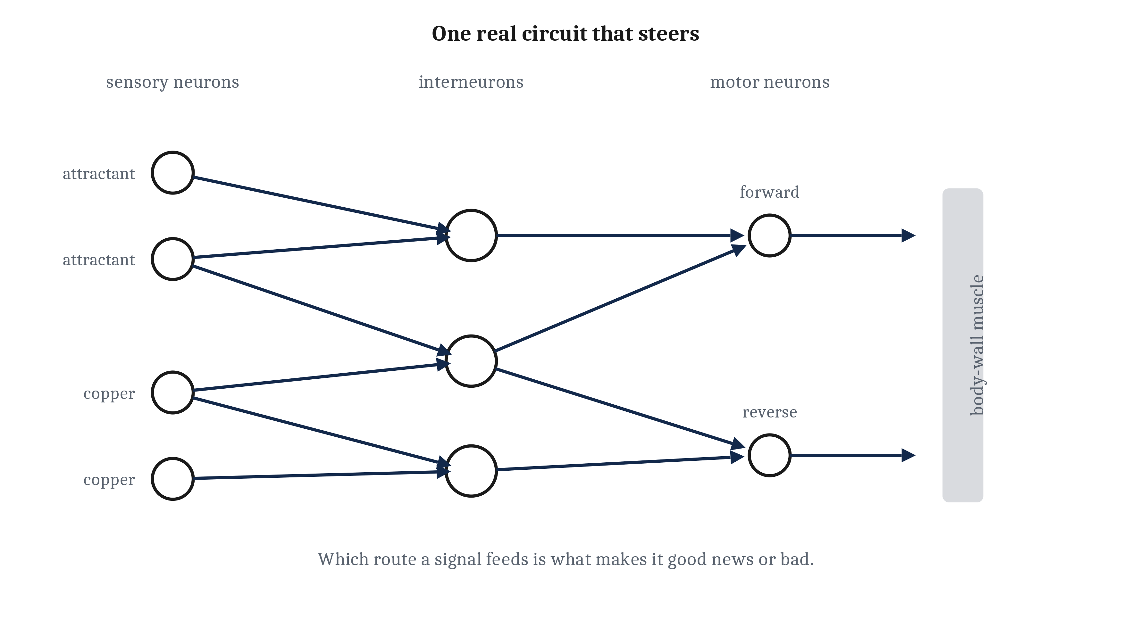
Sense, Combine, Act — in Three or Four Cells
Sensory neurons in the head, to interneurons receiving from several at once, to motor neurons driving the body wall. The worm does not point itself at the food. Going straight is not a behavior — it is what happens when the rule for turning is not met.
Notes:
Here is what the completed map buys us: one behavior, traced end to end.
Three layers. Sensory neurons in the head respond to chemicals in the water. They feed interneurons, each receiving from several sensory neurons at once. The interneurons feed motor neurons, which drive the body-wall muscles. That is sense, combine, act — accomplished in three or four cells.
And the interneurons are doing exactly what we built in the second lecture. Receiving from several sources, weighing what arrives, producing a verdict. We are cashing that section in rather than restating it.
Now the part that surprises people, and I want to set up the wrong answer first so you can feel it being taken away. The intuitive picture is that the worm senses where the food is and points itself at it. It does not do that, and it cannot.
What it does instead is this. Its head sweeps side to side as it moves, and what it works with is the difference between what it senses now and what it sensed a moment ago. If the concentration is rising, nothing triggers a turn, and the worm keeps going more or less straight. If the concentration is falling, the worm turns more often, roughly at random, until it happens to be heading somewhere better.
Read that second sentence again, because there is something strange in it. Going straight is not a behavior the worm produces. It is what happens when the rule for turning is not met.
So steering, in the end, requires remarkably little. A comparison across time, and a rule about when to turn. It does not require knowing where the target is. It does not require trying to go anywhere in particular.

Slide 5
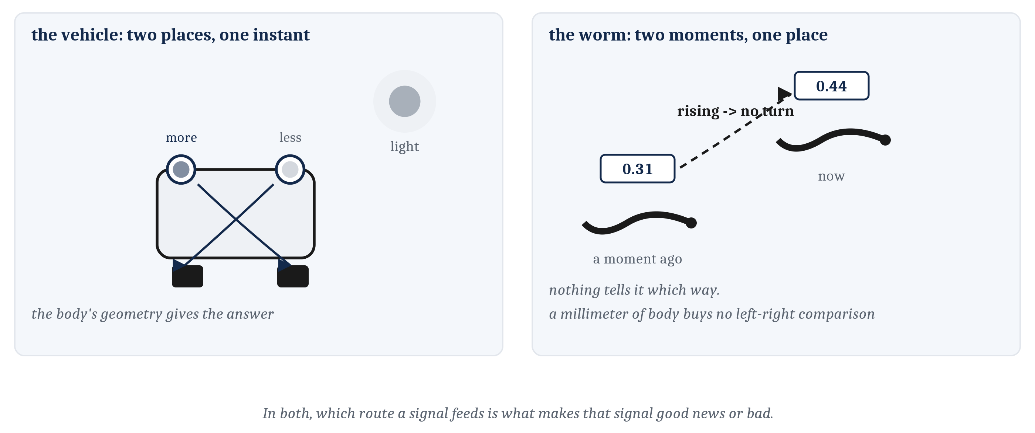
Two Ways to Steer
The vehicle you built compares two places at one instant — its body's geometry delivers the answer. Each side of the worm compares two moments at one place: now against a moment ago. The vehicle is told which way the light is. The worm is not.
Notes:
You built one of the two machines on this slide with your own hands, so this comparison is worth making carefully.
A Braitenberg vehicle carries two light sensors, one on each side, each wired to a motor. Whichever sensor receives more light drives its motor harder, and the body swings. Whether it swings toward the light or away from it depends on nothing more than whether each sensor feeds the motor on its own side or the motor across from it.
That last sentence is the one thing the vehicle and the worm genuinely share. In both, which route a signal feeds is what makes that signal good news or bad news. That is the labeled line from the second lecture, showing up in two very different animals — one of which is not an animal.
Now the difference, and please get this one the right way round because it is the easiest thing here to invert. The vehicle compares **two places at one instant**. Left sensor against right sensor, right now, and the body's own geometry delivers the answer. Each side of the worm compares **two moments at one place**. Now against a moment ago.
The vehicle, in other words, is told which way the light is. The worm is not.
And the reason the worm cannot use the vehicle's trick is almost comically simple. It is a millimeter long. There is not enough distance between one side of a worm and the other for a left-versus-right comparison to carry any information worth having. Its chemosensory wiring does not attempt it.
Cash that out in movement and you get what you actually see under a microscope. When things improve, a smooth wave passes head to tail and the animal glides forward. When things worsen, it reverses and makes a deep bend, and sets off again in some new direction.
One more case, and it is the hard one Module 3 left open. Put food odor on the far side of a strip of copper. Copper is detected by sensory neurons that drive avoidance; the food odor by sensory neurons that drive approach. Both converge on a small number of interneurons receiving from both routes at once, and those interneurons produce a single verdict. The worm crosses when the attractant inputs win. That trade-off, which we described at the computational level in the first lecture and built at the algorithmic level in the second, is now a specific small number of cells.

Slide 6
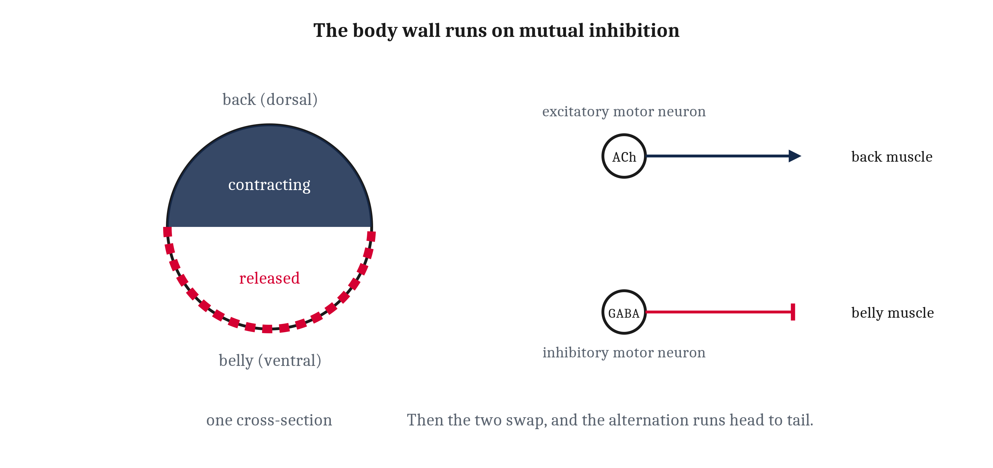
The Two Ends We Kept Skipping
Transduction — converting an event in the world into a change in membrane voltage — is the one thing a sensory neuron does that no other neuron does. At the far end, the neuromuscular junction: the verdict stops being a voltage and becomes a force.
Notes:
Module 3 explained one neuron talking to the next — a transmitter binds, a channel opens, ions cross, the voltage moves. The second lecture of this module built circuits out of that. Both of us skipped both ends, and this slide closes them. The vertebrate version of all this is Module 8; what follows is a sketch.
At the sensory end, the stimulus itself is the key, and different senses use different mechanisms. A touch presses on the membrane and pulls a channel open mechanically. An odor molecule binds a receptor protein on the surface, and a short chain of steps inside the cell opens a channel a moment later. Different keys, different locks.
But notice where they converge. Once the channel opens, touch and smell are the same: ions cross, the voltage moves, and from there the cell behaves like any other neuron. So the part that is genuinely unique to a sensory neuron is narrow, and it has a name. **Transduction** is converting an event in the world into a change in membrane voltage, and it is the one thing a sensory neuron does that no other neuron does.
Now I have to stop and correct something I told you in Module 3, and I would rather do it out loud than let you find it later.
In Module 3 I said a neuron's output is all-or-nothing. In *C. elegans*, that is mostly not true. The worm's genome contains no voltage-gated sodium channels at all, and most of its neurons signal with graded changes in voltage — a larger input producing a larger swing, continuously. Jellyfish do have sodium spikes, and one of the worm's smell neurons has a calcium-based spike, so this is not a claim about invertebrates in general. It is a claim about this animal and a number of other small ones.
Here is what rescues the broader point, and it is worth more than the correction. A threshold is a claim about a *function*: below some level of input nothing happens, above it something does. An all-or-none spike is only one way to build one. A graded signal that stays too small to release any transmitter until the input is large enough builds exactly the same thing. So the thresholds we spent the last lecture on survive intact; what changes is the hardware underneath them.
At the far end, the **neuromuscular junction** — where a motor neuron ends on a muscle cell. Acetylcholine crosses it and opens channels, and the muscle depolarizes much as a neuron would. Then the specifically muscular part: calcium floods in, filaments slide past one another, the fiber shortens and pulls. The verdict stops being a voltage and becomes a force.
And look at how it is wired, because it is an old friend. The worm's muscles run in strips along its length. Excitatory motor neurons release acetylcholine onto the muscle on one side while inhibitory motor neurons release GABA onto the muscle on the opposite side. The body bends. Then the two swap. That is the second lecture's mutual inhibition, implemented in musculature.
One correction to the picture you are almost certainly forming. The two opposed sides are the worm's **back and belly**, not its left and right. A worm lies on its side, so a bend that looks from above like a sweep left and right is, in the animal's own frame, a bend upward and downward.
Lift the same motif one layer up and you get the sentence I want to end on. One small group of interneurons drives the forward wave, another drives the backward one, and the two suppress each other, so only one is in charge at any moment. Which means the rule about when to turn is not written down anywhere in this animal. It is which of two mutually inhibiting groups of cells currently has the upper hand.

Slide 7
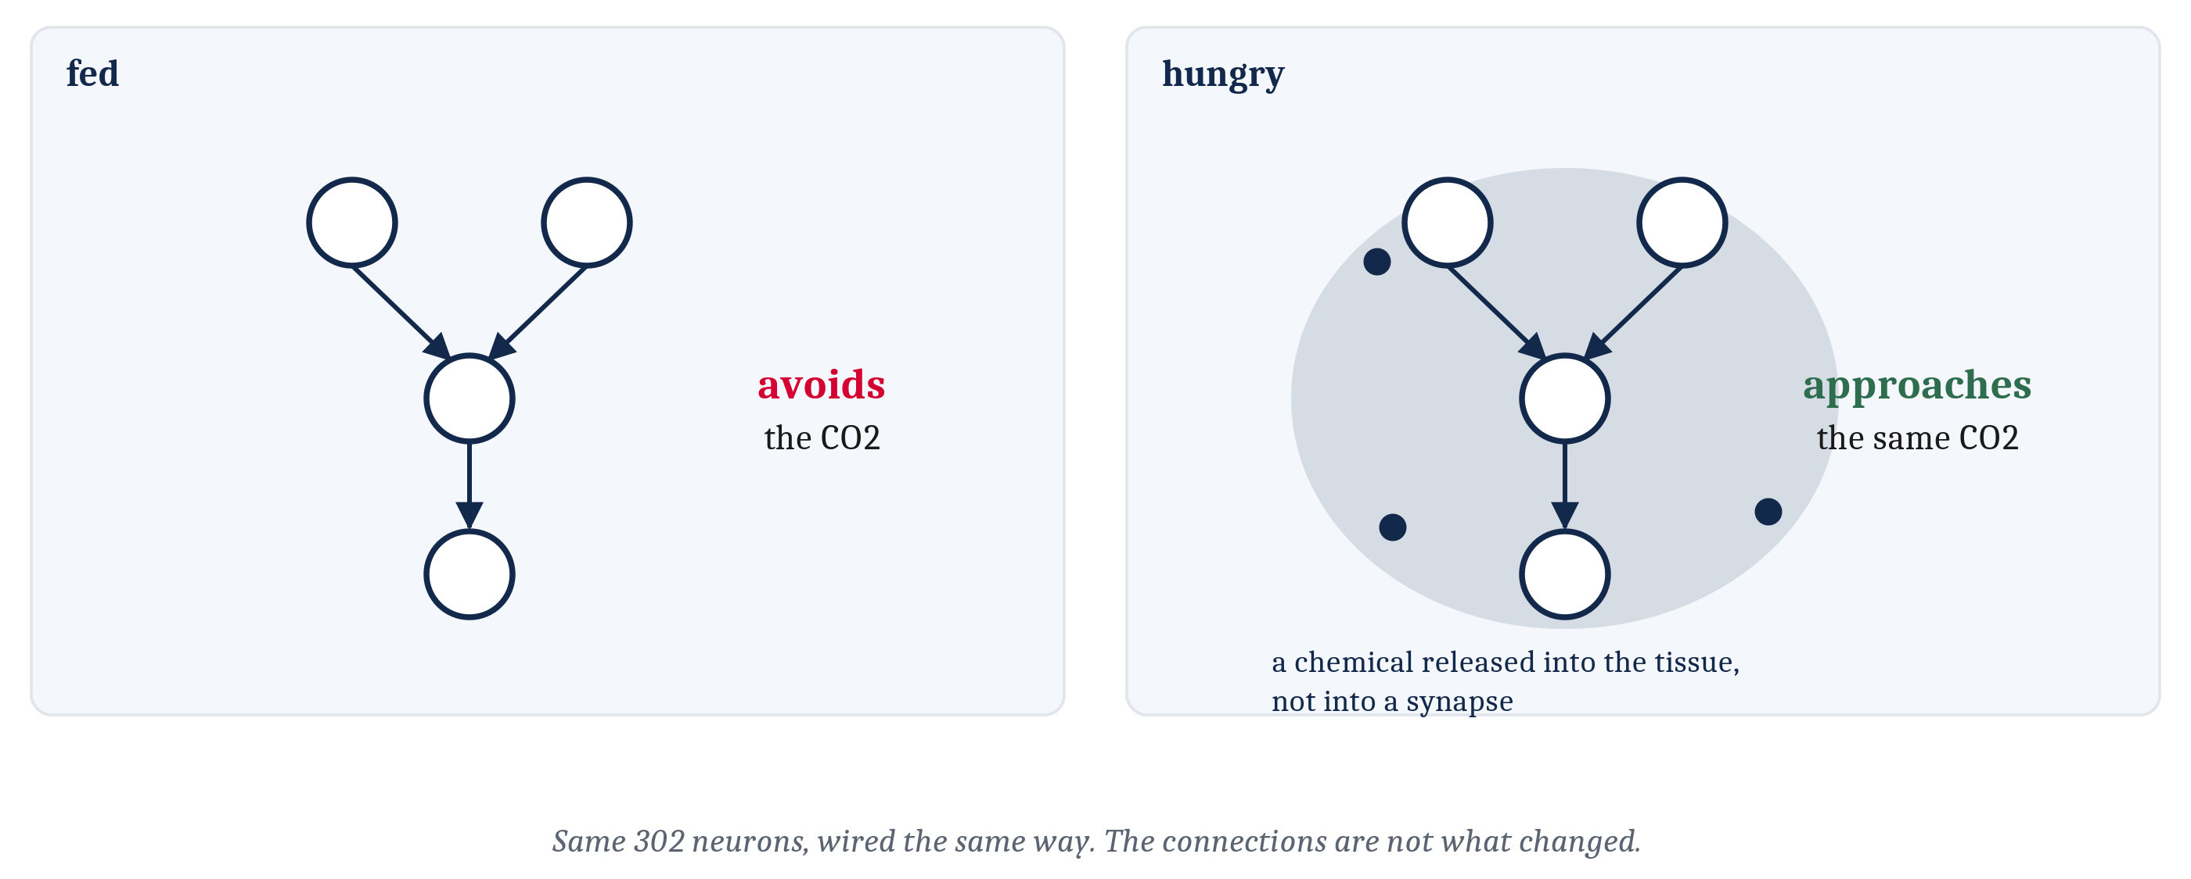
The Map Is Complete, and It Is Not Enough
The worm's wiring has been known for decades and its behavior still cannot be predicted from the diagram. A fed worm and a hungry worm respond to the same molecule in opposite ways — same 302 neurons, wired the same way.
Notes:
We have now explained the worm's circuit end to end. Which makes this the right moment for the most important limitation in the lecture.
The worm's wiring has been completely known for decades. Its behavior still cannot be predicted from the diagram.
The evidence is simple to state. Give the same animal the same input twice and it may do different things. A worm that has just eaten and a worm that has gone hungry for hours will respond to the same molecule in opposite ways — with the same 302 neurons, wired the same way.
So something is varying, and it is not the connections. Which means the diagram is not the whole machine.
Now think back to Module 3, where we set up a trade-off between two ways of signaling. Chemical signaling was the old way: slow, unaimed, and it could not be switched off. Neural signaling was fast, precisely targeted, and switchable, and that is why animals built it.
Here is the move. The old way did not go away.
A **neuromodulator** is a chemical released into the surrounding tissue rather than into a single synapse. It reaches many cells at once. It acts over seconds to minutes rather than milliseconds. And — this is the part that distinguishes it from a neurotransmitter — it carries no message at all.
What it does instead is change what the cells receiving it do with the messages they are already getting. It turns a neuron's sensitivity up or down, making one pathway temporarily easier and another harder.
And that gives us the sentence this slide exists for. Because of neuromodulation, one wiring diagram can behave as several different circuits, depending on what chemicals are currently nearby. The worm's connections do not change when it gets hungry. What changes is the chemistry running through them.

Slide 8
Four Molecules
Not four unrelated chemicals — four ways of moving an animal around the same two-dimensional space we built in the last lecture. Read the third column as a direction of travel, not a destination.
Molecule | What it does | Where it moves the animal | In human life
Dopamine | Drives pursuit of a thing: wanting, and the effort spent getting it | Raises arousal; raises expected valence rather than current valence | Motivation, and what is captured in addiction
Serotonin | Signals satiety and sets the overall tone of the system | Lowers arousal; raises valence toward contentment | Mood and patience; a common target of medication
Norepinephrine | Sets vigilance: how strongly to react to anything | Raises arousal, at either valence | Alertness and startle; arousal set too high in anxiety
Endorphins and other opioids | Carry relief and satisfaction: liking rather than wanting | Raises valence; lowers arousal | Pleasure and pain relief; the target of opioid drugs
Notes:
Four molecules, and I want to frame them before I name them, because a list of four chemicals is exactly the kind of thing that gets memorized and never understood.
These are not four unrelated chemicals. They are four ways of moving an animal around one space — the valence and arousal plane we built in the last lecture. That is why the third column exists.
*Dopamine* drives pursuit. It is the chemistry of wanting a thing and going after it, and of the effort spent getting there. Now the common misperception, and it is worth naming because most people arrive holding it: dopamine is not the chemistry of enjoying the thing once it arrives. Hold that; we come back to it on the last two slides.
*Serotonin* tracks satiety and the overall tone of the system. There is a lovely piece of worm evidence for this: a hungry worm that finds bacteria to eat slows almost to a stop, and that slowing depends on serotonin.
*Norepinephrine* sets arousal and vigilance — the dial for how strongly an animal reacts to anything at all. Note that I said *in vertebrates*. That scoping is going to matter in two slides and I am not going to explain it yet.
And *endorphins*, along with the other opioids the body makes for itself, carry relief and satisfaction. These are the chemistry of liking rather than wanting — which is precisely why the two can come apart.
One instruction about the third column, from the chapter itself. Read it as a direction of travel, not as a destination. Where an animal ends up depends on where it started.
And read the fourth column as the answer to a question you may reasonably be asking, which is why a lecture about a millimeter-long worm has anything to do with you.

Slide 9
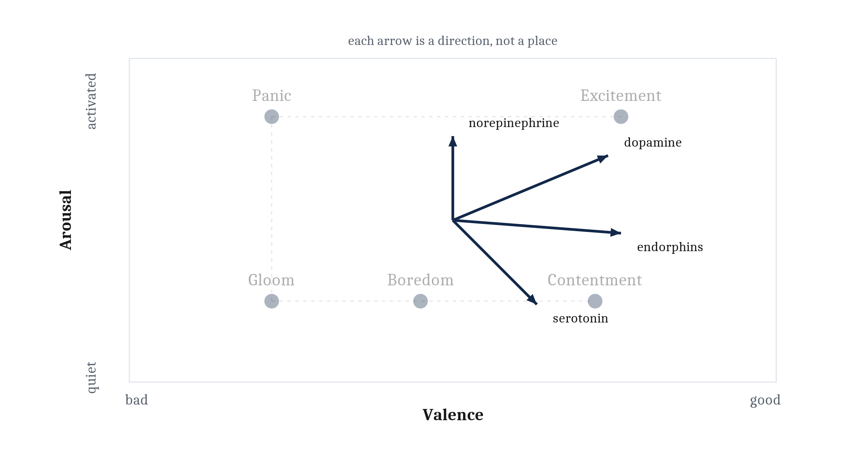
Directions, Not Locations
The same affect plane, with the four drawn as arrows from a common point rather than as positions. A neuromodulator does not put an animal somewhere — it moves the animal from wherever it already is.
Notes:
Here is the same plane from the last lecture, and the four molecules drawn onto it — but drawn as arrows rather than as points, and the difference is the whole content of the figure.
A neuromodulator does not put an animal somewhere. It moves the animal from wherever it already is. Dopamine on a quiet animal and dopamine on an already agitated one do not produce the same state, because they start from different places and the arrow is the same.
Look at the pairs. Dopamine and norepinephrine both raise arousal, and they differ in what they do to valence. Serotonin and the endorphins both raise valence, and they differ in what they do to arousal. The four are not arbitrary; they roughly span the space.
And this is why the space was worth building in the first place. In the last lecture I argued for a space over a list on the grounds that a list only holds what someone thought to name. Here is the second dividend. Because affect is a space, a chemical can be described as a *direction* — and four directions cover a great deal more ground than four named states ever could.

Slide 10
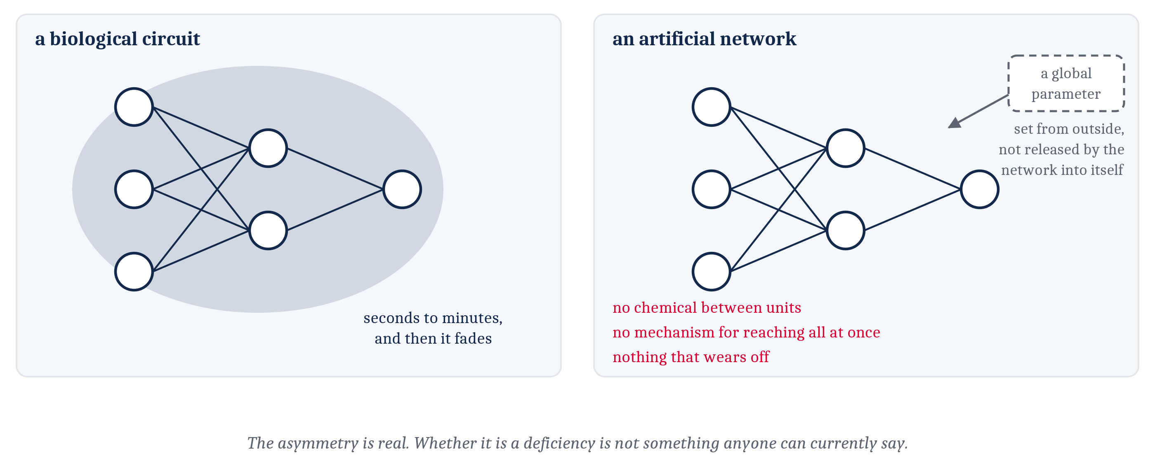
Where the Comparison Finally Breaks
An artificial network has weights and activations, and that is all it has. Nothing corresponds to a chemical released into the space between units, reaching all of them at once, and then wearing off.
Notes:
The comparison between biological and artificial systems has held up remarkably well for three lectures. This is where it breaks, and it is worth being precise about where.
In Module 3 we located one divergence, and it was about materials: the same algorithm — weighted input summed into an output — implemented in radically different stuff. This second one sits higher up.
An artificial network has weights and activations, and that is all it has. Three things follow. Nothing in it corresponds to a chemical released into the space between units. It typically has no mechanism for reaching all units at once, changing how every one of them responds for a stretch of time. And nothing in it wears off.
There is a nearest analogue, and it is worth taking seriously before dismissing it: a globally set parameter, a number applied across the whole network at once. But look at where it comes from. It is set from outside, by whoever is running the system. It is not released by the network into itself in response to what is happening to it. That is a real difference and not a quibble.
Now I am going to do something I have tried to do throughout this course when it is warranted, which is to stop rather than resolve. The asymmetry is real. Its implications are unclear in both directions. It is not obvious that artificial systems are missing something they need. And it is not obvious that they are not.

Slide 11
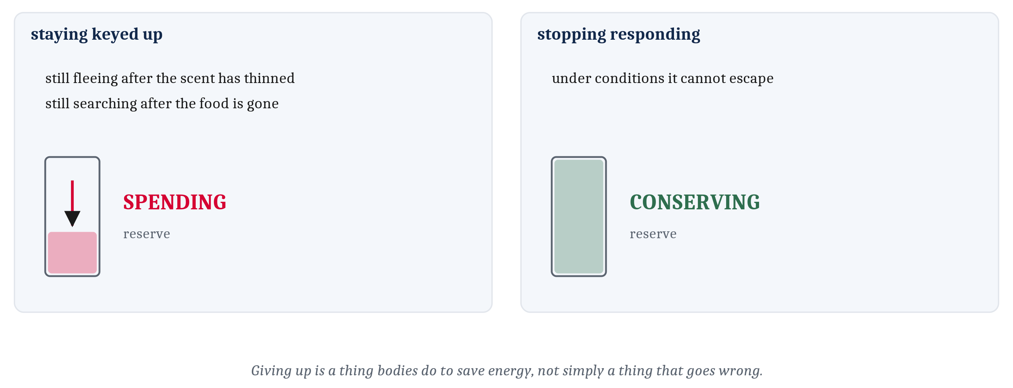
What a State Costs
A chemical in the tissue keeps a circuit tuned one way for minutes — which has a consequence the wiring diagram does not show. Staying keyed up is spending; stopping responding is conserving.
Notes:
We now have the mechanism for the fourth demand, so it is worth asking what it costs — which is the implementational level's second question, and we have not asked it yet in this lecture.
Recall what a persistent state buys. It is what lets an animal keep fleeing after the scent has thinned, and keep searching after some of the food is gone. That is why persistence was worth having in the first place. And neuromodulators are an important part of how a small animal maintains one: a chemical released into the tissue keeps a circuit tuned one way for minutes, long after the event that set it off.
Holding a state that way has a consequence the wiring diagram does not show, and it is metabolic.
Reacting strongly is expensive. So an animal that stays keyed up is spending, continuously. And an animal that stops responding — under conditions it cannot escape — is conserving.
I want to draw the conclusion carefully, because it is the one moment in this module where the biology touches something a lot of people have personal experience of. That is the non-pathologizing way to understand a great many behaviors, in animals and in humans. Giving up is a thing bodies do to save energy. It is not simply a thing that goes wrong.
I am not making a clinical claim, and the chapter does not either. What I am saying is that a behavior which looks like failure from the outside can look like an accounting decision from the inside.

Slide 12
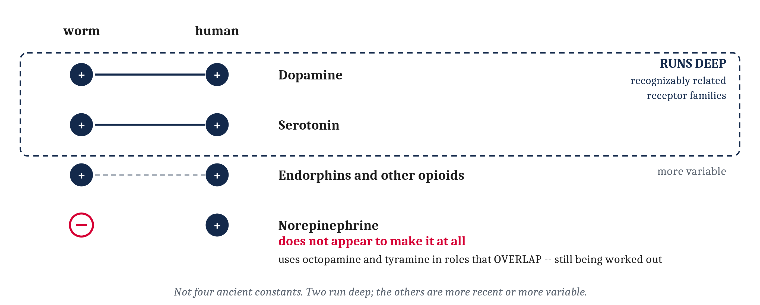
How Much of This Is Actually Ours
Dopamine and serotonin are present in both, acting through recognizably related receptor families. The worm does not appear to make norepinephrine at all. Two run deep; the others are more recent or more variable.
Notes:
A lecture about a millimeter-long worm bears on human motivation because some human chemistry is very old. That is the premise. Now the qualification, and I want to give it in the same breath rather than as a footnote, because the qualification is the interesting part.
The conservation is partial.
Dopamine and serotonin are the strong cases. Both are present in the worm and in us, and they act through receptor families that are recognizably related across that evolutionary distance. That is a real finding and it is not a small one.
But hold the resemblance loosely. A worm slowing down on a bacterial lawn and a person losing interest in a meal are not the same event, and nothing here says they are.
Norepinephrine is the weak case, and this is the fact I most want you to leave with, because it is the one that gets smoothed over. The worm does not appear to make norepinephrine at all. It uses two other amines, octopamine and tyramine, in roles that overlap with the vertebrate arousal system — and the details are still being worked out.
Notice the hedges in that sentence. *Does not appear to.* *Overlap.* *Still being worked out.* Those are the chapter's and they are load-bearing. Strip them and a careful claim becomes a false one.
So the four molecules are not four ancient constants. Two run deep. The others are more recent, or more variable.
And that sorting is not a caveat, it is a result — because it is exactly what Module 2's comparative method is for. Shared machinery is evidence of shared ancestry. Different machinery doing a similar job is evidence of something else, often shared constraints. Telling those two apart is the whole business of comparative work, and here we have just done it on four molecules.

Slide 13
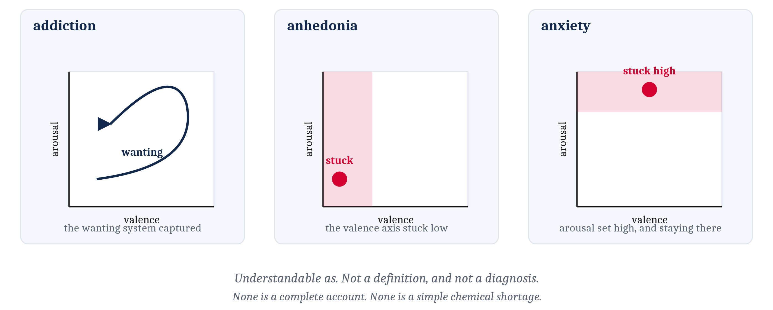
Motivation, Mood, and Alertness
Addiction as the wanting system captured. Anhedonia as the valence axis stuck low. Anxiety as arousal set high and staying there. None of these is a complete account — and none of them is a simple chemical shortage.
Notes:
Motivation, mood, and alertness in ordinary human life run on these systems. So here are three things in the chapter's own built vocabulary — and then two retractions, which matter as much as the readings do.
Addiction is understandable as the wanting system being captured, and driven by something that does not feed it.
Anhedonia — the loss of the ability to enjoy things — is understandable as the valence axis being stuck in a low state, so that nothing registers as worth pursuing.
And anxiety is understandable as arousal set high, and staying there.
Notice that each of those is a structural description. Each one says where in the space something has gone, or which direction has been hijacked. That is what it looks like to describe a condition with the machinery we have spent three lectures building.
Now both retractions, and I would rather over-say these than under-say them.
The first. None of these readings is a complete account of any of those conditions, in humans or in worms. They are ways of understanding, not definitions and not diagnoses.
The second, and this is the one I will argue for. None of these conditions is a simple chemical shortage. The phrase *chemical imbalance* has entered ordinary speech, and it suggests a level that has dropped and could be topped up. That is not what anyone finds when they look.
What they find is much closer to what this module has been describing. Systems with feedback. Systems with states that persist. Systems with histories. And systems that go wrong in ways that match their structure — which is a harder thing to say and a much more useful one.

Slide 14
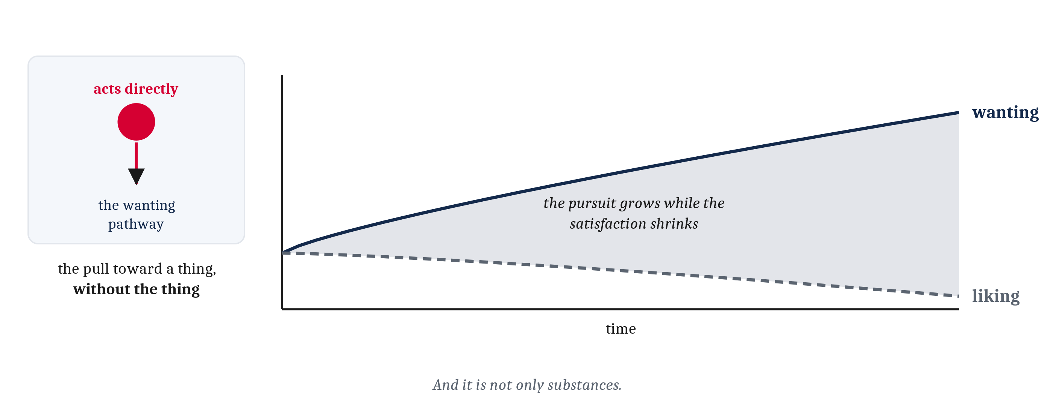
A System That Assigns Value Can Be Fooled About Value
Anything acting directly on the wanting chemistry produces the pull toward a thing, without the thing. When wanting and liking come apart, the pursuit can grow while the satisfaction shrinks.
Notes:
One last consequence, and it follows from everything rather than introducing anything new.
A system that assigns value is a system that can be fooled about value.
Here is the mechanism, and it is short. Anything that acts directly on the wanting chemistry — meaning dopamine and its receptors — produces the pull toward a thing without the thing. The pursuit is manufactured at the point where pursuit is decided, rather than arriving through the senses from something in the world.
That is what addictive substances do. And now the distinction I asked you to hold from the four-molecules slide finally pays off: it is why wanting and liking can come apart.
When they come apart, that is not a curiosity. It is the center of the problem. The pursuit can grow while the satisfaction shrinks — and a person in that state is not enjoying anything more, they are wanting it more.
And it is not only substances. Any arrangement that reliably triggers pursuit can sit on the same circuit. Things designed to hold attention sit on it, whether or not anyone intended them to — and I want to be careful there, because that is a claim about what the circuit responds to, not an accusation about anyone's intentions.
With that, steering has been answered at all three levels. Why it was worth having. What arrangements compute it. And what tissue and chemistry run it.

Slide 15
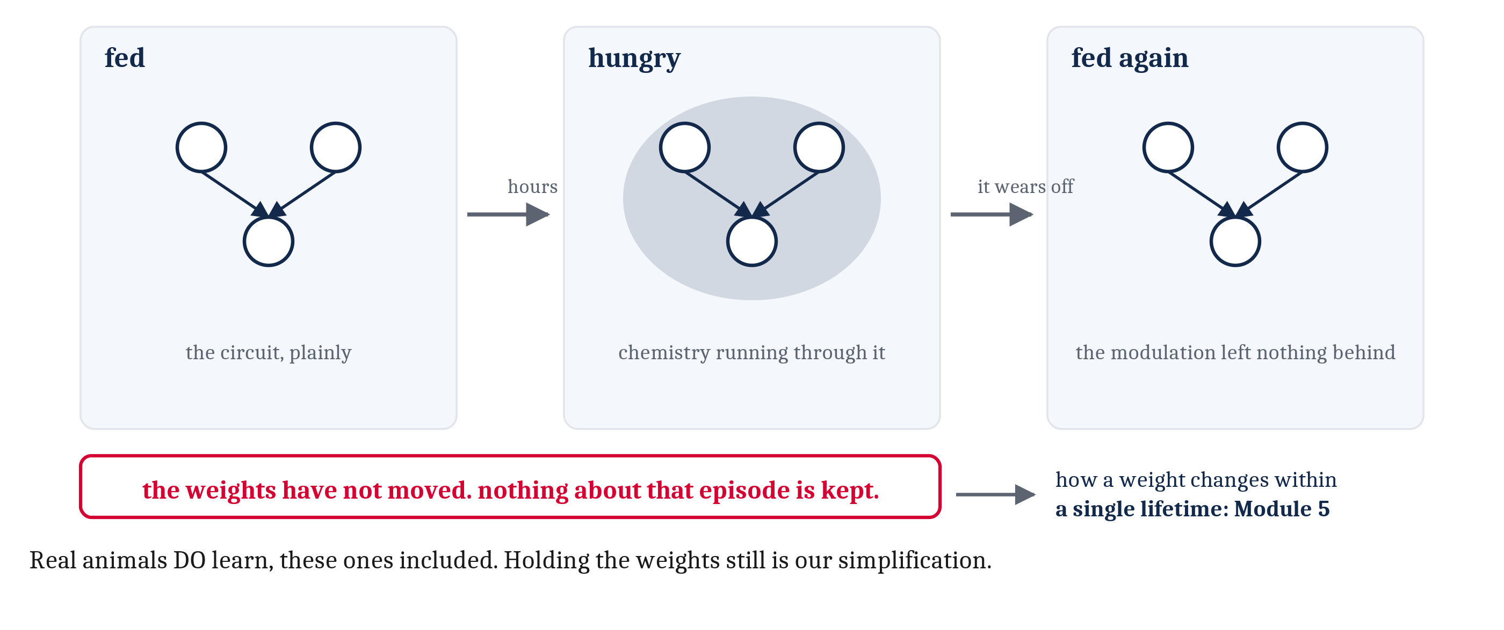
What Wiring Made Possible, and What It Still Cannot Do
Good and bad are verdicts an arrangement assigns. The neuromodulation that looked like the missing flexibility is not learning — it leaves nothing behind. But the fixed weights are ours, not the animals'. Real animals learn, these ones included.
Notes:
We have examined one object three times: an arrangement of neurons, which we called a neural circuit.
The computational answer was steering. An animal that moves in a direction has to settle which direction, and settling a direction demands evaluating what arrives, combining signals that disagree, committing to one action, and letting the animal's own condition change the verdict.
The algorithmic answer was a short list of wiring patterns. Convergence and divergence. Weights against a threshold. Lateral inhibition, mutual inhibition, and recurrent feedback loops.
And the implementational answer is this lecture: a net of neurons condensing into rings and ganglia and then into a front end, a worm whose diagram is complete, and a handful of chemicals released into the tissue that retune the whole arrangement for minutes at a time.
Which lets me restate the module's claim as a result rather than a promise. Good and bad are verdicts an arrangement assigns, rather than properties the world provides. The value of an input comes from what a cell is wired to — and also from the chemistry currently running through the circuit, which decides how much any of it matters at this moment.
On the machines: the demands are the same and the wiring patterns are very nearly the same, which is why one set of diagrams served for both. The chemistry is not, and neither are a lot of the implementational details. Whether that absence is a deficiency is not something anyone can currently say.
Now the last thing, and it is a near miss on purpose.
Neuromodulation looks, at first, exactly like the thing missing from every arrangement in this module. The same wiring produces different behavior from one hour to the next. Surely that is the flexibility we said these circuits lacked.
It is not, and here is the test. A hungry worm and a fed worm run the same circuit with different chemistry. Once the chemistry wears off, the modulation has left nothing behind. The weights have not moved. Nothing about that episode is kept.
So the circuits we have built in this module meet the world with a repertoire that was set before the encounter began. They meet it the same way on the thousandth encounter as on the first.
Real animals do not, and I want to be exact about this, because the tidy version of the story is false. *C. elegans* learns. Cnidarians learn. The fixed weights are ours, not theirs — leaving learning out of this module was a choice we made, because a circuit is very much easier to understand while its numbers hold still. Module 5 is where the numbers start to move.
How a weight changes within a single lifetime is Module 5, and we start it next. Module 6 scales the arrangement up into a vertebrate brain. Module 7 asks what a single decision boundary cannot separate. And in Modules 11 and 12, value comes back, once decisions stop being reflexive.

Slide 16
Image Sources (1 of 2)
Slide | Image | File | Licence | Source
2 | Four degrees of concentration | fig-cephalization.png | CC BY 4.0 | Jon Willits — drawn for the Module 4 reading · own work
3 | What a complete wiring diagram cost | fig-connectome-scale.png | CC BY 4.0 | Jon Willits — drawn for this lecture · own work
4 | The chemotaxis circuit, surface to muscle | fig-worm-circuit.png | CC BY 4.0 | Jon Willits — drawn for the Module 4 reading · own work
5 | Two places at one instant, and two moments at one place | fig-two-ways-to-steer.png | CC BY 4.0 | Jon Willits — drawn for this lecture · own work
6 | The body wall as mutual inhibition | fig-motor-alternation.png | CC BY 4.0 | Jon Willits — drawn for the Module 4 reading · own work
7 | One wiring diagram, two behaviors | fig-same-wiring-two-behaviors.png | CC BY 4.0 | Jon Willits — drawn for this lecture · own work
9 | The four neuromodulators as directions on the affect plane | fig-modulator-space.png | CC BY 4.0 | Jon Willits — drawn for the Module 4 reading · own work
10 | What an artificial network has, and what it does not | fig-the-divergence.png | CC BY 4.0 | Jon Willits — drawn for this lecture · own work

Slide 17
Image Sources (2 of 2)
Slide | Image | File | Licence | Source
11 | The metabolic ledger of a persistent state | fig-the-ledger.png | CC BY 4.0 | Jon Willits — drawn for this lecture · own work
12 | The four, sorted by how conserved they are | fig-conservation.png | CC BY 4.0 | Jon Willits — drawn for this lecture · own work
13 | Three conditions, read structurally | fig-three-conditions.png | CC BY 4.0 | Jon Willits — drawn for this lecture · own work
14 | Wanting and liking, coming apart | fig-hijacked.png | CC BY 4.0 | Jon Willits — drawn for this lecture · own work
15 | The near miss, and the hand-off | fig-nothing-is-kept.png | CC BY 4.0 | Jon Willits — drawn for this lecture · own work

