Slide 1

BCOG 100
Course Overview
Lecture 0 — What Is Brain and Cognitive Science?
Notes:
Welcome.
I am Jon Willits, and I will be teaching this course.
Let me say a little about why I am the person standing up here, because it shapes what this course is going to be.
I am a cognitive scientist.
My own research is on how people learn and store meaning — how a word like “orange” comes to mean anything at all, and how that knowledge gets built out of nothing but ordinary experience.
I got there by a route that is worth describing, because the route is basically this course.
My undergraduate degree was in Computer Science, during the “.com boom” days of the late 1990s.
I was part of a startup that made software for making websites.
But it was all so boring.
And I didn’t want to go work for Pets.com.
I didn’t really even want to make a lot of money.
I wanted to do something interesting.
I got interested in AI.
Which in the year 2000 was, shall we say, pretty unintelligent.
I wanted to figure out how to make AI better, and I decided instead to study the only working example of intelligence we had: living organisms.
I got my PhD studying how humans learn and represent knowledge.
I studied adults, and I studied 9-month-old babies.
And I continued to study machines.
I was trained in building neural networks, the kind of algorithm that powers most of what is called AI today.
But I used them to try to predict and explain human behavior.
Now those types of AI systems have gained enormously in power and prominence.
And I am one of the world’s experts in how they work: what they are good at and not good at, and the ways in which they learn and think like humans and the ways they do not.
So I have spent my career sitting between four things: how brains work, how minds work, how children learn, and how machines that appear to think actually do it.
Notice what I am not.
I am not a neuroscientist.
I am not a philosopher.
I am not an AI engineer.
I have to read all of their work in order to do mine.
That is not a personal failing, it is the situation this entire field is in.
It is exactly why I think this material is worth teaching as one subject rather than as five separate ones.
The last thing I will say is that I still find this stuff genuinely astonishing.
I have been doing it for a long time and it has not worn off.
If any of that comes through in the next fifty minutes, that is the main thing I am hoping for today.

Slide 2
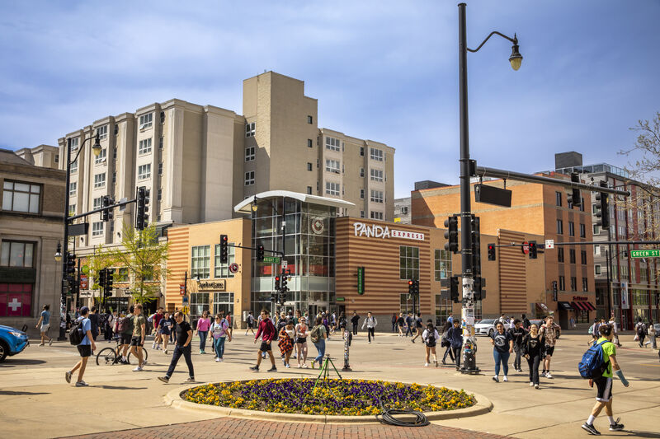
Look At What You Can Do
Notes:
I want to start the semester without telling you anything about the course.
Look at the first picture.
That is Green Street on an ordinary afternoon.
Your visual system just carved that image into ground and sky, buildings and people, near and far.
It found maybe forty humans in it, and it did that in about a tenth of a second.
Nobody had to teach you how to do this.

Slide 3
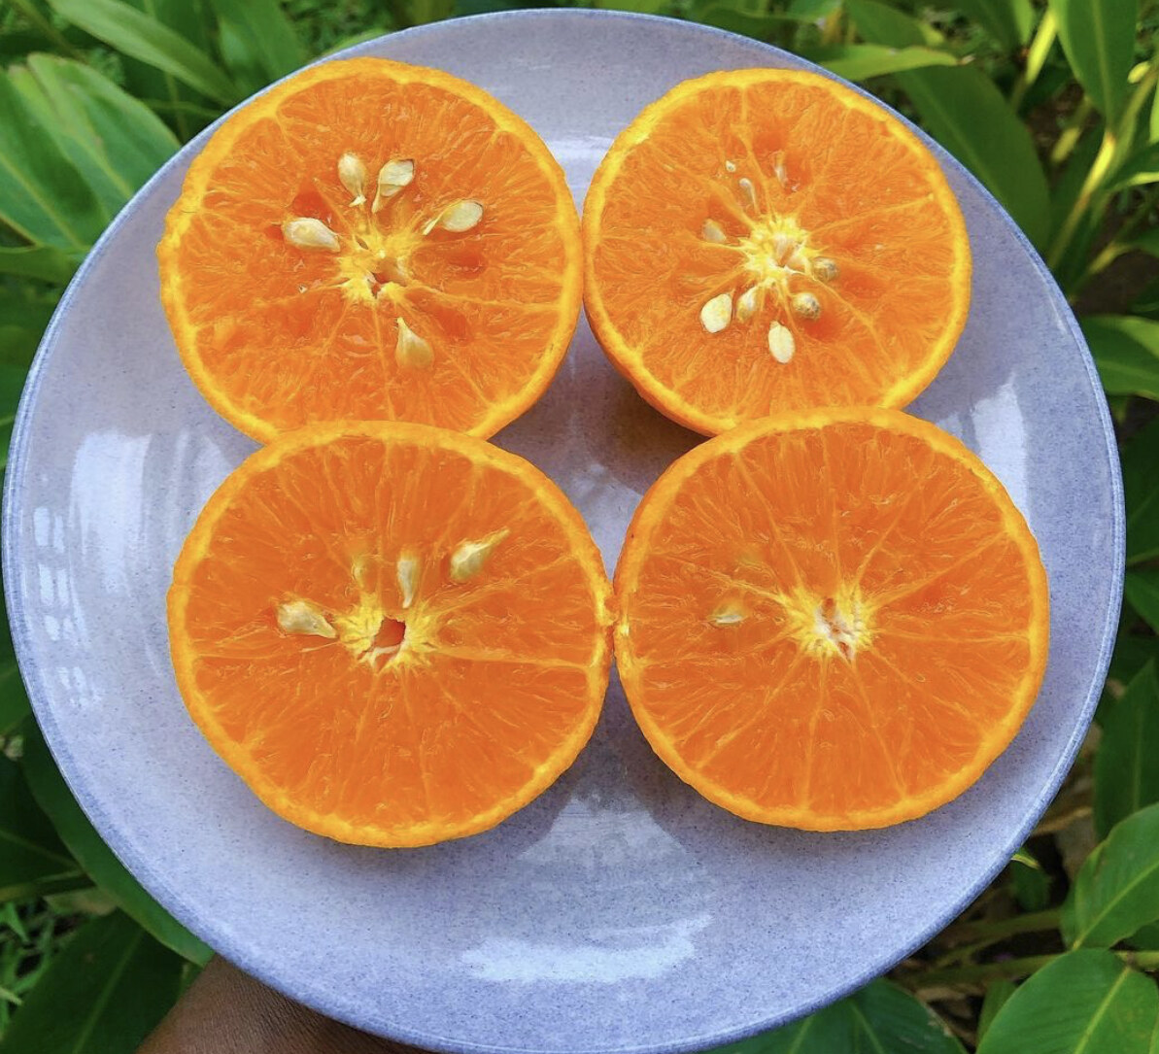
Look At What You Can Do
Notes:
Second picture.
Oranges.
Notice that recognizing them was not the only thing that happened.
Some of you got a little hungry.
Why should identifying an object come bundled with wanting it?
Hold onto that, because it turns out to be a deep question about what minds are for.

Slide 4
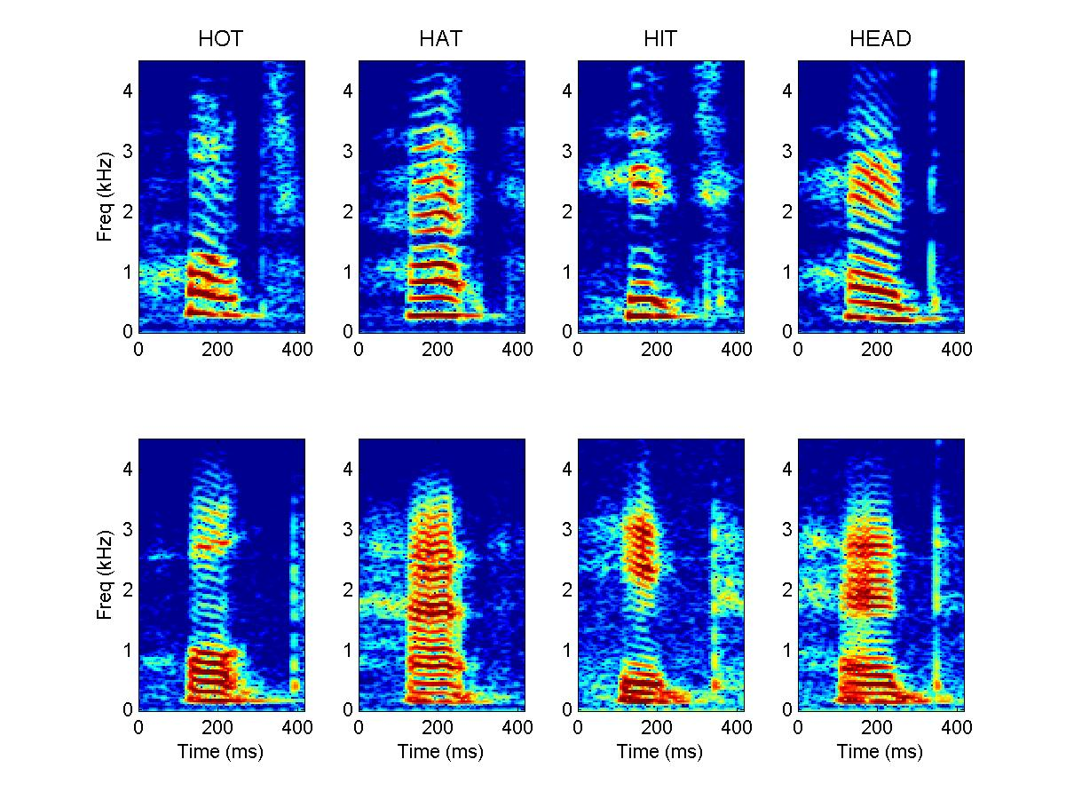
Look At What You Can Do
Notes:
Third picture.
Those are spectrograms — pictures of sound.
Top row is one person saying HOT, HAT, HIT, HEAD.
Bottom row is a different person saying the same four words.
Look at any column: same word, two speakers, and the pictures look nothing alike.
Now look across a row: different words from one speaker that look more similar to each other than the matching pair does.
So the acoustic signal does not contain a stable thing called "HOT."
And yet you almost never struggle to tell HOT from HAT, when spoken by different people.
Something in your head is finding a category that is simply not there in the sound.

Slide 5
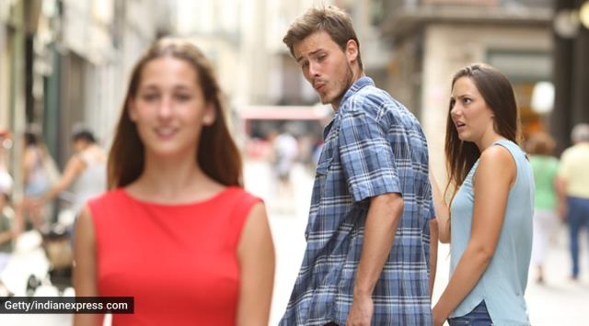
Look At What You Can Do
Notes:
Fourth picture.
Everybody in this room got the joke in under a second.
That required reading three faces, inferring what each person wants, inferring what each knows about the others, and finding it funny.
We have no idea how to build a machine that does that reliably.
Every one of these is a puzzle.
This course is about how those puzzles get solved.

Slide 6
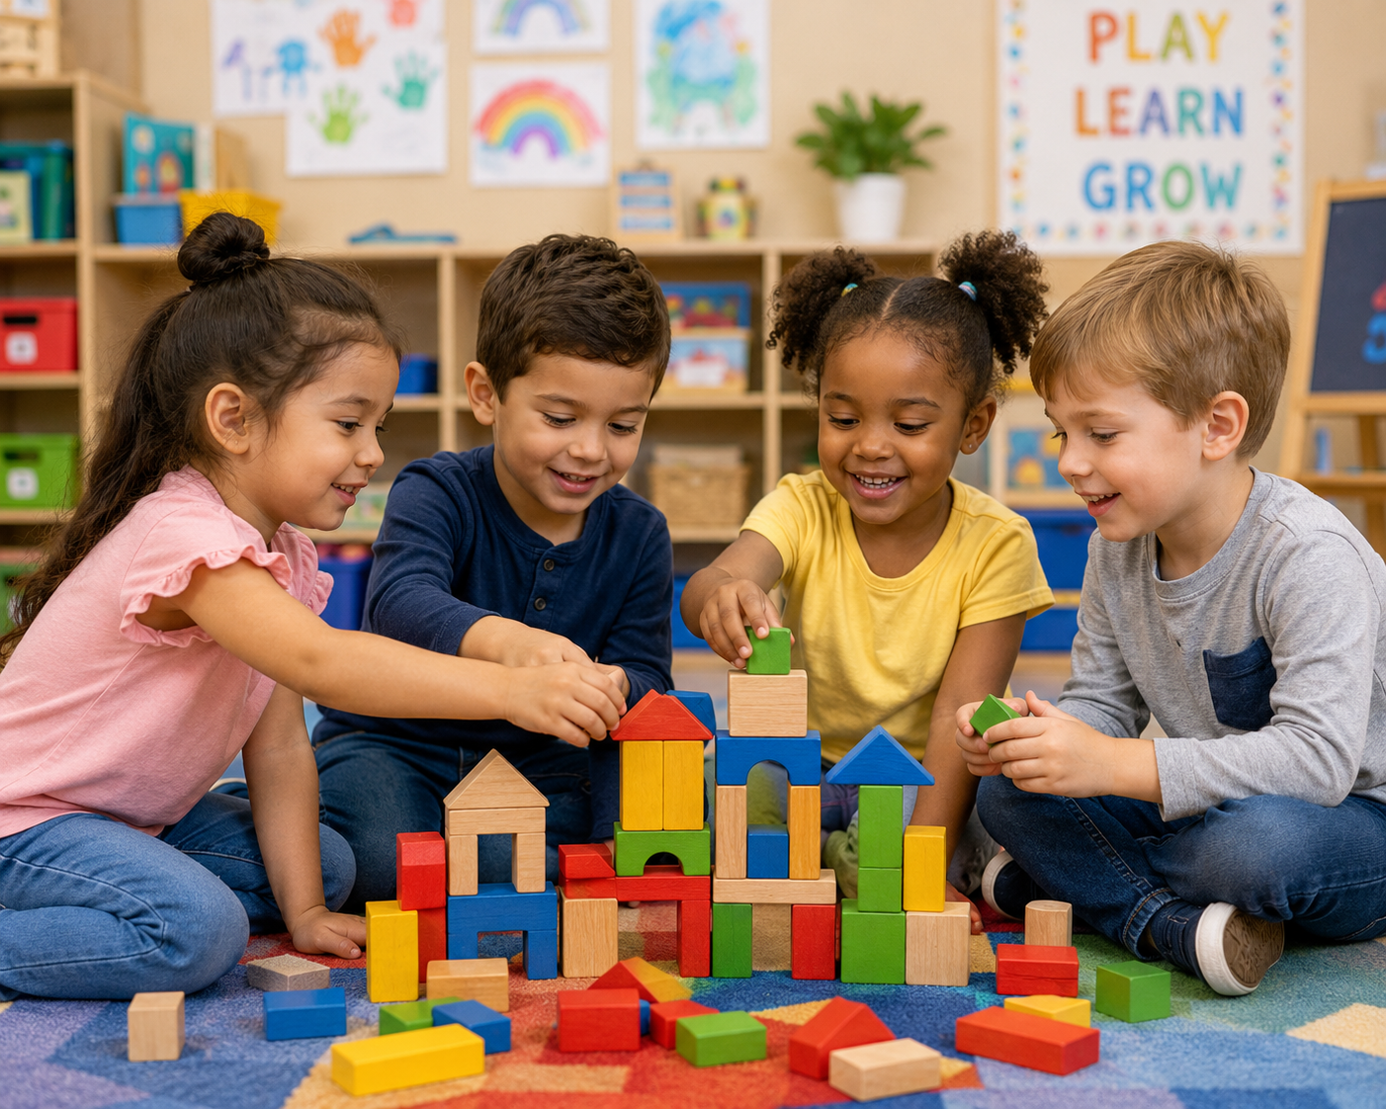
And This One Is Three Years Old
Notes:
Here is the one that most people take for granted.
By about age four, a child has mastered the grammar of their native language.
No lessons.
No rules written down.
No one systematically correcting them.
Just the talk going on around them.
And while doing that, they are also learning that blocks fall down and not up, that the other child has their own goals, and that if they want the red block they might have to ask. And that the other child might say no or even get angry.
We have spent decades and billions of dollars trying to get machines to do all of these different things.
A four-year-old does it practically for free.

Slide 7
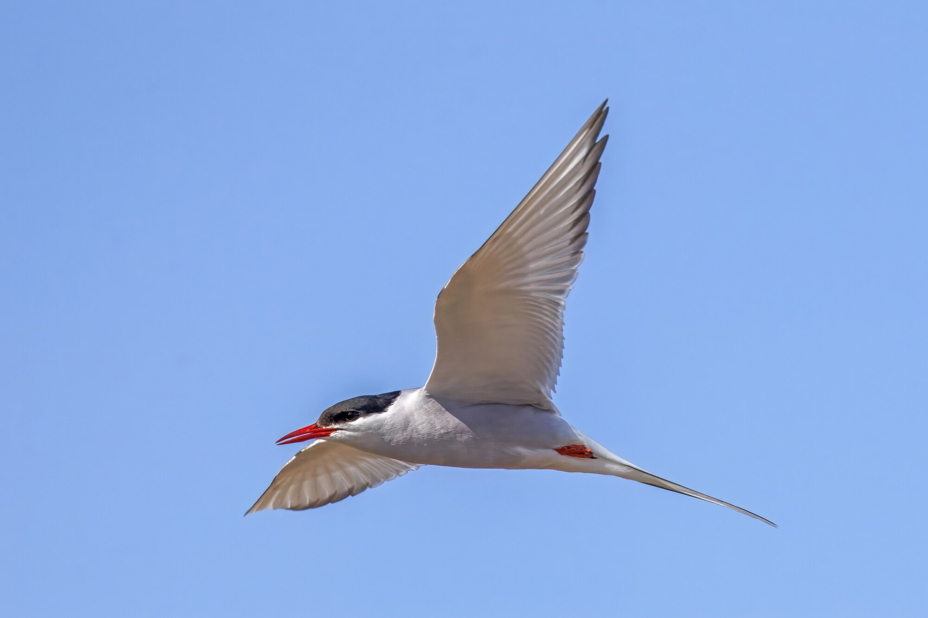
Minds Built Nothing Like Ours
Notes:
Now let us leave humans entirely.
An Arctic tern flies from the Arctic to the Antarctic and back every year.
Tens of thousands of miles.
It arrives at feeding grounds it has never seen.

Slide 8
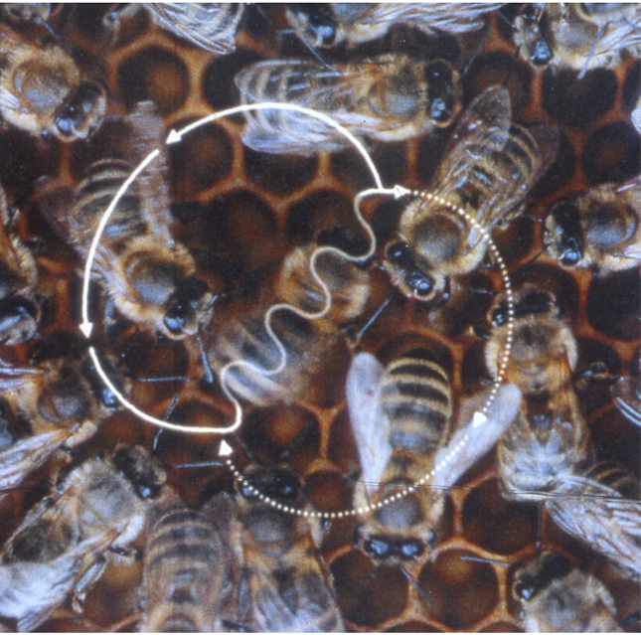
Minds Built Nothing Like Ours
Notes:
A honeybee finds a good patch of flowers, comes home, and dances.
The angle of the dance tells the other bees which direction to fly, relative to the sun.
The duration tells them how far.
That is a symbolic communication system, in an animal with fewer than a million neurons.

Slide 9
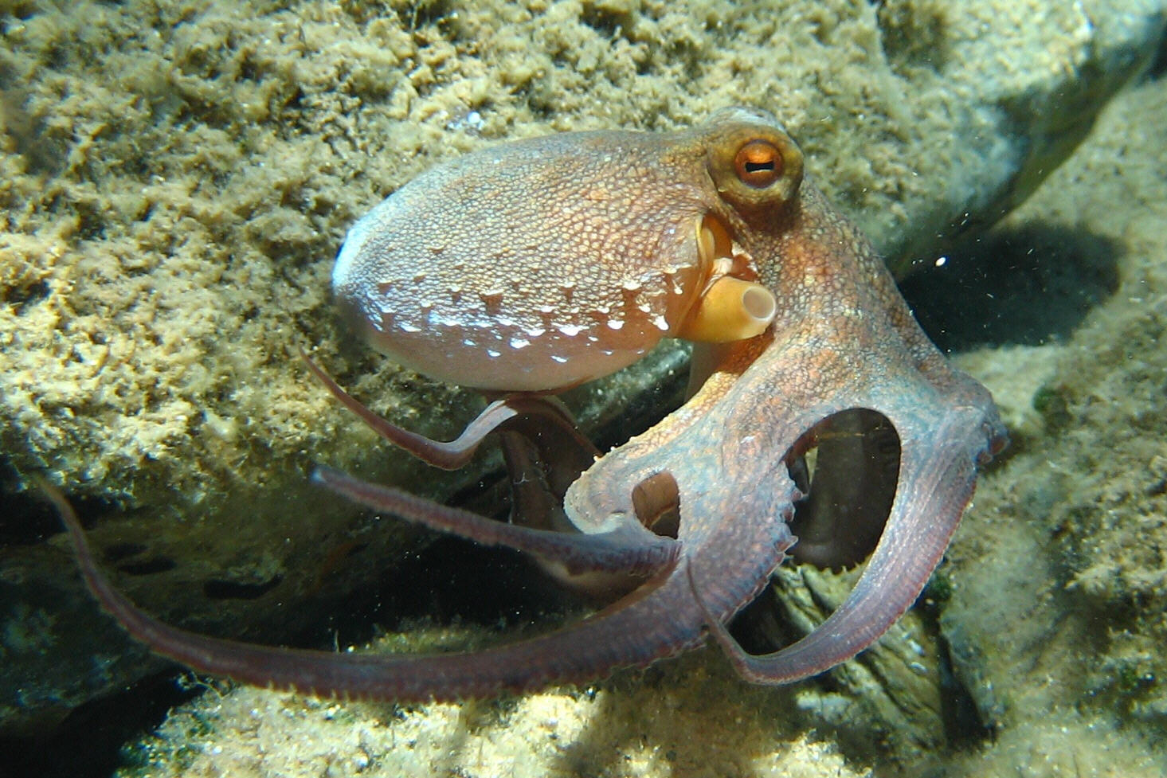
Minds Built Nothing Like Ours
Notes:
An octopus works out how to unscrew a jar to get the crab inside.
Most of its neurons are not in a central brain at all.
They are distributed through its arms.
When an octopus solves that problem, it is not obvious *who* solved it.
None of these animals is built like us.
All of them are doing something we would call intelligent.
What does intelligence mean, if it can encompass so many different abilities and be built in so many different ways?

Slide 10
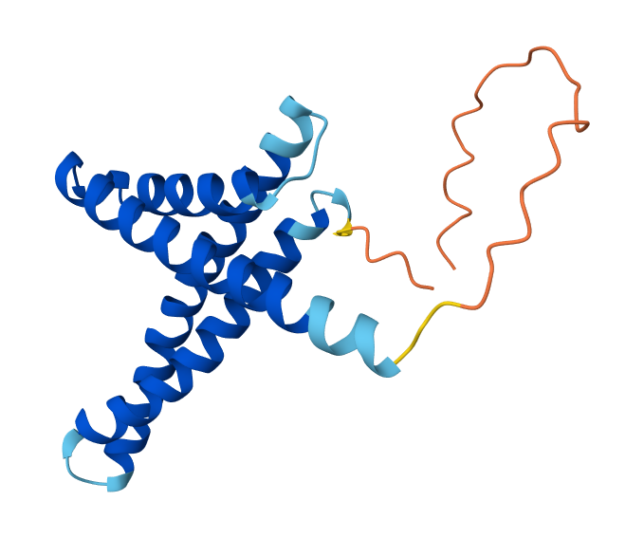
Minds With No Neurons At All
Notes:
And now systems with no neurons whatsoever.
The first reads a protein's chain of amino acids and predicts the three-dimensional shape it folds into.
Biologists worked on that problem for fifty years.

Slide 11
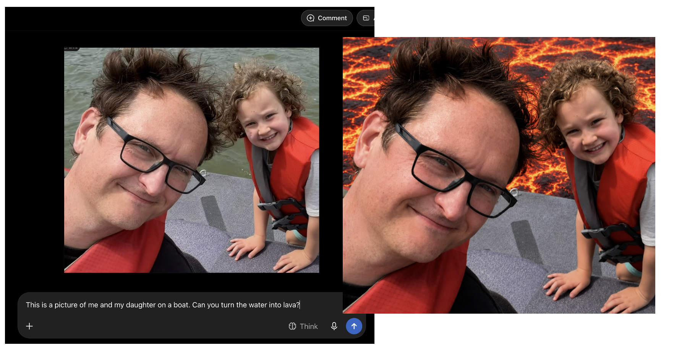
Minds With No Neurons At All
Notes:
The second one is mine.
That is a real photograph of me and my daughter on a boat.
I gave it to a model with one sentence — turn the water into lava — and it did.
Look at the second picture and notice what had to be got right: the light on our faces, the reflections, the fact that we are not on fire.
That scene has never existed anywhere, and there it is.

Slide 12
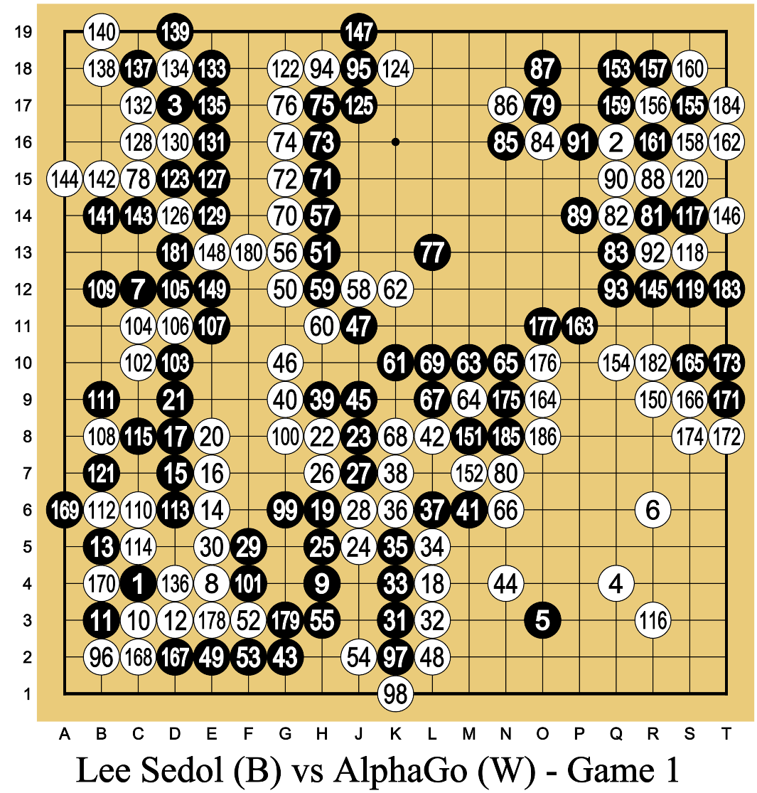
Minds With No Neurons At All
Notes:
The third was given the rules of Go and nothing else.
It taught itself by playing against itself until it could beat the best humans alive.

Slide 13
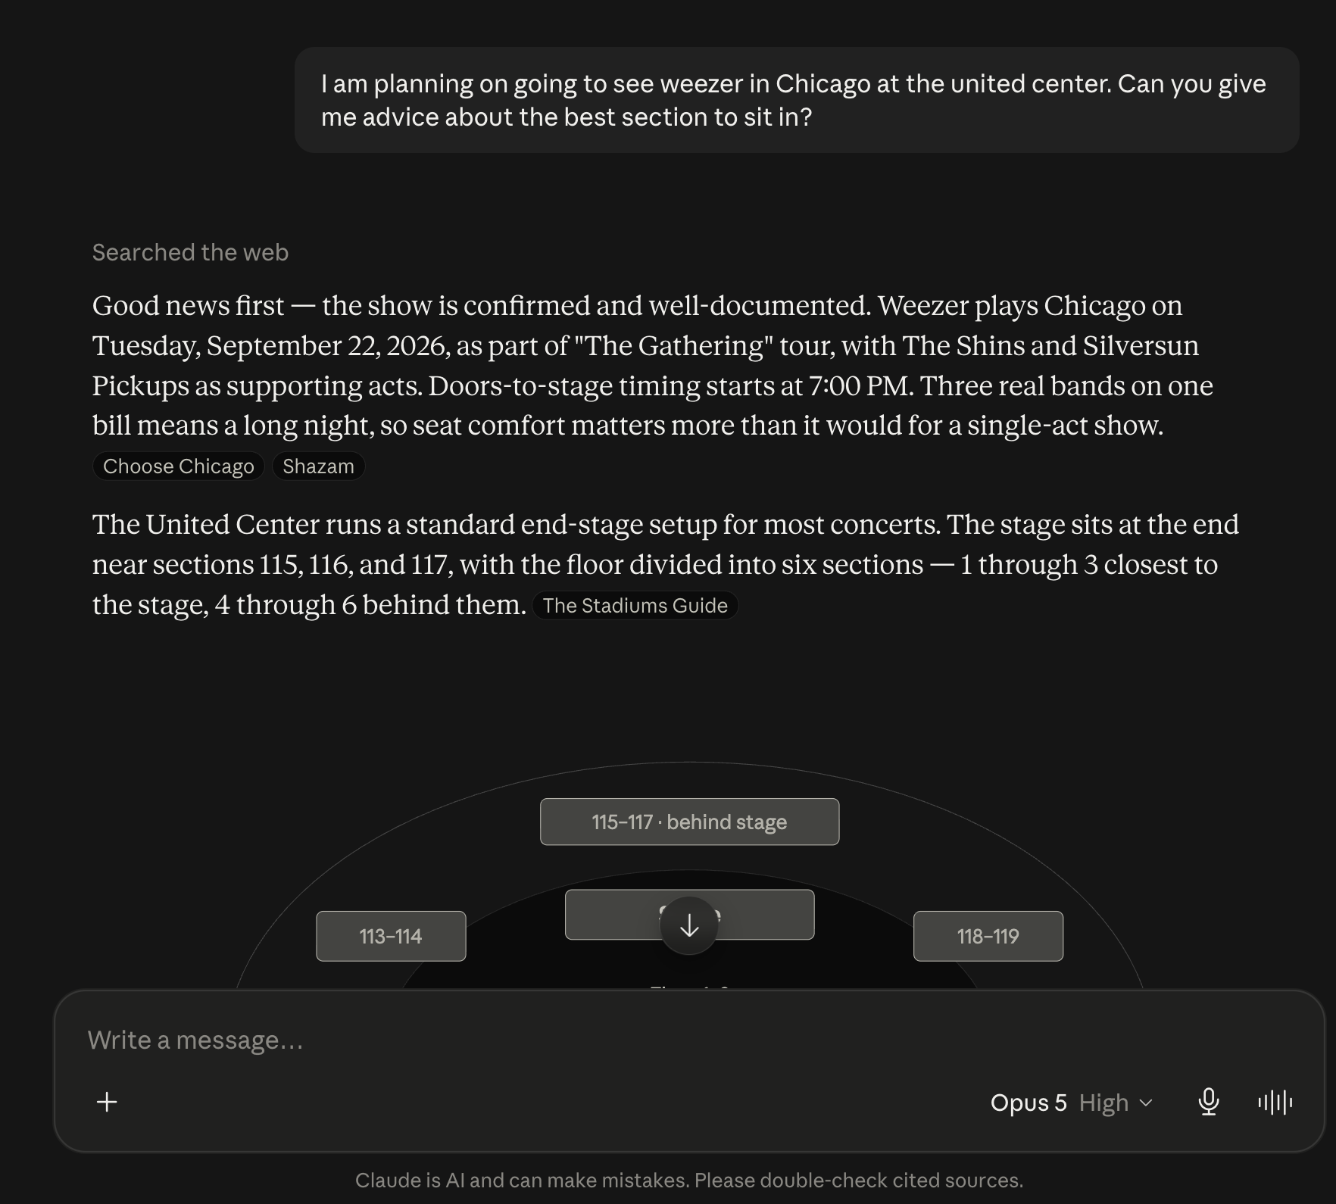
Minds With No Neurons At All
Notes:
And the fourth is the one every single person in this room has already used.
A system you can type a question to in plain English, and it will answer, argue back, write you an essay, explain a proof, and do it in whatever language you ask for.
Ten years ago, essentially everyone in this field would have told you that was decades away.
It is worth sitting with how strange it is that this became ordinary in about three years.
I want to be careful here.
I am not claiming these systems have minds.
That is genuinely one of the open questions in this field, and we will spend real time on it.
What I am claiming is narrower, and harder to dodge.
The capabilities of these systems present us with a strong argument that whatever explains intelligent behavior cannot only be a fact about neurons.
Because here is intelligent-looking behavior with no neurons in it at all.

Slide 14
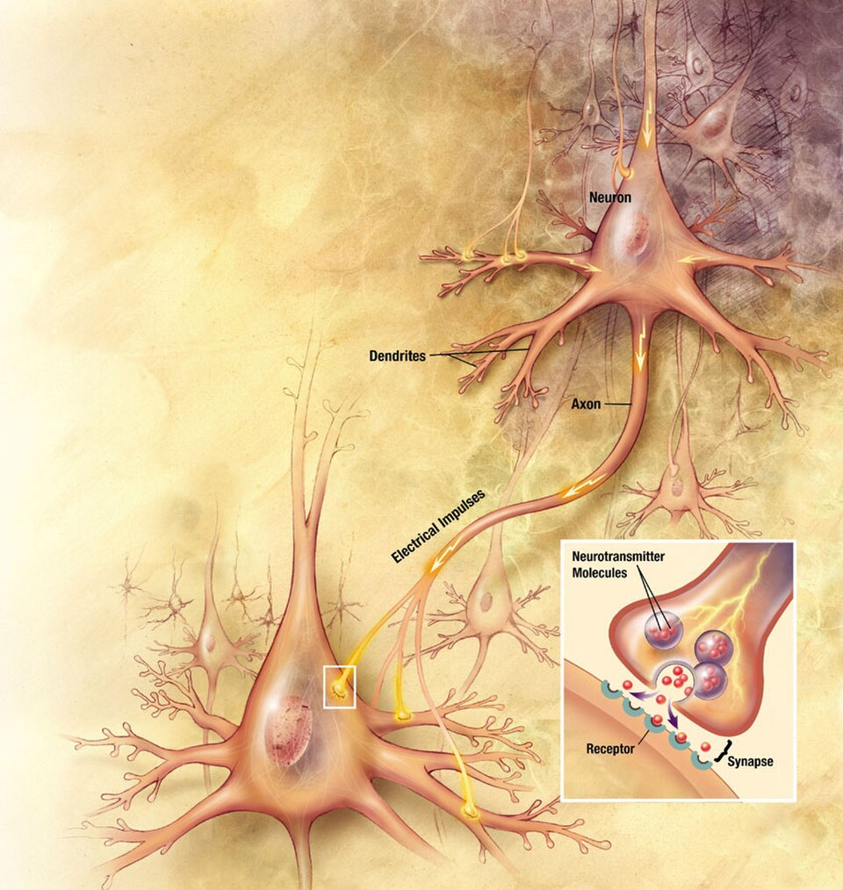
Twenty Watts
One neuron is a fairly simple machine
You have 86 billion of them, each in conversation with thousands of others
The whole thing runs on about 20 watts — less than a household lightbulb
The machines that fold proteins, play Go, and run chatbots fill warehouses and draw the power of a small town
How do you get all of that out of this?
Notes:
All the amazing things we have discussed that your minds do, do it all with this relatively simple machine, the neuron.
How can we get all that amazing stuff out of this simple machine?
Now to be fair, it’s not just one.
You have 86 billion neurons, each in conversation with thousands of others.
But still, if I wire 86 billion calculators together, I dont think any magical intelligence would occur.
And even more impressively, the whole thing runs on about 20 watts — less than a household lightbulb.

Slide 15
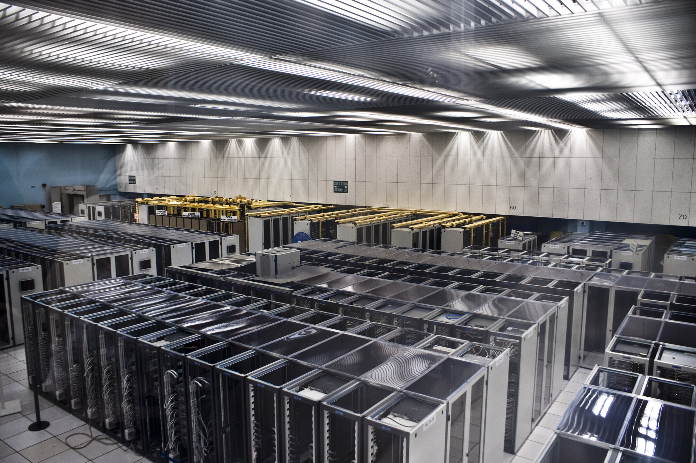
Twenty Watts
One neuron is a fairly simple machine
You have 86 billion of them, each in conversation with thousands of others
The whole thing runs on about 20 watts — less than a household lightbulb
The machines that fold proteins, play Go, and run chatbots fill warehouses and draw the power of a small town
How do you get all of that out of this?
Notes:
Compare that to the machines that fold proteins, play Go, and power chatbots like ChatGPT and Claude.
These machines require data centers that fill warehouses and draw the power of a small town.
The capability, and efficiency, of our brains is a huge mystery that we will spend the semester answering.

Slide 16
Which of These Is Most Impressive?
Which of the things we just saw is the most impressive?
Which one is least like the others?
Which of them, if any, has a mind?
Notes:
Let us actually argue about this for a few minutes.
Turn to someone near you.
Three questions on the slide.
I do not expect the right answer.
It’s not even clear there is a “right” answer.
I want to hear what your intuitions are.
[Take answers. Listen for: complexity, learning without instruction, generality, consciousness, "it's just following rules."]
Whatever you just said is a hypothesis about what intelligence is.
And nearly every one of them is a preview of a week later in this course.

Slide 17
What Is Brain and Cognitive Science?
The study of the mind and the brain, with two commitments:
Interdisciplinary — no one field can explain a mind by itself
Computational — minds take in information, store, represent, or are affected by the info, and act on it
An ambition more than an accomplished fact
Notes:
So: brain and cognitive science.
The study of mind and brain, across humans, other animals, and machines, over a lifetime and over evolutionary time.
Two commitments hold it together, and the reading takes them one at a time.
It has to be interdisciplinary, because no single field's tools reach everything that shapes a mind.
And it treats minds as computational, because that is the description that fits a person and a bee and a machine at the same time.
Now the honest part, and I want to say this on day one.
Brain and cognitive science is not a finished, unified field.
It is a bet that these scattered questions are really facets of one subject.
A linguist and a neuroscientist can study the same capacity for twenty years and never read each other's papers.
That happens constantly.
So when I say "the field," I mean an ambition that a lot of people are working toward.
I think it is the right bet.
But you should know it is a bet.

Slide 18
Interdisciplinary BCS
Psychology
Neuroscience
Philosophy
Computer Science and Artificial Intelligence
Anthropology
Linguistics
Education
Ecology and Evolutionary Biology
Notes:
Here is the roster.
A mind is shaped by cells and chemistry, by brain structure, by evolutionary history, by individual development, by language, and by culture.
No one field's tools reach all of that.
Each of these grew up around one of those forces, and each on its own sees only its own slice.

Slide 19
One Moment, Five Questions
A three-year-old says: "I goed to the store."
Neuroscientist — what has to be in place, physically, for her to produce a form she has never once heard?
Psychologist — did she look up a word, or did she build something and apply it?
AI researcher — what would a system need, in order to make exactly this mistake?
Linguist — "goed" is nowhere in what she heard. What does the error reveal about the grammar she has already built?
Philosopher — is "she has a rule" a claim about what is in her head, or just a tidy description of her behaviour?
Notes:
This is the most important idea in the lecture, so I am going to slow down.
The reading gives you one version of this — a friend calls your name across a room and you turn around. Here is a second one, because the point is worth having twice.
Go back to the kids with the blocks.
A three-year-old says "I goed to the store."
That is a mistake, obviously. But look at what kind of mistake it is.
Nobody has ever said "goed" to her. It is not in the input. She did not copy it from anywhere.
She produced it because she has worked out that English past tense adds an -ed, and she applied that to a verb that does not follow the rule.
The error is evidence of something she built.
Now watch five different people look at that same three-year-old.
The neuroscientist asks what has to be in place, physically, for a small child to produce a form she has never heard.
The psychologist asks whether she retrieved a stored word or constructed one on the spot, and what that says about how words are organized in there.
The AI researcher asks what a system would need in order to make this exact mistake — and notes, with interest, that language models make it too.
The linguist asks what the error reveals about the grammar she has already extracted from a few years of overheard talk.
The philosopher asks whether saying "she has a rule" is a claim about something in her head, or just a convenient way of describing what she does — and whether those are even different claims.
Notice what did *not* change across those five.
The subject.
It is one child, one mistake, the whole way down.
What changed is the *question*.
That is the key to the entire enterprise.
These fields differ far less in what they study than in which question they ask about it.
It is why they talk past each other.
And it is why the right relationship among them is not a ranking — not "neuroscience is the real science and the rest is stamp collecting" — but integration.
Each of them is answering a question the others need answered too.

Slide 20
Computational BCS
Computational Metaphor
Information comes in, is held or transformed by the system somehow, and an action comes out
A common shorthand: the brain is the hardware, the mind is the software
Two questions follow, and they run through the whole course:
how does a mind hold on to information, and how does it act on what it holds
Computational Methods
Computer-based experiments
Computer-driven tools like EEG and fMRI
Complex data analysis and machine learning
Computational models and simulations
Notes:
The word "computational" gets used two completely different ways in this field, and people conflate them constantly.
So let us separate them now.
The first is a claim about what a mind *is*.
A mind takes in information, holds on to it or is changed by it in some internal way, does something to it, and produces an output.
Sound hits your eardrum; somewhere between there and your behaviour it becomes speech sounds, then words, then a speaker and a meaning; and you turn around.
The shorthand you will hear is hardware and software: the brain is the machine, the mind is what it is running.
And out of this fall the two questions that will follow us all semester.
How does a mind hold on to information, and what does it do with what it holds.
The field's usual names for those two questions are *representation* and *processing*, and I will use those words — with the flag that exactly what "representation" commits you to is itself argued about, and we sharpen it in the next two modules.
Write both words down. We will use them every week.
The second sense is just a claim about how, as scientists, we do Brain and Cognitive Science.
We run experiments on computers, we use instruments like fMRI that are computational to their core, and we increasingly lean on machine learning, computational models, and AI to find patterns in data far too large for a person to sort by hand.
The two reinforce each other.
Thinking of the mind as computation is what makes it natural to study the mind by computing.

Slide 21
Is the Brain Really a Computer?
The brain has no clean divide between hardware and software
It does not run in the tidy, step-by-step way a laptop does
A mind is bound up with a body and a world, not sealed inside a skull
"Computation" may have stretched so far that it explains nothing
A lens, not a doctrine
Notes:
I have just spent five minutes selling you the computational picture, so let me spend two minutes attacking it.
Sometimes you hear people say something like “the brain is the hardware, and the mind is the software”.
But there is no clean hardware/software divide in a brain.
Brains do not execute one tidy step after another.
A mind is bound up with a body moving through a world — thinking may be as much a matter of acting as of shuffling symbols in the head.
And some people argue the word has stretched so far that calling everything computation explains nothing at all.
These are serious objections, from serious people, and I wouldn't wave them away.
Here is how I want you to think about it.
Computation is a lens, not a doctrine.
A lens earns its place if it brings things into focus.
And the computational lens has brought an enormous amount into focus over fifty years.
But a lens is not the same as the thing seen through it.
Saying a mind is computational is not saying a mind *is* a laptop.
We will use the computational lens for everything it is worth, and stay alert to where it strains.

Slide 22
Three Levels, Three Questions
What problem is this system solving, and why?
How does it solve that problem — what does it represent, and what processes act on it?
What is it physically made of, and how does that stuff carry the work out?
Not three rival answers. Three different questions.
Notes:
Last big idea before we talk about the course itself.
If every discipline asks its own question, how do the answers fit into one account of one mind?
The answer we will adopt is that the questions sort into a small number of levels of analysis.
Three of them.
What problem is being solved, and why.
How does it get solved — what is represented, and what processes act on it.
And what the thing doing the solving is physically made of.
The critical move is that these are not three competing answers.
They are three different questions, and a full understanding requires all three.
This framework has a name and a much longer story, and it is the backbone of the entire course.
We will discuss it in detail in the next two lectures.

Slide 23
Where We're Going
We follow the order evolution built things in — and at each step, we compare against machines.
What evolution added | The problem it solved
The first neurons | Sense and act faster than chemistry alone allows
Neural circuits, affect and valence | Work out whether a thing is good or bad, and do something about it
Learning and plasticity | Change with experience, instead of being finished at birth
The vertebrate brain | Run many systems at once, in one body
Pattern recognition | Find the same thing again, having never seen it the same way twice
Perception and action | Act on a world you can only ever sample
Spatial cognition | Know where you are, and get back
Memory, imagination and generative models | Use the past, and run a future before living it
Social cognition | Predict the most complicated thing in the environment: other minds
Planning and decision-making | Choose between futures that have not happened
Language | Put a thought into someone else's head
Symbolic cognition | Think about what is not present, and what is not real
Culture | Inherit what others worked out, without working it out yourself
Notes:
Here is the shape of the semester.
We are not going to march through the disciplines one at a time, a week of neuroscience, a week of linguistics, a week of AI.
We are going to follow the story of the evolution of the human mind.
We start with the first neurons and ask why anything would evolve one.
Then circuits, and how a nervous system gets something like a feeling.
Then learning. Then the vertebrate brain. Then recognizing patterns, remembering, imagining, dealing with other minds, planning, language, symbols, culture.
Roughly the order it actually happened in.
And the question every single week is the same one: what problem did this capacity solve for the creature that first had it?
That question is what makes this one story instead of fifteen disconnected topics.
One more thing to flag now, because it runs through everything.
At each of these steps we will also look at what the machine version looks like.
Artificial neurons when we do neurons.
Vision models when we do pattern recognition.
Chatbots and large language models when we get to language.
AI is not a bonus topic at the end of this course.
It is a comparison we make the whole way through.

Slide 24
What a Week Looks Like
The reading is posted before the week it covers begins
Three lectures
One lab
A five-minute quiz at the start of most classes — starting in week 2, and always about the week before
Practice questions, ungraded and unlimited, on Canvas
Notes:
So here is the rhythm, and it is the same every week.
The reading for a week goes up before that week starts.
You read it before the first class of the week.
Three lectures.
One lab.
And a short quiz at the start of most classes — though not this week.
Quizzes start in week 2, and I will come back to why in a moment.
Everything is on Canvas and on the course website, and the website is public — the whole textbook is free and open.

Slide 25
How You're Graded
Daily in-class quizzes — 136 points, 34% (40 given, 34 counted)
Lab assignments — 120 points, 30% (14 given, 12 counted)
Final exam — 144 points, 36%
Total — 400 points
Extra credit: research participation (SONA) up to 3%, course notes up to 3%
Generous drops, which is why there are no make-ups
Notes:
Four hundred points, three components, roughly equal thirds.
Daily quizzes are worth a hundred and thirty-six.
There are forty of them and I count your best thirty-four.
Labs are a hundred and twenty; fourteen assigned, best twelve counted.
The final is a hundred and forty-four.
Notice we let you drop a lot of stuff.
You can miss six quizzes and two labs with no penalty and no explanation needed.
That is deliberate, and it is why there are no make-ups.
If you are sick, or your car dies, or you’re traveling, or you have a bad week — that is what the drops are for.
You do not need to email me a doctor's note or an excuse.
Two extra credit routes, three percent each: research participation through SONA, and submitting your course notes for feedback.

Slide 26
Why It's Built This Way
Practice questions on Canvas: ungraded, unlimited, with explanations for every answer
The daily quiz is on paper, closed book, drawn from those same practice questions
Quizzes start in week 2, and each one covers the week before — you always get a week with the material first
The final is drawn from them too
No midterm — the daily quizzes already spread the observations out
Notes:
I want to explain the reasoning, because this is unusual and it confuses people if I do not.
There is a large pool of practice questions for every module.
They are not graded.
You can do them as many times as you want.
Every answer comes with an explanation of why it is right or wrong.
The daily quiz is five minutes, on paper, closed book, and drawn from that same pool.
So is the final.
Two things about the timing, and they are both in your favour.
Quizzes do not start until week 2.
And every quiz runs a full week behind the material.
The quiz on Monday of week 2 covers Monday of week 1 — today — and the reading behind it.
So you are never asked about something you have not had a week to sit with, attend a class on, and practise.
If a topic confused you on the day, you have a week and a question pool to fix that before it counts.
Which means the practice pool is not a study aid off to the side.
It is the study path.
If you work the practice questions, you have already seen the questions.
Though the question bank is huge, and there is no way you will see all the questions.
But each chapter has a limited number of topics and question types.
Canvas has a document titled “How to Study for this Class” with more info.
Why on paper?
Honestly: because I want to know what *you* know, not what ChatGPT, Claude, and Gemini know.
A system where you practice unlimited, and are checked briefly in person, is one I can trust and you can prepare for.
But also, my PhD is in how semantic memory works; how do people learn and store information.
And I put what I know about that into practice in how I design this course.
How the textbook is written, how the lectures are constructed, what the learning objectives are, and what the assignments are.
It’s all designed to maximize what you can learn.

Slide 27
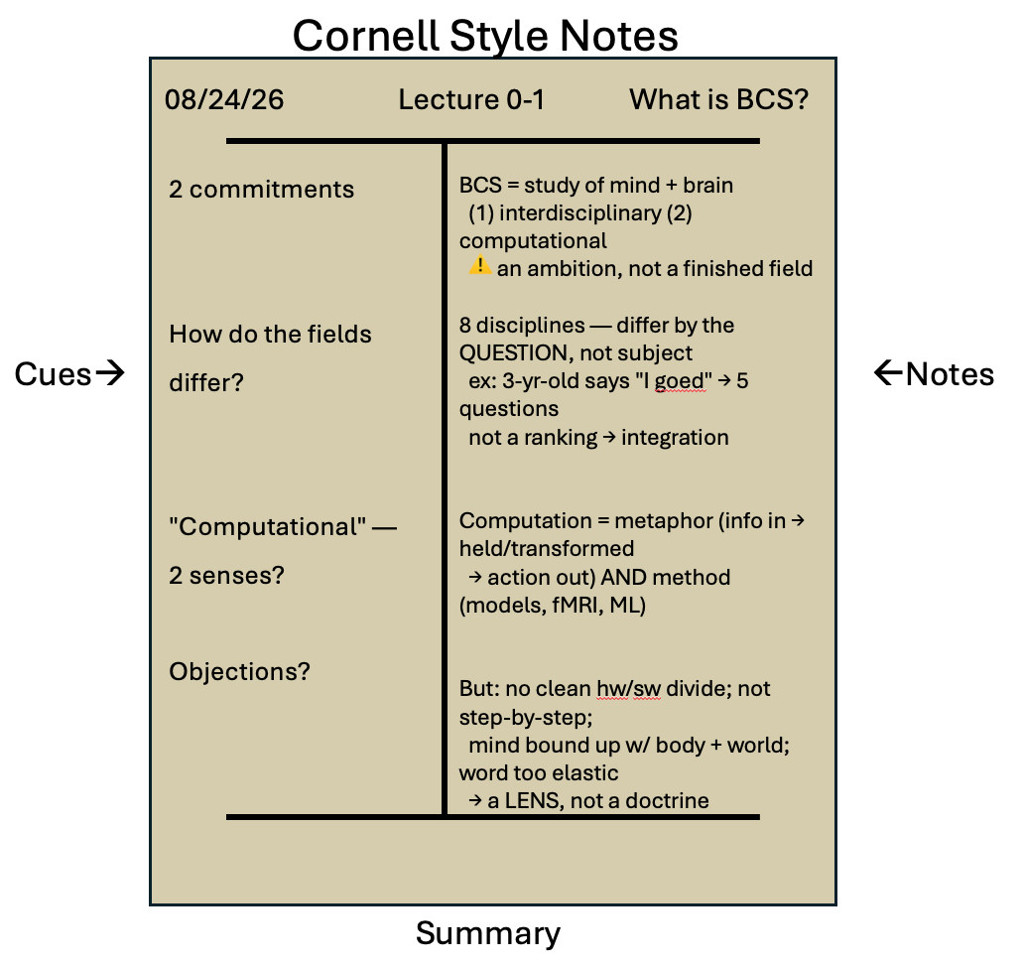
How to Do Well
Come to class. Do the reading before the week starts. Work the practice questions.
Take notes with a real method — SQ3R, Cornell Notes — described in a document on Canvas.
Ask questions, and come to office hours
Notes:
The unglamorous slide, but this is the one that actually predicts your grade.
Come to class — from week 2 there is a quiz at the start, so this one is self-enforcing.
Do the reading before the week starts, not the night before the quiz.
Work the practice questions.
Take notes with an actual method rather than transcribing me.

Slide 28
How to Do Well
Beware the illusion of understanding — following an explanation is not the same as being able to produce it
The fix is not rereading. It is closing the thing and making yourself produce the answer, badly, before you check
Notes:
Now let me name the trap underneath all of this, because it is the single most common way a smart student ends up with a bad grade.
You read something — a chapter, a web page, an answer from a chatbot — and it makes sense.
Every sentence lands as you read it.
You come away thinking: yes, I have got this.
That feeling is not knowledge. It is recognition.
It is the feeling of following someone else's explanation while their explanation is still in front of you.
Then you sit down to a quiz question with nothing in front of you, and discover you cannot produce any of it.
This is called the illusion of understanding, and I want to be clear that it is not a sign that you are bad at this.
It catches everyone, and it catches confident people hardest, because the feeling is strongest exactly when the explanation was clearest.
A good explanation is *more* dangerous this way than a bad one. Confusion is useful information; clarity removes the signal that would have told you to go back.
The fix is not reading it again.
Reading it again feels wonderful and does almost nothing.
The fix is retrieval: closing the thing and making yourself produce the answer, badly, before you check.
That is uncomfortable, it feels like failing, and it is the part that actually works.
Hold on to that idea. The next slide is about a tool that is extremely good at producing clear explanations.

Slide 29
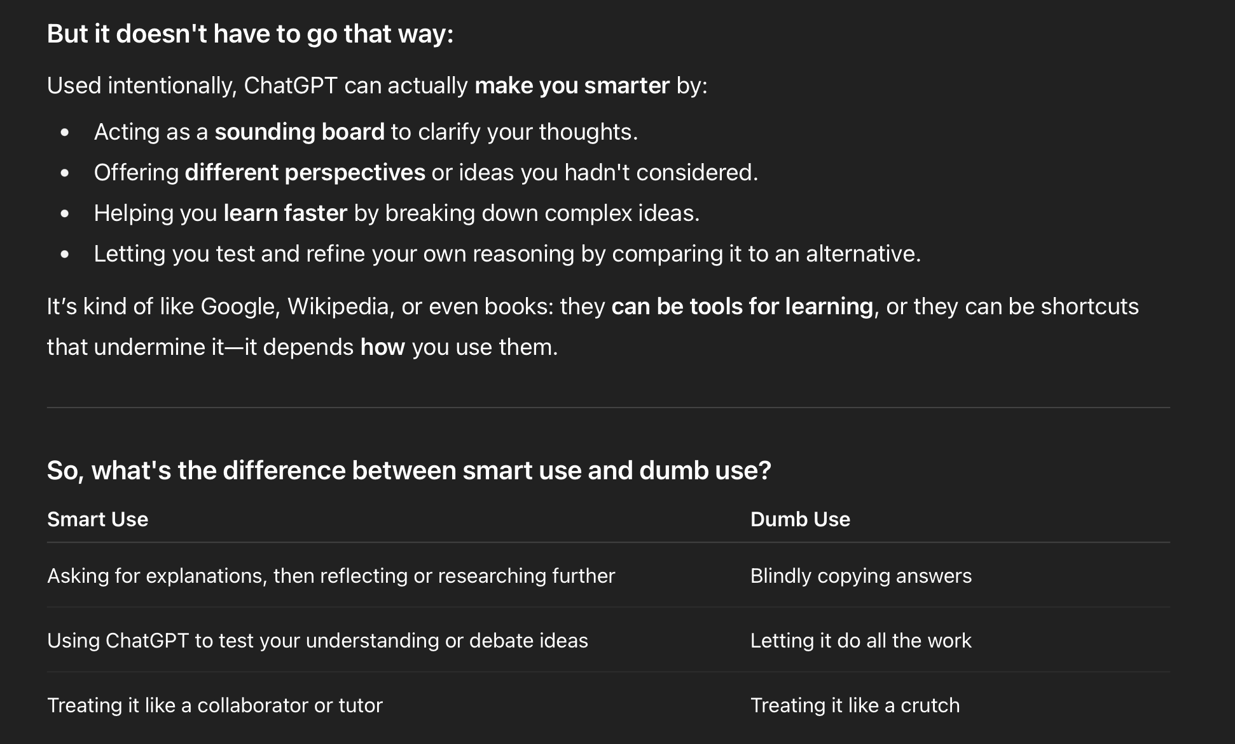
Using AI in This Course
Not this. Do not have a model produce answers, text, code, or figures you hand in. That covers every lab
This, and I encourage it. Re-explain a passage you have already read · quiz you, answer withheld until you commit · decode notation · argue with reasoning you have already worked out
The test: if you finish and could not now do the thing yourself, it did not help you
Notes:
You are going to use these tools. I would rather talk about it than pretend otherwise.
The whole policy is one sentence: do not have a model produce work you hand in, and do use it, if you want, to help you understand things you have already worked on.
The part that is not allowed is narrow, and I do not think it is controversial.
Do not have a model write your lab report.
A lab report is not a document anyone needs to exist — nobody is waiting on it. It is a by-product of your learning, and the learning is the whole reason the lab is assigned.
So work produced by a model has skipped the only part that was worth doing.
The allowed list is deliberately generous, and here is why.
You arrive with very different amounts of background, for reasons that are nobody's fault.
Telling someone missing a piece of that background that they may not have a hard passage explained to them would be unkind and self-defeating. That is exactly how a gap gets closed.
So: have it re-explain something you read and did not follow. Have it quiz you, and make it withhold the answer until you commit. Have it decode notation. Have it attack a position you have already taken.
All of those help you build the thing. None of them build it for you.
And here is the only test you need: if you finish the exchange and could not now do the thing yourself, it did not help you.
That table on the screen is ChatGPT's own answer, by the way — I asked it whether it makes people dumber. Its smart-use column is nearly the list I just gave you.

Slide 30
Using AI in This Course
These tools raise the ceiling for someone who already has the skill and lower the floor for someone who does not — for the same reason. An expert is checking the output; a novice is trusting it
Experienced developers, on their own job: expected 24% faster · believed they had been 20% faster · measured 19% slower
Full policy in the syllabus · the whole argument in Artificial Intelligence in This Course, on Canvas · each lab report ends with one sentence on whether you used AI
Notes:
Briefly, why the line sits there, because you are entitled to disagree with the actual argument.
The same tool helps an expert and hurts a beginner, and it is one mechanism.
The model does part of the reasoning. If you have the skill, you can check the output. If you do not, you cannot check it at all.
The difference between an expert reading a model's answer and a beginner reading it is that one is verifying and the other is trusting — and the beginner usually cannot tell which they are doing.
Here is the study that convinced me. Experienced developers, doing their own paid work with AI assistance.
Beforehand they expected to be about a quarter faster. Afterwards they reported being about a fifth faster.
Against the clock, they were about a fifth *slower*. They were not slightly off; they were wrong about the direction.
So when a student tells me they can tell when AI is helping them, I believe they are sincere. I do not believe the report.
And the honest thing about my own use: this course was built with a lot of AI assistance, by someone who has spent twenty-five years on the subject. That asymmetry is the argument. I can check the output.
The full policy is in the syllabus, and the whole case, with the studies, is a document on Canvas called "Artificial Intelligence in This Course." It is not required. If you have views about this, please read it and come argue with me.

Slide 31
Take Care of Yourself
Sleep, eat, move, keep a schedule you can actually keep
Wellbeing, writing, and disability resources are linked on the syllabus
Asking early works far better than asking late
Notes:
Last thing, and it is not filler — it is the slide I most mean.
Sleep, food, movement, and a schedule you actually keep will do more for your grade than any study trick I have just given you.
That is not a motivational poster. Memory consolidation happens while you sleep. This is a course about brains; yours is the one you are using.
There are wellbeing, writing, and disability resources linked on the syllabus.
Please use them, and please use them early. Asking early works far better than asking late — the version of a problem you bring me in week 3 is nearly always fixable, and the version you bring me in week 14 sometimes is not.
That goes for me too. Come to office hours. Come when nothing is wrong.

Slide 32
Before Next Class
Read Chapter 1 — Mind and Brain
The question we open with: is your mind nothing but your brain?
Notes:
That is the course.
Before next class, read Chapter 1.
It is on the website and linked from Canvas.
And here is the question we open with.
Go back to the oranges for a second.
You recognized them, and some of you felt a flicker of wanting them.
The recognizing looks like something a machine could do.
The wanting feels like something else.
So: is your mind nothing but your brain?
People have been arguing about that for about two and a half thousand years, and we have not settled it.
But we have gotten much clearer about what the possible answers are, and about which ones cost you something.
That is where we pick up. See you then.

Slide 33
Image Sources (1 of 2)
Slide | Image | File | Licence | Source
2 | Green Street, Champaign | green_street_crowd.jpg | CC BY 4.0 | Jon Willits — own photograph · own work
2 | Sliced oranges | oranges.jpg | CC BY-SA 4.0 | Edithobayaa1 · https://commons.wikimedia.org/wiki/File:Sliced_oranges_in_Ghana.jpg
2 | Spectrograms: HOT, HAT, HIT, HEAD | spectrograms_hot_hat_hit_head.jpg | CC BY 4.0 | Jon Willits — own figure · own work
2 | Distracted boyfriend meme | distracted_boyfriend_meme.jpg | All rights reserved — used as fair use, educational; licence being sought | Photograph by Antonio Guillem (to verify) · https://commons.wikimedia.org/wiki/File:Distracted_boyfriend_meme.jpg
3 | Children building together | children_block_tower.png | CC BY 4.0 | Jon Willits — generated with ChatGPT (OpenAI) · own work
4 | Arctic tern in flight | arctic_tern_in_flight.jpg | CC BY-SA 4.0 | Charles J. Sharp, Sharp Photography · https://commons.wikimedia.org/wiki/File:Arctic_tern_(Sterna_paradisaea)_in_flight_Myrar.jpg
4 | The honeybee waggle dance | honeybee_waggle_dance.png | CC BY 2.5 | Figure design: J. Tautz and M. Kleinhenz, Beegroup Würzburg; from Chittka L, PLoS Biol 2004 · https://commons.wikimedia.org/wiki/File:Bee_waggle_dance.png
4 | Common octopus | octopus.jpg | CC BY-SA 3.0 | Beckmannjan · https://commons.wikimedia.org/wiki/File:Octopus_vulgaris2.jpg

Slide 34
Image Sources (2 of 2)
Slide | Image | File | Licence | Source
5 | AlphaFold prediction — TIMM17A | alphafold_predicted_structure.png | CC BY 4.0 | AlphaFold Protein Structure Database (Jumper et al., 2021) · https://commons.wikimedia.org/wiki/File:Prote%C3%ADna_TIMM17A.png
5 | Turning water into lava | ai_image_editing.png | CC BY 4.0 | Jon Willits — own photograph, edited with ChatGPT (OpenAI) · own work
5 | Lee Sedol vs AlphaGo, game 1 | alphago_board.png | CC BY-SA 4.0 | Wesalius · https://commons.wikimedia.org/wiki/File:Lee_Sedol_(B)_vs_AlphaGo_(W)_-_Game_1.svg
5 | A conversation with a chatbot | chatbot_interface.png | CC BY 4.0 | Jon Willits — own screenshot; interface is Claude (Anthropic) · own work
6 | Neurons and the synapse | neurons_wikimedia_commons.jpg | Public domain (PD-USGov) | https://commons.wikimedia.org/wiki/File:Neurons_big1.jpg
6 | CERN data centre | datacenter_hall.jpg | CC BY-SA 3.0 | Florian Hirzinger · https://commons.wikimedia.org/wiki/File:CERN_Server_03.jpg
18 | Cornell Notes — this lecture | cornell_notes_example.png | CC BY 4.0 | Jon Willits — own work · own work
19 | ChatGPT on smart use versus dumb use | llm_screenshot_2.png | Author's own screenshot; the interface shown is the vendor's | Screenshot by Jon Willits · own work

