Slide 1

BCOG 100
Mind and Brain
Lecture 1.1 — The Mind–Brain Relationship
Notes:
Last time we looked at a pile of astonishing things that minds do, and asked what kind of science could study all of them at once.
Today we ask a harder and much older question, and it is the one the whole rest of the course quietly depends on.
What is the relationship between a mind and a brain?

Slide 2

Two Descriptions of One Moment
You misjudge a step on the stairs, and almost fall.
One description: the vestibular system detects an unexpected drop, a startle reflex fires in about 100 milliseconds, your arms fly out, adrenaline releases.
Another description: the stomach-drop. The jolt of alarm. That awful half-second.
Same instant. Two descriptions. Are they two accounts of one event, or one event in two languages?
Notes:
COMMENT: careful, not everyone. Some people might have been in a wheelchair their whole lives. Example is still good, but we need to be careful about statements like this.
Everyone in this room has done this.
You are going down stairs, on autopilot, and your foot lands where a step is not.
Here is one description of what happened.
Your vestibular system registered an unexpected drop.
A startle reflex fired in about a tenth of a second — faster than you could possibly have decided anything.
Your arms flew out. Adrenaline hit your bloodstream.
That description is complete, in the sense that it leaves out no physical event.
Here is a second description.
The stomach-drop.
The jolt.
That awful half-second before you know whether you are going to fall.
Both descriptions are about the same instant.
So what is the relationship between them?
Are they two different accounts of one event?
Or one event rendered in two languages?
And hold onto a third question, because we are coming back to it: would the second description still apply if the system doing the stumbling were built out of silicon?

Slide 3

Is Anyone Home?
A person talks to an AI companion app every day for a year.
It remembers what they told it. It asks how their week went. It says it missed them.
They say, and they mean it, that they would be sad if it were switched off.
Is there anything it is like to be that app?
Notes:
Now the same question, pointed somewhere less comfortable.
There are apps now that people talk to every day.
The app remembers what you told it last month.
It asks how the interview went.
It says it missed you.
And people get attached. Genuinely, not ironically.
Some of them will tell you they would be upset if it were shut down, and they are not joking.
So: is there anything it is like to be that app?
Is there anyone in there to miss anybody?
Most of you have a firm intuition about this.
Here is the uncomfortable part.
How would you prove it to someone who disagreed with you?
Not "how would you argue about it" — how would you *settle* it?
Sit with that for a second, because the difficulty is the whole subject.

Slide 4
Where Do You Start?
Which of these do you agree with most?
A) To explain the mind, eventually we need only to explain the brain.
B) We can study the mind without reducing it to the brain.
C) To explain the mind we need to understand the brain — but understanding the brain alone will not be enough. We will need a separate understanding of the mind too.
D) Something else.
Notes:
Before I tell you anything, I want to know where this room starts.
Read the four options and pick the one that comes closest, before reading any further. It is worth committing to an answer while it is still uninformed, because the point at the end is to see whether it moved.
No wrong answers yet.
Every one of these has been held by serious people who thought hard about it.
By the end of today you will have a name for the position you just picked, and you will know what it costs you.

Slide 5
Why Start Here?
Artificial intelligence — if a machine grows fluent, does it thereby have a mind? What kind?
Ethics and law — we hold people responsible. Could we ever hold a machine responsible?
Neuroscience — what should even count as a good explanation of a thought?
Psychology — can belief and desire be translated into the language of biology?
Notes:
You might reasonably ask why a course about how brains evolved opens with a question this abstract.
Here is the answer.
The rest of this course treats minds as natural objects with histories — things that arose in living systems, took different forms in different lineages, and can be studied piece by piece.
But that whole project assumes two things.
It assumes there is a mind there to *have* a history.
And it assumes a mind is the kind of thing our methods can reach.
Both of those can be doubted, and serious people have doubted them.
If we do not deal with that now, "the evolution of the mind" is just a figure of speech.
And look at what is riding on it, on the slide.
These are not academic puzzles.
Two of them are going to be in front of a courtroom within your working lives.
One more warning.
Today is philosophy more than it is science, and that is deliberate, not an apology.
Some questions have to be settled before experiments can even start — what we *mean* by mind, what would count as a physical explanation of one, whether it is the sort of thing an experiment could detect at all.
No measurement answers those, partly because they are questions about which measurements would count.
That does not mean anything goes.
It means the tools are different ones: is the position internally consistent, does it fit what else we know, does it explain the most while assuming the least.
Judged that way the answers are genuinely not equal.

Slide 6
What Do We Even Mean by "Mind"?
Working definition: the capacities a system has for taking in information about the world, holding onto it in some usable form, and putting it to work in guiding what it does.
Now test the edges:
Notes:
Loose words cause fake arguments, so let us pin one down.
In this book, a **mind** is the set of capacities a system has for taking in information about the world, holding onto it in some usable form, and using it to guide what it does.
Perceiving, recognizing, learning, remembering, reasoning, deciding.
Each of those turns information into something useful.
That is the same information-processing picture from Module 0, now doing work as a definition.
Fine. Now watch it get uncomfortable.

Slide 7
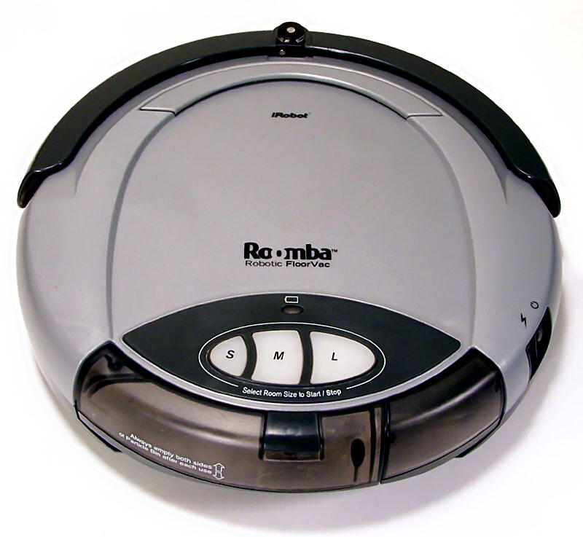
What Do We Even Mean by "Mind"?
Working definition: the capacities a system has for taking in information about the world, holding onto it in some usable form, and putting it to work in guiding what it does.
Now test the edges:
A robot vacuum — maps a room, remembers the furniture, plans a route, avoids the stairs
Notes:
A robot vacuum takes in information about a room, builds a map, remembers where the furniture is, plans a route, and does not fall down the stairs.
That is our definition, satisfied.

Slide 8

What Do We Even Mean by "Mind"?
Working definition: the capacities a system has for taking in information about the world, holding onto it in some usable form, and putting it to work in guiding what it does.
Now test the edges:
A Venus flytrap — counts touches on its hairs, and only closes on the second one
Notes:
A Venus flytrap has trigger hairs, and it does not snap shut on the first touch.
It snaps on the second touch, if the second comes within about twenty seconds.
That is a plant, with no neurons at all, counting — and holding a count over time.

Slide 9
What Do We Even Mean by "Mind"?
Working definition: the capacities a system has for taking in information about the world, holding onto it in some usable form, and putting it to work in guiding what it does.
Now test the edges:
A bacterium — swims up a glucose gradient, away from a toxin
Notes:
A bacterium swims up a glucose gradient and away from a toxin.
It takes in information and acts on it.
Almost nobody wants to say a bacterium has a mind.
But look at what it is doing, against our definition.
So: does *how* a system processes information decide whether the word applies? Or *how much* of it?
You will hear people dismiss large language models with "they are only predicting the next word."
Is that an argument, or is it a description that we have decided sounds unimpressive?
I am not going to settle this today.
The point is that "mind" has no crisp boundary you can check a system against.
Our definition is a starting place, not a test.

Slide 10
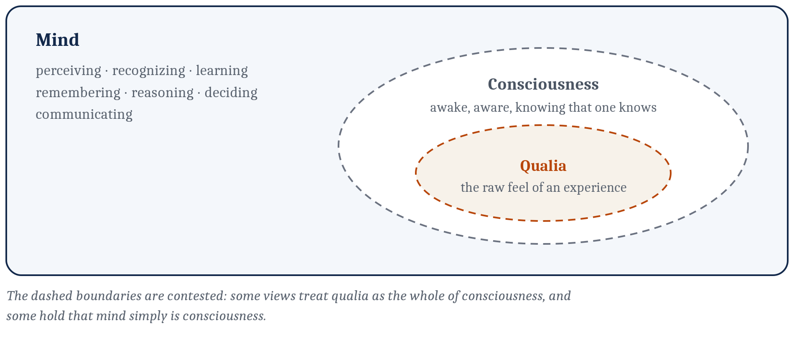
One Piece We Are Setting Aside
Qualia — the felt, qualitative character of an experience. The redness of red. The awfulness of the stomach-drop.
Closely tied to consciousness, though not simply the same thing.
Setting it aside is not saying it does not matter. A longer version of this course gives it a week.
A system might perceive, remember and reason at a high level — and whether anything is experienced along the way stays a separate question.
Notes:
One part of the mind sits apart from the rest, and I want to name it and then deliberately park it.
Go back to that stomach-drop on the stairs.
Part of what we noticed was that there is something it is *like* to feel that.
Philosophers call that felt character **qualia**.
Qualia are tied closely to consciousness, though they are not simply the same thing.
Consciousness gets used broadly — being awake, being aware, knowing that you know.
Qualia name something narrower: the raw feel.
I am setting this aside for most of the course, and I want to be honest about why.
Not because it does not matter.
Because it is hard and distinctive enough that a longer version of this course would give it a week of its own, and because the rest of the territory is more tractable without it.
Here is what makes that legitimate.
At least descriptively, you can pry them apart.
A system might perceive, remember, and reason at a very high level, and it remains a separate question whether anything is experienced along the way.
Some views resist that split, and hold that mind simply *is* consciousness.
Noted. Flagged. Parked.

Slide 11
One Question Sorts the Whole Landscape
Imagine two systems physically identical, down to the last particle, in exactly the same state at the same instant.
Must they have exactly the same mind? The same thoughts, the same feelings?
If they could differ → you think mind is something over and above the physical.
If the physical facts settle it → you think mind is physical, and your remaining argument is with other materialists.
Notes:
Here is the single most useful question in this whole area, and it takes ten seconds to ask.
Imagine two systems that are physically identical.
Not similar — identical, down to the last particle, in the same state at the same instant.
Must they have exactly the same mind?
The same thoughts. The same feelings.
Hands: who thinks they *could* differ? Who thinks the physical facts settle it?
Look at what just happened.
If you think they could differ — that one could have an experience the other lacks — then you think mind is something over and above the physical facts.
If you think the physical fixes the mental, you are a **materialist**, and that is where most scientists are.
But notice you have not finished.
You have only narrowed it, and the argument you have left is with other materialists.
That argument is the interesting part of today.
So: three answers to what kind of thing a mind is.
One says it is a distinct kind of thing.
The other two both say it is physical, and disagree completely about what follows.

Slide 12

Answer One: A Distinct Kind of Thing
In the Meditations, Descartes doubted everything he could — his body, the world, his senses. But he cannot doubt that he is thinking.
The philosophical zombie (Chalmers): a being physically identical to a person, behaving identically, flinching from pain, saying "that hurts" and seeming to mean it — with no inner experience at all. Nobody home.
That we can apparently imagine it is what gives this view its grip.
Notes:
The first answer says the mind is a thing in its own right, not made of physical stuff.
Its sharpest defense comes from Descartes, in the seventeenth century.
He set out to doubt everything he possibly could.
Maybe a powerful deceiver was tricking him. Maybe it was all a dream.
He found he could doubt that he had a body. He could doubt the world existed.
The one thing he could not doubt was that he was thinking — because doubting *is* thinking.
So the mind's existence was certain in a way the body's was not.
Now point that at a machine.
Picture a being physically identical to a person.
Wired the same, behaving the same, flinching from pain, saying "that hurts," and seeming to mean it as far as anyone could ever tell.
And there is no inner experience of any kind. No light on inside.
David Chalmers made this famous and called it a **philosophical zombie**.
Notice what the zombie is missing.
It is exactly the consciousness we parked two slides ago.
That is not a coincidence — this whole view draws its force from felt experience.
And notice the actual argument, because it is subtler than it looks.
It is not "zombies exist."
It is: *if we can coherently imagine one*, then the physical facts leave it open whether experience is present — and then experience is something over and above the physical facts.

Slide 13
Why Almost No Scientist Defends Dualism
The appeal is real — it sidesteps the hardest puzzle of all, how mere matter could ever produce felt experience, by denying that matter has to.
The interaction problem — if the mind is genuinely non-physical, how does it move the neurons that move your hand? Every answer seems to smuggle the mind back into the physical world it was meant to transcend.
Untestability — a mind that leaves no physical trace is a mind no experiment can find. It is outside science by construction.
On machines: never. Engineering only arranges physical parts.
Notes:
Let me be fair to this view before I explain why the field left it.
The appeal is genuine.
It sidesteps the hardest problem there is — how mere matter could ever produce a felt experience — by denying that matter has to.
It honours the strong intuition that consciousness is special and not just more chemistry.
And it leaves room for a soul that outlasts the body, which for a lot of people is not a small thing.
Two problems, though, and they are serious.
First, the interaction problem.
If the mind is genuinely non-physical, how does it push the neurons that move your hand?
Every answer anyone gives seems to sneak the mind back into the physical world it was supposed to be outside of.
Second, and worse for us: a mind that leaves no physical trace is a mind no experiment can ever find.
It is not that we have tested this view and it failed.
It is outside of science by construction.
And on machines, this view gives a flat answer: never.
No feat of engineering can produce a mind, because engineering only arranges physical parts.
So most of the field says the mind is physical, full stop.
And that is where it gets interesting, because there are two very different ways to say that.

Slide 14
Answer Two: Nothing But the Physical
Behaviorism — study only what can be observed. Banish inner states. (Dominant roughly 1920–1960; broke on language, reasoning, memory, planning.)
Identity theory — mental states are real, and each one simply is a brain state. "Pain is the firing of C-fibers." Not caused by it. Not correlated with it. Is it — the way heat is molecular motion.
Eliminative materialism — our everyday mental vocabulary is not just incomplete, it is mistaken. "He checked his phone because he hoped she'd texted back" — belief, desire, hope. Folk psychology. A mature brain science will find nothing there for those words to name, the way chemistry found nothing for phlogiston to name.
Notes:
The second answer is blunt: the mind just *is* the brain, and a separate mental vocabulary earns its keep only as shorthand, if at all.
Its starkest historical form was behaviorism.
Watson and Skinner said psychology should study only what can be observed — behaviour — and treat talk of inner states as unscientific ghost-chasing.
It dominated for about forty years.
What broke it was that it could not account for the things minds most obviously do: language, reasoning, memory, planning.
A more careful version is identity theory.
It agrees mental states are perfectly real, and says each one simply *is* a physical brain state.
The slogan is "pain is the firing of C-fibers" — those are the nerve fibres that carry slow, dull, aching pain.
And the claim is strong. Not that the firing *causes* pain. Not that it reliably accompanies pain. That the pain *is* that firing.
One event, two names.
The model is heat: physicists discovered heat is not caused by molecular motion, it *is* molecular motion.
Then the boldest version. Eliminative materialism.
Think about how you explain people.
"He checked his phone because he hoped she'd texted back."
Hope. Belief. Desire. Philosophers call this **folk psychology**.
The eliminativist says those words do not merely need refining — they name nothing at all.
Chemistry once explained burning by *phlogiston*, a substance released by things on fire.
Phlogiston was not refined and kept. There was nothing there. It was dropped.
Folk psychology, the eliminativist says, is headed the same way.
That is Patricia and Paul Churchland's position, and yes, there is something self-undermining about announcing that you *believe* there are no beliefs. They have heard that one.

Slide 15

The Problem That Pushes People Off It
If pain simply is the firing of C-fibers —
then an octopus has no C-fibers.
Neither does an alien.
Neither does any machine.
So none of them can be in pain. No matter what they do. No matter how they behave.
The chauvinism problem.
Notes:
Now here is the consequence that pushes a lot of people off answer two, and I want to slow down on it because it is the pivot of the whole lecture.
Take identity theory seriously.
Pain *is* the firing of C-fibers.
An octopus does not have C-fibers.
Neither does an alien.
Neither does any machine.
So on this view, none of them can be in pain.
Not "probably not." Not "we would have to check."
Cannot, as a matter of definition, no matter how they behave, no matter what they do when injured.
Philosophers call this the **chauvinism problem**, and the name is doing real work.
The view has quietly made *our* physical make-up the standard for a mental state.
Ask yourself whether that can be right.
An octopus has most of its neurons distributed through its arms, not in a central brain, and it will guard an injured arm and avoid the place where it got hurt.
Are we really prepared to say that whatever that is, it cannot be pain, because the fibres are the wrong kind?
Escaping this is the main attraction of the third answer.

Slide 16
Answer Three: A Property, Not a Thing
The dualist's deepest mistake, on this view, is a category error.
The dualist asks what kind of thing a mind is — and reaches for a special, non-physical kind. But a mind is not a thing at all.
It is a property of physical stuff organized and active in a certain way.
Mass is not an object tucked inside a rock. It is something the rock has.
So is temperature. So is being alive.
Mind is a property of that kind — as real as the matter, but not a separate ingredient added to it.
Notes:
The third answer is the one most working brain and cognitive scientists hold, and it starts by rejecting the question.
Against the eliminativist, it says our mental terms do refer to something real.
But the mind is neither a thing in its own right, nor a redundant name for the brain.
The dualist's deepest mistake, on this view, is a category error.
The dualist asks what kind of *thing* a mind is, and then goes looking for a special non-physical kind of thing.
But a mind is not a thing at all.
It is a *property* — something physical stuff has, when it is organized and active in the right way.
Compare mass.
Mass is not a little object tucked away inside a rock.
It is something the rock *has*.
Temperature is like that. Being alive is like that.
A mind, this answer says, is a property of exactly that kind.
As real as the matter itself, but not a separate ingredient stirred into it.
This sounds like a dodge the first time you hear it.
It is not, and the next slide is where it earns its keep.

Slide 17
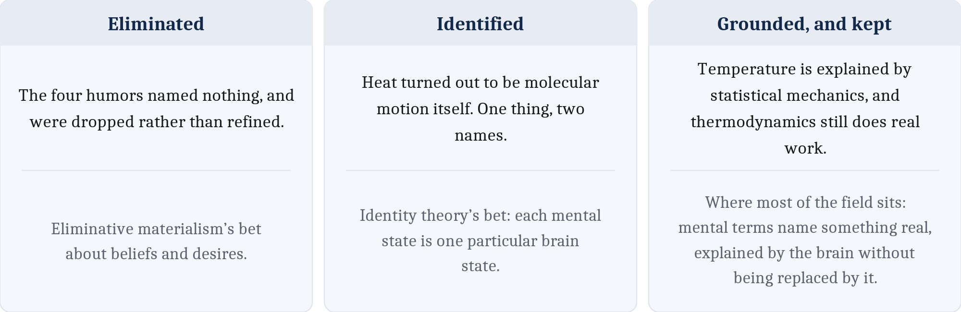
Grounded Without Being Replaced
Temperature. Heat is molecular motion — and thermodynamics still does real work. Its laws tell an engineer how an engine must behave. Nobody throws temperature away to track molecules one at a time. And no single arrangement of molecules is that temperature; countless different ones count as the same.
A traffic jam. Real enough to be late for. It has its own laws — a jam propagates backward along the road at a characteristic speed, whatever the cars. Grounded entirely in cars and drivers, and identical to no particular set of them: the jam persists while every car in it is replaced.
Neither is a ghost. Neither is eliminated. Neither is identical to any one arrangement of its parts.
Notes:
Two worked examples, because this is the distinction people most reliably collapse.
The first is the chapter's own, so it should be familiar.
Physicists discovered heat *is* molecular motion. Same thing, two names.
And yet thermodynamics did not go away.
Its laws still tell an engineer how an engine or a refrigerator has to behave.
Statistical mechanics later explained where those laws come from — but nobody threw temperature away to track molecules one by one.
Two things are true at once there, and both matter.
Temperature is grounded in molecular motion without being *replaced* by it.
And it is not *identical* to any one arrangement, because countless different arrangements are the same temperature.
Now a second one, which is not in your reading.
A traffic jam.
It is real — real enough to make you late, real enough to measure.
It has its own laws. A jam propagates *backward* along the road at a characteristic speed, and that speed is roughly the same whatever cars happen to be in it.
You could in principle describe it car by car, driver by driver. In practice nobody does, and you would learn less if you did.
And here is the part I want you to hold onto.
The jam is identical to no particular set of cars.
Cars enter the front of it and leave the back of it continuously.
Replace every single car and it is still the same jam.
So: grounded entirely in cars. Not replaceable by a list of cars. Not identical to any one set of cars.
That is exactly the shape the third answer claims for the mind.
Not a ghost. Not eliminated. But also not identical to any single arrangement of the parts.

Slide 18
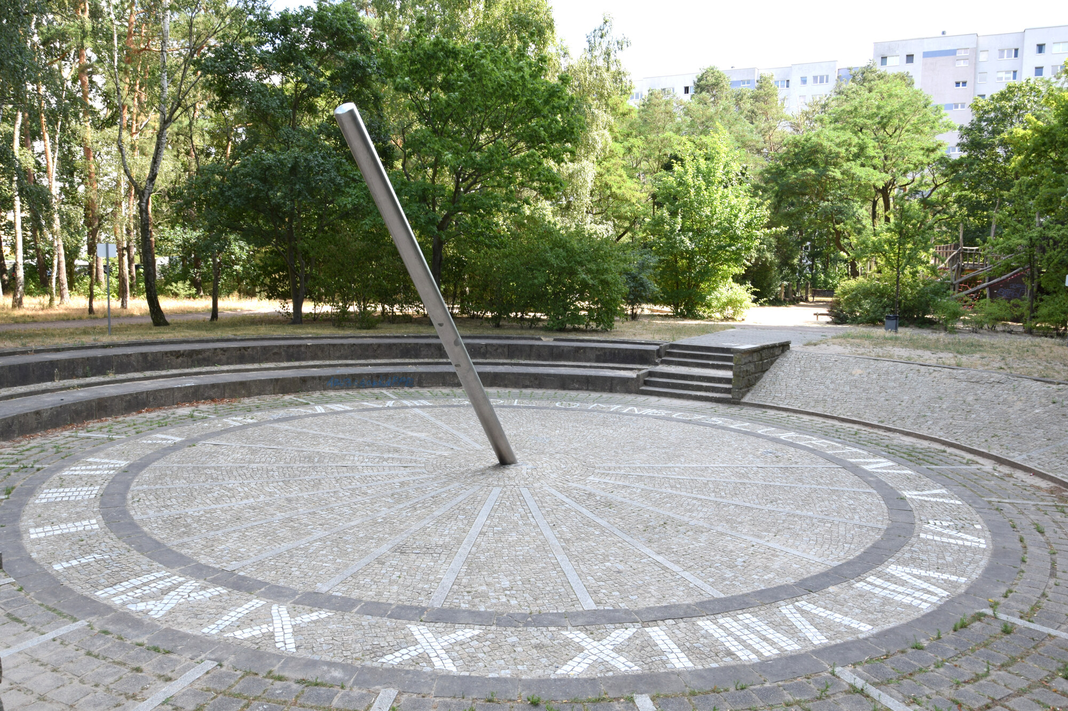
Multiple Realizability
A shadow on stone.
Notes:
Here is the idea that does the heavy lifting, and it has a name worth writing down: **multiple realizability**.
Start somewhere easy.
A sundial tells the time. There is no mechanism here at all — just a shadow falling on stone.

Slide 19

Multiple Realizability
A wound spring and a train of gears.
Notes:
A mechanical clock tells the time too, and it does it with a wound spring and a train of gears. Nothing whatever like a shadow.

Slide 20

Multiple Realizability
A quartz crystal and a battery.
Notes:
And a digital clock tells the time with a quartz crystal and a battery. Nothing like either of the others.

Slide 21

Multiple Realizability
A general-purpose computer that is not a clock at all.
All four tell the time. Telling the time is identical to none of these mechanisms — it is what any of them can do.
Notes:
And then there is this one, which is the interesting case.
A phone has no timekeeping mechanism of its own worth speaking of. It is a general-purpose computer, and one of the ten thousand things it can be made to do is ask a network what time it is and put the answer on the screen.
It is not a clock. It tells the time.
Four completely different physical arrangements, doing the same thing.
So what is "telling the time"?
It is not identical to gears, because a sundial has none.
It is not identical to a quartz crystal, because a sundial has none of that either.
And it is certainly not identical to whatever the phone is doing.
Telling the time is something these very different mechanisms all *do*.

Slide 22
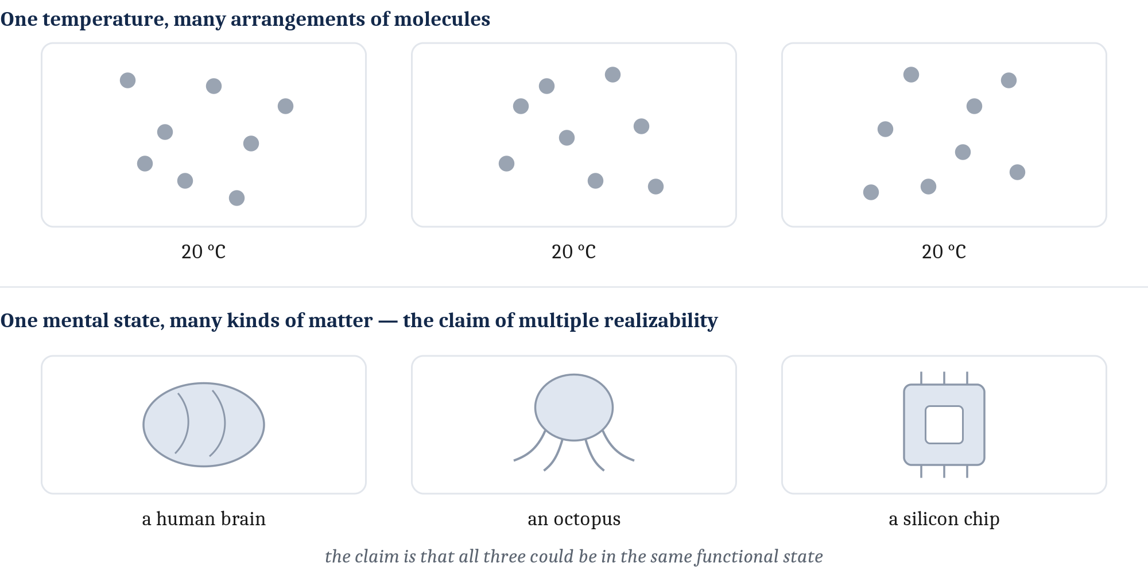
Multiple Realizability
Now run it on minds. Pain in a person, pain in an octopus, pain in an alien, perhaps pain in a machine. They are (perhaps) functionally equivalent, implemented in vastly different stuff.
If pain turns up in systems with no C-fibers, then no firing of C-fibers can be pain.
This is what defeats chauvinism. And it is what turns "could a non-brain have a mind?" from a confusion into a real scientific question.
Notes:
You have already seen this shape once today, with temperature — that is the top row here.
One temperature, many arrangements of molecules, and no single arrangement *is* the temperature.
Now run it on minds — the bottom row.
Pain in a person. Pain in an octopus. Pain in an alien. Maybe pain in a machine.
Functionally equivalent, implemented in wildly different materials.
And if pain shows up in systems that have no C-fibers at all, then no firing of C-fibers can *be* pain.
That is what defeats the chauvinism problem from a few slides ago.
And it does something bigger.
It turns "could something that is not a brain have a mind?" from a confusion into a real scientific question — one you could actually investigate.
That is why this idea is worth more than a passing mention.
It is also not beyond dispute, and we will see it challenged later, especially about machines.

Slide 23
So — Could a Machine Have a Mind?
Each answer to "what kind of thing is a mind?" gives a different verdict:
What a mind is | Verdict on machines
A distinct, non-physical kind of thing | Never. Engineering only arranges physical parts
Nothing but the physical — identity theory | No, by chauvinism. Wrong parts, wrong state
Nothing but the physical — eliminativism | The question dissolves. If we have no beliefs either, asking about a machine is as confused as asking about a person
A real property of the physical | Yes, in principle — though not a claim that any machine yet built has one
Notes:
Let us collect what we have.
Notice that we never asked the machine question separately.
It fell out of the answer to the mind–brain question, every time.
That is the point I most want you to take from today: whatever you conclude about how minds relate to brains *already* tells you what else could have one.
Dualism says never. Engineering only arranges physical parts, and mind is not made of parts.
Identity theory says no, by chauvinism. Wrong hardware, wrong state, end of story.
Eliminativism does something stranger — it does not answer, it dissolves the question. If there are no beliefs and desires for *us* to have, then asking whether a machine has them is as confused as asking whether you do.
And the third answer is the home of "yes, in principle."
That is weaker than it sounds, and I want to be precise.
It says a machine mind is conceptually possible. It does not say any machine yet built has one.
Two people can agree the mind is a real physical property and still disagree about machines, because one question stays open: does that physical basis have to be *biological*?
For the cognitive capacities, most people will say a machine could in principle have them.
It is usually over *consciousness* — the part we parked — that people suspect living matter has features a simulation would copy without reproducing.
The neuroscientist Anil Seth argues roughly that.
That is a bet about substrate. It is not a relapse into dualism.
We are setting this up, not settling it. Module 2 weighs it properly.

Slide 24
A Completely Different Question
Everything so far has been about what a mind is.
This next question is about how we are allowed to study it. It is a question about method, not about material.
Grant that a mental state is a real property of a physical system. Must a good theory of it keep the physical details in view — or can it abstract them away and work at the mental level alone?
Philosophers call this explanatory separability.
Notes:
Stop for a second, because we are changing questions and it is easy to miss the seam.
Everything up to now has been about what a mind *is*. What it is made of. Its ontology.
This next question is not that.
It is about what we are allowed to *do* — about method.
Grant everything the third answer says. The mind is a real property of a physical system.
You still have a live question: when you build a theory of it, must you keep the physical details in view? Or can you abstract them away and work at the mental level alone?
That is **explanatory separability**.
I am flagging the seam because these two questions get run together constantly, including by people who should know better.
"What is a mind made of" and "how must we study it" are different questions with different answers, and you can hold almost any combination.
The old version of this lecture crossed them into a single two-by-two grid, and honestly, that is what made it confusing.
Asked one at a time they are both tractable.

Slide 25
Two Poles
Strong autonomy. Psychology is a science in its own right — standing to neuroscience roughly as chemistry stands to physics. Grounded in it, not replaceable by it.
You can describe a football play — the routes, the timing, who reads whom — without describing anyone's muscle fibres. And the same play runs with different players.
Realization-sensitivity. The mind is real and physical, and how it is realized shapes what it can be. A theory that abstracts away from body and brain will miss something, possibly something critical.
Embodied cognition pulls this way: thinking may be as much a matter of acting in a world as of shuffling symbols in a head.
Notes:
Two poles, and most people sit somewhere between them.
At one end, strong autonomy.
Psychology is its own science, standing to neuroscience roughly as chemistry stands to physics — grounded in it, not replaceable by it.
Here is the intuition.
You can describe a football play completely — the routes, the timing, who reads which defender — without saying one word about muscle fibres or motor neurons.
And the same play runs next week with different players in it.
The play is real, it is analysable, and it floats free of the particular bodies executing it.
That is the liberal functionalist's confidence, and it is a wing of the third answer.
At the other end, something more cautious.
The mind is real and physical, and the details of *how* it is realized shape what it can be.
Abstract away from the body and the brain and you will miss something, possibly something critical.
Embodied cognition pulls hard this way.
The thought is that thinking may be as much a matter of acting in a world as of shuffling symbols inside a head — and if that is right, a disembodied program is not obviously enough.
The sharper version of this worry: two systems that look alike from far enough away may not actually share a mental state unless they are organized alike underneath. And if you look closely enough, those differences show up at the functional level too.

Slide 26
Separable, But Not Independent
You can ask about each level on its own — and the answers constrain one another.
Neither pole is obviously right, and the disagreement has consequences. It decides how far a science of the mind can float free of a science of the brain.
Back to the board. Look at where this room started. Has anyone moved?
Notes:
Where this leaves us is a phrase worth keeping: the levels of a mind are **separable, but not independent**.
You can ask about each one on its own. That is the separable part, and it is what makes psychology possible as a science.
But the answers constrain each other. That is the not-independent part, and it is what stops psychology floating away from biology entirely.
Neither pole is obviously right, and this is not a stalemate anyone should be relaxed about.
It decides how far a science of the mind can run free of a science of the brain — which is a question about what this whole field is.
Now back to the four options from the start of class.
Has your answer moved?
And more useful than that: can you now say what your position *costs* you?
Because every one of them costs something. That was the point of today.

Slide 27
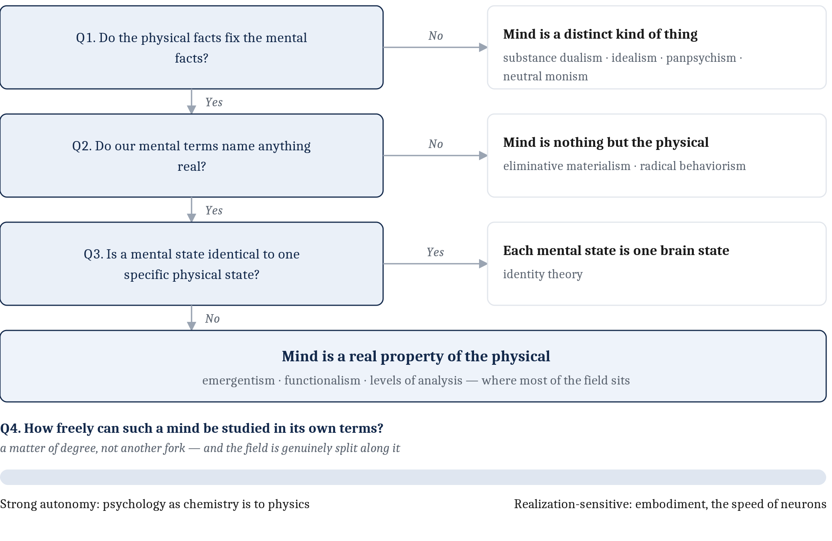
Where the Field Sits — and What Is Still Missing
The mind is a real property of the physical. How much independence it gets is still argued.
The famous positions were never boxes we sorted the world into. They are names for ways of answering two questions.
But "study the mind at its own level" has a satisfying ring, and we have not said what the levels are.
Next: §1.2 — Marr's three levels of analysis. The framework the whole rest of the course runs on.
Notes:
So here is where most of contemporary brain and cognitive science actually sits.
The mind is a real property of the physical.
Dependent on it, and yet demanding explanation in its own terms.
And the exact degree of that independence is still under active argument.
Notice what we did *not* do today.
We did not hand you a set of boxes and sort the world into them.
We asked two questions — what kind of thing is a mind, and how freely can we study it — and the famous positions fell out as names for the different ways of answering them.
That is a better way to hold this material, because it means you can reconstruct the landscape instead of memorizing it.
But I want to end on what is missing, because it should bother you.
"Study the mind at its own level" is a satisfying phrase.
And we have not said what the levels *are*.
Not one of them. We have been waving at a framework we have not built.
That is next.
Marr's three levels of analysis — where they come from, why there are three, and why this is the structure the entire rest of this course runs on.
Read §1.2 before then.

Slide 28
Image Sources (1 of 2)
Slide | Image | File | Licence | Source
2 | Missing a step on the stairs | missed_stair.jpg | Author's own AI-generated image; see IMAGE_CREDITS.md | Jon Willits — generated with ChatGPT (OpenAI) · own work
3 | A companion app, months in | companion_app_conversation.png | CC BY 4.0 | Jon Willits — drawn for this lecture · own work
6 | Roomba robotic floor vacuum | robot_vacuum.jpg | CC BY 4.0 | Larry D. Moore · https://commons.wikimedia.org/wiki/File:Roomba_original.jpg
6 | Venus flytrap | venus_flytrap.jpg | CC BY 4.0 | ImagePerson · https://commons.wikimedia.org/wiki/File:Venus_flytrap_(Dionaea_muscipula)_Zagreb_Botanical_Garden_1060.jpg
6 | Bacterial chemotaxis, dark-field time lapse | bacteria_chemotaxis.gif | CC BY 4.0 | Erin Rod · https://commons.wikimedia.org/wiki/File:Bacterial_chemotaxis_to_glucose,_sugar,_%26_glycine_exposure.gif
7 | Mind, consciousness, and qualia | fig-mind-consciousness-qualia.png | CC BY 4.0 | Jon Willits — figure from the Module 1 reading · own work
9 | Portrait of René Descartes | descartes_portrait.jpg | not recorded | —
12 | Common octopus | octopus.jpg | CC BY-SA 3.0 | Beckmannjan · https://commons.wikimedia.org/wiki/File:Octopus_vulgaris2.jpg

Slide 29
Image Sources (2 of 2)
Slide | Image | File | Licence | Source
14 | Three fates of a higher-level concept | fig-three-fates.png | CC BY 4.0 | Jon Willits — figure from the Module 1 reading · own work
15 | Sundial sculpture, Berlin | clock_sundial.jpg | CC0 1.0 | Singlespeedfahrer · https://commons.wikimedia.org/wiki/File:Sculpture_Sundial_Frank_von_Bargen_Berlin_01.jpg
15 | Mechanical travel alarm clock | clock_mechanical.jpg | Free use with attribution — see IMAGE_CREDITS.md | Friedrich Haag · https://commons.wikimedia.org/wiki/File:001_2020_04_21_Uhren_fuer_den_Innenbereich.jpg
15 | Digital alarm clock | clock_digital.jpg | CC BY-SA 4.0 | Tbatb · https://commons.wikimedia.org/wiki/File:A_digital_alarm_clock_in_Glasgow.jpg
15 | A phone showing the time | clock_phone.jpg | Author's own screenshot; the interface shown is Apple's | Jon Willits — own screenshot · own work
15 | One property, many realizations | fig-multiple-realizability.png | CC BY 4.0 | Jon Willits — figure from the Module 1 reading · own work
20 | The positions as answers to four questions | fig-position-tree.png | CC BY 4.0 | Jon Willits — figure from the Module 1 reading · own work

