Slide 1

BCOG 100
1.2 Levels of Analysis
Notes:
Wednesday we asked what kind of thing a mind is, and we landed somewhere specific: a mind is a real property of a physical system — dependent on the physical, and still demanding explanation in its own terms.
Today we cash the second half of that. What does it actually mean to explain something "in its own terms"?

Slide 2
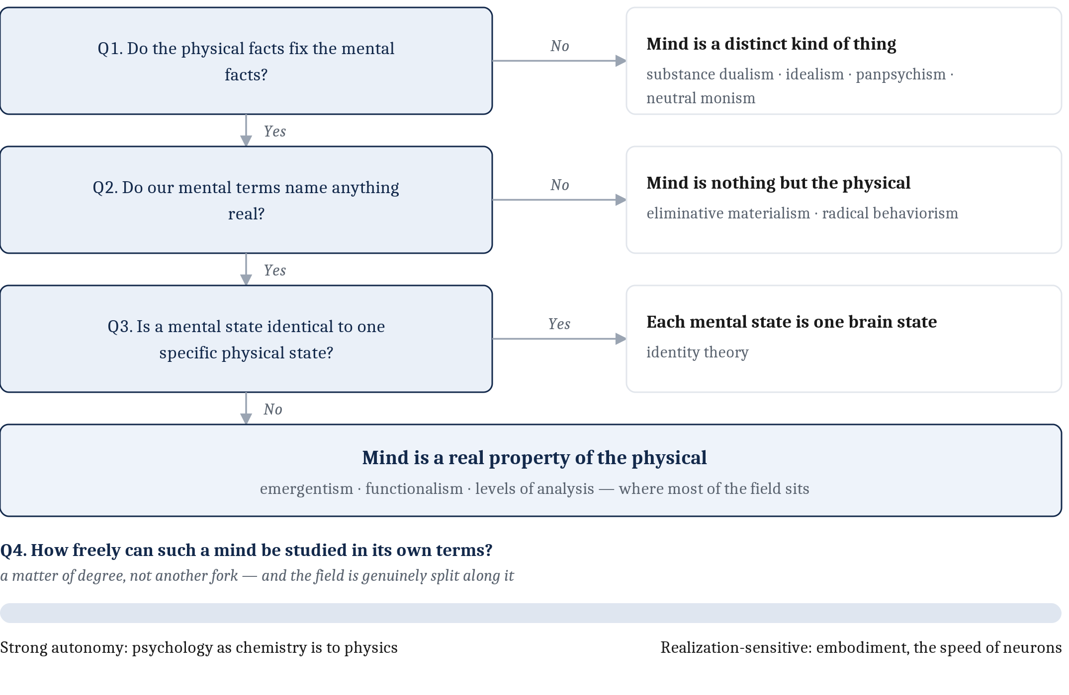
Where We Stopped, and What I Owe You
Notes:
Let me start by being straight with you about where we stopped on Wednesday, because we did not get as far as I planned.
Where we got to was the third answer, and I think it is the right one. A mind is not a thing. It is a *property* — something physical stuff has when it is organized and active in the right way. Like mass. Like temperature. Like being alive.
That is a real place to stand. It is also, right now, thin, and I want to name exactly how.
The standard way people finish that sentence is: *and therefore you can study the mind at its own level.* You will read that phrase everywhere. Say it out loud and it sounds like an answer.
But nobody has told you what a **level** is. Including me.
That is the first debt, and most of today pays it off.
And there is a second one, which we simply ran out of clock for on Wednesday. Granting that a mind is a property of the physical — how freely can we study it in its own terms? Does a good theory of the mind have to keep the biology in view, or can psychology run more or less free of it? We will get there at the end of the hour, and I will tell you now that the field is genuinely split on it.
So: what the levels are, why one is never enough, why these particular three are the spine of this course — and then that second question.

Slide 3
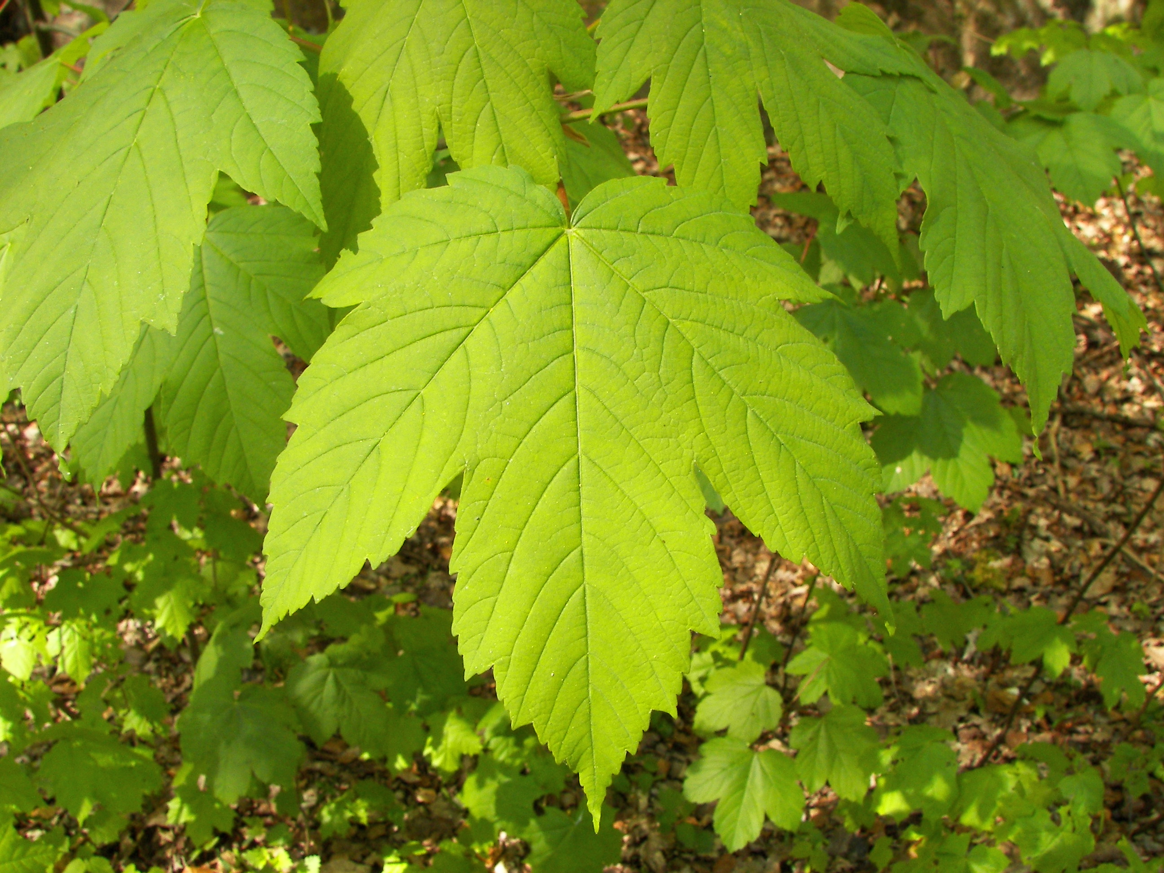
Start Where There Is No Mind At All
A leaf. Ask three different questions about it:
What is it for? Capturing energy from sunlight.
By what strategy? Spread thin and wide to catch as much light as possible; track the sun; run a chemical cascade that stores the energy in a bond.
What is it made of? Chloroplasts, stacked membranes, pigment molecules, pores that open and close.
Now: which of those three is the real explanation?
Notes:
Before we go anywhere near minds, let us do this somewhere it cannot get complicated.
A leaf. There is nothing it is like to be a leaf. No consciousness, no inner life, nothing to argue about.
Ask three questions about it.
What is it for? Capturing energy from sunlight.
By what strategy? Spread out thin and wide so you intercept as much light as you can. Track the sun over the day. Run a chemical cascade that takes that light and stores the energy in a chemical bond.
And what is it made of? Chloroplasts. Stacked membranes. Pigment molecules. Little pores on the underside that open and close.
Here is my question, and I want you to actually feel the answer rather than just agree with it.
Which of those three is the *real* explanation of the leaf?
None of them, and that is the point.
The chemistry does not make it false that the leaf is for capturing light. Knowing what it is for does not tell you it uses chloroplasts.
They are three different questions, and you have not understood the leaf until you can answer all three.
And notice — this is the same move we made Wednesday, one level up. We refused to throw out the mind in favor of the brain. Now we are refusing to throw out one kind of *explanation* in favor of another.

Slide 4
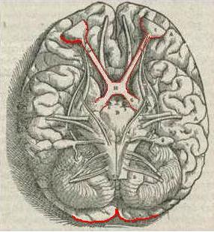
Where This Framework Came From
1970s. Neuroscientists are learning an enormous amount about individual neurons in the visual system — and getting no closer to explaining how seeing works.
David Marr's complaint: trying to understand vision by studying neurons alone is like trying to understand the flight of a bird by studying only feathers.
It cannot be done.
Not because feathers are irrelevant. Because the question you are asking is not a question about feathers.
Notes:
This framework has an origin, and the origin is a complaint.
In the nineteen-seventies, vision neuroscience was going extremely well and also, in a sense, going nowhere. People were learning an enormous amount about what individual neurons in the visual system do. And it was not adding up to an explanation of how seeing works.
David Marr, who is the person this framework is named after, put it in a line that has stuck for fifty years.
Trying to understand vision by studying only neurons is like trying to understand the flight of a bird by studying only feathers. It cannot be done.
I want to be careful about what that means, because it is easy to hear it as anti-neuroscience. It is not.
Feathers are not irrelevant to flight. You cannot fly without them.
The point is that "how does a bird fly" is a question about airfoils and lift and air — and no amount of detail about the structure of a feather answers it, because it is not a question about feathers.
Marr's proposal was that there are three kinds of question here, and you need all three.

Slide 5
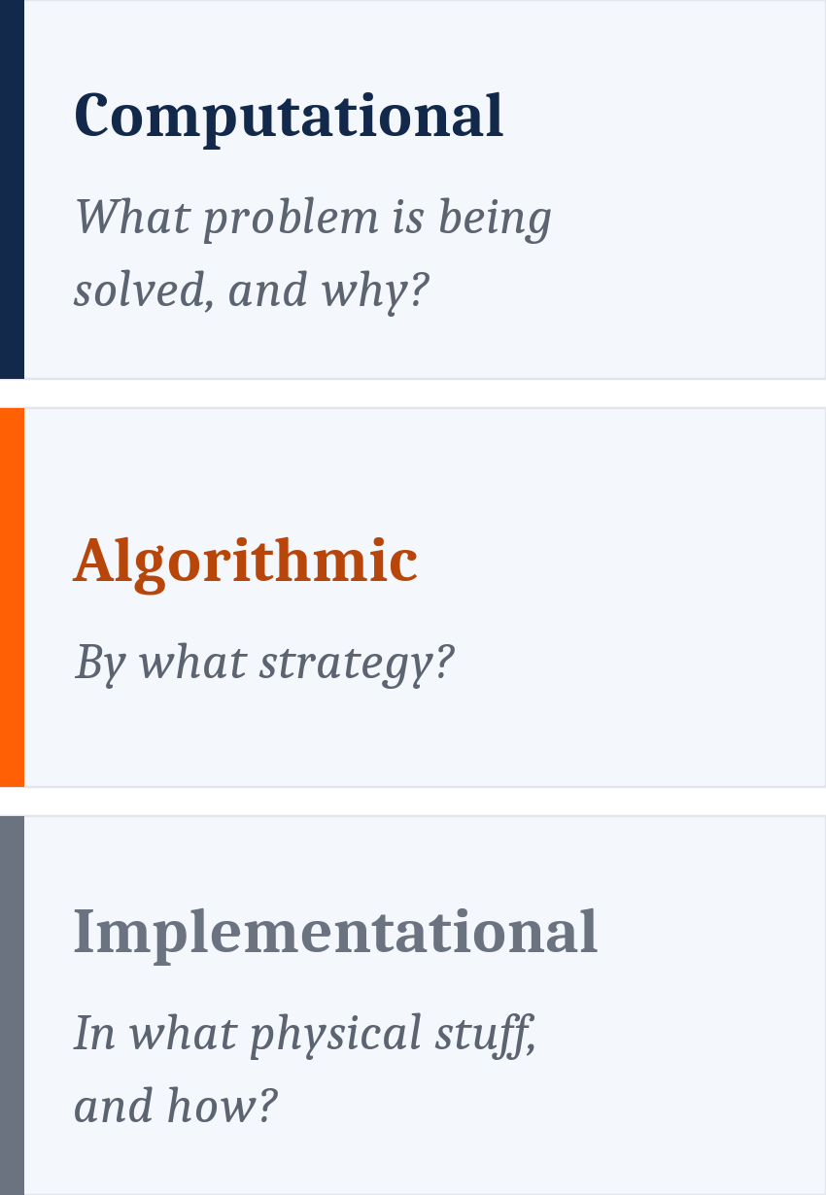
Marr's Three Levels
Marr's contribution was not discovering that these differ. It was naming them, sharpening them, and insisting all three are needed.
Notes:
Here are the three. They are worth knowing well, because the rest of the semester runs on them.
The **computational** level asks what problem the system is solving. Not "what does it do" in a vague sense — what is the task, and what would anything at all have to respect in order to accomplish it? This is a question about the problem itself, not about the machinery. You can often answer it without knowing anything about what the system is built from.
The **algorithmic** level asks how the problem gets solved. What procedure? Operating over what representations? What are the actual steps?
The **implementational** level asks what physical stuff carries those steps out, and how.
Notice these map straight onto the three questions we just asked about the leaf. What for. By what strategy. Made of what.
And notice what Marr's actual contribution was, because people get this wrong. He did not discover that these are different questions. Aristotle was doing something similar two thousand years earlier — he had four questions rather than three. Dennett has a version with three stances. There is a whole mechanistic tradition in philosophy of biology with its own carving.
What Marr did was name these three, sharpen them, and insist that all three are needed. And we are adopting his version — not because it is uniquely correct, but because it lines up almost perfectly with how our field already divides itself. More on that in a few minutes.

Slide 6
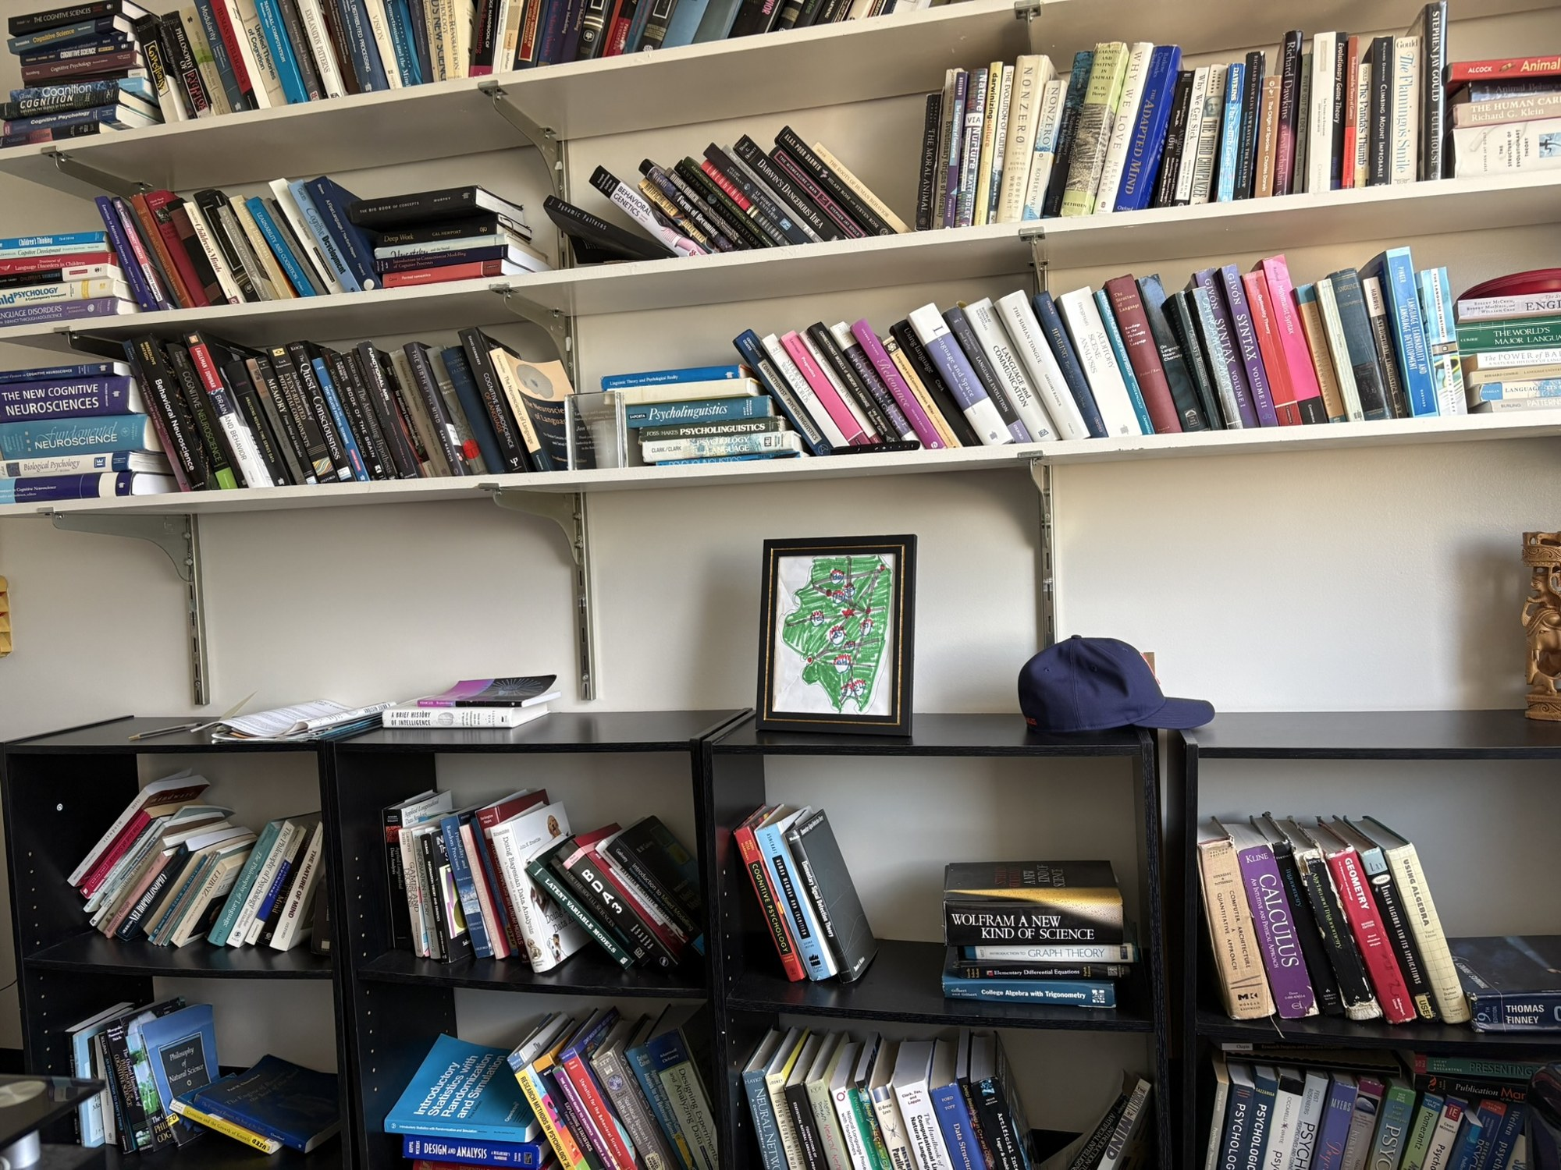
One Problem, Many Solutions
The problem: put a shelf of books in alphabetical order.
Stated without any procedure at all. It is a fact about the task.
The procedures. Take one book at a time and slot it where it belongs. Or split the shelf in half, sort each half, merge them. Or find the earliest, put it first, repeat.
All different. All correct.
Notes:
Let us make the three levels concrete on something completely mundane.
The problem: put a shelf of books in alphabetical order.
Notice I just stated that without telling you a single thing about how to do it. That is the computational level. It is a fact about the task. Anything that solves it has to respect it.
Now, how?
You could take one book at a time and slot it into the right place among the ones already sorted.
You could split the shelf in half, sort each half, and merge them together.
You could scan the whole shelf for the earliest title, put it at the front, and repeat.
Those are genuinely different procedures. They take different amounts of time. They are all correct.
That is the algorithmic level, and here is the thing I want you to notice: knowing the problem did not tell you which one to use.

Slide 7
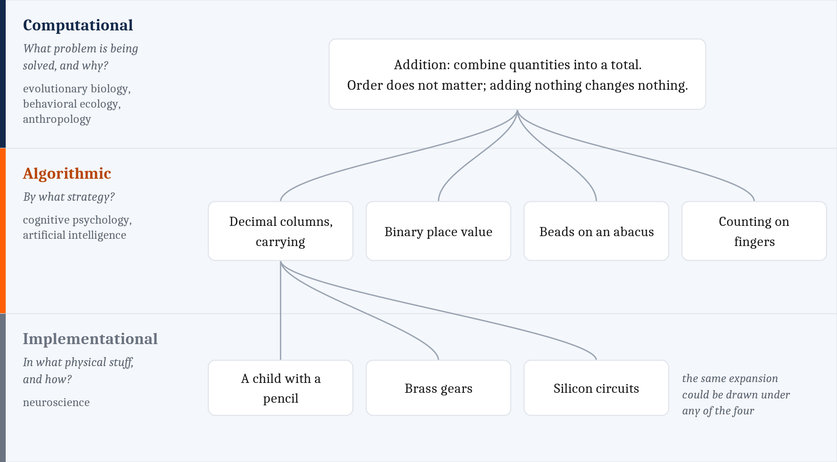
One Problem, Many Solutions
The machinery. You, on a Saturday. A library cart and three volunteers. A database, in four milliseconds.
Same procedure. Utterly different stuff.
Notes:
And each of those procedures can run on completely different stuff.
You, alone, on a Saturday afternoon.
A library cart and three volunteers.
A database that does it in four milliseconds.
Same procedure. Utterly different physical material.
The chapter makes the same point on addition rather than books: one problem at the top, several procedures under it, several machines under one of those.
It is worth noticing that this is a *tree* and not a stack. Most people arrive picturing a layer cake, where each level has exactly one thing above it and one below. It is not like that. It branches, in both directions.

Slide 8
Why You Cannot Skip One
The relations are many-to-one in both directions:
one problem → many algorithms
one algorithm → many implementations
So, fixing one level leaves the others open.
Knowing the problem does not tell you the procedure.
Knowing the procedure does not tell you the hardware.
Which means an answer at one level cannot stand in for an answer at another.
These are not three descriptions of one fact. They are answers to three different questions.
Marr went further, and this part is contested: he argued the levels are ordered, computational first, so analysis should run top-down.
We will come back and challenge it at the end.
Notes:
This is the argument, and it is a structural one rather than a matter of taste. I want to do it slowly because everything else rests on it.
The relations between the levels are many-to-one, in both directions.
One problem can be solved by many algorithms. One algorithm can be implemented in many different materials.
Follow the consequence.
If knowing the problem left only one possible procedure, then describing the problem would *be* describing the procedure. But it does not — you saw three ways to sort a shelf.
And if knowing the procedure left only one possible machine, describing the procedure would be describing the hardware. But it does not.
So fixing any one level leaves the others genuinely open. Which means an answer at one level cannot stand in for an answer at another. There is real information at each level that the others do not contain.
That is why this is not three ways of saying the same thing. It is three answers to three different questions.
And this is exactly Marr's complaint about the feathers, now stated precisely. A complete description of the neurons — the implementation — does not contain the answer to what problem the system solves, or by what procedure. Not because the neuroscience is bad. Because that information lives at a different level.
One more thing about Marr before we move on, and this one is more controversial than anything I have said so far.
He argued the three levels are *ordered*, with the computational first. On his view, analysis should run top-down: work out what problem the system is solving, then what algorithm could solve it, and only then go looking for that algorithm in the tissue.
You can see why he thought so — it is the natural reading of the feathers complaint. The neuroscientists were failing because they started at the bottom.
I want to flag clearly that this is a claim rather than an obvious truth, and that plenty of people disagree with it. Keep it in your pocket. We are going to come back and hit it fairly hard at the end of the hour.

Slide 9
Why These Three Are the Spine of This Course
The levels line up with how brain and cognitive science already divides itself:
Computational — evolutionary biology, behavioral ecology, anthropology
Algorithmic — cognitive psychology, artificial intelligence
Implementational — neuroscience
That is not a coincidence. The fields grew up around different questions.
Which explains a great deal about why they talk past one another — and means their findings can be combined rather than ranked.
Notes:
So why does this framework organize a whole course?
Because the three levels line up with the way our field already divides itself into disciplines.
The computational question — what problem is this for — is home turf for evolutionary biology, behavioral ecology, anthropology, and parts of psychology.
The algorithmic question is the province of cognitive psychology and artificial intelligence.
The implementational question belongs to neuroscience.
And that alignment is not a happy accident. It is the other way around. Those fields grew up around different questions in the first place. The disciplinary boundaries *are* the level boundaries, more or less.
Two payoffs from noticing that.
The first is that it explains a lot of the friction. When a neuroscientist and a cognitive psychologist seem to be disagreeing, very often they are not disagreeing at all — they are answering different questions and each thinks the other is answering theirs badly.
The second is the reason we run the course this way. If you lay the levels side by side, the findings from these fields can be *combined* rather than *ranked*. You stop asking which discipline has the real answer. That question dissolves.
From Module 3 onward, most weeks give each level its own lecture. Monday computational, Wednesday algorithmic, Friday implementational. This is the structure you are going to live in.

Slide 10
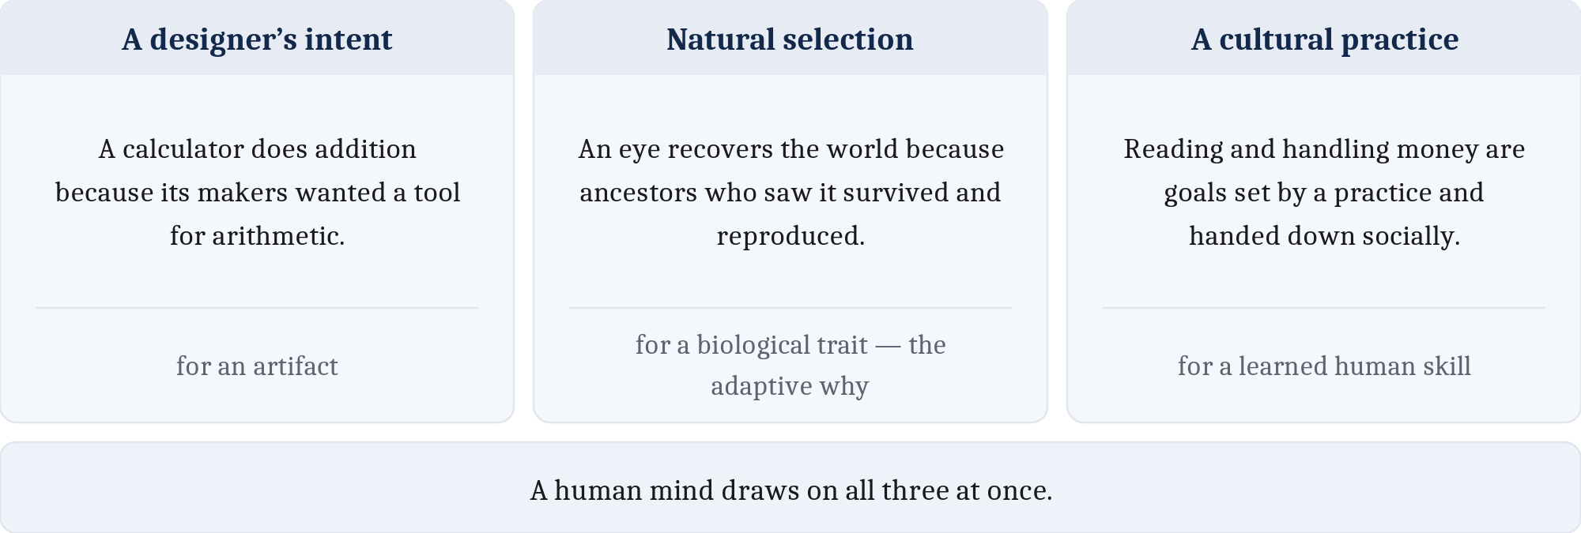
Where Does a "Why" Come From With No Designer?
For a calculator: somebody wanted one.
A leaf has no designer. Neither does an eye, or a memory system.
For living things, the computational question becomes one about ancestry and survival — the adaptive why.
But an adaptive why is a hypothesis to be tested, not a story to be assumed.
Notes:
Now a wrinkle in the computational level that turns out to matter enormously.
For something a person made, the "what is it for" question is easy. A calculator is for arithmetic because the people who built it wanted an arithmetic tool. The why bottoms out in somebody's intention.
But a leaf has no designer. Neither does an eye. Neither does a memory system.
So for living things, the computational question turns into a question about ancestry and survival. What problem did this organism's ancestors face, such that solving it helped them survive and reproduce and pass on the machinery that did the solving? That is what we call the **adaptive why**.
And I want you to see that this is why evolution is the spine of this course rather than one week's topic. It is not that we like evolution. It is that for a biological system, the adaptive why *is* the computational level. You cannot do the top level of Marr's framework on an organism without doing evolution.
Now the guardrail, and I am giving it to you immediately rather than later, because the failure mode is seductive.
An adaptive why is a hypothesis. It is something you test. It is not a story you make up because it sounds good.
Not every trait is an adaptation. Some are byproducts of something else. Some are the residue of chance. Some are historical accidents that simply stuck around.
It is very easy to tell a satisfying story about why some feature must have been selected for, and be completely wrong. We will keep running into this.
So there are three sources of a computational goal, one for each kind of system: a designer's intent, natural selection, and a cultural practice. The third one is where we go next.

Slide 11
The Third Source: Culture
Many problems a modern mind solves were set by cultural practice. Natural selection has not had nearly enough time.
Music. Every known human culture makes it. But which scales, which rhythms, which instruments — are handed down, not inherited. And it runs on machinery that was doing other jobs first: hearing out a voice in a noisy room, timing a movement.
Is the capacity for music itself an adaptation, or did culture recruit it? People genuinely disagree — which is what a hypothesis looks like.
 | Adapted across generations | Adapted within a lifetime
Timescale | many generations | days to years
Mechanism | natural selection on a lineage | learning and practice
What changes | gene frequencies in a population | one brain
What is passed on | genes | skills, taught
Notes:
The third source of a computational goal is culture, and for our species it is enormous.
A great many of the problems your mind solves every day were set by cultural practice rather than by a designer or directly by selection. Selection has not had anything like enough time.
Take music.
Every known human culture makes music. There is no society we have found that does not. So it is about as universal as a human practice gets.
But *which* music is handed down, not inherited. Which scales count as in tune, which rhythms are danceable, which instruments exist at all — you learned that, from people around you.
And it plainly runs on machinery that was doing other jobs first. Picking a melody out of a noisy room is the same problem as picking a voice out of a noisy room. Clapping on the beat uses motor timing that was there for walking and throwing.
Now here is where it gets genuinely interesting, and it is why I picked music rather than something tidier.
Is the *capacity* for music itself an adaptation? Did selection build it because musical groups cooperated better? Or is music something culture recruited out of parts that evolved for hearing and moving?
People who study this for a living disagree. Right now. In print.
And that is not a weakness of the example — that is what I meant ten minutes ago when I said an adaptive why is a hypothesis. Here is one being argued about.
One last thing, and it is the correction to an over-correction. Do not walk out of here thinking culture explains what evolution cannot. The capacity to acquire things through culture — our flexible learning, our language, our habit of teaching each other — is itself among the strongest biological adaptations we have. Cultural goals rest on an evolved foundation. They do not replace it.
Which brings me to one word that names two completely different things, and telling them apart is genuinely one of the hard tasks of this field. We say a trait is *adapted* across generations, by selection acting on a lineage. And we say a skill is *adapted* within a lifetime, by a person learning it. Both leave a mind better matched to a problem. Almost nothing else about them is the same.

Slide 12
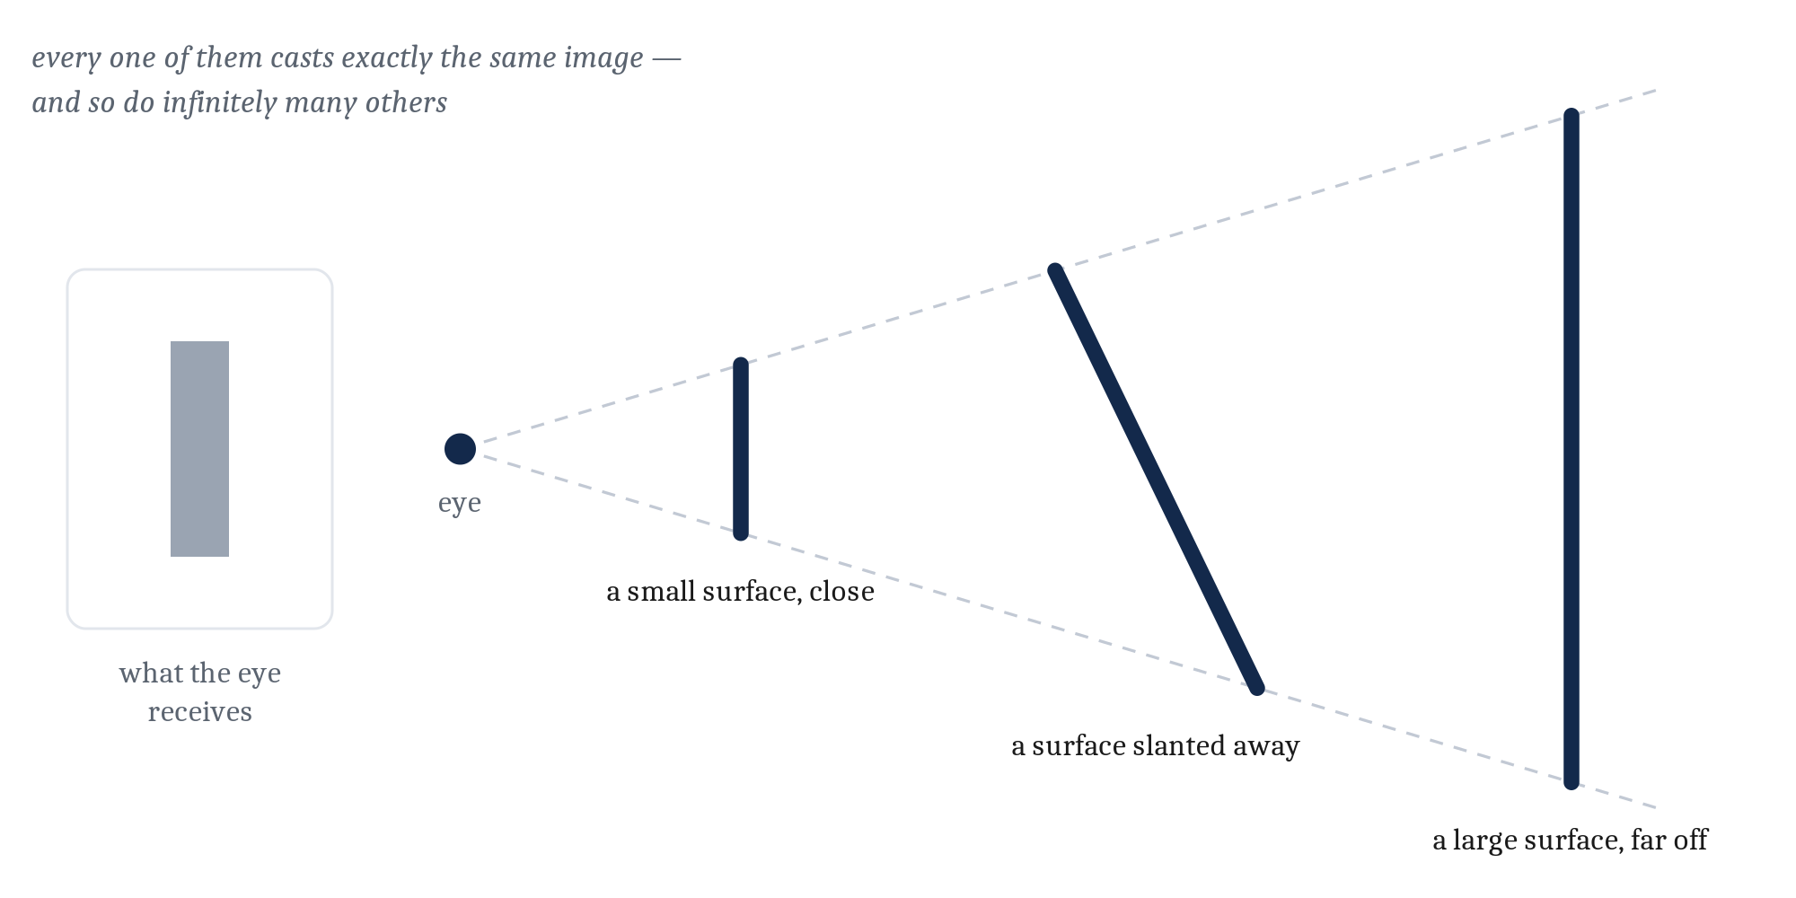
A Worked Case: Vision
The obvious answer: vision is for seeing what is out there.
Not wrong. But…
The retinal input is, in effect, flat.
What the animal needs to know about is the solid world that produced it.
Infinitely many 3D scenes cast exactly the same flat image. The data alone cannot say which one is out there. This is an ill-posed problem.
Notes:
Let us take one capacity and run it all the way through all three levels, so you see the framework working rather than just asserted. Vision, because it is the case Marr himself worked on and the one the field understands best.
Computational level first. What problem is vision solving?
Obvious answer: seeing what is out there. And that is not wrong. But it hides the actual difficulty, and you only see the difficulty when you look at what the eye has to work with.
The retina registers how much light, and of what color, lands on each point of a surface that has no depth of its own. That is it. The input is effectively a flat array of brightness and color. Like a camera sensor.
But a flat picture is not what an animal needs. What you need to know about is the solid world that produced it — where things are, how far away, what shape, which ones are separate objects.
So one way to state vision's problem is: recover the three-dimensional world from the flat pattern of light.
And here is the part that should bother you.
Infinitely many different three-dimensional scenes would cast exactly the same flat image. Every one of those surfaces has its ends on the same two rays. From the image alone there is no way to tell which one is actually out there.
That is called an **ill-posed problem** — the data do not determine the answer.
Which raises the obvious question. You are all doing this right now, apparently effortlessly. How?

Slide 13
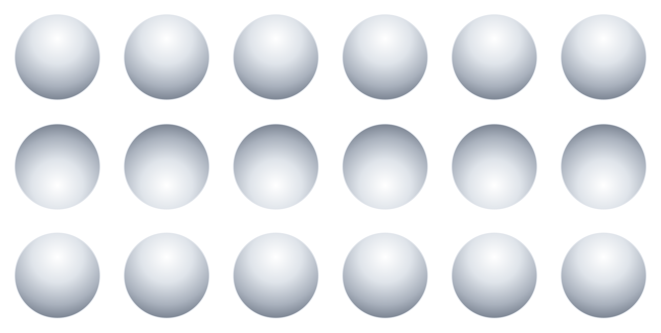
Your Visual System Is Guessing Right Now
Which of these are bumps, and which are dimples?
Notes:
Which of those discs are bumps coming toward you, and which are dimples pressed in? It is worth deciding before reading on, because people do not always agree.
Every one of those discs has *identical* shading. The picture is generated, so that is guaranteed rather than approximate. The only difference is that one row is turned upside down.
So why do they look different?
Because the visual system is solving an ill-posed problem by making an assumption. And the assumption is: light comes from above. It has been true for essentially every moment of your evolutionary history, and it is a very good bet.
If light comes from above, a bump is lit on top and shadowed underneath. A dimple is the reverse. Flip the shading and you flip what it must be.
Nobody decides to do this, and nobody can decide to stop. Look as hard as you like; the effect does not go away.

Slide 14
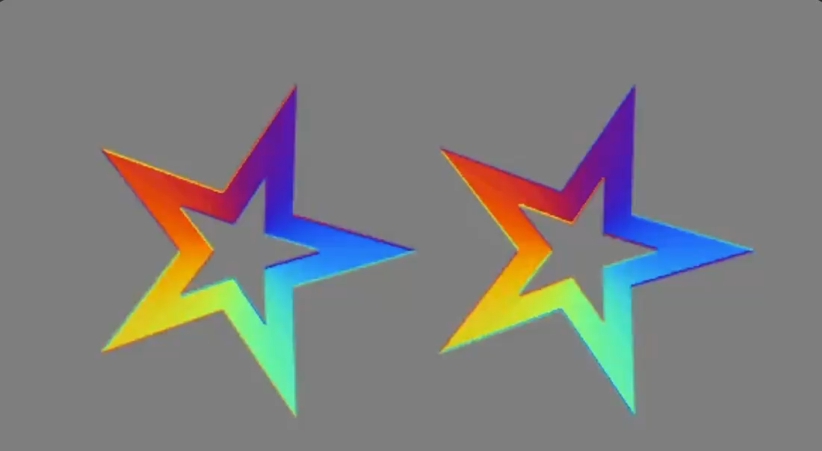
Your Visual System Is Guessing Right Now
Are the stars moving?
Notes:
Are these starts moving. They look like it.
But this is an illusion.
If you focus really intensely at one edge of one star and try to see if it is moving you will see it is not.
Again the visual system is solving an ill-posed problem by making an assumption.
. The colors are changing in ways that your eyes interpret as motion
As before, look as hard as you like; the effect does not go away.
And here is the payoff for the whole framework. That assumption is not visible in the neurons. You could map every cell in the visual system in complete detail and never find a neuron labeled "light comes from above." You find it by asking what problem is being solved and what would be needed to solve it — which is the computational level, doing work that no amount of implementational detail could have done.

Slide 15
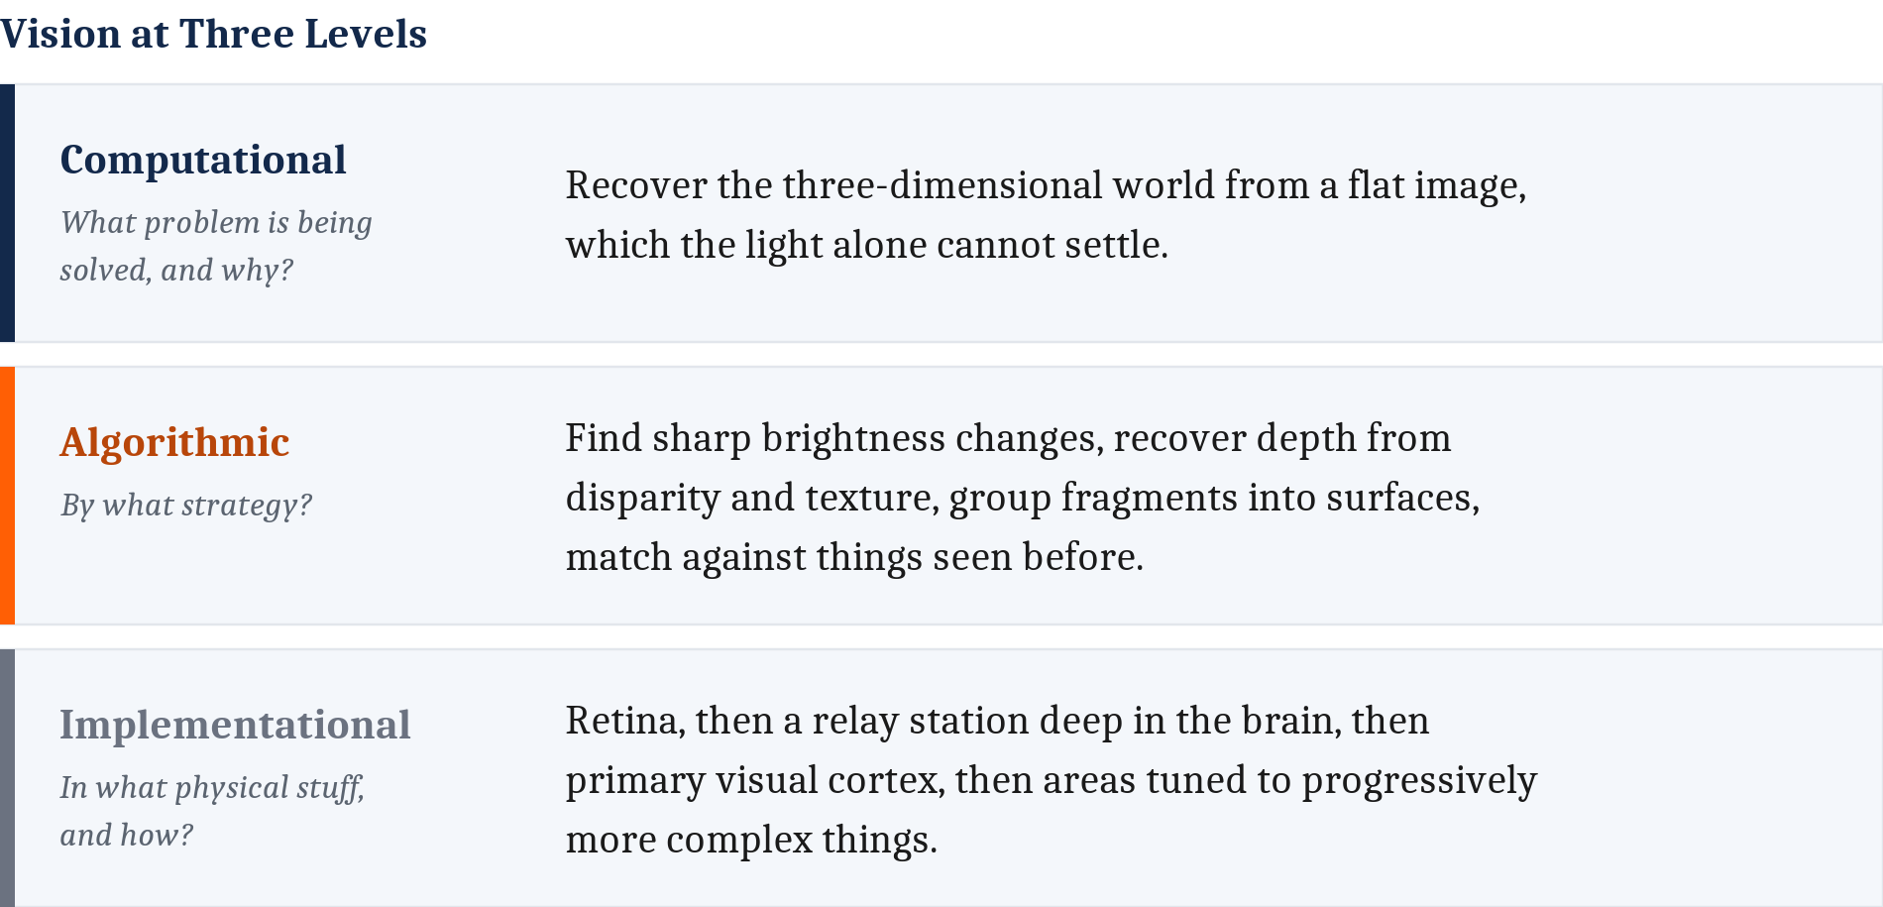
Vision, All Three Levels
Notes:
Here is the whole thing assembled.
At the computational level: recover the solid world from a flat and ambiguous image, using assumptions about how the world usually is. That is the problem, properly stated.
At the algorithmic level: find edges where brightness changes sharply. Group those edges into surfaces. Use the slight difference between your two eyes, and the way texture gets finer with distance, to get depth. Segment the scene into separate objects. Match those against what you have stored.
Notice I described all of that without mentioning a single neuron. That is why it is cognitive psychology's territory.
At the implementational level: light hits photoreceptors, signals pass through the retina to the thalamus and on to primary visual cortex, where Hubel and Wiesel found cells that fire specifically for edges at particular orientations — and onward through a hierarchy toward areas specialized for objects and faces. Though I should say the real thing is a good deal messier than any clean pipeline.
And now the actual argument of this whole section.
Hubel and Wiesel's finding, on its own, is a curiosity. Some cells like lines at particular angles. So what?
It becomes *understanding* the moment you join it to the algorithm it serves — edge detection — and to the problem that algorithm is worth solving — recovering a solid world from a flat image.
That is Marr's complaint, answered. Not by doing less neuroscience. By putting the neuroscience in a frame that makes it mean something.
One caution before we leave vision, because it is a thread this course keeps picking up. A convolutional neural network — the kind of system behind modern image recognition — behaves in some ways remarkably like human vision, and it is very tempting to conclude they are doing the same thing. Resist that, for the reason we established earlier: vision is many-to-one, and ours is not the only solution. The way you actually find out is to look at how each one *fails*. We have illusions we cannot switch off; image networks fall over on pixel changes you literally cannot see. Two systems running the same algorithm should break in the same places, and these do not. We take that up properly in Module 2.

Slide 16
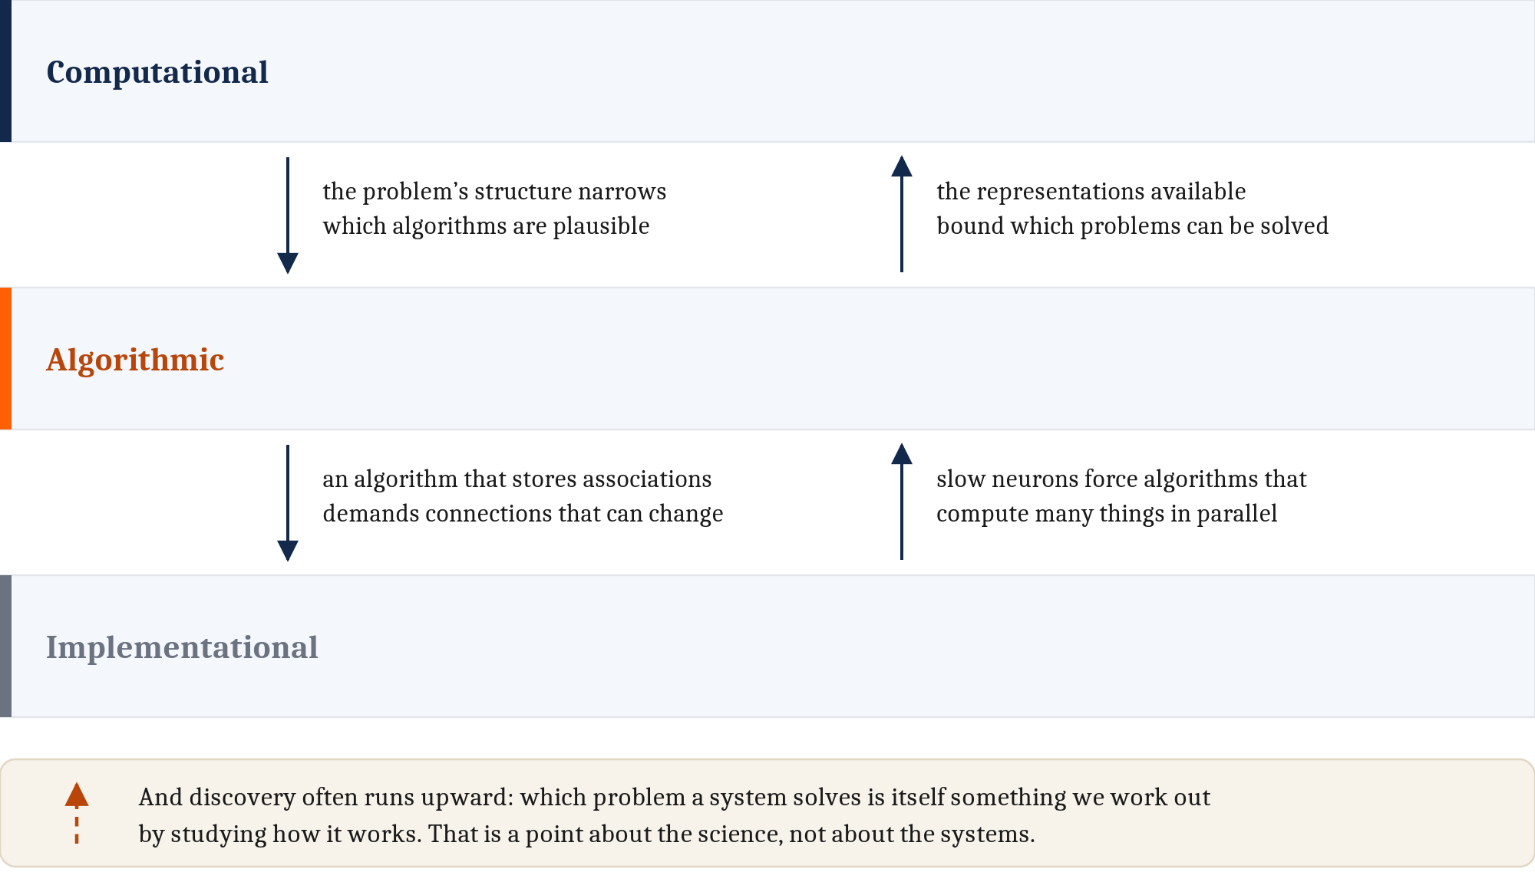
Separable, But Not Independent
Worked through like that, the levels look almost too clean. But they are not sealed rooms.
Notes:
Now I promised we would come back and challenge Marr, and here it is.
Worked through the way I just did it, the levels look almost too clean. Three neat boxes, do them in order. That is not quite right, and the qualification is where the framework gets interesting.
The levels are conceptually separable. They are not independent. They constrain each other, and they do it in both directions.
Marr emphasized the downward direction: the structure of the problem narrows which algorithms are plausible.
But others have pointed out the upward constraints are at least as strong. What a system is built from shapes which procedures are even available to it. And it goes further than that — the representations a system happens to have bound which problems it can attempt at all, not merely how it solves them. A mind with no way to represent exact large quantities cannot attempt problems that require them. Place-value notation did not just make arithmetic easier; it made some problems thinkable.
And recast all this through evolution, which is the deepest version of the objection. Evolution does not have a problem in mind and then design a solution. Implementations compete, and what is available to compete is constrained by whatever structures already exist. It tinkers. It settles for good enough. So the clean top-down story is an idealization — it fits an AI engineer, who really does start with a problem, far better than it fits natural selection.
Then a third dependence, and this one is different in kind — it is about *us* rather than about the systems. Working out what problem a system solves is itself part of the scientific job. We do not get handed the computational level and then go looking. Often we work out what the problem was by studying how the thing works. That is why the dashed arrow in the figure is drawn differently.
And that applies to what I told you twenty minutes ago. "Vision recovers the 3D world" is a *theory* about vision's problem. It is contested. Some people think the real problem is much leaner than that. I stated it as though it were a fact, and I want you to notice that I did.
Here is the move that turns all of this from a complaint into a strength. Because the levels constrain one another, narrowing any one of them narrows the others. They are a scaffold, not three sealed rooms. That is what makes the framework useful rather than merely tidy.
And this is worth one extra minute, because we ran out of time on Wednesday before I could make the point about minds — so let me make it here, where it is arguably clearer anyway.
Exactly the same phrase describes the relationship between mind and brain. Fully independent would slide back toward dualism — a mind floating free of the physical. No separability at all would collapse into nothing-but-the-brain, where psychology is a placeholder for neuroscience we have not done yet.
Separable but not independent is precisely the shape a real property of the physical ought to have. Which is the answer we landed on Wednesday, now with the argument attached.

Slide 17
What the Hardware Forces
The clearest case of an upward constraint. A brain cannot win by doing steps quickly — so it does not use algorithms that need long sequences. It uses ones that do enormous numbers of things in parallel.
 | Neuron | Silicon transistor
Basic signaling operation | roughly a millisecond | far less than a billionth of a second
Speed gap | — | at least a million times faster
Connections per unit | thousands | a handful
What that forces on the algorithm | compute many things at once | compute fast, one step at a time
Notes:
The single clearest example of the implementation constraining the algorithm.
A neuron is slow. Its basic signaling operation takes roughly a millisecond. A silicon transistor switches in far less than a billionth of a second — at least a million times faster, and I want to be careful with that number, because an earlier draft of the chapter said "about a million" and that understated it by roughly two orders of magnitude.
Now think about what that means for you.
You recognize a face in a few hundred milliseconds. If a neuron takes a millisecond per operation, that is a budget of a few hundred sequential steps. A few hundred. That is nothing — no program you have ever used does anything interesting in a few hundred sequential steps.
So how do you do it?
Not by being fast. By being wide. Your neurons are slow individually but there are tens of billions of them, each connected to thousands of others, and they all work at once. A brain cannot win a race on sequential speed, so it does not run algorithms that need long sequences. It runs algorithms that do enormous numbers of things in parallel.
That is not a fact about what vision is for. It is not a fact about the procedure in the abstract. It is the hardware reaching up and constraining what procedures are even on the table.

Slide 18
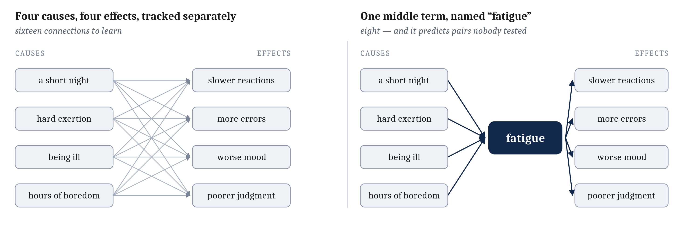
When Does a Higher-Level Concept Earn Its Keep?
Fatigue is not a thing you can point to in the brain. So why keep the word?
Notes:
Last idea, and it is the one that tells you when you are allowed to do any of this.
We have been very comfortable saying higher-level explanations are real and not to be thrown away. Fair enough. But that cannot be a free pass. Some higher-level concepts are junk. What separates them?
Take fatigue.
There is no fatigue organ. You cannot point to it on a scan. It is a concept sitting between things you can measure.
Several things cause it. A short night. Hard physical exertion. Being ill. Three hours of something boring.
And it has several effects. Slower reactions. More errors. Worse mood. Poorer judgment.
Now count. Without the concept, you have to learn every cause-to-effect link separately. Short night to slow reactions. Short night to more errors. Exertion to slow reactions. Exertion to more errors. Four causes times four effects — sixteen separate facts.
With the concept, each cause connects to fatigue, and fatigue connects to each effect. Four plus four. Eight.
And the payoff is not just economy. It *predicts*. If I tell you someone has been ill, you immediately expect worse judgment — even if nobody ever tested that specific pair. The concept gave you that for free.
That is the test. A higher-level concept earns its keep when it buys you predictive power you would not otherwise have. Not when it sounds right. Not when it is intuitive. When it predicts.
That is the standard this course holds *mind* to, and memory, and attention, and every other higher-level thing in it.

Slide 19
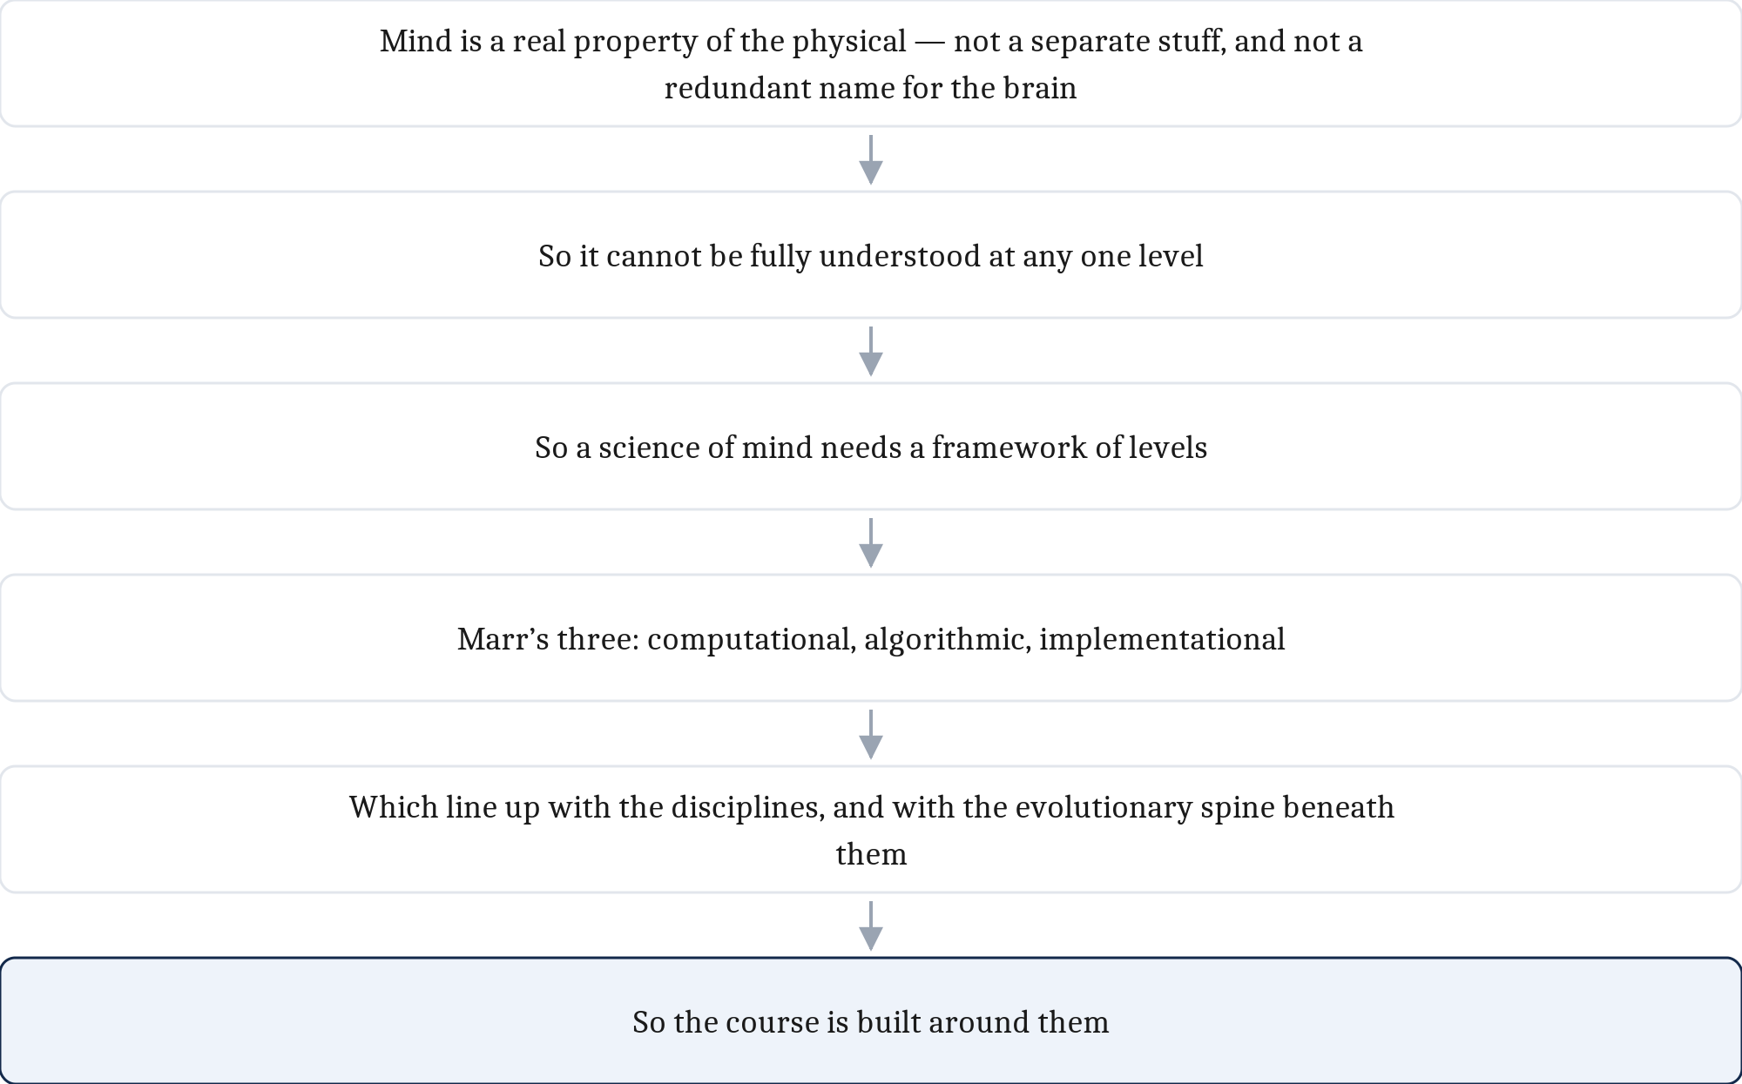
The Whole Argument, and What to Carry
Carry the three questions. Let the roster of positions go.
The habit that matters: when you meet a claim about the mind, ask which level is this working at?
Next: Module 2 — Comparative Approaches. If a mind is a matter of organization, then minds elsewhere — other species, other machines — become a real question. That is where we go.
Notes:
Let me compress two days into one chain, because it really is a single line of argument.
The mind is dependent on the physical but separable from it in explanation. Therefore there is more than one level at which it can be explained. Therefore we need a framework of levels. Marr's three do the job. Those levels map onto the disciplines and onto the evolutionary structure of the course. Therefore the course is built around them.
Now — what to carry forward, and what to let go.
Let go of the roster. Substance dualism, identity theory, eliminative materialism, functionalism. I am not going to ask you to recite those. They were scaffolding to get us to a position, and we got there.
Carry the three questions. What problem is being solved. By what procedure. In what physical stuff. Those you will use every week.
And above all, carry the habit. When you meet a claim about the mind — in this course, in a paper, in an argument online — ask which level it is working at.
I mean it about the arguments. An enormous number of disagreements in this field are two people answering different questions and each convinced the other is wrong. Being able to see that is genuinely one of the most useful things you will take out of this course.
One last thing, resolving where we started on Wednesday.
We opened with two questions that looked separate. What kind of thing is a mind, and how freely can we study it. They turned out to be one question with two faces, and the answer falls out of everything we have done: anything organized in the right way could in principle have a mind, and anything that has one can be asked these same three questions about it.
Which sets up Monday exactly. If a mind is a matter of organization rather than substance, then minds somewhere else — in other species, in machines — stop being science fiction and become an empirical question. That is Module 2.

Slide 20
Image Sources (1 of 2)
Slide | Image | File | Licence | Source
2 | Wednesday's four questions, and where they land | fig-position-tree.png | CC BY 4.0 | Jon Willits — figure from the Module 1 reading · own work
3 | A sycamore leaf | leaf_sycamore.jpg | CC BY-SA 2.5 | Willow, via Wikimedia Commons · https://commons.wikimedia.org/wiki/File:Acer_pseudoplatanus_002.jpg
4 | The visual system, from Vesalius's Fabrica, 1543 | vesalius_visual_system.jpg | Public domain | Andreas Vesalius, De humani corporis fabrica (1543), via Wikimedia Commons · https://commons.wikimedia.org/wiki/File:1543,Vesalius%27Fabrica,VisualSystem,V1.jpg
5 | The three levels, as the three questions they ask | fig-marr-column.png | CC BY 4.0 | Jon Willits — figure drawn from the Module 1 reading's shared source · own work
6 | An unsorted bookshelf | bookshelf_unsorted.jpg | CC BY 4.0 | Jon Willits — own photograph · own work
6 | Addition at three levels, as a branching tree | fig-marr-branching.png | CC BY 4.0 | Jon Willits — figure from the Module 1 reading · own work
9 | Three sources of a computational goal | fig-three-whys.png | CC BY 4.0 | Jon Willits — figure from the Module 1 reading · own work
11 | One image, infinitely many scenes | fig-ill-posed.png | CC BY 4.0 | Jon Willits — figure from the Module 1 reading · own work

Slide 21
Image Sources (2 of 2)
Slide | Image | File | Licence | Source
12 | Light from above | fig-light-from-above.png | CC BY 4.0 | Jon Willits — figure from the Module 1 reading · own work
13 | Vision, answered three ways | fig-vision-three-levels.png | CC BY 4.0 | Jon Willits — figure from the Module 1 reading · own work
14 | The levels constrain one another, both ways | fig-constraint-arrows.png | CC BY 4.0 | Jon Willits — figure from the Module 1 reading · own work
16 | Why a middle term earns its keep | fig-fatigue-links.png | CC BY 4.0 | Jon Willits — own work · own work
17 | Module 1 as one chain of claims | fig-argument-chain.png | CC BY 4.0 | Jon Willits — figure from the Module 1 reading · own work

