Slide 1

BCOG 100
Comparative Approaches
Lecture 2.1 — The Comparative Method
Notes:
Last week we spent two days on a single system.
We asked what kind of thing a mind is, and then we asked how to explain one — and the answer was Marr's: three questions, all of them needed, asked of one mind at a time.
This week we do the opposite move. We stop taking one system apart and start setting two of them side by side.
That turns out to be the thing this field mostly does. It is also much harder to do correctly than it looks, and today is about why.

Slide 2
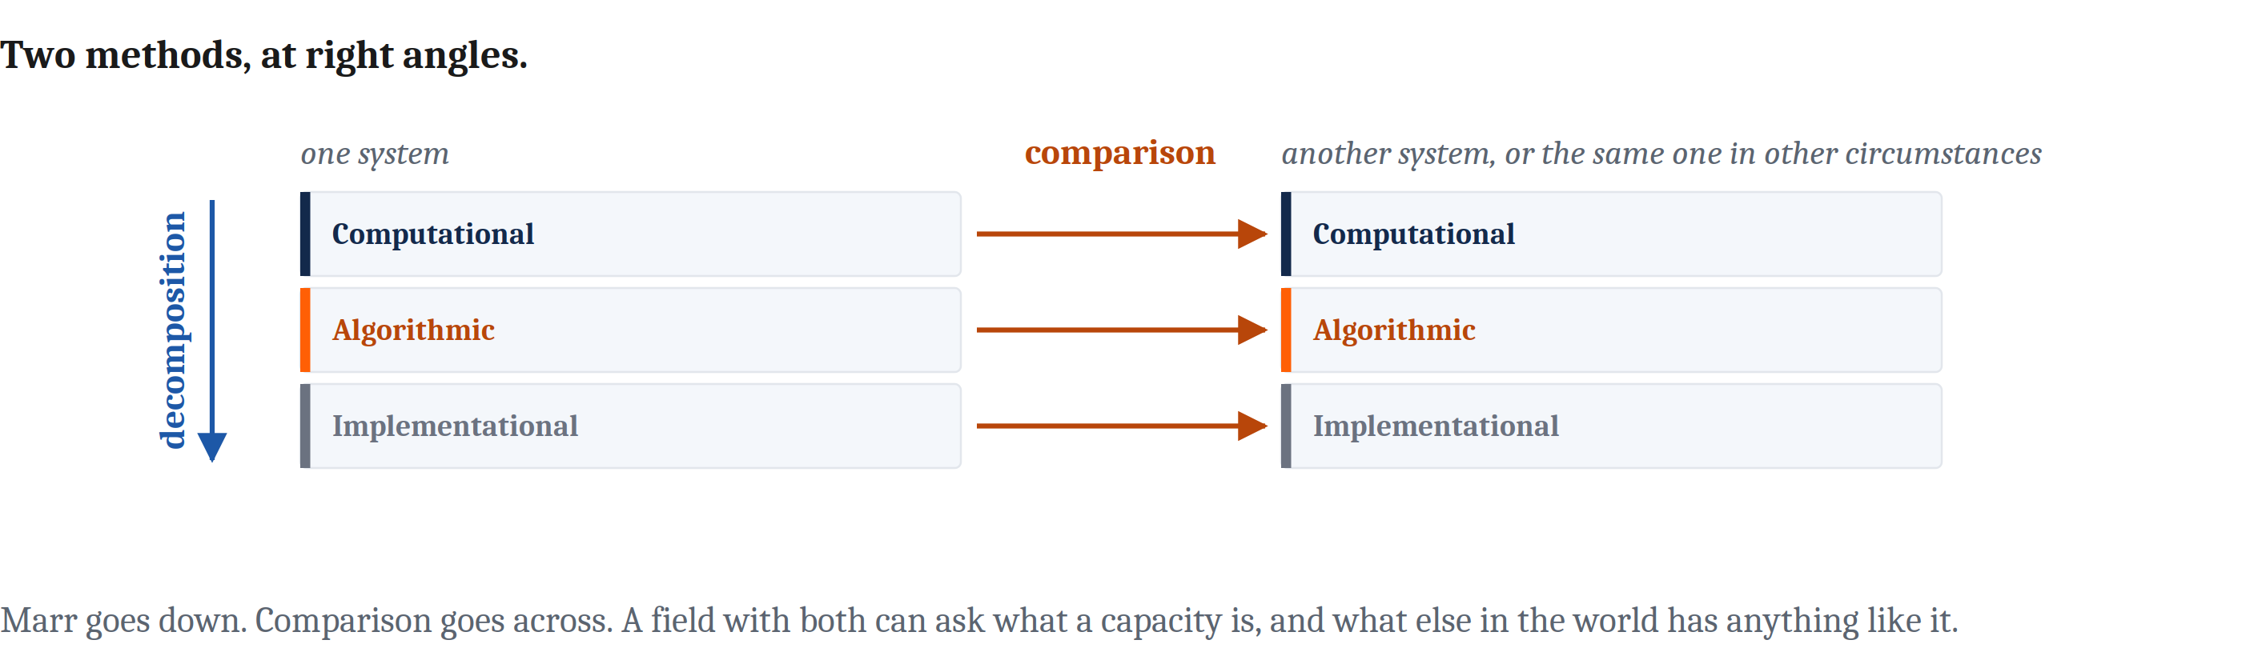
A Second Method, at Right Angles to the First
A field with both can ask what a capacity is, and also ask what else in the world has anything like it.
The practice has a name: the comparative method.
Notes:
Here is the shape of the week in one slide.
Marr's levels are a vertical method. One system, and you go down through it — what problem, by what procedure, in what stuff.
Comparison is horizontal. You hold one question fixed and reach sideways with it, to another system, or to the same system under different circumstances.
Neither replaces the other, and a field that has both can ask two quite different kinds of question. What is this capacity? And also: what else in the world has anything like it?
The practice has a name. We are going to call it the comparative method, and I want to flag one thing about the name straight away, because it will confuse you in about two days if I do not.
In evolutionary biology, "the comparative method" means something narrower — specifically the comparison of traits across species. That is Wednesday's lecture. In this book we are using the phrase wider than that: any case at all where two measurements are made so that each can inform the other.
So when you meet the term in a biology paper it will be doing less work than it does here.

Slide 3
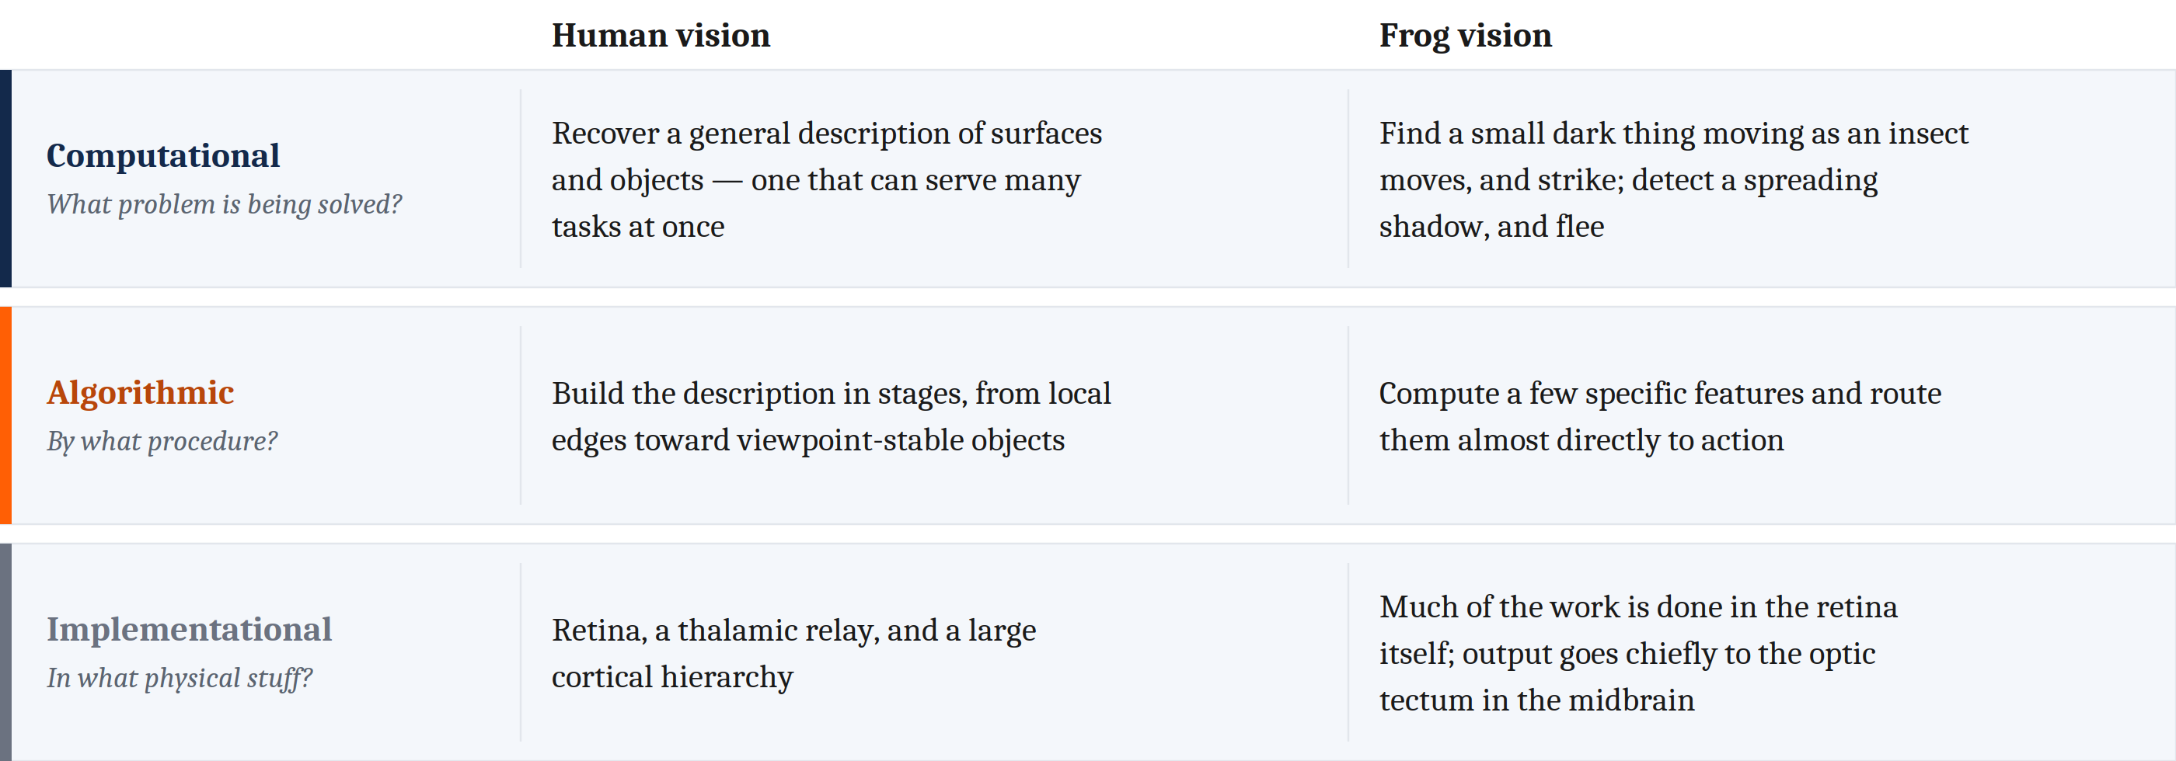
One Figure, Two Methods
Down a column is Marr. Across a row is comparison.
The frog is not a poor version of a human visual system. It is solving a different problem, and its machinery fits that problem well.
Notes:
You built the left-hand column of this figure last week without knowing it was a column.
The right-hand column is the comparative move. Same three questions, different animal.
Lettvin and his colleagues described the frog's eye in the nineteen-fifties, and the description is startling. A frog's eye is to a large extent a device for finding bugs. Show it a motionless fly and it will ignore it — may not, in any useful sense, see it at all. A frog can starve to death surrounded by dead flies.
[Give them a moment with the figure before going on. It is the slide; let them read it.]
Now here is the whole method in one picture, and it is worth slowing down for.
Reading down a column is doing Marr. One system, three questions.
Reading across a row is doing the comparative method. One question, two systems.
And look at what reading across gets you, because this is the first real conclusion of the module. Nothing in that figure says the frog is a worse version of us. The frog is solving a different problem, and it is solving it well.
Hold onto that, because the pull to read a difference as a deficit is very strong, and Wednesday is going to be almost entirely about resisting it.

Slide 4
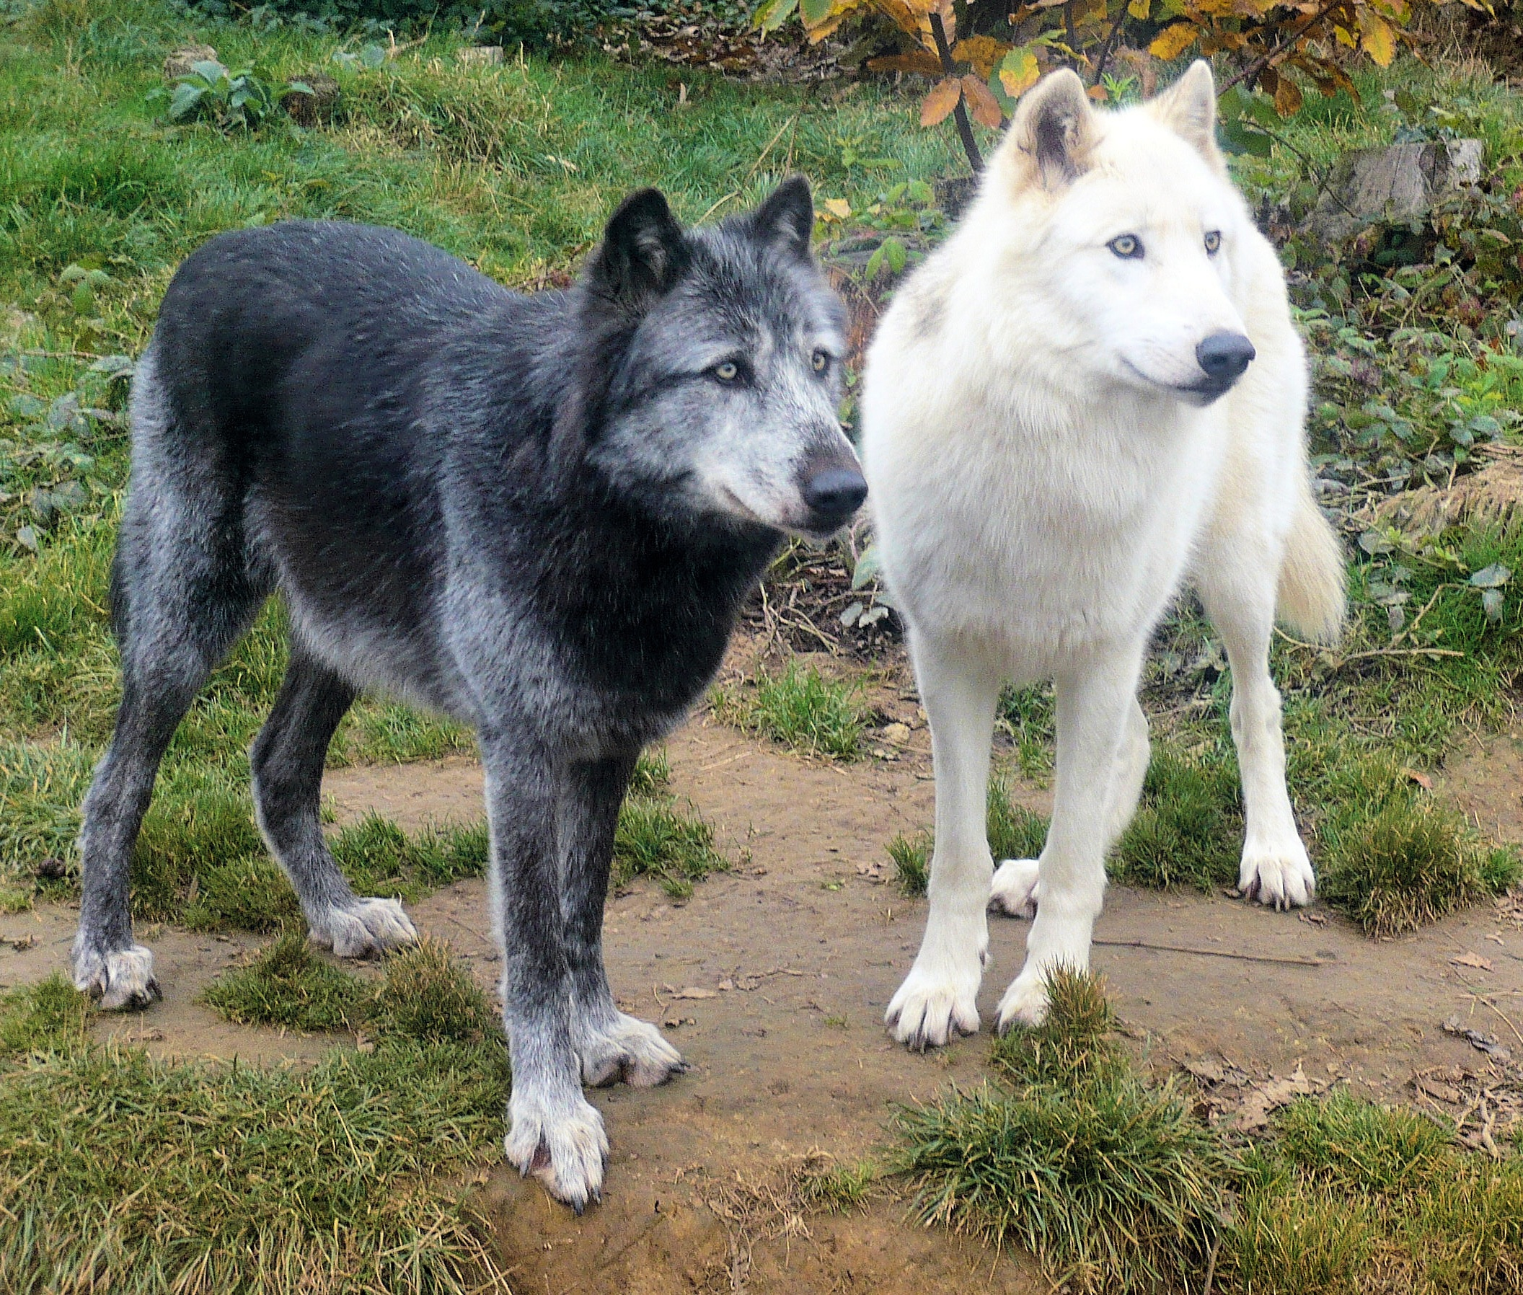
What Would You Conclude?
A person and an image-recognition model both label the wolf as a dog.
Across a large test set:
the person is right about 95% of the time
the model is right about 95% of the time
the two agree with each other 95% of the time
This is the kind of finding reported as evidence that the model sees the way people do.
Does it show that?
Notes:
Let me give you a result and ask you what follows from it.
Somebody runs a person and an image-recognition model over the same large set of photographs. The person gets about ninety-five percent right. The model gets about ninety-five percent right. And the two of them agree with each other on ninety-five percent of the images — same answer, right or wrong.
You will see findings shaped exactly like this reported as evidence that the model is doing something like what we do.
So. Turn to the person next to you for a minute. Does that number show it? And if not, what else could produce it?
[Take answers. The ones worth drawing out: the model was trained on labels people produced, so it may simply have inherited our answers. Or neither inherited anything and the photographs they both miss are just the hard ones. Or they really do work alike. Or some of it is luck.]
Every one of those is live. And notice none of them is ruled out by the number itself.

Slide 5
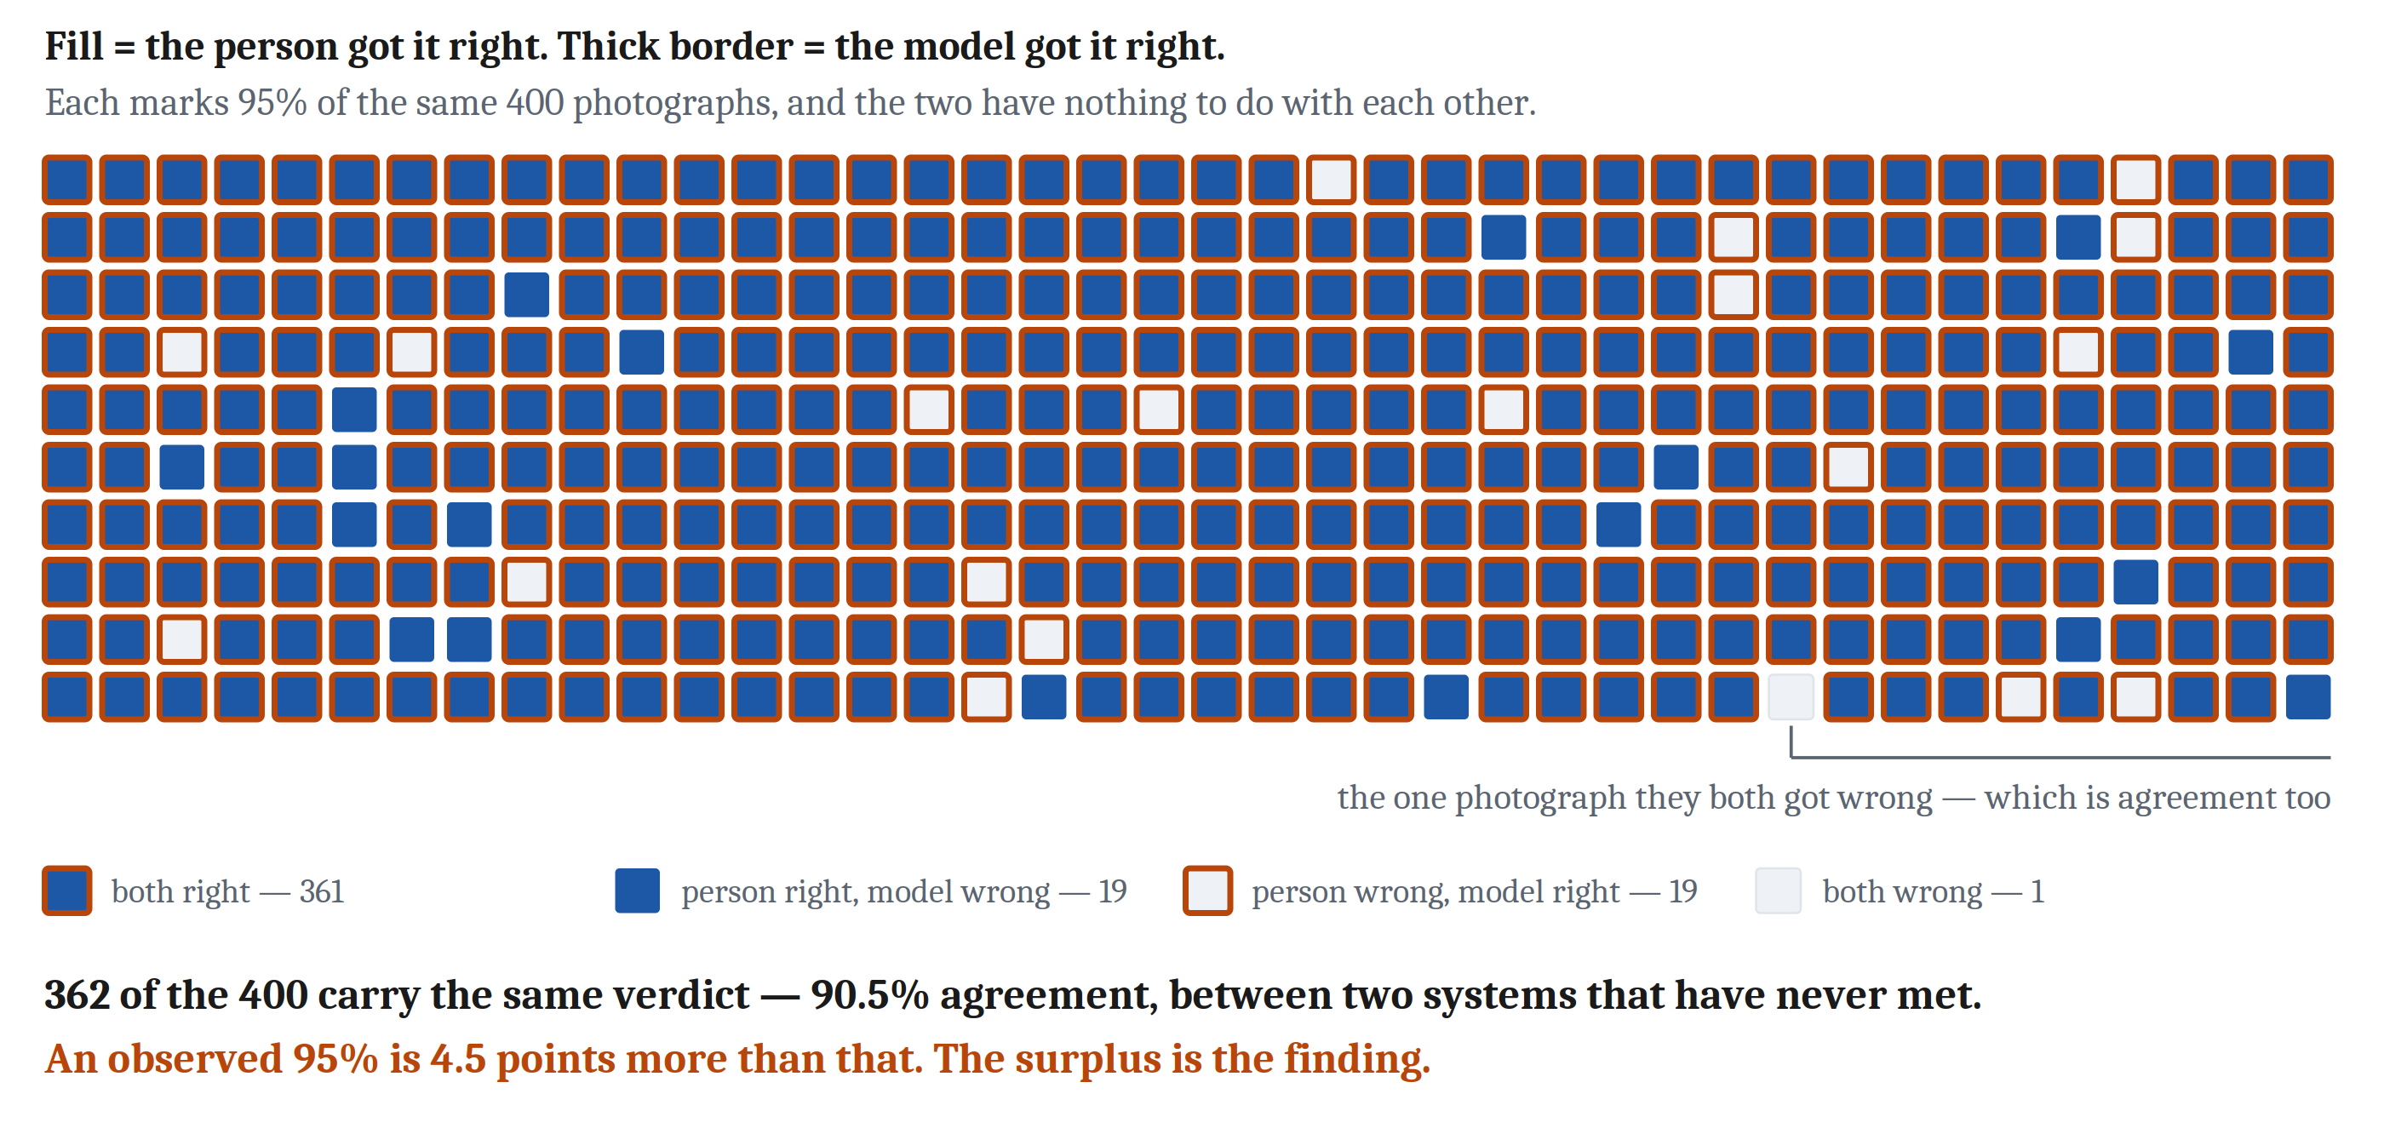
A Comparison Cannot Interpret Itself
Two independent systems, each right 95% of the time, with random errors, will still agree about 90% of the time. But 95% agreement is about five points above what independence alone produces.
It is this surplus that calls for an explanation, not the agreement.
Noticing that two things are similar is the easy part. The work is figuring out why.
Notes:
Here is the part that should change how you read numbers like that one for the rest of your life.
Suppose the two systems have nothing whatever to do with each other. Independent. Each right ninety-five percent of the time, errors scattered at random.
How often do they agree? Not fifty percent. About ninety percent — because both of them are usually right, and two systems that are usually right mostly say the same thing.
So the ninety-five percent is not ninety-five points of evidence. It is about five points above what you would get from two systems that had never heard of each other.
It is the surplus that needs explaining. Not the agreement.
And this is the sentence the whole module hangs on: a comparison cannot interpret itself. Two measurements set side by side give you a relationship, and the relationship does not tell you why it is there.
Noticing that two things are similar is the easy part. Everything hard comes after.
So for the rest of today: given a resemblance, what do we ask about it?

Slide 6
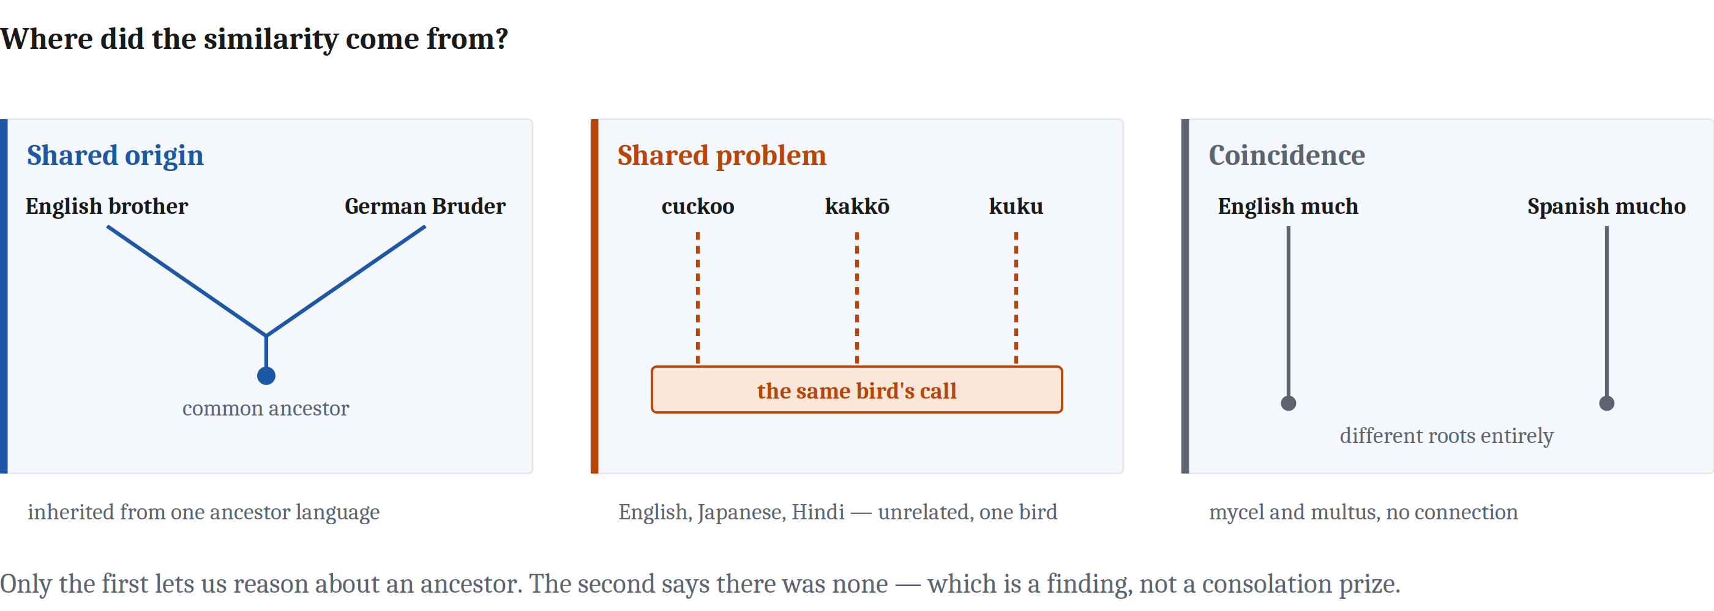
Question One: Where Did the Similarity Come From?
Shared origin lets us reason about the ancestor. Shared problem licenses no claim about an ancestor at all — arriving twice independently is the claim that the ancestor lacked it. Coincidence teaches nothing.
Notes:
Given a resemblance, there are three questions to ask about it. Here is the first, and it is the one people skip.
Where did the similarity come from?
Let me do this with words, because languages let us see all three answers in one place.
English has *brother*. German has *Bruder*. Those are not alike by accident and neither language borrowed from the other — both inherited the word from a language that no longer exists, and which we know about partly by noticing resemblances like this one. Shared origin. The likeness is a family resemblance, in a fairly literal sense.
Second case. English has *cuckoo*. Japanese has *kakkō*. Hindi has *kuku*. Those languages are not related in any way that would explain it, and nobody borrowed anything. They converged because they were all doing the same thing — imitating the same bird, which obligingly says its own name. Shared problem. Two systems arriving at the same solution because they ran into the same constraint, and the world contains only so many solutions.
Third. English *much*, Spanish *mucho*. Same meaning, nearly the same sound, and completely unrelated — *much* comes down from Old English *mycel*, and *mucho* from Latin *multus*. They arrived at the same place from different directions, and there is no story to tell about it. Coincidence.
Now, what does each of those let you say?
Shared origin lets you reason backwards. If two things share something because they got it from somewhere, you can ask about the somewhere — and historical linguists reconstruct whole vanished languages this way.
Shared problem gives you nothing at all about an ancestor, and I want you to see that this is not a technicality. Saying the thing arose twice, independently, is *exactly* the claim that there was no common source to reason about. The two answers are not two flavors of the same finding. They are incompatible.
And coincidence teaches nothing.
So — which of those three sounds like the disappointing answer?
Most people say shared problem, and I think that is backwards, and it is worth a minute.
If two unrelated systems land on the same solution, you have learned that the pressure was real. You have learned that this problem has few enough workable solutions that independent attempts converge on one. And you have learned what solving that problem actually looks like.
That is a computational-level finding, in Marr's sense. It is a claim about the problem itself. Losing the ancestor is a real loss, but what you get instead is not a consolation prize.
One last thing, and file it for Wednesday. Historical linguistics calls this exact procedure *the comparative method*, and it borrowed the name from biology. The first two cases you just saw are homology and analogy, in words rather than in bodies. We will do them properly on Wednesday.

Slide 7
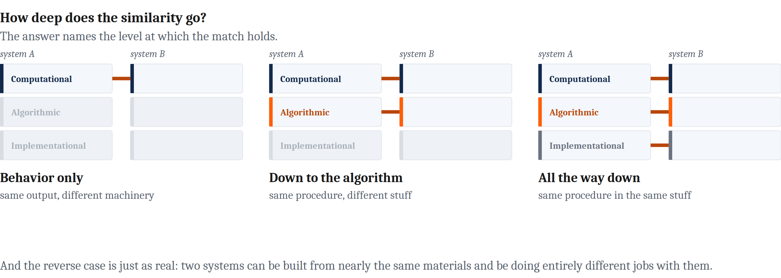
Question Two: How Deep Does It Go?
A merely behavioral match teaches less than we might think.
And the reverse case is just as real: two systems can be built from nearly the same materials and be doing entirely different jobs with them.
Notes:
Second question. How deep does the similarity go?
The answer names a level. Which is convenient, because we spent Friday on the levels.
Two systems can match only in what they do — same output, same problem solved, and nothing alike inside. They can match down at the algorithmic level, running something like the same procedure. Or they can match all the way down to the physical implementation.
A match only in behavior teaches less than we usually think it does. That is most of what today has been about.
But I want to give you the other direction too, because it is the half people forget.
Two systems can be built from nearly identical materials and be doing completely different jobs with them. The muscle in your heart and the muscle in your bicep are made of much the same stuff. That shared stuff tells you almost nothing about what either one is for.
So depth is not a ladder where sharing the hardware means sharing the function. It is a question about *where* the match is, and it has to be asked, not assumed.

Slide 8
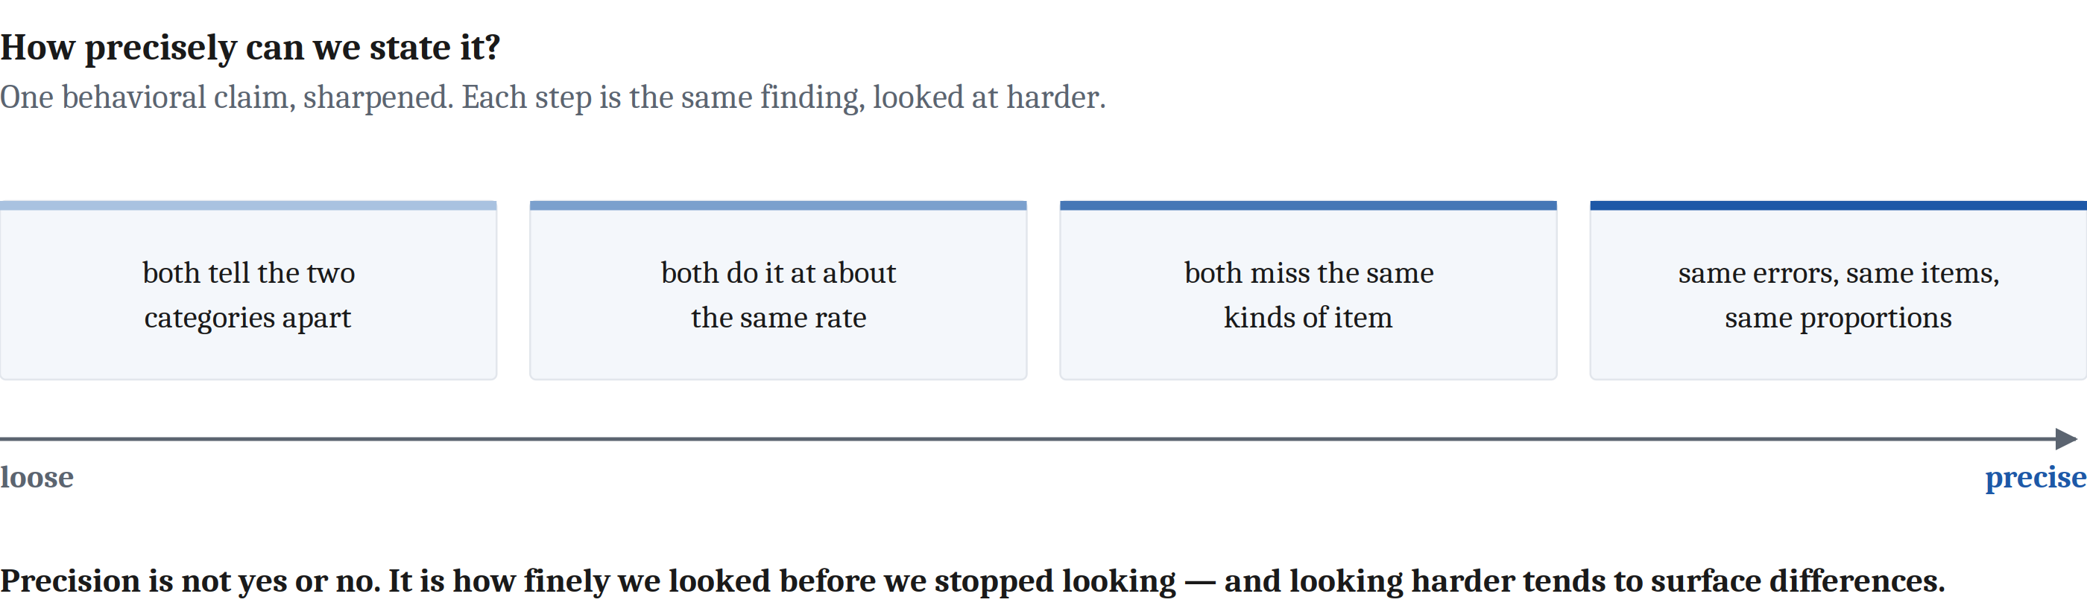
Question Three: How Precisely Can We State It?
Depth asks at which level. Precision asks how finely specified the match is at whatever level we are looking — so a claim can be shallow and precise, or deep and vague.
To say two systems behave alike is never to say they would behave alike in every circumstance. It is to say they matched on what we happened to measure.
Notes:
Third question, and this is the one that gets collapsed into the second one most often.
Depth asks which level the match is at. Precision asks how finely specified the match is, at whatever level you happen to be looking.
Those come apart. A claim can be shallow and extremely precise. It can be deep and hopelessly vague.
At the behavioral level, the loose version is: both systems can tell those two categories apart, on average, better than chance. The precise version is: the same pattern of errors, on the same items, in the same proportions. Those are very different claims, and both of them are "behavioral."
The same split runs at the other two levels, and the reading works all three — I will let you have that one on the page.
Here is the line I want you to leave with. To say that two systems behave alike is never to say they would behave alike in every possible circumstance. It is to say they matched on the things we happened to measure.
Precision is not yes or no. It is how finely you looked before you stopped looking.
And looking harder tends to surface differences. Which means a comparison that has survived a lot of looking is worth much more than one that survived a little — and the way you tell those apart is by asking how hard anyone actually looked.

Slide 9
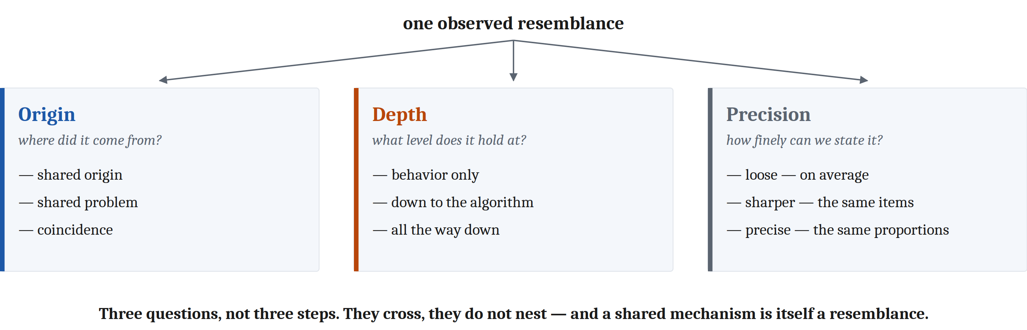
Three Questions, Not Three Steps
They cross. They do not nest, and they are not a sequence.
And a shared mechanism is itself a resemblance — which sends us straight back to question one.
Notes:
So: three questions. Origin, depth, precision.
The picture matters here, and specifically the fact that it is three panels side by side rather than a flowchart. These are not three steps you take in order. They cross.
Two species can share an origin and have drifted into quite different mechanisms — shared origin, shallow match. Two systems that arrived at a capacity completely independently can end up with nearly the same machinery, if the problem has few workable solutions — no shared origin, deep match. A precise behavioral match can tell you nothing whatever about depth.
Every combination is possible, which is why you have to ask all three rather than infer two of them from one.
And here is the move I like best in this chapter.
Suppose you do the work, get down to the mechanism, and find the two systems share one. You have a shared mechanism.
But a shared mechanism is itself a resemblance. So now you get to ask question one about *it*. Why do they share it — inherited, or independently arrived at?
It is not a checklist you finish. It is a loop. Depth tells you what is shared, precision tells you how well you have pinned it down, and origin tells you why it is there at all.

Slide 10
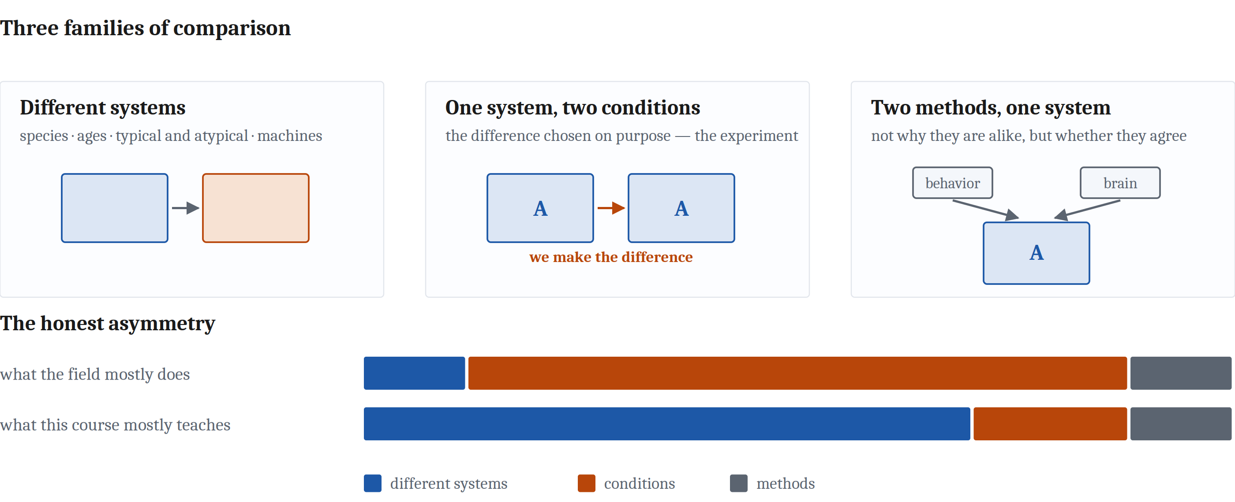
Three Families of Comparison
The same three questions run through all three families. Only the vocabulary changes.
Notes:
Those three questions are not specific to comparing two organisms, and I want to show you the map before we go anywhere.
Comparisons come in three families.
First, different systems set beside each other. Across species. Across ages. Across typical and atypical minds. Across the line between living things and machines.
Second, one system under different conditions, where you chose the difference on purpose. That is the ordinary experiment. It is also the naturalistic version, where you find a difference rather than making one.
Third, different methods pointed at the same system — where the question is not why two things are alike but whether two independent ways of measuring agree.
The three questions run through all of them. What changes is the vocabulary. Across species, shared origin and shared problem get the formal names homology and analogy, and that is Wednesday. Across the natural/artificial divide, it is the *depth* question that gets formal names, and that is Friday.
Now, one piece of honesty about this course, which the chapter puts in writing and I want to say out loud.
The great majority of actual day-to-day work in cognitive psychology and neuroscience is family two. Somebody has a theory, the theory predicts one thing in this condition and another thing in that condition, and they go and look. That is the job.
And this course is going to spend most of its time on family one.
That is a choice, and the reason is that setting a human mind beside an octopus's, or an infant's, or a machine's exposes things that no amount of careful work inside a single system will show you. It is the more integrative mode, and it is what a first course is for.
But you should know that the comparison you would make most often as a working scientist is the one getting the least room here. That is a claim about what to teach, not a ranking of what matters.

Slide 11
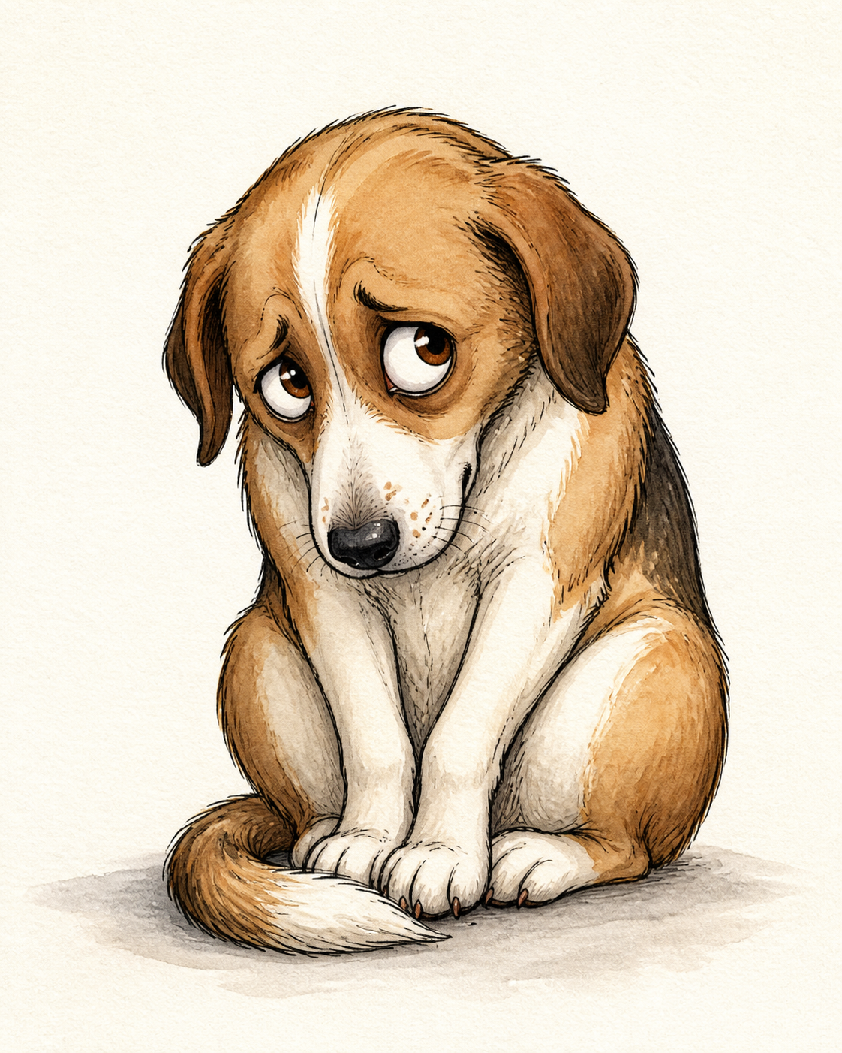
Four Ways This Goes Wrong
Anthropomorphism — projecting human qualities onto a system that has not earned the description. The dog that looks guilty. The chatbot that sounds like it means it.
Anthropocentrism — treating the human case as the reference point, the default, the "normal" one.
Unconstrained adaptationism — assuming every trait must be a finely tuned solution to some problem.
Notes:
Four names. You will use all four for the rest of the semester.
Anthropomorphism is projecting human qualities onto something that has not earned the description. The dog that looks guilty when you come home. The chatbot that sounds like it means what it is saying.
Anthropocentrism is subtler, and I think it does more damage. It is treating the human case as the reference point — the default, the normal one. Once you have done that, every other mind gets measured by how close it comes to ours, and described in terms of what it is missing. Nobody announces they are doing this. It shows up in the adjectives.
Unconstrained adaptationism is assuming that every trait has to be a finely tuned solution to some problem.
Let me show you why that one is a problem rather than just a bias. Why is human childhood so long? Obvious answer: all that extra time buys an enormous amount of learning before you have to fend for yourself. Sounds right.
Now suppose human childhood were short instead. Why? Obvious answer: it minimizes the years of helplessness when a juvenile is most vulnerable. Also sounds right.
If both outcomes get an equally smooth explanation, the explanation is not doing any work. That is what makes it unconstrained. Any story you can tell just as easily about the opposite result is not evidence for anything.

Slide 12
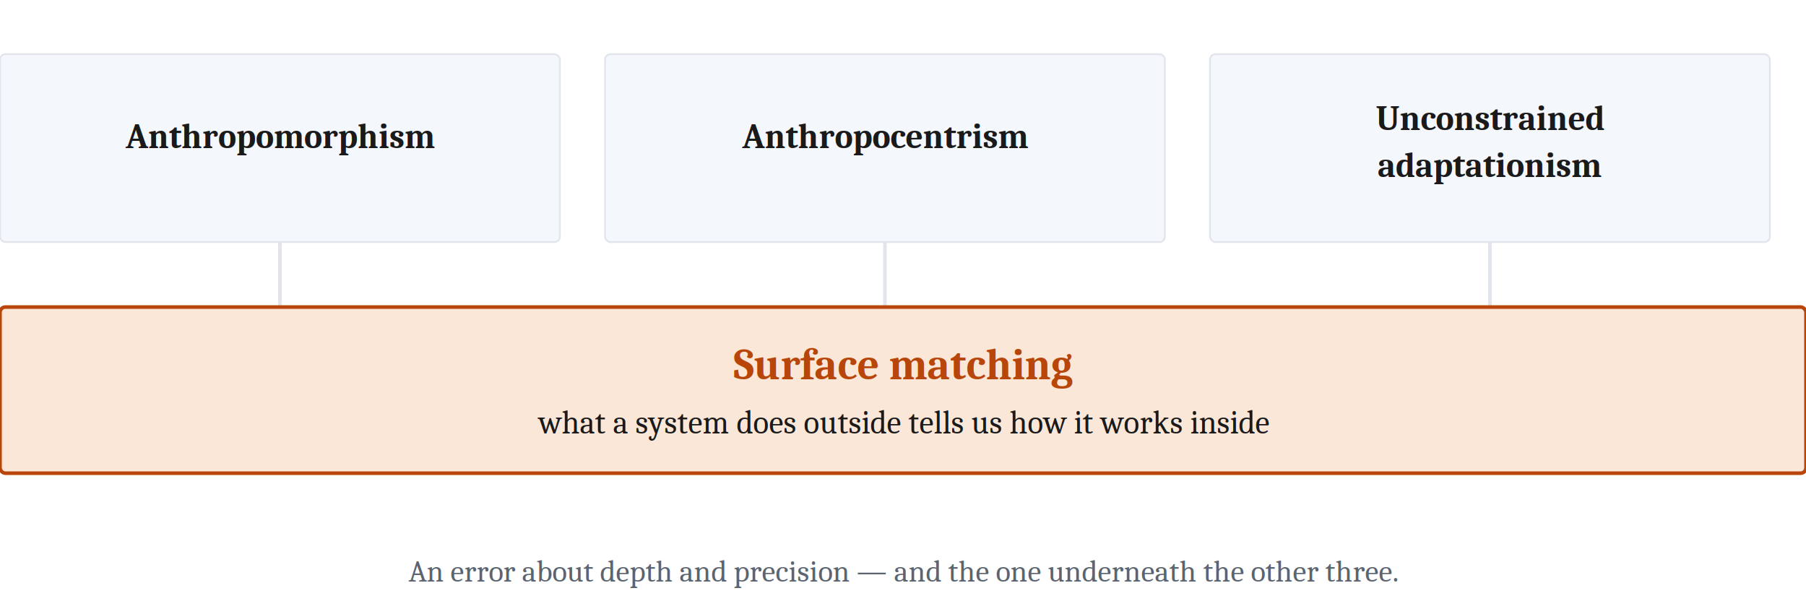
Four Ways This Goes Wrong
Surface matching is the theme under the other three. It is an error about depth and precision: two systems that behave alike get treated as alike underneath, when the only things checked were the handful of dimensions somebody happened to measure.
Notes:
And here is what is underneath all three.
Surface matching. The assumption that what a system does on the outside tells you how it works on the inside.
Notice that this is precisely an error about our second and third questions. Two things behave alike, so we treat them as alike underneath — when the only thing anybody checked was the handful of dimensions that happened to get measured.
Every one of the first three errors is a special case of it.

Slide 13
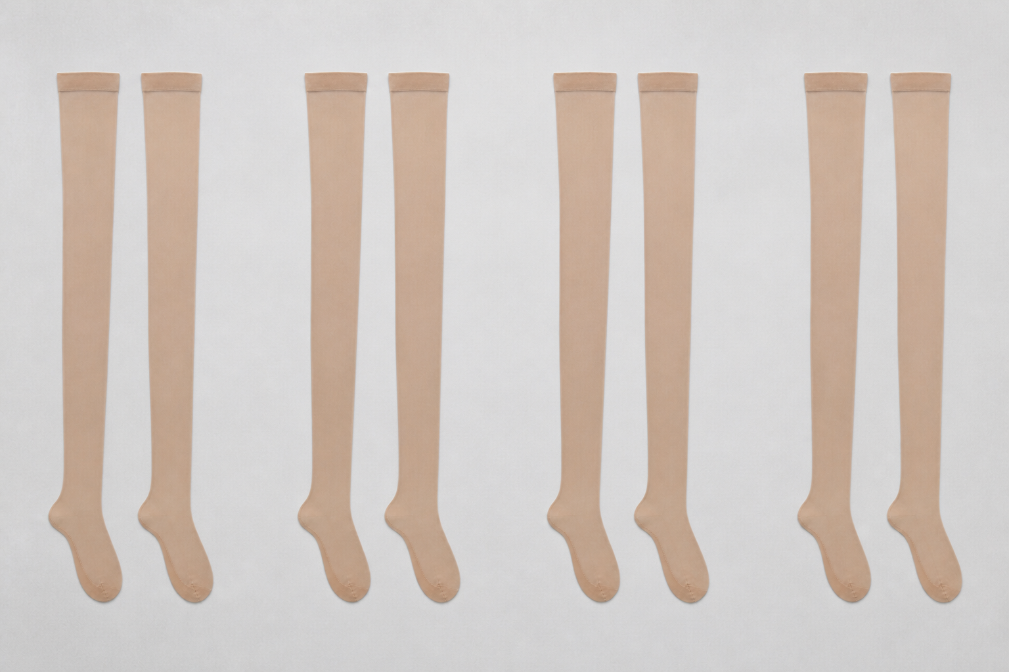
And We Do It to Ourselves
Nisbett and Wilson. Shoppers were shown several pairs of stockings laid out in a row.
The pairs were identical.
Shoppers chose the rightmost pair far more often than any other.
Asked why, they explained their choice by the knit and the sheerness of the fabric — and denied that position had anything to do with it.
We often have no direct access to why we did something. We generate a plausible reason instead.
Notes:
I have been talking as though surface matching is a mistake we make about other creatures. It is not.
Nisbett and Wilson ran a study that I think about constantly.
They set out several pairs of stockings in a row and asked shoppers to pick the best one. The pairs were identical. Same stockings, four times over.
People overwhelmingly chose the one on the right.
Then they were asked why. And they did not say "no idea." They gave reasons — the knit, the sheerness, the feel of the fabric. And when it was suggested that maybe position had something to do with it, they rejected that. Not sheepishly. They found it implausible.
The conclusion Nisbett and Wilson drew is that we frequently have no direct access to why we did what we did, and what we produce instead is a plausible-sounding reason, generated after the fact, and delivered with confidence.
Which is exactly the error. Something on the outside — a choice — got read as evidence about the process on the inside, and the reading was wrong.
The discipline that keeps us honest about animals is the same discipline that keeps us honest about ourselves.

Slide 14
None of This Is Neutral
Arguments about whether animals think, whether a fetus has experiences, whether a machine understands anything, are very often powered by something other than the evidence.
Claims about who has which capacity have historically tracked claims about who is owed what.
The pull runs both ways. Wanting to raise an animal's standing is a reason to read its behavior generously. Not wanting to change how animals are used is a reason to read the same behavior thinly.
Neither motive makes anyone wrong — but motives shape which studies get run, which results feel convincing, and which get explained away.
Also in the chapter, and still fair game: comparison across conditions (the experiment, confounds, control conditions) · across ages · across typical and atypical minds.
Notes:
One last thing, and it goes before the comparisons rather than after them, deliberately.
Comparisons of minds are almost never neutral.
Arguments about whether animals think, whether a fetus has experiences, whether a machine understands anything — these are very often powered by something other than the evidence, and it is worth knowing that going in.
The reason is not mysterious. Claims about who has which capacity have historically tracked claims about who is owed what — what treatment, what protection, what rights. Deciding that something reasons, or suffers, has consequences, and everyone in the argument knows it.
And I want to be careful, because the pull runs in both directions. Wanting to raise an animal's moral standing is a reason to read its behavior generously. Not wanting to change how animals get used is a reason to read exactly the same behavior thinly.
Here is the part that matters. Neither of those makes anybody wrong. A motivated researcher can be perfectly correct. What motives do is shape which studies get run, which results feel convincing, and which ones get explained away.
This course is not going to settle what any creature is owed. What it will do is keep pointing at where the bias shows up, which is nearly everywhere — across species, across ages, across cultures, across typical and atypical minds, across sex and gender, and now across the line between living things and machines.
Two housekeeping notes before you go.
The chapter has three sections we are not lecturing on: comparison across conditions — which is the experiment, confounds, control conditions — comparison across ages, and comparison across typical and atypical minds. They are on the page, they are the same three questions in three more places, and they are fair game on a quiz. Read them.
And Wednesday we take the oldest of these comparisons, and the one this whole course is built on: across species.

Slide 15
Image Sources (1 of 2)
Slide | Image | File | Licence | Source
2 | Decomposition runs down one system; comparison runs across to another | fig-two-methods.png | CC BY 4.0 | Jon Willits — drawn for this lecture · own work
3 | Marr's three questions, asked of human and frog vision | fig-levels-vision.png | CC BY 4.0 | Jon Willits — drawn for this lecture from the Module 2 reading's table · own work
4 | Two wolves | Black_and_White_Wolves.jpg | CC BY 2.0 | Stéfan, via Wikimedia Commons · https://commons.wikimedia.org/wiki/File:Black_and_White_Wolves.jpg
5 | Two independent 95% verdicts over the same 400 photographs | fig-agreement-overlap.png | CC BY 4.0 | Jon Willits — drawn for this lecture · own work
6 | The three answers to the origin question, drawn as topology | fig-origin-topology.png | CC BY 4.0 | Jon Willits — drawn for this lecture · own work
7 | A match that stops at the top, in the middle, and all the way down | fig-depth-levels.png | CC BY 4.0 | Jon Willits — drawn for this lecture · own work
8 | One behavioral claim, sharpened four times | fig-precision-ladder.png | CC BY 4.0 | Jon Willits — drawn for this lecture · own work
9 | The three questions to ask of a resemblance | fig-three-questions.png | CC BY 4.0 | Jon Willits — drawn for this lecture · own work

Slide 16
Image Sources (2 of 2)
Slide | Image | File | Licence | Source
10 | The three families, and the asymmetry between what the field does and what this course teaches | fig-three-families.png | CC BY 4.0 | Jon Willits — drawn for this lecture · own work
11 | A dog with a guilty expression | guilty_dog.png | Status unsettled; see this folder's IMAGE_CREDITS.md | Jon Willits — generated image · own work, generated with ChatGPT Codex
11 | The three named errors, and the unnamed one underneath them | fig-surface-matching.png | CC BY 4.0 | Jon Willits — drawn for this lecture · own work
12 | Four identical pairs of stockings in a row | stocking_pairs.png | Status unsettled; see this folder's IMAGE_CREDITS.md | Jon Willits — generated image · own work, generated with ChatGPT Codex

