Slide 1

BCOG 100
Comparative Approaches
Lecture 2.3 — Comparing Minds, Machines, and Methods
Notes:
Two weeks, and we have compared a human to a frog, a human to an image model, and a human to a crow and an octopus.
This lecture finishes the module with the two comparisons we have been circling. First, minds against machines — which is the other thread this whole course is built on. And then something different: not two systems, but the two or three ways we have of looking at one.
And I owe you an answer. In the first lecture of this module I gave you a number and told you we would come back to it.

Slide 2

Three Questions
Can anything but a human brain have a mind?
Can a machine?
We gave a reason to think the question is legitimate:
a mind looks like a property of how a system is organized, not of what it happens to be made of.
If that is right, nothing rules out a machine having one in advance.
It also does not settle that a machine does.
The question gets no clean yes or no.
People asking whether a machine really thinks are usually asking three different questions at once, without noticing.
Most disagreements about artificial intelligence are disagreements about which of the three is being asked.
Notes:
Let me set this up, because it is the most confused public conversation in the field and there is a reason for the confusion.
Back in Module 1 we asked whether anything other than a human brain could have a mind. And the reason for thinking that question is even legitimate goes roughly like this. A mind appears to be a property of how a system is *organized* — of what it does and how the parts relate — rather than a property of the stuff it happens to be made of. The same computation can run on different hardware. If that is right, then nothing rules out in advance that some other kind of stuff, arranged the right way, could have one.
Notice what that does and does not do. It removes an objection. It does not establish anything positive. So the honest answer to "could a machine have a mind" is not yes and not no.
But that is not why the argument never ends.
The argument never ends because when somebody asks whether a machine *really* thinks, they are almost always asking three different questions at the same time, and they have not noticed that they are three.
Once you can name the three, most public disagreements about AI turn out to be two people answering different questions and each thinking the other is wrong.
So: the three.

Slide 3
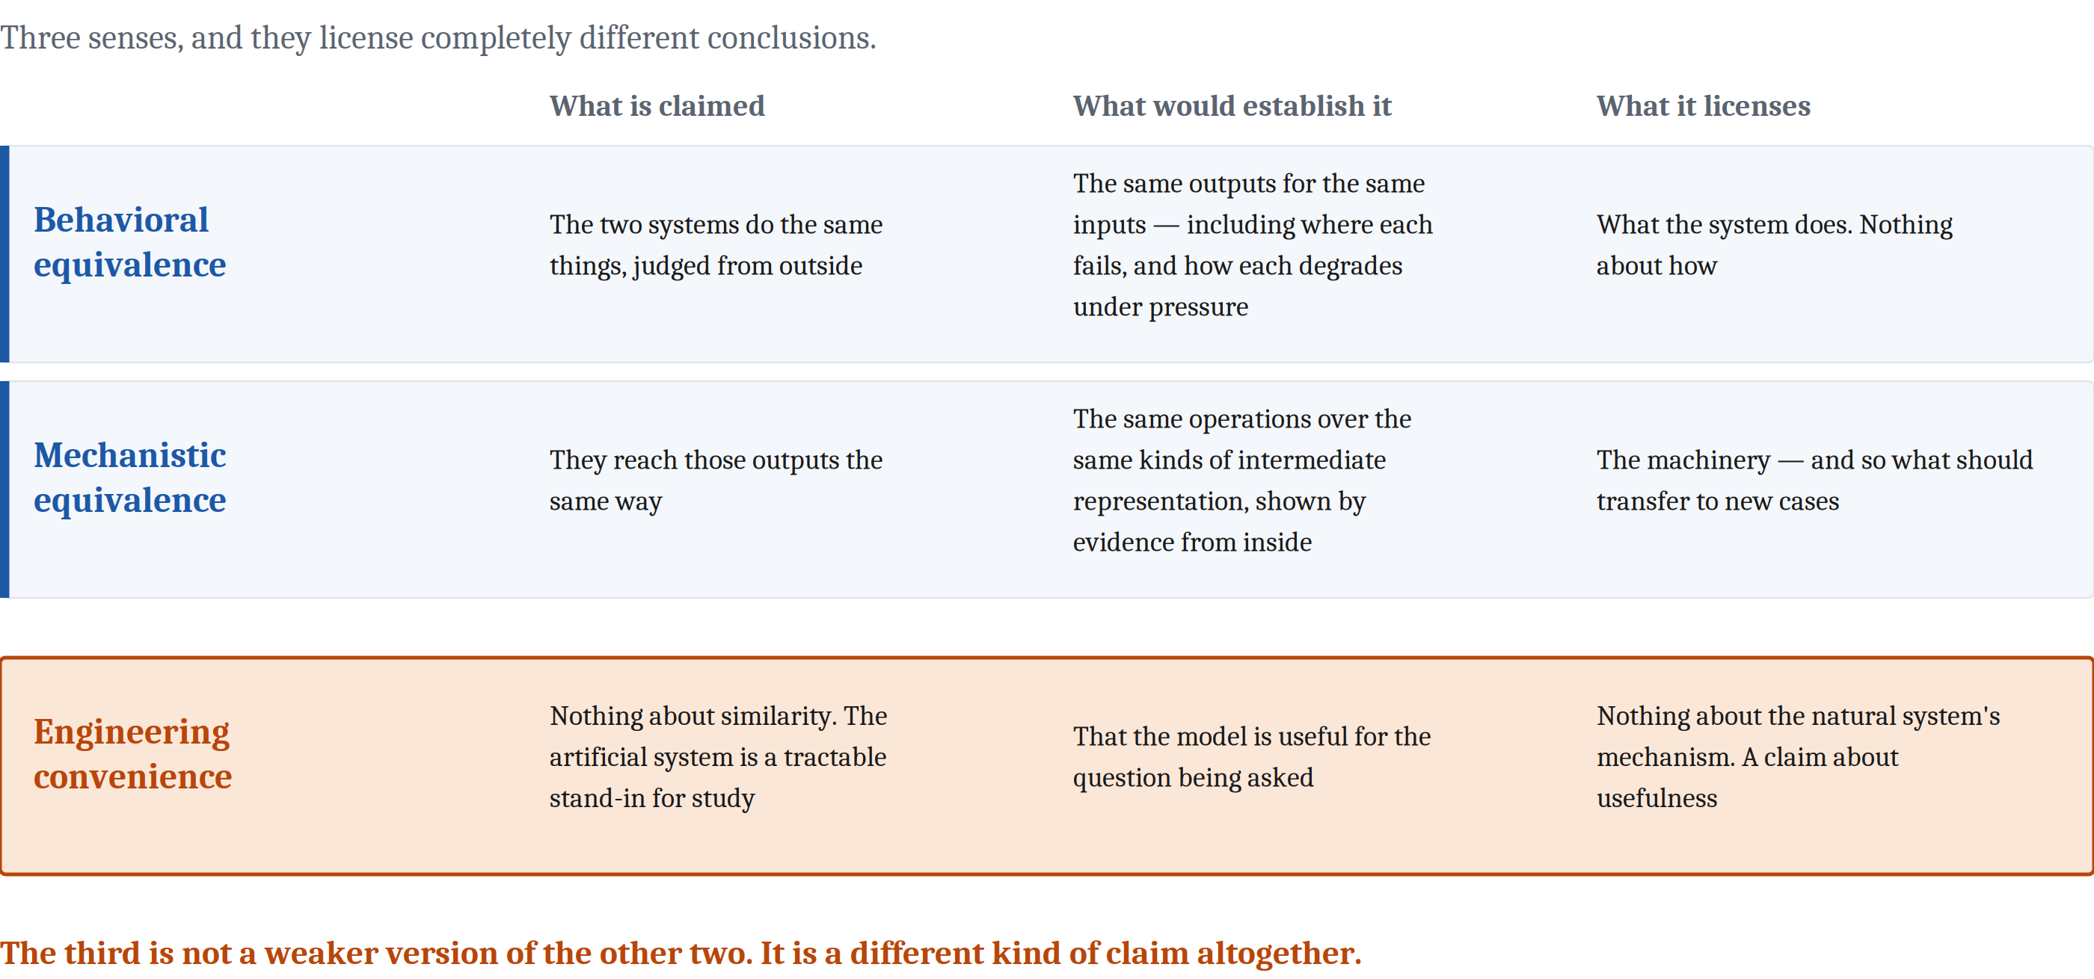
Three Ways a Machine Can Match a Mind
Notes:
Three senses, and they license completely different conclusions.
**Behavioral equivalence.** Two systems are behaviorally equivalent when they do the same things, judged from outside. Same inputs, same outputs, and an observer watching only what goes in and what comes out could not tell them apart. Notice what that claim contains about the inside of either system: nothing. Not "not much." Nothing.
**Mechanistic equivalence.** They get to those outputs the same way — the same operations, over the same kinds of intermediate representation. Much stronger claim. Much harder to establish.
Now, those two should look familiar, because you have met them already. That is the depth question from the first lecture of this module, with formal names for the case where one of the systems is artificial. Behavioral equivalence is a match at the computational level only. Mechanistic equivalence runs down to the algorithm, and sometimes further.
And here is the part I want you to hold onto, because it is the engine of everything we do in this course.
Behavioral and mechanistic equivalence are not really two categories. They are the same question asked at two grains. And two systems that match behaviorally at a coarse grain will *nearly always* come apart at a finer one — because looking harder just means measuring more things.
That sounds like a nuisance. It is the opposite. The fine-grained behavioral differences are exactly what let us work out what is happening inside a system without opening it up. That is how this whole science is possible.
**Third: engineering convenience.** And this one is different in kind, which is why it gets its own row and why it causes so much trouble.
A researcher trains an artificial network on a recognition task and then looks at what its internal layers came to represent. They are not claiming the network *is* a brain. They are claiming it is a workable model of one — the way a wind tunnel is a workable model of the sky.
Engineering convenience is not a claim about similarity at all. It is a claim about usefulness. And treating it as though it were a similarity claim is, I would say, a large share of the confused writing about artificial intelligence.
One last thing, and then we go to the two famous arguments. How much equivalence is enough depends entirely on what you want it for. Can this machine do a person's job? That is a practical question, and behavioral equivalence at the grain of that job might completely answer it. Does it solve the problem the way the person does? That is a scientific question, and behavioral equivalence cannot answer it at all.
Confusing those two is how a system that is genuinely useful comes to get described as though it were genuinely a mind.

Slide 4
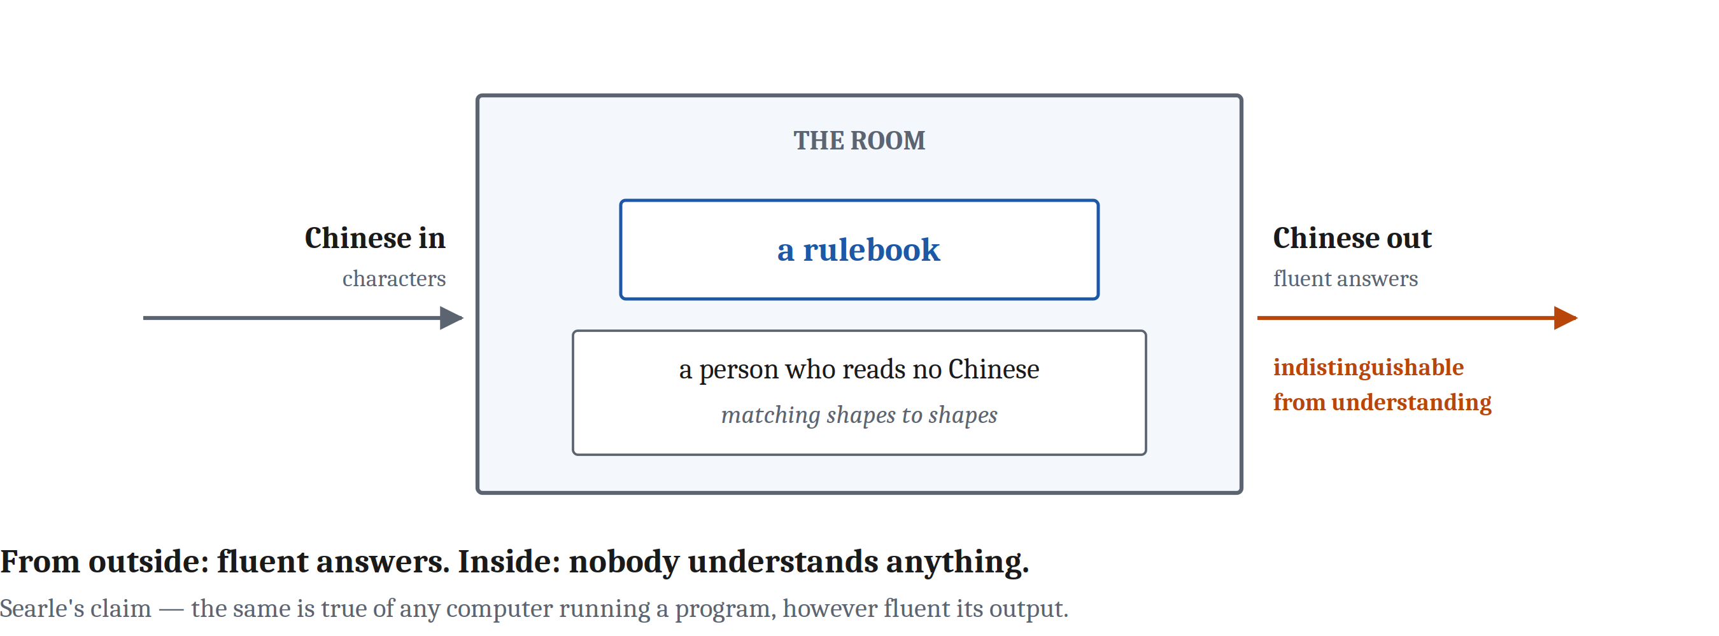
A Criterion, and Its Most Famous Objection
Turing (1950). If you cannot tell the hidden partner from a person, the machine passes. The criterion is deliberately behavioral.
Searle (1980). The room answers fluently and no one inside understands a word. Behavior of the right kind is not sufficient for understanding.
Both sides are reading machinery off a behavioral match — which is surface matching, the error we named in the first lecture of this module.
Notes:
The cleanest statement of behavioral equivalence as a *criterion* came from Alan Turing in 1950.
Turing was one of the people who invented the computer, and he also thought hard about intelligence in humans and machines. His move was to say: the question of whether machines can think is too vague to answer, so let us replace it with something we can actually run. Put a person in conversation with a hidden partner. If they cannot reliably tell whether the partner is a person or a machine, the machine passes.
That is the Turing test, and notice its logic is deliberately behavioral. What the machine does is all that matters.
Whether that is right — whether behavioral equivalence is all that matters — is extremely controversial, and the most famous objection came from the philosopher John Searle in 1980.
Imagine a person locked in a room. They have a rulebook: when these Chinese characters come in, send those Chinese characters out. They do not know Chinese. They cannot read a word of it. Characters come in through a slot, they look them up, they follow the rules, they pass characters back out.
To a Chinese speaker standing outside, the room gives fluent, sensible answers.
The person inside understands nothing whatsoever. They are moving shapes around according to instructions.
Searle's argument — the Chinese Room — is that the same is true of any computer running any program, however fluent its output. Behavior of the right kind is not sufficient to demonstrate understanding.
I want to be careful here, because it is easy to leave this slide thinking Searle won, or that Turing did.
Look at what the whole exchange *is*, in our terms. Both sides are arguing about whether a behavioral match tells you about the machinery underneath.
That is surface matching. We named it in the first lecture of this module, and here it is running one of the most famous debates in the history of the field — with extremely smart people on both sides.
Naming the error does not tell us how to avoid it. So how do we avoid it?

Slide 5
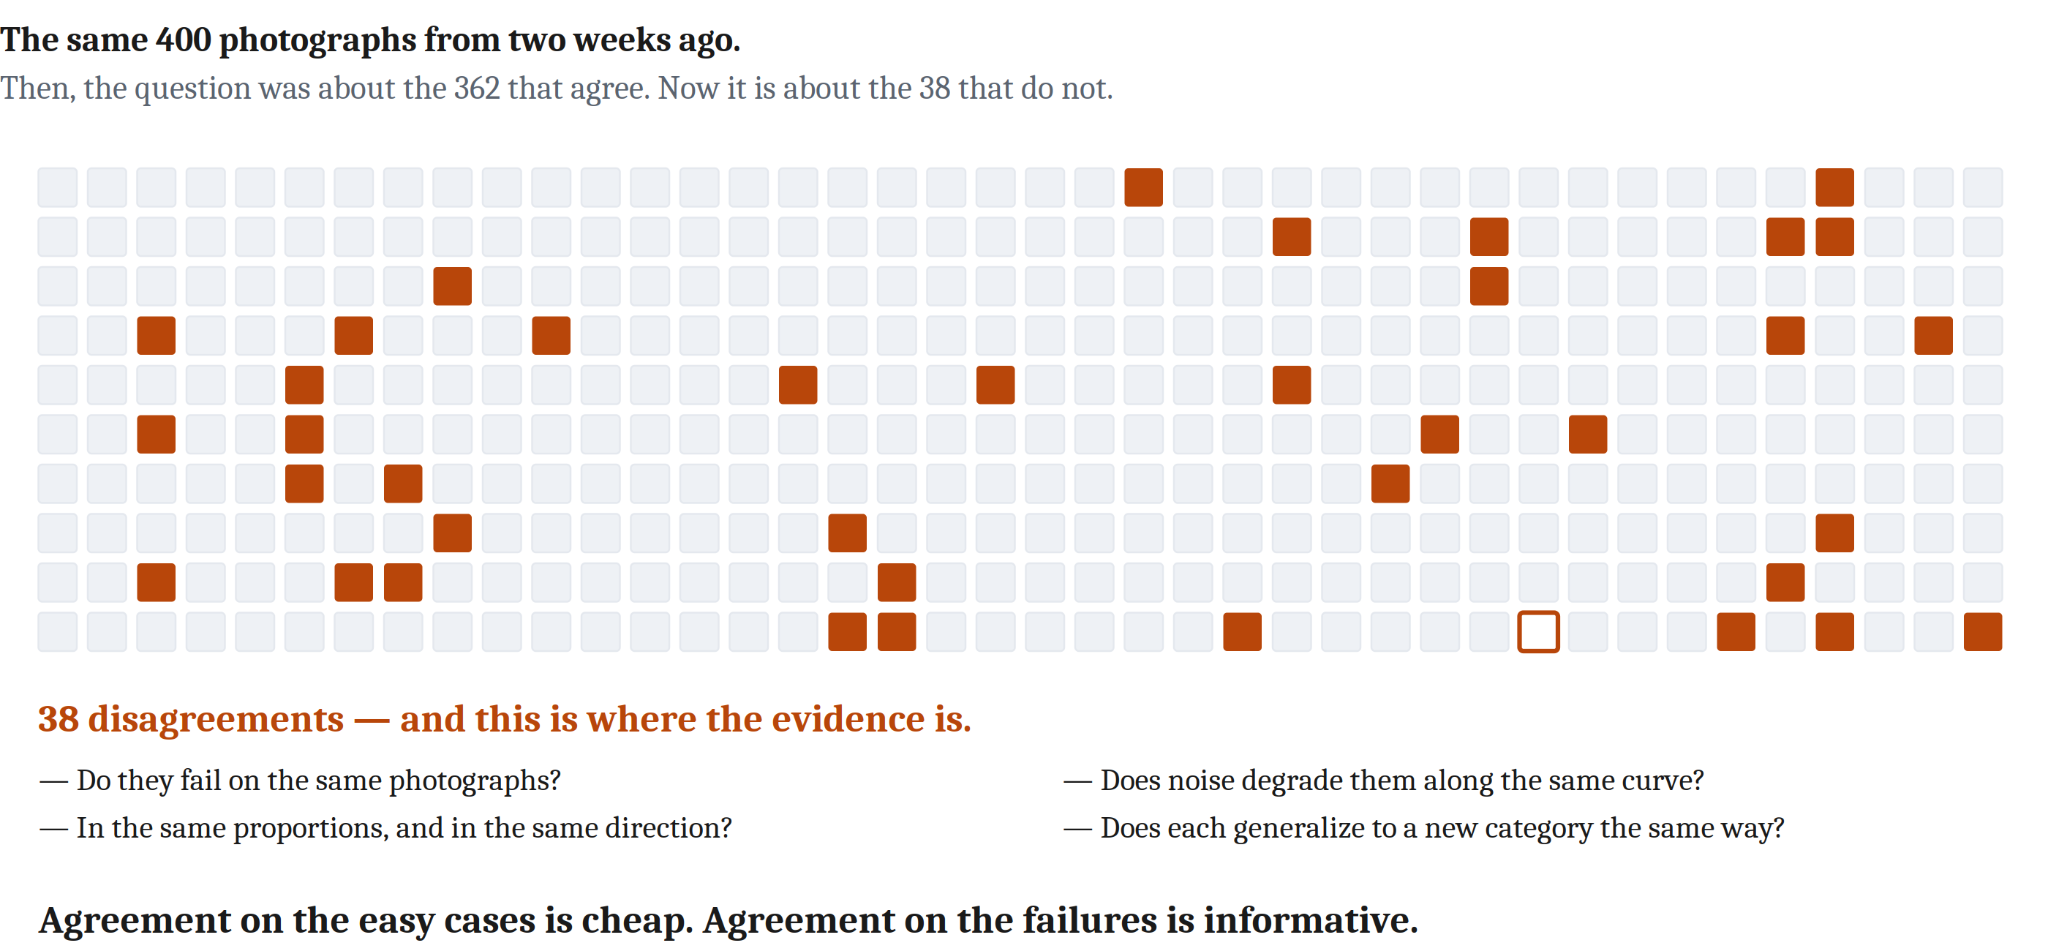
Remember Our Computer Vision Example?
In this module's first lecture: a person and an image model, each right about 95% of the time, agreeing with each other 95% of the time. Independence alone would already produce about 90.5%. I said the surplus is what needs explaining, and left it there.
Notes:
In the first lecture of this module I put a number on the board and then walked away from it. Here it is again.
A person and an image-recognition model. Each about ninety-five percent correct. Agreeing with each other about ninety-five percent of the time.
And we did the arithmetic: two systems that had never heard of each other, each usually right, would already agree about ninety percent of the time. So the finding is not ninety-five points of evidence. It is about four and a half points of surplus over nothing at all.
I said the surplus is the thing that needs explaining, and then I said we would come back to it.
This is the coming back.
Here is what does *not* settle it. More agreement does not settle it. Better accuracy does not settle it. Running more images does not settle it.
What settles it is what happens when you push both systems until they break.
Do they fail on the same photographs? In the same proportions? In the same direction — the same wrong answers, not just wrong ones? When you add noise, do both degrade along the same curve, or does one fall off a cliff while the other sags? Show each a category it has never seen; do they generalize the same way?
That is the test, and here is the sentence to take out of the whole module.
Agreement on the easy cases is cheap. Agreement on the *failures* is informative.
Think about why. Both systems are usually right, so agreeing when things are easy costs nothing — that is the ninety percent we computed. But there are a thousand different ways to be wrong about a photograph. Two systems landing on the *same* wrong answer, at the same rate, in the same circumstances, is not something independence gives you for free.
And you have seen this rule before, in the species comparison. When two species both cache and recover food, how do you find out whether they are really doing the same thing? Find out whether they break the same way.
Same rule. Crows in the species comparison, machines here. That is what it means for this to be a *method* rather than a list of topics.

Slide 6
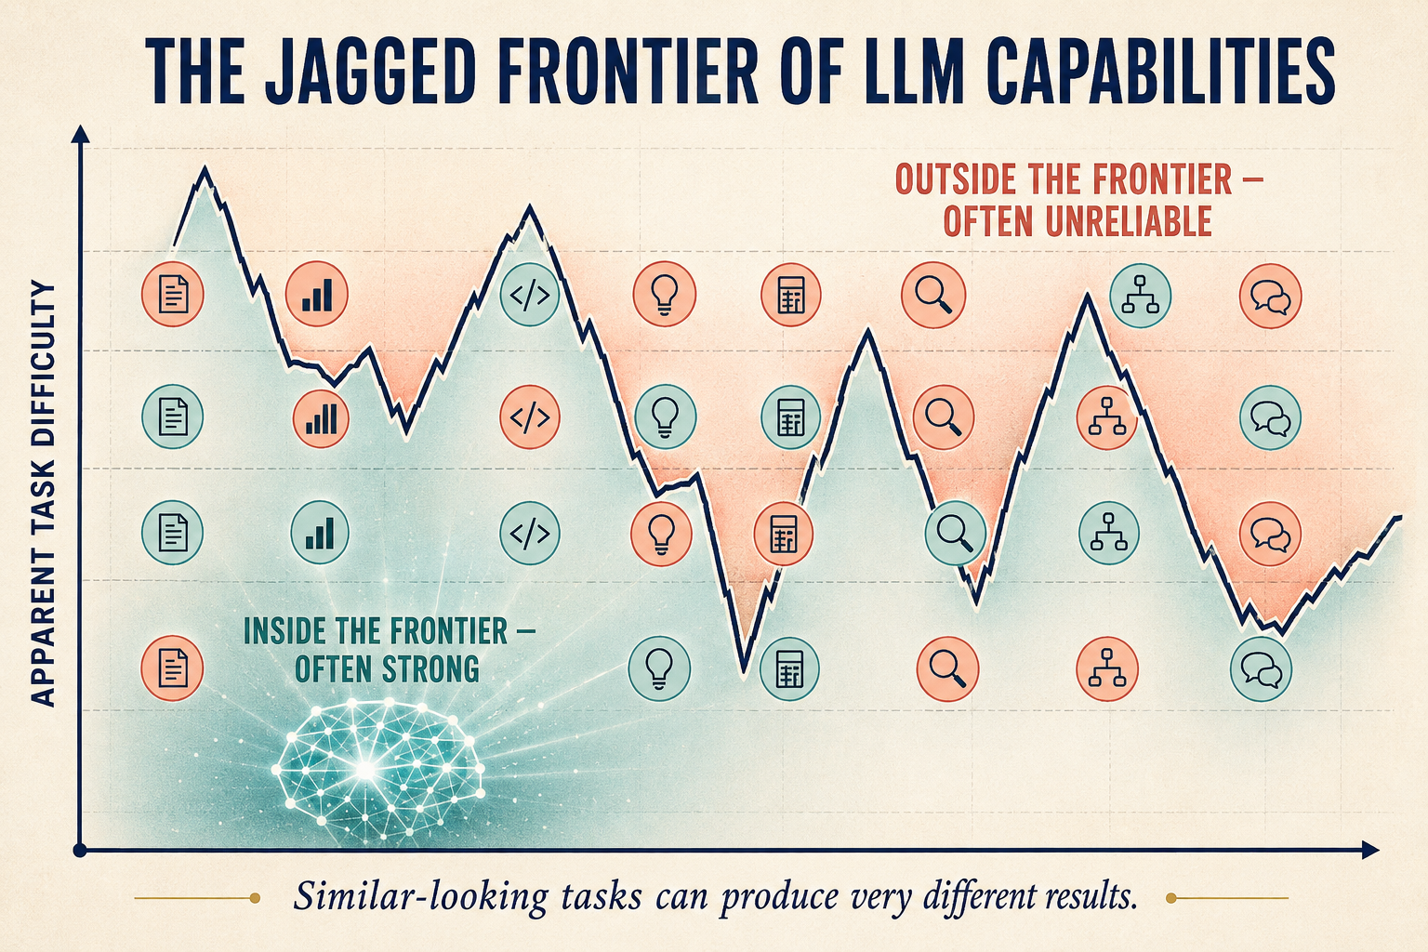
Run the Test on a Language Model — Then on Yourself
The verdict is mixed, and honestly mixed.
Behaviorally close · mechanistically uncertain · diverging under pressure.
Now the other direction. The common dismissal: it is just predicting the next word, so it is not really thinking.
That assumes two things. That we know what real thinking is at the mechanistic level. And that prediction is not it.
We do not know the mechanisms of human thinking. And an influential family of theories holds that the brain is itself largely a prediction engine — constantly anticipating its next input and learning from the error.
Notes:
So run the test on the systems everybody is arguing about.
The honest answer is mixed, and I want to give you the mixed version rather than a verdict, because the mixed version is the true one.
Behaviorally, large language models are very close to people on a great many tasks. And they diverge in ways no person ever would. They fail at problems a child handles easily. They succeed at problems most adults cannot do. You can rephrase a question in a way that changes nothing about its content and push one into confident nonsense.
So: behaviorally close. Mechanistically uncertain. And diverging under pressure — which, by the rule we just established, is the evidence that actually matters.
Now I want to turn the same discipline around, because this is where I think most people in this argument get lazy, and it includes people who agree with me.
The common dismissal goes: it is *just* predicting the next word. Therefore it is not really thinking.
Stop and unpack what that sentence assumes. It assumes we know what real thinking is, at the mechanistic level. And it assumes that prediction is not it.
We do not know the mechanisms of human thinking. That is substantially what this course is about, and we are three weeks in with fifteen to go.
And on the second assumption — there is a large and influential family of theories in cognitive psychology and neuroscience holding that the brain is itself largely a prediction engine. Constantly anticipating its next input, and learning from the error when it is wrong.
I am not telling you that is settled. I am telling you that "prediction is obviously not thinking" is a claim somebody has to argue for, and the people waving it around usually have not.
Here is the shape of the error, and you met it in the species comparison.
We credit ourselves with a rich process we cannot describe. And we deny the machine one we can describe completely.
That is the Clever Hans mistake, made about ourselves. And a fairer position — the one I would defend — holds humans and machines to the same standard.

Slide 7
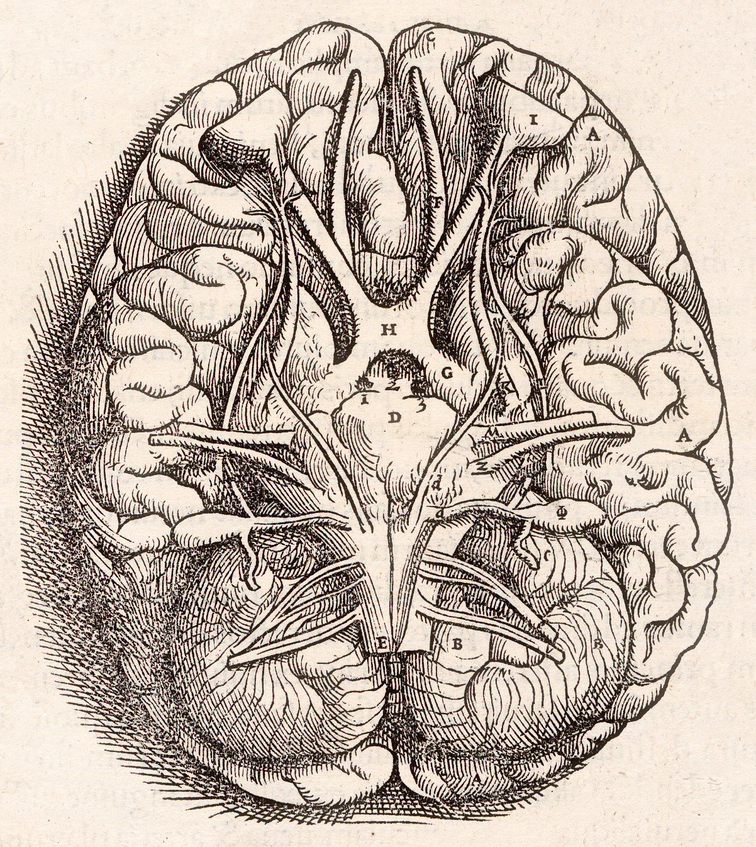
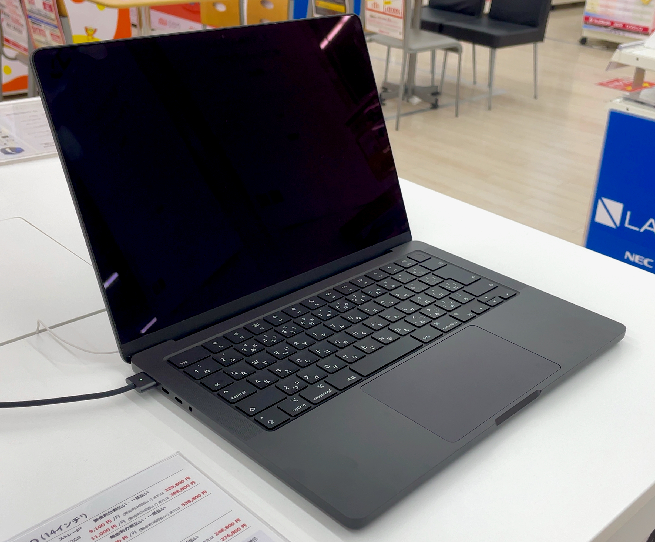
What Would Change Your Mind?
Some of you have a strong feeling that a machine simply cannot understand anything. That feeling arrives before any argument. It is what makes the Chinese Room feel compelling.
Two things are true about it at once.
The uncomfortable one. Claims about who has a mind travel with claims about who is owed what. If granting that a machine understands would be inconvenient or frightening, we have a motive that has nothing to do with evidence. Reasoning backward from the answer we want is not reasoning.
The fair one. Holding a belief firmly enough that it takes a lot to move you is not irrational — a more surprising claim should need stronger evidence. And when an argument arrives somewhere you are confident is wrong, you are entitled to suspect the argument.
So, what separates them is not how strongly the conviction is felt. It is whether you can say, in advance, what would change it.
Notes:
Let me talk to the feeling directly, because a good number of you have it and it deserves better than being talked around.
The feeling is that a machine simply cannot be intelligent, or conscious, or really understand anything. And it does not arrive at the end of an argument. It arrives first. It is a large part of why the Chinese Room feels so compelling to so many people — the argument gives a shape to something already believed.
Two things are true about that feeling at the same time.
The uncomfortable one first. Claims about who has a mind have always traveled with claims about who is owed what — that was the species comparison, with animals. If granting that a machine understands something would be inconvenient, or frightening, or bad for how we would like the world to be, then we have a motive, and the motive has nothing to do with evidence.
And reasoning backward from the answer you want is not reasoning. In its sharpest form: if no possible observation would change your mind, then whatever you are doing, it is not science.
But I do not want to leave it there, because the intuition is not simply a bias, and pretending it is would be its own kind of laziness.
Holding a belief firmly enough that it takes a great deal of evidence to shift is not irrational. A more surprising claim *should* require stronger evidence. That is ordinary good sense.
And there is a genuinely respectable move available here: when an argument arrives somewhere you are confident cannot be right, you are entitled to suspect there is something wrong with the argument, rather than accept the conclusion. Scientists do that all the time, correctly.
So what separates the reasonable version from the unreasonable one? It is not how strongly the conviction is felt.
It is whether you can say, in advance, what would change it.
So let me actually ask you, and take a minute with the person next to you.
What would a machine have to *do* before you granted that it understood something? Be specific. Not "act human" — what observation, what test, what result?
[Take a few. Push for specificity: a behavior is a start, but by our own rule, what should they want to see about failures?]
If you can answer that, your intuition is doing scientific work — it is a high bar, and high bars are fine.
If there is no answer at all — if nothing you can imagine would count — then what you have learned is that for you, this is not a scientific question. Which is worth knowing about yourself, and is not a criticism.

Slide 8
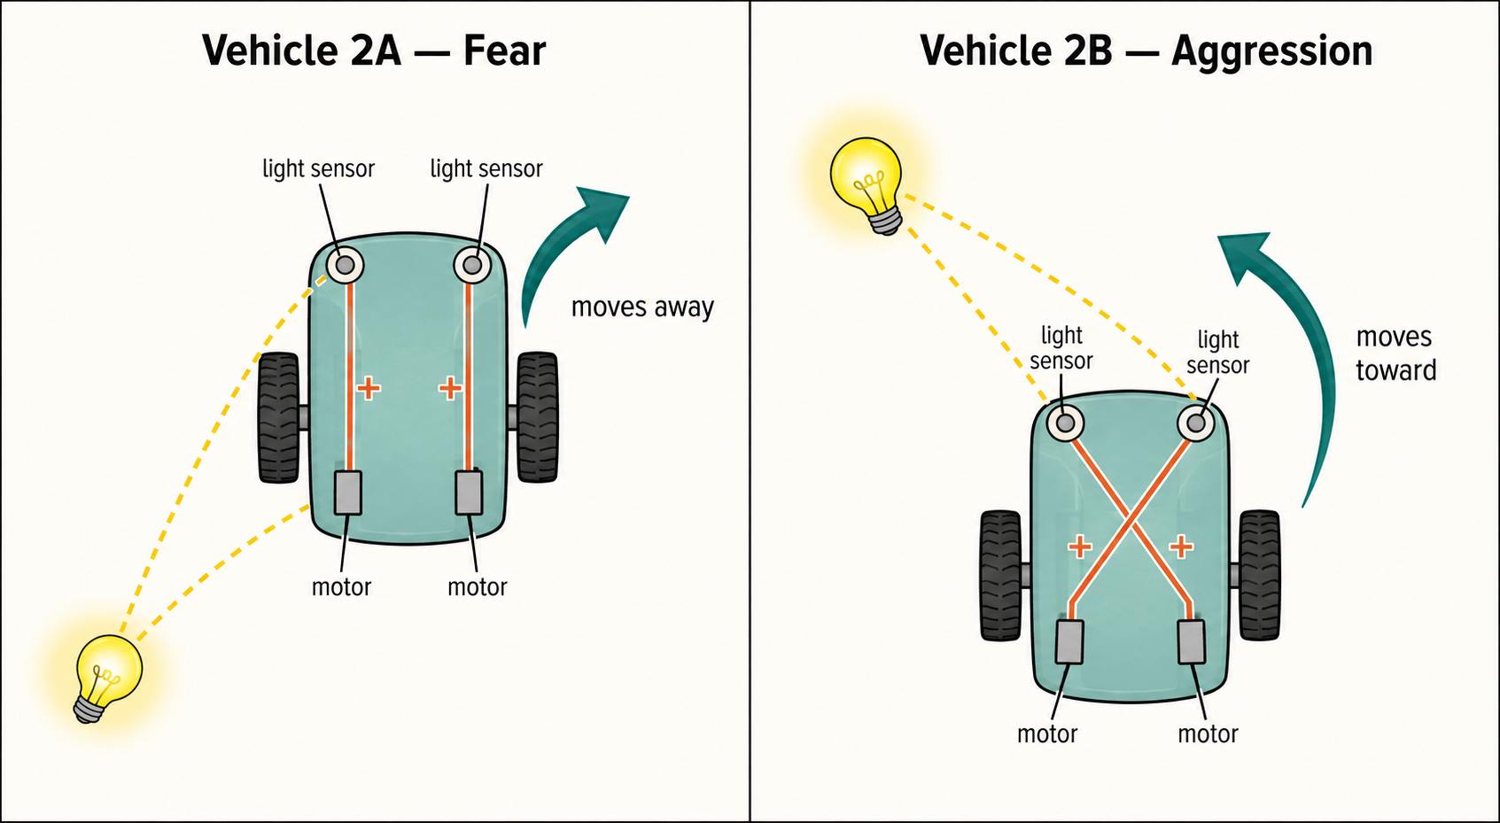
Building One as a Way of Finding Out
An artificial system does not have to be a candidate mind to be scientifically useful. It can be a hypothesis.
Building a system that reproduces some capacity is a way of finding out what that capacity requires.
And the failures are as informative as the successes: if a model has to be given something extra before it can handle a new situation, that requirement is a claim about what the natural system needs too.
This has a name — the synthetic method, sometimes called understanding by building — and a long history in this field.
You have already done it. Two sensors, two motors, a couple of wires — crossed or uncrossed. And you described what you built as afraid.
Notes:
I have spent most of this hour on artificial systems as *rivals* — could a machine have a mind, does it really understand. That is the argument everyone wants to have.
It is not the most useful thing artificial systems do for this science, and I want to spend the back half of the lecture on what is.
An artificial system does not have to be a candidate mind to be scientifically useful. It can be a hypothesis.
Here is what that means concretely. Suppose you want to know what is required to recognize a face, or to navigate a room, or to learn a word. One thing you can do — a real thing, not a metaphor — is try to build something that does it, and see what you turn out to need.
If you cannot build it without X, that is evidence that X is required. Not proof. Evidence.
And the failures are as informative as the successes, which is the part people miss. If your model handles everything you trained it on and then falls apart on a new situation, and you find you have to give it some extra capacity before it copes — that requirement is a claim about the natural system too. It says: whatever solves this problem needs this. Including you.
This has a name. The synthetic method. Understanding by building. It has a long history in this field and it is going to show up in almost every module from here.
And you have already done it, in the Braitenberg lab.
Two sensors. Two motors. A couple of wires, crossed or uncrossed. That is the entire system.
And I would bet that some of you, watching the thing veer away from the light, described it out loud as *afraid*.
Hold both halves of that. You built it, so you know exactly what is inside — there is no mystery, you can see every wire. And it still pulled the description out of you.
That is the synthetic method telling you something about vehicles, and something about you.

Slide 9
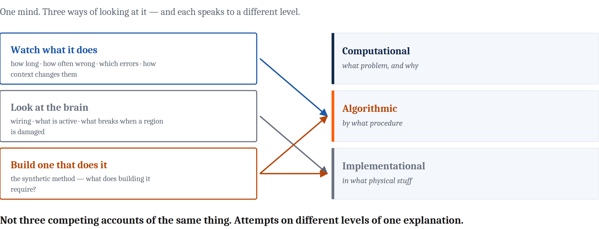
Three Ways to Study a Mind
Now one mind on the table, and what gets compared is the ways we have of looking at it.
Notes:
Everything so far in this lecture, and the whole of the species comparison, set two different systems beside each other. Now something changes.
There is one mind on the table. What gets compared is the set of ways we have of looking at it.
And the question changes with it. No longer *why do these two things resemble each other*. Instead: do two independent ways of measuring the same thing tell the same story — and what do we make of it when they do not?
There are three ways.
**Watch what it does.** Cognitive psychology measures behavior. How long something takes. How often it goes wrong. Which errors, specifically. How context changes them. And notice — almost all of that works by comparing a person in one set of circumstances to the same person in another. That is the second family of comparison from day one, the one I told you the field uses most and this course spends least time on. This is where it lives.
**Look at the brain directly.** Neuroscience measures the physical system. How the parts are wired. Which neurons or regions become active. How responses change over time. What stops working when a region is damaged. What changes when you switch cells on or off.
**Build one.** Which is the method we just spent a slide on.
Now map them onto Marr, because this is the payoff.
Behavioral methods speak mostly to the algorithmic level. They constrain what procedure is being run without telling you anything about the hardware.
Neural methods speak mostly to the implementational level.
And models can be built at either — and are often the only way to check that a proposed algorithm actually produces the behavior it is supposed to explain. Which is a real service. It is very easy to describe an algorithm in words that turns out not to work when you make it run.

Slide 10
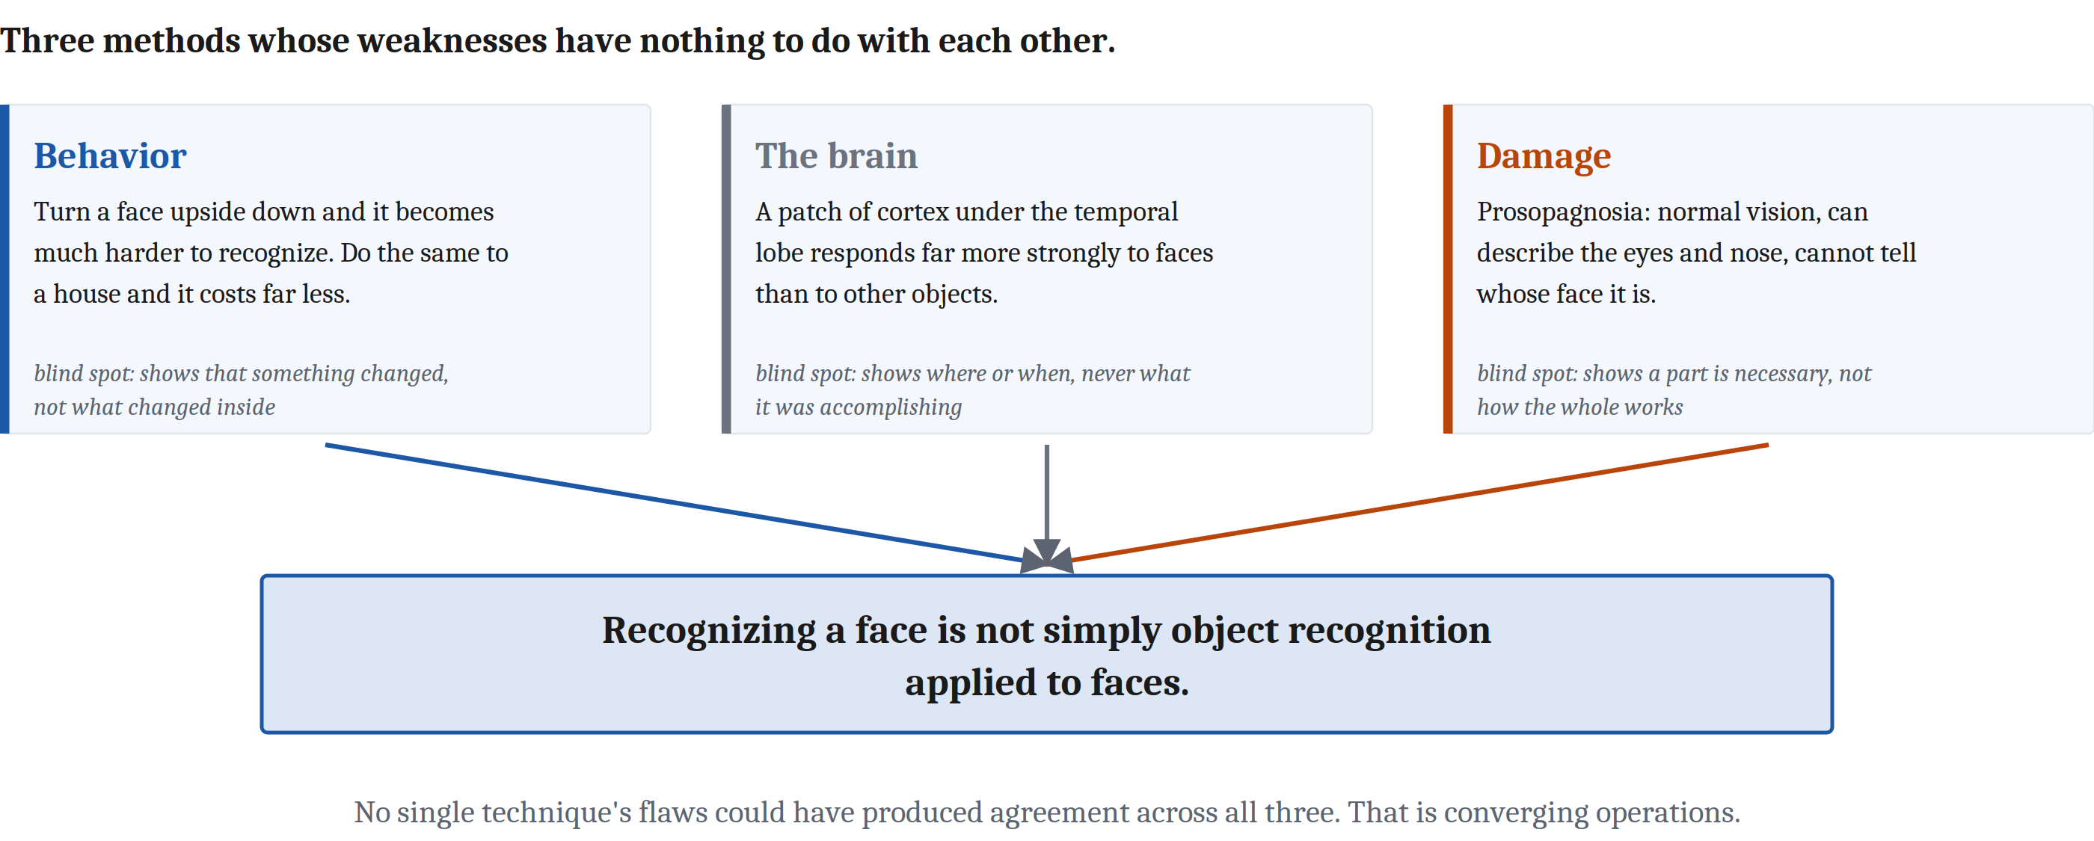
Every Method Has a Blind Spot
Notes:
Every method has a characteristic blind spot. That is the important part — not that they have limits, but that the limits are *different from each other*.
A behavioral measure can show you that something changed without showing you what changed inside. A brain measure can show you where something happened, or when, often not both at once, and never explicitly what that activity was accomplishing. A model can show you that a set of assumptions is or is not sufficient to produce a behavior, without showing you that any actual mind uses those assumptions.
I want to be precise about what those are. They are not flaws waiting to be fixed by better equipment. They are boundaries on what that kind of measurement is able to see at all.
Which gives you the way out. Use several methods whose weaknesses are *unrelated*, and see whether they agree. If they do, the agreement is unlikely to be an artifact of any one technique — because no single technique's flaws could have produced agreement across all of them.
That strategy is called converging operations, and it is one of the most important ideas in this course.
Let me do it properly with one case: recognizing a face.
**Behavior.** We treat faces as wholes rather than as collections of parts. The evidence is beautifully simple — turn a photograph upside down. A face becomes dramatically harder to recognize. Do the same to a house, or a chair, and it costs you much less. So whatever we do with faces depends on their normal overall arrangement in a way that object recognition generally does not.
**The brain.** There is a patch of cortex on the underside of the temporal lobe that responds far more strongly to faces than to other objects.
**Damage.** Prosopagnosia. Patients with normal vision, who can describe the eyes and the nose in front of them perfectly well, and cannot tell you whose face it is.
Three methods with almost nothing in common. An upside-down photograph, a scanner, and a brain injury. They point at the same conclusion: recognizing a face is not simply object recognition applied to faces.
And the honest hedge, which the reading gives and I will give you too: exactly what *is* going on is still very much argued about. Converging operations got us to a conclusion. It did not get us to a mechanism.

Slide 11
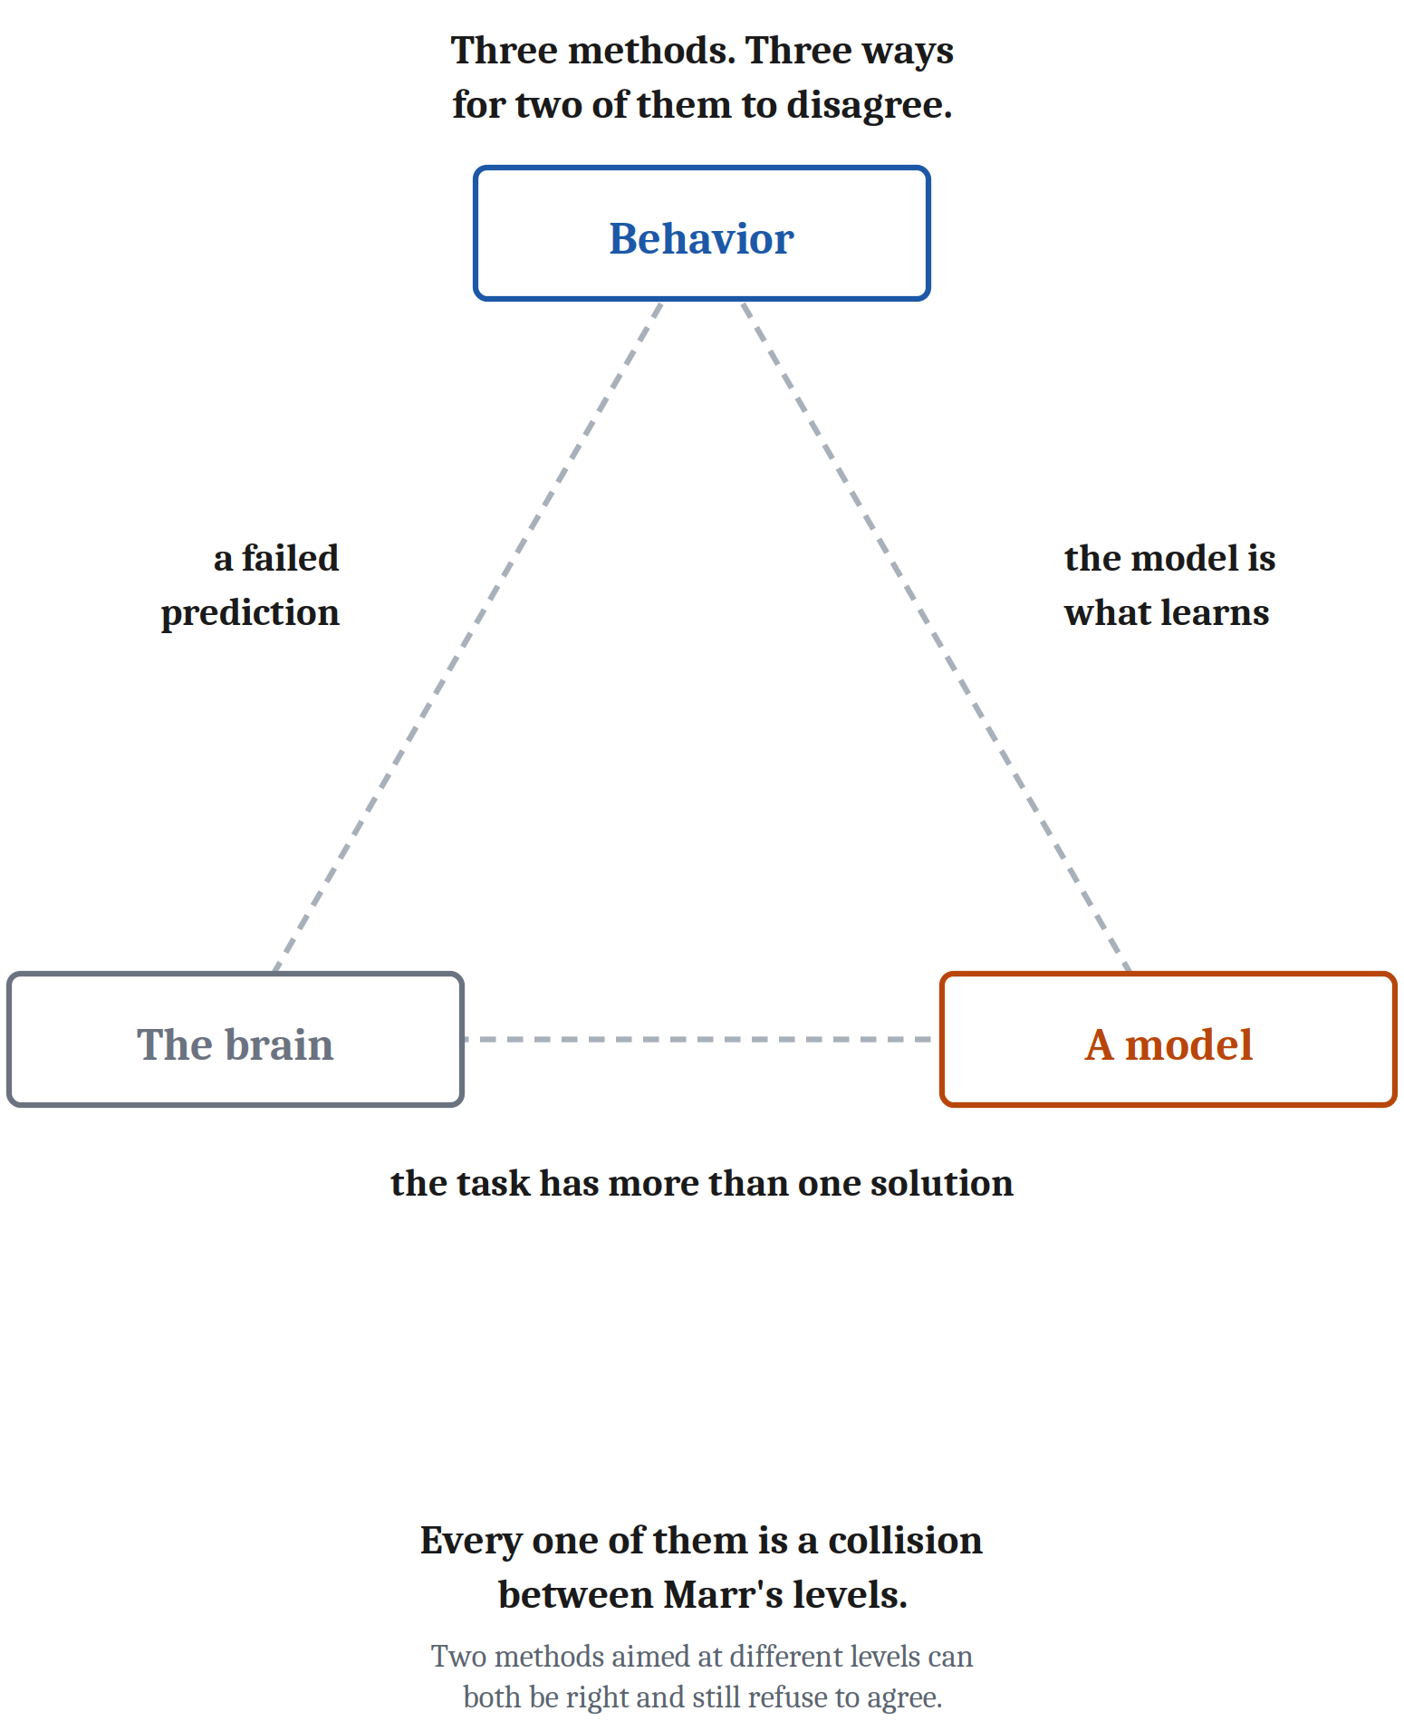
And When They Disagree
Agreement is not the only informative outcome. When two methods disagree, the disagreement is itself a finding.
And which two disagree tells us what kind of finding we have.
Brain and behavior. Primary visual cortex is where signals from the eye first arrive. Destroy it and vision in that part of the field should be gone — and patients report seeing nothing there. Ask them to guess where a light appeared and they say guessing is pointless. Then they guess far better than chance.
Behavior and a model — the lesson is usually about the model. A model that reproduces most of a behavior and breaks on one case is telling us precisely what it is missing.
Brain and a model — the lesson is often that the task can be solved more than one way, and the brain's particular solution is a fact needing its own explanation.
Notes:
We have been treating agreement as the good outcome. It is not the only informative one.
When two methods disagree, that disagreement is itself a finding — because it means at least one of them is measuring something other than what we assumed it was measuring.
And here is the useful part: *which* two disagree tells you what kind of finding you have. Three cases.
**Brain against behavior.** These almost always start as a failed prediction. A brain measure supports some claim about what a structure does, that claim predicts what should happen to behavior when the structure is damaged, and then behavior does something else.
The case I want you to have is blindsight.
Primary visual cortex is where signals from the eye first arrive in cortex. So destroy a piece of it, and vision in the corresponding part of the visual field should be gone. And that is what patients report. Ask them what they see over there and they say nothing. They are not being coy; they are reporting accurately.
Now ask one of them to *guess* where a light just appeared. They will tell you the request is pointless, because they cannot see anything.
And then they guess far better than chance.
Sit with the shape of that. The anatomy predicted nothing would get through. Some part of behavior says otherwise. And the contradiction is the finding: visual processing and visual awareness are separable things, and some visual information is reaching behavior by a route that does not pass through the damaged structure.
**Behavior against a model.** Here the lesson is usually about the model, and this is the synthetic method doing its real work. A model that reproduces most of a behavior and then breaks on one particular case is telling you exactly what it is missing. The gap is a specification of the missing part — which is why building a model is worth doing even when it turns out to be wrong.
**Brain against a model.** Here the lesson is often that the task can be solved in more than one way. A model may perform beautifully by a route the brain demonstrably does not take. That is not a failure of either one. It means the problem admits several solutions — and that the brain's particular solution is a fact that needs its own explanation, rather than something that follows from the task.
And now put all three together, because they are the same thing.
Every one of those disagreements is a collision between Marr's levels. Brain against behavior: how an implementation supports an algorithm. Behavior against model: what the algorithm actually is. Brain against model: whether a proposed algorithm is the one the implementation is running.
Evidence about any one level constrains the others without determining them. Which means two methods aimed at different levels can both be right and still refuse to agree.

Slide 12
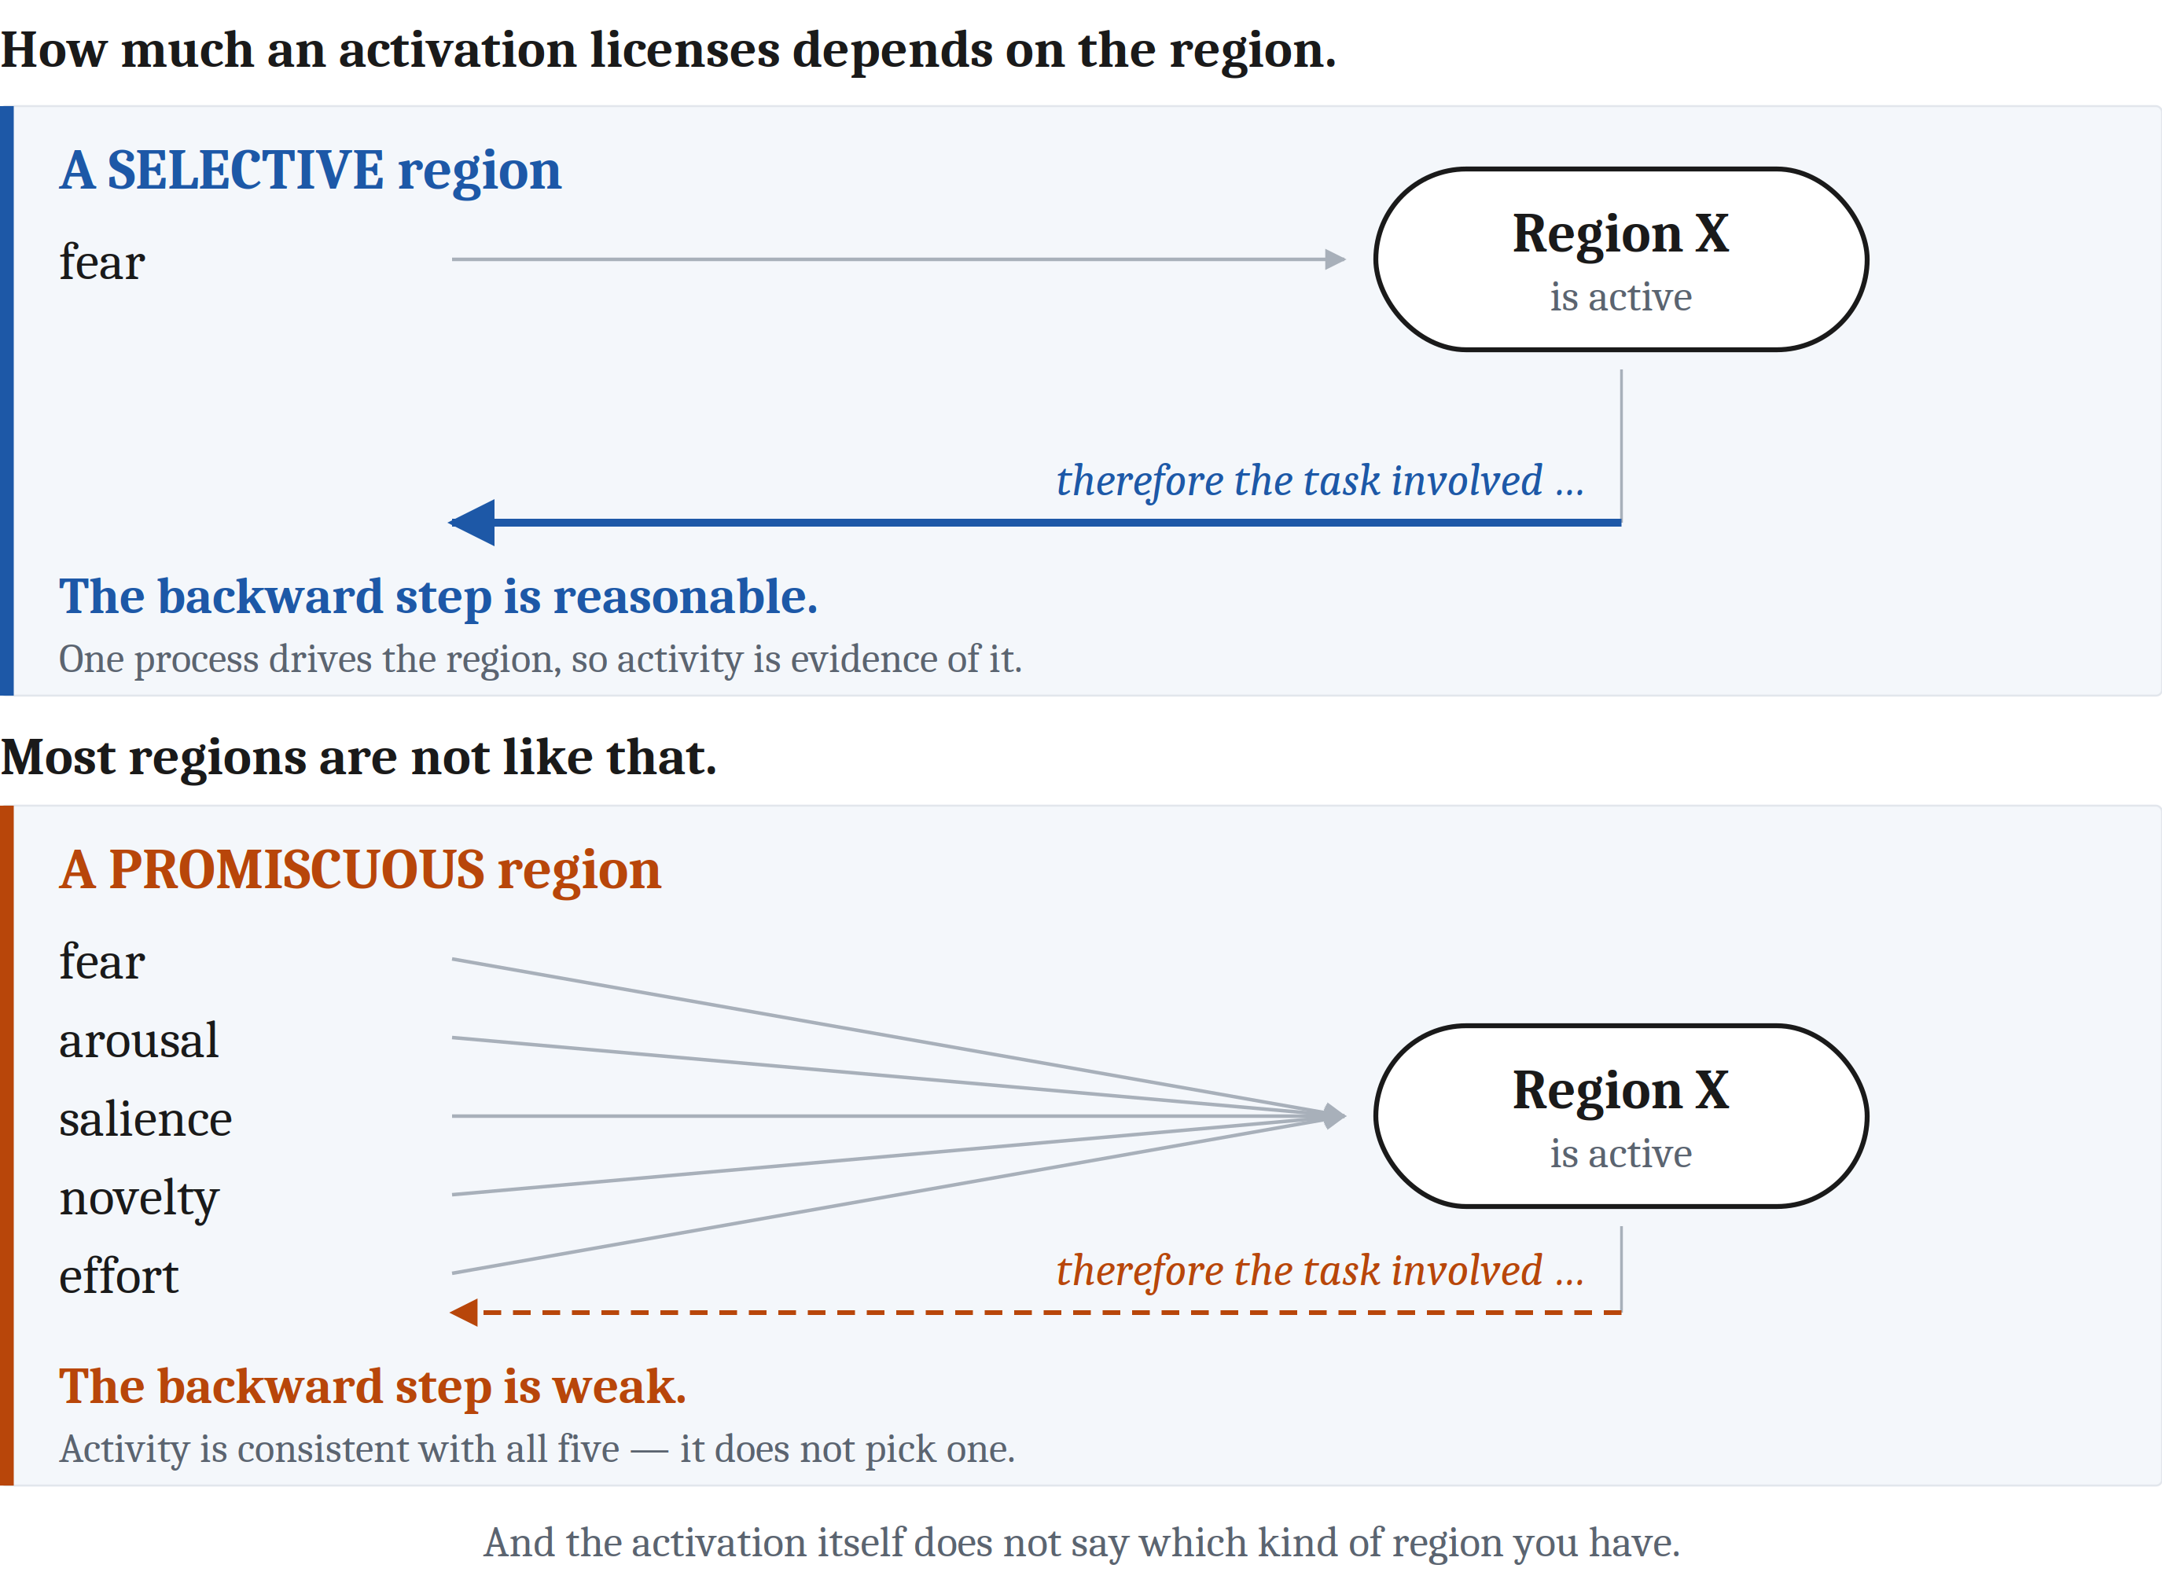
The Error This Family Makes
Reverse inference: going from "this brain region was active during the task" to "therefore the task involved the process that region does."
An activation is a relationship between two measurements, and a relationship never interprets itself.
How much a given activation licenses depends on how selectively that region responds — an empirical question whose answer differs region by region.
Notes:
Each family of comparison has a characteristic error. Across species it was the ladder. Across the natural and artificial divide it was surface matching. Here it is reverse inference.
Reverse inference is the move from "this brain region was active during the task" to "therefore the task involved the process that region does."
You will see it constantly, and not only in journalism. It is tempting because it feels like reading the answer off the machine.
It is often wrong, for a simple reason. Brain regions are not dedicated to single processes. A region that lights up during fear also lights up during a great many other things. So finding it active during your task is weak evidence that fear was the critical ingredient — much weaker than the sentence "the fear region was active" makes it sound.
And you already know what this is. An activation is a relationship between two measurements. And a relationship never interprets itself.
That is the sentence this entire module has been built on, and here it is once more, in a lab coat, at the end of the module.
How much a given activation actually licenses depends on how selectively that region responds — which is an empirical question, with a different answer for different regions. Some regions are quite selective and the inference is reasonable. Most are not.

Slide 13
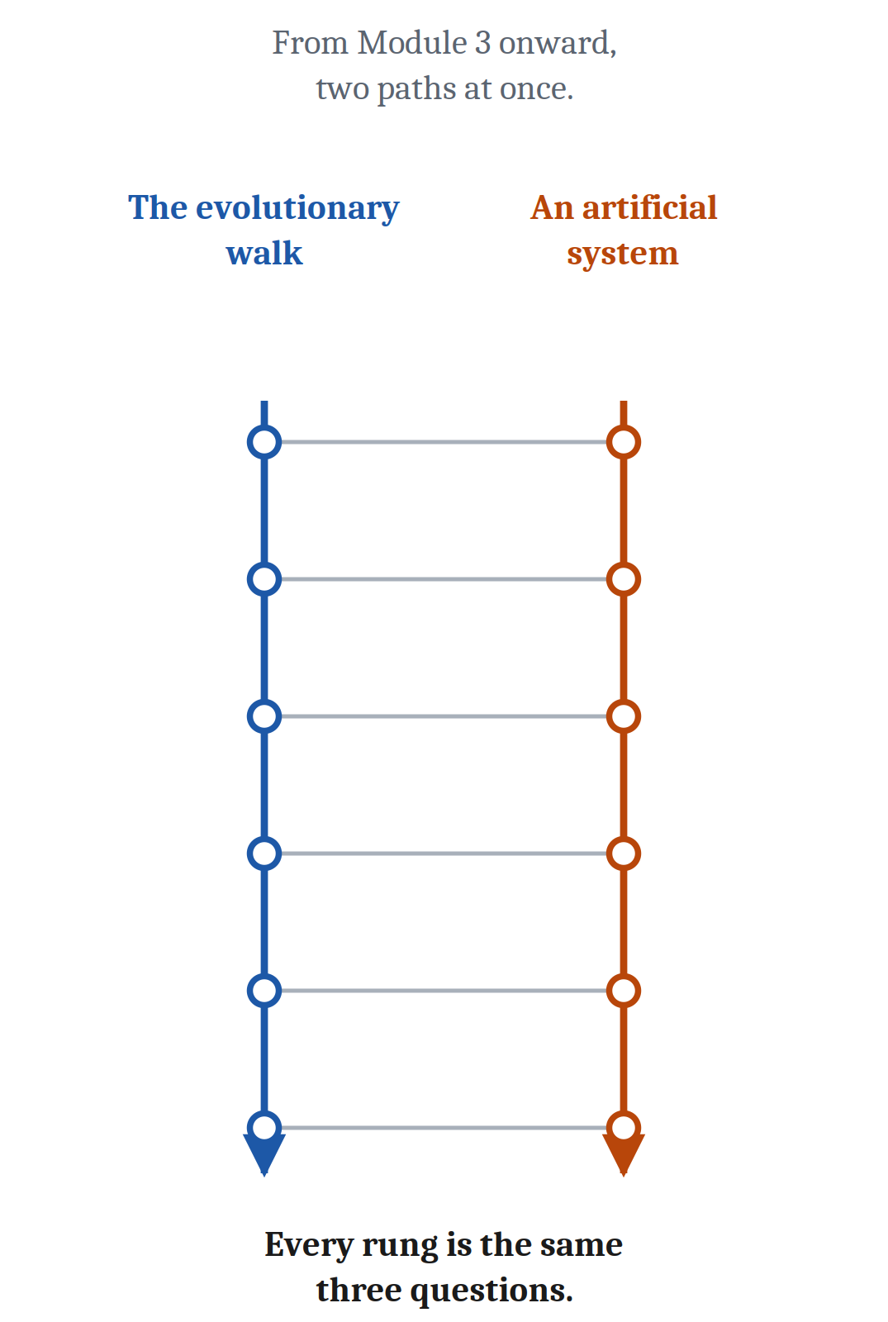
Two Threads, and What Comparison Provides
From Module 3 onward, two paths at once
The evolutionary narrative
Natural vs. artificial comparisons
Each pairing is an instance of the same three questions: why do these two resemble each other, given that one was designed and one evolved · how deep does it go · how precisely can we state it.
Done carefully, comparison licenses conclusions about origins, about mechanisms, and about the problems a capacity was a solution to. Not bad for a method that requires only looking at two things at once.
What it does not do: settle what any creature is owed. And it cannot reach all the way into another mind — what it is truly like to be an octopus, an infant, or a machine is not a question this method answers.
Notes:
Two things to finish, and then Module 3.
First, the shape of the rest of the course. In the species comparison I announced one thread: the evolutionary walk, each module taking a step along the path that produced human minds. Here is the second.
From Module 3 onward, at almost every step, we will set beside that step an artificial system built to solve a version of the same problem. When we do simple nervous systems, the robot vacuum is sitting right there. When we do learning from reward, so are the engines that taught themselves chess and Go. Pattern recognition and layered networks. Planning and search. Language and language models.
Do not memorize that list. Notice what the pairings are *for*.
Every one of them is an instance of the three questions from the first lecture of this module. Why do these two resemble each other, given that one was designed and the other evolved? How deep does the resemblance run? How precisely can we state it?
The answers come out differently every single time. And the differences are what teach us — about the brain, and about the machine.
There is a moral note here too, and it is a different one from the one I made earlier. Earlier I said that moral stakes can bend our judgment about what a machine *is*. This one runs the other way: what would *follow* if the judgment came out a particular way. If a machine were ever mechanistically equivalent to a mind in whatever respects we decide should matter, questions would follow about what we owe it. Most researchers think current systems are nowhere near that bar. But asking what would have to be true before it became a serious question is not a foolish thing to be doing now rather than later.
Second, and last. What does this method actually buy us?
Done carefully, comparison licenses conclusions about origins, about mechanisms, and about the problems a capacity was a solution to. Which is quite an accomplishment for a method whose entire requirement is looking at two things at the same time.
And here is what it does not do. It does not settle what any creature is owed — not an animal, not a fetus, not a machine. And it cannot reach all the way into another mind. What it is truly like to be an octopus, or an infant, or a machine, is not a question this method answers.
At the start of this course you had a mind and a brain and no way to get from one to the other. You now have Marr's three levels for taking one system apart, and three questions for setting any two things beside each other.
That is the toolkit. Everything from here is using it.
Next, we start using it. Module 3: the neuron. The first cell specialized for carrying a signal quickly over distance — and the first module to give each of Marr's three levels a section of its own.

Slide 14
Image Sources (1 of 2)
Slide | Image | File | Licence | Source
2 | Three question marks | three_question_marks.png | Jon's own generated image; cleared for classroom and web use | Jon Willits — generated image · own work
3 | The three senses in which a machine can match a mind | fig-three-modes.png | CC BY 4.0 | Jon Willits — drawn for this lecture from the Module 2 reading's table · own work
4 | The Chinese Room | fig-chinese-room.png | CC BY 4.0 | Jon Willits — drawn for this lecture · own work
5 | The same 400 photographs, with the question moved to the disagreements | fig-breaking-same-way.png | CC BY 4.0 | Jon Willits — drawn for this lecture · own work
6 | The jagged frontier | jagged_frontier.png | Jon's own generated image; cleared for classroom and web use | Jon Willits — generated image · own work
7 | The base of the brain, from Vesalius's Fabrica (1543) | vesalius_base_of_brain.jpg | public domain | Andreas Vesalius, De humani corporis fabrica (1543); scan via e-rara · https://commons.wikimedia.org/wiki/File:1543,_Andreas_Vesalius%27_Fabrica,_Base_Of_The_Brain.jpg
7 | A current laptop | macbook_pro.jpg | CC BY-SA 4.0 | Kyu3a, own work — CC BY-SA 4.0 · https://commons.wikimedia.org/wiki/File:M3_Macbook_Pro_14_inch_Space_Grey_model_(cropped).jpg
8 | Braitenberg's Vehicle 2, wired both ways | braitenberg_vehicles.png | Jon's own generated image; cleared for classroom and web use | Jon Willits — generated with ChatGPT · own work

Slide 15
Image Sources (2 of 2)
Slide | Image | File | Licence | Source
9 | The three methods, and the levels each one speaks to | fig-three-methods.png | CC BY 4.0 | Jon Willits — drawn for this lecture · own work
10 | Three methods with almost nothing in common, converging on one conclusion | fig-converging-faces.png | CC BY 4.0 | Jon Willits — drawn for this lecture · own work
11 | Three methods, and the three ways two of them can disagree | fig-disagreement-triangle.png | CC BY 4.0 | Jon Willits — drawn for this lecture · own work
12 | The backward step, for a selective region and a promiscuous one | fig-reverse-inference.png | CC BY 4.0 | Jon Willits — drawn for this lecture · own work
13 | Two rails, joined at every step | fig-two-threads.png | CC BY 4.0 | Jon Willits — drawn for this lecture · own work

