Slide 1

BCOG 100
Neurons and Neural Communication
Lecture 3.1 — The Evolutionary Function of Neurons
Notes:
Module 2 finished with a toolkit and a promise. The toolkit was Marr's three levels for taking one system apart, and three questions for setting any two things side by side. The promise was that everything from there on would be us using that toolkit.
This is us using it. Module 3 is about one cell — the neuron, the cell that turns an event into a fast, precisely aimed signal.
It is also the first piece of biological machinery this course examines at all three of Marr's levels, one level at a time, one lecture each. This lecture is the first of the three, and it asks the computational question: what problem were neurons the solution to, and why did only some kinds of living things ever need to solve it?

Slide 2
One Cell, Three Questions
This is the shape of every module from here to the end of the course. One capacity, three sections in the reading, three meetings, one per level.
Level | The question it asks | Discipline | This module's example: the neuron
Computational | What problem is being solved, and why does solving it matter? | Evolution and ecology | Fast, long-distance, reliable signaling, for an animal that must sense, decide, and act before something else does
Algorithmic | What is represented, and by what procedure? | Cognitive psychology and AI | Receive, integrate, transmit; a threshold, and an all-or-nothing spike
Implementational | By what physical means, and at what cost? | Neuroscience | Ion gradients across a membrane, the sodium-potassium pump, and the action potential
Notes:
Module 1 gave us this table and made a promise about it: that from that point on the course would take one capacity at a time and work it at all three levels. Module 3 is where the promise starts being kept, and the table gets its first reprint. Every module from here on reprints it with its own example in the last column.
So here is the plan for the three meetings on the neuron. This lecture asks why neurons evolved. The second asks what a neuron computes. The third asks how a living cell physically manages it, and what it costs to run.
Two things about the neuron organize all three. The first is that neurons are the animal's answer to a problem: ordinary chemical signaling was not fast enough for many of the problems animals face. The second is that neurons are the body's first great metabolic outlier. They are extraordinarily expensive to run.
Hold on to the second one, because it is the thread that ties the far ends of this module together. The story that opens this lecture, about how life became rich enough to build neurons at all, is the same story that closes the third lecture, about why the brain is the most expensive organ in the body.
There is a second thread, and it runs to the end of the course. The unit at the heart of modern artificial intelligence is also called a neuron, and artificial neurons were built as stripped-down copies of biological ones. We will set the two side by side as we go, and look hardest at the place where they turn out to differ most — which is not what they compute, but what they are made of.

Slide 3
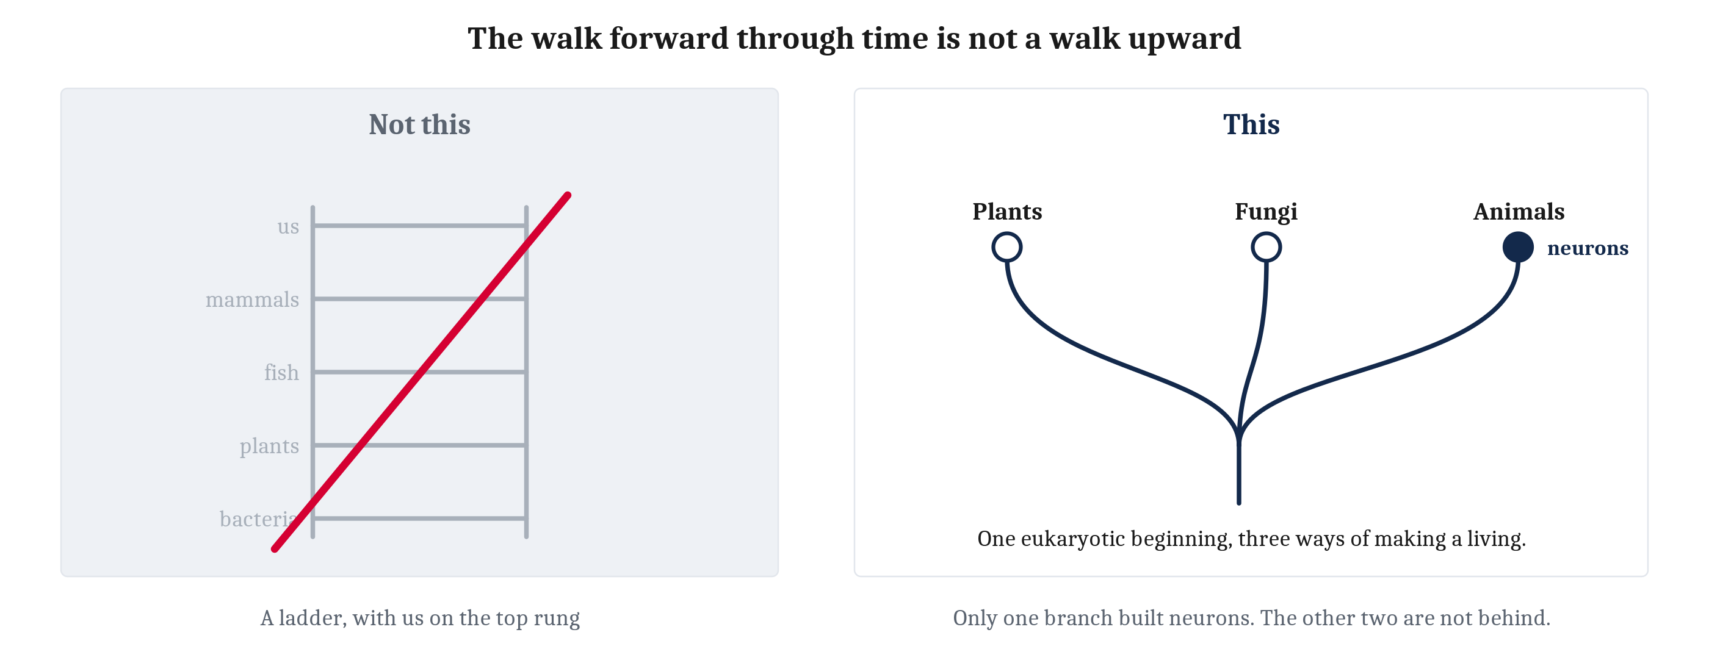
What a Computational Question Asks About a Living Thing
Living things have no designer. So the only answer to what is this for? that does not appeal to magic is a historical one — which makes asking what a neuron is for the same as asking what selective pressure favored building one.
Notes:
Marr's computational level asks what problem is being solved. For a machine, that question has an easy answer, because somebody built the machine and had something in mind. For a living thing there is no designer and nobody had anything in mind, so the question has to be answered a different way.
The only answer available that does not appeal to magic is a historical one. A structure is here because the organisms that had it left more descendants than the organisms that did not. So asking what a neuron is for is exactly the same as asking what selective pressure favored building one.
That means we are about to use Module 2's logic of natural selection again — variation arises among individuals, some of it is heritable, and some heritable variants leave more descendants than others. What is new is where we point that logic. In Module 2 we pointed it at species, and at the traits species have. Here we point it at something more fundamental: at the kinds of cells an organism has. A neuron is an adaptation in exactly the sense Module 2 gave that word, and the same three-part logic that explains the coloring of a moth also explains why some lineages came to build neurons and most never did.
Now the warning, and it matters more here than anywhere else in the course so far. Module 2 was firm that evolution is not a climb toward anything and that there is no ladder with us at the top of it. This lecture walks forward through time — chemistry, then cells, then animals — and that walk reads very easily as a walk upward. It is not one.
Neurons are not an achievement that some lineages managed and others failed at. They are an expensive solution to a specific problem, taken by only some living things. Plants have no neurons and are not thereby behind. By every measure that matters to a plant, plants are doing just fine, thank you very much.
Keep the picture on the right in mind for the whole lecture. Three branches, all the same height, and only one of them ever built a neuron.

Slide 4
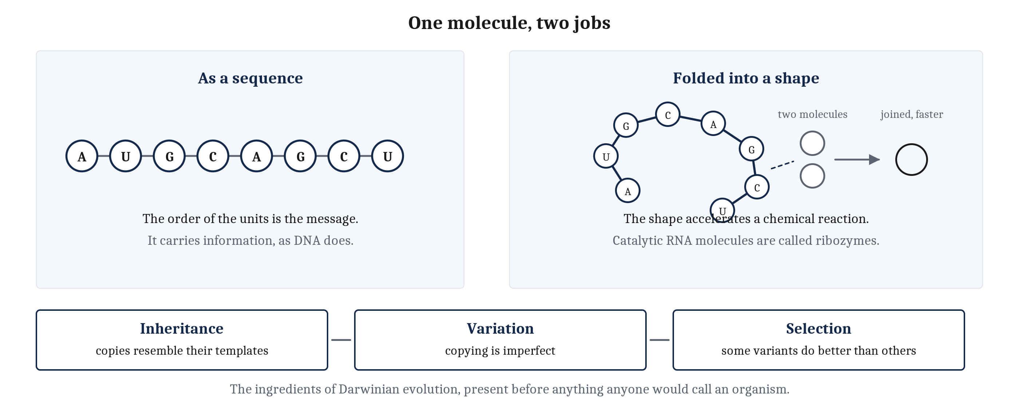
Before There Were Cells
The RNA-world hypothesis. RNA carries information in its sequence and, folded into certain shapes, accelerates chemical reactions. One molecule, two jobs — and with it inheritance, variation and selection, before there were cells at all.
Notes:
A neuron is a cell, and an unusually elaborate one. So before we can ask how evolution produced such a thing, there first had to be cells at all. And a cell is not an obvious object. A cell is a bounded, organized system of chemistry that maintains and repairs itself, obtains energy and materials from its surroundings, and belongs to a lineage capable of making more cells. It is far from obvious how the chemistry of a lifeless planet ever crossed that threshold.
So the story starts earlier than an introduction to the mind usually starts. Earth formed about four and a half billion years ago, and for hundreds of millions of years afterward, energy from sunlight, lightning, impacts, geothermal heat and chemical gradients drove an enormous number of reactions. Some of those reactions produced increasingly complex organic molecules.
One leading hypothesis about what happened next is the RNA-world hypothesis. RNA is a carbon-based polymer, and it is remarkable for doing two quite different things. In its sequence it carries information, the way DNA does. And folded into certain shapes it accelerates chemical reactions, the way a protein does. Catalytic RNA molecules of that kind are called ribozymes.
Be careful with how strong that claim is. The RNA-world hypothesis does not say scientists know life began with RNA. Simpler chemical systems may have come first, and precisely how RNA itself first arose remains unresolved. This is one of the few places in the course where we are teaching something genuinely unsettled as though it were background, and it is worth saying so out loud.
Here is the part that matters for us. At some point RNA, or something like it, became involved in making copies of molecular sequences. Once those copies resembled their templates, there was inheritance. Because copying was imperfect, there was variation. And if some variants survived or reproduced better than others, there was selection.
Three ingredients, and they are the same three from Module 2. Which means the basic machinery of Darwinian evolution was present before anything existed that everyone would agree to call an organism. Evolution may have begun before cells, and perhaps before life had a clear boundary at all.

Slide 5
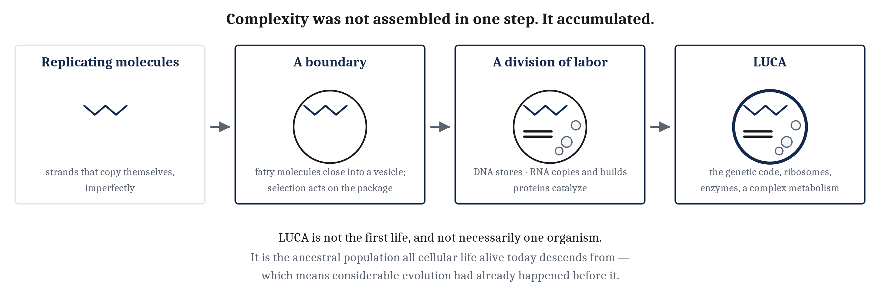
A Boundary, and What It Bought
Replicating molecules are not yet cells. What they lack is a boundary — and once a vesicle could grow and split, selection could act on the whole package rather than on naked molecules.
Notes:
Replicating molecules are not yet cells. What they lack is a boundary.
The next step may have begun when some of those replicating systems became enclosed. Simple fatty molecules exist in which one part interacts with water and another avoids it, and molecules like that assemble spontaneously into hollow, membrane-bound vesicles. Most vesicles would have contained nothing of consequence. Some may have trapped RNA and other useful molecules.
A membrane buys three things at once. It lets small building blocks pass in and out while retaining longer strands inside. It keeps cooperating molecules together. And it shields them from being diluted away. Vesicles can also take up more fatty molecules, grow, and split under physical forces, passing some contents to each daughter. So if a particular RNA system helped its vesicle grow, persist or reproduce, then selection could now act on the whole package rather than on naked molecules. Packages like that are called protocells.
At some stage protocells also changed how they stored information, moving it into DNA, which is less vulnerable to spontaneous breakdown and whose complementary strands make damaged information easier to recover. That produced the division of labor cells still run on. DNA stores the instructions. RNA copies them and uses them to build proteins, while keeping some of its earlier catalytic roles. Proteins became the principal catalysts of cellular chemistry.
By the time of LUCA — the Last Universal Common Ancestor — that division of labor was probably established. Be careful with what LUCA is. LUCA was not the first life, and not necessarily a single organism. LUCA is the ancestral population from which all cellular life alive today descends. It already had the genetic code, ribosomes, protein enzymes and a complex metabolism, which means considerable evolution had already happened before it. LUCA marks not life's beginning but the deepest common ancestor that surviving organisms let us reconstruct.
Notice the shape of the whole slide, because it is the answer to one of the two questions this module opens with. Complexity was not assembled in one step. It accumulated.

Slide 6
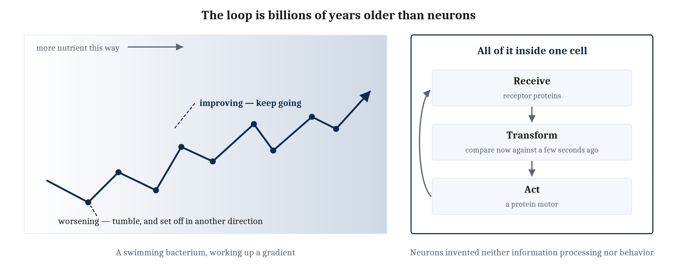
Behavior Is Older Than Neurons
A swimming bacterium compares the nutrient concentration now against the concentration a few seconds ago. Neurons invented neither information processing nor behavior. What they added is a way to move information fast between distant parts of one body.
Notes:
One feature of the early cellular world matters more for us than any particular piece of chemistry, and it is easy to get backwards.
Long before life had neurons, cells had evolved ways of sensing their surroundings and acting on what they sensed. Take a swimming bacterium such as *E. coli*. It can compare the concentration of a nutrient right now against the concentration it encountered a few seconds ago. If conditions are improving, it carries on in roughly the same direction. If conditions are worsening, it tumbles and sets off in another. That behavior is called chemotaxis, and it gradually carries the bacterium toward nutrients and away from things that would harm it.
Look at what that requires. Receiving information from the world. Transforming that information internally — and notice that comparing now against a few seconds ago is a comparison across time, which means something in the cell is holding a trace of the recent past. Then changing behavior in response.
That is a complete sensing-and-acting loop, and it is billions of years older than neurons. One cell closes it, with no nervous system anywhere, using receptor proteins, molecular signaling pathways, and a protein motor.
So it is worth being careful about what neurons actually contributed, and we will be careful about it twice more in this lecture. Neurons did not invent information processing. Neurons did not invent behavior. Both were in place long before them.
What neurons added is narrower and more specific: a specialized means of transmitting information rapidly between distant parts of a multicellular organism, so that many cells could sense and act as one coordinated whole.
Everything else in this lecture is about why that particular addition was worth building.

Slide 7
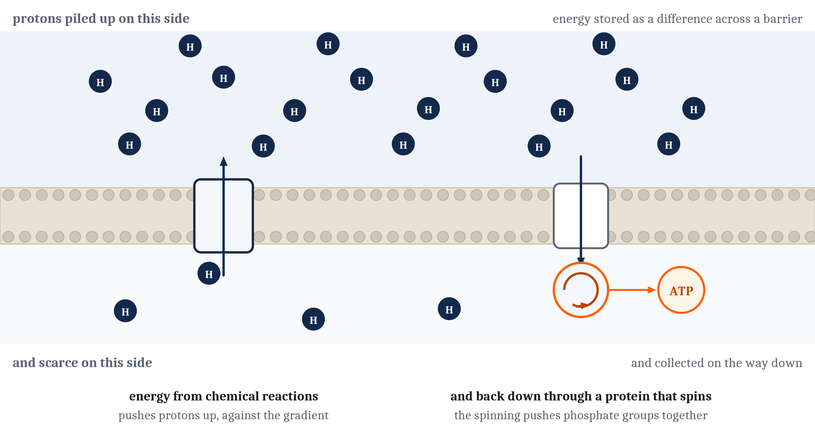
Everything Costs, and It Is All Paid in One Currency
ATP stores energy in a chemical bond and releases it where it is needed. A cell's whole economy is making ATP and spending it.
Early life could produce energy. It was energy poor.
Notes:
Everything a cell does costs something. Building a protein, moving a flagellum, repairing damage, copying a genome — all of it costs, and a great deal.
Cells pay every one of those bills in the same currency. ATP is a small molecule that stores energy in a chemical bond and releases it where the cell needs it, and a cell's entire economy consists of making ATP and spending it.
That raises an obvious question, and the answer is one of the nicer facts in this whole section. Why ATP? And the answer is that ATP did not have to be invented for the job at all. Adenosine triphosphate is a nucleotide — one of the four building blocks that RNA is assembled from — and the phosphates on it are exactly what activated those building blocks so they could join into chains. So the molecule was already lying around, already abundant, and already carrying energy in its phosphate bonds before anything needed a currency.
Phosphate bonds also happen to suit the role unusually well. They release a great deal of energy when broken, and they do not break on their own in water. So a cell can store energy in them and then spend it when it chooses, rather than losing it. Why this nucleotide rather than one of the other three is still argued over. What is not in doubt is that once ATP was the currency it became very difficult to replace, because by then everything else was built to use it.
Now, how did early cells actually make it? The scheme is ingenious and meager at once. Energy from chemical reactions is used to pump protons across a membrane, so protons pile up on one side. They then flow back through a protein that spins as they pass. And here is the part worth pausing on: making ATP means pushing phosphate groups together, and phosphate groups repel one another electrically. The spinning is the mechanical force that does that pushing.
Water behind a dam is the usual comparison, and it is a good one, because the arrangement stores energy as a difference held across a barrier and collects it on the way down. Hold on to that shape. In the third lecture of this module we will meet a membrane holding a difference across itself again, for a completely different purpose.
The scheme works. It works in essentially every cell alive today. What it did not do, in early life, is produce very much. Early life could produce energy. It was energy poor.

Slide 8
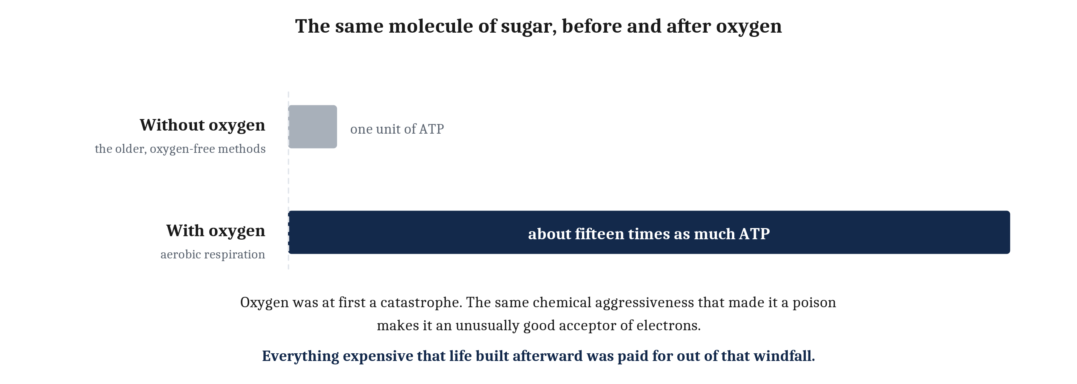
Poison Into Windfall
Photosynthesis turned sunlight into storable sugar. Its waste product, oxygen, was at first a catastrophe — the Great Oxygenation Event. The same aggressiveness that made oxygen a poison makes it an unusually good acceptor of electrons.
Notes:
Then a revolution. Some cells evolved the ability to capture sunlight. Photosynthesis uses light to build sugar out of carbon dioxide and water, and that sugar can be broken down later to power the creation of ATP. So a renewable and enormous energy source became a storable chemical one.
The consequences for life were large. The consequences for the planet were larger, because photosynthesis has a waste product, and the waste product is oxygen.
For most life on Earth at the time, that oxygen was a catastrophe. Oxygen is chemically aggressive. It wrecks the molecules of organisms not built to handle it. Its accumulation is associated with one of the earliest mass extinctions in Earth's history, known as the Great Oxygenation Event. A very large number of lineages were killed by pollution produced by other organisms.
And then comes the turn that the rest of this module depends on. The same chemical aggressiveness that made oxygen a poison makes it an unusually good acceptor of electrons. Any lineage that could put oxygen at the end of the chain, as the final acceptor of the electrons stripped from food, could extract far more energy out of the same meal. That process is aerobic respiration, and it yields something like fifteen times as much ATP from a molecule of sugar as the older, oxygen-free methods do.
Look at the two bars for a second, because the ratio is the content. Not fifteen percent more. Fifteen times.
Oxygen was a poison. It became a windfall for the cells that happened to be able to use it. And everything expensive that life built afterward — including us, and including every neuron in this room — was paid for out of that windfall.

Slide 9
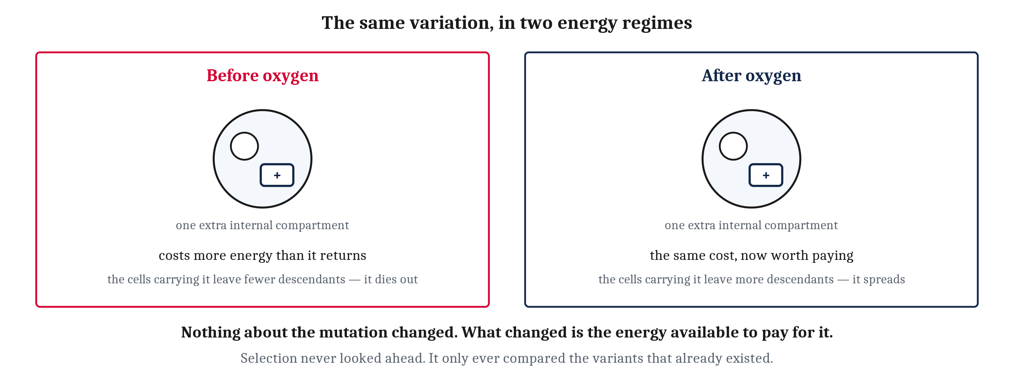
Nothing Was Waiting
A surplus makes arrangements affordable that were not affordable before — and affordable invites the misreading most people actually hold. Nothing was waiting. There were no plans.
Notes:
A large and reliable energy surplus makes arrangements affordable that were not affordable before, and the history of life after oxygen is largely a history of newly affordable adaptations.
But the word *affordable* invites a misreading, and it is worth heading off carefully, because it is the misreading most people actually hold about evolution.
It can sound as though life had been waiting for the money to arrive. As though there were plans in a drawer somewhere, blueprints for a bigger cell, and life was saving up. There were no plans. Nothing was waiting.
Here is what was actually happening. Before oxygen, mutations pushing toward greater complexity arose exactly as mutations always do. A larger cell. An extra internal compartment. More machinery to build and maintain. Those variants appeared, and they died out. What they cost in energy was more than what they returned, so the cells carrying them left fewer descendants and the variation did not spread.
Then some lineages happened onto a way of using oxygen, and the arithmetic changed underneath them. The very same variation that had been too expensive to keep was now worth its price, and the cells carrying it left more descendants rather than fewer.
Look at the two cells in the picture. They are the same drawing, deliberately. Nothing about the mutation changed. What changed is the energy available to pay for it.
Selection never looked ahead. It only ever compared the variants that already existed, and a new energy surplus changed which of them was worth keeping. That is the whole mechanism, and it is worth holding on to, because the same shape of argument comes back at the end of the module when we ask why brains are built the way they are.

Slide 10
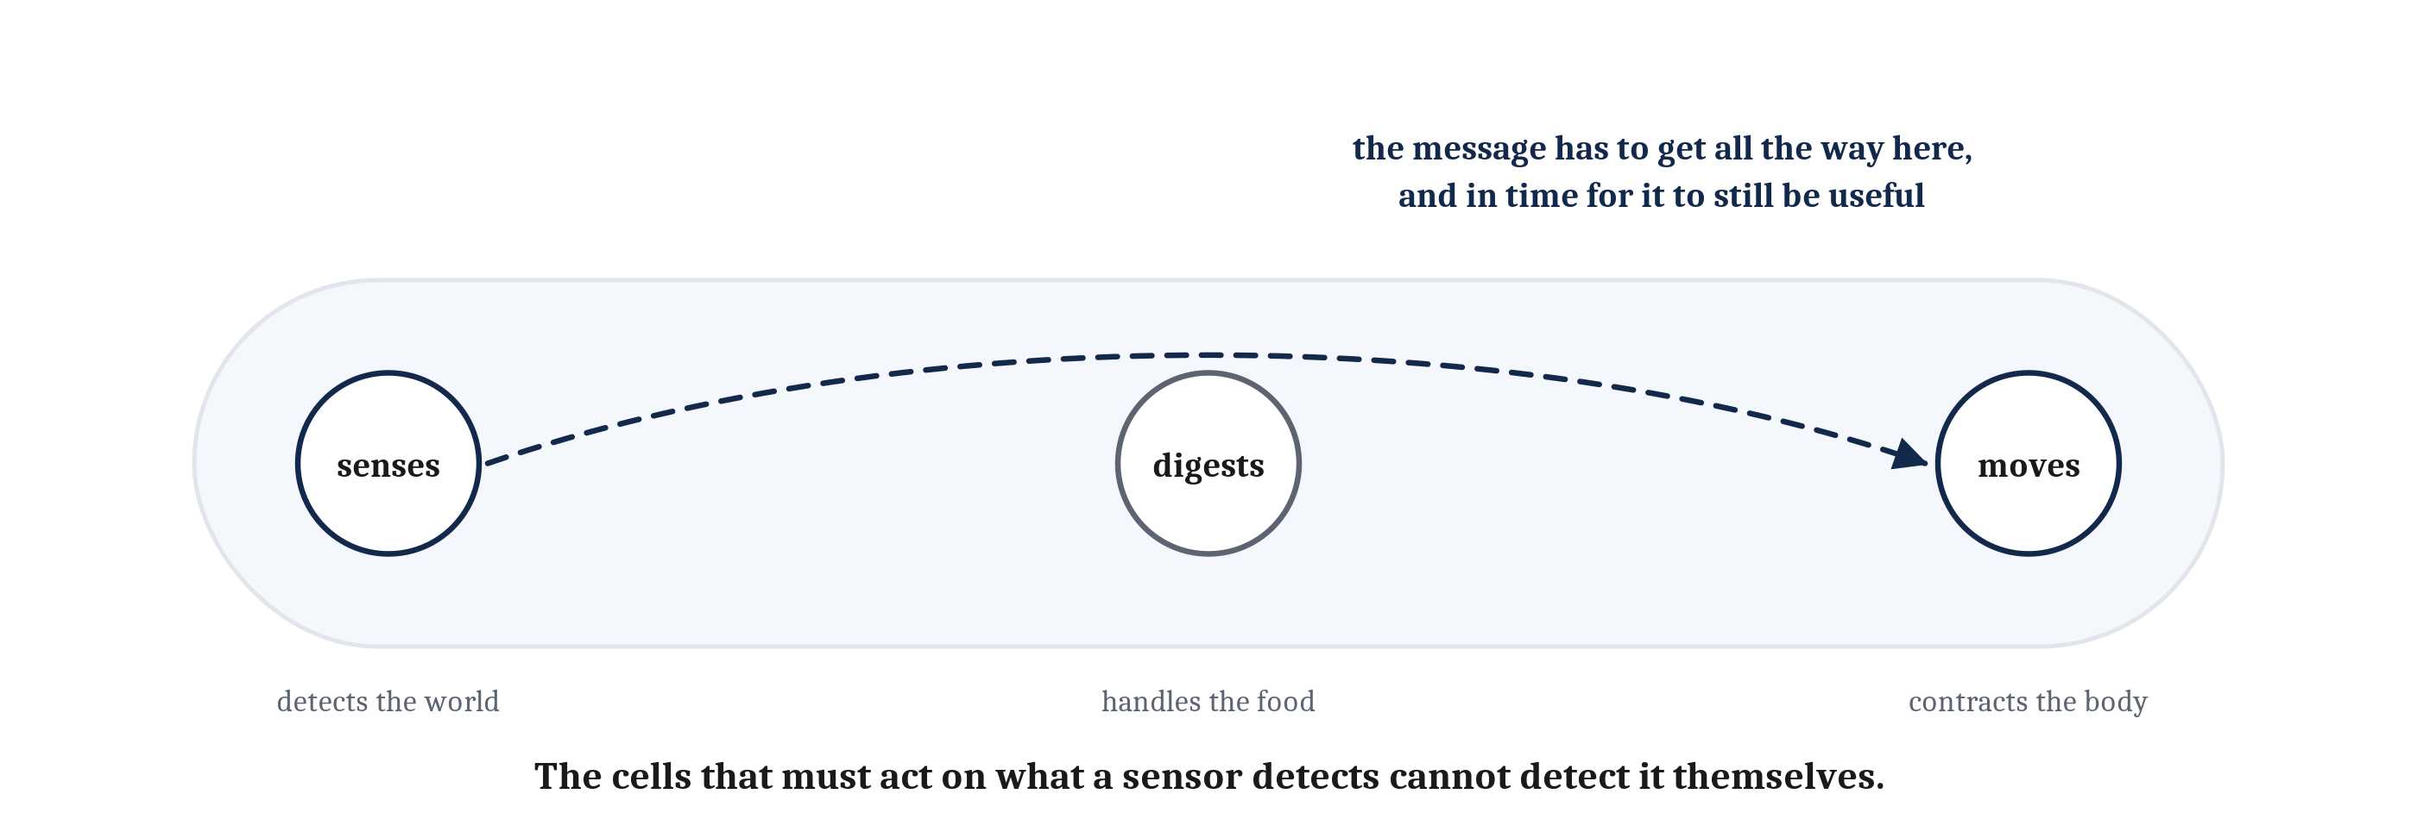
Specialization Creates a Problem
Multicellularity allows division of labor, and division of labor creates a problem that did not exist before it. Call it the coordination problem — and how urgently it needs solving depends entirely on how the organism makes its living.
Notes:
So what did the surplus buy? Two things that matter to us.
The first is bigger, more elaborate cells. A eukaryote is a cell with its DNA enclosed in a nucleus and its chemistry divided among internal compartments, and it is the kind of cell plants, fungi and animals are all built from. Eukaryotes appear to have arisen through endosymbiosis: one cell engulfed another and, instead of digesting it, kept it. The engulfed oxygen-users became mitochondria, compartments dedicated to aerobic respiration. A cell with its own internal power plants can pay for a great deal more machinery than a cell without them.
The second is multicellularity — the arrangement in which cells that could live independently instead stay together and function as a single organism. Multicellularity has arisen many separate times, which is worth noticing on its own. What it allows is division of labor. If every cell must do every job, every cell will probably be mediocre at all of them. If cells can specialize, some can be built for movement, others for digestion, others for sensing, and each can be far better at its one job than any generalist could be at any job. Bones, muscles, skin and organs are what specialization looks like once it has been running for a while.
And now the problem, which is the hinge of this entire lecture.
Specialization creates a difficulty that did not exist before it. A colony of identical cells has nothing much to coordinate. A body of specialized cells has to act as one thing. The cells that sense are not the cells that move, and the cells that move are not the cells that digest. So information gathered by one kind of cell has to reach a completely different kind, and reach it in time for the information to still be useful.
Say that last part again, because it is the sentence the whole module turns on. The cells that must act on what a sensor detects cannot detect it themselves.
Call that the coordination problem. Every complex multicellular organism has some version of it. And how urgently it needs solving turns out to depend entirely on how the organism makes its living.

Slide 11
Three Ways to Be Complex
Complex multicellular life did not solve the coordination problem once. It solved it at least three times, differently — and all three are complex, all three are multicellular, all three descend from the same eukaryotic beginning. Only one of them evolved neurons.
 | Plants | Fungi | Animals
How it gets energy | Makes its own food from sunlight | Grows into its food and absorbs it | Finds food, and eats other organisms
What the body does | Stays put; grows toward light and water | Stays put; grows through the material it feeds on | Moves through the world, and is moved through by others
What can go wrong in a second | Very little | Very little | Being eaten; losing prey; a bad step
Coordination it needs | Slow and chemical is enough | Slow and chemical is enough | Fast, aimed, whole-body
Notes:
Complex multicellular life did not solve the coordination problem once. It solved it at least three times, in three different ways, and setting the three side by side isolates exactly the variable we are looking for.
Reading across this table is Module 2's comparative method, applied not to two species but to three whole ways of making a living. And notice that it is the mirror of Module 2's more common move. There, we usually asked why two things are alike. Here the useful question is the opposite one: these three are all complex, all multicellular, all descended from the same eukaryotic beginning — and only one of them evolved neurons. So what separates that one from the other two?
Go down the rows. How each one gets its energy: a plant makes its own from sunlight, a fungus grows into its food and absorbs it, an animal finds food and eats other organisms. What the body does: two of the three stay put, and one moves through the world and is moved through by others.
Now the third row, which is the row that does the work, and it is the one I would like everyone to take away from this slide. What can go wrong in a second? For a plant, very little. For a fungus, very little. For an animal: being eaten, losing prey, or a bad step.
That is the variable. And the last row is its consequence — slow and chemical coordination is entirely sufficient for two of the three strategies, and the third one needs coordination that is fast, aimed, and whole-body.
The table also makes the anti-ladder point concrete in a way that is worth naming. Plants and fungi are not simpler organisms that fell short of a nervous system. They solve the coordination problem perfectly well for the lives they lead. Neurons only become worth paying for if what can go wrong in a second is something that can go wrong in a second.

Slide 12
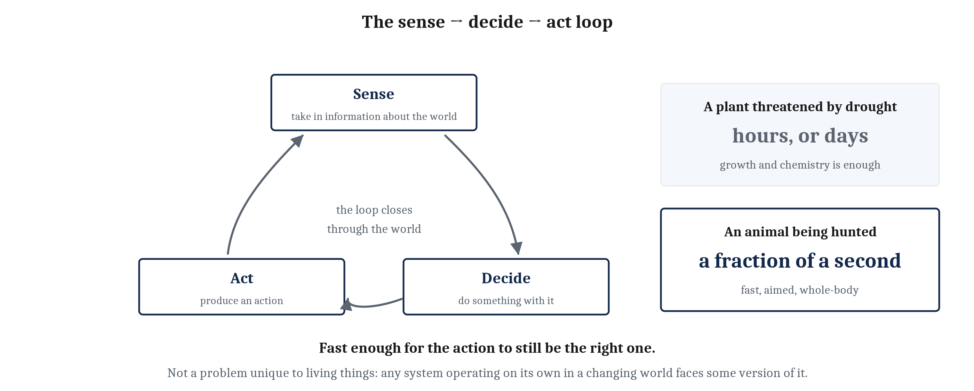
What Can Go Wrong in a Second
The separating variable is speed, and the reason is that animals eat other organisms and are eaten by them. The sense → decide → act loop returns at the algorithmic level, and again at the implementational level.
Notes:
The separating variable is speed, and the reason for it is blunt. Animals eat other organisms, and animals are eaten by them.
A plant threatened by drought has hours, or days, to respond, and it responds with growth and chemistry, and that is enough. An animal being hunted has a fraction of a second.
Put those two facts in a population over time and you get an arms race. In a predator–prey arms race, the animal that senses, decides and acts slightly faster than its opponent is the animal that eats, or the animal that escapes. And both of those outcomes get written into the next generation. So the animal way of life puts a premium on speed that the other two strategies simply do not have.
That premium is worth giving a name, because it is what the rest of this module is about and a good deal of the rest of the course as well. Call it the sense → decide → act loop. Take in information about the world, do something with it, and produce an action — fast enough that the action is still the right one when it happens.
Three things to notice about the loop before we leave it.
First, it closes through the world rather than inside the animal. The action changes the situation, and the changed situation is what gets sensed next.
Second, it comes back twice more in this module, at both of the remaining levels. In the next lecture we ask what a neuron computes, and the answer is a specialized version of this loop running inside a single cell. In the third we ask what it physically costs to run it fast.
Third, and this is the one that reaches furthest: the loop is not a problem unique to living things. Any system that has to operate on its own in a changing world faces some version of it. A robot faces it. A self-driving car faces it, and in a later module we will look at what its answer is.
The neuron is evolution's answer.

Slide 13
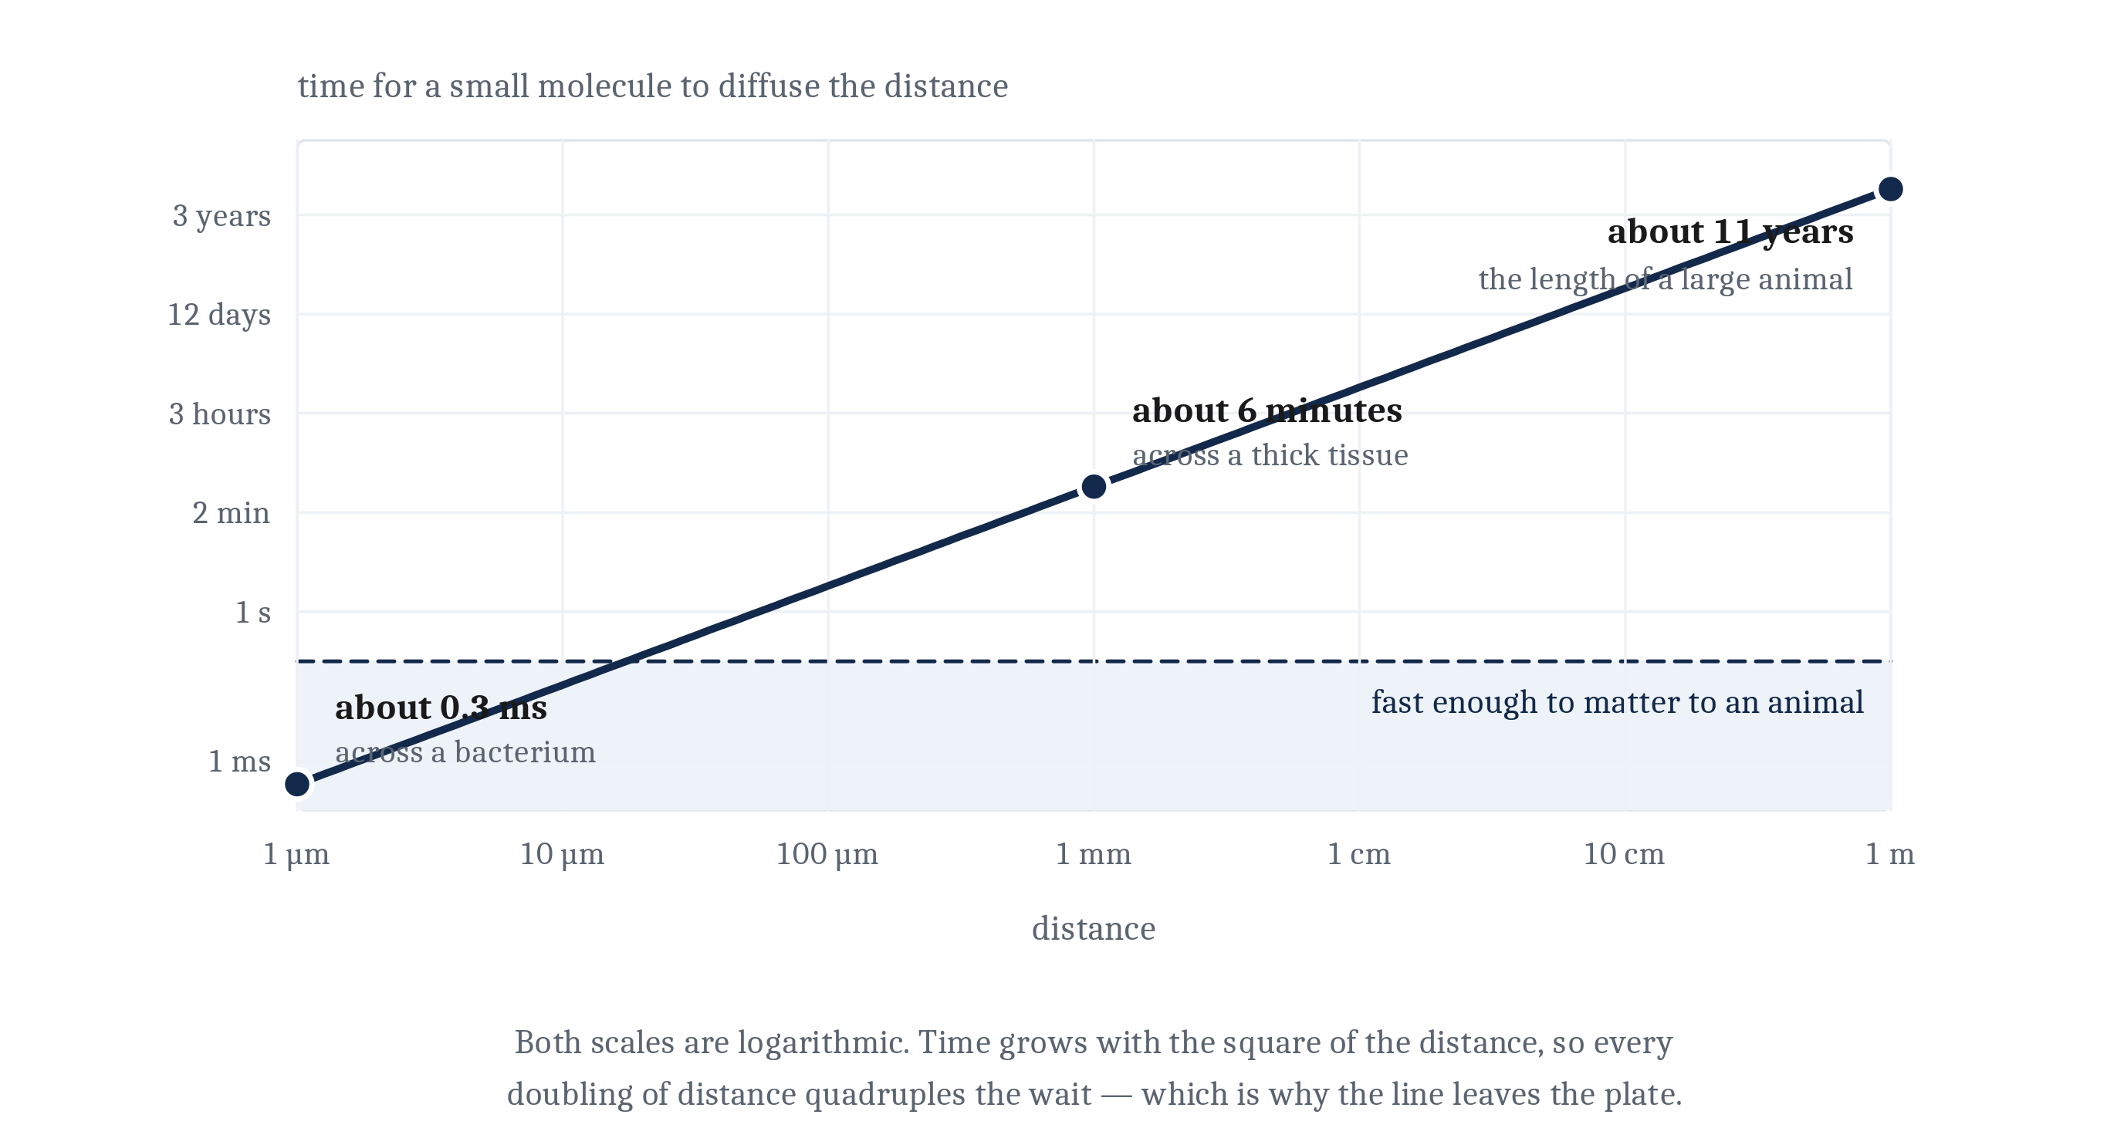
Why Chemistry Was Not Fast Enough
Chemical signaling is cheap and reaches everywhere. But it moves by diffusion, and diffusion time grows with the square of the distance — so it cannot cross an animal in time, it cannot be aimed, and it cannot easily be switched off.
Notes:
The obvious solution to the coordination problem was already available, and animals still use it. Cells had been signaling to one another chemically for billions of years before animals existed, and animal bodies do it constantly — a hormone released into the bloodstream by one tissue, traveling through the body, changing what other tissues do. Chemical signaling is cheap, it reaches everywhere, and it requires no special apparatus beyond the ability to make the molecule and respond to it.
Its limitation is that it moves by diffusion, and diffusion is slow in a way that gets rapidly worse with distance.
Here are the three numbers, and they are worth being shocked by. A small molecule crosses a micrometer — roughly the width of a bacterium — in about a millisecond. It crosses a millimeter in several minutes. And it would cross a meter, the length of a large animal, in something on the order of a decade.
That is not a gentle degradation. The reason is on the graph: the time does not grow in proportion to the distance, it grows with the square of the distance. Every doubling of distance quadruples the wait. Look at where the shaded band is — that band is the fraction of a second an animal being hunted actually has — and look at how quickly the line leaves it.
And distance is only the first of three limitations. Diffusion also spreads in every direction at once, which means a chemical signal cannot be aimed at one destination. And it lingers, which means it cannot easily be switched off.
For a message like *grow*, or *get hungry*, or *begin reproducing*, all three of those limitations might be perfectly fine. For a message like *the left side of the body should contract, now*, they could be fatal.

Slide 14
The Trade
A neuron is the cell specialized to make one trade: give up chemical signaling's cheap broadcast reach, and buy speed, distance, and aim in return. That is the computational-level answer to what a neuron is for.
 | Chemical signaling | Neural signaling
How the message travels | by diffusion, or carried in the bloodstream | as a signal regenerated at full strength along a fiber
Crossing the length of a large animal | years, left to diffusion | a fraction of a second
Where it arrives | everywhere at once | at one specific destination
Switching it off | it lingers | it ends with the signal
What it costs | cheap, and needs no special apparatus | expensive, and the cost is the third lecture of this module
The kind of message it suits | grow, get hungry, begin reproducing | the left side of the body should contract, now
Notes:
So here is the answer this lecture has been building to, and it is a trade rather than an upgrade.
A neuron is the cell specialized to make that trade. It takes an event — in the world, or elsewhere in the body — and converts it into a signal that travels fast, travels far without weakening, and arrives at one specific destination rather than everywhere. That is the computational-level answer to what a neuron is for.
Read the table as two columns that are both still in use, because the single most common way to get this wrong is to read it as neural signaling replacing chemical signaling. It did not. The two coexist in every animal body, doing the jobs each is suited to, and animals still run on hormones for everything that can afford to be slow. What neurons bought is the bottom right cell: a message that is aimed, and arrives now.
Which is also why neurons took hold in the animal lineage and not in plants or fungi. The lineages whose sense → decide → act loop ran faster were the lineages that ate rather than were eaten.
And now the bill. Fast, aimed, long-distance signaling is not free, and the cost is the other thread of this module. Speed of that kind has to be paid for — and the surplus that made animals possible in the first place is the same surplus that neurons spend in order to signal. We will find out exactly how much in the third lecture of this module, and the number is going to be larger than anyone expects.
That is the computational level: what problem neurons solved, and for whom it mattered. Next is the algorithmic level, and it is a different question about the same cell. Granting that a neuron's job is to take signals in, combine them, and pass one along — what exactly is it computing?

Slide 15
Image Sources (1 of 2)
Slide | Image | File | Licence | Source
3 | Not a ladder | fig-not-a-ladder.png | CC BY 4.0 | Jon Willits — drawn for this lecture · own work
4 | One molecule, two jobs | fig-rna-two-jobs.png | CC BY 4.0 | Jon Willits — drawn for this lecture · own work
5 | An accumulation, not a sequence of steps | fig-accumulation.png | CC BY 4.0 | Jon Willits — drawn for this lecture · own work
6 | The loop, closed inside one cell | fig-chemotaxis.png | CC BY 4.0 | Jon Willits — drawn for this lecture · own work
7 | Early life's way of making ATP | fig-proton-gradient.png | CC BY 4.0 | Jon Willits — the chapter's own figure, from figures/03_neurons_and_neural_communication/make_figures.py · own work
8 | Fifteen times as much, from the same sugar | fig-fifteen-times.png | CC BY 4.0 | Jon Willits — drawn for this lecture · own work
9 | The same variation, in two energy regimes | fig-same-mutation.png | CC BY 4.0 | Jon Willits — drawn for this lecture · own work
10 | The coordination problem | fig-coordination.png | CC BY 4.0 | Jon Willits — drawn for this lecture · own work

Slide 16
Image Sources (2 of 2)
Slide | Image | File | Licence | Source
12 | The sense → decide → act loop | fig-sense-decide-act.png | CC BY 4.0 | Jon Willits — drawn for this lecture · own work
13 | How long diffusion takes | fig-diffusion-distance.png | CC BY 4.0 | Jon Willits — the chapter's own figure, from figures/03_neurons_and_neural_communication/make_figures.py · own work

