Slide 1

BCOG 100
Neurons and Neural Communication
Lecture 3.2 — How Neurons Process Information
Notes:
The first lecture of this module asked what neurons are for, and answered with a problem. Animals have to sense, decide, and act faster than diffusing chemicals allow, and a neuron is the cell specialized to make that trade — giving up cheap broadcast reach, and buying speed, distance, and aim.
This lecture asks a different question about the same cell. Granting that a neuron's job is to take signals in, combine them, and pass one along — what exactly is it computing?
That is Marr's algorithmic level, and it is a question about procedure rather than about purpose.

Slide 2
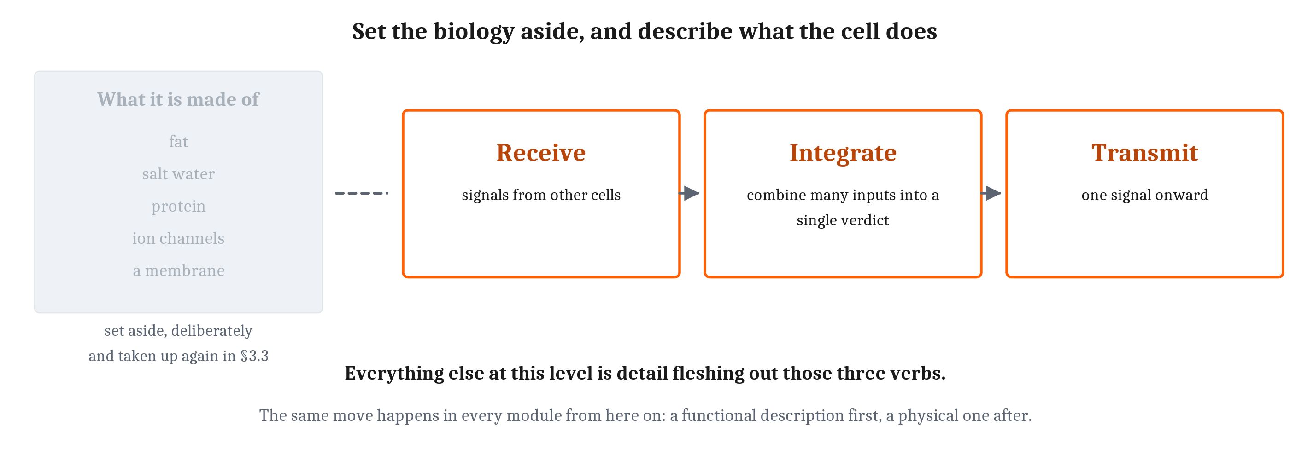
The Algorithmic Question
For the rest of this lecture we set the biology aside, and describe the neuron as though we did not know what it was built from. That move is deliberate, and it happens in every module from here on.
Notes:
Here is the move, and I want to perform it out loud rather than just do it, because it is a method and not an omission.
A neuron is made of fat and salt water and protein. It has a membrane, and pores through that membrane, and all of that is real and all of it matters. And for the next fifty minutes we are going to pretend we do not know any of it.
That is not laziness. It is the abstraction Module 1 argued makes comparison between brains and machines possible at all. If we describe a neuron only in terms of what it is made of, then it can only ever be compared to other things made of the same stuff. Describe it in terms of what it does, and it becomes comparable to anything that does the same thing.
We pay a price for that, and the price is that we will say some things in this lecture that are only true at this level of description. The third lecture of this module is where we go back and get the biology, and where we find out what the abstraction cost us.
So: at this level of abstract description, a neuron does three things. It receives signals from other cells. It integrates them — combining many inputs into a single verdict. And it transmits one signal onward.
Receive, integrate, transmit. Everything else in this lecture is detail fleshing out those three verbs.

Slide 3
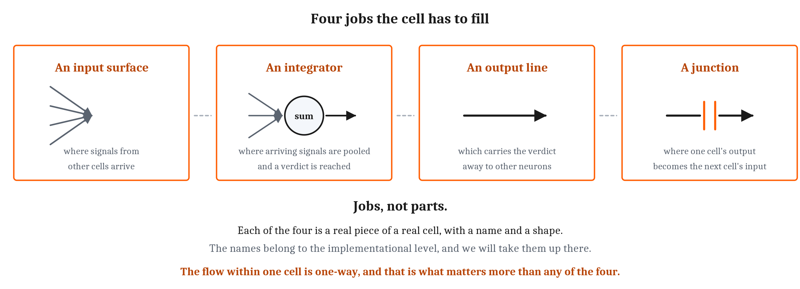
Four Jobs, and Not One of Them Is a Part
Receiving, integrating and transmitting require four things, and at this level they are better thought of as jobs than as objects. Each is a real piece of a real cell with a name and a shape — and the names belong to the next lecture.
Notes:
Receiving, integrating and transmitting require four things, and I want to name them as jobs rather than as objects.
There has to be an input surface, which is where signals from other cells arrive. There has to be an integrator, where the arriving signals are pooled and a verdict is reached. There has to be an output, which carries that verdict away to other neurons. And something has to be the junction, where the output of one cell becomes the input of the next.
Each of those four is a real piece of a real cell. Each has a name, and a shape, and a great deal of biology attached to it. Every one of those names is in the third lecture of this module, and none of them is in this one, and that separation is deliberate rather than tidy.
Here is why it matters, and it is the reason the chapter is organized this way. If we learn "receive, integrate, transmit" and immediately attach four cell parts to it, then the functional description and the physical description fuse into one thing in memory, and we lose the ability to ask the question this whole course is built on: could something else, made of something else, fill these four jobs?
So hold them apart for now. Four jobs, four blanks.
And one feature of the arrangement matters more than any of the four, which is where we go next.

Slide 4
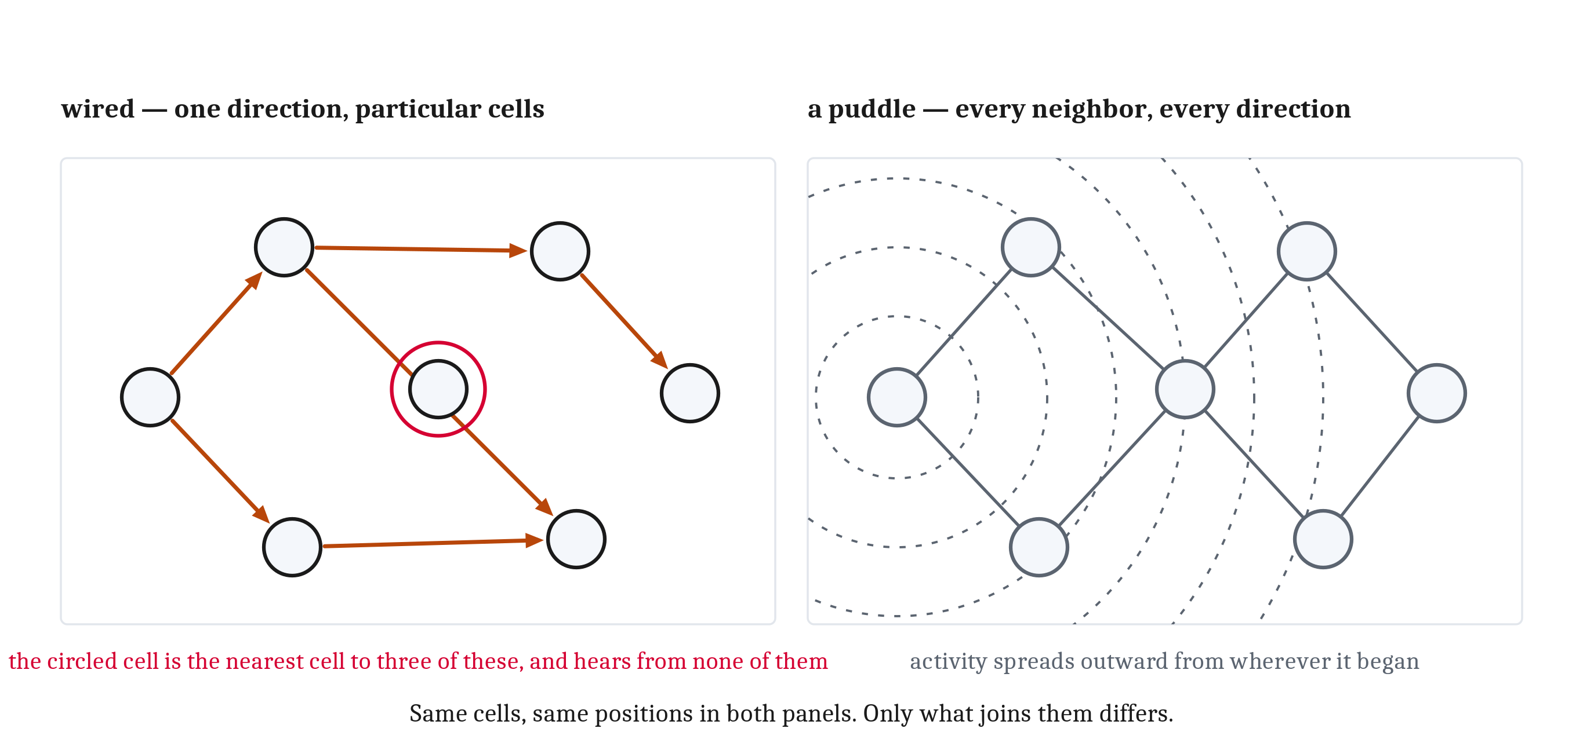
A Circuit, Not a Puddle
The flow within a single neuron is one-way, which is what makes it possible to build a circuit rather than a puddle. So connection is a matter of wiring rather than proximity — and in a puddle, being next to something is the same as being connected to it.
Notes:
Both panels have the same seven cells, in the same positions. What differs is how they are joined.
On the left, the flow within each cell is one-way. Signals arrive at one end, are pooled, and leave from the other, and they cannot run backward. A cell with a distinct input end and a distinct output end can be wired to other cells in a definite direction. That is what makes it possible to build a circuit.
And look at what a circuit gets us. Whether two neurons are connected has nothing whatever to do with whether they are near each other. One cell's output line can run the length of the body to reach the cells it talks to. Meanwhile a cell pressed right up against it — touching it — receives nothing at all. That is the circled cell in the middle of the left panel, sitting in the crowd and connected to nobody.
Connection is a matter of wiring rather than proximity.
Now the right panel, which is what we get without one-way flow. If signals could enter and leave anywhere on a cell's surface, every cell would influence every neighbor it touched, in every direction at once, and activity would spread outward in rings from wherever it began rather than travel anywhere in particular.
That is the puddle. In a puddle, being next to something is the same as being connected to it.
And notice that the puddle has exactly the defect we spent the first lecture of this module on. A message that goes everywhere carries no information about where it was meant to arrive. Diffusion had that problem. A neuron without directionality would have it too.
One-way flow is what turns a collection of cells into something that can be wired to compute. Module 4 is entirely about what happens once that becomes possible.

Slide 5
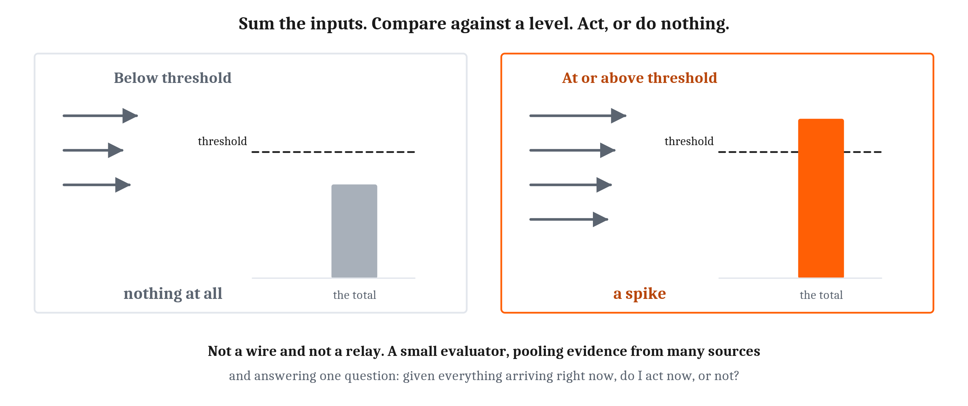
Integration and Threshold
Integration is the middle verb: the arriving signals are added up. And then the crux — the neuron does not report the total, it compares the total against a threshold. Nothing in that operation requires any idea what the inputs mean.
Notes:
The middle verb is the interesting one, and here is why something has to happen there. A neuron receives from many cells at once and produces one output. Many in, one out. So something in between has to reduce the many to the one.
What happens is integration: the arriving signals are added up.
And now the crux, which is the part worth slowing down for. The neuron does not report the total. It compares the total against a threshold — a level the summed input has to reach. Below threshold, the neuron does nothing at all. At or above it, the neuron acts.
Look at the two panels. Same cell, same threshold, drawn at the same height in both because the cell is not adjusting anything. All that differs is what arrived.
So a single neuron is not a wire, and it is not a relay that passes information along. It is a small evaluator. It pools evidence from many sources and answers one question with it: given everything arriving right now, do I act now, or not?
That is a real computation, performed by one cell. And notice how little the cell needs in order to do it. Nothing in that operation requires a view of the animal's situation, or any idea what the inputs mean, or any sense of what is at stake. Sum the inputs. Compare against a level.
Almost everything in this book is built out of that operation, repeated in enormous numbers. The magic is in how the neurons are wired together, not in any one of them.
One honest caveat before we go on, and I will come back to it near the end. Sum-and-threshold is a *choice about how closely to look*. We take it because it is simple enough to reason about and to build with. Whether a real neuron is doing something considerably richer that this description throws away is an open question, and a live one.

Slide 6
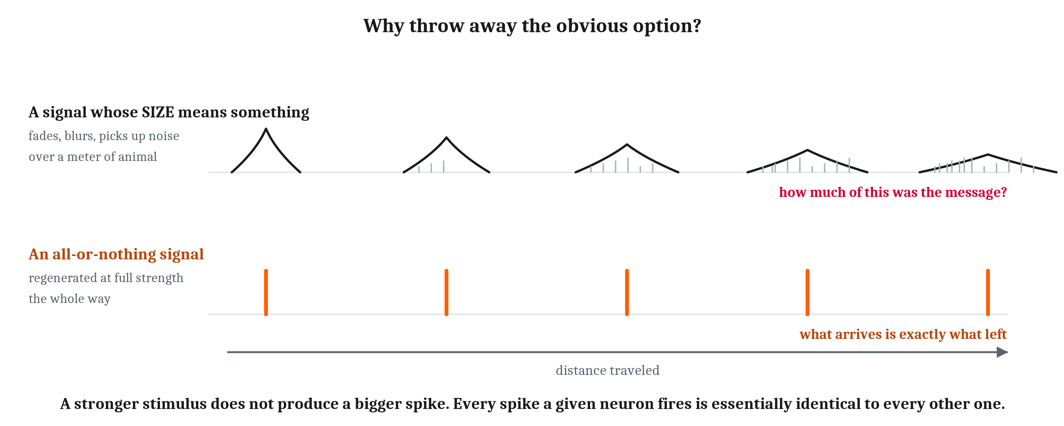
The All-or-Nothing Spike
When a neuron acts it produces an action potential, commonly called a spike. What matters at this level is its shape — which is to say that it does not have a variable one. All-or-nothing: no small ones, no large ones, none that fade partway along.
Notes:
When a neuron does act, what it produces is an action potential — commonly called a spike. A brief, stereotyped electrical event that travels the length of the cell.
What matters at this level of description is its shape, which is to say that it does not *have* a variable shape.
An action potential is all-or-nothing. Cross the threshold, and the neuron produces a full spike. Fall short, and it produces nothing. There is no such thing as a small action potential, or a large one, or one that fades partway along.
This is the single most counterintuitive fact about neurons, and it is worth stating in the form people get wrong. **A stronger stimulus does not produce a bigger spike.** Every spike a given neuron fires is essentially identical to every other one.
Now ask Marr's question about that design. Why would a signaling system throw away the obvious option — letting the signal's size carry the message? Size is free. Size is right there.
The answer is exactly the demand we established in the first lecture of this module. Look at the top row. A graded signal, one whose size means something, degrades as it travels. It fades with distance. It blurs in time. It picks up noise from everything around it. And by the time it has crossed a meter of animal, there is no way on earth to tell how much of what arrived was the message and how much was the journey.
Now the bottom row. An all-or-nothing signal has none of those problems, because it is regenerated at full strength the whole way. What arrives at the far end is exactly what left.
Fast, sharply timed, and as reliable at a meter as at a micrometer — which is precisely the combination the animal way of life demanded and chemical signaling could not supply.

Slide 7
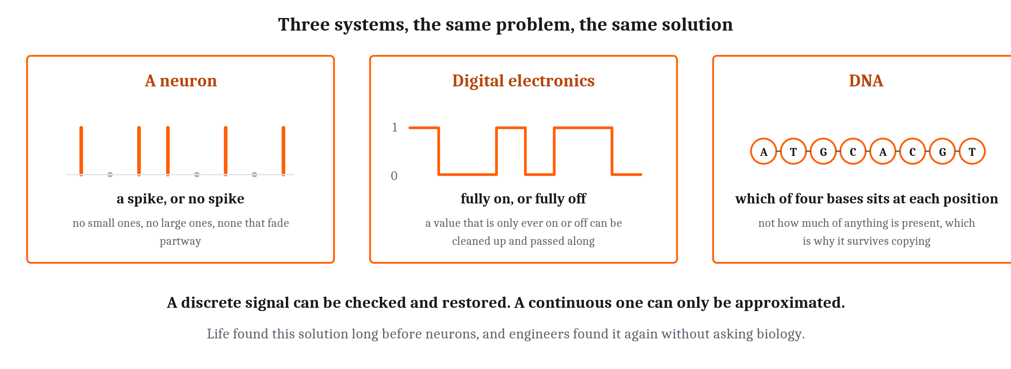
The Same Solution, Found Three Times
Human engineers made the same choice, independently and for the same reason. And life had made it long before neurons or electronics.
Notes:
It is worth noticing that we are not the first to have this idea, and neither was evolution.
Human engineers made exactly the same choice, independently, and for exactly the same reason. Digital signals are all-or-nothing precisely so that a value which is only ever fully on or fully off can be cleaned up and passed along without accumulating error. A value that varies continuously cannot be.
So here are two very different kinds of system — biological organisms and digital electronics — facing the same problem of getting a message somewhere intact, and arriving at the same solution.
And life had found it long before either neurons or electronics existed. The information in DNA is carried by *which* of four base molecules occupies each position. Not by how much of anything is present. That is why a sequence can be copied for billions of years and still be read correctly.
Three systems. One problem. One solution.
Here is the sentence underneath all three, and it is the general principle rather than a fact about any of them. A discrete signal can be checked and restored. A continuous one can only be approximated.
Now, all of that leaves us with a serious problem, and it is the objection anyone should be raising by now.

Slide 8
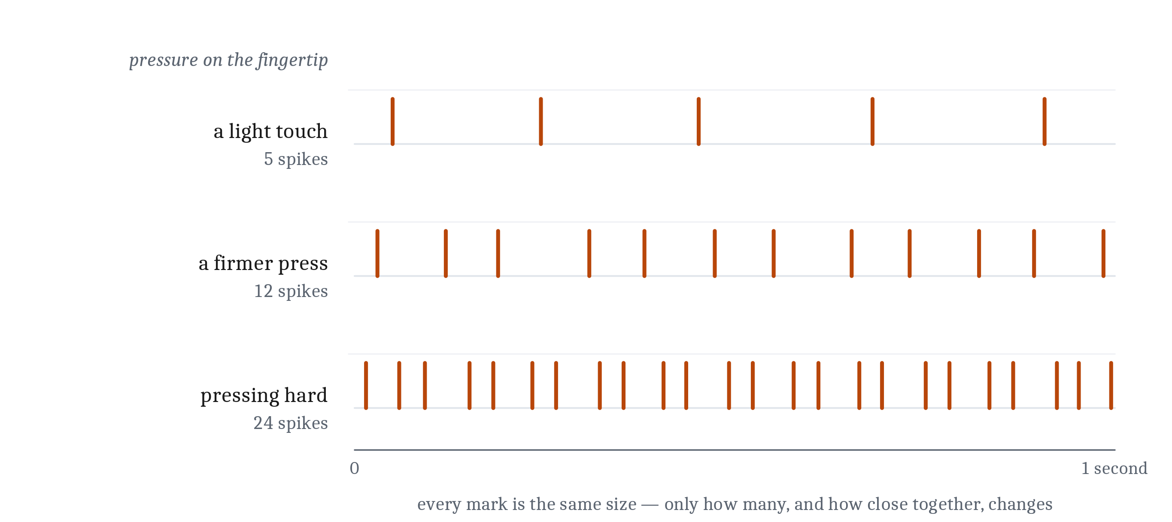
If Every Spike Is Identical, Where Is the Message?
A neuron's message is not in any one spike, any more than the meaning of a sentence is in any one word. It is in how many, and when — the neuron's firing rate.
A stronger stimulus does not produce a bigger spike. It produces more spikes, faster.
Notes:
If every spike is identical, how can a neuron say anything except *yes*? A cell that can only produce one signal can only carry one message. That objection is exactly right, and it has more than one answer.
The first answer is about a single cell's own output, and the key is this. A neuron's message is not in any one spike, any more than the meaning of a sentence is in any one word. It is in how many, and when.
Present a neuron with a faint stimulus and it fires occasionally. Present it with a strong one and it fires far more often, with the spikes closer together. Nothing about any individual spike has changed. What changed is the number of them in a stretch of time. That is the neuron's firing rate, and the sequence itself is a spike train.
Let us make it concrete with the chapter's own example, and it is a good one because everyone can do it right now. Press a finger against a table. Gently at first, then hard.
The receptors in that fingertip have to report not merely that contact happened but *how much* of it — and they have to report it most of a meter away, to the spinal cord and the brain.
Now run the two options we have already ruled out, one at a time.
Chemical only. A chemical signal could carry the amount very easily, because the quantity released can be made proportional to the pressure. But left to diffusion the message takes years to cross the arm. Carried in the blood it arrives faster, and it also arrives everywhere in the body rather than at the one place that needs it.
Purely all-or-none. One spike for contact and nothing otherwise. That arrives in milliseconds and arrives intact — and it can report only *that* something was touched, not how firmly.
The firing rate gets both. Every spike is identical and regenerated at full strength, so the message survives the trip the way a digital signal does. And the number of spikes in a second is a quantity that can take any value in a range, so the amount survives too.
Press harder and the receptors fire faster. What travels up the arm is a stream of identical pulses. What arrives is a number.
Two things before we move on. There is more in a spike train than its rate — the precise timing of spikes carries information too, and in some systems a great deal of it. And rate and timing are not the whole story: a spike's effect also depends on which chemical carries it to the next cell, on how strong that particular connection is, and on which cell fired in the first place. Those come later, and two of them are other modules. Rate and timing come first because they are what a single cell can vary on its own.

Slide 9
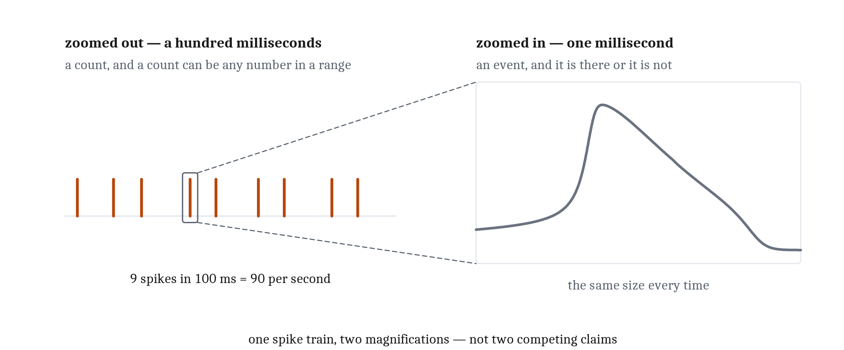
Two Ways to Describe One Output
A neuron's output is all-or-nothing. A neuron's output is a rate that can take many values. Both are true, and they are descriptions at two different time scales rather than competing claims.
Notes:
We now have two descriptions on the table that look like they contradict each other, and we are about to use them side by side for the rest of the module. So let us be explicit about it.
A neuron's output is all-or-nothing. A neuron's output is a rate that can take many values.
Both are true. They are not two competing theories, and they are not two rival explanations. They are descriptions at two different time scales.
Look at a single millisecond, on the right, and there is either a spike or there is not — and if there is one, it is the same size as all the others. Look at a hundred milliseconds, on the left, and there is a count instead. And a count is a number that can land anywhere in a range.
Here is the sentence to take away. A rate is not an alternative to all-or-nothing signaling. A rate is what a lot of all-or-nothing events look like when they stop being looked at one at a time.
And notice where we are: this is Marr's point, arriving in a new place and doing real work. Which description is the right one depends entirely on the question being asked. Ask what a cell contributes to an animal's behavior over a stretch of time long enough for behavior to happen, and the rate is the quantity that matters. Ask how the cell physically produces one event, and the individual spike is the object of study.
That is exactly the division of labor for the rest of this module. This lecture, at the algorithmic level, describes neurons in terms of rates. The next one, at the implementational level, describes a single spike in terms of ions crossing a membrane.
Both will be models of the same cell. And the fact that they look nothing alike is not a problem to be resolved. It is what having multiple levels of analysis is for.

Slide 10
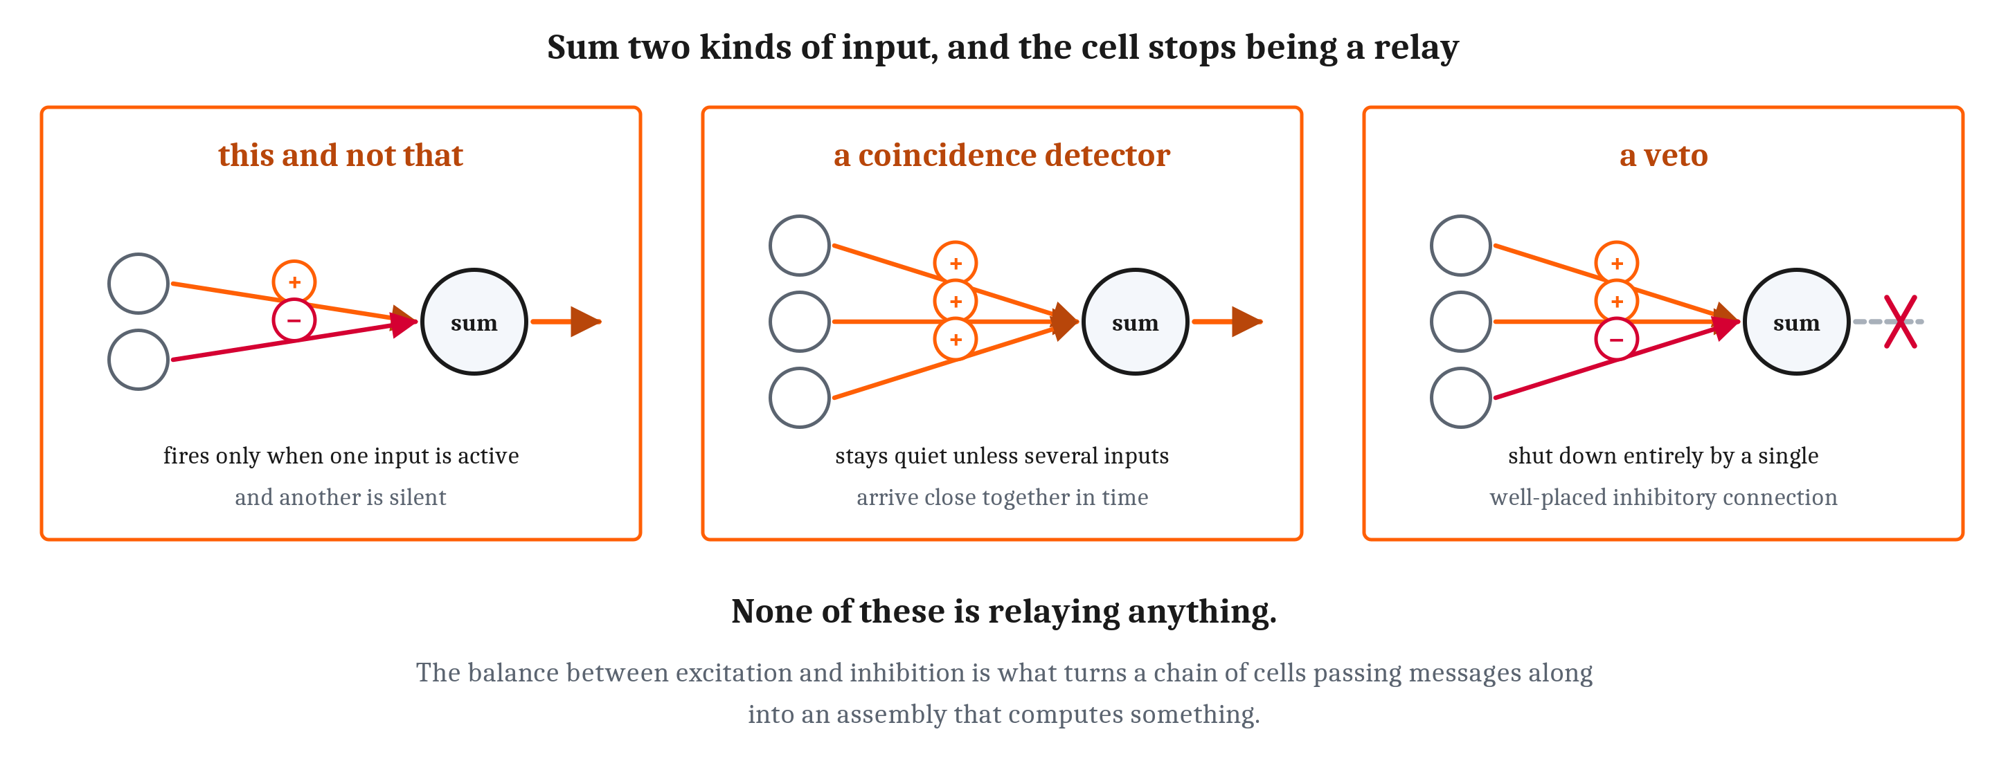
Excitation, Inhibition, and Modulation
So far every input has pushed the same way. That was a simplification. An arriving spike releases a neurotransmitter: excitatory ones push the receiving cell toward its threshold, inhibitory ones push it away. Which chemicals do which job belongs to the next lecture.
Notes:
Everything so far has described the inputs arriving at a neuron as all pushing in the same direction — toward the threshold. That was a simplification, and here is the rest of it.
Signals usually cross the junction between cells chemically. The arriving spike causes the sending cell to release a neurotransmitter, a chemical that drifts across the gap and binds to the receiving cell. And what the receiving cell does about that depends on which chemical arrived.
Excitatory neurotransmitters push the receiving neuron toward its threshold, making a spike more likely. Inhibitory neurotransmitters push it away from its threshold, making a spike less likely.
Which particular chemicals do which job is a fact about the machinery, and it belongs to the third lecture of this module. At this level, all we need is a plus and a minus.
And look what a plus and a minus buy us, because this is where the cell stops being a relay.
Because the integrator sums both kinds together, a neuron can fire only when one input is active *and* another is silent. That is the beginning of *this and not that* — which is a logical operation, performed by one cell.
It can stay quiet unless several inputs arrive close enough together in time. That is a coincidence detector.
And it can be shut down entirely by a single well-placed inhibitory connection. That is a veto.
None of those is a matter of relaying anything. The balance between excitation and inhibition is what turns a chain of cells passing messages along into an assembly that computes something. Module 4 is where that gets explored properly.
One more category, mentioned rather than taught. Some signals do not push a neuron toward its threshold or away from it. They change how strongly it responds to everything else — turning the whole cell's sensitivity up or down. That is modulatory signaling, and it is how an animal's internal state reaches into a circuit and changes what that circuit does with the same inputs. The same circuit for recognizing food may respond differently when the animal is hungry. The chemicals that do that work are Module 4's.

Slide 11
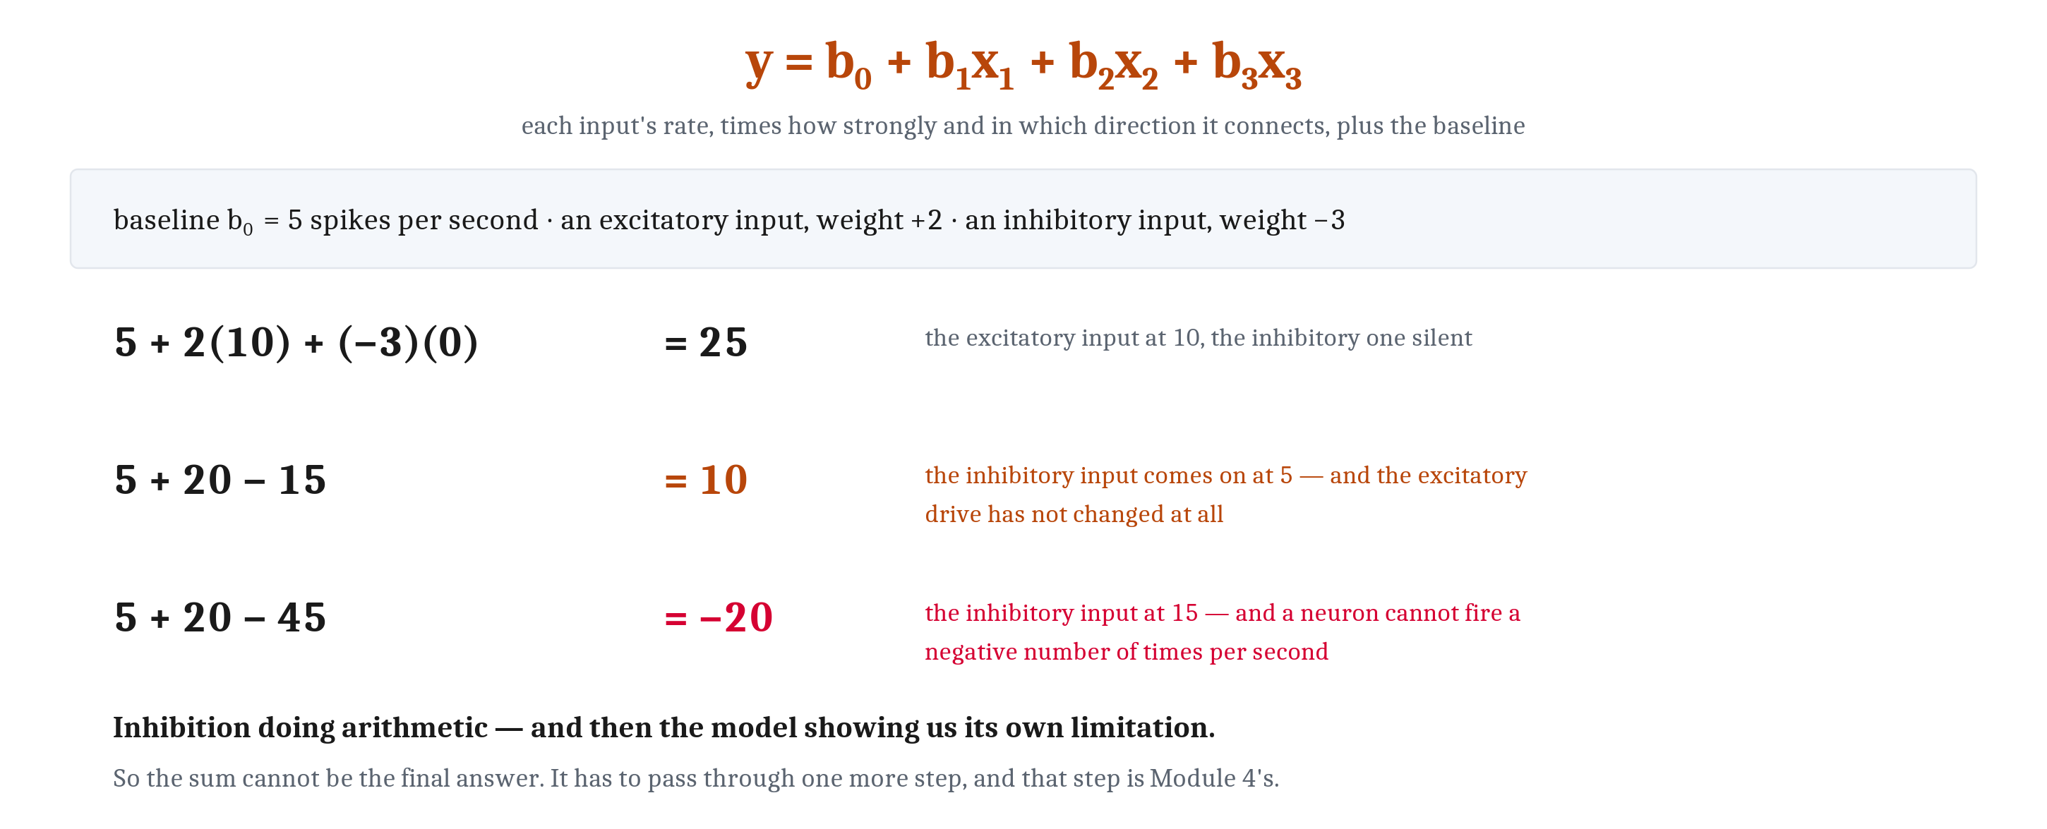
Writing a Neuron Down
Words are where an account like this stops in many introductory courses. A description in words can be agreed with. A description precise enough to compute with makes predictions — including about cases nobody has tested. That is Module 2's synthetic method: understanding by building.
Notes:
Everything so far has been said in words, and in a lot of introductory courses that is where an account like this stops. It is worth going one step further, because writing a description down as something computable is a great deal of what this field actually does with an account of this kind.
Module 2 called that the synthetic method: understanding by building. A description in words can be agreed with. A description precise enough to compute with makes predictions — including predictions about cases nobody has tested — and it can be wired to other descriptions like it, run, and tested.
So let us build it from the rate description, since rate is the property we can put a number on.
One neuron receives input from several others, and each of those has its own firing rate. Call those input rates x-one, x-two, x-three. Each connection also has a strength and a sign — an excitatory connection pushes up, an inhibitory one pushes down, and connections differ in how much of either they do. That strength-with-a-sign is the connection's **weight**. And most neurons are not silent when left alone; they fire at some low background baseline. Call that b-nought.
Which gives the equation on the board. Take each input's rate, multiply it by how strongly and in which direction that input connects, add up the results, and add the baseline. The total is what this neuron does.
Now the numbers, because the arithmetic is where the idea actually lands.
Baseline of five spikes per second. Two inputs: the first excitatory with a weight of two, the second inhibitory with a weight of minus three.
The first input fires at ten, the second is silent. Five plus two times ten, plus minus three times zero. Twenty-five spikes per second.
Now bring the second input on at five, and leave the first exactly where it was. Five plus twenty minus fifteen. Ten spikes per second.
Look hard at that. The excitatory drive did not change at all. And the cell's output fell by more than half.
That is inhibition doing arithmetic, and it is the mechanism behind every claim in Module 4 about how circuits make decisions.
And now push the same example one step further, because the model is about to show us its own limitation. Let the inhibitory input rise to fifteen. Five plus twenty minus forty-five. Minus twenty.
A neuron cannot fire a negative number of times per second.
So the sum cannot be the final answer. It has to pass through one more step — a function that holds the output at zero whenever the total falls below zero. And a real cell imposes a ceiling too, since no neuron fires faster than a few hundred times a second.
There are several simple ways to modify the linear function to respect both, and they are Module 4's. I am leaving it here as a problem rather than fixing it, because noticing that the model breaks is more useful than being handed the patch.

Slide 12
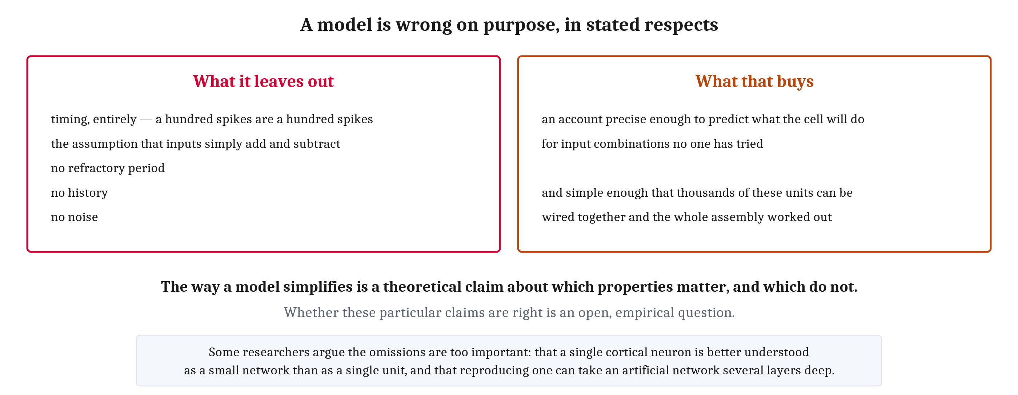
What the Model Is Worth
A model is a deliberate simplification, and the honest way to present one is to say what it leaves out. The way a model simplifies is a theoretical claim about which properties matter, and which do not.
Notes:
A model is a deliberate simplification, and the honest way to present one is to say what it leaves out. So here is what this one leaves out.
It ignores timing entirely, treating a hundred spikes as a hundred spikes whenever they arrived. It assumes the inputs simply add and subtract, when a real cell does something considerably more complicated with signals arriving at different points on its input surface. It has no refractory period — that is the enforced pause after each spike, which the next lecture explains. It has no history, and no noise.
Every one of those is a way the model is wrong. And it is wrong in those ways on purpose.
That last sentence is the one I would like everyone to take away from this slide, because it generalizes far beyond neurons. **The way a model simplifies is a theoretical claim about which properties are important for a given kind of explanation, and which are not.** A simplification is not a shrug. It is an assertion.
Which means it can be wrong, and whether a particular model is right about its simplifying claims is an open, empirical question.
And on this model, some serious researchers think the answer is no. Their argument is that the branching input surface performs enough computation of its own that a single cortical neuron is better understood as a small network than as a single unit — and that reproducing what one such cell does can take an artificial network several layers deep. That is a live disagreement, from people who work on this, and I am not going to resolve it here.
But now the other side, which is why the model is worth having anyway. What the omissions buy is an account precise enough to predict what the cell will do for input combinations no one has tried, and simple enough that thousands of these units can be wired together and the behavior of the whole assembly worked out.
That trade is the argument. Not that the model is true.

Slide 13
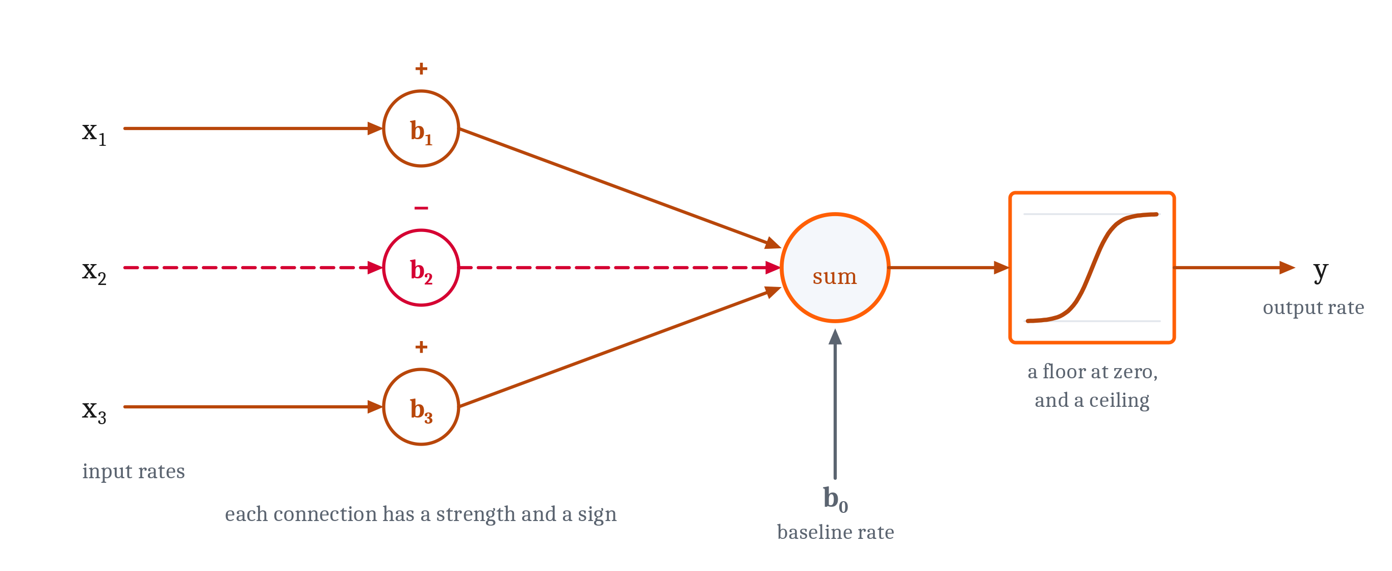
The Same Function in Silicon
Numbers in. Each multiplied by a weight. Summed. Passed through a function. That is the model of a biological neuron we arrived at by describing a cell — and it is also, almost exactly, the unit at the heart of an artificial neural network.
Notes:
Look at what we built. Numbers go in. Each one is multiplied by a weight. The results are summed. The total passes through a function.
That is the model of a biological neuron we arrived at by describing a cell, at the algorithmic level, with the biology set aside.
And it is also, almost exactly, the unit at the heart of an artificial neural network — where positive and negative weights play precisely the roles that excitation and inhibition play in a cell.
Now, the resemblance is not a coincidence, and it is not a discovery either. Nobody built a network, looked at it, and gasped. The artificial neuron is called a neuron because it was built as a stripped-down copy of real ones. It is a caricature, and it is a caricature deliberately.
But here is what it demonstrates, and I want to state the idea rather than assume it, because it is one we have not properly worked through together.
The claim is called **multiple realizability**, and it goes like this. If what makes something a mind — or in this case, what makes something a neuron in the functional sense — is a matter of what it *does* rather than what it is *made of*, then the same function could in principle run in more than one kind of stuff. That is an argument people usually make with thought experiments.
This is not a thought experiment. Here is one function — receive, integrate, threshold — running in wet tissue in one case and in silicon in the other. Both built. Both working. It is the most concrete case of the idea this course has met.
Hold on to that, because the next lecture takes the same two systems and looks at their machinery instead of their function, and the picture there is completely different. That is where the comparison between minds and machines actually strains.
What happens when many of these units are wired together, and what happens when the weights are allowed to change with experience, are Modules 5 and 7.

Slide 14
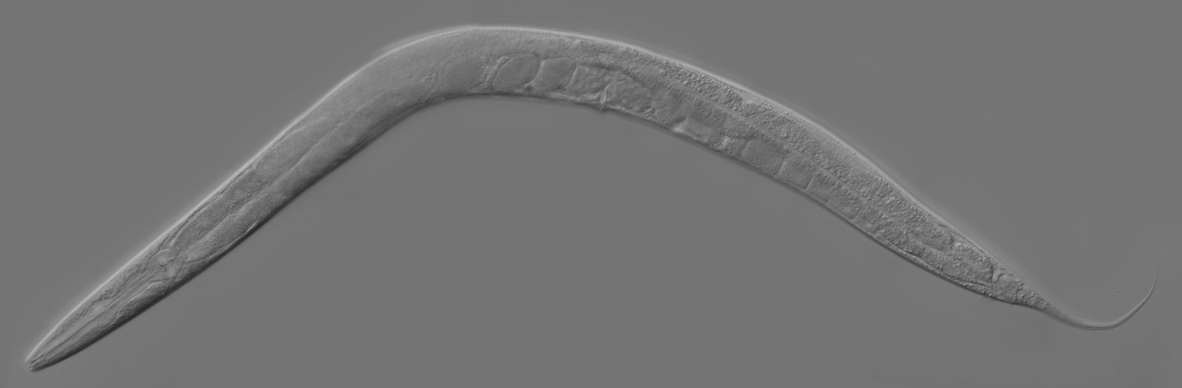
From One Neuron to a Behaving Animal
Caenorhabditis elegans: a soil worm about a millimeter long, with exactly 302 neurons, and the first animal whose entire wiring diagram was worked out — a map we call a connectome.
Sense, integrate, act — in an animal, using three or four cells in a row.
Notes:
One cell that sums its inputs and answers a yes-or-no question is a long way from an animal doing anything. The gap is smaller than it looks, and the cheapest way to see that is to look at the simplest animal anyone has fully mapped.
This is *Caenorhabditis elegans*. A soil worm, about a millimeter long. Its adult hermaphrodite form has exactly three hundred and two neurons — not approximately, exactly, and the same three hundred and two in every individual. It was the first animal whose entire wiring diagram was worked out: every cell, and every connection between them. A map like that is called a connectome.
And a worm with three hundred and two neurons behaves. It steers toward the smell of food and away from substances that would damage it. It reverses when its nose meets an obstacle. It changes what it does when it has not eaten.
What produces that behavior is nothing but the arrangement this lecture has been describing, repeated and connected.
Sensory neurons at the front end respond to chemicals in the water. Their output lines run to interneurons, which receive input from several sensory cells at once and do exactly what we said integration does — sum, compare against a threshold, produce a verdict. Those interneurons connect to motor neurons, which drive the muscles that bend the body.
Sense, integrate, act. In an animal. Using three or four cells in a row.
The first lecture of this module argued that the animal way of life demanded a fast sense → decide → act loop. There it is, made out of neurons, in an animal too small to see without a microscope.
One last thing, and it is the sentence to carry into Module 4. The worm can do considerably more than that sketch suggests — it weighs a good smell against a bad one, it crosses a barrier only if the food is worth it, it behaves differently when hungry. And almost all of that depends on how its neurons are *organized*, rather than on what any one of them computes.
So: we now have an account of what a neuron computes, and a model precise enough to calculate with. Both were built with the biology deliberately set aside, and both describe the cell in terms of rates.
Which leaves the question we postponed at the start. How does a living cell, made of fat and salt water and protein, physically produce any of this? What is an action potential actually made of? And what does it cost to run one?
That is Marr's implementational level, and it is where we go next.

Slide 15
Image Sources (1 of 2)
Slide | Image | File | Licence | Source
2 | Receive, integrate, transmit | fig-three-verbs.png | CC BY 4.0 | Jon Willits — drawn for this lecture · own work
3 | Four jobs the cell has to fill | fig-four-roles.png | CC BY 4.0 | Jon Willits — drawn for this lecture · own work
4 | A circuit and a puddle, from the same seven cells | fig-circuit-vs-puddle.png | CC BY 4.0 | Jon Willits — the chapter's own figure, from figures/03_neurons_and_neural_communication/make_figures.py · own work
5 | Sum, compare, act or do nothing | fig-sum-and-threshold.png | CC BY 4.0 | Jon Willits — drawn for this lecture · own work
6 | Why throw away the obvious option | fig-graded-vs-all-or-none.png | CC BY 4.0 | Jon Willits — drawn for this lecture · own work
7 | Three systems, one solution | fig-three-discrete-codes.png | CC BY 4.0 | Jon Willits — drawn for this lecture · own work
8 | Three levels of pressure, in identical marks | fig-rate-code.png | CC BY 4.0 | Jon Willits — the chapter's own figure, from figures/03_neurons_and_neural_communication/make_figures.py · own work
9 | One spike train at two magnifications | fig-two-time-scales.png | CC BY 4.0 | Jon Willits — the chapter's own figure, from figures/03_neurons_and_neural_communication/make_figures.py · own work

Slide 16
Image Sources (2 of 2)
Slide | Image | File | Licence | Source
10 | Three things a cell can do that a relay cannot | fig-excite-inhibit-veto.png | CC BY 4.0 | Jon Willits — drawn for this lecture · own work
11 | The model, worked three times | fig-worked-arithmetic.png | CC BY 4.0 | Jon Willits — drawn for this lecture · own work
12 | What it leaves out, and what that buys | fig-model-omissions.png | CC BY 4.0 | Jon Willits — drawn for this lecture · own work
13 | A single unit, biological or artificial | fig-neuron-model.png | CC BY 4.0 | Jon Willits — the chapter's own figure, from figures/03_neurons_and_neural_communication/make_figures.py · own work
14 | Adult Caenorhabditis elegans hermaphrodite | fig-c-elegans.jpg | CC BY-SA 2.5 | Zeynep F. Altun, editor of WormAtlas · https://commons.wikimedia.org/wiki/File:Adult_Caenorhabditis_elegans.jpg

