Slide 1

BCOG 100
Neurons and Neural Communication
Lecture 3.3 — The Biology of Neurons, including Metabolism
Notes:
Two questions down, one to go. The first lecture of this module asked what neurons are for and answered with a problem — animals need to sense, decide and act faster than diffusing chemicals allow. The second asked what a neuron computes, and answered with three verbs, a threshold, and a model precise enough to calculate with.
Both of those were built with the biology deliberately set aside. This lecture goes and gets it.
The implementational question is the third and last of Marr's levels: what physical stuff actually does this, and by what means? And this module adds a second half to that question, which most treatments leave out — what does it cost to run?

Slide 2
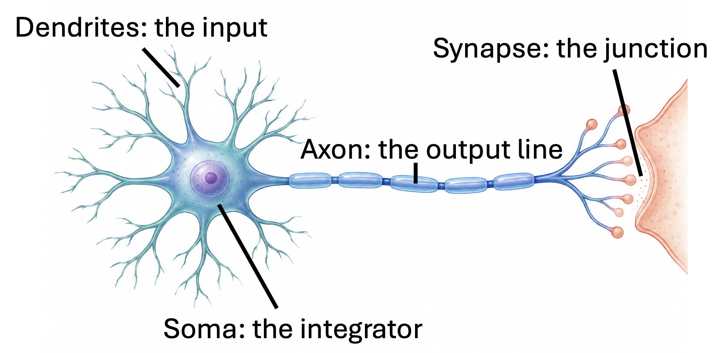
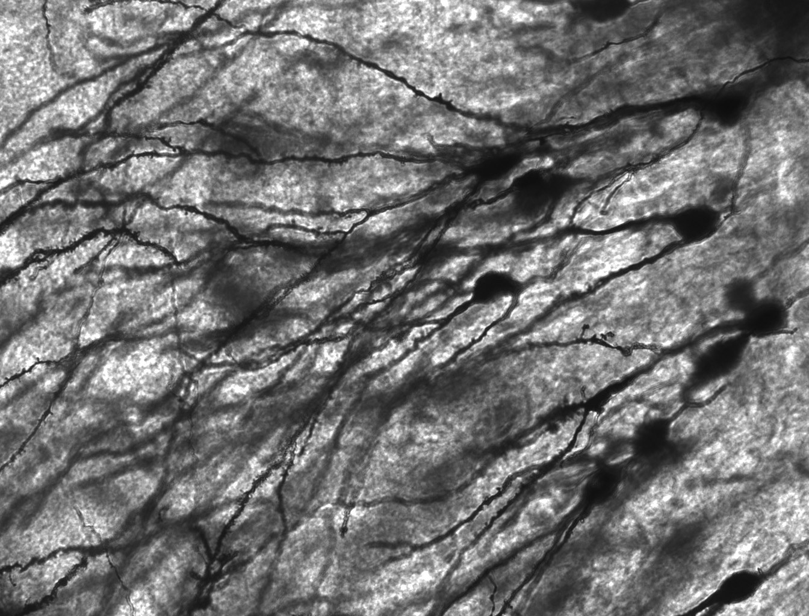
Four Roles, and the Parts That Fill Them
The input surface is the dendrites. The integrator is the soma, the cell body. The output line is the axon, a single fiber that may run a meter in a large animal. The junction is the synapse, the narrow gap between an axon's ending and the next cell's dendrites.
Notes:
Here is the move this lecture makes, and it is the reverse of the one the last lecture made. There we described a neuron as though we did not know what it was built from. Now we bring the biology back — as machinery.
Take the four roles from the last lecture, in the same order, and give each one its part.
The input surface is the dendrites: a branching collection of tendrils reaching out from the cell body, often thousands of them, each carrying signals from a different source.
The integrator is the soma — the cell body itself.
The output line is the axon: a single long fiber, which may run a millimeter, or in a large animal a meter or more. One cell, a meter long.
And the junction, where one cell's output becomes the next cell's input, is the synapse — the narrow gap between an axon's ending and the next cell's dendrites.
Now, the sentence that makes this a Marr lecture rather than an anatomy lesson. **Those specific biological implementations are not necessary for the description of how a neuron computes that we gave in the last lecture.** Something else could have filled those four roles. But every one of them matters to how the computation is physically carried out — which is what the rest of this lecture is about.
And one thing to notice while both pictures are up, because it matters later. The picture on the left is a diagram: one cell, four parts, tidily separated. The picture on the right is what that actually looks like in tissue — a field of real neurons, stained, at forty times. Nothing is tidily separated. Those dendrites overlap so thoroughly that you cannot follow one cell from end to end.
Hold that gap in mind. When we said last time that some researchers think the branching input surface computes enough on its own that one cortical neuron is better described as a small network — *that* is the picture they are looking at.
One more warning before we start. The last lecture worked at the scale of firing rates, over stretches of time long enough for behavior to happen. This one works at the scale of one event lasting about a thousandth of a second. Those are different questions about the same cell, and the two descriptions are going to look nothing alike. That is not a failure of either. It is what having three levels is for.

Slide 3
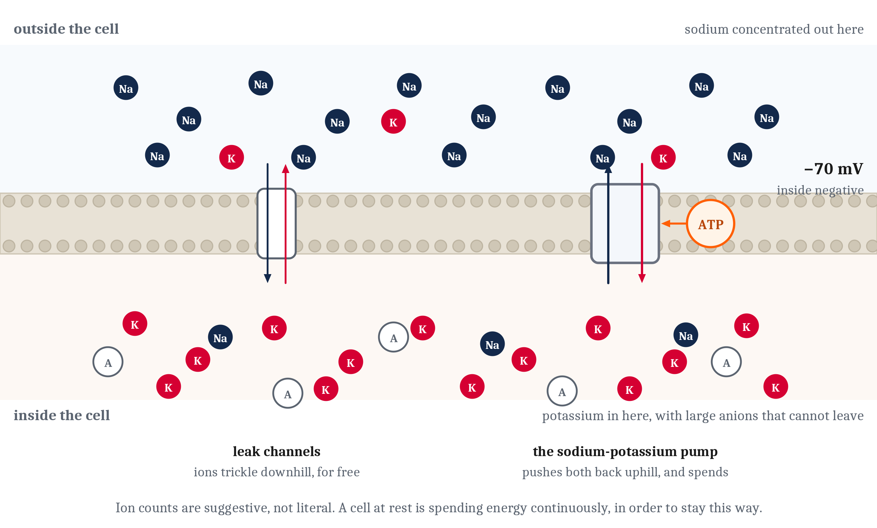
A Neuron at Rest Is Not a Neuron Switched Off
Sodium concentrated outside, potassium inside, both positive — and the inside negative anyway. That imbalance is the resting membrane potential, and the sodium-potassium pump holds it there, spending a molecule of ATP per cycle. A neuron doing nothing is spending energy continuously, and what it buys is readiness.
Notes:
A neuron, like any cell, is wrapped in a membrane made of two layers of fatty molecules with their water-repelling ends facing each other. Charged particles cannot cross that oily sheet on their own, and that is the fact everything else in this lecture rests on. Whatever is inside stays inside, unless something lets it through.
And what is dissolved on either side is not the same. Sodium ions are concentrated outside the cell. Potassium ions inside it. Both are positively charged.
The inside of a neuron is nonetheless negative relative to the outside, and there are two reasons rather than one. The cell holds large negatively charged molecules that cannot cross the membrane at all. And potassium escapes more easily than sodium gets in.
An imbalance of charge across a barrier is a voltage. The voltage across a resting neuron's membrane is its resting membrane potential — roughly seventy thousandths of a volt, inside negative.
The number matters less than what it means, and here is what it means. **A neuron at rest is not a neuron that is switched off.** It is a neuron held under tension. Like a charged battery, or a drawn bow. Everything is already in place for something to happen very fast.
Now, nothing about that arrangement is stable on its own, because the membrane is not perfectly sealed. Studded through it are protein pores called ion channels, and a few kinds stand permanently open. Through those, ions trickle steadily downhill — potassium drifting out, sodium drifting in, each moving in the direction that erases the imbalance. Left alone, the gradients would run down to nothing within minutes.
They do not run down, because the cell continuously pushes ions back where they came from. The sodium-potassium pump drives sodium out and potassium in, against their concentration gradients — the direction they do not want to go — and it pays for each cycle by spending a molecule of ATP.
So a resting neuron is not sitting still. It is holding a steady state, with the pump spending energy continuously to keep everything in balance.
Register that before we go on, because the last third of this lecture is built on it. A neuron doing absolutely nothing — receiving no input, sending no signal, sitting quietly in the dark — is spending energy continuously. And what that spending buys is readiness.

Slide 4
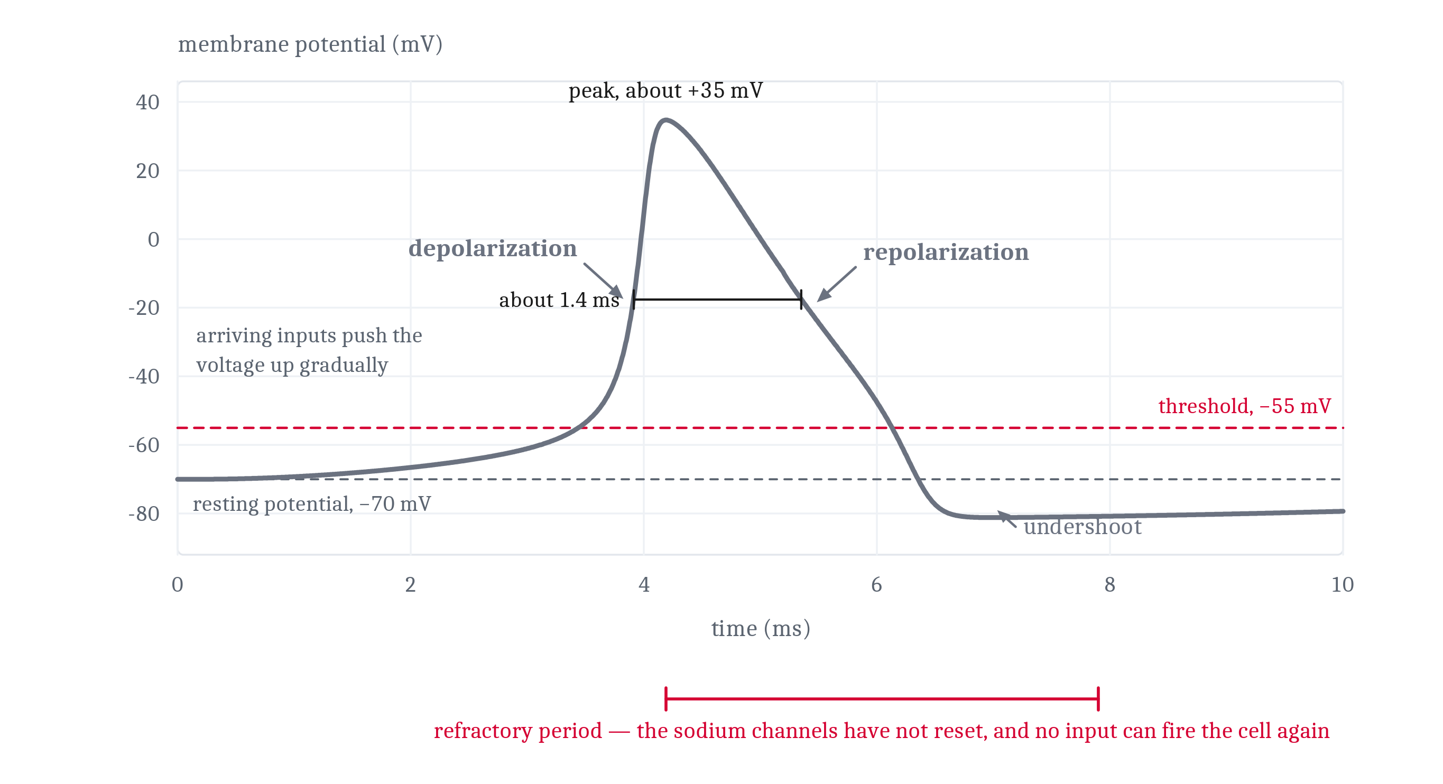
How a Spike Happens
Past a critical level, voltage-gated sodium channels open. Sodium rushes in, which pushes the voltage further up, which opens more channels. Once that loop starts it cannot be stopped partway — depolarization. Then the channels shut themselves off, potassium flows out — repolarization — and for a short interval no input can make the cell fire: the refractory period.
Notes:
Most ion channels, unlike the permanently open ones, are gated — they let their ion through when open and not when closed. What opens them divides them into the two kinds that matter here. A ligand-gated channel opens when a particular chemical binds to it. A voltage-gated channel opens in response to the voltage across the membrane itself.
The ligand-gated channels are the inputs from the last lecture, made physical. A neurotransmitter released at a synapse binds to receptors on the receiving cell's dendrite. Channels open, ions trickle through, the membrane voltage shifts slightly. An excitatory input lets in positive charge and nudges the voltage upward, toward zero. An inhibitory input pushes it back down.
So the summation we described as adding up inputs is, physically, these small voltage shifts arriving at the cell body and combining into a net change of potential across the membrane. That is what the arithmetic actually was.
The voltage-gated channels are what turn that sum into a spike, and they do it through a runaway.
If the combined inputs push the membrane voltage past a critical level — around fifteen thousandths of a volt above rest — voltage-gated sodium channels begin to open. Sodium rushes in. That pushes the voltage further up. Which opens more sodium channels. Which lets in more sodium.
Follow the trace. That near-vertical climb is that loop running. Once it starts it cannot be stopped partway, and the voltage shoots from negative to positive in about a millisecond. That is depolarization, the rising phase.
Then the part that answers an obvious question — if the loop cannot be stopped, what stops it? The same depolarization that opened the sodium channels also closes them, through a second and slower mechanism in the same protein. One protein, two mechanisms, on different time courses. The channels open, and then a fraction of a millisecond later they shut themselves off.
Slower potassium channels then open and let potassium flow out, carrying positive charge with it and driving the voltage back down toward rest. That is repolarization. It overshoots slightly, which is the dip below the resting line.
And for a short interval afterward, the sodium channels have not yet reset, and no amount of input can make the cell fire again. That interval is the refractory period.

Slide 5
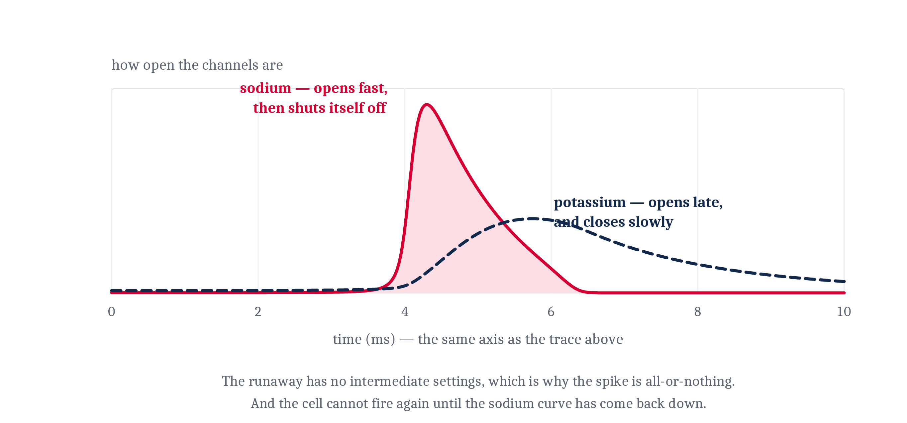
Why All-or-Nothing Was Never a Stipulation
A spike is all-or-nothing because the rising phase is a positive feedback loop, and a positive feedback loop has no intermediate settings. There is no way for a cell to produce half of an action potential — and the refractory period settles two more of the last lecture's assertions for free.
Notes:
That mechanism is the answer to a question the last lecture raised and did not answer. We said a spike is all-or-nothing. We did not say why.
Here is why, and it is worth appreciating, because it converts a stipulated fact into a consequence.
**A spike is all-or-nothing because the rising phase is a positive feedback loop — and a positive feedback loop has no intermediate settings.** Either the threshold is crossed and the loop runs to completion, producing a full spike, or it is not crossed and nothing happens at all. There is no way for the cell to produce half of an action potential. Not because it is forbidden to. Because there is no mechanism by which it could.
That is what an implementational account buys you. It does not merely say what the machinery is. It *explains* something the level above could only assert.
And the refractory period settles two more of the last lecture's assertions, both for free.
First, one-way propagation. A spike travels in one direction down the axon because the stretch it just left is briefly unable to fire again — it is in its refractory period. The wave cannot go backward because backward is exhausted.
Second, the ceiling. A neuron has a maximum firing rate, a few hundred spikes per second at most, because it has to wait out the refractory period between events. That is where the ceiling in the linear model came from.
Look at the two curves while I say the last part. Sodium opens fast and inactivates fast — that is the runaway and its own shutoff. Potassium opens late and closes slowly, and that slow tail is the undershoot and the refractory period.
Three claims from the last lecture, all of them explained by one mechanism, none of them assumed.

Slide 6
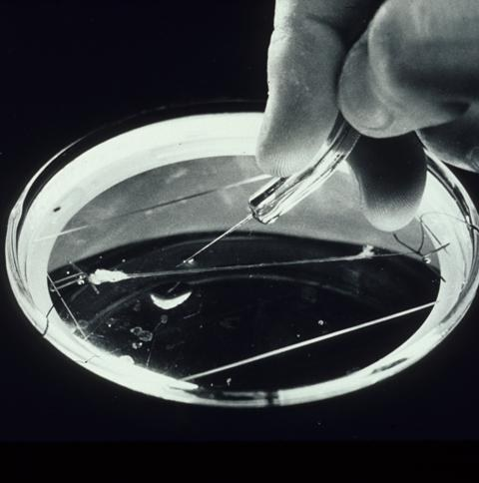
How Did Anyone Find This Out?
Everything so far is a story about invisible particles crossing a barrier we cannot watch. Stories like that are easy to tell and hard to believe.
Hodgkin and Huxley, late 1940s. The squid giant axon — a nerve fiber up to a millimeter thick, large enough to thread a wire down the inside of it.
They held the membrane voltage at fixed values, measured the currents, and wrote equations for how permeability to sodium and potassium changes with voltage and over time.
Then they calculated what an action potential should look like — and out came a curve with the right shape, height, duration, and conduction speed. None of it had been built in.
And nobody had ever seen an ion channel.
Notes:
Everything in the last two slides is a story about invisible particles crossing a barrier nobody can watch. Stories like that are easy to tell and hard to believe. So it is worth knowing how this one came to be believed, because the answer is one of the best demonstrations in science of a habit this course keeps coming back to.
In the late 1940s and early 1950s, Alan Hodgkin and Andrew Huxley worked on the giant axon of the squid. That is a nerve fiber up to a millimeter thick — which is enormous, for an axon, and it is the whole reason the work was possible. It was large enough to thread a wire down the *inside* of it, which no ordinary axon permits.
Using that access, they held the membrane voltage at fixed values and measured the currents that flowed at each one.
And then they did something more ambitious than measuring. They wrote down a set of equations describing how the membrane's permeability to sodium and to potassium changes with voltage and over time, and fitted the constants in those equations to what they had measured.
Then they used the equations to calculate what an action potential should look like.
Out came a curve with the right shape, the right height, the right duration, and a conduction speed matching the real axon. None of those values had been built into the equations. They had built something that behaved like a neuron, and it did so in ways they had not put in by hand.
Now the part worth dwelling on, which is what they did *not* have.
Nobody had seen an ion channel. There was no direct evidence that the membrane contained discrete protein pores at all. Individual channels would not be observed for another two decades. Their equations described the *behavior* of whatever was letting ions through, inferred entirely from the outside.
And when the physical channels were finally found — they were largely as the equations required them to be.
That is Module 2's synthetic method, understanding by building, working at the implementational level. It is why the account on the last two slides is a description of a mechanism rather than a plausible tale. They shared a Nobel Prize for it in 1963.

Slide 7
Two Models of One Neuron
Neither is a simplified version of the other, and neither is more true. They answer different questions, at different time scales, at different levels.
 | The rate model | The Hodgkin-Huxley model
Marr's level | algorithmic | implementational
What it represents | firing rates, and a weight on each connection | currents crossing a membrane, and a voltage
The time scale it works at | long enough for behavior to happen | about a thousandth of a second
The question it answers | what does this cell contribute to a circuit? | how does a cell physically produce one event?
What it is built from | one line of arithmetic | equations fitted to measured currents
What it cannot say | how a spike is made | what an assembly of ten thousand cells does
Wire ten thousand together | the behavior of the whole can be worked out | enormous cost, and very little more learned
Notes:
That is the second model of a neuron this module has built, and setting the two side by side is the clearest view of Marr's levels the course can offer.
In the last lecture we formalized a neuron as a weighted sum of input rates. One line of arithmetic. Hodgkin and Huxley formalized it as a set of currents crossing a membrane over the course of a millisecond.
Read the table as two answers rather than as a scorecard, because the rows are not a competition. **Neither is a simplified version of the other, and neither is more true.**
Ask what a cell contributes to a circuit, and the rate model is the one that helps. Ask how a cell physically produces one event, and the linear model has nothing whatever to say — it does not contain a spike.
And look hard at the last row, because it is the counterintuitive one and it is the row I would put on an exam. Wire ten thousand Hodgkin-Huxley models together and the result would teach us very little more than the simpler model would, at enormous computational cost.
**A more detailed model can be worse for a question.** That is not a compromise, and it is not a limitation of our computers. It is a fact about what models are for.
Both are wrong in the way that all models are wrong — deliberately, and in stated respects. And both are indispensable.

Slide 8
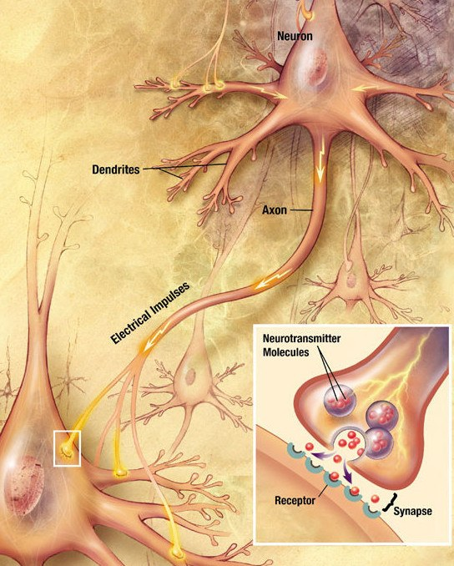
Down the Axon, and Across the Gap
A spike arrives at the far end not as a single event traveling but as a chain of events regenerating — each patch of membrane, as it depolarizes, pushes the patch ahead of it past threshold. Nothing weakens along the way.
Regenerating at every point is slow and expensive, so many vertebrate axons are wrapped in myelin, in segments with small bare gaps. The spike is regenerated only at the gaps and the stretches between are crossed passively — far faster, and considerably cheaper.
At the axon's end the arriving spike lets calcium in; calcium causes vesicles of neurotransmitter to fuse with the surface and spill into the gap. Every stage of that costs energy — ions pumped back, transmitters manufactured and loaded, vesicle membrane recovered and reused.
Notes:
A spike at one end of an axon is useless unless it arrives at the other. And how it arrives is not what most people picture.
It does not travel down the axon the way a signal travels down a wire. It arrives as a chain of events *regenerating*. Each patch of membrane, as it depolarizes, pushes the patch ahead of it past threshold, and that patch fires in turn, and so on down the line.
Nothing is transmitted the way a wire transmits, and nothing weakens along the way. That is the physical basis of the claim we made two lectures running — that what arrives at the end is exactly what started at the beginning.
But regenerating a spike at every single point along a meter of axon is slow, and it is expensive. Vertebrates largely avoid doing it. Many axons are wrapped in myelin, a fatty sheath laid down by supporting cells in segments, with small bare gaps between them. Ion channels cluster at those gaps, so the spike is regenerated only there, and the stretches in between are crossed passively. The signal effectively jumps from gap to gap.
That is both far faster and considerably cheaper — far fewer ions cross the membrane, and so far fewer have to be pumped back. Hold on to the *cheaper*, because it comes back near the end of this lecture as a design decision rather than a detail.
At the axon's end, the signal changes form entirely. The arriving spike opens channels that let calcium into the neuron. Calcium entry causes vesicles — small membrane packets holding neurotransmitters — to fuse with the cell's surface and spill their contents into the synaptic gap. The neurotransmitters cross, bind to the ligand-gated receptors we met two slides ago, and the whole cycle begins again in the next cell.
The picture shows three of those steps. It does not show the calcium entry, or the vesicles fusing, or the clearing up afterward — which is largely reuptake, the sending cell pulling its transmitter back in to repackage it.
And that last omission is worth naming out loud, because every stage of the sequence costs energy. The ions that crossed have to be pumped back. The transmitters have to be manufactured and loaded into vesicles. The vesicle membrane has to be recovered and reused.
Which is where the rest of this lecture goes.

Slide 9
It Is the Channel, Not the Molecule
In the brain the dominant excitatory transmitter is glutamate and the dominant inhibitory one is GABA. But the difference between them is not really a fact about the two molecules. It is a fact about the channels their receptors open.
 | Glutamate | GABA
Its receptors open channels permeable to | sodium | chloride
The charge that ion carries | positive | negative
Which way that charge moves | into the receiving cell | into the receiving cell
What the membrane voltage does | climbs toward threshold | is pushed down, away from threshold
The effect, named | excitatory | inhibitory
Notes:
Which transmitter crosses the gap settles whether the effect is excitatory or inhibitory. In the brain, the dominant excitatory transmitter is glutamate, and the dominant inhibitory one is GABA.
Now, that is the sentence that ends up on a flashcard, and the flashcard is wrong in an interesting way. **The difference between them is not really a fact about the two molecules.** It is a fact about the channels their receptors open.
Read the table left to right, because it is a causal chain rather than a list of properties.
Glutamate binds to receptors that open channels permeable to sodium. Sodium is positive. It flows into the receiving cell. So the voltage climbs toward threshold. Excitatory.
GABA binds to receptors that open channels permeable to chloride. Chloride is negative. It also flows into the receiving cell — same direction — and because the charge is negative the voltage is pushed *down*, away from threshold. Inhibitory.
Notice what actually differs between those two rows. Not the direction of flow. Not the molecule's own nature. One row: the ion the channel lets through.
And here is the consequence, which is the reason this slide exists rather than a list of transmitters. **The same neurotransmitter can excite one cell and inhibit another** — if the two cells carry different receptors, opening channels for different ions.
A student who has learned "glutamate equals excitatory" as a fact about the molecule cannot get that. A student who has understood this table gets it immediately.

Slide 10
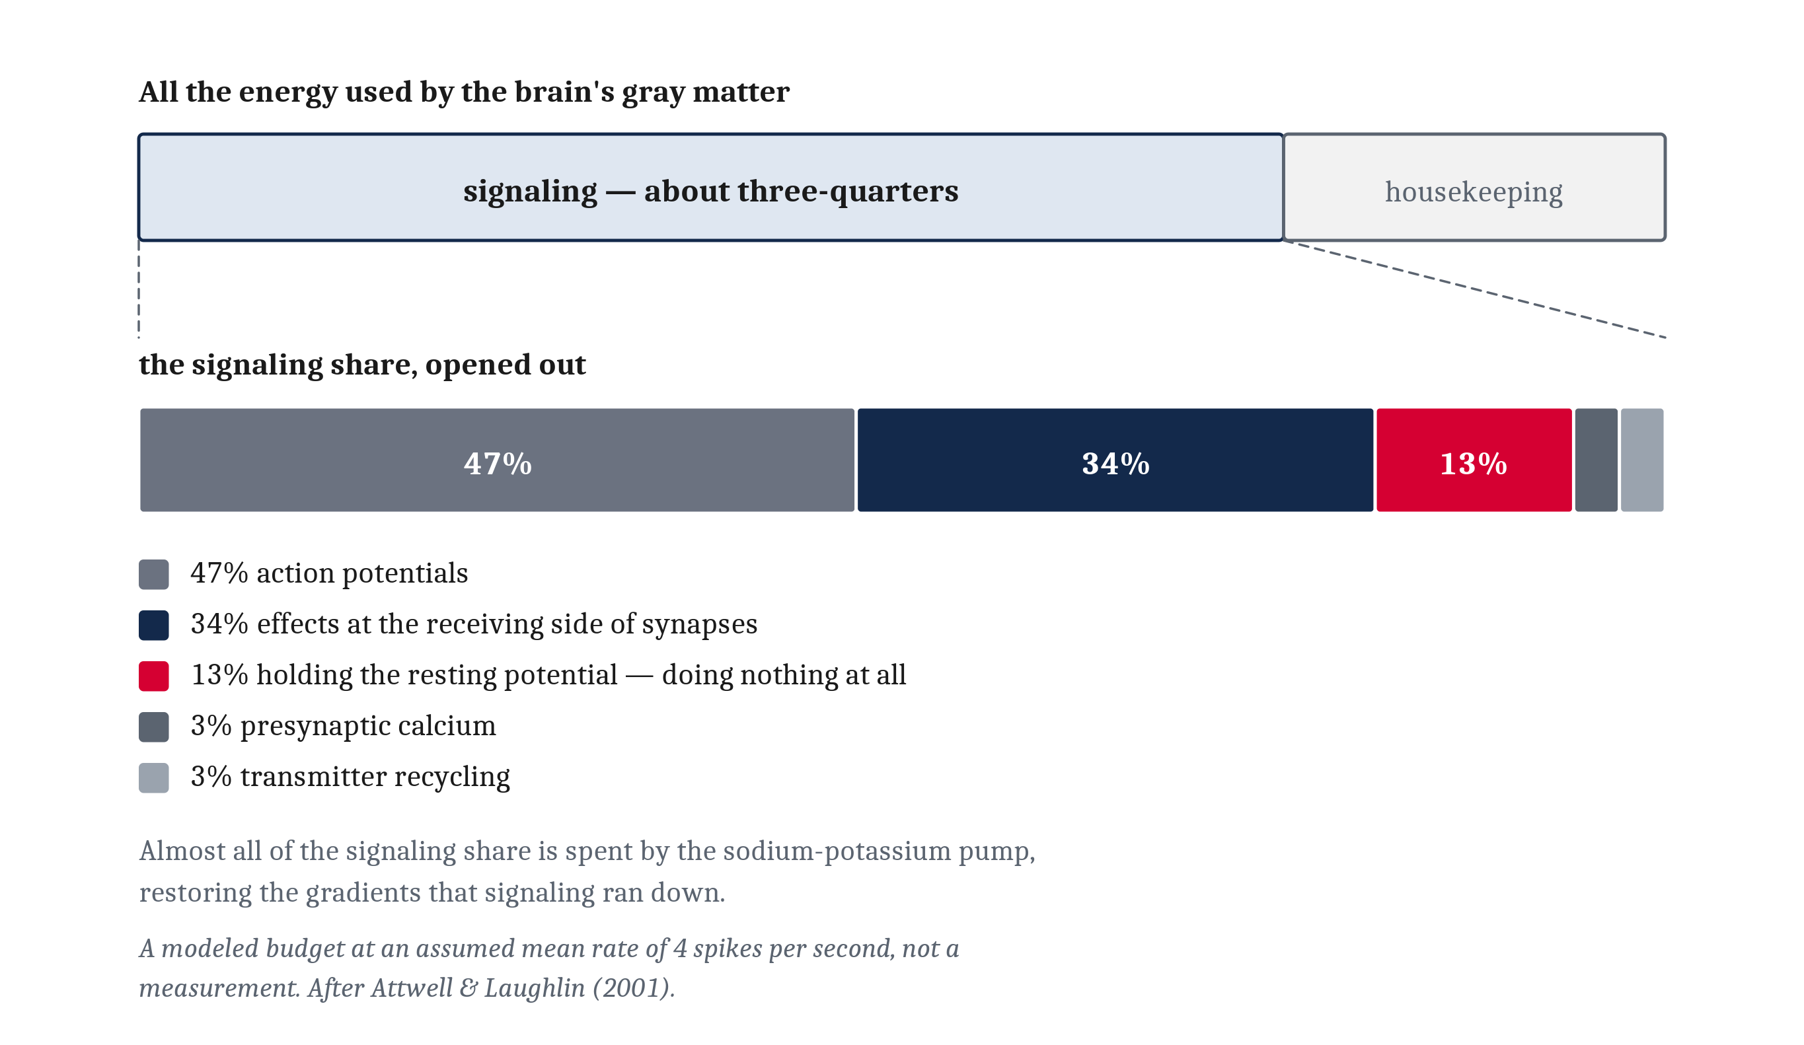
What Signaling Costs
Bio-energetics: how an organism gets, stores and spends energy. The cost of computing with neurons is dominated not by the computing but by the cleanup. Two findings, two different denominators — three-quarters of gray-matter energy goes to signaling rather than housekeeping, and almost all of that goes on the pump.
Notes:
Neurons' ability to send information reliably over long distances comes with a price, and the study of that kind of price is bio-energetics — how an organism gets, stores and spends energy.
The reason neural signaling is expensive follows directly from how it works, and we have already built the whole argument. Energy has to be spent just to maintain the resting state. And a spike happens by *letting ions run down gradients that were built at a cost*. The signal is the spending of energy.
Every ion that crossed the membrane during an action potential has to be hauled back across it afterward, one ATP at a time, by the sodium-potassium pump and related systems.
So here is the sentence to take away from this slide. **The cost of computing with neurons is dominated not by the computing but by the cleanup** — restoring the gradients that signaling ran down.
Now the numbers, and putting numbers on this is harder than it sounds, because you cannot easily meter a working brain. The standard figures come from a careful accounting by David Attwell and Simon Laughlin, who priced out each step of signaling in ATP and added it up.
Their budget for gray matter concluded two things, and I want to keep them apart, because they get collapsed constantly and the collapsed version is false.
**One.** About three-quarters of the energy goes to signaling rather than to housekeeping — building proteins, maintaining the cell.
**Two.** Almost all of *that signaling cost* goes on the sodium-potassium pump.
Two different denominators. Not "three-quarters of the brain's energy goes to the pump", and not "seventy percent of brain ATP goes to the pump" either. Read the figure: it opens out in two steps for exactly this reason.
Within the signaling share, at an assumed average firing rate: action potentials roughly half, effects at the receiving side of synapses about a third, and simply holding the resting potential a further one-eighth.
That last figure is the one to notice. **A substantial slice of the brain's budget is spent by neurons that are doing nothing at all except staying ready.**
And the unit price. A single spike, on Peter Lennie's estimate, costs on the order of two and a half billion molecules of ATP. Two and a half billion, for one bit of neural activity. Everything else in this lecture follows from that number.

Slide 11
The Brain as a Metabolic Outlier
About two percent of body weight, about twenty percent of the body's oxygen at rest. Expressed as power rather than as a share, the same measurement is roughly the twenty watts from Module 0 — one fact stated two ways.
Measured against | The figure
the body, at rest | about 2% of body weight and about 20% of the oxygen used — one measurement stated two ways, and about twenty watts
a lifetime | as much as half of the body's oxygen use in the middle of the first decade of childhood, while the brain is still being built
other mammals | non-primate mammals spend 3–5% of the daily energy budget on the brain, other primates 8–10%, humans 20–25%
one neuron | about the same in a human as in any other primate
Notes:
An adult human brain is about two percent of body weight, and consumes about twenty percent of the body's oxygen at rest.
Expressed as power rather than as a share, the same measurement comes to roughly the twenty watts mentioned back in Module 0. Those are not two facts. They are one fact stated two ways.
Twenty percent is a striking share of a basal metabolic rate, and it is not evenly distributed across a life. In the middle of the first decade of childhood, when the brain is still being built, its share of the body's oxygen use reaches as much as *half*. A growing child is, metabolically speaking, mostly a brain with a body attached.
Across species: humans devote something like twenty to twenty-five percent of the daily energy budget to the brain. Other primates, eight to ten. Non-primate mammals, three to five.
Three ranges, and I am giving them as three ranges deliberately rather than as a superlative, because the comparative data support the ranges and do not support "more than any other mammal."
So the human brain is genuinely an outlier — and now the last row, which decides what *kind* of outlier it is.
The cost of running a single human neuron is not remarkable. It is about the same as a primate neuron. What is unusual is how many of them there are. **The cost is large because the brain is large, on an ordinary primate body plan — not because human neurons are special.**
That distinction matters, because this is the point in the module where Module 2's warning is easiest to forget. A number like twenty percent invites reading as an achievement — evidence that we are the animal that invested most heavily in thinking.
It is better read as a constraint. A brain that expensive has to be fed every day, which limits what else an animal can be and what it has to eat. Every lineage that did not build a big brain was not failing to. It was solving its own problems at a price it could afford.

Slide 12
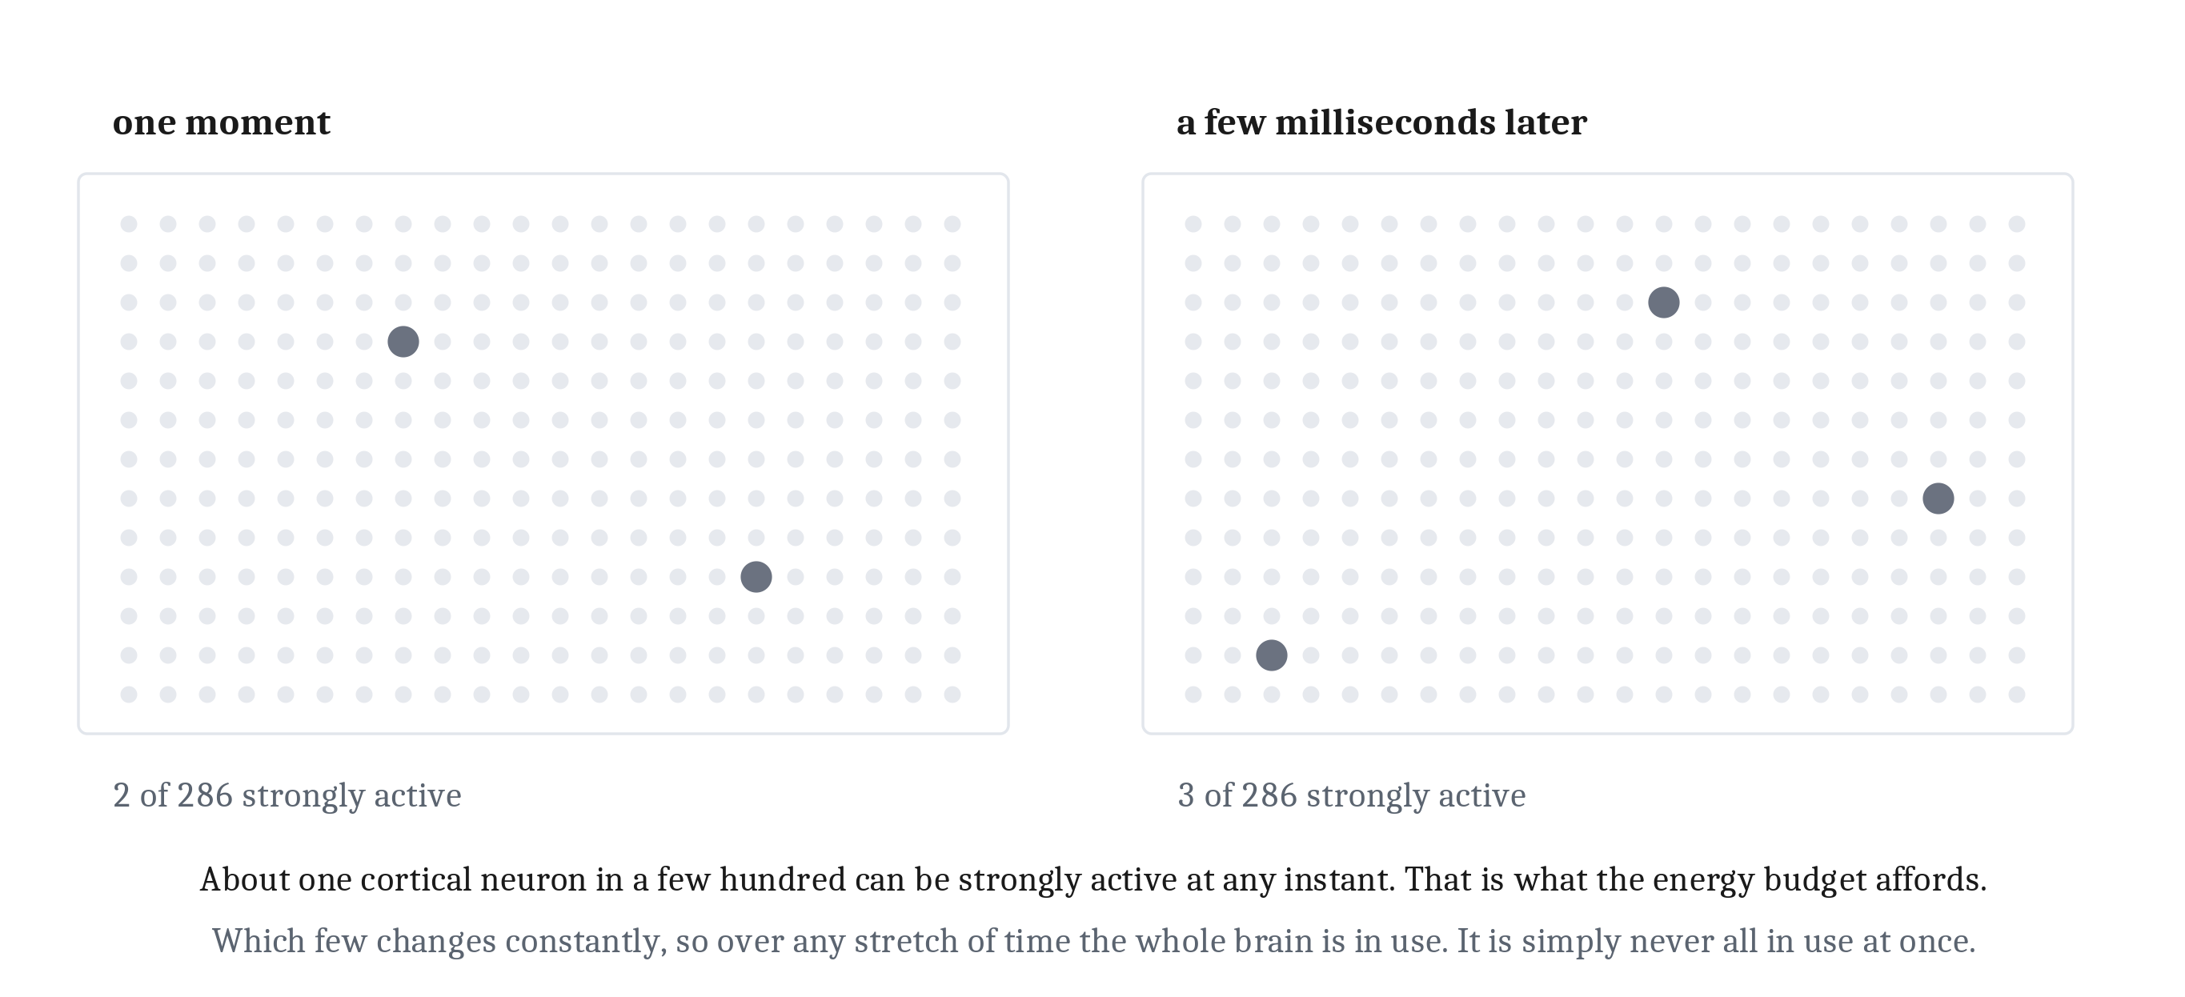
Energy as a Design Constraint
Run the accounting in reverse, and only a small proportion of cortical neurons can be strongly active at any one moment — on the order of one in a few hundred. That is sparse coding, and it is not an accident or an inefficiency.
The ten-percent claim is false in every sense that matters. What is true is stranger: which small share is firing changes moment to moment, so over any stretch of time the whole brain is in use. It is simply never all in use at once.
Notes:
If the energy cost were merely large it would be a fact about brains. What makes it interesting is that it is also a *design pressure* — visible in how brains are built and used.
So consider what the budget permits, and here is the nice move: the same accounting that gave us the cost of a single spike can be run in reverse.
Given what the brain costs to run, and given what a spike costs, the sustainable average works out to a fraction of a spike per neuron per second. Which means only a small proportion of cortical neurons can be strongly active at any one moment — on the order of one in a few hundred.
Activity that thin is called sparse coding. And the point is that it is not an accident, and not an inefficiency. It is what the budget will pay for.
Now, something close to that fact circulates in the world in a badly mangled form, and this is the one slide in this module I would like everyone to be able to reproduce at a party.
The claim that we use only ten percent of our brains is false in every sense that matters. What the claim asserts is that most of the brain sits idle — a reserve of unused capacity waiting to be unlocked. Nothing supports that. Every region does something. Damage almost anywhere produces some deficit. Imaging finds activity throughout.
What is true is narrower, and considerably stranger, and it is the two panels. At any given instant only a small share of neurons are firing hard — and which small share it is changes from moment to moment. Two frames a few milliseconds apart, and it is a different handful.
Over any stretch of time the whole brain is in use. It is simply never all in use at once.
And a brain in which most neurons fired most of the time would not be a better brain that evolution failed to build. Two reasons, and they are independent. It would not code for information as effectively, since there is information in *which* neurons are firing and which are not — that one is Module 4's. And it is also a brain that could not be fed.
Myelin, from earlier, is the same logic in a different place: insulating an axon cuts both the delay and the ion traffic. So is the balance a brain strikes between the cells that compute and the fibers that connect them, because wiring costs energy too and a brain has to buy both out of one budget.
Energy is a metabolic constraint — one of the forces that determines what a nervous system can look like.

Slide 13
The Same Function, and the Place It Strains
The last lecture's equation described a biological neuron and an artificial one about equally well. Set the two implementations side by side and the resemblance vanishes completely — which is where the comparison between minds and machines actually strains.
 | A neuron | A transistor
What physically moves | ions, bodily, from one side of a membrane to the other | charge, along a conductor
Is chemistry involved | yes, and chemistry takes time | no
Time for one event | about a millisecond | a small fraction of a billionth of a second
What one event costs | ATP, spent hauling back every ion that crossed | electrical energy, most of it leaving as heat
Where the power comes from | food, and it has to be found every day | a supply outside the machine
What has to be carried away | waste heat, at a rate the body can manage | waste heat, and packing enough parts together makes it the limit
What those constraints force above | very many things at once, and most cells quiet | long sequences of steps, run very fast
Notes:
Go back to the equation from the last lecture. It described a biological neuron and an artificial one about equally well, and that was the point of writing it down.
Now set the two *implementations* side by side, and the resemblance vanishes completely.
One is protein pores in an oily membrane, moving salt against concentration gradients in warm water, paying for every single ion with a molecule of ATP. The other is voltage on a silicon transistor — charge pushed along a conductor, a switch thrown by an electric field, with no chemistry involved anywhere.
That is multiple realizability, which the last lecture introduced: one function, two substrates, both built and both running. And what this table adds is that it *locates the divergence*. Natural and artificial systems behave extremely similarly at the algorithmic level, where one short equation served both. They could hardly be more different at the implementational level.
**That is where the comparison between minds and machines actually strains.** Not in what they compute. In what they are made of. This course will come back to it.
The difference shows up first as speed. An action potential takes about a millisecond. A transistor switches in a small fraction of a billionth of a second. And that gap is not a matter of engineering care — no amount of care would close it — because the two are not doing the same kind of physical thing. A neuron signals by bodily moving ions from one side of a membrane to the other, which is chemistry and takes time. A transistor moves charge through a conductor, which does not.
Module 1 noted that brains are built from slow components, and drew the consequence: a system that has to answer in a few hundred milliseconds using parts that take a millisecond each cannot run a long sequence of steps one after another. It has to do very many things at once instead. What this module adds is *the reason the parts are slow*.
Which gives us the last row, and the biggest idea in this lecture.
**The implementational level is not simply where a function gets realized, with everything important settled above it. It sets terms the levels above have to respect.**
Neurons are slow and expensive, so brains are massively parallel and mostly quiet. Sparse coding is not a design preference; it is a consequence of a design constraint. Transistors are fast and individually cheap, so machines can run long sequences of steps very quickly — but pack enough of them together and the heat becomes the limit, and the power has to come from outside the machine.
Two implementations of a similar function. Two different sets of constraints. Two quite different architectures built on top of them.
That is Module 1's claim that the levels are separable but not independent, and it is no longer a slogan.

Slide 14
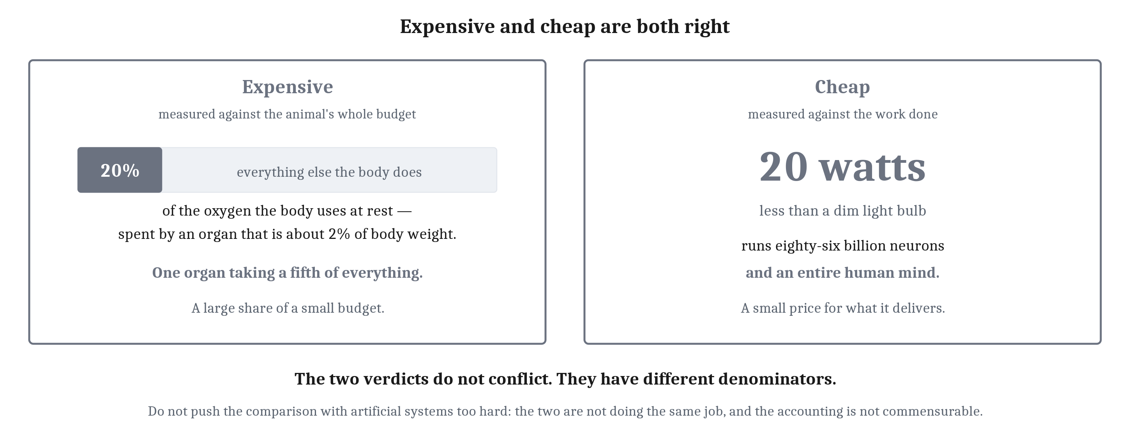
Expensive and Cheap, and What Comes Next
We have built a neuron three times over — once as a solution to a problem, once as a function, and once as a physical machine with a running cost.
Notes:
One tension to resolve before we finish, because this module has spent four slides calling neurons expensive and is about to call them cheap.
Eighty-six billion neurons run an entire human mind on about twenty watts. Less than a dim light bulb. Artificial systems trained to do far narrower things consume orders of magnitude more.
Do not push that comparison too hard — the two are not doing the same job and the accounting is not really commensurable. But do use it to reframe, because **expensive and cheap are both right, and they do not conflict.** They are measured against different things.
Expensive against the animal's whole budget: one organ taking a fifth of everything the body spends. Cheap against the work done: twenty watts, for an entire mind.
A large share of a small budget. And a small price for what it delivers.
That closes the arc this module opened. The opening asked two questions — where the complexity of a cell came from, and why it was worth the effort.
The first answer was accumulation. Complexity was not assembled in one step.
The second has two halves. Oxygen answered one: a new energy source that made expensive cells affordable for the first time. And the other half is an accounting. Neurons cost more to run than anything else an animal builds, and animals that acquired them have gone on building them ever since — because what the outlay buys is the ability to sense, decide, and act before something else does.
One continuous story. Neurons exist because life became rich enough to run them. They persist because what they do is worth what they cost. And they are built the way they are because even now, life cannot quite afford to run them carelessly.
So we have built a neuron three times over. Once as a solution to a problem. Once as a function. Once as a physical machine with a running cost. Three answers that do not resemble one another in the slightest — and they are not in competition, because they are answers to three different questions. That is a full turn of the wheel Module 1 promised, and it will now turn once per module for the rest of the course.
Last thing, and it is the handoff.
It is tempting to end by saying a single neuron is too simple to do anything interesting. That is false, and it is worth being precise about why. Give a neuron an excitatory input from one smell and an inhibitory input from another. Its rate climbs with the first and falls with the second. Wire that output to something that steers, and the animal moves toward one and away from the other. **The arithmetic is well within a single cell.**
What is *not* in the cell is any of the meaning. A rate is only a rate. It becomes approach because of what the cell happens to be wired to — and the very same cell, wired to the opposite muscles, would produce avoidance.
Which is the lesson of the Braitenberg vehicles from Module 1's lab, where the behavior changed completely depending on how the wires crossed, while the parts stayed exactly the same.
Value, goals, and states that outlast their causes are not properties a neuron has. They are properties an *arrangement* has. None of them comes from building a better neuron. They come from wiring ordinary ones together.
Which is where Module 4 begins.

Slide 15
Image Sources (1 of 2)
Slide | Image | File | Licence | Source
2 | The neuron and its four parts | fig-neuron-anatomy.png | CC BY 4.0 | Jon Willits — own work; base illustration generated with ChatGPT, labels added by the author · own work
2 | Golgi-stained neurons of the dentate gyrus, 40x | fig-real-neuron.jpg | CC BY-SA 2.5 | MethoxyRoxy · https://commons.wikimedia.org/wiki/File:Gyrus_Dentatus_40x.jpg
3 | The resting membrane, and what holds it there | fig-membrane-gradients.png | CC BY 4.0 | Jon Willits — the chapter's own figure, from figures/03_neurons_and_neural_communication/make_figures.py · own work
4 | Membrane voltage during a single action potential | fig-action-potential.png | CC BY 4.0 | Jon Willits — the chapter's own figure, from figures/03_neurons_and_neural_communication/make_figures.py · own work
5 | How open the channels are, through the same event | fig-channel-states.png | CC BY 4.0 | Jon Willits — the chapter's own figure, from figures/03_neurons_and_neural_communication/make_figures.py · own work
6 | Giant axon of the squid, with pipette | fig-squid-axon.jpg | Public domain (PD-USGov) | NIH History Office · https://commons.wikimedia.org/wiki/File:Giant_Axon_of_Squid_(14356033761).jpg
8 | Neurons and their jobs, with a synapse inset | fig-synapse.jpg | Public domain (US federal work) | Christy Krames, MA, CMI, for the US National Institute on Aging, National Institutes of Health · https://commons.wikimedia.org/wiki/File:Chemical_synapse_schema_cropped.jpg
10 | The gray-matter energy budget, opened out in two steps | fig-energy-budget.png | CC BY 4.0 | Jon Willits — the chapter's own figure, from figures/03_neurons_and_neural_communication/make_figures.py · own work

Slide 16
Image Sources (2 of 2)
Slide | Image | File | Licence | Source
12 | The same field, a few milliseconds apart | fig-sparse-coding.png | CC BY 4.0 | Jon Willits — the chapter's own figure, from figures/03_neurons_and_neural_communication/make_figures.py · own work
14 | Two denominators | fig-two-denominators.png | CC BY 4.0 | Jon Willits — drawn for this lecture · own work

