Slide 1

BCOG 100
Pattern Recognition
Lecture 7.1 — The Pattern Recognition Problem
Notes:
This module is about how an animal recognizes a thing by the pattern it makes across many inputs, and recognizes it again when the pattern changes.
This first lecture is the computational level. It asks what problem is being solved, and why solving it matters to the animal. So everything in it is stated in terms of inputs, responses, and what the animal does. How a nervous system or a machine might solve the problem waits for the next two lectures.
The animal we will follow is a small fish in a stream where eels hunt. Before asking what the neocortex computes, which is the question Module 6 left open, we need to be exact about what recognizing an eel requires.

Slide 2
To Start: Never the Same Twice
In your group, three minutes.
Pick a smell, a voice, or a face that someone in the group always recognizes. No two encounters with it are ever exactly the same.
What stays the same, so that it can still be recognized? And what nearly identical thing would have to be told apart from it?
Notes:
This question is the reading’s first one, put in everyday form.
Groups usually start with what stays the same: coffee always smells like coffee, a friend’s voice is the same voice on a bad phone line. The interesting move is noticing how hard it is to say what that same thing is. Coffee is a mixture of many chemicals, and the mixture is never exactly the same twice. A voice on a phone has lost much of what it sounds like in person.
The second question is usually harder to answer. What would have to be told apart from it? Decaf from regular, one sibling’s voice from another’s, a stranger who looks a little like a friend.
Hold on to both answers. The first is one demand recognition makes, and the second is another, and the main point of this lecture is that the two demands pull against each other.

Slide 3
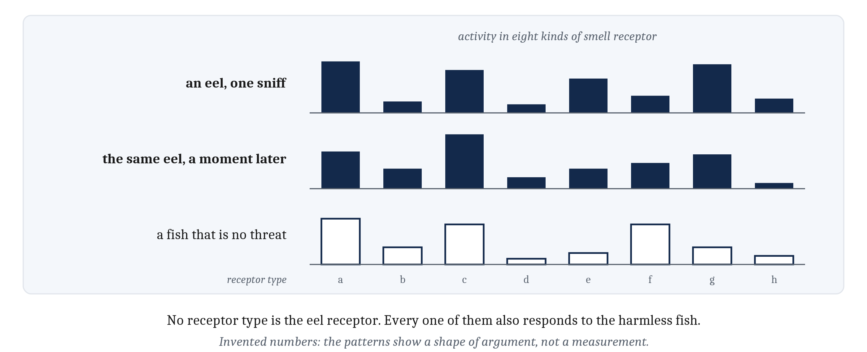
No Detector for an Eel
An eel’s smell is a pattern across many receptors, never twice the same, and much of it shared with harmless fish.
Notes:
A small fish lives in a stream where eels hunt. Now and then, the water carries the smell of an eel. But the fish never encounters the same eel smell twice. Each eel gives off a complex mixture of chemicals, the mixture differs from eel to eel and from moment to moment, and it mixes with rotting leaves, other fish, and the mud of the stream bed.
Out of all that variation, the fish needs one question answered: is a dangerous eel nearby, or not? And the answer is only useful if it comes while there is still time to get away.
Nothing in the fish’s nostrils stands for an eel. Each kind of smell receptor responds to some chemicals and not to others. So what identifies an eel is a pattern of activity across many receptors, and much of that same pattern turns up for fish that are no threat at all. We are in the same position with coffee. There is no coffee molecule, and no coffee receptor. There is a pattern of chemicals that is characteristic of coffee.
Compare the units of Modules 4 and 5. A unit added up its weighted inputs and fired when the sum crossed a threshold, which amounts to drawing one straight line through the space of its inputs. Module 5 showed how learning could move that line. Where one input, or one simple combination, reliably meant food or copper, one line was enough. But most of what matters to an animal has no detector of its own. Prey, predators, mates, and the way home all arrive as patterns across many inputs, and the patterns change from one encounter to the next.
Module 6 left a question open. The pallium grew in mammals into the neocortex, a nearly uniform sheet with one kind of circuit and the same six layers, whether its signals come from the eyes, the skin, or the ears. Is that one operation general enough to serve all of them, or does each area simply do whatever its input makes it do? Our fish has no neocortex, but it has a pallium, and it faces the same problem. So before asking what the neocortex computes, we need to be exact about what recognizing an eel requires.

Slide 4
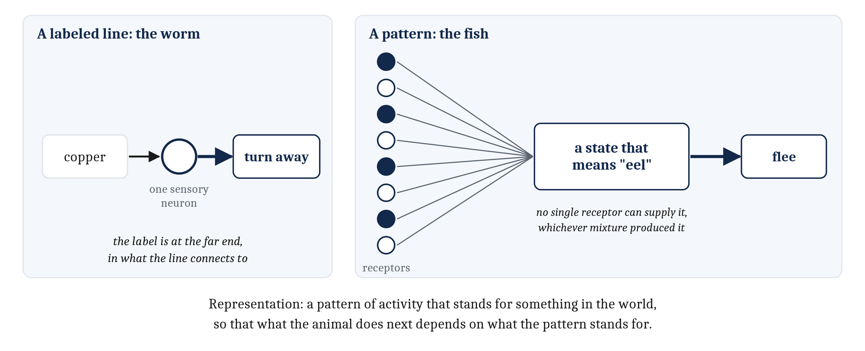
Two Ways to Recognize Something
Pattern recognition needs something between receptors and muscles: a representation, activity that stands for the eel whichever mixture produced it.
Notes:
An animal can recognize something in two quite different ways.
The first is how the worm from Module 4 recognizes copper. A sensory neuron responds to copper, and its output is routed to the machinery that turns the worm away. Nothing else has to happen. The neuron firing is, in effect, the worm recognizing copper. Module 4 called this a *labeled line*, and the label is not on the line itself. It is at the far end, in what the line connects to.
The second is how the fish recognizes an eel. Nothing in its nostrils responds to eels and only to eels. An eel is identified by a combination of activity across many receptors, and no one of them identifies it alone. That is **pattern recognition**. Most of what matters to a fish has to be recognized this way: its prey, its predators, a mate, and the way back to shelter.
Pattern recognition needs something between the receptors and the muscles. The fish has to end up in a state that means “eel”, and none of its receptors can supply that state by itself. So somewhere downstream, activity has to arise that stands for the eel, whichever mixture of chemicals produced it. A pattern of activity that stands for something in the world, so that what the animal does next depends on what the pattern stands for, is a **representation**.
Notice the definition is about what the pattern does for the animal, not about where it sits or what it looks like.
This also pays off something from Module 5. Which pairings an animal learns easily is partly a question about representations. A new connection can only link things the nervous system already represents, so how easily two things are paired depends in part on how each was represented beforehand.

Slide 5
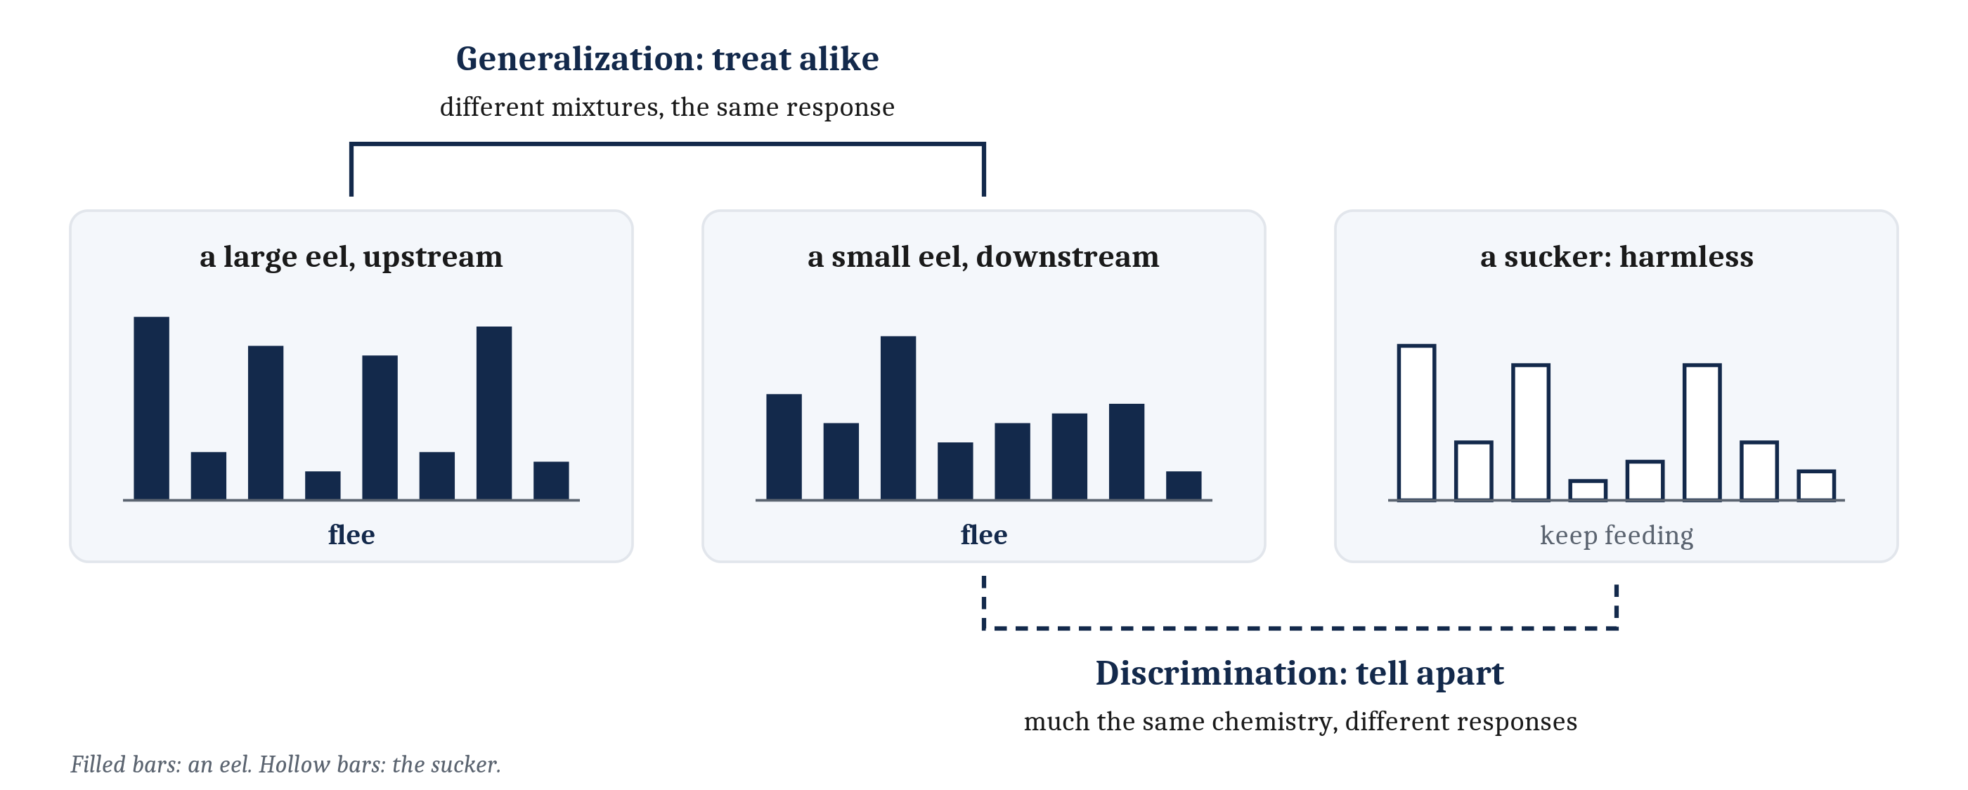
Telling Apart, Treating Alike
Discrimination: inputs calling for different responses must be told apart. Generalization: inputs calling for the same response must be treated alike.
Notes:
Recognizing an eel makes two demands at once.
The first is **discrimination**. Inputs that call for different responses have to be distinguished, even when they overlap. Suppose a harmless fish, a sucker, shares the stream, and its smell shares much of its chemistry with the eel’s. The small fish has to flee from one and ignore the other, although most of what reaches its nostrils is the same in both cases.
Discrimination usually improves with experience. Eleanor Gibson argued that learning to perceive is not adding detail to thin, vague sensations. It is separating things that used to blur together. A novice wine drinker can tell red from white. An expert can also tell apart grapes and regions that taste the same to the novice. Experience has pulled apart inputs the novice treats as alike.
The second demand is **generalization**. Inputs that call for the same response have to be treated alike, even if they barely overlap. A large eel upstream and a small eel downstream give off quite different mixtures, but both call for flight.
It is tempting to think of generalization as a failure: the animal responds to a new eel as to an old one because it cannot tell them apart. Roger Shepard argued the opposite. Generalizing is a bet that two things share a consequence. His example was an animal made sick by a caterpillar. Seeing a second caterpillar that looks a little different, it may tell the two apart perfectly well. What it cannot tell is whether the second one will make it sick too. Treating the two alike is a bet that it will.

Slide 6
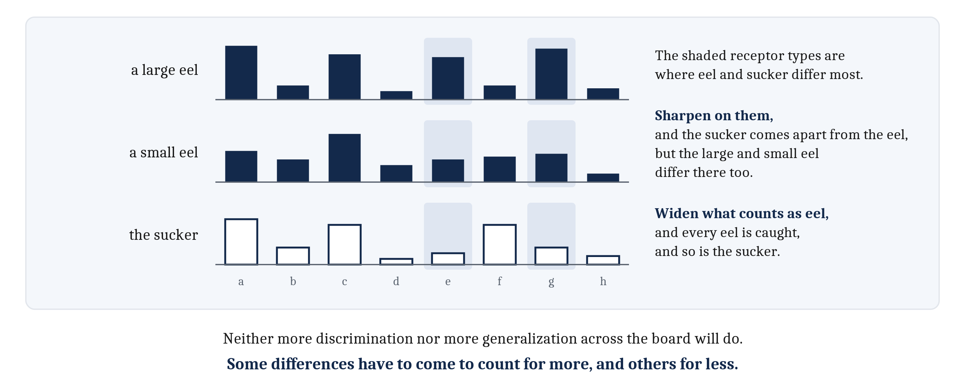
Two Demands, One Mapping
The two demands push on the same inputs in opposite directions. Some differences have to come to count for more, and others for less.
Notes:
A system that met only one of these demands would fail. A fish that only discriminated would treat every eel as a new thing, and nothing it learned about one eel would carry over to the next. A fish that only generalized would lump the eel together with the sucker, and flee from both or from neither.
Meeting both at once is hard, because they push on the same inputs in opposite directions. Look at the shaded receptor types. Getting better at telling the eel from the sucker means attending more closely to the shaded receptor types, where their smells differ. But a large eel and a small eel differ in some of those same ways. So a fish that has sharpened its discrimination may begin to treat the two eels as different things.
Going the other way fails too. Widening what counts as an eel, so that every eel is caught, also widens it toward the sucker.
So the fish cannot get there by becoming more discriminating, or more general, across the board. It needs the eel pulled apart from the sucker and every eel drawn together, for the same smells. Some differences have to come to count for more, and others for less.
Here is the problem in one sentence. The fish’s input at any moment is a pattern of activity across its smell receptors. What its world calls for is a mapping from inputs to responses: this pattern means flee, that one means keep feeding. Discrimination and generalization are two demands on that single mapping.

Slide 7
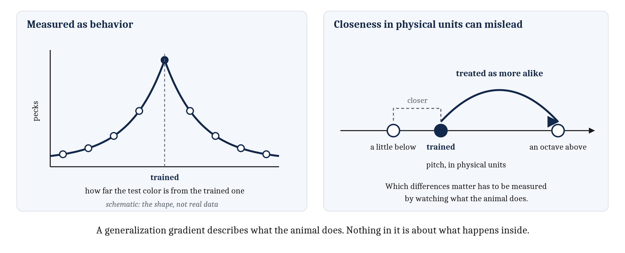
How Alike Does Something Have to Be?
A generalization gradient is a description of behavior: how strongly the trained response is given, as the test input differs more from the trained one.
Notes:
If generalizing is a bet, how far from a known case should it extend? The natural answer is: the more a new case resembles the known one, the more readily it should be treated the same way.
We can measure generalization without saying anything about what goes on inside the animal. Train an animal to give a response to one input, then test it on inputs that differ from the trained one by different amounts. The tendency to respond falls off smoothly as the new input differs more, and often steeply. That fall-off is a **generalization gradient**.
These gradients were measured long before anyone spoke of representations. Pavlov’s dog, conditioned to salivate to one tone, also salivated to other tones, and less the more they differed. Pigeons trained to peck at one color also peck at other colors, and less often the further the color is from the trained one.
The catch is in how the difference is measured. Shepard found that closeness in physical units is not a good predictor of how animals generalize. The same physical difference can matter a great deal on one dimension and hardly at all on another, and the pattern differs from species to species. A tone can be treated as more like the tone an octave above it than like tones that are physically closer, right below.
So the differences that govern generalization are not simply the physical ones. For the small fish, which differences make a new smell more or less like an eel has to be measured by watching what the fish does.

Slide 8
Deciding Under Noise: Four Outcomes
Signal detection theory: every detection decision is a hit, a miss, a false alarm, or a correct rejection.
 | The fish flees | The fish stays
An eel is present | Hit | Miss
No eel is present | False alarm | Correct rejection
Notes:
Now add noise. No two sniffs of an eel are the same, and the receptors and neurons that respond to them are noisy too. So the evidence for “eel” that reaches the fish varies from one encounter to the next, even when an eel is there, and the evidence when no eel is there varies as well.
Plot how often each amount of evidence occurs, once for encounters with an eel and once without, and the two distributions overlap. Somewhere along that evidence axis, a line has to be drawn: flee above it, keep feeding below it.
The framework for decisions of this kind is **signal detection theory**. It was developed in the 1950s for detecting faint signals on radar, and it is now used wherever a decision is about whether something is there: a faint tone, a disease, a remembered face, a junk message.
Any single decision has one of four outcomes. A target present and judged present is a **hit**. A target present and judged absent is a **miss**. No target present, but one judged to be there, is a **false alarm**. No target present and none judged to be there is a **correct rejection**.
For the fish, fleeing from an eel is a hit, staying put beside one is a miss, bolting from nothing is a false alarm, and feeding calmly when no eel is near is a correct rejection.

Slide 9
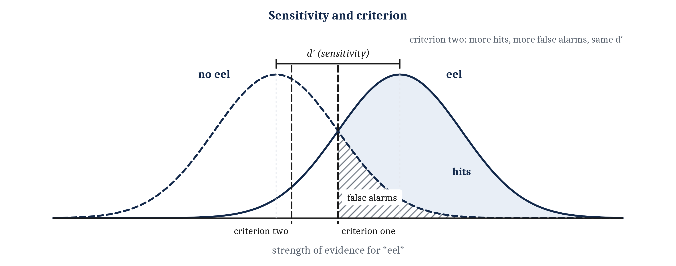
Two Quantities, Not One
Sensitivity: how far apart the two distributions lie (d′). Criterion: where the line is drawn. Moving the criterion never changes sensitivity.
Notes:
Signal detection theory separates two quantities that are easy to confuse.
**Sensitivity** is how far apart the two distributions lie. It is usually measured as *d′*, read “d-prime”, the distance between their centers in units of their spread. The **criterion** is where the line is drawn.
Moving the criterion trades one kind of error for the other. Slide it left, to criterion two, and there are more hits and fewer misses, but also more false alarms. What it does not do is change sensitivity, because the distributions have not moved at all.
Two people on a face memory test show why this matters. Each sees 50 faces they studied and 50 new ones. One says “yes, I saw that one” to 42 studied faces and 8 new ones, and is right 84% of the time. The other says “yes” to 49 studied faces and 25 new ones, and is right only 74% of the time. But both have a *d′* of 2.0. The second person simply says “yes” more often. Percent correct mixes sensitivity and criterion together, and signal detection theory pulls them apart.
The same confusion is built into everyday speech. A smoke alarm that goes off whenever toast burns is often called sensitive. In these terms, it has a low criterion.

Slide 10
Where Should the Criterion Go?
It depends on what each outcome gains or loses, and on how common targets are. Accuracy is the wrong measure when the two errors cost different amounts.
Case | What each error costs | Best criterion
The small fish | A miss may end its life; a false alarm loses a few minutes of feeding | Liberal
Rare targets | False alarms lose a great deal | Conservative
A worked example | A false alarm loses 15 points; a miss loses 1 | Conservative: accuracy peaks at neutral, but points peak here
A dim room | Sensitivity is poorer | More extreme in the same direction
Notes:
Which criterion is best depends on what each outcome gains or loses, and on how common targets are. When targets are rare and false alarms lose a great deal, the best criterion is conservative. When misses lose a great deal, it is liberal.
So accuracy is the wrong measure whenever the two errors cost different amounts. In the worked example in the table, a false alarm loses 15 points and a miss loses only 1. Accuracy is highest with a neutral criterion, but the points earned are highest with a conservative one.
Sensitivity matters here too. The poorer the sensitivity, the more extreme the best criterion becomes, which is why people walk more carefully in a dim room.
Now the fish. Missing an eel may end its life, while a false alarm costs a few minutes of feeding. So the best criterion for this fish is liberal. A jumpy fish is wrong more often than a cautious one, but the cautious fish is eventually eaten.
That is an argument about where the best criterion lies. Whether any real fish sits near it can be answered only by measuring real fish.
One last contrast, and it sets up the rest of the module. The two quantities are different kinds of thing to change. The criterion can move with no change in how the fish represents what reaches its nostrils. Sensitivity can improve only through a better representation of the input.

Slide 11
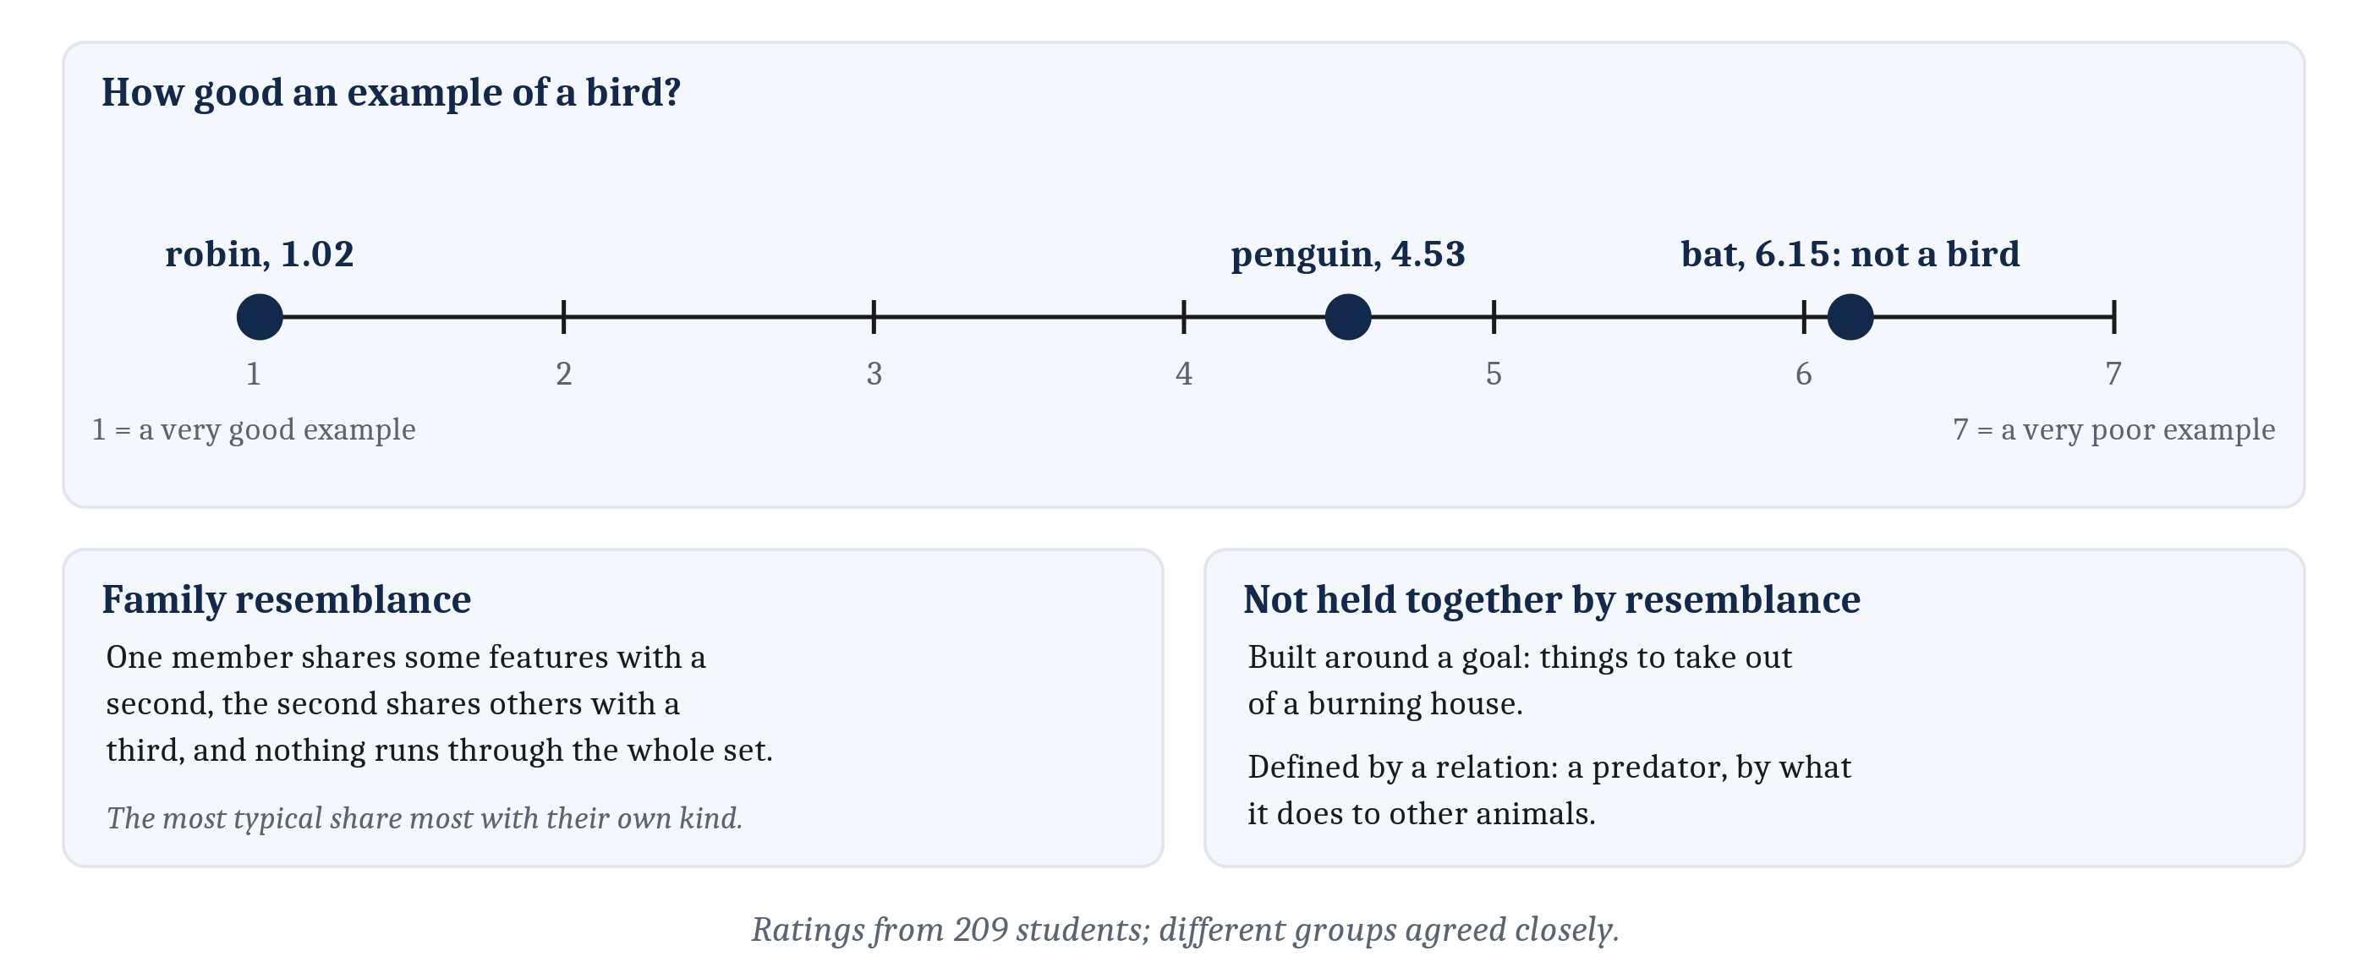
Categories Have Structure
A category is a set of things treated as the same kind, for some purpose. Typicality: some members are better examples than others.
Notes:
So far the fish has one target. Most recognition is sorting into categories. A **category** is a set of things treated as the same kind, for some purpose, and some members are better examples than others.
Eleanor Rosch asked 209 students to rate members of ten everyday categories on a seven-point scale, where 1 is a very good example and 7 a very poor one. For birds, a robin was rated 1.02, close to the best possible score. A penguin was 4.53. A bat, which is not a bird at all, was 6.15. Different groups of students agreed closely. This graded goodness of membership is **typicality**.
What makes one member more typical? When people listed the attributes of twenty members of a category, few or no attributes were listed for all twenty. Members overlapped the way faces in a family do, which is called *family resemblance*. The most typical members shared the most features with their own category and the fewest with neighboring ones.
Two cautions about this evidence. It comes from human beings. And although any account of categories has to explain it, several quite different accounts explain it equally well, so on its own typicality cannot decide between them.
And not every category is held together by resemblance. Some are built around a goal, like things to take out of a burning house, whose members have almost nothing in common. Some are defined by a relation: nothing about an animal’s appearance makes it a predator; what it does to other animals does. Categories also let an animal infer properties it cannot see, and let people explain and communicate. So recognition is not only a matter of how alike inputs are. It is a matter of which inputs share a consequence.

Slide 12
When Only Combinations Matter
For some categories, no single input carries any information. The fruit-eater’s rule is exclusive or (XOR): one smell or the other, but not both.
 | Smell B absent | Smell B present
Smell A absent | No fruit | Ripe fruit
Smell A present | Ripe fruit | Rotting fruit
Notes:
For some categories, each input carries information on its own: a little more of one smell makes an eel a little more likely, whatever else is present. For others, no input carries any information on its own, and the right response depends only on the combination.
Take a hypothetical animal that feeds on fallen fruit. Either of two smells alone means ripe fruit. Both together mean the fruit is rotting, and neither means there is no fruit at all. Check the table: smell A is present in half the cases that mean food and half that do not, and so is smell B. Neither says anything about food by itself. Only the combination does. The rule is called *exclusive or*, often written XOR.
A second case has the same character. Suppose a fruit smells right only when one chemical is at just the right strength: too little means unripe, too much means rotten. More of the chemical is good news up to a point and bad news after it, so its strength on its own does not point consistently either way.
This problem was found in animals before anyone studied XOR in circuits or built an artificial network. In some discrimination tasks, an animal is rewarded for going right when two cards are white and left when they are black, so every single cue is rewarded half the time. An account in which animals learn only about single cues predicted that no animal could learn it. Animals learned it anyway, and later studies found the same from rats to monkeys.
People manage too. In controlled experiments, categories that could be sorted by adding up evidence one feature at a time were no easier to learn than categories that could not, and two practiced observers learned a category with the shape of exclusive or.
Why a single unit cannot do what these animals do is a question for the next lecture.

Slide 13
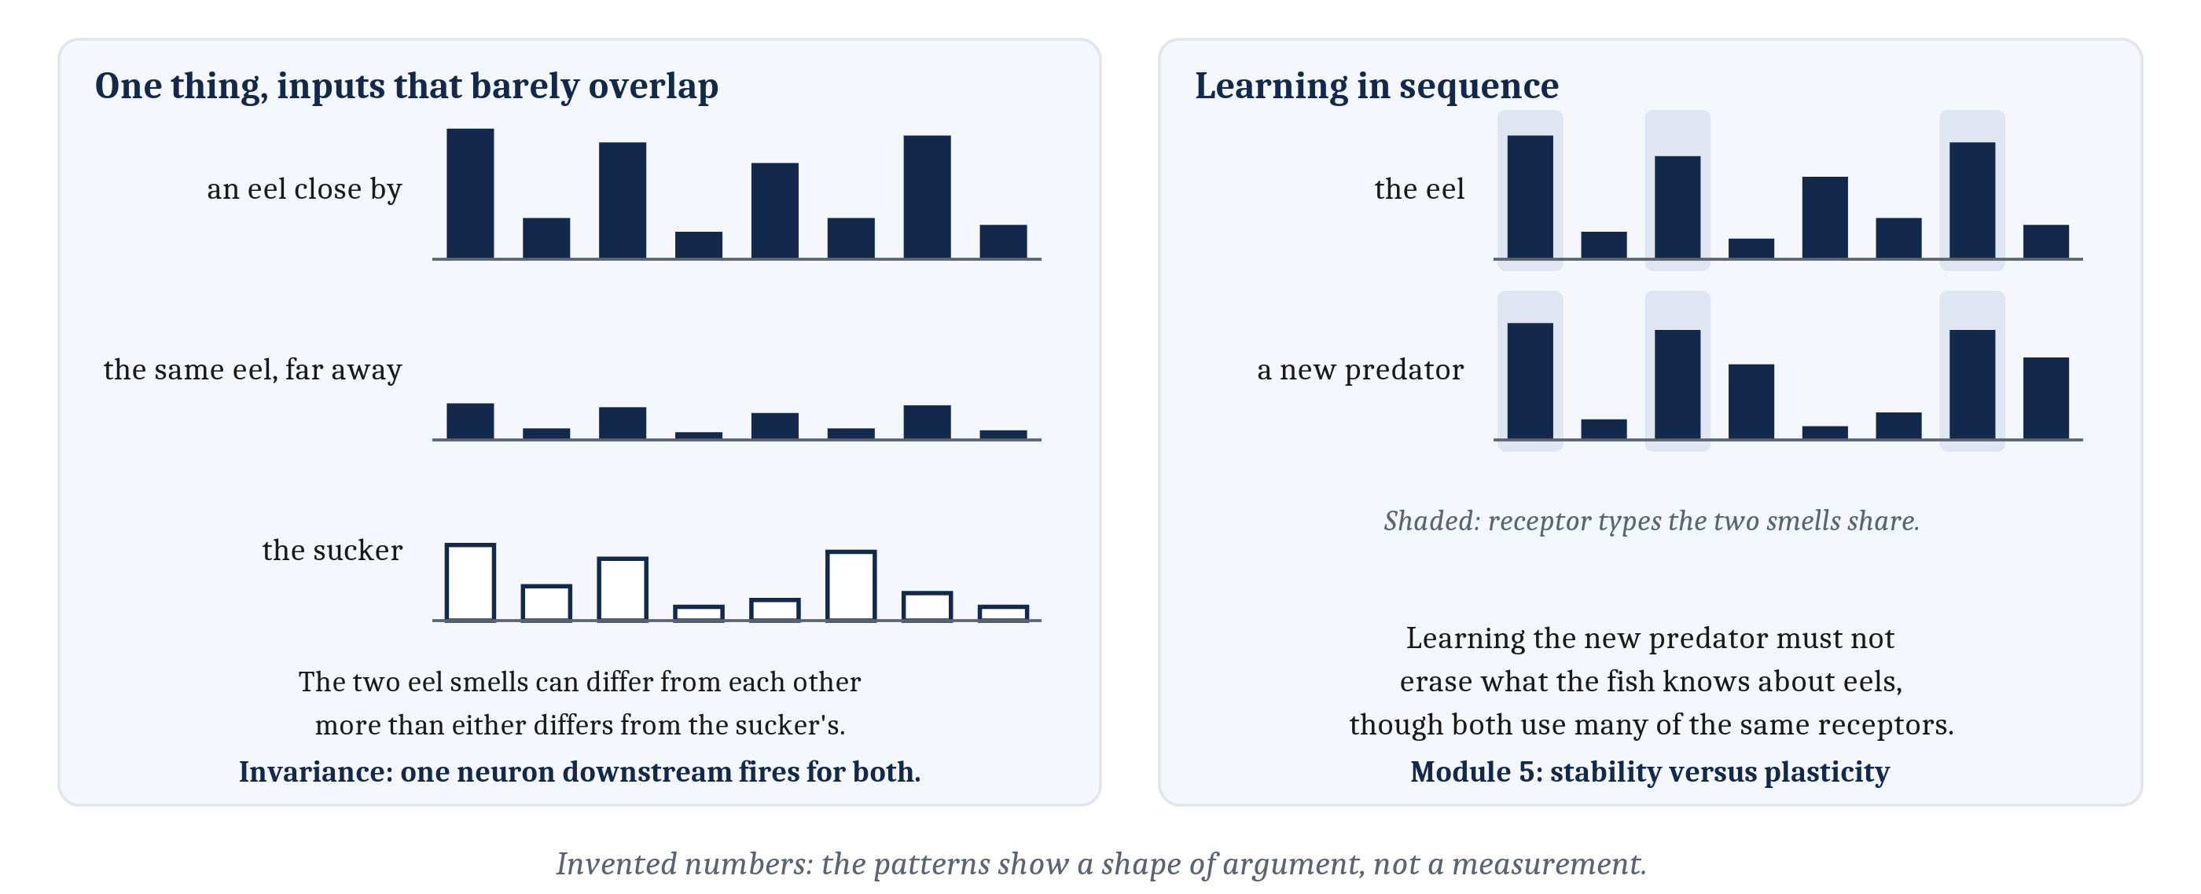
The Hardest Cases: Invariance, and Learning in Sequence
Invariance: recognizing one thing across changes that leave its inputs barely overlapping. And new learning has to add to old without overwriting it.
Notes:
Two last demands complete the problem.
Sometimes one thing produces inputs that barely overlap. An eel close by and the same eel far away produce smells at very different strengths. A face seen from the front shares little of its image with the same face turned to one side. Recognizing a thing across changes like these is **invariance**. The smells of one eel can differ from each other more than either differs from the sucker’s, and they still have to be treated as one thing. That is discrimination and generalization at their hardest.
Module 1 showed the reverse side of this difficulty in vision: many different scenes can cast exactly the same image. Invariance is the other side, since one object can cast many different images. For a nervous system, it means some neuron downstream has to fire for every eel smell, faint or strong, and stay quiet for the sucker, even when the sucker’s smell is more like one of the eel smells than the eel smells are like each other.
The last demand adds time. A fish does not learn what an eel smells like all at once. It learns across many encounters, and it learns about other things in between. Those things often overlap: the smell of a new predator may share much of its chemistry with the eel and with harmless fish. So learning about one bears on what is already known about the others, and new learning has to add to old without overwriting it.
When the same features turn up in objects that are rewarded and in objects that are not, no single feature is reliable, and only combinations are. The more objects share features, the more of the reliable information lies in combinations.
This is the trade-off Module 5 called stability versus plasticity: changing enough to learn something new, and little enough to keep what was learned before. For the small fish, learning a new predator must not erase what it knows about eels.
That is the whole problem, stated without saying anything about how it is solved. The next lecture is about the procedures that might solve it.

Slide 14
A Detector for AI-Written Essays
In your group, four minutes.
A company sells a detector that flags student essays as AI-written.
What are its four outcomes? Which error costs more, and to whom?
The company announces a new version that is “more sensitive”: it catches more AI-written essays. What else would we need to know before believing that its sensitivity improved?
Notes:
This question runs slides 8 to 10 on a case in the news.
The four outcomes first. An AI-written essay flagged is a hit, and one that slips through is a miss. A student’s own essay flagged is a false alarm, and one left alone is a correct rejection. Most groups decide that the false alarm costs more, and that the cost falls on a student who did nothing wrong.
The second question is the one the lecture equips us for. A detector that catches more AI-written essays may simply have a lower criterion, like the smoke alarm that goes off for toast. If so, it also flags more human essays. To know whether sensitivity improved, we need the false-alarm rate as well as the hit rate, before and after. Catching more is not evidence by itself.
Then base rates. Suppose 1,000 essays, of which 50 are AI-written. A detector that catches 90% of those makes 45 hits. If it also flags 5% of the 950 human essays, that is about 48 false alarms, so roughly half of the flagged essays were written by students. How common the target is changes what a flag means, and where the criterion ought to sit.
If the room is quiet, give it those numbers and ask only whether a flag from this detector should count as proof.

Slide 15
Image Sources
Slide | Image | File | License | Source
3 | No receptor stands for an eel | fig-never-twice.png | CC BY 4.0 | Jon Willits — drawn for this lecture · own work
4 | A labeled line, and a pattern | fig-two-ways.png | CC BY 4.0 | Jon Willits — drawn for this lecture · own work
5 | Two demands on the same smells | fig-two-demands.png | CC BY 4.0 | Jon Willits — drawn for this lecture · own work
6 | Why the two demands conflict | fig-pull-both-ways.png | CC BY 4.0 | Jon Willits — drawn for this lecture · own work
7 | Generalization, measured as behavior | fig-gradient-behavior.png | CC BY 4.0 | Jon Willits — drawn for this lecture · own work
9 | Sensitivity and criterion | fig-sdt.png | CC BY 4.0 | Jon Willits — drawn for the Module 7 reading · own work
11 | Graded membership, and categories beyond resemblance | fig-typicality.png | CC BY 4.0 | Jon Willits — drawn for this lecture, after Rosch's reported ratings · own work
13 | Invariance, and learning in sequence | fig-hardest-cases.png | CC BY 4.0 | Jon Willits — drawn for this lecture · own work

