Slide 1

BCOG 100
Pattern Recognition
Lecture 7.2 — Neural Networks and Pattern Recognition
Notes:
The last lecture stated the problem: tell apart what calls for different responses, treat alike what comes from the same thing, and do it from inputs that are never twice the same.
This lecture is the algorithmic level. Knowing that some smells should send the fish fleeing is not the same as having a way to sort them. An algorithm is a procedure that does the sorting, using what has been learned from the smells already experienced.
We will meet several such procedures, from psychology and from artificial neural networks, and see what each can and cannot do. A network here always means an artificial one: units and weighted connections of the kind from Module 4, run on a computer. A network describes an algorithm. Whether brains carry out the same algorithm is the question of the next lecture.

Slide 2
To Start: Define a Chair
In your group, three minutes.
Write a definition of chair that every chair meets and nothing else does.
Then test it: a beanbag, a bar stool, a tree stump someone is sitting on, a chair in a dollhouse, a throne.
Notes:
The last lecture’s theme was that recognition has to tell apart and treat alike at the same time. A definition is the oldest proposal for doing both: list what every member has, and sort by the list.
Groups usually start with something like “a seat with legs and a back, for one person to sit on”. The test cases then do their work. A beanbag has no legs. A bar stool has no back. A tree stump is sat on but was never made to be a chair. A dollhouse chair cannot be sat on at all. And a throne meets the definition but feels like a strange example.
Most groups end up adding exceptions, or retreating to “something made for sitting”, which lets in benches and sofas.
That experience is the case the next slide makes, and it is worth noticing what kind of case it is. Nothing went wrong with the logic of definitions. What went wrong is that the category does not seem to have a list to find.

Slide 3
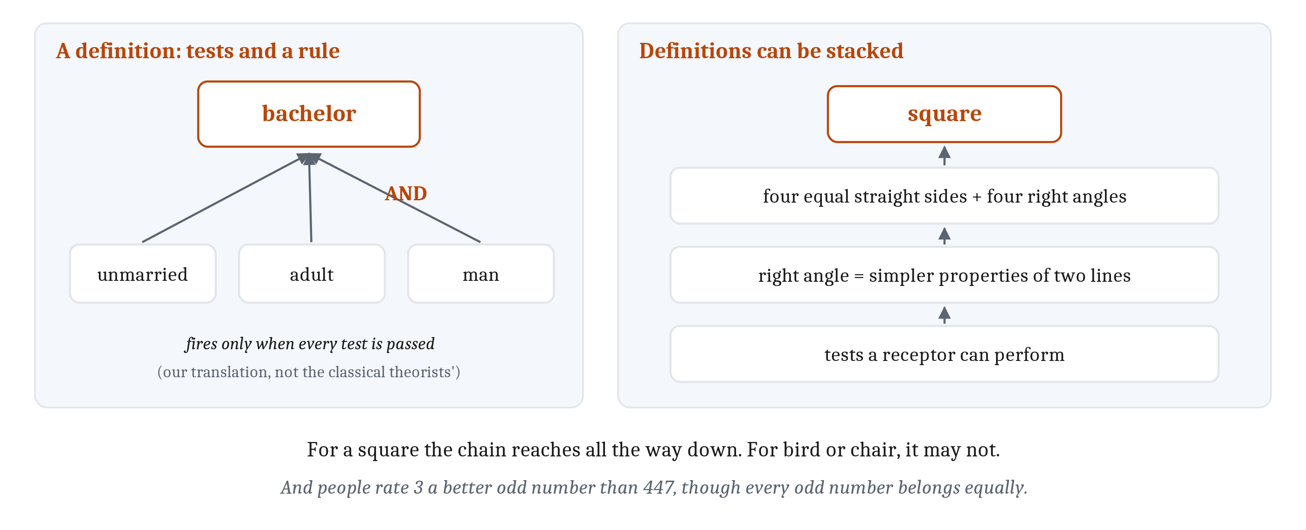
Definitions and Rules
The classical view: a category is defined by features that are individually necessary and jointly sufficient. A definition can be read as labeled-line tests combined by a rule.
Notes:
The oldest answer to how categories might be formed is the **classical view**. A category is defined by features that are individually necessary and jointly sufficient: everything with all of them belongs, and nothing without them does. A *bachelor* is an “unmarried adult man”. An *odd number* is a “whole number that leaves a remainder of 1 when divided by 2”. Membership is all or none, and every member belongs equally. For a long time this was the default account in both psychology and philosophy.
It can be seen as a more complex labeled line. A labeled line is a single test; a definition is a set of tests combined by a rule. In Module 4’s terms, which is our translation rather than the classical theorists’, each feature could be detected by a labeled line and the category by a unit computing AND over them. The rule need not be AND: “smell A or smell B, but not both” is a perfectly good rule, so a definition can capture the fruit from the last lecture.
Definitions can also be stacked. A square has four equal straight sides and four right angles, and a right angle is itself defined by simpler properties of lines. Built this way, a definition is a hierarchy of tests, with tests a receptor can perform at the bottom: in Module 4’s terms, a hierarchy of units, each computing a truth table over the units beneath it. That works only if every level can be defined all the way down. For a square it can. For *bird* or *chair*, it may be much harder.
So the case against the classical view does not rest on what definitions can compute. It rests on what people’s categories turn out to be like, and most cognitive scientists do not take it as the best general account. The main evidence is typicality. When people listed attributes of twenty members of a category, few or none were true of all twenty, so there is nothing for a definition to list. And a definition makes every member equally good, while people rate a robin a far better bird than a penguin.
But typicality alone does not refute definitions. One study found people rate 3 a better odd number than 447, while knowing every odd number belongs equally. Graded ratings can sit alongside a definition. Some categories are probably learned as rules, and others are not.
One more sense of the word. In psychology and philosophy, a *concept* is also a part of thought that combines with others: anyone who can think of a pet and of a fish can think of a pet fish. Whether definitions, or anything else in this lecture, can play that part is a question for Module 14.

Slide 4
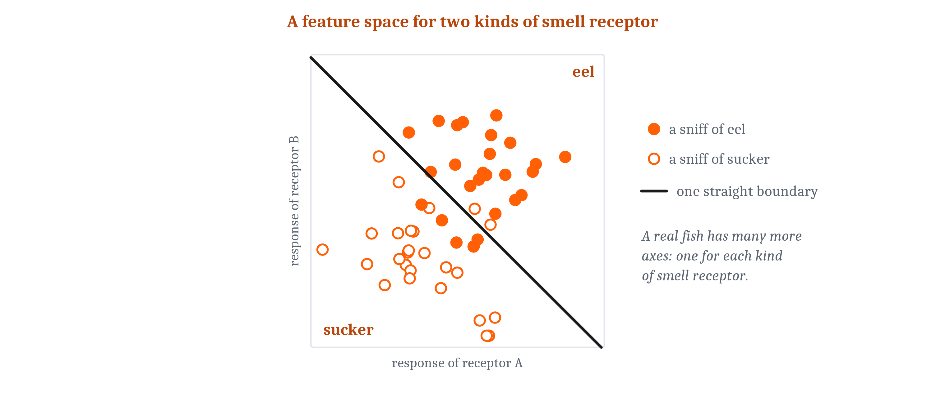
A Space of Inputs
A feature space has one axis per feature and one point per input. Linear separability: one straight line, or flat surface, can divide two categories.
Notes:
The most widely used alternative to definitions starts from a picture of the inputs. Give each kind of receptor an axis, and the smell at each moment becomes a point, placed by how strongly each receptor responds.
Simplify to two receptors. One sniff of eel is a point on a flat plane, many sniffs of many eels make a scattered cloud, and sniffs of the sucker make a second cloud overlapping the first at its edge. A space like this, one axis per feature and one point per input, is a **feature space**. Inputs that are alike land close together, and inputs that are different land far apart.
Now the last lecture’s mapping from inputs to responses has a picture. The inputs that should get one response form a region, and the mapping divides the space into regions with a boundary between them. Where that boundary runs is set by the inputs themselves: which smells come from eels, which from suckers, and how much they overlap.
A real fish has many receptor types, so many axes. With three, a straight boundary is a flat plane. Beyond three we cannot picture it, but the space can still be split in two by a single hyperplane.
Two categories are linearly separable when one straight line or flat surface puts all of one on one side and all of the other on the other. That is **linear separability**. These clouds would be separable if they did not overlap. Module 4’s AND and OR are separable, which is why one unit could compute each.

Slide 5
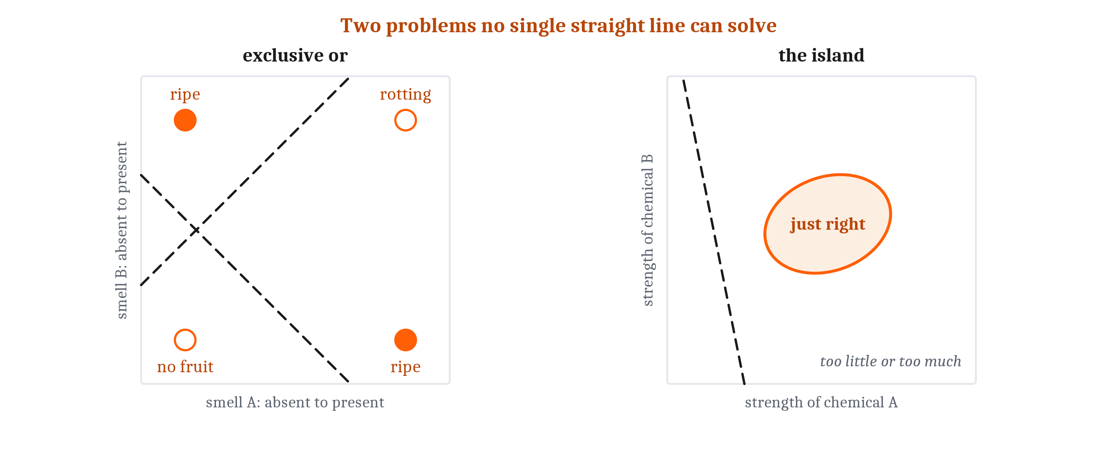
A Space of Inputs
A feature space has one axis per feature and one point per input. Linear separability: one straight line, or flat surface, can divide two categories.
Notes:
Many relationships are not. Put the fruit’s four cases in a space with one axis per smell. The two food cases sit at opposite corners, and so do the two others. No straight line puts both food corners on one side. The just-right-strength fruit is an island in the middle, and a straight line can cut off one side of it but cannot wrap around it.
Whether one line is enough depends on which features the space is built from. Add a third input that is active only when both smells are present, the product of the two, and the rotting corner moves away from the others: now a flat plane separates food from the rest. Add an input reporting the chemical’s squared distance from its ideal strength, and one threshold on that input marks off the island.
With the right features, the hard problems become easy. So the question is where features come from. They can be learned, wired at random, or built in, and all three come up in this lecture.

Slide 6
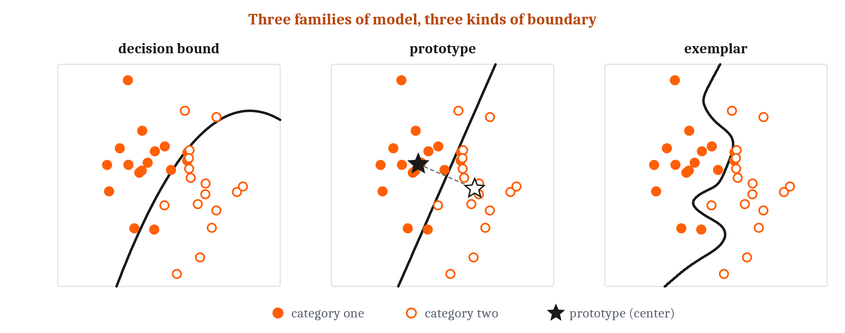
Three Families of Algorithm
A decision-bound model stores the boundary. A prototype model stores each category’s center; an exemplar model stores every member. Both decide by similarity.
Notes:
Psychologists have proposed three families of algorithm that treat an input as a point in a feature space. They differ in what is stored and consulted before a response. Every one of them ends up drawing a boundary, whether it stores one or not, and that is how they can be compared: two models drawing the same boundary are very hard to tell apart in data.
The most direct family learns the boundary itself. A **decision-bound model** divides the space into regions and responds by the region an input falls in. It grew out of signal detection theory: the last lecture’s criterion is a boundary on one axis, and a decision bound is the same idea with many axes. Some bounds have a verbal form, like “large squares belong to category A”, which is a rule; many do not. A classical definition is a decision bound made of straight cuts along the axes.
The simplest decision-bound model is a single Module 4 unit. Its **decision boundary** is a straight line. The weights turn the line, and the threshold or baseline slides it, which is why one unit did both AND and OR: their lines are parallel. And the unit’s weighted sum is its evidence, its threshold its criterion, so the boundary is exactly the set of inputs whose evidence sits at the criterion. No single unit’s straight line can compute exclusive or, so an animal or person that learns it has something more complex inside than one circuit drawing one line. Decision-bound models in psychology can curve, though, and wrap around the island.
The other two families store members, and the boundary follows. A **prototype** model stores one summary per category, its central tendency, and assigns a new input to the closest prototype. An **exemplar** model stores the members themselves, adds up a new input’s **similarity** to every stored member category by category, and picks the largest total. The generalization gradient does the weighting: a near example counts for a lot, a distant one for almost nothing.
Similarity in which space? Physical units predict behavior poorly, as the octave showed. A better predictor is distance in a *psychological space* recovered from behavior, in which gradients are remarkably regular: one review of twelve, from people and pigeons, colors to speech sounds, found them all falling nearly exponentially, for a single experience tested right away: a strong regularity, not a law without exceptions. And attention can stretch the dimensions that matter. That is the wine expert, as geometry, and the fish needs the dimensions separating eel from sucker stretched in just that way.
A close relative from machine learning, and one of its oldest methods, is **k-nearest-neighbor classification**: find the *k* stored examples closest to the input, and take the most common category among them. Where an exemplar model lets every example vote, weighted by similarity, *k*-nearest-neighbor gives the *k* closest one equal vote each. With enough examples, its boundary can follow almost any shape.

Slide 7
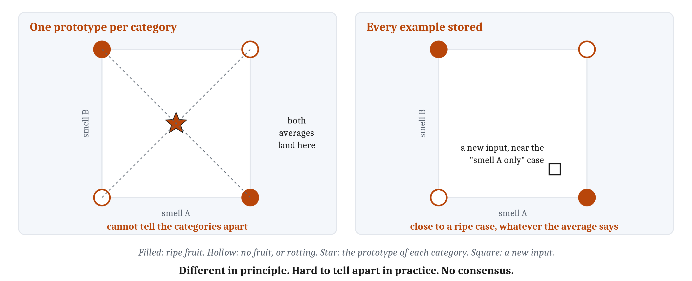
Prototypes or Exemplars?
One prototype per category can only sort linearly separable categories. Exemplars keep the cases. Different in principle, hard to tell apart in practice.
Notes:
Typicality first. In a feature space, a typical member sits close to many others and an atypical one sits out at the edge. Both prototype and exemplar models explain that, since a typical member is close to the prototype and also to many stored examples. So typicality alone cannot tell them apart.
One classic result looked at first like strong support for prototypes. People taught distorted versions of two dot patterns later classified the undistorted originals, which they had never seen, nearly as well as the distortions they had studied. But an exemplar model predicts the same thing, because each original sits in the middle of its distortions. For about twenty years, experiments then built categories where closeness to the prototype and closeness to particular examples pointed different ways. They have mostly, but not always, favored exemplars.
The boundaries show a sharper difference. A nearest-prototype model draws a straight boundary, halfway between the two prototypes and at right angles to the line joining them. Weighting features tilts it but leaves it straight, which makes it very hard to tell apart from a straight-line decision bound. So a model with one prototype per category shares a single unit’s limit: it can only sort linearly separable categories.
Exclusive or makes that vivid. The two ripe cases sit at opposite corners, so their average is the center of the square. The two other cases average to the same point. Two categories with the same prototype cannot be told apart by their prototypes. An exemplar model has no such limit, because it keeps the cases: an input matching “smell A only” is close to a ripe case, whatever the average says.
So in principle the three families are different algorithms with different boundary shapes. In practice they have been hard to separate. Each family contains many models. Some prototype models keep several prototypes per category, and those are not limited to straight lines. It has been argued that any prototype model could be mimicked by an exemplar model and the reverse, and two models that draw the same boundary will be hard to tell apart from behavior. Decades of experiments have produced no agreement, and many researchers now think people use more than one.
One translation sets up everything that follows, and it is ours rather than the psychologists’. An exemplar model behaves like a layer of units between input and decision, one per stored example, each responding to inputs close to its own example. That layer is what lets it handle exclusive or. In network terms, it behaves like a hidden layer.

Slide 8
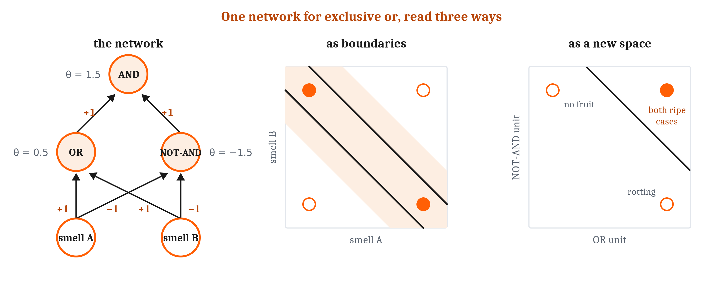
A Layer Between Input and Output
A hidden layer re-represents the input so that the last step is easy. The second hidden unit means “not rotting”, which no receptor supplies.
Notes:
A **hidden layer** is a layer of units between input and output. Its units are not driven directly by the world, and their activity does not directly drive behavior. What they stand for depends on their weights, and they come to stand for combinations of the inputs.
Here is one network that computes exclusive or for the fruit. The first hidden unit fires when either smell is present: OR. The second fires unless both are present: NOT-AND, so it is silent exactly when the fruit is rotting. The output fires only when both hidden units fire: AND. Work the four cases and the output fires for either smell alone, and for neither of the other two. Each unit computes something a single unit can manage. None computes exclusive or alone. Together they do.
The same network reads three ways. Logically, it composes truth tables: AND over OR and NOT-AND is exclusive or. As boundaries, each hidden unit draws its own line, and the output keeps the band between them, which holds both ripe corners. Geometrically, the hidden layer moves the inputs to new positions in the space of hidden-unit activity, where both ripe cases land on one point and one straight line separates them.
Those are three descriptions of one fact. The hidden layer re-represents the input, so that the last step is easy. At the level of the animal, the second hidden unit is a neuron whose activity means “not rotting”. No smell receptor carries that information, and the animal needs it.
So why was exclusive or ever a problem? Because someone had to set those weights by hand. Rosenblatt’s perceptron of 1958 already had a middle layer, but it was wired at random and never trained; learning happened only at the output. In 1969, Minsky and Papert published a careful analysis of what networks without trainable hidden units cannot do. It was widely understood that a hidden layer could recode a problem. What nobody had was a general way to train one.
The delta rule from Module 5 trains an output unit: compare its output with the correct answer and adjust the weights. But how do we adjust a hidden unit’s weights when nobody knows what its correct output should be?

Slide 9
Three Ways to Set the Hidden Weights
Structural credit assignment: when the output is wrong, which connections inside were responsible?
Answer | What weight changes depend on | Which weights change | What the hidden layer comes to represent | A named case
Backpropagation (error-driven) | An error against a target, from a teacher or the world’s next input | Every weight | Whatever combinations reduce the error | The digit-reading network; Elman’s next-word networks
Fixed random wiring, trained output | For the output connections only, an error or a reward | Only hidden-to-output | Whatever combinations the random wiring produced | The perceptron; the insect mushroom body, as proposed
Competitive learning | Nothing outside the network | Only the winner’s weights | Clusters of inputs that overlap, useful or not | Topographic maps; the neocognitron
Notes:
Module 5’s credit assignment was working out which action was responsible for an outcome that came later. A hidden layer poses the same problem in space rather than time: when the output is wrong, which connections deep inside were responsible? That is **structural credit assignment**, and there are three broad answers.
The first passes the error back. **Backpropagation** extends Module 5’s delta rule: each connection still changes in proportion to the error at the receiving unit times the activity of the sending unit. A hidden unit’s error is computed from the errors of the units it feeds, sent backward through the same connections the activity came forward through, and scaled by how much the unit’s output would change if its input changed. It is Module 5’s gradient descent run through every layer at once, made widely known in 1986. Its strength is that training finds the combinations the task needs. Its cost is that every output needs a target. But the target need not come from a teacher. In prediction learning the target is the next input. Elman trained networks on nothing but a stream of words, predicting the next word, and their hidden layers grouped the words into nouns and verbs, and the nouns into animals, people, and objects, though nothing in the input said which words were which. Whether a brain could pass errors back is a question for the next lecture.
The second answer is that nothing sets the hidden weights. That was the original perceptron: a large middle layer wired at random and never trained, with only the output connections adjusted. With many more middle units than inputs, each combining a random handful, some unit is likely to respond to “smell A without smell B” without anyone arranging it. Spreading an input across many more units is **dimensionality expansion**, and it helps because a straight boundary can separate far more sets of points in many dimensions than in few. It works best with sparse coding, from Module 3, where few units are active at once. The cost is a great many units, with no guarantee the needed combinations are among them. Part of a fly’s brain, the mushroom body, has an arrangement of this kind, which we will see.
The third needs no teacher. In **competitive learning**, units receiving the same input inhibit each other until one wins, like Module 4’s winner-take-all circuits, and the winner moves its weights a little toward the input: a Hebbian step, kept in check because only the winner learns. Each unit ends up at the center of a cluster of similar inputs. If the winner’s neighbors move too, neighboring units come to respond to similar inputs, and the result is a topographic map, Module 6’s arrangement, from experience alone. The limit is that competition finds how inputs overlap, which is not always what the animal needs.
What does a single hidden unit end up standing for? In a **localist representation**, each thing has its own unit, so which unit is active is the information: Module 3’s point that a spike’s meaning lies in which cell fired, taken all the way. In a **distributed representation**, each thing is a pattern across many units, and each unit serves many things. Distributed codes make similar things look similar for free, degrade gracefully, and pack many patterns into few units. Localist codes are easy to read and keep things cleanly apart. Which kind brains use is still argued, and a mixture is a serious option.

Slide 10
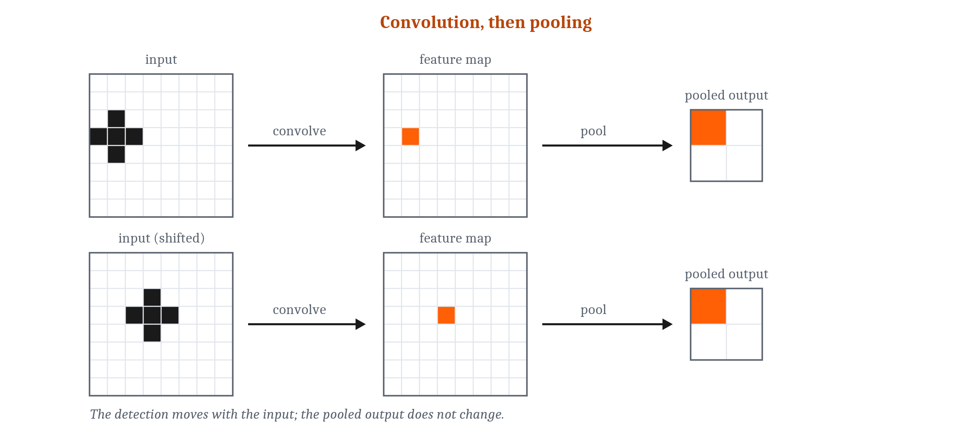
Stacking Layers for Invariance
Convolution copies one detector to every position, so its map shifts with the input. Pooling makes a small shift stop mattering. Both are an inductive bias.
Notes:
Invariance was the hardest demand from the last lecture. A network can meet part of it through its wiring, by building in assumptions about which changes do not matter.
**Convolution** applies one small feature detector at every position: a detector for a short vertical edge, say, copied across the whole image with the same weights in every copy. The feature is found wherever it falls, and when the input shifts, the map of where it was found shifts too. So convolution alone does not make the response unchanged by a shift. It makes the response move with the input. **Pooling** then combines detections across a small neighborhood, so a small shift no longer changes the pooled output. Stack several rounds, and each layer responds to combinations of the features below, over a wider region, tolerating a little more shift and distortion at each step.
This architecture was built twice, with two answers to who sets the weights. Fukushima’s *neocognitron*, in 1980, set them by competition, with no teacher. LeCun and colleagues, in 1989, kept the design and trained every weight by backpropagation. Their network read handwritten zip-code digits, learning from several thousand labeled examples and then tested on digits it had never seen.
Building an assumption into the wiring is a bet about the task. The bet of a *convolutional neural network* is that a feature means the same thing wherever it appears. That is an **inductive bias**, Module 5’s term, here built into a network’s wiring rather than an animal’s lineage. When the bet is right, it helps. The digit-reading network had 64,660 connections but only 9,760 adjustable weights, because so many were shared, and on new digits it made 5.0% errors against 8.1% for a fully connected network with about as many weights.
Now the limits. Convolution and pooling build in tolerance to one change, a shift in position, and imperfectly. They build in nothing for size, rotation, or viewpoint. For the fish, an eel to the left or right is a shift, but an eel near and far is a change of size, and front and side are different viewpoints. Networks that handle those mostly get there by training on examples that already contain them, often each image copied shifted, rotated, rescaled, or blurred. Whether training like that explains how animals manage is a live dispute.

Slide 11
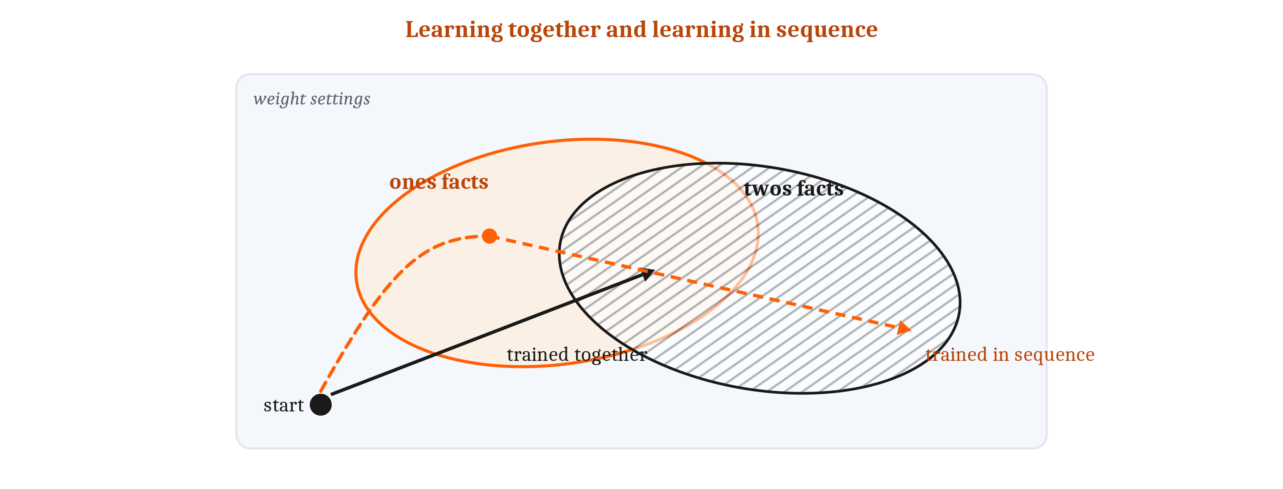
What Shared Weights Give, and Take Away
Catastrophic interference: new learning wipes out old. Generalization and interference are the same effect, seen from two sides; learning in sequence is the trigger.
Notes:
When the patterns a learner stores are carried by the same units, learning a new one moves weights an old one depends on. So new learning can disturb old.
The last lecture’s feature-ambiguity problem is the simplest case. A learner that sees only single features raises a feature’s weight whenever it is rewarded and lowers it whenever it is not. When a feature appears on two kinds of objects, the learner keeps undoing its own learning, and the more features are shared, the worse it gets. Representing the combination stops the interference, because a combination can be reliably rewarded even when none of its parts is.
In a network trained by backpropagation, the disturbance can be extreme. In a classic demonstration, a network learned all the addition facts about “ones”, like 1 + 4 and 6 + 1, and was then trained on the “twos”. After a single pass, it began answering ones problems as if they were twos problems: 5 + 1 came out as 7, and 6 + 1 as 8. Its score on the ones fell from 100 percent to 57 percent by the most lenient criterion, and to 30 percent after a second pass. New learning wiping out old this drastically is **catastrophic interference**.
The cause is the same property that makes the network useful. Every weight takes part in many input–output pairs. That sharing is why similar inputs get similar outputs for free, which is generalization, and also why changing weights for new pairs changes old answers. Generalization and interference are one effect, seen from two sides.
The trigger is learning in sequence. Trained on all the facts at once, the same network learns them all. Trained on one set and then another, it moves its weights to wherever suits the newest set, regardless of where the old set needed them.
People forget too. Learning a new list of associations that conflicts with an old one costs people some of the old list. The difference is how much. In a classic study, people still recalled more than half of an old list after mastering a new one, while the network had lost all of its old list by the time it had learned about a fifth of the new one. Engineers slow the loss by protecting the weights that matter most for old learning, or by mixing old examples back in. How brains manage is a question for Module 10.

Slide 12
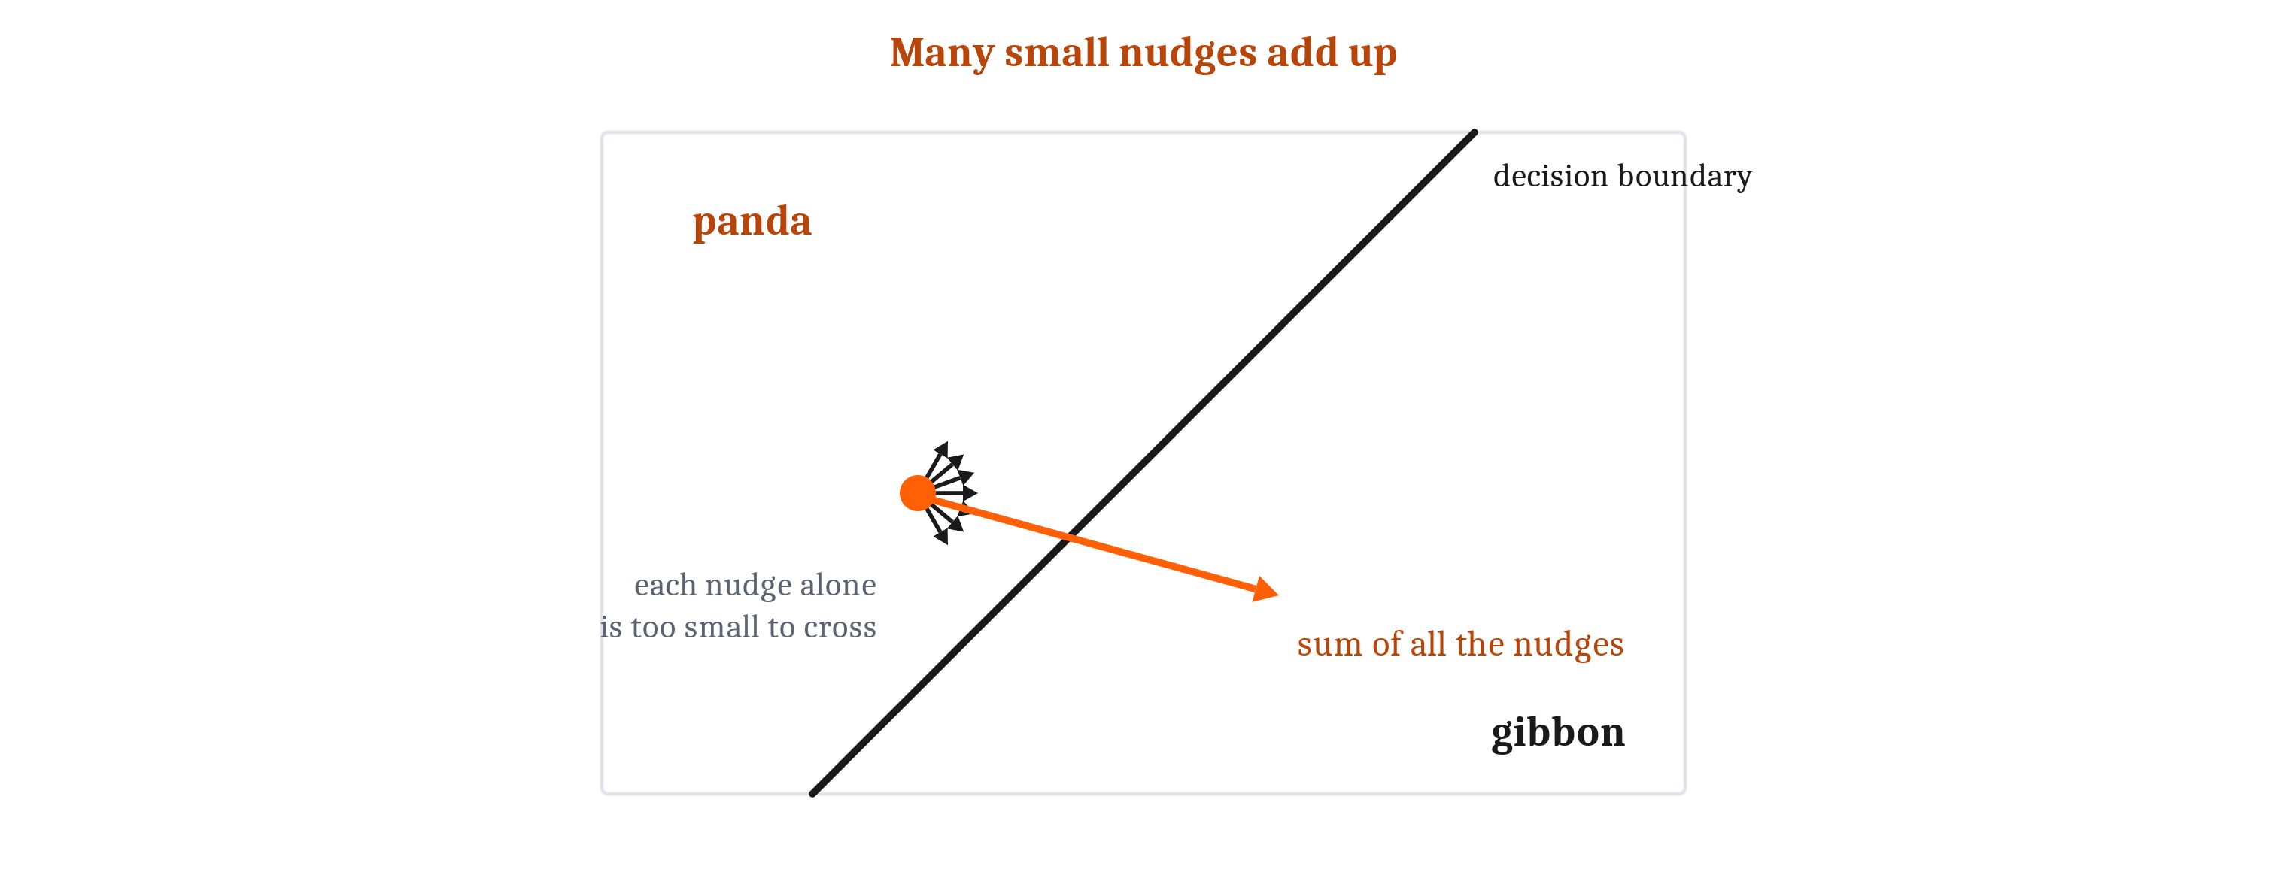
Fooled by Small Changes, Lost Far from Home
Adversarial examples, texture bias, overfitting, and weak out-of-distribution generalization: the characteristic failures, and some of their reasons.
Notes:
Module 1 listed how image-recognizing networks characteristically fail: fooled by changes a person would not notice, leaning on texture over shape, and generalizing poorly when conditions shift. Now we can see some reasons.
An **adversarial example** is an input changed slightly and deliberately so that a network gives a confident wrong answer. In one well-known case, a network called a panda photograph “panda” at 57.7 percent confidence, and after a carefully chosen pattern was added, “gibbon” at 99.3 percent. The change at each pixel can be about as small as an image file can record.
One explanation uses a tool from Module 4. A unit computes a weighted sum over many thousands of inputs. Move every input a tiny amount, each in the direction its weight favors, and the tiny changes add up: no pixel moves much, but the total crosses the boundary. On this account even a single unit should be fooled, and it is. A unit that told handwritten 3s from 7s with 1.6 percent error misclassified 99 percent of inputs nudged along its own weights. Direction is what matters; random noise of the same size rarely works. But the researchers who first reported adversarial examples proposed a different cause, and the explanation is still debated.
**Texture bias**: given a picture with a cat’s shape and an elephant’s skin, people say “cat”, and networks trained on a standard photo collection mostly said “elephant”. People chose shape about 96 percent of the time, the networks between 17 and 43 percent. The bias came from the training images, not the architecture: the same architecture, trained on photographs repainted in the styles of different paintings, chose shape 81 percent of the time instead of 22. What a classifier learns depends on its experience, not only on how it is built.
A network can fit its training examples closely, accidents included, and still do poorly on new ones. That is **overfitting**, which is why classifiers learn from a training set and are scored on a separate test set. The digit-reading network made 0.14 percent errors on its 7,291 training digits and 5.0 percent on 2,007 new ones. But a test set comes from the same collection, so even a good score is a score on familiar kinds of input. **Out-of-distribution generalization**, to inputs unlike anything in training, is much weaker. Current classifiers interpolate well and extrapolate poorly.
Arithmetic in early large language models shows it. Trained only to predict the next word, never taught arithmetic, they answered two-digit additions perfectly and most three-digit ones correctly, though almost none of those problems appeared in their training text: three-digit numbers are common, so a new problem sat among familiar ones. With four digits they were right about a quarter of the time, and with five about one time in ten. In feature-space terms, a classifier is reliable near the region its training examples occupy and much less so far from it, which is also why a network trained on familiar angles often fails on unusual ones.

Slide 13
Gaps in Recognition, or Something Else Missing?
Not every failure is the same kind of failure. Systematicity: combining known parts in new ways.
Failure | What kind of failure it is | Where we take it up
Adversarial examples | A gap in pattern recognition | This module
Texture bias | A gap in pattern recognition, produced by the training data | This module
Overfitting | A gap in pattern recognition, reduced by inductive bias | This module
Failure out of distribution | A gap in pattern recognition | This module
Catastrophic interference | A gap in the learning procedure, under learning in sequence | This module; how brains avoid it, Module 10
Knowing what an object is like, beyond recognizing it | A mark of a later capacity | Modules 8 and 12
Reasoning about causes | A mark of a later capacity | Module 12
Systematicity | A mark of a later capacity | Modules 13 and 14
Notes:
Some failures are gaps in pattern recognition itself: adversarial examples, texture bias, overfitting, and failure out of distribution. A better classifier could, in principle, close them. Catastrophic interference is a gap of a different kind: it lies in the learning procedure, and appears when learning happens in sequence.
Others look like marks of capacities pattern recognition alone does not supply. Recognizing a refrigerator is pattern recognition. Knowing it is heavy and rigid, and what would happen if it were pushed, may draw on something more. So may reasoning about causes. So may **systematicity**, combining known parts in new ways, so that anyone who understands “the eel chased the fish” also understands “the fish chased the eel”. Causes and planning are Module 12’s, language Module 13’s, and symbols Module 14’s.
A similar argument has been made about the psychological models. Prototype, exemplar, and nearest-neighbor models all rest on similarity, and some researchers argue similarity cannot be what holds a category together, because anything is similar to anything in some respect. A cloud and a white feather are very similar in color and in floating, and very different in size and use. Similarity alone cannot say which respects matter.
On one alternative, a category is held together by a theory: an understanding of why its members have the features they do. In one study, children heard about a raccoon that doctors changed to look and smell like a skunk, and older children usually said it was still a raccoon. Their answer followed what the animal was underneath, which goes beyond its pattern just as knowing a refrigerator is heavy does. For a fish’s smells, similarity may carry most of the load. For human concepts, how much it carries is still debated.
And whether the missing pieces have to be built in, or can be learned from enough of the right experience, is open. The digit-reading network generalized better because of what was built into it; the texture-bias networks learned shape once their experience changed. Even among researchers who think current networks are missing these pieces, there is no agreement on whether the pieces must be built in.

Slide 14
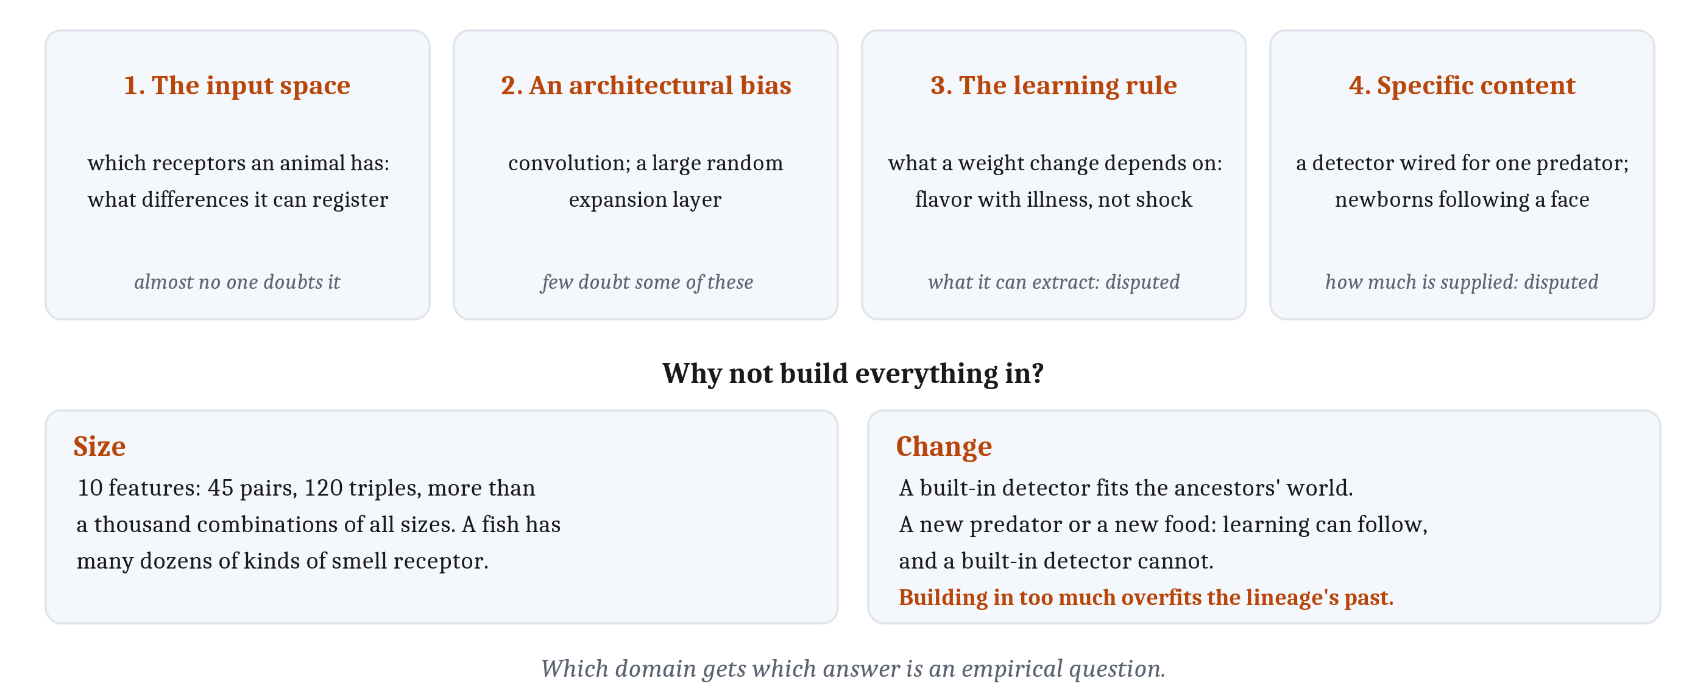
What Has to Be Built In?
Not “innate or learned?” but what exactly is built in. Four candidates, and two reasons not to build in everything.
Notes:
This is Module 2’s debate between nativists and empiricists, and its lesson applies: the useful question is not whether a capacity is innate or learned, but what exactly is claimed to be built in. Pattern recognition lets us list the candidates precisely.
First, the input space. Which receptors an animal has decides which differences it can register at all: no learning lets a fish tell apart two smells its receptors respond to identically. It can also make problems easier. A receptor or early circuit that already responds to a combination of chemicals would hand later circuits exclusive or already solved. That is an inductive bias supplied by the lineage, the same bet a convolutional network makes in its wiring.
Second, an architectural bias. Convolution assumes a feature means the same thing everywhere. A large random expansion layer, like the fly’s, assumes useful combinations will turn up among random ones. Both are in place before learning starts.
Third, the learning rule. Backpropagation and competitive learning, given the same inputs, come to represent different things. Animals differ too: a rat links a new flavor with illness after one pairing, even hours apart, but hardly links a flavor with a shock at all.
Fourth, specific content: a detector already wired for one predator, or a caregiver. Newborns in their first hour follow a face-like pattern further than the same parts scrambled.
Building in everything fails for two reasons. Size: with 10 features there are 45 pairs, 120 triples, and over a thousand combinations; a fish has dozens of receptor types, and no lineage could build in, in advance, the few combinations that will matter. And change: a built-in solution fits the ancestors’ world, and when a new predator or food arrives, learning can follow and a built-in detector cannot. Building in too much is overfitting to the lineage’s past. Hidden layers are valuable for exactly these reasons: learning can find the combinations a task needs, in the world as it is now. Selection can also arrive at useful combinations, but it takes generations to do what learning does in part of a lifetime. Which domain gets which answer is an empirical question.
Machine learning faces the same choice, and calls the built-in side **feature engineering**: deciding, before learning, what the inputs will be. The networks behind AlphaGo, which beat one of the world’s strongest Go players in 2016, received stone positions plus features Go players consider important, such as how many open points surround each group; a later version dropped the extra features. Language models learn from text already cut into words and word pieces. Someone always decides where learning starts.
Disagreements about nativism are often about different items on this list. Almost no one doubts receptors are built in, and few doubt some architectural biases are. The live disputes are how much specific content is supplied, and how much a general architecture and learning rule can extract. Fish show the answer can differ by species: in some, there is evidence that fish raised without predators react to predator odor the first time; in others, they learn it, by smelling the predator together with chemicals from a hurt member of their own species, Module 5’s associative learning. A ready-made detector and a learned one can produce the same behavior, and only animals raised without the experience can tell them apart. The next lecture’s cortical evidence bears on the same question: when a region’s input is changed early in life, much of what it comes to do follows the new input.

Slide 15
Sort the Failure
In your group, four minutes. Using the table on gaps and marks, sort each case, and say what evidence would change your answer.
A few small stickers on a stop sign, and a classifier reads it as a speed-limit sign.
A skin-lesion classifier gives higher cancer scores when the photo shows the surgical-marker ink dermatologists use to mark a mole.
A model names every object on a kitchen shelf, but cannot say what would happen if the shelf gave way.
Notes:
The first two are reported findings, and the third is made up to fit the refrigerator.
The stop sign is the adversarial case moved into the physical world: small, deliberate changes that a person still reads as a stop sign, misread by the research classifiers in most test frames. The stickers were visible, made to look like graffiti, rather than imperceptible. It is a gap in pattern recognition, one that a better classifier could, in principle, close. What would change the answer is evidence that no better classifier could.
The skin-lesion case is closest to texture bias. The authors suggested that, in the photos such classifiers learn from, the moles that worried doctors were often the ones a doctor had already circled, so the ink was a reliable cue in the data and a meaningless one in the world. The classifier learned what its experience contained. It is a gap in pattern recognition produced by the training data, and the repainting result suggests the fix is in the data, not the architecture.
The kitchen shelf is a mark of a later capacity. Naming the jars is recognition. Knowing that they would fall, and break, is knowing what objects are like and reasoning about causes, Modules 8 and 12. A group that argues a bigger classifier trained on enough falling shelves would manage it has found the live dispute: whether the missing pieces must be built in, or can be learned from enough of the right experience.
If the room is quiet, give it only the first two and ask which one is about the training data.

Slide 16
Image Sources (1 of 2)
Slide | Image | File | License | Source
3 | A definition as tests and a rule, and stacked | fig-definition-tree.png | CC BY 4.0 | Jon Willits — drawn for this lecture · own work
4 | Eel and sucker sniffs in a two-receptor space | fig-feature-space.png | CC BY 4.0 | Jon Willits — drawn for the Module 7 reading · own work
4 | Two cases no single straight line can divide | fig-xor.png | CC BY 4.0 | Jon Willits — drawn for the Module 7 reading · own work
5 | Three families, three boundaries | fig-three-families.png | CC BY 4.0 | Jon Willits — drawn for the Module 7 reading · own work
6 | Why one prototype cannot learn exclusive or | fig-one-prototype.png | CC BY 4.0 | Jon Willits — drawn for this lecture · own work
7 | One network for exclusive or, read three ways | fig-xor-three-ways.png | CC BY 4.0 | Jon Willits — drawn for the Module 7 reading · own work
9 | Convolution, then pooling | fig-conv-pool.png | CC BY 4.0 | Jon Willits — drawn for the Module 7 reading · own work
10 | Learning together, and learning in sequence | fig-interference-weights.png | CC BY 4.0 | Jon Willits — drawn for the Module 7 reading · own work

Slide 17
Image Sources (2 of 2)
Slide | Image | File | License | Source
11 | Many small nudges add up | fig-many-small-nudges.png | CC BY 4.0 | Jon Willits — drawn for the Module 7 reading · own work
13 | Four things that could be built in | fig-four-candidates.png | CC BY 4.0 | Jon Willits — drawn for this lecture · own work

